Slide 1
Transport Research and Analysis
Module 1: Introduction to Transport Research and Analysis
Lab 2: Designing Surveys

Slide 3
Table of Contents
Practical 2: Designing Surveys
3. Google Forms: Creating a Passenger Survey | 14
3.1 Introduction to Google Forms | 15
3.2 Step-by-Step Survey Creation | 16
3.3 Collaborative Survey Development | 17
4. Class Activity: Distributing and Responding to the Survey | 18
4.1 Sharing the Survey | 19
4.2 Student Participation | 20
5. Google Sheets: Analyzing Survey Responses | 21
5.1 Accessing Responses | 22
5.2 Data Cleaning | 23
5.3 Data Analysis Techniques | 24
5.4 Interpreting Results | 25
5.5 Home Assignment | 26
0. Objective | 1
0.1 Learning Objectives | 2
1. Introduction to Survey Design | 3
1.1 Definition and Purpose of Surveys | 4
1.2 Types of Surveys | 5
1.3 Applications in Engineering | 6
1.4 Overview of the Survey Design Process | 7
2. Survey Creation Principles | 8
2.1 Defining Clear Objectives | 9
2.2 Question Formulation | 10
2.3 Structuring the Survey | 11
2.4 Ensuring Reliability and Validity | 12
2.5 Ethical Considerations | 13
i
Designing Surveys

Slide 4
Table of Contents
Practical 2: Designing Surveys
6. References | 27
6.1 Reference Textbooks & Tutorials | 28
ii
Designing Surveys

Slide 5
Section 0:
Objective
Designing Surveys

Slide 6
0. Learning Objectives – Lab 2: Designing Surveys
Section No | Learning Objective | Activity Type | Activity Done by | Allocated Time
1 | Understand the purpose of surveys in engineering research | Presentation | Teacher | 15 minutes
1 | Identify types of surveys and their real-world applications | Presentation | Teacher | 10 minutes
2 | Formulate clear and unbiased survey questions | Presentation | Teacher | 15 minutes
2 | Apply principles of reliability, validity, and ethics | Presentation | Teacher | 10 minutes
2 | Structure surveys for logical flow and efficiency | Presentation | Teacher | 10 minutes
3, 4 | Create and distribute surveys using Google Forms | Practical | Teacher +Students | 35 minutes
5 | Analyse responses using Google Sheets to extract insights | Presentation + Practical | Teacher | 30 minutes
5 | Explaining the Home Assignment and Submission | Practical | Teacher | 10 minutes
 | TOTAL |  |  | 135 minutes
2
Designing Surveys

Slide 7
Section 01:
Introduction to Survey Design
Designing Surveys

Slide 8
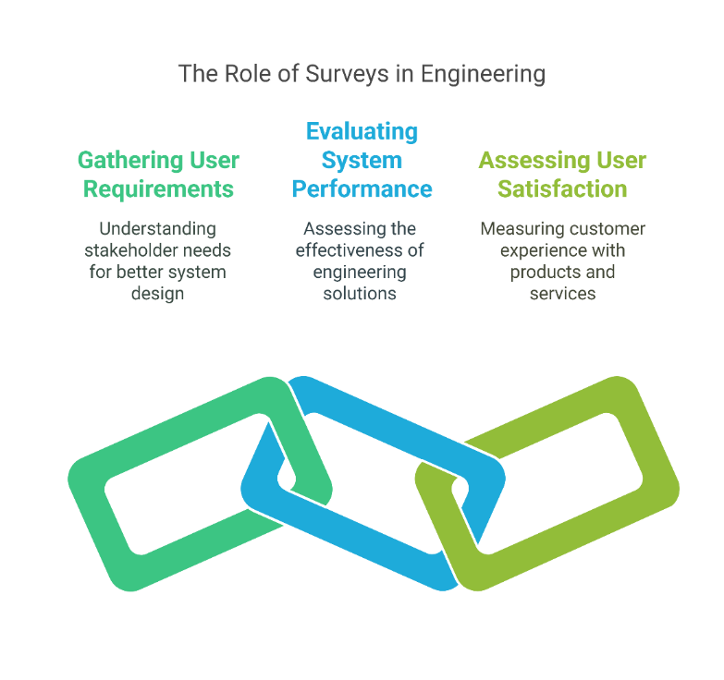
1. Introduction to Survey Design
1.1 Definition and Purpose of Surveys
What is a Survey?
A survey is a systematic method for collecting information from individuals to describe, compare, or explain their knowledge, attitudes, and behaviors.
Surveys help researchers gather structured data from a sample to make informed conclusions about a larger population.
Purpose in Engineering:
  Gathering user requirements – Understanding the needs of stakeholders for better system design.
  Evaluating system performance – Assessing the effectiveness of engineering solutions.
  Assessing user satisfaction – Measuring customer experience with products and services.
4
Designing Surveys

Slide 9
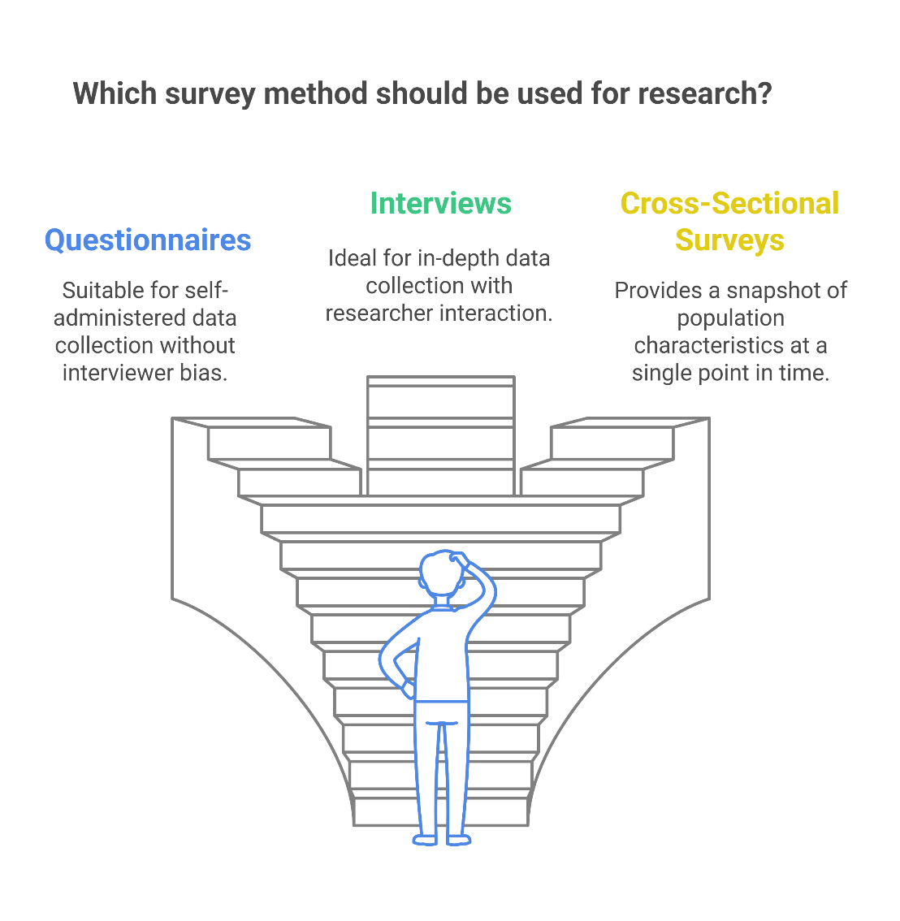
1. Introduction to Survey Design
1.2 Types of Surveys
By Administration Method:
Surveys help researchers gather structured data from a sample to make informed conclusions about a larger population.
Questionnaires: Self-administered instruments where respondents provide answers without an interviewer.
Interviews: Researcher-administered surveys conducted in person or over the phone, allowing for in-depth data collection.​
By Timeframe:
Cross-Sectional Surveys: Collect data at a single point in time to provide a snapshot of a population's characteristics or opinions.​
Longitudinal Surveys: Collect data over an extended period to observe changes and developments within a population.
5
Designing Surveys

Slide 10
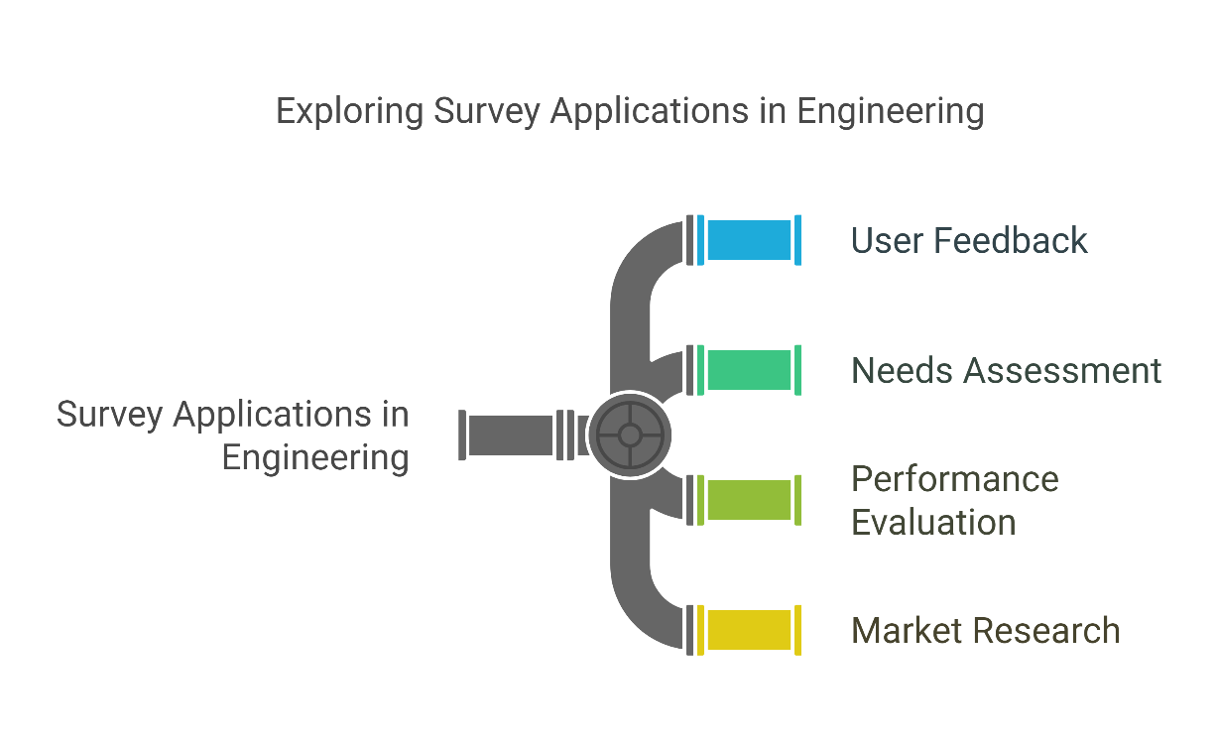
1. Introduction to Survey Design
1.3 Applications in Engineering
Group Discussion:
Divide students into small groups to brainstorm how surveys can be applied in engineering contexts. Potential applications include:​
  User Feedback:​
  Needs Assessment:​
  Performance Evaluation:​
  Market Research:
6
Designing Surveys

Slide 11
1. Introduction to Survey Design
Objectives: Clearly articulate the goals of the survey to ensure focused data collection.​
Design the Survey:
  Question Development: Create clear and unbiased questions that align with the survey's objectives.
  Response Options: Determine appropriate answer formats (e.g., multiple-choice, Likert scales).
Select the Sample: Identify and recruit a representative subset of the target population to participate in the survey.​
Distribute the Survey: Choose the most effective method for reaching respondents (e.g., online platforms, mail, in-person).​
Collect and Analyze Data: Gather responses systematically and use statistical tools to interpret the data and draw meaningful conclusions.​
Report Findings: Present the results in a clear and actionable manner to inform decision-making.
1.4 Overview of the Survey Design Process
7
Designing Surveys

Slide 12
Section 02:
Survey Creation Principles
Designing Surveys

Slide 13
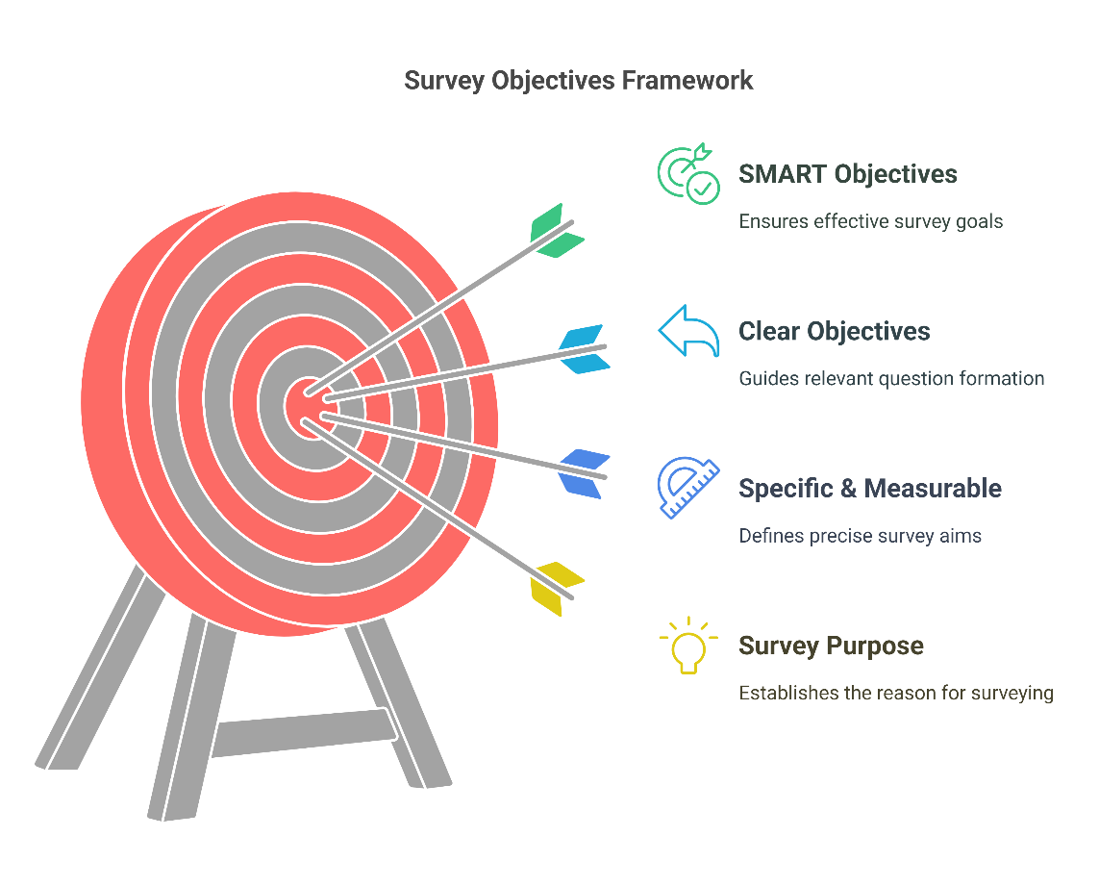
2. Survey Creation Principles
2.1 Defining Clear Objectives
What are Survey Objectives?
Objectives define the purpose of the survey and ensure collected data is useful.
Clear objectives prevent irrelevant questions and increase response quality.
Example of Good vs. Bad Objectives:
        "To understand transportation habits." (Too vague)
        "To identify the percentage of students using public transport, cycling, or driving to campus." (Specific & measurable)
        Tip: Use SMART objectives (Specific, Measurable, Achievable, Relevant, Time-bound).
9
Designing Surveys

Slide 14
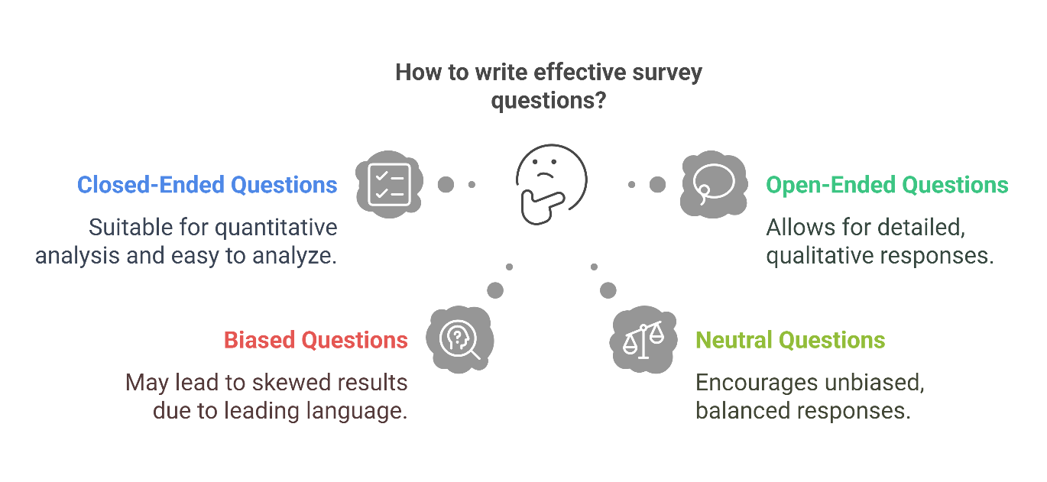
2. Survey Creation Principles
2.2 Question Formulation
Guidelines for Writing Effective Questions
Clarity – Use simple, unambiguous language.
Neutrality – Avoid leading or biased questions.
Relevance – Ensure each question aligns with survey objectives.
Types of Questions:
Closed-Ended Questions:
  Multiple-choice
  Likert Scale (Strongly Agree → Strongly Disagree)
  Yes/No
Open-Ended Questions:
  “What challenges do you face while using public transport?”
Example of Biased vs. Neutral Questions:
"Do you agree that electric vehicles are the best solution for pollution?" (Leads to a positive response)
"How effective do you think electric vehicles are in reducing pollution?" (More neutral)
10
Designing Surveys

Slide 15
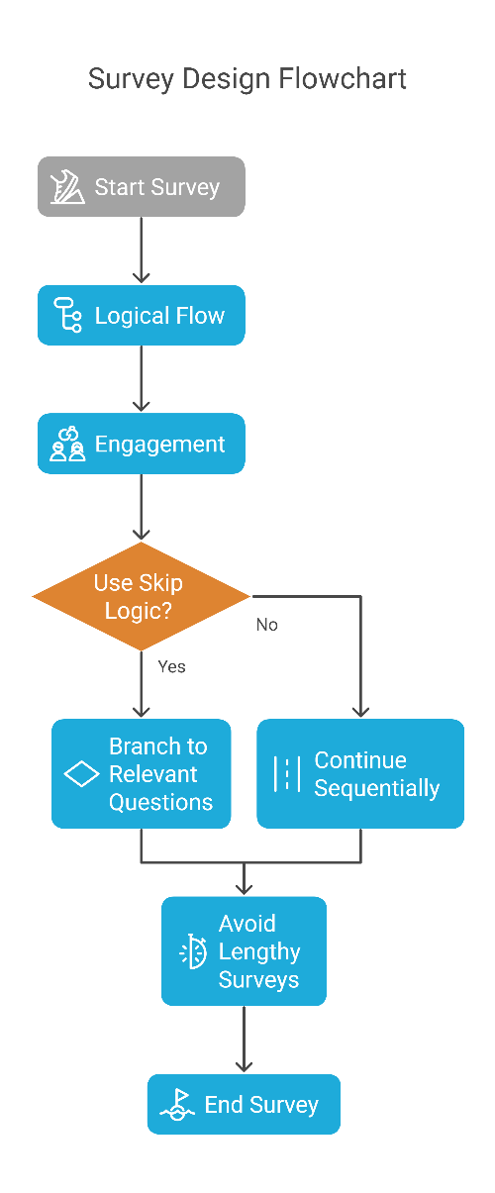
2. Survey Creation Principles
2.3 Structuring the Survey
Principles of a Well-Structured Survey:
Logical Flow: Group related questions together.
Engagement: Start with easy questions to build respondent interest.
Skip Logic: Use branching to make the survey efficient (e.g., If "No" → Skip to Question 5).
Example of Logical Question Flow:
Q1: Do you use public transport? (Yes/No)
Q2: If Yes → How often do you use it?
Q3: If No → What prevents you from using it?
Tip: Avoid making surveys too long to response because it cause rates drop if surveys take more than 5-10 minutes.
11
Designing Surveys

Slide 16
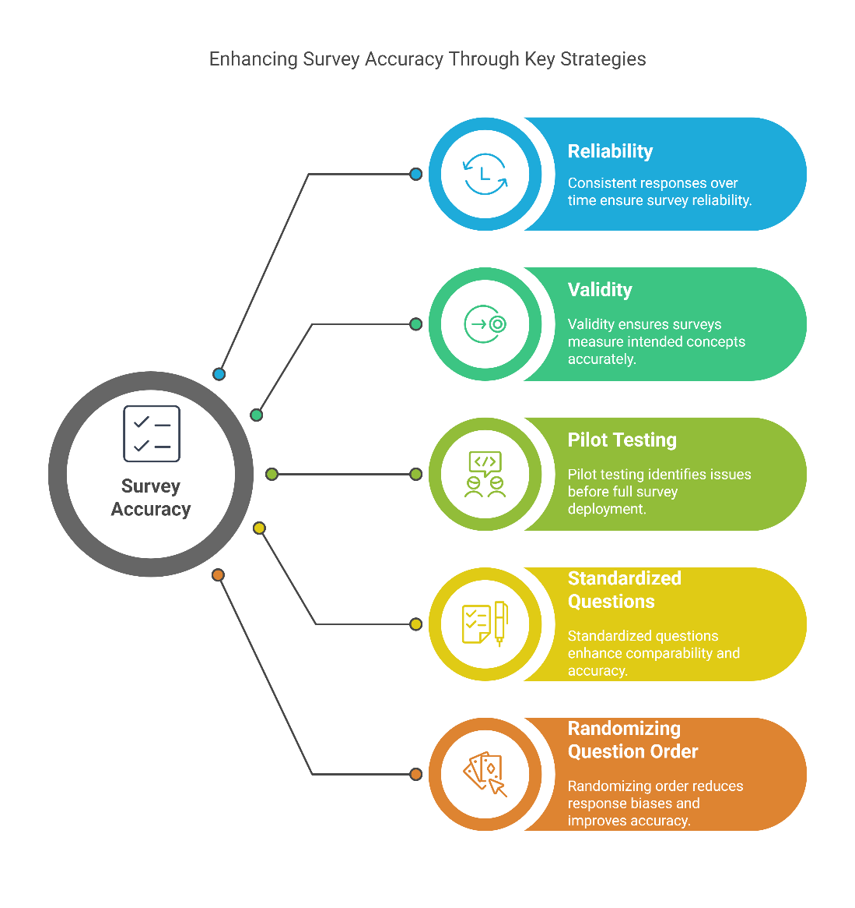
2. Survey Creation Principles
2.4 Ensuring Reliability and Validity
Reliability: Consistency of responses over time.
Validity: Measuring what is intended.
Strategies to Improve Survey Accuracy:
Example of Biased vs. Neutral Questions:
  Pilot Testing: Test the survey with a small group first.
  Using Standardized Questions: If applicable, use validated survey questions.
  Randomizing Question Order: Prevents response biases.
  Example: If you survey the same group twice, do you get consistent responses? That’s reliability.
12
Designing Surveys

Slide 17
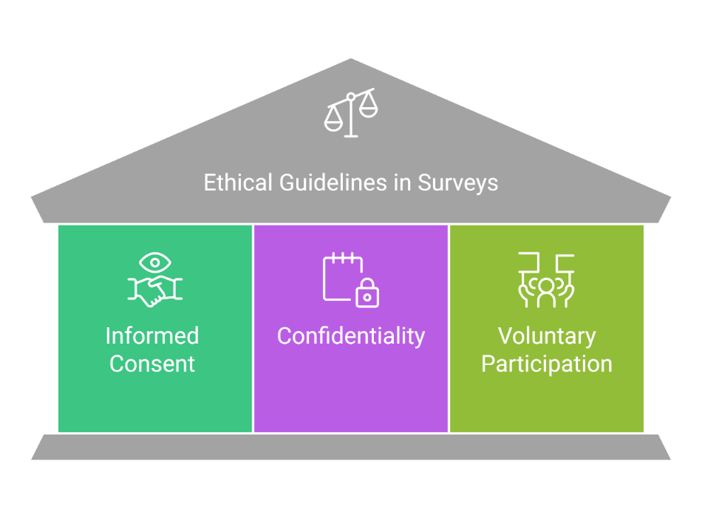
2. Survey Creation Principles
2.5 Ethical Considerations
Key Ethical Guidelines:
Informed Consent: Explain the survey’s purpose and how data will be used.
Confidentiality: Ensure respondents’ identities remain protected.
Voluntary Participation: Respondents must be able to opt out.
  Example of Ethical Issues in Surveys:
Collecting personal data (name, email) without disclosure.
Using survey data for marketing without consent.
  Tip: Always provide an opt-out option and a privacy statement.
13
Designing Surveys

Slide 18
Section 03:
Google Forms: Creating a Passenger Survey
Designing Surveys

Slide 19

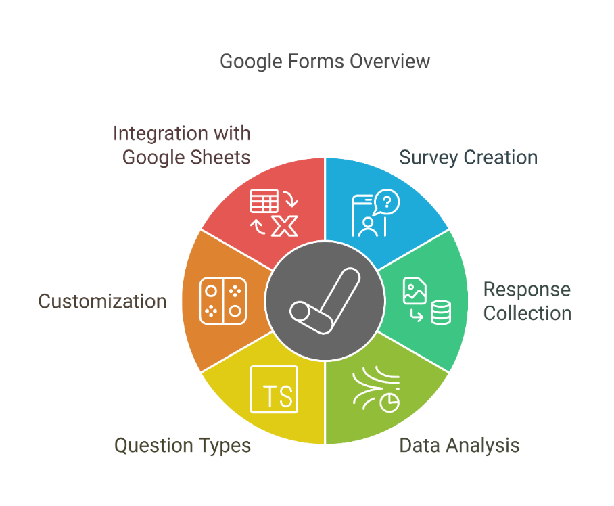
3. Google Forms: Creating a Passenger Survey
3.1 Introduction to Google Forms
What is Google Forms?
A free tool for creating surveys, collecting responses, and analyzing data.
Used widely in research, education, and business for efficient, paperless data collection.
  Key Features of Google Forms:
Various question types (multiple-choice, dropdowns, short text).
Customizable themes and branding.
Skip logic and response validation.
Integration with Google Sheets for analysis.
15
Designing Surveys

Slide 20

3. Google Forms: Creating a Passenger Survey
3.2 Step-by-Step Survey Creation
Create a new form: Go to Google Forms.
Title and description: Clearly define the survey’s purpose.
Add 10 questions:.
  Type of transport used
  Frequency of travel
  Overall satisfaction (1-5 scale)
  Issues faced (multiple choice)
  Suggestions for improvement
Customize design: Change themes, fonts, colors.
Configure settings: Allow multiple responses or restrict to one per participant.
Live Demo: Students create their own Google Form survey in class.
https://youtu.be/BtoOHhA3aPQ
16
Designing Surveys

Slide 21
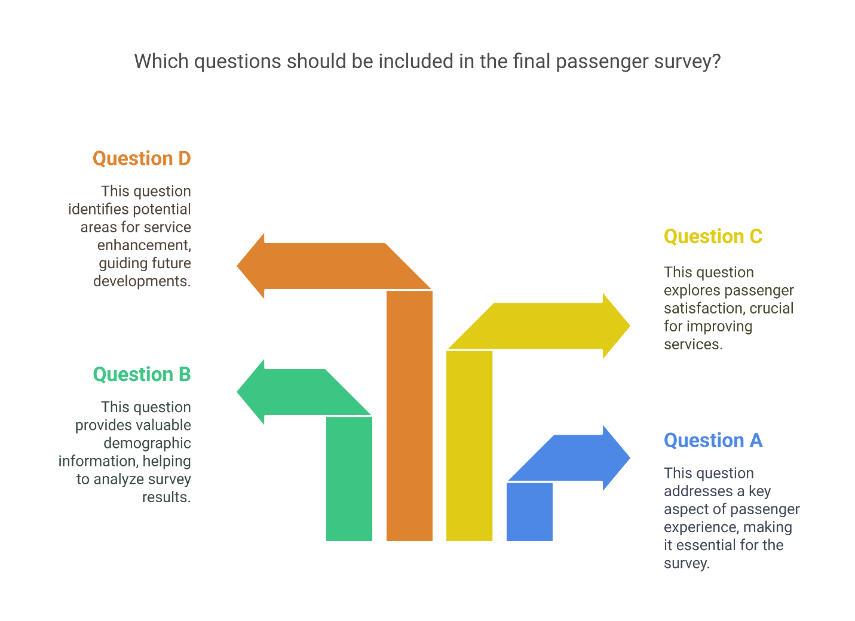
3. Google Forms: Creating a Passenger Survey
3.3 Collaborative Survey Development
Students brainstorm and refine survey questions.
Class votes on which 10 questions to include in the final passenger survey.
Discussion: Why were certain questions chosen over others?
Tip: Encourage students to critically evaluate why specific wording is better.
17
Designing Surveys

Slide 22
Section 04:
Class Activity: Distributing and
Responding to the Survey
Designing Surveys

Slide 23
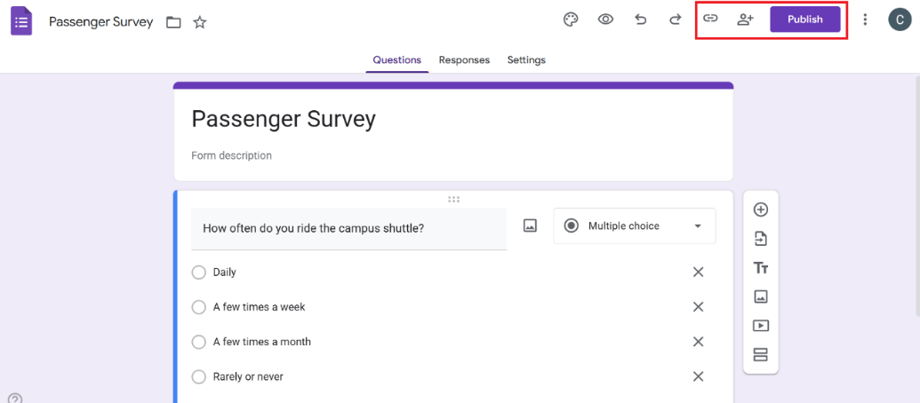
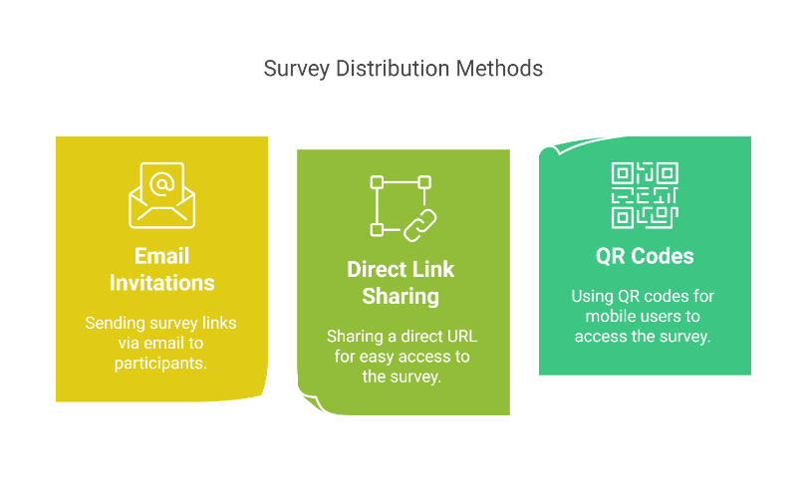
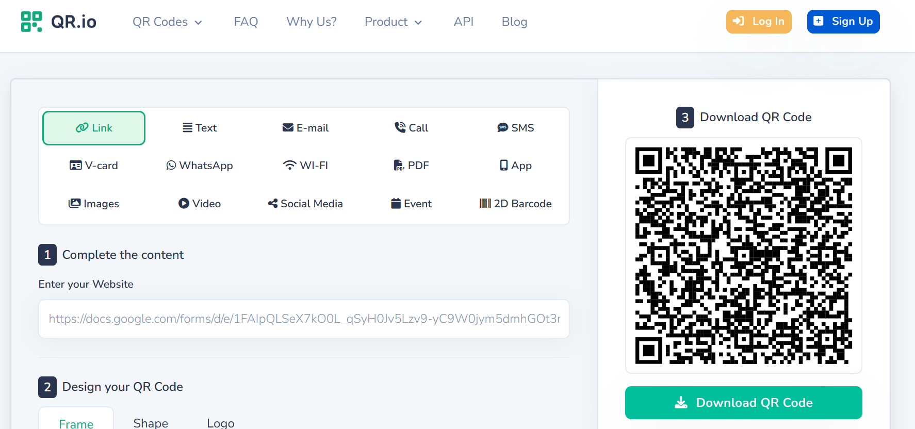
4. Class Activity: Distributing and Responding to the Survey
4.1 Sharing the Survey
Methods of Distribution:
  Email invitations
  Direct link sharing
  QR codes (for mobile surveys)
Live Task: Students share their Google Form survey with classmates.
19
Designing Surveys

Slide 24
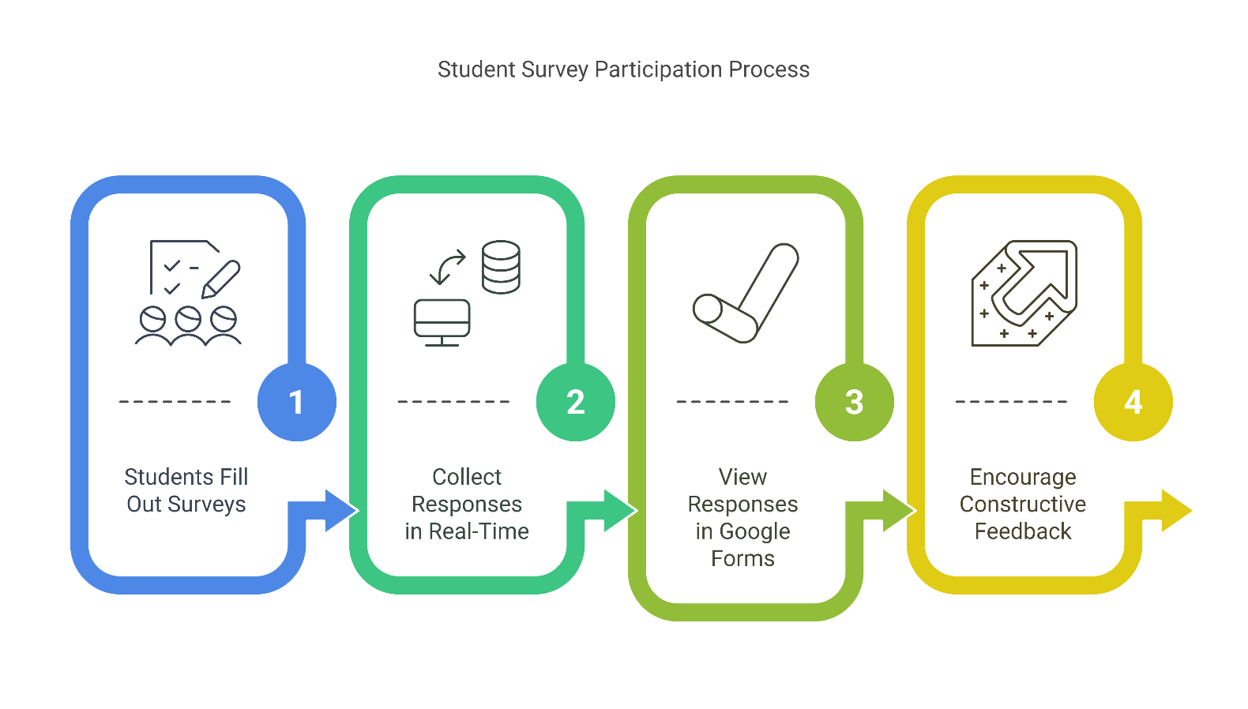
4. Class Activity: Distributing and Responding to the Survey
4.2 Student Participation
Students fill out each other’s surveys.
Responses are collected in real-time and viewed in Google Forms.
Tip: Encourage students to provide constructive feedback on clarity and ease of answering.
20
Designing Surveys

Slide 25
Section 05:
Google Sheets: Analyzing Survey Responses
Designing Surveys

Slide 26
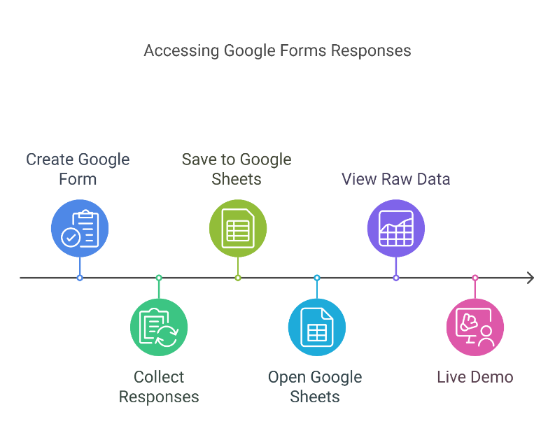
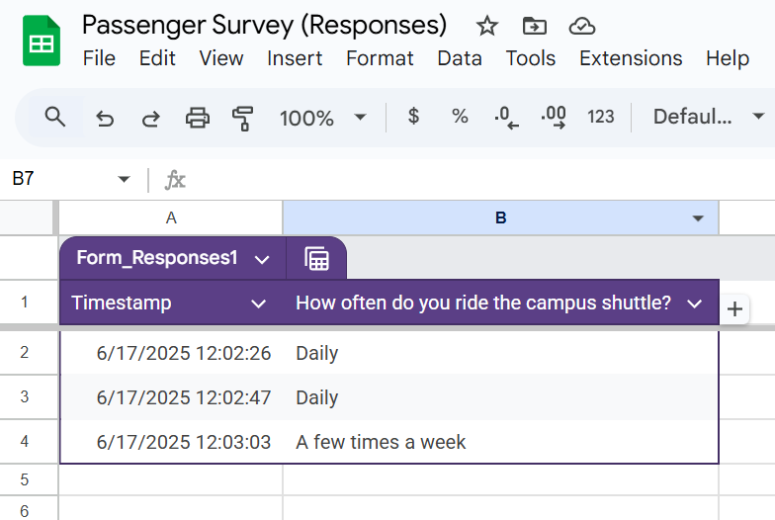
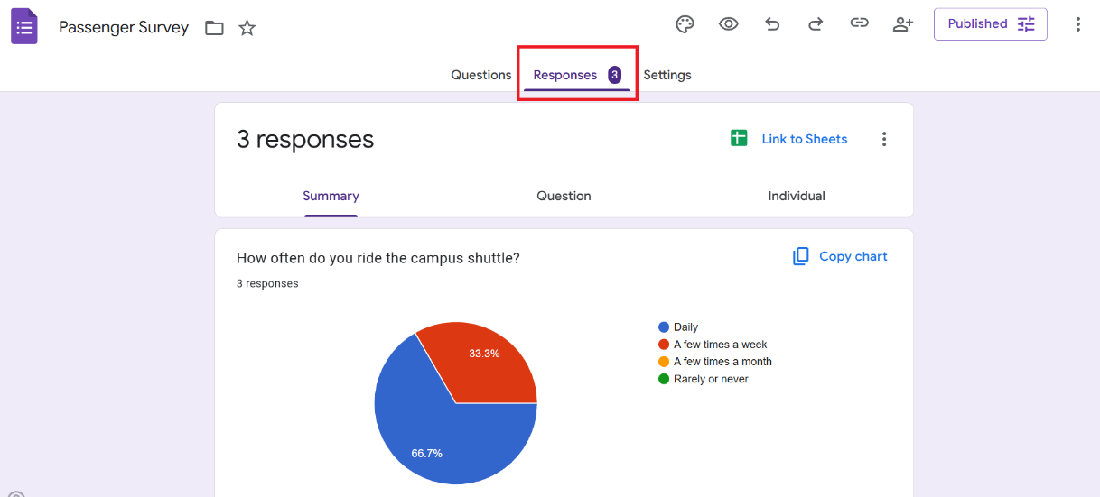
5. Google Sheets: Analyzing Survey Responses
5.1 Accessing Responses
Google Forms automatically saves responses in Google Sheets.
Open Google Sheets and view raw survey data.
Live Demo: Instructor shows how to open the response spreadsheet.
22
Designing Surveys

Slide 27
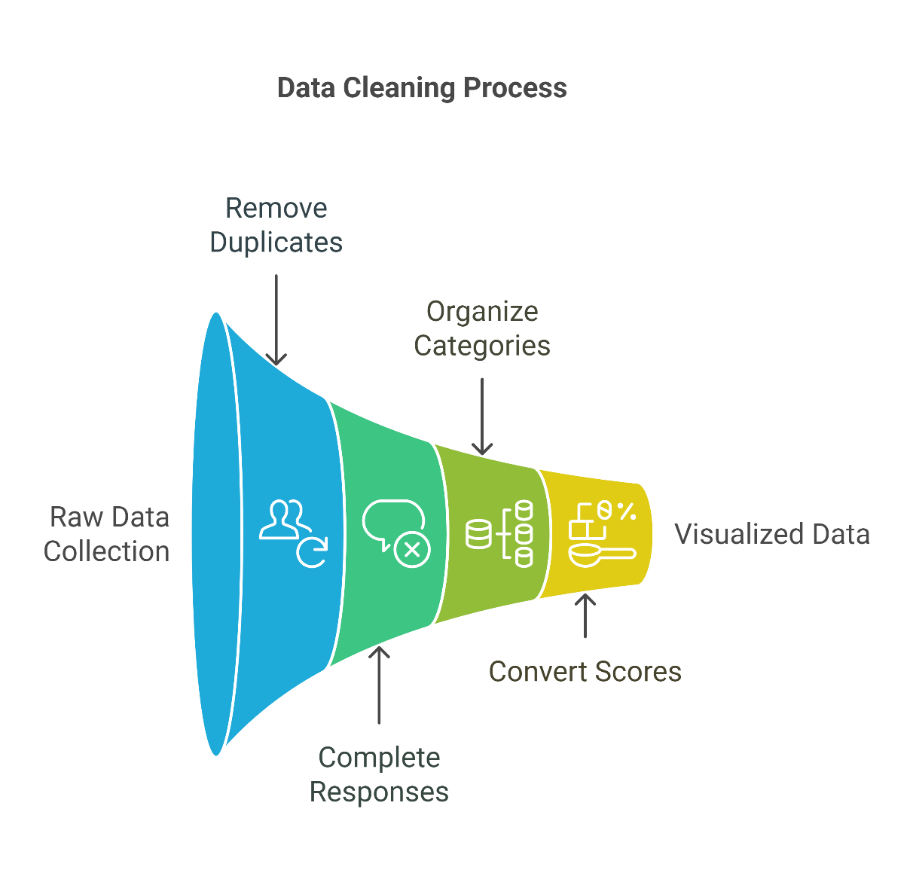
5. Google Sheets: Analyzing Survey Responses
5.2 Data Cleaning
Remove duplicate or incomplete responses.
Organize data into categories for analysis.
Example: Convert satisfaction scores (1-5) into percentage-based charts.
23
Designing Surveys

Slide 28
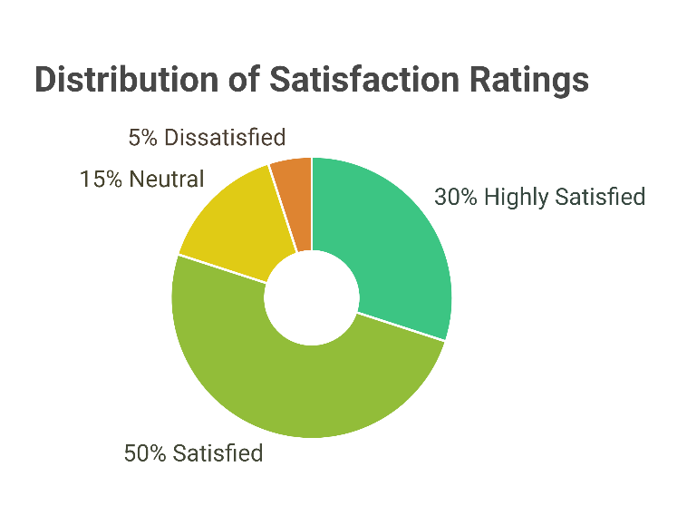
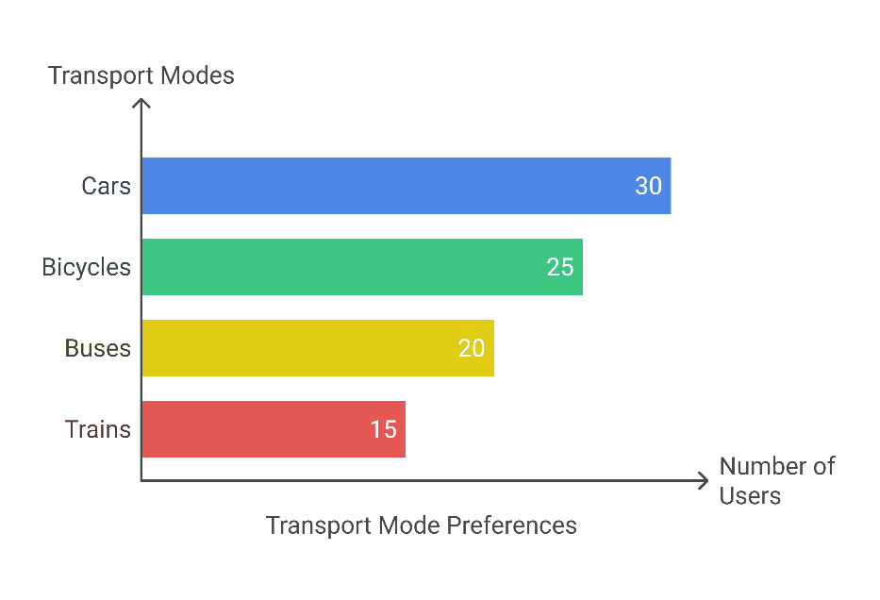
5. Google Sheets: Analyzing Survey Responses
5.3 Data Analysis Techniques
Remove duplicate or incomplete responses.
Basic statistical functions:
  AVERAGE – Find the mean rating for satisfaction.
  COUNTIF – Count how many users selected each transport mode.
Creating graphs & charts:
  Bar graphs: Transport mode preferences.
  Pie charts: Satisfaction ratings.
  Line graphs: Travel frequency trends.
Live Activity: Students generate at least one chart from survey data.
24
Designing Surveys

Slide 29
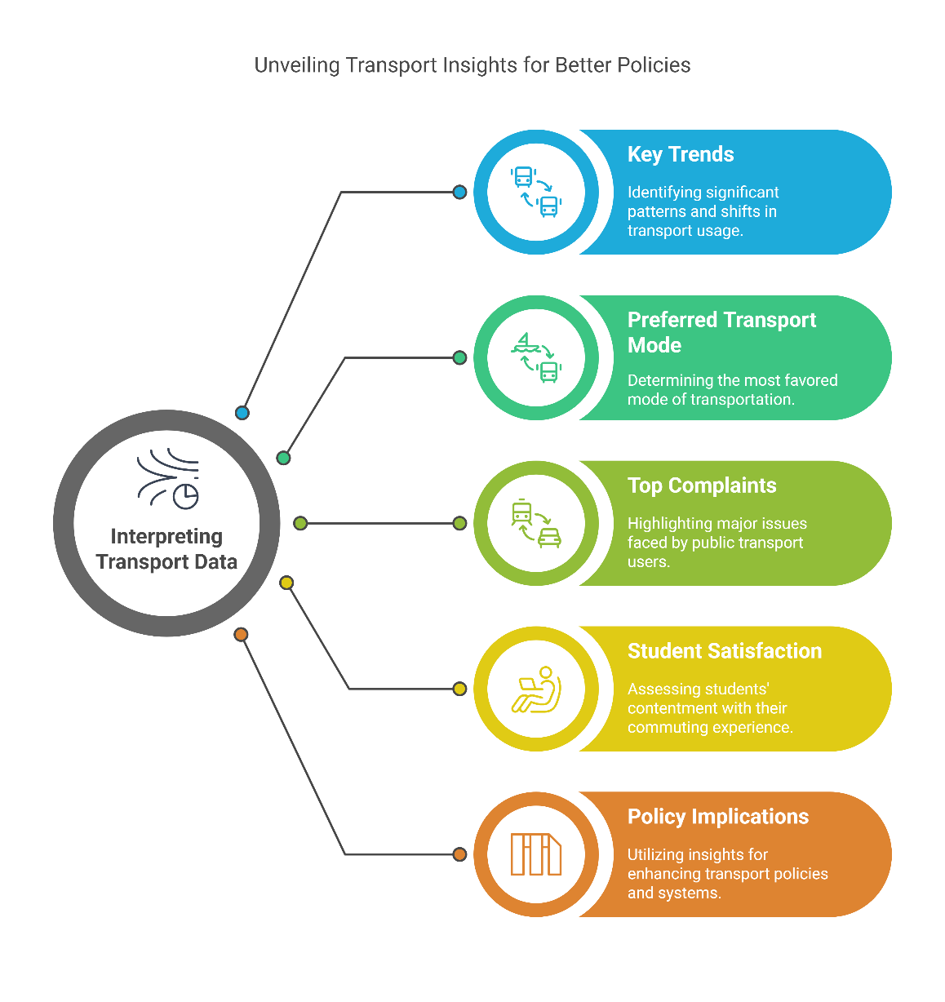
5. Google Sheets: Analyzing Survey Responses
5.4 Interpreting Results
Identify key trends from the data.
Discuss findings:
  Which transport mode is most preferred?
  What are the top complaints about public transport?
  Are students satisfied with their daily commute?
  Final Discussion: How can these insights be used for policy-making or system improvements?
25
Designing Surveys

Slide 30
5. Google Sheets: Analyzing Survey Responses
5.5 Home Assignment
Create a 10-question transport survey using Google Forms
Distribute it to at least 10 respondents
Clean and analyse responses using Google Sheets
Generate 2+ charts and interpret the results
Reflect on insights for engineering decision-making
📂 Refer to the detailed assignment document (Practical_2___Home_Assignment.pdf) for full instructions, structure, and grading criteria.
📂 Refer (Practical 2 - Submission Report.zip) for final report submission template in LaTeX.
26
Designing Surveys

Slide 31
Section 06:
References
Designing Surveys

Slide 32
6. References
6.1 Reference Textbooks & Tutorials
From YouTube: https://youtu.be/BtoOHhA3aPQ
https://support.google.com/docs/answer/6281888
Fowler, F. J. (2014) Survey research methods. 5th edition. Thousand Oaks: SAGE Publications, Inc.
28
Designing Surveys

Slide 33
Thank you for your Attention!

