Slide 1
Transport Research and Analysis
Module 1: Introduction to Transport Research and Analysis
Lab 01: Overview of Transport Data Sources and Tools

Slide 3
Table of contents
Lab 01: Overview of Transport Data Sources and Tools
Section 0: Objectives and Learning Outcomes ....................................... 4
Section 1: Introduction to Transport Dataset ........................................ 7
1.1. What Are Transport Datasets? .............................................. 8
1.2. Importance of Transport Datasets and Types ........................... 9
1.3. Different types or categories of transport data ................. 10
1.4. Survey of different Sources of Transport Data .......................... 11
Section 2: Installation Guide for the tools .............................................. 12
2.1. Installation of MATLAB and Tutorials ..................................... 13
2.2. Installation of Python and Tutorials ........................................ 15
2.3. Installation of Excel and Tutorials .......................................... 17
2.4. Installation of VISUM and Tutorials ....................................... 19
2.5. Installation of VISSIM and Tutorials ....................................... 21
Section 3: Introduction to MATLAB .................................................... 23
3.1. Overview of MATLAB ................................................................. 24
3.2. MATLAB Variables and Data Types .............................................. 26
3.3. Matrix and Array Operations ........................................................ 27
3.4. Generating Vectors and Matrices ................................................. 29
3.5. Matrix Indexing ………………………………………............................ 30
3.6. Arithmetic and Element-wise Operations ………………………...………. 31
3.7. Plotting Functions in MATLAB ………………………………………..…… 33
Section 4: Introduction to Python ....................................................... 39
4.1. Overview of Python ................................................................. 40
4.2. Variables, Objects, and Classes ................................................ 41
4.3. Basic Syntax Rules ................................................................. 43
4.4. Function Syntax and Calling Functions ....................................... 44
4.5. Common Data Types and Operators ……………………………........... 46
4.6. Input and Output Operations ..................................................... 47
4.7. Conditional Statements ............................................................ 48
4.8. Loops .................................................................................. 49
4.9. Exercise .............................................................................. 51
Section 5: Introduction to MS EXCEL ........................................... 52
5.1. Overview of MS Excel ............................................................. 53
5.2. Basic Actions (Copy, Paste, Sort, Insert) ..................................... 54
5.3. File Management (Open, Save, Export) ...................................... 55
5.4. Home, Insert, and Formula Tabs ............................................... 56
5.5. Numeric Formats and Basic Formulas ……………………………….... 57
5.6. Common Excel Functions ………………………………...….……......... 58
Overview of Transport Data Sources and Tools

Slide 4
Table of contents
Lab 01: Overview of Transport Data Sources and Tools
Section 6: Introduction VISUM .............................................................. 59
6.1. Introduction to VISUM / VISEM .......................................... 60
6.2. Core Capabilities ............................................................ 62
6.3. Typical VISUM workflow ............................................... 63
6.4. VISUM GUI .................................................................. 64
Section 7: Introduction to VISSIM ......................................................... 65
7.1. Introduction to VISSIM .............................................................. 66
7.2. Core Capabilities .................................................................. 67
7.3. VISUM can’t answer (but VISSIM can) .................................. 68
7.4. VISSIM GUI ......................................................................... 69
Section 8: Homework Assignment .......................................................... 70
8.1. Assignment Tasks .................................................................... 71
8.2. Homework Report Structure ................................................... 75
Overview of Transport Data Sources and Tools

Slide 5
Section 00:
Objectives and Learning Outcomes
Overview of Transport Data Sources and Tools

Slide 6
0. Objectives and Learning Outcomes
0.1. Objectives
Section No | What we’ll do | Tool(s) you’ll see | Activity Type | Activity done by | Duration
1 | Introduction to the Transport-data landscape – 8 key categories |  | Lecture | Lecturer | 15mins
1 | Where to grab real files – live tour of OSM, GTFS & national count portals | Browser | Practical | Lecturer | 15mins
2 / 3 /4 / 5 | Install & first-touch demos MATLAB: read + plot Python (Colab): describe + bar chart Excel: import + PivotTable | MATLAB · Python/Colab · Excel | Lecture + Practical | Lecturer | 30mins
6 | Introduction to VISUM – strategic network model: import OD, run assignment | VISUM | Lecture | Lecturer | 10mins
7 | Introduction to VISSIM – microscopic corridor sim: signal phasing, animation | VISSIM | Lecture | Lecturer | 10mins
8 | Lab Assignment | MATLAB and Python | Lecture | Lecturer | 10mins
Overview of Transport Data Sources and Tools

Slide 7
0. Objectives and Learning Outcomes
0.2. Learning Outcome
By the end of this lab, you will be able to …
Classify eight major types of transport data and match each to a typical file format.
Locate & download at least one open dataset (e.g. GTFS, loop counts, OSM) relevant to your project.
Install and launch five core tools – MATLAB, Python/Colab, Excel, VISUM, and VISSIM – on your own device or via campus licence.
Execute basic tasks in each analysis tool:
MATLAB – load CSV & create a simple plot
Python/pandas – compute descriptive stats and make a bar chart
Excel – build a 2-click PivotTable
Describe, in one sentence each, when to choose
a macroscopic planner (VISUM/VISEM) versus
a microscopic simulator (VISSIM).
Overview of Transport Data Sources and Tools

Slide 8
Section 01:
Introduction to Transport Dataset
Overview of Transport Data Sources and Tools

Slide 9
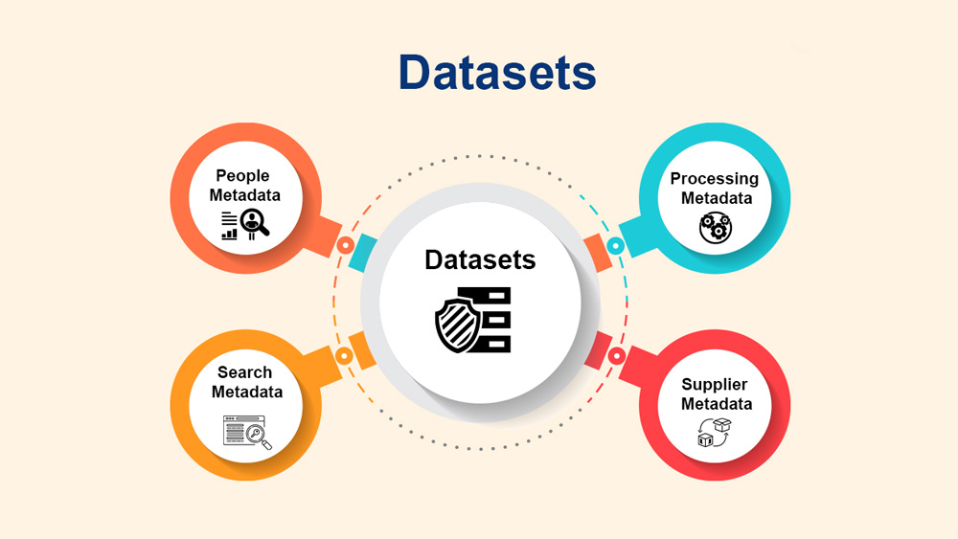
1. Introduction to Transport Dataset
1.1. What Are Transport Datasets?
Transport datasets refer to structured data collected for analyzing transportation systems.
They include information on:
  Traffic Flow (speed, congestion, vehicle count)
  Public Transport (bus/train schedules, passenger demand)
  Road Infrastructure (routes, intersections, accidents)
  Travel Behavior (commute patterns, mode of transport)
Overview of Transport Data Sources and Tools

Slide 10
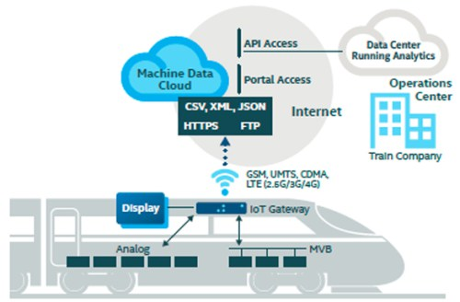
1. Introduction to Transport Dataset
1.2. Importance of Transport Datasets and Types
Why Are Transport Datasets Important?
  Data-Driven Decision Making: Helps in urban planning & policy formulation.
  Optimizing Transport Systems: Reducing congestion & improving efficiency.
  Enhancing Safety: Identifying accident-prone areas.
  Sustainability: Supporting smart & green mobility solutions.
Types of Transport Data
  Spatial Data: GIS maps, road networks, route maps
  Temporal Data: Traffic flow over time, public transport schedules
  Behavioral Data: Surveys on travel preferences & mode choices
  Sensor & IoT Data: Data from GPS, cameras, smart traffic signals
Overview of Transport Data Sources and Tools

Slide 11
1. Introduction to Transport Dataset
1.3. Different types or categories of transport data
 | Transport-data category | Typical data items (examples) | Common formats / specs | Example public source(s) & link
1 | Network & infrastructure | Road centre-lines, lane geometry, rail tracks, stop locations | Shapefile, GeoJSON, GPKG | OpenStreetMap export; Geofabrik regional shapefiles
2 | Service / supply | Timetables, routes, headways, vehicle capacity | GTFS, NeTEx, TransXChange | Agency GTFS feeds (e.g., gtfs.org reference)
3 | Demand & mobility patterns | Household travel surveys, smart-card tap logs, mobile-phone OD matrices | CSV, Parquet, proprietary binaries | 2017 U.S. National Household Travel Survey micro-data
4 | Traffic & operations | Loop count volumes, probe speeds, incident logs, signal states | CSV, XML, JSON, vendor APIs | FHWA Traffic Monitoring Guide detector data examples
5 | Freight & logistics | Truck GPS pings, weigh-in-motion, port/rail manifests | CSV, SQL dumps, EDI | U.S. FAF (Freight Analysis Framework), port authority open data
6 | Shared & micromobility | Bike-share / scooter availability, trip starts & ends | GBFS JSON | GBFS feeds published by Lime, Nextbike, etc.
7 | Environmental & asset condition | Emissions & noise sensors, RWIS weather, LiDAR pavement scans | CSV, NetCDF, LAS | National RWIS archives; municipal open-air quality portals
8 | Socio-economic / land-use context | Census demographics, zoning polygons, POI layers | Shapefile, GeoPackage, CSV | Eurostat GISCO, U.S. Census TIGER/Line, OpenStreetMap POIs
Overview of Transport Data Sources and Tools

Slide 12
1. Introduction to Transport Dataset
1.4. Survey of different Sources of Transport Data
 | Portal (what it hosts) | Typical data items (examples) | Formats | Spatial / temporal coverage
1 | OpenStreetMap / Geofabrik download server | Road centre-lines, paths, rail tracks, POIs | PBF, Shapefile, GeoJSON | Global – daily extracts by continent & country
2 | GTFS Data Exchange / gtfs.org directory | Timetables, stop locations, route shapes for > 1 500 transit agencies | GTFS (zip of text files) | Worldwide (agency-by-agency)
3 | UK DfT Road-Traffic Stats portal | Annual & hourly counts, AADT, classification at 46 k count sites | CSV, API | Great Britain, 2000 – 2024
4 | FHWA Traffic Monitoring Guide sample sets | Detector loop, WIM, speed sensor metadata for method studies | CSV, PDF spec | U.S. highways (example datasets)
5 | National Household Travel Survey (NHTS) | Trip diary micro-data, person & vehicle files | CSV, SAS, SPSS | United States, waves 2001 – 2022
6 | Eurostat GISCO – Transport networks | TEN-T rail/road layers, ferry routes, ports | Shapefile, GPKG | EU-27 plus EFTA, updated irregularly
7 | GBFS directory (shared-mobility feeds) | Real-time bike/scooter dock status, trip logs | GBFS JSON | 400 + cities globally
8 | Freight Analysis Framework (FAF 5) | OD tables for tonnage & value by mode/commodity | CSV, DBF | U.S. domestic & international flows, base 2017 + forecasts to 2050
Overview of Transport Data Sources and Tools

Slide 13
Section 02:
Installation Guide for the Tools
Overview of Transport Data Sources and Tools

Slide 14

2. Installation Guide for the Tools
2.1. Installing MATLAB Desktop (Windows/ MacOS/ Linux)
Get a licence
  Login to the – MATLAB website using your university email, You may already have access to MATLAB and Simulink.
Download the installer
  Profile ▸ Downloads ▸ choose the current release (e.g. R2025a).
  Save the setup.
Run the installer
  Sign in with your MathWorks ID.
  Select licence (trial or academic).
  Tick the toolboxes you need (MATLAB, Statistics, Mapping, …).
  Pick the install folder (≈ 10 GB for base + common toolboxes).
  Install & activate – the wizard activates automatically if you are online.
Installation document and video can be found HERE.
Overview of Transport Data Sources and Tools

Slide 15
2. Installation Guide for the Tools
2.1.1. Alternative tools and Tutorials
Zero-install option: MATLAB Online
  Go to https://matlab.mathworks.com/ and sign in.
  The browser IDE launches with 5 GB cloud drive.
  Upload your .m files or drag-drop data; almost all toolboxes work. (Great for Chromebook users or quick debugging.)
If you can’t install MATLAB: GNU Octave (free)
  Download from https://octave.org/download (≈ 300 MB).
  Most core MATLAB syntax (matrices, plotting) runs unchanged.
  Limitations: fewer toolboxes, UI/layout differs.
Tutorials
  MATLAB Onramp | Self-Paced Online Courses - MATLAB & Simulink
  Introduction to Programming with MATLAB | Coursera
  MATLAB Tutorials: Getting Started with MATLAB - YouTube
Overview of Transport Data Sources and Tools

Slide 16

2. Installation Guide for the Tools
2.2. Installing Python with Anaconda (recommended for beginners)
Download
  Go to https://www.anaconda.com → pick the 64-bit Graphical Installer for Windows / macOS / Linux.
Run the installer
  Accept licence → Just Me scope is fine.
  Keep the default path (C:\Users\<you>\anaconda3 or /Users/<you>/anaconda3).
  Tick “Add Anaconda to PATH” only if you don’t already use another Python.
  Finish → launch Anaconda Navigator.
Verify
  Open Anaconda Prompt (Win) or Terminal (macOS/Linux) and type;
      conda info
      python -V # should print Python 3.12.x (or current)
Installation document and video can be found HERE.
Overview of Transport Data Sources and Tools

Slide 17

2. Installation Guide for the Tools
2.2.1. Alternative tools and Tutorials
Zero-install option: Google Colab
  Visit https://colab.research.google.com & sign in with Google.
  Click “New notebook” → you get Python 3.10+ in the cloud.
  Upload datasets via the sidebar or mount Google Drive. (Great when using a Chromebook or if admin rights block Anaconda.)
Tutorials
  https://www.codecademy.com/learn/learn-python-3
  Learn Python - Full Course for Beginners [Tutorial]
  Google's Python Class | Python Education | Google for Developers
  Learn Python | Kaggle
  Python Tutorial –W3 schools
  Python Full Course for Beginners [2025]
Overview of Transport Data Sources and Tools

Slide 18

2. Installation Guide for the Tools
2.3. Installing Excel via Microsoft 365 (desktop app)
Check eligibility
  Most universities give you a free Microsoft 365 Education licence.
  Sign in with your school e-mail at office.com → banner “Office 365 A1 is free for students”.
Download installer
  Office home page ▸ Install apps ▸ Microsoft 365 apps
Run setup & activate
  Accept defaults → sign-in prompt appears after first launch → Excel opens activated.
Installation document and video can be found HERE.
Overview of Transport Data Sources and Tools

Slide 19
2. Installation Guide for the Tools
2.3.1. Alternative tools and Tutorials
Zero-install: Excel for the Web
Browse to office.com → App launcher ▸ Excel.
New blank workbook or upload an .xlsx.
Edits auto-save to OneDrive; core formulas & charts work, macros don’t.
Alternative
  Google Sheets - browser-only, real-time collaboration; import/export .xlsx
Tutorials
  Browse all training - Training | Microsoft Learn
  Free Excel Tutorials at GCFGlobal
  Excel Introduction - Learn Excel Basics – YouTube
Overview of Transport Data Sources and Tools

Slide 20

2. Installation Guide for the Tools
2.4. Installing VISUM
Choose your licence route
  Campus licence - Ask your IT help-desk for the network licence file (*.lic) or the PTV Hub username.
  Free Student Trial - Register on PTV Vision Traffic Suite for Students → receive a 6-month, function-limited licence (max 30 zones / 1 500 links). – Download from HERE.
Download the installer (Windows-only)
  Log in at the student portal ➜ Download VISUM 2025.
  Optional: also grab the Tutorial Data Pack (TutorialData.zip).
  Check system: Windows 10 64-bit or Windows 11, 8 GB RAM, 10 GB free disk, DirectX 11 GPU.
Install & activate
  Run PTV_Visum_2025.exe → “Install for all users”.
  When the Licence Wizard pops up;
    Trial: select “Activate via PTV Hub / student licence” ➜ paste the code from your confirmation e-mail.
  Finish – first launch may take 1-2 min while toolboxes register.
Installation document and video can be found HERE.
Overview of Transport Data Sources and Tools

Slide 21
2. Installation Guide for the Tools
2.4.1. Tutorials
VISUM Tutorials
  PTV Visum | First Steps – YouTube
  PTV VISUM Tutorials – YouTube
  Visum Quickstart ENG | PDF | Matrix (Mathematics) | Button (Computing)
Overview of Transport Data Sources and Tools

Slide 22
2. Installation Guide for the Tools
2.5. Installing VISSIM
Choose your licence route
  Campus licence - Ask your IT help-desk for the network licence file (*.lic) or the PTV Hub username.
  Free Student Trial - Register on PTV Vision Traffic Suite for Students → receive a 6-month, function-limited licence (max 30 zones / 1 500 links). – Download from HERE.
Download the installer (Windows-only)
  Log in at the student portal ➜ Download VISUM 2025.
  Optional: also grab the Tutorial Data Pack (TutorialData.zip).
  Check system: Windows 10 64-bit or Windows 11, 8 GB RAM, 10 GB free disk, DirectX 11 GPU.
Install & activate
  Run PTV_Visum_2025.exe → “Install for all users”.
  When the Licence Wizard pops up;
    Trial: select “Activate via PTV Hub / student licence” ➜ paste the code from your confirmation e-mail.
  Finish – first launch may take 1-2 min while toolboxes register.
Installation document and video can be found HERE.
Overview of Transport Data Sources and Tools

Slide 23
2. Installation Guide for the Tools
2.5.1. Tutorials
VISUM Tutorials
  PTV Vissim | Tutorials – YouTube
  PTV Vissim - First Steps ENG PDF | PDF | Traffic | Simulation
  PTV VISUM Tutorial - Lesson 0 - VISUM Basics
Overview of Transport Data Sources and Tools

Slide 24
Section 03:
Introduction to Matlab
Transport Research and Analysis
Overview of Transport Data Sources and Tools

Slide 25

3. Introduction to Matlab
3.1. Overview of MATLAB
Matrix Laboratory
  MATLAB is basically a high-level language which has many specialized toolboxes for making things easier for us
Dynamically typed language
  Variables require no declaration
  Creation by initialization (x=10;)
All variables are treated as matrices
  Scalar: 1×1 matrix; Vector: N×1 or 1×N matrix
  Calculations are much faster
Overview of Transport Data Sources and Tools

Slide 26
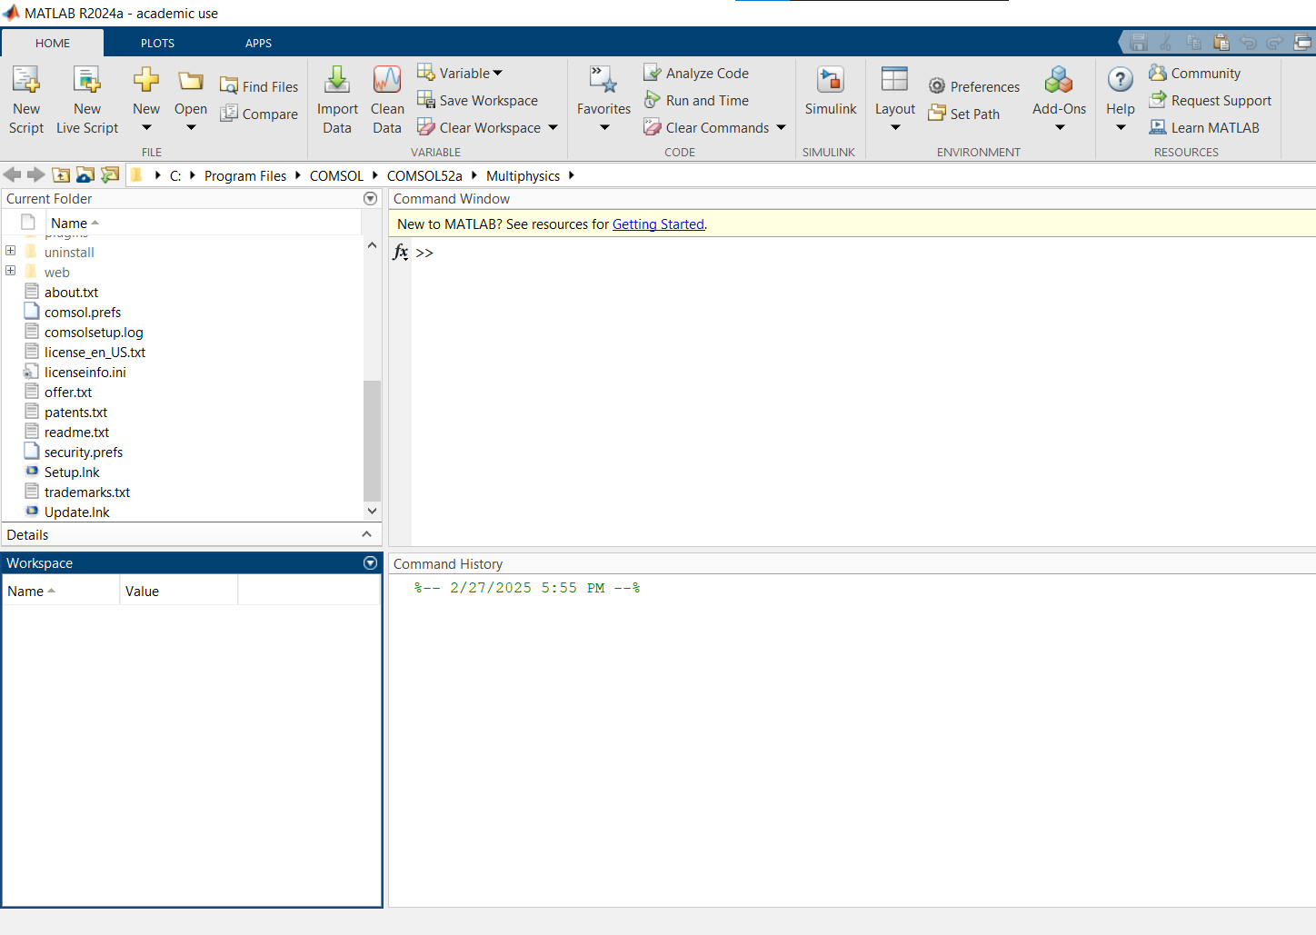
3. Introduction to Matlab
3.1. Overview of MATLAB
Command Window
  type commands
Current Directory
  View folders and m-files
Workspace
  View program variables
  Double click on a variable
  to see it in the Array Editor
Command History
  view past commands
  save a whole session
  using diary
Press up arrow on the command window for command history
Overview of Transport Data Sources and Tools

Slide 27
3. Introduction to Matlab
3.2. MATLAB Variables and Data Types
Variables
No need for types. i.e.,
All variables are created with double precision unless specified and they are matrices.
After these statements, the variables are 1x1 matrices with double precision
int a;
double b;
float c;
Example:
>>x=5;
>>x1=2;
Overview of Transport Data Sources and Tools

Slide 28
3. Introduction to Matlab
3.3. Matrix and Array Operations
a vector x = [1 2 5 1]
x =
1 2 5 1
a matrix y = [1 2 3; 5 1 4; 3 2 -1]
y =
1 2 3
5 1 4
3 2 -1
transpose y = x’ y =
      1
      2
      5
      1
7
Overview of Transport Data Sources and Tools

Slide 29
3. Introduction to Matlab
3.3. Matrix and Array Operations
Long Array, Matrix
t =1:10
t =
1 2 3 4 5 6 7 8 9 10
k =2:-0.5:-1
k =
2 1.5 1 0.5 0 -0.5 -1
B = [1:4; 5:8]
x =
1 2 3 4
5 6 7 8
8
Overview of Transport Data Sources and Tools

Slide 30
3. Introduction to Matlab
3.4. Generating Vectors and Matrices
Generating Vectors from functions
zeros(M,N) MxN matrix of zeros
ones(M,N) MxN matrix of ones
rand(M,N) MxN matrix of uniformly distributed random
numbers on (0,1)
x = zeros(1,3)
x =
0 0 0
x = ones(1,3)
x =
1 1 1
x = rand(1,3)
x =
0.9501 0.2311 0.6068
9
Overview of Transport Data Sources and Tools

Slide 31
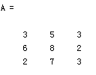


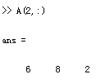

3. Introduction to Matlab
3.5. Matrix Indexing
The matrix indices begin from 1 (not 0 (as in C))
The matrix indices must be positive integer
Given:
A(-2), A(0)
Error: ??? Subscript indices must either be real positive integers or logicals.
A(4,2)
Error: ??? Index exceeds matrix dimensions.
Overview of Transport Data Sources and Tools

Slide 32
3. Introduction to Matlab
3.6. Arithmetic and Element-wise Operations
Operators (arithmetic)
+ addition
- subtraction
* multiplication
/ division
^ power
‘ complex conjugate transpose
Overview of Transport Data Sources and Tools

Slide 33
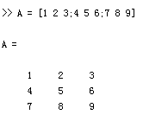
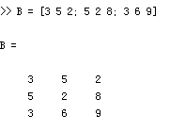
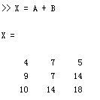
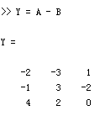
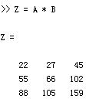
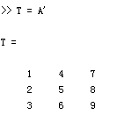
3. Introduction to Matlab
3.6. Arithmetic and Element-wise Operations
Matrices Operations
Given A and B:
Addition
Subtraction
Product
Transpose
Overview of Transport Data Sources and Tools

Slide 34
3. Introduction to Matlab
3.7. Plotting Functions in MATLAB
Basic Task: Plot the function sin(x) between 0≤x≤4π
Create an x-array of 100 samples between 0 and 4π.
Calculate sin(.) of the x-array
Plot the y-array
>>x=linspace(0,4*pi,100);
>>y=sin(x);
>>plot(y)
Overview of Transport Data Sources and Tools

Slide 35
3. Introduction to Matlab
3.7. Plotting Functions in MATLAB
Plot the function e^{-x/3}sin(x) between 0≤x≤4π
Create an x-array of 100 samples between 0 and 4π.
Calculate sin(.) of the x-array
Calculate e^{-x/3} of the x-array
Multiply the arrays y and y1
>>x=linspace(0,4*pi,100);
>>y=sin(x);
>>y1=exp(-x/3);
>>y2=y*y1;
Overview of Transport Data Sources and Tools

Slide 36
3. Introduction to Matlab
3.7. Plotting Functions in MATLAB
Plot the function e^{-x/3}sin(x) between 0≤x≤4π
Multiply the arrays y and y1 correctly
Plot the y2-array
>>y2=y.*y1;
>>plot(y2)
Overview of Transport Data Sources and Tools

Slide 37
3. Introduction to Matlab
3.7. Plotting Functions in MATLAB
Display Facilities
plot(.)
stem(.)
Example:
>>x=linspace(0,4*pi,100);
>>y=sin(x);
>>plot(y)
>>plot(x,y)
Example:
>>stem(y)
>>stem(x,y)
Overview of Transport Data Sources and Tools

Slide 38
3. Introduction to Matlab
3.7. Plotting Functions in MATLAB
Display Facilities
title(.)
xlabel(.)
ylabel(.)
>>title(‘This is the sinus function’)
>>xlabel(‘x (secs)’)
>>ylabel(‘sin(x)’)
Overview of Transport Data Sources and Tools

Slide 39
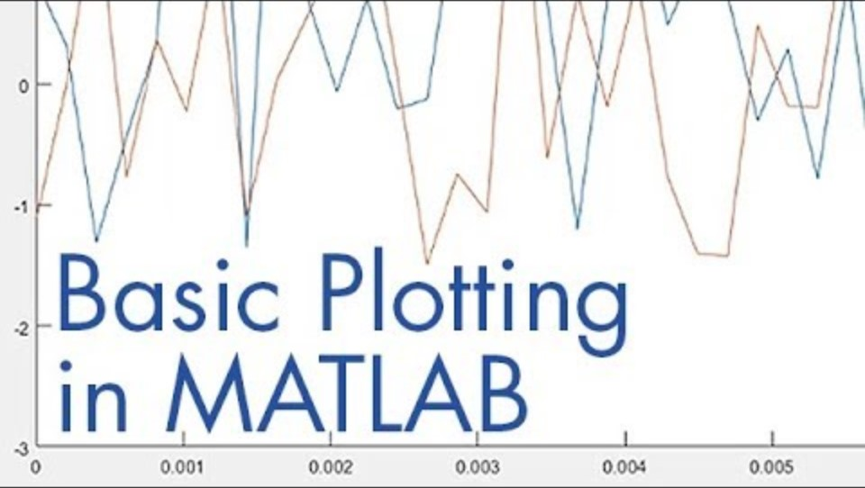
3. Introduction to Matlab
3.7. MATLAB Quick Demo (Teaser Video)
Source - https://www.youtube.com/watch?v=GtmUXVzw4lQ
Overview of Transport Data Sources and Tools
Notes:
Here is a quick teaser for MATLAB.

Slide 40
Section 04:
Introduction to Python
Overview of Transport Data Sources and Tools

Slide 41

4. Introduction to Python
4.1. Overview of Python
Python
  Python is a popular high-level programming language used in various applications
    Python is an easy language to learn because of its simple syntax
    Python can be used for simple tasks such as plotting or for more complex tasks like machine learning
Overview of Transport Data Sources and Tools

Slide 42
4. Introduction to Python
4.2. Variables, Objects, and Classes
Variable
  A variable is a reference to a value stored in a computer’s memory.
  Variables can be sorted into a variety of categories (or data types) such as numbers (int/float etc), Boolean values (true/false), and sequences (strings, lists etc).
Object
  An object is a collection of data from a computer’s memory that can be manipulated.
      ALL VARIABLES ARE OBJECTS although some objects can be defined by data referred to by multiple variables.
    Methods are the functions used to act on/alter an object’s data. They describe what your object can “do.”
Overview of Transport Data Sources and Tools

Slide 43
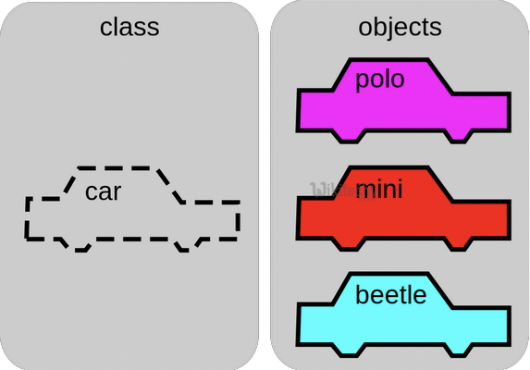
4. Introduction to Python
4.2. Variables, Objects, and Classes
Classes
  A class is a collection of objects who share the same set of variables/methods.
    The definition of the class provides a blueprint for all the objects within it (instances).
    Instances may share the same variables (color, size, shape, etc.), but they do NOT share the same values for each variable (blue/red/pink, small/large, square/circular etc.)
Instance #1
Color: Pink
Name: Polo
Instance #2
Color: Red
Name: Mini
Instance #3
Color: Blue
Name: Beetle
Overview of Transport Data Sources and Tools

Slide 44
4. Introduction to Python
4.3. Basic Syntax Rules
The name of your variable (myInt etc.) is placed on the left of the “=“ operator.
  Most variable names are in camel case where the first word begins with a lowercase letter and any subsequent words are capitalized
  Variable names may also appear in snake case where all words are lowercase, with underscores between words
The assignment operator (“=“) sets the variable name equal to the memory location where your value is found.
The value of your variable (“Hello, World”) is placed on the right of the “=“ operator.
  The type of this value does NOT need to be stated but its format must abide by a given object type (as shown).
myString = “Hello, World”
myInt = 7
myFloat = 7.0
myList = [7, 8, 9]
myBoolean = true
Overview of Transport Data Sources and Tools

Slide 45
4. Introduction to Python
4.4. Function Syntax and Calling Functions
  Function Syntax
    def...: indicates that you are defining a new function.
    function() refers to the name of your function. By convention, this name is typically lowercase and represents a verb/action.
    a,b refers to parameters (values or variables) that can be used within the statements of your function’s definition (......). If your function has no parameters, an empty parenthetical () is used.
    The return statement is an optional statement that will return a value for your function to your original call.
def function(a, b):
......
return a + b
Overview of Transport Data Sources and Tools

Slide 46
4. Introduction to Python
4.4. Function Syntax and Calling Functions
  Calling a function
    Call the function by referring to its name (function()) and by placing
    any necessary arguments (1, 2) within the parenthesis separated by
    commas. myValue = function(1, 2)
    If you wish, you can set your function call equal to a variable (myValue). The value returned by the function will be assigned to your variable name.
myValue = function(1, 2)
Overview of Transport Data Sources and Tools

Slide 47
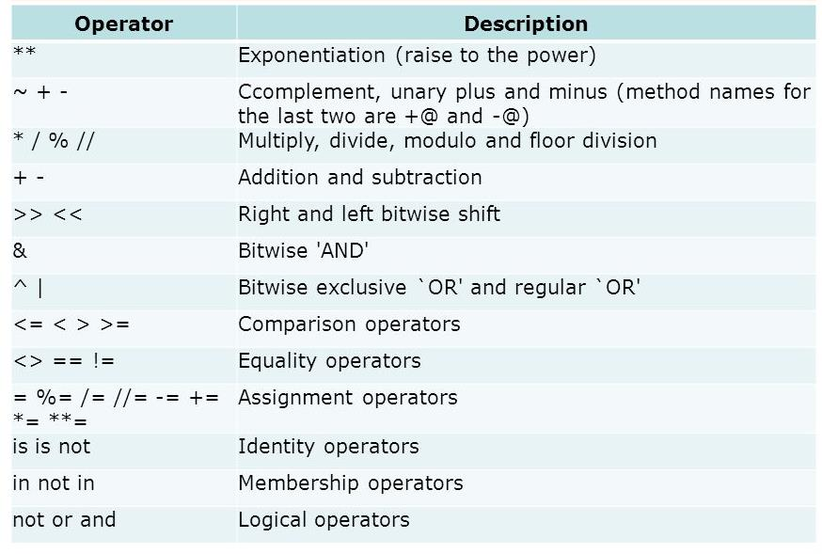
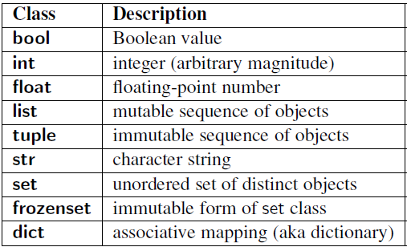
4. Introduction to Python
4.5. Common Data Types and Operators
A data type is a means of classifying a value and determining what operations can be performed on it. All objects have a data type.
Operators are symbols used carry out specific functions/computations.
Overview of Transport Data Sources and Tools

Slide 48
4. Introduction to Python
4.6. Input and Output Operations
Input functions (input()) allow users of a program to place values into programming code.
  The parameter for an input function is called a prompt. This is a string (this can be indicated by “” or ‘’) such as “Enter a number: “
    The user’s response to the prompt will be returned to the input statement call as a string. To use this value as any other data type, it must be converted with another function (int()).
Print functions (print()) allow programs to output strings to users on a given interface.
    The parameter of this function is of any type. All types will automatically be converted to strings.
xString = input(“Enter a number: “)
x = int(xString)
y=x+2
print(y)
Overview of Transport Data Sources and Tools

Slide 49
4. Introduction to Python
4.7. Conditional Statements
If-else statement
  If-else statements allow programmers to adapt the function of their code based on a given condition.
  If a given condition (i.e. x % 2 == 0) is true, then the statements following the if statement (if) will be executed. If the condition is false, the statements following the else statement (else) will be executed.
    The condition is tested using the Boolean operators == (is equal to), != (is not equal to), and (used to test multiple conditions), and or (used to test if AT LEAST ONE condition is true).
    Additionally, else-if statements (elif) can be used to provide unique coding statements for multiple conditions.
xString = input(“Enter a number: “)
x = int(xString)
if x % 2 == 0:
print(“This is an even number”)
elif x == 0:
print(“This number equals 0”)
else:
print(“This is an odd number”)
Overview of Transport Data Sources and Tools

Slide 50
4. Introduction to Python
4.8. Loops
“For” Loops
  For loops perform the same task (iterate) for the number of times specified by an iterable (something that can be evaluated repeatedly such as a list, string, or range).
  for defines the for loop
  x is the variable defining the number of times the statements within the loop (print(myInt)) are executed.
  The range(start, stop, step) function is often used to define x.
    The starting value is defined by start, the final value is defined by stop – 1, and the magnitude at which x changes between loops is defined by step.
  in is a Boolean operator that returns true if the given value (x) is found within a given list, string, range etc.
myString = input(“Enter a number: “)
myInt = int(myString)
for x in range(0, 5, 1): print(myInt)
Overview of Transport Data Sources and Tools

Slide 51
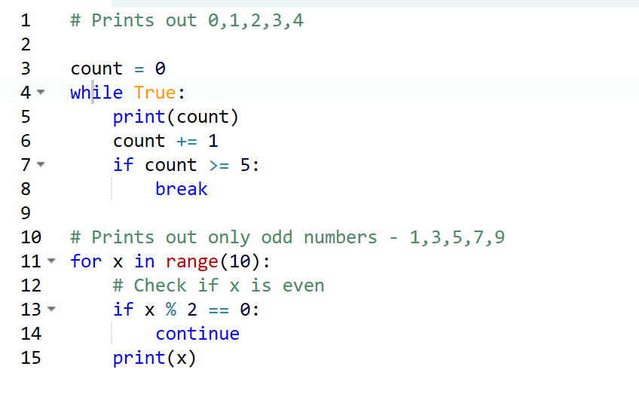
4. Introduction to Python
4.8. Loops
While Loops
  While loops are statements that iterate so long as a given Boolean condition is met.
    x (the variable determining whether or not the condition is met) is defined and manipulated OUTSIDE of the header of the while loop (while)
    The condition (x < 5) is a statement containing a Boolean variable.
    break is a statement used to exit the current for/while loop.
    continue is a statement used to reject all statements in the current for/while loop iteration and return to the beginning of the loop.
myString = input(“Enter a number: “)
myInt = int(myString)
x = 0
while x < 5:
print(myInt)
x= x +1
Overview of Transport Data Sources and Tools

Slide 52
4. Introduction to Python
Let’s Go Coding!
For more broad knowledge - https://www.w3schools.com/python/default.asp
Overview of Transport Data Sources and Tools

Slide 53
Section 05:
Introduction to MS Excel
Overview of Transport Data Sources and Tools

Slide 54
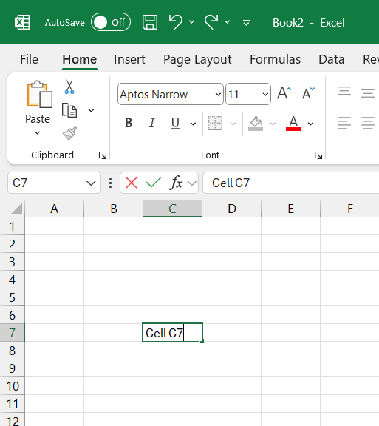
5. Introduction to MS Excel
5.1. Overview of MS Excel
Microsoft Excel consists of Workbooks.
Each Workbook is made up of an infinite number of worksheets.
Each worksheet has 1,048,576 rows and 16,384 columns.
A cell is the intersection between a column and a row.
Each cell is named for the column letter and row number that intersect to make it.
Column C
Row 7
Overview of Transport Data Sources and Tools

Slide 55
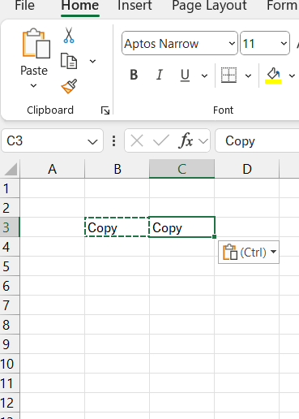
5. Introduction to MS Excel
5.2. Basic Actions (Copy, Paste, Sort, Insert)
Basic actions
  Excel allows for some basic actions which we have used before in other programs
  Copy/Paste (Rows, Columns, Cells, etc.)
  Insert (Rows and Columns)
  Sort (Alphabetically, Numerically, Chronologically, etc.)
Overview of Transport Data Sources and Tools

Slide 56
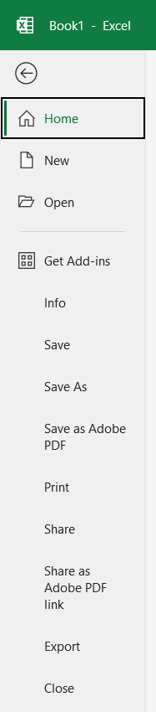
5. Introduction to MS Excel
5.3. File Management (Open, Save, Export)
Office button/ File
  New -To open new workbook. (CTRL+N)
  Open -To open existing document (CTRL+O)
  Save -To save a document. (CTRL+S)
  Save As -To save copy document. (F12)
  Print -To print a document. (CTRL+P)
  Share -To send a copy of document to other people.
  Export -To export for different file types.
  Close -To close a document (CTRL+W).
Overview of Transport Data Sources and Tools

Slide 57
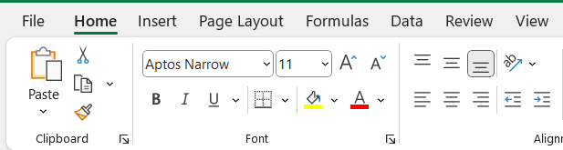
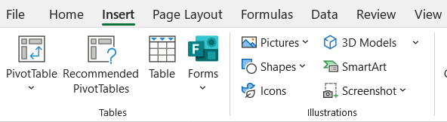
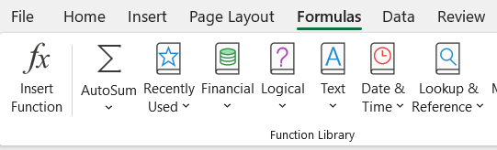
5. Introduction to MS Excel
5.4. Home, Insert, and Formula Tabs
Home Tab
  The Home menu allows you to make changes to any data that was entered.
Insert Tab
  The Insert menu allows you to insert worksheets, rows, columns, graphs, tables, pictures, objects.
Formula Tab
  The Formula menu allows you to apply formulars, different type of numeric formats, and do the calculations.
Overview of Transport Data Sources and Tools

Slide 58
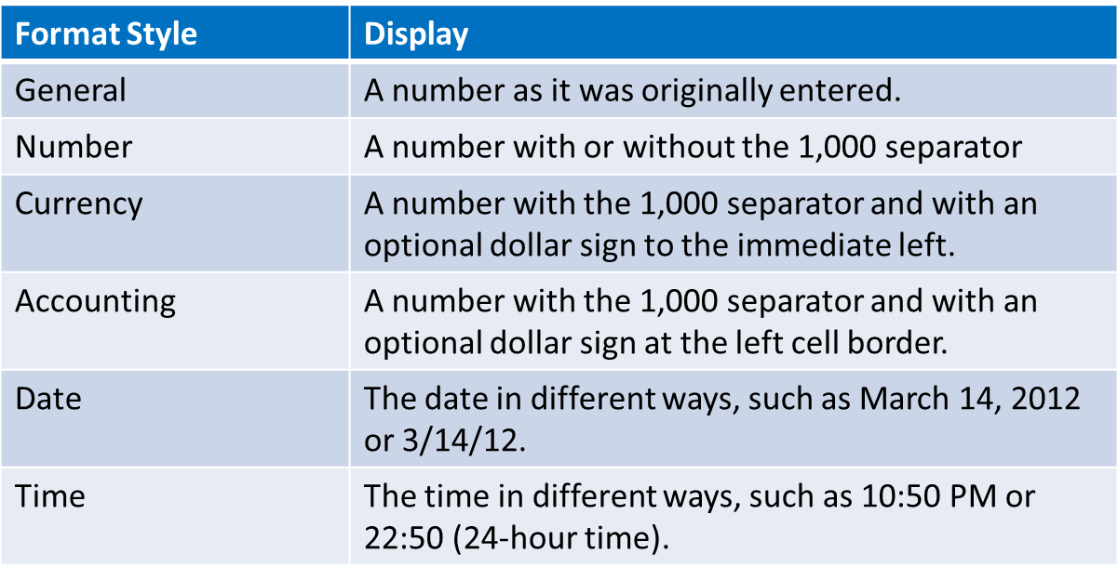
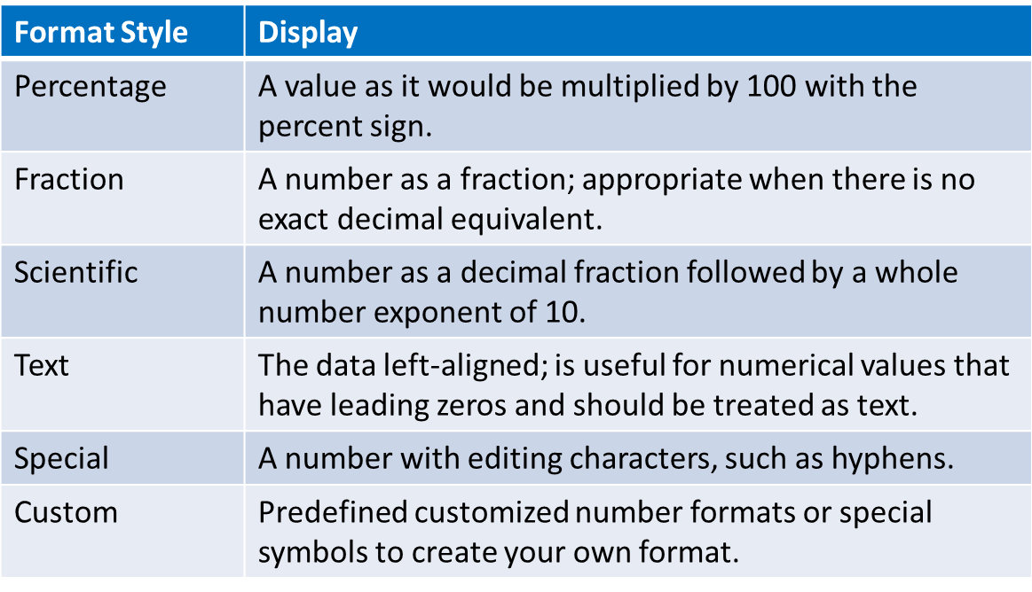
5. Introduction to MS Excel
5.5. Numeric Formats and Basic Formulas
Numeric formats
Overview of Transport Data Sources and Tools

Slide 59
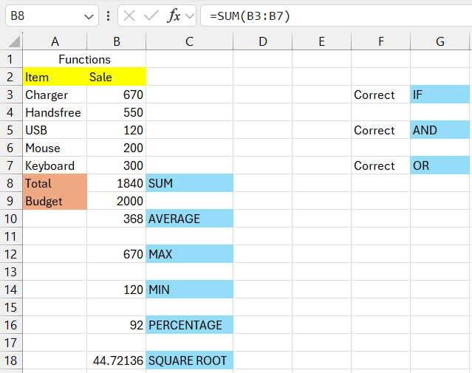
5. Introduction to MS Excel
5.6. Common Excel Functions
Excel Formulas
  You must have an equal's sign ( = ) as the first character in a cell that contains a formula.
  The = sign tells excel that the contents of the cell is a formula
  Without the = sign, the formula will not calculate anything. It will simply display the text of the formula.
Functions
  SUM =SUM(B3:B7)
  AVERAGE =AVERAGE(B3:B7)
  MAX =MAX(B1:B7)
  MIN =MIN(B1:B7)
  SQRT =SQRT(B9)
  TODAY =TODAY()
  Count =COUNT(A13:A34)
  Per% =B8/B9*100
  IF =IF(B3>B4,"Correct", "Incorrect")
  AND =IF(AND(B3>B7, B3>B6), "Correct", "Incorrect")
  OR =IF(OR(B3>B7, B3>B6), "Correct", "Incorrect")
Overview of Transport Data Sources and Tools

Slide 60
Section 06:
Introduction to VISUM/VISEM
Overview of Transport Data Sources and Tools

Slide 61
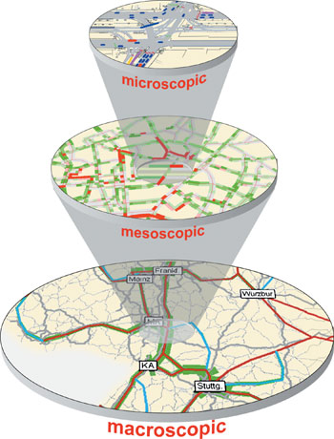
6. Introduction to PTV VISUM
6.1. Introduction to VISUM
What is VISUM?
  Macroscopic modelling & simulation platform for road, rail, public-transport and multimodal networks.
  Part of the PTV Vision suite; regarded as the industry standard for strategic transport planning.
  Used by 10 000+ professionals in 80 countries for everything from national demand models to city-centre tram studies.
Modeling of private vehicles and their interactions (PTV VISSIM)
Modeling of individual vehicles which move through the network based on macroscopic properties | Modeling of individual vehicles which move through the network based on macroscopic properties
Vehicles move through the network as packages of vehicles | Cell based approaches
Modeling of traffic using the relationship between aggregated quantities like flow, speed, density (PTV Visum)
Overview of Transport Data Sources and Tools

Slide 62
6. Introduction to PTV VISUM
6.1. Introduction to VISEM
What is VISEM?
  VISEM is a classic travel demand modeling module within PTV VISUM. It supports macroscopic modeling by estimating trip generation, distribution, and mode choice, helping planners forecast travel demand based on land use and socio-economic data. Its functionality is now largely integrated into Visum’s modern demand modeling tools.
Modeling of private vehicles and their interactions (PTV VISSIM)
Modeling of individual vehicles which move through the network based on macroscopic properties | Modeling of individual vehicles which move through the network based on macroscopic properties
Vehicles move through the network as packages of vehicles | Cell based approaches
Modeling of traffic using the relationship between aggregated quantities like flow, speed, density (PTV Visum)
Overview of Transport Data Sources and Tools

Slide 63
6. Introduction to PTV VISUM
6.2. Core capabilities
Area | Key functions
Network building | Import or draw links, nodes, turns; code PT lines, stops and timetables.
Demand modelling | Four-step workflow (trip generation → distribution → mode choice → assignment).
Traffic assignment | User-equilibrium, stochastic & capacity-restraint algorithms for cars; frequency-based passenger assignment for PT.
Scenario management | Copy / branch models, change inputs, run batch comparisons, produce KPI deltas.
Results & visuals | Link volumes, speeds, V/C, PTA passenger loads, accessibility contours, emissions.
Overview of Transport Data Sources and Tools

Slide 64
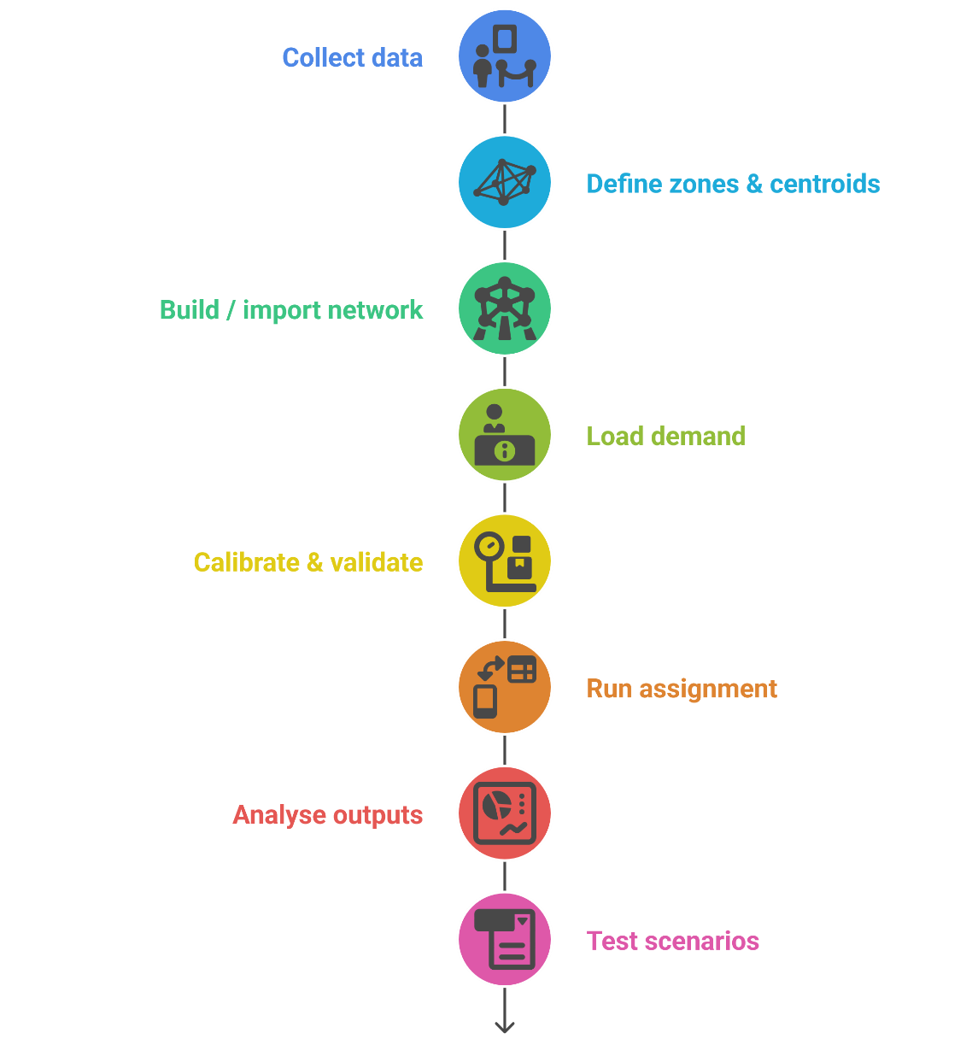
6. Introduction to PTV VISUM
6.3. Typical VISUM workflow (8-step “big picture”)
Collect data – OSM shapefiles, GTFS, traffic counts, OD matrices.
Define zones & centroids – connect to network with centroid connectors.
Build / import network – edit attributes, check connectivity.
Load demand – import OD tables, create PT line routes & headways.
Calibrate & validate – compare model flows with count stations; adjust matrices.
Run assignment – choose algorithm & convergence settings.
Analyse outputs – maps, tables, charts, skim matrices.
Test scenarios – new road, new metro line, policy measures; compare KPIs.
Overview of Transport Data Sources and Tools

Slide 65
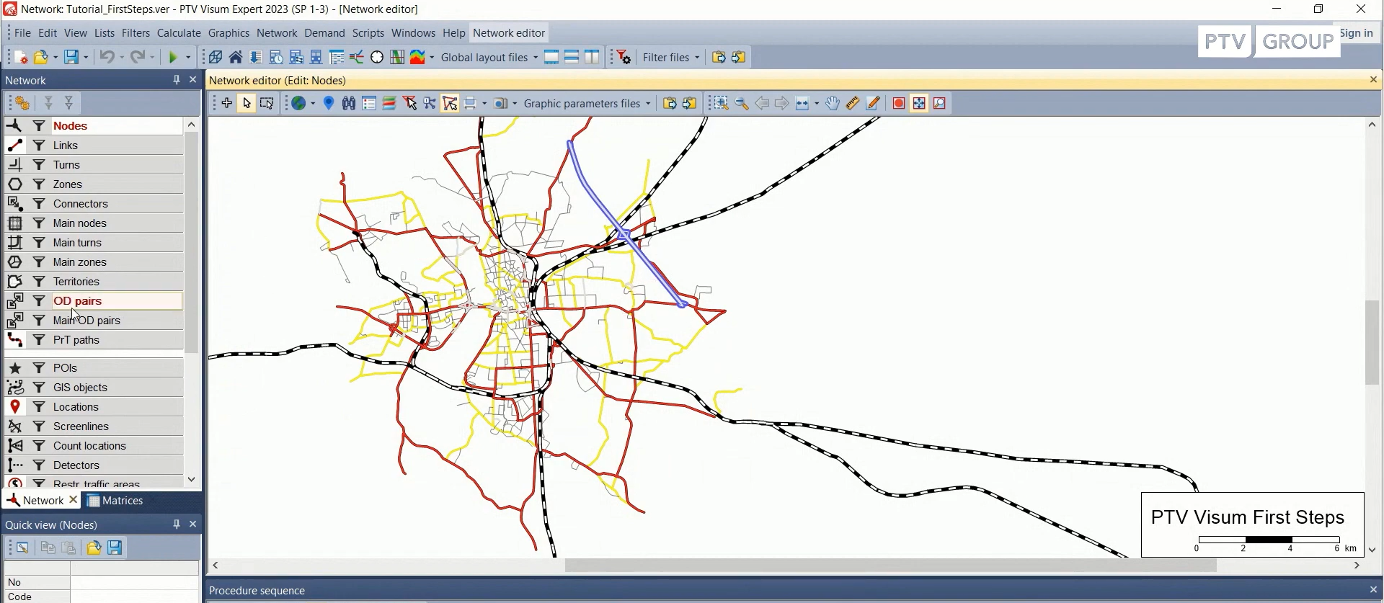
6. Introduction to PTV VISUM
6.4. VISUM GUI
Network Editor Window
Network Objects
Quick View
Overview of Transport Data Sources and Tools

Slide 66
Section 07:
Introduction to VISSIM
Overview of Transport Data Sources and Tools

Slide 67
7. Introduction to PTV VISSIM
7.1. Introduction to PTV VISSIM
What is VISSIM?
  Microscopic, time-step traffic-simulation platform: every vehicle, cyclist, pedestrian and transit unit is modelled as its own agent, obeying car-following & lane-changing logic.
  Strategic (VISUM) ➜ Mesoscopic ➜ Microscopic = VISSIM
  VISSIM computes every vehicle, cyclist and pedestrian step-by-step (0.1 s) using car-following & lane-changing physics, so you can answer intersection-level questions that a macro model cannot.
Modeling of private vehicles and their interactions (PTV VISSIM)
Modeling of individual vehicles which move through the network based on macroscopic properties | Modeling of individual vehicles which move through the network based on macroscopic properties
Vehicles move through the network as packages of vehicles | Cell based approaches
Modeling of traffic using the relationship between aggregated quantities like flow, speed, density (PTV Visum)
Overview of Transport Data Sources and Tools

Slide 68
7. Introduction to PTV VISSIM
7.2. Core capabilities
Area | Key functions
True multimodality | Mix cars, trucks, LRT, buses, bikes & walking flows in one scene; vehicles obey mode-specific behaviour sets.
Behavior realism | Built-in Wiedemann 99 car-following, lane-change logic, and an Automated-Vehicle model for ACC/ALC research.
Fine-grained control | Signal groups, actuated controllers, conflict areas, priority rules, dynamic route choice.
Mic-to-macro bridge | Direct import from VISUM (link geometry & demand) → test operational tweaks without redrawing the whole network.
Rich outputs & visuals | 2-D/3-D animations, delay & queue stats, emission & noise estimates, video export for stakeholder buy-in.
Overview of Transport Data Sources and Tools

Slide 69
7. Introduction to PTV VISSIM
7.3. Problems VISUM can’t answer (but VISSIM can)
Real-world question | Why VISUM alone is insufficient | How VISSIM answers it
Will a two-stage left-turn signal clear the queue in < 90 s during the PM peak? | VISUM assigns flow at 15-min or 1-hr resolution; it knows volumes, not second-by-second shock-waves. | Simulates every vehicle at 0.1-s steps, models queue spill-back, and returns the max discharge time per cycle.
What happens if we convert the curb lane to a bus-only lane between 7–10 a.m.? | VISUM can reallocate link capacity, but can’t model lane-change turbulence near the merge taper. | Vehicle agents decide when/where to merge; outputs show bus travel-time savings and car delay by lane.
Will an autonomous shuttle (max 15 km h⁻¹) mix safely with cyclists on a shared path? | VISUM has no car-following or gap-acceptance behaviour at bike speeds. | Uses ACC/ALC behaviour sets + cyclist model to track headways; exports post-encroachment-time safety metrics.
Can pedestrian crossings clear before the next platoon arrives? | Macro models treat pedestrians as demand modifiers, not moving agents. | Simulates pedestrian trajectories, signal compliance, and queue build-up; reports average wait and LOS.
Does an adaptive (SCOOT-like) signal reduce overall delay vs. fixed-time? | VISUM can’t emulate detector logic or real-time phase calls. | Built-in controller library (Ring-Barrier, VAP) runs detection-based timings, letting you compare delay/queue KPIs.
Overview of Transport Data Sources and Tools

Slide 70
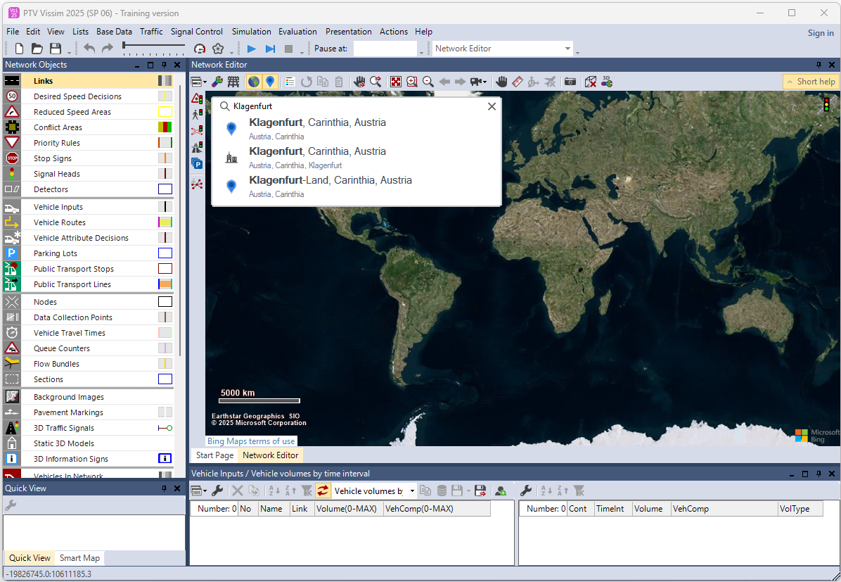
7. Introduction to PTV VISSIM
7.4. VISSIM GUI
Network Editor Window
Network Objects
Quick View
Overview of Transport Data Sources and Tools

Slide 71
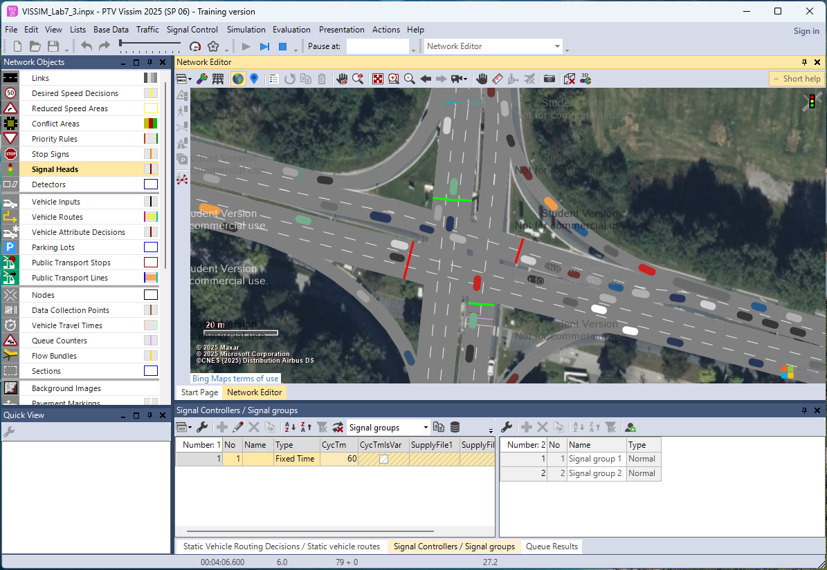
7. Introduction to PTV VISSIM
7.4. VISSIM GUI
Overview of Transport Data Sources and Tools

Slide 72
Section 08:
Lab Assignment
Overview of Transport Data Sources and Tools

Slide 73
8. Lab Assignment
8.1. Comparative Analysis of Transport Data in MATLAB and Python
Task 1: Dataset Selection and Download
  Objective: Introduce students to transport data portals.
  Instructions:
    Visit one of the following or any website mentioned in the lecture:
      GTFS feeds
      Eurostat GISCO
      FHWA Traffic Monitoring
  Download a dataset containing traffic volume, public transport schedules, or travel demand (preferably in .csv format).
  Briefly describe what the dataset contains.
Overview of Transport Data Sources and Tools

Slide 74
8. Lab Assignment
8.1. Comparative Analysis of Transport Data in MATLAB and Python
Task 2: Data Visualization in MATLAB
  Objective: Practice basic MATLAB plotting and vector operations.
  Instructions:
    Load the dataset into MATLAB using readtable() or csvread().
    Clean/filter the data (if necessary).
    Create at least two plots (e.g., line chart for time series, bar chart for category-wise counts).
Task 3: Data Visualization in Python (Colab or Jupyter)
  Objective: Use pandas and matplotlib for the same dataset.
  Instructions:
    Import the dataset using pandas.read_csv().
    Perform similar plotting and summarization as in MATLAB.
Overview of Transport Data Sources and Tools

Slide 75
8. Lab Assignment
8.1. Comparative Analysis of Transport Data in MATLAB and Python
Task 4: Compare the Results
  Objective: Reflect on tool capabilities.
  Instructions:
    Summarize in a short report:
    Which tool was easier to use?
    Which offered better plotting flexibility?
    Any differences in how the results are visualized or interpreted?
Overview of Transport Data Sources and Tools

Slide 76
8. Lab Assignment
8.2. Lab Report Structure
Section | Title | Description
1 | Title Page | Lab title, course, student name, ID, date
2 | Objectives | Goals and intended learning outcomes of the lab
3 | Introduction | Background on transport data and relevance of the tools
4 | Methodology Dataset Acquisition MATLAB Analysis Python Analysis | Step-by-step procedure for dataset handling and visualization
5 | Results | Plots and observations from both tools
6 | Discussion | Comparative analysis, tool effectiveness, challenges
7 | Conclusion | Summary of learnings and reflections
8 | References | Cited sources: datasets, software, tutorials
9 | Appendices | Code, extra plots, screenshots, raw data excerpts
Overview of Transport Data Sources and Tools

Slide 77
Thank you for your Attention!

