Slide 1
Transport Research and Analysis
Module 1: Introduction to Transport Research and Analysis
Lecture 2: Transport Research Methods

Slide 3
Table of contents
Section 1 Introduction to Transport Research Methods .................. 4
Why Transport Research? ......................................... 5
Characteristics of Transport Research ....................... 6
Classification of Transport Research …….................... 7
Section 2 Overview of Transport Research Methods ...................... 8
Overview of Transport Research Methods .................... 9
Section 3 Quantitative Research Methods ..................................... 10
What is Quantitative Research? ................................. 11
Common Quantitative Methods ................................. 12
Advantages & Challenges of Quantitative method ........ 13
Section 4 Qualitative Research Methods …..................................... 19
What is Qualitative Research? ................................... 20
Common Qualitative Methods ................................... 21
Section 5 Mixed Methods Research .............................................. 29
What is Mixed Methods Research? ............................ 29
Mixed Methods Research ......................................... 30
Case Study - Evaluating Congestion
Pricing in Singapore ….................................................. 33
Section 6 Data Collection in Transport Research .......................... 35
Primary Data vs. Secondary Data .............................. 36
Primary Data Collection Methods ............................. 37
Secondary Data Collection Methods ......................... 38
Big Data & AI in Transport Research .......................... 39
Challenges in Data Collection ……………………............. 40
Section 7 Quiz & Group Discussion ............................................... 41
Quiz ……………......................................................... 42
Group Discussions ................................................. 43
Transport Research Methods

Slide 4
Objectives
0.1. Learning Objectives
By the end of this lecture, you will:
  Understand the different types of transport research methods
  Differentiate between quantitative and qualitative approaches
  Learn about data collection techniques and sources
  Identify real-world applications of transport research
Transport Research Methods

Slide 5
Section 01:
Introduction to Transport Research Methods
Transport Research Methods

Slide 6
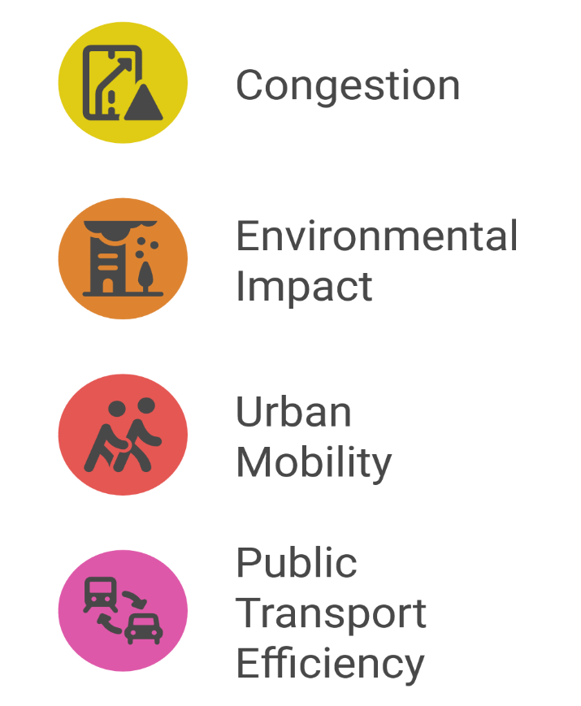
1. Introduction to Transport Research Methods
1.1. Why Transport Research?
Transport plays a critical role in the economy
Research helps in policy-making, infrastructure planning, and efficiency improvements
Addresses -
Example: Research on public transport subsidies influences government policies
Transport Research Methods

Slide 7
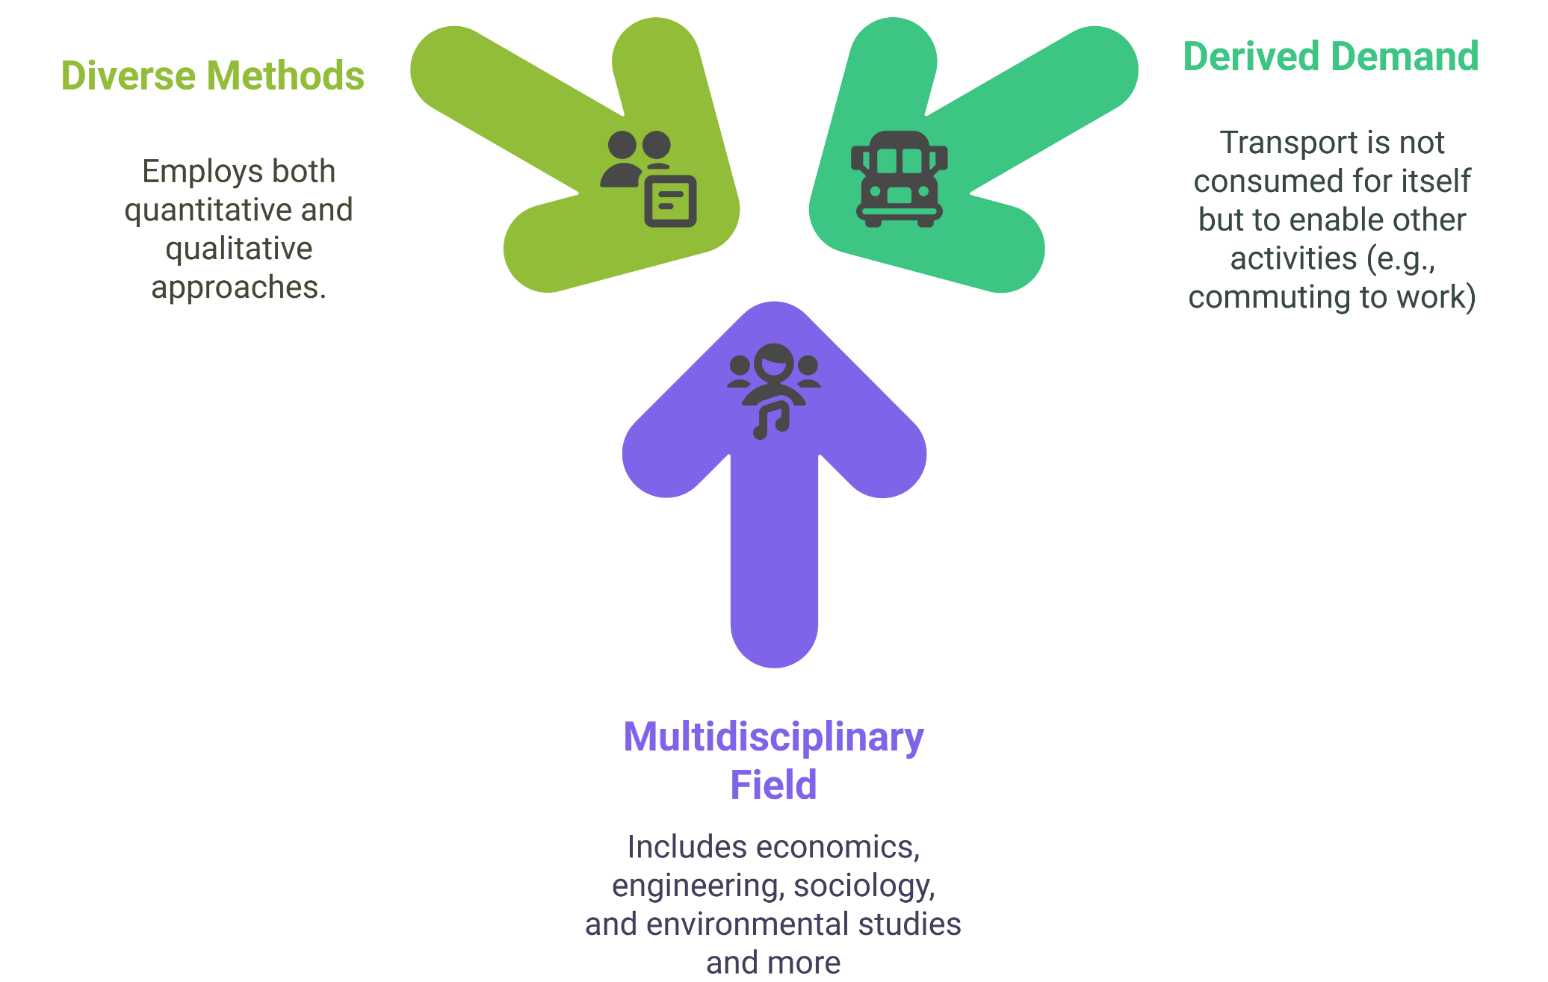
1. Introduction to Transport Research Methods
1.2. Characteristics of Transport Research
Transport Research Methods

Slide 8
1. Introduction to Transport Research Methods
1.3. Classification of Transport Research
Basic vs. Applied Research
  Basic: Theoretical studies (e.g., transport demand elasticity)
  Applied: Practical applications (e.g., optimizing public transport routes
Policy-Oriented vs. Operational Research
  Policy: Studying transport regulations and their impact
  Operational: Improving logistics, scheduling, and service efficiency
Theoretical vs. Empirical Research
  Theoretical: Developing models (e.g., congestion pricing models)
  Empirical: Using real-world data to validate theories
Transport Research Methods

Slide 9
Section 02:
Overview of Transport Research Methods
Transport Research Methods

Slide 10
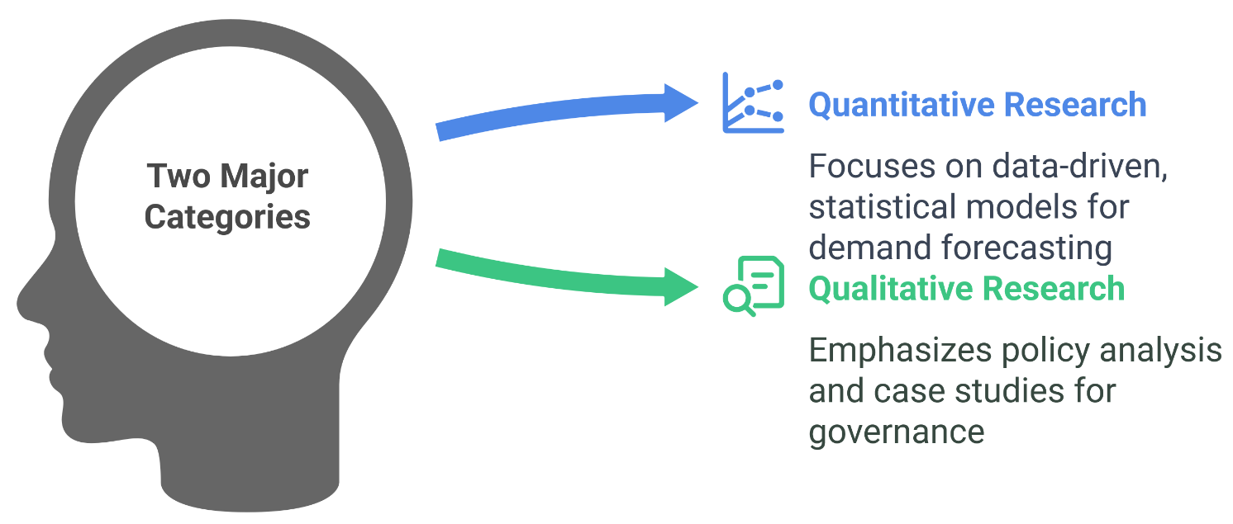
2. Overview of Transport Research Methods
2.1. Overview of Transport Research Methods
Two major categories:
Why research methods matter:
  Helps improve transport planning
  Informs infrastructure investments
  Supports policy-making decisions
Transport Research Methods

Slide 11
Section 03:
Quantitative Research Methods
Transport Research Methods

Slide 12
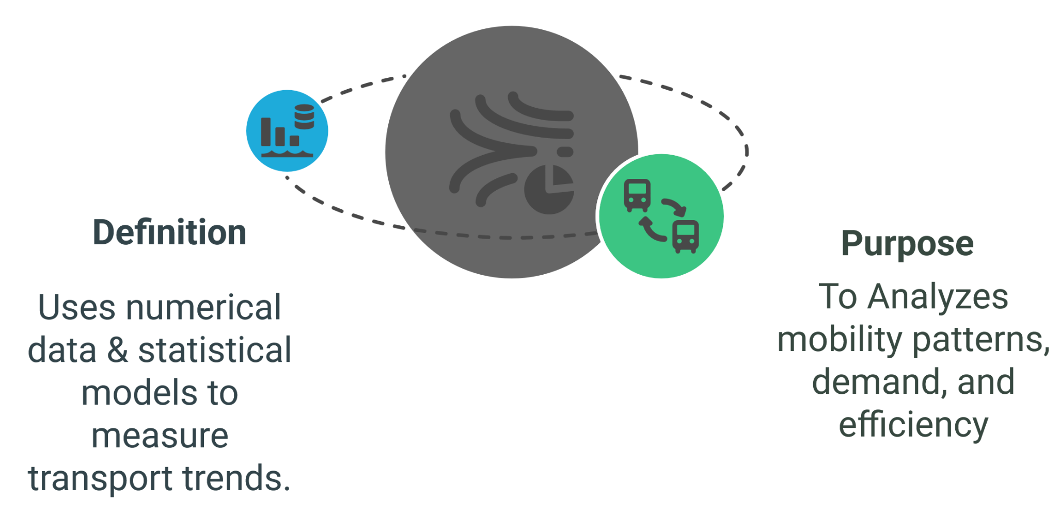
3. Quantitative Research Methods
3.1. What is Quantitative Research?
Transport Research Methods

Slide 13
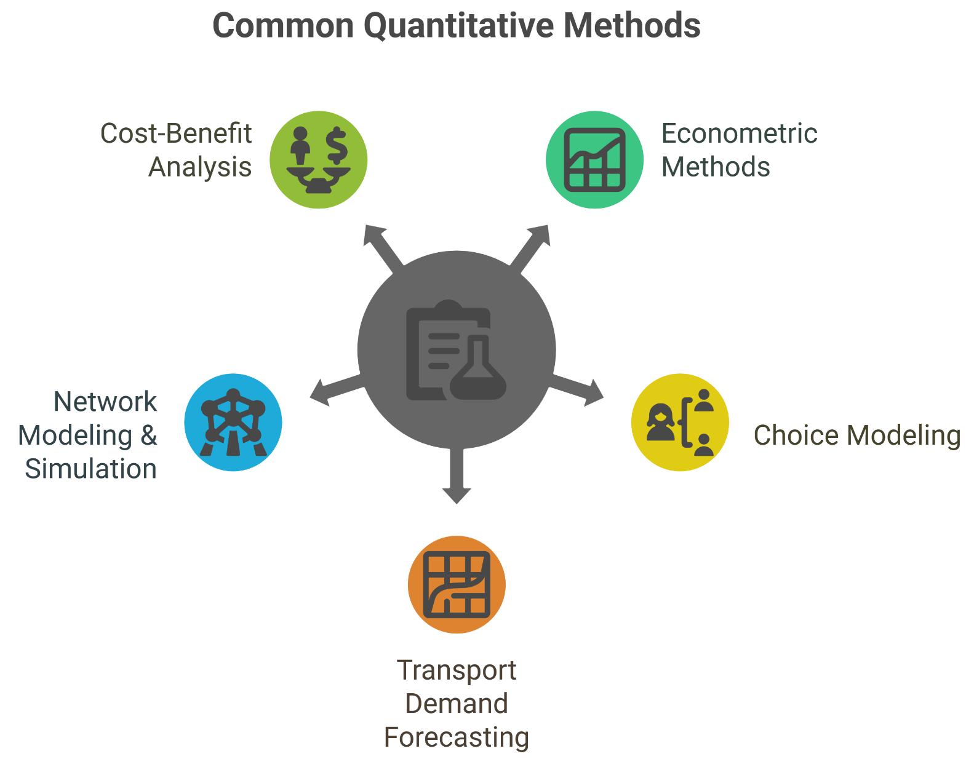
3. Quantitative Research Methods
3.2. Common Quantitative Methods
Transport Research Methods

Slide 14
3. Quantitative Research Methods
3.2.1. Econometric Methods (Quantitative)
Purpose:
Econometric methods are essential tools for measuring efficiency, forecasting demand, and evaluating the impacts of transport policies
They provide a quantitative approach to understanding complex relationships in the transport sector
Common Techniques
  Regression Analysis: Examines the relationships between various transport factors.
  Time Series Models: Predicts future trends, such as traffic volumes, based on historical data.
  Panel Data Analysis: Studies variations across time and regions to understand the effects of different policies or conditions.
Example: Estimating the impact of fuel prices on car travel demand
Transport Research Methods

Slide 15
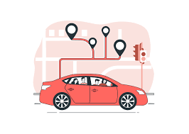
3. Quantitative Research Methods
3.2.2. Choice Modeling (Quantitative)
Purpose:
Understand travel behavior and mode choice
Two key types:
Revealed Preference (RP) – Observed behaviors (e.g., people choosing a train over a car)
Stated Preference (SP) – Hypothetical choices (e.g., survey asking if people would use a new metro line)
Logit Models: Predicts probability of choosing a specific mode (car, bus, train)
Applications:
        Public transport demand forecasting
        Highway toll pricing impact
        Ride-sharing adoption analysis
Transport Research Methods

Slide 16
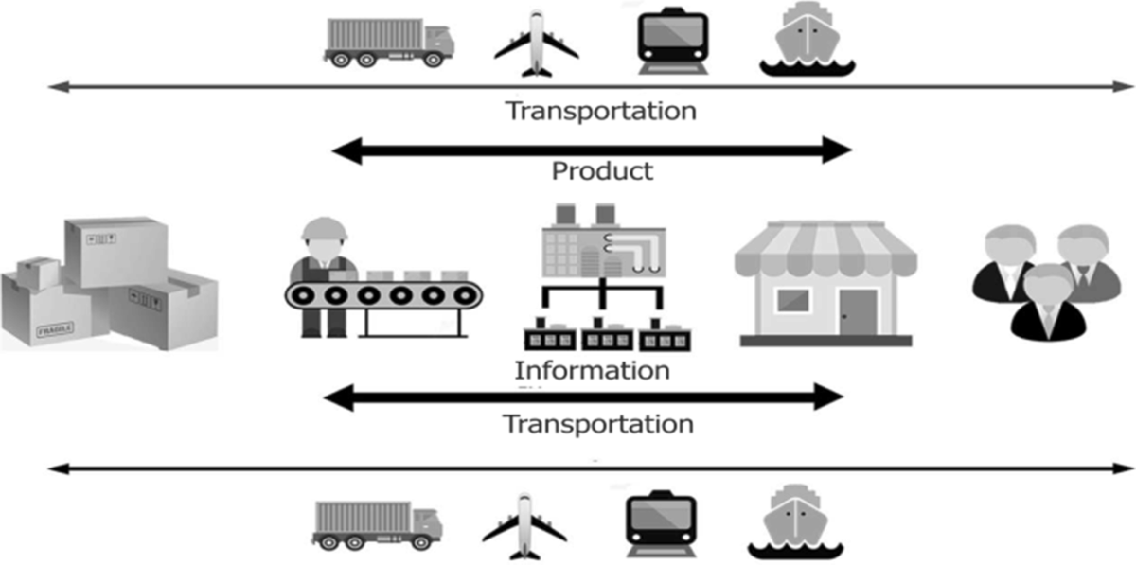
3. Quantitative Research Methods
3.2.3. Transport Demand Forecasting (Quantitative)
Purpose:
Predict future transport demand
Methods:
Regression models (e.g., fuel prices vs. car use)
Time series analysis (trend forecasting)
Discrete choice models (passenger preferences)
Example: Predicting the number of shipment depends on the demand for the product
Transport Research Methods

Slide 17
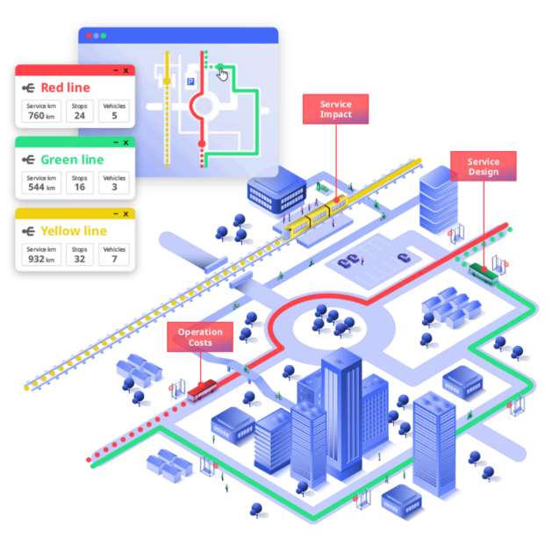
3. Quantitative Research Methods
3.2.4. Network Modeling & Simulation (Quantitative)
Purpose:
To simulate and analyze traffic flows, congestion, and infrastructure performance using mathematical and computational models.
Types of models:
Macroscopic Models – Overall network performance
Microscopic Models – Individual vehicle movement
Mesoscopic Models – Combines macro-level flows with some micro-level detail
Input Data Sources:
Traffic counts (vehicle volumes, turning movements)
Road geometry (lanes, speed limits, signal timings)
Origin-Destination (OD) matrices
Public transport timetables and routes
Applications:
Simulating traffic congestion to test road expansion projects
Evaluating public transport scheduling strategies
Transport Research Methods

Slide 18
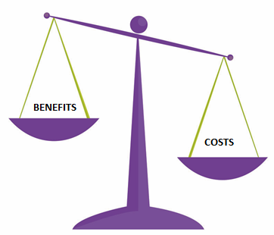
3. Quantitative Research Methods
3.2.5 Cost-Benefit Analysis (CBA) in Transport (Quantitative)
Purpose:
Evaluates the economic viability of transport projects
Steps in CBA:
Identify costs (infrastructure, maintenance, externalities)
Identify benefits (time savings, reduced pollution)
Discount future costs and benefits to present value
Example: Analyzing the financial feasibility of a new metro line
Transport Research Methods

Slide 19
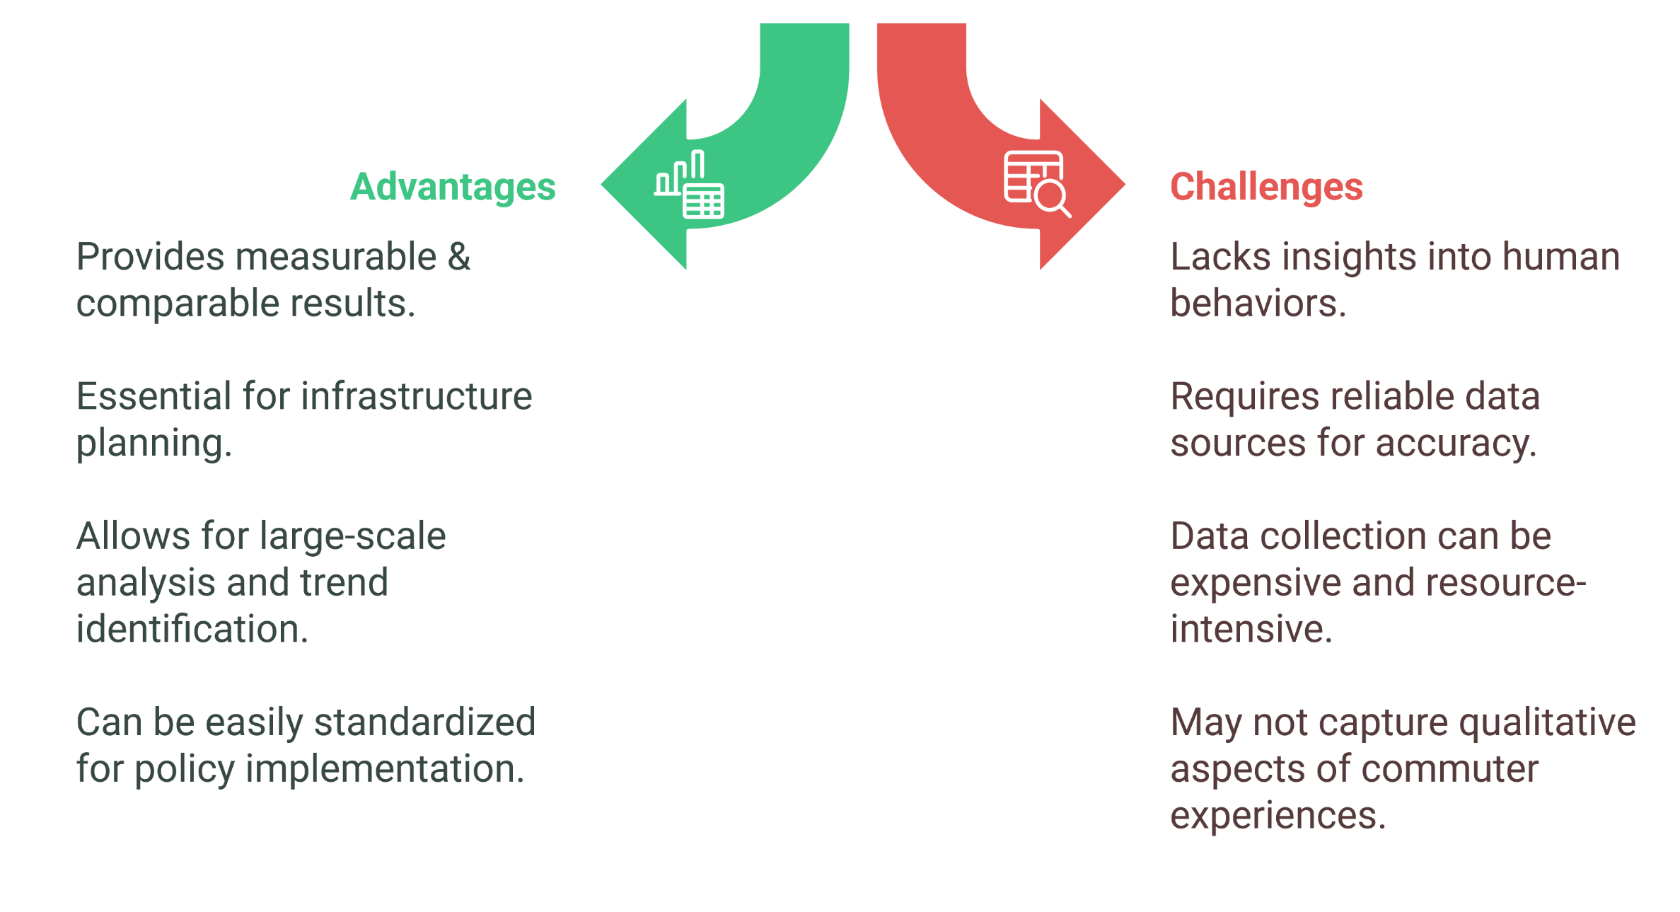
3. Quantitative Research Methods
3.3. Advantages & Challenges of Quantitative method
Transport Research Methods

Slide 20
Section 04:
Qualitative Research Methods
Transport Research Methods

Slide 21
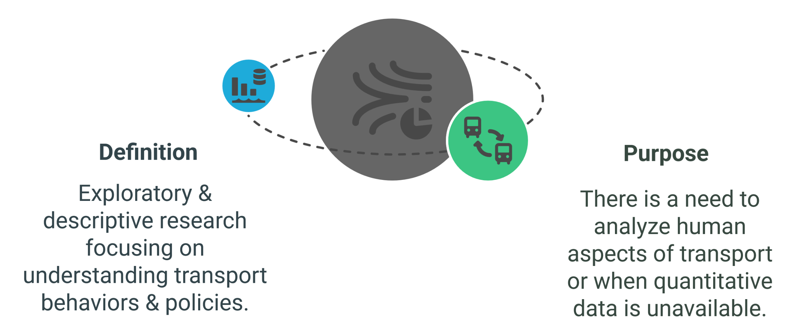
4. Qualitative Research Methods
4.1. What is Qualitative Research?
Transport Research Methods

Slide 22
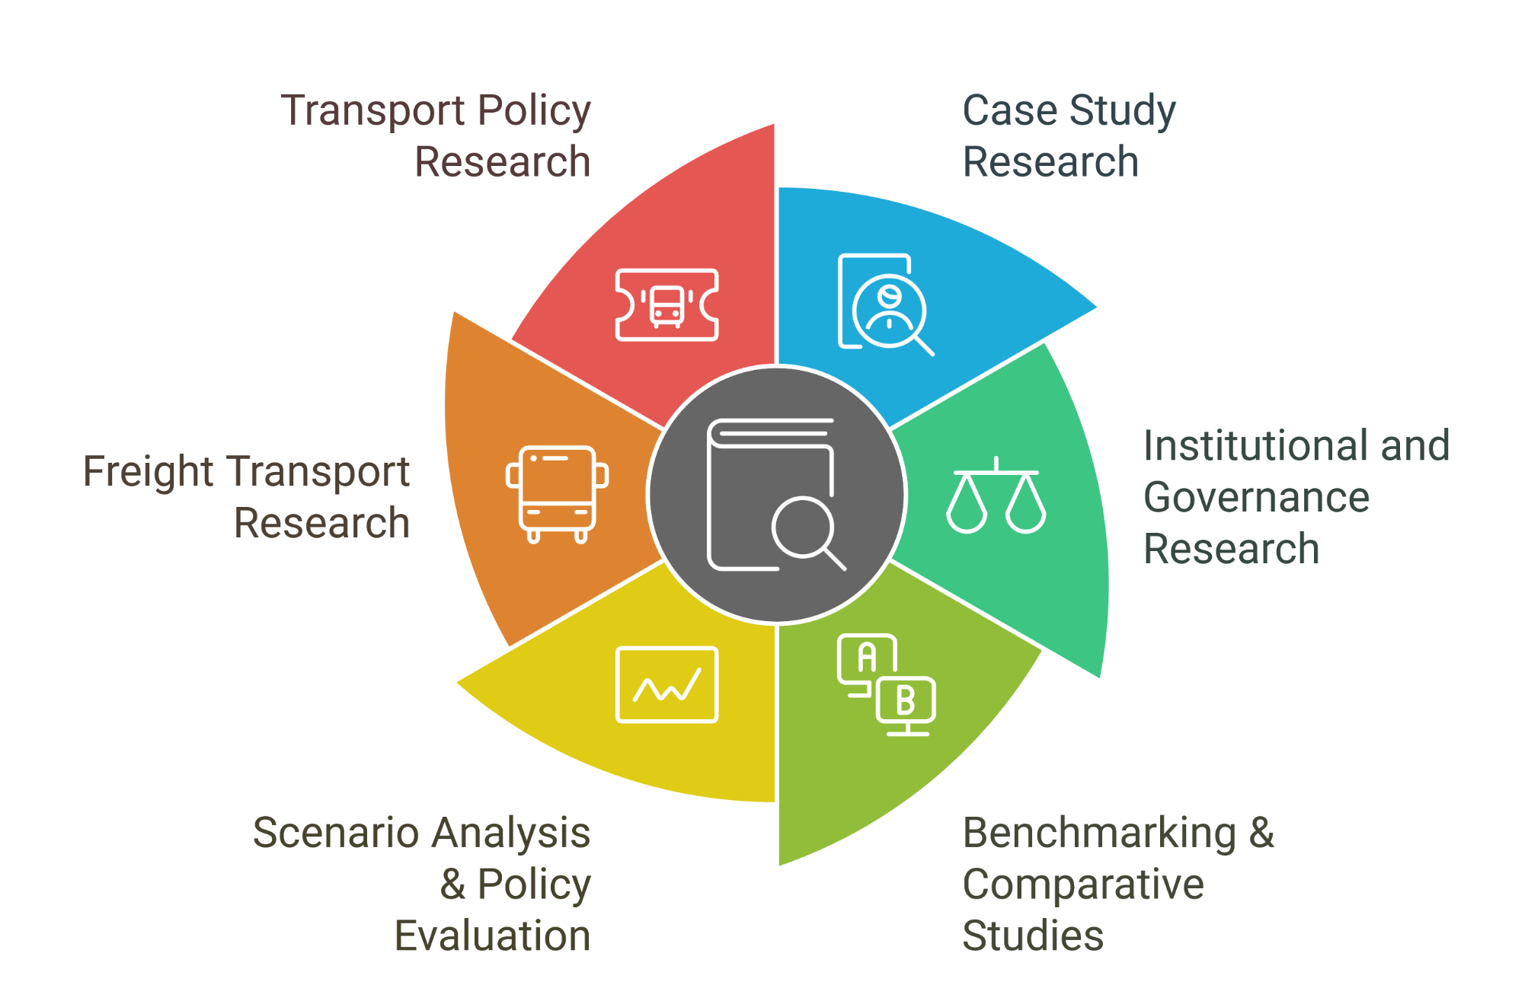
4. Qualitative Research Methods
4.2. Common Qualitative Methods
Transport Research Methods

Slide 23
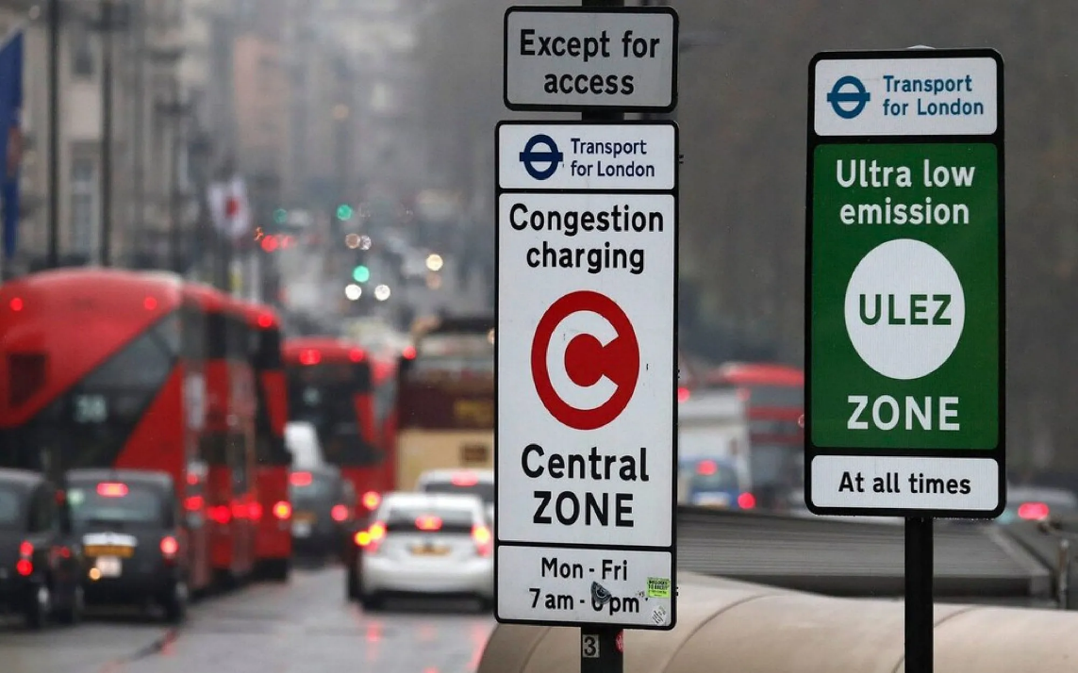
4. Qualitative Research Methods
4.2.1. Case Study Research (Qualitative)
Definition:
In-depth investigation of a specific transport system, project, or policy within its real-world context to Understand successes, failures, and influencing factors and to Generate insights for policy recommendations and best practices.
Methods:
Interviews (policymakers, users, stakeholders).
    Document analysis (policy papers, reports).
    Field observations (on-site assessments).
Example: London’s congestion pricing scheme – Studying its success in reducing traffic
Transport Research Methods

Slide 24
4. Qualitative Research Methods
4.2.2. Institutional and Governance Research (Qualitative)
Definition:
Explores how institutions, policies, and governance structures shape transport systems and decision-making.
Key Focus Areas:
Role of national vs. local authorities in transport planning.
Public-private partnerships (PPP) in transport infrastructure.
Governance challenges in sustainable transport transitions
Methods:
Interviews (policymakers, users, stakeholders).
    Document analysis (policy papers, reports).
    Field observations (on-site assessments).
Example: Investigating how governance structures in London facilitated congestion charging policies.
Transport Research Methods

Slide 25
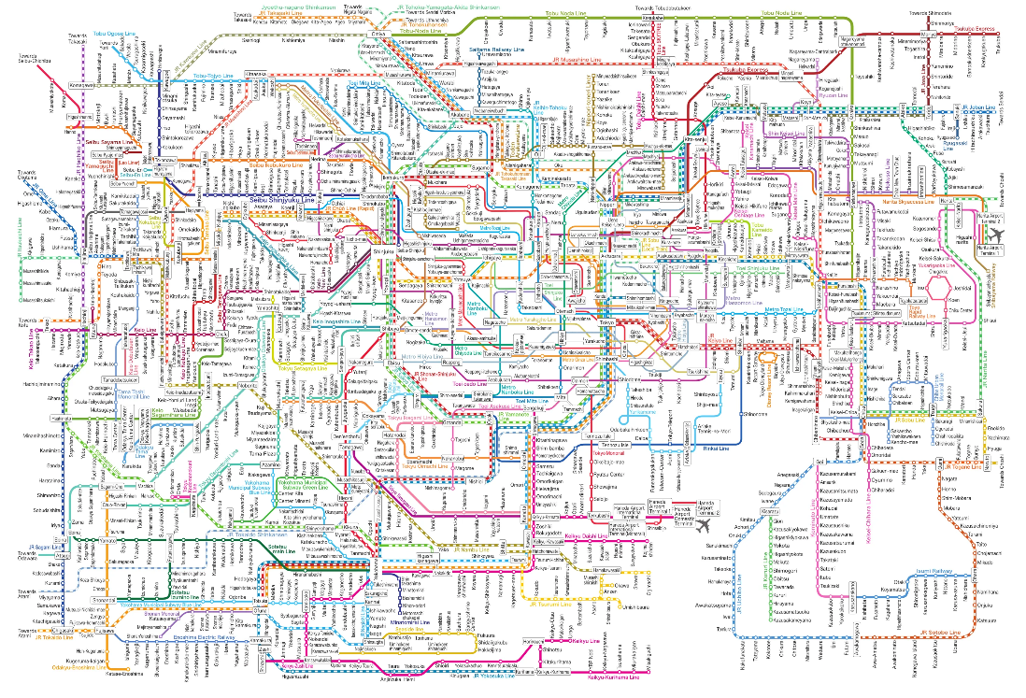
4. Qualitative Research Methods
4.2.3. Benchmarking & Comparative Studies (Qualitative)
Definition:
Systematic comparison of transport policies, performance metrics, or system designs across different regions or cities to identify best practices and areas for improvement, and to evaluate efficiency, sustainability, and accessibility of transport systems.
Methods:
Performance indicators (travel time, CO₂ emissions, cost).
Case comparisons (policy effectiveness across regions).
Expert interviews and secondary data analysis.
Example: Comparing metro systems in Tokyo, New York, and Paris in terms of punctuality, affordability, and accessibility.
Tokyo Metro System
Transport Research Methods

Slide 26
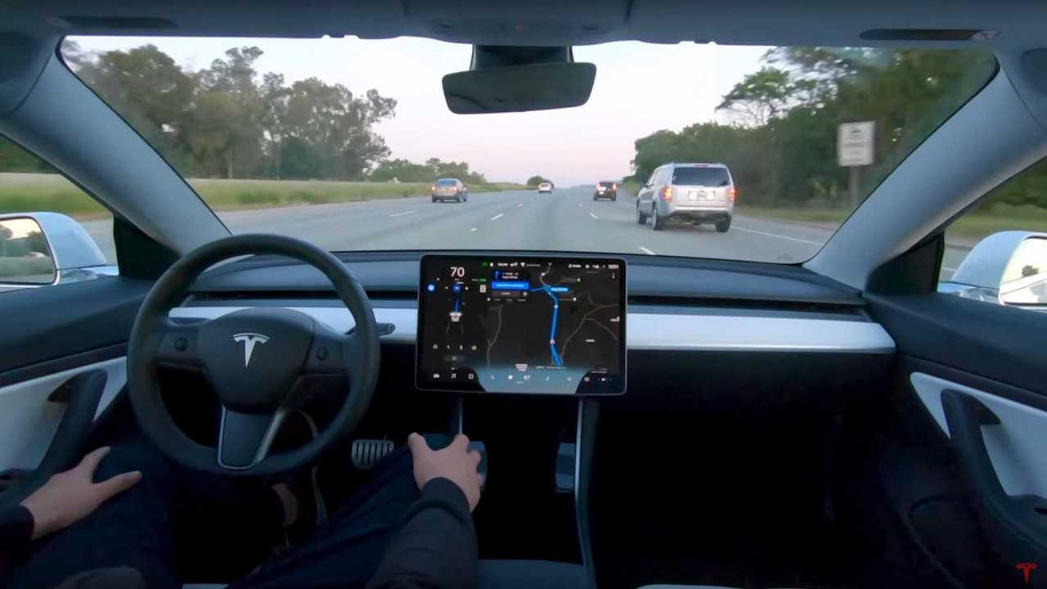
4. Qualitative Research Methods
4.2.4. Scenario Analysis & Policy Evaluation (Qualitative)
Definition:
Examines possible future transport scenarios based on qualitative and expert-driven insights to support strategic planning and risk assessment, and to evaluate potential impacts of new policies or technologies.
Methods:
Expert workshops (brainstorming future possibilities).
Stakeholder engagement (surveys, focus groups).
Delphi method (iterative expert consultation).
Example: Analyzing the potential impact of autonomous vehicles on urban congestion and job markets in 2050.
Transport Research Methods

Slide 27
4. Qualitative Research Methods
4.2.5. Freight Transport Research (Qualitative)
Definition:
Investigates logistics, supply chain management, and freight transport efficiency.
Key Focus Areas:
Last-mile delivery and urban logistics.
Impact of regulations on freight efficiency.
Role of technology (e.g., AI in supply chains).
Methods:
Interviews with logistics firms and regulators.
Case studies on freight innovations (drones, electric trucks).
Regulatory and policy analysis (trade policies, emissions laws).
Example: Studying the impact of Low Emission Zones (LEZ) on urban freight distribution in European cities.
Transport Research Methods

Slide 28
4. Qualitative Research Methods
4.2.5. Transport Policy Research (Qualitative)
Definition:
Evaluates the design, implementation, and effectiveness of transport policies in achieving societal goals.
Key Focus Areas:
Sustainability (reducing emissions, promoting active transport).
Equity and accessibility (affordable transport for all).
Economic impact (job creation, infrastructure funding).
Methods:
Policy document analysis (government reports, white papers).
Stakeholder interviews (policymakers, NGOs, businesses).
Case studies of policy implementation (successes and failures).
Example: Assessing how congestion pricing in Stockholm reduced traffic congestion and improved air quality.
Transport Research Methods

Slide 29
Section 05:
Mixed Methods Research
Transport Research Methods

Slide 30
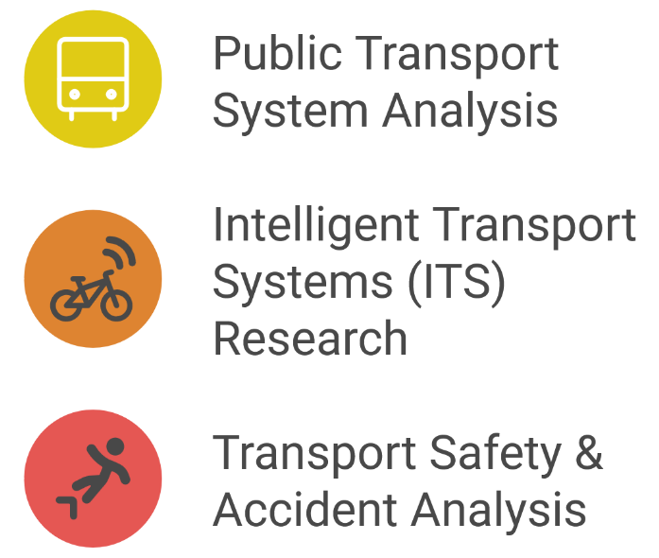
5. Mixed Methods Research
5.1. What is Mixed Methods Research?
Definition:
Combines qualitative & quantitative research to provide deeper insights.
Purpose:
In order to capture both statistical patterns and contextual insights
Example: Studying ride-sharing impacts using surveys (qualitative) + GPS data (quantitative).
We can use mixed method analysis in below context:
Transport Research Methods

Slide 31
5. Mixed Methods Research
5.2. Mixed Methods Research
Public Transport System Analysis
Combines qualitative and quantitative techniques to evaluate public transport systems' effectiveness, efficiency, and user satisfaction.
Quantitative Analysis:
    Surveys (ridership data, satisfaction scales), performance metrics (waiting times, travel speed, punctuality).
    Qualitative Analysis:
  Interviews (passengers, operators), focus groups, ethnographic studies (observing rider behaviors).
Intelligent Transport Systems (ITS) Research
Investigates the integration of advanced technologies into transport systems to improve efficiency, safety, and environmental sustainability.
Quantitative Analysis:
    Traffic flow data analysis (sensor data), system performance metrics (response time to congestion, accident reduction rates).
    Qualitative Analysis:
  User feedback (interviews with commuters, ITS stakeholders), case studies of ITS implementation, focus groups.
Transport Research Methods

Slide 32
5. Mixed Methods Research
5.2. Mixed Methods Research Cont.
Transport Safety & Accident Analysis
Uses a blend of qualitative and quantitative methods to investigate transport accidents, causes, and safety improvements.
Quantitative Analysis:
    Accident data analysis (crash statistics, accident hotspots, injury severity).
Qualitative Analysis:
  Interviews with accident survivors, emergency responders, and traffic safety experts; case studies of high-risk areas.
Transport Research Methods

Slide 33
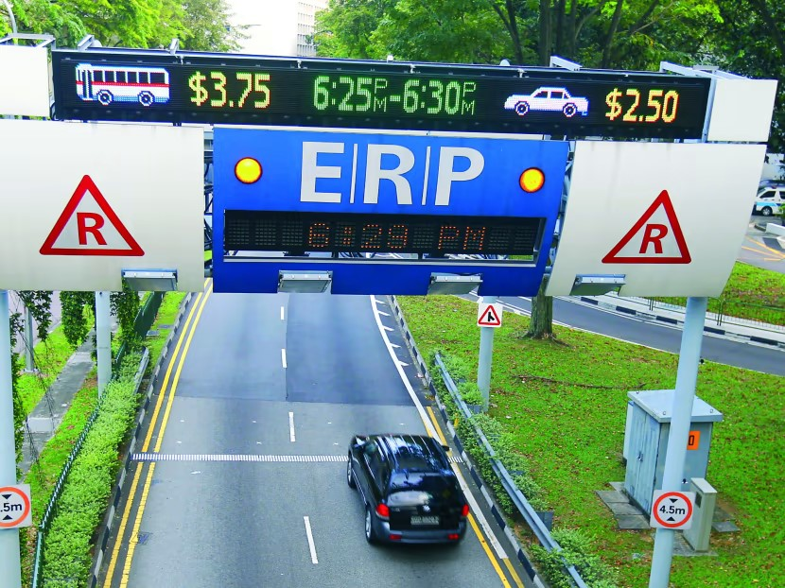
5. Mixed Methods Research
5.3. Case Study - Evaluating Congestion Pricing in Singapore
Singapore’s Electronic Road Pricing (ERP) system is one of the most advanced congestion pricing models in the world. This case study examines the research methods used to evaluate its effectiveness, using both quantitative and qualitative approaches.
Quantitative Approach (Measuring Traffic Impact)
Research Focus:
Traffic volume reduction before and after ERP implementation.
Speed improvements on key roads (expressways and CBD).
Impact on public transport usage (bus/train ridership changes).
Data Collection Methods:
  Traffic counters & vehicle sensors to track volume.
  GPS & mobile data analysis to monitor congestion trends.
  Public transport ridership statistics (MRT and bus data).
Findings from Traffic Analysis:
  Traffic volume reduced by 24% in ERP-covered areas.
  Average vehicle speed increased by 20% (from 30 km/h to 45 km/h).
  Public transport ridership increased by 15%, indicating a shift from private to public modes.
Transport Research Methods

Slide 34
5. Mixed Methods Research
5.3. Case Study - Evaluating Congestion Pricing in Singapore Cont.
Qualitative Approach (Understanding Public Perception)
Research Focus:
Commuter satisfaction surveys on ERP system.
Behavioral changes in transport choices (Did people change routes/timing?).
Social equity concerns (Is it fair to lower-income drivers?).
Data Collection Methods:
  Surveys & Interviews of drivers and commuters.
  Focus Groups with business owners, logistics firms, and transport authorities.
  Policy review to assess public sentiment before and after adjustments to ERP pricing.
Findings from Traffic Analysis:
  60% of drivers supported ERP, citing improved traffic flow.
  35% opposed due to higher costs of commuting.
  Businesses near ERP zones reported a slight decline in customer footfall.
  Commuters adjusted travel times to avoid peak-hour charges.
Transport Research Methods

Slide 35
5. Mixed Methods Research
5.3. Case Study - Evaluating Congestion Pricing in Singapore Cont.
Outcome: Balanced Approach to Pricing & Efficiency
Dynamic Pricing Adjustments
  Prices were increased during extreme peak hours to further reduce congestion.
  Prices were lowered during off-peak hours to avoid unnecessary penalties.
Public Transport Enhancements
  The government reinvested ERP revenue into improving MRT & bus services.
  Introduced discounted fares during off-peak hours to encourage modal shift.
Social Equity Adjustments
  Special tax rebates & subsidies for lower-income drivers.
  More incentives for carpooling & electric vehicles.
Transport Research Methods

Slide 36
Section 06:
Data Collection in Transport Research
Transport Research Methods

Slide 37
6. Data Collection in Transport Research
6.1. Primary Data vs. Secondary Data
Primary Data:
First-hand data collected through research activities such as:
Surveys & Questionnaires: Gathering individual travel behavior, preferences, and satisfaction levels.
Field Studies & Experiments: Directly observing transport patterns, road safety measures, and infrastructure performance.
GPS & IoT Sensors: Real-time tracking of vehicle movements, pedestrian mobility, and public transport frequency.
Secondary Data:
Pre-existing datasets compiled from various sources:
Government Reports & Transport Statistics: National and regional databases provide historical insights into traffic patterns, fuel consumption, and road safety.
Recorded data using Traffic Sensors & Smart City Data: Camera-based monitoring, automated vehicle counters, and intelligent transport systems (ITS) data help in urban transport planning.
Transport Research Methods

Slide 38
6. Data Collection in Transport Research
6.2. Primary Data Collection Methods
Surveys & Questionnaires – Understanding Commuter Preferences
Collect data on trip frequency, travel duration, mode choice, and satisfaction levels.
Can be paper-based, online, or mobile surveys integrated with transport apps.
Example: City-wide public transport surveys in London & Singapore help improve services.
Field Experiments – Measuring Traffic Congestion Patterns
Conduct real-world observations and controlled studies to assess congestion levels.
Example: Placing sensors on road intersections to track vehicle counts & traffic bottlenecks.
Helps researchers develop congestion pricing strategies & signal optimization.
Sensors (GPS, IoT, etc.) – Collecting Real-time Travel Data
GPS devices track route efficiency, congestion, and real-time vehicle movement.
IoT-enabled smart traffic systems detect accidents, traffic jams, and peak-hour usage trends.
Example: Google Maps & Waze use GPS and crowdsourced data to provide real-time route suggestions.
Transport Research Methods

Slide 39
6. Data Collection in Transport Research
6.3. Secondary Data Collection Methods
National Transport Databases
Governments and research bodies maintain datasets on road conditions, accident rates, and fuel usage.
Examples:
  US National Household Travel Survey (NHTS) for analyzing mobility patterns.
  European Mobility Reports for studying public transport demand.
Public Transport Usage Statistics
Metro, bus, and rail networks maintain ridership records to optimize scheduling & fleet size.
Examples:
  Transport for London (TfL) uses Oyster Card data to monitor peak-hour demand.
  New York MTA tracks subway ridership patterns to improve frequency adjustments.
Open Data Platforms (Google Mobility, City Transport APIs)
Provides aggregated anonymized mobility data for researchers and policymakers.
Examples:
  Google Mobility Reports track travel trends post-pandemic.
  City Transport APIs (London, Berlin) provide real-time bus & metro occupancy data.
Transport Research Methods

Slide 40
6. Data Collection in Transport Research
6.4. Big Data & AI in Transport Research
AI-based Predictive Analytics for Traffic Management
AI algorithms analyze historical traffic patterns to predict congestion levels & suggest rerouting strategies.
Example:
  Singapore’s AI-powered smart traffic system reduces congestion by dynamically adjusting signal timings.
  Los Angeles uses AI-based toll pricing to manage express lane demand.
IoT Sensors to Collect Live Traffic and Vehicle Data
Smart sensors detect real-time road conditions, weather impacts, and vehicle speeds.
Examples:
  India’s Smart Traffic Signals automatically adjust green-light durations based on traffic flow.
  Autonomous vehicles use LiDAR & IoT sensors to navigate safely in real-world environments.
Transport Research Methods

Slide 41
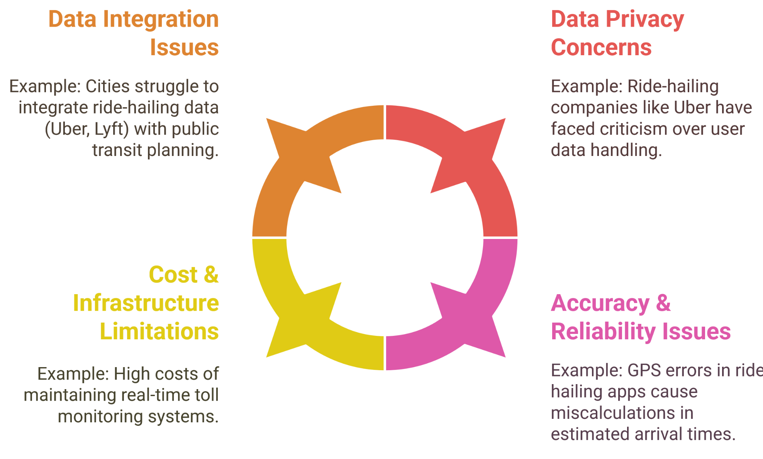
6. Data Collection in Transport Research
6.5. Challenges in Data Collection
Transport Research Methods

Slide 42
Section 05:
Quiz & Group Discussion
Transport Research Methods

Slide 43

6. Quiz & Group Discussion
6.1. Quiz
What is the difference between quantitative and qualitative research?
Which research method is best for understanding commuter experiences?
Why is it beneficial in transport studies?
What is the main difference between primary and secondary transport data?
What is a major challenge in integrating different transport data sources?
What is a common challenge in qualitative transport research?
Transport Research Methods

Slide 44
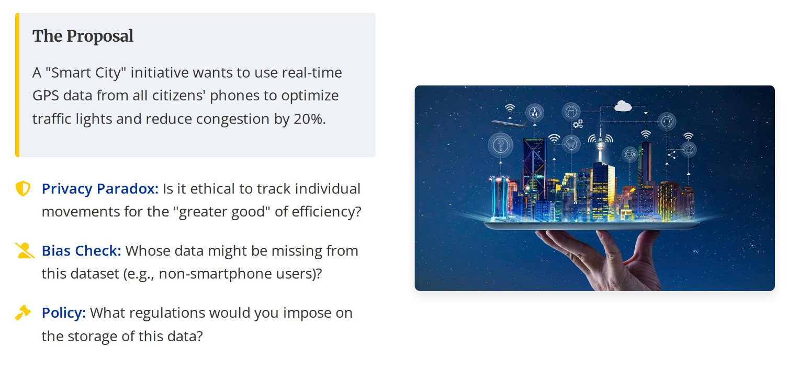
6. Quiz & Group Discussion
6.2. Group Discussions
Transport Research Methods

Slide 45
Thank you for your Attention!

