Slide 1
Transport Research and Analysis
Module 2: Transport Data Collection and Management
Lecture 9: Data Visualization in Transportation

Slide 3
Table of Contents
Lecture 9: Data Visualization in Transportation
1. Introduction to Data Visualization | 1
1.1 What is Data Visualization (DV)? | 2
1.2 The Role of DV in Transportation Analytics | 3
1.3 Historical Context and Modern Trends | 4
2. Purpose of Data Visualization | 5
2.1 Communicating Complex Information Simply | 6
2.2 Supporting Decision-Making in Transport Planning | 7
2.3 Enhancing Stakeholder Engagement | 8
2.4 Examples from Traffic, Transit, and Infrastructure Projects | 9
3.3 Avoiding Misleading or Cluttered Graphics | 13
3.4 Visual Encoding & Perception in Engineering. Contexts | 14
4. Challenges & Opportunities in Transport Data Visualization | 15
4.1 Common Challenges | 16
4.2 Opportunities | 20
5. Tools and Software for Visualization | 23
5.1 Microsoft Excel | 24
5.2 Python | 26
5.3 When to Use Excel vs Python | 29
3. Principles of Effective Data Visualization | 10
3.1 Clarity, Accuracy, and Simplicity | 11
3.2 Choosing the Right Chart Types | `12
i
Data Visualization in Transportation

Slide 4
Table of contents
Lecture 9: Data Visualization in Transportation
6. Creating Effective Transport Data Visualizations | 30
6.1Real-World Case Study: Public Transport Usage (Excel & Python) | 31
6.2 Map-Based Visualizations | 32
6.3 Time-Series Visualization | 33
6.4 Dos & Don’ts of Transport Data Dashboards | 34
ii
Data Visualization in Transportation

Slide 5
Section 01:
Introduction to Data Visualization
Data Visualization in Transportation

Slide 6
1. Introduction to Data Visualization
1.1 What is Data Visualization (DV)?
Definition:
Data Visualization is the graphical representation of information and data using visual elements like charts, graphs, maps, and dashboards.
Goal:
To simplify complex datasets and reveal patterns, trends, and outliers that may be hidden in raw data.
Why it matters in engineering:
Engineers deal with high-volume, multidimensional datasets. DV makes these insights interpretable and actionable.
“A good visualization tells a story, removes noise, and highlights what's important.”
2
Data Visualization in Transportation

Slide 7
1. Introduction to Data Visualization
1.2 The Role of DV in Transportation Analytics
Descriptive Analytics:
Show current or historical transport conditions (e.g., average speeds, passenger load by route).
Diagnostic Analytics:
Reveal root causes behind delays, accidents, or congestion.
Predictive Analytics:
Visualize forecasts using time-series or simulation outputs (e.g., ridership under different scenarios).
Prescriptive Analytics:
Communicate recommended actions to planners and decision-makers (e.g., rerouting options, signal timing adjustments).
3
Data Visualization in Transportation

Slide 8
1. Introduction to Data Visualization
1.3 Historical Context and Modern Trends
      Past:
      Static graphs in transport studies and reports (e.g., line graphs, pie charts in Excel).
      Limited interaction, mainly used for reporting.
      Present:
      Dynamic, real-time dashboards using tools like Python (Plotly, Dash) and Power BI.
      Integration with GIS systems and live data feeds (e.g., vehicle GPS).
      Trends:
      📈 Shift from static to interactive visualizations
      🧠 Use of machine learning outputs in dashboards
      🌍 Growing use of geo-visualizations for transport equity and emissions
      🧩 Embedding visualizations into automated reporting systems
4
Data Visualization in Transportation

Slide 9
Section 02:
Purpose of Data Visualization
Data Visualization in Transportation

Slide 10
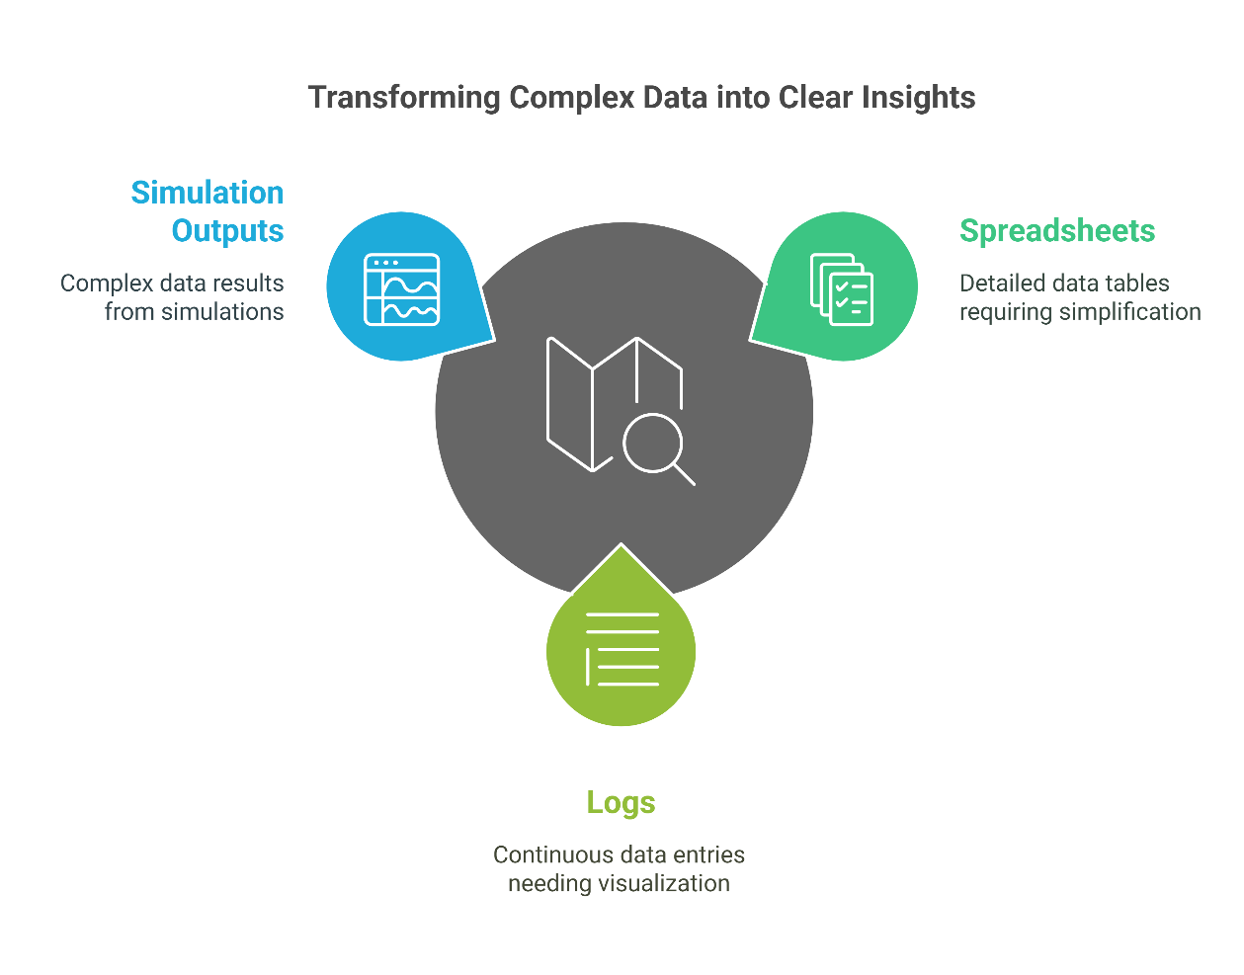
2. Purpose of Data Visualization
2.1 Communicating Complex Information Simply
Raw transport data is often overwhelming. DV transforms complex spreadsheets, logs, and simulation outputs into digestible visuals.
Good visualizations reduce cognitive load, highlight key metrics, and help readers quickly grasp trends, anomalies, or patterns.
Example:
Instead of showing 1,000 rows of trip records, use a heatmap to reveal peak usage zones and times.
"If you can't explain it simply, you don't understand it well enough." — Albert Einstein (applies to visuals too!)
6
Data Visualization in Transportation

Slide 11
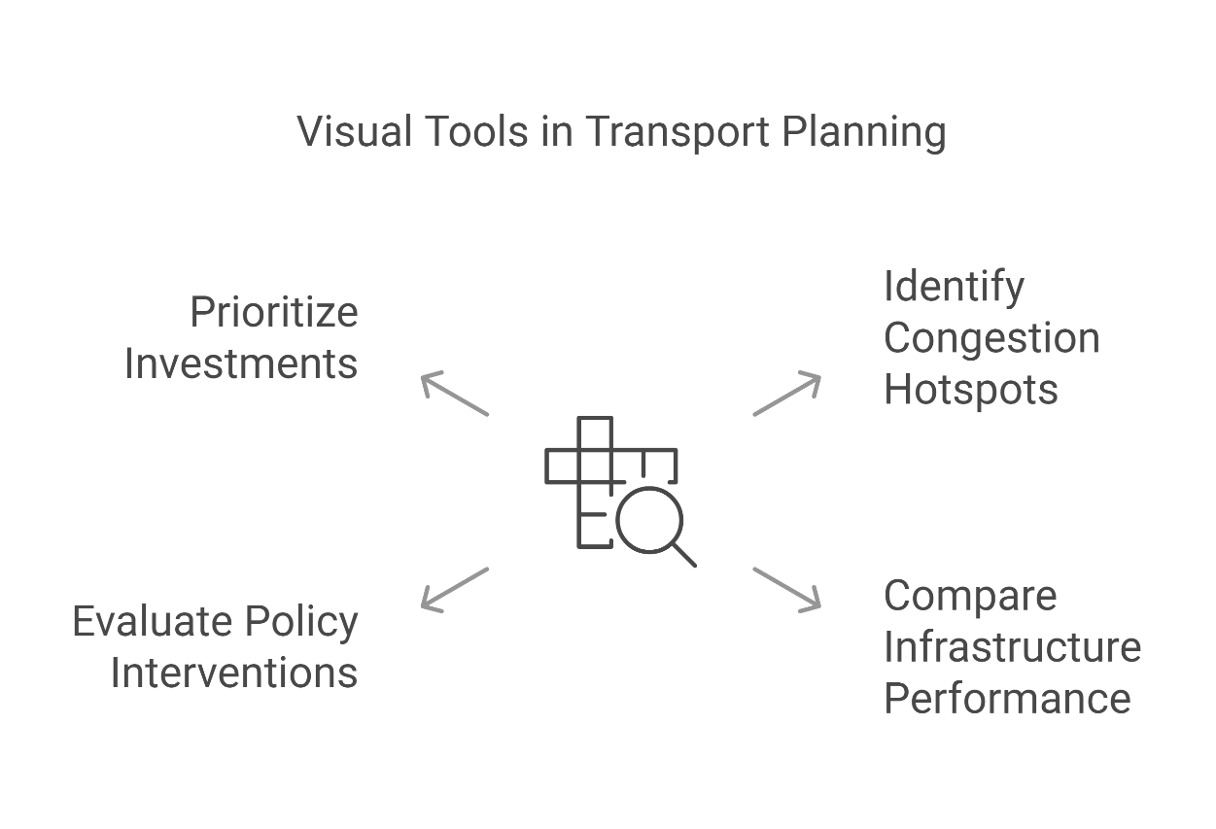
2. Purpose of Data Visualization
2.2 Supporting Decision-Making in Transport Planning
Visuals help engineers and planners:
Identify congestion hotspots
Compare infrastructure performance over time
Evaluate policy interventions (e.g., new bike lanes, BRT systems)
Dashboards and visual summaries are used to prioritize investments and plan for future demand.
Example:
Visualizing traffic flow changes before and after signal optimization using line graphs and bar charts.
7
Data Visualization in Transportation

Slide 12
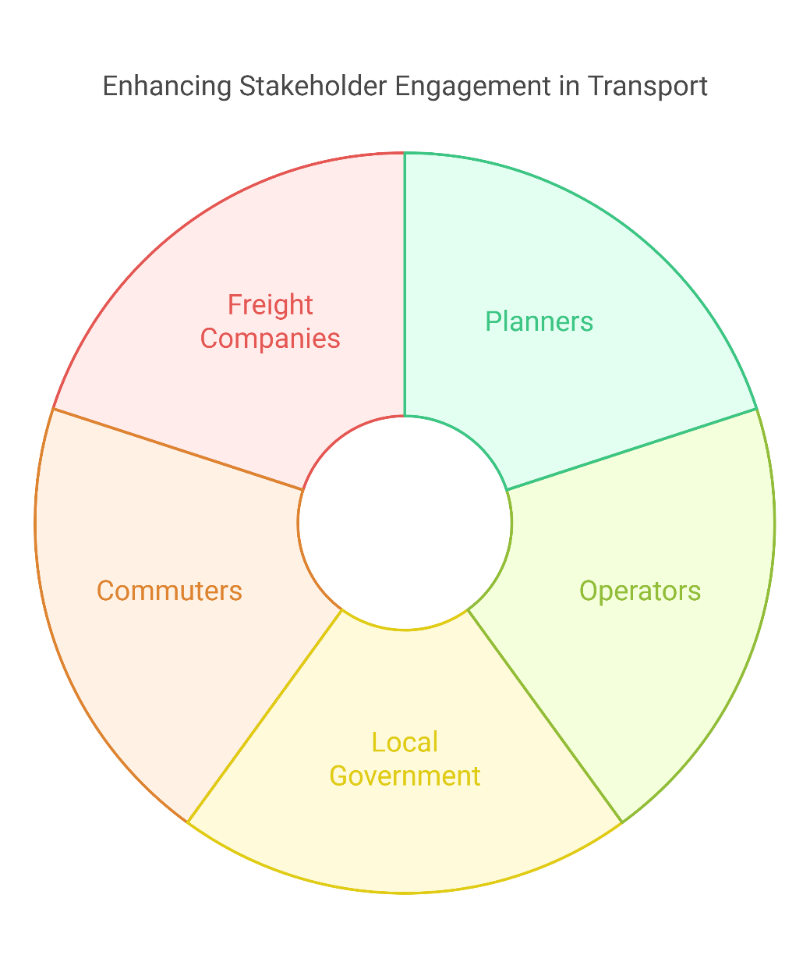
2. Purpose of Data Visualization
2.3 Enhancing Stakeholder Engagement
Transport systems involve many stakeholders:
Planners, operators, local government, commuters, freight companies, etc.
Visualization makes it easier to:
Present data in public consultations
Build transparency and trust
Support non-technical audiences in understanding mobility challenges
Example:
Use of interactive dashboards during urban mobility projects to show how different districts are affected.
8
Data Visualization in Transportation

Slide 13
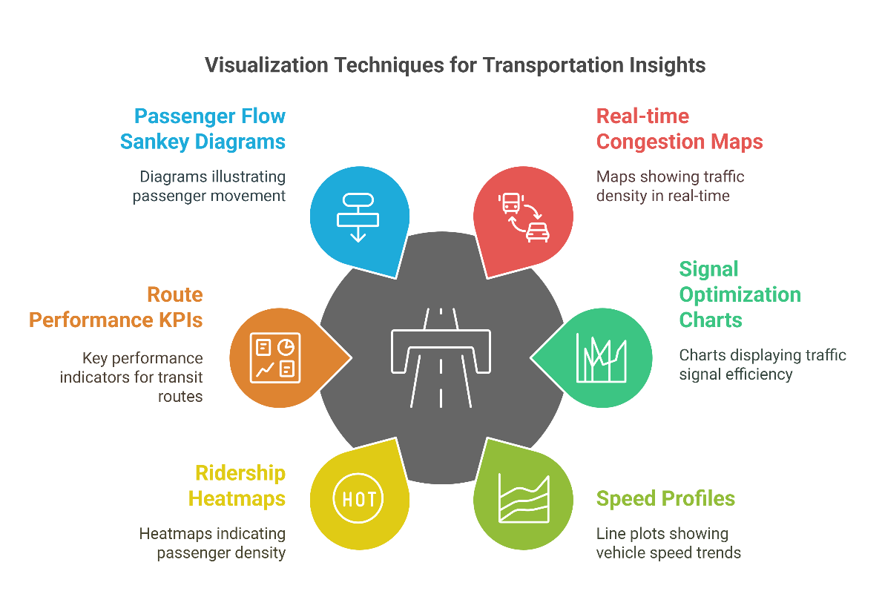
2. Purpose of Data Visualization
2.4 Examples from Traffic, Transit, and Infrastructure Projects
Traffic:
Real-time congestion maps
Signal optimization charts
Speed profiles using line plots (Python: Matplotlib or Seaborn)
Transit:
Ridership heatmaps
Route performance KPIs
Passenger flow Sankey diagrams (Python: Plotly)
Infrastructure:
Bridge condition visualizations
Road network age vs maintenance costs
Visualizing crash locations on GIS maps
9
Data Visualization in Transportation

Slide 14
Section 03:
Principles of Effective Data Visualization
Data Visualization in Transportation

Slide 15
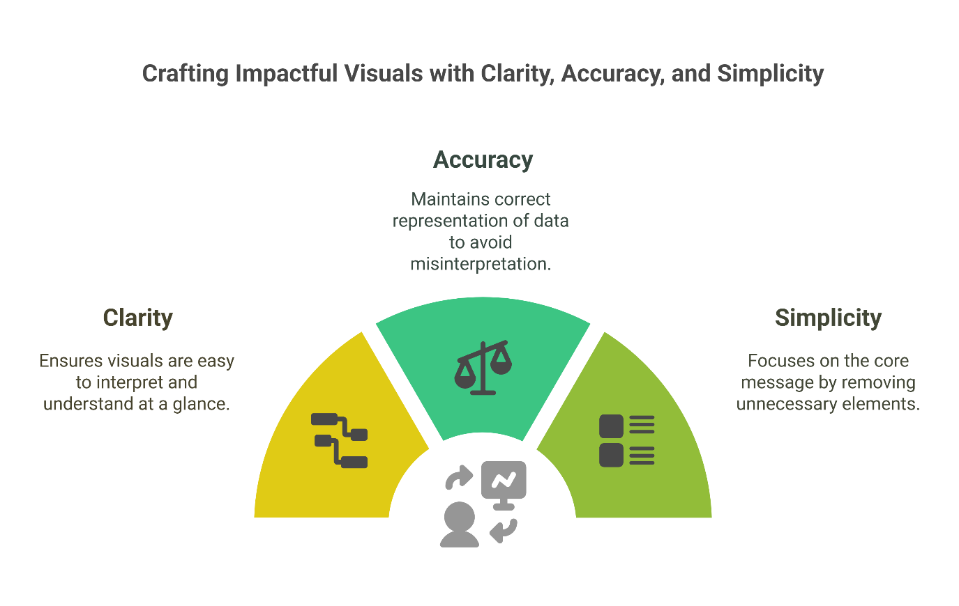
3. Principles of Effective Data Visualization
3.1 Clarity, Accuracy, and Simplicity
Clarity:
Visuals should be easy to interpret at a glance.
Use clean layouts, consistent colors, and concise labels.
Accuracy:
Never distort scales, axes, or proportions — misrepresentation leads to wrong conclusions.
Always label units (e.g., km/h, passengers/day).
Simplicity:
Eliminate unnecessary elements (3D effects, excessive gridlines, clipart).
Focus on the message, not decoration.
11
Data Visualization in Transportation

Slide 16
3. Principles of Effective Data Visualization
3.2 Choosing the Right Chart Types
Data Type | Recommended Chart
Time series (e.g., traffic flow) | Line chart
Mode share | Pie chart or stacked bar chart
Spatial (e.g., stop locations) | Map, heatmap
Comparisons (e.g., station usage) | Bar/column chart
Relationships (e.g., cost vs ridership) | Scatter plot
⚠️ Don’t default to bar/pie charts for everything — think about what relationship you’re trying to show.
12
Data Visualization in Transportation

Slide 17
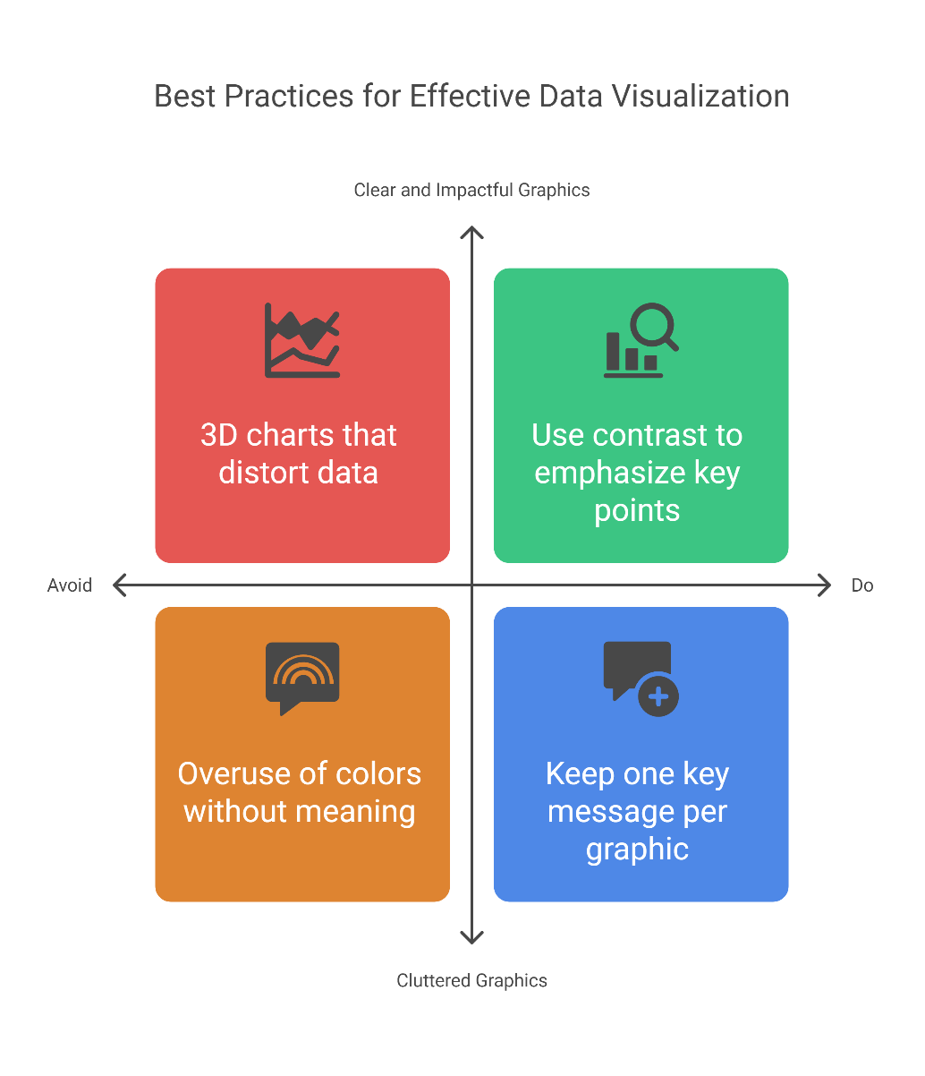
3. Principles of Effective Data Visualization
3.3 Avoiding Misleading or Cluttered Graphics
Avoid:
3D charts that distort data
Overuse of colors without meaning
Unlabeled axes or inconsistent scales
Too many variables on a single chart
Do:
Use contrast to emphasize key points
Annotate important events or peaks
Keep one key message per graphic
13
Data Visualization in Transportation

Slide 18
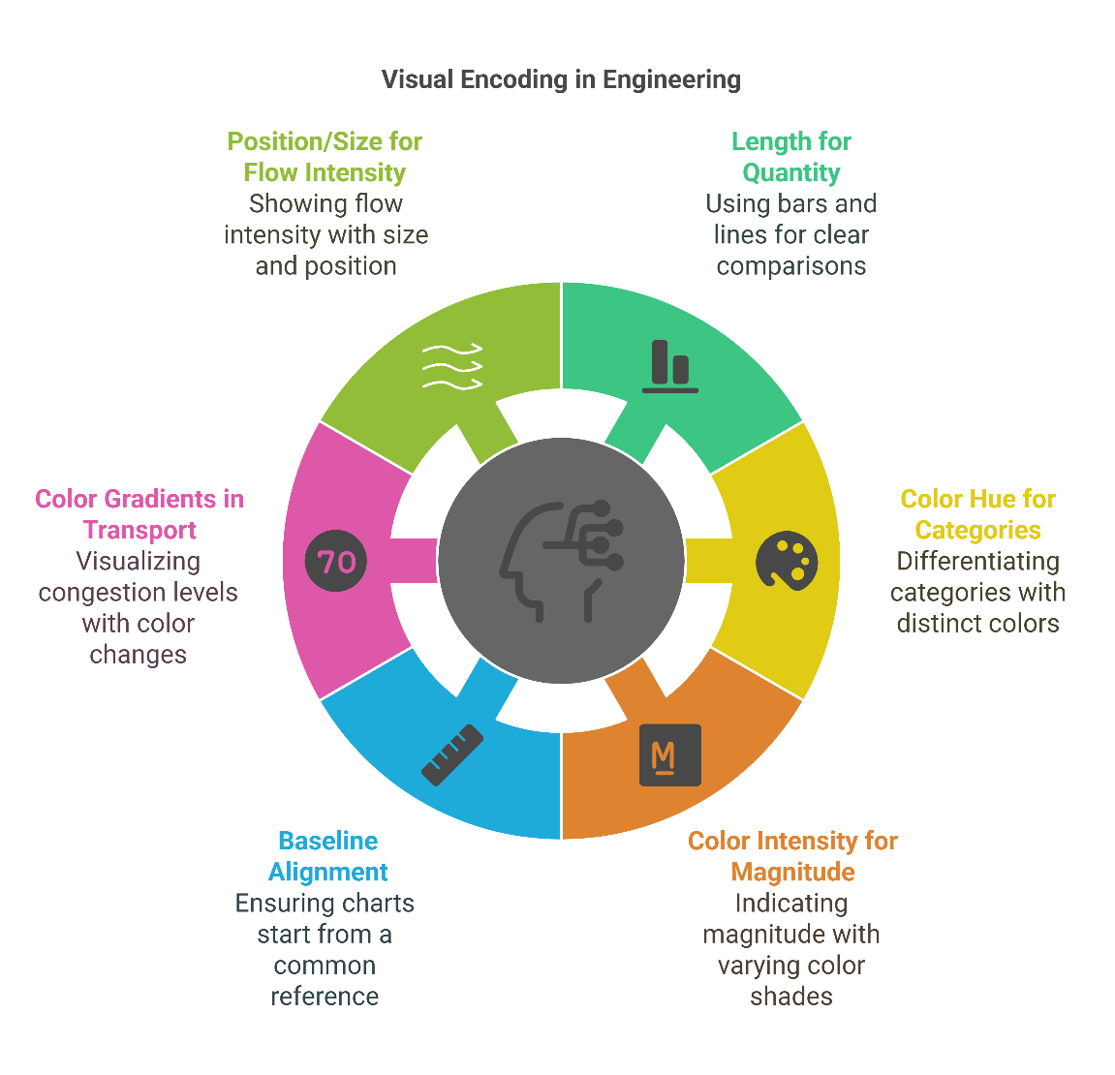
3. Principles of Effective Data Visualization
3.4 Visual Encoding & Perception in Engineering Contexts
Our brains process position, length, and color more accurately than area or volume.
Visual encoding tips:
Use length (bars, lines) for quantity comparisons.
Use color hue for categories, and color intensity for magnitude.
Align charts to common baselines (e.g., y-axis starts at zero).
In transport:
Use color gradients to represent congestion levels
Use position/size to show flow intensity or risk hotspots
14
Data Visualization in Transportation

Slide 19
Section 04:
Challenges & Opportunities in Transport Data Visualization
Data Visualization in Transportation

Slide 20
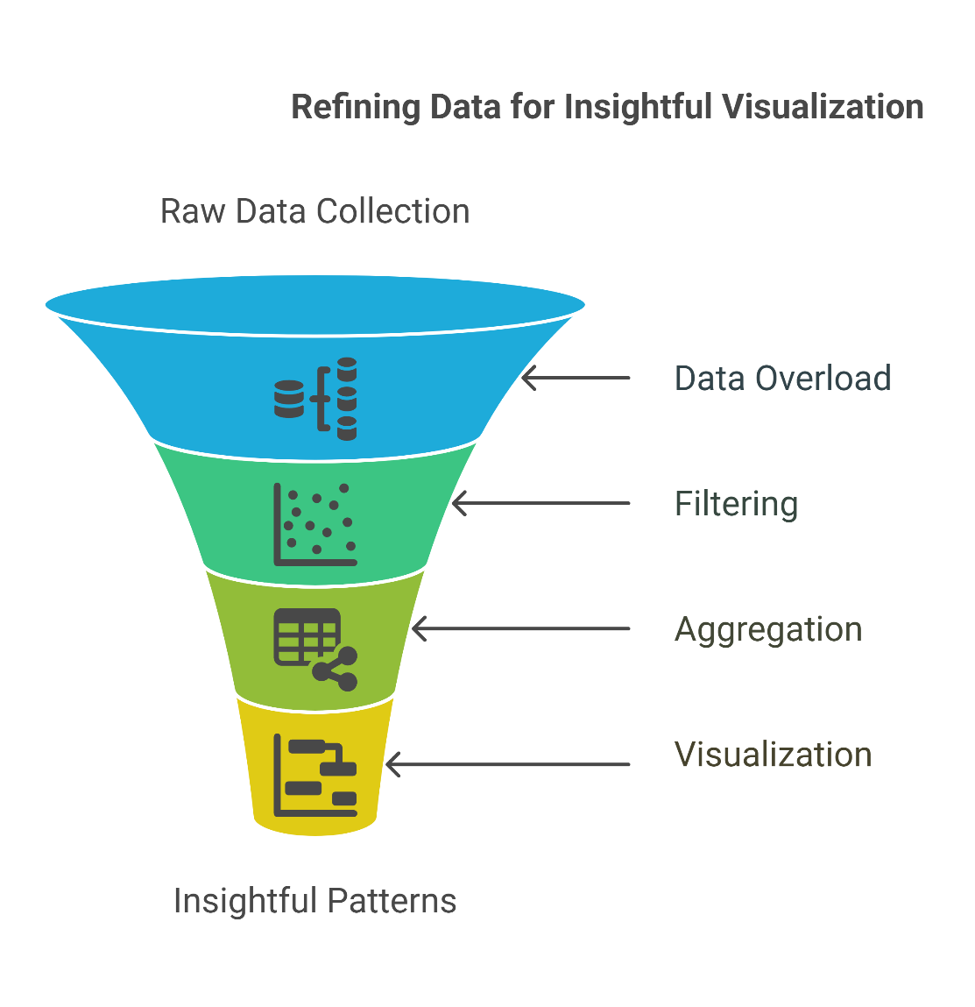
4. Challenges & Opportunities in Transport Data Visualization
4.1 Common Challenges
Data Overload
Massive datasets from GPS, smartcards, sensors, and mobile apps can overwhelm even skilled analysts.
Without filtering or aggregation, visualizations become noisy and unreadable.
Example: A raw GPS trace of every vehicle in a city — useful insights are lost in clutter.
✅ Solution: Use summary statistics, filtering, and layering to reveal key patterns.
16
Data Visualization in Transportation

Slide 21
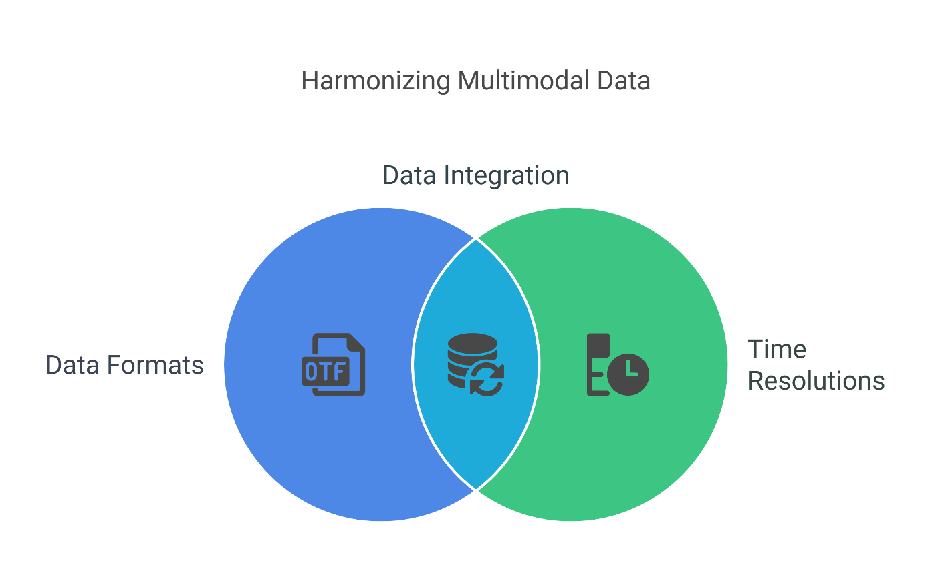
4. Challenges & Opportunities in Transport Data Visualization
4.1 Common Challenges
Multimodal Integration
Combining data from buses, trains, bikes, pedestrians, and ride-hailing services is tricky due to:
i. Different formats
ii. Time resolutions
iii. Spatial granularity
Example: Mapping delays across modes may require syncing bus GPS with train timetables and bike-share usage logs.
✅ Solution: Use tools like Python Pandas, data joins, and standardized formats (GTFS, GeoJSON).
17
Data Visualization in Transportation

Slide 22
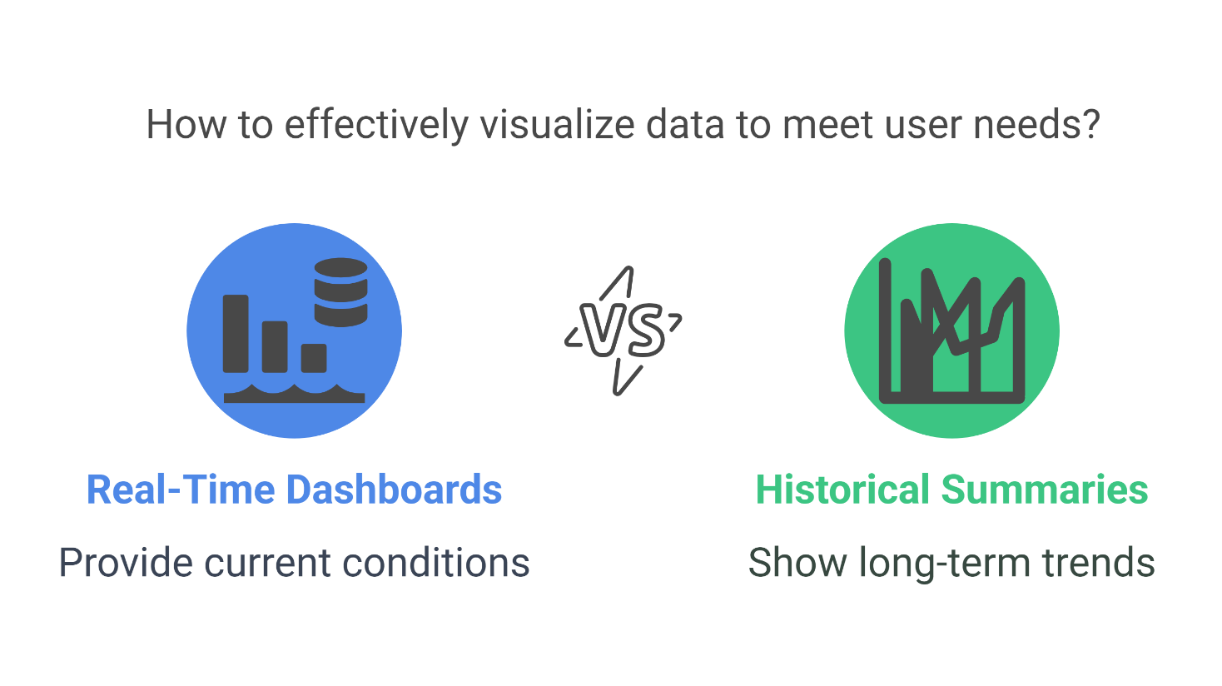
4. Challenges & Opportunities in Transport Data Visualization
4.1 Common Challenges
Real-Time vs Historical View
Visualizations may either:
i. Show current conditions (real-time dashboards), or
ii. Summarize trends over months/years.
Challenge: Combining both views without confusing the user or distorting the story.
✅ Solution: Offer toggles, sliders, or filters to switch between time windows (e.g., in Plotly Dash).
18
Data Visualization in Transportation

Slide 23
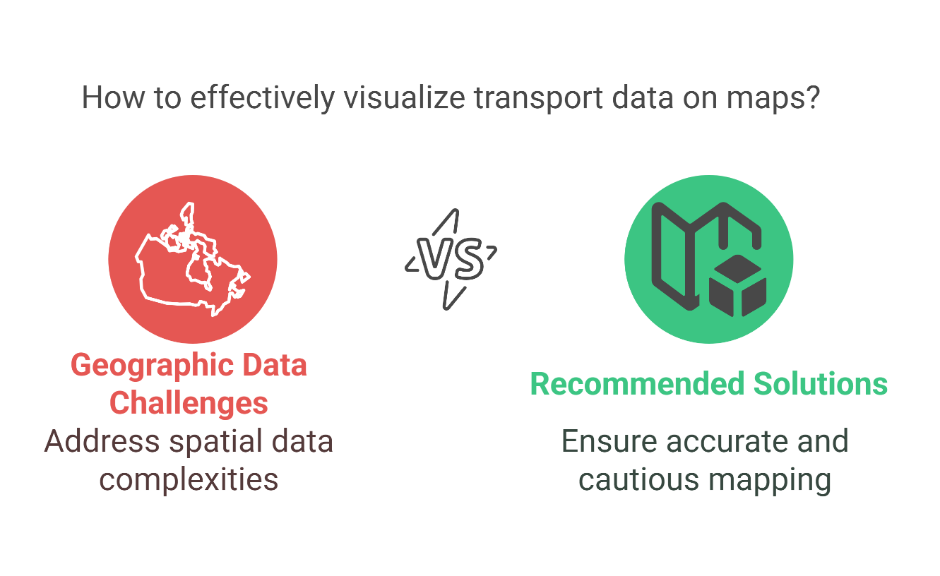
4. Challenges & Opportunities in Transport Data Visualization
4.1 Common Challenges
Geographic Data Complexity
Transport data is spatially rich — and visualizing on maps introduces:
    ii. Coordinate systems
    iii. Layering issues
    iv. Map projections & distortions
Example: Heatmaps on top of incorrect basemaps can misrepresent density.
✅ Solution: Use libraries like GeoPandas, Folium, or Mapbox with caution and accuracy.
19
Data Visualization in Transportation

Slide 24
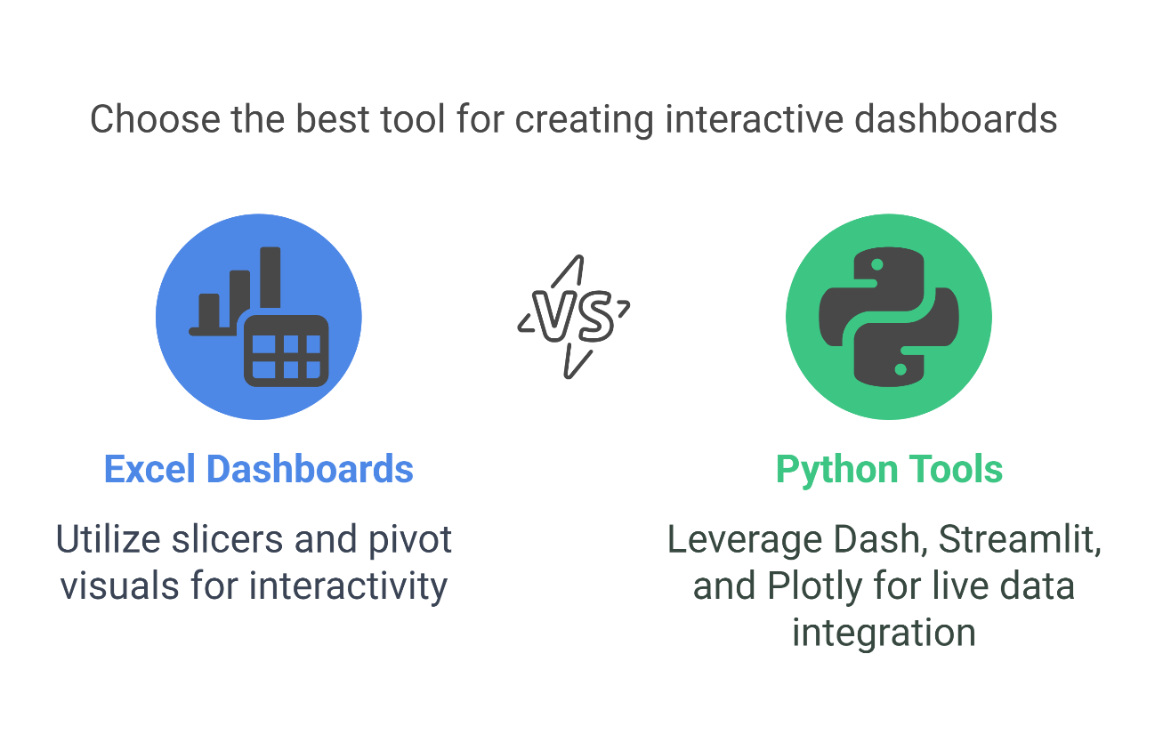
4. Challenges & Opportunities in Transport Data Visualization
4.2 Opportunities
Interactive Dashboards
Go beyond static plots — use tools like:
i. Excel Dashboards (slicers, pivot visuals)
ii. Python (Dash, Streamlit, Plotly) for live charts and data inputs
Empower users to explore trends, filter by region, or simulate scenarios.
Example: A dashboard for metro usage by time, station, and day-type built in Python + Plotly.
20
Data Visualization in Transportation

Slide 25
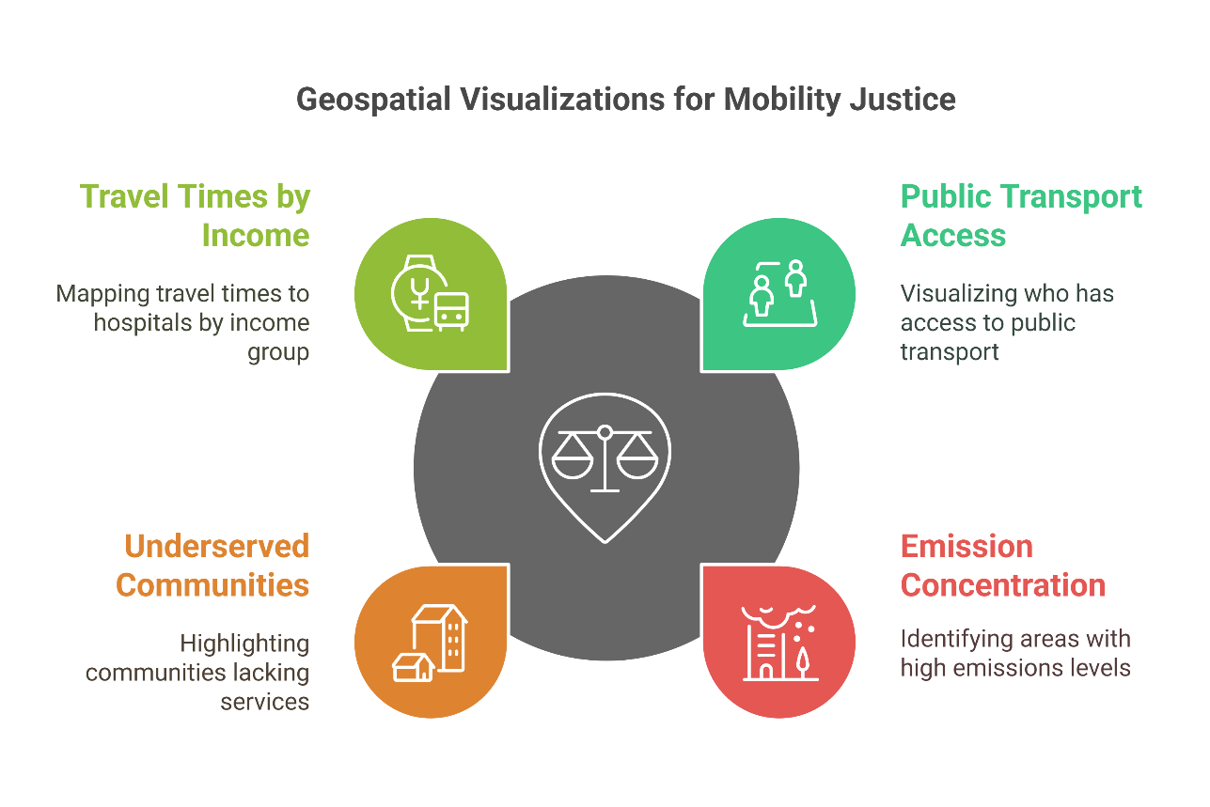
4. Challenges & Opportunities in Transport Data Visualization
4.2 Opportunities
Visualizing Equity, Emissions, and Accessibility
Use geospatial visualizations to show:
i. Who has access to public transport?
ii. Where do emissions concentrate?
iii. Which communities are underserved?
Encourages data-driven justice in mobility planning.
Example: A chloropleth map showing travel times to the nearest hospital by income group.
21
Data Visualization in Transportation

Slide 26
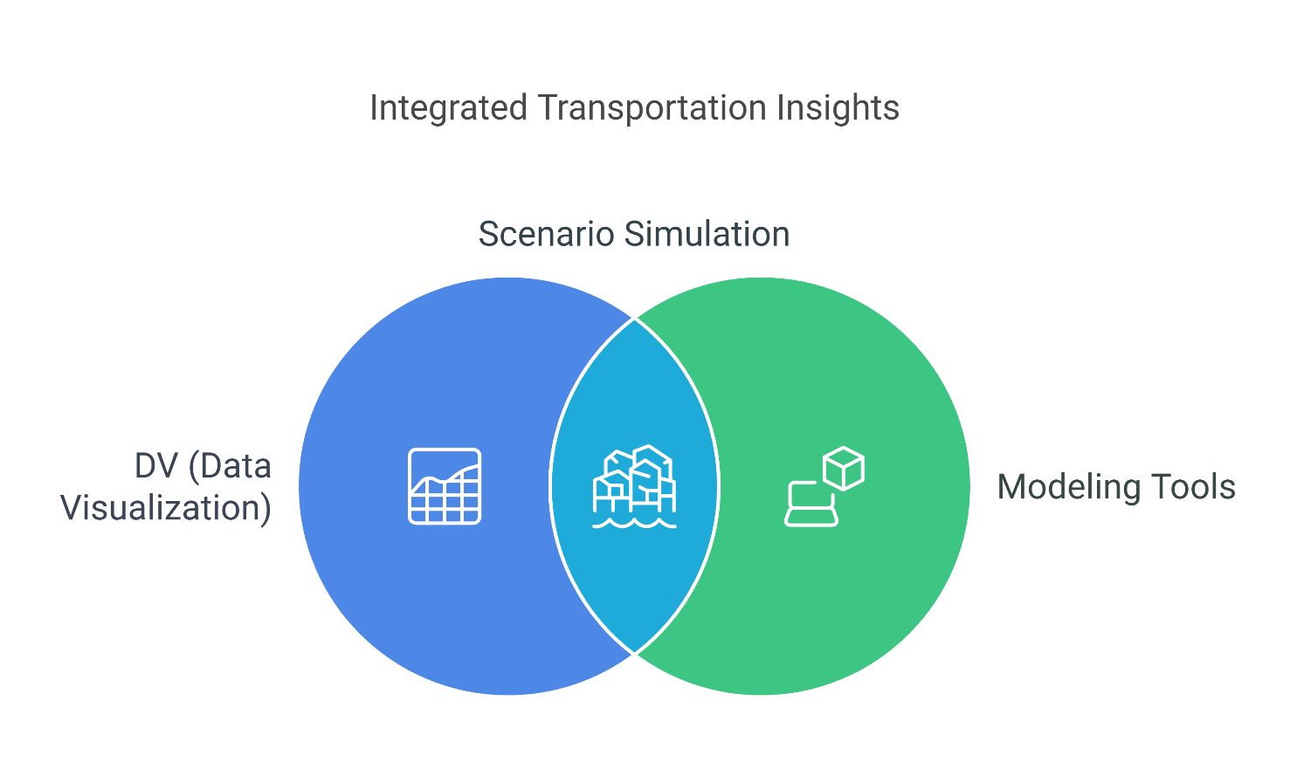
4. Challenges & Opportunities in Transport Data Visualization
4.2 Opportunities
Scenario Simulation & Forecasting
Integrate DV with modeling tools to:
i. Show future congestion under different population growth scenarios
ii. Visualize impact of introducing a new bus corridor or cycle lane
iii. Estimate CO₂ reductions from electric vehicle adoption
Communicate complex models through storytelling visuals.
Transport Data Collection and Management
22
Data Visualization in Transportation

Slide 27
Section 05:
Tools and Software for Visualization
Transport Data Collection and Management
Data Visualization in Transportation

Slide 28

5. Tools and Software for Visualization
5.1 Microsoft Excel
Charts & Conditional Formatting
Quick wins for small-to-medium datasets.
Line, bar, pie, area, and scatter charts are easy to create.
Conditional formatting (color scales, data bars) helps highlight:
Overcrowded routes
Performance deviations
Congestion levels
Example: Use conditional color formatting to show increasing delays across bus stops.
Transport Data Collection and Management
24
Data Visualization in Transportation

Slide 29
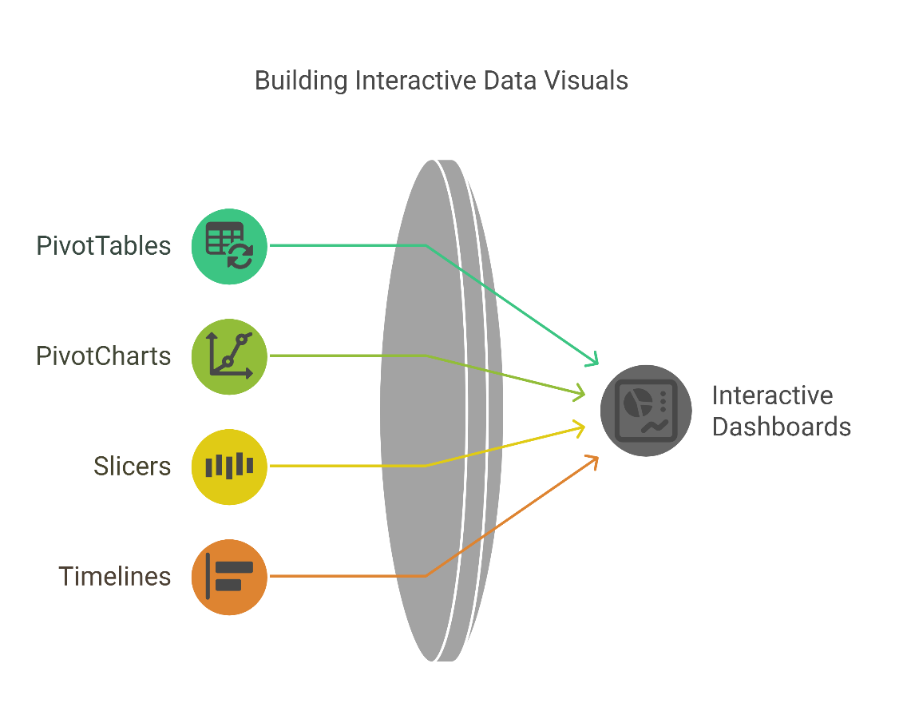
5. Tools and Software for Visualization
5.1 Microsoft Excel
Pivot Charts & Dashboards
Create summarized tables and visuals by filtering dimensions (e.g., time, route, region).
Combine charts, filters, and KPIs into interactive dashboards using:
PivotTables + PivotCharts
Slicers and Timelines
Example: A dashboard comparing monthly ridership trends across three transport lines.
Best For: Exploratory analysis, reporting, low-code environments, small datasets.
Transport Data Collection and Management
25
Data Visualization in Transportation

Slide 30
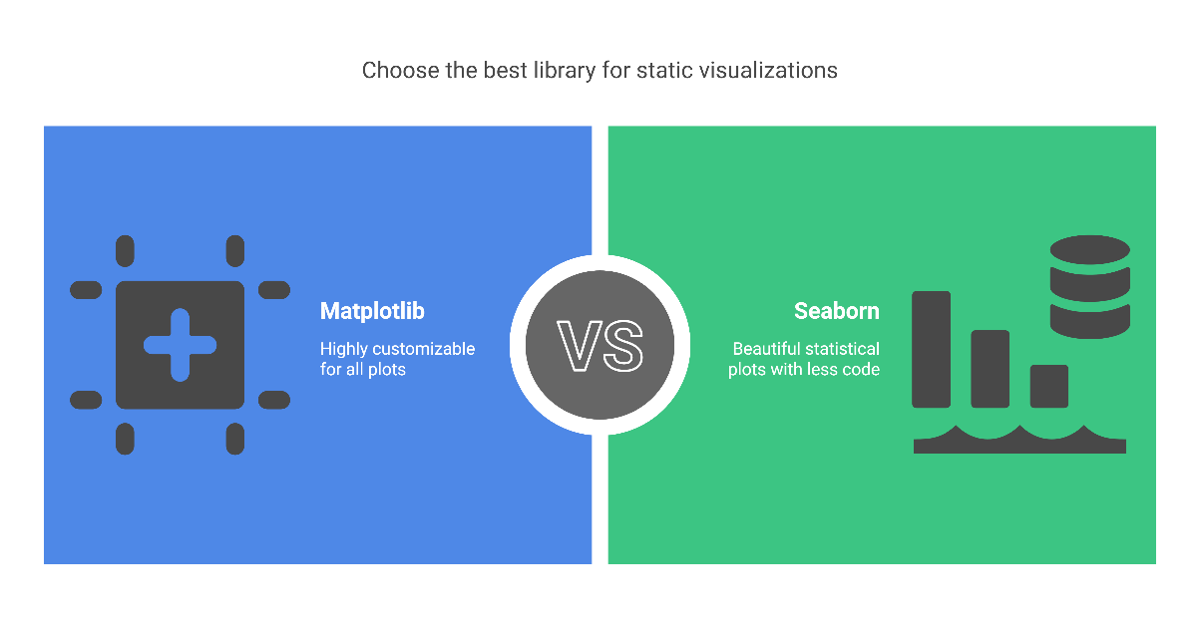
5. Tools and Software for Visualization
5.2 Python
Matplotlib & Seaborn (Static Visuals)
Matplotlib: The base for all Python plots; highly customizable.
Seaborn: Built on Matplotlib; offers beautiful statistical plots with less code.
Example: Use Seaborn heatmap() to visualize station-to-station transfer density.
Ideal for:
Plotting time series (e.g., traffic flow)
Histograms (e.g., travel time distributions)
Boxplots (e.g., variation in speeds)
Transport Data Collection and Management
26
Data Visualization in Transportation

Slide 31
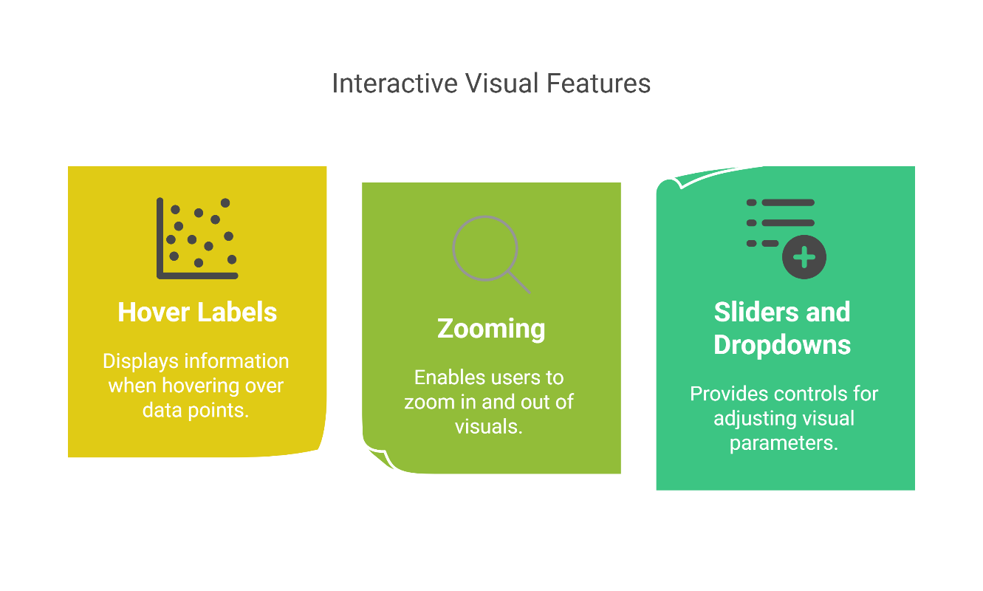
5. Tools and Software for Visualization
5.2 Python
Plotly (Interactive Visuals)
Allows creation of interactive and web-based visuals:
  i. Hover labels
  ii. Zooming
  iii. Sliders and dropdowns
Great for dashboards and embedding in web apps (Dash, Streamlit)
Example: Plotly scatter_mapbox() to show real-time bus locations with ridership levels.
Transport Data Collection and Management
27
Data Visualization in Transportation

Slide 32
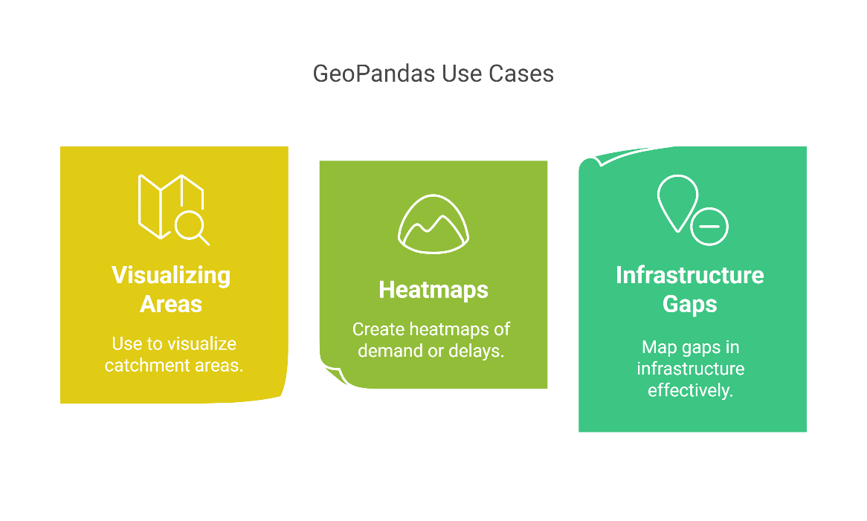
5. Tools and Software for Visualization
5.2 Python
GeoPandas (Geospatial Visualization)
Combines Pandas + Shapely + Matplotlib for spatial data.
Easy to load, filter, and plot GeoJSON, shapefiles, or OSM data.
Use for:
Visualizing catchment areas
Heatmaps of demand or delays by region
Mapping infrastructure gaps
Can be combined with Folium, Plotly, or contextily for basemaps
Transport Data Collection and Management
28
Data Visualization in Transportation

Slide 33
5. Tools and Software for Visualization
5.3 When to Use Excel vs Python
Scenario | Recommended Tool
Quick analysis / small dataset | Excel
Dashboards for static reports | Excel
Repetitive and automated plots | Python
Interactive, web-based visuals | Python (Plotly, Dash)
Geospatial transport analysis | Python (GeoPandas)
Excel = accessibility, speed, simplicity
Python = power, flexibility, automation, scale
Transport Data Collection and Management
29
Data Visualization in Transportation

Slide 34
Section 06:
Creating Effective Transport Data Visualizations
Transport Data Collection and Management
Data Visualization in Transportation

Slide 35
6. Creating Effective Transport Data Visualizations
6.1 Real-World Case Study: Public Transport Usage
Scenario: Analyzing one month of ridership data from 5 bus routes.
In Excel:
Use PivotTables to summarize daily ridership by route.
Create a clustered column chart for side-by-side comparison.
Add slicers to filter by week or route.
In Python:
import seaborn as sns
sns.lineplot(data=df, x='Date', y='Passengers', hue='Route’)
Use Seaborn for line plots to show ridership trends.
Add moving average smoothing to reveal seasonal effects.
Outcome: Identify peak travel days, underperforming routes, and day-of-week patterns.
Transport Data Collection and Management
31
Data Visualization in Transportation

Slide 36
6. Creating Effective Transport Data Visualizations
6.2 Map-Based Visualizations
Goal: Show spatial variation in transport metrics.
Tools:
Excel: Use conditional formatting with station coordinates (limited, basic mapping).
Python: Use GeoPandas, Folium, or Plotly.
import geopandas as gpd
gdf.plot(column='congestion_index', cmap='Reds', legend=True)
Example: Map showing red zones of high congestion near city centers.
Use gradient coloring or graduated symbols for better interpretability.
Transport Data Collection and Management
32
Data Visualization in Transportation

Slide 37
6. Creating Effective Transport Data Visualizations
6.3 Time-Series Visualization
Why it matters: Transport systems are inherently temporal.
In Excel:
Use line charts with multiple series (e.g., routes A–E).
Highlight anomalies with data labels or callouts.
In Python:
Use Matplotlib or Seaborn for flexible time-axis handling.
Add trend lines, event markers, and zoomable interfaces (e.g., Plotly).
Insight: Spot seasonal dips (e.g., holidays), growth patterns, or delays post-construction.
Transport Data Collection and Management
33
Data Visualization in Transportation

Slide 38
6. Creating Effective Transport Data Visualizations
6.4 Dos & Don’ts of Transport Data Dashboards
✅ Do This | ❌ Avoid This
Use color meaningfully (e.g., red for delay) | Too many colors with no legend
Keep it simple (1 message per visual) | Overloading one chart with 6+ variables
Include legends, units, labels | Ambiguous data with no context
Use consistent date/time formats | Mixing 12h/24h or MM/DD vs DD/MM
Test with end users (non-technical too) | Designing only for technical users
Rule of thumb: If a chart requires more than 10 seconds to explain — simplify it.
Transport Data Collection and Management
34
Data Visualization in Transportation

Slide 39


