Slide 1
Transport Research and Analysis
Module 2: Transport Data Collection and Management
Lab 5: Importance of Data Visualization in Transport Research

Slide 4
Table of Contents
Lab 5: Importance of Data Visualization in Transport Research
0. Objective | 1
0.1 Learning Objectives | 2
1. Introduction to Data Visualization in Transport Research | 3
1.1 Importance of Data Visualization | 4
1.2 From Raw Data to Insights | 5
1.3 Role in Transport Planning and Decision-+Making | 6
2. Types of Visualizations and Their Uses | 7
2.1 Line Charts – Spotting Trends | 8
2.2 Histograms – Understanding Distribution | 9
2.3 Scatter Plots – Spotting Anomalies and +Relationships | 10
2.4 Heatmaps – Revealing Patterns | 11
3. Excel Practical: Hands-on Visualization | 12
3.1 Overview of Dataset | 13
3.2 Creating Histograms in Excel | 14
3.3 Creating Line Charts in Excel | 15
3.4 Creating Scatter Plots in Excel | 16
3.5 Bonus Explorations | 17
4. Python Practical: Advanced Visualization | 18
4.1 Overview of Python/Colab Environment | 19
4.2 Loading and Inspecting Transport Data | 20
4.3 Creating Line Charts with Python | 21
4.4 Creating Histograms with Python | 22
4.5 Creating Box Plots with Python | 23
4.6 Creating Heatmaps with Python | 24
4.7 Interpretation and Insights | 25
i
Importance of Data Visualization in Transport Research

Slide 5
Table of Contents
Lab 5: Importance of Data Visualization in Transport Research
5. Comparative Discussion: Excel vs Python Approaches | 26
5.1 Strengths and Limitations | 27
5.2 When to Choose Each Tool | 28
5.3 Integrating Results for Reports | 29
6. Summary and Reflections | 30
6.1 Why Visualization is Essential | 31
6.2 Supporting Transport Planning | 32
6.3 Home Assignment for Students | 33
7. References | 34
7.1 Reference Textbooks & Tutorials | 35
ii
Importance of Data Visualization in Transport Research

Slide 6
Section 0:
Objective
1
Importance of Data Visualization in Transport Research

Slide 7
0.1 Learning Objectives
Section No | Learning Objective | Activity Type | Activity Done by | Allocated Time
1 | Explain the role and importance of data visualization in transport research | Lecture | Teacher | 15 minutes
2 | Identify and describe key visualization types (line charts, histograms, scatter plots, heatmaps) | Lecture | Teacher | 15 minutes
2 | Interpret visualizations to uncover trends, distributions, anomalies, and patterns | Lecture | Teacher | 15 minutes
3 | Create and analyse visualizations in Excel (histograms, line charts, scatter plots) | Practical | Teacher+Students | 35 minutes
4 | Develop advanced visualizations in Python/Colab (line charts, histograms, box plots, heatmaps) | Practical | Teacher+Students | 45 minutes
5, 6 | Compare strengths, limitations, and integration of Excel and Python outputs, Home Assignment Explanation | Lecture | Teacher | 10 minutes
 | TOTAL |  |  | 135 minutes
2
Importance of Data Visualization in Transport Research

Slide 8
Section 01:
Introduction to Data Visualization in Transport Research
3
Importance of Data Visualization in Transport Research

Slide 9
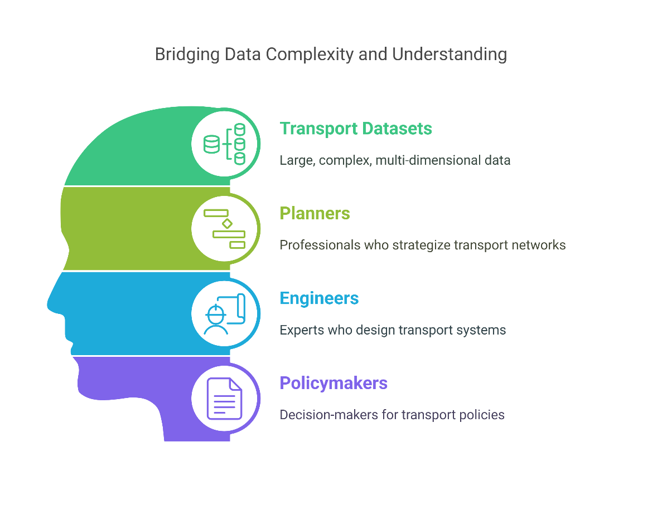
1. Introduction to Data Visualization in Transport Research
1.1 Importance of Data Visualization
Simplifies large and complex transport datasets.
Reveals patterns, trends, and anomalies that are not obvious in raw data.
Enhances communication and engagement with stakeholders.
Supports transparent, evidence-based decision-making.
Saves time and reduces the risk of misinterpretation or errors.
"Data visualization is the bridge between complex data and human understanding."
4
Importance of Data Visualization in Transport Research

Slide 10
1. Introduction to Data Visualization in Transport Research
1.2 From Raw Data to Insights
Example dataset: Daily ridership counts across transport modes or stations/ junctions.
Raw table: hard to read patterns.
Line chart: reveals temporal trends.
Heatmap: shows weekly usage intensity.
🧠 Question: Which of these formats is most intuitive? Why?
5
Importance of Data Visualization in Transport Research

Slide 11
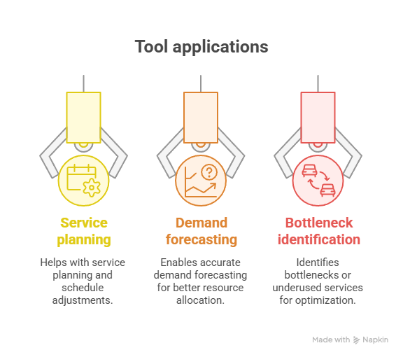
1. Introduction to Data Visualization in Transport Research
1.3 Role in Transport Planning and Decision-Making
Essential tool for:
      Service planning and schedule adjustments
      Demand forecasting
      Identifying bottlenecks or underused services
Enables data-driven justification for investments and policy changes.
Supports transparent communication with the public and stakeholders.
Makes complex technical analyses accessible to non-experts.
Helps ensure transport systems are efficient, safe, and user-focused.
6
Importance of Data Visualization in Transport Research

Slide 12
Section 02:
Types of Visualizations and Their Uses
7
Importance of Data Visualization in Transport Research

Slide 13
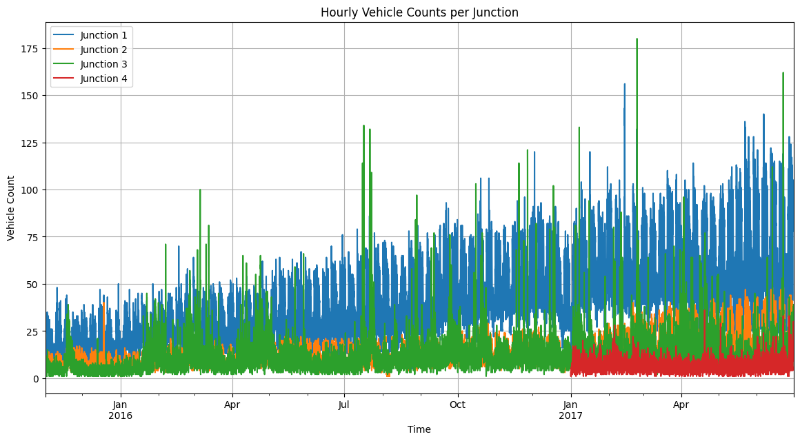
2. Types of Visualizations and Their Uses
2.1 Line Charts – Spotting Trends
      Long-term patterns: Ridership growth, seasonal dips (e.g., holidays).
      Compare modes: Bus vs. Rail trends over time.
      Identify “recovery” patterns post-disruption (e.g., post-pandemic).
Based on “Traffic Prediction Dataset” from Kaggle
8
Importance of Data Visualization in Transport Research

Slide 14
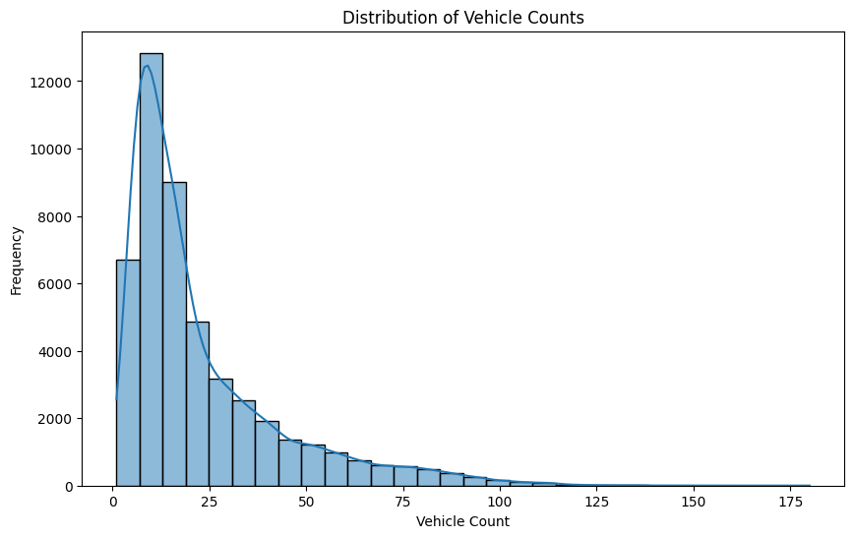
2. Types of Visualizations and Their Uses
2.2 Histograms – Understanding Distribution
Histograms show how often values fall within certain ranges.
Identify common vs. rare ridership volumes.
Detect skew (e.g., most days low usage, few high-demand days).
Practical Insight: Know when to expect peak capacity challenges.
Based on “Traffic Prediction Dataset” from Kaggle
9
Importance of Data Visualization in Transport Research

Slide 15
2. Types of Visualizations and Their Uses
2.3 Scatter Plots – Spotting Anomalies and Relationships
Explore relationships: e.g., Bus vs Tube usage.
Look for outliers: Days with extremely high/low usage.
Investigate: Special events, strikes, weather impacts?
Bonus Insight: Use trendlines to assess correlation strength.
10
Importance of Data Visualization in Transport Research

Slide 16
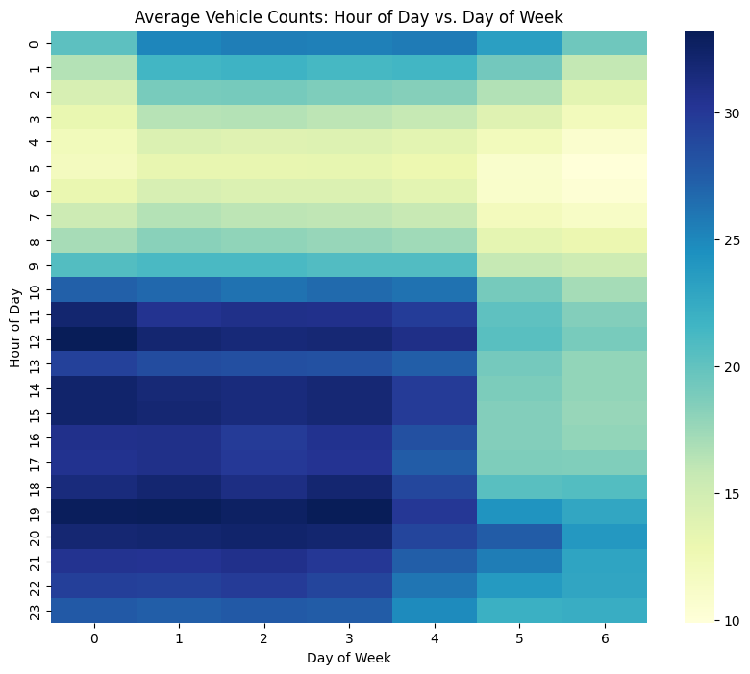
2. Types of Visualizations and Their Uses
2.4 Heatmaps – Revealing Patterns
Best for combining two dimensions: Day of week vs Week of year.
Example: Daily system-wide ridership (CTA dataset).
Patterns emerge:
  Lower usage on weekends
  Drops during holiday weeks
Great for: Service planning, holiday scheduling, demand forecasting.
Based on “Traffic Prediction Dataset” from Kaggle
11
Importance of Data Visualization in Transport Research

Slide 17
Section 03:
Excel Practical: Hands-on Visualization
12
Importance of Data Visualization in Transport Research

Slide 18
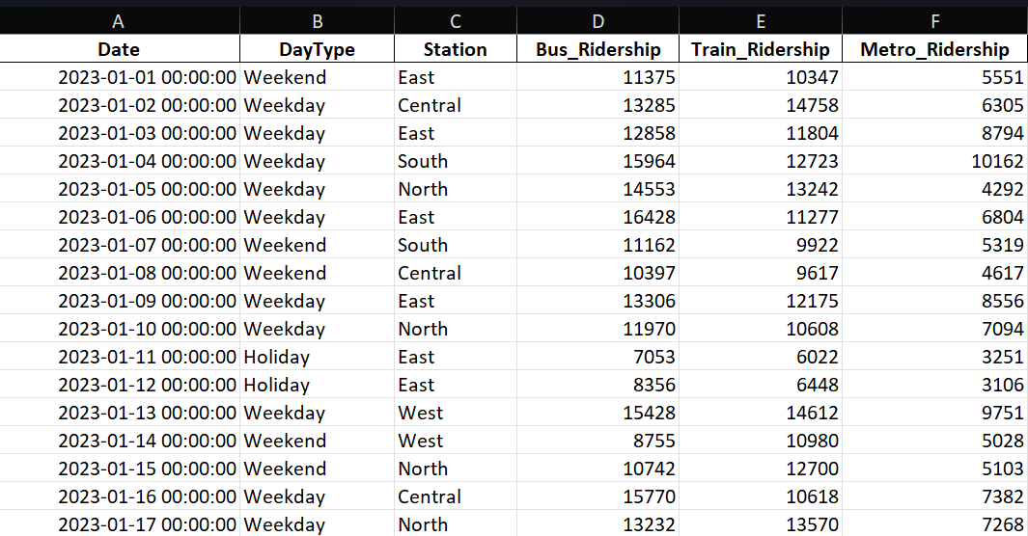
3. Excel Practical: Hands-on Visualization
3.1 Overview of Dataset
Daily transport ridership records
Includes Date and DayType (Weekday, Weekend, Holiday)
Lists Station names
Contains Bus, Train, and Metro Ridership numbers
Supports analysis of trends and patterns
📂 Refer Excel_Visualization_Practical.pdf Practical Sheet
13
Importance of Data Visualization in Transport Research

Slide 19
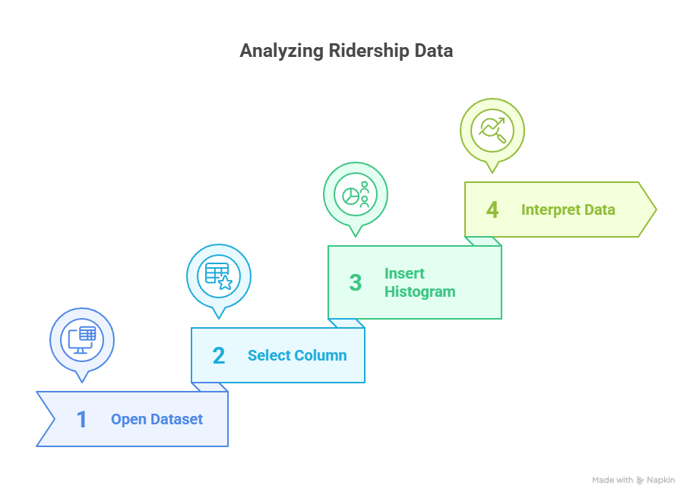
3. Excel Practical: Hands-on Visualization
3.2 Creating Histograms in Excel
Understand distribution of ridership data
Open dataset in Excel
Select ridership column (Bus, Train, Metro)
Insert histogram chart
Interpret spread, skew, and outliers
14
Importance of Data Visualization in Transport Research

Slide 20
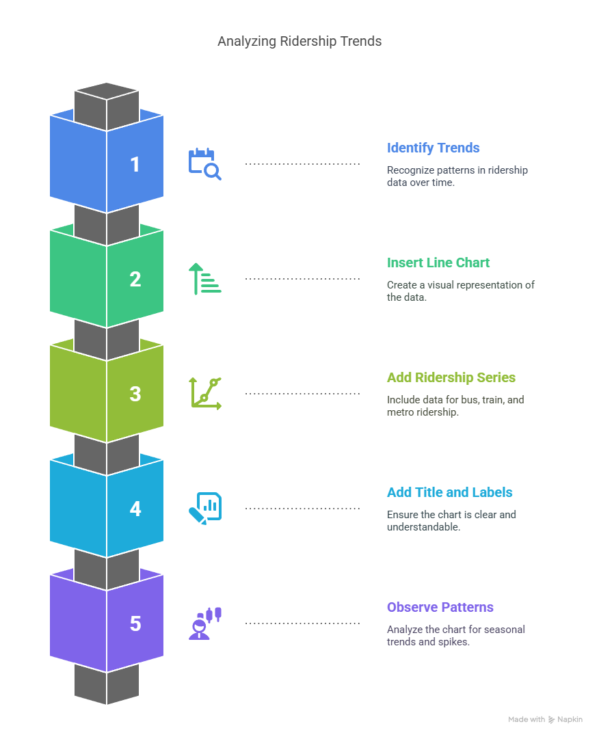
3. Excel Practical: Hands-on Visualization
3.3 Creating Line Charts in Excel
Identify trends over time
Insert line chart with Date on X-axis
Add Bus, Train, Metro Ridership as series
Add clear title and axis labels
Observe seasonal patterns and spikes
15
Importance of Data Visualization in Transport Research

Slide 21
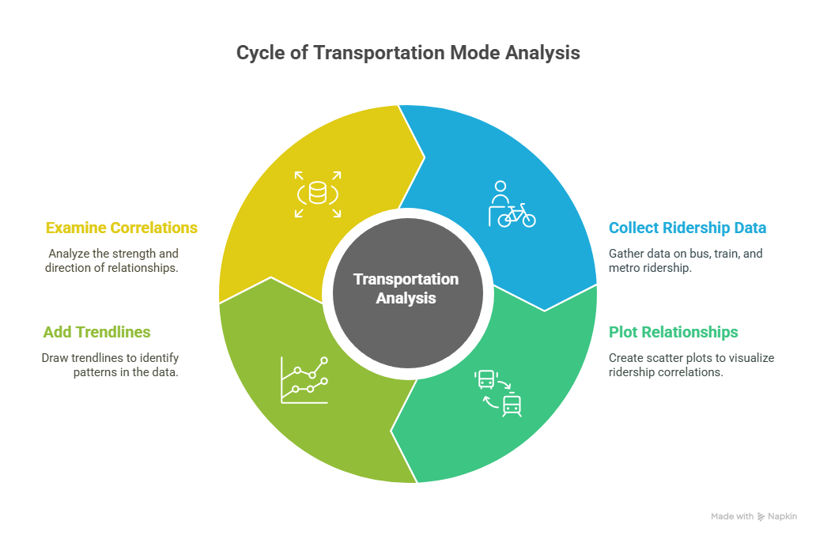
3. Excel Practical: Hands-on Visualization
3.4 Creating Scatter Plots in Excel
Explore relationships between modes
Insert scatter plot
Plot Bus vs. Train Ridership
Repeat for Train vs. Metro
Add trendlines and examine correlations
16
Importance of Data Visualization in Transport Research

Slide 22
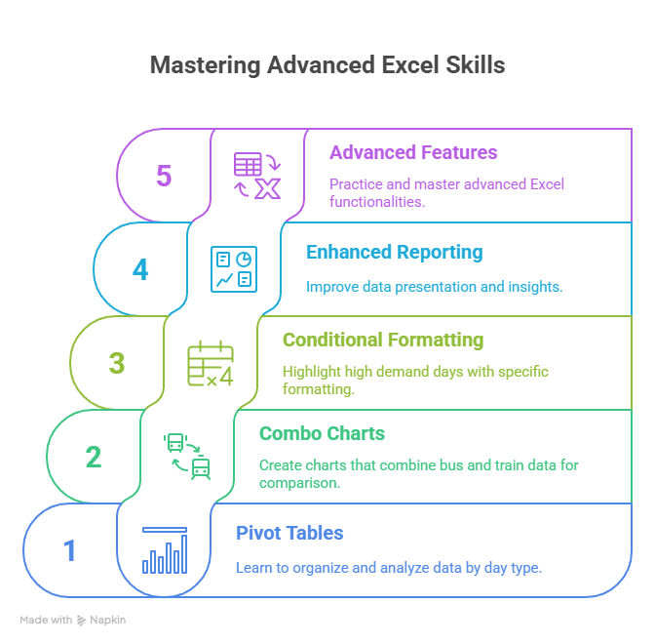
3. Excel Practical: Hands-on Visualization
3.5 Bonus Explorations
Create Pivot Tables by DayType
Build Combo Charts for Bus and Train
Apply Conditional Formatting for high demand days
Enhance reporting and insights
Practice advanced Excel features
17
Importance of Data Visualization in Transport Research

Slide 23
Section 04:
Python Practical: Advanced Visualization
18
Importance of Data Visualization in Transport Research

Slide 24

4. Python Practical: Advanced Visualization
4.1 Overview of Python/Colab Environment
Use Google Colab for cloud-based coding
Write and run Python code in a browser
Access libraries for data analysis and visualization
Load, process, and visualize transport datasets
Collaborate and share notebooks easily
Access by https://colab.research.google.com/
📂 Refer Colab_Traffic_Visualization_Practical.ipynb
19
Importance of Data Visualization in Transport Research

Slide 25



4. Python Practical: Advanced Visualization
4.2 Loading and Inspecting Transport Data
Import necessary Python libraries
Load transport ridership dataset into Colab
Inspect columns and data types
Check for missing values or errors
Understand data structure for analysis
20
Importance of Data Visualization in Transport Research

Slide 26

4. Python Practical: Advanced Visualization
4.3 Creating Line Charts with Python
Use matplotlib or seaborn libraries
Plot Date on X-axis and ridership modes on Y-axis
Add titles and axis labels for clarity
Customize colors and styles
Visualize trends and seasonal patterns
21
Importance of Data Visualization in Transport Research

Slide 27

4. Python Practical: Advanced Visualization
4.4 Creating Histograms with Python
Use matplotlib or seaborn histograms
Select Bus, Train, or Metro Ridership columns
Set bin sizes for detail level
Highlight distribution shape and skew
Identify peak demand and outliers
22
Importance of Data Visualization in Transport Research

Slide 28
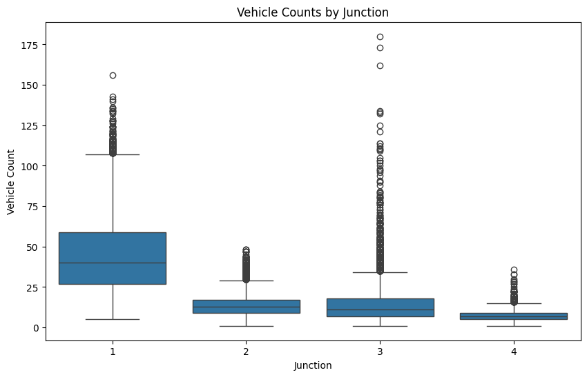
4. Python Practical: Advanced Visualization
4.5 Creating Box Plots with Python
Plot relationships between two ridership modes
Use matplotlib or seaborn box plots
Add titles and axis labels
Include trendlines if needed
Detect correlations and anomalies
23
Importance of Data Visualization in Transport Research

Slide 29

4. Python Practical: Advanced Visualization
4.6 Creating Heatmaps with Python
Use seaborn heatmap functions
Create pivot tables for day vs. week patterns
Visualize usage intensity over time
Identify peak days, weekends, holidays
Support planning and scheduling decisions
24
Importance of Data Visualization in Transport Research

Slide 30
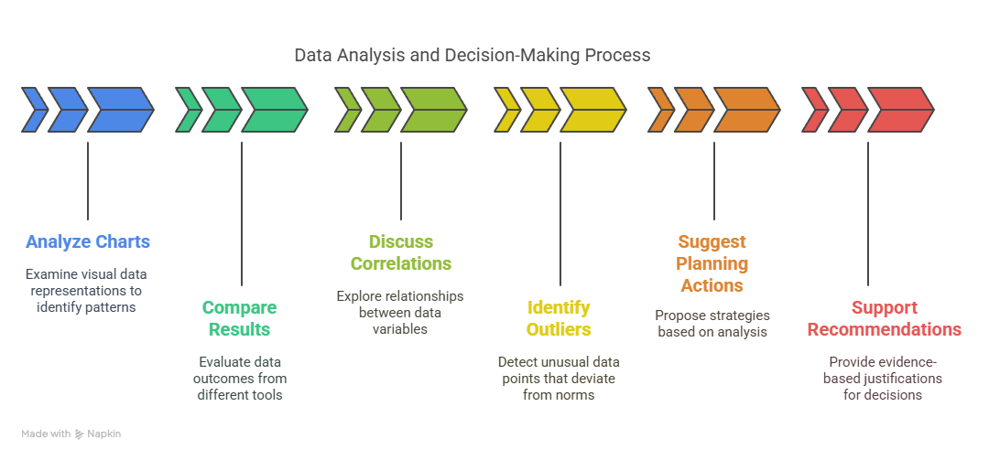
4. Python Practical: Advanced Visualization
4.7 Interpretation and Insights
Analyze charts to uncover patterns and trends
Compare results from Excel and Python
Discuss correlations and outliers
Suggest planning actions based on findings
Support clear, data-driven recommendations
25
Importance of Data Visualization in Transport Research

Slide 31
Section 05:
Comparative Discussion: Excel vs Python Approaches
26
Importance of Data Visualization in Transport Research

Slide 32
5. Comparative Discussion: Excel vs Python Approaches
5.1 Strengths and Limitations
Excel | Python
User-friendly and accessible | Allows advanced, flexible visualizations
Quick for simple charts and summaries | Handles large datasets easily
Limited customization options | Supports automation and reproducibility
Struggle with large datasets | Requires coding skills and has a learning curve
27
Importance of Data Visualization in Transport Research

Slide 33
5. Comparative Discussion: Excel vs Python Approaches
5.2 When to Choose Each Tool
Excel | Python
Quick exploratory analysis | Large, complex datasets
Small to medium datasets | Custom and advanced visualizations
Sharing with non-technical audiences | Automated and reproducible analysis
📄 Combine Excel and Python for complete reporting
28
Importance of Data Visualization in Transport Research

Slide 34
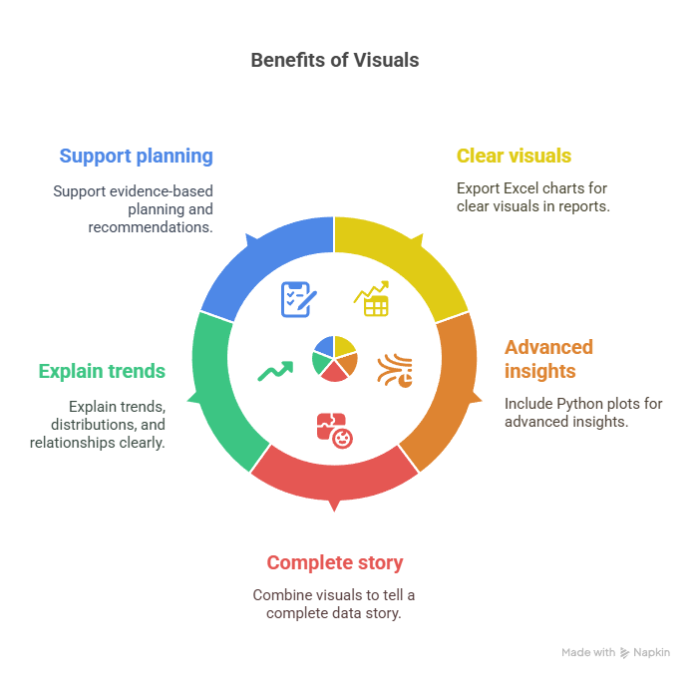
5. Comparative Discussion: Excel vs Python Approaches
5.3 Integrating Results for Reports
Export Excel charts for clear visuals in reports
Include Python plots for advanced insights
Combine visuals to tell a complete data story
Explain trends, distributions, and relationships clearly
Support evidence-based planning and recommendations
29
Importance of Data Visualization in Transport Research

Slide 35
Section 06:
Comparative Discussion: Excel vs Python Approaches
30
Importance of Data Visualization in Transport Research

Slide 36
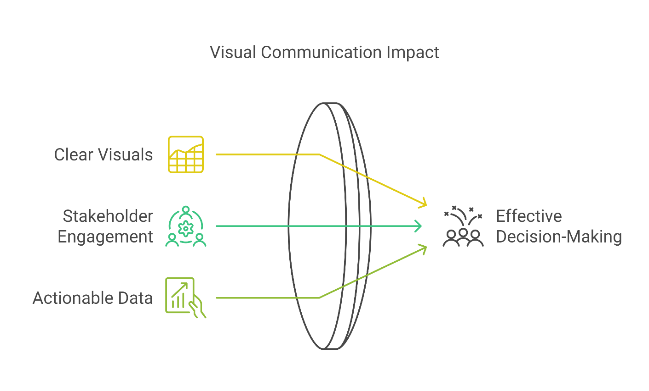
6. Summary and Reflections
6.1 Why Visualization is Essential
Simplifies complex transport datasets
Reveals trends, patterns, and anomalies
Makes data easier to understand and explain
Supports clear and persuasive communication
Enables data-driven and informed decisions
31
Importance of Data Visualization in Transport Research

Slide 37
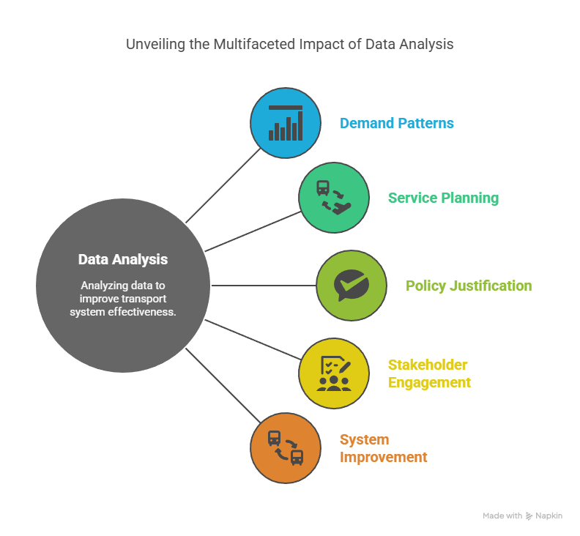
6. Summary and Reflections
6.2 Supporting Transport Planning
Helps identify demand patterns and peak periods
Supports service planning and scheduling decisions
Justifies policy changes and investments
Engages stakeholders with clear evidence
Promotes safe, efficient, and user-focused transport systems
32
Importance of Data Visualization in Transport Research

Slide 38

6. Summary and Reflections
6.3 Home Assignment for Students
Load and inspect the transport ridership dataset in Colab
Create a line chart to show trends over time
Build histograms to analyze distribution of ridership
Make scatter plots to explore mode relationships
Generate a heatmap for DayType or Station patterns
Write short interpretations and submit notebook with report PDF
📂 Refer provided Home_Assignment_Practical_5.pdf
33
Importance of Data Visualization in Transport Research

Slide 39
Section 07:
References
34
Importance of Data Visualization in Transport Research

Slide 40

7. References
7.1 Reference Textbooks & Tutorials
https://youtu.be/_YWwU-gJI5U
https://www.w3schools.com/python/matplotlib_intro.asp
https://www.geeksforgeeks.org/python/python-seaborn-tutorial/
https://youtu.be/eHtZrIb0oWY
35
Importance of Data Visualization in Transport Research

Slide 41
Thank You for Your Attention

