Slide 1
Transport Research and Analysis
Module 2: Transport Data Collection and Management
Lecture 5: Transport Data Types and Sources

Slide 3
Table of Contents
Transport Data Types and Sources
Section 1: Overview and Objectives ……………………..………………………………………………. 4
1.1 Overview …..…….………………………………….…………….…………………………….………. 5
Section 2: Background and Motivation …………...………..…………………………………………... 6
2.1 What is Transport Data? …..………………………………….…………………………….………. 7
2.2 Raw Data into Actionable Insights ……………..………………………………………………….. 9
Section 3: Data vs Information ………………………………...………………..………………………… 10
3.1 What is Data? ….………………………………..………………………….…………………………. 11
3.2 What is Information? ….…………………………………...……...……….…………………………. 11
3.3 Importance of Converting Data into Information ….…………….………………………………. 13
Section 4: Traffic Data ………………………………….…………………...….………………………….. 14
4.1 What is Traffic Data? …………………………………………………..……….……………………. 15
4.2 Types of Traffic Data ………………...……………………………….….…………………………... 16
4.3 Sources of Traffic Data …………………………………………..…….…………………………... 17
4.4 Applications of Traffic Data ………………………..……………..…….…………………………... 18
4.5 Case Study …………………………………….……………………..…….…………………………... 19
Section 5: Public Transport Data ……………………..…………………...….………………………….. 20
5.1 What is Public Transport Data? ……………………………………..……….……………………. 21
Notes:
# English
First of all, let’s take a look at what’s included in this lab.
We begin with Section 1: Lab Overview and Required Tools, where we’ll talk about the lab objectives, the overall content, and the tools will be using.
Then in Section 2: Data Preprocessing Techniques, we’ll explore the key steps used to clean and prepare raw datasets.
After that, in Section 3: Data Format Standardizing, we’ll learn how to make the data consistent—such as aligning time formats, currencies, and measurement units across different sources.
# French
Tout d'abord, examinons le contenu de ce laboratoire.
Nous commençons par la section 1 : Présentation du laboratoire et outils requis, où nous aborderons les objectifs du laboratoire, le contenu général et les outils utilisés. Ensuite, dans la section 2 : Techniques de prétraitement des données, nous explorerons les étapes clés du nettoyage et de la préparation des jeux de données brutes.
Ensuite, dans la section 3 : Normalisation des formats de données, nous apprendrons à assurer la cohérence des données, notamment en alignant les formats d'heure, les devises et les unités de mesure entre différentes sources.

Slide 4
Table of Contents
Transport Data Types and Sources
5.2 Types of Public Transport Data ….………………………….…………………………….………. 22
5.3 Sources of Public Transport Data ….………………………..…………………………….………. 23
5.4 Applications of Public Transport Data .……………………..…………………………….………. 24
5.5 Case Study .…………….………………………………………….………………………….………. 25
Section 6: Environmental Data ……..………………………...…………………………………………... 27
6.1 What is Environmental Data? …..…………………………….…………………………….………. 28
6.2 Types of Public Environmental Data …………………..………………………………………….. 29
6.3 Sources of Public Environmental Data …………………………………………………………….. 30
6.4 Applications of Environmental Data ……………………………………………………………….. 31
6.5 Case Study: How Cities Use Environmental Data? …………………………………………….. 32
Section 7: Socioeconomic/Demographic Data …………….………………..………………………… 33
7.1 What is Socioeconomic/Demographic Data? ……………...………….…………………………. 34
7.2 Types of Socioeconomic Data ….……….……………………...……….…………………………. 35
7.3 Sources of Socioeconomic Data ………………………………..…………………………………. 36
7.4 Applications of Socioeconomic Data ….…………………………..………………………………. 37
7.5 Case Study: How Cities Use Socioeconomic Data? ….……..…………………………………. 38
Section 8: Quiz ………………………………………………………………..….………………………….. 39
8.1 MCQ Questions (x10) ………………………………………….………….…………………………. 40
Notes:
# English
First of all, let’s take a look at what’s included in this lab.
We begin with Section 1: Lab Overview and Required Tools, where we’ll talk about the lab objectives, the overall content, and the tools will be using.
Then in Section 2: Data Preprocessing Techniques, we’ll explore the key steps used to clean and prepare raw datasets.
After that, in Section 3: Data Format Standardizing, we’ll learn how to make the data consistent—such as aligning time formats, currencies, and measurement units across different sources.
# French
Tout d'abord, examinons le contenu de ce laboratoire.
Nous commençons par la section 1 : Présentation du laboratoire et outils requis, où nous aborderons les objectifs du laboratoire, le contenu général et les outils utilisés. Ensuite, dans la section 2 : Techniques de prétraitement des données, nous explorerons les étapes clés du nettoyage et de la préparation des jeux de données brutes.
Ensuite, dans la section 3 : Normalisation des formats de données, nous apprendrons à assurer la cohérence des données, notamment en alignant les formats d'heure, les devises et les unités de mesure entre différentes sources.

Slide 5
Section 01:
Overview and Objectives
Notes:
# English
Now we are in Section 1: Overview and Tools.
Let’s quickly see what this lab is about and what tools we’ll use.
# French
Nous voici maintenant à la section 1 : Présentation et outils.
Voyons rapidement en quoi consiste cet atelier et quels outils nous utiliserons.

Slide 6
1. Overview and Objectives
1.1 Overview: Autonomous Vehicles
Transport systems generate large amounts of data that help planners understand movement patterns, infrastructure performance, environmental impacts, and user needs. This lecture introduces key types of transport data, where they come from, and how they support planning and decision-making.
Learning Objectives:
✅ Identify the major categories of transport-related data
✅ Distinguish between data and information
✅ Explain why transport data is essential for planning and policy
✅ Recognize common data sources for traffic, public transport, environmental, and socioeconomic analysis
✅ Understand real-world applications through case studies

Slide 7
Section 02:
Background and Motivation
Notes:
# English
Now we are in Section 1: Overview and Tools.
Let’s quickly see what this lab is about and what tools we’ll use.
# French
Nous voici maintenant à la section 1 : Présentation et outils.
Voyons rapidement en quoi consiste cet atelier et quels outils nous utiliserons.

Slide 8
2. Background and Motivation
2.1 What is Transport Data?
Transport data refers to any collected data that helps analyze, plan, and improve transportation systems. It provides insights into traffic flow, transport efficiency, environmental impacts & socioeconomic factors.
Examples of Transport Data:
# | Transport Data Types | Examples
1 | Traffic Data | Vehicle Count Data, Traffic Speed Data, Traffic Flow Data, Accident/Crash Data, Road Congestion Data, Toll Booth Transactions
2 | Public Transport Data | Passenger Ridership Data, Public Transport Schedules, Smart Card & Ticketing Data, Bus & Train Occupancy Levels, Public Transport Reliability, Subsidized Transport Data
3 | Environmental Transport Data | Vehicle Emissions Data, Fuel Consumption Data, Air Quality Data, Noise Pollution Data, Electric Vehicle (EV) Usage Data, Sustainable Transport Data
4 | Socioeconomic Data | Car Ownership Data, Mode Choice Data, Work Commute Patterns, Transport Affordability Data, Mobility for Special Groups
5 | Freight & Logistics Data | Freight Volume Data, Warehouse Storage Data, Delivery Route Optimization Data, Supply Chain Transport Data
6 | Active Transport Data | Bicycle Usage Data, Walking Patterns, Bike-Sharing Data, Sidewalk Accessibility Data
7 | Aviation & Maritime Transport Data | Airport Passenger Data, Flight Delay Data, Cargo Ship Traffic Data, Maritime Accident Reports, Cruise Ship Passenger Data
8 | Emerging Technologies & Smart Mobility Data | Autonomous Vehicle Test Data, Ride-Sharing Data, Smart Traffic Signal Data

Slide 9
2. Background and Motivation
Informs Decision-Making and Policy
Helps governments & city planners design efficient transport systems. Supports evidence-based policy-making.
Supports Infrastructure Planning
Determines where new roads, bridges, or railways are needed.
Enhances Safety and Efficiency
1.3 Why is Transport Data Important?
Identifies accident-prone areas to improve road safety.
Encourages Sustainable Practices
Helps measure the impact of public transport on reducing car usage.

Slide 10
2. Background and Motivation
1
Raw Data → Collecting Information
Gathering unstructured data from various sources (ex: GPS logs, sensor readings, user inputs, or website traffic)
Data → Actionable Insights
2
Data Pre-processing → Cleaning & Organizing
2.2 Raw Data into
Actionable Insights
Removing duplicates, handling missing values, correcting errors, and structuring data to make it usable.
“We turn raw data into actionable insights by processing and analyzing it to extract meaningful patterns. Raw data is often unstructured and contains errors, so we clean, organize, and analyze it to uncover trends.”
3
Data Analysis → Identifying Patterns & Trends
Applying statistical methods, visualization tools, or AI models to understand relationships and extract meaningful insights.
4
Data Processing → Transforming & Structuring for Use
Aggregating, summarizing, and converting analyzed data into a format that decision-makers can interpret.
5
Actionable Insights → Making Data-Driven Decisions
Using findings to implement real-world actions like adjusting business strategies, optimizing operations, or improving customer experiences.

Slide 11
Section 03:
Data vs Information
Notes:
# English
Now we are in Section 1: Overview and Tools.
Let’s quickly see what this lab is about and what tools we’ll use.
# French
Nous voici maintenant à la section 1 : Présentation et outils.
Voyons rapidement en quoi consiste cet atelier et quels outils nous utiliserons.

Slide 12
3. Data vs Information
3.1 What is Data?
Data refers to raw, unprocessed facts and figures collected from various sources.
✅ Data has no clear meaning until it is processed. It can be numbers, words, images, GPS points, sensor readings, or survey answers.
✅ In transport studies, data may include things like traffic counts, bus arrival times, accident numbers, or travel speeds.
✅ Data is important because it is the starting point for analysis, but on its own, it does not tell a full story.
3.2 What is Information?
Information is processed, structured, and meaningful data that supports decision-making.
✅ When we analyze data, categorize it, or summarize it, we convert it into information.
✅ Information helps us understand patterns, make comparisons, and support decisions.
✅ For example, converting raw traffic counts into a report showing peak-hour congestion is information.

Slide 13
3. Data vs Information
Now that we understand the basic difference between data and information, we can compare them more clearly. The following table summarizes how data and information differ in terms of meaning, usefulness, and level of processing.
Aspect | Transport Data Types | Examples
Nature | Raw, unstructured facts | Processed, meaningful insights
Format | Numbers, text, symbols, images | Reports, graphs, charts, summaries
Usefulness | Needs analysis to be useful | Ready for decision-making
Example | 500 cars passed a checkpoint. Number of cars passing a traffic light per hour GPS coordinates of buses on a route Speed of vehicles recorded by radar | Peak traffic flow is 500 cars/hour. Peak traffic occurs between 7 AM - 9 AM with 2,000 vehicles per hour. Buses on Route A take 10 minutes longer during rush hour due to congestion. The accident rate is highest at the intersection of Main St and 5th Ave.

Slide 14
3. Data vs Information
3.3 Importance of Converting Data into Information:
Traffic Management:
✅ Real-time sensor data helps adjust traffic signals to reduce congestion. Information
derived from this data helps identify peak congestion times and high-traffic zones.
Public Transport Optimization:
✅ GPS-based bus tracking improves bus scheduling and reduces delays. Information
extracted can optimize routes for efficiency and reduced waiting times.
Road Safety & Accident Prevention:
✅ Accident reports identify high-risk areas for better road planning. Information
extracted helps determine why accidents happen.
Urban Planning & Infrastructure Development:
✅ Data on travel patterns helps in building efficient roads and transport networks.
Information derived helps forecast future transport demands and allocate budgets efficiently.
Smart City Integration & Future Mobility:
✅ Future cities rely on integrated transport data for autonomous vehicles, ride-sharing, and AI-driven solutions. Information extracted helps predict future mobility trends.

Slide 15
Section 04:
Traffic Data
Notes:
# English
Now we are in Section 1: Overview and Tools.
Let’s quickly see what this lab is about and what tools we’ll use.
# French
Nous voici maintenant à la section 1 : Présentation et outils.
Voyons rapidement en quoi consiste cet atelier et quels outils nous utiliserons.

Slide 16
4. Traffic Data
4.1 What is Traffic Data? 🚦
Traffic data refers to information about vehicle movements and road usage collected to manage and optimize road networks.
Traffic data helps planners understand where, when, and how people travel. It reveals congestion points, travel speeds, and road usage patterns, supporting decisions that improve safety, efficiency, and mobility.
Why is it Important?
  ✅ Helps optimize traffic signals and reduce congestion.
  ✅ Supports highway expansion and new road construction.
  ✅ Improves public transport scheduling and efficiency.
  Traffic data helps transport planners understand how, when, and where people travel. It shows where roads are busy, where delays happen, and how people use buses, trains, or cars. This information is important for improving roads, reducing traffic jams, planning new bus routes, and making travel safer and faster for everyone.

Slide 17
4. Traffic Data
4.2 Types of Traffic Data 🚦
Type | Description | Use Case
Traffic Volume Counts | Number of vehicles passing a fixed point per hour or day. | Used to identify high-traffic areas.
Speed Data | Average speed of vehicles on different road sections. | Helps determine where speed limits or enforcement is needed.
Vehicle Classification | Categorizes vehicles into cars, buses, trucks, motorcycles. | Used for road capacity planning and freight management.
Origin-Destination Data | Tracks where vehicles start and end their journeys. | Helps optimize road networks and public transit routes.
Congestion & Delay Data | Identifies traffic bottlenecks and average wait times. | Used to improve traffic flow and reduce travel time.
Travel Time Data | The time taken to travel between two points under different conditions. | Supports navigation apps like Google Maps in suggesting routes.
Pedestrian & Bicycle Data | The movement of pedestrians and cyclists at crossings and sidewalks. | Helps in planning safe pedestrian zones and bike lanes.
Parking Data | Availability and occupancy of parking spaces in urban areas. | Helps in reducing illegal parking and traffic congestion.
Accident & Incident Data | Location, frequency, and causes of road accidents. | Helps improve road safety measures like speed enforcement and signage.
Environmental Traffic Data | Emissions and noise levels related to vehicle movement. | Helps in developing low-emission zones and air pollution controls.

Slide 18
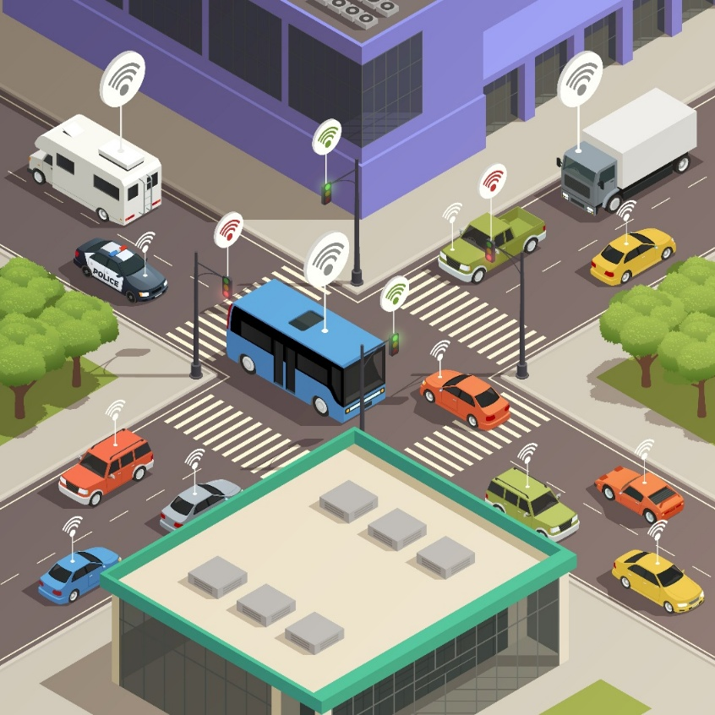
4. Traffic Data
4.3 Sources of Traffic Data 🚦
Road-Based Sensors & Cameras
Loop Detectors: Embedded in roads to count vehicles.
Radar Sensors: Measure vehicle speed and classify vehicle types.
CCTV Cameras: Used for real-time monitoring of traffic flow.
GPS & Mobile Tracking
GPS Devices: vehicle real-time movement tracking.
Navigation Apps (Google Maps, Uber, Waze): Provide live traffic updates and congestion data.
Road-Based Sensors & Cameras
Traffic Police Reports: Used for accident data and road safety improvements.
Manual Traffic Counts: Conducted at intersections to count vehicle13

Slide 19
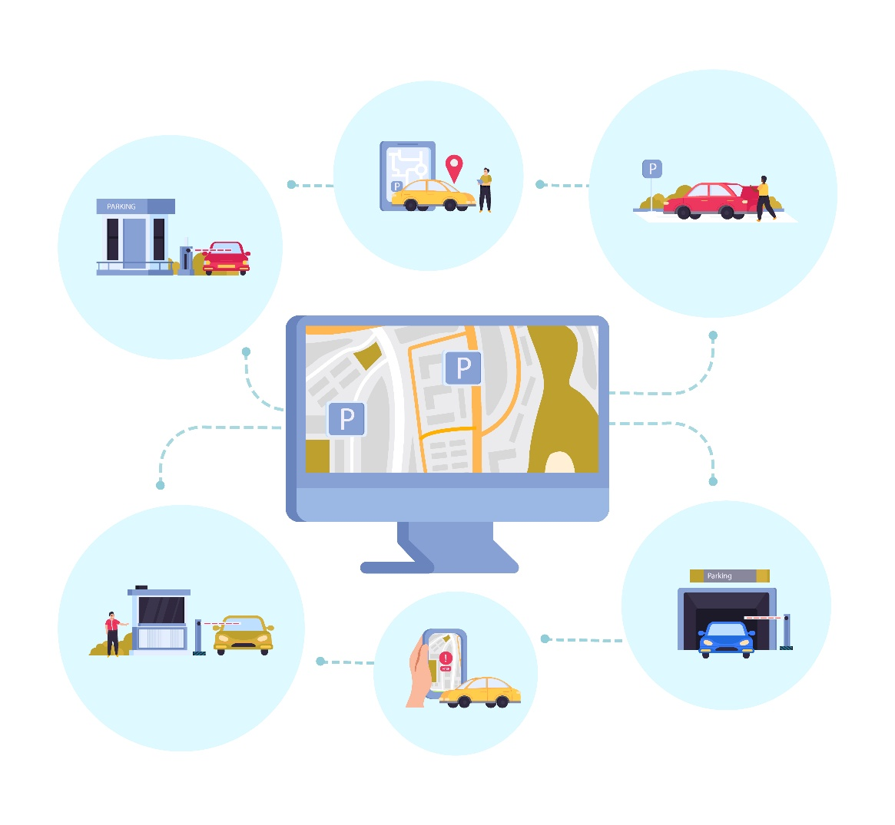
4. Traffic Data
4.4 Applications of Traffic Data 🚦
Traffic Management & Signal Optimization
01
🚦 Smart traffic lights adjust green light duration based on congestion levels.
🚗 AI-powered systems predict traffic patterns to prevent bottlenecks.
Highway Design & Road Capacity Planning
02
🛣️ Identifies areas where new roads, lanes, or bypasses are needed.
📊 Helps in evaluating existing roads for expansion or redesign.
Real-Time Navigation & Routing
03
📍 Google Maps, Waze, and Uber use real-time traffic data to suggest faster routes.
🕒 Reduces travel time and improves driver experience.
Public Transport Planning
04
🚌 Helps optimize bus routes and schedules based on real-time congestion.
🚆 Used for train & metro frequency adjustments during peak hours.
Road Safety & Accident Prevention
05
⚠️ Identifies high-accident zones for better enforcement.
📢 Helps in setting up speed cameras & warning signs.
📌 Key Insight: Traffic data transforms city planning, making roads safer and travel more efficient.

Slide 20

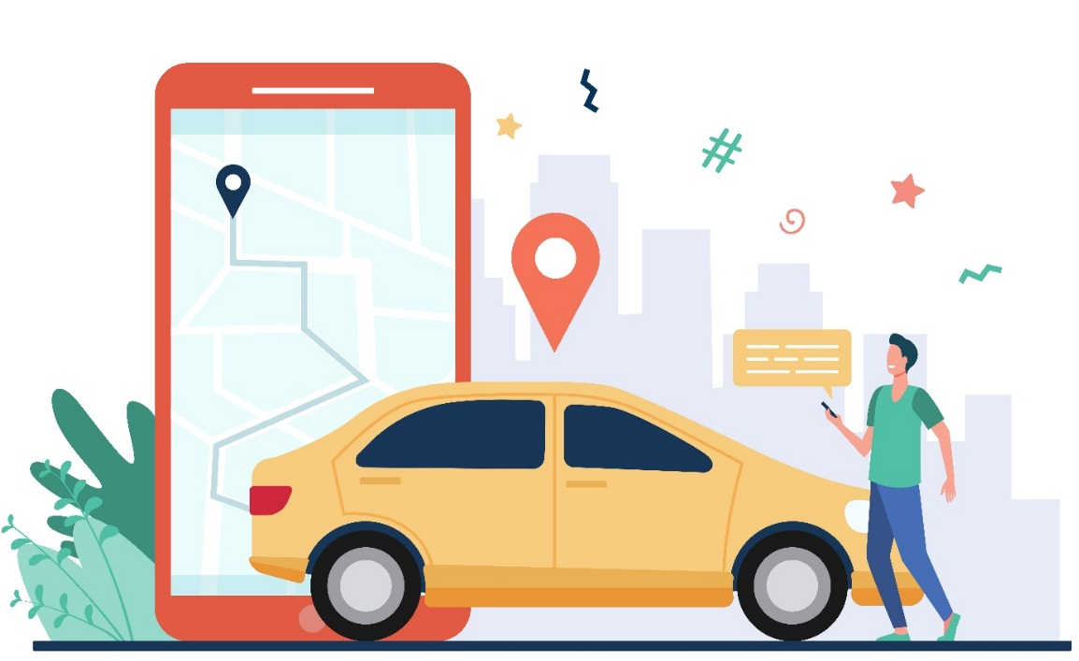
4. Traffic Data
4.5 Case Study: How Google Maps Uses Traffic Data? 🚦
01. Data Sources
✅ GPS from smartphones
✅ Live speed monitoring from users
✅ Traffic sensor data from government agencies
02. How it Works
1️⃣ Detects slow-moving traffic on a highway.
2️⃣ Identifies alternative routes with lower congestion.
3️⃣ Provides real-time updates to users.
03. Impact
✔️ Reduces travel time
✔️ Prevents road congestion
✔️ Helps emergency vehicles find the fastest routes

Slide 21
Section 05:
Public Transport Data
Notes:
# English
Now we are in Section 1: Overview and Tools.
Let’s quickly see what this lab is about and what tools we’ll use.
# French
Nous voici maintenant à la section 1 : Présentation et outils.
Voyons rapidement en quoi consiste cet atelier et quels outils nous utiliserons.

Slide 22
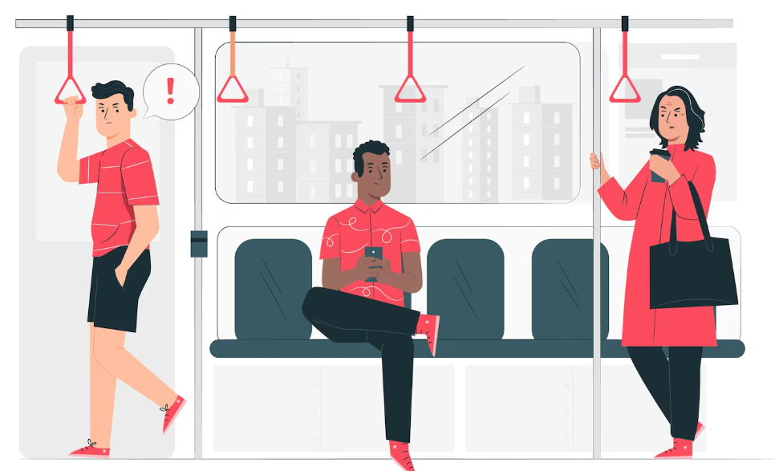
5. Public Transport Data
5.1 What is Public Transport Data?
✅ Public transport data includes information about buses, trains, metros, and other transit services collected to optimize operations, improve passenger experience and enhance efficiency.
✅ It helps in route planning, reducing delays, and managing transport demand.
Why is it Important?
✅ Ensures efficient scheduling and reduced wait times for passengers.
✅ Helps governments optimize resources for new transport routes.
✅ Supports fare pricing strategies based on demand.
Public transport data helps improve service reliability by allowing better schedules and reduced wait times. It also supports decisions on new routes and resource allocation and helps set fair pricing based on passenger demand.

Slide 23
5. Public Transport Data
5.2 Types of Public Transport Data
Type | Description | Use Case
Ridership Numbers | Measures how many passengers use a transit system daily. | Helps plan fleet size and frequency.
Schedules & On-Time Performance | Monitors if buses/trains run as scheduled. | Improves reliability by reducing delays.
Fare Collection Data | Tracks revenue from ticket sales and smart cards. | Helps in fare pricing and financial planning.
Real-Time Location Data | GPS tracking of buses, trains, and metros. | Enables live updates and passenger notifications.
Passenger Flow Analysis | Identifies peak travel hours and crowd density. | Helps reduce overcrowding.
Trip Duration Data | Measures the time taken by passengers to complete journey. | Helps improve route efficiency and reduce travel time.
Waiting Time Data | Tracks the time passengers spend waiting at stops/stations. | Helps optimize schedules and reduce long wait times.
Passenger Satisfaction Surveys | Collects passenger feedback on service quality, comfort, and reliability. | Helps transit agencies improve customer experience.
Connectivity & Transfers Data | Measures ease of transfer between different modes (bus, metro, rail). | Helps in seamless integration of multimodal transport.
Operational Cost Data | Tracks expenses related to fuel, maintenance, and labor. | Supports financial sustainability and budget planning.

Slide 24
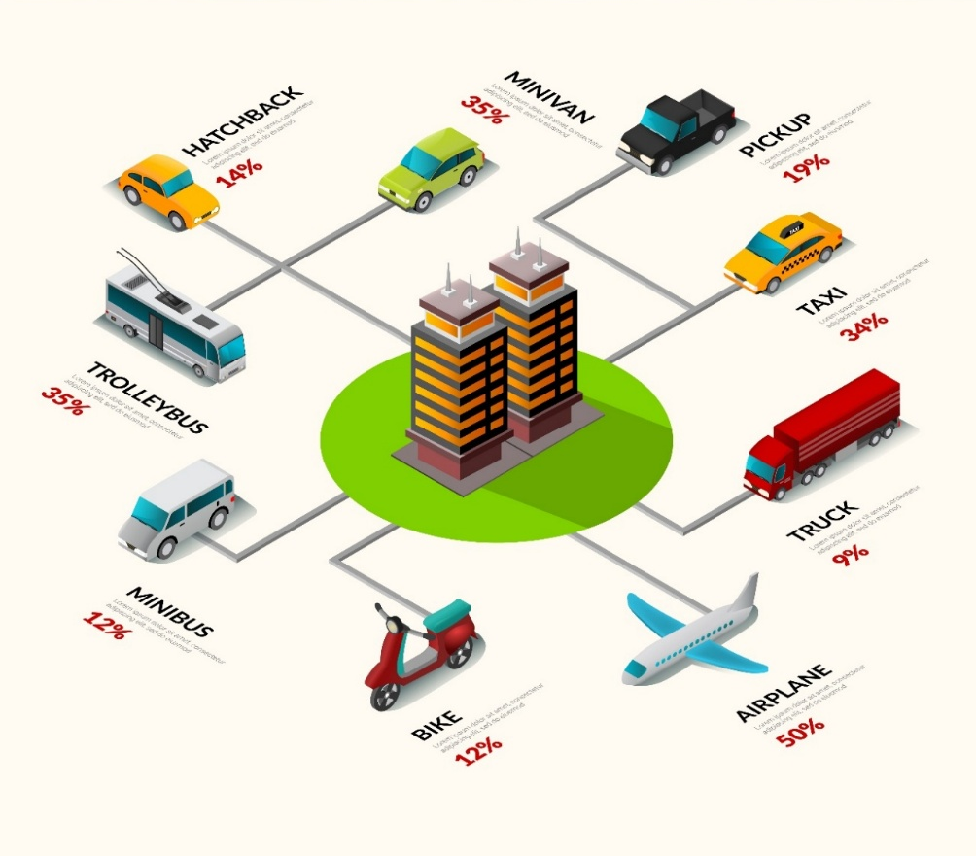
5. Public Transport Data
5.3 Sources of Public Transport Data
1. Automatic Fare Collection (AFC) Systems
💳 Examples: MetroCard (New York), Oyster Card (London), Octopus Card
🔹 Tracks passenger entry & exit points to analyze travel demand.
🔹 Helps optimize fare structures and detect fraud.
2. Passenger Surveys & Mobile Apps
📋 Surveys collect:
✔️ Passenger feedback on delays, comfort, and accessibility.
✔️ Travel patterns (ex: daily commuters vs occasional users).
3. GPS & Automatic Vehicle Location (AVL) Systems
📍 Installed on buses, trains, and metros to:
✔️ Track vehicle movements in real time.
✔️ Detect delays and unexpected disruptions.
✔️ Help passengers with real-time arrival updates.
Combining multiple data sources improves transport planning accuracy.

Slide 25
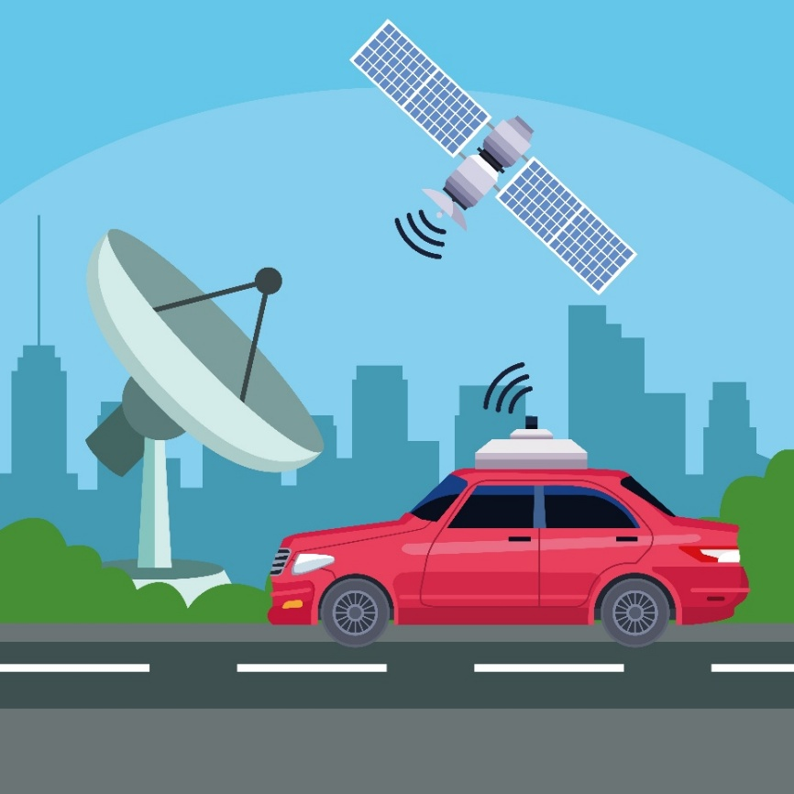
5. Public Transport Data
5.4 Applications of Public Transport Data
Service Optimization & Scheduling
🚌 Helps determine bus/train frequency based on passenger demand.
📅 Improves peak hour planning by deploying extra buses/trains.
2. Route Planning & Expansion
🌍 Identifies areas with low public transport coverage.
📊 Helps in planning new bus or metro routes for underserved regions.
3. Real-Time Passenger Information
📍 GPS-based tracking provides live updates on train/bus arrival times.
🔔 Reduces passenger frustration by minimizing uncertainty.
3. Improving Passenger Satisfaction
✔️ Helps reduce overcrowding by tracking passenger density.
✔️ Identifies frequent delays and suggests operational improvements.
Data-driven decisions create efficient and passenger-friendly public transport systems.

Slide 26
5. Public Transport Data
5.5.1 Case Study 1: How Cities Use Public Transport Data? 🚦
Example 1: London Underground (UK)
1️⃣ Smart Card Data (Oyster Cards) helps analyze daily passenger flows.
2️⃣ Live GPS tracking optimizes train frequency during peak hours.
3️⃣ Passenger feedback leads to station redesign & better signage.
The London Underground uses public transport data to keep one of the world’s busiest metro systems running smoothly.
Smart card data reveals how passengers move across the network, helping planners adjust services during peak times.
Real-time GPS data supports quick decisions about train frequency, while passenger feedback is used to improve station layouts and communication. Overall, data helps London reduce delays and create a more comfortable travel experience.

Slide 27
5. Public Transport Data
5.5.2 Case Study 2: How Cities Use Public Transport Data? 🚦
Example 2: Singapore’s Smart Transport System
1️⃣ AI-based bus dispatching predicts demand & prevents overcrowding.
2️⃣ Cashless fare collection speeds up boarding and reduces delays.
The London Underground uses public transport data to keep one of the world’s busiest metro systems running smoothly.
Smart card data reveals how passengers move across the network, helping planners adjust services during peak times.
Real-time GPS data supports quick decisions about train frequency, while passenger feedback is used to improve station layouts and communication. Overall, data helps London reduce delays and create a more comfortable travel experience.

Slide 28
Section 06:
Environmental Data
Notes:
# English
Now we are in Section 1: Overview and Tools.
Let’s quickly see what this lab is about and what tools we’ll use.
# French
Nous voici maintenant à la section 1 : Présentation et outils.
Voyons rapidement en quoi consiste cet atelier et quels outils nous utiliserons.

Slide 29
6. Environmental Data
6.1 What is Environmental Data?
        ✅ Environmental data refers to information collected on air quality, noise pollution, and energy consumption to understand the impact of transport systems on the environment.
        ✅ It helps in reducing pollution, promoting sustainability, and developing greener transport policies.
Why is it Important?
Identifies Areas with High Transport Demand
Why is it Important?
Supports Efficient Resource Allocation
        Understanding the demographic and socioeconomic characteristics of a population is essential for developing fair and efficient
        transport systems.
Enables Equity in Access
Facilitates Sustainable Urban Growth
Improves Environmental and Health Outcomes

Slide 30
6. Environmental Data
6.2 Types of Public Environmental Data
Type | Description | Use Case
Air Quality Data | Measures pollutants like CO₂, NOₓ, and particulate matter (PM). | Helps regulate emissions and implement low-emission zones.
Noise Pollution Data | Tracks traffic noise levels in urban and residential areas. | Used to plan noise barriers and improve urban planning.
Energy Consumption Data | Tracks fuel usage by vehicle type (diesel, petrol, electric). | Encourages fuel efficiency and electric vehicle adoption.
Greenhouse Gas (GHG) Data | Measures CO₂ emissions per transport mode. | Supports climate action strategies and carbon offsetting.
Water Quality Data | Monitors pollutants in water sources, including pH levels, heavy metals, and microbial contamination. | Helps ensure safe drinking water, protect ecosystems, and regulate industrial discharge.
Soil Quality Data | Measures contamination levels, nutrient content, and erosion rates in soil. | Supports sustainable agriculture, land use planning, and pollution control.
Biodiversity Data | Tracks species distribution, habitat health, and population trends of flora and fauna. | Aids in conservation efforts, wildlife protection, and ecosystem management.
Weather and Climate Data | Collects temperature, humidity, rainfall, and extreme weather events. | Used for climate modeling, disaster preparedness, and agricultural planning.
Tracking environmental data helps policymakers create cleaner, healthier cities.

Slide 31
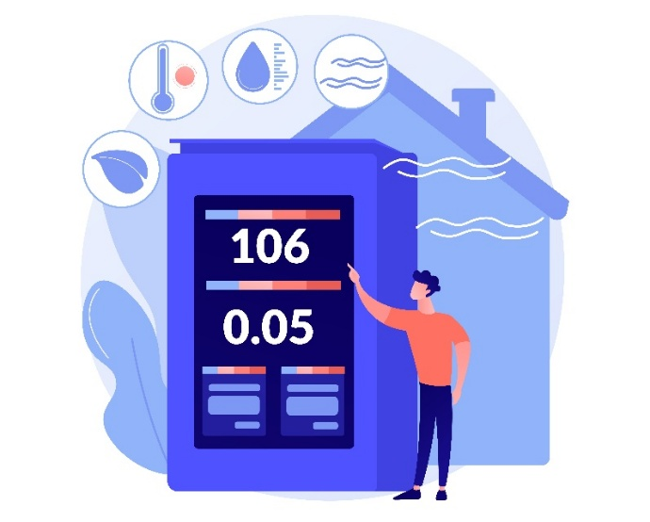
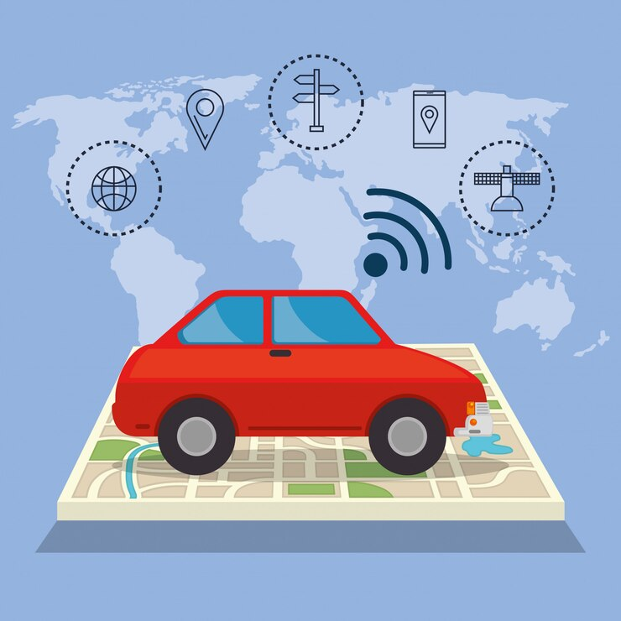
6. Environmental Data
6.3 Sources of Public Environmental Data
Environmental Sensors & Air Quality Monitors
📡 Installed in urban areas to:
✔️ Measure real-time air pollution levels (CO₂, NOₓ, PM).
✔️ Detect high-pollution areas near busy roads and industrial zones.
2. Emission Models & Vehicle Data
🚗 Uses fuel type and vehicle distance travelled to:
✔️ Estimate emissions from different vehicle categories (cars, trucks, buses).
✔️ Support government policies on low-emission zones and congestion charges.
3. Satellite & Aerial Imagery
🛰️ Used for large-scale environmental monitoring:
✔️ Tracks urban expansion, deforestation, and transport-related changes.
✔️ Identifies heat islands caused by excessive road traffic.
Combining multiple data sources provides accurate insights into transport
pollution.

Slide 32

6. Environmental Data
6.4 Applications of Environmental Data
Environmental Impact Assessments (EIA)
📊 Helps policymakers understand:
✔️ How new roads affect air quality and ecosystems.
✔️ Which areas need green corridors or pollution control measures.
2. Greener Transport Policies & Urban Planning
🌱 Supports:
✔️ Shifting to electric buses and trams to cut emissions.
✔️ Expanding bike lanes, pedestrian zones, and public transport networks.
3. Noise Reduction & Smart City Design
🔇 Helps in:
✔️ Installing noise barriers near highways and airports.
✔️ Zoning regulations to reduce traffic noise in residential areas.
Environmental data is critical for sustainable, livable cities.

Slide 33
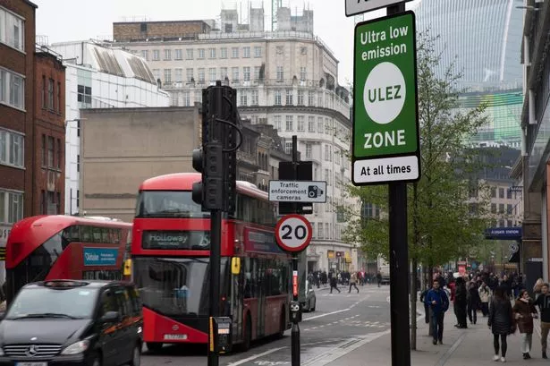
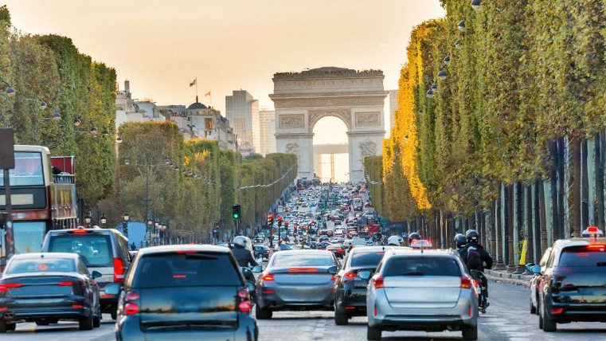
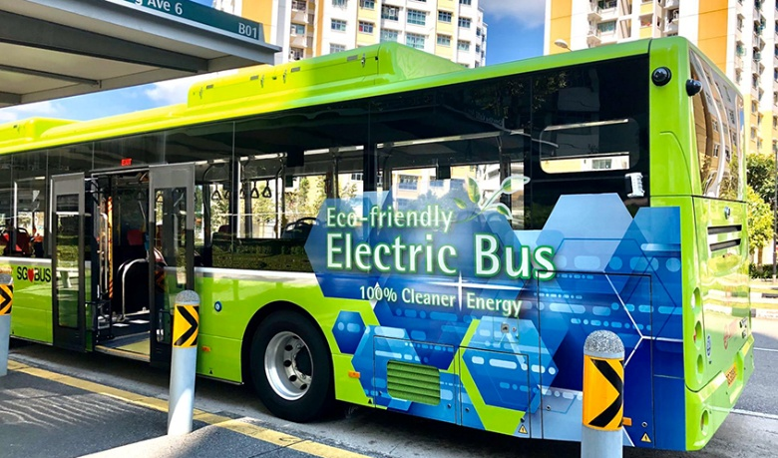
6. Environmental Data
6.5 Case Study: How Cities Use Environmental Data? 🚦
Ex 1: London’s Ultra Low Emission Zone (ULEZ)
1️⃣ Uses real-time air quality data to charge high-emission vehicles
entering the city.
2️⃣ Has reduced NO₂ pollution by 44% since implementation.
^{Paris}
^{London}
Ex 2: Paris Smart Noise Reduction Project
1️⃣ Monitors traffic noise and adjusts speed limits dynamically to
reduce noise pollution.
^{Singapore}
Ex 3: Singapore’s Green Transport Plan
1️⃣ Uses GPS & fuel data to encourage electric taxis & buses.
2️⃣ Has cut public transport emissions by 30% in 5 years.

Slide 34
Section 07:
Socioeconomic/Demographic Data
Notes:
# English
Now we are in Section 1: Overview and Tools.
Let’s quickly see what this lab is about and what tools we’ll use.
# French
Nous voici maintenant à la section 1 : Présentation et outils.
Voyons rapidement en quoi consiste cet atelier et quels outils nous utiliserons.

Slide 35

7. Socioeconomic/Demographic Data
7.1 What is Socioeconomic/Demographic Data?
✅ Socioeconomic data links transportation with population, income, and employment trends to design inclusive, efficient, and accessible mobility solutions.
✅ This information helps planners design accessible, equitable, and efficient transport systems.
Why is it Important?
✔️ Identifies areas with high transport demand.
✔️ Helps governments design affordable public transport.
✔️ Supports sustainable urban planning and investment.
Socioeconomic and demographic data help identify which communities need better transport services based on population, income, and employment trends. This supports fair and inclusive planning, ensuring public transport is affordable and accessible for all.

Slide 36
7. Socioeconomic/Demographic Data
7.2 Types of Socioeconomic Data
Type | Description | Use Case
Population Density | Number of people per square kilometer. | Determines where new transport services are needed.
Employment Rates | Percentage of the working-age population employed. | High employment areas need better transit access.
Income Levels | Tracks household income distribution. | Helps design affordable fare systems and subsidies.
Car Ownership Rates | Measures how many households own private vehicles. | Supports policies for car-free zones or public transport expansion.
Commuting Patterns | Analyzes how people travel for work and education. | Optimizes routes for efficiency and demand.
Age Distribution | Tracks the age demographics of a region. | Helps plan transport accessibility for elderly and students.
Education Levels | Measures the percentage of population with different education levels. | Supports planning of transport routes near schools and universities.
Household Size | Determines the average number of people per household. | Helps assess transport demand in high-density family areas.
Migration Patterns | Tracks population movement between cities and regions. | Assists in forecasting transport demand for growing urbans.
Disability & Accessibility Needs | Measures the percentage of people with disabilities requiring transport assistance. | Supports inclusive transport planning with ramps, low-floor buses, and elevators.
Different socioeconomic factors affect how people move and access transport.

Slide 37

7. Socioeconomic/Demographic Data
7.3 Sources of Socioeconomic Data
Census Data & Government Reports
📊 Official national data provides:
✔️ Population distribution, employment rates, and household income levels.
✔️ Long-term trends to predict future transport needs.
2. Household Travel Surveys
📝 Collects data on:
✔️ Daily commuting habits, preferred transport modes, and travel costs.
✔️ Helps policymakers design better transit routes and pricing models.
3. National Databases & Private Sector Data
📍 Tracks:
✔️ Public transit usage trends, economic shifts, and new job centers.
✔️ Used by planners to forecast future infrastructure needs.
Data from multiple sources helps create accurate mobility models.

Slide 38
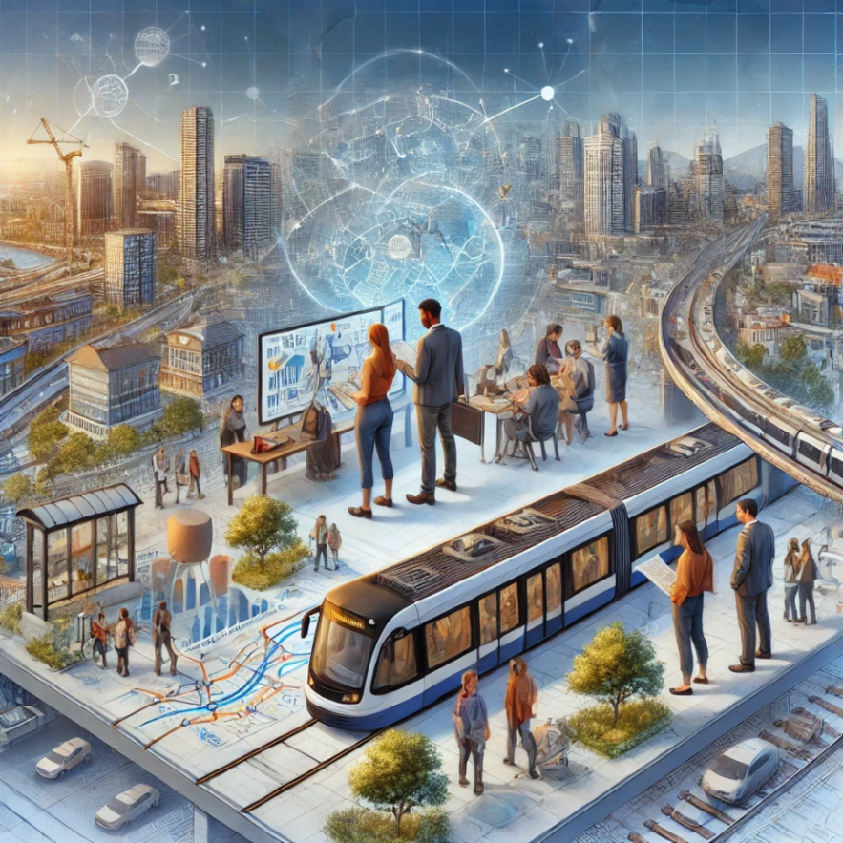
7. Socioeconomic/Demographic Data
7.4 Applications of Socioeconomic Data
Equity in Transport Planning
🌍 Ensures that:
✔️ Low-income areas have access to affordable transit.
✔️ Public transport investments are distributed fairly.
2. Forecasting Future Transport Demand
📈 Helps:
✔️ Identify high-growth areas needing future transit expansions.
✔️ Plan for sustainable urban mobility and smart city initiatives.
3. Noise Reduction & Smart City Design
💰 Supports:
✔️ Cost-benefit analysis of new transport projects.
✔️ Ensures investments are financially viable and beneficial for the public.
Socioeconomic data helps shape a fair, efficient, and future-ready transport system.

Slide 39
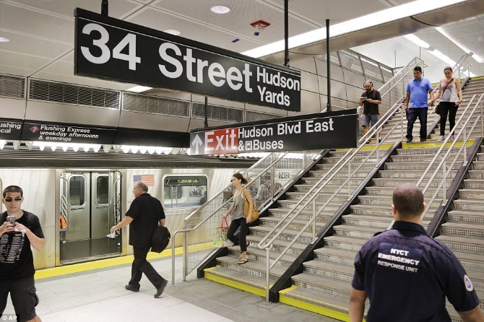
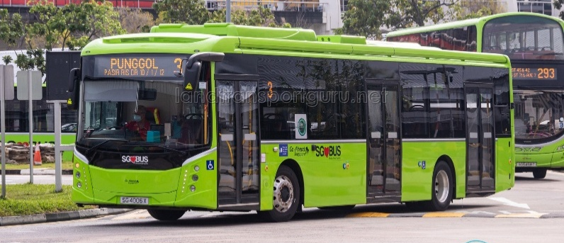
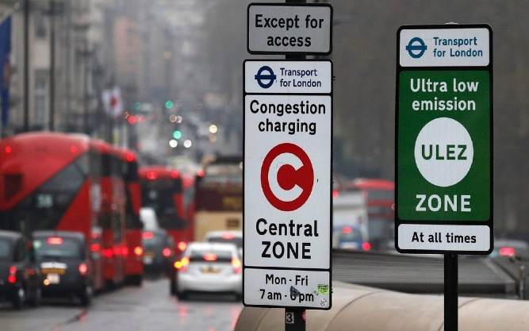
7. Socioeconomic/Demographic Data
7.5 Case Study: How Cities Use Socioeconomic Data? 🚦
Ex 1: New York City Subway Expansion
1️⃣ Used population density & income data to expand transit into underserved neighborhoods.
2️⃣ Result: Increased ridership & reduced commute times for low-income communities.
^{New York City Subway}
Ex 2: Singapore’s Smart Public Transport System
1️⃣ Real-time economic data helps adjust bus/train frequency based on workforce demand. It reduced overcrowding and improved efficiency.
^{Singapore}
Ex 3: London’s Congestion Pricing Policy
1️⃣ Uses car ownership & commuting data to implement congestion charges.
2️⃣ Result: More people shifted to public transport, reducing urban traffic.
^{London}

Slide 40
Section 08:
Quiz
Notes:
# English
Now we are in Section 1: Overview and Tools.
Let’s quickly see what this lab is about and what tools we’ll use.
# French
Nous voici maintenant à la section 1 : Présentation et outils.
Voyons rapidement en quoi consiste cet atelier et quels outils nous utiliserons.

Slide 41
8. Quiz
1. What is the primary purpose of transport data?
                To increase the number of vehicles on the road
                To improve decision-making, planning, and efficiency in transportation
                To make transportation more expensive
                To reduce the number of roads in a city
2. Which of the following is an example of raw transport data?
                A report summarizing monthly traffic congestion patterns
                A government policy document on transport planning
                GPS coordinates collected from vehicles at different time intervals
                A newspaper article about a new metro system
3. What is the key difference between data and information?
                Data is always more accurate than information
                Information is unprocessed, whereas data is structured
                Data is raw, while information is processed and meaningful
                Data and information are the same and can be used interchangeably

Slide 42
8. Quiz
4. Which of the following is NOT a common source of transport data?
                Traffic sensors and cameras
                Passenger surveys
                Stock market reports
                GPS tracking devices
5. Public transport data includes all of the following EXCEPT:
                Passenger ridership numbers
                Air quality measurements from vehicles
                Fare collection data
                Bus and train schedules
6. Which of the following is an example of environmental transport data?
                The number of passengers using a bus route daily
                The average noise level measured near a busy highway
                The time it takes for a train to travel between two stations
                The number of taxis operating in a city

Slide 43
8. Quiz
7. Why is socioeconomic data important in transport planning?
                It helps determine if transport services are accessible to different income groups
                It is only useful for calculating bus fares
                It has no relation to transport planning
                It is mainly used to control vehicle ownership
8. Which transport data source provides real-time tracking of vehicle movements?
                Household travel surveys
                Manual traffic counts
                GPS tracking systems
                Public transport ticket sales
9. What is a common application of traffic data?
                Designing movie theaters
                Adjusting traffic signals to improve flow
                Selling bus tickets at a lower price
                Increasing the number of taxis in rural areas

Slide 44
8. Quiz
10. Which of the following is a challenge in collecting transport data?
                Data collection methods are always 100% accurate
                Data can be incomplete, inconsistent, or biased
                Transport data is always available for free from all sources
                Transport data is only useful for road projects

Slide 45
Thank you for your attention!
Notes:
# English
Thanks for following along See you in the next session!

