Slide 1
Transport Research and Analysis
Module 2: Transport Data Collection and Management
Lecture 6: Data Collection Techniques
Notes:
"Good morning, everyone. Welcome to Lecture 6 in our module on Transport Data Collection and Management. My name is [Professor's Name], and today we will be diving into the foundational topic of Data Collection Techniques. This lecture is a cornerstone of our course, as the quality and relevance of any transport research or analysis hinge directly on the methods we use to gather our data. We will explore the core methodologies that professionals in the field use every day to understand how people and goods move through our transportation systems. We'll start with the fundamentals, move through the primary methods—surveys, sensors, and observation—and conclude with a look at how to choose the right tool for your research question. Let's begin."

Slide 3
Table of contents
Lecture 6: Data Collection Techniques
Section 00: Introduction & Objectives…….....................4
0.0. Agenda / Roadmap…................................................5
0.1. Core Concepts in Data Collection………...................6
0.2. Role of Transport Data in Transportation Systems....7
0.3. Foundational Ethical & Privacy Principles……….......8
0.4. Foundational Ethical & Privacy Principles……….......9
Section 01 Surveys ........................................................10
1.0. Introduction To Surveys .........................................11
1.1. Key Elements of Effective Survey Design…............12
1.2. Survey Collection Methods......................................13
1.3. Hybrid Methods.......................................................14
1.4. The Hybrid Strategy................................................15
1.5. Designing Effective Surveys ...................................16
1.6. Question Types.......................................................17
1.7. The Challenge of Sampling & Bias ……..................18
1.8. Mitigating Survey Bias ……….................................20
1.9. Digital Tools for Modern Surveys............................21
1.10. The Modern Survey Workflow.............................22
1.11. Case Study 1.......................................................23
1.12. Interactive Poll.....................................................24
1.13. Applications of Sensor & GPS Data……………...29
Section 02 Sensors and GPS Data Collection........... 25
2.0. Introduction to Sensor & GPS Data...................... 26
2.1. Sensors as a Data Sources…………………..…….27
2.2. How GPS Works for Transport Analysis............…28
2.3. Applications of Sensor & GPS Data…………….....29
2.4. The Core Challenge............. ……………………….30
2.5. Case Study 2: GIS-Based Bike Lane Monitoring...31
2.6. Advantages vs. Challenges...................................32
2.7. Future Trends in Sensor Technology.....................33
Section 03 Observational Techniques........................34
3.0. Introduction to Observational Methods…………....35
3.1. Structured vs. Unstructured Observation...............36
3.2. Participant vs. Naturalistic Observation………..….37

Slide 4
Table of contents
Lecture 6: Data Collection Techniques
3.3. Manual vs. Automated Observation........................38
3.4. The Observer Effect: Minimizing Bias.....................39
3.5. Case Study 3..........................................................40
3.6. Strengths vs. Limitations of Observation.................41
3.7. Interactive Observation Exercise............................42
3.8. Synthesis: Choosing the Right Tool........................44
Section 04: Conclusions and Key Takeaways.............45
4.0. The Data Cycle…....................................................46
4.1. Key Takeaways & Best Practices…........................47
4.2. Summary: Review of Core Methods……................48
4.3. Q&A and Discussion………....................................49
4.4. References & Further Reading………..………........50

Slide 5
Section 00:
Introduction & Objectives

Slide 6

00. Introduction & Objectives
0.0. Agenda / Roadmap.
Lecture Roadmap
Foundations of Data Collection: Core Concepts & Ethical Principles
Method 1: Surveys & Questionnaires: The Voice of the Traveler
Method 2: Sensor & GPS Data: The Digital Footprint
Method 3: Observational Techniques: Seeing Behavior in Action
Synthesis & Conclusion: Choosing the Right Approach
Notes:
"To give you a clear roadmap for our 135-minute session, here is our agenda. We will begin with the foundational principles that underpin all data collection—key concepts like reliability and validity, and the critical importance of ethical conduct. From there, we will systematically explore the three primary families of data collection techniques. First, we'll look at surveys and questionnaires, which allow us to directly ask people about their travel behaviors and preferences. Next, we’ll go into the world of sensor and GPS data, understanding how technology provides a passive but incredibly rich stream of information. After that, we'll cover observational techniques—the art and science of watching and recording behavior in its natural context. Finally, we will bring everything together in our synthesis, where we'll compare these methods and discuss how to select the most appropriate technique for your specific research goals. This structure will guide us from the 'why' to the 'how' of transport data collection."

Slide 7
00. Introduction & Objectives
0.1. Core Concepts in Data Collection
Reliability: The consistency of a measure.
  (Can you get the same result again?)
  Example: An automated traffic counter that consistently records the same traffic volume on a given day of the week is considered reliable.
Validity: The accuracy of a measure.
  (Are you measuring the right thing?)
  Example: A travel time survey is valid if it accurately captures the actual travel times experienced by commuters.
Bias: A systematic error that skews results.
  (Is your method flawed in one direction?)
  Example: A survey that only asks commuters who drive alone about their transportation preferences will likely be biased towards car-centric solutions.
Sampling: Selecting a representative part of the whole.
  (Does your small group reflect the large group?)
  Example: Randomly selecting households from a city's resident list to participate in a travel survey is a common sampling technique.
Notes:
Some core concepts in Data collection which are Reliability, Validity, Bias, and sampling.

Slide 8
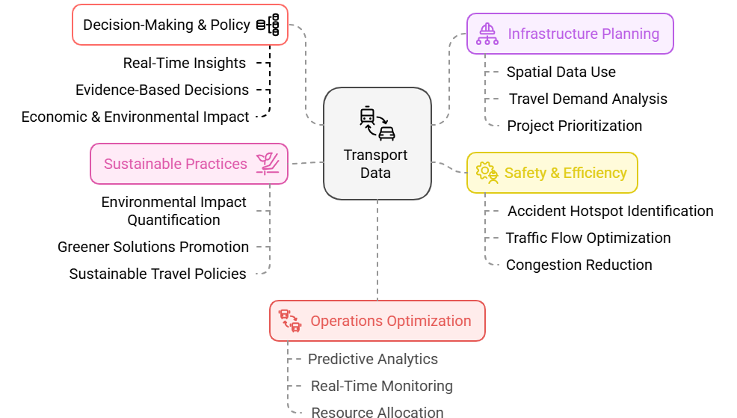
00. Introduction & Objectives
0.2. Role of Transport Data in Transportation Systems
Notes:
This slide covers the role of Transport Data in Transportation Systems. Data is crucial in transport systems as it provides detailed insights on all sections within the system.

Slide 9
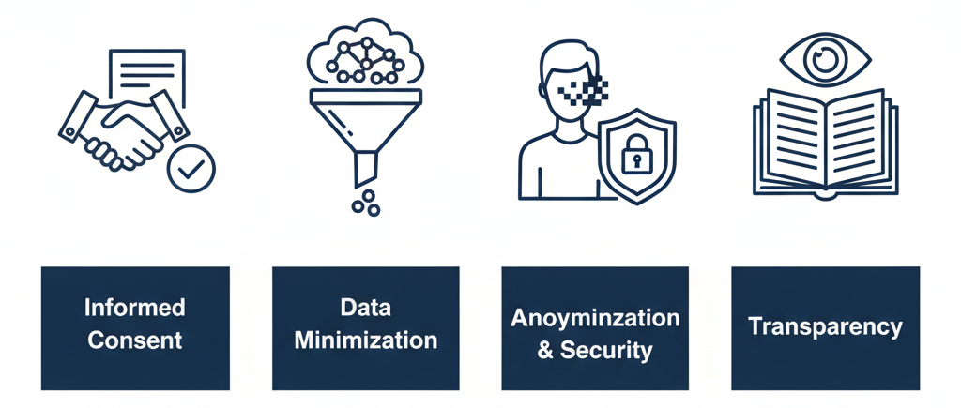
00. Introduction & Objectives
0.3. Foundational Ethical & Privacy Principles
Informed Consent: Participants must fully understand the study and explicitly agree to join. Permission must be clear, voluntary, and documented.
Data Minimization: Collect only the data that is essential to your research question. If you don't need it, don't ask for it.
Anonymization & Security: Actively remove or obscure all Personally Identifiable Information (PII). Data must be encrypted and securely stored to prevent breaches.
Transparency: Be completely open about how you collect, use, and protect data. This builds the public trust that is essential for research.
Notes:
"Equally important to the technical quality of our data are the ethical principles that guide our work. Responsible data collection is non-negotiable in our field, especially as we gain access to more detailed and personal information. Let's focus on four key principles.
First, Informed Consent. This means individuals must explicitly agree to participate before you collect any data from them. You must clearly explain what data you're collecting, how it will be used, and who will have access to it. It also means they have the right to withdraw their consent at any time.
Second, Data Minimization. This is the principle of 'less is more.' Only collect the data that is absolutely essential to answer your research question. Avoid the temptation to gather extra information 'just in case,' as every additional data point can increase privacy risks.
Third, Anonymization and Security. We have a duty to protect our participants. This involves removing or masking Personally Identifiable Information—like names, addresses, or exact GPS trails of homes—to prevent individual identification. Furthermore, the data must be stored securely using measures like encryption to prevent unauthorized access or breaches.
Finally, Transparency. Be clear and open with the public and your participants about your data practices. This builds trust and ensures accountability. As transport researchers, we are stewards of this data, and we must handle it with the utmost care and respect for individual privacy."

Slide 10
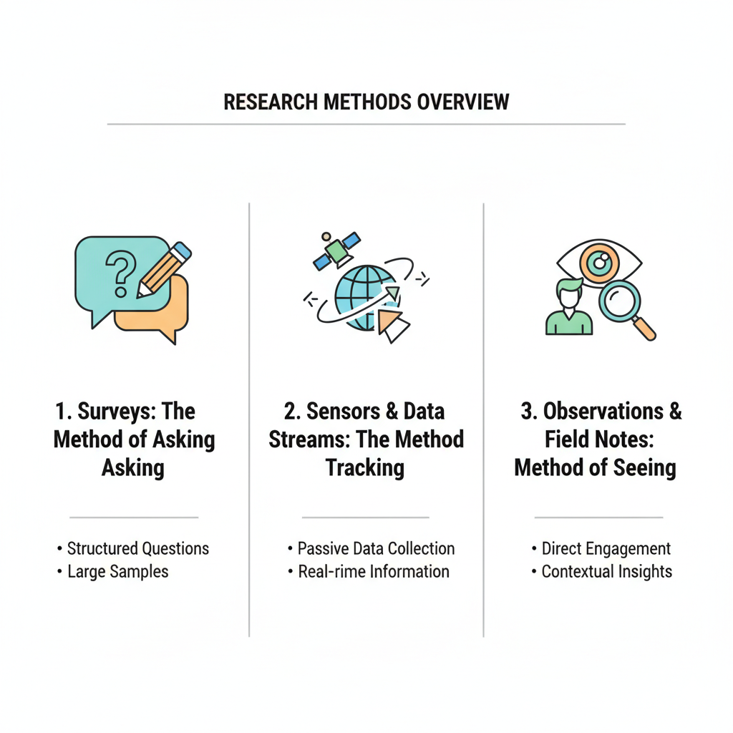
00. Introduction & Objectives
0.4. The Three Pillars of Data Collection
Surveys: The Method of Asking
  Directly questioning people about behaviors, opinions, and preferences.
  Primary goal: To understand the "why" behind travel choices.
Sensor & GPS: The Method of Measuring
  Passively collecting objective data on movement and system performance using technology.
  Primary goal: To understand the "what, where, and when" of travel.
Observational Methods: The Method of Watching
  Systematically observing and recording behaviors in their natural setting.
  Primary goal: To understand the "how" of interactions within the transport environment.
Notes:
"Now that we have our foundational principles in place, let's introduce the three main pillars of data collection in transport research. Almost every technique we use can be categorized into one of these three broad approaches.
The first is Surveys. This is the method of asking. We design questionnaires and interact directly with individuals to gather data on their travel patterns, choices, attitudes, and demographic characteristics. This is our primary way of understanding the 'why' behind people's travel decisions.
The second pillar is Sensor and GPS data. This is the method of measuring passively. Instead of asking, we use technology—like traffic loops, cameras, and GPS devices—to automatically collect vast amounts of data on vehicle speeds, traffic volumes, and individual travel paths. This gives us a highly detailed, objective picture of system performance and movement.
The third pillar is Observational Methods. This is the method of watching. Researchers directly observe and record behaviors as they happen in the real world—counting pedestrians at an intersection, noting interactions on a public bus, or analyzing traffic conflicts. This provides rich, contextual data that might be missed by surveys or sensors.
Each of these pillars has unique strengths and weaknesses, and often the most powerful research combines them. We will now spend the next part of our lecture exploring each one in detail, starting with surveys."

Slide 11
Section 01:
Surveys
Notes:
Section 01, Surveys

Slide 12
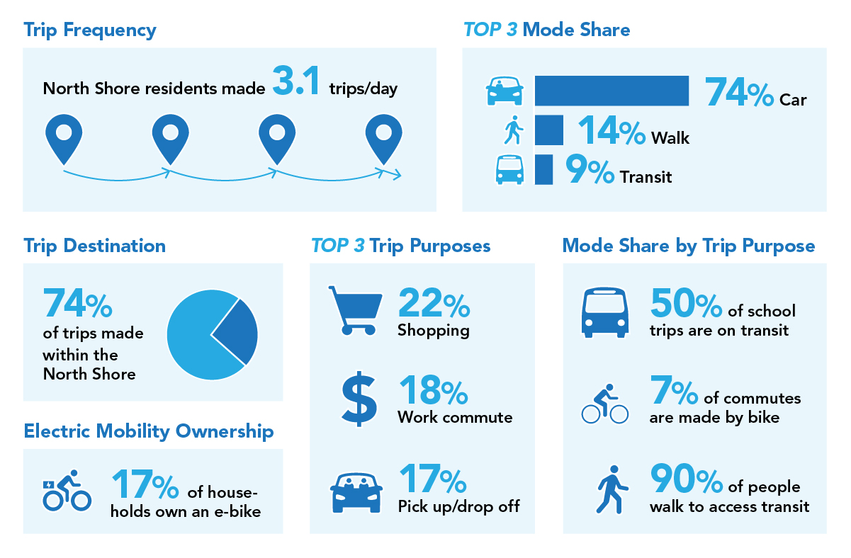
01. Surveys
1.0. Introduction to Surveys: Capturing Human Behavior
What is a Survey? A structured method for asking people questions.
Primary Goal: To directly collect data on behavior, attitudes, and personal characteristics.
In Transport, it Answers:
  Who is traveling?
  Where and when do they travel?
  How do they travel?
  Most importantly: Why?
Surveys
Notes:
"Let's begin with our first pillar: surveys. At their core, surveys are a systematic way of asking questions to a sample of a population to gather information. In transportation, they are indispensable because so much of what we need to know resides inside people's heads—their perceptions, their decision-making processes, and their future intentions.
As you can see from this example graphic, which summarizes findings from a community travel survey, we can learn a great deal. We can quantify travel behavior, such as the fact that North Shore residents in this study made an average of 3.1 trips per day. We can identify mode share—what percentage of people are driving, walking, or taking transit. And we can understand trip purpose—what percentage of trips are for work versus shopping. Surveys provide both quantitative data and the valuable qualitative context needed to interpret that data. They are our window into the human element of transportation."

Slide 13
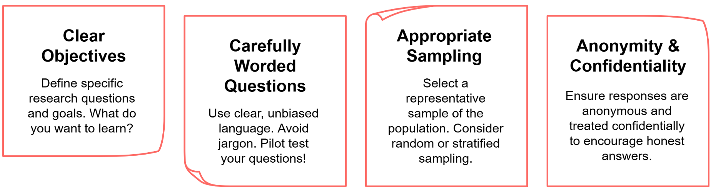
01. Surveys
1.1. Key Elements of Effective Survey Design

Slide 14
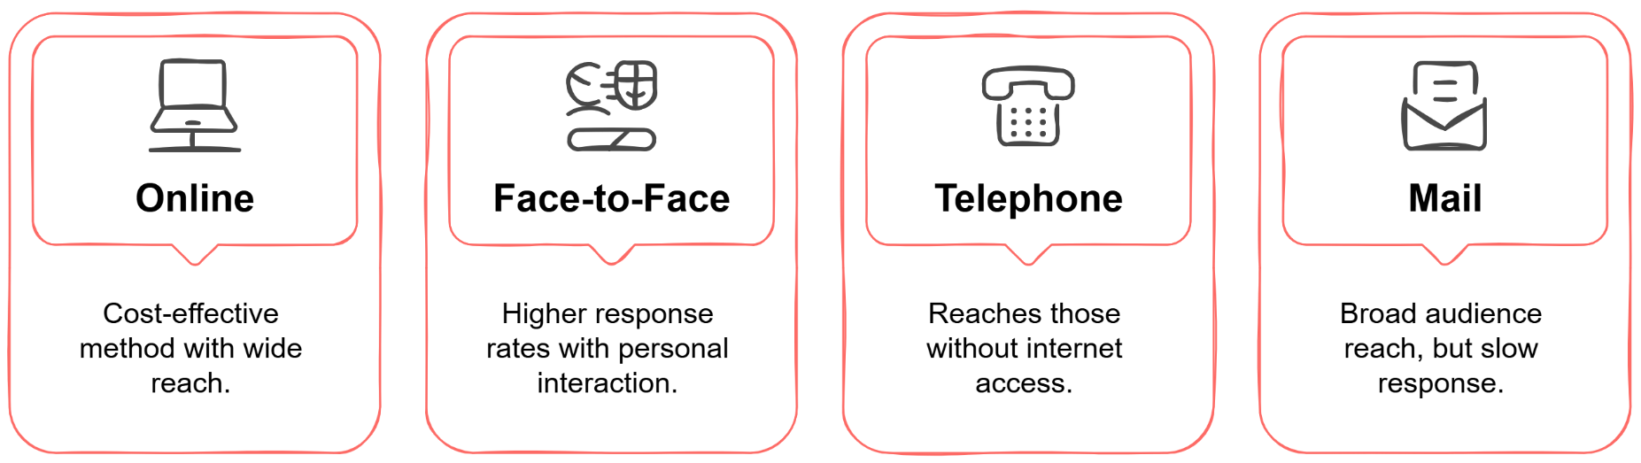
01. Surveys
1.2. Survey Collection Methods
Notes:
"There are several different ways, or 'modes,' to administer a survey, and the method you choose will have significant implications for your budget, timeline, and data quality. Let’s compare the most common ones.
Face-to-face surveys, like intercept surveys at a transit station, often yield the highest quality data. You get high response rates because it's harder to refuse someone in person, and the interviewer can explain complex or confusing questions. However, this is by far the most expensive and time-consuming method, and the interviewer's own characteristics can inadvertently bias responses.
Online surveys have become incredibly popular because they are cost-effective and can reach a vast, geographically dispersed audience very quickly. Data entry is automatic, which reduces errors. The major drawbacks are typically lower response rates and a significant sampling bias, as they systematically exclude older populations, lower-income groups, and rural residents who may lack reliable internet access.
Telephone surveys were once a gold standard but are now facing challenges. While they can still reach households without internet, response rates have plummeted due to caller ID and general public reluctance to answer calls from unknown numbers.
Finally, traditional Mail surveys have the advantage of being able to reach almost any household with a physical address. However, they are known for having very low response rates and a slow turnaround time.
The choice of method is a trade-off between cost, reach, and the potential for bias. As we'll see next, sometimes the best approach is to combine them."

Slide 15
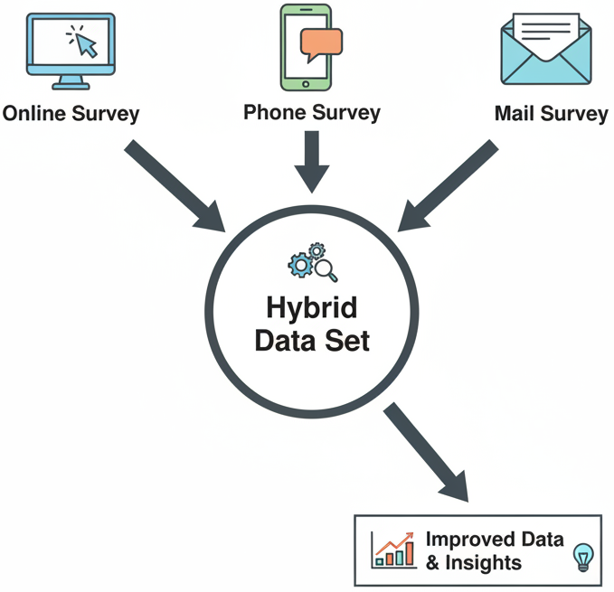
01. Surveys
1.3. Hybrid Methods: The Best of Both Worlds
Definition: Strategically combining multiple survey modes in a single study to maximize data quality and reach diverse populations.
Key Advantages:
  Improved Coverage: Reach a broader demographic by offering different participation options.
  Enhanced Response Rates: Follow up with non-responders using an alternative method.
  Increased Data Quality: Cross-validate data by leveraging the strengths of different modes.
Example: Start with a cost-effective online survey, then conduct in-person interviews with key demographic groups that were underrepresented in the online responses.
Notes:
"Recognizing that every single survey mode has inherent weaknesses, researchers often turn to hybrid methods, also known as mixed-mode surveys. The strategy is simple but powerful: combine different survey approaches within a single study to leverage their individual strengths and compensate for their weaknesses.
The primary advantage is improved coverage. An online survey might be great for reaching younger, tech-savvy urban residents, but a follow-up mail or telephone survey can ensure you also capture the perspectives of older or more rural populations.
This approach can also significantly enhance response rates. For instance, you might send an initial invitation by mail, which includes a link to an online survey, but also provides a phone number for those who prefer that mode. You can then use telephone calls to follow up specifically with those who haven't responded.
Ultimately, this leads to increased data quality. The example here is a common and highly effective strategy: you cast a wide, inexpensive net with an online survey to gather a large base of data. You then analyze the demographics of your respondents and identify which groups are underrepresented. Finally, you conduct targeted, in-person interviews—which are expensive but yield rich data—specifically within those underrepresented groups to balance your sample and enrich your findings. This thoughtful, multi-pronged approach is often the gold standard in modern survey research."

Slide 16
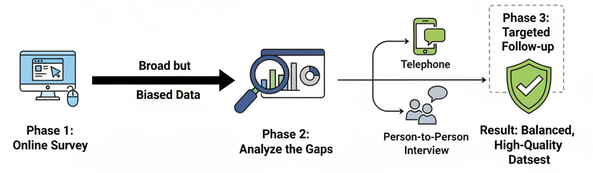
01. Surveys
1.4. The Hybrid Strategy
Notes:
"Recognizing that every single survey mode has inherent weaknesses, researchers often turn to hybrid methods, also known as mixed-mode surveys. The strategy is simple but powerful: combine different survey approaches within a single study to leverage their individual strengths and compensate for their weaknesses.
The primary advantage is improved coverage. An online survey might be great for reaching younger, tech-savvy urban residents, but a follow-up mail or telephone survey can ensure you also capture the perspectives of older or more rural populations.
This approach can also significantly enhance response rates. For instance, you might send an initial invitation by mail, which includes a link to an online survey, but also provides a phone number for those who prefer that mode. You can then use telephone calls to follow up specifically with those who haven't responded.
Ultimately, this leads to increased data quality. The example here is a common and highly effective strategy: you cast a wide, inexpensive net with an online survey to gather a large base of data. You then analyze the demographics of your respondents and identify which groups are underrepresented. Finally, you conduct targeted, in-person interviews—which are expensive but yield rich data—specifically within those underrepresented groups to balance your sample and enrich your findings. This thoughtful, multi-pronged approach is often the gold standard in modern survey research."

Slide 17
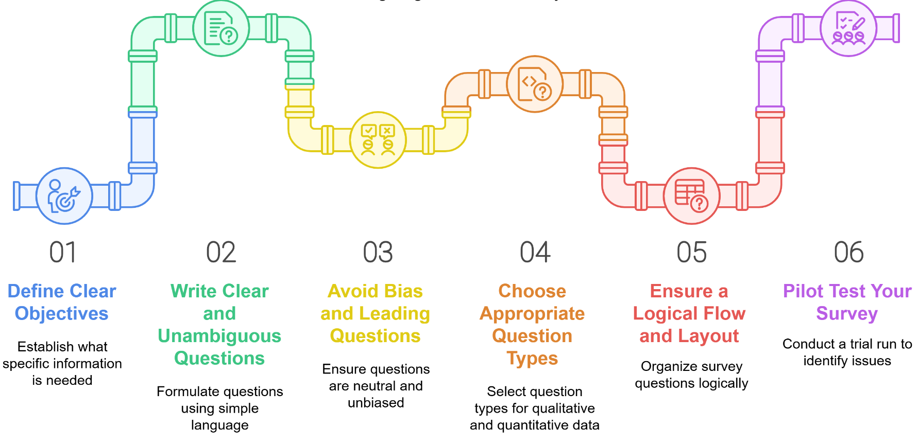
01. Surveys
1.5. Designing Effective Surveys: A 6-Step Process
Notes:
"The quality of your survey data is determined long before you ever send it out; it's determined in the design phase. A well-designed survey is crucial for collecting accurate and reliable data. We can think of this as a six-step process, as illustrated by this pipeline graphic.
Step 1: Define Clear Objectives. Before you write a single question, you must know exactly what you are trying to learn. What specific information is needed?
Step 2: Write Clear Questions. Use simple, unambiguous language. Avoid jargon and acronyms. If a question can be misinterpreted, it will be.
Step 3: Avoid Bias. Ensure your questions are neutral and do not lead the respondent to a particular answer. For example, instead of asking 'Don't you agree that we need more funding for bike lanes?', ask 'How would you prioritize funding for different transportation modes in the city?'
Step 4: Choose Appropriate Question Types. As we'll see on the next slide, you need to decide when to use open-ended questions for detailed insights versus closed-ended questions for quantitative data.
Step 5: Ensure Logical Flow. Organize your questions logically. Start with easy, general questions and move to more specific or sensitive ones later.
Step 6: Pilot Test! This is the single most critical step that is often skipped. Before a full launch, test your survey on a small group. This will help you identify confusing questions, estimate the completion time, and fix any technical glitches. Never skip the pilot test."

Slide 18
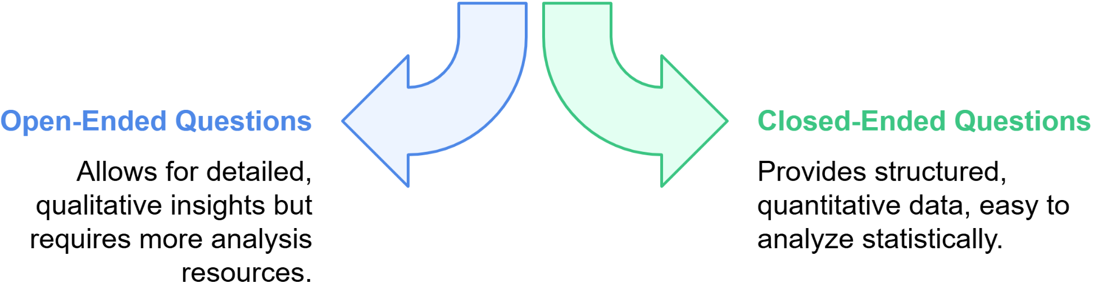
01. Surveys
1.6. Question Types: Open-Ended vs. Closed-Ended
Open-Ended: The "Why"
  Purpose: To explore and discover.
  Format: Asks for a response in the respondent's own words.
  Example: "What could we do to improve your experience at this train station?"
  Data: Rich, qualitative, and unexpected insights.
  Challenge: Time-consuming to analyze.
Closed-Ended: The "How Many"
  Purpose: To measure and quantify.
  Format: Provides a fixed set of answers to choose from.
  Example: "Rate the cleanliness of this train station: (Excellent / Good / Fair / Poor)"
  Data: Clean, quantitative, and easy to chart.
  Challenge: May miss important context or nuance.
Notes:
"When designing your survey, a key decision is choosing between open-ended and closed-ended questions.
Open-ended questions, like the example 'What are the biggest challenges you face during your daily commute?', invite respondents to answer in their own words. They are excellent for exploratory research and for capturing rich, detailed qualitative insights you might not have anticipated. You can uncover the 'why' behind behaviors. The downside is that the analysis is time-consuming, as it requires you to read, categorize, and code the responses thematically.
Closed-ended questions, on the other hand, provide respondents with a pre-defined set of answers to choose from. This includes multiple-choice questions, rating scales, or simple yes/no options. As you can see in the example, the response options are already structured. This makes the data quantitative and very easy to analyze. You can quickly calculate frequencies and averages. The drawback is that you limit the responses and may miss important nuances.
A good survey often uses a combination of both. You might use closed-ended questions to gather core quantitative data and then include an optional open-ended question at the end, such as 'Is there anything else you would like to tell us?', to capture any additional insights."

Slide 19
01. Surveys
1.7. The Challenge of Sampling & Bias
The Goal: A Perfect Miniature
Your small group (the sample) must be a mirror image of the large group (the population).
Two Ways the Mirror Cracks:
Selection Bias (The Who You Ask Problem)
  Your method for choosing people systematically misses entire groups.
  Example: A survey about delivery truck access conducted only between 10 AM and 2 PM misses all the pre-dawn and evening delivery drivers.
Non-Response Bias (The Who Answers Problem)
  The people who complete your survey are fundamentally different from those who don't.
  Example: In a survey about a new train line, only those who strongly support it or vehemently oppose it bother to respond, while the neutral majority stays silent.
Notes:
"We've discussed designing good questions, but who we ask is just as important. Since we can't survey an entire city or country, we rely on sampling. The goal is to select a smaller group that accurately mirrors the characteristics of the larger population. If our sample is not representative, our findings will be skewed, a problem we call bias.
Let's look at two critical types of bias. First, Selection Bias. This happens during the design phase, when our method of choosing participants systematically leaves out parts of our population. The classic modern example is an online survey. By its very nature, it excludes older adults, low-income individuals, or rural residents who are less likely to have reliable internet access. Our sample is biased from the very beginning.
Second is Non-Response Bias. This occurs after we've sent the survey out. It's the systematic difference between those who choose to respond and those who don't. A common example in our field is that people with very strong opinions—either extremely positive or, more often, extremely negative—are more likely to respond. For instance, in a transit satisfaction survey, moderately content passengers might ignore it, while only the happiest or most frustrated respond, leading to a polarized and inaccurate picture of overall satisfaction. Addressing both of these biases is essential for the validity of any survey research."

Slide 20
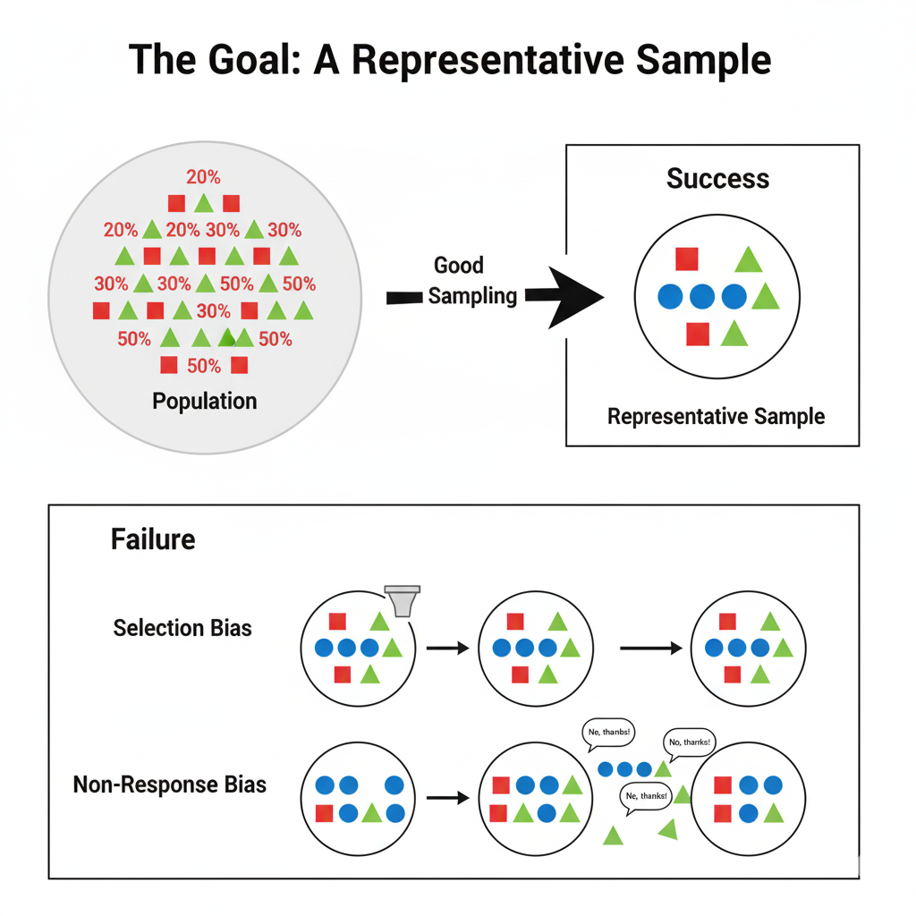
01. Surveys
1.8. The Challenge of Sampling & Bias
Notes:
"We've discussed designing good questions, but who we ask is just as important. Since we can't survey an entire city or country, we rely on sampling. The goal is to select a smaller group that accurately mirrors the characteristics of the larger population. If our sample is not representative, our findings will be skewed, a problem we call bias.
Let's look at two critical types of bias. First, Selection Bias. This happens during the design phase, when our method of choosing participants systematically leaves out parts of our population. The classic modern example is an online survey. By its very nature, it excludes older adults, low-income individuals, or rural residents who are less likely to have reliable internet access. Our sample is biased from the very beginning.
Second is Non-Response Bias. This occurs after we've sent the survey out. It's the systematic difference between those who choose to respond and those who don't. A common example in our field is that people with very strong opinions—either extremely positive or, more often, extremely negative—are more likely to respond. For instance, in a transit satisfaction survey, moderately content passengers might ignore it, while only the happiest or most frustrated respond, leading to a polarized and inaccurate picture of overall satisfaction. Addressing both of these biases is essential for the validity of any survey research."

Slide 21
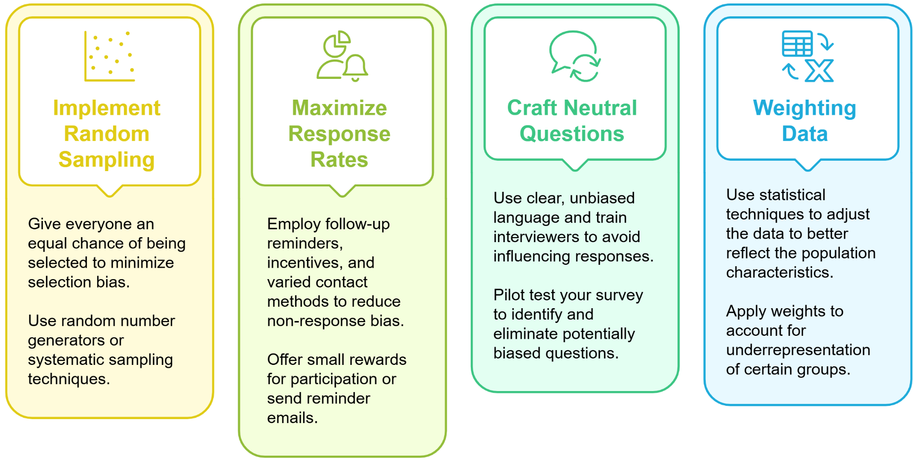
01. Surveys
1.9. Mitigating Survey Bias: Key Strategies
Notes:
"Understanding bias is only half the battle. We must actively employ strategies to minimize it. Here are four of the most effective techniques.
First, Implement Random Sampling. This is the cornerstone of unbiased research. A true random sample ensures that every single person in your target population has an equal chance of being selected. This is our best defense against selection bias.
Second, Maximize Response Rates. To combat non-response bias, we need to encourage as many people as possible from our initial sample to participate. Proven methods include sending follow-up reminders, offering small incentives like a gift card or entry into a prize drawing, and using a hybrid approach with multiple contact methods.
Third, as we've discussed, Craft Neutral Questions. This mitigates response bias, where the wording of a question itself pushes respondents toward a certain answer.
Finally, even with the best methods, a sample may not perfectly match the population. We can use a powerful statistical technique called Weighting. After we collect the data, we compare our sample's demographics—say, age and gender distribution—to known population data from a census. If our sample has, for example, too few young people, we can assign a slightly higher 'weight' to the responses from the young people we did survey. This adjustment helps our final results better reflect the true population, correcting for minor sampling or non-response issues."

Slide 22








01. Surveys
1.10. Digital Tools for Modern Surveys
Notes:
"Fortunately, we have a wide array of powerful digital tools to help us execute these survey methods. It's useful to think of them in three categories based on their function.
For Survey Design and Distribution, platforms like Google Forms and SurveyMonkey are excellent for creating and distributing simple to moderately complex surveys quickly. For more advanced academic or commercial research that requires complex logic, branching, and randomization, a platform like Qualtrics is the industry standard.
For Data Collection in the Field, especially for face-to-face interviews, we need tools that can work offline and sync data later. Open Data Kit, or ODK, is an open-source tool that is fantastic for this, particularly in resource-constrained environments. REDCap is another secure platform commonly used in academic and clinical research for managing online surveys and databases.
Finally, once the data is collected, it needs to be analyzed. Data Analysis and Visualization tools are crucial. SPSS is a powerful, user-friendly statistical software package. R is a free, open-source programming language that has become the standard for statistical computing and graphics among researchers. And a tool like Tableau allows you to create interactive dashboards and compelling visualizations to communicate your findings effectively. As you progress in your careers, you will almost certainly work with some or all of these platforms."

Slide 23
01. Surveys
1.11. The Modern Survey Workflow: From Question to Insight
Step 1: Build & Deploy
(Tools for creating and distributing your survey)
Step 2: Collect in the Field
(Tools for face-to-face interviews, often offline)
Step 3: Analyze & Visualize
(Tools for finding and communicating the story in your data)
Notes:
"Fortunately, we have a wide array of powerful digital tools to help us execute these survey methods. It's useful to think of them in three categories based on their function.
For Survey Design and Distribution, platforms like Google Forms and SurveyMonkey are excellent for creating and distributing simple to moderately complex surveys quickly. For more advanced academic or commercial research that requires complex logic, branching, and randomization, a platform like Qualtrics is the industry standard.
For Data Collection in the Field, especially for face-to-face interviews, we need tools that can work offline and sync data later. Open Data Kit, or ODK, is an open-source tool that is fantastic for this, particularly in resource-constrained environments. REDCap is another secure platform commonly used in academic and clinical research for managing online surveys and databases.
Finally, once the data is collected, it needs to be analyzed. Data Analysis and Visualization tools are crucial. SPSS is a powerful, user-friendly statistical software package. R is a free, open-source programming language that has become the standard for statistical computing and graphics among researchers. And a tool like Tableau allows you to create interactive dashboards and compelling visualizations to communicate your findings effectively. As you progress in your careers, you will almost certainly work with some or all of these platforms."

Slide 24
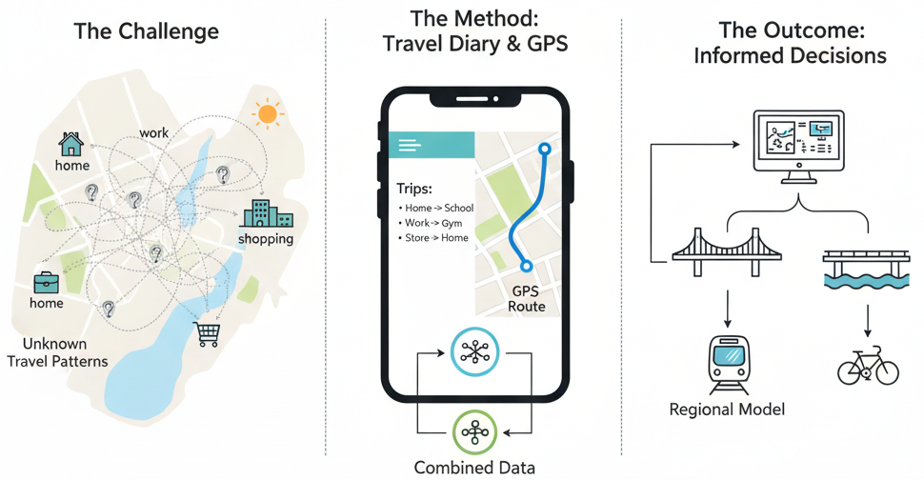
01. Surveys
1.12. Case Study 1: The Household Travel Survey (HTS)
Putting It All Together: The Household Travel Survey (HTS)
The Challenge:
  How does an entire region really travel? Every trip, every mode, every purpose. This data drives multi-billion dollar planning decisions.
The Method:
  The Diary (The "Why"): Participants self-report their trips, purpose, and mode choice.
  The GPS (The "Where"): Passive smartphone tracking provides objective, precise route and time data.
The Outcome:
  The "Digital Twin" of Regional Travel. This foundational dataset powers the computer models used to test every major infrastructure project and policy decision.
Notes:
"Let's ground this theory in a real-world example: the Household Travel Survey, or HTS. This is one of the most important tools in transportation planning.
The Challenge for any major metropolitan area is knowing how, when, where, and why its residents travel. Without this detailed data, it's impossible to make informed decisions about where to invest billions of dollars in infrastructure.
The Method to address this is a massive undertaking. The HTS is a perfect example of a hybrid approach. A random sample of households is recruited. They are asked to keep a travel diary for a specific period, often a week, where they record all the trips they make, their purpose—work, school, shopping—and the mode they used. To validate and enrich this self-reported data, participants also use a smartphone app or a dedicated device that passively tracks their GPS location. This combines the 'why' from the diary with the objective 'what and where' from the GPS.
The Outcome of this intensive process is the gold-standard dataset for regional transport planning. This data feeds the complex models that forecast future traffic demand, evaluate the potential impact of new transit lines, and guide policy on everything from congestion pricing to land use."

Slide 25
01. Surveys
1.13. Interactive Poll: Survey Application
Let's Apply This!
Scenario: You need to evaluate the success of a new protected bike lane.
Question: Which survey method would you prioritize to get the most valuable feedback?
  Online survey sent to all city residents.
  Face-to-face intercept surveys on the bike lane.
  Mail survey to households in adjacent neighborhoods.
  A hybrid approach combining B and C.
Go to [mentimeter.com] and use code [XXXX XXXX]
(A QR code linking directly to the poll should be displayed.)
QR Code Here
Notes:
"Let's ground this theory in a real-world example: the Household Travel Survey, or HTS. This is one of the most important tools in transportation planning.
The Challenge for any major metropolitan area is knowing how, when, where, and why its residents travel. Without this detailed data, it's impossible to make informed decisions about where to invest billions of dollars in infrastructure.
The Method to address this is a massive undertaking. The HTS is a perfect example of a hybrid approach. A random sample of households is recruited. They are asked to keep a travel diary for a specific period, often a week, where they record all the trips they make, their purpose—work, school, shopping—and the mode they used. To validate and enrich this self-reported data, participants also use a smartphone app or a dedicated device that passively tracks their GPS location. This combines the 'why' from the diary with the objective 'what and where' from the GPS.
The Outcome of this intensive process is the gold-standard dataset for regional transport planning. This data feeds the complex models that forecast future traffic demand, evaluate the potential impact of new transit lines, and guide policy on everything from congestion pricing to land use."

Slide 26
Section 02:
Sensors and GPS Data Collection
Notes:
Section 2, Sensors and GPS data Collection

Slide 27
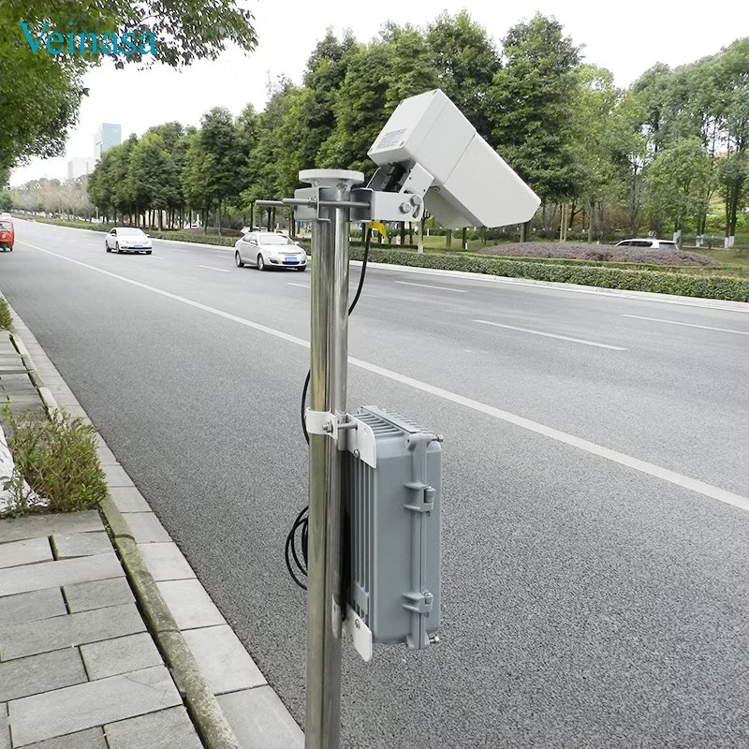
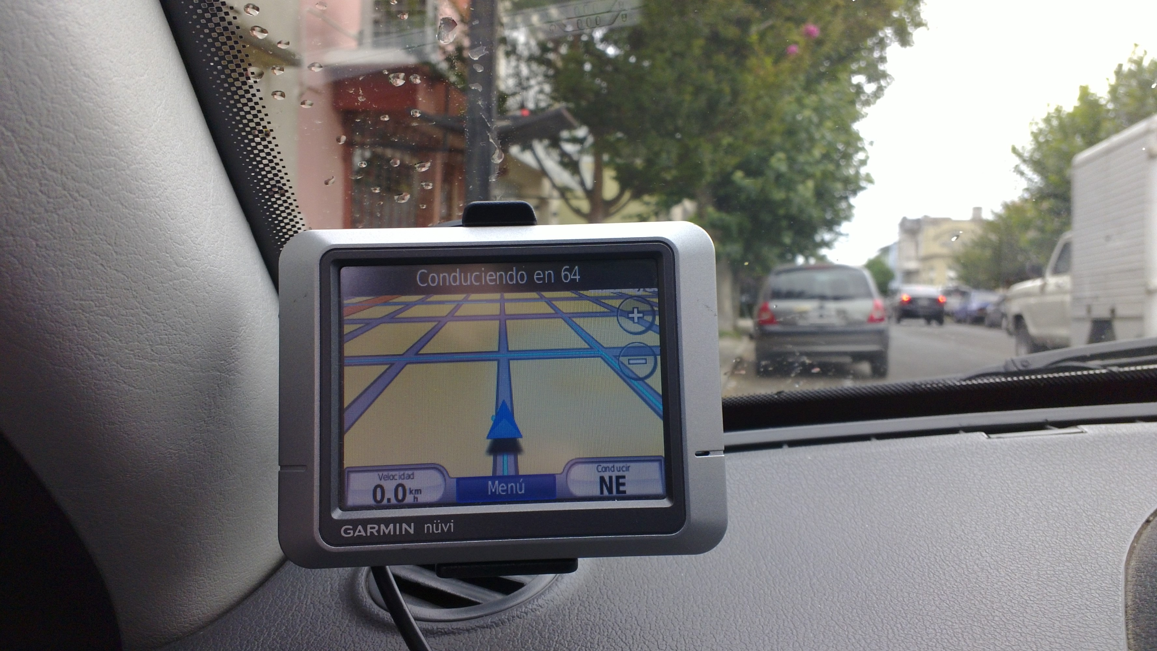
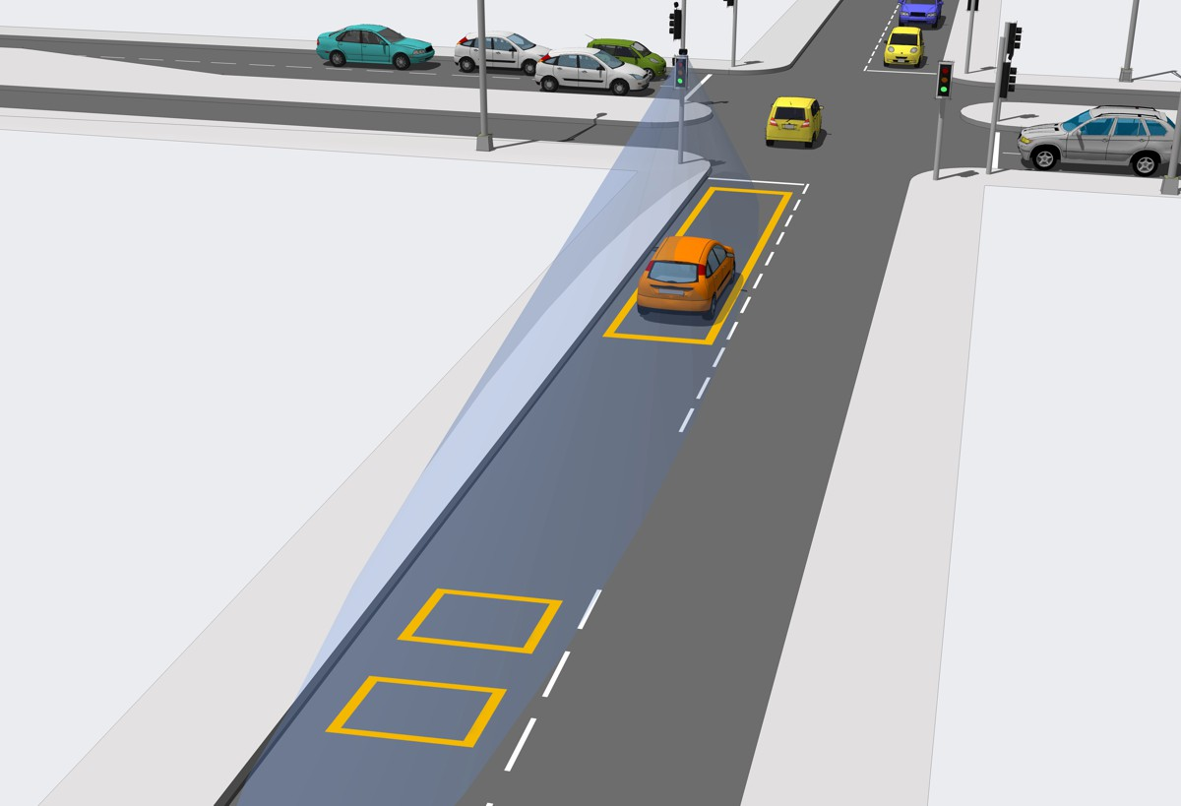
02. Sensors and GPS Data Collection
2.0. Introduction to Sensor & GPS Data
A Shift from Reported to Measured Behavior
The Shift: We stop asking people what they did. We measure it directly.
What is it? Passive, automated technology that captures high-resolution data on movement and performance in real-time.
Two Core Sources:
  The Infrastructure: Sensors embedded in the system.
  (Loop Detectors, Traffic Cameras, Radar)
  The User: Sensors carried by the traveler.
  (Vehicle GPS, Smartphones)
Traffic Cameras
loop detectors
GPS receivers
Notes:
"We now move to our second pillar of data collection, which represents a fundamental shift in perspective. While surveys rely on what people report they did, sensor and GPS data capture what they actually did. This is the world of measured, objective behavior.
We define this category as the set of technologies that passively and automatically collect vast amounts of high-resolution data. This data can be about the transportation system itself—like traffic volumes and speeds—or about the users moving through it.
The sources are diverse. We have fixed, roadside sensors like the loop detectors embedded in pavement, advanced traffic cameras, and radar units that monitor flow. And increasingly, the source is in-vehicle or personal devices—the dedicated GPS units in fleet vehicles and, most importantly, the powerful, sensor-packed smartphones that billions of people carry with them every day. This flood of data has given us an unprecedented, real-time view into the dynamics of our transportation networks."

Slide 28
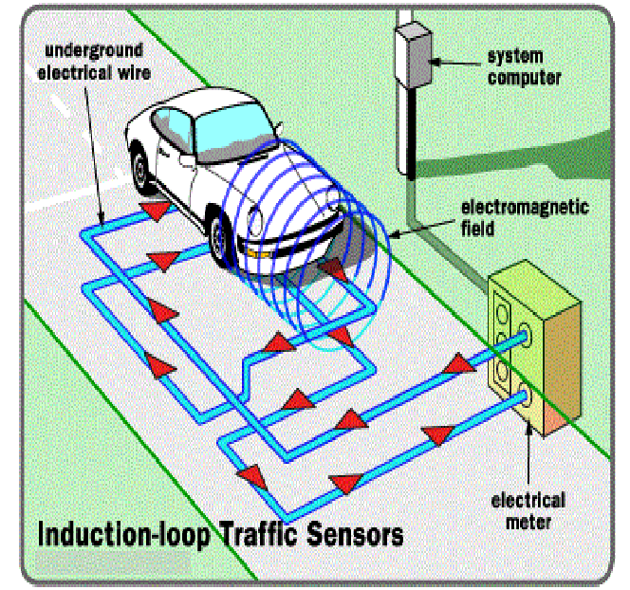
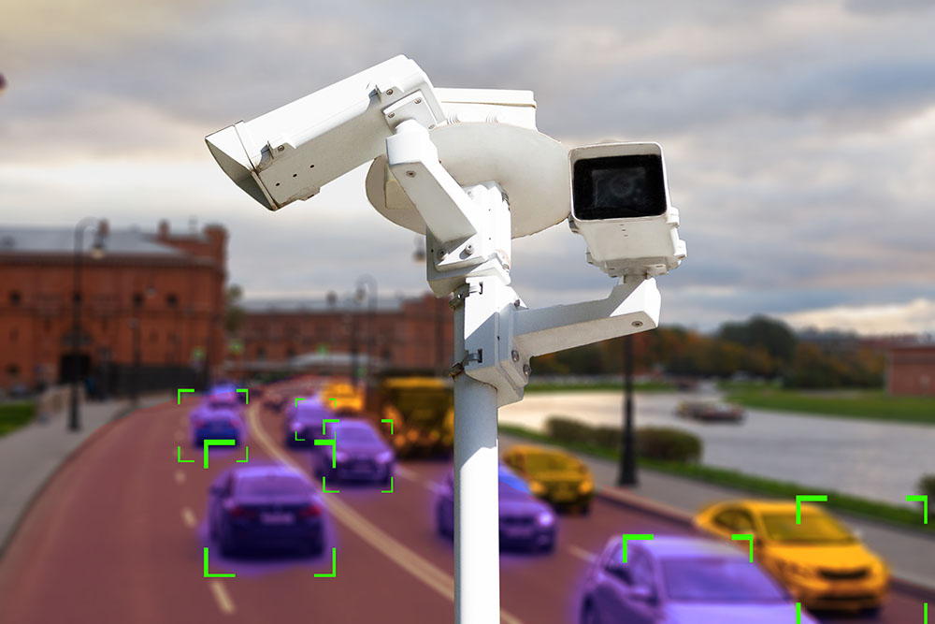
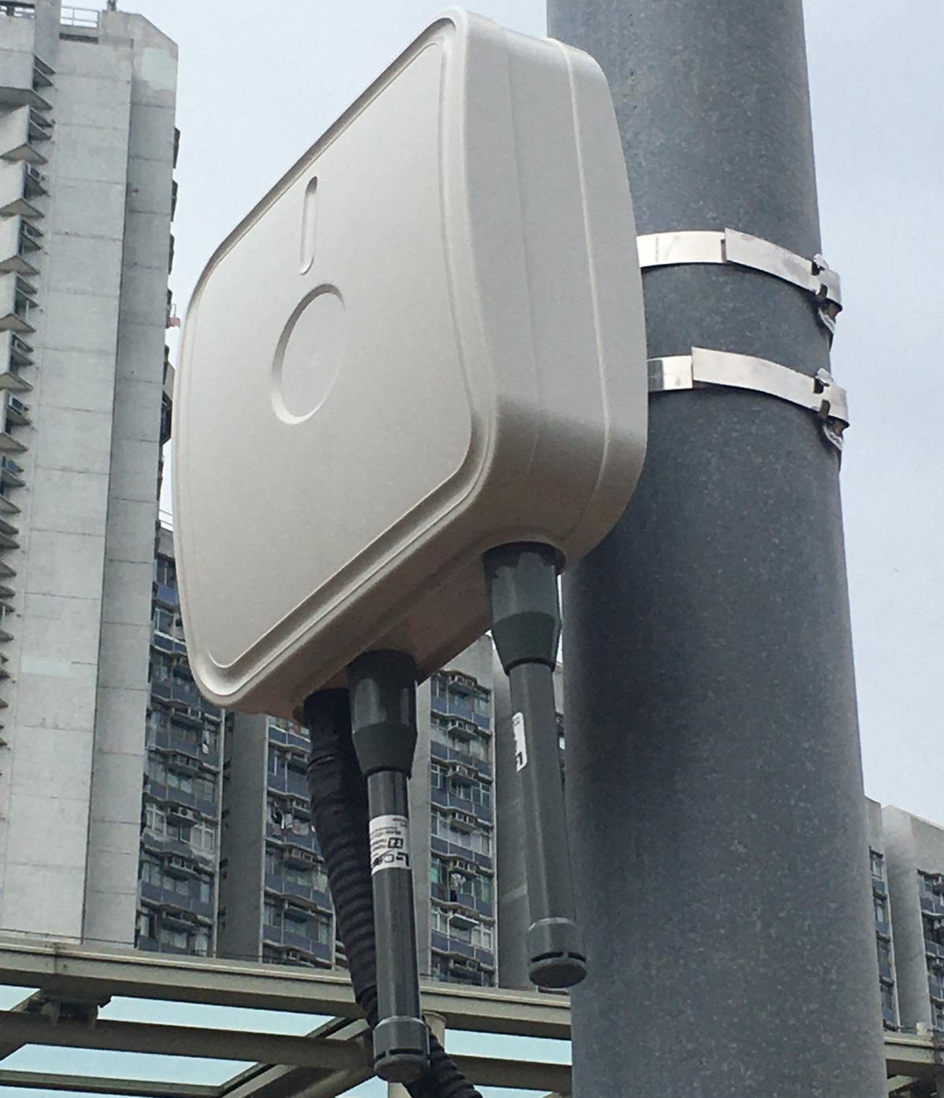
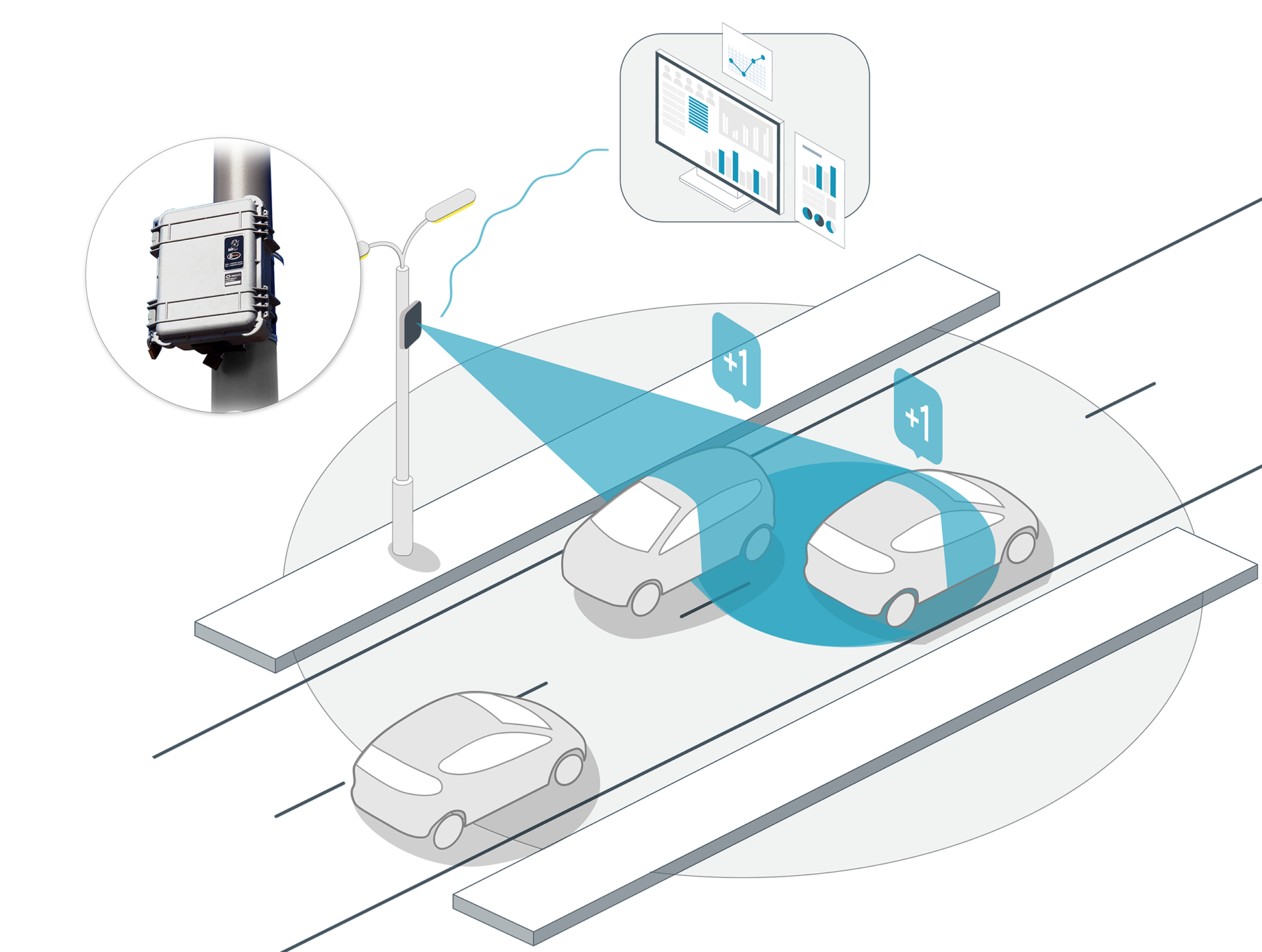
02. Sensors and GPS Data Collection
2.1. Sensors as a Data Sources
Inductive Loop Detectors The Workhorse: Reliable vehicle detection and counting..
Video Analytics Cameras The Brain: Classifies all road users (cars, bikes, people).
Cameras
Inductive Loop Detectors
Bluetooth/Wi-Fi Scanners The Timekeeper: Calculates corridor travel time.
Radar Sensors The All-Seeing Eye: Measures speed in any weather.
Radar Sensors
Bluetooth and Wi-Fi Detectors
Notes:
"Let's take a closer look at the key types of sensors that form the backbone of our intelligent transportation systems.
First, Inductive Loop Detectors. These are the workhorses of traffic detection. They are essentially coils of wire embedded in the pavement that create a magnetic field. When a car passes over, it disrupts the field, registering a detection. They are very reliable for counting vehicles and measuring occupancy at intersections.
Second, Video Analytics Cameras. These are far more than simple security cameras. They use powerful AI algorithms to process video feeds in real-time. They can count vehicles, but also classify them, track turning movements, and detect pedestrians and cyclists, providing a much richer picture of intersection activity.
Third, Radar Sensors. These devices emit radio waves and measure the reflections to detect the presence, speed, and distance of vehicles. Their major advantage is that they are highly accurate and are unaffected by weather conditions like rain, fog, or darkness, which can be a challenge for video cameras.
Finally, a clever technology: Bluetooth and Wi-Fi Scanners. These are small devices that anonymously detect the unique MAC addresses of Bluetooth or Wi-Fi signals from phones and vehicles. By placing these scanners at different points along a corridor, a system can match the anonymous IDs and calculate the exact travel time between those points, giving a highly accurate measure of congestion."

Slide 29
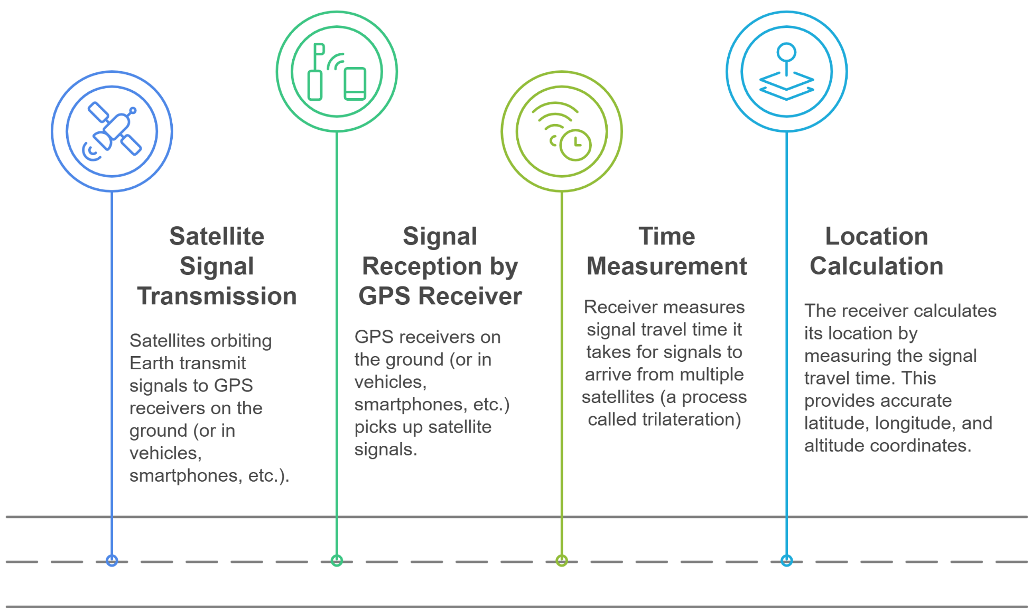
02. Sensors and GPS Data Collection
2.2. How GPS Works for Transport Analysis
Notes:
"GPS, or the Global Positioning System, is the foundation of most modern navigation and tracking. The principle behind it is remarkably elegant.
It starts with Transmission. A constellation of about 30 GPS satellites is constantly orbiting the Earth, and each one is continuously broadcasting a signal that contains its exact location and the precise time the signal was sent.
Next is Reception. A GPS receiver on the ground—in your smartphone, your car, or a dedicated tracking device—is constantly listening for these signals. It needs to 'hear' from at least four satellites simultaneously.
The magic is in Trilateration. The receiver measures the time it took for the signal from each satellite to arrive. Since the signal travels at the speed of light, this time delay can be converted into a very precise distance. So, the receiver knows it is 'X' kilometers from Satellite A, 'Y' from Satellite B, and 'Z' from Satellite C.
Finally, by knowing its distance from at least four different satellites, the receiver can calculate its precise Location in three dimensions—latitude, longitude, and altitude. When a device records these location points every few seconds, it creates a trajectory or 'breadcrumb trail' that provides a detailed record of a journey."

Slide 30
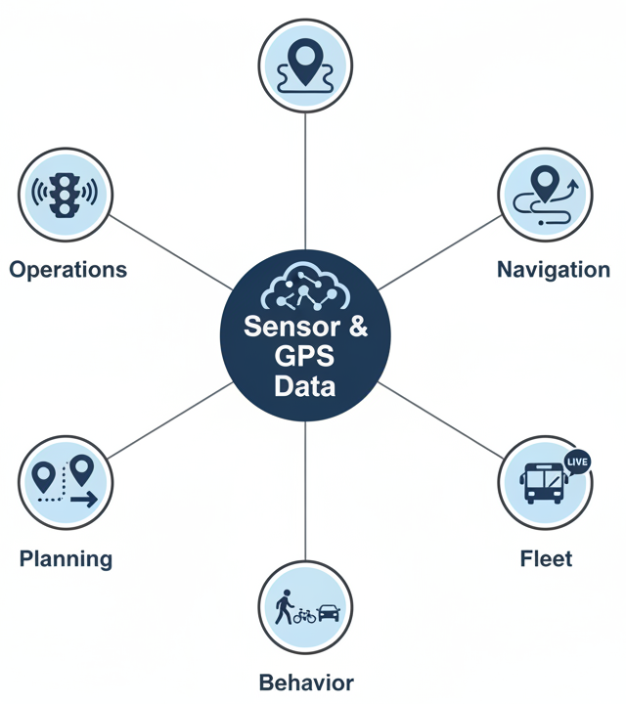
02. Sensors and GPS Data Collection
2.3. Applications of Sensor & GPS Data
Real-Time Traffic Monitoring & Control: Traffic Signal Control, Incident Detection
Navigation & Route Optimization: Live Traffic, Route Optimization
Public Transport Fleet Management: Bus/Train Tracking, On-Time Performance
Origin-Destination Pattern Analysis: Origin-Destination Analysis
Transportation Mode Detection: Automated Mode Detection
Notes:
"The true value of sensor and GPS data is unlocked through its diverse applications, which form the core of what we call Intelligent Transportation Systems, or ITS.
It enables Real-Time Traffic Monitoring, allowing traffic management centers to see congestion forming, detect incidents, and dynamically adjust traffic signal timing to improve flow.
It powers the Navigation and Route Optimization apps we all use. By crowdsourcing anonymized speed data from thousands of users, these services can find the fastest route based on actual, current conditions.
For Public Transport, GPS is essential. Operators use it for fleet management to track the real-time location of every bus and train, which feeds the arrival time information passengers rely on and helps monitor on-time performance.
At a strategic level, by aggregating massive amounts of anonymized location data, planners can conduct large-scale Origin-Destination analysis to see where people are traveling from and to, informing long-range infrastructure planning.
Finally, with advanced machine learning algorithms, we can now perform Transportation Mode Detection, analyzing the speed and movement patterns in a GPS track to automatically determine if a person was walking, cycling, driving, or taking a train, providing rich behavioral insights."

Slide 31
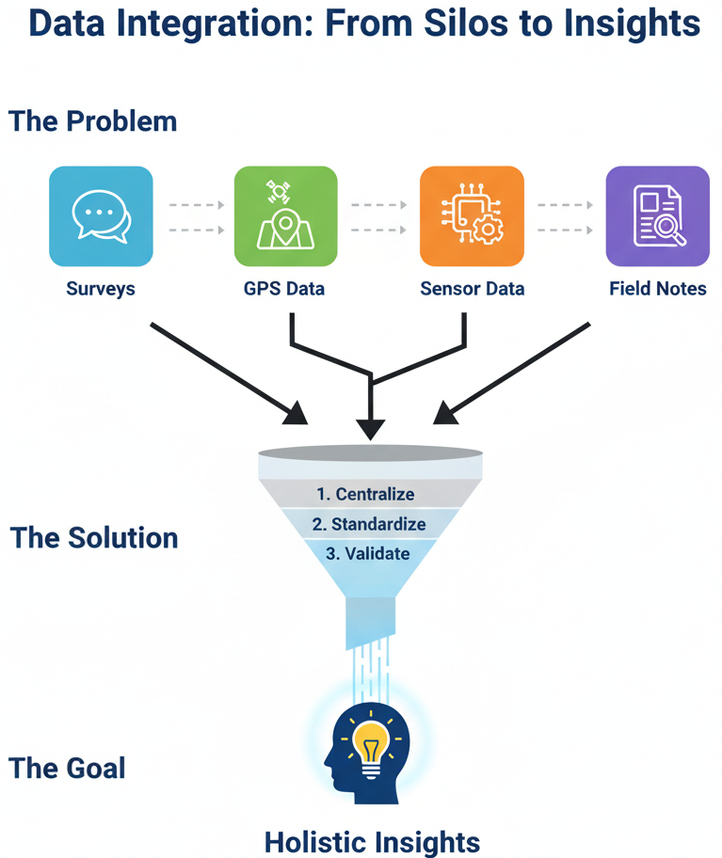
02. Sensors and GPS Data Collection
2.4. The Core Challenge: Data Integration
The Problem: Data Silos
Each source provides a valuable, but incomplete, piece of the puzzle.
↓
The Solution: A 3-Step Integration Strategy
  Centralize: Bring all data into a single "data lake."
  Standardize: Convert data to a common "language" and format.
  Validate: Clean the data, remove errors, ensure quality.
↓
The Goal: Holistic Insight
A single source of truth for better decision-making.
Notes:
"However, having all this data creates a monumental challenge: integration. We have traffic counts from sensors, route trajectories from GPS, and user demographics from surveys. Each dataset lives in its own silo and speaks its own language. The real, deep insights emerge only when we can successfully merge them.
The goal is to move from fragmented data points to a single, holistic view of our transportation system. Imagine being able to layer real-time traffic speeds from GPS data over a map of road conditions from your asset management system, and then correlating that with accident hotspots and public satisfaction survey results. That is the power of integration.
The solution isn't simple, but it requires a strategic approach. First, we must centralize the data, bringing it out of its silos and into a common data warehouse or data lake. Second, we must standardize it, converting it into common formats so that the different datasets can actually 'talk' to each other. Finally, and most critically, we must validate it. This means implementing automated and manual checks to clean the data, remove errors, and ensure it is accurate and reliable. Because making important decisions based on poor-quality, un-integrated data is often worse than having no data at all."

Slide 32
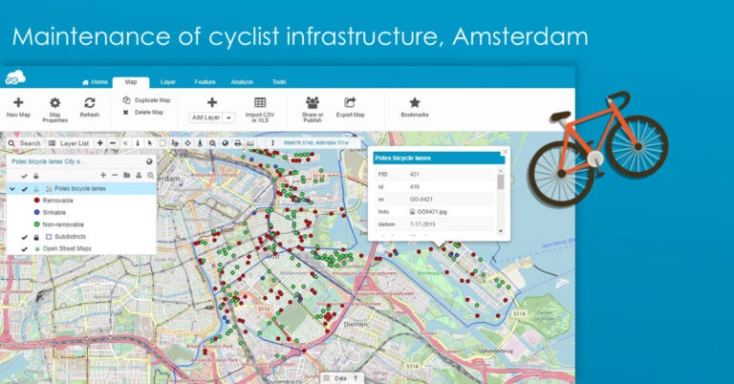
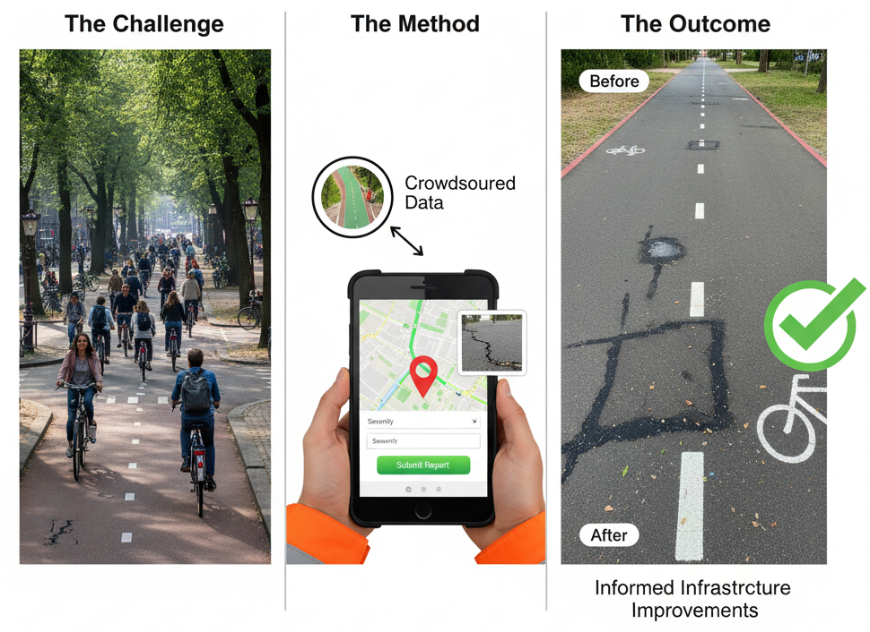
02. Sensors and GPS Data Collection
2.5. Case Study 2: GIS-Based Bike Lane Monitoring
The Challenge (Amsterdam):
To efficiently manage and maintain an extensive and heavily used network of bicycle infrastructure.
The Method (A GIS-Based Solution):
  Mapping: All bike lanes, racks, and signage were mapped in a Geographic Information System (GIS).
  Mobile Data Collection: Field staff used mobile devices with GPS to report issues (e.g., potholes, faded markings) in real-time, tagging the exact location and attaching photos.
The Outcome:
Streamlined maintenance workflows, faster response times, and a safer, better user experience for cyclists.
https://www.giscloud.com/
Notes:
"Let's look at one more case study for sensor and GPS data, this time focusing on how it can be used for asset management. We'll look at the city of Amsterdam.
The Challenge for Amsterdam is not a lack of cycling, but the opposite: its vast and vital network of bike lanes requires constant maintenance to ensure safety and usability. Traditional paper-based reporting was slow and inefficient.
The Method they implemented was a modern, GIS-based solution. First, the city created a comprehensive digital map of its entire cycling network in a GIS. Then, they equipped field staff with mobile devices. When a staff member identifies an issue—a pothole, a broken sign, a faded lane marking—they can open an app, use the phone's GPS to tag the precise location, take a photo of the problem, and submit a report directly to a central database.
The Outcome of this integration of GIS, GPS, and mobile technology was a dramatic improvement in operational efficiency. Maintenance requests became instant and precise. This led to faster repair times, a data-driven approach to prioritizing work, and ultimately, a safer and more reliable cycling network for everyone. This is a perfect example of how sensor data isn't just for monitoring traffic, but for actively managing infrastructure."

Slide 33
02. Sensors and GPS Data Collection
2.6. Advantages vs. Challenges of Sensor/GPS Data
The Promise (Advantages)
Objective Truth: Measures what happened, free from human bias or recall error.
Real-Time Insight: Provides a live, continuous pulse of the network's performance.
Unprecedented Scale: Captures data from entire systems (cities, regions) 24 hours a day.
Low Long-Term Cost: Once installed, the marginal cost of collecting each new data point is near zero.
The Peril (Challenges)
Data Overload: Requires massive storage and sophisticated data science skills to manage and interpret.
The Privacy Minefield: Raises profound ethical questions about surveillance and the use of personal location data.
High Upfront Investment: Sensor networks are expensive to install, calibrate, and maintain over their lifecycle.
It Never Knows "Why“: Shows what is happening with perfect clarity but offers zero insight into human motivation.
Notes:
"As we've seen, this technology is incredibly powerful, but it's not a silver bullet. We must maintain a balanced perspective on its advantages and challenges.
On the advantages side, sensor and GPS data is objective and highly accurate. It captures real-world behavior, free from the recall errors or social desirability bias that can affect surveys. It is fundamentally a real-time data source, which is transformative for operational management. And the scale is immense; we can collect data 24/7 across an entire network. Once the initial infrastructure is in place, the cost per data point can be very low.
However, there are significant challenges. The sheer volume of data can be overwhelming, creating a 'data overload' problem that requires powerful computing infrastructure and specialized skills to analyze. As we discussed earlier, the collection of detailed location data raises major privacy concerns that require careful ethical management, consent, and anonymization. The initial cost of purchasing, installing, and maintaining a network of physical sensors can be very high. And perhaps most importantly, sensor data tells us the 'what,' 'where,' and 'when' with incredible precision, but it tells us nothing about the 'why.' We see a driver took a longer route, but we don't know if it was to avoid traffic, run an errand, or simply enjoy a scenic drive. For that, we still need other methods."

Slide 34

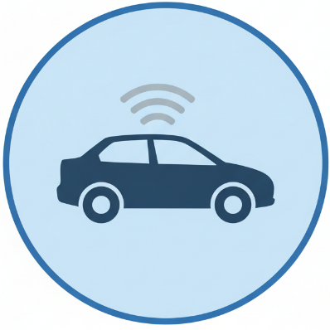
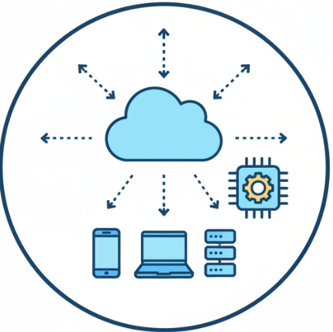
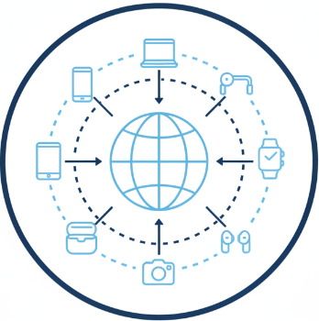
02. Sensors and GPS Data Collection
2.7. Future Trends in Sensor Technology
1. AI-Powered Analytics: From Data to Decisions, Automatically: AI will not just collect data, but will predict congestion, detect anomalies, and interpret video in real-time.
2. Connectivity (5G & V2X): The Real-Time Conversation: Vehicles, infrastructure, and pedestrians will communicate instantly with each other to prevent collisions and optimize flow.
3. Internet of Things (IoT): The World is the Sensor: Billions of tiny, cheap, connected sensors will be embedded in roads, signs, and vehicles, creating a unified data mesh.
4. Edge Computing: Processing at the Source: Instead of sending raw video, the sensor itself will analyze the data and send only the answer (e.g., "3 cars, 1 bike").
Notes:
"This field is evolving at an incredible pace, so let's briefly look at the key trends that will shape the future of transport data collection.
First, AI-Powered Analytics. We are moving beyond simple data collection to having artificial intelligence algorithms that can analyze these vast datasets for us. AI is already transforming video analytics, and it will increasingly be used to identify complex travel patterns and predict future congestion with remarkable accuracy.
Second, Enhanced Connectivity. The rollout of 5G and the development of Vehicle-to-Everything, or V2X, communication technologies will be a game-changer. This will allow vehicles to communicate directly and instantly with other vehicles, with traffic signals, and with the broader infrastructure, enabling a new level of real-time, cooperative traffic management.
Third, The Internet of Things (IoT). Sensors are becoming smaller, cheaper, and more energy-efficient. This means we can embed them in almost anything, creating a dense network of interconnected devices that share data seamlessly.
Finally, Edge Computing. Instead of sending a raw video feed from a traffic camera to a central server for analysis, edge computing allows the analysis to happen on the camera itself. The device only sends the final, processed result—for example, '5 cars, 2 trucks, 1 cyclist'—which drastically reduces the amount of data that needs to be transmitted and stored. These trends point to a future of more intelligent, more connected, and more responsive transportation systems."

Slide 35
Section 03:
Observational Techniques
Notes:
Section 03, Observational Techniques

Slide 36

03. Observational Techniques
3.0. Introduction to Observational Methods
Direct Observation: Watching and recording behaviors or events as they occur in real time.
  Example: Counting the number of pedestrians crossing at a crosswalk in each period.
Indirect Observation: Studying the traces or outcomes of behaviors rather than witnessing the behaviors themselves.
  Example: Analyzing traffic congestion by examining road wear patterns, pavement markings, or the accumulation of litter at bus stops to infer traffic volume and commuter behavior.
Why Use It?
  See What People Actually Do: Captures authentic, spontaneous behavior.
  Understand the Context: Provides rich contextual data that other methods miss. Reveals the "why" behind the "what" (e.g., environmental barriers, social interactions).
  Bridge the "Say-Do" Gap: Uncovers the difference between a person's self-reported behavior and their actual behavior.
Notes:
"We now arrive at our third and final pillar of data collection: Observational Methods. If surveys are about asking and sensors are about measuring, observation is about watching.
We define it as the systematic recording of behaviors and interactions in their natural context. This is about going out into the field and seeing how people actually use the transportation system.
So, why do this when we have advanced technology? Because observation offers unique advantages. It captures authentic, spontaneous behavior that isn't influenced by the structure of a survey question. It provides incredibly rich contextual data. You don't just see that a pedestrian is crossing the street; you see that they are struggling with a stroller, that the curb is too high, and that they had a near-miss with a turning vehicle. Most importantly, it can reveal the critical gap between what people say they do and what they actually do. A survey respondent might say they always wait for the walk signal, but an observational study might find that jaywalking is the norm at a particular intersection, providing a more accurate picture for safety analysis."

Slide 37
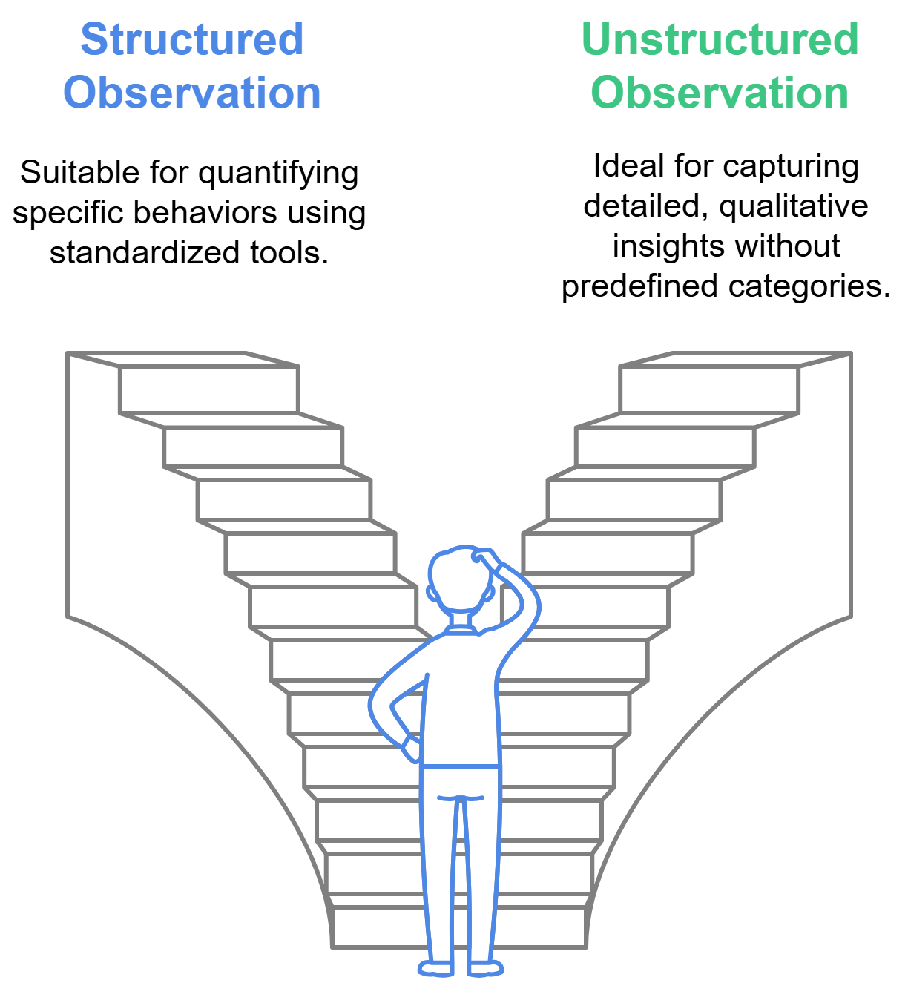
03. Observational Techniques
3.1. Structured vs. Unstructured Observation
Structured Observation (Quantitative):
  Using a pre-defined checklist or coding scheme to record specific behaviors.
  Example: Using a tally sheet to count the number of cyclists who stop at a stop sign versus those who do not.
  Best for: Quantifying specific behaviors and testing hypotheses.
Unstructured Observation (Qualitative):
  Taking detailed, free-form notes on behaviors and context without pre-defined categories.
  Example: Observing interactions at a bus stop and taking notes on how people queue, interact with the driver, and handle payment.
  Best for: Exploratory research and discovering unexpected patterns.
Notes:
"Observational studies can be approached in two main ways, depending on your research question.
The first is Structured Observation. This is a quantitative approach. Before you go into the field, you create a very specific checklist, a coding sheet, or a 'protocol' that defines exactly what you are looking for. Your job as the observer is simply to tally or record instances of these pre-defined behaviors. The example here is a classic traffic safety study: you have two columns, 'stopped' and 'did not stop,' and you make a tally mark for each cyclist. This method is reliable, easy to replicate, and provides quantitative data that can be analyzed statistically. It's best for testing a specific hypothesis.
The alternative is Unstructured Observation. This is a qualitative, more exploratory approach. Instead of a checklist, you go into the field with a blank notebook. You record detailed, descriptive notes on everything that seems relevant. You're not just counting behaviors; you're describing them in rich detail. The bus stop example is perfect: you would take notes on the social dynamics, the environmental conditions, and any unexpected events. This method is fantastic for capturing rich context and discovering patterns you didn't know existed. The trade-off is that the data is more subjective and much more time-consuming to analyze."

Slide 38
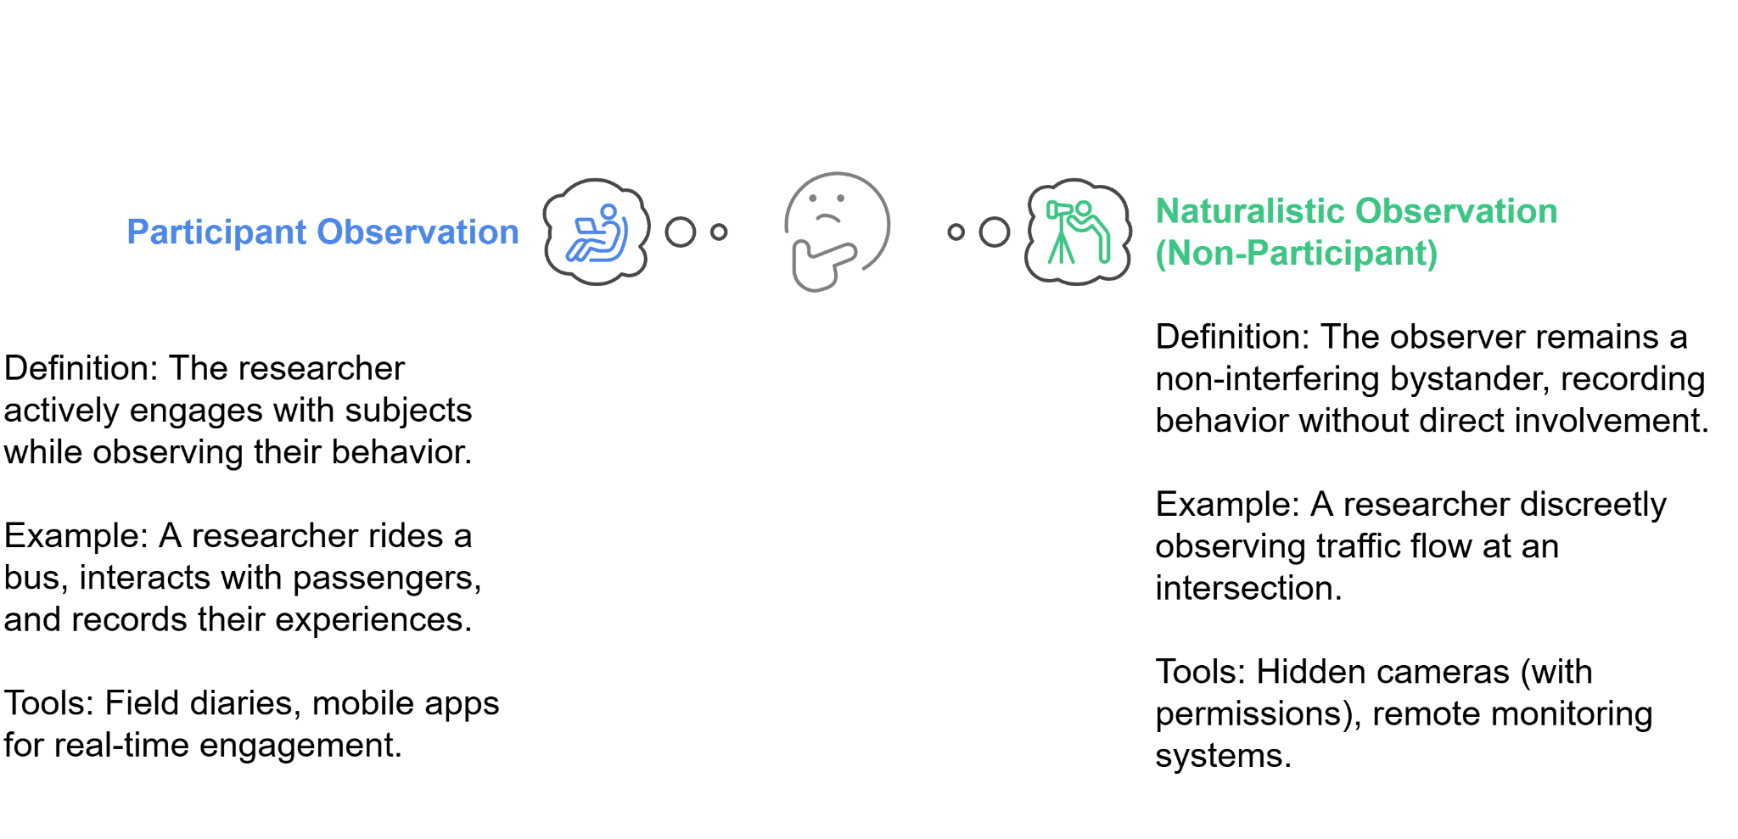
03. Observational Techniques
3.2. Participant vs. Naturalistic Observation
Notes:
"Another key distinction is the role of the researcher themselves.
In Participant Observation, the researcher is not a detached observer; they are an active participant. They immerse themselves in the environment they are studying to gain an insider's perspective. The classic example is a transport ethnographer who rides a bus route every day for a month. They are not just watching; they are experiencing the service, talking to other passengers, and asking the driver questions. This method provides incredibly deep, empathetic insights.
The opposite is Naturalistic Observation, where the goal is to observe behavior without the subjects knowing they are being watched. The researcher is a fly on the wall, a detached and invisible bystander. This is crucial when the mere presence of an observer might change people's behavior—an effect known as the Hawthorne effect. For example, if drivers know they are being watched at an intersection, they might behave more cautiously than they normally would. To achieve this, researchers might use remote cameras or observe from a location where they won't be noticed. This method captures more authentic, unfiltered behavior."

Slide 39
03. Observational Techniques
3.3. Manual vs. Automated Observation
Manual Observation (The Human Eye)
What: Human observers directly counting, classifying, or documenting behaviors in real-time.
Pros: Nuanced understanding, flexible, captures rich context.
Cons: Resource-intensive, prone to observer bias and fatigue.
Automated Observation:
What: Using technology (sensors, computer vision) to collect observational data.
Pros: Highly efficient and scalable, consistent, continuous data collection.
Cons: High initial cost, can lack contextual understanding, potential for algorithmic bias.
Notes:
"Finally, we need to consider who—or what—is doing the observing.
Manual Observation is the traditional method, where human observers are in the field with clipboards, tally counters, or notebooks. This is still incredibly valuable. A human observer can understand nuance and context in a way a machine cannot. They can adapt to unexpected situations and capture rich qualitative details. However, it is very resource-intensive—it's expensive to have trained staff in the field for long periods—and it can be susceptible to human error, fatigue, and subjective bias.
The alternative is Automated Observation. Here, we use technology to do the watching for us. The most common example is using video cameras paired with computer vision algorithms to automatically count and classify vehicles, pedestrians, and cyclists. This is tremendously efficient and scalable. A single system can collect data 24/7 without getting tired or bored, and it applies its counting rules with perfect consistency. The downsides are the high initial cost for the technology and software, the potential for algorithmic bias if the system isn't trained properly, and the fact that it can miss the subtle context that a human observer would notice."

Slide 40
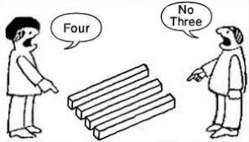
03. Observational Techniques
3.4. The Observer Effect: Minimizing Bias
Observer Bias: When a researcher's expectations or preferences unintentionally influence data collection and interpretation.
Key Strategies to Stay Objective:
  Standardize Protocols: Use clear, detailed checklists and data collection rules that all observers must follow precisely.
  Use Multiple Observers: Have two or more observers collect data independently, then check for consistency (Inter-Rater Reliability).
  "Blind" the Observers: If possible, keep observers unaware of the specific research hypotheses or expected outcomes.
Notes:
"A major threat to the validity of observational research is Observer Bias. This is the unintentional tendency for a researcher's own expectations, beliefs, or personal biases to influence what they see and how they record it. For example, a researcher who believes that cars rarely yield to pedestrians might be more likely to notice and record instances of that behavior, while overlooking instances where drivers do yield.
Combatting this requires strict strategies. First, Standardize your protocols. Every observer must use the exact same detailed checklist and follow the same set of rules for what constitutes a specific behavior. This removes subjective interpretation.
Second, a powerful technique is to Use Multiple Observers. Have two or more researchers observe the same event independently and then compare their data. If their records are highly consistent, you have high 'inter-rater reliability,' which gives you confidence in the data's objectivity. If their records differ wildly, it indicates the protocol is too ambiguous.
Finally, whenever possible, you should "Blind" the observers. This means the people collecting the data are not told the specific research question or the expected outcome. This prevents their expectations from influencing their observations. By implementing these strategies, we can significantly increase the objectivity and reliability of our observational findings."

Slide 41
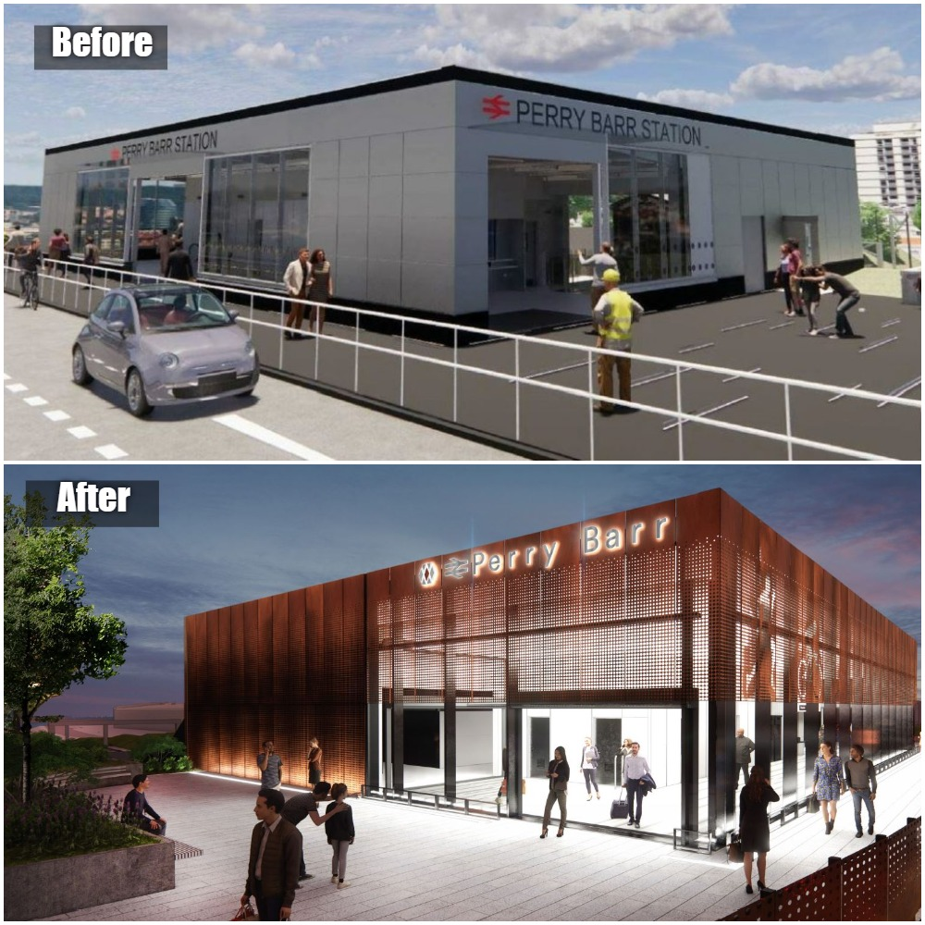
03. Observational Techniques
3.5. Case Study 3: Pedestrian Flow at Perry Barr Station
The Challenge (Birmingham, UK): Perry Barr Station anticipated a 58% increase in passengers and needed to ensure its new design could handle the flow safely and efficiently.
The Method (Observational & Modeling):
Data Sources: Utilized existing data from direct observations of pedestrian movements.
3D Modeling: Used software (MassMotion) to create a detailed digital simulation of the station.
Scenario Analysis: Tested various station layouts against different passenger flow conditions to identify potential bottlenecks.
The Outcome: The study provided data-driven insights that directly informed the station's final redesign, ensuring it could meet future demand and enhance the commuter experience.
Notes:
"Let's see how these observational techniques can be applied to a large-scale infrastructure project. We'll look at the redevelopment of Perry Barr Station in Birmingham, UK.
The Challenge was significant. The station was expecting a massive 58% surge in passenger numbers due to a major sporting event and local redevelopment. The designers needed to be certain that the new station layout could handle this increased flow without creating dangerous crowding or congestion.
The Method was a sophisticated blend of observation and simulation. The consulting firm started with observational data to understand how pedestrians currently moved through similar spaces. This real-world data on walking speeds, queuing behavior, and movement patterns was then used to calibrate a highly detailed 3D model of the proposed station design. They then ran scenario analyses, simulating different levels of passenger demand to see how the design would perform under pressure. This allowed them to identify potential bottlenecks and problem areas before a single brick was laid.
The Outcome was a design informed by robust, data-driven insights. The simulation study helped optimize the station layout to improve pedestrian flow and safety, directly influencing the final architectural plans. This proactive approach demonstrates how observational data is crucial for designing better, more efficient public spaces."

Slide 42
03. Observational Techniques
3.6. Strengths vs. Limitations of Observation
Strengths:
Rich Context: Provides a deep understanding of how and why behaviors occur.
Authentic Data: Captures genuine behavior in a natural setting.
Flexibility: Can be adapted to various research questions and environments.
Reveals the Unexpected: Excellent for discovering unforeseen patterns and problems.
Limitations:
Resource Intensive: Can be very time-consuming and costly.
Observer Bias: Findings can be influenced by the researcher's subjectivity.
Lack of Generalizability: Findings from one specific location may not apply elsewhere.
Ethical Concerns: Raises privacy issues if individuals are observed without their knowledge or consent.
Notes:
"To conclude our section on observational methods, let's summarize the key strengths and limitations in a balanced way.
The primary strength of observation is its ability to provide rich contextual data. You see the whole picture, not just an isolated data point. This leads to authentic data, capturing what people really do, not just what they say they do. The method is also highly flexible and can be adapted to study a wide range of phenomena. And because it's often exploratory, it is fantastic for revealing unexpected patterns that you would never think to ask about in a survey.
However, there are significant limitations. High-quality observation is resource-intensive; it takes a lot of time and trained personnel. As we've discussed, observer bias is a constant threat to the validity of the findings. The results often suffer from a lack of generalizability; just because you observe a certain behavior at one intersection doesn't mean it happens everywhere. And finally, there are serious ethical concerns. Observing and recording people, especially without their consent, must be handled with extreme care to protect their privacy and dignity."

Slide 43
03. Observational Techniques
3.7. Interactive Observation Exercise
Let's Practice Our Observation Skills
Your Task (in small groups):
  Watch the clip carefully.
  As a group, discuss and take notes on the following:
    What different modes of transport are present?
    What formal or informal interactions or conflicts do you observe between users?
    What aspects of the infrastructure (e.g., markings, signage, design) are influencing behavior?
We will discuss your findings as a class in 5 minutes.
Notes:
"Now that we understand the principles of observation, let's put them into practice. I'm going to show a short video clip of a busy transportation environment. I want you to get into small groups of three or four.
Your task is to act as a research team conducting an unstructured observation. As you watch the clip, pay close attention to the details. Afterwards, you'll have about five minutes to discuss within your groups what you saw. I want you to focus on three things: first, simply identify all the different modes of transport you see. Second, describe any interactions or conflicts between different users—pedestrians and cyclists, cars and buses. Third, and most importantly, identify specific elements of the infrastructure and consider how they might be influencing the behaviors you are seeing.
(Play the video clip)
Okay, please take the next five minutes to discuss in your groups. I'll be walking around to listen in, and then we'll come back together to share what you found."
(After 5 minutes, facilitate a class discussion, highlighting different observations from various groups and connecting them to concepts like structured vs. unstructured observation.)

Slide 44
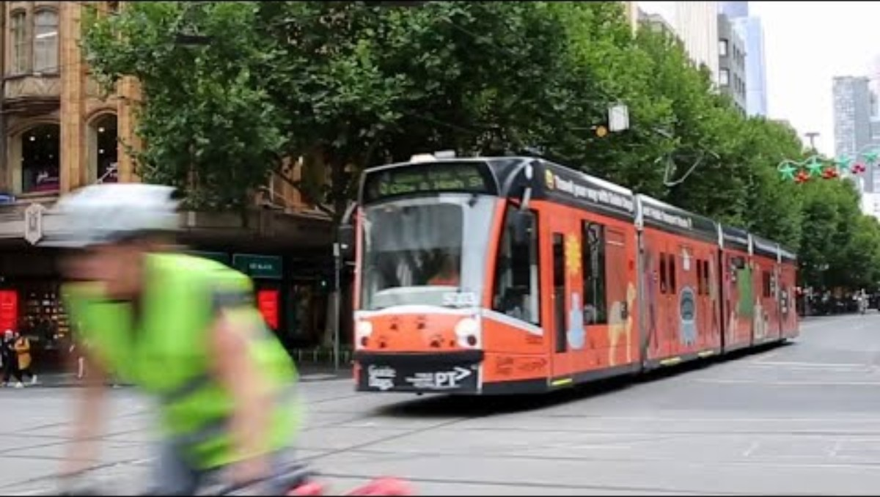
03. Observational Techniques
3.8. Interactive Observation Exercise
Notes:
"Now that we understand the principles of observation, let's put them into practice. I'm going to show a short video clip of a busy transportation environment. I want you to get into small groups of three or four.
Your task is to act as a research team conducting an unstructured observation. As you watch the clip, pay close attention to the details. Afterwards, you'll have about five minutes to discuss within your groups what you saw. I want you to focus on three things: first, simply identify all the different modes of transport you see. Second, describe any interactions or conflicts between different users—pedestrians and cyclists, cars and buses. Third, and most importantly, identify specific elements of the infrastructure and consider how they might be influencing the behaviors you are seeing.
(Play the video clip)
Okay, please take the next five minutes to discuss in your groups. I'll be walking around to listen in, and then we'll come back together to share what you found."
(After 5 minutes, facilitate a class discussion, highlighting different observations from various groups and connecting them to concepts like structured vs. unstructured observation.)

Slide 45
03. Observational Techniques
3.9. Synthesis: Choosing the Right Tool
Feature | Surveys | Sensor & GPS | Observation
Data Type | Qualitative & Quantitative | Quantitative | Qualitative & Quantitative
Primary Question | Why? (Motivations, Perceptions) | What? Where? When? (Objective Facts) | How? (Behaviors, Interactions)
Cost | Medium to High | High (Initial), Low (Operational) | Medium to High
Scalability | Medium | High | Low
Objectivity | Low to Medium (Subjective) | High (Objective) | Medium (Prone to Bias)
Contextual Richness | Medium | Low | High
Notes:
"We have now explored our three pillars of data collection in detail. The most important skill for a researcher is not just knowing how to use each method, but knowing when to use each method. There is no single 'best' approach; the choice always depends on your research question. This table provides a summary to guide your thinking.
If your primary question is 'Why?'—if you need to understand people's motivations, opinions, and perceptions—then surveys are your best tool.
If your question is 'What, Where, and When?'—if you need objective, precise, large-scale data on movements and volumes—then Sensor and GPS data is unmatched in its power and scalability.
And if your question is 'How?'—if you need to understand the nuances of behavior, interactions, and how people operate within a specific context—then observation will provide the richest insights.
Notice the trade-offs. Surveys can give you the 'why,' but they are less objective. Sensors give you objectivity and scale, but they provide no context. Observation gives you context, but it is difficult to scale and can be subjective. This is why the most robust research often combines these methods, using a multi-pronged approach to get a complete picture."

Slide 46
Section 04:
Conclusions and Key Takeaways
Notes:
Section 04: Conclusions and Key Takeaways

Slide 47
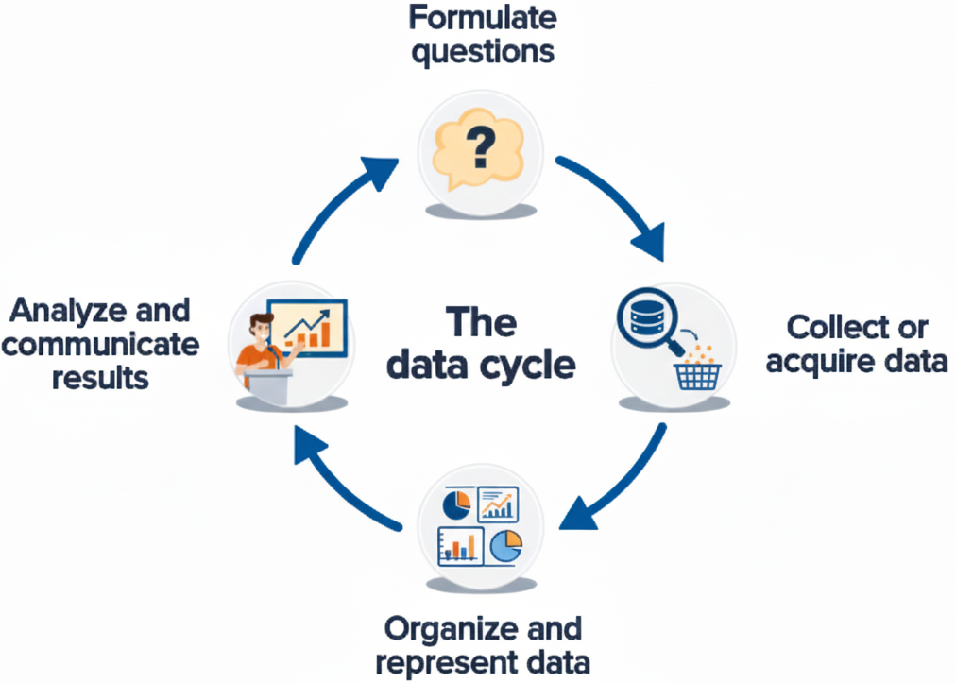
04. Conclusions and Key Takeaways
4.0. The Data Cycle: A Continuous Process
Notes:
"It's important to remember that data collection is not an isolated event. It is a key step in a larger, continuous process that we can call the Data Cycle.
It always begins with formulating a question. A well-defined question is the most important prerequisite for good research. What do we need to know?
Only then do we move to collecting the data, using the methods we've spent today discussing. This is the heart of the process, but it is guided entirely by the initial question.
Once collected, the raw data is often messy. It must be organized, cleaned, and represented in a way that makes it usable—through databases, charts, and maps.
Finally, we analyze the data and communicate the results. This is where we find the answers to our initial questions. But importantly, good analysis often generates new questions, which starts the entire cycle over again. This iterative process of questioning, collecting, and analyzing is the engine of scientific discovery and effective transport planning. It is a journey, not a destination."

Slide 48
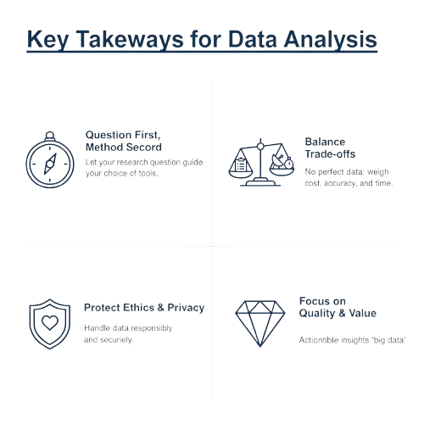
04. Conclusions and Key Takeaways
4.1. Key Takeaways & Best Practices
1. Start with Clear Objectives: Your research question dictates your method.
2. No "Perfect" Method Exists: All methods involve trade-offs between cost, scale, and richness. The best approach is often a hybrid one.
3. Ethics and Privacy are Paramount: Responsible data handling is a non-negotiable foundation of all research.
3. Quality In, Quality Out: Rigorous planning, pilot testing, and bias mitigation are essential for trustworthy results.
Notes:
"This field is evolving at an incredible pace, so let's briefly look at the key trends that will shape the future of transport data collection.
First, AI-Powered Analytics. We are moving beyond simple data collection to having artificial intelligence algorithms that can analyze these vast datasets for us. AI is already transforming video analytics, and it will increasingly be used to identify complex travel patterns and predict future congestion with remarkable accuracy.
Second, Enhanced Connectivity. The rollout of 5G and the development of Vehicle-to-Everything, or V2X, communication technologies will be a game-changer. This will allow vehicles to communicate directly and instantly with other vehicles, with traffic signals, and with the broader infrastructure, enabling a new level of real-time, cooperative traffic management.
Third, The Internet of Things (IoT). Sensors are becoming smaller, cheaper, and more energy-efficient. This means we can embed them in almost anything, creating a dense network of interconnected devices that share data seamlessly.
Finally, Edge Computing. Instead of sending a raw video feed from a traffic camera to a central server for analysis, edge computing allows the analysis to happen on the camera itself. The device only sends the final, processed result—for example, '5 cars, 2 trucks, 1 cyclist'—which drastically reduces the amount of data that needs to be transmitted and stored. These trends point to a future of more intelligent, more connected, and more responsive transportation systems."

Slide 49
04. Conclusions and Key Takeaways
4.2. Summary: Review of Core Methods
Surveys & Questionnaires:
  Gather insights directly from individuals about their behaviors, preferences, and attitudes.
Sensors & GPS Data:
  Provide objective, real-time data on traffic flow, vehicle movements, and system performance.
Observational Techniques:
  Capture detailed, contextual data on behaviors and interactions in natural settings.
Combining these three approaches is crucial for a great understanding of transportation.
Notes:
"So, to summarize our entire lecture in one slide. We have covered the three pillars of transport data collection.
Surveys and Questionnaires are our tools for gathering direct insights into the human element—the 'why' behind the data.
Sensors and GPS provide the objective, large-scale, real-time data that gives us a 'God's-eye view' of the what, where, and when of system performance.
And Observational Techniques allow us to capture the rich, contextual data on real-world behaviors and interactions that are often missed by the other two methods.
Remember that each has unique strengths. The true mastery of this topic lies in understanding these strengths and knowing how to combine these approaches to build a comprehensive, nuanced, and reliable understanding of the complex world of transportation."

Slide 50
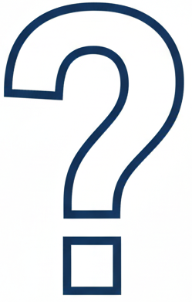
04. Conclusions and Key Takeaways
4.3. Q&A and Discussion
Discussion & Questions
Let's Discuss:
  What are the most significant ethical implications of new data collection technologies?
  How do you think the rise of AI and automation will transform transportation data collection in the next 10 years?
Notes:
"That brings us to the end of the formal content for today. I want to thank you for your attention and engagement. We have covered a great deal of ground, from foundational principles to the practical application of the core data collection methods in our field.
I would now like to open the floor for any questions you may have about anything we've discussed.
And to get us started on a broader discussion, I'd like you to consider these two questions: First, what do you see as the most pressing ethical challenges we will face as these data collection technologies become even more powerful and pervasive? And second, looking forward, how do you predict that trends like AI will fundamentally change the job of a transport researcher in the coming decade?
Please, what are your questions and thoughts?"

Slide 51
04. Conclusions and Key Takeaways
4.4. References & Further Reading
For further exploration of these topics, please consult the following resources:
Core Text:
  Ortúzar, J. de D., & Willumsen, L. G. (2011). Modeling Transport (4th ed.). John Wiley & Sons. (Especially Chapters 3 & 4 on data collection).
Survey Design:
  Dillman, D. A., Smyth, J. D., & Christian, L. M. (2014). Internet, Phone, Mail, and Mixed-Mode Surveys: The Tailored Design Method (4th ed.). John Wiley & Sons.
Transport Data Science:
  Gonzalez, H., & van der Schaar, M. (Eds.). (2022). Handbook on Transport Data Science. Edward Elgar Publishing.
Observational Methods:
  Angrosino, M. V. (2007). Doing Ethnographic and Observational Research. SAGE Publications.
Notes:
"Finally, for those of you who wish to go deeper into these topics, here are a few foundational texts. The Ortúzar and Willumsen book is a classic in our field and provides an excellent overview of transport data. Dillman's book is considered the bible of modern survey design. The new Handbook on Transport Data Science provides insights into cutting-edge computational methods. And Angrosino's book is a great practical guide to observational research. These will all be valuable resources throughout your academic and professional careers. Thank you once again for your time and participation."

Slide 52
Thank you for your attention!
Notes:
Thank You

