Slide 1
Transport Research and Analysis
Module 2: Transport Modeling and Simulation
Lab 6: Introduction to Transport Modeling

Slide 3
Table of Contents
Lab 6: Introduction to Transport Modeling
Section 0: Objectives & Learning Outcomes | 4
0.1. Objectives | 5
0.2. Learning Outcomes | 7
0.3. Reference to the corresponding theoretical lecture | 8
Section 1: Introduction to Transport Modelling | 9
1.1. What is Trip distribution? | 10
1.2. Methods of Trip Distribution | 11
1.3. Basic Assumptions | 12
Section 2: The Gravity Model | 13
2.1. The Gravity Model – Concept & Assumptions | 14
2.2. Formula of the Gravity Model | 15
2.3. Friction Factors | 16
2.4. Types of Gravity Models | 17
Section 3: Zoning in Transport Planning | 18
3.1. What is zoning? | 19
3.2. How are zones created? | 20
3.3. Why zoning matters? | 21
Section 4: Input Data | 23
4.1. Required Input Data | 24
4.2. Origin-Destination Matrix | 25
4.3. Fij – Friction Factor & Cost Matrix | 26
4.4. Tij Matrix | 27
4.5. Balancing Iteration | 28
Section 5: In Class Practical Example | 30
5.1. Calibration (Excel) | 31
5.2. Colab (Python Exercises) | 33
Introduction to Transport Modeling

Slide 4
Table of Contents
Lab 6: Introduction to Transport Modeling
Section 6: Homework Assignment | 39
6.1. Assignment Tasks | 40
6.2. Report Structure and Submission | 43
Introduction to Transport Modeling

Slide 5
Section 00:
Objectives and Learning Outcomes
Introduction to Transport Modeling

Slide 6
0. Objectives and Learning Outcomes
0.1. Objectives
Section No | Activity | Tool(s) | Activity Type | Activity done by | Duration
1 | Understand the role of trip distribution in transport models while being introduced to the concept of transport modeling |  | Presentation | Teacher | 10mins
1 | Learn the theoretical foundation and assumptions of the gravity model including production, attraction, and travel impedance |  | Presentation | Teacher | 10mins
3 | Observe how input data (Production, Attraction, Cost) and balancing procedures are handled manually in Excel for a simple OD system | Excel | Presentation + Practical | Teacher | 10mins
4 | Understand how to input OD data and compute trip distribution using a fixed beta values in a gravity model implementation | Colab (Python) | Presentation + Practical | Teacher | 15mins
4 | Apply the gravity model using your own inputs to understand how trip distribution results are derived from fixed beta value | Colab (Python) | Practical | Teacher | 15mins
Introduction to Transport Modeling

Slide 7
0. Objectives and Learning Outcomes
0.1. Objectives
Section No | Activity | Tool(s) | Activity Type | Activity done by | Duration
4 | Visualize how adjusting beta value affects the spatial distribution of trips and convergence speed in the gravity model | Colab (Python) | Presentation + Practical | Teacher | 15mins
4 | Experiment with different beta values to analyze how sensitivity in friction factors influences trip outcomes | Colab (Python) | Practical | Teacher | 15mins
4 | Learn how to manually input and apply a custom Fij friction matrix and explore its effect on trip distribution | Colab (Python) | Presentation + Practical | Teacher | 10mins
4 | Test your own manually defined friction matrix and compare the outcome to exponential deterrence results | Colab (Python) | Presentation | Teacher | 10mins
4 | Understand how regression modeling is used to forecast transport demand based on features like distance and fare | Colab (Python) | Presentation | Teacher | 10mins
5 | Homework Assignment Introduction |  | Presentation | Teacher | 10mins (2-3 hours at home)
Introduction to Transport Modeling

Slide 8
0. Objectives and Learning Outcomes
0.2. Learning Outcome
By the end of this lab, you will be able to …
Understand the purpose of trip distribution modeling and its relevance in transport planning and decision-making.
Explain the structure and assumptions of the Gravity Model, including how friction factors influence trip allocation.
Apply the Gravity Model using both Excel and Python (Colab) for small Origin-Destination (OD) systems.
Use exponential deterrence functions and experiment with different β (beta) values to calibrate trip flows.
Analyze convergence patterns and evaluate average trip length and friction curves from the model output.
Manually define and apply custom friction factors (Fij) and assess their impact on trip distribution.
Use regression modeling to predict transport demand based on real-world transport features (as an advanced application).
Summarize and report modeling results clearly through visualizations, trip matrices, and analytical interpretations.
Introduction to Transport Modeling

Slide 9
0. Objectives and Learning Outcomes
0.3. Reference to the corresponding lecture (10)
In Lecture 10, You Were Introduced To:
  The Four-Step Transport Model, including:
    Trip Generation (Step 1)
    Trip Distribution (Step 2)
    Mode Choice and Assignment (Step 3 & 4)
  The conceptual purpose of trip distribution — matching trip origins and destinations
  General mention of Gravity Models as one approach (without equations or calibration)
  The importance of model structure and input quality in transport forecasting
Why This Context Matters for Lab 06:
  Lab 06 focuses in-depth on Step 2: Trip Distribution
  You apply inputs from Step 1 (Production & Attraction) in both manual and coded modeling
  This is where theory becomes calculation: you’ll build OD matrices, apply friction functions, and analyze trip flows
  Gravity Model implementation helps you explore how β values and cost impedance influence spatial patterns
Introduction to Transport Modeling

Slide 10
Section 01:
Introduction to Transport Modelling
Introduction to Transport Modeling

Slide 11
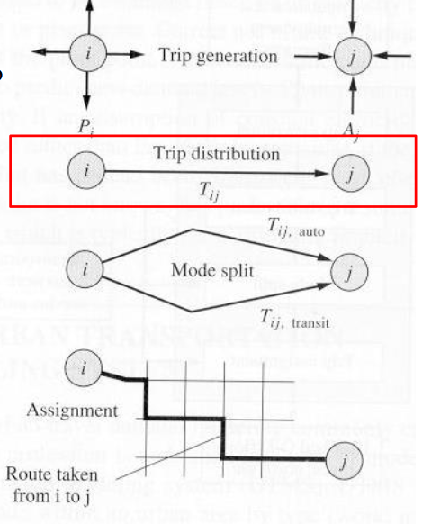
1. Introduction to Transport Modelling
1.1. What is Trip distribution?
Definition
Trip distribution is the process by which trips generated in one zone are allocated toother zones in the study area.
Introduction to Transport Modeling

Slide 12
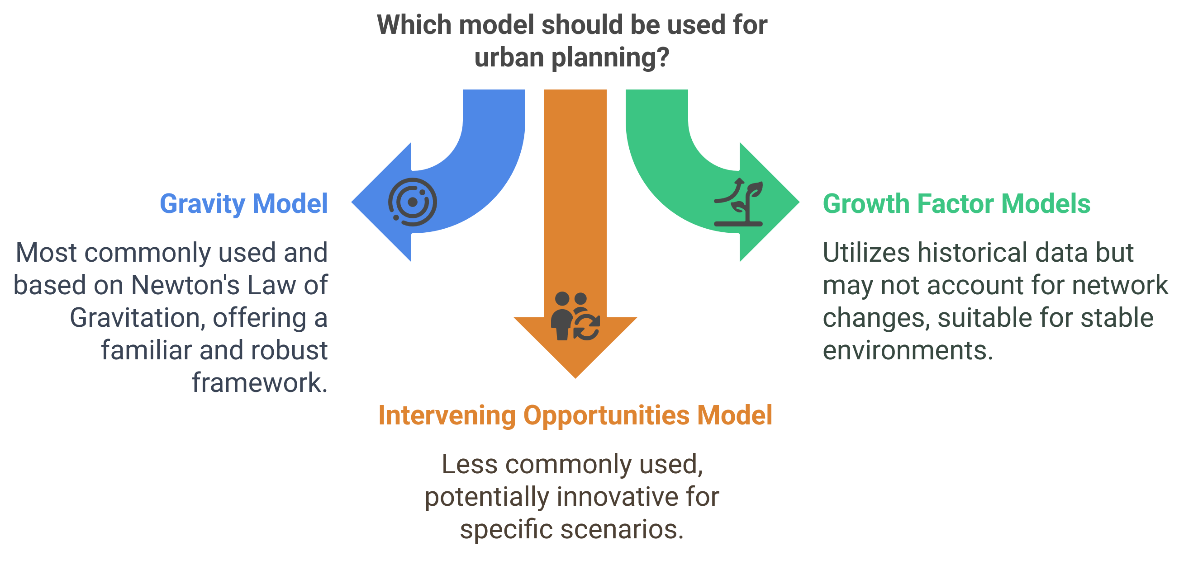
1. Introduction to Transport Modelling
1.2. Methods of Trip Distribution
Introduction to Transport Modeling

Slide 13
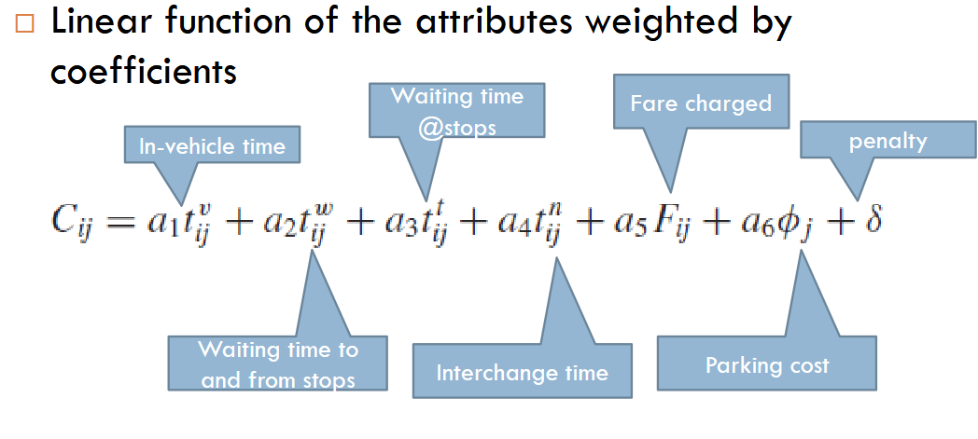
1. Introduction to Transport Modelling
1.3. Basic Assumptions
Number of trips decrease with COST between zones
The cost function can be considered in terms of
Distance
Time
Money
It is convenient to use a measure combining all the main attributes to disutility of the journey
Introduction to Transport Modeling

Slide 14
Section 02:
The Gravity Model
Introduction to Transport Modeling

Slide 15
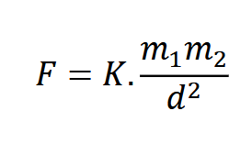
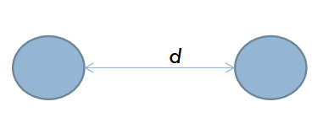
2. The Gravity Model
2.1. The Gravity Model – Concept & Assumptions
Based on Newton’s Law of Gravity,
which states that attraction between two bodies is proportional to their masses and inversely proportional to the square of the distance.
In transport:
m1
m2
  Trip production and attraction = "Mass"
  Travel impedance (e.g., time or cost) = "Distance"
Assumptions of the Gravity Model:
More trips occur between zones with high trip productions and attractions.
Fewer trips occur between zones that are far apart (high travel impedance).
Introduction to Transport Modeling

Slide 16
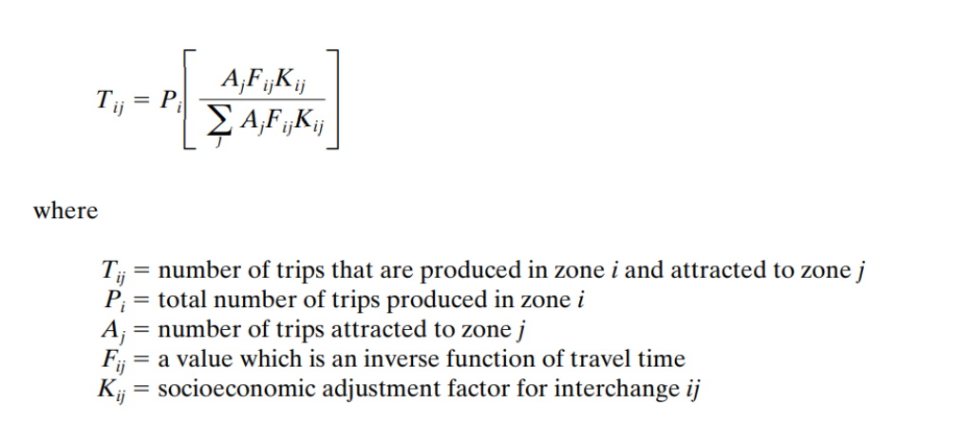
2. The Gravity Model
2.2. Formula of the Gravity Model
Introduction to Transport Modeling

Slide 17
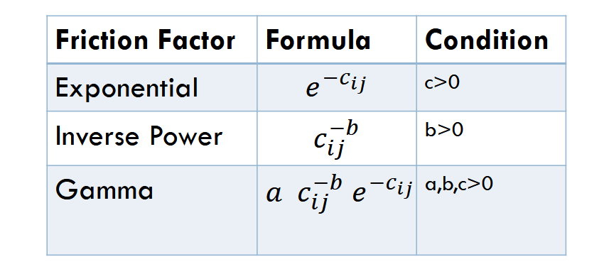
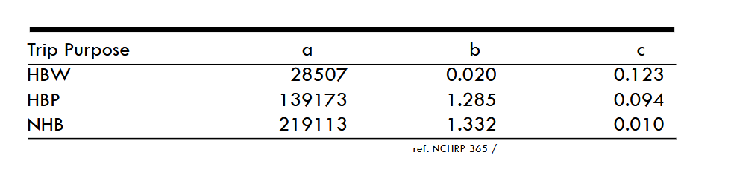
2. The Gravity Model
2.3. Friction Factors
β
Introduction to Transport Modeling

Slide 18

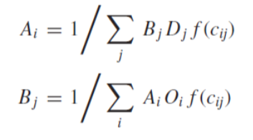
2. The Gravity Model
2.4. Types of Gravity Models
Singly Constrained Gravity Model
  Either trip productions or attractions are fixed.
  Example: Used when we know total trips leaving but not exact destinations.
  One set of balancing factors (Bj=1)
Doubly Constrained Gravity Model
  Both trip productions and attractions must match.
  Used when total trips leaving and arriving in zones must be equal.
  Most commonly used in transport planning.
  Two sets of balancing factors
Introduction to Transport Modeling

Slide 19
Section 03:
Zoning in Transport Planning
Introduction to Transport Modeling

Slide 20
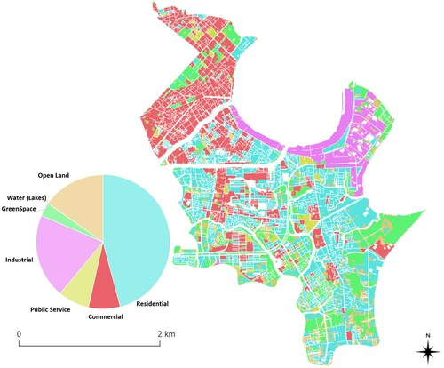
3. Zoning in Transport Planning
3.1. What is Zoning?
Zoning is the division of a study area into spatial units (zones) to simplify and structure transport modeling, especially for trip generation and distribution.
  Each zone is treated as a uniform area with shared socio-economic and land-use characteristics.
  Zoning allows aggregate analysis instead of analyzing each building, household, or road segment individually.
  In models like the Gravity Model, zones define the structure of the Origin-Destination (OD) matrix.
Introduction to Transport Modeling

Slide 21
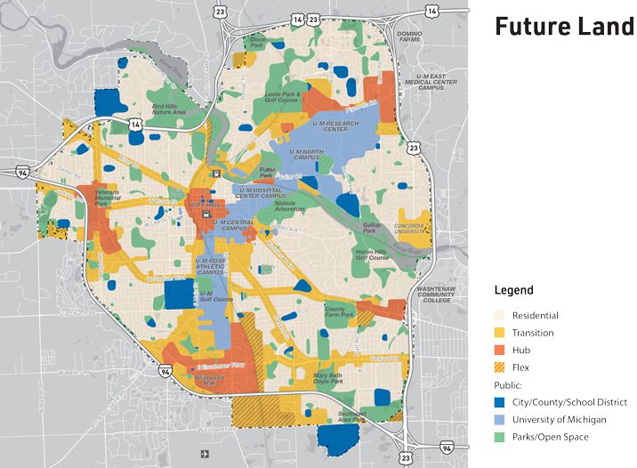
3. Zoning in Transport Planning
3.2. How Are Zones Created?
Zones are defined based on a mix of geographic, functional, and data availability criteria:
1. Administrative boundaries
  Wards, districts, municipal zones
  Easy data access (census, land use)
2. Traffic Analysis Zones (TAZs)
  Special units used in urban transport planning
  Created by combining traffic flow patterns, road networks, land use types
3. Homogeneity of land use
  Zones often contain a similar mix (e.g., residential, industrial, commercial)
4. Data availability
  Defined to align with available population, employment, or trip data sources
5. Size and shape considerations
  Should be compact and convex if possible
  Should minimize internal variability (e.g., all of a zone is either residential or commercial)
Introduction to Transport Modeling

Slide 22
3. Zoning in Transport Planning
3.3. Why zoning matters?
In trip distribution modeling, these zones serve as:
  Trip Production Zones (Origin zones): Where trips begin
  Trip Attraction Zones (Destination zones): Where trips end
Role | Impact
Trip Productions (P) | A higher number of residents, workers, or generators in a zone increases trip generation
Trip Attractions (A) | More services, jobs, schools, or commercial centers → higher trip attraction potential
Zone Size & Shape | Larger or irregular zones can distort distance/travel cost and skew results
Zone Count | Too few zones oversimplify travel; too many create data & computational complexity
Introduction to Transport Modeling

Slide 23
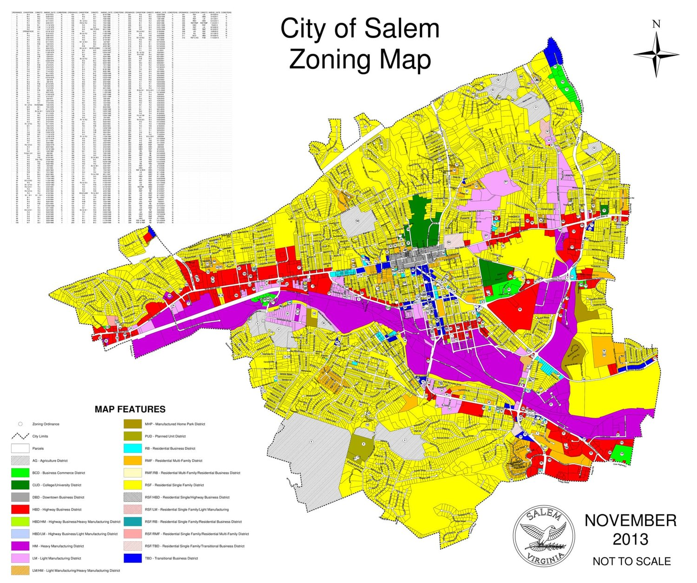
3. Zoning in Transport Planning
3.3. Why zoning matters? Cont.
Introduction to Transport Modeling

Slide 24
Section 04:
Input Data
Introduction to Transport Modeling

Slide 25
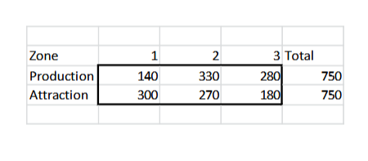
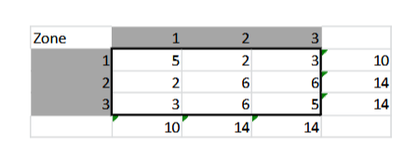
4. Input Data
4.1. Required Input Data
Productions [P]
Attractions [A]
Origin-Destination Matrix
Cost Matrix
Choose a Friction Function
P & A table
OD Matrix
Introduction to Transport Modeling

Slide 26
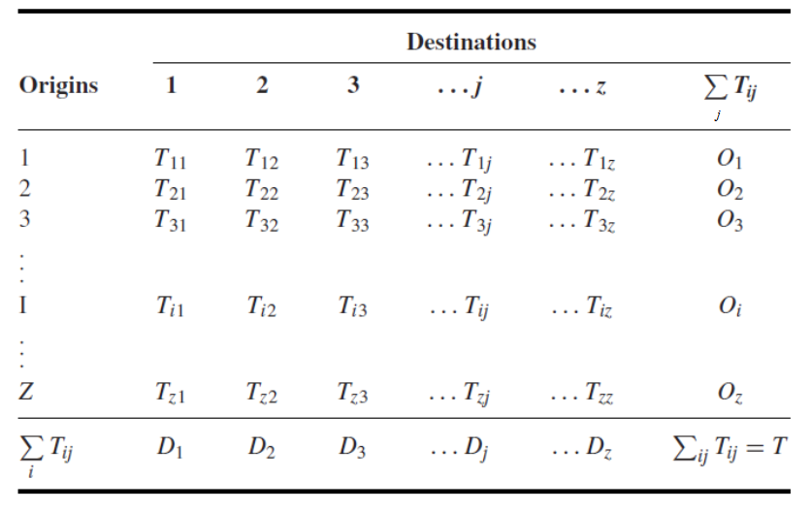
4. Input Data
4.2. Origin-Destination Matrix
Introduction to Transport Modeling

Slide 27
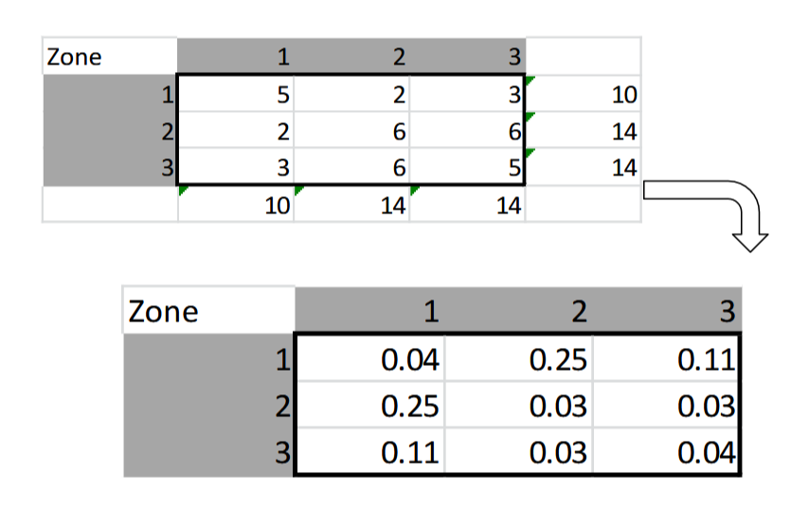
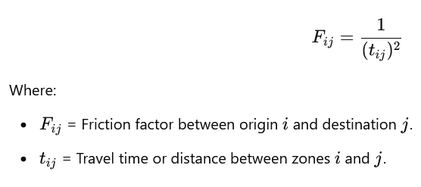
4. Input Data
4.3. Fij – Friction Factor & Cost Matrix
Selected Fij (Friction Factor) = Inverse Square Fn
Cost Matrix
Introduction to Transport Modeling

Slide 28
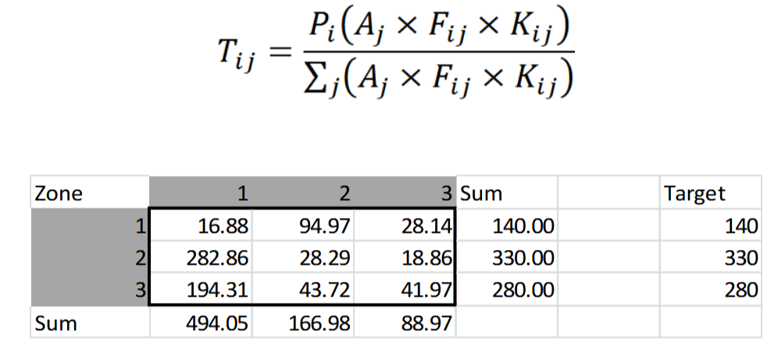
4. Input Data
.4. Tij Matrix
Apply the values and calculate the Tij values and create the below table
Apply balancing factors, bj =1.00, ai = (300/494.05) and so on.
Introduction to Transport Modeling

Slide 29
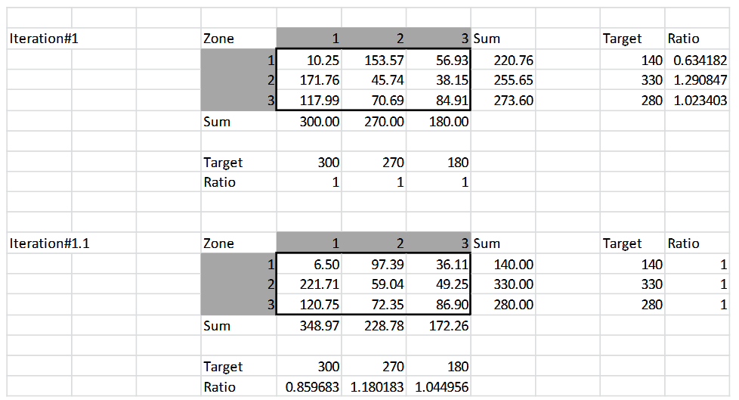
4. Input Data
4.5. Balancing Iteration #1
Apply balancing factors for each iteration.
New value is calculated by multiplying previous values and both ai, bj ratios
Introduction to Transport Modeling

Slide 30
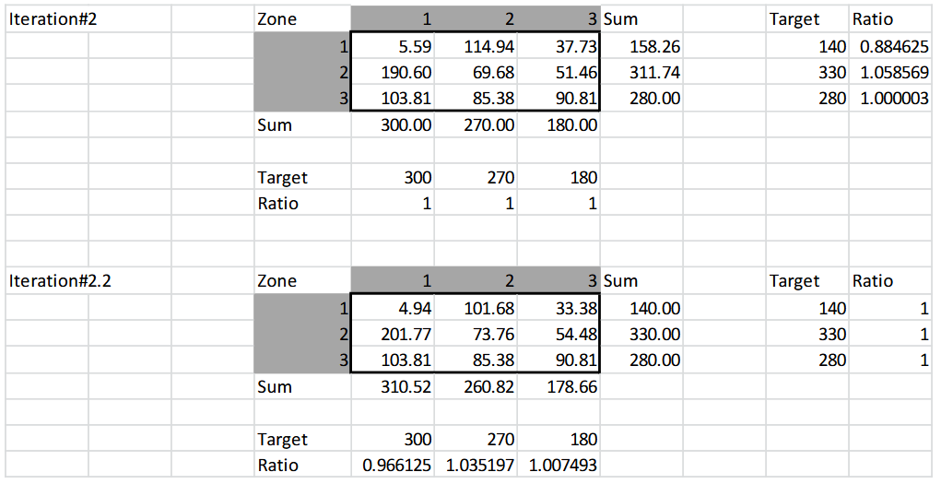
4. Input Data
4.5. Balancing Iteration #2
Apply balancing factors for each iteration.
New value is calculated by multiplying previous values and both ai, bj ratios
Introduction to Transport Modeling

Slide 31
Section 05:
Practical Example
Introduction to Transport Modeling

Slide 32


5. Practical Example
5.1. Calibration
Conduct an iterative procedure till convergence criteria is satisfied.
Also, can write programs to automate this procedure.
Let's proceed with a practical example using “Exponential Friction Factor” in EXCEL and PYTHON for calibration and calculations.
For “Exponential Friction Factor”, we use different “β” values for calibration.
Until we meet balanced or convergence criteria, we guess the “β” values for different iterations.
Introduction to Transport Modeling

Slide 33
5. Practical Example
5.1. Gravity Model Analysis with Excel
Activity 1: Excel – Trip Distribution Setup
  File: Trip Distribution Lab Example.xlsx
  Platform: Microsoft Excel (or Google Sheets)
  Purpose: Manual setup and understanding of Gravity Model calculations
  Steps:
    Open the Excel file and review:
      Zone-level Trip Productions (P) and Attractions (A)
      Skim Matrix (Cij): Travel cost between zones
      Friction factor (Fij) calculated via: f(c) = exp(-β × Cij)
    Observe the resulting trip distribution matrix and average trip length
    This file sets the foundation for what we’ll do in Python
Introduction to Transport Modeling

Slide 34
5. Practical Example
5.2. Gravity Model Analysis with Python
Activity 2: Python (Colab) – Fixed β values Gravity Model
  File: Gravity_Model_Student_Input.ipynb
  Platform: Google Colab
  Purpose: Automate trip distribution using a fixed β value
  Steps:
    Upload the file to Google Colab
    Input your own:
      Number of zones
      Productions (P) and Attractions (A)
      Cost Matrix (Cij)
    β value is fixed in the code (beta = -0.035)
    Run all cells to view:
      Trip matrix
      Heatmap
      Convergence plots
      Average trip length
Introduction to Transport Modeling

Slide 35
5. Practical Example
5.2. Gravity Model Analysis with Python
Activity 3: Python (Colab) – Fixed P, A, C Gravity Model
  File: Interactive_Gravity_Model_Lab.ipynb
  Platform: Google Colab
  Purpose: Visualize the impact of changing β on a fixed OD system
  Steps:
    Upload the notebook to Colab
    No need to input P, A, or C — these are preloaded
    Use the slider to change β (e.g., -0.01 to -0.20)
    Observe:
      Trip matrix updates
      Convergence plots
      Friction factor curve
Introduction to Transport Modeling

Slide 36
5. Practical Example
5.2. Gravity Model Analysis with Python
Activity 4: Python (Colab) – Gravity Model (β Slider + Sensitivity)
  File: Gravity_Model_Student_Input(Exponential_Deterrence_Function).ipynb
  Platform: Google Colab
  Purpose: Fully interactive tool to test different OD systems and β values
  Steps:
    Upload to Colab
    Input:
      Zone count
      Productions (P), Attractions (A)
      Cost matrix (Cij)
      Adjust β via slider
    Run the model and analyze:
      Convergence pattern
      Trip matrix and heatmap
      Friction curve
Introduction to Transport Modeling

Slide 37
5. Practical Example
5.2. Gravity Model Analysis with Python
Activity 5: Python (Colab) – Manual Friction Factor Matrix
  File: Gravity_Model_Manual_Friction.ipynb
  Platform: Google Colab
  Purpose: Manually define friction factors (Fij) for full control
  Steps:
    Upload to Colab
    Enter:
      P, A, C as before
      A custom Fij matrix directly
    Run to see how manual adjustments affect trip balancing
Introduction to Transport Modeling

Slide 38
5. Practical Example
5.2. Gravity Model Analysis with Python
Activity 6: Python (Colab) – Transport Demand Prediction (Regression)
  File: Transport_Demand_Regression_Lab.ipynb
  Platform: Google Colab
  Purpose: Use real-world transport data to predict passenger demand
  Steps:
    Open and run through all cells
    Perform EDA, train a linear regression model
    Use distance, fare, and route data to forecast number of passengers
Introduction to Transport Modeling

Slide 39
5. Practical Example
5.3. Interpretation of Results
Key Insights from Practical Application:
What happens if travel times increase?
How does calibration affect the results?
How do different “β” values change trip distribution?
References
https://www.youtube.com/watch?v=ADnEmJInvpA
https://www.youtube.com/watch?v=wCvchbssjfc
Introduction to Transport Modeling

Slide 40
Section 06:
Homework Assignment
Introduction to Transport Modeling

Slide 41
6. Homework Assignment
6.1. Gravity Model Analysis with Sensitivity Exploration
Objective
You are expected to:
  Apply the gravity model to a custom OD system
  Calibrate trip distribution using the exponential friction function
  Analyze the effect of varying β (deterrence parameter)
  Interpret convergence and spatial distribution patterns
Introduction to Transport Modeling

Slide 42
6. Homework Assignment
6.1. Gravity Model Analysis with Sensitivity Exploration
Steps:
Your Own OD System:
  Define a 4-zone or 5-zone system.
  Set Production and Attraction values for each zone.
  Create a Travel Cost (Skim) Matrix (in minutes or generalized cost).
Use the Provided Notebook:
  Open the notebook: Gravity_Model_Student_Input(Exponential_Deterrence_Function).ipynb.
  Input your own data.
  Run the model for at least three different β values (e.g., -0.01, -0.035, -0.10).
  Record outputs for each run: trip matrix, convergence behavior, average trip length, heatmap, and F(c) curve.
Introduction to Transport Modeling

Slide 43
6. Homework Assignment
6.1. Gravity Model Analysis with Sensitivity Exploration
Analysis:
  Compare the three β values:
    How did trip distribution change?
    What happened to convergence speed and error plots?
    What trends did you observe in friction factor curves?
Save Your Work:
  Download and save your modified .ipynb file.
  Export your trip matrices and plots for the report (screenshots or images).
Deliverables:
  .ipynb file.
  Homework Report PDF
Deadline: 1 week
Introduction to Transport Modeling

Slide 44
6. Homework Assignment
6.2. Lab Report Structure
Section | Title | Description
1 | Title Page | Lab title, course, student name, ID, date
2 | Objectives | Goals and intended learning outcomes of the lab
3 | Introduction | Input Data,Table of zones, production, attraction, and travel cost matrix
4 | Methodology | Describe the exponential friction function and how β affects F(c)
5 | β Calibration Results | For each β: include trip matrix, convergence behavior (iterations), average trip length, and heatmap
6 | Discussion + Comments | Comparison of β Scenarios Comparative observations: effect on trip distribution patterns and convergence Interpretation & Insights What do the results imply in a transport planning context? (e.g., short trips more likely with high friction, etc.)
7 | Conclusion | Summary of learnings and reflections
8 | References | Cited sources: datasets, software, tutorials
9 | Appendices | Code, extra plots, screenshots, raw data excerpts
Introduction to Transport Modeling

Slide 45
Thank you for your attention!

