Slide 1
Transport Research and Analysis
Module 3: Transport Modeling and Simulation
Lecture 10: Introduction to Transport Modeling

Slide 3
Table of contents
Section 1 Introduction to Transport Modelling …….......................... 3
What is Transport Modelling? ....................................................... 4
How Do We Model Real-World Transport Systems? .................... 5
The Four-Step Transport Model ................................................... 6
Assumptions & Limitations of Transport Modelling ....................... 8
Example - Predicting Traffic Congestion ...................................... 9
Section 2 Purpose & Applications of Transport Models .................. 10
Key Functions of Transport Models ...................................... 11
Sectors Using Transport Models …...................................... 12
Real-World Applications of Transport Modelling …........... 13
Why is Transport Modelling Important? ........................... 14
Case Study – Optimizing Public Transport in London ....... 15
Section 3 Types of Transport Models ................................................ 17
Overview of Transport Model Classifications .................... 18
Macroscopic Models – City-Wide Analysis ....................... 19
Microscopic Models – Individual Vehicle Behavior ............ 21
Mesoscopic Models – Hybrid Approach ........................... 23
Section 4 Mathematical Approaches in Transport Modelling …..…….... 25
Deterministic Models – Predict Fixed Outcomes ................... 26
Stochastic Models – Introduces Randomness ....................... 27
Additional mathematical approaches .................................... 28
Case Study – AI-Based Traffic Prediction in Singapore ......... 29
Section 5 Transport Model Development Process ................................... 30
Steps in Developing a Transport Model ................................ 31
Step 01 - Define the Research Objective .............................. 32
Step 02 - Data Collection – Traffic counts, GPS data, travel surveys .............................................................................. 33
Step 03 - Select Model Type (Macroscopic, Microscopic, Mesoscopic) ....................................................................... 34
Step 04 - Calibration & Validation …..................................... 35
Step 05 - Implementation & Scenario Testing ….............….... 36
Challenges in Model Development ....................................... 37
Case Study – Tokyo’s Transport Model …............................. 38
Case Study – Impact of COVID-19 on Transport Modelling .... 40
Section 6 Quiz & Group Discussion ........................................................... 43
Quiz ................................................................................... 44
Group Discussion ................................................................ 45
Introduction to Transport Modeling

Slide 4
0. Objectives
0.1. Learning Objectives
0.2. Objectives
Define & Understand: Grasp the fundamental definition of transport modeling and its critical role in informing policy, infrastructure planning, and sustainable development.
Master the Framework: Analyze the classic "Four-Step Transport Model" (Generation, Distribution, Mode Choice, Assignment) as the backbone of urban planning.
Differentiate Approaches: Distinguish between Macroscopic (city-wide), Microscopic (individual behavior), and Mesoscopic (hybrid) modeling methodologies.
Apply & Evaluate: Understand the model development lifecycle—from data collection to calibration—and evaluate real-world applications like congestion pricing.
Introduction to Transport Modeling
Notes:
More details will be discussed in the future lectures

Slide 5
Section 01:
Introduction to Transport Modelling
Introduction to Transport Modeling

Slide 6
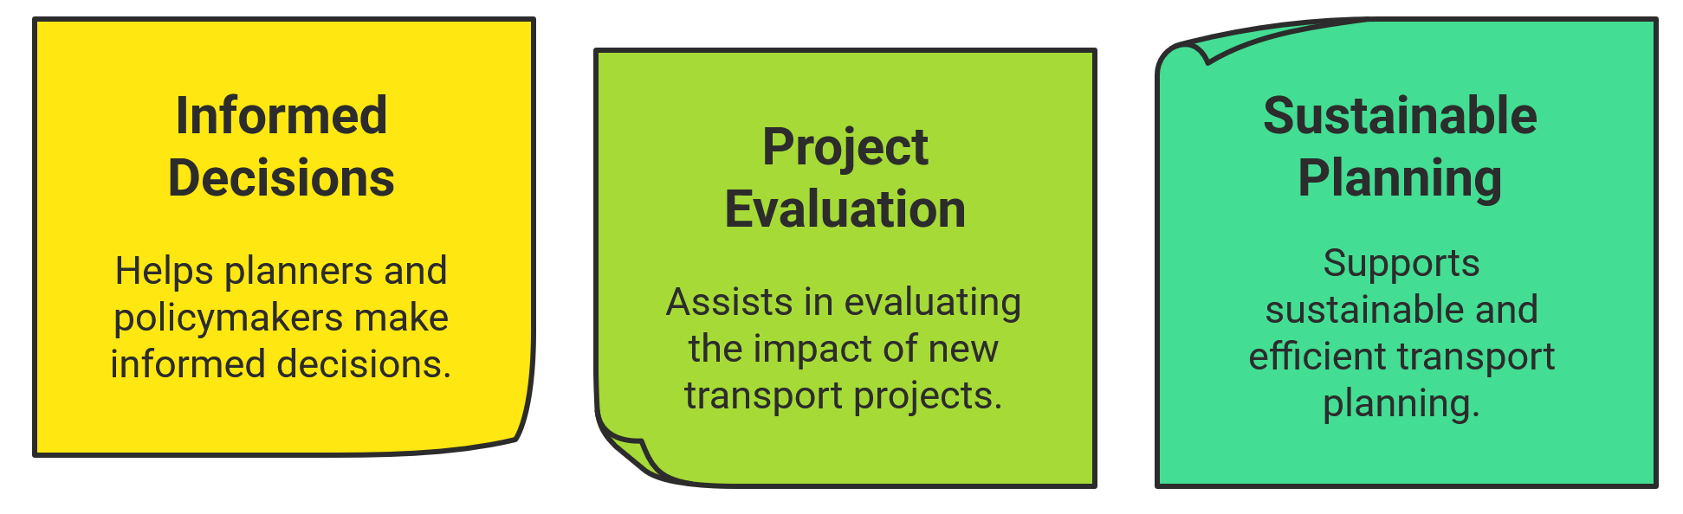
1. Introduction to Transport Modelling
1.1. What is Transport Modelling?
Definition
Transport modelling is a mathematical representation of real-world transport systems used for analysis and decision-making.
It helps to simulate and forecast future transport behavior based on demand, infrastructure, and policies.
Why is it Important?
Introduction to Transport Modeling

Slide 7
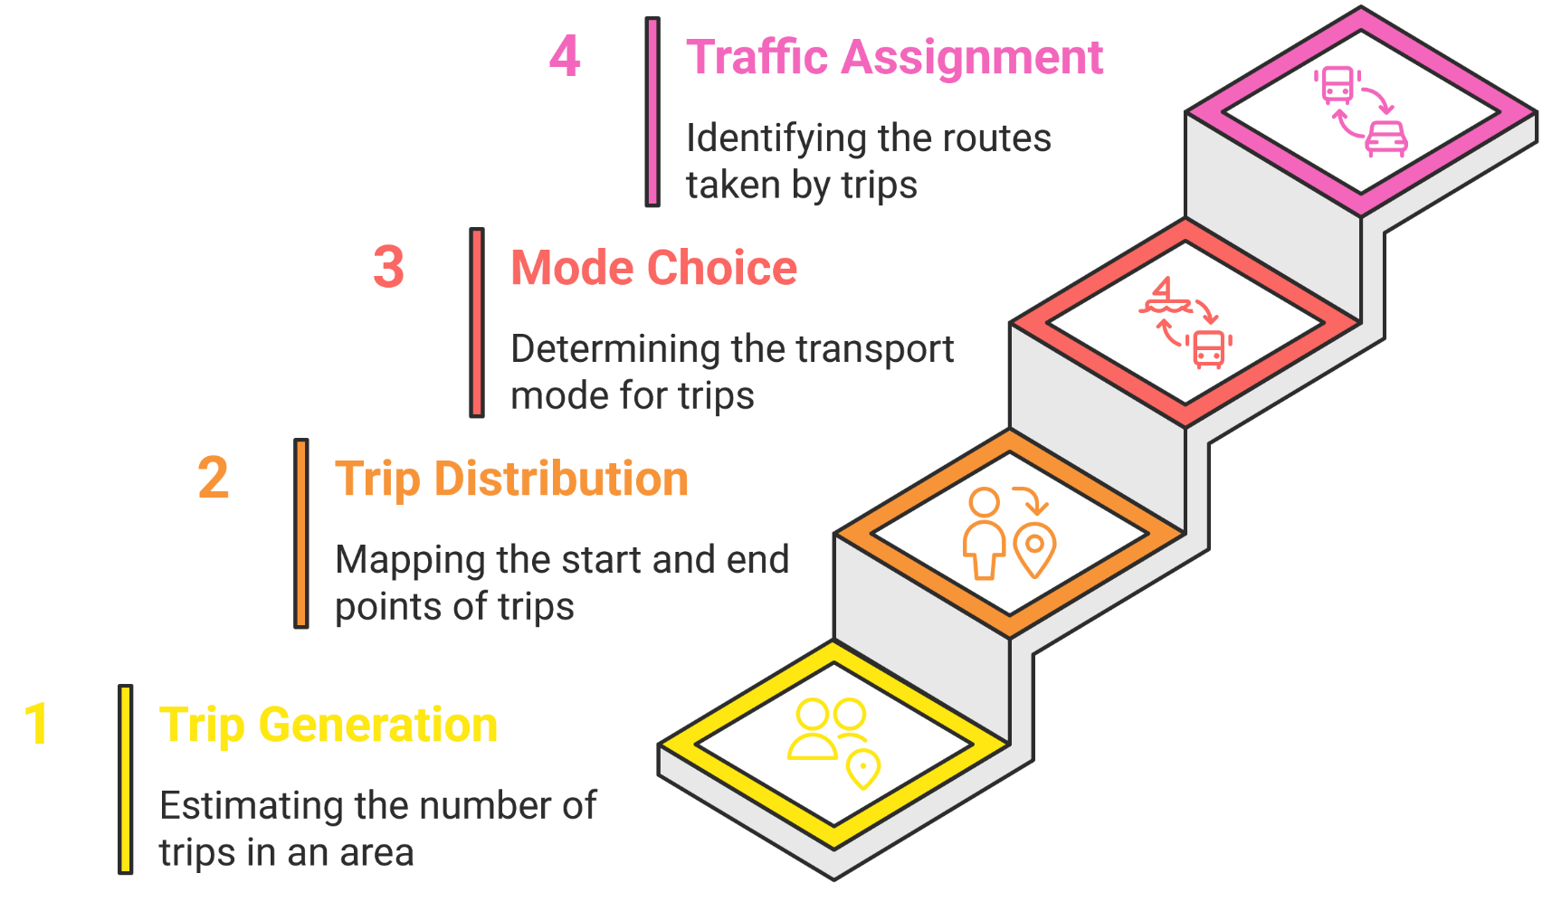
1. Introduction to Transport Modelling
1.2. How Do We Model Real-World Transport Systems?
There are many advanced models exists today, but the Four-Step Model remains the backbone of urban transport planning and is still widely used.
The Four-Step Transport Model
Introduction to Transport Modeling

Slide 8
1. Introduction to Transport Modelling
1.3. The Four-Step Transport Model
Trip Generation
Determines the number of trips originating from and destined for different geographic zones.
Factors affecting trip generation include:
  Land use (residential, commercial, industrial)
  Socio-economic characteristics (income, car ownership)
  Accessibility
Trip Distribution
Matches trip origins to trip destinations (Origin-Destination pairs).
Methods include:
  Gravity models – Trips are more likely between active zones but decrease with distance or cost.
  Growth-factor models – Uses past data to predict future trends.
  Entropy-maximizing approach – A statistical method for trip distribution patterns.
Introduction to Transport Modeling
Notes:
More details will be discussed in the future lectures

Slide 9
1. Introduction to Transport Modelling
1.3. The Four-Step Transport Model
Mode Choice
Determines what transport mode is used for each trip.
Influencing factors:
  Travel time and cost
  Comfort and convenience
  Availability of transport options
Traffic Assignment
Assigns trips to specific routes within the transport network.
Private vehicle assignment considers:
  Road selection based on travel time and congestion.
Public transport assignment considers:
  Route frequency, transfers, and capacity.
Introduction to Transport Modeling

Slide 10
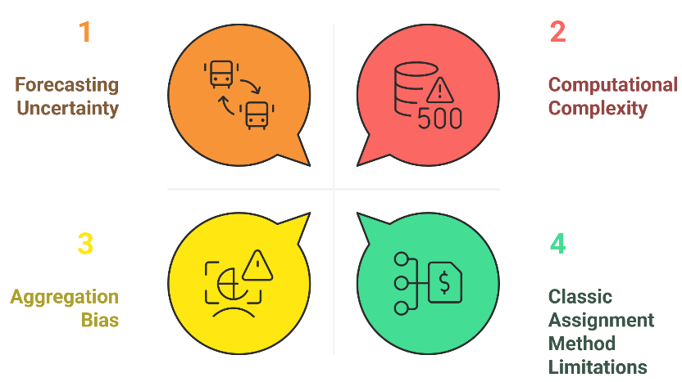
1. Introduction to Transport Modelling
1.4. Assumptions & Limitations of Transport Modelling
Key Assumptions:
Transport models simplify reality, relying on assumptions for decision-making.
Travelers are assumed to make rational choices (route, mode, destination) based on utility maximization.
Accuracy depends on high-quality input data, balancing model complexity and data precision.
Key Limitations:
Forecasting Uncertainty: Transport behavior is dynamic and difficult to predict precisely.
Computational Complexity: Large-scale models require significant computing resources.
Classic Assignment Method Limitations:
  Assumes all travelers perceive costs similarly.
  Assumes perfect knowledge of travel costs across the network.
  Struggles to represent day-to-day variations and dynamic traffic conditions.
  Errors in input data impact model reliability.
Aggregation Bias: Moving from disaggregate (individual) data to aggregate predictions can introduce inaccuracies.
Introduction to Transport Modeling

Slide 11
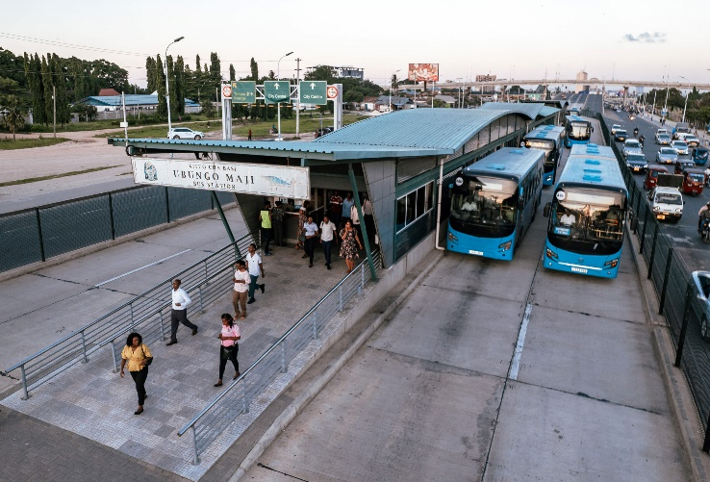
1. Introduction to Transport Modelling
1.5. Example – Predicting Traffic Congestion
Scenario:
A city plans to introduce a bus rapid transit (BRT) system.
Using the Four-Step Model:
Trip Generation – Identify areas with high travel demand, focusing on commuters along the BRT corridor.
Trip Distribution – Predict how travel patterns change, with some car users shifting to BRT.
Mode Choice – Model how factors like cost and travel time influence the shift from private cars to BRT.
Trip Assignment – Simulate traffic flow changes, showing reduced congestion on key roads.
Model Output:
Less congestion on major arterial roads.
More public transport usage.
Potential congestion shifts on feeder roads.
Introduction to Transport Modeling

Slide 12
Section 02:
Purpose & Applications of Transport Models
Introduction to Transport Modeling

Slide 13
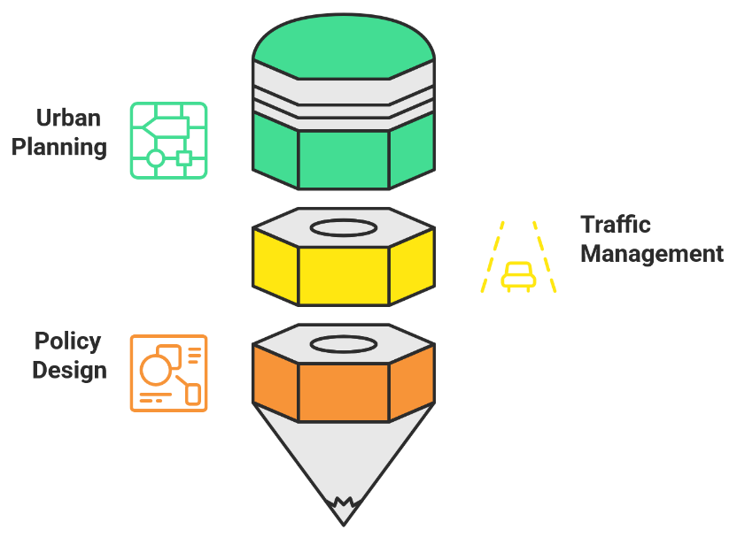
2. Purpose & Applications of Transport Models
2.1. Key Functions of Transport Models
Urban Planning: Designing Transport Networks
Helps plan and evaluate transport infrastructure (roads, public transport).
Assesses demand for new projects and their cost-benefit trade-offs.
Aids in optimizing spatial distribution of activities and zoning systems.
Traffic Management: Optimizing Congestion Control
Analyzes supply-demand balance to evaluate congestion solutions.
Assesses the impact of policies like bus priority lanes and congestion pricing.
Helps study peak-period congestion and dynamic traffic conditions.
Policy Design: Evaluating Investment Decisions
Forecasts the impact of transport policies and infrastructure investments.
Supports decision-making by predicting effects on congestion, delays, and emissions.
Private sector use: demand forecasting for revenue projections in transport projects.
Introduction to Transport Modeling

Slide 14
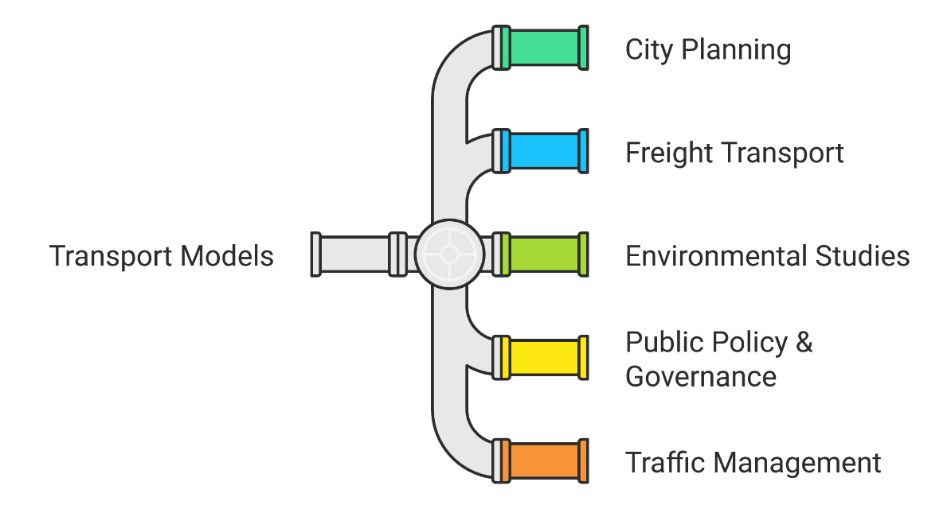
2. Purpose & Applications of Transport Models
2.2. Sectors Using Transport Models
Example:
City Planning – Forecasting travel demand for new metro lines and road expansions.
Freight Transport – Optimizing supply chain routes and logistics efficiency.
Environmental Studies – Assessing emissions reduction from sustainable transport policies.
Public Policy & Governance – Evaluating the impact of transport investments and regulations.
Traffic Management – Analyzing congestion patterns to improve road network performance.
Introduction to Transport Modeling

Slide 15
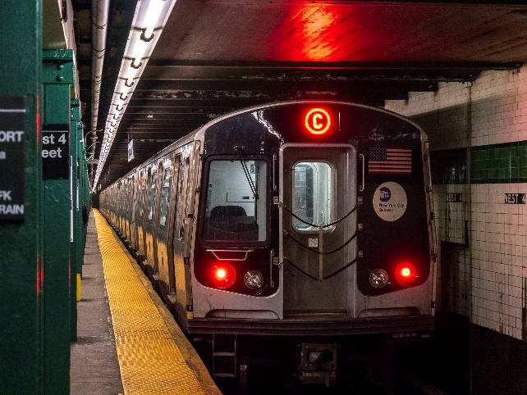
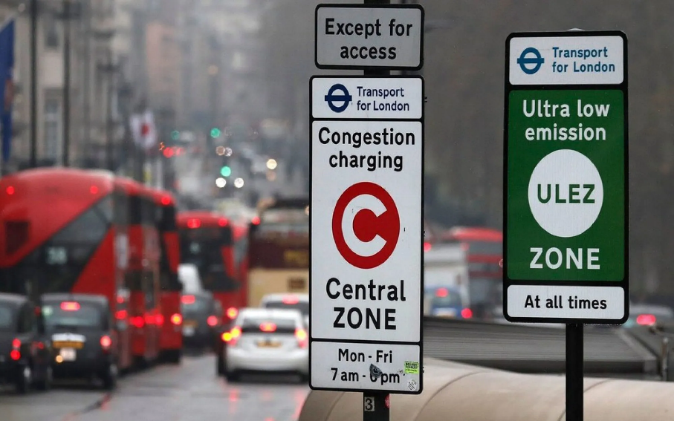
2. Purpose & Applications of Transport Models
2.3. Real-World Applications of Transport Modelling
Example:
Singapore – Used transport models to optimize public transit, reducing congestion.
London – Implemented congestion pricing models to manage peak-hour traffic.
New York – Subway and bus network models help improve transit efficiency.
Freight & Logistics – Companies like Amazon & FedEx use models to optimize supply chains.
Autonomous Vehicles – Transport models aid in testing self-driving car deployment.
New York Subway
London congestion system
Introduction to Transport Modeling

Slide 16
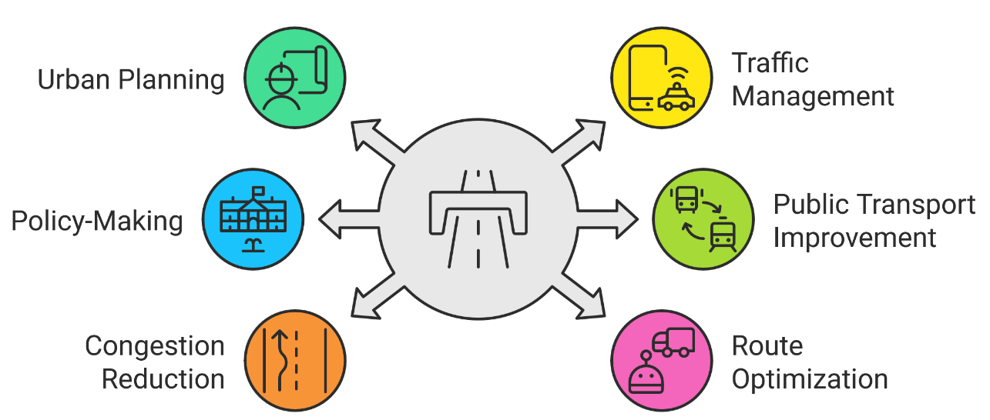
2. Purpose & Applications of Transport Models
2.4. Why is Transport Modelling Important?
Key Points:
Analyzes, predicts, and optimizes mobility patterns.
Essential for urban planning, traffic management, and policy-making.
Real-World Impact:
Cities improve public transport and reduce congestion using transport models.
Freight & logistics industries optimize delivery routes with predictive models.
Supports sustainable mobility by evaluating environmental impacts.
Introduction to Transport Modeling

Slide 17
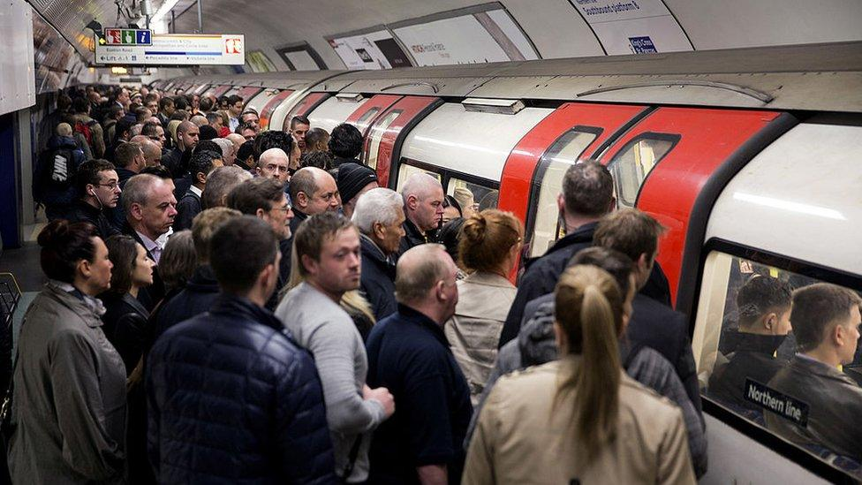
2. Purpose & Applications of Transport Models
2.5. Case Study – Optimizing Public Transport in London
Background: Public Transport Challenges in London
Problem: London’s metro (Tube) and bus network faced overcrowding, delays, and inefficiencies.
Key Issues:
Peak-hour congestion leading to longer commute times.
Inconsistent bus frequencies affecting passenger reliability.
Unpredictable traffic conditions causing delays in public transport.
Role of Transport Modelling in the Solution
How was transport modelling applied?
Macroscopic Demand Models: Used to predict passenger volumes on different routes.
Microscopic Simulation Models: Analyzed real-time bus movements to identify bottlenecks.
AI-Based Traffic Flow Models: Adjusted bus and metro schedules dynamically based on demand.
Introduction to Transport Modeling

Slide 18
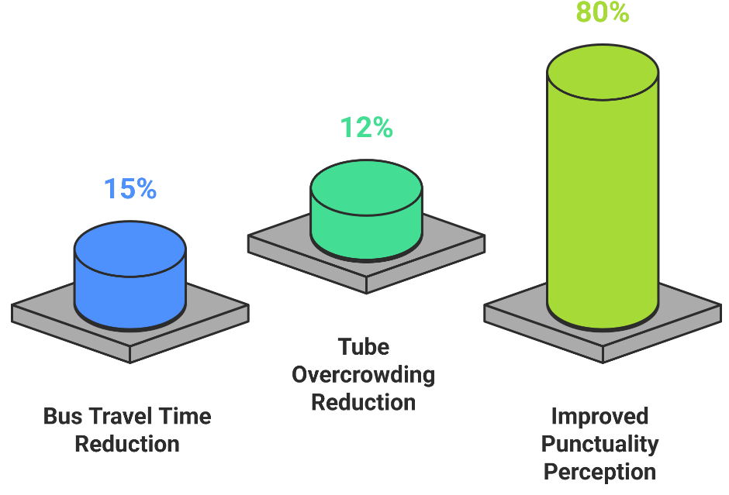
2. Purpose & Applications of Transport Models
2.5. Case Study – Optimizing Public Transport in London Cont.
Key Modifications Implemented:
Optimized Bus Frequency → Increased buses during peak hours.
Real-Time Traffic Monitoring → AI adjusted metro and bus timetables dynamically.
Congestion Management → Introduced smart fare pricing & travel demand redistribution.
Results & Impact
Bus travel times reduced by 15% due to optimized scheduling.
Tube overcrowding dropped by 12%, improving passenger comfort.
Better commuter experience → 80% of surveyed passengers noticed improved punctuality.
Lower carbon footprint due to fewer idle vehicles and congestion reduction.
Introduction to Transport Modeling

Slide 19
Section 03:
Types of Transport Models
Introduction to Transport Modeling

Slide 20
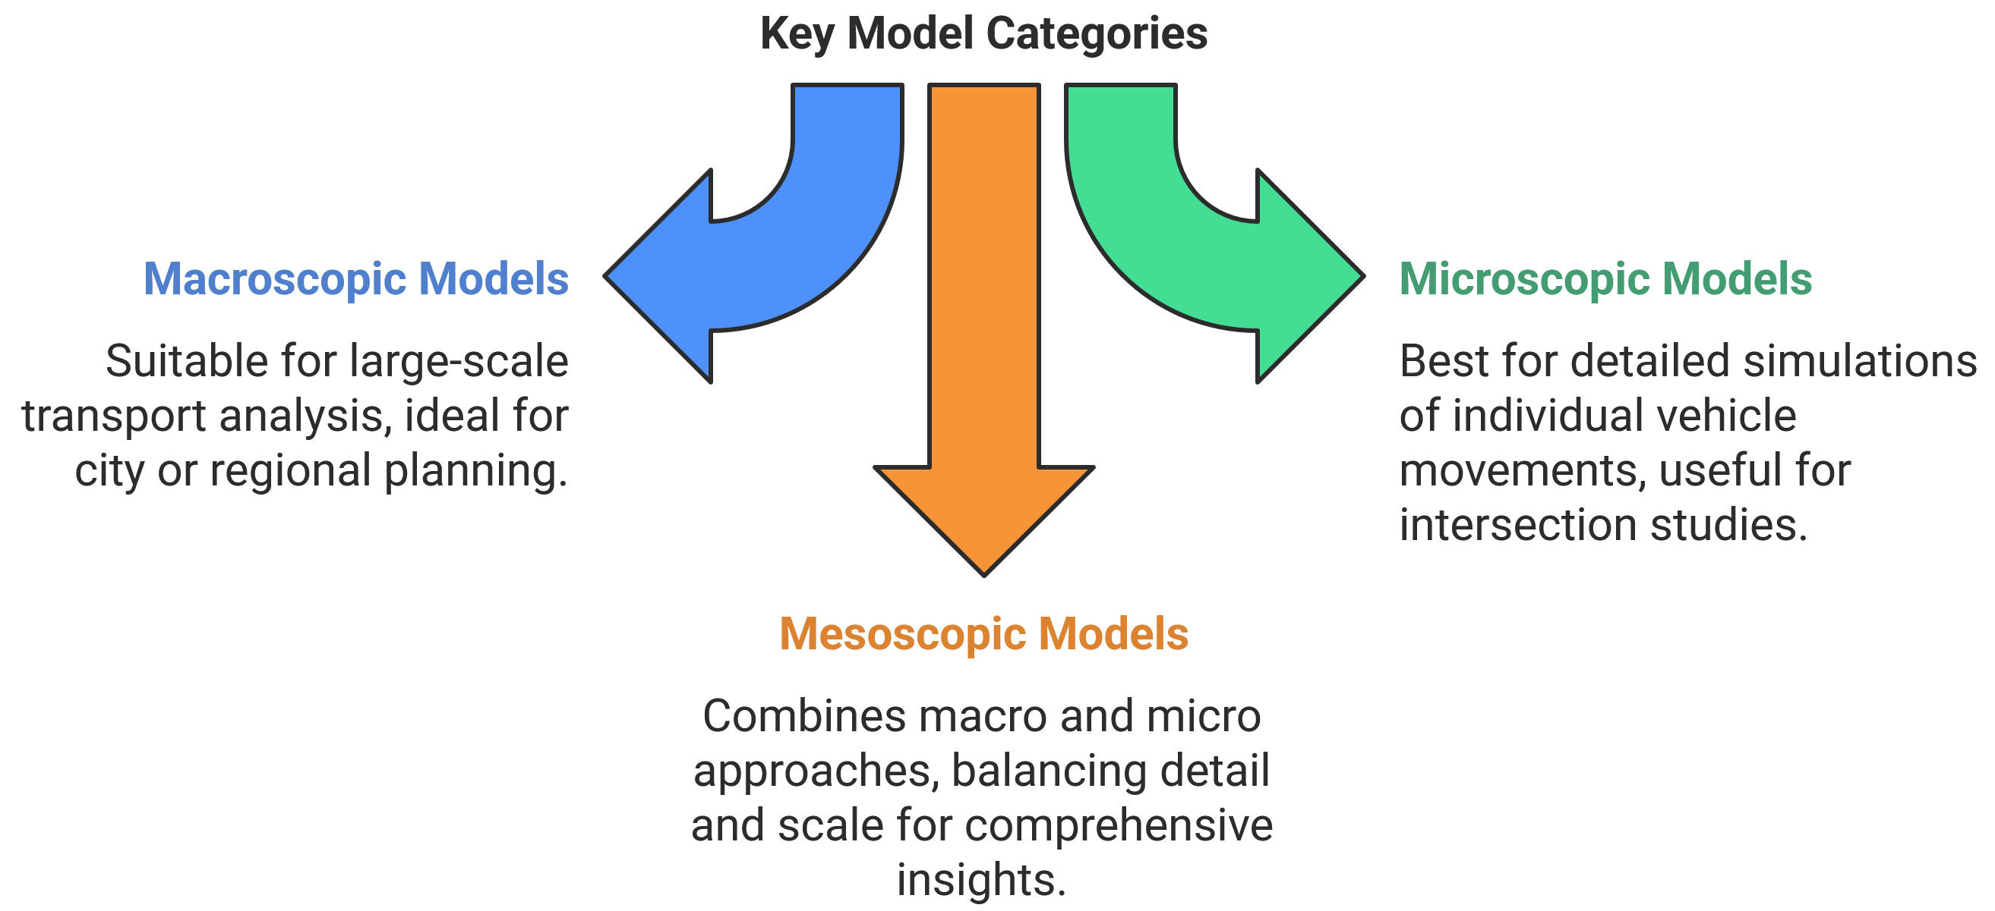
3. Types of Transport Models
3.1. Overview of Transport Model Classifications
Introduction to Transport Modeling

Slide 21
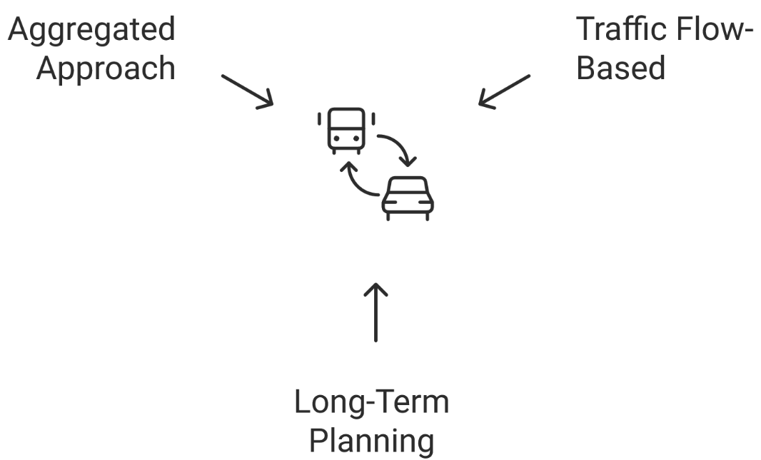
3. Types of Transport Models
3.2. Macroscopic Models – City-Wide Analysis
Definition:
Macroscopic models analyze large-scale transport networks by treating traffic as a continuous flow, rather than tracking individual vehicles.
These models estimate overall traffic demand and network capacity, helping planners make long-term infrastructure decisions.
Key Characteristics:
Aggregated Approach: Works with large datasets, not individual vehicle movements.
Traffic Flow-Based: Uses equations like the Speed-Flow-Density Relationship.
Long-Term Planning: Best for regional transport strategies, metro expansion, and road network forecasting.
Introduction to Transport Modeling

Slide 22
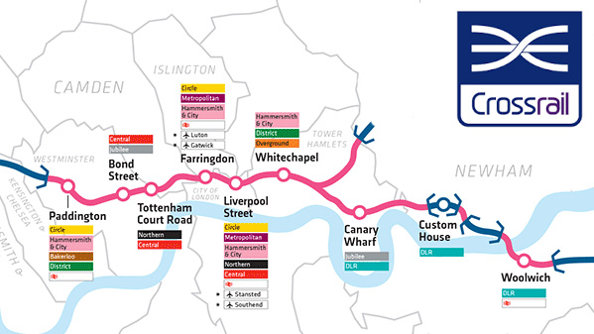
3. Types of Transport Models
3.2. Macroscopic Models – City-Wide Analysis Cont.
Example: Forecasting Future Metro Line Demand
Crossrail in London → Transport models were used to predict ridership, optimize train frequency, and justify investment.
Used in large-scale transport studies for highway expansions, metro feasibility, and national transport policies.
Common Macroscopic Modelling Techniques
Four-Step Transport Model (FSM): Trip generation, trip distribution, mode choice, and traffic assignment.
Volume-Delay Functions: Predicts how travel time increases with congestion.
Introduction to Transport Modeling

Slide 23
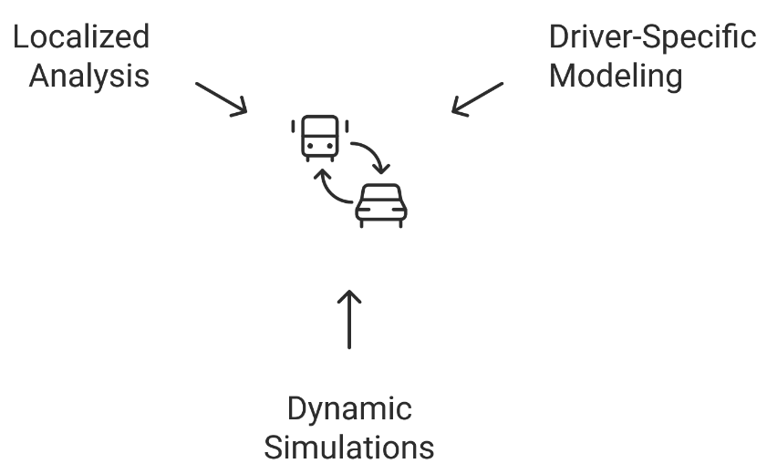
3. Types of Transport Models
3.3. Microscopic Models – Individual Vehicle Behavior
Definition:
Microscopic models simulate individual vehicle interactions, including acceleration, lane-changing, and stopping behavior.
Used for detailed analysis of traffic operations, intersections, and highway systems.
Key Characteristics:
Driver-Specific Modeling: Captures behavior like lane-changing, merging, and reaction times.
Dynamic Simulations: Each vehicle is modeled as a separate entity.
Best for Localized Analysis: Used in evaluating intersection efficiency, roundabout designs, and autonomous vehicle testing.
Introduction to Transport Modeling

Slide 24
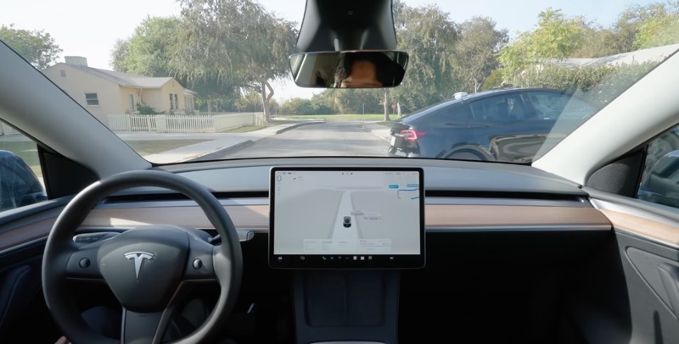
3. Types of Transport Models
3.3. Microscopic Models – Individual Vehicle Behavior Cont.
Example: Evaluating Road Safety Policies Using AI-Based Driver Models
Simulating lane-changing behavior to assess accident-prone areas.
Testing traffic light optimization strategies in urban settings.
Used for self-driving car simulations (e.g., Tesla, Waymo).
Common Microscopic Modelling Techniques
Car-Following Models – Simulates how drivers maintain distance (e.g., Gipps Model, Intelligent Driver Model).
Lane-Changing Models – Predicts driver decisions to switch lanes (e.g., MOBIL Model, Wiedemann Model).
Gap-Acceptance Models – Used for merging and intersection behavior analysis.
Common Microscopic Modelling Software:
VISSIM, AIMSUN, SUMO, TransModeler – Simulates vehicle-level movements.
Introduction to Transport Modeling

Slide 25
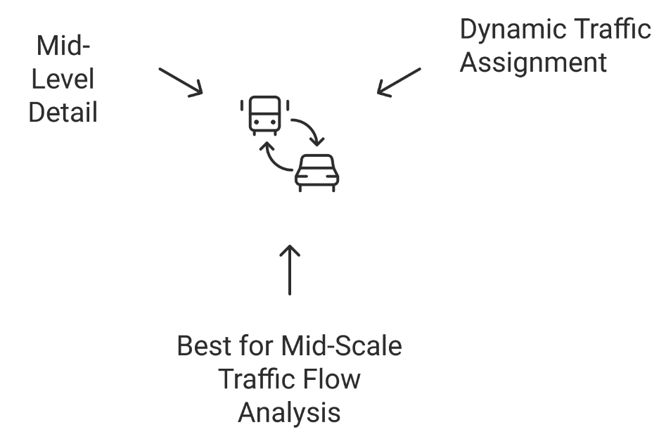
3. Types of Transport Models
3.4. Mesoscopic Models – Hybrid Approach
Definition:
Simulating lane-changing behavior to assess accident-prone areas.
Testing traffic light optimization strategies in urban settings.
Used for self-driving car simulations (e.g., Tesla, Waymo).
Key Characteristics:
Mid-Level Detail: Captures vehicle groups rather than every individual vehicle.
Dynamic Traffic Assignment: Simulates how traffic evolves over time.
Best for Mid-Scale Traffic Flow Analysis: Works well for corridor-level studies, traffic incident impact assessment, and congestion pricing evaluation.
Introduction to Transport Modeling

Slide 26
3. Types of Transport Models
3.4. Mesoscopic Models – Hybrid Approach Cont.
Example: Traffic Simulation for Toll Road Pricing in the Netherlands
Mesoscopic models helped predict how dynamic toll pricing influences driver route choice.
Result: Reduced peak-hour congestion by shifting demand to alternative routes.
Where Are Mesoscopic Models Used?
Urban Traffic Management Systems → Predicts traffic congestion at city-level intersections.
Toll Road Analysis → Evaluates driver behavior in response to pricing strategies.
Express Lane Simulations → Used in California to optimize HOV lane policies.
Common Mesoscopic Modelling Software:
AIMSUN Next, Dynameq, MATSim, PTV Vistro – Used for corridor-based traffic analysis.
Introduction to Transport Modeling

Slide 27
Section 04:
Mathematical Approaches in Transport Modelling
Introduction to Transport Modeling

Slide 28
4. Mathematical Approaches in Transport Modelling
4.1. Deterministic Models – Predict Fixed Outcomes
Definition:
Uses fixed mathematical equations to predict exact transport conditions.
Assumes consistent driver behavior and fixed demand levels.
Example:
A deterministic model can predict exact congestion levels on a highway under given conditions (e.g., traffic volume, speed limits).
Limitations:
Cannot account for sudden lane changes or unpredictable congestion.
Best suited for macroscopic models.
Introduction to Transport Modeling

Slide 29
4. Mathematical Approaches in Transport Modelling
4.2. Stochastic Models – Introduces Randomness
Definition:
Incorporates probability distributions to account for variability in travel demand and human behavior.
Simulates real-world uncertainties, making it more flexible and realistic.
Example:
A stochastic model can predict different congestion outcomes for the same highway under varying driver behaviors.
Limitations:
Microscopic and Mesoscopic Models → Used to simulate complex interactions (e.g., stop-and-go traffic patterns).
Autonomous Vehicle Testing → AI-based learning models use stochastic simulations to account for human unpredictability.
Introduction to Transport Modeling

Slide 30
4. Mathematical Approaches in Transport Modelling
4.3. Additional mathematical approaches
Mathematical Model | Description | Common Transport Applications
Agent-Based Models (ABM) | Models' individual travelers as agents making independent choices based on set rules. | Simulating pedestrian movement, ride-sharing behavior (Uber, Lyft), and evacuations.
Discrete Choice Models (DCM) | Predicts how travelers make choices (e.g., transport mode, route selection). | Mode choice analysis, impact of toll roads, pricing strategies.
Network Flow Models | Focuses on how trips move through a transport network. | Used in macroscopic models for highway capacity planning, metro network optimization.
Machine Learning-Based Models | AI-driven models that learn from large datasets to make transport predictions. | Smart traffic lights, congestion prediction, adaptive transport planning.
Cellular Automata Models (CA) | Breaks road networks into small grid cells, modeling movement at microscopic levels. | Simulating vehicle behavior in intersections, parking lot dynamics.
Introduction to Transport Modeling

Slide 31
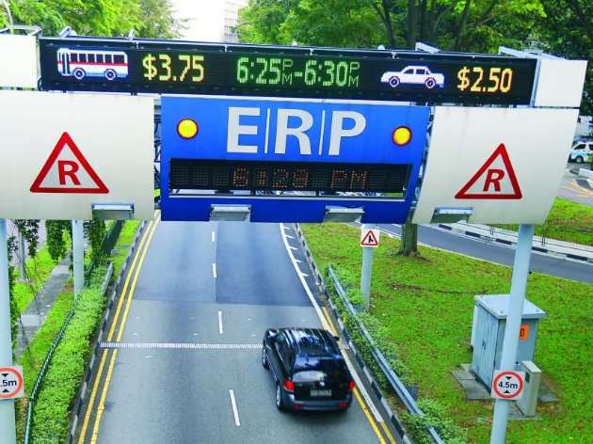
4. Mathematical Approaches in Transport Modelling
4.4. Case Study – AI-Based Traffic Prediction in Singapore
How AI-Powered Models Adjust Traffic Signals in Real-Time
Singapore’s Land Transport Authority (LTA) uses AI-based transport modelling to manage urban traffic flow.
Machine learning algorithms analyze real-time GPS data from taxis, ride-hailing apps, and road sensors.
Key Components of the Model:
Data Collection → GPS, IoT sensors, and CCTV cameras gather traffic flow data.
Prediction Models → AI algorithms forecast congestion before it happens.
Real-Time Traffic Signal Adjustments → Traffic lights dynamically change based on congestion forecasts.
Results:
15% reduction in average travel time during peak hours.
Better synchronization of traffic lights to improve flow efficiency.
Decreased vehicle emissions by reducing unnecessary idling.
Introduction to Transport Modeling

Slide 32
Section 05:
Transport Model Development Process
Introduction to Transport Modeling

Slide 33
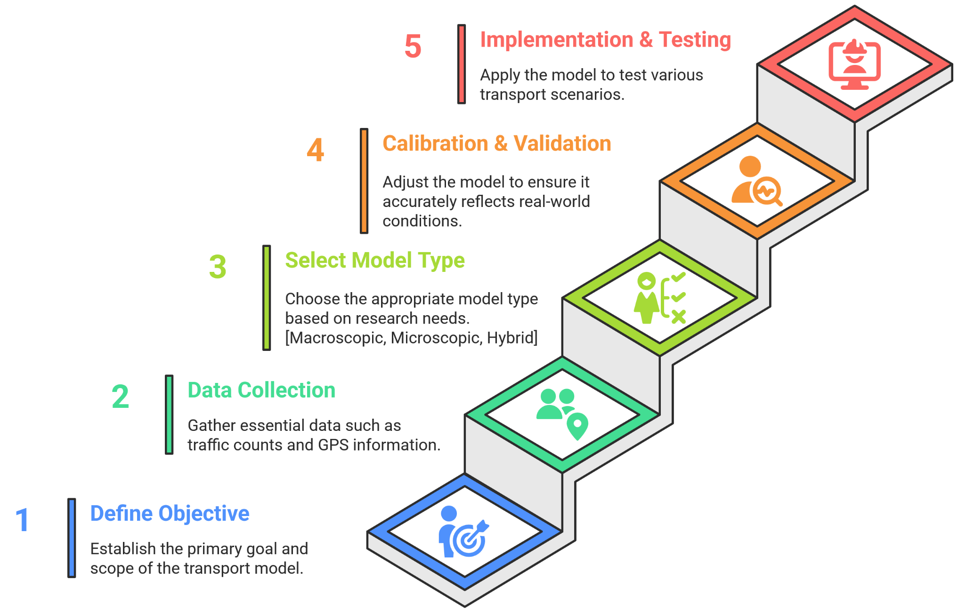
5. Transport Model Development Process
5.1. Steps in Developing a Transport Model
Introduction to Transport Modeling

Slide 34
5. Transport Model Development Process
5.2. Step 01 - Define the Research Objective
Why is this step important?
Clearly defines the problem or objective the model aims to address.
Guides the selection of model type, data sources, and performance indicators.
Key Questions to Ask:
What aspect of transport needs to be analyzed? (e.g., congestion, public transit efficiency, route optimization)
Is the goal forecasting, policy testing, or operational improvements?
What level of detail is required? (Macroscopic, Microscopic, or Mesoscopic model?)
Introduction to Transport Modeling

Slide 35
5. Transport Model Development Process
5.3. Step 02 - Data Collection – Traffic counts, GPS data, travel surveys
Why is data collection critical?
Transport models require high-quality data to make reliable predictions.
Data can be collected from multiple sources, including field surveys, sensors, and historical records.
Types of Data Used in Transport Models:
Traffic Counts: Number of vehicles passing a location at different times.
GPS & Mobile Data: Tracks vehicle movement and congestion in real-time.
Travel Surveys: Understands commuter preferences, trip frequency, and mode choice.
Land Use & Socioeconomic Data: Population density, employment, and income levels impact travel demand.
Introduction to Transport Modeling

Slide 36
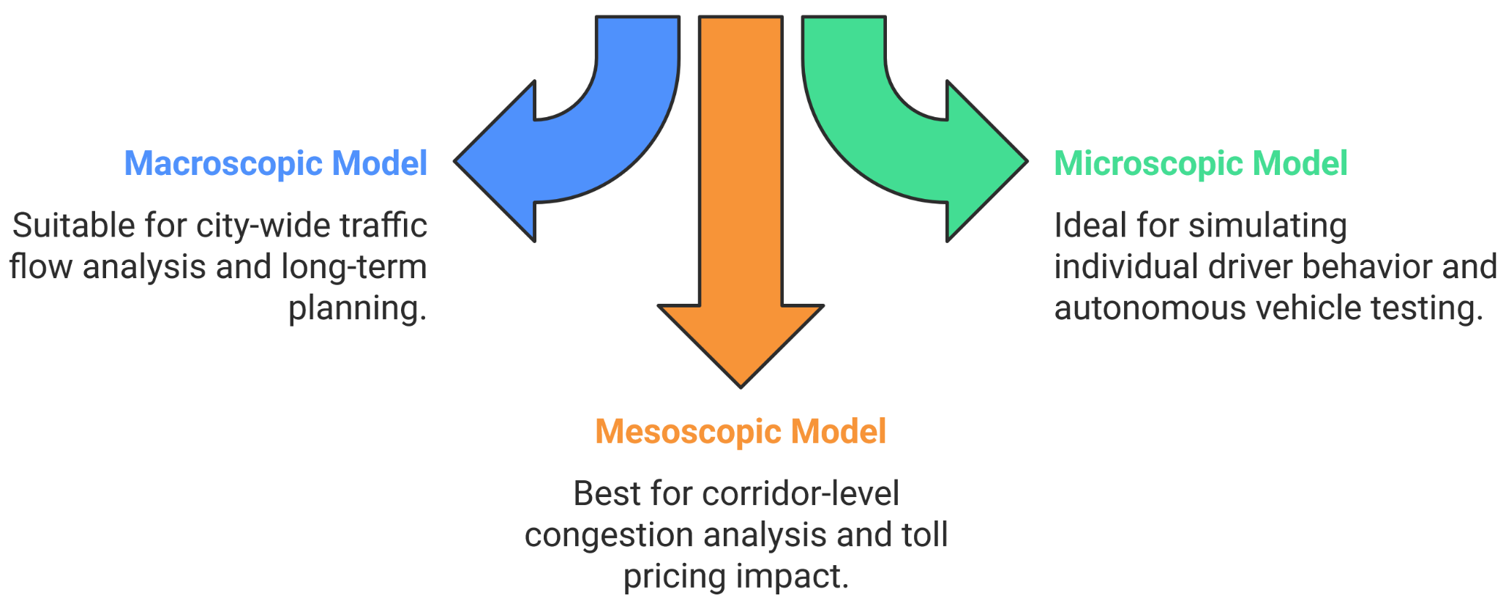
5. Transport Model Development Process
5.4. Step 03 - Select Model Type (Macroscopic, Microscopic, Mesoscopic)
Why is model selection important?
The type of model chosen depends on the research objective, data availability, and required level of detail.
Model Type Selection Criteria:
Introduction to Transport Modeling

Slide 37
5. Transport Model Development Process
5.5. Step 04 - Calibration & Validation
What is Calibration & Validation?
Calibration: Adjusting model parameters to match observed traffic behavior.
Validation: Comparing model predictions with actual transport data to measure accuracy.
Why is it necessary?
A poorly calibrated model can produce misleading results, leading to costly mistakes in transport planning.
Common Calibration & Validation Techniques:
Comparing model outputs to real-world traffic counts & travel times.
Using historical data to test the model’s accuracy.
Fine-tuning variables like travel demand elasticity & congestion delays.
Introduction to Transport Modeling

Slide 38
5. Transport Model Development Process
5.6. Step 05 - Implementation & Scenario Testing
What is Implementation & Scenario Testing?
Implementation – Applying the transport model to analyze real-world conditions.
Scenario Testing – Simulating different transport policies, infrastructure changes, or demand variations.
Why is it important?
Helps evaluate the impact of road expansions, public transit projects, or policy changes.
Identifies potential traffic bottlenecks and future mobility challenges.
Supports decision-making by testing multiple "what-if" scenarios before implementation.
Introduction to Transport Modeling

Slide 39
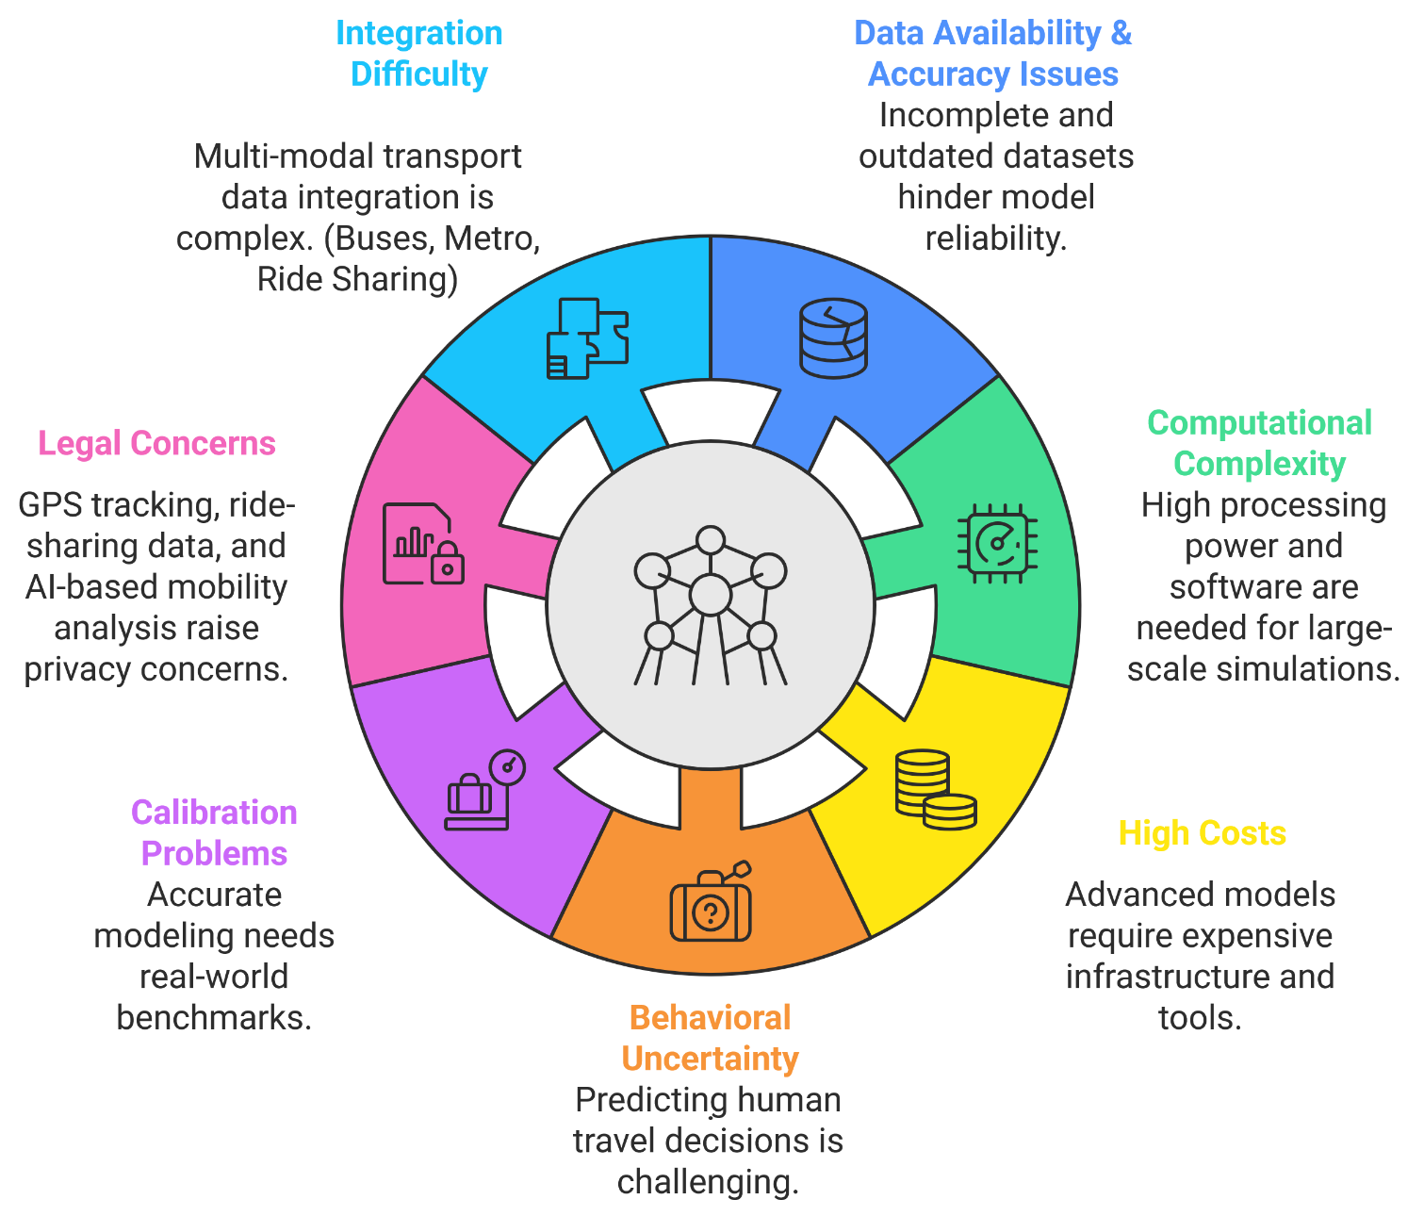
5. Transport Model Development Process
5.7. Challenges in Model Development
Introduction to Transport Modeling

Slide 40
5. Transport Model Development Process
5.8. Case Study – Tokyo’s Transport Model
Using AI & Machine Learning to Optimize Rail Passenger Demand
Background: Tokyo’s Peak-Hour Congestion Challenge
8+ million daily passengers → severe overcrowding during peak hours.
Traditional scheduling methods couldn’t effectively predict demand spikes.
Objective: Use AI-driven transport modelling to optimize train frequency, predict congestion, and improve efficiency.
How AI & Machine Learning Were Applied
AI-based Passenger Demand Prediction → Analyzed historical ridership, ticketing data, and GPS movement trends.
Real-Time Train Frequency Optimization → Adjusted train schedules dynamically to prevent congestion.
Multi-Modal Transport Integration → Recommended bus, cycling, and walking alternatives in high-traffic zones.
Introduction to Transport Modeling

Slide 41
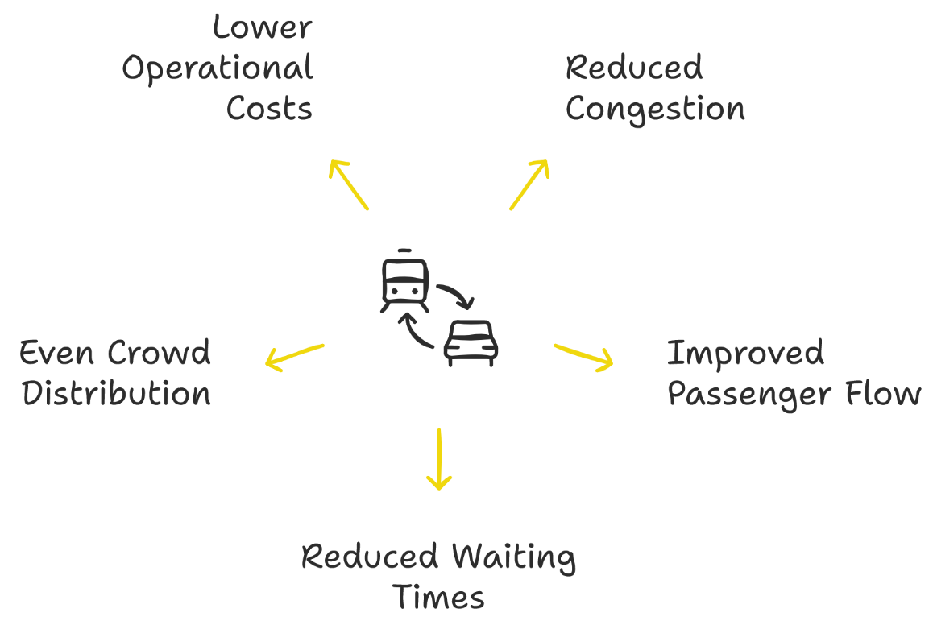
5. Transport Model Development Process
5.8. Case Study – Tokyo’s Transport Model Cont.
Results & Impact of AI Transport Modelling in Tokyo
Reduced peak-hour congestion by 18%.
Improved passenger flow and train punctuality.
Reduced passenger waiting times by 15% through better scheduling.
More even distribution of crowd levels in train carriages.
Lowered operational costs by reducing unnecessary empty trains during off-peak hours.
Introduction to Transport Modeling

Slide 42
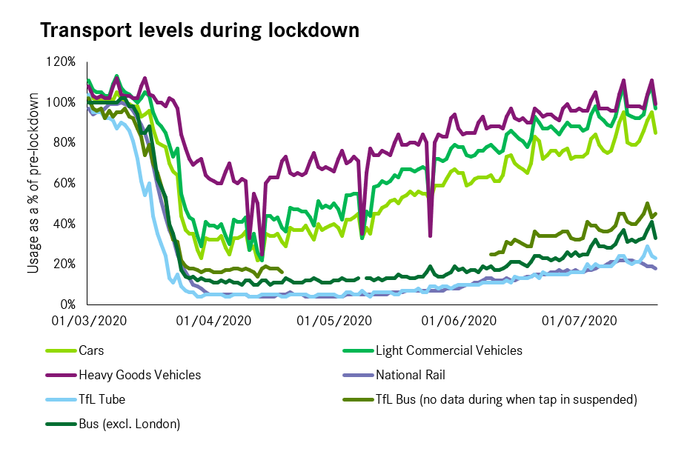
5. Transport Model Development Process
5.9. Case Study – Impact of COVID-19 on Transport Modelling
How the COVID-19 Pandemic Disrupted Traditional Transport Models
Background: The Challenge of Unpredictable Mobility
Pre-pandemic models assumed stable travel demand.
Public transit ridership dropped 50-90% due to lockdowns & remote work.
Transport planners struggled as traditional models became unreliable.
Key Changes & Impact on Transport Models
Public Transport Decline & Mode Shift
Subway/bus ridership fell; cycling, walking, & private cars increased.
Example: NYC subway ridership dropped 75% in early 2020.
Remote Work & Reduced Travel Demand
Peak-hour congestion assumptions failed.
Example: London Tube ridership stayed 30% below pre-pandemic levels in 2022.
Introduction to Transport Modeling

Slide 43
5. Transport Model Development Process
5.9. Case Study – Impact of COVID-19 on Transport Modelling Cont.
Key Changes & Impact on Transport Models Cont.
Demand Uncertainty & Forecasting Challenges
Traditional forecasting models failed, requiring real-time data integration.
Example: Uber & Lyft adjusted pricing & availability dynamically.
Rise of Active & Alternative Transport Modes
Increased cycling, scooter use, & walking.
Cities adapted with new bike lanes (e.g., Paris, Berlin).
Long-Term Impact on Transport Modelling
More flexible, adaptive models integrating uncertainty factors.
Greater reliance on real-time data for dynamic transport planning.
Post-pandemic focus on resilience, sustainability, & multi-modal transport.
Introduction to Transport Modeling

Slide 44
5. Transport Model Development Process
5.9. Case Study – Impact of COVID-19 on Transport Modelling Cont.
Lessons for Future Transport Models
Real-Time Data is Essential
AI & Big Data now track real-time mobility shifts.
Scenario-Based Transport Planning
Cities develop multiple demand models (e.g., hybrid work trends).
Example: Singapore adjusted metro schedules for flexible commuting.
AI & ML for Predictive Analytics
AI detects emerging commuting patterns faster than traditional methods.
Example: Google Mobility Reports aided city planning.
Sustainable Transport Priority
Governments focus on pedestrian-friendly urban designs.
Example: Paris expanded bike lanes permanently post-pandemic.
Introduction to Transport Modeling

Slide 45
Section 06:
Quiz & Group Discussion
Introduction to Transport Modeling

Slide 46
6. Quiz & Group Discussion
6.1. Quiz
What is the primary goal of transport modeling?
Which of the following is NOT a step in the Four-Step Transport Model?
What is a key limitation of transport modeling?
What type of transport model simulates individual vehicle movements and behaviors?
Which factor does NOT significantly influence mode choice in transport modeling?
What is the primary advantage of macroscopic transport models?
Which transport modeling method assumes all travelers take the shortest path?
What role does AI play in modern transport modeling?
Which city implemented congestion pricing models to manage peak-hour traffic?
What data sources are commonly used in transport modeling?
Introduction to Transport Modeling

Slide 47
6. Quiz & Group Discussion
6.2. Group Discussion
Transport Modeling for Developing vs. Developed Countries
Key Discussion Points:
Infrastructure & Data Availability
Modeling Priorities
Technology & Resources
Policy & Implementation
Introduction to Transport Modeling

Slide 48
Thank you for your attention!

