Slide 1
Transport Research and Analysis
Module 3: Transport Modeling and Simulation
Lecture 13: Public Transport Modeling
Notes:
"Good morning. Welcome to Lecture 13 of our module. Today, we delve into the fascinating and complex world of Public Transport Modeling. In our previous sessions, we've discussed data collection and traffic flow theory in a general sense. Now, we will apply those concepts to one of the most vital components of any urban environment: its public transport system. Modeling is the bridge between raw data and informed, multi-million-dollar investment decisions. It is the tool we use to understand, predict, and ultimately improve the services that millions of people rely on every day. Over the next 90 minutes, we will explore what these models are, how they are built, and how they shape the future of our cities. Let's begin."

Slide 3
Table of contents
Data Management and Cleaning in Transportation Research
00: Introduction & Objectives……...................................4
0.0. Lecture Overview......................................................5
0.1. Linking to Traffic Flow Fundamentals........................6
0.2. Learning Objectives…………………………………....7
01 The Why & What of Public Transport Modeling........8
1.0. What is Public Transport Modeling?..........................9
1.1. The Key Questions Modeling Answers……….........10
1.2. The Purpose of Modeling……….............................11
1.3. How Modeling Supports Decision-Making…...........12
02 The System We Model………....................................15
2.0. The Components of a Public Transport System......16
2.1. System Interactions & Efficiency…………..…..……17
2.2. Core Principles of Public Transport Operations…...18
2.3. How These Principles Shape Planning………….....19
2.4. Example: Peak vs. Off-Peak Adjustments………….20
03 The Modeling Workflow...........................................21
3.0. The Model Development Workflow…….................22
3.1. The Modeling Process in Detail…………….………23
3.2. Simulating Public Transport in Action……..………24
3.3. Common Software Tools……….............................25
3.4. Methodological Principles for Robust Modeling…..26
3.5. Small Group Activity……………….........................27
04 Core Application......................................................34
4.0. Defining Optimization……………….……………....35
4.1. The Reality of Constraints & Trade-Offs...............36
4.2. Strategy 1: Service Frequency Optimization….….37
4.3. Strategy 2: Route Optimization………………........38
4.4. Route Optimization in Action……….……………....39
4.5. Example: AI-Based Bus Scheduling………............40
4.6. Group Discussion……………………………..….….41

Slide 4
Table of contents
Data Management and Cleaning in Transportation Research
05: Real-World Impact & Conclusion………..................................35
5.0. Case Study 1: London's Congestion & Low-Emission Zones...36
5.1. Case Study 2: Tokyo's Metro System Efficiency......................37
5.2. The Role of Stakeholders & Societal Goals.............................38
5.3. Final Quiz.................................................................................39
5.4. References & Further Reading.................................................40

Slide 5
Section 00:
Introduction and Objectives
Notes:
Section 00: Introduction and Objectives

Slide 6

00. Introduction & Objectives
0.0. Lecture Overview.
Lecture Roadmap
The "Why" and "What" of Modeling: Defining PT modeling and its purpose.
The System We Model: Understanding the core components and principles of a PT network.
The Modeling Workflow: A step-by-step guide to building a model.
Core Application: Using models for network and service optimization.
Real-World Impact: Case studies, stakeholder roles, and conclusion.
Notes:
"To provide a clear roadmap for our session, here is our journey for today. We will begin with the fundamentals: the 'Why' and the 'What' of modeling. We'll define what a public transport model is and establish why it's such a critical tool for urban planners.
Next, we will ground our discussion in reality by examining the system we are trying to model, looking at the physical and operational principles of a real-world public transport network.
From there, we'll move into the technical core of the lecture: the modeling workflow. This will be a step-by-step guide on how models are actually constructed, from data collection to software implementation.
Then, we will explore the primary application of these models: using them to optimize routes, schedules, and service frequency to improve the system's performance.
Finally, we will bring everything together to look at the real-world impact, with case studies from major cities and a discussion on how modeling fits into the broader context of urban planning and sustainability. This structure will take us logically from theory to practice."

Slide 7
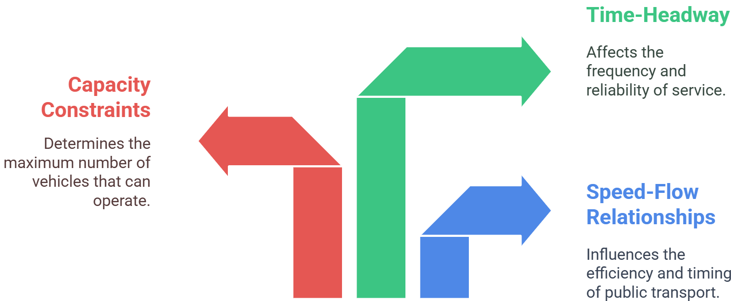
00. Introduction & Objectives
0.1. Linking to Traffic Flow Fundamentals
Recap: Traffic Flow Theory & Simulation
  We explored microscopic vs. macroscopic approaches, capacity, and congestion.
Today's Goal: Applying Theory to Public Transport
  We now apply those fundamentals to public transport, focusing on route planning and operational optimization.
Key Linkages:
Notes:
"Before we dive in, let's explicitly connect today's topic to our last lecture on traffic flow. We discussed core concepts like capacity and congestion. Today, our goal is to apply those very fundamentals specifically to public transport systems.
As you can see from the diagram, these concepts are directly linked. Capacity constraints don't just apply to roads; they determine the maximum number of buses or trains a corridor can handle. The relationship between speed and flow is critical for determining the efficiency and timing of public transport. And the concept of time-headway—the time between consecutive vehicles—is a fundamental measure of service frequency and reliability in any transit system. Public transport modeling, in many ways, is an advanced application of the traffic flow principles we have already learned. It adds layers of complexity, such as passenger behavior and fixed schedules, which we will explore today."

Slide 8

00. Introduction & Objectives
0.2. Learning Objectives.
By the end of this lesson, you should be able to:
Define Public Transport Modeling and explain its strategic purpose in urban planning.
Identify the core components and operational principles of a public transport network.
Outline the key stages of the transport model development workflow, from data collection to validation.
Explain how models are used to optimize service frequency and route design within real-world constraints.
Analyze the role of modeling in real-world projects and its connection to broader societal goals.
Notes:
"To be very clear about what we aim to accomplish today, here are the key skills you should have by the end of our 90-minute session.
First, you will be able to define what a public transport model is and, more importantly, explain its strategic purpose and why it is such a vital tool for planners.
Second, you will be able to look at a real-world transit system and identify its core components and the operational principles that govern its performance.
Third, we will move into the technical side, and you will be able to outline the main steps in the professional workflow for developing, calibrating, and validating a transport model.
Fourth, you will be able to explain the core application of these models—how we use them to optimize services within the limits of budgets and other real-world constraints.
And finally, you will be able to analyze how modeling is used to inform major projects, like those in London and Tokyo, and understand its connection to broader societal goals like equity and sustainability.
With these goals in mind, let's begin by connecting today's topic to the fundamentals of traffic flow."

Slide 9
Section 01:
The "Why" and "What" of Public Transport Modeling
Notes:
Section 01: The "Why" and "What" of Public Transport Modeling

Slide 10
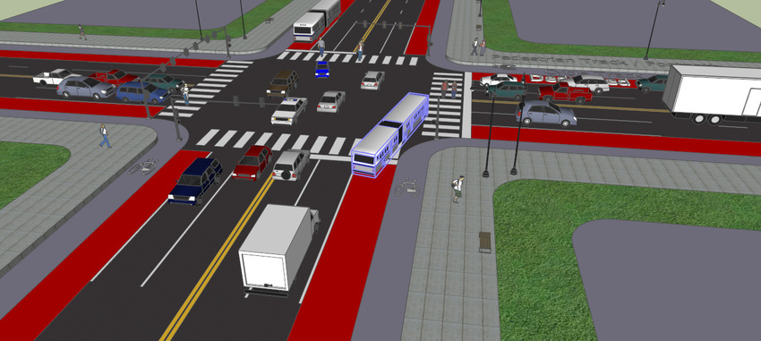
01. The "Why" and "What" of Public Transport Modeling
1.0. What is Public Transport Modeling?.
A mathematical and simulation-based approach to analyzing public transport systems (buses, trams, metro). It uses real-world data to optimize routes, schedules, and resources.
Why It Matters:
  Informs data-driven decisions for future transport investments.
  Reduces congestion, operational costs, and emissions.
  Enhances service reliability and the overall passenger experience.
Notes:
"So, let's start with a formal definition. What exactly is public transport modeling? At its core, it is a combination of mathematics and simulation. We create a digital representation of a public transport network and the people who use it. Critically, these are not just abstract cartoons; they are sophisticated models built upon and calibrated with real-world data—ridership counts, GPS tracks, survey results, and more.
The ultimate purpose of building these complex digital twins is to improve the real-world system. So, why does it matter? Because these models are the primary tools that allow planners to make informed, data-driven decisions about where to invest billions of dollars in new infrastructure. They help us design systems that reduce congestion and operational costs. And most importantly, they help us create a service that is more reliable, convenient, and enjoyable for the passenger. It is the essential analytical engine behind modern public transport planning."

Slide 11
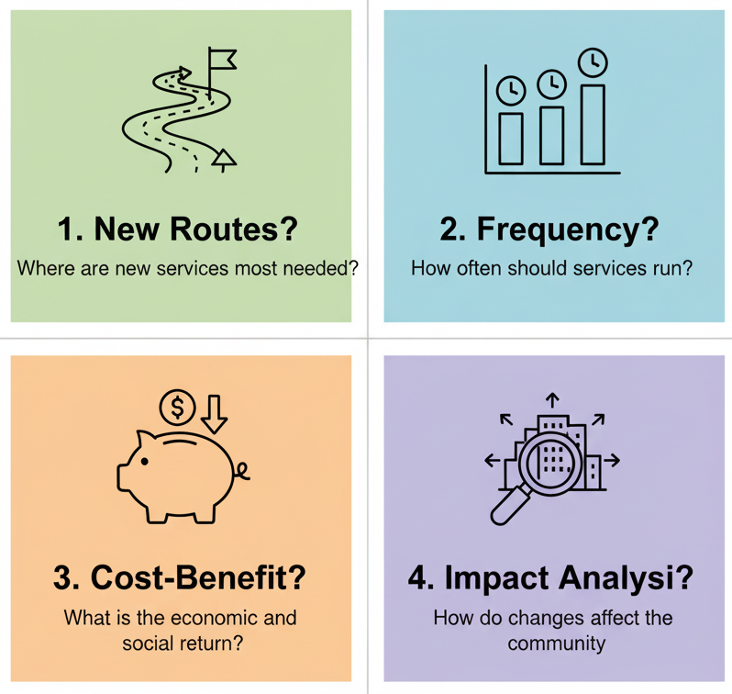
01. The "Why" and "What" of Public Transport Modeling
1.1. The Key Questions Modeling Answers
Public transport models are designed to answer fundamental planning and operational questions:
Where should new routes be added to serve the most people?
How frequently should buses or trains run to balance service quality with operational costs?
Which solutions are most cost-effective for improving service and attracting new riders?
How will a proposed change (e.g., a new fare, a dedicated bus lane) impact the wider network and passenger behavior?
Notes:
"The value of a model is determined by the quality of the questions it can help us answer. We don't build models for their own sake; we build them to solve concrete problems.
For example, a model can help us answer strategic questions like: Where should we invest in new routes? By modeling population density, job locations, and travel demand, we can identify corridors where a new bus or train line would provide the greatest benefit.
They help us with operational questions, such as determining the optimal service frequency. Should a bus run every 10 minutes or every 15 minutes? A model can simulate the trade-off between the improved passenger experience of a higher frequency and the increased operational cost.
Models are also essential for evaluating which potential improvements are the most cost-effective. Will we get a better return on investment from adding more buses, or from implementing a dedicated bus lane to improve the speed of the existing fleet?
Finally, they allow us to test the potential impact of a policy change before we implement it in the real world, reducing the risk of costly mistakes. These are the practical, high-stakes questions that modeling empowers us to answer with data."

Slide 12
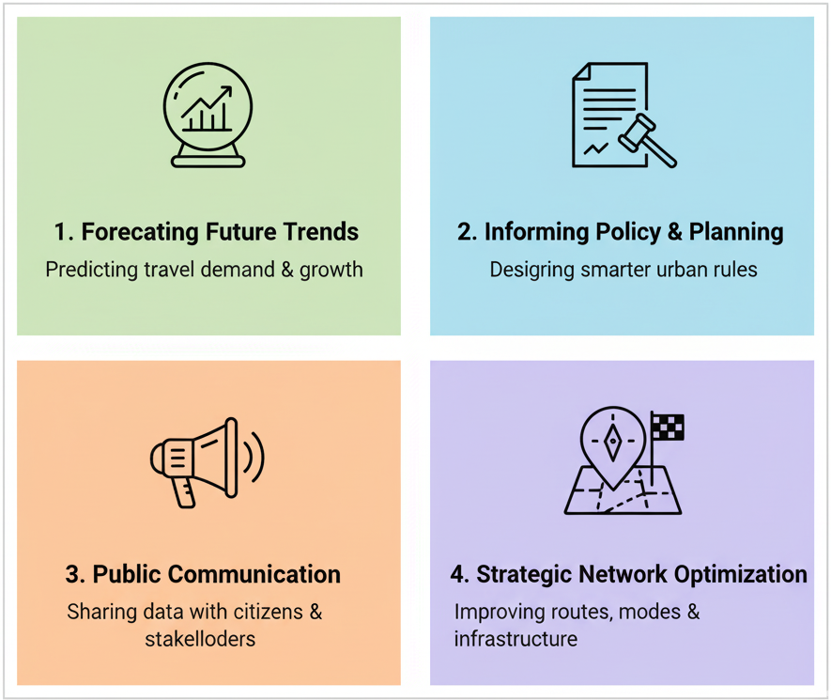
01. The "Why" and "What" of Public Transport Modeling
1.2. The Purpose of Modeling: A Strategic View
Models are tools for strategic planning and communication.
  Forecasting Demand & Performance: Estimate future travel volumes, speeds, and mode shares to inform long-range plans.
  Evaluating Policy & Investment Options: Assess the impacts of proposed infrastructure projects, new technologies, or policy changes.
  Improving Stakeholder Communication: Use model outputs and visualizations to build consensus among planners, politicians, and the public.
  Supporting Strategic Decision-Making: Provide quantitative, evidence-based insights for sustainable and equitable transport planning.
Notes:
"Zooming out from the specific questions, we can see that modeling serves several high-level strategic purposes.
First and foremost, it is our primary tool for forecasting future demand and performance. By analyzing current trends and demographic projections, models allow us to estimate what our transport network will need to handle in 10, 20, or 30 years' time.
Second, they provide a virtual sandbox for evaluating policy and investment options. Before a city commits to a multi-billion-dollar metro line, models are used extensively to simulate its potential impacts on ridership, traffic congestion, and the environment, ensuring it's a sound investment.
Third, they are a powerful tool for improving stakeholder communication. It is much easier to explain the benefits of a dedicated bus lane to the public and to politicians when you can show them a data-driven visualization or a clear set of performance metrics that come directly from a model.
Ultimately, these all feed into the primary purpose: supporting strategic decision-making. Models provide the quantitative, evidence-based foundation that allows planners to move beyond intuition and make robust, defensible decisions that lead to more sustainable and equitable transportation systems for the future."

Slide 13
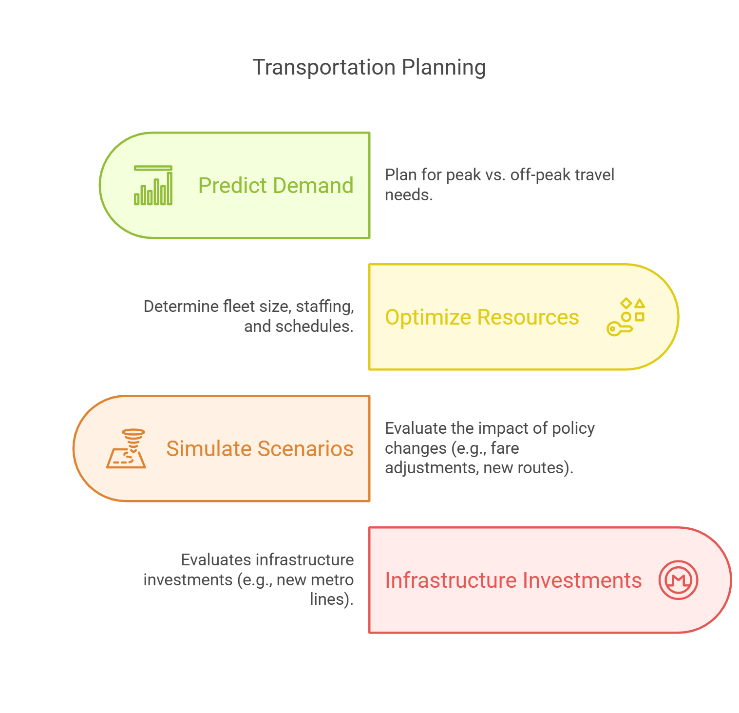
01. The "Why" and "What" of Public Transport Modeling
1.3. How Modeling Supports Decision-Making.
A direct link from model activities to real-world planning outcomes:
Predict Demand -> Plan for peak vs. off-peak travel needs.
Simulate Scenarios -> Evaluate the impact of policy changes (e.g., fare adjustments, new routes).
Optimize Resources -> Determine optimal fleet size, staffing, and schedules.
Evaluate Investments -> Assess the need for new infrastructure (e.g., new metro lines, bus terminals).
Notes:
"To conclude our introductory section, let's look at this direct pathway from a model's function to a real-world decision. This slide provides a perfect summary of what we've just discussed.
When we use a model to Predict Demand, that directly informs how we plan our service to handle the morning rush hour versus the midday lull.
When we Simulate Scenarios, we are testing the potential effects of a new policy, like a fare increase or a new bus lane, before we spend any political or financial capital implementing it.
When we Optimize Resources, the model's output tells a transit agency how many buses it needs to own and how many drivers it needs to employ to run an efficient service.
And when we Evaluate Investments, the model provides the crucial cost-benefit analysis that justifies building a new metro line or expanding a bus terminal.
This clear linkage is why modeling is not just an academic exercise; it is an indispensable tool in the modern transportation planner's toolkit. With this 'why' and 'what' firmly established, we will next turn our attention to the real-world system that we are trying to represent in these models."

Slide 14
Section 02:
The System We Model: Core Components & Principles
Notes:
"That brings us to the second section of our lecture. Before we can effectively model a public transport system, we must first have a clear and structured understanding of the system itself. In this section, we will deconstruct a real-world public transport network into its fundamental components and governing principles. We are moving from the abstract concept of modeling to the concrete reality of what is being modeled."

Slide 15
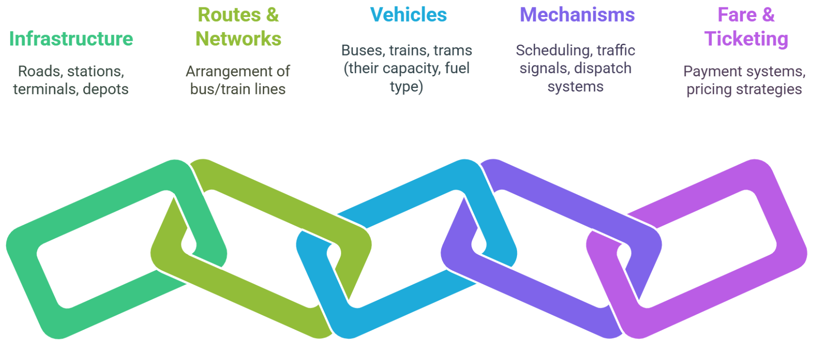
02. The System We Model: Core Components & Principles
2.0. The Components of a Public Transport System
A public transport network is a system of five interacting components:
Vehicles: The fleet of buses, trains, and trams (including their capacity and fuel type).
Control Mechanisms: The operational systems (scheduling, traffic signals, dispatch systems).
Infrastructure: The physical foundation (roads, stations, tracks, depots).
Routes & Networks: The arrangement of the bus and train lines that define the service pattern.
Fare & Ticketing: The payment systems and pricing strategies
Notes:
"At its most fundamental level, we can think of any public transport system as being made up of five core, interconnected components, as shown in this diagram.
First, we have the Infrastructure. This is the fixed, physical part of the system: the roads the buses drive on, the tracks the trains run on, and the stations and depots that support the service.
Second are the Routes and Networks. This is the specific geographic layout of the services—the lines on the map that show where the vehicles go.
Third, of course, are the Vehicles themselves. This includes the number of buses or trains in the fleet, but also their specific characteristics, such as their passenger capacity, their fuel type, and their accessibility features.
Fourth are the Control Mechanisms. This is the 'brain' of the system. It includes the timetables and schedules, the dispatch systems that manage the vehicles in real-time, and the traffic signals that can give buses priority.
And finally, we have the Fare and Ticketing systems, which includes not just the price of a ticket, but the entire system for how passengers pay for the service.
A comprehensive transport model must be able to represent each of these five components and, as we'll see next, the way they interact."

Slide 16
02. The System We Model: Core Components & Principles
2.1. System Interactions & Efficiency
Efficiency is not found in any single component, but in how they work together.
Key System Interactions:
  Well-Aligned Schedules: Ensure timetables are synchronized and coordinated to minimize passenger wait times during transfers.
  Efficient Vehicles: Match the right vehicle capacity to the route's demand to minimize operational costs and avoid overcrowding.
  Smart Fare Systems: Use modern ticketing technology (like contactless payment) to accelerate passenger boarding and reduce dwell times at stops.
Notes:
"A crucial concept in transport modeling is that you cannot optimize the system by looking at each of those five components in isolation. True efficiency comes from the interactions between them. A model must capture these interactions to be realistic.
Let's look at three key examples. We need Well-Aligned Schedules. A bus schedule might be perfect on its own, but if it's not coordinated with the train schedule at a major station, passengers will face long, frustrating transfer times. The efficiency comes from the interaction.
We need Efficient Vehicles. This means matching the vehicle size to the demand on the route. Running large, empty buses on a quiet route is inefficient, but running small buses on a busy route leads to overcrowding and passengers being left behind.
And we need Smart Fare Systems. The interaction between the fare system and the vehicle is critical. An old, slow cash-based system can lead to long queues and increase the 'dwell time' at each stop, which slows down the entire route. A modern, contactless system speeds up boarding and improves overall service reliability.
A good model doesn't just represent the components; it represents the dynamic relationships between them."

Slide 17
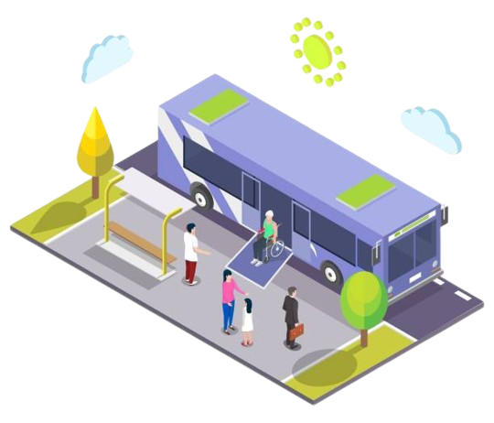
02. The System We Model: Core Components & Principles
2.2. Core Principles of Public Transport Operations
Efficiency is not found in any single component, but in how they work together.
Effective public transport is governed by five core operational principles:
Supply & Demand: Service levels must be planned to match passenger needs and demand patterns.
Capacity: The system must provide enough vehicles and space to accommodate passenger demand, especially during peak periods.
Reliability: Consistent and predictable schedules are essential to minimize delays and build passenger trust.
Accessibility: Stations, stops, and vehicles must be convenient, easy to reach, and usable for all passengers.
Cost Efficiency: The system must be designed to optimize the budget, reducing wasted trips and underutilized vehicles.
Notes:
"Having deconstructed the system into its components, we can now define the core principles that govern its planning and operation. An effective public transport model must account for these five principles.
First is the fundamental economic principle of Supply and Demand. We must provide enough service (supply) to meet the needs of our passengers (demand), and this demand is not static—it varies dramatically by time of day and location.
Second is Capacity. This is a direct consequence of demand. We need to ensure we have enough vehicles in the fleet, and that those vehicles are large enough, to handle the number of passengers who want to travel, especially during the morning and evening peaks.
Third is Reliability. This is arguably the most important factor for passenger satisfaction. A service is reliable if it runs on time, with consistent headways. Unpredictable delays are a primary driver of frustration and can cause people to abandon public transport.
Fourth is Accessibility. This principle covers how easy it is for people to use the service. Are the stations conveniently located? Are they physically accessible to people with disabilities? Are transfer points easy to navigate?
Finally, all of this must be balanced against the principle of Cost Efficiency. Public transport is almost always subsidized, and we have a responsibility to use public funds wisely by optimizing routes and schedules to reduce waste. These five principles are often in tension with one another, and modeling helps us navigate the trade-offs."

Slide 18
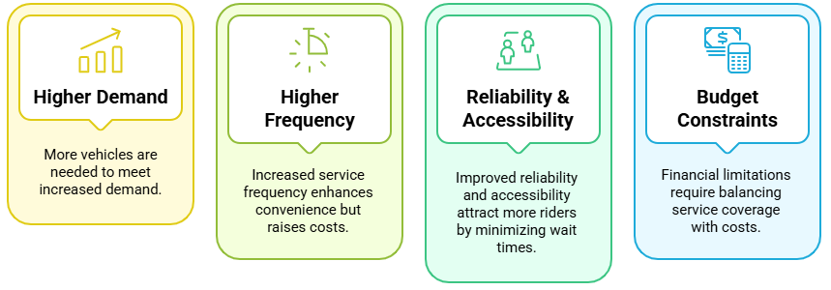
02. The System We Model: Core Components & Principles
2.3. How These Principles Shape Planning
These principles create a series of critical trade-offs for planners.
Notes:
"These principles don't exist in a vacuum; they directly shape the planning process by creating a set of fundamental trade-offs, as illustrated here.
If a city is growing and experiences Higher Demand, the direct consequence is that the transit agency needs more vehicles and drivers to serve that demand.
If we want to provide a Higher Frequency of service—say, a bus every 10 minutes instead of every 20—that makes the service much more convenient and attractive to riders, but it also directly raises our operational costs for fuel and staffing.
Similarly, investing in Reliability and Accessibility—for example, by building dedicated bus lanes or upgrading stations—will attract more passengers and improve the quality of life, but these are significant capital investments.
And all of these decisions are governed by the overarching reality of Budget Constraints. A transit agency has a finite amount of money, forcing it to constantly make difficult decisions and find the right balance between providing wide service coverage and high-quality service. Models are the tools we use to quantitatively explore these trade-offs and find the optimal balance point."

Slide 19
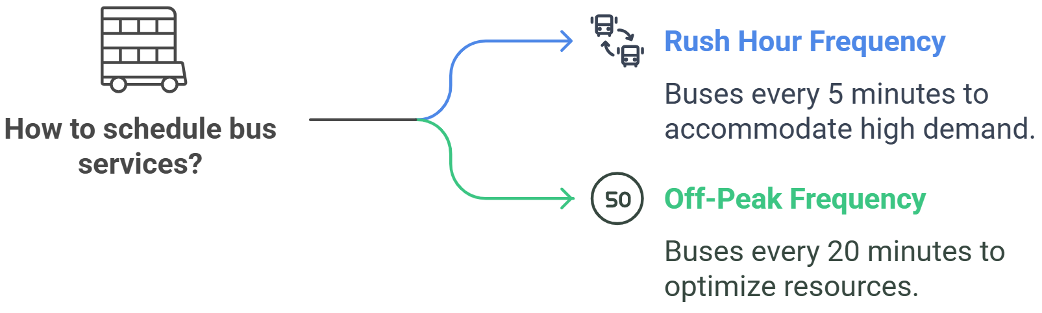
02. The System We Model: Core Components & Principles
2.4. Example: Peak vs. Off-Peak Adjustments
Rush Hour / Peak Demand: Goal: Accommodate high demand, prioritize reliability. Action: Run buses at a high frequency (e.g., every 5 minutes).
Midday / Off-Peak Demand: Goal: Maintain coverage, prioritize resource efficiency. Action: Run buses at a lower frequency (e.g., every 20 minutes).
The Core Challenge: Finding the right balance between service quality and operational cost.
Notes:
"Let's look at a very simple, universal example of these principles in action: scheduling a bus service for peak versus off-peak periods.
During the morning and evening rush hours, passenger demand is at its highest. The primary goal for the transit planner is to provide enough capacity to accommodate everyone and ensure the service is reliable. To achieve this, they will schedule buses to run at a very high frequency—perhaps every 5 minutes on a busy corridor.
However, during the midday off-peak period, demand is much lower. The goal shifts from accommodating massive crowds to providing a baseline level of service coverage while optimizing resources. Running a bus every 5 minutes would be incredibly wasteful. Instead, the planner will reduce the service to a lower frequency—say, every 20 minutes.
This constant adjustment throughout the day is a perfect illustration of the core challenge in transit planning: finding the right balance between providing a high level of service for passengers and maintaining cost efficiency for the agency. And models are used extensively to fine-tune these schedules to match the specific demand patterns of each route."

Slide 20
Section 03:
The Modeling Workflow: From Data to Decisions
Notes:
"That concludes our look at the real-world system. We've deconstructed the components, and we understand the operational principles and trade-offs that govern them.
We are now ready to move into Section 3, where we will focus on the technical workflow of modeling. This section will provide a step-by-step guide to the process that transportation planners use to build, calibrate, and use these complex models. We are now shifting our focus from the 'what' to the 'how'."

Slide 21
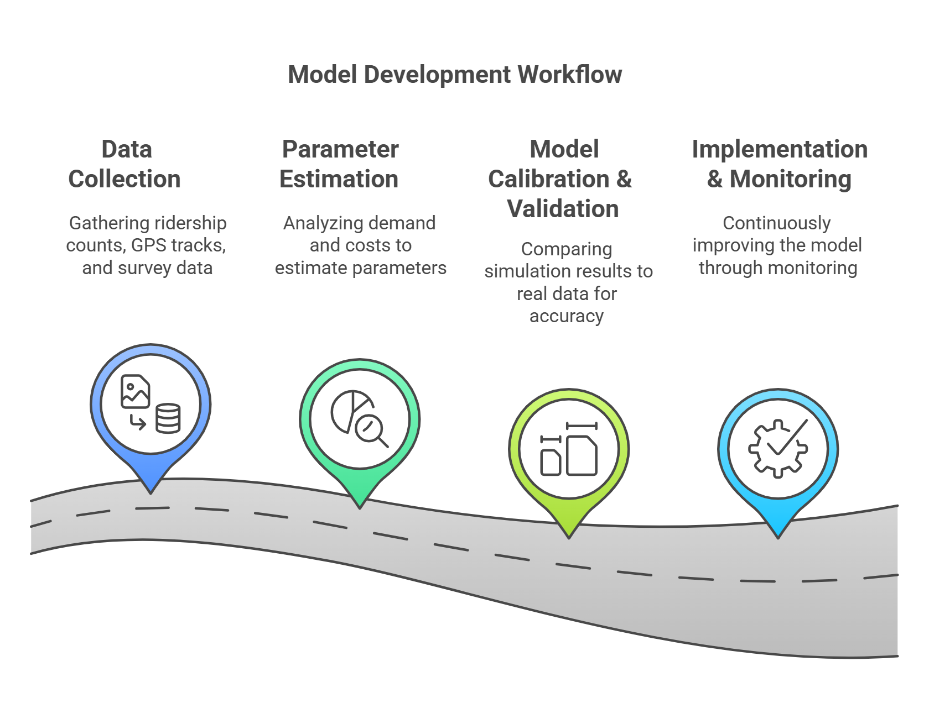
03. The Modeling Workflow: From Data to Decisions
3.0. The Model Development Workflow
These principles create a series of critical trade-offs for planners.
Gathering essential inputs like ridership counts, GPS tracks, and survey data.
Analyzing demand data and operational costs to estimate key model parameters.
Using the validated model for analysis and continuously improving it with new data.
Comparing initial simulation results to real-world data and adjusting the model for accuracy.
Notes:
"The development of a professional transport model is not an ad-hoc process; it follows a rigorous, systematic workflow, which can be broken down into these four key stages.
It always begins with Data Collection. As we've emphasized, models are built on a foundation of real-world data. This includes everything from ridership counts from automated passenger counters, to GPS tracks from buses, to survey data about why people travel.
The second stage is Parameter Estimation. This is where we analyze the collected data to derive the key numbers, or parameters, that will drive the model. For example, we analyze passenger data to estimate the value of time, or we analyze operational data to estimate the cost per hour of running a bus.
The third and most critical stage is Model Calibration and Validation. We build an initial version of the model, run a simulation, and then we compare the model's output to reality. Does our model predict the same number of passengers on a route that we observe in the real world? If not, we go back and adjust the model's parameters until its results accurately replicate reality. This is how we build trust in the model.
Finally, once validated, the model moves into Implementation and Monitoring. It is now ready to be used for the strategic decision-making we discussed earlier. And the process doesn't stop; as new data becomes available, we use it to continuously monitor and refine the model over time."

Slide 22
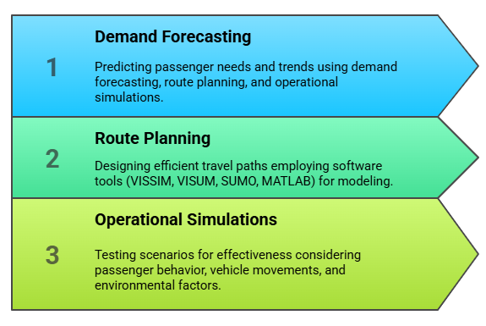
03. The Modeling Workflow: From Data to Decisions
3.1. The Modeling Process in Detail
What does a model actually do? It performs three core functions:
Predicting passenger needs and travel patterns using demographic data, land use information, and economic forecasts.
Designing the most efficient network of routes and schedules. This often involves specialized software (e.g., VISSIM, SUMO, VISUM).
Testing the performance of the planned network under various scenarios, considering passenger behavior, vehicle movements, and interactions with traffic.
Notes:
"Let's zoom in on that workflow and look at the core functions that a typical transport model performs. We can think of it as a sequence of three key activities.
The first is Demand Forecasting. The model needs to predict how many people will want to travel, from where, to where, and at what time. This is often the most complex part of the model, and it uses inputs like population data, employment locations, and land use plans to generate these travel demand patterns.
Once we have an estimate of the demand, the next step is Route Planning. This is where we design the public transport network to serve that demand. We decide where the routes should go, where the stops should be located, and what the schedules should be. This is often done with the help of specialized planning software, some of which we'll see on a later slide.
Finally, we conduct Operational Simulations. We take our forecasted demand and our planned network, and we run a simulation to see how the system would actually perform. This is a dynamic process where we can test the network's effectiveness, see where crowding might occur, and analyze the impacts of traffic congestion on the reliability of our service. These three functions form the analytical engine of the model."

Slide 23
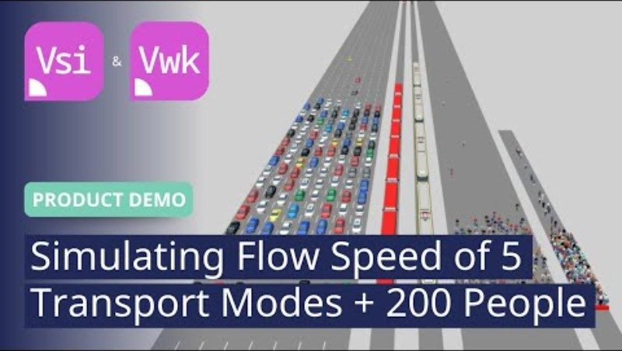
03. The Modeling Workflow: From Data to Decisions
3.2. Simulating Public Transport in Action
Notes:
"To make this concept of 'operational simulations' more concrete, we're going to watch a short video showing the output of a real transport simulation model. It's one thing to talk about these processes in the abstract; it's another to see them in action.
As you watch this clip, I want you to pay attention to a few things. First, notice how the model represents both the vehicles—the buses or trains—and the individual passengers. Second, observe how the public transport vehicles have to interact with the general traffic network. Finally, think about what kinds of insights a planner could gain from watching this visualization—where are the bottlenecks, where is the crowding, where are the delays? This is the direct output of the models we've been discussing."

Slide 24




03. The Modeling Workflow: From Data to Decisions
3.3. Common Software Tools
Professional transport models are built using specialized software.
Key Platforms:
  VISSIM / VISUM: Industry-standard software for advanced, multi-modal traffic and public transport simulations.
  SUMO (Simulation of Urban MObility): A popular open-source tool for urban mobility modeling, highly customizable.
  MATLAB / Python: General-purpose programming environments used for developing custom algorithms, optimization routines, and data analysis scripts that often feed into the main simulation models.
  QGIS: One of many GIS software, Free & Open Source, Increasingly popular, Allows access to wide range of tools.
Notes:
"These complex simulations are not built from scratch; planners rely on highly specialized software tools. Let me introduce a few of the most common platforms you will encounter in the industry.
The PTV suite, which includes VISSIM and VISUM, is arguably the commercial industry standard. VISSIM is a microscopic simulator, meaning it models the detailed movement of every individual vehicle and passenger, making it excellent for detailed operational analysis. VISUM is a macroscopic, strategic planning tool for network-wide analysis.
On the open-source side, SUMO is an extremely powerful and popular tool. Because it's open-source, it's highly flexible and can be customized for specific research needs. It is used extensively in the academic community.
Finally, it's important to recognize the role of general-purpose programming environments like MATLAB and Python. While they are not dedicated transport simulators, they are the tools we use to do the heavy-lifting on the data analysis side, and to develop the custom optimization algorithms that we then use to design the networks we test in the simulation software. In practice, a modeling project will often use a combination of these tools."

Slide 25
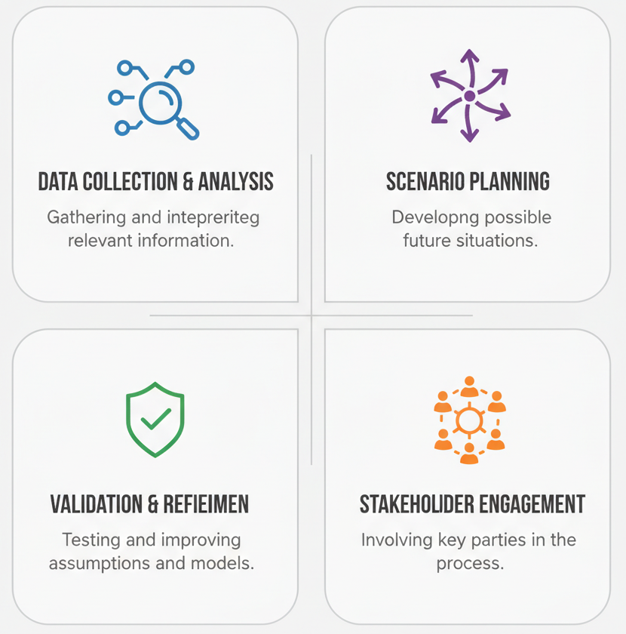
03. The Modeling Workflow: From Data to Decisions
3.4. Methodological Principles for Robust Modeling
Building a trustworthy model requires adherence to four key principles:
  Be Data-Driven: Models must be built on a foundation of high-quality, real-world data.
  Use Scenario Exploration: Test the model under multiple plausible future scenarios (e.g., high vs. low population growth) to ensure your plans are robust.
  Validate & Adapt: The model must be rigorously calibrated and validated against observed reality to ensure its accuracy and credibility.
  Engage Stakeholders: Incorporate insights from the public, policy-makers, and transport experts to align the model's assumptions with real-world expectations.
VALIDATION AND REFINEMENT
Notes:
"Building a model is not just about using the right software; it's about following a rigorous scientific methodology. The trustworthiness of your model's results depends on your adherence to these four key principles.
First, and we've said this before, the process must be data-driven. The quality of your model is only as good as the quality of the data you put into it.
Second, a good modeler never assumes they can perfectly predict the future. Instead, they use scenario exploration. They run the model under a range of different potential futures—a future with high population growth, one with low growth, one with a major shift to remote work, and so on. This allows them to identify strategies that are robust and perform well across a variety of conditions.
Third, as we discussed in the workflow, the model must be rigorously validated and adapted. You must prove that your model can accurately replicate the real world before you can use it to make predictions about the future.
Finally, modeling should not be a black-box exercise. It is essential to engage stakeholders throughout the process. This includes talking to the public, to policy-makers, and to transit operators to ensure that the assumptions you are building into your model are reasonable and align with the community's goals and expectations."

Slide 26
03. The Modeling Workflow: From Data to Decisions
3.5. Small Group Activity
Prompt:
In a city you know well, which operational principle (e.g., Reliability, Accessibility, Cost Efficiency) is the biggest priority for improving public transport, and why?
Instructions:
2-3 minutes to discuss in pairs, then share highlights with the class.
Notes:
"Okay, before we move on to our next section on optimization, let's pause for a quick activity to apply some of these concepts. Please get into pairs.
I want you to think about a city you know well—it could be your hometown, or the city you live in now. Based on your experience, which of the core operational principles we discussed—things like Reliability, Accessibility, or Cost Efficiency—do you think is the single biggest priority for improving public transport in that city, and why?
For example, is the biggest problem that the buses are never on time, making Reliability the top priority? Or is it that the fares are too high, making Cost Efficiency the main issue?
Take two or three minutes to discuss this with your partner, and then I'll ask a few groups to share their thoughts."
(Facilitate the activity. This encourages students to connect the abstract principles to their own lived experiences, making the concepts more memorable.)

Slide 27
Section 04:
Core Application: Network & Service Optimization
Notes:
"Alright, that discussion highlights that the 'right' priority is always context-specific, which is precisely why we need models to evaluate these different choices.
This brings us to Section 4 of our lecture. We've learned what a PT system is and how to build a model of it. Now, we're going to focus on the primary application: using these models to optimize the network and the service. This is where we move from simply representing the system to actively trying to improve it, using the model as our guide."

Slide 28
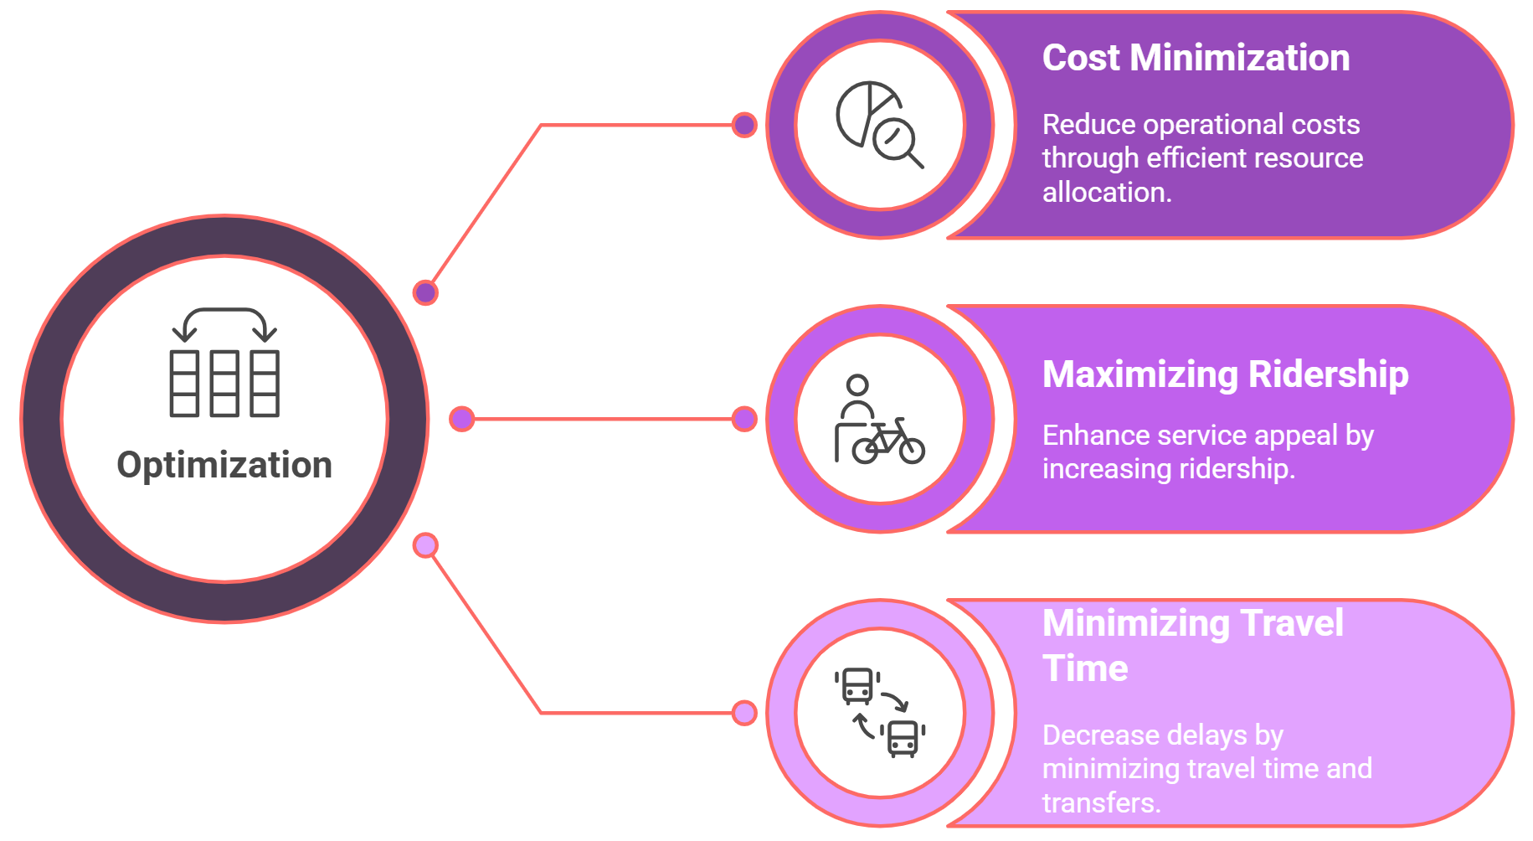
04. Core Application: Network & Service Optimization
4.0. Defining Optimization
What is Optimization in Public Transport?
It is the process of using models to find the best possible allocation of resources to meet a set of competing objectives.
The Three Competing Goals:
Notes:
"Let's start by defining what we mean by 'optimization' in this context. It's not about finding a single, perfect solution. Rather, optimization is the process of navigating trade-offs to find the best possible balance between several competing goals. In public transport, we are typically trying to balance three key objectives.
First, from the perspective of the transit agency, we want to achieve Cost Minimization. We have a limited budget, so we need to use our resources—our buses, our drivers, our fuel—as efficiently as possible.
Second, from a societal and environmental perspective, we want Ridership Maximization. We want to make the service so attractive and convenient that we encourage as many people as possible to leave their cars at home and use public transport instead.
Third, from the perspective of the existing passenger, we want Travel Time Minimization. We want to design routes and schedules that are fast, direct, and reliable, reducing the time people spend commuting.
The challenge, of course, is that these three goals are often in direct conflict. Running more buses to maximize ridership and minimize travel times directly increases our costs. Optimization is the art and science of using models to find the sweet spot where we can achieve the best possible outcomes across all three objectives."

Slide 29
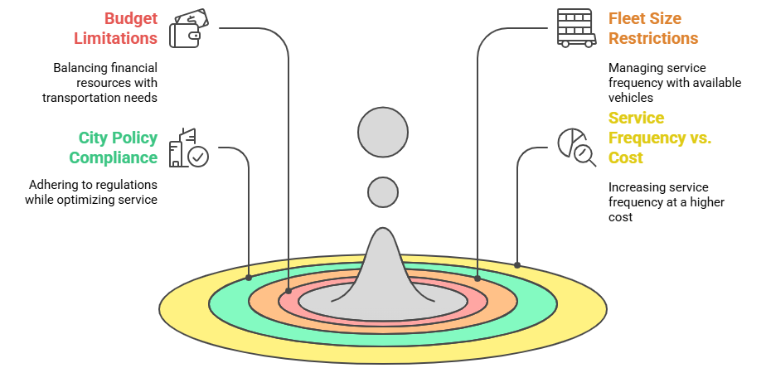
04. Core Application: Network & Service Optimization
4.1. The Reality of Constraints & Trade-Offs
Optimization does not happen in a vacuum. It is always limited by real-world constraints.
Key Constraints in Transportation Planning:
Notes:
"A model can suggest a theoretically 'perfect' solution, but if that solution isn't feasible in the real world, it's useless. That's why any optimization process must be grounded in the reality of constraints. These are the boundaries that limit our choices.
The most obvious constraint is the budget. A transit agency has a finite amount of money, and any proposed service plan must fit within that budget.
Similarly, an agency has a finite fleet size. A model can't suggest a schedule that requires 500 buses if the agency only owns 400.
There are also policy constraints. The plan must comply with city regulations, such as noise ordinances, and it must align with broader policy goals, like the city's climate action plan.
And as we've discussed, there is the inescapable trade-off between service frequency and cost. Every decision to increase service in one area may require a corresponding decrease in another to stay within the budget. A good optimization model doesn't just find the best solution; it finds the best solution that is feasible within these real-world constraints."

Slide 30
04. Core Application: Network & Service Optimization
4.2. Strategy 1: Service Frequency Optimization
Goal: To match the service level (frequency) to passenger demand throughout the day.
Key Trade-Offs:
  High Frequency (e.g., every 5-10 minutes):
    Pros: Reduces passenger wait times, improves convenience, can handle high demand.
    Cons: Higher operational costs (more fuel, more drivers).
  Low Frequency (e.g., every 30-60 minutes):
    Pros: Saves money, efficient for low-demand routes or times.
    Cons: Longer wait times, risks overcrowding if demand is underestimated.
The Balancing Act: Models are used to find the optimal frequency for each route at each time of day to balance service quality and cost.
Notes:
"Let's now look at the specific strategies that we use models to explore, starting with Service Frequency Optimization. This is one of the most common and impactful tasks in transit planning.
The core goal is simple: to match the frequency of the service to the passenger demand, which, as we know, changes throughout the day.
The trade-off is very clear. A high frequency service is what passengers want. It means short wait times and a feeling of convenience—you can just turn up and go. However, this is expensive for the agency to provide.
On the other hand, a low frequency service is much cheaper to operate. But it leads to longer, less convenient wait times for passengers. And if you set the frequency too low for the demand, you risk having your vehicles become uncomfortably overcrowded.
The balancing act, therefore, is to use demand models to forecast the ridership on each route for each hour of the day, and then use that forecast to set the optimal frequency that provides a good level of service without wasting resources. This is what we call 'headway planning'."

Slide 31
04. Core Application: Network & Service Optimization
4.3. Strategy 2: Route Optimization
Goal: To design a network of routes that is efficient, easy to understand, and serves the most people.
Common Route Optimization Strategies:
  Express vs. Local Routes:
    Offer faster, limited-stop "express" services on high-demand corridors, complemented by "local" routes that serve all stops.
  Feeder Services:
    Design shorter routes that connect suburbs or smaller towns to major transit hubs (like a train station), rather than running long, inefficient routes all the way downtown.
  Dynamic Routing:
    Use real-time data to adjust routes or timetables on-the-fly to respond to unexpected demand or disruptions (e.g., on-demand microtransit).
Notes:
"Beyond just the frequency of service, models are essential for optimizing the very structure of the routes themselves. The goal is to design a network that is both efficient for the operator and easy to use for the passenger.
There are several key strategies. One common approach is to create a mix of Express and Local Routes. On a very busy corridor, you might have a local bus that stops on every block, and an express bus that only stops at a few major intersections, providing a much faster trip for those traveling longer distances.
Another powerful strategy, especially in suburban areas, is to design Feeder Services. Instead of having dozens of long, meandering bus routes all trying to go downtown, you can design a more efficient system where shorter local routes 'feed' passengers into a central, high-capacity transit hub, like a train station.
A more modern and technologically advanced strategy is Dynamic Routing. This is often used for on-demand or 'microtransit' services. Instead of a fixed route, the vehicle's path is adjusted in real-time based on passenger requests, using algorithms to find the most efficient path to pick everyone up.
Models are used to test and compare these different network structures to see which one provides the best balance of coverage, efficiency, and speed."

Slide 32
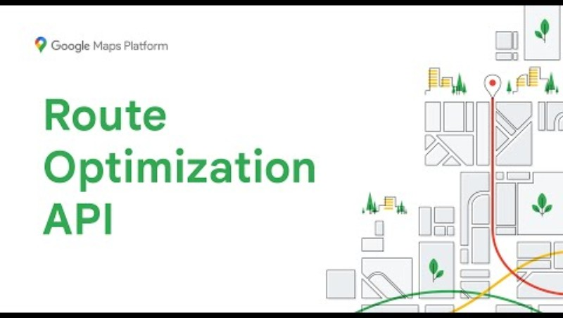
04. Core Application: Network & Service Optimization
4.4. Route Optimization in Action
Notes:
"These concepts of network redesign can be abstract, so to make them more tangible, we're going to watch a short animated video that visualizes a real-world bus network redesign. This is the kind of visual output that planners use to communicate the benefits of their proposed changes to the public.
As you watch, I want you to look for the strategies we just discussed. How does the 'before' network of complex, winding routes compare to the streamlined 'after' network? Can you identify where the planners have created new high-frequency corridors or implemented feeder services to connect to a main line? This is the practical result of the route optimization process."

Slide 33
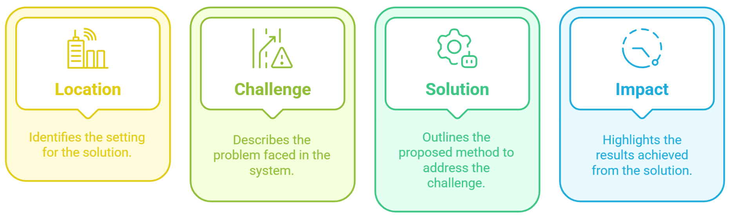
04. Core Application: Network & Service Optimization
4.5. Example: AI-Based Bus Scheduling
Using modern technology to solve a classic transit problem.
Notes:
"We now arrive at the final, crucial step in our workflow: Data Validation. You've stored your data, and you've gone through the intensive process of cleaning it. But before you begin your analysis, you must perform one last quality check. Validation is the process of confirming that your cleaned dataset is not only clean, but also correct and logical.
We can think of this as a four-step process. First, you must explicitly Define the Rules for your dataset. This is like creating a contract for your data. What are the criteria for correctness? For example, a rule might be that trip duration can never be negative.
Second, you Apply Range Checks. This involves checking your numerical values against plausible limits. For example, a recorded vehicle speed of 500 km/h might be a clean number, but it's not a valid one. You would set a rule to flag any speed outside a plausible range, say 0 to 150 km/h.
Third is Cross-Referencing. Here, you check your data against an external, authoritative source. For example, you would check all the transit stop IDs in your dataset to make sure they all exist in the official master list of stops provided by the transit agency.
Finally, you perform Logical Checks. This is about checking for internal consistency. The classic example is checking that a trip's end time is always after its start time. Data that violates these fundamental rules is not valid, and validation is the process of finding and flagging these issues."

Slide 34
04. Core Application: Network & Service Optimization
4.5. Example: AI-Based Bus Scheduling
Using modern technology to solve a classic transit problem.
Location: A major city with a bus network facing frequent delays.
Challenge:
  Bus schedules were based on ideal, free-flow traffic conditions and were therefore consistently unreliable, leading to "bus bunching" and passenger frustration.
Solution:
  An AI model was developed and trained on years of historical bus GPS data and real-time traffic data to generate more realistic, resilient, and reliable schedules.
Impact:
  Improved on-time performance, more predictable journey times, and increased passenger satisfaction.
Notes:
"Let's look at a quick example of how modern technology is being applied to optimization. This is a common scenario in many large cities.
The challenge is a classic one: the printed bus schedule says a bus should arrive every 10 minutes, but in reality, the buses are constantly stuck in traffic, leading to unreliable service and the frustrating phenomenon of 'bus bunching,' where three buses arrive at once after a 30-minute wait. This happens because the schedules were written for perfect, ideal conditions, not for the messy reality of urban congestion.
The solution that many agencies are now adopting is to use AI and machine learning. Instead of writing schedules by hand, they train a model on years of historical data—every GPS ping from every bus, every day. The model learns the actual, historical travel times on each street at each time of day. It can then generate schedules that are far more realistic and resilient.
The impact of this data-driven approach is a significant improvement in on-time performance. The schedules are more honest, the journey times are more predictable, and this leads directly to a better passenger experience and increased trust in the system."

Slide 35
04. Core Application: Network & Service Optimization
4.6 Group Discussion
Prompt:
"Redesign one bus route in your hometown for better frequency and coverage. What specific changes would you make and why?"
Instructions:
  2-3 minutes to brainstorm in groups.
  Focus on route length, stop locations, scheduling, and coverage.
Notes:
"Alright, let's have one final quick group discussion to apply these optimization strategies. I want you to think about a bus route in your hometown or a city you know well—preferably one that you think could be improved.
The prompt is this: Redesign that one bus route for better frequency and coverage. What specific changes would you make? For example, would you straighten the route to make it faster? Would you add feeder services? Would you change the frequency at different times of day?
Take two or three minutes to brainstorm some ideas in your groups. Think about the route's path, where the stops are, and how often it runs. Then, I'll ask a few groups to share their best ideas."
(Facilitate the discussion. This activity encourages students to think like planners, applying the concepts of route design and frequency optimization to a familiar context.)

Slide 36
Section 05:
Real-World Impact & Conclusion
Notes:
"Those are some excellent ideas, and they show you are thinking critically about the trade-offs involved in network design.
This brings us to our final section. We have now covered the why, the what, and the how of public transport modeling. To conclude, we will synthesize all of this by looking at the real-world impact through two major case studies. We will also discuss the crucial role of stakeholders in the modeling process and then summarize the key takeaways from our entire lecture."

Slide 37
05. Real-World Impact & Conclusion
5.0. Case Study 1: London's Congestion & Low-Emission Zones
The Problem: Severe traffic congestion in Central London was undermining bus reliability and causing major air quality issues.
The Modeled Solution:
  Implement a Congestion Charge for vehicles entering the central zone.
  Reinvest the revenue generated directly into enhancing bus services (more routes, higher frequency).
  Later expanded into Low-Emission Zones with even stricter standards.
The Results:
  Reduced Congestion: Bus speeds improved by approximately 20% in central areas.
  Increased Ridership: A notable growth in bus usage as it became a more reliable option.
  Improved Air Quality: Measurable improvements in air quality due to reduced traffic.
Notes:
"Let's begin our look at real-world impact with one of the most famous and successful examples of transport policy informed by modeling: London's Congestion Charge.
For decades, the problem in Central London was gridlock. Traffic was so bad that the iconic red buses were crawling at speeds slower than bicycles, making the service completely unreliable and contributing to dangerously poor air quality.
The solution, which was extensively modeled to predict its impacts, was radical at the time: charge a fee for private vehicles to enter the city center during peak hours. Crucially, the policy dictated that the net revenue from this charge would be ring-fenced and reinvested directly into improving the public transport system, especially bus services. This policy was later expanded into the even stricter Low-Emission and Ultra-Low Emission Zones.
The results were a clear and resounding success. With fewer cars on the road, congestion dropped dramatically, and bus speeds improved significantly. As the bus became a faster and more reliable option, ridership increased. And with less traffic, the city saw measurable improvements in air quality. This is a textbook case of how modeling can be used to design a bold policy that manages road demand while simultaneously improving public transport."

Slide 38
05. Real-World Impact & Conclusion
5.1. Case Study 2: Tokyo's Metro System Efficiency
The Challenge: Extreme peak-hour crowding on the Tokyo Metro system was causing significant delays, operational inefficiency, and severe passenger discomfort.
The Modeled Solution:
  An integrated system combining automated train scheduling with real-time crowd monitoring on station platforms.
  The system can dynamically adjust service frequency and train dwell times in response to actual passenger loads.
The Results:
  Reduced Delays: Significant improvement in on-time performance, even during the busiest peak hours.
  Increased Frequency: The system automatically runs trains more frequently when and where they are needed most, easing crowding.
  Enhanced Passenger Experience: Improved passenger comfort and safety due to more managed and predictable crowd levels.
Notes:
"Our second case study takes us to one of the largest and most complex public transport systems in the world: the Tokyo Metro.
The challenge in Tokyo is one of immense scale. The system handles millions of passengers every day, and the level of peak-hour crowding is legendary, leading to delays as trains struggle to depart from packed platforms.
The solution they've implemented is a masterclass in operational modeling and control. It's a highly sophisticated system that uses real-time data from platform sensors and ticketing gates to constantly monitor crowd levels. This data feeds directly into an automated train scheduling system. If the model detects that a particular platform is becoming dangerously crowded, it can automatically dispatch an extra train or adjust the frequency of the entire line in real-time.
The results have been remarkable. The system has led to a significant reduction in delays, improving on-time performance across the network. By dynamically increasing frequency when it's most needed, the system helps to alleviate the worst of the crowding. And this, in turn, leads to a safer and more comfortable experience for passengers. This is a perfect example of how modeling is used not just for long-range planning, but for minute-by-minute operational control."

Slide 39

05. Real-World Impact & Conclusion
5.2. The Role of Stakeholders & Societal Goals
Modeling is not just a technical exercise; it's a collaborative process that must serve broader societal goals.
Who Uses These Models?
  City Planners, Transit Agencies, and Governments.
Why Collaboration Matters:
  To ensure the model's assumptions reflect community needs and policy constraints.
Aligning with Transportation Goals:
  Mobility & Accessibility: Ensuring efficient movement and easy access for all.
  Equity: Providing fair and just access to transportation for all populations.
  Sustainability: Focusing on reducing environmental impact and long-term costs.
Notes:
"It's crucial to understand that modeling does not happen in a vacuum. It is deeply embedded in a social and political context. A technically perfect model that doesn't align with the community's goals is a failure.
So, who uses these models? Primarily city planners and transit agencies, who use them to design services and justify investments to governments and the public.
This is why stakeholder collaboration is so important. A modeler must work closely with these groups to ensure the model's assumptions are realistic. For example, a model might suggest that closing a bus stop would be more efficient, but community feedback might reveal that the stop is essential for elderly residents. This feedback is a vital input.
Ultimately, the goal of modeling is to help us achieve our broader societal transportation goals. These include providing Mobility and Accessibility for everyone. It includes promoting Equity, ensuring that our transport system serves underserved communities and provides fair access to opportunities. And, of course, it includes Sustainability, designing systems that reduce our environmental impact. A successful modeling project is one that is not only technically sound, but also collaboratively developed and aligned with these core values."

Slide 40
05. Real-World Impact & Conclusion
5.3. Final Quiz
Let's check our understanding:
  Name one key factor that differentiates PT modeling from private vehicle modeling.
  Which operational principle measures how regularly buses or trains arrive?
  True/False: An optimization model can find a perfect solution that ignores budget constraints.
  Give one example of a constraint you might face when scheduling a bus route.
Answers:
  PT vs. private vehicles: Schedules, vehicle capacity, passenger dwell times at stops.
  Regularity principle: Reliability.
  False. Optimization is always subject to real-world constraints.
  Constraints: Budget limitations, number of available buses, driver labor rules.
Notes:
"Alright, to wrap everything up, let's do a final quick quiz to review the key concepts from today's lecture.
First, name one factor that makes public transport modeling different from modeling private cars.
(Pause)
Key differentiators include fixed schedules, vehicle capacity limits, and passenger dwell times at stops.
Second, which principle measures how regularly the service arrives?
(Pause)
That would be Reliability.
Third, True or False: Optimization can ignore budget constraints.
(Pause)
That is definitively False. All optimization operates within a set of constraints.
And finally, give me one example of a constraint you might face when scheduling a bus route.
(Pause)
Common constraints include the overall budget, the number of buses in your fleet, and driver labor rules that limit shift lengths.
Excellent. It sounds like you have a solid grasp of the core ideas we've covered today."

Slide 41
05. Real-World Impact & Conclusion
5.4. References & Further Reading
Core Textbooks:
  Ortúzar, J. de D., & Willumsen, L. G. (2011). Modeling Transport (4th ed.). John Wiley & Sons.
  Vuchic, V. R. (2007). Urban Transit Systems and Technology. John Wiley & Sons.
Network & Service Planning:
  Ceder, A. (2016). Public Transit Planning and Operation: Modeling, Practice and Behavior. CRC Press.
Modeling Software & Research:
  Horn, M. (2021). MATSim for Beginners. Technical University of Berlin. (Available Online)
  PTV Group. (n.d.). Scientific Publications and White Papers on VISUM/VISSIM. (Available on the PTV Group website).
Notes:
"That brings us to the end of our lecture on Public Transport Modeling. For those of you who wish to explore this topic in greater depth, these are some of the foundational texts and resources in our field. The textbook by Ortúzar and Willumsen is a cornerstone of transport modeling in general. Vuchic's work is a classic on transit systems and technology, while Ceder's book provides an excellent, detailed look at planning and operations. Finally, for those interested in specific software, the documentation and white papers for platforms like MATSim and the PTV suite are invaluable resources.
Thank you for your attention and participation. I'm now happy to take any final questions."

Slide 42
Thank you for your attention!
Notes:
Thank You

