Slide 1
Transport Research and Analysis
Module 4: Sustainable Transport and Policy Analysis
Lab 10: Cost-Benefit Analysis

Slide 3
Table of contents
Lab 10: Cost-Benefit Analysis
Section 0: Objectives & Learning Outcomes | 3
0.1. Objectives | 4
0.2. Learning Outcomes | 5
0.3. Reference to the corresponding theoretical lecture | 6
Section 1: Introduction to CBA | 7
1.1. What is Cost-Benefit Analysis (CBA)? | 8
1.2. Why is CBA essential in Transport Planning? | 9
Section 2: Costs & Benefits | 10
2.1. Components of Costs | 11
2.2. Components of Benefits | 12
2.3. From Costs and Benefits → To Viability | 13
2.4. Interpreting CBA Results | 14
2.5. Sensitivity Analysis in CBA | 15
Section 3: Practical Example | 16
3.1. Cost-Benefit Analysis with Excel | 18
3.2. Cost-Benefit Analysis with Python | 19
Section 4: Homework Assignment | 20
4.1. Assignment Tasks | 21
4.2. Report Structure and Submission | 25
Cost-Benefit Analysis

Slide 4
Section 00:
Objectives and Learning Outcomes
Cost-Benefit Analysis

Slide 5
0. Objectives and Learning Outcomes
0.1. Objectives
Section No | Activity | Tool(s) | Activity Type | Activity done by | Duration
1, 2 | Define CBA, its importance in transport planning, session overview | Slides | Presentation | Teacher | 20mins
3 | Walkthrough of professional CBA spreadsheet: components, logic, outputs | Excel | Presentation | Teacher | 20mins
3 | Execute simple benefit-cost analysis with core components (Time, Delay, Distance) | Colab (Python) | Demonstration + Practical | Teacher + Student | 45mins
4 | Add advanced benefits (emission, safety, congestion, economic growth); test scenarios | Colab (Python) | Demonstration + Practical | Teacher + Student | 45mins
5 | Compare Python results; analyze NPV, BCR, sensitivity and viability | Colab (Python) | Practical | Teacher + Student | 30mins
6, 7 | Homework instructions: improve viability, update NPV/BCR, write short report |  | Presentation | Teacher | 20mins
Cost-Benefit Analysis

Slide 6
0. Objectives and Learning Outcomes
0.2. Learning Outcome
By the end of this lab session, students will be able to:
  Explain the role of Cost-Benefit Analysis (CBA) in transport project evaluation, including its relevance to public investment decisions.
  Identify and classify key cost and benefit components used in transport CBA, including direct, indirect, and external elements.
  Navigate and interpret a professional CBA Excel tool (USDOT template), understanding the structure, formulas, and result indicators (NPV, BCR).
  Execute a simplified Python-based CBA model, interpreting results such as net present value (NPV), benefit-cost ratio (BCR), and delay costs.
  Apply a more advanced Python-based CBA model with additional components such as emission reduction, safety, and economic development.
  Assess project viability under different scenarios and explain how sensitivity analysis influences policy and decision-making.
  Redesign a transport project scenario by adjusting assumptions to enhance economic viability.
  Prepare a structured report that presents and interprets CBA results, explains methodological steps, and makes a policy recommendation.
Cost-Benefit Analysis

Slide 7
Section 01:
Introduction to CBA
Cost-Benefit Analysis

Slide 8
1. Introduction to CBA
1.1. What is Cost-Benefit Analysis (CBA)?
Definition
A systematic method to evaluate project impacts in monetary terms, comparing total benefits against total costs.
Purpose:
Helps assess whether a project is worth doing
Captures both financial and economic impacts
Supports transparent, evidence-based decision making
In Transport Projects:
Ensures investments provide net value to society
Avoids wasteful or harmful projects
Balances user benefits with project costs
Cost-Benefit Analysis

Slide 9
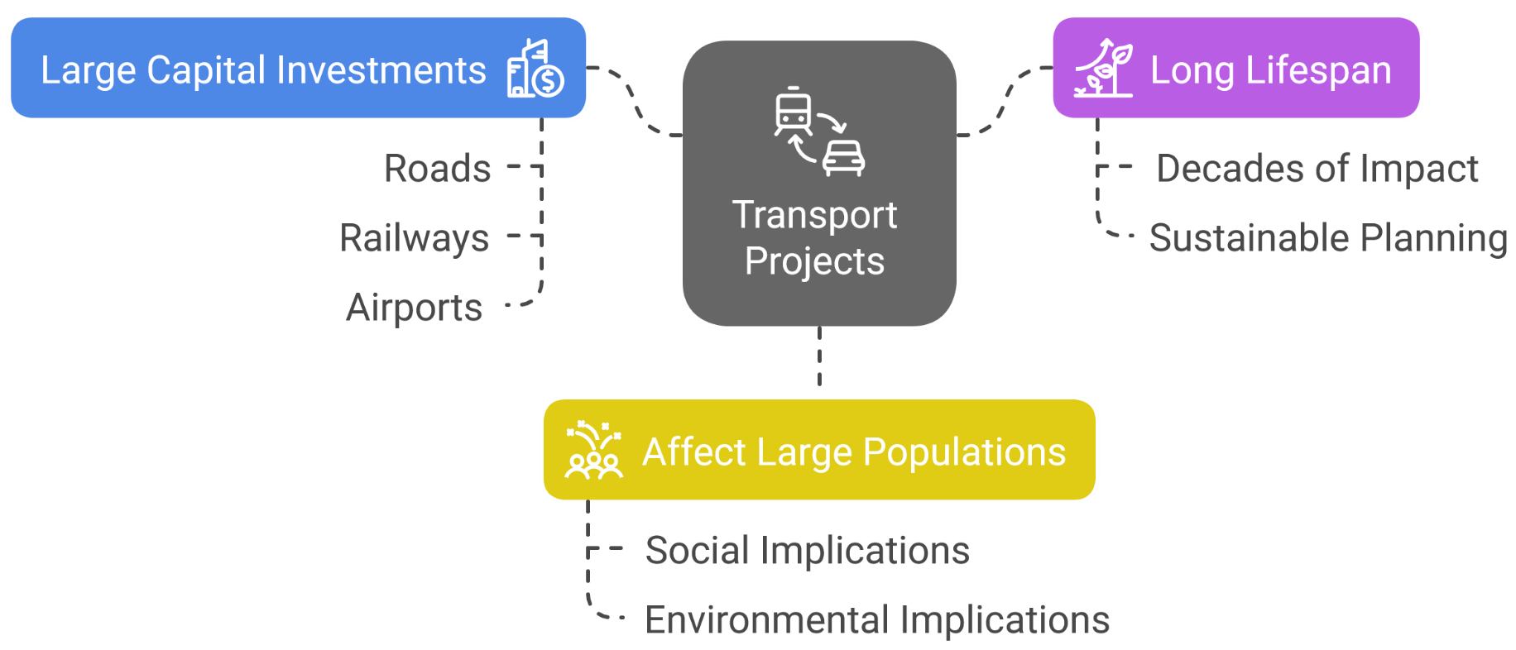
1. Introduction to CBA
1.2. Why is CBA essential in Transport Planning?
CBA answers key questions:
Does the project generate enough value to justify costs?
What are the trade-offs (cost vs. benefits)?
How sensitive is the outcome to key assumptions?
Without CBA → Risk of poor investment and negative societal impact.
Cost-Benefit Analysis

Slide 10
Section 02:
Costs & Benefits
Cost-Benefit Analysis

Slide 11
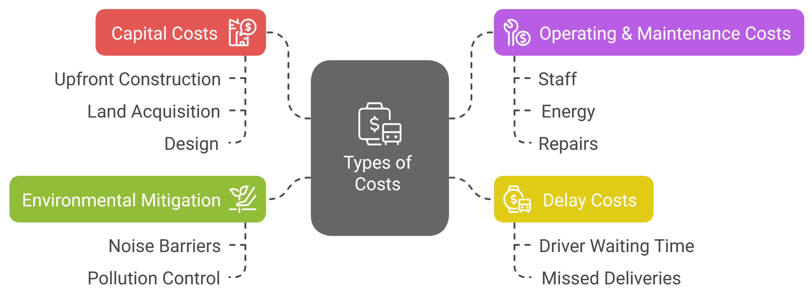
2. Costs & Benefits
3.1. Components of Costs
Costs represent resources spent.
All costs are discounted to present value for NPV calculation.
Cost-Benefit Analysis

Slide 12
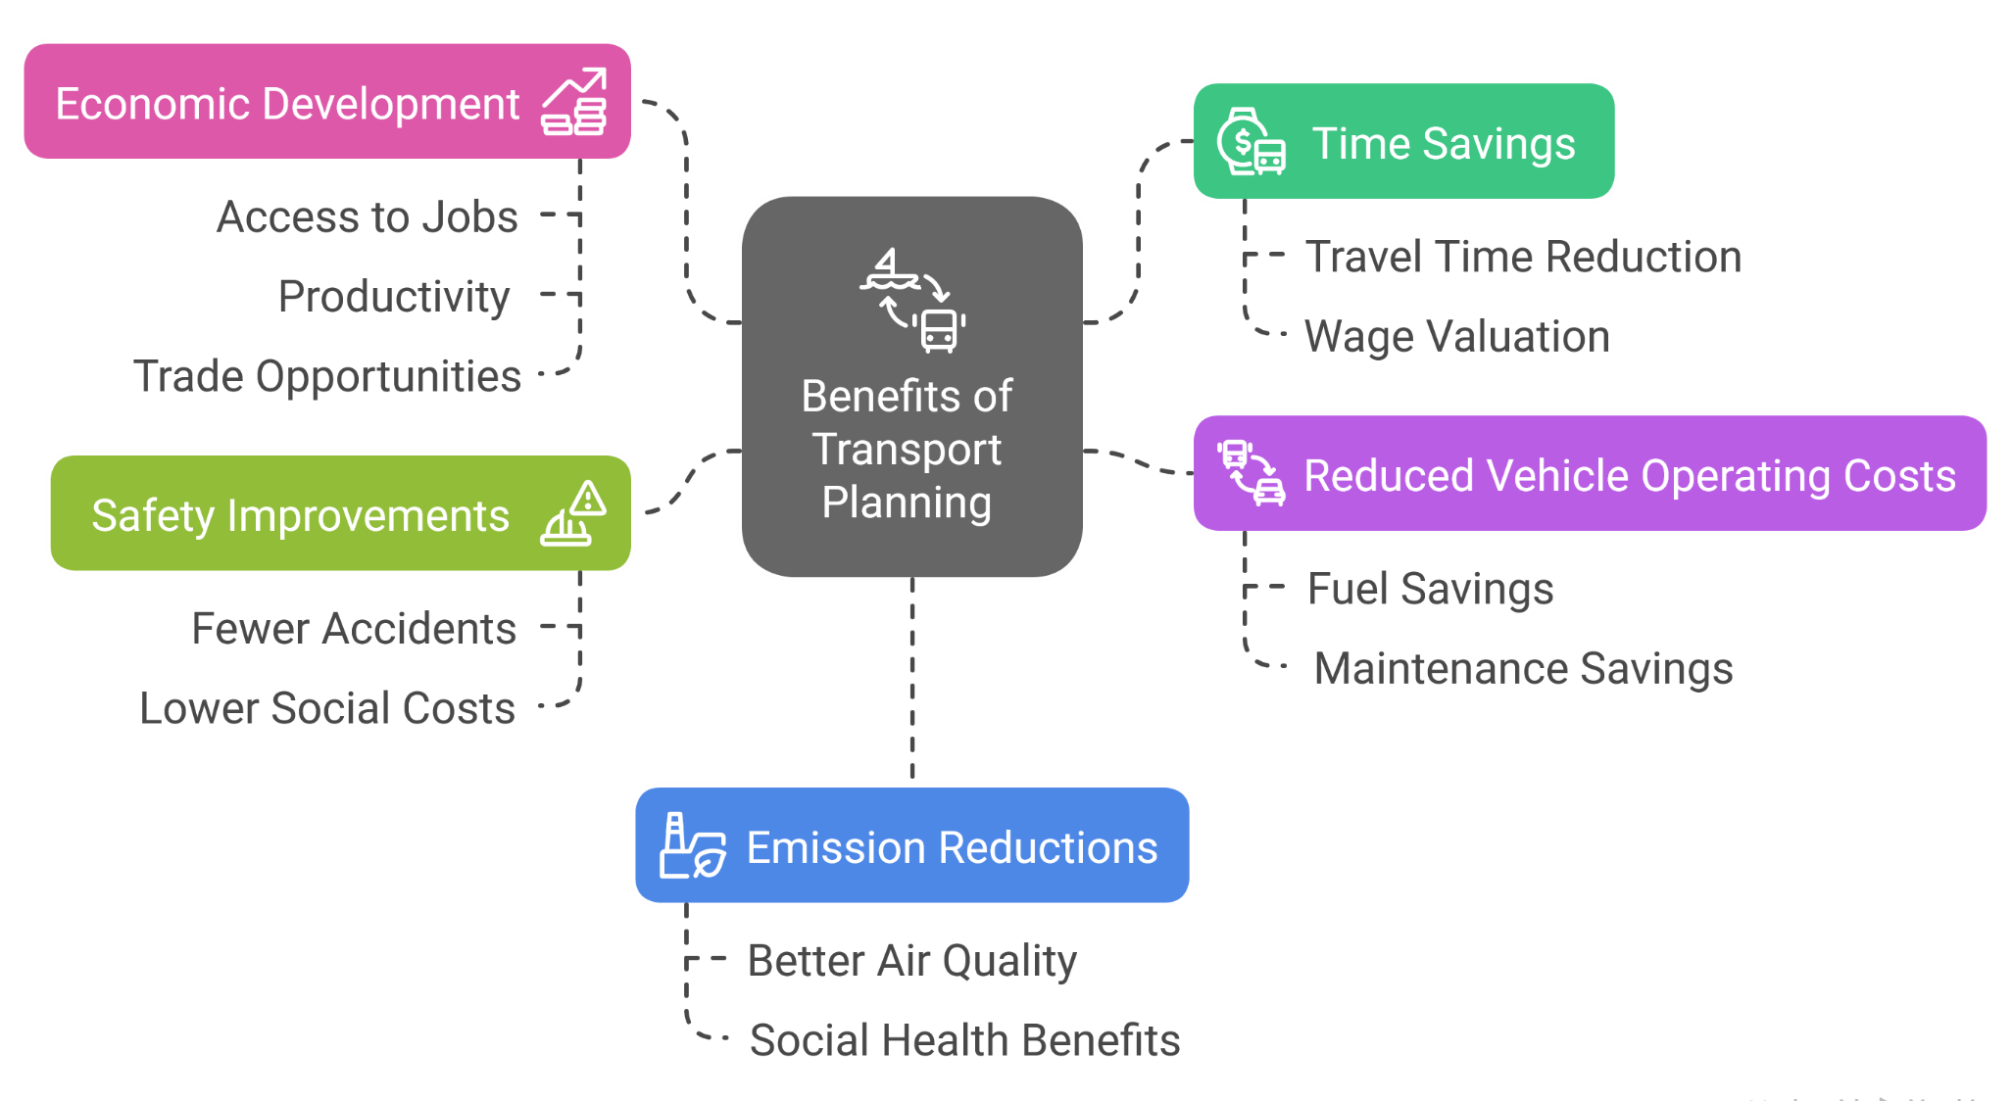
2. Costs & Benefits
2.2. Components of Benefits
Benefits represent positive project impacts.
All benefits are discounted to present value for NPV/BCR calculation.
Cost-Benefit Analysis

Slide 13
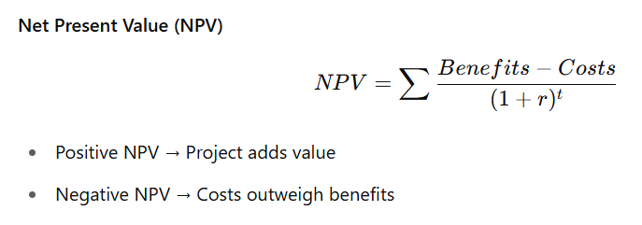
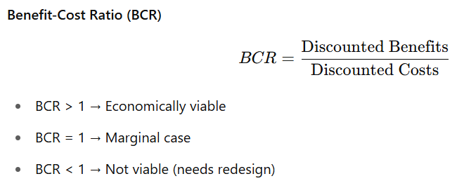
2. Costs & Benefits
2.3. From Costs and Benefits → To Viability
Comparing discounted costs and benefits gives us:
Cost-Benefit Analysis

Slide 14
2. Costs & Benefits
2.4. Interpreting CBA Results
Interpreting indicators → Project decision making
BCR Range | Interpretation | Recommendation
BCR > 1 | Project adds value | Proceed
BCR ≈ 1 | Marginal case | Further policy/strategic assessment
BCR < 1 | Project not viable | Redesign or abandon
  CBA does not make the decision → it informs the decision makers.
Cost-Benefit Analysis

Slide 15
2. Costs & Benefits
2.5. Sensitivity Analysis in CBA
Why do Sensitivity Analysis?
  Assumptions are uncertain → costs and benefits may change
  Test robustness → Will the project still be viable if things get worse?
  Helps manage risk → Decision makers want confidence
Examples:
  Higher construction costs
  Higher delay costs (as we will test today)
  Lower-than-expected benefits
  Good projects remain viable even under stress → Sensitivity helps prove that.
Cost-Benefit Analysis

Slide 16
Section 03:
Practical Example
Cost-Benefit Analysis

Slide 17


3. Practical Example
3.1. Practical
Let's proceed to hands on experience in calculating CBA for projects on Excel and Python.
Also, can write programs to automate this procedure.
Let's proceed with a practical example using “USDOT BCA Spreadsheet Template 11.18.24” in EXCEL to identify the excel template for CBA analysis.
After that we will proceed to use CBA analysis knowledge to a realistic transport dataset and see how project viability is calculated.
Cost-Benefit Analysis

Slide 18
3. Practical Example
3.1. Cost-Benefit Analysis with Excel
Activity 1: Exploring USDOT Excel Tool
  File name: USDOT BCA Spreadsheet Template 11.18.24.xlsx
  Platform: Microsoft Excel (or Google Sheets)
  Purpose: Understand the structure and components of a professional transport CBA tool
  Steps:
    Open the Excel file and explore key input/output sections:
      Cost inputs (capital, operating)
      Benefit streams (time savings, etc.)
      Output indicators (NPV, BCR, IRR)
    Review embedded formulas and linked worksheets
    Discuss how these templates are used in real-world project appraisals
Cost-Benefit Analysis

Slide 19
3. Practical Example
3.2. Cost-Benefit Analysis with Python
Activity 2: Python CBA Model (Basic)
  File (Python Code): Transport_CBA_Practical_with_less_componenets.ipynb
  Platform: Google Colab (Python)
  Purpose: Build a basic transport CBA model using travel delay and distance data
  Steps:
    Load and inspect datasets: Routes_Table.csv, Trip_Table.csv, Service_Table.csv
    Merge datasets and calculate:
      Transport cost = distance × cost per km
      Delay cost = max(0, delay minutes) × 0.5
      Total cost = transport cost + delay cost
    Add a flat per-trip benefit (e.g., $10 per trip)
    Compute Net Present Value (NPV) and Benefit-Cost Ratio (BCR) over 10 years
    Perform sensitivity analysis by increasing the delay penalty to test project viability under risk
    Interpret results: Is BCR > 1? What does it suggest about economic viability?
Cost-Benefit Analysis

Slide 20
3. Practical Example
3.2. Cost-Benefit Analysis with Python
Activity 2: Python CBA Model (Extended)
  File: CBA_Practical_Notebook_with_extra_components.ipynb
  Platform: Jupyter Notebook (Python)
  Purpose: Extend the basic CBA by including broader benefits and fixed costs for realism
  Steps:
    Load the same datasets and calculate transport cost, delay cost, and total cost
    Add project-level costs:
      Capital cost (e.g., $500,000 one-time)
      Annual operating cost (e.g., $100,000)
    Add additional annual benefits:
      Emission reduction, safety improvement, congestion reduction, economic development
    Calculate total annual benefits and total annual costs, then compute updated NPV and BCR
    Perform sensitivity analysis: test high-delay cost scenario
    Compare results with the basic model and draw conclusions about viability and policy implications
Cost-Benefit Analysis

Slide 21
Section 04:
Homework Assignment
Cost-Benefit Analysis

Slide 22
4. Homework Assignment
4.1. Redesigning a Transport Project for Economic Viability using Python
Objective
  Apply a Python-based Cost-Benefit Analysis (CBA) model to evaluate a transport project scenario.
  Identify and interpret key economic indicators, including Net Present Value (NPV) and Benefit-Cost Ratio (BCR).
  Modify project assumptions (costs, benefits, delays, subsidies) to simulate real-world redesign strategies.
  Assess the economic viability of transport projects under different input conditions.
  Analyze the impact of external benefits such as emission reduction, safety, and economic development on overall project feasibility.
  Compare baseline and redesigned scenarios and justify changes using economic reasoning.
  Document and present analysis results in a clear, structured, and policy-relevant format.
Cost-Benefit Analysis

Slide 23
4. Homework Assignment
4.1. Redesigning a Transport Project for Economic Viability using Python
Steps:
Open the Notebook
  Use the file: CBA_Practical_Notebook_with_extra_components.ipynb
  Run the notebook once with the default values.
  Record the initial results:
    Net Present Value (NPV)
    Benefit-Cost Ratio (BCR)
    Project recommendation (Viable / Not Viable)
Cost-Benefit Analysis

Slide 24
4. Homework Assignment
4.1. Redesigning a Transport Project for Economic Viability using Python
Steps:
Redesign the Project Assumptions
Make at least 2–3 changes to the following variables to improve the project's viability:
  Examples of Improvements:
  Increase per-trip benefit (e.g., from $10 to $30)
  Add or increase annual benefit values, such as:
    Emission reduction benefit
    Safety benefit
    Economic development benefit
  Reduce or eliminate capital cost (simulate a government grant)
  Reduce delay costs by assuming better operations
  Lower operating costs per year
Cost-Benefit Analysis

Slide 25
4. Homework Assignment
4.1. Redesigning a Transport Project for Economic Viability using Python
Steps:
Recalculate & Compare
  Re-run the notebook with your new assumptions.
  Note the updated NPV and BCR
  Check whether the project is now economically viable
Save Your Work:
  Download and save your modified .ipynb file.
  Export your trip matrices and plots for the report (screenshots or images).
Deliverables:
  .ipynb file.
  Homework Report PDF
Deadline: 1 week
Cost-Benefit Analysis

Slide 26
6. Homework Assignment
6.2. Lab Report Structure
Section | Title | Description
1 | Title Page | Lab title, course, student name, ID, date
2 | Objectives | List of goals and learning outcomes (e.g., evaluate viability, modify assumptions, interpret NPV/BCR)
3 | Introduction | Brief context of CBA in transport projects, importance of NPV and BCR in decision-making
4 | Methodology | Description of the Python model used; variables involved (e.g., costs, benefits, capital, discount rate); outline of changes made
5 | Results (Base vs Redesign) | Table of original vs modified assumptions, before/after NPV and BCR values, final recommendation
6 | Analysis & Interpretation | Justification of the changes made, impact of each component (e.g., added benefits or reduced costs), and whether the project became viable
7 | Conclusion | Summary of findings, reflection on redesign process, and key
8 | References | List of any cited sources: datasets used, official values for economic impacts, tutorials, etc.
9 | Appendices | Optional: screenshots of code, outputs, tables, additional charts or sensitivity results
Cost-Benefit Analysis

Slide 27
Thank you for your attention!

