Slide 1
Transport Research and Analysis
Module 3: Advanced Topics and Case Studies
Lecture 21: Autonomous & Connected Vehicles

Slide 3
Table of Contents
Traffic Flow Theory and Simulation
Section 1: Overview and Objectives ……………………..………………………………………………. 4
1.1 Overview & Learning Objectives ………...…….…………….…………………………….………. 5
1.2 Why Study Autonomous & Connected Vehicles? …..…….…………………………….………. 6
Section 2: Autonomous Vehicles (AVs) …………..………..…………………………………………... 7
2.1 What Are Autonomous Vehicles? …...……………………….…………………………….………. 8
2.2 Levels of Autonomy (SAE Classification) ………………………….…………………………….. 9
2.3 Key Technologies in Autonomous Vehicles ………………..………………………………….... 10
2.4 Why Autonomous Vehicles are Important in Transport? …………………………………….... 11
2.5 Advantages of Autonomous Vehicles ………………………..………………………………….... 12
2.6 Limitations and Challenges of AVs …………….……………..………………………………….... 13
Section 3: Fundamental Concepts of Traffic Flow ……………………..…..………………………… 14
3.1 What Are Connected Vehicles? ….…………….…………………….….…………………………. 15
3.2 Types of V2X Communication ….……………………..……………………………………………. 16
3.3 Technologies Behind Connected Vehicles ….……………………………………………………. 17
3.4 Technologies Behind Connected Vehicles ….……………………………………………………. 18
3.5 Connected Vehicle Applications ….………………..………………………………………………. 19
Notes:
# English
First of all, let’s take a look at what’s included in this lab.
We begin with Section 1: Lab Overview and Required Tools, where we’ll talk about the lab objectives, the overall content, and the tools will be using.
Then in Section 2: Data Preprocessing Techniques, we’ll explore the key steps used to clean and prepare raw datasets.
After that, in Section 3: Data Format Standardizing, we’ll learn how to make the data consistent—such as aligning time formats, currencies, and measurement units across different sources.
# French
Tout d'abord, examinons le contenu de ce laboratoire.
Nous commençons par la section 1 : Présentation du laboratoire et outils requis, où nous aborderons les objectifs du laboratoire, le contenu général et les outils utilisés. Ensuite, dans la section 2 : Techniques de prétraitement des données, nous explorerons les étapes clés du nettoyage et de la préparation des jeux de données brutes.
Ensuite, dans la section 3 : Normalisation des formats de données, nous apprendrons à assurer la cohérence des données, notamment en alignant les formats d'heure, les devises et les unités de mesure entre différentes sources.

Slide 4
Table of Contents
Traffic Flow Theory and Simulation
Section 4: Autonomous vs Connected Vehicles …………………………..………………………….. 20
4.1 Autonomous vs Connected Vehicles ……………………………..………………………………. 21
4.2 How They Work Together (CV + AV = CAV) …………………....….…………………………... 22
4.3 Challenges of Integration ……………………………………..…….….…………………………... 23
Section 5: Impacts on Transport Systems ……....……………………………………………………... 24
5.1 Impacts on Transport Systems …..……………………….….…………………………….………. 25
Section 6: Challenges & Future Prospects ………….........…………..………………………………. 29
6.1 Challenges & Future Prospects ……………………..........……………………………….………. 30
6.2 Future Prospects ………………………………………..…………………………………….………. 33
Section 7: Quiz ………………………………………………………………..….………………………….. 34
7.1 MCQ Questions (x10) ………………………………………….………….…………………………. 35
Notes:
# English
First of all, let’s take a look at what’s included in this lab.
We begin with Section 1: Lab Overview and Required Tools, where we’ll talk about the lab objectives, the overall content, and the tools will be using.
Then in Section 2: Data Preprocessing Techniques, we’ll explore the key steps used to clean and prepare raw datasets.
After that, in Section 3: Data Format Standardizing, we’ll learn how to make the data consistent—such as aligning time formats, currencies, and measurement units across different sources.
# French
Tout d'abord, examinons le contenu de ce laboratoire.
Nous commençons par la section 1 : Présentation du laboratoire et outils requis, où nous aborderons les objectifs du laboratoire, le contenu général et les outils utilisés. Ensuite, dans la section 2 : Techniques de prétraitement des données, nous explorerons les étapes clés du nettoyage et de la préparation des jeux de données brutes.
Ensuite, dans la section 3 : Normalisation des formats de données, nous apprendrons à assurer la cohérence des données, notamment en alignant les formats d'heure, les devises et les unités de mesure entre différentes sources.

Slide 5
Section 01:
Overview and Objectives
Notes:
# English
Now we are in Section 1: Overview and Tools.
Let’s quickly see what this lab is about and what tools we’ll use.
# French
Nous voici maintenant à la section 1 : Présentation et outils.
Voyons rapidement en quoi consiste cet atelier et quels outils nous utiliserons.

Slide 6
1. Overview and Objectives
1.1 Overview: Autonomous & Connected Vehicles
This lecture introduces Autonomous Vehicles (AVs) and Connected Vehicles (CVs). You will learn what they are, how they work, the technologies behind them, their benefits and challenges, and how they will shape future transport systems. The lecture also explores real-world applications and global trends in autonomous and connected mobility.
Learning Objectives:
By the end of this lecture, students will be able to:
Explain the basic concepts of Autonomous and Connected Vehicles
Understand the differences between AVs and CVs
Identify the technologies used in both systems
Describe their potential impacts on transportation systems
Recognize challenges and future opportunities

Slide 7
1. Overview and Objectives
1.2 Why Study Autonomous & Connected Vehicles?
Understanding AVs and CVs is essential as these technologies are rapidly shaping the future of mobility. They influence road safety, urban planning, traffic management, logistics, and public transport. For transport professionals, knowing how these systems work helps in designing smarter and more sustainable mobility solutions.
How Do AVs & CVs Fit into Modern Transport?
Part of Intelligent Transportation Systems (ITS).
Support Mobility-as-a-Service (MaaS) and on-demand mobility.
Improve traffic management, especially in cities.
Support sustainability goals (reduced emissions, shared mobility).

Slide 8
Section 02:
Autonomous Vehicles (AVs)
Notes:
# English
Now we are in Section 1: Overview and Tools.
Let’s quickly see what this lab is about and what tools we’ll use.
# French
Nous voici maintenant à la section 1 : Présentation et outils.
Voyons rapidement en quoi consiste cet atelier et quels outils nous utiliserons.

Slide 9
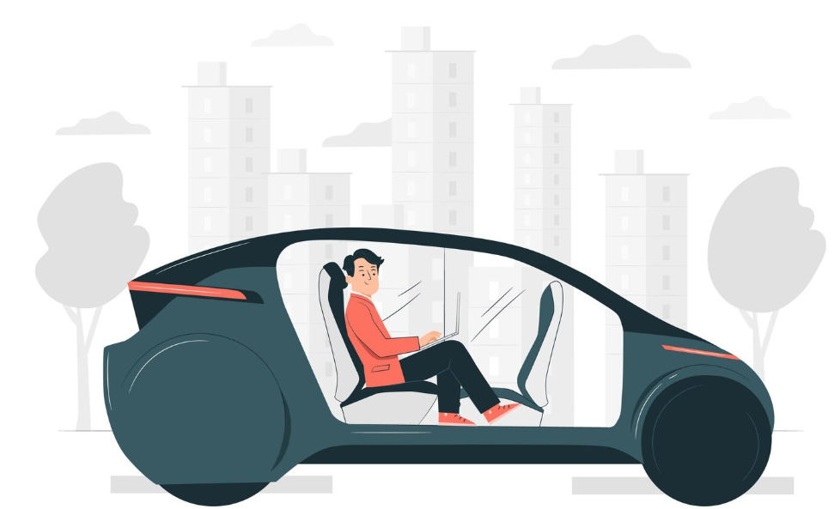
2. Autonomous Vehicles
2.1 What Are Autonomous Vehicles?
Autonomous Vehicles (AVs) are vehicles that can monitor their surroundings, make decisions, and control driving tasks with limited or no human input. They rely on advanced software, AI, and sensor systems to navigate safely.
How Do AVs Work? (The AV Pipeline)
Perception: Detect vehicles, pedestrians, signs, lane markings
Localization: Determine exact position using GPS, IMU, and HD maps
Prediction: Estimate what other road users may do next
Planning: Select safe and efficient routes and maneuvers
Control: Execute steering, braking, and acceleration
This multi-stage process allows the AV to behave like a human driver, but using sensors and algorithms.

Slide 10
2. Autonomous Vehicles
2.2 Levels of Autonomy (SAE Classification)
The levels of autonomy describe how much control a vehicle can take over from a human driver.
They range from Level 0, where the driver handles everything, to Level 5, where the vehicle can drive itself under all conditions without any human involvement.
These levels help classify current technologies, set industry standards, and guide the development of future autonomous systems.
Level | Name | Description
0 | No Automation | Human driver controls everything
1 | Driver Assistance | One automated system (e.g., cruise control)
2 | Partial Automation | Car can steer and accelerate, but driver must monitor
3 | Conditional Automation | Car drives itself but expects human to take over
4 | High Automation | Fully autonomous in specific areas or conditions
5 | Full Automation | No human input needed — anywhere, anytime
Most commercial systems today operate at Levels 1–2, with Level 3 emerging.

Slide 11
2. Autonomous Vehicles
2.3 Key Technologies in Autonomous Vehicles
Autonomous vehicles rely on a combination of advanced sensors, mapping systems, and artificial intelligence to perceive their surroundings and make driving decisions. Cameras, radar, and LiDAR capture detailed information about the road environment, while GPS and high-definition maps help the vehicle determine its exact location. Machine learning algorithms interpret sensor data, predict the movement of other road users, and plan safe paths. Together, these technologies enable AVs to understand, navigate, and respond to complex real-world conditions.
Cameras for visual detection
Radar for distance/speed tracking
LiDAR for 3D environment mapping
Ultrasonic sensors for low-speed situations
High-definition maps & GPSAI/Deep Learning for perception and decision-making
Vehicle control systems (steering, braking, throttle)

Slide 12
1. Introduction
2.4 Why Autonomous Vehicles are Important in Transport?
The transport sector is undergoing a major transformation. Traditional vehicles are being replaced or supplemented with smart technologies. AVs and CVs are at the heart of this change.
1. Safety Improvements
  ✅ 94% of road accidents are caused by human error (ex: distraction, fatigue, speeding).
  ✅ AVs can reduce accidents by making consistent, safe decisions based on data and sensors.
  ✅ CVs allow vehicles to alert each other about hazards or sudden stops, improving reaction time.
2. Efficiency in Traffic Flow
  ✅ AVs maintain optimal speed and following distance, reducing congestion.
  ✅ CVs can coordinate with traffic signals to reduce unnecessary stops, especially at intersections.
Why Autonomous Vehicles are Important ?
3. Environmental Benefits
  ✅ Smoother driving and fewer stop-and-go patterns reduce fuel consumption and emissions.
  ✅ Optimized routing can reduce travel times and carbon footprints.
4. Accessibility
  ✅ AVs can offer mobility for people who cannot drive elderly, disabled, or those without licenses.
  ✅ Improved connectivity supports public transport integration, real-time routing, and shared
  mobility.
5. Urban Planning Implications
  ✅ Reduction in the need for large parking spaces (if AVs can drop passengers and drive away).
  ✅ Potential redesign of cities to focus more on people, not cars.

Slide 13
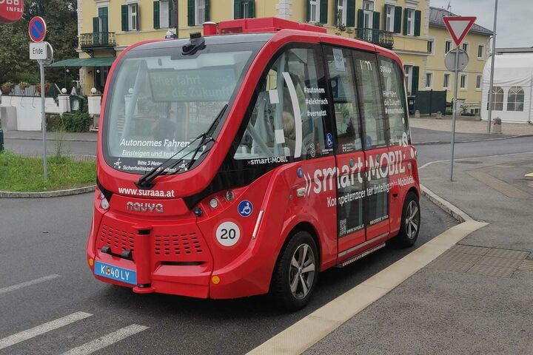
2. Autonomous Vehicles
2.5 Advantages of Autonomous Vehicles
Autonomous vehicles offer the potential to make roads safer, reduce congestion, and improve mobility for people who cannot drive. By removing human error and optimizing driving behavior, AVs can create smoother, more efficient, and more accessible transport systems.
  Reduce human-error-related crashes
  Improve mobility for elderly and disabled people
  Reduce congestion with smoother driving
  Increase fuel efficiency
  Reduce parking needs through shared Avs
  Support cleaner and more sustainable urban transport
  Reduction in road rage, speeding, and aggressive driving
  behavior.

Slide 14
2. Autonomous Vehicles
2.6 Limitations and Challenges of AVs
Despite their potential, autonomous vehicles still face major challenges such as sensor limitations, unpredictable road conditions, cybersecurity risks, and difficulties handling rare or complex situations. These issues make widespread deployment slow and require ongoing research and regulation.
  Difficulty in bad weather (fog, heavy rain)
  Complex “edge case” scenarios
  Cybersecurity and safety concerns
  High cost of sensors and development
  Need for reliable digital maps and connectivity
  Slow regulatory approval and certification

Slide 15
Section 03:
Connected Vehicles
Notes:
# English
Now we are in Section 1: Overview and Tools.
Let’s quickly see what this lab is about and what tools we’ll use.
# French
Nous voici maintenant à la section 1 : Présentation et outils.
Voyons rapidement en quoi consiste cet atelier et quels outils nous utiliserons.

Slide 16
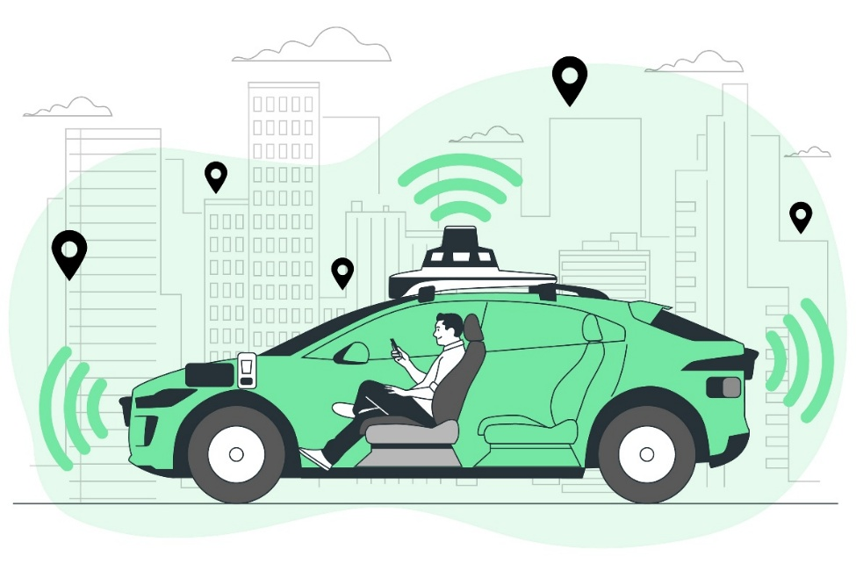
3. Connected Vehicles
3.1 What Are Connected Vehicles?
Connected Vehicles (CVs) exchange information with other vehicles, road infrastructure, pedestrians, and networks. This communication improves safety, traffic flow, and situational awareness.
CV = “Vehicle that talks to the road and other vehicles”
How Connected Vehicles (CVs) Work?
Imagine a CV approaching a traffic signal:
✅ The signal transmits its current state (green/yellow/red) and timing.
✅ The car receives this info in real-time and adjusts its speed accordingly.
✅ If another vehicle is approaching the same intersection,
their CV systems communicate to ensure safe crossing.

Slide 17
3. Connected Vehicles
3.2 Types of V2X Communication
Vehicle-to-Everything (V2X) communication enables vehicles to exchange information with their surroundings to improve safety and traffic efficiency. It includes communication with other vehicles, road infrastructure, pedestrians, and cloud networks. These different V2X types help vehicles anticipate hazards, coordinate movements, and make smarter driving decisions.
Type | Full Form | Purpose
V2V | Vehicle-to-Vehicle | Share speed, location, direction to avoid collisions
V2I | Vehicle-to-Infrastructure | Communicate with traffic lights, road signs, toll booths
V2P | Vehicle-to-Pedestrian | Detect nearby pedestrians, especially in low-visibility conditions
V2N | Vehicle-to-Network | Connect to cloud services for updates, traffic, and weather information
V2X | Vehicle-to-Everything | Collective term for all these interactions

Slide 18
3. Connected Vehicles
3.3 Technologies Behind Connected Vehicles
✅ Uses Wi-Fi-like signals for V2V and vehicle-to-infrastructure communication.
✅ Very low latency (fast response time).
✅ Works within a 300-meter range.
Dedicated Short-Range Communication (DSRC)
✅ Uses existing 4G/5G cellular networks.
✅ Offers broader range than DSRC.
✅ Supports cloud connectivity for real-time updates, apps, and services.
Cellular Vehicle-to-Everything (C-V2X)
✅ Enables accurate real-time vehicle location tracking.
✅ Supports navigation, route optimization, and geofencing.
✅ Synchronizes vehicle position with infrastructure and cloud systems for coordinated responses.
GPS Integration

Slide 19
1. Introduction
3. Technology & Principles of Connected Vehicles (CVs)
3.4 Technologies Behind Connected Vehicles
Connected vehicles rely on wireless communication technologies such as DSRC, C-V2X, and 5G to exchange real-time information with other vehicles and infrastructure. These technologies enable fast, reliable data sharing that improves safety, coordination, and traffic efficiency.
Benefits of Connected Vehicles
Prevent crashes through shared awareness
Early hazard detection (slippery roads, stopped vehicles)Reduce traffic congestion
Support eco-driving and fuel savings
Improve efficiency of intersections (signal optimization)Enable coordinated driving like platooning

Slide 20
1. Introduction
3. Technology & Principles of Connected Vehicles (CVs)
3.5 Connected Vehicle Applications
Connected vehicle applications use real-time communication to enhance safety, reduce delays, and support smarter traffic management. They enable features like collision warnings, signal priority, cooperative merging, and improved routing for more efficient travel.
Red-light violation warnings
Smart traffic signal priority
Emergency vehicle pre-emption
Queue detection and congestion alerts
Cooperative lane merging at bottlenecks
Truck platooning for fuel efficiency

Slide 21
Section 04:
AV vs CV
Notes:
# English
Now we are in Section 1: Overview and Tools.
Let’s quickly see what this lab is about and what tools we’ll use.
# French
Nous voici maintenant à la section 1 : Présentation et outils.
Voyons rapidement en quoi consiste cet atelier et quels outils nous utiliserons.

Slide 22
4. Autonomous vs Connected Vehicles (AVs vs CVs)
4.1 Autonomous vs Connected Vehicles
Although Autonomous Vehicles (AVs) and Connected Vehicles (CVs) are often discussed together, they are distinct technologies with different principles, goals, and challenges. However, they are also complementary working together for greater safety and efficiency.
Feature | Autonomous Vehicles (AVs) | Connected Vehicles (CVs)
Core Idea | Self-driving; vehicle navigates without human input | Communicates with other vehicles/infrastructure
Primary Focus | Independence, perception, decision-making | Cooperation, real-time communication
Technologies Used | Sensors (LiDAR, radar, cameras), AI, ML | DSRC, 5G/C-V2X, GPS, IoT
Network Dependency | Mostly operates independently | Highly dependent on external network and communication systems
Examples | Waymo, Tesla Autopilot, Cruise | Audi’s Traffic Light Info, Smart Traffic Systems
Benefits | Navigation without driver, reduced human error | Better situational awareness, traffic coordination
Limitations | Expensive sensors, complex decision-making in edge cases | Needs widespread infrastructure and standardization

Slide 23
4. Autonomous vs Connected Vehicles (AVs vs CVs)
4.2 How They Work Together (CV + AV = CAV) 🚗🤝
AVs + CVs create Connected Autonomous Vehicles (CAVs) that combine sensing and communication for smarter mobility.
For example:
  ✅ An AV can perceive obstacles with its sensors.
  ✅ A CV can receive road hazard alerts from other vehicles or infrastructure before sensors detect them.
  ✅ Together, CAVs can predict, react, and collaborate more effectively in complex environments.
Advantages of Integration:
Benefit | Description
Redundancy | If sensors fail (fog, obstruction), CV data provides backup
Cooperative Driving | Enables coordinated maneuvers like platooning and lane merging
Better Traffic Management | Vehicles adjust behavior based on shared real-time data
Enhanced Safety | More awareness of unseen events (e.g., vehicle braking suddenly ahead)

Slide 24
4. Autonomous vs Connected Vehicles (AVs vs CVs)
4.3 Challenges of Integration
  ✅ AVs can perceive obstacles, lane markings, and traffic conditions using cameras, radar and LiDAR.
  ✅ CVs can receive early warnings from other vehicles or infrastructure including hazards that sensors cannot yet see.
  ✅ CAVs, can anticipate risks earlier, react faster, and coordinate movement with surrounding vehicles.
  Key Integration Challenges:
  Data Fusion Complexity: Merging sensor data (AV) with communication data (CV) requires highly accurate and reliable fusion algorithms.
  Communication Reliability: CAVs depend on stable 5G/DSRC coverage. Delays or signal loss can affect decision-making.
  Standardization Issues: Different regions use different V2X standards (DSRC, C-V2X), making interoperability difficult.
  Cybersecurity Risks: CV communication can be targeted by hackers.
  System Coordination: AVs respond to real-time perception; CVs use shared information.
  Infrastructure Requirements: CAVs need upgraded traffic signals, sensors, and digital infrastructure, which many cities lack.

Slide 25
Section 05:
Impacts on Transport Systems
Notes:
# English
Now we are in Section 1: Overview and Tools.
Let’s quickly see what this lab is about and what tools we’ll use.
# French
Nous voici maintenant à la section 1 : Présentation et outils.
Voyons rapidement en quoi consiste cet atelier et quels outils nous utiliserons.

Slide 26
5. Impacts on Transport Systems
5.1 Impacts on Transport Systems
Autonomous and connected vehicles can significantly improve how transport systems operate by enhancing safety, reducing congestion, and supporting more efficient and sustainable mobility. They also influence public transport, urban planning, and overall travel behavior.
1. Traffic Efficiency and Flow 🚗
  ✅ Smoother Traffic Flow: AVs and CVs can maintain optimal speeds and safe distances, reducing stop-and-go driving.
  ✅ Reduced Congestion: Coordinated movements (like platooning) and route optimization ease bottlenecks.
  ✅ Intersection Management: Connected vehicles can communicate with traffic signals and other vehicles to reduce waiting times.
Ex: Studies suggest that even a 10% penetration of AVs can improve highway throughput and lower delays.

Slide 27
1. Introduction
5. Impacts on Transport Systems
2. Road Safety ⚠️
  ✅ Major Safety Gains: Over 90% of road accidents are due to human error. AVs can potentially eliminate many of these causes.
  ✅ Real-Time Hazard Warnings: CVs can alert each other and infrastructure about hazards
  (ex: accidents, slippery roads).
But Caution: Full safety depends on robust AI, sensor accuracy, and secure data sharing.
3. Environmental Impacts 🌱
✅ Potential Reductions in Emissions:
                Smoother acceleration and deceleration.
                Less idling in traffic.
                Efficient route selection.
But Caution: Widespread AV use may increase total travel demand
(ex: empty vehicle trips, longer commutes), offsetting some environmental benefits.

Slide 28
1. Introduction
5. Impacts on Transport Systems
4. Modal Shift and Urban Mobility 🧍‍♂️🚉
✅ Public Transport Integration:
                AVs/CVs could serve as feeders to main transit lines.
                May increase coverage in low-demand areas (first-mile/last-mile).
            ✅ Shift from Private Car Ownership to Shared Mobility:
                Rise of Mobility-as-a-Service (MaaS) models.
                Encourages vehicle sharing and subscription-based transport access.
5. Urban and Infrastructure Planning 🏙️
✅ Reduced Parking Demand:
                AVs can drop passengers off and park themselves far away or remain in use.
                Cities may reclaim land currently used for parking.
But Caution: Widespread AV use may increase total travel demand
(ex: empty vehicle trips, longer commutes), offsetting some environmental benefits.

Slide 29
1. Introduction
5. Impacts on Transport Systems
6. Economic and Social Impacts 📈
✅ Job Displacement:
                Impacts on drivers (ex: taxi, delivery, truck drivers).
            ✅ Increased Accessibility:
                Enhanced mobility for elderly, disabled and underserved communities.

Slide 30
Section 06:
Challenges & Future Prospects
Notes:
# English
Now we are in Section 1: Overview and Tools.
Let’s quickly see what this lab is about and what tools we’ll use.
# French
Nous voici maintenant à la section 1 : Présentation et outils.
Voyons rapidement en quoi consiste cet atelier et quels outils nous utiliserons.

Slide 31
1. Introduction
6. Challenges & Future Prospects
6.1 Challenges & Future Prospects
While Autonomous and Connected Vehicles (AVs and CVs) hold transformative potential, several technical, ethical, infrastructural, and societal challenges must be addressed before widespread adoption.
1. Technical Challenges ⚙️
  ✅ Sensor Limitations: Cameras, LiDAR, and radar can be impaired by fog, rain, or snow.
  ✅ Edge Cases in AI: Unexpected or rare scenarios (ex: hand signals from a traffic officer, animals crossing) are hard to program into autonomous systems.
  ✅ Data Processing Speed: Real-time decision-making requires ultra-fast data processing and low-latency communication.
🧠 AVs must replicate — and ideally surpass — human-level driving judgment.

Slide 32
1. Introduction
6. Challenges & Future Outlook
2. Legal and Ethical Concerns 🧑‍⚖️
  ✅ Liability in Crashes: Who is responsible in an accident the manufacturer, software developer, or the passenger?
  ✅ Ethical Dilemmas: How should an AV react when a crash is unavoidable? (ex: protect occupants vs. pedestrians)
  ✅ Regulatory Gaps: Many countries lack a clear legal framework for testing or operating AVs.
⚖️ Legal readiness is just as important as technical capability.
3. Cybersecurity and Privacy 🔐
  ✅ Data Vulnerability: Vehicles connected to networks are exposed to hacking, spoofing, or data theft.
  ✅ Location Tracking: Continuous monitoring may raise concerns about surveillance and user privacy.

Slide 33
1. Introduction
6. Challenges & Future Outlook
4. Infrastructure Readiness 🏙️
  ✅ Communication Infrastructure: Successful CV deployment depends on 5G, roadside units (RSUs), and vehicle-to-everything (V2X) technologies.
  ✅ Road Markings and Signage: AVs depend on well-maintained road infrastructure to operate safely.
💡 Developing countries may face larger hurdles due to infrastructure deficits.
5. Social Acceptance and Behavioral Change 💼
  ✅ Trust and Fear: Public hesitance to ride in driverless cars remains high.
  ✅ Job Displacement: Widespread adoption could impact millions of professional drivers globally.
  ✅ Learning Curve: People need time to understand how to interact with AVs and CVs safely.

Slide 34
1. Introduction
6. Challenges & Future Outlook
6.2 Future Prospects 🌍
Despite the hurdles, industry and governments are moving steadily toward integration:
  1. Short-term [0–5 years]:
  ✅ Pilot projects, AV shuttles, testing zones
  ✅ Increased V2X deployment in cities
  2. Medium-term [5–15 years]:
  ✅ Widespread connected vehicle ecosystem
  ✅ Automated freight and logistics
  ✅ Mixed traffic with partial autonomy
  3. Long-term [15+ years]:
  ✅ Fully autonomous mobility networks
  ✅ Smart cities with integrated CAV systems
  ✅ Major reduction in crashes and emissions

Slide 35
Section 07:
Quiz
Notes:
# English
Now we are in Section 1: Overview and Tools.
Let’s quickly see what this lab is about and what tools we’ll use.
# French
Nous voici maintenant à la section 1 : Présentation et outils.
Voyons rapidement en quoi consiste cet atelier et quels outils nous utiliserons.

Slide 36
7. Quiz
1. What is the main difference between autonomous and connected vehicles?
                Autonomous vehicles rely on communication between vehicles
                Connected vehicles drive themselves without human input
                Autonomous vehicles make decisions independently, connected vehicles rely on communication
                Both require no human driver
2. Which of the following is NOT a sensor commonly used in autonomous vehicles?
                LiDAR
                Radar
                Sonar
                Thermometer
3. What does V2X stand for in connected vehicle technology?
                Vehicle-to-Exit
                Vehicle-to-Everything
                Vehicle-to-Xenon
                Vehicle-to-Extra

Slide 37
7. Quiz
4. What is one key benefit of connected vehicles (CVs)?
                Complete independence from internet connectivity
                Improved social interaction between drivers
                Real-time information sharing to avoid collisions
                Ability to fly over congested roads
5. Which of these is a potential ethical concern with autonomous vehicles?
                Too much data being shared with passengers
                Deciding who is responsible for cleaning the car
                Making decisions during unavoidable crashes
                Network bandwidth usage
6. What challenge do both AVs and CVs face in poor weather conditions?
                Excessive fuel usage
                Sensor failure or reduced visibility
                Passenger refusal to ride
                Legal parking

Slide 38
7. Quiz
7. How could AVs impact urban transport systems positively?
                Reduce road capacity
                Increase travel times
                Improve traffic efficiency and safety
                Promote private vehicle ownership
8. Which infrastructure upgrade is essential for connected vehicle communication?
                Wider roads
                5G and roadside communication units
                Electric charging stations only
                More toll booths
9. What is a common public concern regarding AV adoption?
                Cars being too quiet
                Loss of driver’s licenses
                Lack of trust in machine decision-making
                Increased walking

Slide 39
7. Quiz
10. Which vehicle type requires external information from its environment to function optimally?
                Manual cars
                Autonomous vehicles only
                Connected vehicles
                None of the above

Slide 40
Thank you for your attention!

