Slide 1
Transport Research and Analysis
Module 5: Advanced Topics and Case Studies
Lecture 22: Urban Mobility and Smart Cities

Slide 3
Table of contents
Section 1 Introduction & Urban Mobility Concepts .......................... 4
Why Focus on Urban Mobility? ................................................. 5
What is Urban Mobility? …........................................................ 6
A Brief History of Urban Travel ................................................. 7
Principles of Sustainable Urban Mobility .................................. 8
Urban Mobility Planning Frameworks in Practice ..................... 9
Measuring Urban Mobility – Key KPIs ...................................... 10
What’s Holding Us Back? ......................................................... 11
Why Transport Matters in Smart Cities ..................................... 12
Section 2 Role of Transport in Smart Cities ....................................... 13
Digital Twins – Simulating Urban Mobility ............................ 14
AI-Enabled Traffic Signals ..…........................................... 15
Mobility-as-a-Service (MaaS) …................................... 16
Electrification & Decarbonization ................................. 17
Barcelona’s Superblocks ............................................. 18
Section 3 Innovative Mobility Solutions ...................................................... 19
What Counts as “Innovation”? .............................................. 20
The Micromobility Boom ...................................................... 21
Connected & Autonomous Shuttles........................................ 22
Urban Air Mobility (eVTOL) .................................................. 23
Smarter Logistics & Last Mile .............................................. 24
Policy & Pricing Innovation .................................................. 25
Making Mobility Equitable .................................................... 26
Section 4 Quiz & Group Discussion ............................................................. 27
Quiz .................................................................................... 28
Group Discussion ................................................................. 29
Urban Mobility and Smart Cities

Slide 4
0. Objectives of the Lecture
0.1. Learning Objectives
Define Urban Mobility: Understand the core concept of urban mobility as the multimodal, door-to-door movement of people and goods, emphasizing accessibility over just speed.
Analyze Smart City Integration: Explore the role of technology in transport, including Digital Twins, AI-enabled traffic signals, and the Internet of Things (IoT) in creating responsive city infrastructures.
Evaluate Innovative Solutions: Assess emerging mobility trends such as Mobility-as-a-Service (MaaS), micromobility (e-scooters/bikes), and Urban Air Mobility (eVTOLs).
Apply Sustainable Frameworks: Learn key planning frameworks like the EU's Sustainable Urban Mobility Plan (SUMP) and the "15-Minute City" concept to design eco-friendly and equitable transport systems.
Address Challenges: Identify barriers to progress, such as institutional silos and funding gaps, while understanding policy tools like congestion pricing and low-emission zones to overcome them.
Urban Mobility and Smart Cities

Slide 5
Section 01:
Introduction & Urban Mobility Concepts
Urban Mobility and Smart Cities

Slide 6
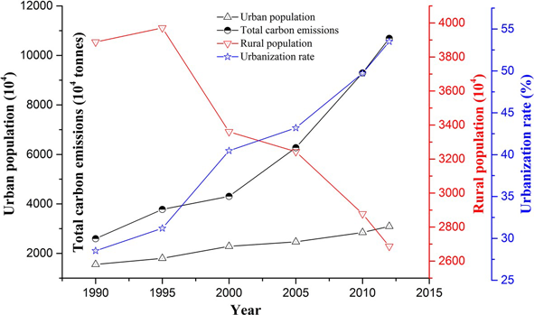
1. Introduction & Urban Mobility Concepts
1.1. Why Focus on Urban Mobility?
Over 58% of the world’s population lives in urban areas—and rising fast.
Key Drivers:
Transport : Largest urban energy user & CO₂ emitter
Congestion costs : ~1% of GDP in major cities (ITF)
Tech revolution : AI, electrification, mobility platforms
Public demand : Clean air, safe streets, accessible options
Policy windows : EU Green Deal, US Infrastructure Act, COP28 goals
Urban Mobility and Smart Cities

Slide 7
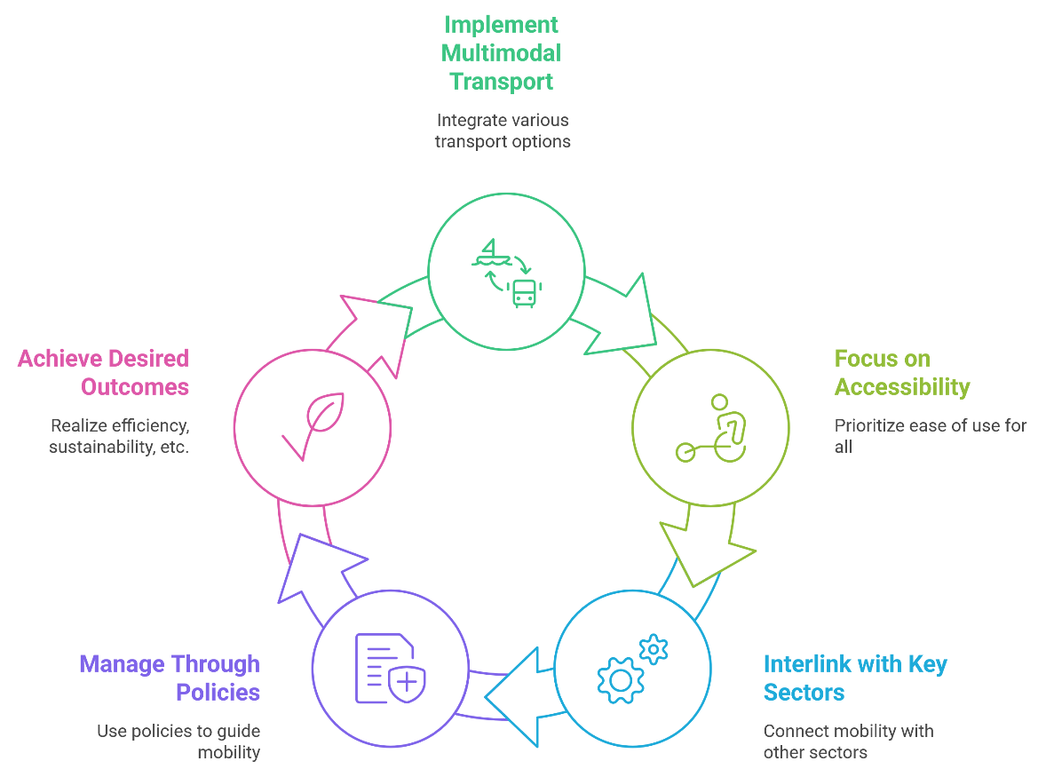
1. Introduction & Urban Mobility Concepts
1.2. What is Urban Mobility?
Definition
The door-to-door movement of people and goods within cities using all available modes.
Key Features:
Multimodal: walk, cycle, Public Transport, car, scooter
Focus on accessibility, not just speed
Interlinked with land use, energy, equity & ICT
Managed through policy, pricing, and public engagement
Outcomes: efficiency, sustainability, safety, inclusivity
Urban Mobility and Smart Cities

Slide 8
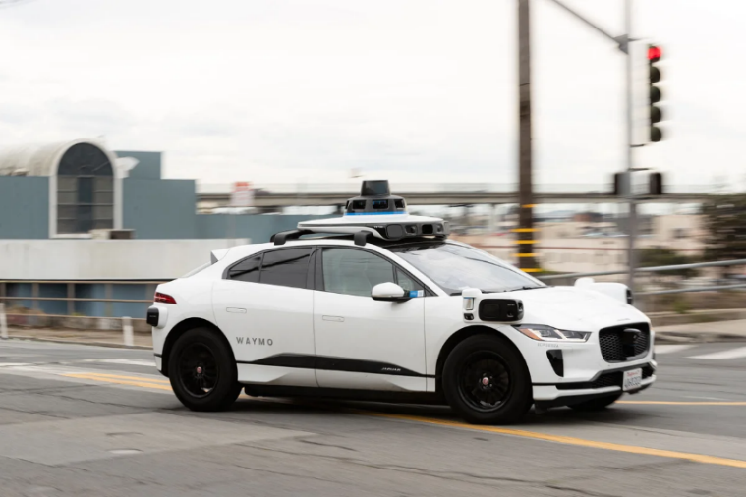
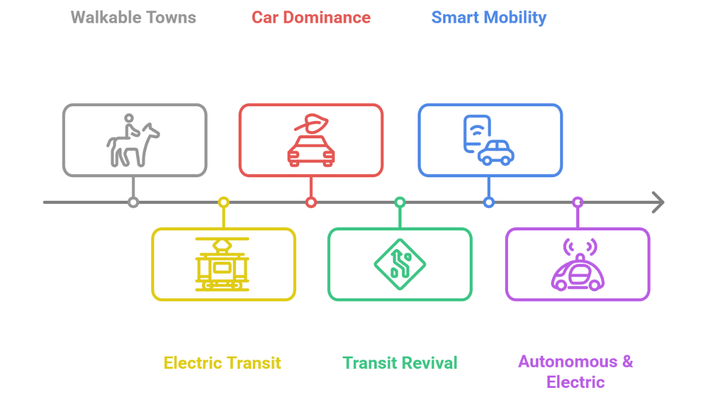
1. Introduction & Urban Mobility Concepts
1.3. A Brief History of Urban Travel
Era | Mode shift & Urban form
Pre – 1900 | Walkable towns + horse carriages
1900 – 1950 | Electric trams & early subways
1950 – 2000 | Car dominance → urban sprawl
2000 – 2015 | Transit revival, bike lanes, congestion zones
2015 - Today | Smart mobility, shared fleets, low-emission zones
Next Decade | Connected, autonomous, electric, and airborne transport
Urban Mobility and Smart Cities
Notes:
More details will be discussed in the future lectures

Slide 9
1. Introduction & Urban Mobility Concepts
1.4. Principles of Sustainable Urban Mobility
Sustainable urban mobility is built on core principles that prioritize people, planet, and place. These guiding values help cities design transport systems that are efficient, inclusive, and future-ready.
Guiding Values:
Proximity: Compact, mixed-use neighbourhoods
Modal Hierarchy: Walking & cycling > public transport > cars
Inclusive Design: Safe & accessible for all
Low-Carbon Energy: Renewable and resilient sources
Efficient Land Use: Streets as multifunctional public space
Adaptability: Monitor, evaluate, revise policies (e.g., Sustainable Urban Mobility Plan)
Urban Mobility and Smart Cities

Slide 10
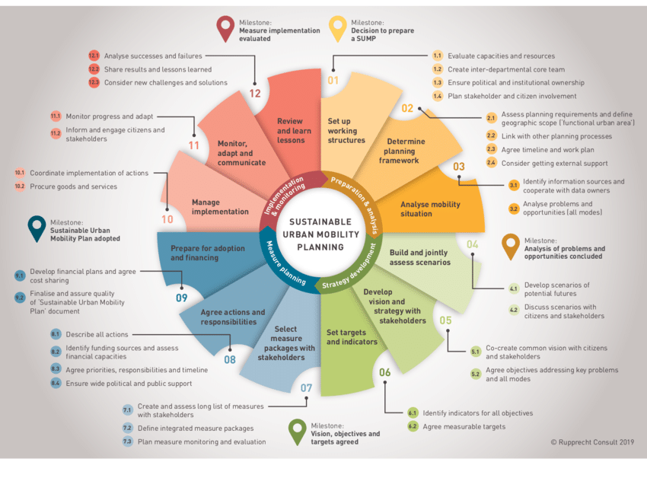
1. Introduction & Urban Mobility Concepts
1.5. Urban Mobility Planning Frameworks in Practice
Cities around the world are adopting strategic frameworks to guide sustainable, inclusive, and tech-enabled mobility systems. Here are some of the most influential models shaping urban planning today:
Planning Tools in Use:
SUMP – EU’s Sustainable Urban Mobility Plan (12-step process)
15-Minute City – Local access to work, shops, healthcare, leisure
Mobility Hubs – Integrate transport, shared modes, parcel lockers
Complete Streets & Mobility Pyramid – Prioritize active mobility
Digital Twins – Simulate urban systems for smarter planning
EU SUMP
Urban Mobility and Smart Cities

Slide 11
1. Introduction & Urban Mobility Concepts
1.6. Measuring Urban Mobility – Key KPIs
Common Performance Metrics
Indicator | Why is it matters?
Avg. door-to-door travel time | Measures real-world access
Mode split | Indicates user preferences
Car-km per capita & parking space | Reflects car dependence
Emissions (GHG, noise, air) | Public health & climate impact
Road injury rate | Safety benchmark
% near frequent public transport | Equity & service quality marker
Urban Mobility and Smart Cities

Slide 12
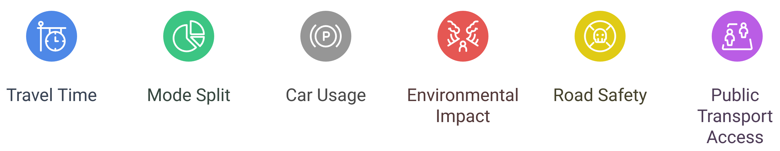
1. Introduction & Urban Mobility Concepts
1.7. What’s Holding Us Back?
Major Obstacles to Progress
Institutional silos: Fragmentation between transport, land-use, energy
Legacy car infrastructure: Expensive to retrofit, culturally entrenched
Funding gaps: Long-term plans vs. short political terms
Data friction: Privacy laws, poor interoperability
Equity challenges: Gentrification, mobility deserts
Public narratives: “War on cars” backlash
Urban Mobility and Smart Cities

Slide 13
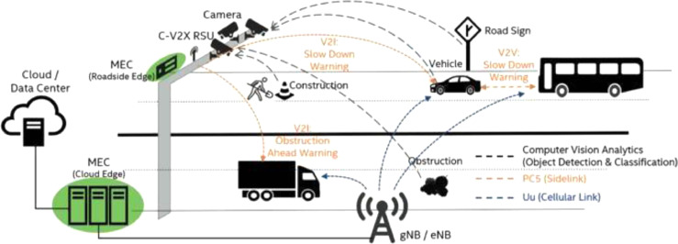
1. Introduction & Urban Mobility Concepts
1.8. Why Transport Matters in Smart Cities
A smart city is only as smart as its mobility system.
Transport’s Backbone Role:
Feeds real-time data to energy, health, emergency, commerce
API-based networks allow adaptive traffic & curb space use
IoT turns roads into the city’s nervous system
Open standards (GTFS-RT, TN-ITS) enable innovation
Governance must balance tech efficiency with public trust
Urban Mobility and Smart Cities

Slide 14
Section 02:
Role of Transport in Smart Cities
Urban Mobility and Smart Cities

Slide 15
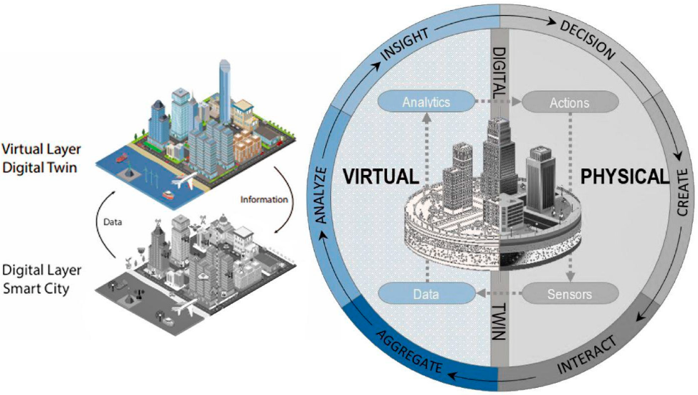
2. Role of Transport in Smart Cities
2.1. Digital Twins – Simulating Urban Mobility
What is a Digital Twin?
A real-time digital replica of physical urban systems (e.g., roads, transport, weather).
How They Work:
Sensors feed live data (e.g., GPS, weather, traffic cameras) into a 3D environment
Enables “what-if” scenario testing for planning & emergencies
Example: OPTICS model at Port of Corpus Christi integrates radar, AIS, weather
Benefits:
Predictive maintenance, incident response, emissions modelling
Integrated view across transport, energy, and logistics systems
Scalable – from street corridors to entire metro regions
Urban Mobility and Smart Cities

Slide 16
2. Role of Transport in Smart Cities
2.2. AI-Enabled Traffic Signals
AI-powered traffic signals are transforming how cities manage intersections—making streets more responsive, efficient, and ready for the future of mobility.
What It Does:
Real-time adaptive signal control based on live traffic conditions
Reduces congestion, fuel use, and delays
Global Impact:
Prague 2024: AI systems cut corridor delays by 15–30%
SCATS: Deployed in 55,000+ intersections across 180 cities
Key Features:
Dynamic prioritization for buses, emergency vehicles, cyclists
Uses cameras, loop sensors, and machine learning algorithms
Fast ROI: < 3 years payback via fuel and time savings
Urban Mobility and Smart Cities

Slide 17
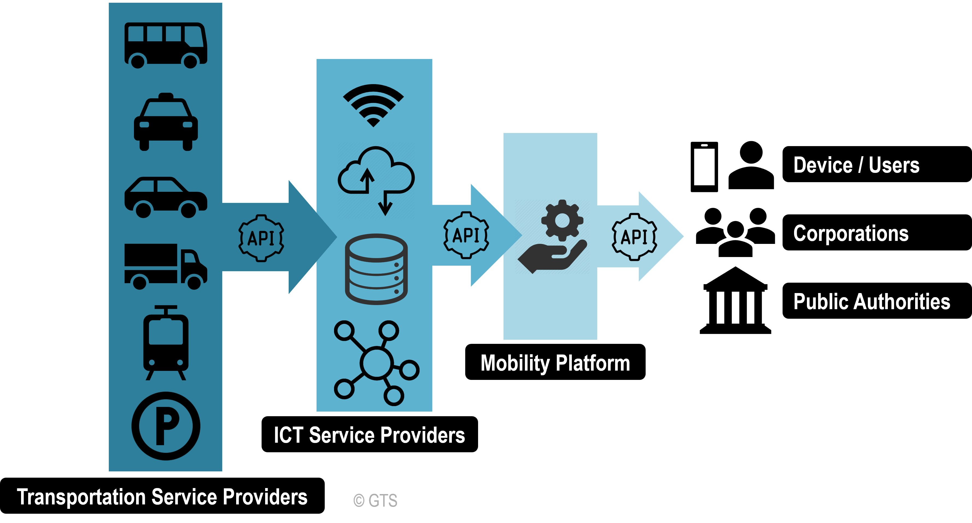
2. Role of Transport in Smart Cities
2.3. Mobility-as-a-Service (MaaS)
A Single Platform for Urban Travel
One app to plan, book, and pay across multiple transport modes
Components:
Public transport + shared bikes + taxis + rentals
Unified route planning, scheduling, ticketing, and payment
Global Examples:
Vienna “Upstream” project: ↓ car use by 21%, ↑ PT by 26%
Helsinki: 12% of MaaS users gave up private cars
Challenges:
Requires open APIs, fare integration, data security
Business models: pay-as-you-go, subscriptions, employer benefits
Urban Mobility and Smart Cities

Slide 18
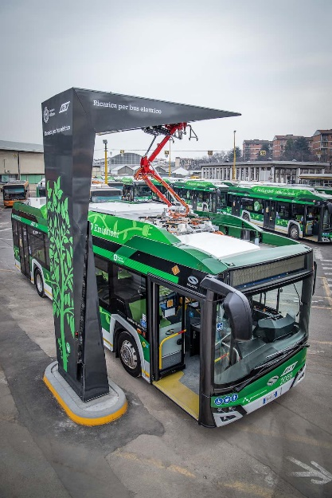
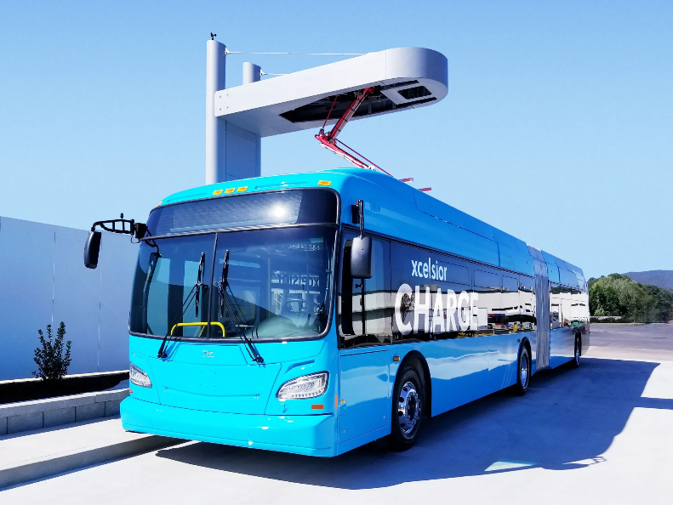
2. Role of Transport in Smart Cities
2.4. Electrification & Decarbonisation
Clean Power for Clean Transport
Global electric bus stock: 635,000+ in 2023 (IEA)
Shenzhen: World’s first 100% electric fleet – 16,000 buses
Charging Options:
Depot charging (overnight)
On-route / inductive
Battery swaps
Vehicle-to-grid (V2G)
Incentives:
Zero-emission mandates
Green bonds, TCO subsidies
Smart grid scheduling to reduce strain
Urban Mobility and Smart Cities

Slide 19
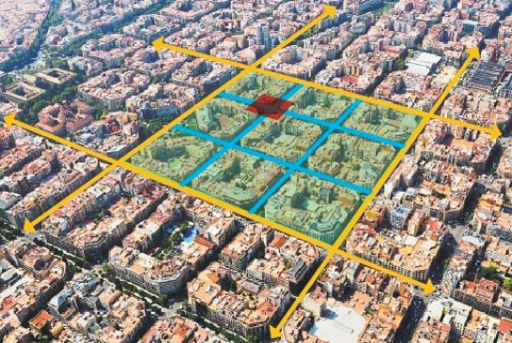
2. Role of Transport in Smart Cities
2.5. Barcelona’s Superblocks
Reclaiming the Street for People
Reorganizing 9 city blocks into low-traffic, pedestrian-friendly zones
Results:
↓ 26% vehicle traffic
↑ 30% cycling, ↑ 10% foot traffic
↓ NO₂, ↓ noise, ↓ heat island effect
Tactical Urbanism:
Quick deployment: planters, paint, bollards
Feedback loops to iterate and scale
Community co-design = political durability
Urban Mobility and Smart Cities

Slide 20
Section 03:
Innovative Mobility Solutions
Urban Mobility and Smart Cities

Slide 21
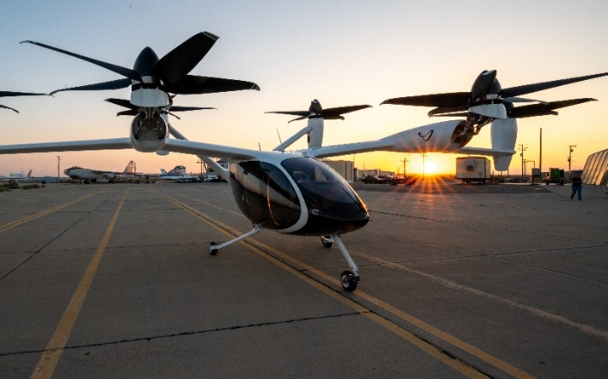
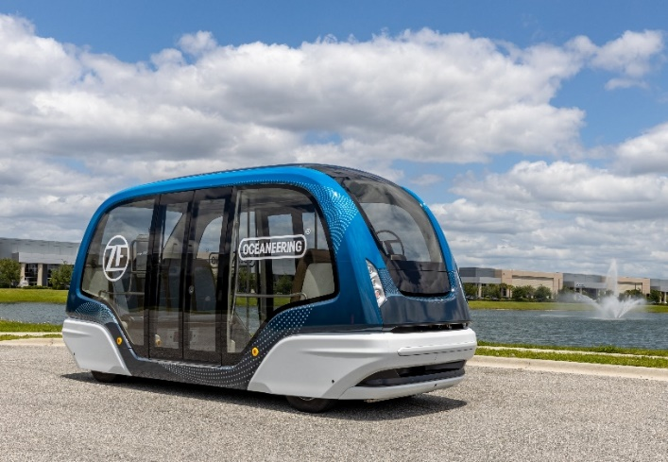
3. Innovative Mobility Solutions
3.1. What Counts as “Innovation”?
Innovation in urban mobility goes beyond technology—it’s about transforming how people and goods move, how decisions are made, and how cities adapt.
Key Innovation Domains:
Micromobility – e-scooters, cargo e-bikes
Autonomous shuttles – campus / first-mile
Urban Air Mobility – eVTOLs
Smart logistics – curb APIs, drones
Policy shifts – pricing, permits
Cross-cutting layer: AI + mobility data platforms
eVTOLs
Autonomous Shuttles
Urban Mobility and Smart Cities

Slide 22
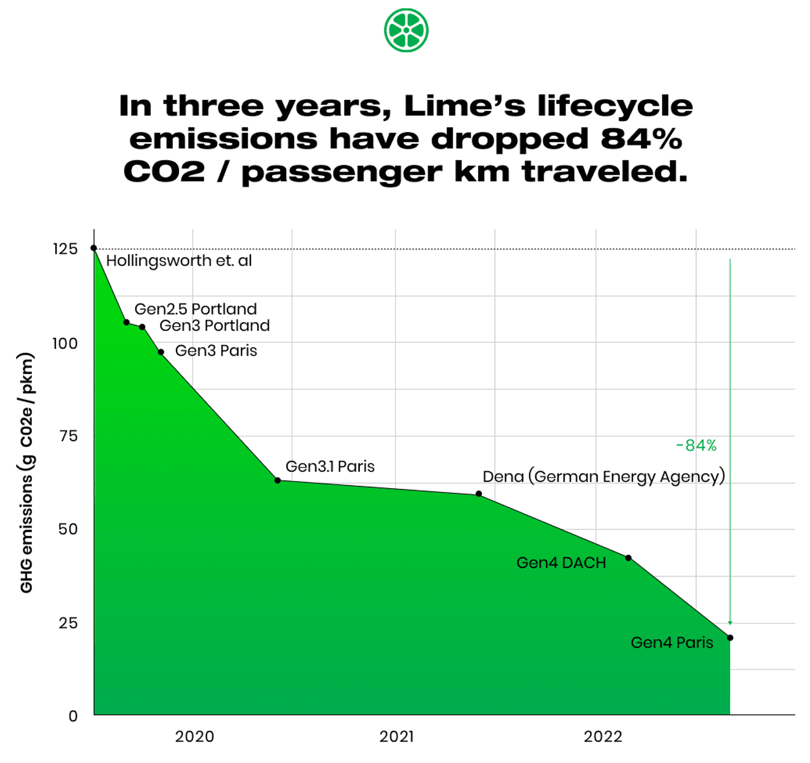
3. Innovative Mobility Solutions
3.2. The Micromobility Boom
Innovation in urban mobility goes beyond technology—it’s about transforming how people and goods move, how decisions are made, and how cities adapt.
Small Vehicles, Big Impact
Market worth $40B (2024) → projected $91B by 2030
Ideal for short trips: < 3 km in dense, urban areas
E-bikes, e-scooters, and cargo bikes lead growth
Revenue Models:
Pay-per-minute
Monthly passes for commuters
In-app ads or bundling with public transport subscriptions
Sustainability:
Shared e-bikes = ~35g CO₂/km (vs. 210g for cars)
Tech features: swappable batteries, geofencing, speed limiters improve safety and efficiency
Urban Mobility and Smart Cities

Slide 23
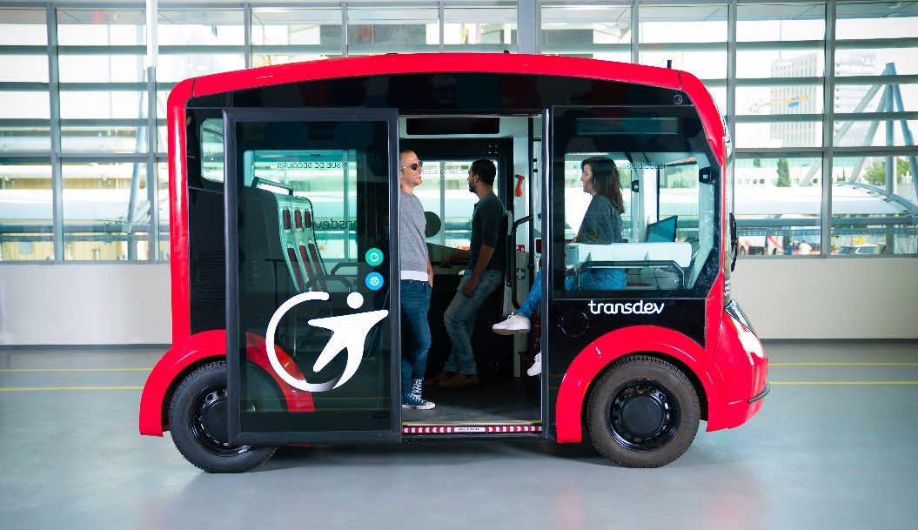
3. Innovative Mobility Solutions
3.3. Connected & Autonomous Shuttles
Autonomous shuttles are moving from test tracks to city streets—bridging first/last-mile gaps and redefining public transport in low-demand zones.
Driverless Minibuses in Real Cities
Level-4 autonomy for fixed-route shared travel
Pilots: Helsinki, Singapore, Phoenix
Capacity: 6–15 passengers
Ideal for first/last-mile to rail stations, campuses
Challenges:
Mixed traffic safety, pedestrian interaction
High-resolution curb & route mapping
Public trust & insurance issues
Urban Mobility and Smart Cities

Slide 24
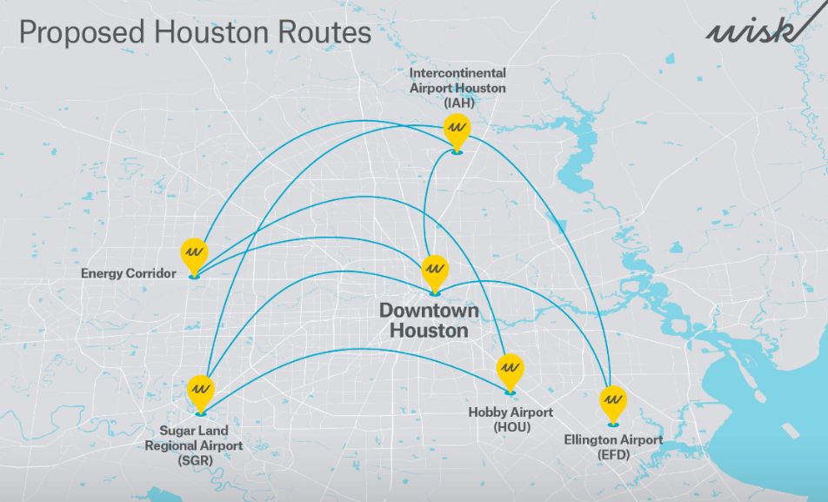
3. Innovative Mobility Solutions
3.4. Urban Air Mobility (eVTOL)
Urban air mobility is no longer science fiction—electric air taxis are being tested today to revolutionize urban commutes and airport access.
What Are eVTOLs?
Small, fully electric vertical take-off and landing aircraft designed for city travel
Typical range: ~80 km
Passenger capacity: 4 seats
Zero-emission, quiet operation
Key Considerations:
Vertiport placement – proximity, safety, land use
Noise regulation & safety standards
Integration with public transport & Mobility-as-a-Service (MaaS) platforms
Real-World Deployment:
Wisk Aero + City of Houston: 6 vertiports planned, live service expected by 2026
Urban Mobility and Smart Cities

Slide 25
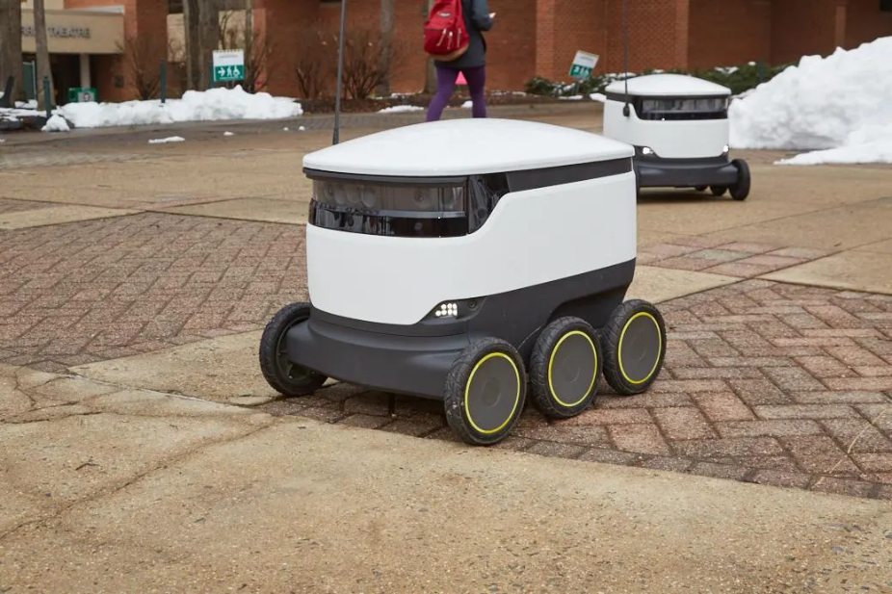
3. Innovative Mobility Solutions
3.5. Smarter Logistics & Last Mile
Urban freight is evolving fast—technology and policy are transforming how goods move through the “last mile” to your door.
Why It Matters:
Cargo e-bikes emit 98% less CO₂ per km than diesel delivery vans
University of Washington (Seattle) pilot: Reduced delivery times in city cores by 50%
Key Innovations:
Sidewalk robots for short-range package delivery
Drones in trial use for aerial drop-offs
Digital curb APIs enabling real-time loading/unloading coordination
Sustainable Strategies:
Zero-emission zones to restrict polluting vehicles
Urban consolidation hubs reduce redundant van trips in dense areas
Urban Mobility and Smart Cities

Slide 26
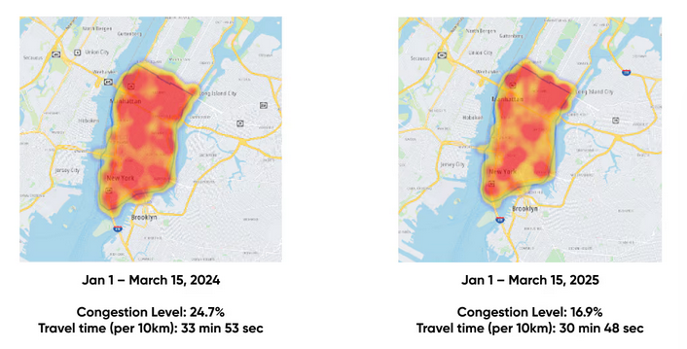
3. Innovative Mobility Solutions
3.6. Policy & Pricing Innovation
When designed thoughtfully, pricing policies can drive sustainable choices while making mobility more equitable and efficient.
Why It Matters:
Smart pricing helps manage demand, reduce congestion, and improve fairness
Smart Pricing in Action:
New York City Congestion Charge (2025): $9 toll → 220,000 fewer cars daily
Dynamic pricing for curb access and e-scooter parking
320+ European cities have implemented Low/Ultra-Low Emission Zones (LEZ/ULEZ)
Equity & Social Incentives:
Mobility credits for low-income users (e.g., discounted public transport or e-bike access)
Public-private partnerships to fund green infrastructure (charging stations, bike lanes)
Urban Mobility and Smart Cities

Slide 27
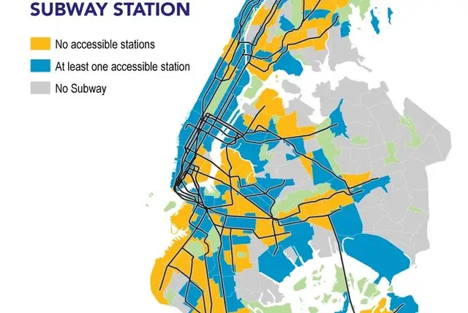
3. Innovative Mobility Solutions
3.7. Making Mobility Equitable
Sustainable mobility must be accessible mobility. Cities can’t be truly smart if they’re not also fair.
Principles of Inclusive Design:
Universal access features: Level boarding, tactile paving, audio signals
Use of data tools to map and address mobility deserts
Equity targets: 100% of population within 30 minutes of jobs, schools, and healthcare
Putting Inclusion into Practice:
Engage under-represented groups in mobility planning
Offer MaaS social tariffs, e-bike loan programs, and caregiver fare discounts
Mobility Desert
Urban Mobility and Smart Cities

Slide 28
Section 04:
Quiz & Group Discussion
Urban Mobility and Smart Cities

Slide 29
4. Quiz & Group Discussion
4.1. Quiz
Explain the concept of "Mobility-as-a-Service (MaaS)."
How do “Superblocks” in Barcelona represent a shift in urban mobility planning?
Why is micromobility considered a sustainable transport solution?
In what ways can policy and pricing tools influence mobility behavior in cities?
How does equity play a role in sustainable urban mobility planning?
What role do technologies like AI-enabled traffic signals and digital twins play in smart city transport systems?
Urban Mobility and Smart Cities

Slide 30
4. Quiz & Group Discussion
4.2. Group Discussion
Discussion Prompts
Topic 1: Should cities invest more in autonomous shuttles or micromobility systems? Why?
Topic 2: Can smart mobility innovations unintentionally widen inequality?
Topic 3: If you were designing a “15-minute city” for your local context, what would be your top priorities?
Urban Mobility and Smart Cities

Slide 31
Thank you for your attention!

