Slide 1
Transport Research and Analysis
Module 5: Advanced Topics and Case Studies
Lab 13: Autonomous Vehicles

Slide 3
Table of Contents
Autonomous Vehicles
Section 1: Lab Overview and Required Tools ………….………………………………………………. 4
1.1 Objectives: Autonomous Vehicles ………….…………………………………………………… 5
1.2 Lab Activities and Time Allocation ...……….…………………………………………………… 6
1.3 Tools Used in This Lab ……………………….…………………………………………………… 7
Section 2: Overview of Autonomous Vehicles ……………..…………………………………………... 8
2.1 What Are Autonomous Vehicles? …..……………………….…………………………….………. 9
2.2 Levels of Driving Automation ………………...…………………………………………………….. 10
2.3 Current Status of AV Deployment ……………………………………………………………….... 11
Section 3: Benefits and Challenges of AVs …………………………………..………………………… 12
3.1 Potential Benefits of AVs ……………..…………….…………………….…………………………. 13
3.2 Key Challenges and Barriers …………………………………………….…………………………. 14
Section 4: Ethical and Legal Considerations ……………………………….………………………….. 15
4.1 Ethical Challenges in AVs ……………………………………………….…………………………. 16
4.2 Legal & Regulatory Frameworks ………………….………………….…………………………... 23
4.3 Class Discussion: Strategies for Safer & More Ethical Deployment ……………………… 25
Notes:
# English
First of all, let’s take a look at what’s included in this lab.
We begin with Section 1: Lab Overview and Required Tools, where we’ll talk about the lab objectives, the overall content, and the tools will be using.
Then in Section 2: Data Preprocessing Techniques, we’ll explore the key steps used to clean and prepare raw datasets.
After that, in Section 3: Data Format Standardizing, we’ll learn how to make the data consistent—such as aligning time formats, currencies, and measurement units across different sources.
# French
Tout d'abord, examinons le contenu de ce laboratoire.
Nous commençons par la section 1 : Présentation du laboratoire et outils requis, où nous aborderons les objectifs du laboratoire, le contenu général et les outils utilisés. Ensuite, dans la section 2 : Techniques de prétraitement des données, nous explorerons les étapes clés du nettoyage et de la préparation des jeux de données brutes.
Ensuite, dans la section 3 : Normalisation des formats de données, nous apprendrons à assurer la cohérence des données, notamment en alignant les formats d'heure, les devises et les unités de mesure entre différentes sources.

Slide 4
Table of Contents
Autonomous Vehicles
Section 5: Class Activity 1 ……………………………………….…………….………………………….. 28
5.1 Analyze Autonomous Vehicle Performance ……………….………….…………………………. 29
5.2 Load & Explore AV Performance Dataset …………………………….…………………………. 31
5.3 Perform Descriptive Statistics …………………………….…………….…………………………. 33
5.4 Create Visualizations ………………………………………..…………….…………………………. 34
5.5 Compare AV vs Human-Driven Vehicle Data …..……………………………………….………. 35
Section 6: Class Activity 2 ………………………………..……………………..………………………… 36
6.1 Build and Simulate AV Behaviour in VISSIM …………………………...………………………. 37
6.2 Setup, Define AVs, Simulate and Analysis ….……………………….…………………………. 38
Section 7: Homework Assignment 1 ………………………………………….………………………….. 46
7.1 Assignment 1: Simulate AV Behaviour in VISSIM …….………………………….……………. 47
Section 8: References ……………………………………………….………….………………………….. 52
8.1 Reference Textbooks & Tutorials ……………………………………….…………………………. 53
8.2 Reference Code for Class Activity …………………………….……….…………………………. 53
Notes:
# English
First of all, let’s take a look at what’s included in this lab.
We begin with Section 1: Lab Overview and Required Tools, where we’ll talk about the lab objectives, the overall content, and the tools will be using.
Then in Section 2: Data Preprocessing Techniques, we’ll explore the key steps used to clean and prepare raw datasets.
After that, in Section 3: Data Format Standardizing, we’ll learn how to make the data consistent—such as aligning time formats, currencies, and measurement units across different sources.
# French
Tout d'abord, examinons le contenu de ce laboratoire.
Nous commençons par la section 1 : Présentation du laboratoire et outils requis, où nous aborderons les objectifs du laboratoire, le contenu général et les outils utilisés. Ensuite, dans la section 2 : Techniques de prétraitement des données, nous explorerons les étapes clés du nettoyage et de la préparation des jeux de données brutes.
Ensuite, dans la section 3 : Normalisation des formats de données, nous apprendrons à assurer la cohérence des données, notamment en alignant les formats d'heure, les devises et les unités de mesure entre différentes sources.

Slide 5
Section 01:
Lab Overview and Required Tools
Notes:
# English
Now we are in Section 1: Overview and Tools.
Let’s quickly see what this lab is about and what tools we’ll use.
# French
Nous voici maintenant à la section 1 : Présentation et outils.
Voyons rapidement en quoi consiste cet atelier et quels outils nous utiliserons.

Slide 6
1. Lab Overview and Required Tools
1.1 Objectives: Autonomous Vehicles
Autonomous Vehicles (AVs) are increasingly integrated into modern transport systems, creating a need for engineers to understand how these vehicles behave, make decisions, and interact with human-driven traffic.
By the end of this lab, students will be able to:
✅ Understand how autonomous vehicles behave in simulated traffic environments.
✅ Analyze differences between autonomous and human-driven vehicles using real or synthetic data.
✅ Visualize key AV performance metrics such as speed, braking distance, and reaction time.
✅ Build a simple traffic simulation in VISSIM that includes autonomous vehicle behavior.
✅ Evaluate safety, efficiency, and flow characteristics when AVs are introduced into a network..
✅ Discuss ethical, legal, and operational implications of deploying AVs in real-world systems.

Slide 7
1. Lab Overview and Required Tools
1.2 Lab Activities and Time Allocation
This lab combines theoretical reflection and practical exercises. Students will analyze autonomous vehicle performance using Python and simulate AV behavior in VISSIM, applying concepts from the lecture to understand safety, efficiency, and traffic impacts.
Section | Topic | Tools | Activity Type | Activity Done By | Duration (min)
1 | Lab Overview and Required Tools | - | Presentation | Teacher + Student | 10
2 | Overview of Autonomous | - | Presentation | Teacher + Student | 10
3 | Benefits and Challenges of AVs | - | Presentation | Teacher + Student | 15
4 | Ethical and Legal Considerations | - | Presentation | Teacher + Student | 15
5 | Class Activity 1: Analyze Autonomous Vehicle Performance | Python, Colab | Class Activity | Teacher + Student | 30
6 | Class Activity 2: Simulate AV Behaviour in VISSIM | VISSIM | Class Activity | Teacher + Student | 90
7 | Homework: Assignment 1 (at home 120-180min) | VISSIM | Homework | Student | 10
Total |  |  |  |  | 180
Notes:
# English
In this lab, we will explore data preprocessing techniques that are essential for preparing raw transport or tabular datasets for analysis. You will learn how to clean, standardize, and visualize real-world datasets using Python and Google Colab.
We have 8 main sections in this lab, and altogether, it will take approximately 135 minutes to complete all the activities.
# French

Slide 8




1. Lab Overview and Required Tools
1.3 Tools Used in This Lab
When following this lab, you will need to use the following tool:
✅ VISSIM: VISSIM is a microscopic traffic simulation software developed by PTV Group. It is widely used by transportation engineers and researchers to model and analyze traffic flow, optimize intersections, and evaluate signal timing strategies.
✅ Python: A programming language widely used for data analysis, visualization, and machine learning.
✅ Google Colab: A free cloud-based platform to write and run Python code directly in the browser, without installation.
Notes:
# English
For this lab, we will use three main tools:
Python for cleaning and analyzing data,
Google Colab to run Python in your browser,
and Excel to quickly preview and inspect the provided CSV datasets and the cleaned output files.
# French
Pour ce laboratoire, nous utiliserons trois outils principaux : Python pour nettoyer et analyser les données, Google Colab pour exécuter Python dans votre navigateur et Excel pour prévisualiser et inspecter rapidement les fichiers CSV bruts.

Slide 9
Section 2:
Overview of Autonomous Vehicles
Notes:
# English
Now we are in Section 1: Lab Overview and Required Tools.
Let’s quickly see what this lab is about and what tools we’ll use.
# French
Nous voici maintenant à la section 1 : Présentation du laboratoire et outils requis.
Voyons rapidement en quoi consiste ce laboratoire et quels outils nous utiliserons.

Slide 10
2. Overview of Autonomous Vehicles
2.1 What Are Autonomous Vehicles?
Autonomous Vehicles (AVs), also known as self-driving cars, are vehicles capable of navigating and driving themselves without human input by using a combination of sensors, software, and onboard computing systems. The goal of AVs is to reduce human intervention, errors, and inefficiencies in driving.
  These vehicles rely on technologies such as:
      ✅ Cameras, for lane recognition and object detection.
      ✅ LiDAR (Light Detection and Ranging), which creates 3D maps of the environment.
      ✅ Radar, which detects speed and distance of nearby objects.
      ✅ GPS, for positioning.
      ✅ Artificial Intelligence (AI), to interpret sensor data and make decisions.

Slide 11
2. Overview of Autonomous Vehicles
2.2 Levels of Driving Automation (SAE Classification)
The Society of Automotive Engineers (SAE) defines 6 levels of vehicle automation:
Level | Name | Control | Human Role
0 | No Automation | Fully human | Driver does everything
1 | Driver Assistance | Basic assist (ex: cruise) | Driver supervises
2 | Partial Automation | Some control (ex: lane + speed) | Driver must stay alert
3 | Conditional Automation | Car handles most tasks | Human takes over if needed
4 | High Automation | Fully autonomous in some conditions | No human required in specific zones
5 | Full Automation | Fully autonomous everywhere | No human needed at all
Most systems in public use today (ex: Tesla Autopilot) are Level 2.

Slide 12
2. Overview of Autonomous Vehicles
2.3 Current Status of AV Deployment:
AV technology is already being tested and deployed in various cities and use cases, including:
  These vehicles rely on technologies such as:
      ✅ Ride-hailing pilots: Waymo, Cruise, and Baidu operate robotaxi services in select cities.
      ✅ Autonomous shuttles: Small-scale, low-speed vehicles used in university campuses, airports, and business parks.
      ✅ Long-haul trucking: Companies like Aurora and TuSimple are testing autonomous freight transport.
  Examples:
        ✅ Waymo (Google’s AV company): Fully driverless taxis operating in Phoenix, Arizona.
        ✅ Tesla “Full Self-Driving” Beta: Partial autonomy with human monitoring required.
        ✅ Europe & Asia: Several smart city pilots in Germany, Singapore, and China integrate AVs with public transport.

Slide 13
Section 3:
Benefits and Challenges of AVs
Notes:
# English
Now we are in Section 1: Lab Overview and Required Tools.
Let’s quickly see what this lab is about and what tools we’ll use.
# French
Nous voici maintenant à la section 1 : Présentation du laboratoire et outils requis.
Voyons rapidement en quoi consiste ce laboratoire et quels outils nous utiliserons.

Slide 14
3. Benefits and Challenges of AVs
1
Improved Road Safety
✅ AVs are expected to significantly reduce crashes
✅ They maintain safe speeds and follow traffic rules reliably.
3.1 Benefits → AVs
2
Reduced Traffic Congestion
Potential Benefits of Autonomous Vehicles
✅ AVs can communicate with each other and optimize movement
✅ Reduced traffic waves and more consistent flow.
“Autonomous vehicles can significantly improve road safety by reducing human errors such as distraction or fatigue. They also help optimize traffic flow and reduce congestion through consistent driving behavior and smart routing.”
3
Increased Accessibility
✅ AVs offer mobility to elderly, disabled, and non-drivers.
✅ Can improve transport coverage in low-density or underserved areas.
4
Environmental Efficiency
✅ Optimization contribute to lower fuel use and emissions.
✅ Can complement electric vehicle adoption.
5
Economic and Productivity Gains
✅ AVs reduce time spent driving, more productive use of travel time.
✅ Can complement electric vehicle adoption.

Slide 15
3. Benefits and Challenges of AVs
3.2 Key Challenges and Barriers
✅ AVs struggle in bad weather, construction zones, or complex environments.
✅ Sensor blind spots and edge-case decision making remain a problem.
1. Technology Limitations
✅ Data privacy and cybersecurity are critical concerns.
✅ Who is liable in a crash? Should AVs prioritize safety of passengers or pedestrians?
2. Legal and Ethical Issues
✅ Many cities are not ready.
✅ AVs require well-maintained roads, updated signage, and possibly V2X communication infrastructure.
3. Infrastructure Requirements
✅ Many people are hesitant to trust fully autonomous systems.
✅ High-profile crashes involving AVs have affected confidence.
4. Public Acceptance
✅ AVs may be expensive to deploy, at least initially.
✅ Risk of increasing mobility gaps between wealthy and underserved communities.
5. Cost and Equity

Slide 16
Section 4:
Ethical and Legal Considerations
Notes:
# English
Now we are in Section 1: Lab Overview and Required Tools.
Let’s quickly see what this lab is about and what tools we’ll use.
# French
Nous voici maintenant à la section 1 : Présentation du laboratoire et outils requis.
Voyons rapidement en quoi consiste ce laboratoire et quels outils nous utiliserons.

Slide 17
4. Ethical and Legal Considerations
4.1 Ethical Challenges in AVs
Autonomous Vehicles (AVs) operate in complex real-world environments and may face situations that involve moral decision-making, such as choosing between two harmful outcomes in a crash scenario. Unlike human drivers who make instinctive or emotional decisions, AVs must follow pre-programmed rules.
These rules raise deep ethical questions:
  ✅ Who gets protected in a no-win situation?
  ✅ Can machines be trusted to make moral choices?
  ✅ Will people accept those choices?
For AVs to coexist safely with pedestrians, cyclists, and human drivers, their decisions must be transparent, accountable, and fair. Without clear ethical guidelines, even safe AV systems may face public resistance due to perceived unfairness or lack of control.

Slide 18
4. Ethical and Legal Considerations
4.1.1 List of key ethical challenges in AVs
# | Challenges | Description
1 | Crash Dilemmas (Trolley Problem) | Deciding who to prioritize in unavoidable accident scenarios (e.g., passenger vs. pedestrian).
2 | Cultural Variation in Moral Judgments | Moral preferences differ across regions—should AVs follow global or local ethics?
3 | Value Alignment & Decision Programming | Translating abstract principles like “minimize harm” into machine-executable logic.
4 | Bias in Training Data | Underrepresentation of certain groups (e.g., children, wheelchair users) may lead to unsafe outcomes.
5 | Privacy & Surveillance | AVs collect detailed location, video, and behavior data—raising concerns about user privacy and consent.
6 | Algorithmic Transparency | Difficulty in explaining how AVs make decisions—can lead to public mistrust and legal ambiguity.
7 | Cybersecurity Risks | Potential for hacking, remote takeover, and ransomware—raising safety and ethical responsibility concerns.
8 | Accountability & Liability | Who is responsible if an AV makes a harmful decision? The programmer, manufacturer, or user?
9 | Accessibility and Fairness | Risk of AVs benefiting only certain social groups, deepening inequality in mobility access.
10 | Trust and Public Acceptance | People must trust AVs to behave ethically, especially in unpredictable situations.

Slide 19
4. Ethical and Legal Considerations
Trolley Problem and the Moral Machine Experiment
The Trolley Problem illustrates situations where all available choices cause harm. AVs may experience comparable scenarios, requiring them to make split-second decisions that balance the safety of passengers, pedestrians, and other road users.
  MIT’s Moral Machine was an online study that collected over 40 million responses from people in 200+ countries. Results showed huge variation in:
      ✅ Favoring the young over the elderly
      ✅ Preferring humans over animals
      ✅ Choosing pedestrians over passengers (or vice versa)
      These variations highlight that there is no global moral consensus, making AV design even more difficult.

Slide 20
4. Ethical and Legal Considerations
Value Alignment and Translating Ethics into Code
It’s one thing to say an AV should “minimize harm,” but what does that mean technically?
  AV software needs to:
      ✅ Detect and identify who is nearby (pedestrian, cyclist, child, etc.)
      ✅ Predict possible outcomes and risks
      ✅ Assign “costs” or priorities to outcomes (ex: 1 life vs 3)
      ✅ Make a decision in milliseconds
      This process involves value alignment, where designers must translate vague ethical principles into measurable, programmable actions. This is highly complex and still an open research problem.

Slide 21
4. Ethical and Legal Considerations
Bias in Perception and Training Data
AVs rely on machine learning trained on vast amounts of video and sensor data. But these datasets often:
      ✅ Contain fewer examples of children, elderly people, people in dark clothing
      ✅ Lack representation of wheelchairs, pedestrians at night, etc.
      As a result, algorithmic bias can occur:
      ✅ Higher miss rates for underrepresented groups
      ✅ Safety inequity in detection and response
Example: Early AV systems performed poorly in night-time pedestrian detection some fatal crashes involved individuals in dark clothing.

Slide 22
4. Ethical and Legal Considerations
Privacy and Surveillance Risks
AVs collect high-resolution, real-time data:
      ✅ 360° video, LiDAR maps, GPS trails
      ✅ Driver/passenger audio, behavior tracking
      This creates potential for:
      ✅ Law enforcement misuse (surveillance without consent)
      ✅ Corporate tracking (behavioral advertising, profiling)
      ✅ Data breaches (identity, location leaks)
AVs essentially function like mobile CCTV with greater detail and coverage.

Slide 23
4. Ethical and Legal Considerations
Cybersecurity as an Ethical Obligation
Unlike regular cars, AVs are internet-connected and software-reliant. This creates serious cybersecurity threats:
      ✅ Remote hijacking of AVs or fleets
      ✅ Ransomware attacks on logistics vehicles
      ✅ System crashes that could cost lives
      Designers and companies have an ethical duty to:
      ✅ Harden systems against attack
      ✅ Report security flaws promptly
      ✅ Offer bug bounties to find vulnerabilities
AVs essentially function like mobile CCTV with greater detail and coverage.

Slide 24
4. Ethical and Legal Considerations
4.2 Legal & Regulatory Frameworks
Goal: map the current patchwork of laws and liabilities so students can see where technical design meets jurisprudence.
      1. Global snapshot (as of 2025)
      ✅ EU: Automated Driving System (ADS) Regulation 2024/2369 – harmonised Type Approval & cyber-security requirements; Vienna Convention amendments allow L3+ under monitoring systems.
      ✅ USA: State-by-state; California DMV permits L4 robotaxis (Waymo, Cruise) with mandatory incident reporting. No federal AV act yet; NHTSA issues recalls for over-the-air defects.
      ✅ China: Ministry of Transport pilot zones; draft rules assign “driving responsibility” to the ADS when in automated mode.
      ✅ Australia & Singapore: graduated permit schemes, insurer first pays, then seeks recovery.
      2. Data governance
      ✅ GDPR & ePrivacy → lawful basis for sensor data; right to deletion vs accident reconstruction duty.
      ✅ ISO 21434 & UNECE WP.29 cybersecurity regulations – mandatory threat analysis and software update policies.

Slide 25
4. Ethical and Legal Considerations
3. Standardisation bodies
      ✅ SAE, ISO / TC 204, IEEE P7000 series (ethically aligned design), CEN-CENELEC.
4. Liability models
# | Model | Who pays first? | Notes
1 | Driver-in-charge (L0–L2) | Human | Existing traffic law
2 | Operational Design Domain (L3) | Manufacturer during automated mode | UN R157 sets fallback minimum risk manoeuvre
3 | Product liability (L4–L5) | Manufacturer / fleet operator | Shift from tort to strict product-safety regimes

Slide 26
4. Ethical and Legal Considerations
4.3 Class Discussion - Strategies for Safer & More Ethical Deployment
      Discuss the following topics to critically explore practical steps that industry, policymakers, and engineers can take to ensure autonomous vehicles (AVs) are deployed safely, ethically, and inclusively.
        1. Transparent Ethical Guidelines 🔐
        ✅ AV developers should adopt clear ethical frameworks and publicly disclose how AVs are programmed to make decisions in edge cases.
        ✅ Governments and international bodies can establish baseline ethical principles for AV behavior similar to medical ethics or aviation safety standards.
        Ex: Germany’s AV ethics commission recommends that AVs must never discriminate based on age, gender, or physical condition.
        2. Bias-Free AI and Inclusive Training Data 🤖
          ✅ Ensure that datasets used to train AVs include diverse environments and demographic groups
          (Ex: children, people with disabilities, various ethnicities, day/night/weather conditions).
          ✅ Conduct regular bias audits to identify & mitigate disparities in object recognition, pedestrian safety, etc.
          ✅ Collaboration with advocacy groups can improve inclusiveness in data and design.

Slide 27
4. Ethical and Legal Considerations
        3. Privacy Protection by Design 🔒
          ✅ Limit the storage and sharing of sensitive personal data (ex: location, faces, driving patterns).
          ✅ Adopt “privacy by design” and data minimization principles from the beginning.
          ✅ Offer users control over their data and implement strict policies for law enforcement access.
        4. Cybersecurity and Safety Standards 🧠
        ✅ Treat cybersecurity as a core ethical obligation, not an optional feature.
        ✅ Establish minimum cybersecurity standards for all AV components.
        ✅ Encourage bug bounty programs, ethical hacking, and mandatory disclosure of vulnerabilities.
        5. Clear Liability and Legal Frameworks ⚖️
          ✅ Define who is responsible in case of an accident: manufacturer, software developer, or vehicle owner?
          ✅ Develop consistent legal standards that support both innovation and public protection.
          ✅ Promote AV insurance models that include both human and machine responsibility.
        6. Public Engagement and Trust Building 📢
          ✅ Involve citizens in AV policy discussions and ethics panels.
          ✅ Conduct public awareness campaigns to demystify how AVs work and how they make decisions.
          ✅ Encourage pilot programs in small-scale urban areas where feedback can be gathered and acted upon.

Slide 28
4. Ethical and Legal Considerations
        7. Equity and Accessibility 🌍
          ✅ Ensure AVs are deployed not only in wealthy urban centers but also in rural and underserved communities.
          ✅ Design for universal accessibility, including low-income users, elderly, and those with mobility impairments.
          ✅ Offer subsidized or shared AV services to reduce the mobility gap.

Slide 29
Section 5:
Class Activity 1: Analyze Autonomous Vehicle Performance
Notes:
# English
Now we are in Section 1: Lab Overview and Required Tools.
Let’s quickly see what this lab is about and what tools we’ll use.
# French
Nous voici maintenant à la section 1 : Présentation du laboratoire et outils requis.
Voyons rapidement en quoi consiste ce laboratoire et quels outils nous utiliserons.

Slide 30
5. Analyze Autonomous Vehicle Performance
5.1 Class Activity 1: Analyze Autonomous Vehicle Performance
You need to implement the Analyze Autonomous Vehicle Performance using Python on Google Colab. Use the provided sample code only as guidance. You are expected to write and run your own version of the model with the class instructor.
How to do?
We will provide a Python code in Google Colab notebook.
Run each cell in the provided Colab notebook step by step.
Modify variable names, plots, and calculations to understand how results change.
Compare your output with the reference table (AV vs Human) and discuss differences.
Link for the reference code: https://colab.research.google.com/drive/1ZkryYxoTJ8Ckl0K6LYP_lAw2KG3EUaa-
Save Your File:
ex: Lab_13_Analyze_Autonomous_Vehicle_Performance.ipynb
Notes:
# English
To understand data preprocessing better, let’s do another real activity using Python. We’ll run code in Google Colab step by step, and see how issues like missing values, duplicates, and formatting errors are fixed. Then we’ll compare the raw data with the cleaned version using charts.

Slide 31
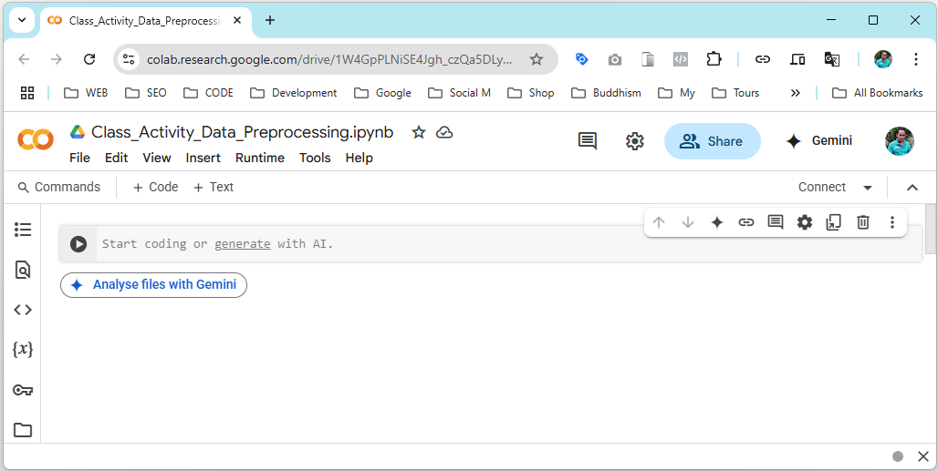
5. Analyze Autonomous Vehicle Performance
Instructions for Using Google Colab
You need to implement the code for Data Preprocessing using Python on Google Colab. Use the provided sample code only as guidance. You are expected to write and run your own version for preprocessing with the class instructor.
Instructions:
How to Build with Google Colab?
Go to: https://colab.research.google.com/
Click “New Notebook”: This will create a blank Python (.ipynb) file in Colab.
Build the model: Use the provided sample code and build the model.
Notes:
# English
In this activity, we’ll use Google Colab to run our Python code.

Slide 32
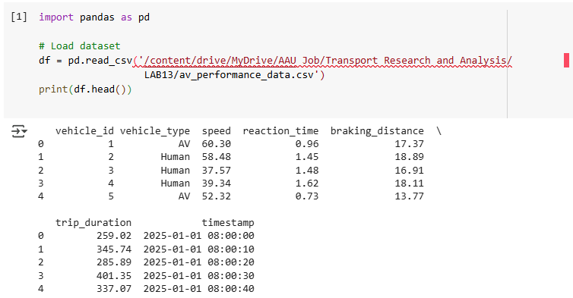
5. Analyze Autonomous Vehicle Performance
5.2 Load and Explore AV Performance Dataset
Objective: Get familiar with the dataset structure and types of variables.
Open the Colab file or create a new Colab notebook.
Upload the dataset or read it using pd.read_csv().
Use df.head(), df.info(), and df.describe() to explore the data.

Slide 33
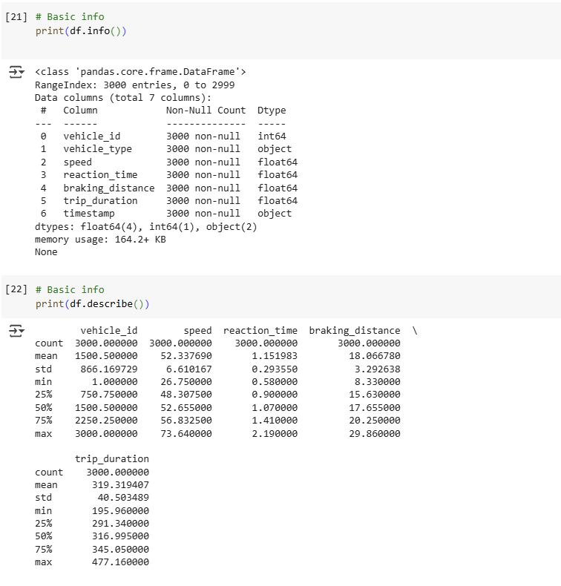
5. Analyze Autonomous Vehicle Performance

Slide 34
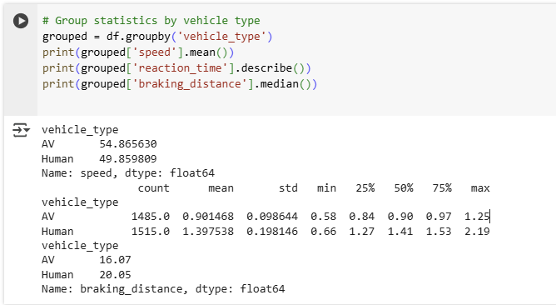
5. Analyze Autonomous Vehicle Performance
5.3 Perform Descriptive Statistics
Objective: Analyze central tendencies and dispersion of performance metrics.
Metrics to analyze:
✅ speed ✅ braking_distance
✅ reaction_time ✅ trip_duration
Tools: Python pandas, numpy
Instructions:
✅ Use .mean(), .median(), .std(), .min(), .max()
✅ Group data by vehicle_type (AV vs Human)
and compare statistics

Slide 35
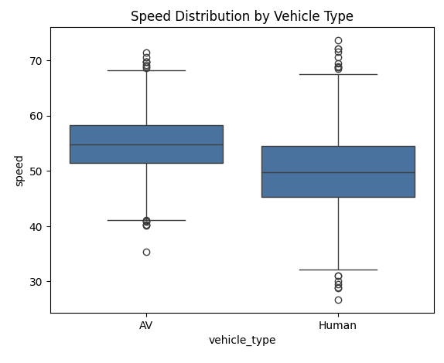
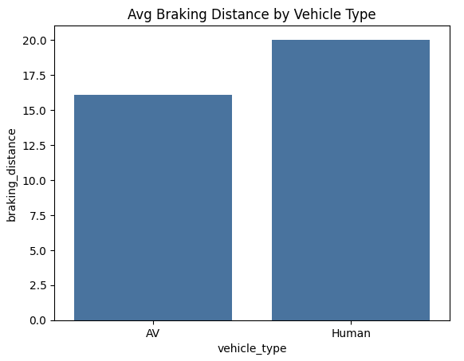
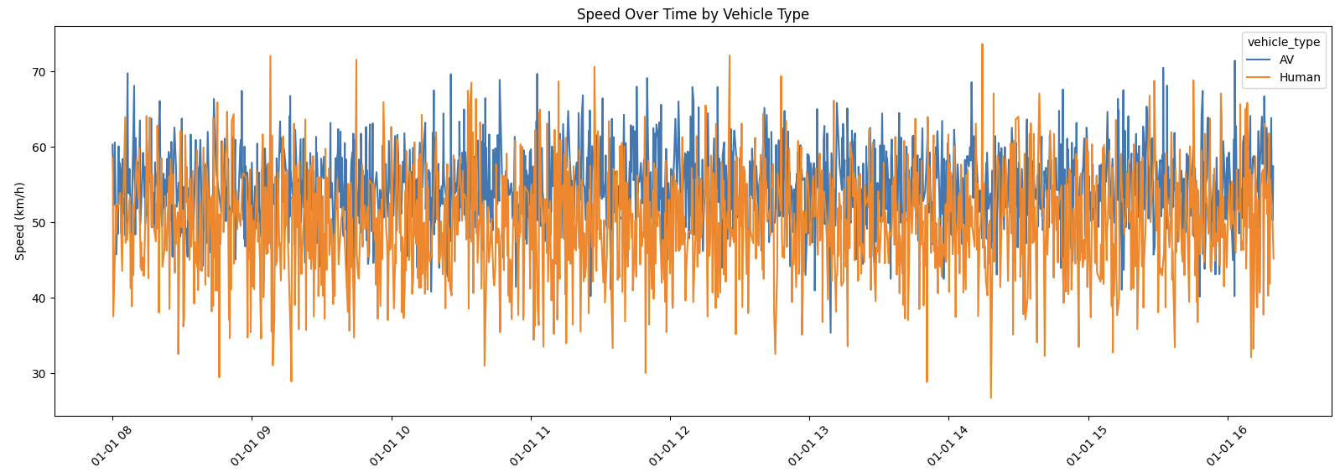
5. Analyze Autonomous Vehicle Performance
5.4 Create Visualizations
Objective: Visualize AV vs human vehicle performance using;
Boxplots: Compare distributions (ex: speed, reaction time)
Histograms: Show frequency of speed or braking distance
Time-Series Plot: Plot speed over time
Libraries: matplotlib, seaborn
Resize wide figures using plt.figure(figsize=(12, 5))
Use hue='vehicle_type' in Seaborn for comparison
Tips:

Slide 36
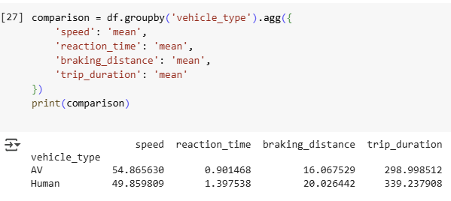
5. Analyze Autonomous Vehicle Performance
5.5 Compare AV vs Human-Driven Vehicle Data
Objective: Summarize and compare key performance indicators between Autonomous Vehicles (AVs) and Human-driven vehicles to assess safety and efficiency.
Metrics to Compare:
# | Metric | AVs | Humans
1 | Average Speed | 54.87 km/h | 49.86 km/h
2 | Reaction Time | 0.90 sec | 1.40 sec
3 | Braking Distance | 16.07 m | 20.03 m
4 | Travel Time | 299 sec | 339 sec
AVs tend to drive more efficiently (higher average speed, shorter travel time) and respond faster (lower reaction time and braking distance), which suggests potential safety and performance benefits.

Slide 37
Section 6:
Class Activity 2: Simulate AV Behaviour in VISSIM
Notes:
# English
Now we are in Section 1: Lab Overview and Required Tools.
Let’s quickly see what this lab is about and what tools we’ll use.
# French
Nous voici maintenant à la section 1 : Présentation du laboratoire et outils requis.
Voyons rapidement en quoi consiste ce laboratoire et quels outils nous utiliserons.

Slide 38
6. Class Activity 2: Simulate AV Behavior in VISSIM
6.1 Class Activity 1 Overview: Build and Simulate AV Behaviour in VISSIM
In this activity, you will create a simple microscopic traffic simulation that includes Autonomous Vehicles (AVs). You will start with a new, empty VISSIM network (.inpx) and progressively build the model following the steps demonstrated in class.
How to do?
In this activity, you will build the entire AV simulation model from scratch. Starting with a new VISSIM project, you will draw the network, set up signals, define an autonomous vehicle type, configure traffic inputs, and run the simulation to observe how AVs behave within the intersection.
Save Your File:
ex: VISSIM_Lab13_Klagenfurt_Intersection.inpx
Notes:
# English
To understand data preprocessing better, let’s do another real activity using Python. We’ll run code in Google Colab step by step, and see how issues like missing values, duplicates, and formatting errors are fixed. Then we’ll compare the raw data with the cleaned version using charts.

Slide 39
6. Class Activity 2: Simulate AV Behavior in VISSIM
6.2 Build and Simulate AV Behaviour in VISSIM
Step 1: Set Up the Intersection (Based on Lab 7)
  This section replicates the intersection design used in Lab 7, up to signal controller creation. You will use this as the base for simulating autonomous vehicle behavior in Lab 13.
  1. Launch VISSIM and Create a New Project
  ✅ Open PTV VISSIM.
  ✅ Go to File > New to create a new project.
  ✅ Save the project as: VISSIM_Lab13_Klagenfurt_Intersection.inpx
  3. Draw Road Links
  ✅ Open the Network Objects > Links tool.
  ✅ Draw the main road with at least 2 links (one for each direction).
  ✅ Add side roads as needed (ex: merging roads or crossing lanes).
  ✅ Specify the correct number of lanes per link (ex: 1 or 2 lanes).

Slide 40
6. Class Activity 2: Simulate AV Behavior in VISSIM
  2. Set the Map Location (Klagenfurt, Austria)
  ✅ Use the “Find Location” button on the toolbar (map icon).
  ✅ Enter Klagenfurt, Austria in the search box.
  ✅ Pan and zoom to locate the intersection which we used in the Lab 7.
  Location: https://maps.app.goo.gl/UYrqEas8xDv3HAz57
  4. Add Connectors
  To enable vehicle turning, merging, and lane transitions:
  ✅ Use Network Objects > Connectors.
  ✅ Connect:
          Side roads → Main road (for merging)
          Main road → Side roads (for exits or turns)
          Across opposing lanes at intersections (for left/right turns)
  ✅ Add intermediate points on connectors to make curves smoother.

Slide 41
6. Class Activity 2: Simulate AV Behavior in VISSIM
  5. Add Signal Heads
  ✅ Go to Network Objects > Signal Heads.
  ✅ Click to place signal heads on each entry point of the intersection.
  ✅ Assign each signal head to the correct Link and Lane.
  ✅ Make sure the signal heads cover all traffic directions (straight, left turn, right turn).
  6. Create and Assign a Signal Controller
  ✅ Go to Base Data > Signal Control > Signal Controllers.
  ✅ Create a new controller and name it (ex: "Main_Intersection_SC").
  ✅ Assign it to control the signal heads placed in Step 5.
  ✅ Use fixed time or actuation logic depending on your experiment.

Slide 42
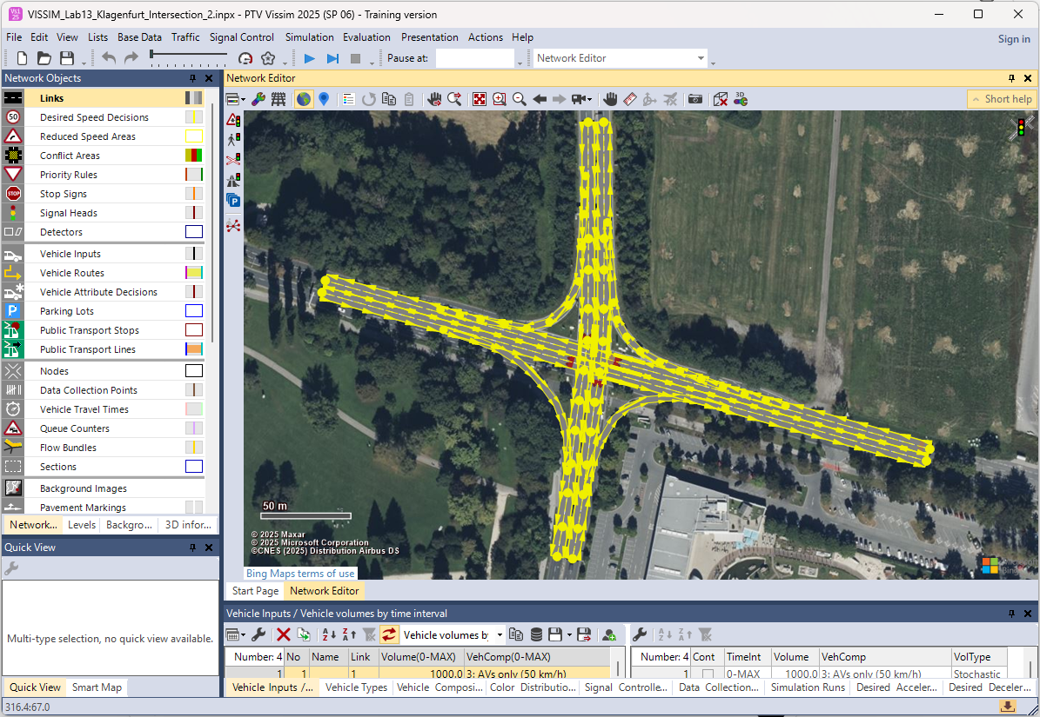
6. Class Activity 2: Simulate AV Behavior in VISSIM

Slide 43
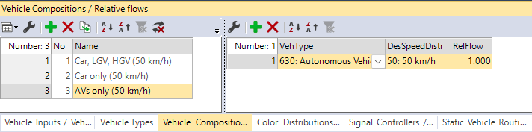
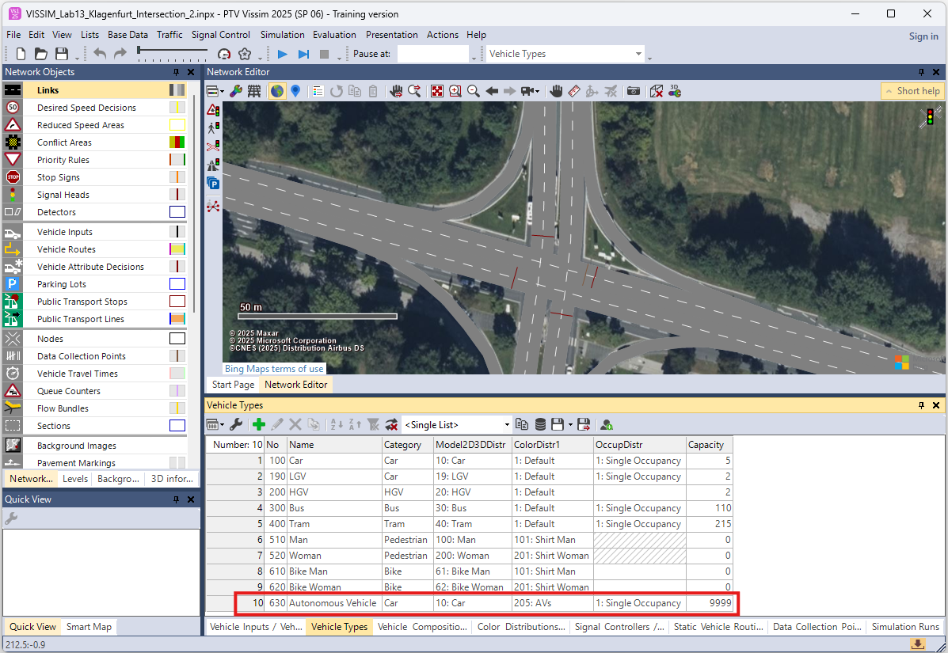
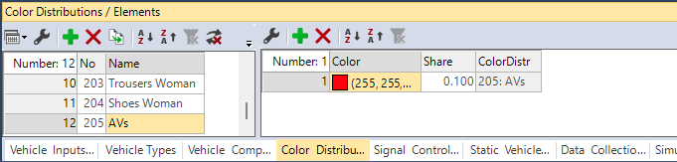
6. Class Activity 2: Simulate AV Behavior in VISSIM
Step 2: Create and Assign AVs to Vehicle Input
  ✅ Go to Menu > Base Data > Vehicle Types
  ✅ Click "New" and name it something like “Autonomous Vehicle”
  ✅ Create new Vehicle Composition; Traffic > Vehicle Compassion > “AVs only (50 km/h)”
  ✅ Assign “Autonomous Vehicle” as Vehicle Type and change the Desired speed: 50 km/h
  ✅ Add specified color to Autonomous Vehicle
  Base Data > Distribution > Color > AVs : (255, 255, 0, 13)

Slide 44
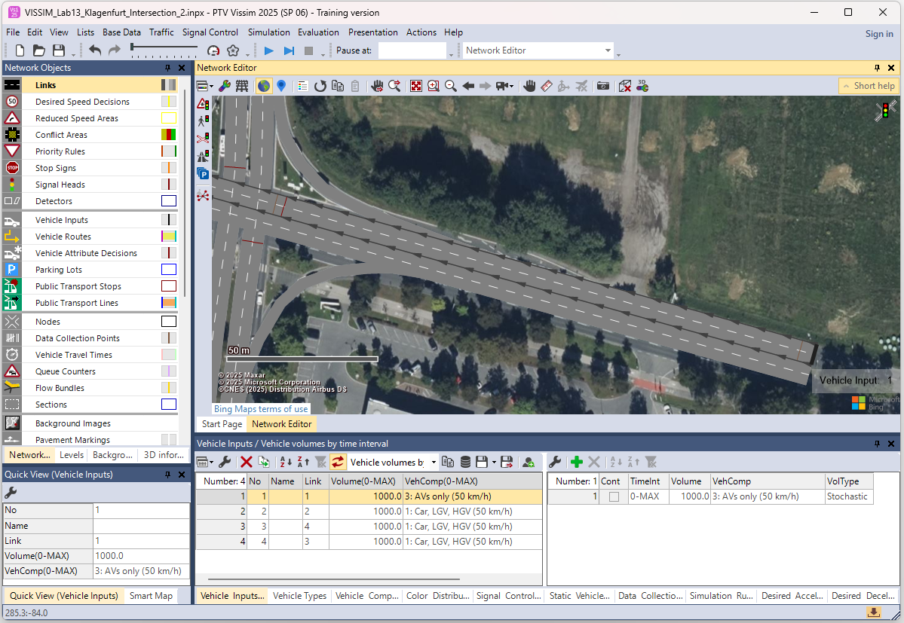
6. Class Activity 2: Simulate AV Behavior in VISSIM
Step 3: Define Vehicle Inputs
  ✅ Go to Network Objects > Vehicle Inputs
  ✅ Add inputs for each starting points in lanes.
  ✅ Assign “Avs only (50 km/h)” vehicle composition type for one of input.
  ✅ For the other input you can assign anything desired.
Step 4: Data Collection Points
  ✅ Go to Network
  Objects > Data Collection Point.
  ✅ Place points at major entry or exit locations.
  ✅ It measures vehicle throughput
  (number of vehicles passing a point).

Slide 45
6. Class Activity 2: Simulate AV Behavior in VISSIM
Step 5: Run the Simulation ▶️
  Click File > Save or press Ctrl + S
  Use the Play button (▶️) in the toolbar to start the simulation.
Step 6: Visual Observation - Behavior Analysis
Use slow-motion playback to closely observe the behavior of Autonomous Vehicles (AVs) in critical areas such as merging zones and signalized intersections.
During the simulation, AVs are displayed in red color for easy identification. Focus on analyzing the following behaviors:
  Merging behavior at connectors
  Reaction time at traffic signals and stop lines
  Lane-changing patterns in mixed traffic
  Queue formation and dissipation during congestion

Slide 46
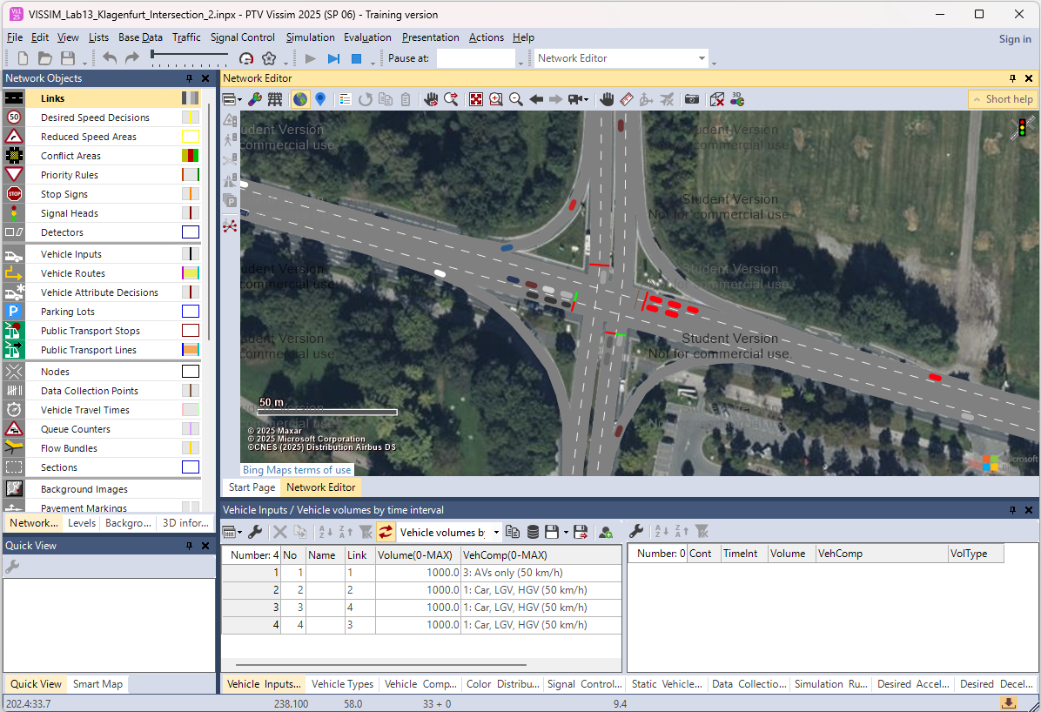
6. Class Activity 2: Simulate AV Behavior in VISSIM

Slide 47
Section 07:
Homework: Assignment 1
Notes:
# English
Next, let’s take a look at your homework assignment for Lab 4.
# French
Ensuite, examinons vos devoirs pour le laboratoire 4.

Slide 48
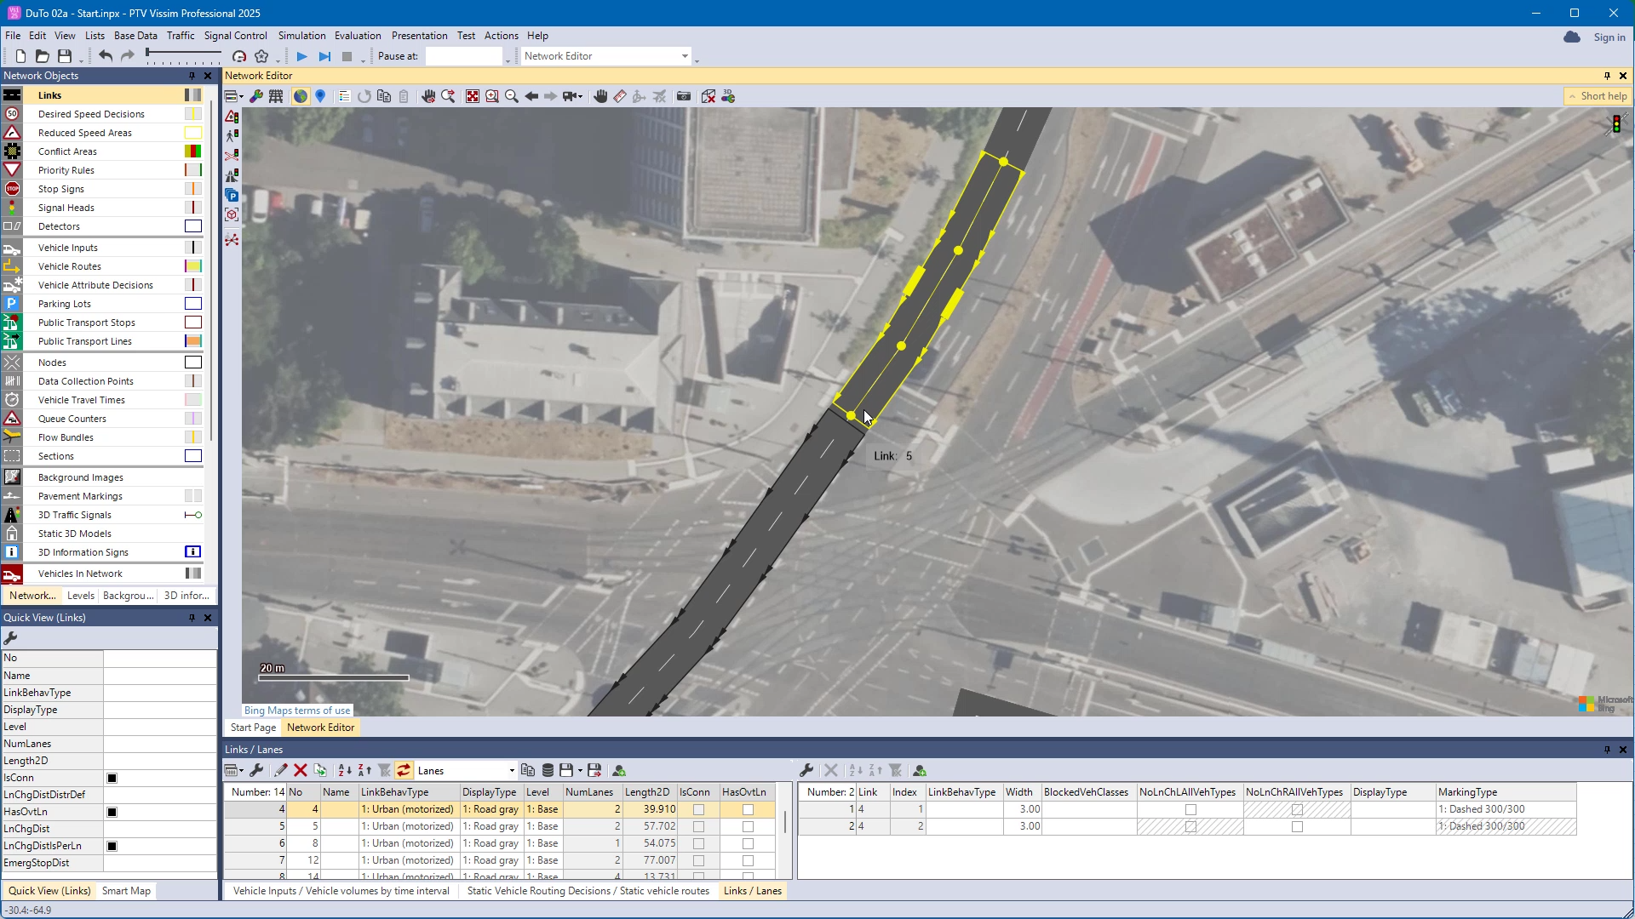
7. Homework: Assignment 1 – Lab 7
7.1 Assignment 1 - Traffic Flow Simulation using VISSIM
In this assignment, you will recreate and extend the simulation completed during Class Activity 2. You must start from a new, empty VISSIM project (.inpx) and progressively build the full AV simulation model by following the steps practiced in class.
Objective of the assignment:
The goal is to build a simple yet complete microscopic simulation model that includes autonomous vehicles, analyze their behavior, and compare it with typical traffic flow patterns. You will replicate the steps demonstrated in class and develop a polished version on your own.
Notes:
# English
# French

Slide 49
7. Homework: Task Instructions
7.2 Assignment 1 - Task Instructions
Follow these steps using PTV VISSIM:
Create a new network and draw the intersection layout from class.
Set the map location (Klagenfurt) and zoom in to your chosen area.
Add road links and connectors for all turning movements.
Insert signal heads and create/assign a signal controller.
Create an Autonomous Vehicle (AV) type, set desired speed, and assign color.
Define vehicle inputs, including at least one AV-only input.
Add data collection points to measure traffic throughput.
Run the simulation and observe AV behavior (merging, lane change, signal reaction).
Capture screenshots of the model, simulation, and observed AV behaviors.
You may enhance your model with extra elements, such as different AV proportions or multiple lanes.
Notes:
# English
# French

Slide 50
7. Homework: Submission Guidelines
7.3 Assignment 1 - Submission Guidelines
Submit the following files:
VISSIM Simulation File (.inpx) — your completed AV simulation.
PDF Report with observations and screenshots
Any exported results from the simulation
Notes:
# English
# French

Slide 51
7. Homework: Report Structure
7.4 Assignment 1 - Report Structure
Your report should include:
Title Page (Name, course, lab, date)
Model Description (intersection, inputs, AV setup)
Signal Timing Modification Summary
Simulation Steps (how you built the model progressively)
Screenshots & Observations
Behavior Analysis (how AVs performed compared to expectations)
Conclusion: what you learned about AV behavior in VISSIM
Notes:
# English
# French

Slide 52
7. Homework: Deadline & Notes
7.5 Assignment 1 - Deadline & Notes
Deadline: Submit all required files before … / … / … (1 week after the Lab 13)
Note: Your grade will consider,
Accuracy and completeness of the simulation
Correct application of class steps
Clarity of screenshots and explanations
Quality of your analysis and observations
Notes:
# English
# French

Slide 53
Section 08:
References

Slide 54
8. References
8.1 Reference Textbooks
  SAE International. (2021). J3016: Taxonomy and Definitions for Terms Related to Driving Automation Systems for On-Road Motor Vehicles. SAE International.
  European Commission. (2023). Ethics of Connected and Automated Vehicles: Recommendations for a Safe and Ethical Transition. EU Publications Office.
  PTV Group. (2024). PTV Vissim 2024 User Manual. PTV Group.
  https://us-resources.ptvgroup.com/en-us/ptv-user-group/2024
8.2 Reference Video Resources
  A to Z video tutorials for VISSIM from PTV Group:
  https://us-resources.ptvgroup.com/en-us/ptv-academy/getting-to-know-ptv-vissim

Slide 55


