Slide 1
Transport Research and Analysis
Module 5: Advanced Topics and Case Studies
Lecture 20: Intelligent Transport Systems
Notes:
"Good morning, and welcome to Lecture 20. Today, we delve into one of the most dynamic and rapidly evolving areas of our field: Intelligent Transport Systems, or ITS. For over a century, our transportation infrastructure was largely static—concrete, steel, and asphalt. But over the past few decades, a quiet revolution has been taking place. We have been embedding intelligence into our infrastructure and our vehicles, using advanced information and communication technologies to make our transport systems safer, more efficient, and more sustainable. In this lecture, we will explore what ITS is, how it works, what it can do, and the challenges we face in implementing it. This is the technology that is actively shaping the future of mobility."

Slide 3
Table of contents
Lecture 20: Intelligent Transport Systems
00: Introduction & Objectives……...................................3
0.0. Lecture Overview......................................................4
0.1. Linking to Previous Lectures………..........................5
0.2. Learning Objectives…………………………………....6
01 Foundations & Architecture of ITS…….………..........7
1.0. What is Intelligent Transport Systems ……...............8
1.1. The Fundamental ITS Insight…………………….......9
1.2. A Brief Evolution of ITS………………………...........10
1.3. The Core Technologies of ITS………………...........11
1.4. ITS Scope………………………………..……...........12
1.5. The ITS Architecture……………………………........13
02 Applications of ITS……………………………….........15
2.0. Overview of ITS Application Areas…..…………......16
2.1. Advanced Traveler Information Systems (ATIS).....18
2.2. Advanced Public Transportation Systems……..…..19
2.3. Vehicle-to-Infrastructure (V2I) Systems………........20
2.4. Connected & Autonomous Vehicles …….………….21
2.5. Transport Demand Management……..……………23
2.6. Application: Smart Parking Management…………25
2.7. Application: Freight and Logistics…..……………...27
03 Impacts & Implementation Challenges..................29
3.0. The Benefits of ITS………………..…….................30
3.1. Benefit in Detail……………………..……………….31
3.2. Benefit in Detail: Improved Safety.…………………32
3.3. The Challenges of Implementing ITS.....................34
3.4. ITS Security & Cybersecurity Challenges…...........35
3.5. A Balanced View: Pros vs. Cons of ITS…….….….36
04 Global Case Studies & Conclusion……………......38
4.0. Global Case Studies..............................................38
4.1. Final Quiz…………………………………................39
4.2. References & Further Reading……………………..40

Slide 4
Section 00:
Introduction and Objectives
Notes:
"Good morning, everyone. Welcome to Lecture 19. Today, we address a topic that is not just a subfield of transportation, but is increasingly seen as the very foundation of sustainable and just transport planning: Social Equity. For a long time, our field was primarily concerned with efficiency—moving as many vehicles as possible, as quickly as possible. But today, we understand that transportation is not an end in itself; it is a means to an end. It is the critical link to opportunity—to jobs, to education, to healthcare, to social connection. And if that link is broken for certain segments of society, then the system has failed. Over the next 90 minutes, we will explore the meaning of transport equity, diagnose the causes and consequences of inequity, and examine the policy tools we have to build a fairer, more just transportation future."

Slide 5

00. Introduction & Objectives
0.0. Lecture Overview.
Lecture Roadmap
Foundations & Architecture: Defining ITS and its technical structure.
Applications: Exploring what ITS does in the real world, from traffic management to autonomous vehicles.
Impacts & Challenges: Analyzing the benefits, drawbacks, and difficulties of implementation.
Global Case Studies & Conclusion: Examining real-world examples and summarizing our key findings.
Notes:
"To guide our 90-minute discussion, we will follow a clear, four-part structure. We will begin with the Foundations and Architecture, where we will define what ITS is, look at its core technologies, and understand the layered technical architecture that all of these systems are built upon.
Next, we will move into the exciting field of Applications. This is the 'what does it do?' section, where we'll explore the vast range of ITS services, from smart traffic signals to connected and autonomous vehicles.
In Section Three, we will take a critical look at the Impacts and Challenges. We'll analyze the proven benefits of ITS, but also provide a balanced view of the significant costs, security risks, and other challenges that come with implementation.
Finally, we will ground our lecture in reality with Global Case Studies and then synthesize our key lessons in the conclusion. This structure will take us logically from the fundamental theory to real-world practice."

Slide 6
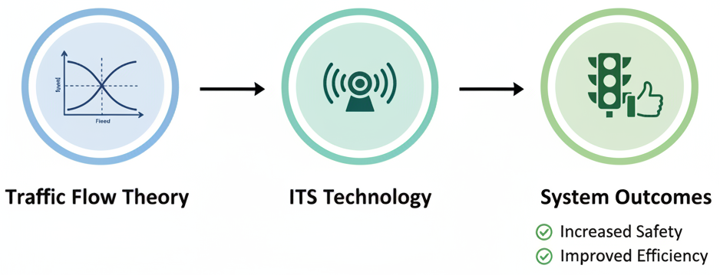
00. Introduction & Objectives
0.1. Linking to Previous Lectures
Recap: The Limits of Traditional Infrastructure
  Previous lectures on Traffic Flow Theory showed us that physical infrastructure (roads, signals) has inherent capacity limits.
Today's Focus: Using Intelligence to Optimize the System
  ITS is the application of technology to better manage, measure, and control traffic flow on our existing infrastructure.
  It is the primary tool we use to squeeze more safety and efficiency out of the system we already have, before we build anything new.
Notes:
"Let's explicitly connect today's topic to our previous lectures on traffic flow. In those sessions, we learned about the fundamental relationships between speed, flow, and density. We saw that our physical infrastructure has hard limits. You can't put more cars on a road than its capacity allows without the system breaking down into congestion.
Today, we focus on the solution. Intelligent Transport Systems are the tools we use to actively manage the traffic flow within those physical limits. If traditional transport engineering is about building the container (the road), ITS is about managing the contents (the vehicles) as intelligently as possible.
ITS gives us the ability to measure the system in real-time, to control it with adaptive signals and variable speed limits, and to provide information to users so they can make smarter choices. It is the key to unlocking the latent capacity and safety potential that is hidden in our existing infrastructure."

Slide 7

00. Introduction & Objectives
0.2. Learning Objectives.
By the end of this lesson, you should be able to:
Define Intelligent Transport Systems (ITS) and identify its core technologies.
Describe the multi-layered architecture of a typical ITS deployment.
Identify and explain the major applications of ITS in traffic management, public transport, and future mobility.
Analyze the primary benefits and challenges associated with implementing ITS projects.
Recognize real-world ITS case studies and their impact on transportation systems.
Notes:
"To set a clear target for our session, here are the key skills you will have by the end of this lecture.
First, you will be able to confidently define what ITS is and name its four core enabling technologies.
Second, you will be able to describe the standard, multi-layered architecture that these systems are built on, from the sensors on the street to the applications in the cloud.
Third, you will be able to identify the major applications of ITS across a wide range of areas, from managing a traffic signal to enabling an autonomous vehicle.
Fourth, you will be able to conduct a balanced analysis of the pros and cons, understanding both the significant benefits and the very real implementation challenges.
And finally, you will be able to recognize and discuss major global case studies, connecting the theory to real-world practice. These objectives will guide our path through the material today."

Slide 8
Section 01:
Foundations & Architecture of ITS
Notes:
"Let's begin. Our first section is dedicated to building a solid foundation. Before we can talk about the exciting applications, we need to understand what ITS is in principle, where it came from, what its core technological ingredients are, and, most importantly, the technical architecture that provides the blueprint for how all these systems are put together."

Slide 9
01. Foundations & Architecture of ITS
1.0. What is Intelligent Transport Systems (ITS)?.
ITS refers to the application of advanced information and communication technologies to transportation in order to improve safety, efficiency, and sustainability.
TECHNOLOGY
SYSTEMS
The Core Idea:
  ITS makes transport infrastructure and vehicles "smarter" through the integration of electronics, data, and communications.
Key Components:
  It is an integrated system of Technology, Systems, and the Institutions that manage them.
ITS
INSTITUTIONS
Notes:
"So let's start with a formal definition. The term Intelligent Transport Systems refers to a broad range of applications that use advanced information and communication technologies to improve the performance of our transportation networks. The primary goals are always to improve safety, efficiency, and sustainability.
The core idea is simple: we are making our traditionally 'dumb' infrastructure—the asphalt and concrete—and our vehicles 'smarter' by embedding them with sensors, processors, and communication devices.
As the diagram shows, a successful ITS is not just about the technology itself. It is an integrated system. It involves the Technology (the hardware and software), the Systems (the processes that use the technology), and, crucially, the Institutions—the city departments, transport agencies, and private companies—that must work together to deploy and manage it all."

Slide 10
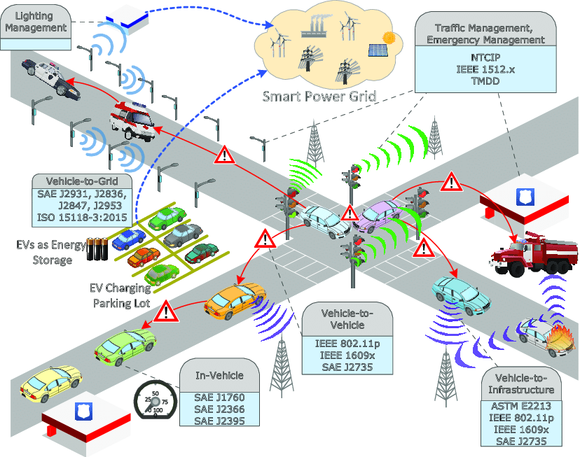
01. Foundations & Architecture of ITS
1.1. The Fundamental ITS Insight
The fundamental insight of ITS is the linkage of vehicles and transportation infrastructure through technology.
The Flow of Intelligence:
  Vehicles and Users generate data and respond to information.
  ITS Infrastructure (Sensors, Communications, Algorithms) collects data, processes it, and makes decisions.
  This intelligence is used to manage the Transportation Infrastructure (e.g., changing signal timing) and inform the vehicles/users.
VEHICLE
ITS INFRASTRUCTURE
SENSORS, COMMUNICATIONS,
IT ALGORITHMS
TRANSPORTATION
INFRASTRUCTURE
(BROADLY DEFINED)
Notes:
"The foundational concept behind all of these complex systems is actually very simple. The fundamental insight of ITS is the creation of a real-time information loop linking vehicles and the infrastructure they operate on.
For a century, these two things were separate. The car was just a machine, and the road was just a surface. ITS creates a nervous system that connects them.
As this flow diagram illustrates, the Vehicles act as both probes, generating data, and as receivers of information. The ITS Infrastructure—the sensors in the road, the communication networks, the AI algorithms in the traffic management center—is the brain. It collects and processes this data. It then uses that processed intelligence to manage the Transportation Infrastructure itself, for example by adjusting traffic signal timings, and to send information back to the vehicles and travelers, for example through a navigation app or a variable message sign. This continuous, real-time feedback loop is the magic of ITS."

Slide 11
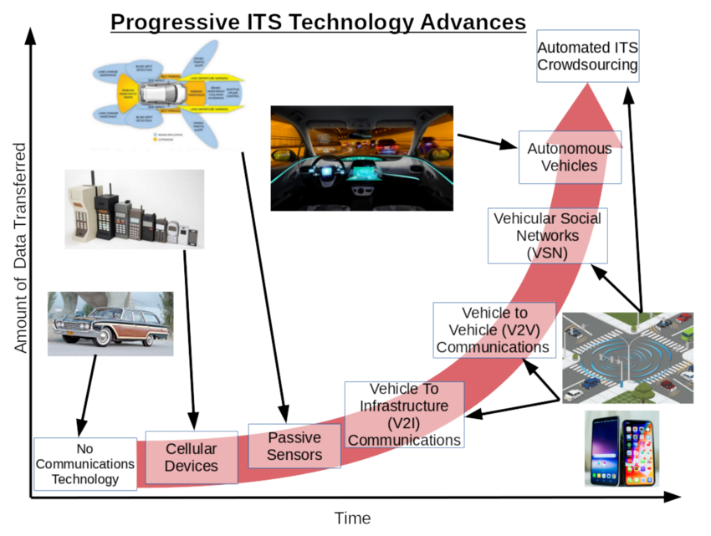
01. Foundations & Architecture of ITS
1.2. A Brief Evolution of ITS
From Mechanical Signals to Connected Systems:
  Early Examples: The first gas-lit traffic signal in 1868; electric traffic lights in 1914.
  Modern ITS Emerges (1980s-90s): Development of centralized traffic control systems and electronic route guidance. The first ITS World Congress in 1994 signals global recognition.
The Exponential Growth of Data:
  The evolution of ITS is a story of increasing data and connectivity.
  We have moved from passive sensors to a world of connected vehicles and crowdsourced data from billions of mobile devices.
Notes:
"ITS can feel like a very futuristic topic, but its roots go back a long way. The very first traffic signal, installed in London in 1868, was a form of intelligent transportation system for its time.
The modern era of ITS, however, really began in the late 20th century with the development of the first computerized, centralized traffic control systems. The global importance of the field was formally recognized in 1994 with the very first ITS World Congress, which has been held every year since.
But the most important story of ITS evolution, as this chart so powerfully illustrates, is the exponential growth in data and connectivity. We started with no real-time communication. We then added passive sensors in the road. This was followed by cellular devices, and then direct Vehicle-to-Infrastructure and Vehicle-to-Vehicle communications. And today, we are moving into a world of automated and crowdsourced data from countless connected devices. This explosion of data is what enables the powerful, real-time applications we are about to discuss."

Slide 12
01. Foundations & Architecture of ITS
1.3. The Core Technologies of ITS.
ITS is enabled by four core, interdependent technologies:
  Sensing (Data Collection): The "eyes and ears" of the system. Gathers real-time data from the environment.
    Examples: Inductive loops, radar, cameras, GPS, lidar.
Communications (Connectivity): The "nervous system." Enables data exchange between vehicles, infrastructure, and centers.
  Examples: Cellular (4G/5G), Wi-Fi, DSRC, fiber optics.
Computing (Processing & Storage): The "brain." Processes and stores vast amounts of transport data.
  Examples: Edge computing, cloud computing, data centers.
Algorithms (Intelligence & Analytics): The "intelligence." Analyzes data, predicts outcomes, and drives smart decisions.
  Examples: AI/Machine Learning, optimization algorithms, data fusion.
SENSING (DATA COLLECTION)
COMMUNICATIONS (CONNECTIVITY)
THE
ITS CORE TECHNOLOGIES
COMPUTING (PROCESSING & STORAGE)
ALGORITHMS (INTELLIGENCE & ANALYTICS)
Notes:
"So, what are the fundamental building blocks of these systems? We can break down all of ITS into four core, interdependent technologies.
First, we have Sensing. These are the eyes and ears of the system, the hardware that collects the raw, real-time data from the physical world. This includes everything from the loops in the pavement to the GPS in your phone and the lidar on an autonomous vehicle.
Second is Communications. This is the nervous system that connects everything. It's the wireless and wired networks that allow data to flow between vehicles, the infrastructure, and the traffic management center.
Third is Computing. This is the brain where all this data is processed and stored. This can happen 'at the edge' on the device itself, or in massive cloud computing data centers.
Finally, and most importantly, we have Algorithms. This is the intelligence that makes the system 'smart.' These are the software programs, from simple control logic to complex Artificial Intelligence, that analyze the data, find patterns, predict congestion, and make the optimal decisions, like what the best traffic signal timing should be right now.
Every ITS application you can think of is simply a new combination of these four core technologies."

Slide 13
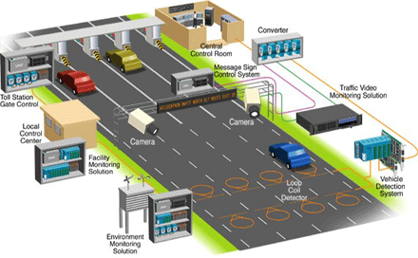
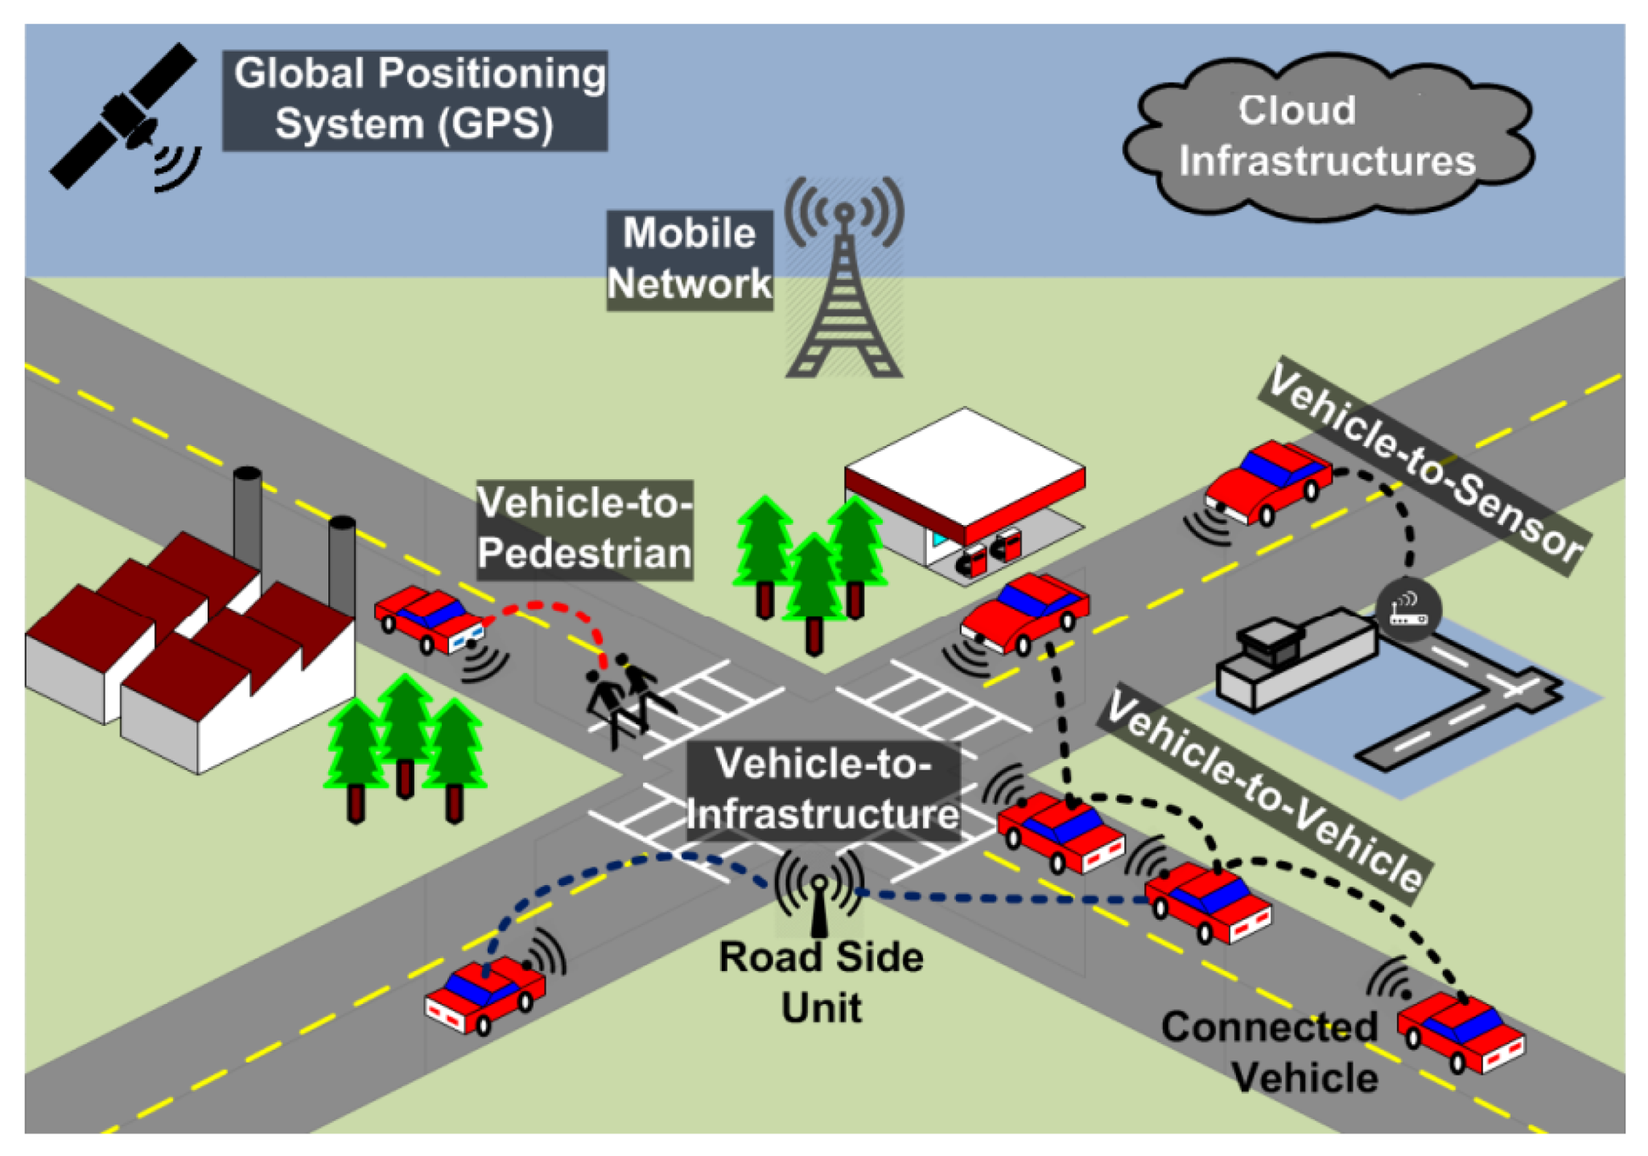
01. Foundations & Architecture of ITS
1.4. ITS Scope.
ITS covers a range of systems managing traffic and transport: from urban traffic control centers and electronic tolling, to in-vehicle navigation, real-time transit information, and beyond. Both roadside infrastructure (e.g. sensors, cameras, signals) and in-vehicle systems (e.g. GPS, driver assistance) are part of ITS. It spans highways, city streets, public transit, freight, and even pedestrian/cyclist safety.
Automated Systems: Electronic tolling.
ITS: A Wide-Reaching Network
🚦 Traffic Management: Urban control, smart signals.
💳 Automated Systems: Electronic tolling.
🗺️ Navigation & Info: In-car GPS, real-time transit data.
👁️ Infrastructure: Roadside sensors & cameras.
🚗 Vehicle Tech: Driver assistance, GPS.
🛣️ Across All Modes: Highways, city streets, public transport, freight, pedestrian/cyclist safety.
ITS: A Wide-Reaching Network
Notes:
"So, what are the fundamental building blocks of these systems? We can break down all of ITS into four core, interdependent technologies.
First, we have Sensing. These are the eyes and ears of the system, the hardware that collects the raw, real-time data from the physical world. This includes everything from the loops in the pavement to the GPS in your phone and the lidar on an autonomous vehicle.
Second is Communications. This is the nervous system that connects everything. It's the wireless and wired networks that allow data to flow between vehicles, the infrastructure, and the traffic management center.
Third is Computing. This is the brain where all this data is processed and stored. This can happen 'at the edge' on the device itself, or in massive cloud computing data centers.
Finally, and most importantly, we have Algorithms. This is the intelligence that makes the system 'smart.' These are the software programs, from simple control logic to complex Artificial Intelligence, that analyze the data, find patterns, predict congestion, and make the optimal decisions, like what the best traffic signal timing should be right now.
Every ITS application you can think of is simply a new combination of these four core technologies."

Slide 14
01. Foundations & Architecture of ITS
1.5. The ITS Architecture.
These technologies are organized into a standardized, multi-layered architecture.
  Application/Control Layer (The "Brain"): The Traffic Management Center and user-facing apps that make decisions and provide services.
  Data Management (Database) Layer: The central storehouse for all real-time and historical traffic data.
  Communication/Network Layer: The networks (mobile, internet, satellite) that transmit the data.
  Sensing/Perceptive Layer (The "Senses"): The sensors and cameras on the street and in vehicles that collect the ground-truth data.
Notes:
"This is one of the most important slides for understanding how these systems are actually built. The core technologies we just discussed are not just thrown together randomly; they are organized into a standardized, multi-layered architecture. You can think of this as the universal blueprint for almost any ITS system.
We start at the bottom with the Sensing or Perceptive Layer. These are the senses of the system—the cameras, speed detectors, and GPS devices in the field that collect the raw data.
That data is then transmitted via the Communication Layer—the mobile networks, fiber optics, and internet connections that move the data from the street to the central system.
The data arrives at the Data Management or Database Layer. This is the central repository, the memory of the system, where all this information is stored, processed, and archived.
And finally, at the very top, we have the Application or Control Layer. This is the brain that uses the data to provide a service. This could be the software running in a city's traffic management center that controls the signals, or it could be a traveler information app on your phone.
This layered approach is a standard engineering principle that allows us to build these complex systems in a modular and scalable way. We will refer back to this architecture as we discuss specific applications."

Slide 15
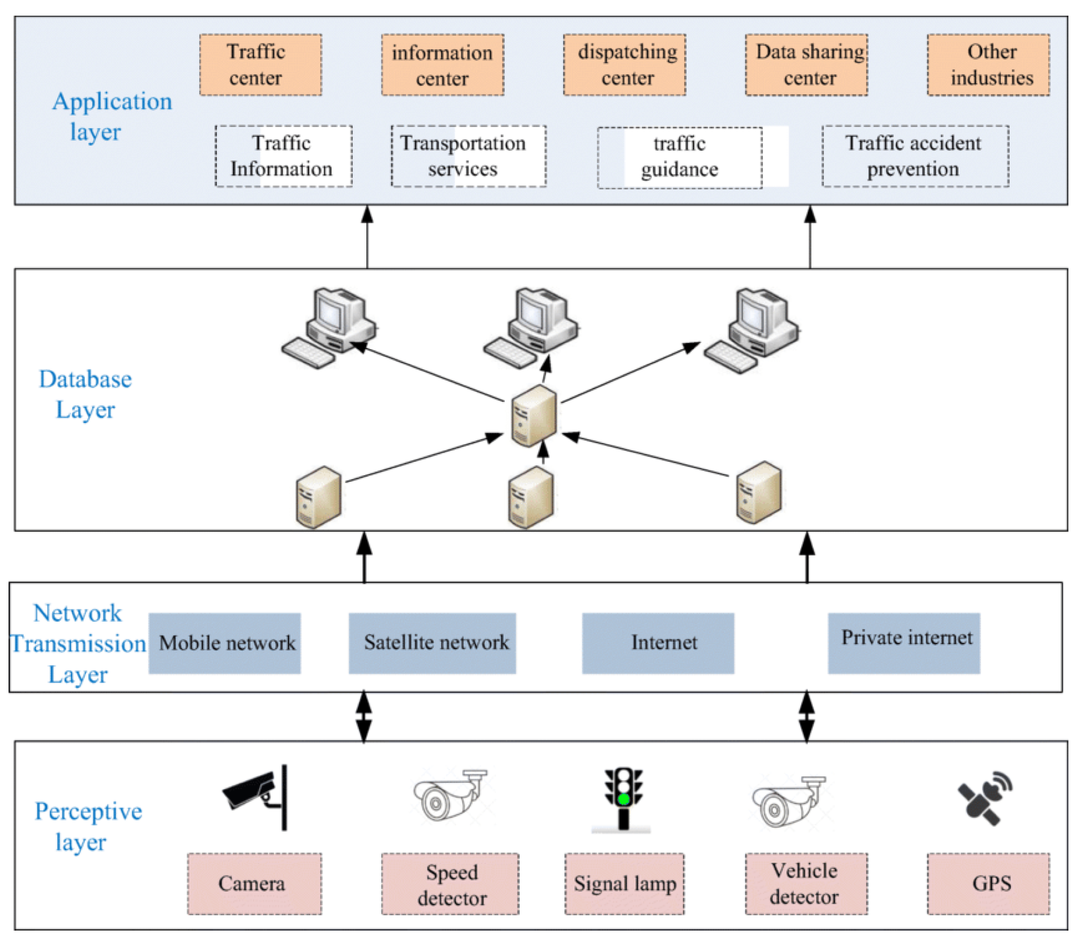
01. Foundations & Architecture of ITS
1.6. The ITS Architecture.
Notes:
"This is one of the most important slides for understanding how these systems are actually built. The core technologies we just discussed are not just thrown together randomly; they are organized into a standardized, multi-layered architecture. You can think of this as the universal blueprint for almost any ITS system.
We start at the bottom with the Sensing or Perceptive Layer. These are the senses of the system—the cameras, speed detectors, and GPS devices in the field that collect the raw data.
That data is then transmitted via the Communication Layer—the mobile networks, fiber optics, and internet connections that move the data from the street to the central system.
The data arrives at the Data Management or Database Layer. This is the central repository, the memory of the system, where all this information is stored, processed, and archived.
And finally, at the very top, we have the Application or Control Layer. This is the brain that uses the data to provide a service. This could be the software running in a city's traffic management center that controls the signals, or it could be a traveler information app on your phone.
This layered approach is a standard engineering principle that allows us to build these complex systems in a modular and scalable way. We will refer back to this architecture as we discuss specific applications."

Slide 16
Section 02:
Applications of ITS: What Does It Do?
Notes:
"That concludes our section on the foundations and architecture of ITS. We have defined what it is and understand the blueprint for how it's built.
Now we move to the most exciting part of the lecture: the Applications. In this section, we will explore the vast and growing range of services that are built upon that architectural foundation. This is the 'what does it do?' section, where we will see how ITS is used in practice to manage traffic, improve public transport, provide information to travelers, and enable the future of mobility with connected and autonomous vehicles. We will go through the major application domains one by one."

Slide 17
02. Applications of ITS: What Does It Do?
2.0. Overview of ITS Application Areas
ITS applications can be grouped into several key functional areas.
Core Application Groups:
  Advanced Traffic Management Systems (ATMS): The tools used by agencies to monitor and control traffic flow.
    Examples: Adaptive signal control, ramp metering.
  Advanced Traveler Information Systems (ATIS): The services that provide real-time information to the public.
    Examples: GPS navigation apps, Dynamic Message Signs.
  Advanced Public Transportation Systems (APTS): The technologies used to improve the efficiency and user experience of public transit.
    Examples: Real-time bus tracking, electronic fare payment.
  Connected & Autonomous Vehicles (CAV): The next generation of vehicles that communicate with each other and the infrastructure.
Notes:
"The world of ITS is vast, so it's helpful to group the applications into a few key functional areas.
First, we have Advanced Traffic Management Systems, or ATMS. These are the tools that the 'system operators'—like a city's traffic management center—use to see what's happening on their network and actively control it. This includes things like smart traffic signals that adjust their timing automatically.
Second are Advanced Traveler Information Systems, or ATIS. These are the services that provide that real-time information back to us, the travelers, so we can make smarter decisions. This category is dominated by the GPS navigation apps on our phones, but also includes the large electronic message signs you see on the highway.
Third, we have Advanced Public Transportation Systems, or APTS. This is the suite of technologies focused specifically on making public transit better, including real-time bus tracking, electronic fare cards, and signal priority for buses.
Finally, we have the most forward-looking category: Connected and Autonomous Vehicles, or CAV. This is the technology that allows vehicles to communicate with each other and with the infrastructure to enable unprecedented levels of safety and cooperation.
We will now take a closer look at each of these application areas."

Slide 18
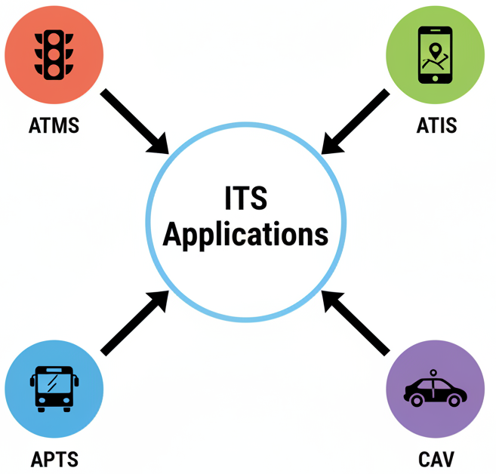
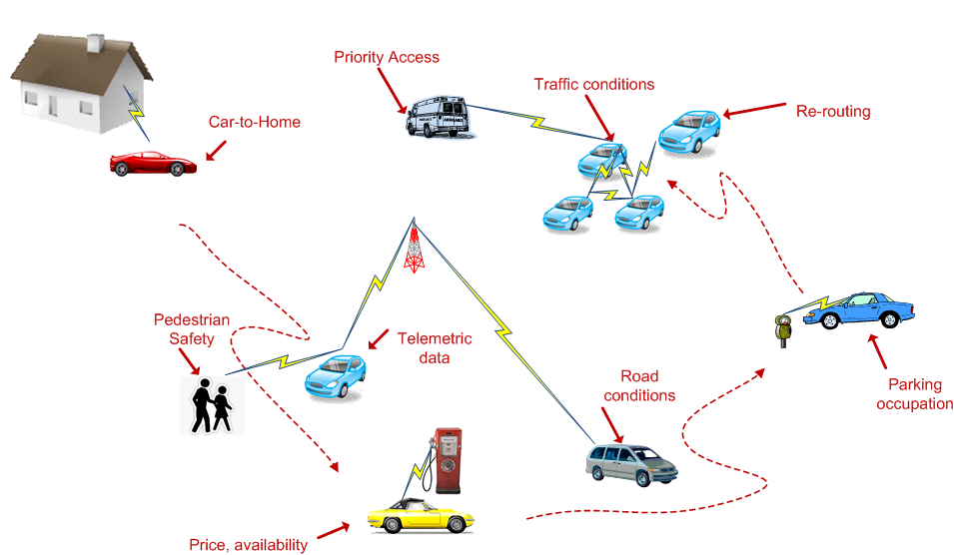
02. Applications of ITS: What Does It Do?
2.0. Overview of ITS Application Areas
Notes:
"The world of ITS is vast, so it's helpful to group the applications into a few key functional areas.
First, we have Advanced Traffic Management Systems, or ATMS. These are the tools that the 'system operators'—like a city's traffic management center—use to see what's happening on their network and actively control it. This includes things like smart traffic signals that adjust their timing automatically.
Second are Advanced Traveler Information Systems, or ATIS. These are the services that provide that real-time information back to us, the travelers, so we can make smarter decisions. This category is dominated by the GPS navigation apps on our phones, but also includes the large electronic message signs you see on the highway.
Third, we have Advanced Public Transportation Systems, or APTS. This is the suite of technologies focused specifically on making public transit better, including real-time bus tracking, electronic fare cards, and signal priority for buses.
Finally, we have the most forward-looking category: Connected and Autonomous Vehicles, or CAV. This is the technology that allows vehicles to communicate with each other and with the infrastructure to enable unprecedented levels of safety and cooperation.
We will now take a closer look at each of these application areas."

Slide 19
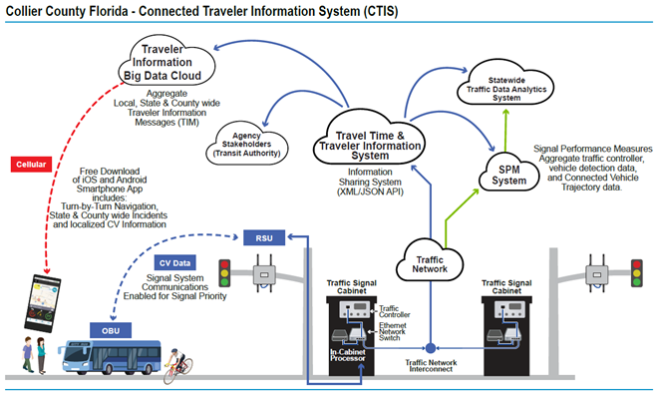
02. Applications of ITS: What Does It Do?
2.1. Application: Advanced Traveler Information Systems (ATIS)
Key Function: To provide real-time traffic and travel information to road users.
How it Works:
  Data on congestion, travel times, incidents, and weather is collected from sensors and crowd-sourcing.
  This information is processed and delivered to travelers via various channels.
Examples:
  GPS navigation apps (e.g., Google Maps, Waze).
  Roadside Dynamic Message Signs (DMS).
User Benefit: Enables informed choices on routes or departure times to avoid congestion.
System Benefit: Helps to naturally distribute traffic load across the network, improving overall efficiency.
Notes:
"Let's start with the ITS application that is most familiar to all of us: Advanced Traveler Information Systems, or ATIS.
The key function of ATIS is to provide us, the travelers, with accurate, real-time information about the state of the transportation network so we can make smarter choices. As this system diagram shows, it's a classic ITS architecture. Data is collected from a wide range of sources—traffic sensors, transit vehicles, and increasingly, from the anonymized GPS data from all of our smartphones. This data is fed into a central system, which then analyzes it to produce a real-time picture of traffic conditions, travel times, and incidents. This information is then pushed out to us through apps like Google Maps or displayed on the large Dynamic Message Signs on the highway.
The benefit to us as users is obvious: we can see the traffic jam ahead and choose a different route. But there is also a huge benefit to the system as a whole. By giving thousands of drivers the information to individually reroute around a crash, ATIS helps the entire network absorb that disruption more efficiently. It's a decentralized form of traffic management."

Slide 20
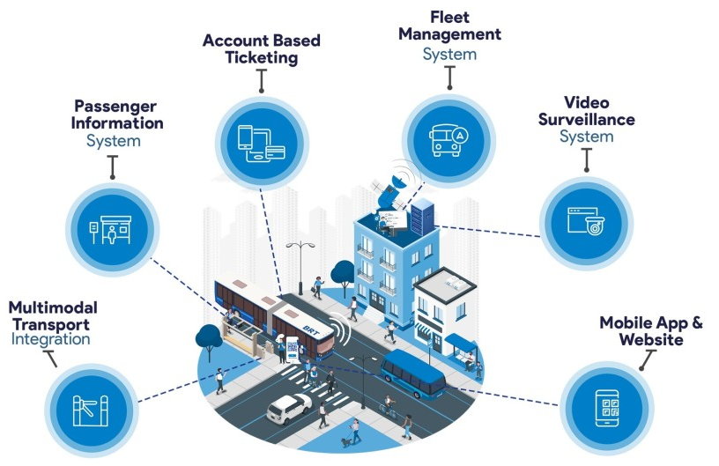
02. Applications of ITS: What Does It Do?
2.2. Application: Advanced Public Transportation Systems (APTS)
Goal: To use technology to improve transit operations, efficiency, and the passenger experience.
Core Features:
  Real-time Bus/Train Tracking: GPS on vehicles provides data for arrival predictions (e.g., "Bus arrives in 5 minutes").
  Electronic Fare Payment: Smart cards or mobile ticketing systems that speed up boarding.
  Transit Signal Priority (TSP): Allows a bus to request a green light extension at an intersection to stay on schedule.
  Passenger Information Displays: Real-time arrival information shown on displays at stations and stops.
Overall Impact: Boosts public transit reliability and attractiveness, making it a more competitive option against the private car.
Notes:
"The next major application area is Advanced Public Transportation Systems, or APTS. This is the suite of technologies focused on making transit a better and more efficient choice.
One of the most impactful features is real-time vehicle tracking. By placing a simple GPS unit on every bus, the agency can track its location, predict its arrival time at upcoming stops, and provide this information to passengers via a mobile app. This single feature dramatically reduces passenger uncertainty and frustration.
Electronic fare payment, like smart cards or mobile apps, makes boarding much faster and more seamless, which reduces the time the bus has to wait at each stop, improving overall route speed.
A more advanced feature is Transit Signal Priority, or TSP. This technology allows a bus that is running behind schedule to communicate with an upcoming traffic signal and request a slightly longer green light, helping it get back on schedule.
Finally, all of this real-time information can be shown on digital displays at stations and bus stops, further improving the passenger experience.
The overall impact of these technologies is to make public transport more reliable, more convenient, and therefore a more attractive and competitive mode of travel."

Slide 21
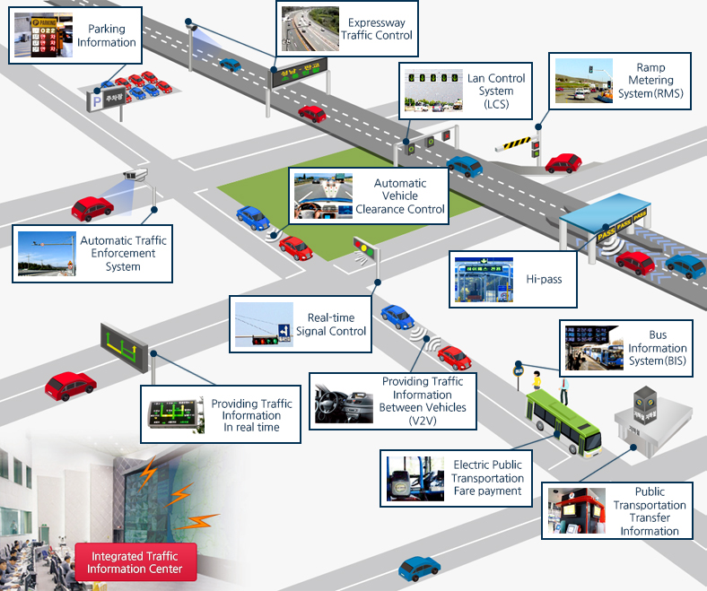
02. Applications of ITS: What Does It Do?
2.3. Application: Vehicle-to-Infrastructure (V2I) Systems
V2I enables vehicles to communicate directly with roadside infrastructure.
Key Function: Allows for real-time information exchange and automated actions.
Examples:
Electronic Toll Collection (ETC): Systems like RFID or DSRC-based tags allow vehicles to pay tolls automatically at highway speeds.
Emergency Vehicle Preemption (EVP): An ambulance or fire truck can automatically request a green light at all upcoming intersections, clearing a path and improving response times.
Real-time Signal Phase and Timing (SPaT): The traffic signal can broadcast its status and future timing to connected vehicles, enabling features like "time to green" displays.
https://www.its.go.kr/Eng/overview/overview01.html
Notes:
"A particularly powerful subset of ITS is Vehicle-to-Infrastructure, or V2I, communication. This is technology that allows vehicles to 'talk' directly to the roadside infrastructure in real-time.
The most common example is Electronic Toll Collection. Instead of stopping to pay a toll, a device in your car communicates with a reader on an overhead gantry, and the transaction happens automatically. This is a simple but incredibly effective V2I application that dramatically improves throughput at toll plazas.
A more critical safety application is Emergency Vehicle Preemption. An ambulance with a V2I transmitter can 'talk' to every traffic signal on its route, requesting a green light before it arrives. This clears a path through traffic, significantly reducing response times and improving safety at intersections.
And looking to the future, V2I will enable things like broadcasting Signal Phase and Timing, or SPaT, data. The traffic light itself will tell approaching cars exactly when it is going to turn green or red. This can enable in-car displays that help drivers pace themselves to avoid stopping, which can save fuel and improve traffic flow."

Slide 22
02. Applications of ITS: What Does It Do?
2.4. The Future: Connected & Autonomous Vehicles (CAV)
Connected Vehicles (The "V2X" Revolution):
  Vehicles that use wireless communication to exchange data with each other (V2V), with infrastructure (V2I), and with pedestrians (V2P).
  This creates 360-degree awareness, enabling real-time safety warnings (e.g., collision alerts, emergency braking notifications) and cooperative maneuvers (e.g., platooning).
Autonomous Vehicles (The "Self-Driving" Revolution):
  Vehicles that use sensors (lidar, radar, cameras) and AI to perceive their environment and navigate without human input.
Connected Automated Vehicles (The Synthesis):
  The ultimate goal: autonomous vehicles that also communicate with each other. This enables them to coordinate their movements, optimizing overall traffic flow and safety far beyond human capability.
Notes:
"This brings us to the future of ITS: Connected and Autonomous Vehicles. It's important to understand that these are two distinct, but related, technologies.
Connected Vehicles are all about communication. We call this V2X, or Vehicle-to-Everything. This is where cars are constantly talking to each other, to the traffic signals, and even to pedestrians' smartphones. This constant data exchange creates a 'sixth sense' for the vehicle, allowing it to know about a hazard around a blind corner or the fact that a car several vehicles ahead has just slammed on its brakes. This enables powerful cooperative safety features.
Autonomous Vehicles, on the other hand, are about perception and control. These are the 'self-driving' cars that use a suite of onboard sensors and powerful AI to 'see' the world and navigate on their own, without human intervention.
The true revolution, and the ultimate goal of ITS research in this area, is the synthesis of these two: Connected Automated Vehicles. These are autonomous vehicles that also talk to each other. This will allow them to move in perfect harmony, coordinating maneuvers like merging and passing with a level of precision and efficiency that is simply impossible for human drivers to achieve."

Slide 23
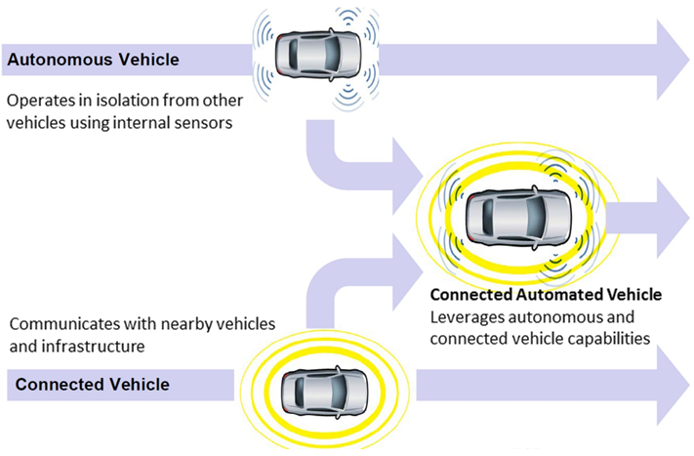
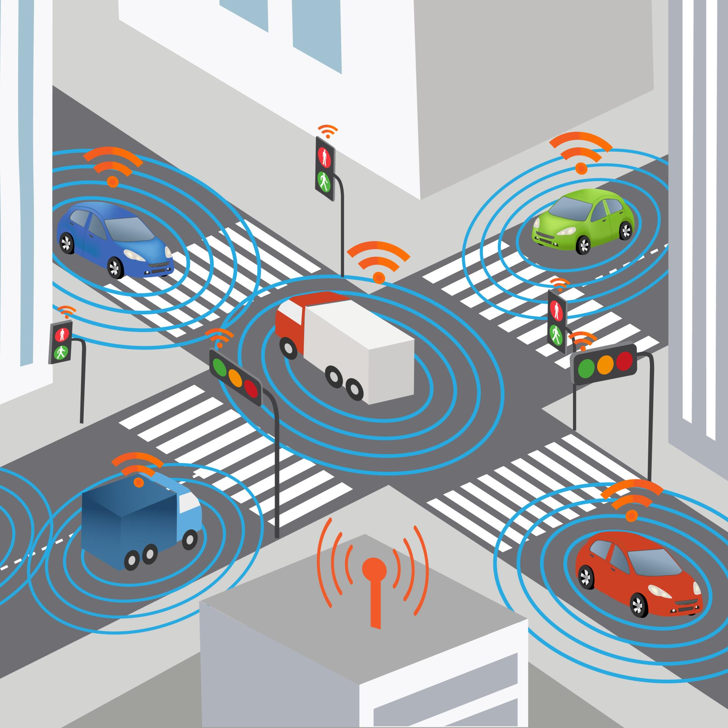
02. Applications of ITS: What Does It Do?
2.4. The Future: Connected & Autonomous Vehicles (CAV)
Connected Vehicles (V2X):
Vehicle-to-Vehicle (V2V) & Vehicle-to-Infrastructure (V2I) data exchange
Real-time safety warnings (e.g., collision alerts, emergency braking notifications)
Enables cooperative maneuvers (platooning, gap-closing)
Autonomous Vehicles:
Leverage high-definition maps, roadside sensors and in-vehicle perception
Reduce stop-and-go and human reaction delays
Optimize overall flow by smoothing speed profiles
https://www.dot.nv.gov/mobility/avcv
https://www.dot.nv.gov/mobility/avcv
Notes:
"This brings us to the future of ITS: Connected and Autonomous Vehicles. It's important to understand that these are two distinct, but related, technologies.
Connected Vehicles are all about communication. We call this V2X, or Vehicle-to-Everything. This is where cars are constantly talking to each other, to the traffic signals, and even to pedestrians' smartphones. This constant data exchange creates a 'sixth sense' for the vehicle, allowing it to know about a hazard around a blind corner or the fact that a car several vehicles ahead has just slammed on its brakes. This enables powerful cooperative safety features.
Autonomous Vehicles, on the other hand, are about perception and control. These are the 'self-driving' cars that use a suite of onboard sensors and powerful AI to 'see' the world and navigate on their own, without human intervention.
The true revolution, and the ultimate goal of ITS research in this area, is the synthesis of these two: Connected Automated Vehicles. These are autonomous vehicles that also talk to each other. This will allow them to move in perfect harmony, coordinating maneuvers like merging and passing with a level of precision and efficiency that is simply impossible for human drivers to achieve."

Slide 24
02. Applications of ITS: What Does It Do?
2.5. Application: Transport Demand Management (TDM)
Using ITS to influence travel behavior and manage demand, not just supply.
Traffic-Focused Strategies (Managing Demand for Roads):
  Congestion Pricing / Dynamic Tolls: Toll prices that change based on the level of real-time congestion.
  High-Occupancy Toll (HOT) Lanes: Allows single-occupant vehicles to pay a toll to use a high-occupancy lane, with the price varying by demand.
Multimodal ITS Levers (Encouraging Alternatives):
  On-Demand Microtransit & Ridesharing: Using apps to provide flexible, shared mobility services.
  Mobility as a Service (MaaS): Integrating trip planning, booking, and payment for all modes (bus, bike-share, scooter, etc.) into a single app.
Notes:
"So far, most of the applications we've discussed are about managing the existing traffic. But a very powerful use of ITS is to go a step further and try to manage the underlying demand itself. This is a field called Transport Demand Management, or TDM.
There are two main ways ITS enables this. First, we have traffic-focused strategies that use pricing to manage the demand for road space. The most well-known of these is congestion pricing, where the toll to enter a city center changes dynamically based on the current level of congestion. The goal is to encourage some drivers to shift their travel to a less congested time, or to switch to a different mode entirely.
Second, we have multimodal levers that use ITS to make the alternatives to driving more attractive. This includes the apps that power on-demand microtransit and ridesharing services. And it includes the broader concept of Mobility as a Service, or MaaS, which aims to create a seamless user experience by integrating all of a city's transportation options—public transit, bike-share, scooters, ride-hailing—into a single app for planning and payment. The goal of MaaS is to make the combined package of shared mobility services so convenient that it becomes a true competitor to owning a private car."

Slide 25
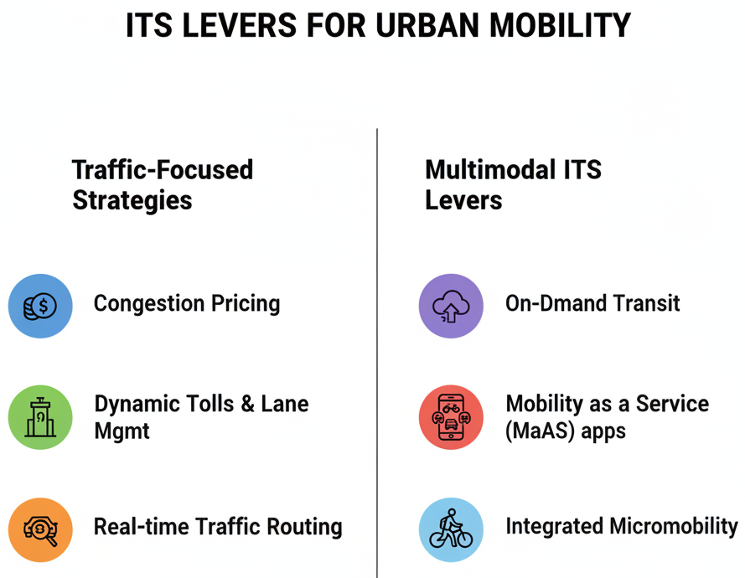
02. Applications of ITS: What Does It Do?
2.5. Application: Transport Demand Management (TDM)
Notes:
"So far, most of the applications we've discussed are about managing the existing traffic. But a very powerful use of ITS is to go a step further and try to manage the underlying demand itself. This is a field called Transport Demand Management, or TDM.
There are two main ways ITS enables this. First, we have traffic-focused strategies that use pricing to manage the demand for road space. The most well-known of these is congestion pricing, where the toll to enter a city center changes dynamically based on the current level of congestion. The goal is to encourage some drivers to shift their travel to a less congested time, or to switch to a different mode entirely.
Second, we have multimodal levers that use ITS to make the alternatives to driving more attractive. This includes the apps that power on-demand microtransit and ridesharing services. And it includes the broader concept of Mobility as a Service, or MaaS, which aims to create a seamless user experience by integrating all of a city's transportation options—public transit, bike-share, scooters, ride-hailing—into a single app for planning and payment. The goal of MaaS is to make the combined package of shared mobility services so convenient that it becomes a true competitor to owning a private car."

Slide 26
02. Applications of ITS: What Does It Do?
2.6. Application: Smart Parking Management
Goal: To reduce congestion caused by drivers "cruising" for parking.
How it Works (A Classic ITS Loop):
  Sensing: Ultrasonic, magnetic, or camera sensors detect whether an individual parking bay is occupied or vacant.
  Communication: This real-time occupancy data is streamed to a central management platform.
  Information: The data is then pushed out to drivers via mobile apps or Variable Message Signs (VMS), guiding them directly to available stalls.
Additional Levers:
  Dynamic Pricing: The price of parking can be adjusted based on real-time demand.
  Electronic Payments: Allows for seamless payment via mobile apps or RFID tags.
Notes:
"A final, very practical application of ITS is Smart Parking Management. Studies have shown that a significant percentage of traffic in congested downtown areas—sometimes as high as 30%—is made up of drivers who are simply circling the block, looking for a place to park.
Smart parking systems attack this problem directly, and they are a perfect example of the classic ITS loop. The process starts with Sensing. Each individual parking spot is equipped with a small sensor—it could be ultrasonic, magnetic, or camera-based—that knows whether a car is present or not.
This real-time occupancy data is then communicated to a central server.
This is where the Information part comes in. The system pushes this data out to the public through mobile apps or on-street digital signs that can guide drivers directly to the nearest available spot. This reduces the time spent cruising, which in turn reduces congestion and emissions.
These systems can also be integrated with other ITS levers, like dynamic pricing, where the price of a parking spot goes up as demand increases, and seamless electronic payment systems."

Slide 27
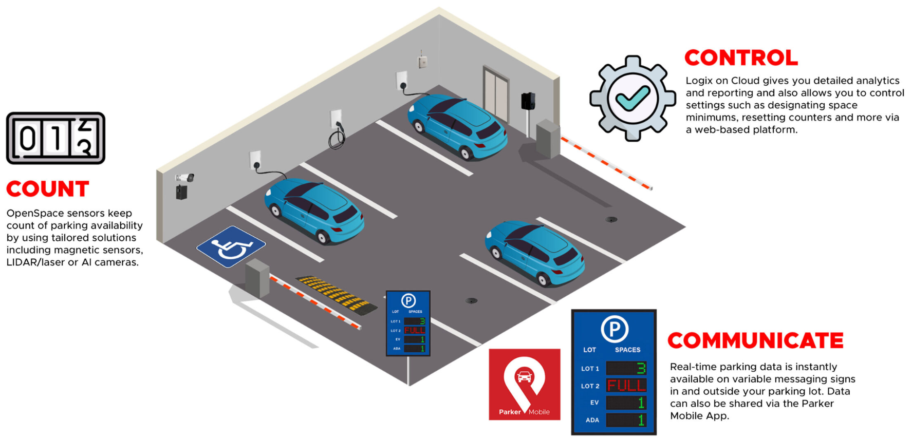
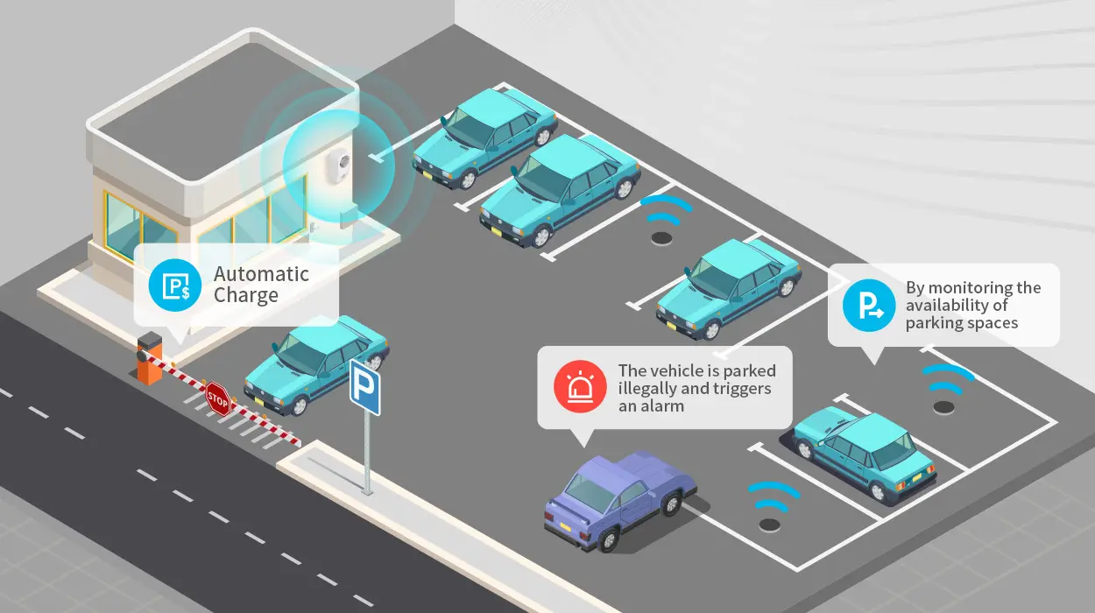
02. Applications of ITS: What Does It Do?
2.6. Application: Smart Parking Management
• Ultrasonic, magnetic and camera sensors stream bay occupancy to the Traffic Management Center (TMC)
• Mobile apps and Variable Message Signs (VMS) guide drivers to available stalls
• Electronic payments via RFID tags, ANPR or mobile wallets
• Dynamic pricing adjusts curb and garage rates by demand
• Cuts cruising VMT (Vehicle Miles Traveled) and CO₂ emissions
https://parkinglogix.com/parking-in-2025-innovating-and-moving-forward-with-parking-logix/
https://www.mokosmart.com/smart-parking-system-using-iot/
Notes:
"A final, very practical application of ITS is Smart Parking Management. Studies have shown that a significant percentage of traffic in congested downtown areas—sometimes as high as 30%—is made up of drivers who are simply circling the block, looking for a place to park.
Smart parking systems attack this problem directly, and they are a perfect example of the classic ITS loop. The process starts with Sensing. Each individual parking spot is equipped with a small sensor—it could be ultrasonic, magnetic, or camera-based—that knows whether a car is present or not.
This real-time occupancy data is then communicated to a central server.
This is where the Information part comes in. The system pushes this data out to the public through mobile apps or on-street digital signs that can guide drivers directly to the nearest available spot. This reduces the time spent cruising, which in turn reduces congestion and emissions.
These systems can also be integrated with other ITS levers, like dynamic pricing, where the price of a parking spot goes up as demand increases, and seamless electronic payment systems."

Slide 28
02. Applications of ITS: What Does It Do?
2.7. Application: Freight and Logistics
ITS is critical for improving the efficiency and safety of the supply chain.
Key Applications:
  Real-time Tracking: GPS and cellular tracking for full visibility of shipment location and status.
  Route Optimization: Using Transport Management System (TMS) algorithms (like Dijkstra's) to calculate the most efficient routes based on real-time traffic and delivery constraints.
  Weigh-In-Motion (WIM): Sensors embedded in the highway that weigh trucks as they drive at speed, improving efficiency and enforcement.
  Fleet Management Dashboards: Centralized platforms that integrate telematics and vehicle data to monitor performance, fuel consumption, and driver behavior.
Outcomes: Reduced idle time, lower fuel consumption, fewer delivery delays.
Notes:
"Finally, it's important to remember that ITS is not just about moving people; it's also absolutely critical for moving goods. The applications in freight and logistics are a huge and economically vital part of the ITS world.
Core applications include real-time tracking, where GPS and cellular technology give logistics companies complete visibility into where their trucks and shipments are at all times.
This data feeds into sophisticated route optimization algorithms. These are the powerful software platforms that solve the 'traveling salesman problem' on a massive scale, calculating the most efficient multi-stop routes for delivery vehicles based on real-time traffic, delivery windows, and other constraints.
Specialized hardware like Weigh-In-Motion sensors allows trucks to be weighed as they travel at highway speeds, which is far more efficient than forcing them to stop at manual weigh stations.
And all of this data is integrated into Fleet Management Dashboards, which are the command centers that allow a company to monitor its entire fleet of vehicles in real-time. The combined outcomes of these technologies are massive gains in efficiency: reduced idle time, significant fuel savings, and more reliable delivery schedules."

Slide 29
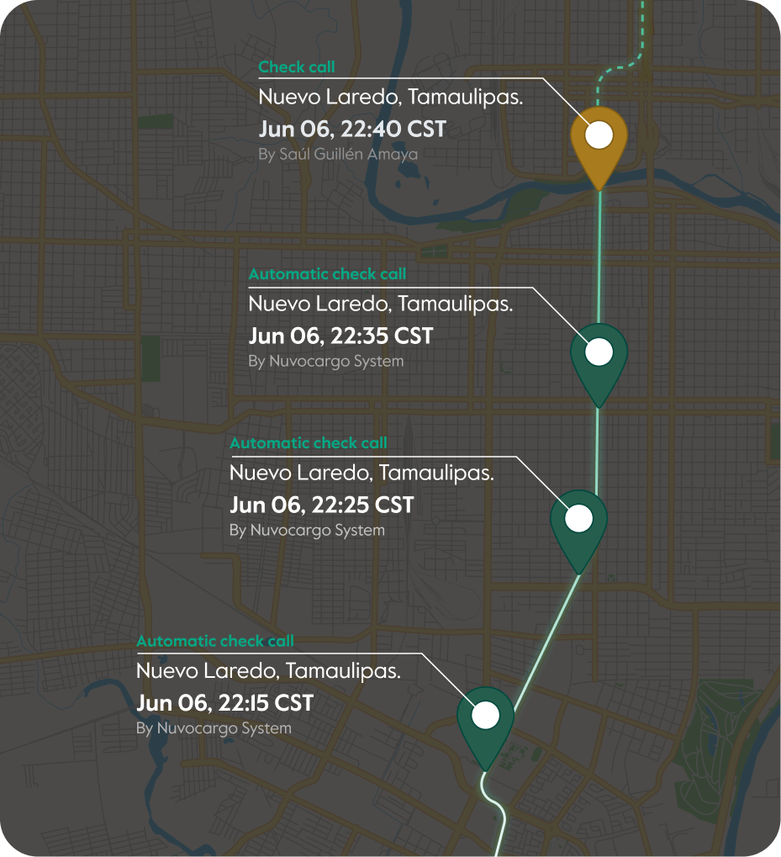
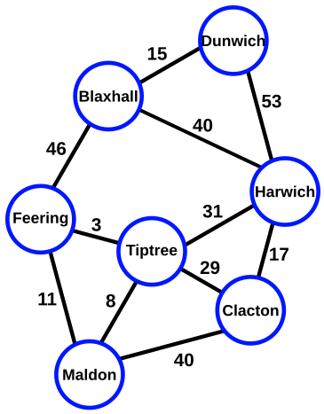
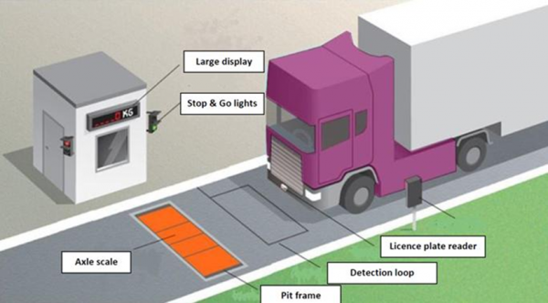
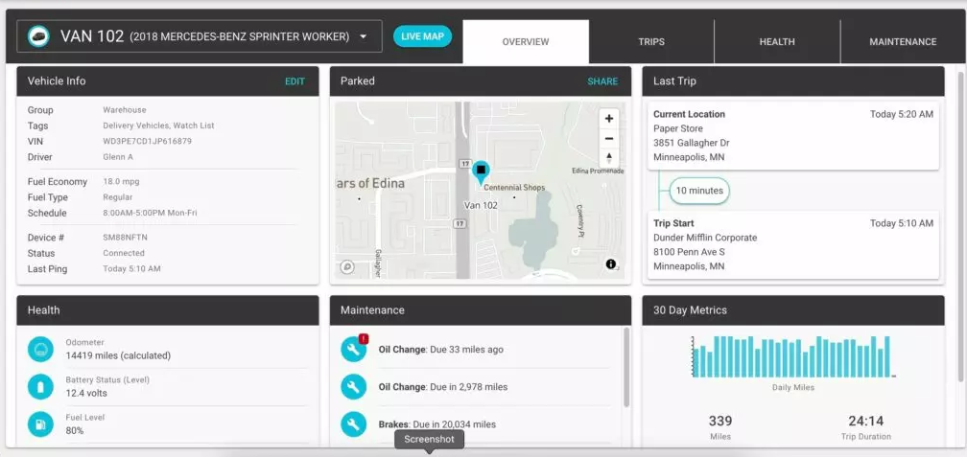
02. Applications of ITS: What Does It Do?
2.8. Application: Freight and Logistics
• GPS and cellular tracking for real-time shipment visibility
• Route optimization via TMS (Transport Management System) algorithms. E.g. Dijkstra’s & A*: Fast shortest-path for individual legs
• Weigh-In-Motion (WIM) sensors for axle load monitoring
• Fleet management dashboards integrating telematics and ELD (Electronic Logging Devices)
Outcomes: reduced idle time, lower fuel consumption, fewer delivery delays
Notes:
"Finally, it's important to remember that ITS is not just about moving people; it's also absolutely critical for moving goods. The applications in freight and logistics are a huge and economically vital part of the ITS world.
Core applications include real-time tracking, where GPS and cellular technology give logistics companies complete visibility into where their trucks and shipments are at all times.
This data feeds into sophisticated route optimization algorithms. These are the powerful software platforms that solve the 'traveling salesman problem' on a massive scale, calculating the most efficient multi-stop routes for delivery vehicles based on real-time traffic, delivery windows, and other constraints.
Specialized hardware like Weigh-In-Motion sensors allows trucks to be weighed as they travel at highway speeds, which is far more efficient than forcing them to stop at manual weigh stations.
And all of this data is integrated into Fleet Management Dashboards, which are the command centers that allow a company to monitor its entire fleet of vehicles in real-time. The combined outcomes of these technologies are massive gains in efficiency: reduced idle time, significant fuel savings, and more reliable delivery schedules."

Slide 30
Section 03:
Impacts & Implementation Challenges
Notes:
"That concludes our tour of the major ITS application areas. We've seen what these technologies can do in a wide range of contexts, from managing traffic to enabling autonomous vehicles.
But a critical academic perspective requires us to do more than just describe the technology. In this third section, we will take a balanced and critical look at the Impacts and Implementation Challenges. We will start by summarizing the proven benefits of these systems. But then we will turn our attention to the very real and significant difficulties associated with deploying ITS, including costs, security, and institutional barriers. This is the 'so what?' and 'what makes it hard?' part of our lecture."

Slide 31
03. Impacts & Implementation Challenges
3.0. The Benefits of ITS: A Consolidated View
ITS strategies deliver a wide range of positive outcomes for the transport system and society.
Benefit Category | Transport Policy Implication
Safer Transportation | Fewer crashes, faster emergency response times, lives saved.
Efficiency & Less Congestion | Smoother traffic flow, shorter and more reliable travel times.
Environmental Benefits | Reduced fuel consumption, lower CO2 and local pollutant emissions.
Economic Productivity | Reduced costs from lost time in traffic, creation of new high-tech jobs.
Improved Mobility Options | More reliable public transit, integrated and accessible shared mobility.
Data-Driven Decisions | Continuous, real-time data feeds enable evidence-based planning and operations.
Notes:
"Let's begin this section by consolidating the proven benefits of ITS. When implemented effectively, these technologies deliver significant and measurable positive impacts across several key areas.
The most important benefit is, of course, Safer Transportation. ITS safety systems lead to fewer crashes, and post-crash technologies lead to faster dispatch of emergency services, which saves lives.
They lead to greater Efficiency and Less Congestion. Smoother traffic flow from adaptive signals and real-time information results in shorter and, just as importantly, more predictable travel times.
This improved efficiency brings direct Environmental Benefits. Less time spent idling in traffic and smoother acceleration and deceleration patterns lead to reduced fuel consumption and lower emissions.
There are also major benefits to Economic Productivity. Reducing the time that people and goods are stuck in unproductive traffic is a direct economic benefit, and the ITS industry itself creates high-value technology jobs.
ITS also leads to Improved Mobility Options, by making public transit a more reliable and attractive choice and by enabling the integrated, shared mobility services we discussed.
And finally, a crucial meta-benefit is the shift to Data-Driven Decisions. ITS provides planners and operators with a continuous stream of real-time data, allowing them to manage their systems based on evidence, not just intuition."

Slide 32
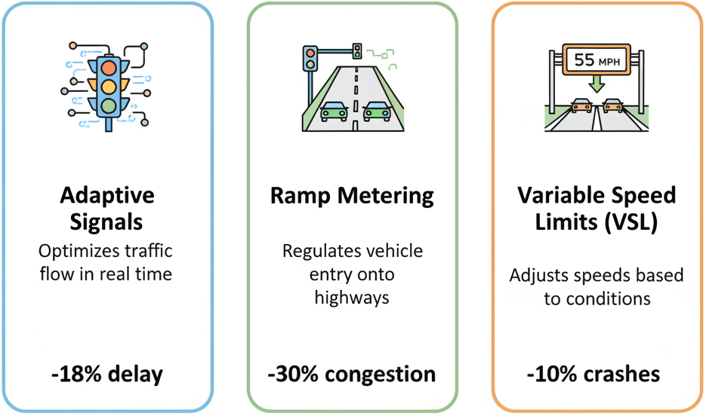
03. Impacts & Implementation Challenges
3.1. Benefit in Detail: Reduced Congestion & Travel Time
ITS reduces congestion by smoothing traffic flow and optimizing capacity.
Key Strategies & Quantified Impacts:
  Adaptive Signal Control (SCATS/SCOOT): Real-time phase tuning using data from loops and cameras.
    Impact: Up to ~18% reduction in delay, ~5% reduction in crashes.
  Ramp Metering: Uses feedback from mainline traffic to control the rate at which vehicles can enter a highway.
    Impact: Up to ~22% reduction in travel time, ~9% increase in capacity.
  Variable Speed Limits (VSL): Harmonizes speeds to prevent "shockwaves" (phantom traffic jams).
    Impact: Up to ~10% increase in throughput.
Notes:
"Let's take a closer look at a few specific examples of how ITS achieves these benefits, starting with congestion reduction.
One of the most powerful tools is Adaptive Signal Control. Instead of a fixed, pre-timed signal plan, these systems use data from sensors at the intersection to adjust the length of the green lights in real-time to match the actual, arriving traffic demand. This alone can reduce delays by nearly 20%.
On highways, Ramp Metering is a highly effective strategy. A traffic light on the on-ramp controls the rate at which cars can enter the mainline. By preventing large platoons of cars from merging all at once, it keeps the traffic on the highway flowing smoothly, which can significantly increase the highway's effective capacity and reduce overall travel times.
And another highway strategy is Variable Speed Limits. When the system detects that congestion is starting to build, it can post lower speed limits on the upstream digital signs. This 'harmonizes' the speed of the approaching vehicles, preventing the stop-and-go 'shockwave' effect, and can actually increase the total number of vehicles that get through the bottleneck. These are just a few examples of the specific, quantifiable impacts of these technologies."

Slide 33
03. Impacts & Implementation Challenges
3.2. Benefit in Detail: Improved Safety
ITS improves safety through collision avoidance, incident detection, and priority services.
Key Strategies & Quantified Impacts:
  Advanced Driver Assistance (ADAS) & Collision Avoidance: Radar/Lidar-based systems for features like Automatic Emergency Braking (AEB).
    Impact: 20-30% reduction in crash risk.
  Automated Incident Detection (AID): Cameras and algorithms that automatically flag stopped vehicles or other hazards.
    Impact: Dispatches emergency units faster (<60 seconds detection).
  Emergency Vehicle Preemption (EVP): Gives signal priority to first responders.
    Impact: Up to 30% reduction in emergency response time.
Notes:
"Perhaps the most important benefit of ITS is its impact on transportation safety. These technologies save lives in several ways.
First, through in-vehicle systems like Advanced Driver Assistance, or ADAS. These are the features in modern cars like Automatic Emergency Braking, which use radar or cameras to detect a potential collision and apply the brakes automatically if the driver doesn't react. These systems have been shown to reduce crash risk significantly.
Second, ITS helps us respond to incidents when they do happen. Automated Incident Detection uses cameras and AI on highways to automatically spot a crash or a stopped vehicle and alert the traffic management center in under a minute. This allows for much faster dispatch of emergency services.
And third, as we've discussed, Emergency Vehicle Preemption allows that ambulance or fire truck to get to the scene faster. By giving them a 'green wave' through traffic, we can cut response times by up to 30%. The cumulative impact of these technologies is fewer primary crashes, faster clearance of incidents which prevents secondary crashes, and ultimately, saved lives."

Slide 34
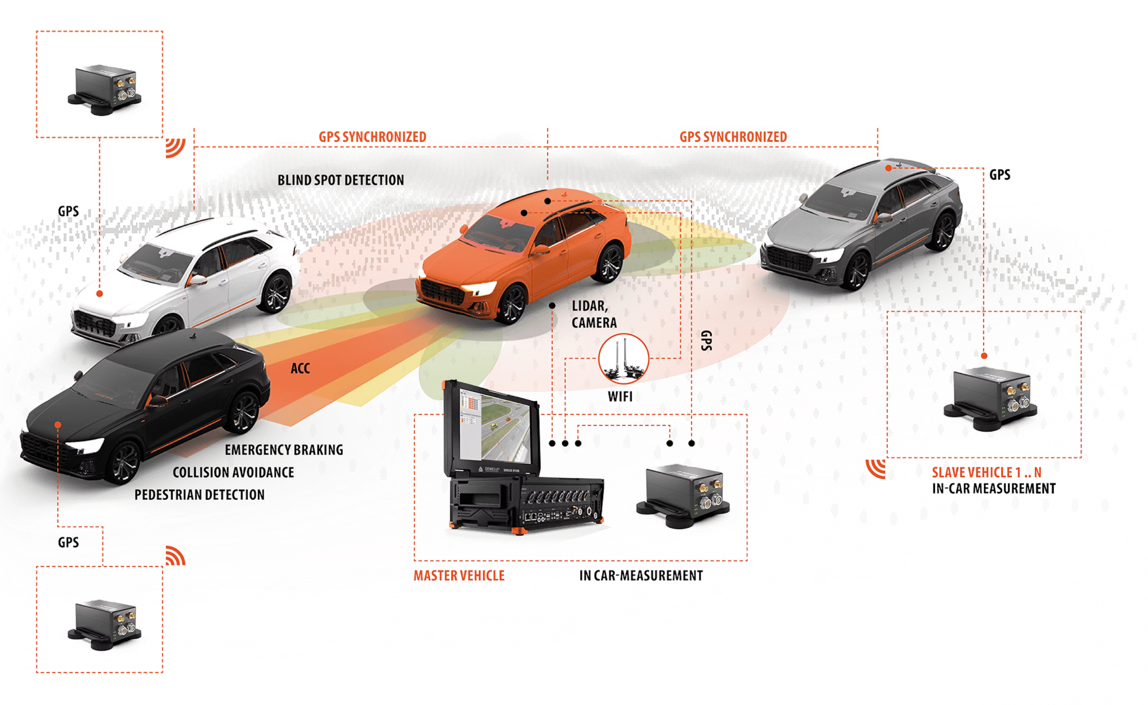
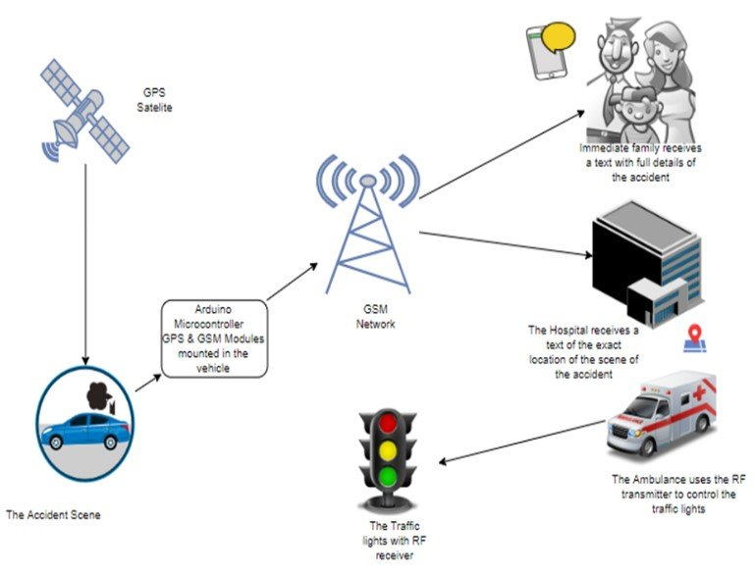
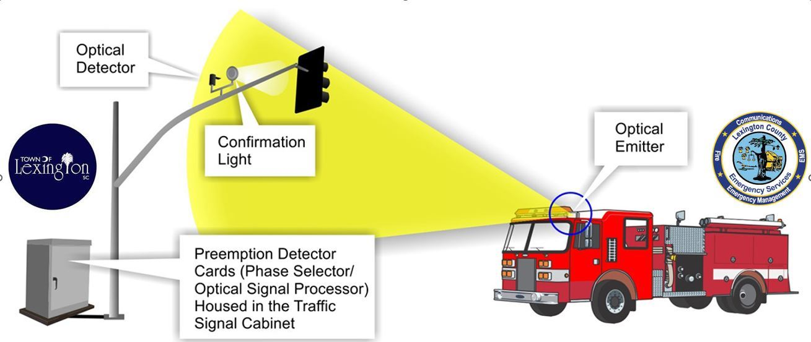
03. Impacts & Implementation Challenges
3.2. Benefit in Detail: Improved Safety
2
1
[8] • Automated Incident Detection (AID) – cameras + algorithms flag stoppages (< 60 s detection) → dispatch tow/emergency units faster
[7] • Advanced Driver Assistance (ADAS) – radar/LiDAR-based collision avoidance, automatic emergency braking → crash risk ↓ 20–30%
3
4
• Quick‐Clearance Protocols – TMC‐triggered alerts and coordinated clearance teams → secondary crashes ↓ 25%
• Overall Impact – fewer primary/secondary accidents, reduced injury severity, lives saved
[9] • Emergency Vehicle Preemption (EVP) – signal priority for first responders via V2I → response time ↓ 30%
Notes:
"Perhaps the most important benefit of ITS is its impact on transportation safety. These technologies save lives in several ways.
First, through in-vehicle systems like Advanced Driver Assistance, or ADAS. These are the features in modern cars like Automatic Emergency Braking, which use radar or cameras to detect a potential collision and apply the brakes automatically if the driver doesn't react. These systems have been shown to reduce crash risk significantly.
Second, ITS helps us respond to incidents when they do happen. Automated Incident Detection uses cameras and AI on highways to automatically spot a crash or a stopped vehicle and alert the traffic management center in under a minute. This allows for much faster dispatch of emergency services.
And third, as we've discussed, Emergency Vehicle Preemption allows that ambulance or fire truck to get to the scene faster. By giving them a 'green wave' through traffic, we can cut response times by up to 30%. The cumulative impact of these technologies is fewer primary crashes, faster clearance of incidents which prevents secondary crashes, and ultimately, saved lives."

Slide 35
03. Impacts & Implementation Challenges
3.3. The Challenges of Implementing ITS
Despite the benefits, deploying ITS is complex and faces significant challenges.
Key Challenges:
  High Initial Costs: Capital-heavy sensors, communication networks, and control rooms require major upfront investment.
  Integration & Interoperability: Getting legacy systems from different vendors to work together using non-standard data protocols is a major technical hurdle.
  Technical Complexity & Obsolescence: The technology evolves rapidly, requiring continuous updates and a highly skilled workforce that can be hard to find in the public sector.
  Privacy & Security: The collection of vast amounts of data raises major public concerns about surveillance and creates new vulnerabilities to cyber-attacks.
  Institutional & Workforce Issues: Siloed government departments, resistance to change, and a need for new staff skills can be major barriers.
Notes:
"Now, we must take a balanced view. For all of its immense potential, implementing ITS in the real world is incredibly difficult. This is not a simple plug-and-play technology.
The first and most obvious barrier is the High Initial Cost. The sensors, the fiber optic networks, the data centers, the traffic management centers—this is all very expensive capital infrastructure.
A massive technical hurdle is Integration and Interoperability. A typical city might have a traffic signal system from Siemens, a camera system from another vendor, and a bus tracking system from a third. Getting these different, often proprietary, systems to talk to each other and share data is a huge and persistent challenge.
There is also the challenge of Technical Complexity and Obsolescence. The technology is advancing so quickly that a system can be nearing obsolescence by the time it is fully deployed. This also creates a major workforce challenge, as public sector agencies struggle to attract and retain staff with the necessary IT and data science skills.
As we collect more and more data, we face major Privacy and Security challenges. The public is rightfully concerned about how this data is being used, and these connected systems create new targets for malicious cyber-attacks.
And finally, there are often Institutional barriers. Different city departments can be very siloed and may not want to share data or control. And there can be a cultural resistance to the change that these new, data-driven ways of working represent."

Slide 36
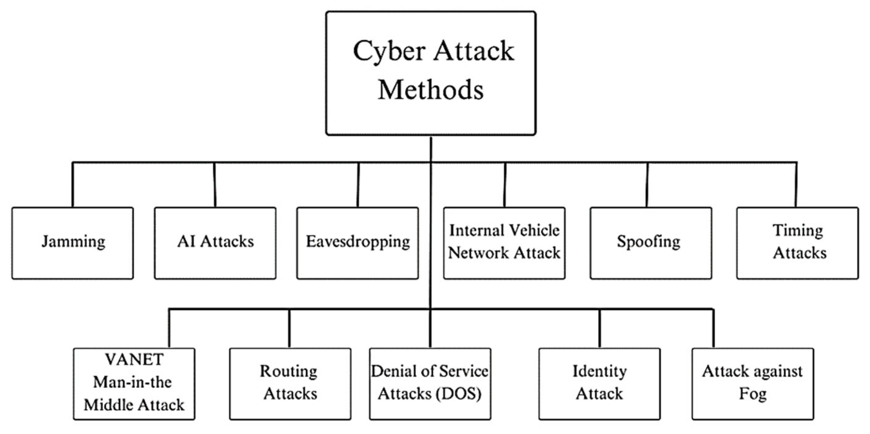
03. Impacts & Implementation Challenges
3.4. ITS Security & Cybersecurity Challenges
As transport systems become more connected, they also become more vulnerable to cyber-attacks.
Examples of Potential Attacks:
  Spoofing: A malicious actor fakes a signal to trigger a system (e.g., falsely triggering an emergency vehicle preemption signal to get a green light).
  Jamming: Disrupting wireless links (e.g., GPS or V2X communications) to disable systems.
  Terrorist Takeover: The malicious control of roadside units or even vehicles.
  Data Manipulation: Hacking into the system to hide or falsify data.
The Solution: Cybersecurity must be a core component of ITS design, not an afterthought.
Notes:
"Let's zoom in for a moment on the security challenge, because it is one of the most significant risks we face. As we connect our critical transportation infrastructure to the internet, we are also exposing it to the risk of cyber-attack.
And the potential attack vectors are numerous. An attacker could engage in 'spoofing,' where they broadcast a fake signal to manipulate the system. For example, they could build a device that mimics the signal of an ambulance to give themselves a green wave through the city.
They could use 'jamming' to block essential wireless communications, potentially disabling a V2X safety system or interfering with GPS signals, which could have catastrophic consequences for autonomous vehicles.
In the most extreme scenarios, we have to consider the risk of a terrorist takeover, where a hacker gains malicious control of the system to cause chaos or a major incident.
Or they could engage in more subtle data manipulation, hacking into the system to alter traffic counts or hide incident data.
The key takeaway here is that cybersecurity cannot be an add-on that we think about after the system is built. It has to be a fundamental, day-one design requirement for any modern, connected ITS deployment."

Slide 37
03. Impacts & Implementation Challenges
3.5. A Balanced View: Pros vs. Cons of ITS
Pros (Advantages) | Cons (Disadvantages)
Safer Transportation & Lives Saved | High Up-front Cost & Ongoing Maintenance
Improved Efficiency & Less Congestion | Complex Implementation & Risk of Failure
Environmental Benefits (Lower Emissions) | Interoperability & Legacy System Issues
Enhanced Economic Productivity | Privacy & Cybersecurity Risks
Better Mobility Options & User Experience | Potential Equity & Accessibility Gaps (The "Digital Divide")
Data-Driven, Evidence-Based Planning | Change Management & Workforce Skills Gap
Notes:
"So, to summarize this entire section, let's put the pros and cons of ITS side-by-side to create a clear, balanced view.
On the PRO side, the benefits are clear and compelling: ITS leads to safer, more efficient, and more environmentally friendly transportation. It boosts economic productivity, improves the user experience, and enables a shift to data-driven decision-making. These are the powerful promises of the technology.
However, on the CON side, the challenges are equally significant. These systems have a very high up-front cost and require continuous, expensive maintenance. The implementation is incredibly complex, and there is a real risk of project failure. We face major hurdles with interoperability, and the privacy and cybersecurity risks are substantial.
A final, crucial challenge is the risk to equity and accessibility. If we are not careful, these advanced technological systems can create a new 'digital divide,' leaving behind those who are not tech-savvy, do not have a smartphone, or cannot afford the new services.
As with any powerful technology, the role of the planner and engineer is to work to maximize these benefits while actively mitigating these significant risks."

Slide 38
Section 04:
Global Case Studies & Conclusion
Notes:
"That concludes our critical analysis of the impacts and challenges. For our final section, we will ground everything we've discussed in a few brief, real-world Global Case Studies. We will then synthesize the key lessons from the entire lecture with a final quiz and discussion before we conclude. This is where we see the theory in practice."

Slide 39
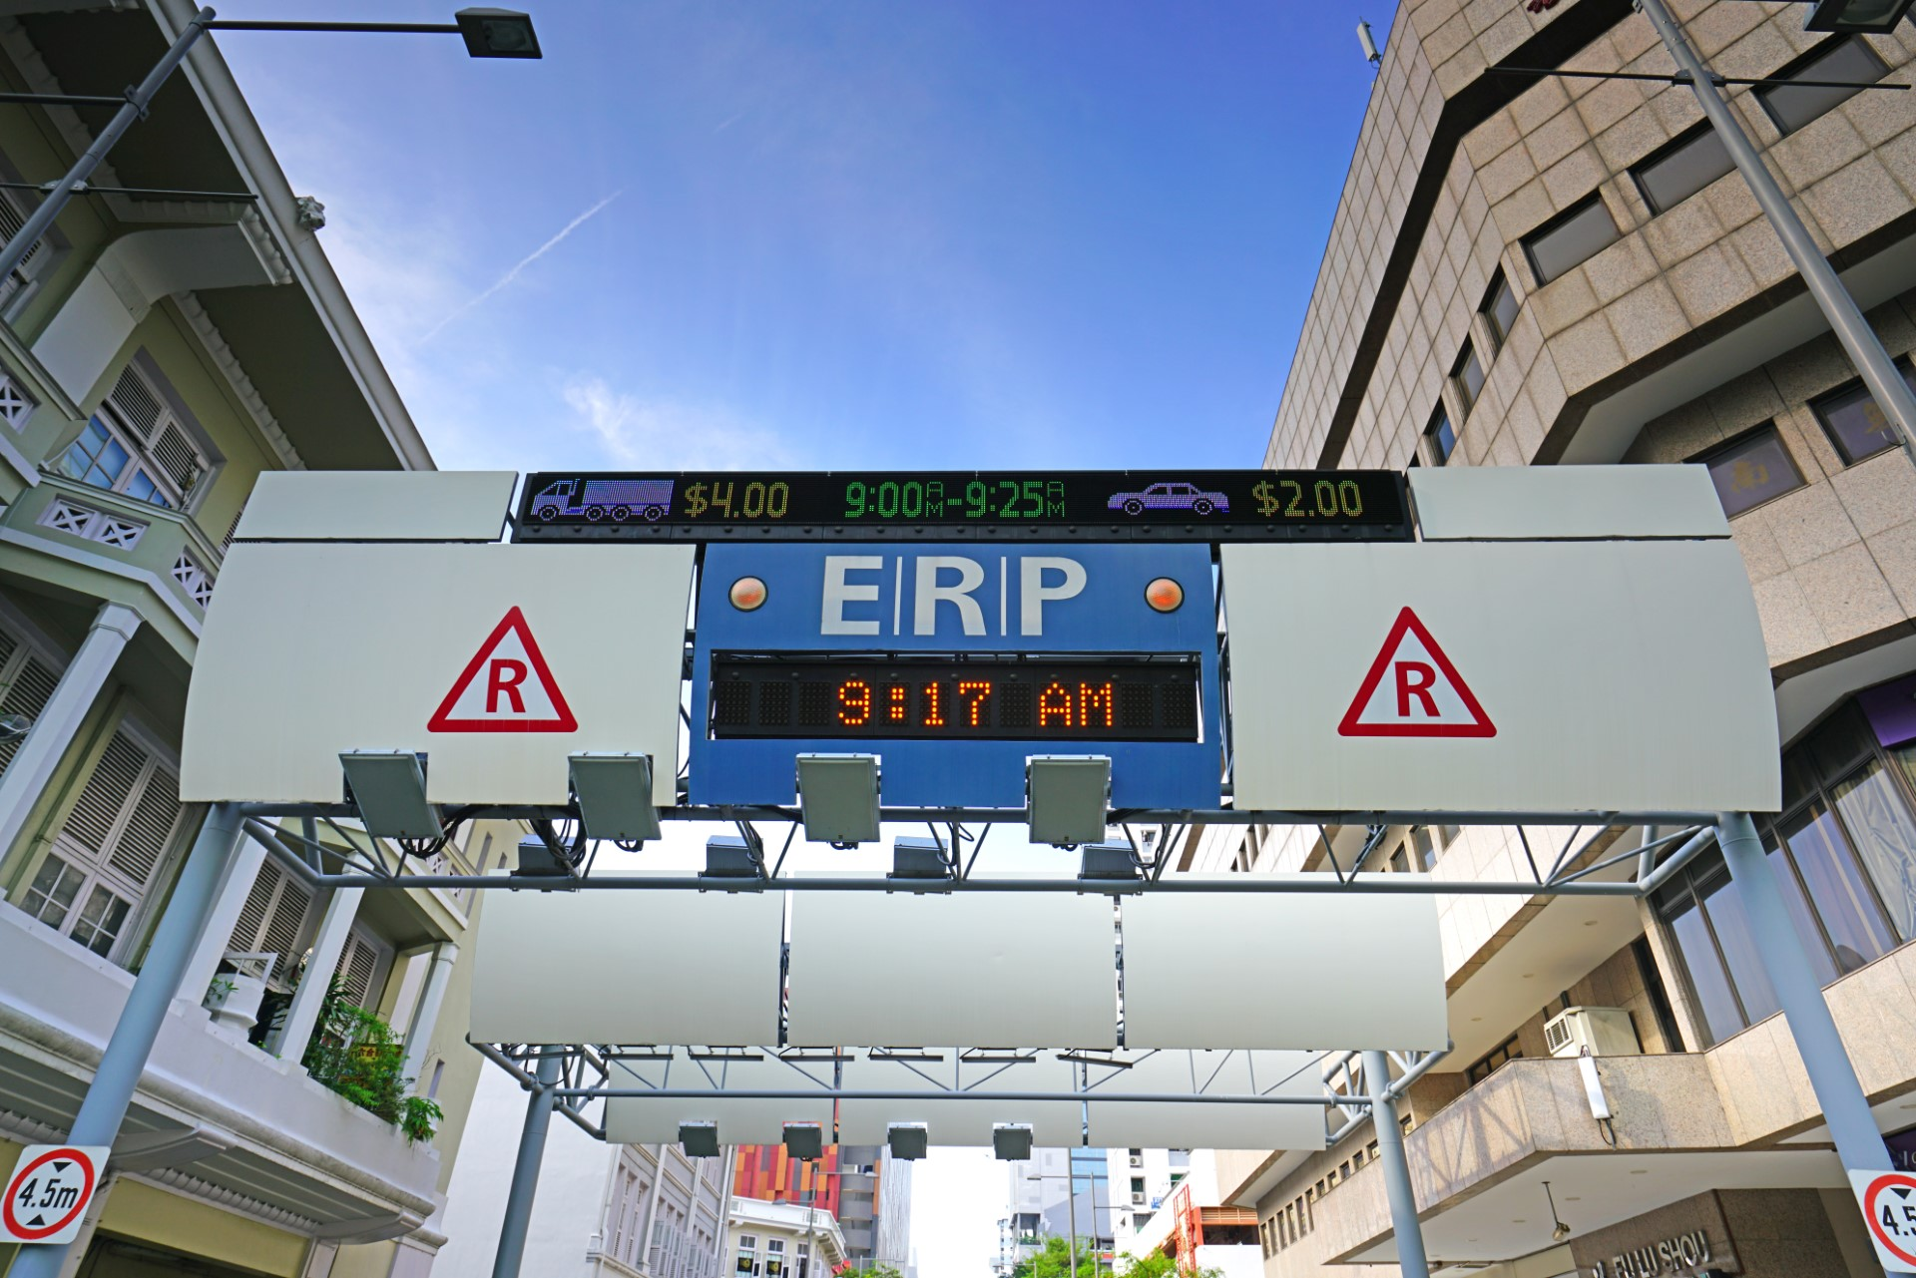
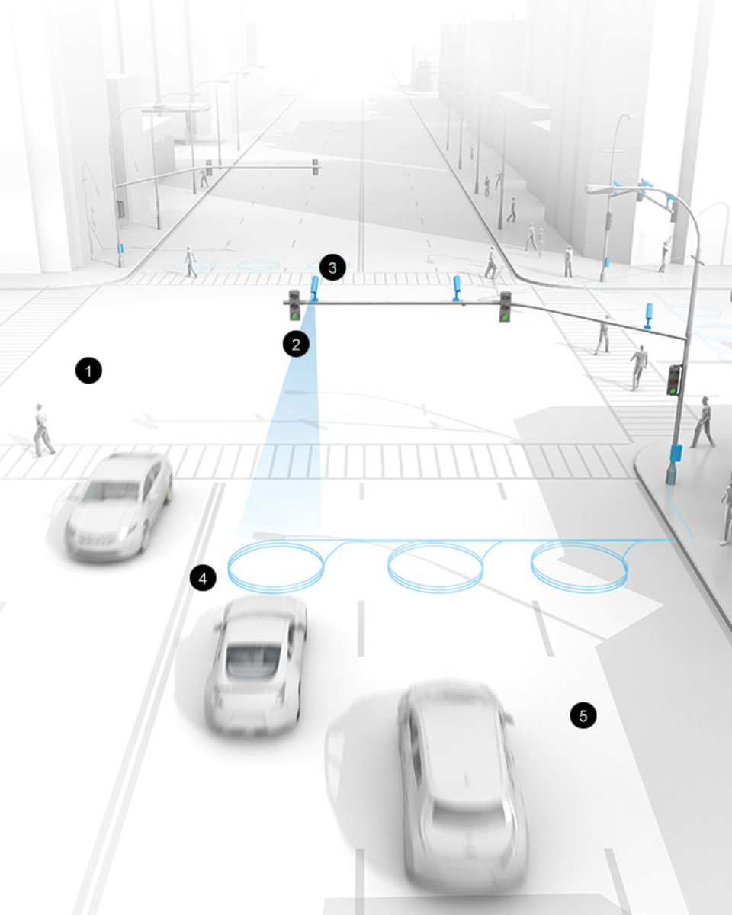
04. Global Case Studies & Conclusion
4.0. Global Case Studies
Singapore: Electronic Road Pricing (ERP)
  One of the world's first and most comprehensive congestion pricing systems. Uses V2I technology to automatically toll vehicles entering the city center, with prices that vary dynamically based on real-time congestion levels. A prime example of using ITS for Transport Demand Management.
Stockholm: Congestion Charge Trial
  A major trial of congestion pricing that was extensively studied. The data and public response from the trial provided the evidence needed to make the system permanent. A key example of data-driven policy-making.
Los Angeles: ATSAC System
  One of the world's largest and most advanced Adaptive Traffic Signal Control systems. Uses thousands of sensors to monitor traffic in real-time and automatically adjust signal timing across the city to improve flow and reduce congestion.
Singapore: Emphasize how road pricing with technology (ERP) [14]
2006 Congestion Charge Trial in Stockholm [15], [16]
Los Angeles – ATSAC (Automated Traffic Surveillance & Control) [17]
Notes:
"Let's briefly look at three pioneering cities that have successfully implemented large-scale ITS projects.
First, Singapore, which has long been a global leader. Their Electronic Road Pricing, or ERP, system is a textbook example of using technology for congestion management. It is a highly sophisticated system that charges drivers dynamically based on the time of day and level of congestion, effectively managing demand for road space in the city center.
Second, Stockholm. Their experience with a Congestion Charge is a masterclass in data-driven policy. They implemented the system as a trial, collected extensive data on its impacts on traffic, public transit use, and public opinion, and then used that overwhelming evidence to gain the political and public support needed to make the system permanent.
And third, Los Angeles. Their ATSAC system is one of the largest adaptive signal control systems on the planet. For decades, they have been a leader in using real-time sensor data to automate and optimize their traffic signal timings across thousands of intersections, squeezing every last bit of efficiency out of their road network.
These cases show that while the challenges are significant, large-scale ITS deployment is not just a theoretical possibility; it is a proven and effective reality in cities around the world."

Slide 40

04. Global Case Studies & Conclusion
4.1. Final Quiz
Test Your Knowledge:
  What does ITS stand for, and what is its primary goal?
  Name two key applications of ITS and briefly describe their purpose (e.g., one in traffic management, one in traveler information).
  List one major benefit of implementing ITS.
  What is one significant challenge or "con" faced when deploying ITS?
  Which city that we discussed implemented a pioneering Electronic Road Pricing (ERP) system?
Notes:
"Alright, to help synthesize and review the key concepts from today's lecture, let's run through a quick, final quiz. I'll read the questions, just think about the answers.
First, what does ITS stand for, and what is its main goal?
Second, can you name two major application areas and what they do?
Third, what is one of the main benefits of ITS?
Fourth, what is one of the biggest challenges to implementing it?
And finally, which of our case study cities is famous for its comprehensive Electronic Road Pricing system?"
(Pause briefly after the questions before moving to the next slide for the answers.)

Slide 41
04. Global Case Studies & Conclusion
4.2. References & Further Reading
Sussman, J. M. (2000). Introduction to Intelligent Transportation Systems. Artech House.
Avcı, İ., & Koca, M. (2024). “Intelligent Transportation System Technologies, Challenges and Security,” Applied Sciences, 14(11), 4646.
Lv, Z., & Shang, W. (2022). “Impacts of intelligent transportation systems on energy conservation and emission reduction of transport systems: A comprehensive review,” Green Technologies and Sustainability, 1(1).
Munir, T., Dia, H., & Ghaderi, H. (2021). “A Systematic Review of the Role of Road Network Pricing in Shaping Sustainable Cities,” Sustainability, 13(21).
Eliasson, J. (2008). “Lessons from the Stockholm congestion charging trial,” Transport Policy, 15(6), 395–404.
Lucic, M. C., Wan, X., Ghazzai, H., & Massoud, Y. (2020). “Leveraging Intelligent Transportation Systems and Smart Vehicles Using Crowdsourcing: An Overview,” Smart Cities, 3(2).
Notes:
"And finally, for those who wish to go deeper into the academic literature, this curated list provides some excellent starting points. Sussman's textbook is a foundational work in the field. The recent review articles by Avcı and Koca, and by Lv and Shang, offer comprehensive overviews of the technologies, challenges, and environmental impacts. And the papers by Munir and Eliasson provide deep insights into road pricing—one of the most impactful ITS policies. These will be excellent resources for your further research. Thank you."

Slide 42
Thank you for your attention!
Notes:
Thank You

