Slide 1
Transport Research and Analysis
Module 5: Advanced Topics and Case Studies
Lab 13: Introduction to Traffic Signal Simulations

Slide 3
Table of contents
Introduction to Traffic Signal Simulations
01: Introduction & Objectives….....................................4
1.1. Objectives & Activities Table………………….....5
1.2. Why Simulate Traffic?.....................................6
1.3. Example………………………………………….....7
1.4. Introducing UXsim: A Modern Python Tool…....8
1.5. Getting Started: Installation & Setup………....10
02: Your First Simulation: A Step-by-Step Guide…...11
2.1 The World Object: Scenario Definition………...12
2.2 Defining the Network: Nodes & Links..............13
2.3 Executing the Simulation................................14
03: Making Sense of the Data: Results Analysis……15
3.1 Key Performance Indicators………………........16
3.2 Exporting Data for Custom Analysis…………...17
3.3 Link-Level Visualization.………………………....18
3.4 Network-Level Visualization……………………....19
04: Modeling Traffic Signals………………………….......20
4.1 Fundamentals of Signal Control in UXsim……...21
4.2 Case Study: A 4-Legged Intersection…………...22
4.3 Advanced Control: Real-time Adaptive Signals..23
05: Advanced Application: Road Tolling…...................24
5.1 The Scenario: A Congested Highway Network...25
5.2 Implementation: Using route_choice_penalty.....26
06: Conclusion………………………………………….......27
6.1 Quantitative Comparison…………………………..28
6.2 Lab Assignment……………………………………..29
6.4 Next Steps & Submission………………………....31
6.5 Summary & Key Takeaways.............................32

Slide 4
Table of contents
Introduction to Traffic Signal Simulations
07: References….……………...............................33
7.1 References…..……………………….……...34

Slide 5
Section 01:
Introduction & Objectives

Slide 6
01. Introduction & Objectives
1.1. Objectives & Activities Table
Section No | Activity | Tool(s) | Activity Type | Activity done by | Duration
1.1 | Introduction to Simulation & UXsim Environment | Slides, Google Colab | Presentation | Teacher | 20 min
2.1 | Activity 1: Build & Run a Basic Scenario | Google Colab | Guided Practical | Teacher + Students | 20 min
3.1 | Activity 2: Analyze & Visualize Results | Google Colab | Individual Task | Student | 15 min
4.1 | Activity 3: Model Traffic Signals | Google Colab, Slides | Guided Practical | Teacher | 30 min
5.2 | Activity 4: Advanced Application: Road Tolling | Google Colab (Python) | Coding Practical | Teacher + Students | 35 min
3.2 | Discussion & Debrief | Slides | Discussion | Teacher + Students | 15 min
Total |  |  |  |  | 135 mins

Slide 7
01. Introduction & Objectives
1.2. Why Simulate Traffic?
Traffic simulation involves creating computer models to replicate the movement of vehicles over a transportation network. It is a critical tool in traffic engineering and ITS for several reasons:
  Cost-Effective Analysis: Test the impact of new infrastructure (e.g., a new lane, a new interchange) before spending millions on construction.
  Safe Experimentation: Evaluate the effects of new policies (e.g., signal timing changes, speed limit adjustments) without disrupting real-world traffic or causing accidents.
  Predictive Power: Forecast future traffic conditions based on changing demand or network modifications.
  Algorithm Development: Provide a sandbox for developing and testing advanced traffic management algorithms, like adaptive signal control or autonomous vehicle coordination.

Slide 8


01. Introduction & Objectives
1.3. Example
A 2-hour simulation of 60,000 vehicles on a 100 sq km grid network completed in 30 seconds, with animations showing link congestion and vehicle trajectories.
Source: UXsim
Source: UXsim

Slide 9
01. Introduction & Objectives
1.4. Introducing UXsim: A Modern Python Tool
UXsim is a lightweight, open-source, and user-friendly microscopic traffic simulator written in Python.
Key Features:
  Python-based: Integrates seamlessly with popular data science libraries like pandas and matplotlib, making analysis powerful and intuitive.
  Microscopic & Mesoscopic: Simulates individual vehicle (or small platoon) behavior while maintaining computational efficiency.
  Easy to Define: Scenarios, including complex networks and signals, can be defined with simple and readable code.
  Rich Visualization: Built-in tools for generating insightful plots, diagrams, and animations to easily understand complex traffic dynamics.
  In this lab, we will use UXsim to explore these capabilities.

Slide 10
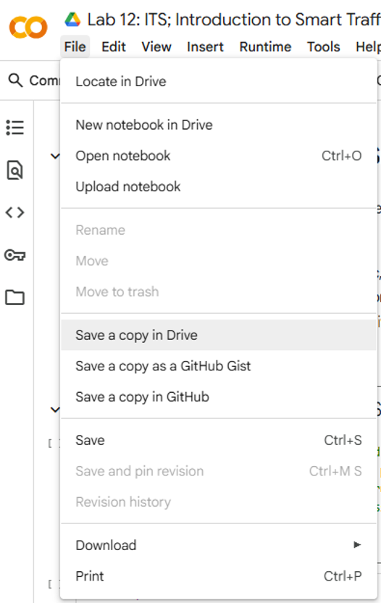
01. Introduction & Context
1.5. Getting Started: Accessing the Google Colab Notebook
Opening the Colab Notebook
How to access the Google Colab notebook.
Step 1: Open the provided link and select File > Save a copy in Drive.
Step 2: Click the Connect button in the top-right to connect to the cloud server.
Step 3: Run the first code cell to install the UXsim environment.
https://colab.research.google.com/drive/1MJsCxaRUtRfDr6xUnsny7pU11VwJuY0a?

Slide 11

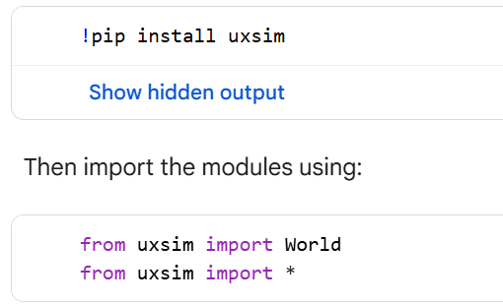
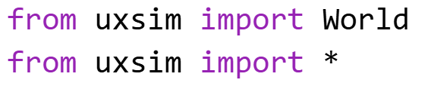
01. Introduction & Objectives
1.6. Getting Started: Installation & Setup
Setting up your environment is the first step. UXsim is installed easily using Python's package manager, “pip”.
Step 1: Install the Package
In your terminal or a code cell in Google Colab, run:
Step 2: Import Modules
In your Python script or notebook, import the necessary modules to begin:

Slide 12
Section 02:
Your First Simulation: A Step-by-Step Guide

Slide 13
02. Your First Simulation: A Step-by-Step Guide
2.1. The World Object: Scenario Definition
Everything in a UXsim simulation is contained within a World object. This object holds the network, vehicles, simulation settings, and results. You create it like this:
Core Parameters:
  name: The name of your scenario, also used as the folder name for saving results.
  deltan: An integer specifying the simulation aggregation unit Δn
  tmax: The total simulation time in seconds.
  print_mode: Set to 1 to see progress updates during the simulation.
  save_mode & show_mode: Control whether visualizations are saved to disk or displayed directly.
  random_seed: A number to ensure your simulation is reproducible. Using the same seed will produce the exact same results every time.

Slide 14
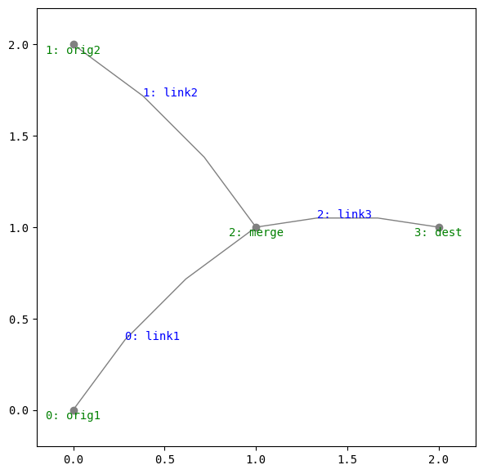

02. Your First Simulation: A Step-by-Step Guide
2.2. Defining the Network: Nodes & Links
A traffic network consists of Nodes (intersections or points) and Links (roads connecting the nodes).
The network is built using the addNode() and addLink() methods. Nodes are defined by a name and x/y coordinates, while links are defined by a name, start/end nodes, and physical properties like length, speed, and lanes.
Once the network is built, you must add vehicles. This is done by defining a traffic demand flow from an origin node to a destination node over a specific time period.
W.adddemand(orig="A", dest="C", t_start=0, t_end=1000, flow=0.4)
You can check the network shape by using W.show_network()
network shape

Slide 15

02. Your First Simulation: A Step-by-Step Guide
2.3. Executing the Simulation
With the network and demand defined, running the simulation is a single command:
W.exec_simulation()
As the simulation runs, UXsim provides real-time feedback on its progress directly in your console:
  Current simulation time: Shows how far along the simulation is.
  Number of vehicles: The total count of active vehicles in the network.
  Average speed: A network-wide average speed, giving a quick sense of congestion.
  Computation time: How long the simulation has taken to run so far.
This output is useful for monitoring the state of long-running simulations.

Slide 16
Section 03:
Making Sense of the Data: Results Analysis

Slide 17
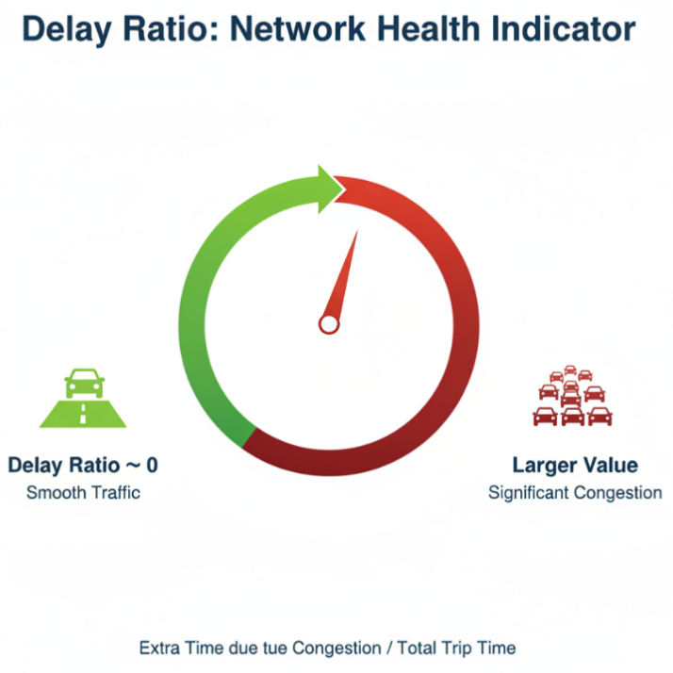
03. Making Sense of the Data: Results Analysis
3.1. Key Performance Indicators: The Analyzer and "Delay Ratio"
The Analyzer class accessible as W.analyzer is responsible for analyzing the results.
A summary of the results can be printed using W.analyzer.print_summary()
A critical metric provided is the Delay Ratio.
Definition: The ratio of extra time spent due to congestion compared to the total trip time.
Interpretation:
  A value near 0 indicates smooth, free-flow traffic.
  A larger value indicates significant congestion, where vehicles spent a large portion of their trip delayed in traffic.
It's a powerful, single-number indicator of overall network health.

Slide 18
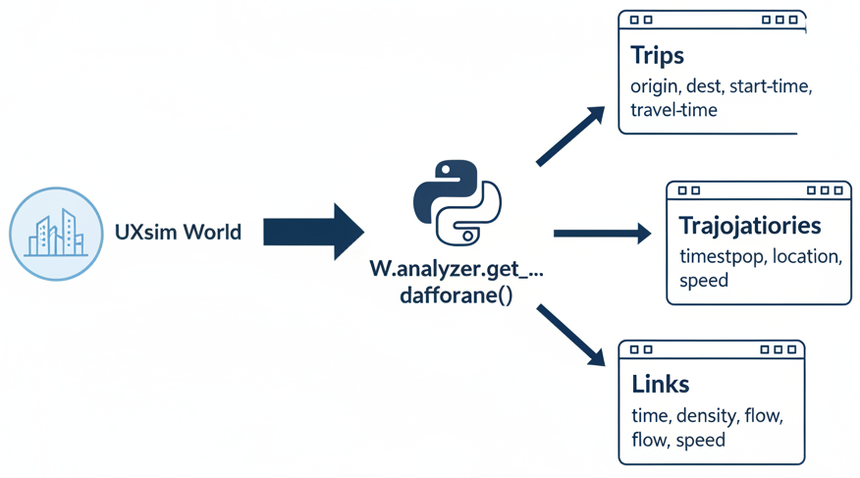
03. Making Sense of the Data: Results Analysis
3.2. Exporting Data for Custom Analysis
For in-depth analysis, UXsim allows you to export simulation data directly into pandas DataFrames—the standard for data analysis in Python.
Available Data:
Trip Data: Information on every vehicle's trip (origin, destination, start time, travel time).
  df_trips = W.analyzer.get_trip_dataframe()
Vehicle Trajectories: Detailed time-stamped location and speed data for each vehicle.
  df_trajectories = W.analyzer.get_vehicle_trajectory_dataframe()
Link States: Time-series data for each link (e.g., density, flow, speed).
  df_links = W.analyzer.get_link_dataframe()
This enables limitless custom analysis, plotting, and statistical testing beyond the built-in functions.

Slide 19
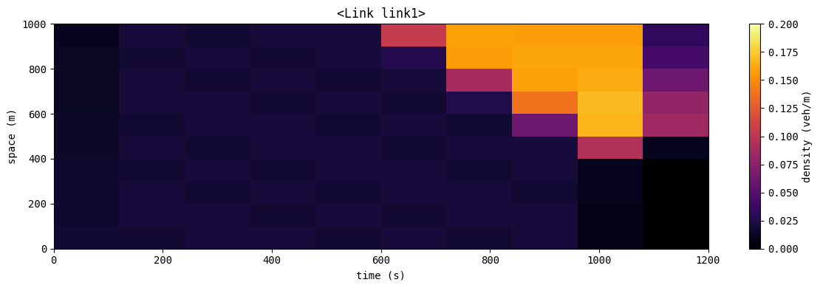
03. Making Sense of the Data: Results Analysis
3.3. Link-Level Visualization: Time-Space Diagrams
Time-space diagrams are a fundamental tool in traffic analysis for visualizing conditions on a specific road segment over time.
W.analyzer.plot_link_td(link_name="road1")
What you can see:
Vehicle Trajectories (Lines): Each line represents a single vehicle.
  Slope of the line: Indicates the vehicle's speed (steeper = faster).
  Horizontal lines: A stopped vehicle (a queue).
Traffic Density (Background Color): The color shows the density of vehicles.
  Red/Dark colors: Indicate high density and the formation of a shockwave (congestion).
This plot is excellent for identifying the exact time and location where congestion begins.

Slide 20

03. Making Sense of the Data: Results Analysis
3.4. Network-Level Visualization: Animations and MFDs (Macroscopic fundamental diagram)
To understand the bigger picture, UXsim offers powerful network-wide visualizations.
Network Animations: See the traffic flow dynamically over time.
  W.analyzer.network_anim(): Creates an animation of link states (color-coded by speed/density).
  W.analyzer.network_fancy(): Creates a high-quality animation showing individual vehicle movements.
Macroscopic Fundamental Diagram (MFD):
W.analyzer.plot_network_mfd()
  This plot summarizes the relationship between the entire network's density (vehicles/km) and flow (vehicles/hour).
  It reveals the network's overall capacity and whether it is operating in a free-flow or congested state.
Network Animations

Slide 21
Section 04:
Modeling Traffic Signals

Slide 22
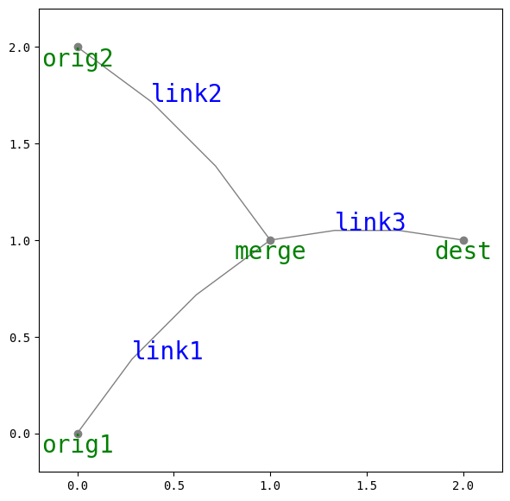
04. Modeling Traffic Signals
4.1. Fundamentals of Signal Control in UXsim
In UXsim, a node can have its traffic signal. A traffic signal determine which link can send vehicles to the node.
signal (on the Node): A list defining the duration of each signal phase in seconds.
        signal=[30, 60] means a two-phase cycle: Phase 0 lasts 30s, and Phase 1 lasts 60s.
signal_group (on the Link): An integer that assigns a link to a specific signal phase.
    signal_group=0 means this link gets a green light during Phase 0.
    signal_group=1 means this link gets a green light during Phase 1.
Example:
Node "merge" has signal=[30, 60].
Link "link1" has signal_group=0.
Link "link2" has signal_group=1.
Result: "link1" is green for 30s, then "link2" is green for 60s, and this cycle repeats.

Slide 23
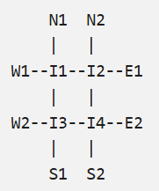
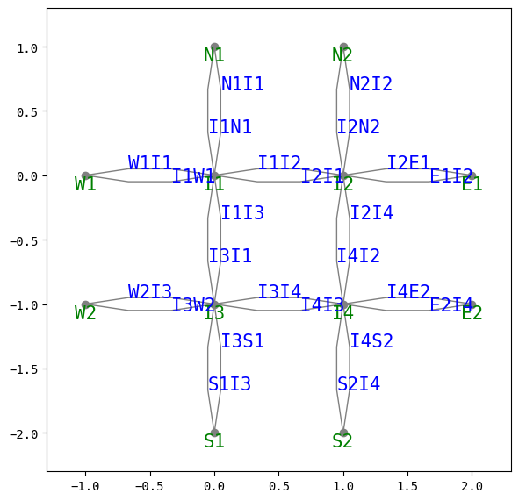
04. Modeling Traffic Signals
4.2. Case Study: A 4-Legged Intersection
The same principles can be scaled to model a standard 4-legged intersection.
Common Approach:
  Phase 0: East-West traffic has the green light. All links for East-West through traffic are assigned signal_group=0.
  Phase 1: North-South traffic has the green light. All links for North-South through traffic are assigned signal_group=1.
The node at the center of the intersection would have a signal definition like signal=[45, 45] for a simple 90-second cycle with equal splits.
This structure allows for the modeling of entire corridors or grids of coordinated signals.

Slide 24
04. Modeling Traffic Signals
4.3. Advanced Control: Real-time Adaptive Signals
Fixed-time signals can be inefficient. Adaptive signal control adjusts timing based on real-time traffic demand. UXsim enables this by letting you intervene in the simulation loop.
The Logic:
Run the simulation in small steps (e.g., 10 seconds at a time) inside a while loop.
Inside the loop, before the next step, check the traffic state. A common metric is the number of vehicles queued on each link: Link.num_vehicles.
Identify the signal phase corresponding to the link with the most vehicles.
Manually set the current signal phase for the node using Node.signal_phase = new_phase.
Execute the next simulation step.
This creates a "max-pressure" or "longest-queue-first" controller that dynamically allocates green time where it's needed most, reducing delays.

Slide 25
Section 05:
Advanced Application: Road Tolling

Slide 26
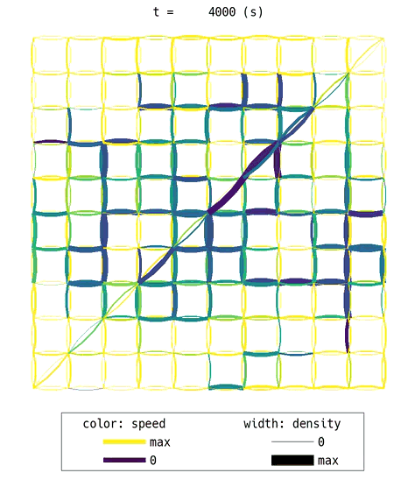
05. Advanced Application: Road Tolling
5.1. The Scenario: A Congested Highway Network
Consider a grid network with arterial roads and a faster, more direct diagonal highway.
The Problem:
Rational drivers will naturally choose the fastest path; the highway.
This leads to an over-concentration of traffic on the highway, causing severe congestion.
The result is a high network-wide delay ratio, as the highway's benefit is negated by traffic jams, and the arterial network remains underutilized.
We will simulate this "no-toll" baseline scenario to observe this effect.

Slide 27
05. Advanced Application: Road Tolling
5.2. Implementation: Using route_choice_penalty
How can we encourage some drivers to use the arterial roads instead? By introducing a highway toll.
In UXsim, a toll is modeled not as a monetary cost, but as a perceived travel time penalty that influences a driver's route choice. This is done using the route_choice_penalty parameter on a link.
W2.get_link("highway1").route_choice_penalty = 70
This adds a 70-second penalty to "highway1" in the route choice calculation.
When a vehicle plans its path, it will treat traveling on this link as if it took 70 seconds longer than it actually does.
If an alternative route on arterial roads is now perceived as faster (original travel time < highway time + penalty), the driver will choose it instead.

Slide 28
Section 06:
Conclusion

Slide 29
06. Conclusion
6.1. Quantitative Comparison: No-Toll vs. With-Toll
After running both simulations, we can use the exported DataFrame to compare them quantitatively.
Expected Outcome:
Metric | No-Toll Scenario | With-Toll Scenario | Change
Delay Ratio | High (e.g., 0.45) | Significantly Lower (e.g., 0.20) | Improvement
Highway Users | High | Lower | Diversion
Avg. Network Speed | Low | Higher | Improvement
Throughput | Sub-optimal | Higher | Improvement
Conclusion: The toll effectively discourages inefficient highway use, leading to a more balanced traffic distribution across the entire network. This improves overall traffic efficiency, reduces delays, and increases average speeds for everyone.

Slide 30
06. Conclusion
6.2. Lab Assignment
Assignment: Optimizing a Congested Intersection with Adaptive Signals
Goal: To implement and evaluate the effectiveness of an adaptive traffic signal controller compared to a fixed-time plan.
Part 1 (Build the Scenario): Construct the 4-legged intersection network from the tutorial. Define a heavy, continuous traffic demand on all four approaches that causes significant congestion with a simple fixed-time signal plan (e.g., 45s/45s).
Part 2 (Baseline Analysis): Run the simulation with the fixed-time signal. Record the final Delay Ratio and the average trip time for all vehicles. Use plot_link_td to visualize the queue formation on one of the main approaches.
Part 3 (Implement Adaptive Control): Modify your code to implement the adaptive signal control logic discussed in the lab. Your controller should grant a green light to the direction (e.g., N-S vs. E-W) that currently has the greater number of total vehicles waiting on its approach links.

Slide 31
06. Conclusion
6.3. Lab Assignment
Assignment: Optimizing a Congested Intersection with Adaptive Signals
Part 4 (Compare and Report): Run the simulation with your adaptive controller.
  Quantitatively Compare: Present a table comparing the Delay Ratio and average trip time for the fixed vs. adaptive scenarios.
  Qualitatively Explain: In a brief paragraph, explain your results. Did the adaptive controller improve performance? Why or why not?
  Visualize: Include a time-space diagram from the adaptive run to visually support your conclusion (e.g., showing shorter, more rapidly clearing queues).

Slide 32
06. Conclusion
6.4. Next Steps & Submission
Task: Complete all sections of the Student Lab Manual, including the final performance numbers and the critical reflection question.
Deliverables:
  A shareable link to your saved Google Colab notebook.
  The completed lab manual.
Submission: Submit both items to the course portal by [Date/Time].

Slide 33
06. Conclusion
6.5. Summary & Key Takeaways
What We Learned Today
Traffic simulation is a powerful and essential tool for transportation engineers.
UXsim provides an accessible, Python-native environment for building, running, and analyzing traffic models.
We can define every core component of a traffic system:
  Networks (Nodes and Links)
  Behavior (Origin-Destination Demand)
  Control (Fixed and Adaptive Signals)
  Policy (Road Tolling)
Effective analysis combines summary statistics (Delay Ratio), detailed data export (pandas), and insightful visualizations (time-space diagrams, animations, MFDs).
These skills form the foundation for tackling more complex ITS challenges.

Slide 34
Section 07:
References

Slide 35
07. References
7.1. References
T. Hishida, “UXsim: An open-source macroscopic and microscopic traffic simulator in Python,” GitHub repository. [Online]. Available: https://github.com/toru-hishida/uxsim
T. Seo, “UXsim: Vehicular traffic flow simulator in road network, written in pure Python,” GitHub repository. [Online]. Available: https://github.com/toruseo/UXsim
T. Seo, “UXsim: Traffic Simulation in Python v1 documentation.” [Online]. Available: https://toruseo.jp/UXsim/docs/
Eclipse Foundation, “Tutorial – SUMO User Conference 2025,” YouTube video, 2025. [Online]. Available: https://www.youtube.com/watch?v=ccc2mnGX_Mg

Slide 36


