Slide 1
Energy and Resource audits
Janita Andrijevskaja, MSc in Economics and Engineering
Early-stage researcher
Tallinn University of Technology

Slide 2
Content
Introduction to Energy and Resource Audits
Audit Frameworks and Standards
Audit Process and Methodology
Resource and Energy Flow Mapping
Performance Indicators and Efficiency Metrics
Identifying and Evaluating Savings Opportunities
Reporting, Follow-Up, and Continuous Improvement

Slide 3
1. Introduction to
Energy and Resource Audits
Audit definition
Business motivation
Efficiency concepts
Audit types
Benefits

Slide 4
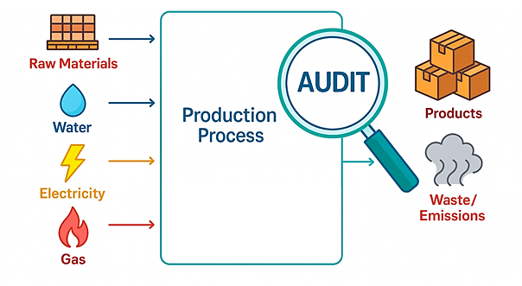
What is an Energy and Resource Audit?
An Energy and Resource Audit is a systematic process for analyzing how energy, water, raw materials, and utilities are used in a facility — and identifying opportunities to reduce waste and improve efficiency.
Scope includes: energy (electricity, thermal energy, fuels), materials, water, air, emissions and waste.
Key goal: "Make more from less" without compromising quality or output.

Slide 5
Why Perform Energy and Resource Audits?
Audits are driven by economic, regulatory, and sustainability needs.
Main objectives:
Identify inefficiencies and losses (heat, compressed air, leaks, oversizing)
Reduce operational costs and resource dependency
Support ISO 50001 or ISO 14001 management systems
Comply with regulations or corporate sustainability targets
Build baselines for future improvements

Slide 6
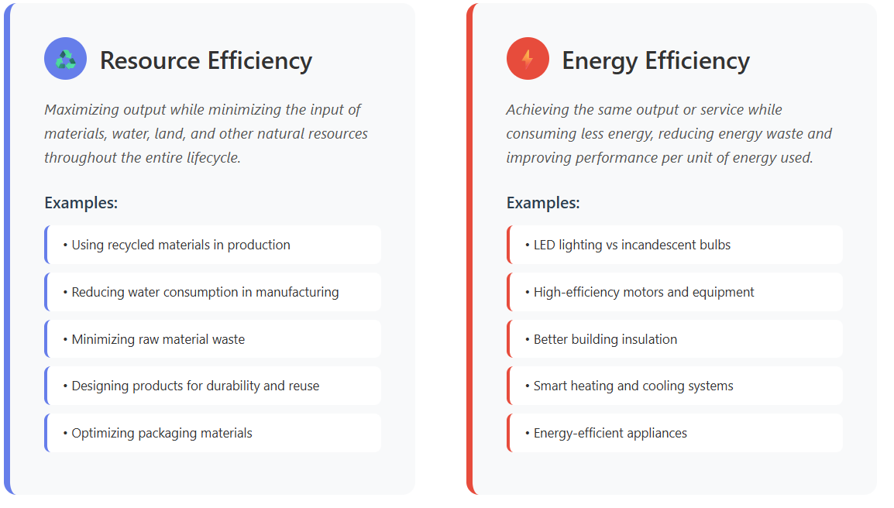
Resource vs. Energy Efficiency:
understanding the difference

Slide 7
Audit Types and Scopes
Type of Audit | Focus
Energy Audit | Electricity, fuels and thermal energy use
Resource Audit | Energy + water + materials + waste + emissions
Utility Audit | Compressed air, HVAC, steam, lighting..
Process Audit | Material flows, transformation losses, process optimization
Compliance Audit | Legal or ISO-based conformance

Slide 8
Benefits of Audits
Discover cross-resource synergies
e.g., heat recovery systems simultaneously reduce energy consumption and water treatment
Uncover hidden cost sinks
e.g., overcompressed air, steam leaks, idle motors, standby power consumption
Improve KPIs
SEC - Specific Energy Consumption
REI - Resource Efficiency Index
WPI - Water Productivity Index
Enable digital monitoring and control systems
Real-time REI tracking, automated anomaly detection, predictive maintenance triggers

Slide 9
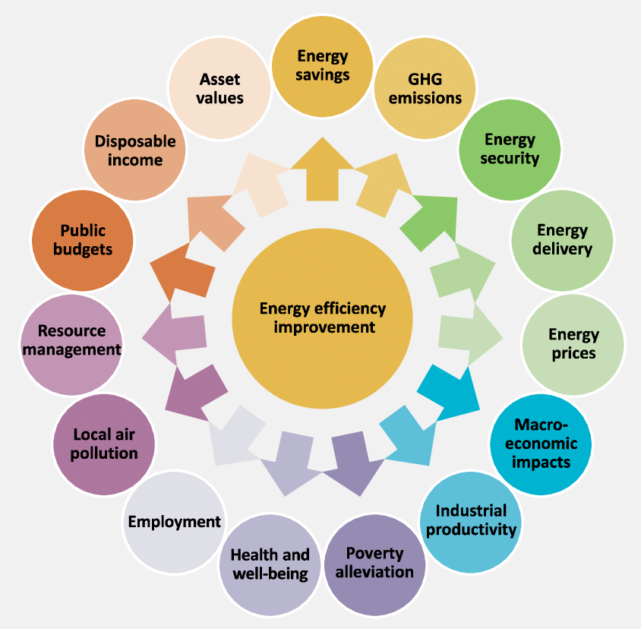
Energy Efficiency:
Beyond Energy Savings
https://www.researchgate.net/figure/Quantification-and-monetization-of-32-impacts-for-21-energy-efficiency-improvement_fig2_325924531

Slide 10

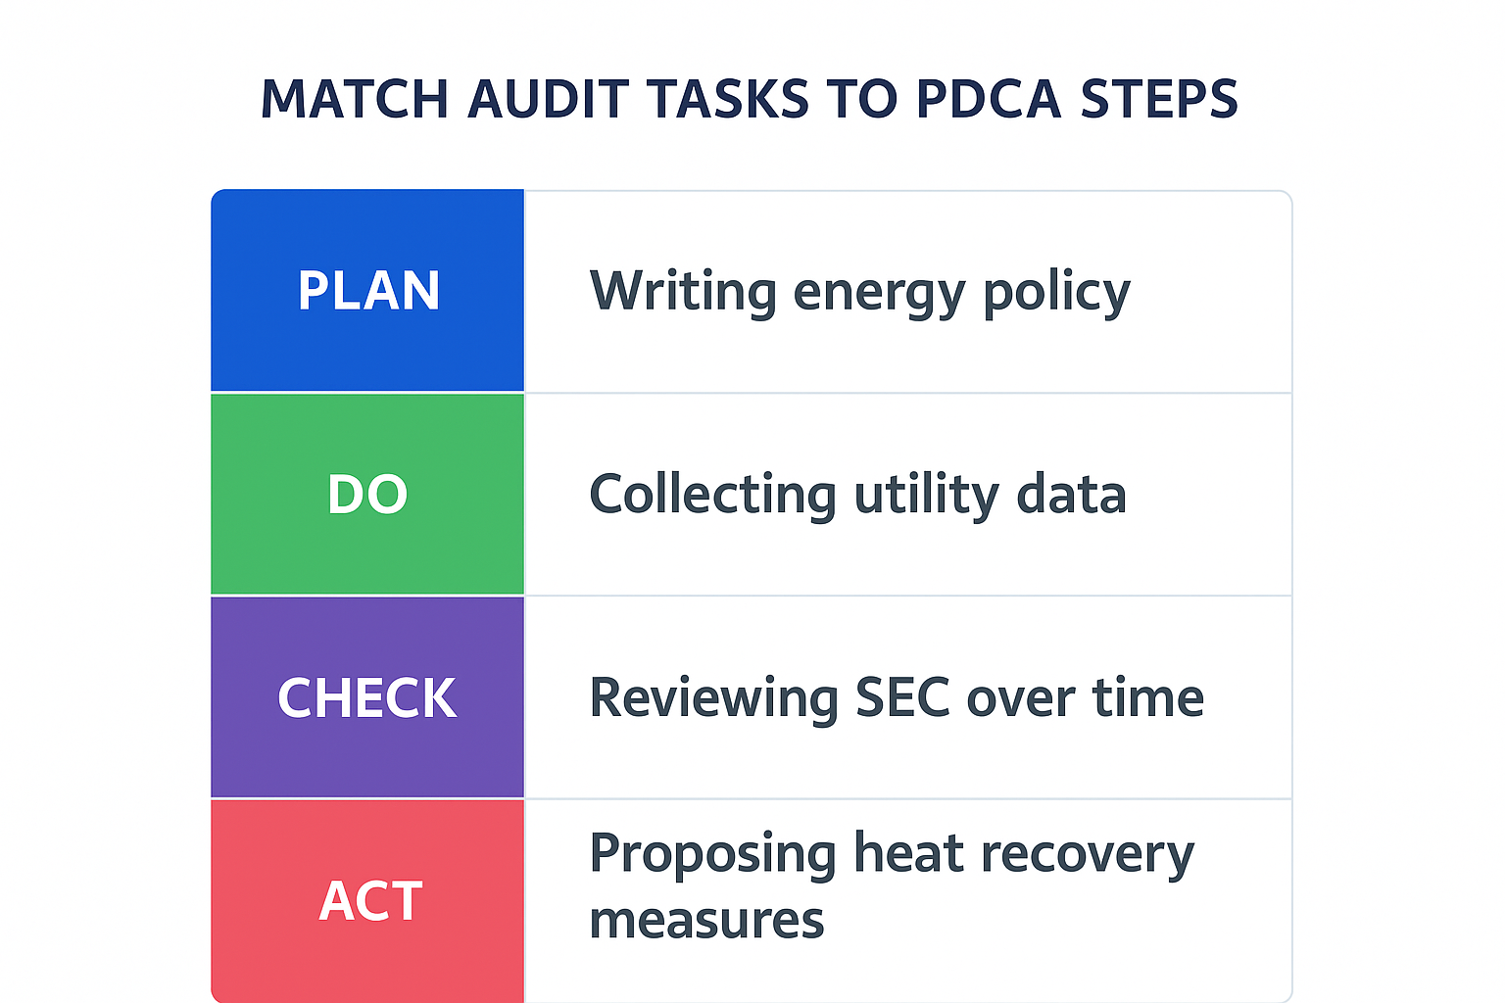
PDCA Cycle Application:
Match each activity to the correct PDCA step
Collecting utility data
Writing energy policy
Proposing heat recovery measures
Reviewing SEC over time

Slide 11
2. Audit Frameworks and Standards
International Standards
Audit Frameworks
Management Systems

Slide 12
Overview of Audit Frameworks
Energy and resource audits can follow structured frameworks established by international standards. These ensure consistency, credibility, and integration with management systems.
Key global frameworks:
ISO 50001: Energy management systems
ISO 14001: Environmental management systems
ISO 14051: Material Flow Cost Accounting (MFCA)
EN 16247 -1 to -5: Series for energy audits (EU-specific)
ASHRAE Level I, II, III: Energy audits (North America)

Slide 13
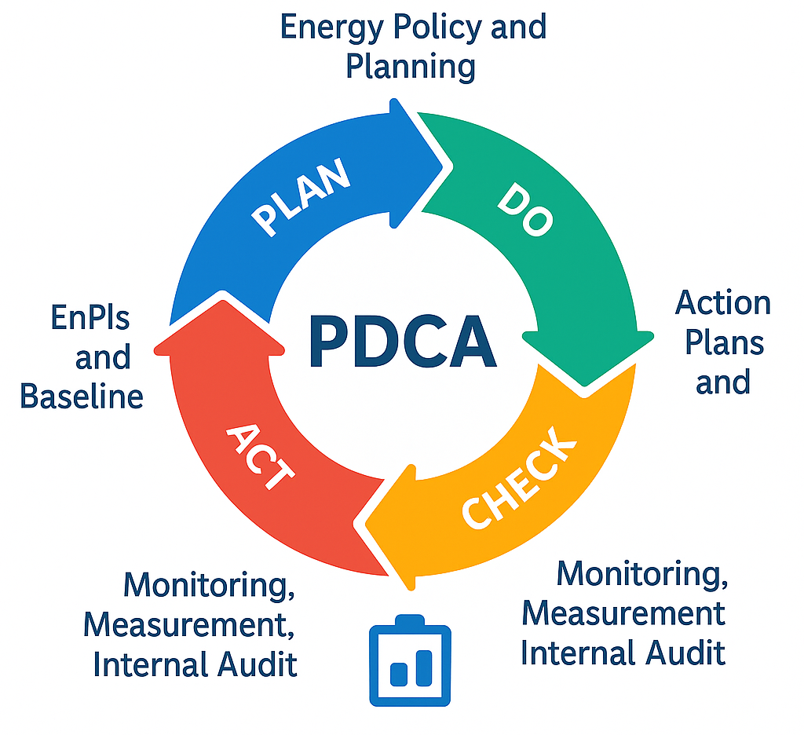
ISO 50001 – Energy Management System
ISO 50001 provides a structured approach for continual improvement of energy performance.
Core elements:
Energy policy and planning
Energy review and baseline
EnPIs (Energy Performance Indicators)
Action plans and implementation
Monitoring, measurement, internal audit
Goal: Integrate energy management into everyday operations
using the Plan-Do-Check-Act (PDCA) cycle.

Slide 14
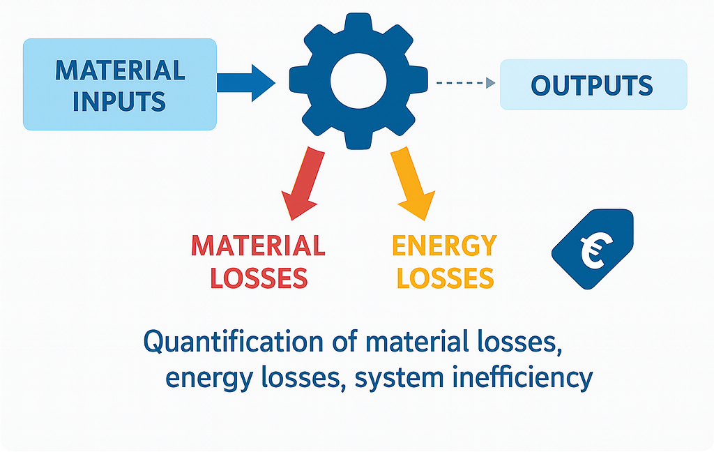
ISO 14051 – Material Flow Cost Accounting
ISO 14051 supports audits focused on material losses and cost structures in production.
Key concepts:
Flow modeling of material inputs and outputs
Quantification of material losses, energy losses, system inefficiencies
Focus on cost drivers related to resource inefficiency

Slide 15
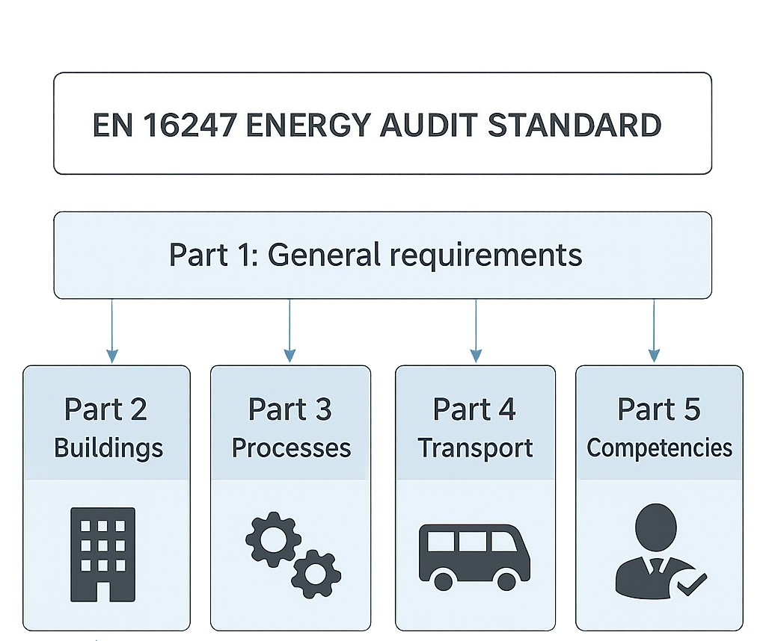
EN 16247 – Energy Audit Standard (EU)
EN 16247 series provides a standardised methodology for energy audits.
Structure:
Part 1: General requirements
Part 2–5: Sector-specific: buildings, processes,
transport, competencies
While EU-based, it aligns closely with ISO 50002
and is valuable as a practical framework
for facility-level audits.

Slide 16
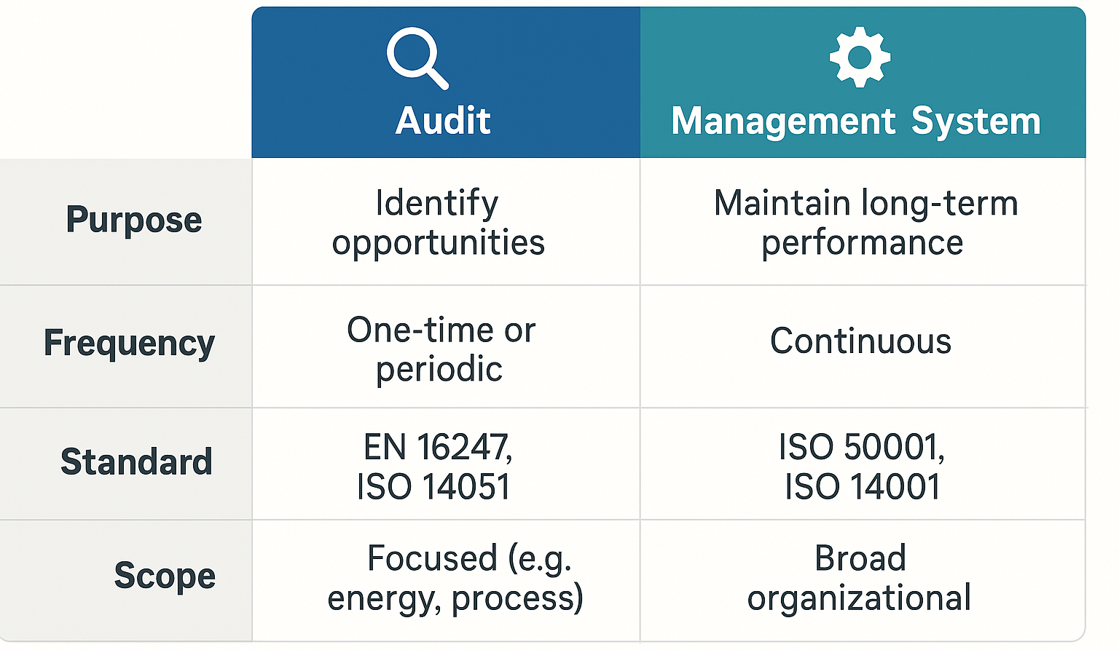
Audit vs. Management Systems
Audits are structured assessments at a point in time.
Management systems are continuous frameworks for improvement.

Slide 17
Integration of Audits into Corporate Systems
Energy/resource audits should integrate with:
Corporate sustainability reporting
ERP and MES systems
Investment decision processes
Audit results can feed:
GHG inventory
Resource productivity KPIs
Energy balance dashboards

Slide 18
3. Audit Process and Methodology
Audit Workflow
Planning Phase
Data Sources
Key Metrics
Monitoring Approaches

Slide 19
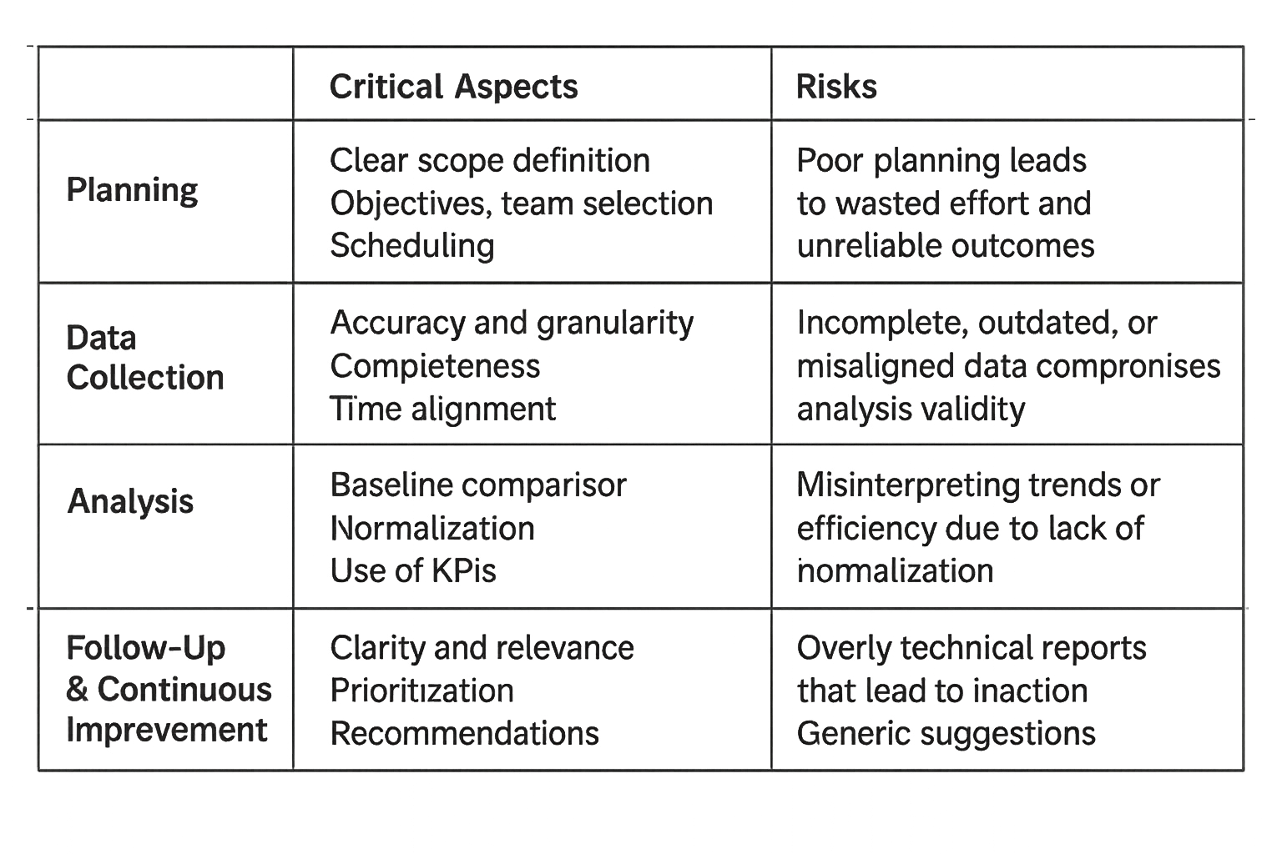
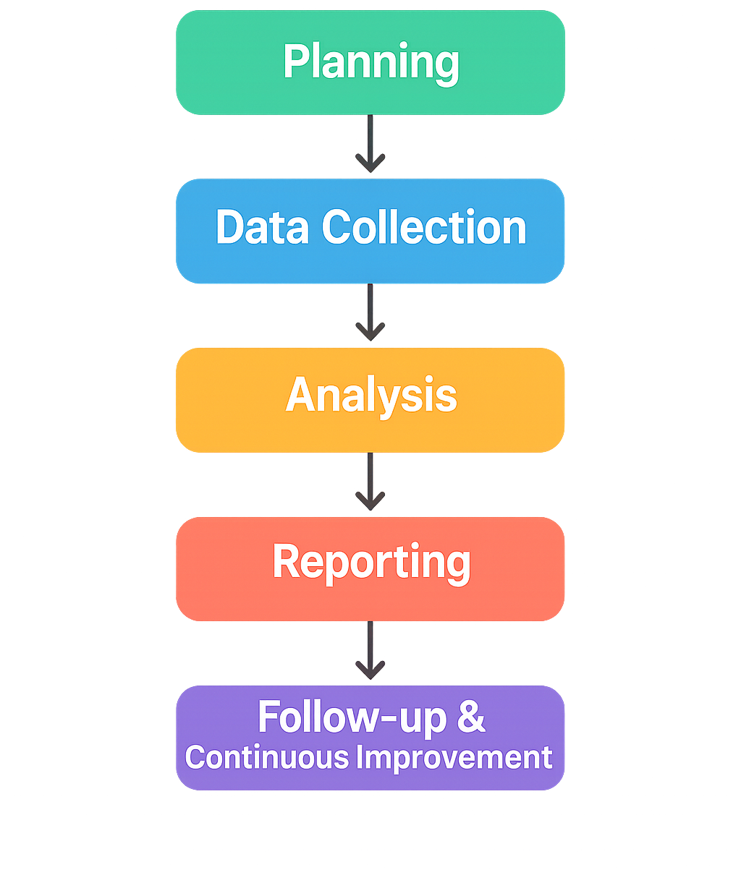
The 5 Phases of an Audit

Slide 20
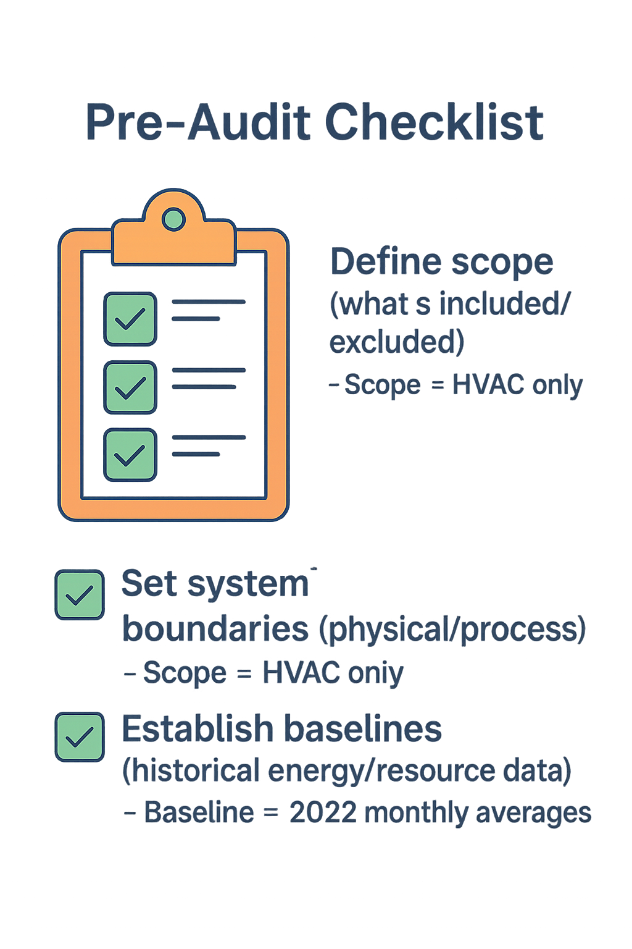
Pre-Audit Checklist
Checklist Items:
Define scope (what’s included/excluded)
Set system boundaries (physical/process)
Establish baselines (historical energy/resource data)
Example:

Slide 21
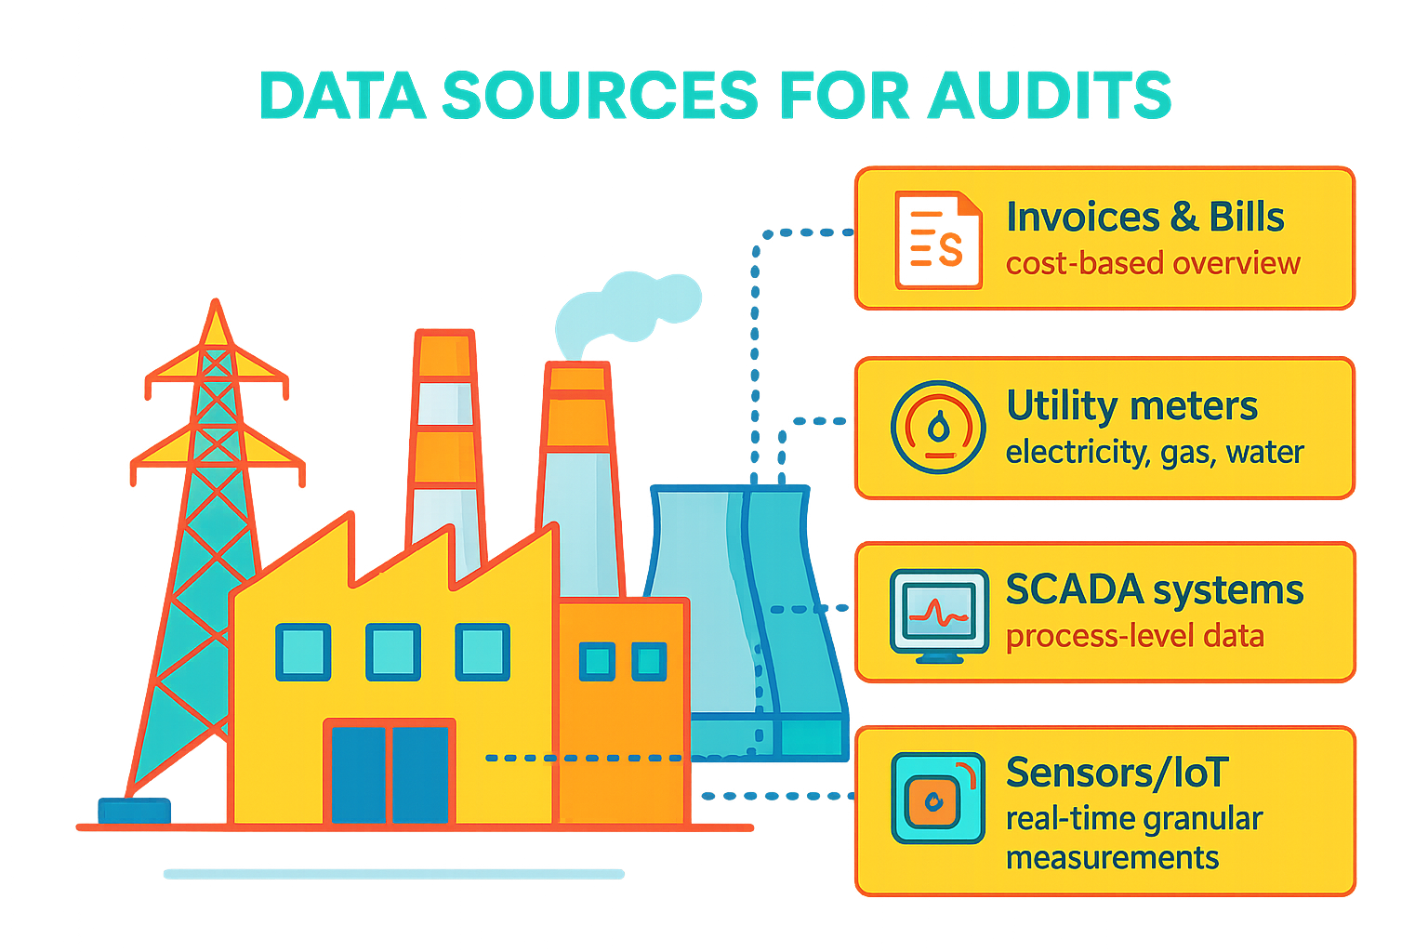

Slide 22
Audit Methodologies (Quantitative Focus)
Audit types
Walkthrough
✔ Quick, low-cost, visual inspection
✘ Limited accuracy, no measurements
Use case: Initial screening, small sites
Detailed audits
✔ Metered, data-driven, system-specific
✘ Requires time, instrumentation
Use case: Investment planning, ISO 50002 compliance
Quantification approaches
Normative
✔ Uses standards, BATs, SECs
✘ May miss local context
Examples: Energy norms for motors, HVAC, compressors
Measured
✔ Based on real metering, SCADA, logging
✘ Needs equipment and monitoring time
Examples: Real-time energy use of steam boilers
Modeled
✔ Simulates processes under scenarios
✘ Complex setup, requires calibration
Examples: EnergyPlus, Excel models, MATLAB

Slide 23
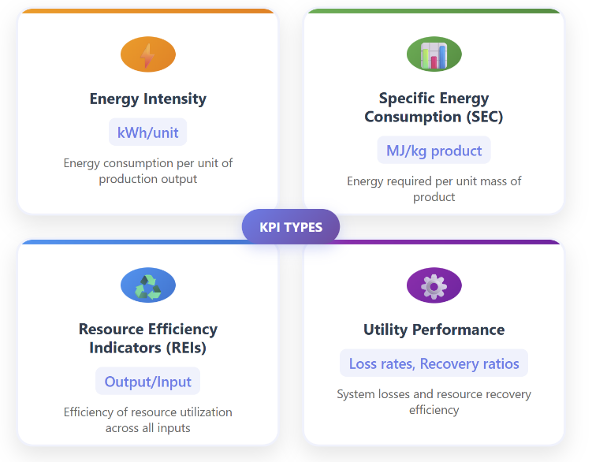
Key Performance Indicators (KPI)

Slide 24
How to Choose the Right KPI
Guiding Questions:
What does the client value most?
What is measurable now?
Do we need normalization (e.g., weather-adjusted)?
Tip: Use both absolute and relative indicators.

Slide 25
Real-Time vs Periodic Auditing
Feature | Real-Time Audits | Periodic Audits
Frequency | Continuous/automated | Scheduled (monthly/yearly)
Tools | Sensors, SCADA, cloud tools | Meters, site visits, reports
Strengths | Early detection, trending | Historical comparison
Weaknesses | Cost, complexity | Delayed response

Slide 26
Summary & Reflection
Which phase is most critical for audit success? Why?
The most critical phase for audit success is the Planning Phase.
Why the Planning Phase?
Defines the scope and objectives – Poorly defined goals lead to irrelevant or incomplete findings.
Selects system boundaries – Determines what is included/excluded in the audit.
Identifies baselines – Establishes the reference against which improvements are measured.
Determines data needs and collection strategy – Ensures that the right data is available and reliable.
Engages key stakeholders early – Builds commitment and access to operational insights.
A weak planning phase leads to wasted effort, poor-quality data, and results that are not actionable.

Slide 27
4. Resource and Energy Flow Mapping
Sankey diagrams
Mass & energy balances
Material Flow Cost Accounting (MFCA)
Process flow sheets
Utilities
Loss streams

Slide 28
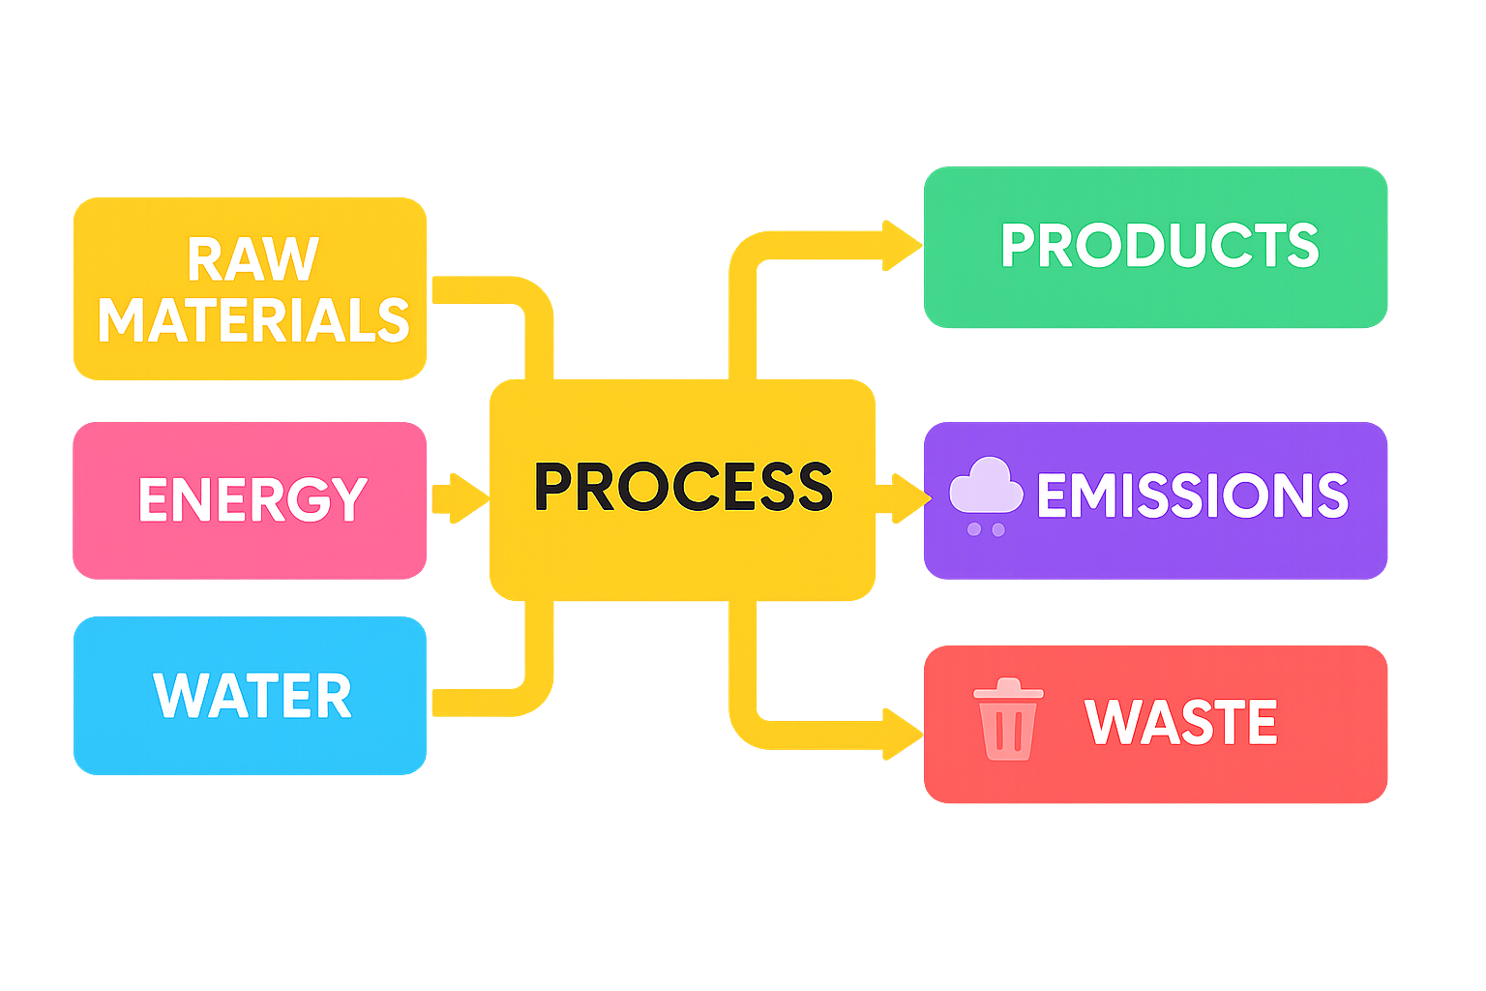
Introduction to Flow Mapping
Visualizing resource flows helps identify:
Major consumers (energy, water, materials)
Points of loss and inefficiency
Opportunities for savings and recovery
Essential for audits, ISO 50001, circular economy planning
Supports strategic decision-making and investment justification

Slide 29
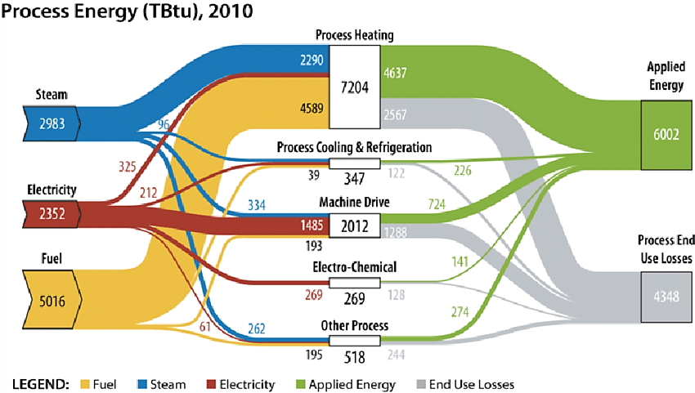
Sankey Diagrams: A Powerful Visual Tool
Flow diagram where arrow width is proportional to quantity (mass, energy)
Ideal for showing:
Energy input/output
Material use vs. Waste
Heat losses
Used in: energy audits, life cycle analysis,
policy modeling
Source: https://www.researchgate.net/profile/Parthiv-Kurup/publication/318873146/figure/fig3/AS:525604258234368@1502325228866/Sankey-diagram-of-process-energy-flow-in-US-manufacturing-sector-in-2010-EERE-2016.png

Slide 30
Exercise: Draw Your Own Sankey
Given:
Electricity input: 1000 kWh
Motors: 600 kWh
Heating: 200 kWh
Losses: 150 kWh
Recovered: 50 kWh
Task: Sketch approximate Sankey

Slide 31
Mass and Energy Balances: Core Audit Tools
Based on conservation laws:
Mass balance: ∑M_{in} = ∑M_{out} ± Δm_{storage}
Energy balance: ∑E_{in} = ∑E_{out} ± ΔE_{storage} + losses
Applies to systems like:
Boilers: Fuel + Air + Water → Steam + Flue gases + Heat losses
Chillers: Electricity + Refrigerant → Cooling + Heat rejection + System losses
Production lines: Raw materials + Energy → Products + Waste + Process losses
System boundary is important!

Slide 32
MFCA (Material Flow Cost Accounting):
Linking Flows with Costs
Tracks both:
Material and energy flows
Financial impacts of losses and inefficiencies
Key idea: Waste is not free
Standardized in ISO 14051
Helps visualize cost of non-product outputs

Slide 33
MFCA Example – Beverage Plant
Water and Bottle Loss
Case:
Inputs:10,000 L water/day @ 1.5 €/m³
2000 PET bottles @ 0.1 €/unit
Losses:8% water (leaks, rinsing)
5% bottles (damaged/rejected)
Calculate:
Cost of water lost per year
Cost of bottle loss per year
Cost of water lost: 800 L ⋅ 1.5€ ⋅ 365 = 438€
Cost of bottle loss: 100 units ⋅ 0.1€ ⋅ 365 = 3 650€

Slide 34
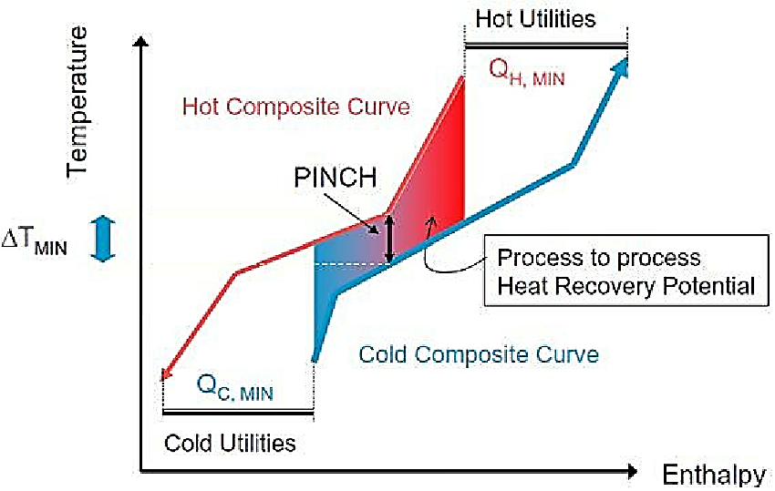
Flow Sheets:
Technical Mapping of Processes
Detailed diagrams showing:
Process steps
Energy & utility inlets
Material inputs/outputs
Waste and emission streams
Uses:
Design and engineering
Pinch analysis
Utility mapping for audits
Source: https://www.researchgate.net/figure/MER-targeting-procedure-with-cold-and-hot-CC_fig2_267544742

Slide 35
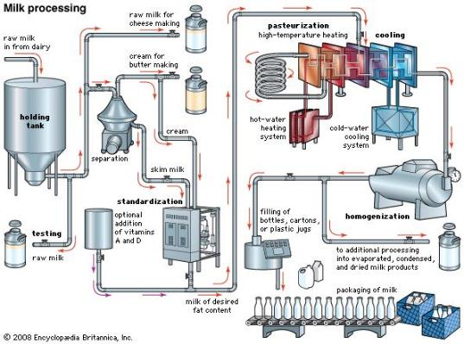
Flow Sheet Example – Dairy Plant
Case: Milk → Pasteurizer → Homogenizer → Filler → Cooler
Diagram includes:
Utilities: steam, cooling water, compressed air
Loss streams: rinse water, emissions
Optional: Include simple KPI tags (SEC, waste rates)
Source: https://cl.pinterest.com/pin/807411039477388349/

Slide 36
5. Performance Indicators and Efficiency Metrics
SEC, REIs, EnPI
Baselines
KPI hierarchy
Eco-efficiency, footprints

Slide 37
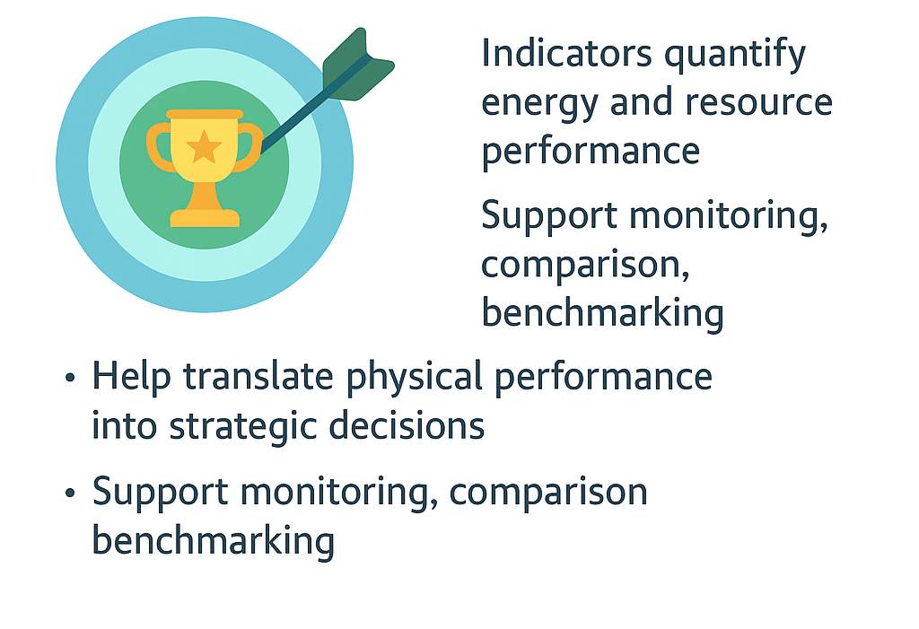
Introduction

Slide 38

Specific Energy Consumption (SEC)
Definition:
Simple, scalable, easy to benchmark
Often used in product-level or batch-level analysis
Limitation: Sensitive to volume fluctuations
= $\frac{ENERGY CONSUMED}{OUTPUT PRODUCED}$
SEC
e.g., kWh/unit, MJ/kg

Slide 39
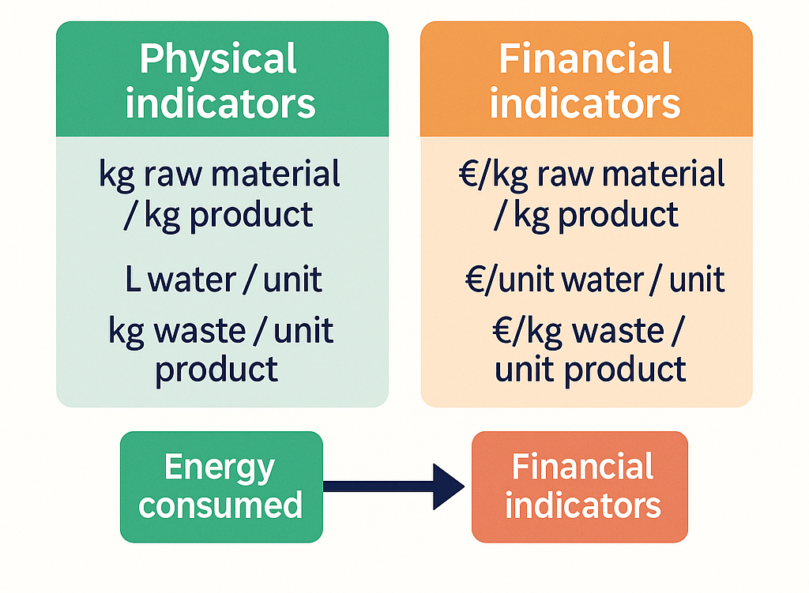
Resource Efficiency Indicators (REIs):
Beyond Energy Alone
Broader than SEC: covers materials, water, waste
Examples:
Material use efficiency: kg raw material / kg product
Water use efficiency: L water / unit
Waste per unit product: kg/unit
Often expressed in both physical and monetary units

Slide 40
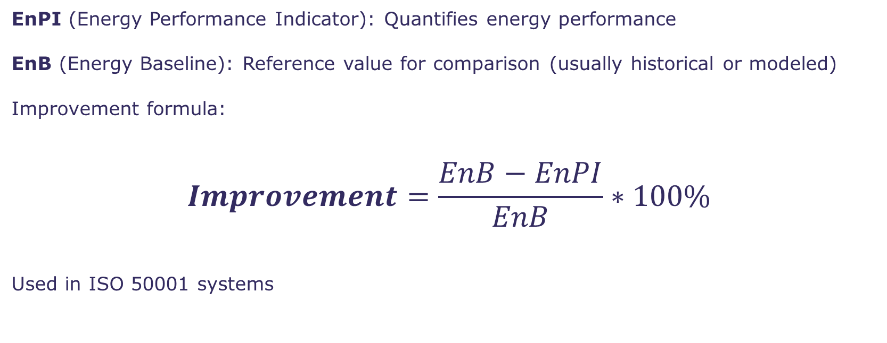
Tracking Changes Over Time
EnPI (Energy Performance Indicator): Quantifies energy performance
EnB (Energy Baseline): Reference value for comparison (usually historical or modeled)
Improvement formula:
$$Improvement=\frac{EnB−EnPI}{EnB}∗100\%$$
Used in ISO 50001 systems

Slide 41
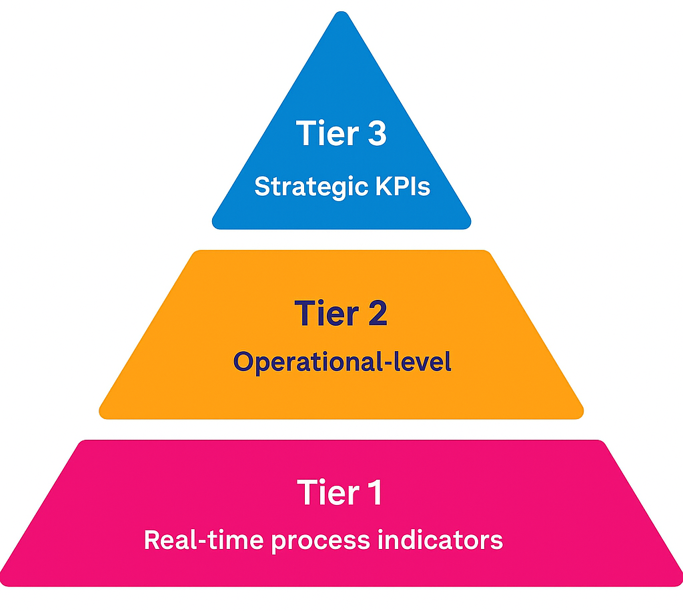
KPI Hierarchy:
From Real-Time to Strategic
Tier 1: Real-time process indicators (e.g., compressor kWh/h)
Tier 2: Operational-level (e.g., kWh/kg product, m³ water/kg)
Tier 3: Strategic KPIs (e.g., energy/GVA, carbon intensity)
Helps link shop floor data with top-level decisions

Slide 42
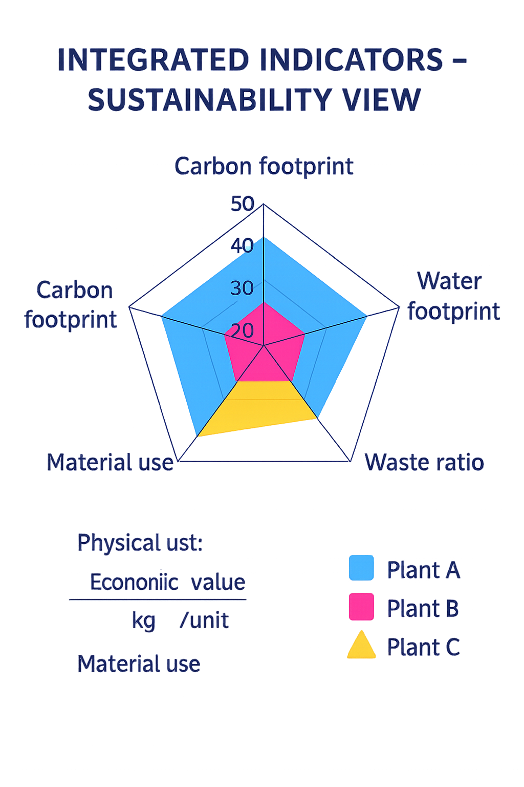
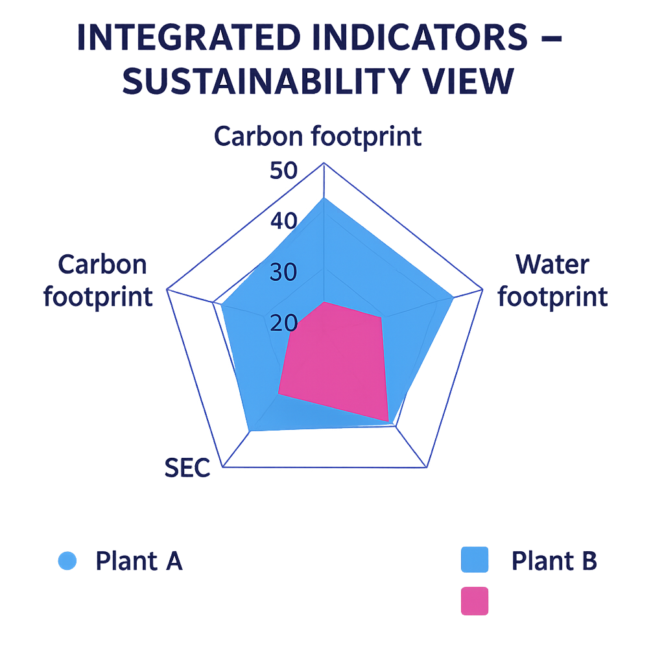
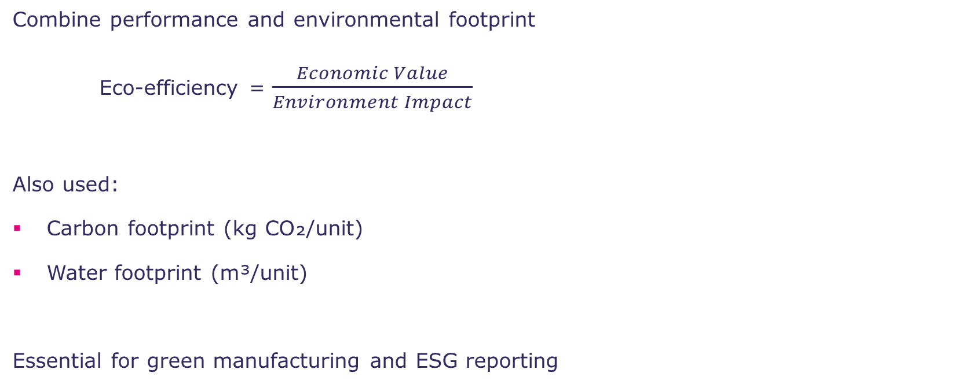
Integrated Indicators – Sustainability View
Combine performance and environmental footprint
Eco-efficiency = $\frac{Economic Value}{Environment Impact}$
Also used:
Carbon footprint (kg CO₂/unit)
Water footprint (m³/unit)
Essential for green manufacturing and ESG reporting

Slide 43
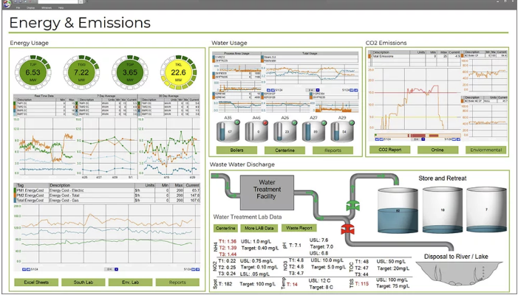
Indicator Dashboard Example
Real-world or mock-up showing SEC, REI, EnPI, footprint
Targets vs actuals
Traffic light or trend arrow system
Source: https://www.dataparc.com/blog/energy-management-manufacturing-monitoring-consumption/

Slide 44
Exercise / Quiz
Which KPI to Choose?
Task:
Case: Beverage factory wants to monitor energy and water use
Choose 2–3 KPIs to track daily and weekly
Bonus: Suggest an integrated KPI

Slide 45
6. Identifying and Evaluating Savings Opportunities
Heat Recovery,
Utilities,
Cross-cutting Technologies,
Measure Types,
Investment Metrics

Slide 46
Where Can We Save Energy and Resources?
Systematic identification is key to audits.
Opportunities exist in:
Process optimization
    Heat integration and waste heat recovery
    Process parameter optimization (temperature, pressure, flow rates)
    Equipment right-sizing and load matching
Utility system improvements
    Motor efficiency upgrades and variable speed drives
    Compressed air system optimization
    Steam system leak repairs and insulation
    HVAC controls and scheduling
Behavioral practices
Cross-cutting technology upgrades

Slide 47
Heat Integration & Waste Heat Recovery
Capture excess heat from:
Flue gases
Condensate
Cooling streams
Techniques:
Heat exchangers
Heat pumps
Cascade systems
Use for: preheating, hot water, drying

Slide 48
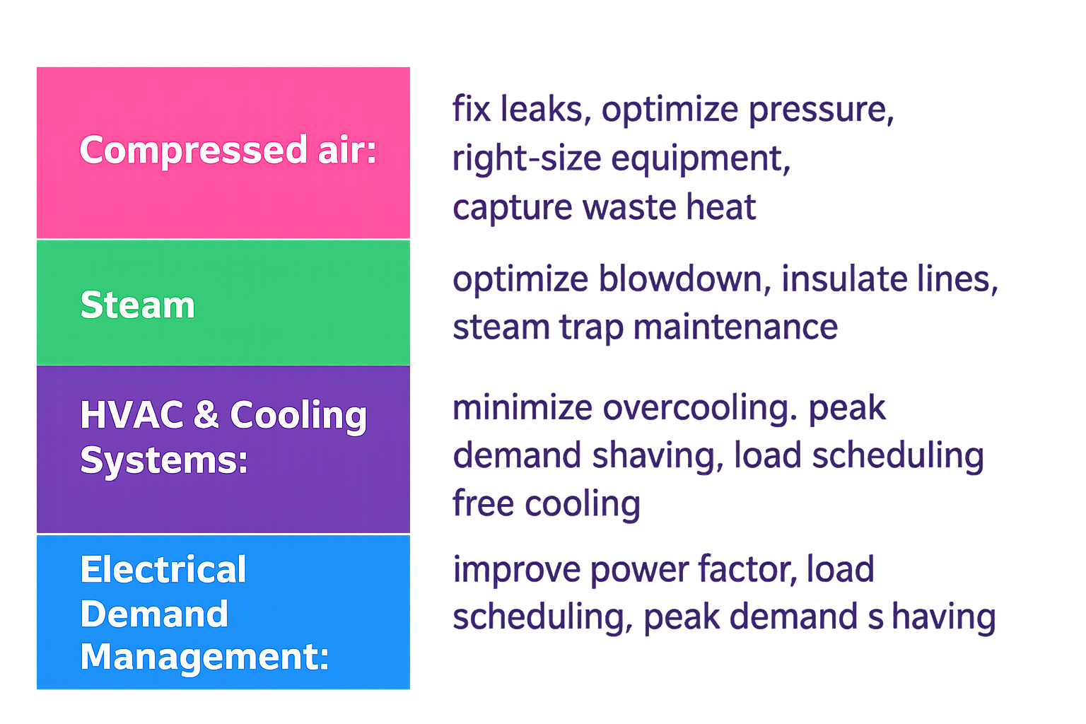
Utility Optimization:
Examples

Slide 49
Cross-Cutting efficiency measures
Apply across sectors:
Motors: VSDs, IE3/IE4 motors, right-sizing, maintenance
Lighting: LED conversion, daylight harvesting, occupancy sensors, task lighting
HVAC: zoning, occupancy control, smart thermostats, energy recovery ventilation
Pumps & compressors: optimize operation
Easy to benchmark and prioritize

Slide 50
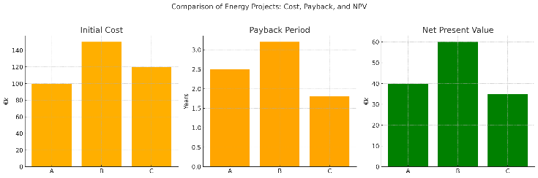
Evaluating Energy Projects: Financial Metrics
Common tools:
Payback Period: time to recover investment
NPV: present value of cash flows
IRR: rate of return
Used to prioritize competing measures

Slide 51
Case Example / Group Exercise
Rank the measures from 1 (highest priority) to 6 (lowest priority).
Justify your choices considering:
  Payback time
  Risk/complexity of implementation
  Strategic impact (e.g., comfort, visibility, ESG)
Which one would you implement first, and why?
Measure | Investment Cost (€) | Annual Savings (€) | Simple Payback (years) | Notes
LED Lighting Retrofit | 10,000 | 4,000 | 2.5 | Low risk, quick installation
VSD for Pumps | 25,000 | 7,500 | 3.3 | Medium risk, high savings potential
Steam Trap Maintenance | 5,000 | 2,500 | 2.0 | Quick win, low cost
Heat Recovery from Compressor | 18,000 | 6,000 | 3.0 | Moderate risk, reduces space heating needs
Compressed Air Leak Detection & Fix | 8,000 | 3,500 | 2.3 | Depends on maintenance culture
Building Insulation Upgrade | 30,000 | 6,000 | 5.0 | High investment, long-term benefit

Slide 52
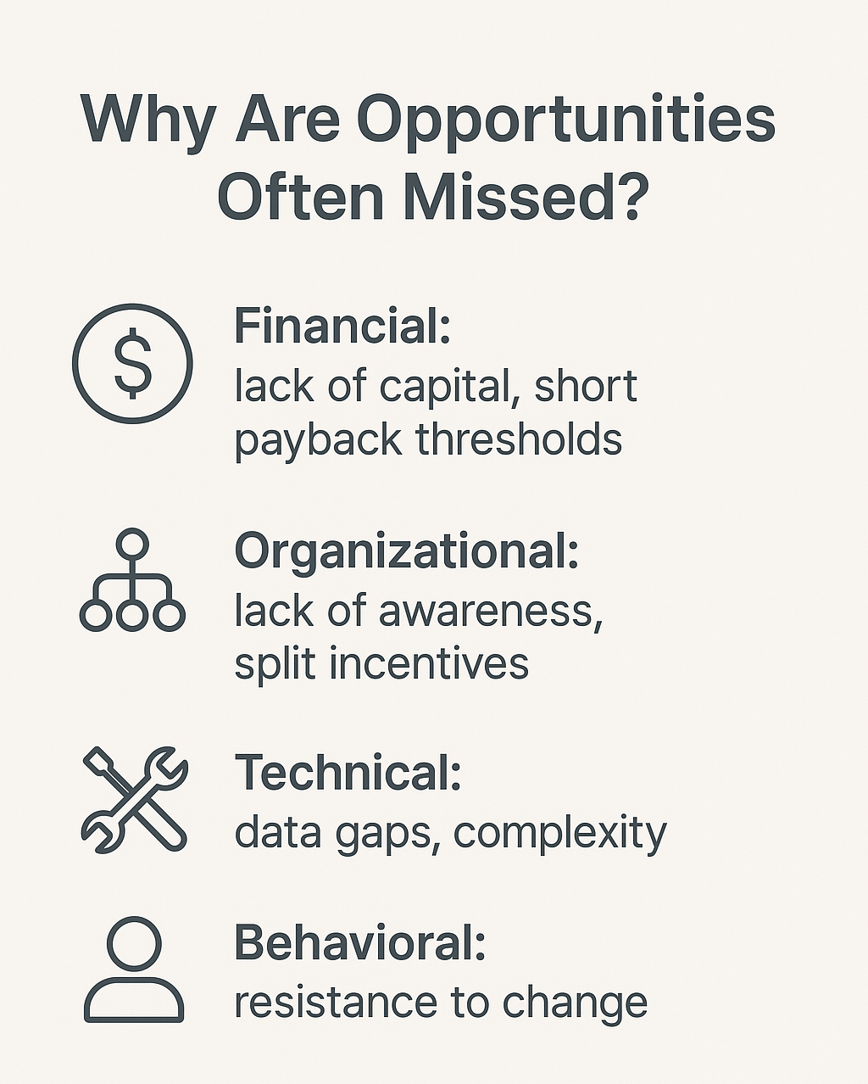
Barriers to Implementation

Slide 53
7. Reporting, Follow-Up, and Continuous Improvement
Findings
Communication
ISO
Monitoring
Feedback

Slide 54
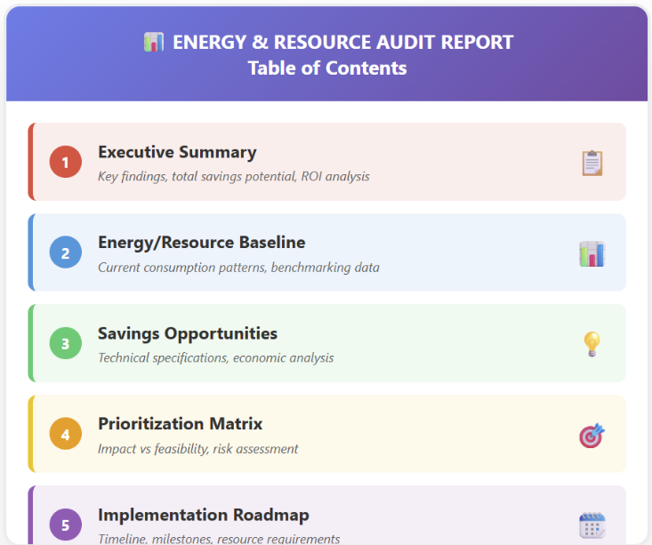
Structure of an Effective Audit Report

Slide 55
Communicating Audit Results
Tailoring communication to different audiences: management vs technical staff
Use of visuals: Sankey diagrams, summary tables, dashboards
Highlighting business impacts (cost savings, risk reduction, compliance)
Importance of clear, actionable language

Slide 56
Integration into Management Systems
Embedding audit results into continuous improvement loops
ISO 50001: energy planning, performance indicators, corrective actions
ISO 14001: resource efficiency in the environmental context
Linkage to operational and strategic plans

Slide 57
Monitoring and Feedback Loops
Establishing a monitoring plan: KPIs, frequency, responsibilities
Tools: SCADA, IoT, smart meters, energy dashboards
Feedback mechanisms: regular reviews, updates to action plans
Learning cycle: Plan → Do → Check → Act (PDCA)

Slide 58
References
Energy audits. (2020). Practical guide for more energy efficient business [https://leap4sme.eu/wp-content/uploads/2022/11/LEAP4SME_Energy_Audits_Booklet_web.pdf]
Kanoglu, M., & Gengel, Y. A. (2020). Energy efficiency and management for engineers. McGraw-Hill Education.
Kaya, D., Kılıç, F. Ç., Öztürk, H.H. (2021). Energy Management and Energy Efficiency in Industry. Springer Cham
Krämer, S., & Engell, S. (2018). Resource efficiency of processing plants: Monitoring and improvement. Wiley-VCH.
Roosa, S.A., Doty, S., Turner, W. C., Ph.D. Energy Management Handbook. (2018). River Publishers.

