Slide 1

Energy storage
Professor Anna Volkova, PhD

Slide 2
Table of contents
Why is energy storage necessary? Before, now - relevance of the problem
Energy storage possibilities
  Gravitational energy storage
  Electricity storage
  Heat storage
  Other storage possibilities
  Parameters of energy storage
Parameters of energy storage
  https://rohe.geenius.ee/blogi/eesti-energia-blogi/kuidas-toimib-moodsa-tehnoloogiaga-energia-salvestamine-vaata-energiasalvestamise-telgitagustesse/
Heat and electricity storage technologies (possibilities, advantages, disadvantages). Examples (selection of so-called case study solutions). Exercise (Anna Volkova): Sizing a heat storage tank to smooth out fluctuations in daily domestic hot water consumption

Slide 3
Idea of storage
Energy storage is accomplished by devices or physical media that store some form of energy to perform some useful operation at a later time.
Storing energy allows humans to balance the supply and demand of energy. Energy storage systems in commercial use today can be broadly categorized as mechanical, electrical, chemical and thermal.

Slide 4
Why energy storage is needed
Improve Reliability & Resilience
  Energy storage can provide backup power during disruptions.
  Storage provides flexibility for the grid, to ensure uninterrupted power/heat to consumers, whenever and wherever they need it.
Integrate Diverse Resources
  Allows to integrate such renewable energy sources, as wind and solar, by storing excess energy when the wind is blowing and the sun is shining and delivering it when the opposite is happening.
  But storage can also support the efficient delivery of electricity for inflexible, baseload resources. When demand changes quickly, and flexibility is required, energy storage can inject or extract electricity /heat as needed to exactly match load – wherever, and whenever it’s needed. Energy storage is an enabling technology. When the sun isn’t shining or the wind isn’t blowing, energy storage can be there. When demand shifts and baseload resources can’t react quickly enough, energy storage can be there.
Reduce Environmental Impacts
  Energy storage enables electricity or heat to be saved for a later, when and where it is most needed. This creates efficiencies and capabilities for the energy systems -including the ability to reduce greenhouse gas (GHG) emissions.
  By introducing more flexibility into the energy system, energy storage can help integrate more solar, wind and distributed energy resources.
  Thermal energy storage allows to prolong stabile full-load biomass CHP operation, thus decreasing peak gas boilers use and electricity production from fossil fuel, saving GHG emissions.

Slide 5
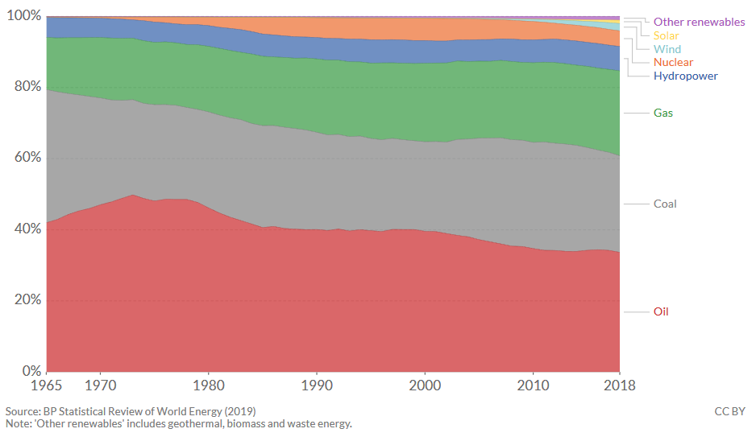
Renewable energy soruces increase: Energy consumption by source, World

Slide 6
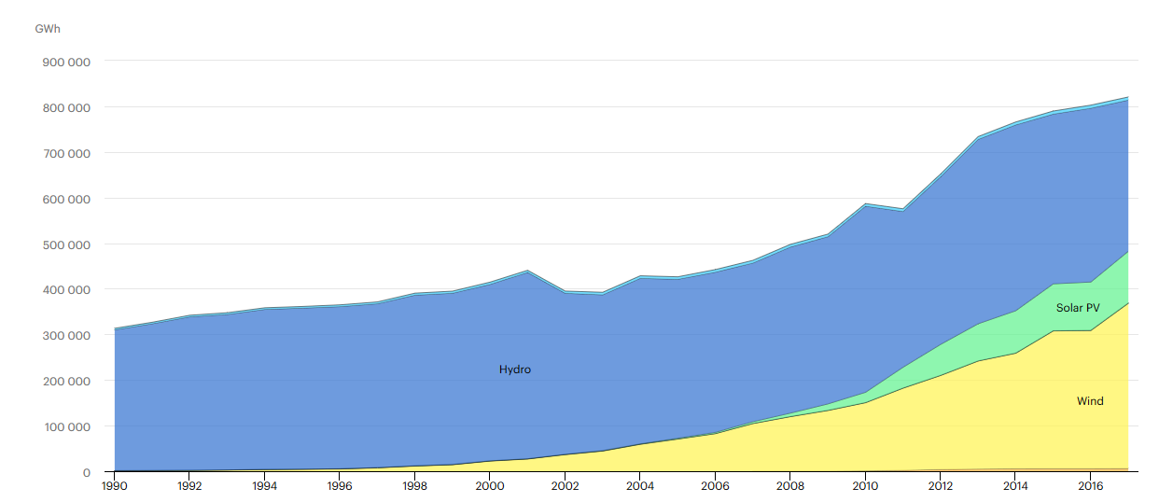
Renewable electricity generation by source (non-combustible), European Union - 28 (1990-2017)

Slide 7
Energy storage technologies
Mechanical energy storage
Chemical energy storage
Sensible heat storage
Electrochemical energy storage
Pumped hydroelectric energy storage
Compressed air energy storage
Thermochemical energy storage
Thermal energy storage
*Batteries (Lead-Acid , Lithium, Lithium-Ion)
*Fuel Cells
* Flow Batteries
Chemical heat pumps
Latent heat storage
*water accumulator tank
*molten salt storage
*aquifer
*borehole
Phase change materials
Pumped hydroelectric stations
*diabatic CAES
*adiabatic CAES *near-isothermal CAES
Direct electrical energy storage
Supercapattery
Supercapacitors
Superconducting magneticenergy storage
SMES devices
Gyroscope energy storage
Flywheel
Energy storage technologies

Slide 8
Energy storage technologies
Mechanical energy storage
Chemical energy storage
Sensible heat storage
Electrochemical energy storage
Pumped hydroelectric energy storage
Compressed air energy storage
Thermochemical energy storage
Thermal energy storage
*Batteries (Lead-Acid , Lithium, Lithium-Ion)
*Fuel Cells
* Flow Batteries
Chemical heat pumps
Latent heat storage
*water accumulator tank
*molten salt storage
*aquifer
*borehole
Phase change materials
Pumped hydroelectric stations
*diabatic CAES
*adiabatic CAES *near-isothermal CAES
Direct electrical energy storage
Supercapattery
Supercapacitors
Superconducting magnetic energy storage
SMES devices
Gyroscope energy storage
Flywheel
Energy storage technologies
For thermal energy storage
For electricity storage

Slide 9
Application of different types of energy storage
Energy storage is very important part of future sustainable smart energy system, including smart electricity grids and smart thermal grids.
For efficient energy system operation different types of energy storage should be implemented
Implementation of different types of energy storage is important in the conditions of fluctuating heat and electricity generation and heat and electricity consumption
Some examples of energy storage integration are below

Slide 10
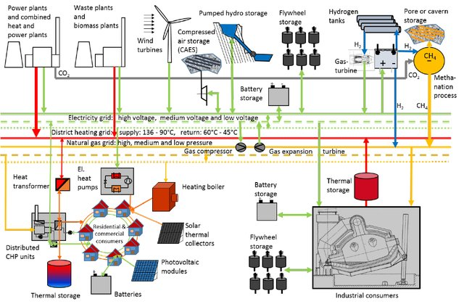
Energy storage importance in sustainable energy system

Slide 11
Another example of energy storage implementation into energy systems

Slide 12
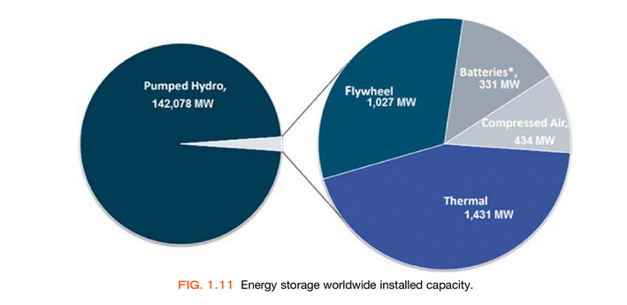
Energy storage Worldwide installed capacity
Pumped hydro technologies are the most used type of energy storage

Slide 13
Energy storage characteristics
Storage capacity: maximum capacity a device is capable of deliviring by returning stored energy to the grid. Typically measured in kW and MW
Energy capacity: The total amount of energy that a storage device can store. Typically measured in kWh and MWh
Efficiency: The maximum amount of energy that can be recovered from a storage device when it is discharged, as a ratio of the energy initially stored
Charging speed: The time needed to charge an energy storage unit. Typically measured in s, min, hours, months.
Discharge speed: time needed to discharge energy storage unit
Energy losses: heat losses or electricity losses. Typically measured in kWh, MWh or %

Slide 14

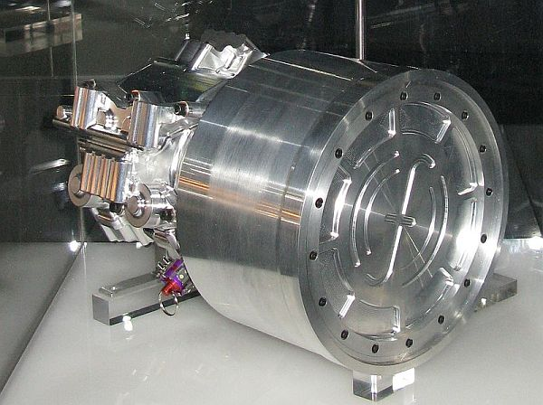
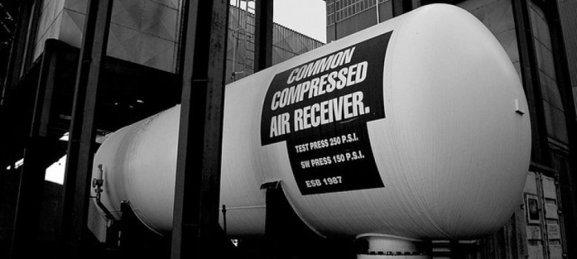
Mechanical energy storage

Slide 15
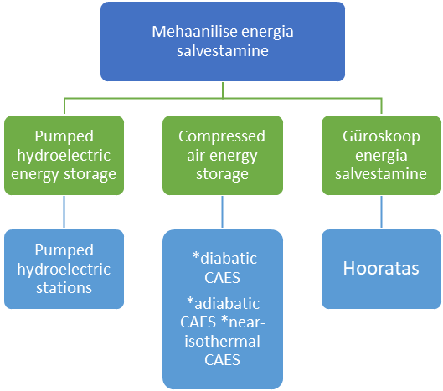
Classification of mechanical energy storage
Mechanical energy storage
Gyroscope energy storage
Flywheel

Slide 16
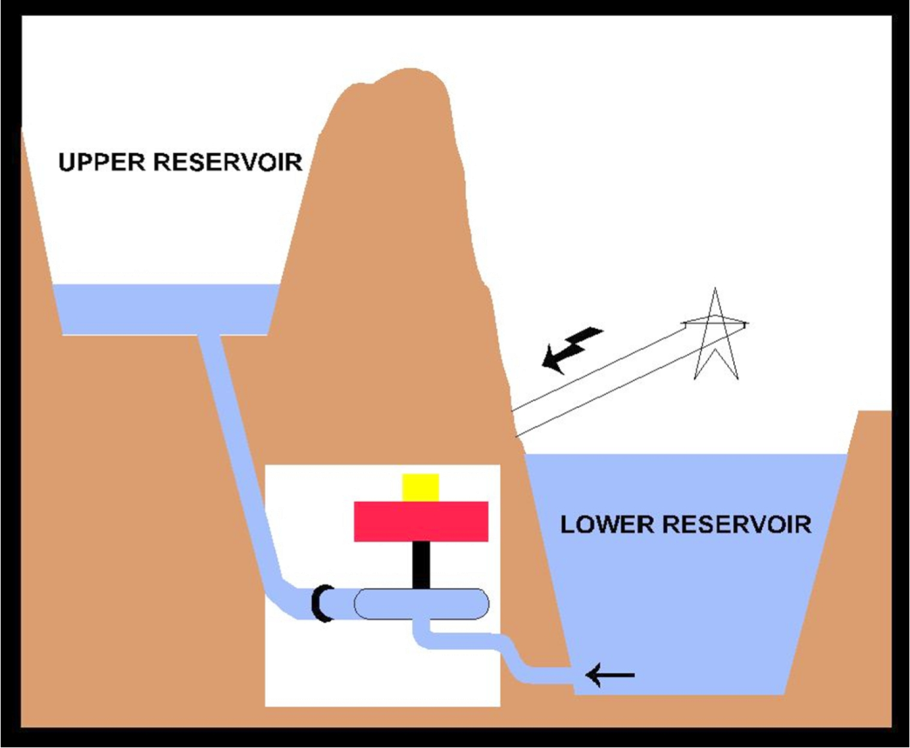
Pumped Hydroelectric Storage (PHS)
Used for load balancing of energy
Water is pumped up in elevation during time of low demand
Water flows back down during times of high demand
Turbines recapture the energy
Video 1 Video 2
Pumped hydroelectric storage (PSH), or pumped hydroelectric energy storage (PHES), PSH along with conventional hydroelectric power plants, is the most advanced and widely used form of energy storage and generation management today. PHES was first used in Italy and Switzerland in the 1890’s. PSH is the most widely used large-scale form of energy storage today.

Slide 17

Pumped Hydroelectric Storage (PHS)
Appropriate geographical conditions are needed (mountainous or upland areas)
Fast response speed, up to 10 minutes from complete standstill to full power in both operating modes. From standby mode, full power can be achieved in 10 to 30 seconds
70-85% of electrical energy is recovered
Energy loss due to evaporation and Pump/generator inefficiency
Currently the most cost-effective way to store large amounts of electricity
Low energy density calls for large bodies of water
Never used in portable technology
Artificial and natural reservoirs

Slide 18
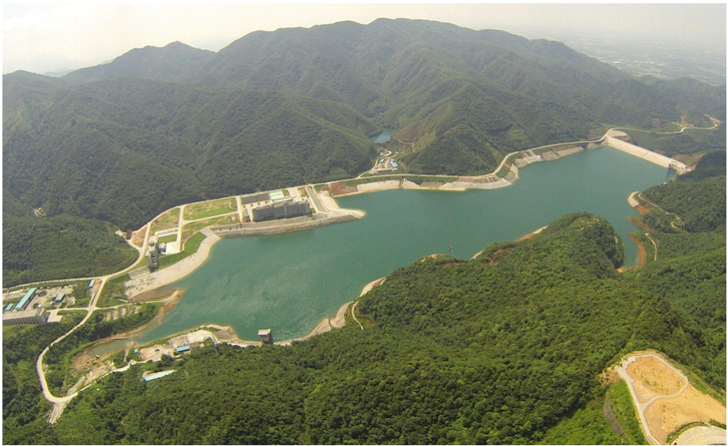

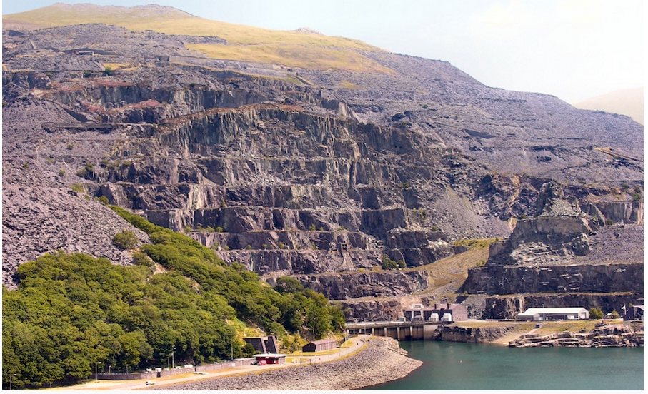
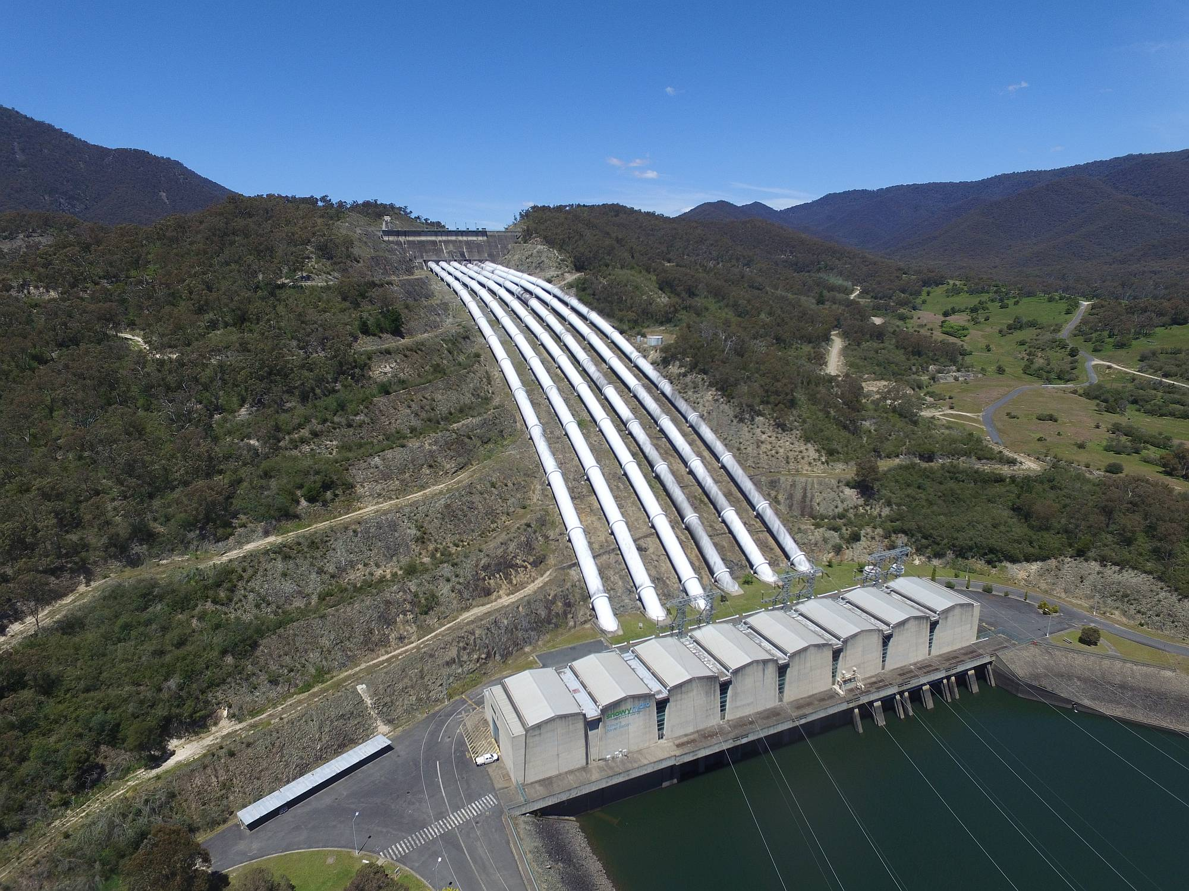
Largest Hydro power storage
China, Huizhou Pumped storage (2, 448 MW):
United Kingdom, Dinorwig (1,728 MW) Dinorwig power station is a pumped storage hydroelectric scheme on the edge of the Snowdonia national park in Gwynedd, North Wales. An important feature of Dinorwig is that it has been designed to assist restarting the National Grid on the occasion of a complete power failure. The plant runs on average at between 70 and 80% efficiency –i.e.it uses 20% more electricity than it actually produces.
Australia, Snowy Mountains (4,500 MW, 7 sites) Snowy Mountains hydroelectric scheme is one of the most complex integrated water and hydro-electric power schemes in the world and is listed as a "world-class civil engineering project" The scheme interlocks seven power stations and 16 major dams through 145 km of transmountain tunnels: https://www.youtube.com/watch?v=IDSSQaHeFu8

Slide 19
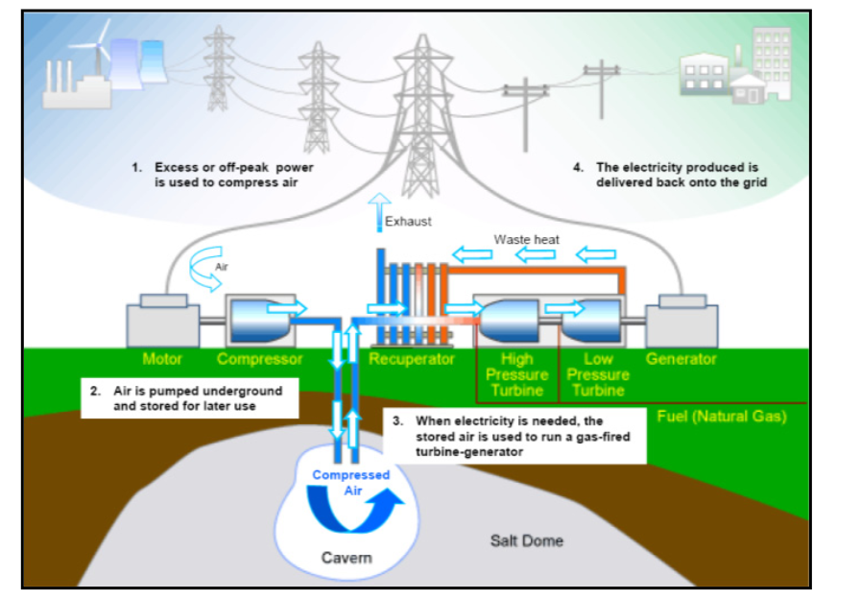
Compressed Air Energy Storage (CAES)
First patent - 1949, in use since 1979
Energy storage occurs by mechanically compressing air with compressors, which is directed into a natural gas-tight underground tank
Containers: specially constructed airtight chambers; existing natural gas-tight spaces; salt chambers, porous rocks, etc.
The release of air pressure drives an air turbine, which is mechanically connected to a generator via a shaft and produces electrical energy from the potential energy

Slide 20
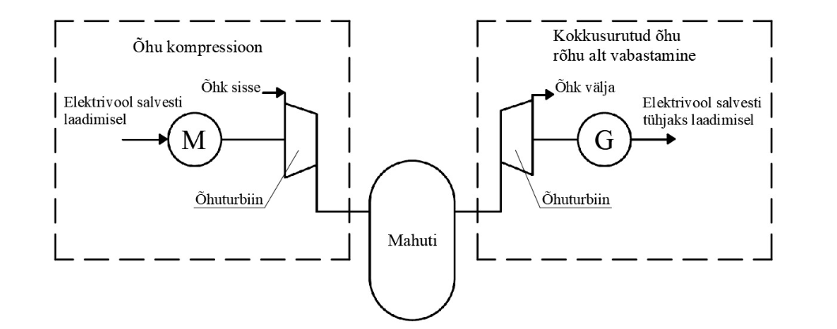
Compressed Air Energy Storage working principle
Air compression
Air decompression
Air in
Air out
Electric current
charging
Electric current discharging
Air turbine
Air turbine
Tank
M – electric motor
G – generaator
During times of low demand electricity compresses air
During times of peak demand compressed air is heated and released

Slide 21

Map of compressed air facilities, CAES assessments, projects and operational facilities around the world.
Source: Mechanical Systems for Energy Storage – Scale and Environmental Issues. Pumped
Hydroelectric and Compressed Air Energy Storage, 2019

Slide 22
Application of CAES
Price arbitrage.
Peak shaving and demand-side management – using CAES to manage the demand-side energy by storing at the lower price and releasing the stored electrical energy during peak-demand times.
Integration of more renewable power generation plants – enabling the seamless integration of renewable power generation plants into the existing power network to provide stable power grids while solving the problems of the inherent intermittence and instability of renewable power generation.
Applications to smart grids and wind energy networks – playing a role in both supply and consumption.
Applications to compressed air engines – compressed air energy being converted into other forms of mechanical energy through compressed air engines.
Applications in other fields – including in the event of power supply failure, CAES acting in black-start capacity, rapidly providing power to important users.

Slide 23
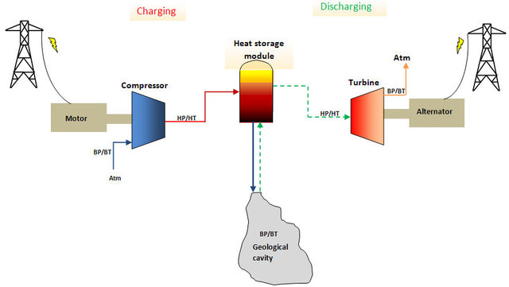
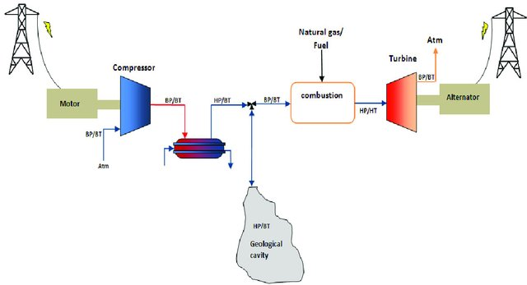
Types Of CAES
Adiabatic storage
  Heat from compression is captured and stored in a solid or liquid
  Hot Oil 300⁰C
  Molten Salt 600⁰C
  Heat is reincorporated during release
  Close to 100% efficiency
  No utility scale plants
Diabatic storage
  Heat is lost through cooling
  Natural gas is burned to reheat compressed air
  Very inefficient 38-68%
  Uses 1/2 gas of an all gas plant
Source: A.Kere Dynamic Behavior of a Sensible-heat based Thermal Energy Storage, Energy Procedia, 2014

Slide 24
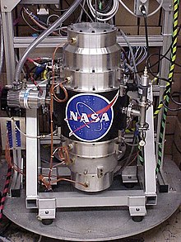
Flywheel Energy Storage Systems (FESS)
Flywheels are an old technology that has recently begun to find use in modern energy storage applications for the efficient delivery of power, rapid absorption and reuse of energy and stabilisation of electricity grid
Flywheel energy storage is based on the principle of a rotating body that stores electrical energy by converting it into mechanical energy. The energy in a flywheel energy storage is stored as rotational kinetic energy.
The storage is charged from the mains or another electrical energy source and when fully charged the flywheel's rotational speed increases. When discharged under load the speed decreases and the kinetic energy is converted back into electrical energy. The energy is transferred from electrical to mechanical and vice versa by means of an electric motor-generator
A flywheel energy storage system consists of three parts:
  flywheel
  engine/generator
  converter
  Additional information: Video

Slide 25
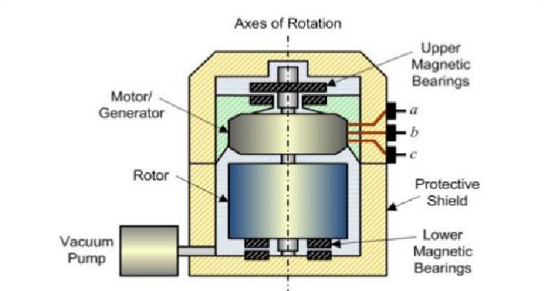
Flywheel Energy Storage System

Slide 26
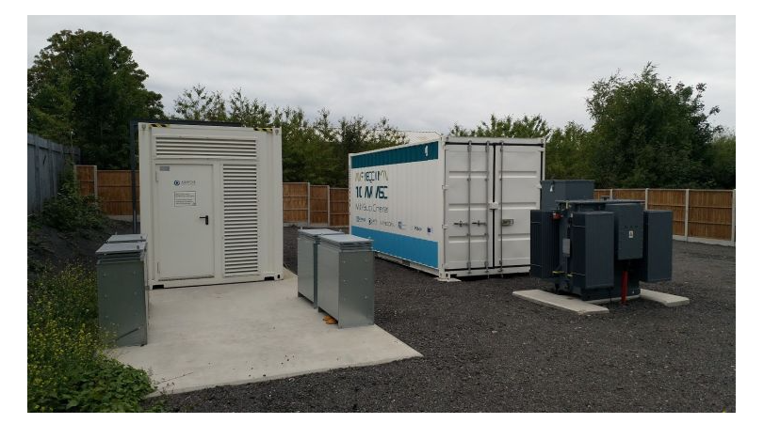
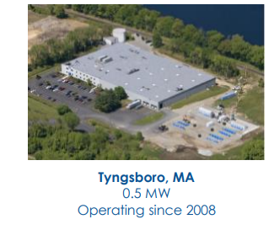
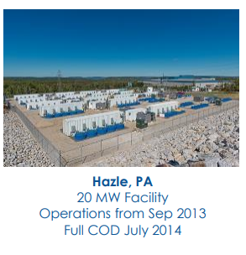
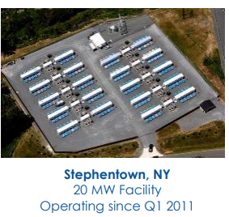
USA
University of Sheffield, 2.5 MW hybrid- lead-acid battery +flywheel (2020)
USA
USA

Slide 27
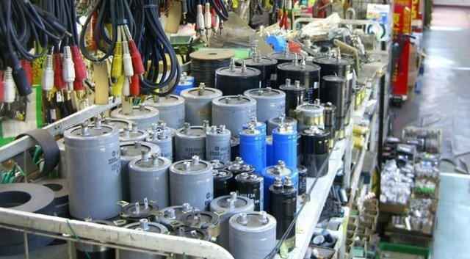
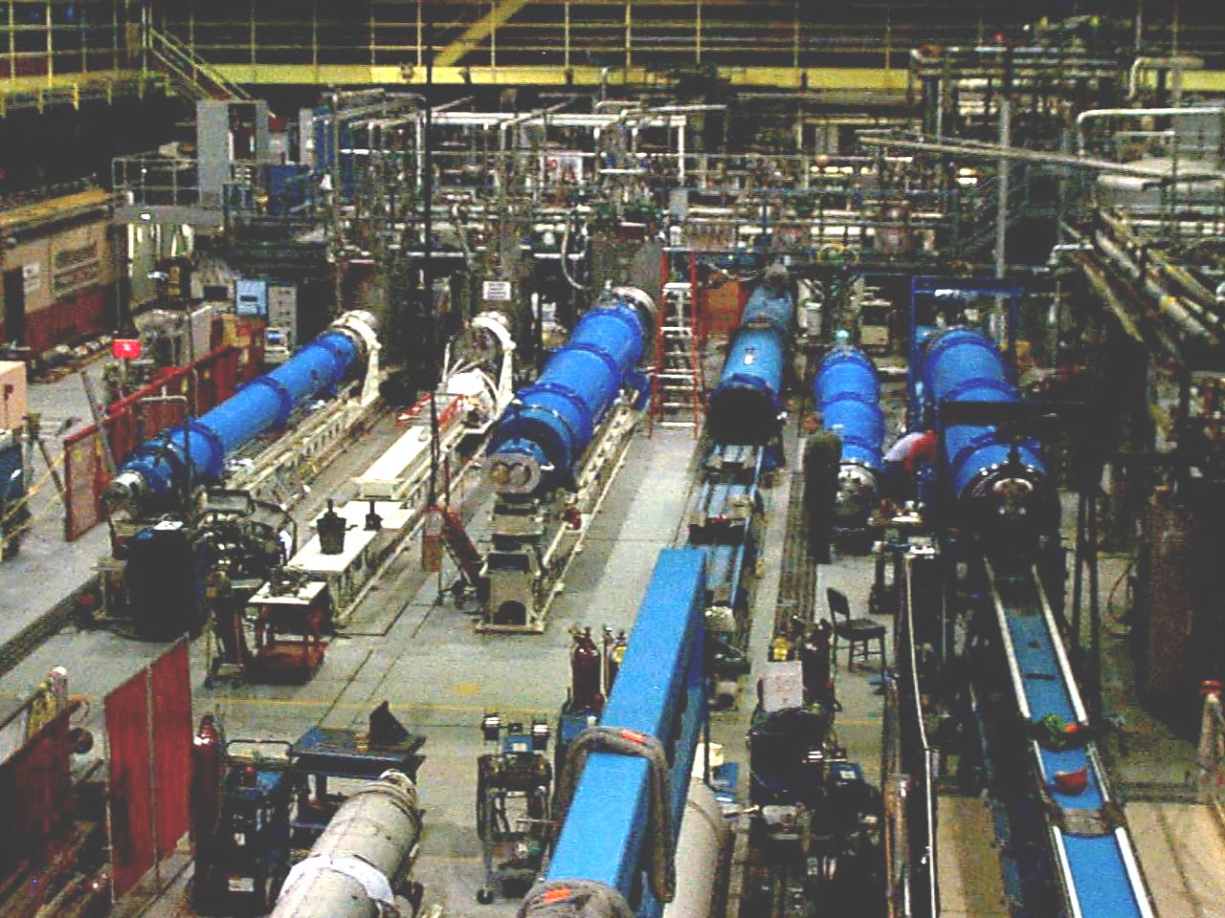
Electrical energy storage

Slide 28
Electrical energy storage
Direct Electrical energy storage
Supercapattery
Superconducting magnetic energy storage
Supercapacitors
SMES devices

Slide 29
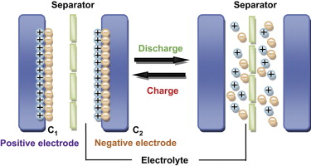
Supercapacitor energy storage
Supercapacitors (SC’s) are energy storages having similarities with both batteries and conventional capacitors
  Unlike batteries, SC’s store electrical energy, not chemical energy.
  Unlike capacitors SC’s contain moving ions.
Supercapacitor Energy Storage, SCES working principle is to absorb or desorb electrical charges during charging and discharging cycles
Supercapacitors are characterized by high charging and discharging currents, low maintenance requirements, and long lifespan.
The capacitor has low leakage currents, which allows it to store energy for a long time, and the efficiency exceeds 95%.

Slide 30
Specialties of supercapacitor
Advantages of a supercapacitor:
  Supercapacitors can be fully charged and discharged in seconds, even in several degrees below zero;
  Almost linear voltage curves enables very accurate state of charge (SoC) estimations;
  SC’s can be charged and discharged even up to a million times.
Disadvantages of a supercapacitor:
  SC’s have very low energy densities vs. batteries;
  SC’s have very high self-discharge vs. batteries

Slide 31
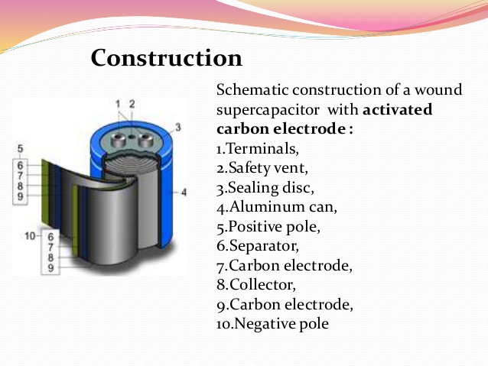
Supercapacitor construction

Slide 32
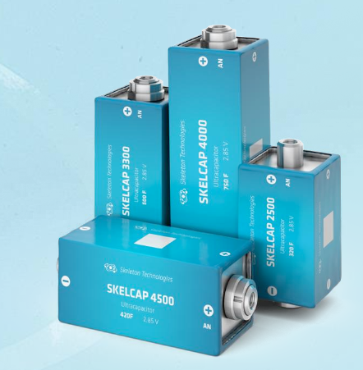
Applications
Regenerative braking
Releasing the power in acceleration
Starting power in start-stop systems
Regulate voltage to the energy grid
Capture power when lowering loads and assisting when loads are lifted
Back-up power in any application where quick discharge (or charge) is required

Slide 33
Superconducting Magnetic Energy Storage
Superconducting Magnetic Energy Storage (SMES) consist of a superconducting coil, a power supply system, and a cooler and vacuum device designed to keep the coil at extremely low temperatures.
Superconducting magnet
Liquid helium/
nitrogen
Cryogenic refrigerator
Helium/Nitrogen
Pump
Cryostat

Slide 34
Applications of SMES
System stability: SMES can reduce low frequency oscillations to enhance transmission capacity and boost voltage stability.
Power quality: SMES systems can offer energy for flexible AC transmission (FACTS).
Paper industry
Motor vehicle assembly
Petrochemical Refineries
Chemical & pharmaceutical companies

Slide 35
Advantages of SMES
Common Challenges
SMES systems have the ability of fast response
They can switch from charge to discharge state (vice versa) within seconds.
The absence of moving parts and high cycling efficiency are some additional advantages
It can be deployed in places where other technologies such as pumped hydro or compressed air are not feasible
Main drawback of the SMES technology is the need of large amount power to keep the coil at low temperature, combined with the high overall cost for the employment of such unit.
To achieve commercially useful levels of storage, around 1 GW.h (3.6 TJ) a SMES installation would need a loop of around 100 miles (160 km).
Another problem is the infrastructure required for an installation. Until room temperature superconductors are found, the 100 mile (160 km) loop of wire would have to be contained within a vacuum flask of Helium/liquid nitrogen. This in turn would require stable support, most commonly envisioned by burying the installation.

Slide 36
Chemical energy storage
Chemical energy storage
Electrochemical
energy storage
Thermochemical energy storage
*Batteries (Lead-Acid, Lithium, Lithium-Ion)
*Fuel Cells
* Flow Batteries
Chemical Heat Pumps

Slide 37
Electrochemical energy storage
Electrochemical energy storage is a method used to store electricity under a chemical form. This storage technique benefits from the fact that both electrical and chemical energy share the same carrier, the electron. This common point allows to limit the losses due to the conversion from one form to another.
Simple chemical reaction between two metallic materials A and B to form an electronically conducting product AB : It is necessary to consider: 1. Driving forces that cause electrochemical transduction in electrochemical cells 2. Major types of reaction mechanisms that can occur
For reaction product phase AB to grow, atoms of either A or B must move (diffuse) through it to reach other side to come into contact with other reactants.
Example:
  A moves through the AB phase to the B side, additional AB will form at AB/ B interface.
  As B is consumed, AB/ B interface moves right.
  Amount of A on the A side has decreased, AB/ B interface moves left. AB grows in width in the middle

Slide 38
Electrochemical energy storage. Types
A battery consists of one or more voltaic cells in series. When a battery is
discharged, the chemical energy stored in it is converted to electrical energy
in the external circuit.
A fuel cell is a voltaic cell in which the reactants supplying the energy are
not stored in the cell itself but rather are continuously supplied to the
electrodes from an external source.
A flow battery is similar to a conventional secondary battery in that it can
be repeatedly charged and discharged. However, the energy storage material
is dissolved in the electrolyte as a liquid and so can be stored in external
tanks.

Slide 39
Batteries
At present batteries are produced in many sizes for wide spectrum of applications. Supplied powers move from W to the hundreds of kW
Common commercially accessible secondary batteries according to used electrochemical system can be divided to the following basic groups:
    standard batteries (lead acid, Ni-Cd)
    modern batteries (Ni-MH, Li–ion, Li-pol),
    special batteries (Ag-Zn, Ni-H₂),
    flow batteries (Br₂-Zn, vanadium redox)
    high temperature batteries (Na-S, Na–metalchloride)
    Additional information

Slide 40
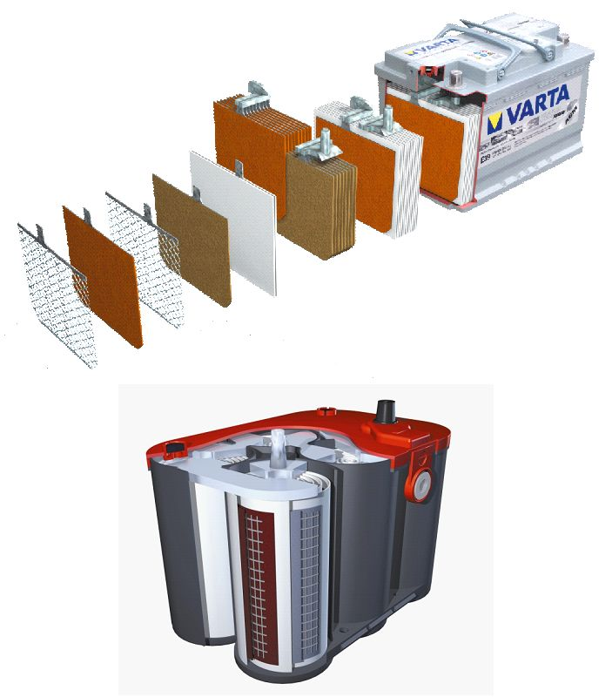
Standard batteries. Lead acid batteries
Lead-acid batteries are suitable for medium and large energy storage applications because they offer a good combination of power parameters and a low price.
Lead acid battery when compared to another electrochemical source has many advantages:
  low price and availability of lead,
  good reliability, high voltage of cell (2 V),
  high electrochemical effectivity (efficiency 75-85%),
  cycle life is from several hundreds to thousands of cycles.
  Thanks to these characteristics is now the most widely used secondary electrochemical source of electric energy and represent about 60% of installed power from all types of secondary batteries. Its disadvantage is especially weight of lead and consequently lower specific energy in the range 30-50 Wh/kg.
Construction of lead acid (LA) battery depends on usage. It is usually composed of some series connected cells. Main parts of lead acid battery are electrodes, separators, electrolyte, vessel with lid, ventilation and some other elements.

Slide 41
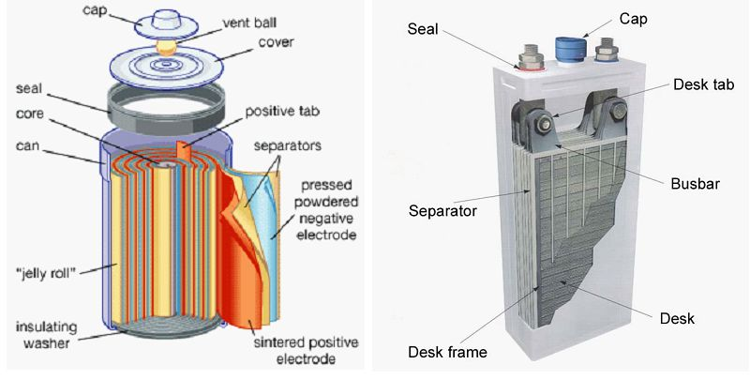
Standard batteries. (NiCd) batteries
They are main representative of batteries with positive Nickel electrode; other possible systems could be system Ni-Fe and Ni–Zn, Ni-H₂ or Ni–MH.
The overall efficiency of NiCd batteries is generally between 60% and 70% under normal conditions, but the low efficiency is compensated by a relatively long lifespan, which can reach 10-15 years depending on the application.
Scheme of spiral wound and prismatic construction of Ni-Cd battery

Slide 42
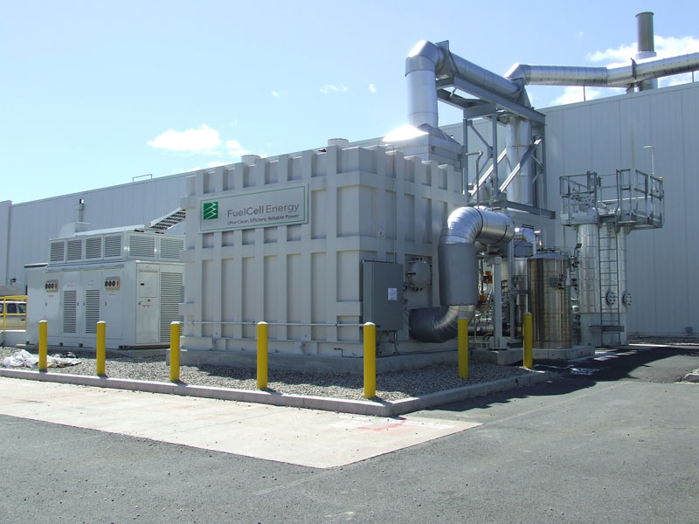
Fuel Cells for energy storage
In addition to the option of using fuel cells for primary power generation, they can also be used reversibly for energy storage. In this process, excess electricity is used to electrolyze water and/or carbon dioxide to produce fuel for later consumption. This excess electricity can come from a renewable source, such as wind or solar, or it can be excess grid electricity during off-peak hours.
They have advantages such as high energy density, deep cycle ability, low self-discharge and inherently decoupled power and energy capacity in a similar manner to flow batteries (see later). Unfortunately, additional catalyst materials such as RuO₂ or IrO₂ are required for the oxygen evolution reaction complicating the design and increasing the cost. Further-more, they are subject to rapid degradation due to the high potentials used in the regenerative mode. They are also very expensive and they generally show a lower round-trip efficiency than competing battery technologies.

Slide 43
Flow batteries
Flow batteries store and release electrical energy with help of reversible electrochemical reactions in two liquid electrolytes. An electrochemical cell has two loops physically separated by an ion or proton exchange membrane.
Electrolytes flow into and out of the cell through separate loops and undergo chemical reaction inside the cell, with ion or proton exchange through the membrane and electron exchange through the external electric circuit.
There are some advantages to using the flow battery when compared with a conventional secondary battery. The capacity of the system is possible to scale by increasing the amount of solution in electrolyte tanks.
The battery can be fully discharged and has little loss of electrolyte during cycling. Because the electrolytes are stored separately, flow batteries have a low selfdischarge. Disadvantage is a low energy density and specific energy.

Slide 44
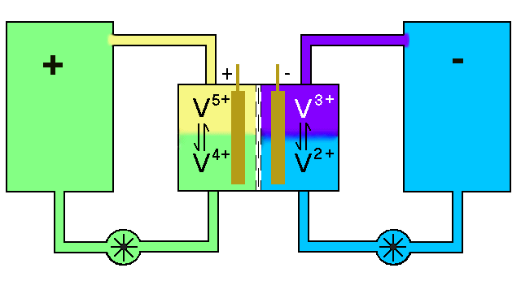
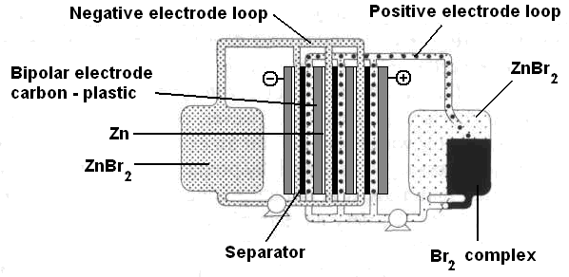
Flow batteries. types
Advantages: unique versatility in various applications, high potential for unit power and energy storage.
Disadvantages: low power density, many battery cells, complex construction compared to conventional technologies.
Video: Giant Vanaadium-redoks akud
Advantages: high unit capacity and long life.
Disadvantages: low energy density and efficiency
Advantages: high unit capacity and long life.
Disadvantages: low energy density and efficiency.
Vanadium redox batteries
Zinc-bromine batteries (ZnBr)
Polysulfide-bromide batteries (PSB)

Slide 45
ThermoChemical Energy Storage
Application: Thermochemical energy storage has the potential to be applied in high-temperature thermal storage. It is expected to have a great potential for high-temperature heat storage with high energy density.
Advantage: the enthalpy of reaction is considerably larger than the specific heat or the heat of fusion. Therefore the storage density is much better. In chemical reactions, energy is stored in the chemical bonds between the atoms that make up the molecules. Energy storage on the atomic level includes energy associated with electron orbital states. Whether a chemical reaction absorbs or releases energy, there is no overall change in the amount of energy during the reaction.
Comparing to other types of heat storage thermochemical energy storage can yield the highest heat storage capacity without producing any thermal losses during the storage period.

Slide 46
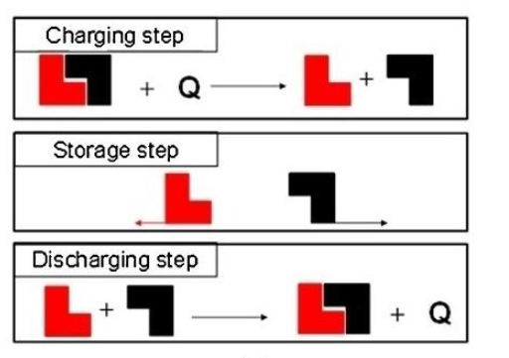
ThermoChemical Energy Storage: idea
During the charging process, heat is applied to the material A, resulting in a separation of two parts B + C.
The resulting reaction products can be easily separated and stored until the discharge process is required.
Then, the two parts B + C are mixed at suitable pressure and temperature conditions, and energy is released
A
C
B
B
C
A
B
C

Slide 47
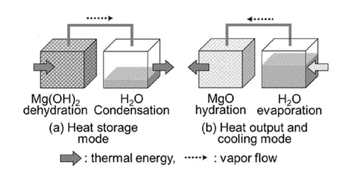
Chemical Heat Pump Operation
A chemical heat pump uses a chemical reaction for thermal energy storage and conversion. The heat pump operation is based on a reaction equilibrium relationship and has two operational modes: heat storage mode and heato output and cooling mode
Example of MgO/H₂O chemical heat pump

Slide 48
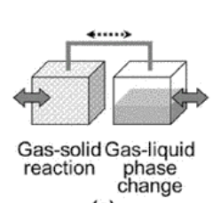
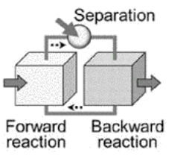
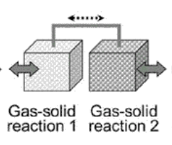
Chemical Heat pump types
Chemical reactions that are reversible can be used for chemical heat pumps. There are different types of chemical heat pump. The structure of a chemical heat pump depends on the reaction used in the pump. The heat pump consists of two reactors. The driving force for heat pump operation comes from the pressure difference between the two reactors.
.
Reaction and phase change batch type
Reaction and reaction batch type
Reaction and separation work continuous type

Slide 49
Thermal energy storage
Sensible heat storage
Latent heat storage
*water accumulator tank
*molten salt storage
*aquifer
*borehole
Phase change materials

Slide 50
Latent Heat storage
“Latent” heat storage materials are phase change materials (PCM).
The thermal energy transfer occurs when a material changes
  from solid to liquid
  from liquid to solid
“Phase” is change in state
Absorbs and releases heat at a nearly constant temperature.
They store 5–14 times more heat per unit volume than sensible storage materials (water, masonry, or rock)

Slide 51
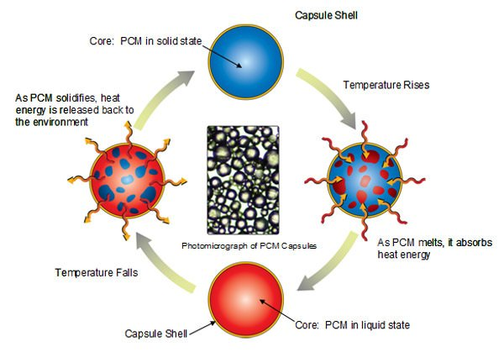
Properties of Phase change materials
Thermal properties
  Suitable phase-transition temperature
  High latent heat of transition
  Good heat transfer
Physical properties
  Favorable phase equilibrium
  High density
  Small volume change
  Low vapor pressure
Kinetic properties
  No supercooling
  Sufficient crystallization rate
Chemical properties
  Long-term chemical stability
  Compatibility with materials of construction
  No toxicity
  No fire hazard
Source: https://www.microteklabs.com/

Slide 52
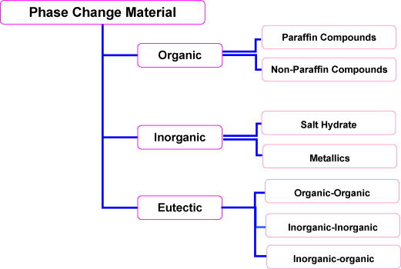
Classification of phase change materials

Slide 53
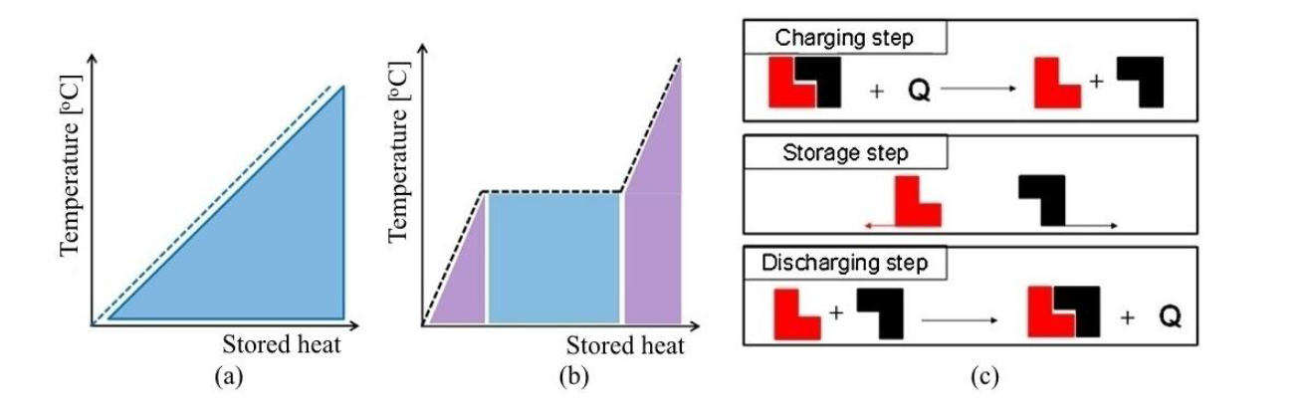
Thermal energy storage. Characteristics
Type | Capacity (kWh/t) | Power (MW) | Efficiency (%) | Storage period
Sensible heat | 10-50 | 0.001-1000 | 50-90 | Days/months
Latent heat | 50-150 | 0.001-1.0 | 75-90 | Hours/months
Chemical | 120-250 | 0.01-1.0 | 75-100 | Hours/days
Sensible heat
Latent heat
Chemical

Slide 54
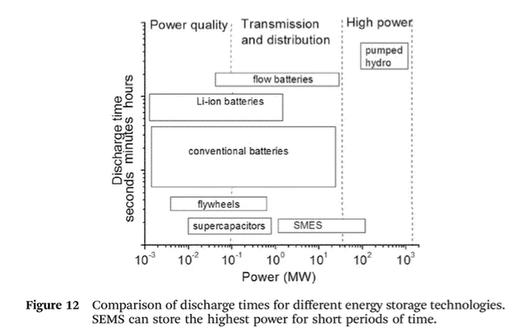

Slide 55
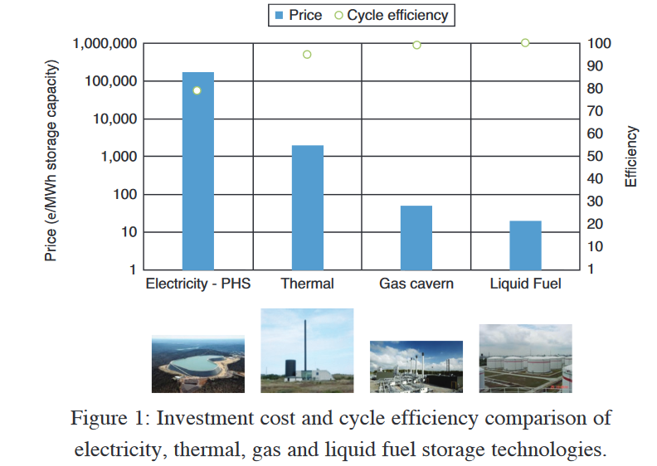
Investment cost and cycle efficiency comparison

Slide 56
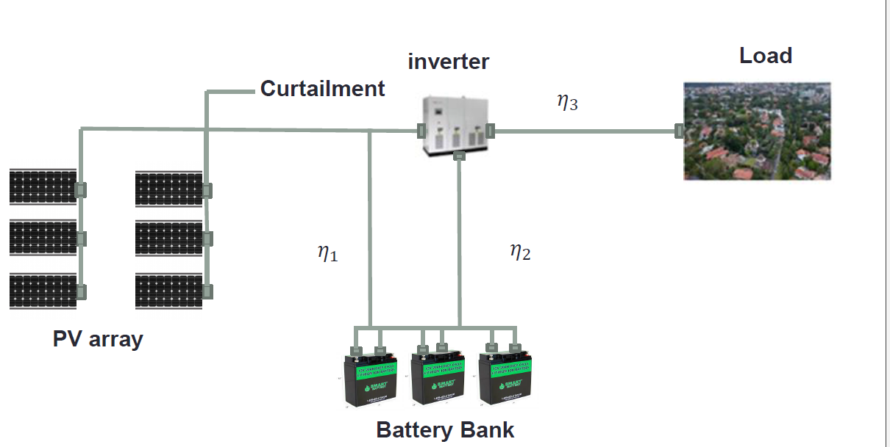

Slide 57
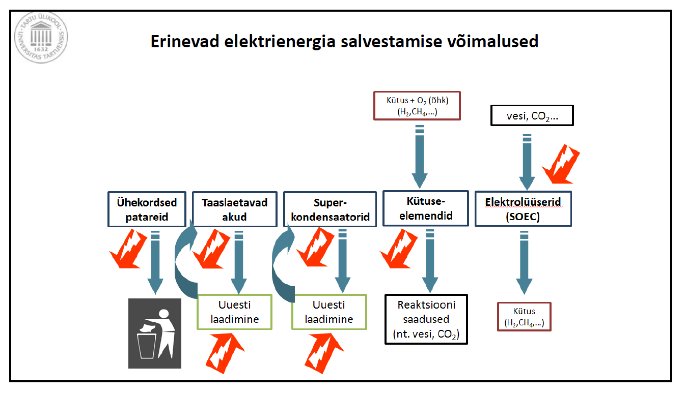
Different options for electricity storing
Fuel + O₂ (air) (H₂, CH₄)
Water, CO₂
Disposable batteries
Rechargeable batteries
Super-capacitors
Fuel
cells
Electrolyzers (SOEC)
Re-charging
Re-charging
Reaction products
(water, CO₂)
Fuel
(H₂, CH_{4,…})

