Slide 1

Solar thermal systems
Mohd Basit Wani, M.Sc.
Early Stage Researcher
Department of Energy Technology
Tallinn University of Technology, Tallinn, Estonia

Slide 2
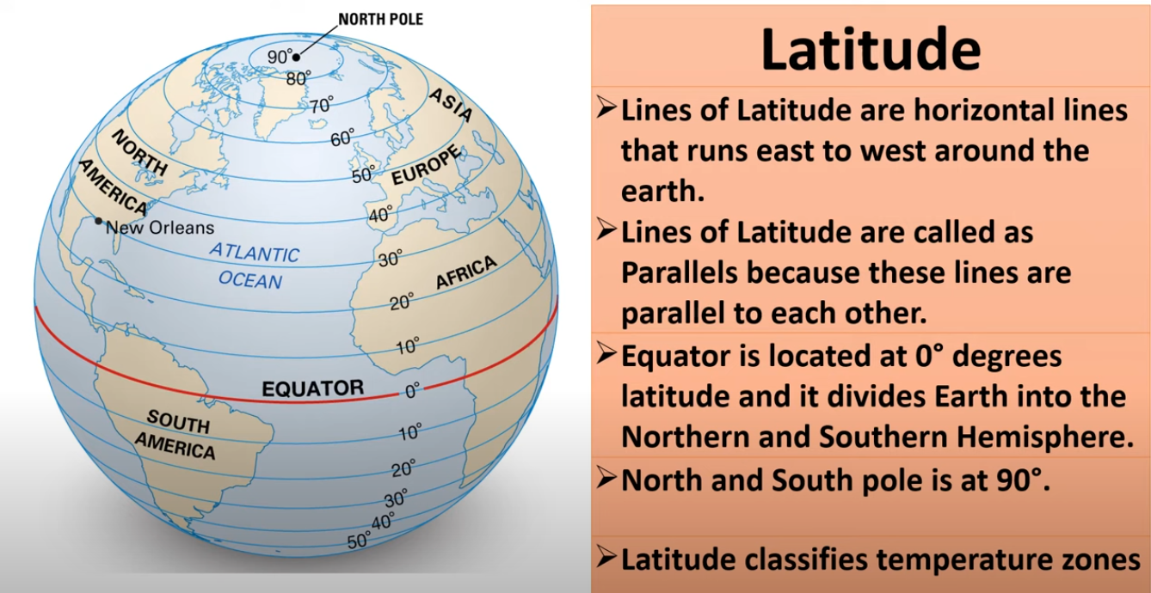
Locations: longitude & latitude
59.4∘ N latitude

Slide 3
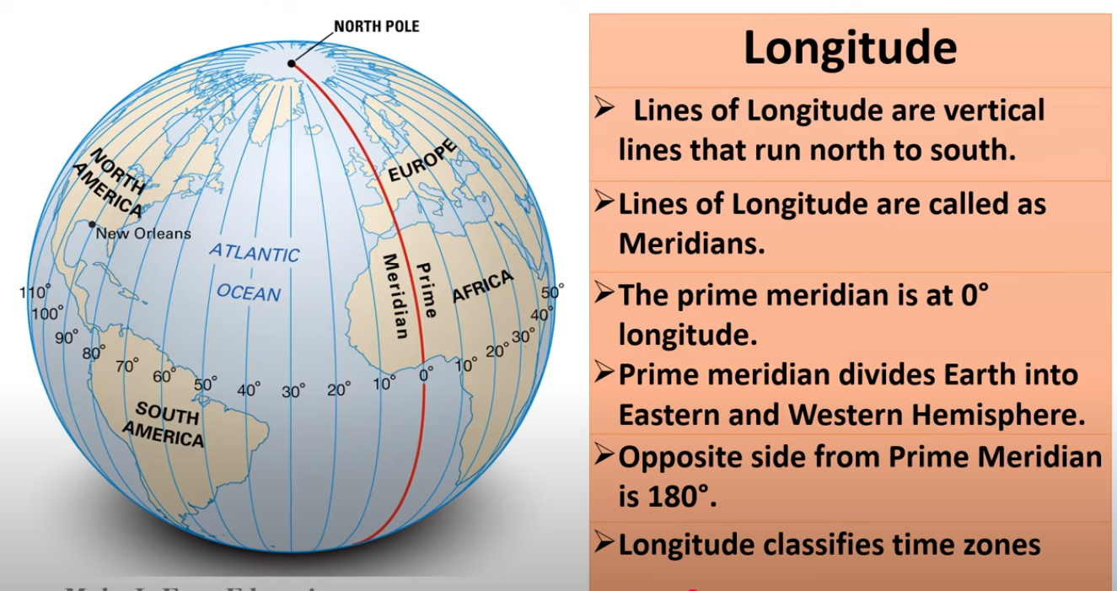
Locations: longitude & latitude
longitude (24.75 ∘ E)
Notes:
Now, let's add longitude. If latitude is like your street, longitude is like your house number. These are the vertical lines that run from the North Pole to the South Pole. They are called meridians. The most important meridian is the Prime Meridian, which is set at 0 degrees. It runs through Greenwich, London, and divides the Earth into the Eastern and Western Hemispheres.
Longitude is measured in degrees east or west of the Prime Meridian, all the way to 180 degrees. Longitude is what helps us figure out time zones. Because the Earth rotates 360 degrees in 24 hours, every 15 degrees of longitude represents a one-hour time difference. This is why when it's noon in one part of the world, it's a different time somewhere else.
Together, latitude and longitude give every single point on Earth a unique, precise address. They're the global positioning system that has guided sailors, pilots, and travelers for centuries. They are the invisible grid that makes our world navigable.
Thank you.

Slide 4
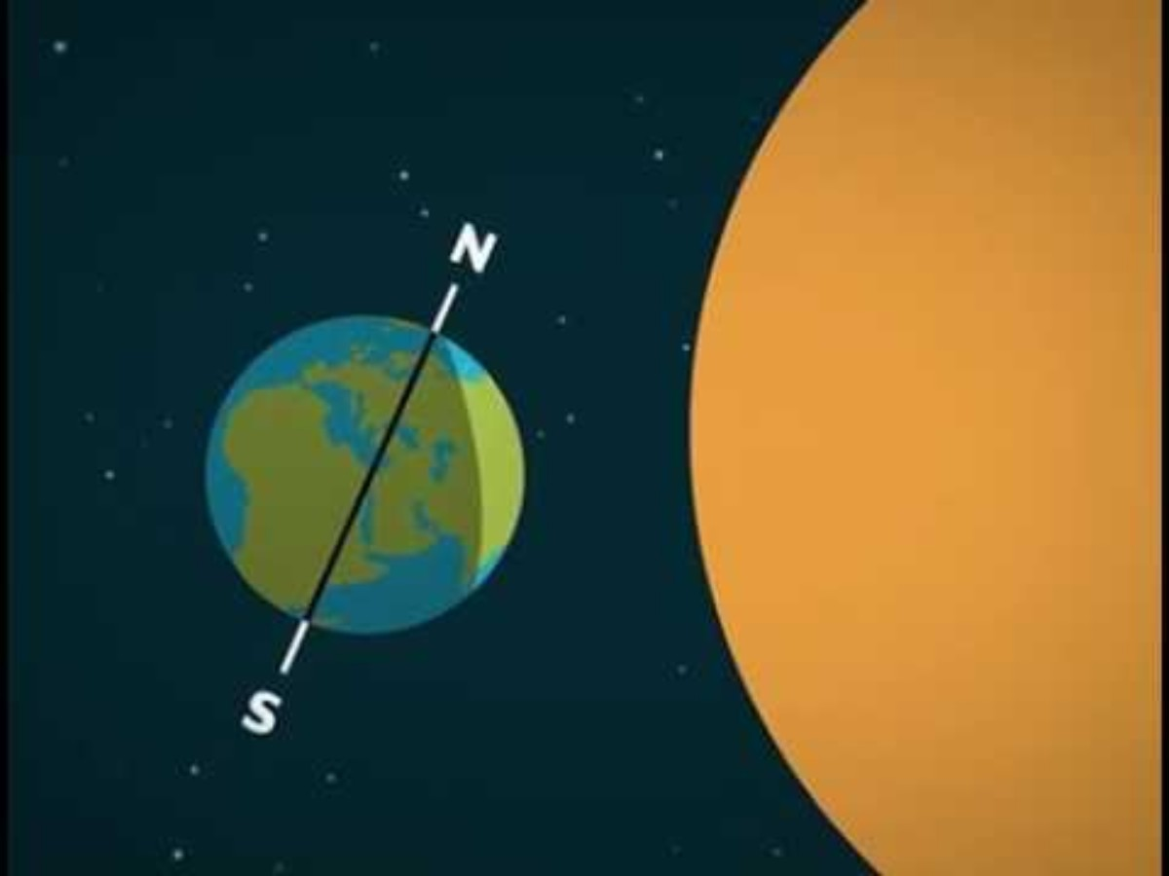
Sun-earth relationship
Source: https://education.nationalgeographic.org/

Slide 5
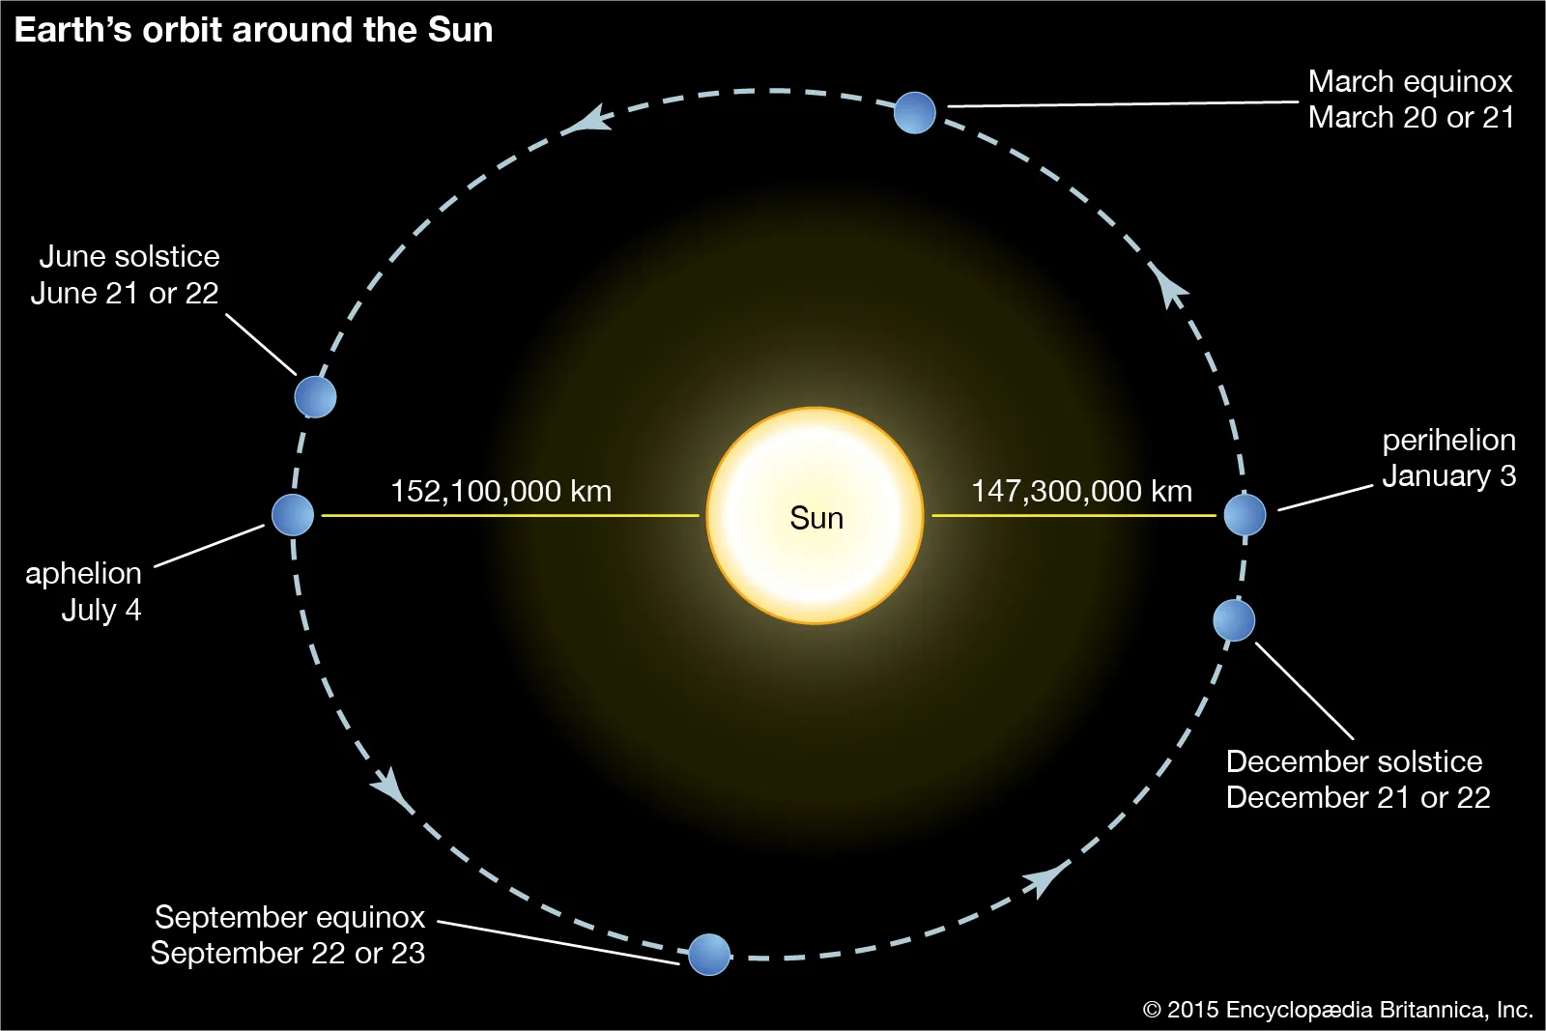
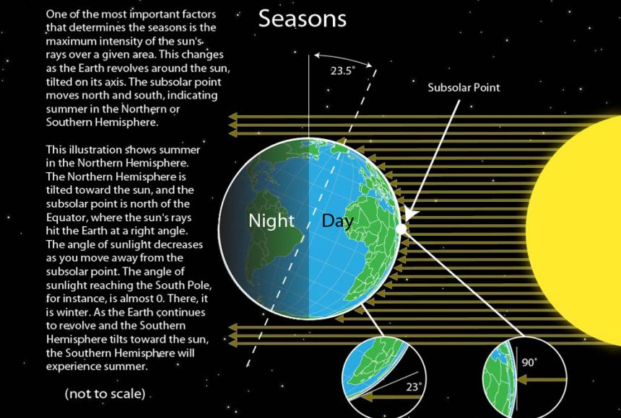
Sun-earth relationship
The distance between the Earth and the Sun is not constant due to the Earth's slightly elliptical orbit.
This distance varies by approximately 1.7%, a small change caused by the orbit's eccentricity.
The average distance, which is about 1.495×10¹¹ meters, is defined as one Astronomical Unit (AU), a standard unit for measuring distances in the solar system.
Source: https://education.nationalgeographic.org/

Slide 6
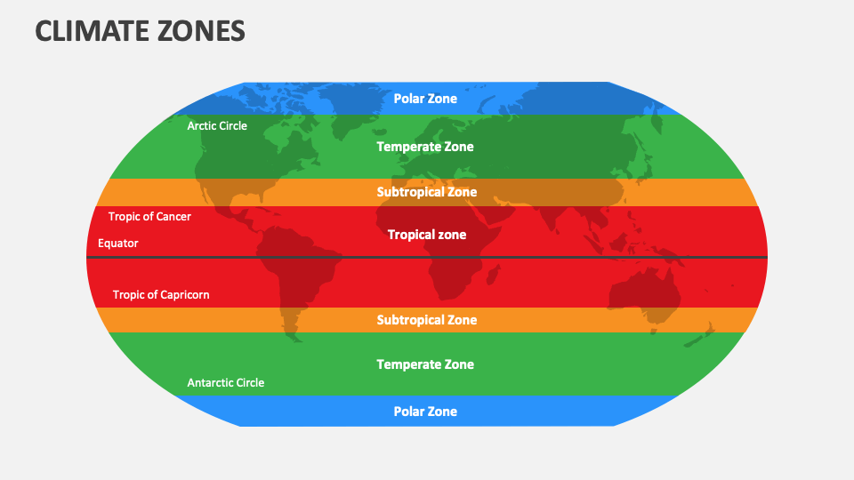
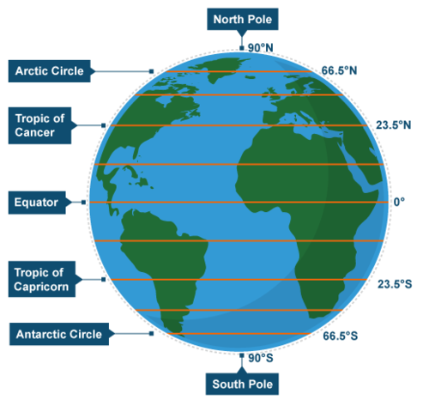
Temperature zones

Slide 7
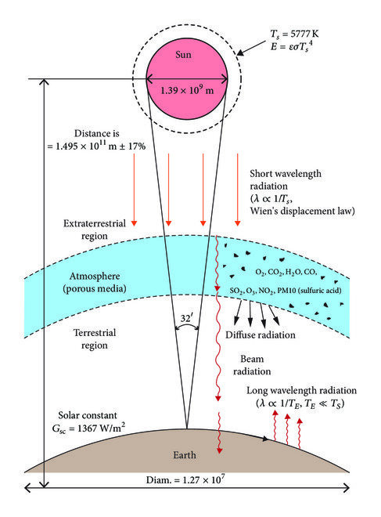
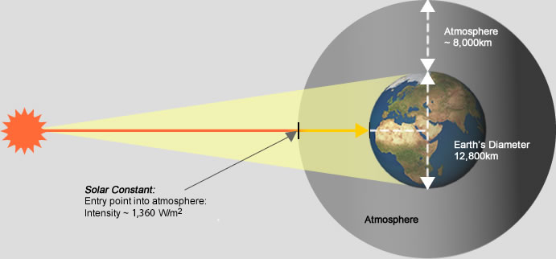
Solar Constant
Behaviour of Solar Radiation
The solar constant (G_{sc} ) is the amount of solar radiation received per unit area in space, outside of the Earth's atmosphere.
It's measured on a surface perpendicular to the Sun's rays and at Earth's average distance from the Sun.
The average value is approximately 1361 W/m².It is not a true constant. It varies slightly due to the Earth's elliptical orbit

Slide 8
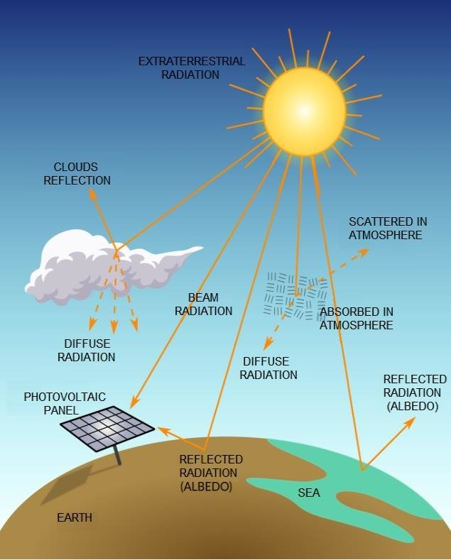
Direct, DIFFUSE AND GLOBAL RADIATION
Direct Normal Irradiance (DNI): Radiation received from the sun in a straight line, measured on a surface always held perpendicular to the solar rays. It represents the unscattered component of sunlight and is measured using a pyrheliometer. DNI is highly dependent on solar position and atmospheric clarity.
Diffuse Horizontal Irradiance (DHI): Radiation that has been scattered by molecules, aerosols, and clouds in the atmosphere and arrives from all parts of the sky dome. It is measured on a horizontal surface with a shaded pyranometer, and it includes no direct component from the solar disk.
Global Horizontal Irradiance (GHI): The total shortwave radiation received on a horizontal surface. It is the sum of the diffuse component plus the direct component projected onto the horizontal plane.

Slide 9
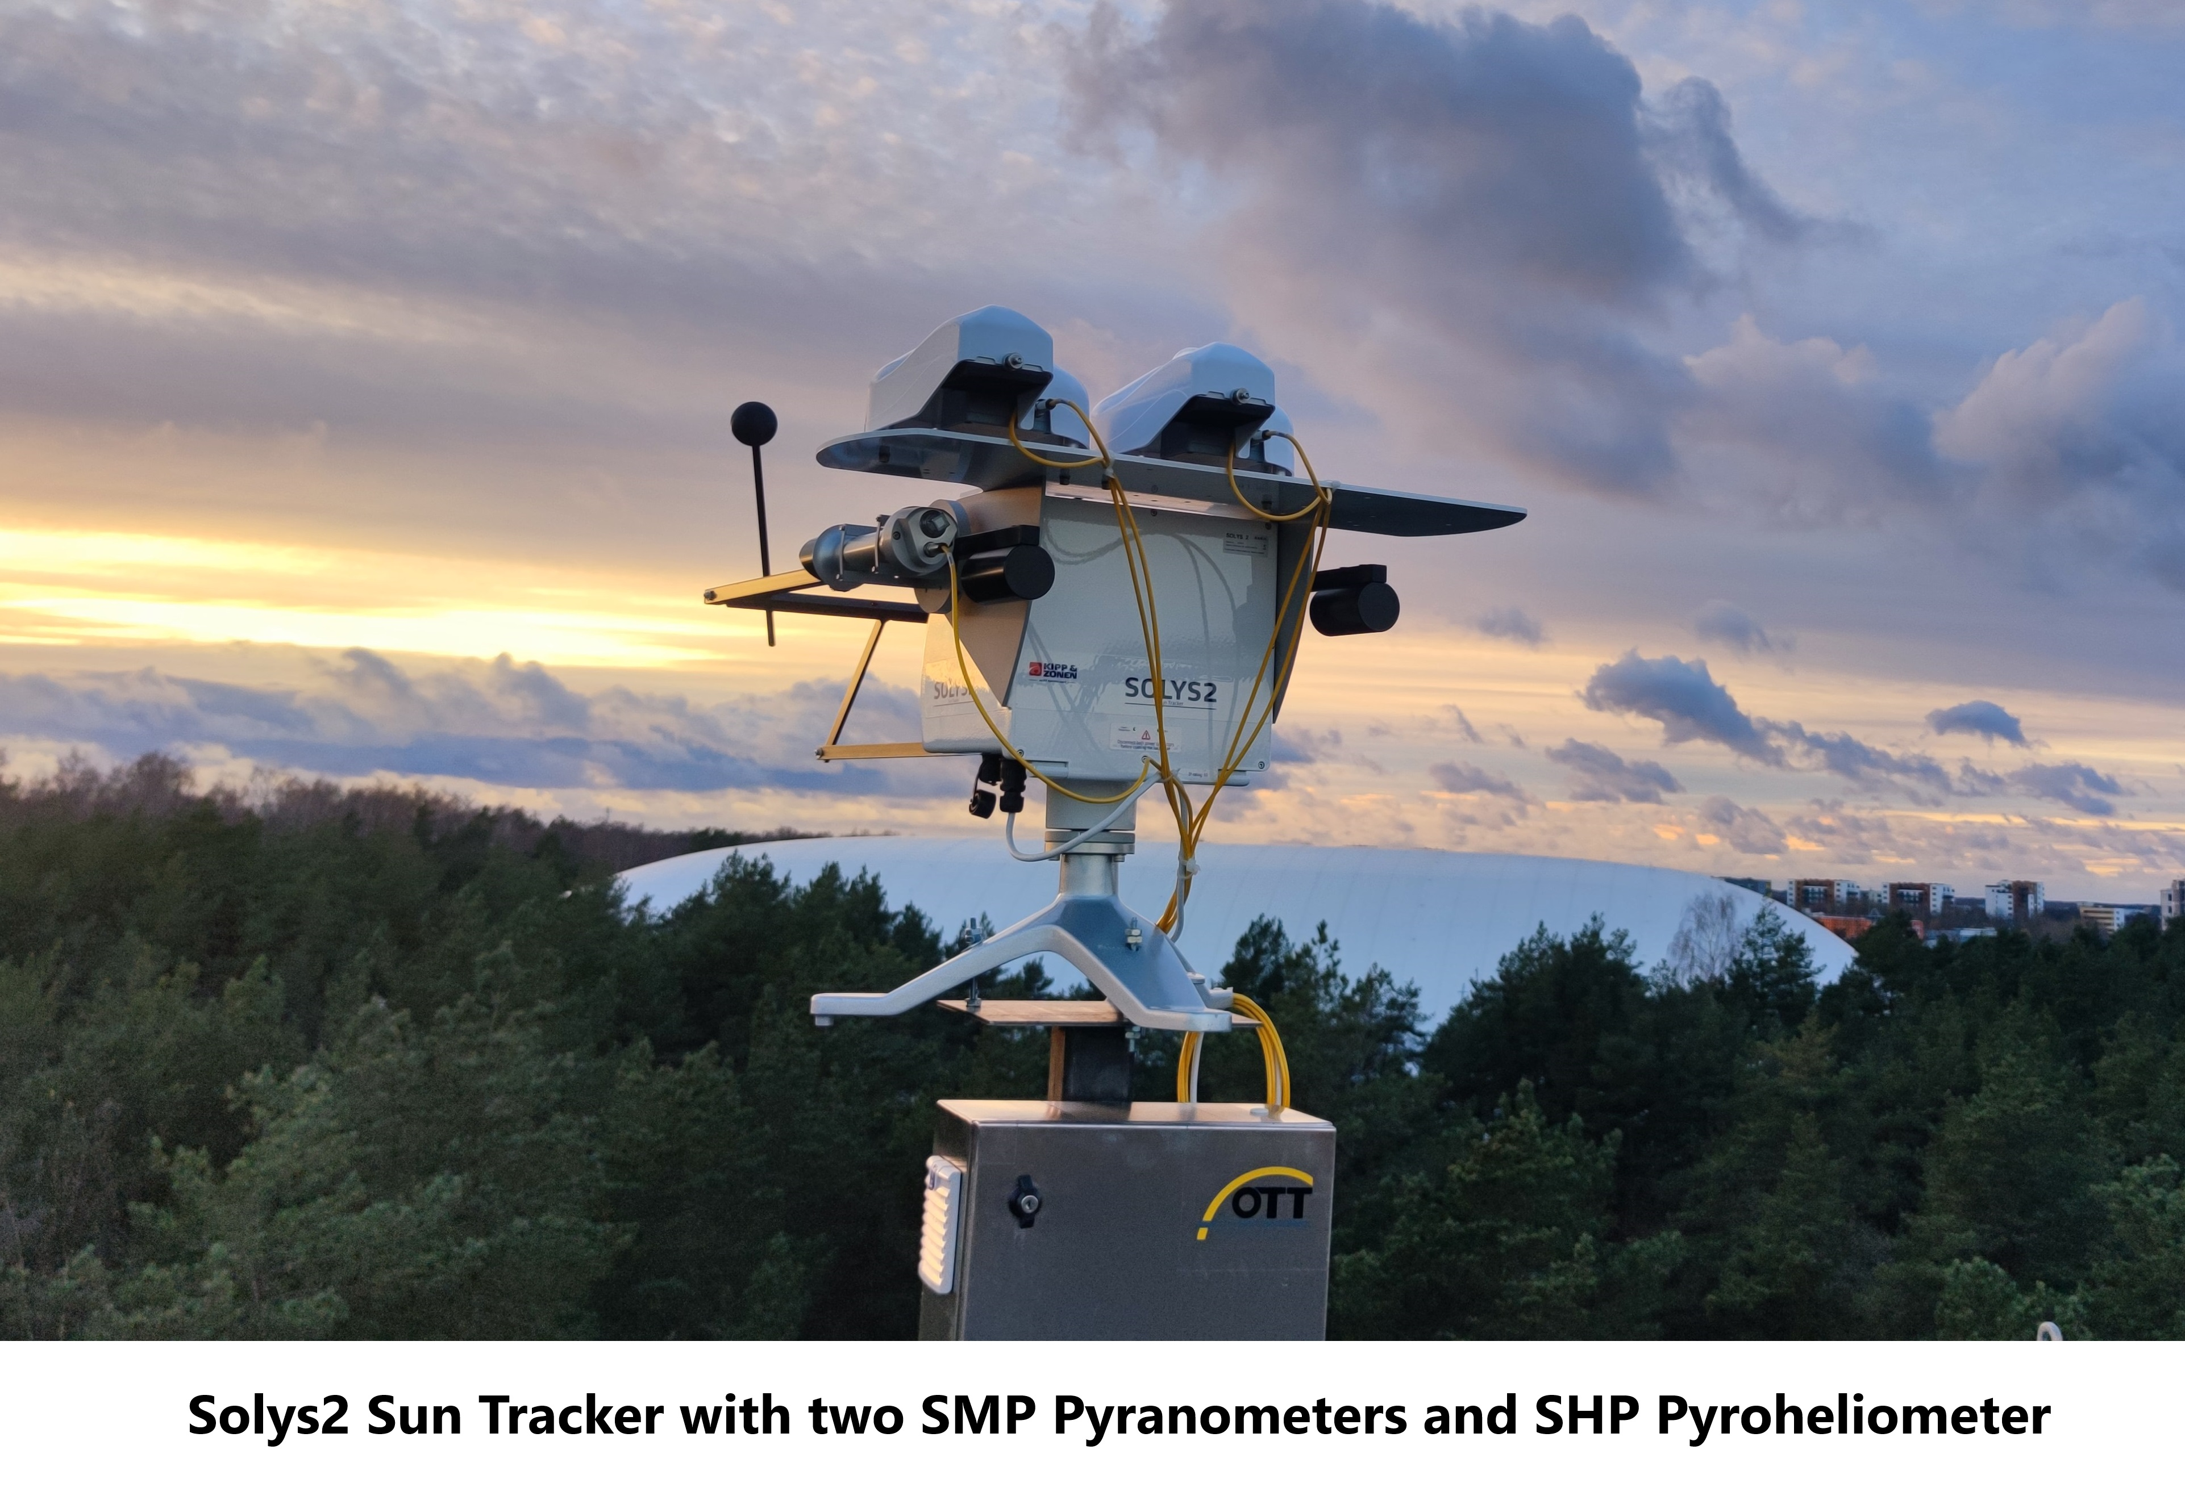
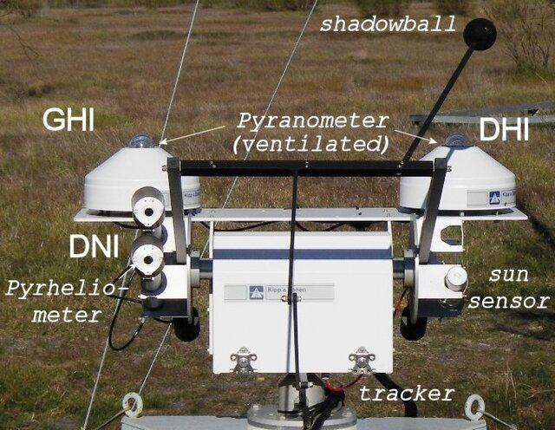
Solar RADIATION measurements
Pyranometer: Used to measure Global Horizontal Irradiance (GHI), which is the total solar radiation (direct + diffuse) received on a horizontal surface. It provides the most commonly used metric for solar energy system design.
Pyrheliometer: Measures Direct Normal Irradiance (DNI) by capturing only the direct beam of sunlight within a narrow field of view. It is mounted on a sun tracker to ensure continuous alignment with the solar disk.
Shaded Pyranometer: Records Diffuse Horizontal Irradiance (DHI) by blocking the direct solar beam using a shading device (ring or ball). This allows only the scattered portion of radiation from the sky to be measured

Slide 10
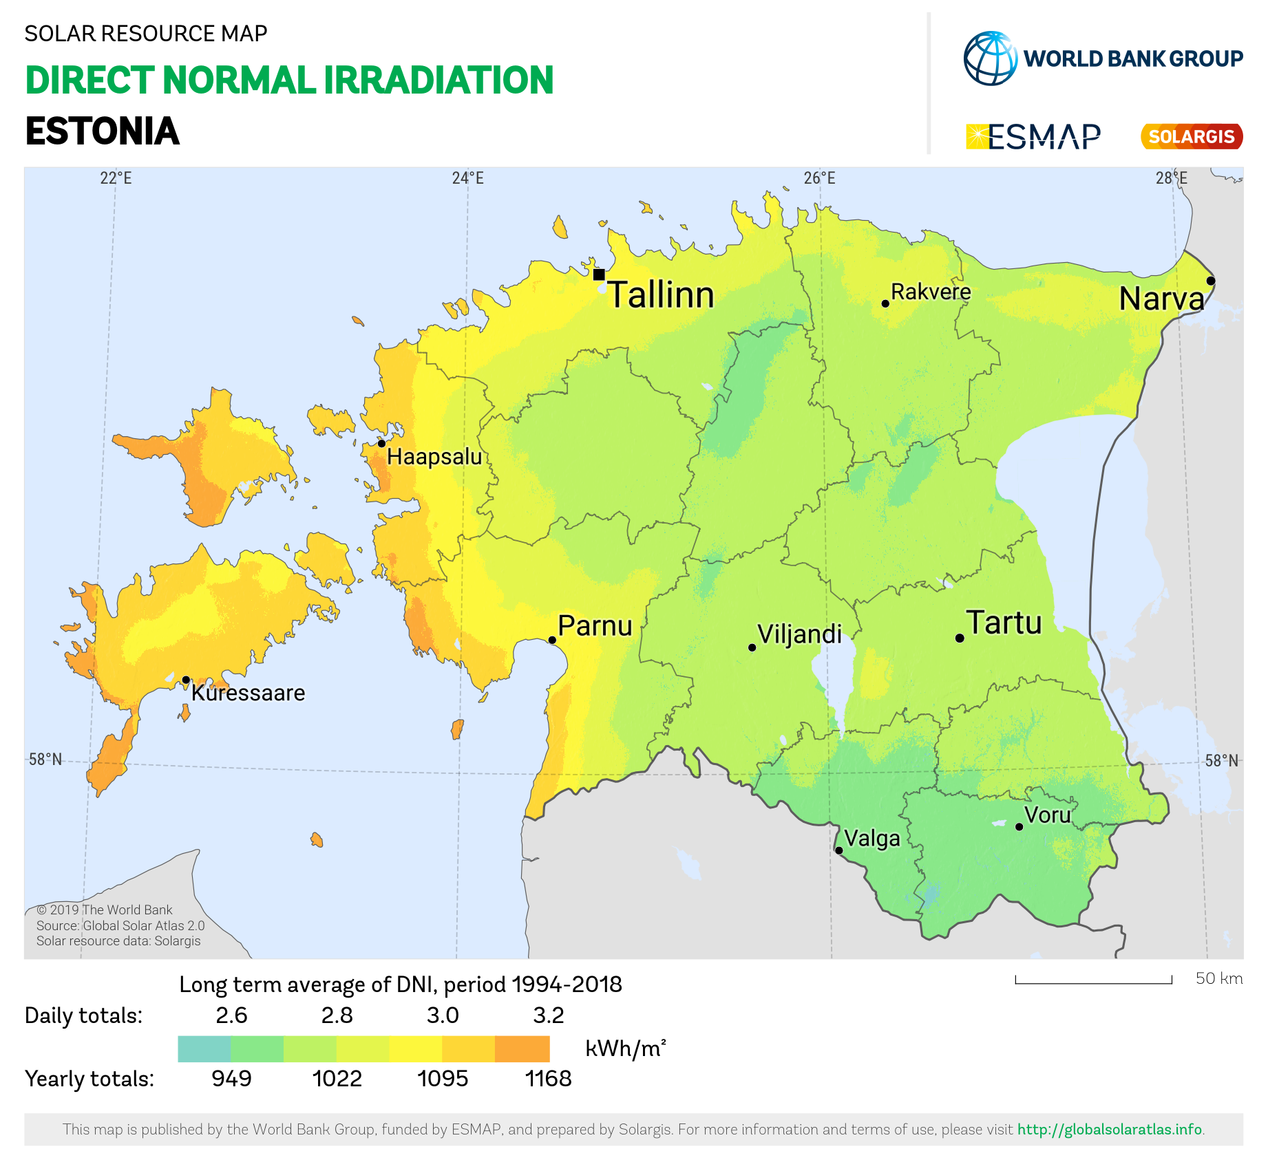
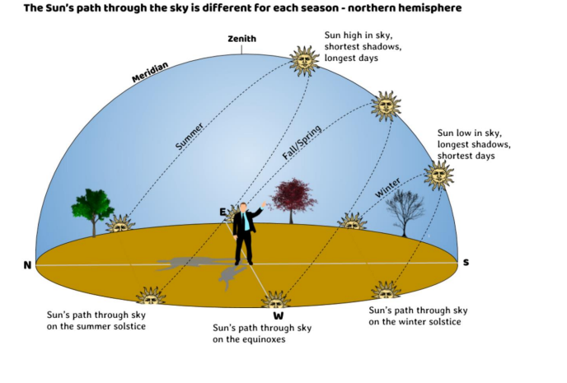
Solar Radiation in Estonia

Slide 11
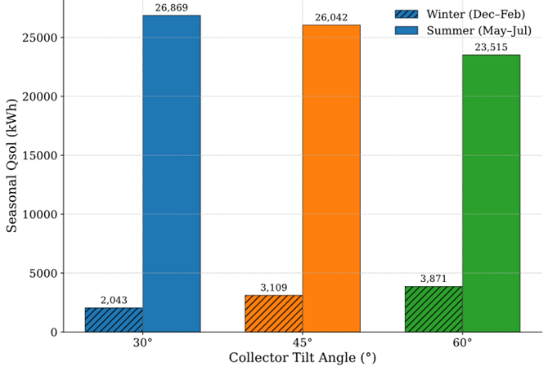
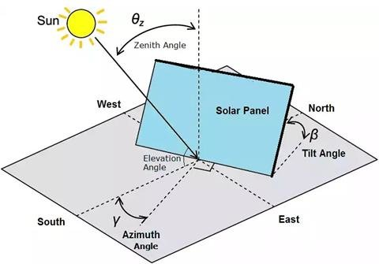
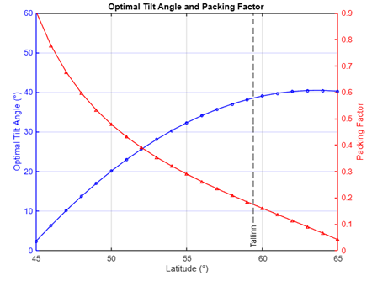
Important Angles
Annual Solar yeild vs Tilt Angle(150m³ )
Zenith Angle (θ_{Z} ): The angle between the sun's rays and the vertical (zenith) direction.
Tilt Angle (β): The angle between the surface of the solar panel and the horizontal ground.
Azimuth Angle (γ): The angle of the panel's orientation relative to true South (in the Northern Hemisphere) or true North (in the Southern Hemisphere).
Elevation Angle: The angle between the sun's rays and the horizontal plane.

Slide 12
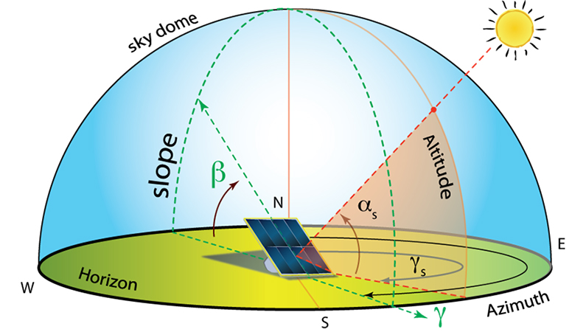
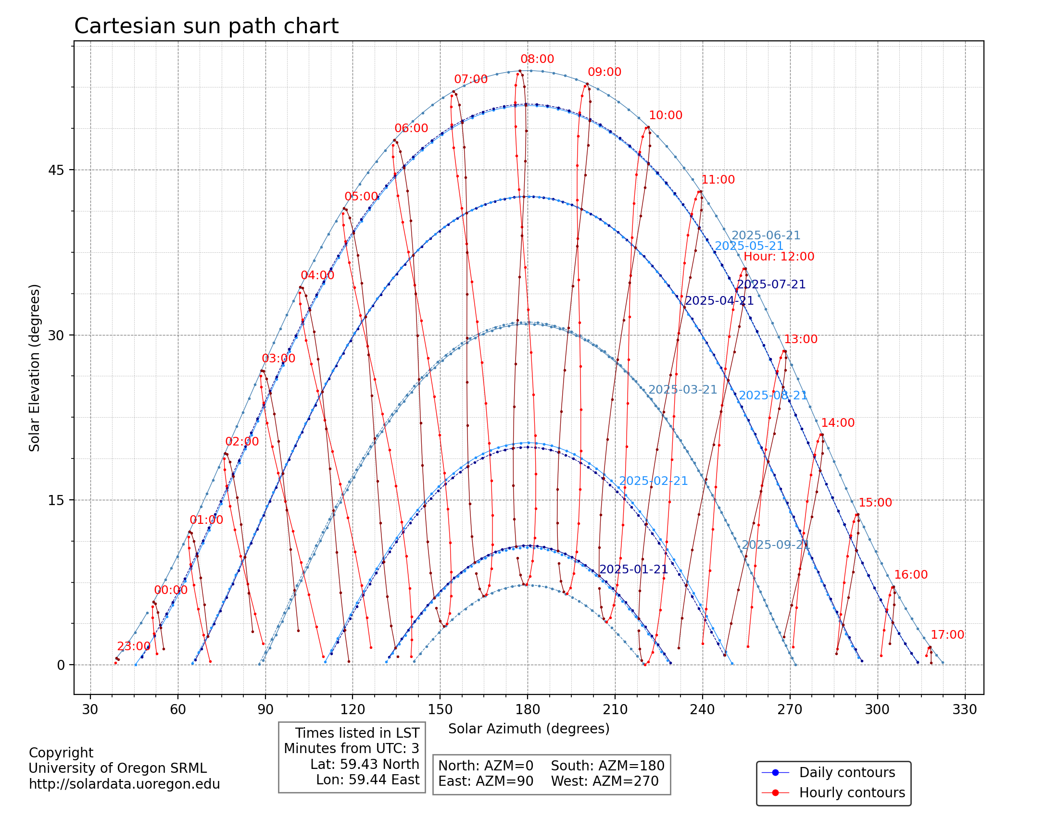
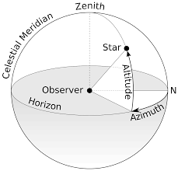
Sun Path Diagram
https://solardata.uoregon.edu/cgi-bin/SunPathChart.py

Slide 13
Solar thermal applications
Residential Water Heating: Heats water for household use, a very common application.
Space Heating: Provides heat for homes and buildings by circulating warm fluid through heating systems.
Swimming Pool Heating: Uses low-temperature collectors to extend the swimming season.
Solar Cooking: Concentrates sunlight to cook food and pasteurize water.
Industrial Process Heat (SHIP): Provides heat for manufacturing processes like food, textile, and chemical production.
Solar Power Plants (CSP): Generates electricity on a large scale by using mirrors to concentrate sunlight, which creates steam to power a turbine.
Cooling and Air Conditioning: Uses solar heat to power chillers that provide cooling for buildings.
Water Desalination and Purification: Utilizes solar heat to evaporate and purify water, removing salt and other impurities.
Agricultural Applications: Used for crop drying and heating greenhouses.
District Heating: Large-scale systems that use largefields of solar collectors to supply hot water to an entire community or neighborhood via a network of insulated pipes. These systems often include seasonal thermal storage to store heat collected in the summer for use during the winter.

Slide 14
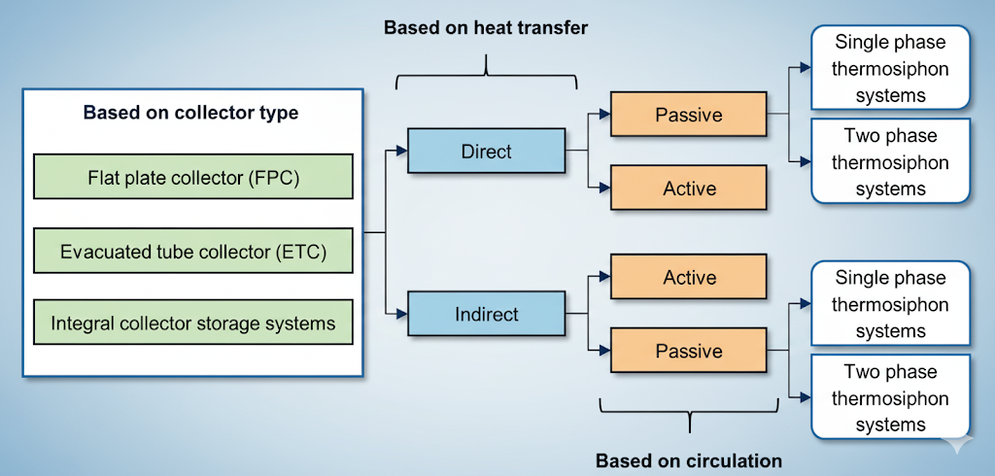
Solar thermal systems

Slide 15
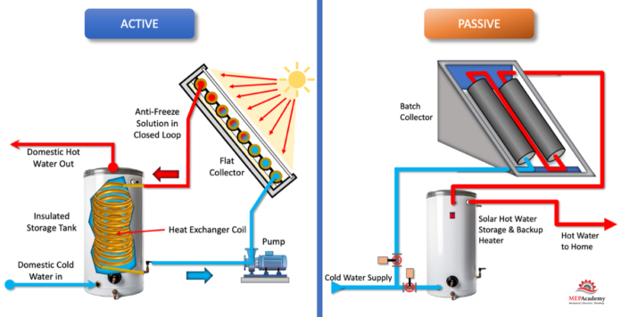
Active and passive systems
Schematic diagrams of passive SWH (A) and active SWH (B).

Slide 16
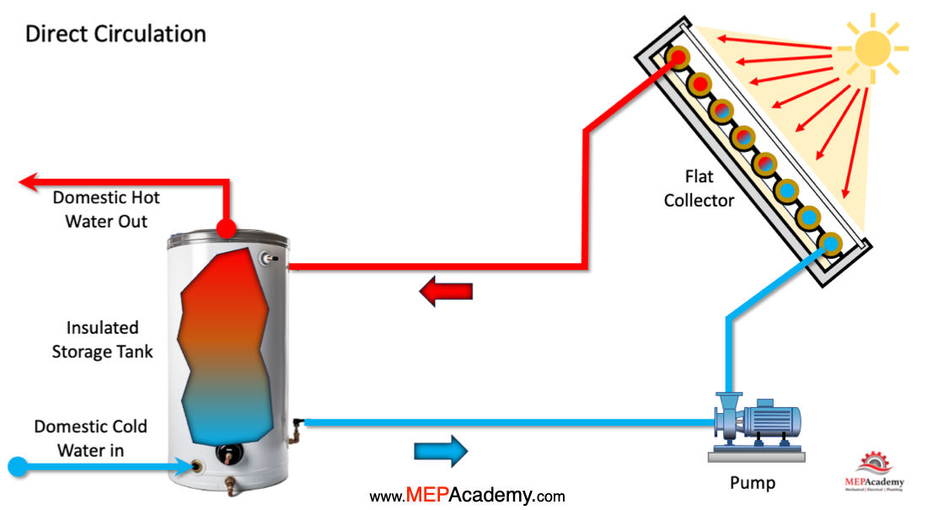
DIRECT Solar Thermal System
In direct systems, the working fluid (often water) is heated directly in the solar collector.
Simple design, with fewer components, making it cost-effective.
Efficient in regions where freezing is not a concern.
Commonly used in domestic hot water systems.
Schematic of Direct Solar Thermal System
Notes:
In an indirect solar thermal system, a fluid circulates through the solar collector to absorb heat and then transfers it to the potable water via a heat exchanger. The fluids used are chosen for their specific properties, such as thermal capacity, freeze protection, and non-toxicity.
The most common types of fluids used are:
Glycol-Water Solutions: This is the most popular choice. Propylene glycol is preferred over ethylene glycol because it is non-toxic and is often rated as "food grade," making it safe for use in systems where there's a risk of accidental contact with drinking water. The glycol is mixed with water to lower the freezing point and provide freeze protection. It also helps to prevent corrosion in the system's pipes and components.
Silicone Fluid: These are synthetic fluids that can withstand a wide temperature range without degrading. They are excellent for freeze protection and can handle very high temperatures without boiling. However, they are more expensive than glycol solutions and can be less thermally efficient. They are also thicker, which requires more pumping power.
Hydrocarbon Oils: These are non-aqueous, heat transfer fluids derived from petroleum. They have a high boiling point and can be used in high-temperature applications. However, they are flammable and can be toxic, so they are not as widely used as glycol.
The choice of fluid depends on the system's design, the climate, and the specific application. Glycol-water solutions offer a great balance of performance, safety, and cost, which is why they are the industry standard for most residential and commercial systems.

Slide 17
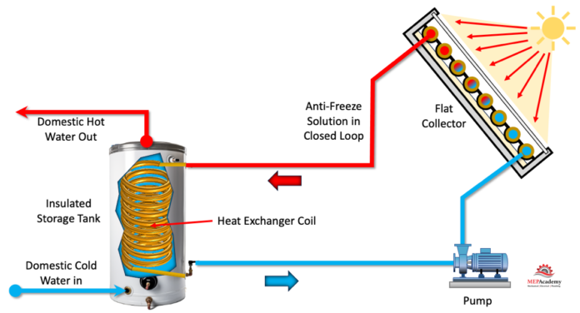
inDIRECT Solar Thermal System
In indirect systems, a heat transfer fluid (such as antifreeze solution) circulates through the collector.
Heat is transferred to water via a heat exchanger.
Provides freeze protection, suitable for colder climates.
More complex and costly, but ensures system reliability.
Schematic of Indirect Solar Thermal System

Slide 18
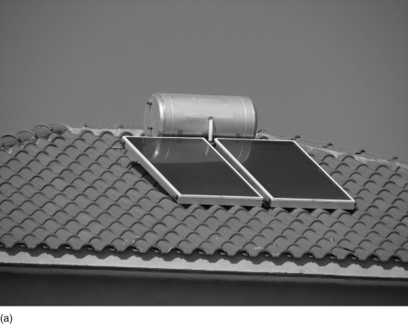
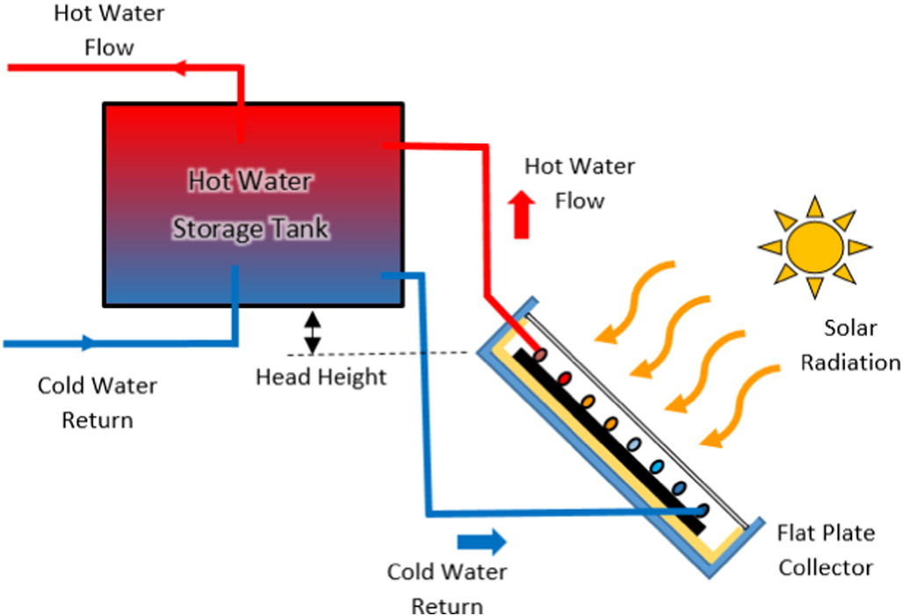
Thermosyphon Hot Water System
A passive solar water heating system that relies on natural convection (thermosyphon effect).
Cold water flows into the collector, gets heated, and rises naturally into the storage tank.
No pumps required, making it simple and reliable.
Works best when the storage tank is placed above the solar collector.
Commonly used in households in warm climates.
Schematic of THERMOSYPHON Solar Thermal System

Slide 19
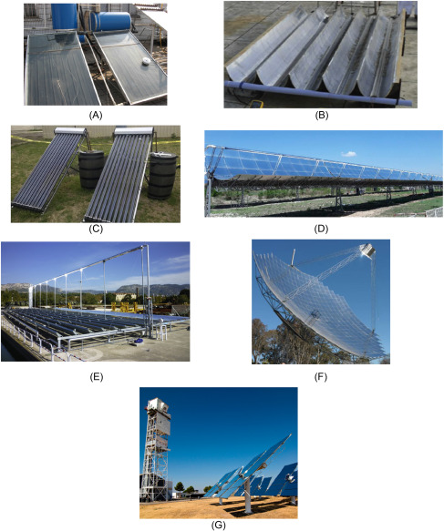
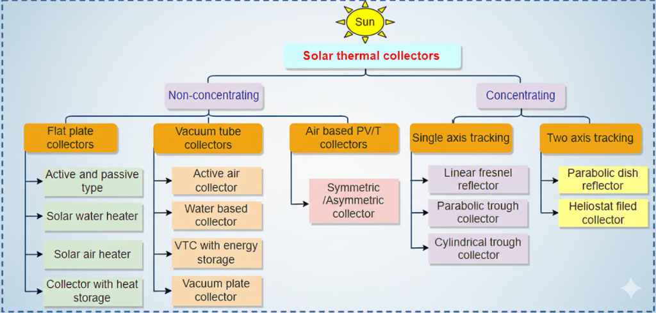
Solar thermal collectors
(A) flat-plate collectors (FPCs), (B) compound parabolic concentrator (CPCs), (C) evacuated tube collector (ETCs), (D) parabolic through concentrators (PTCs), (E) linear Fresnel reflectors (LFRs), (F) parabolic dish concentrator (PDC), and (G) heliostat field (solar tower)

Slide 20
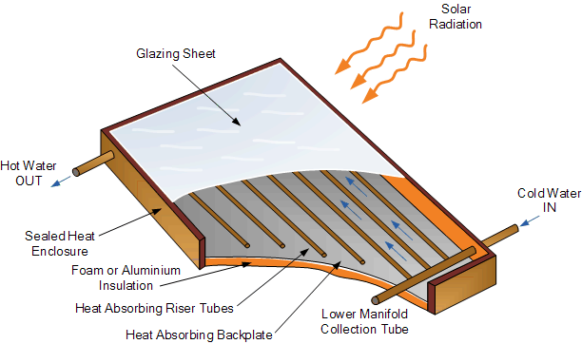
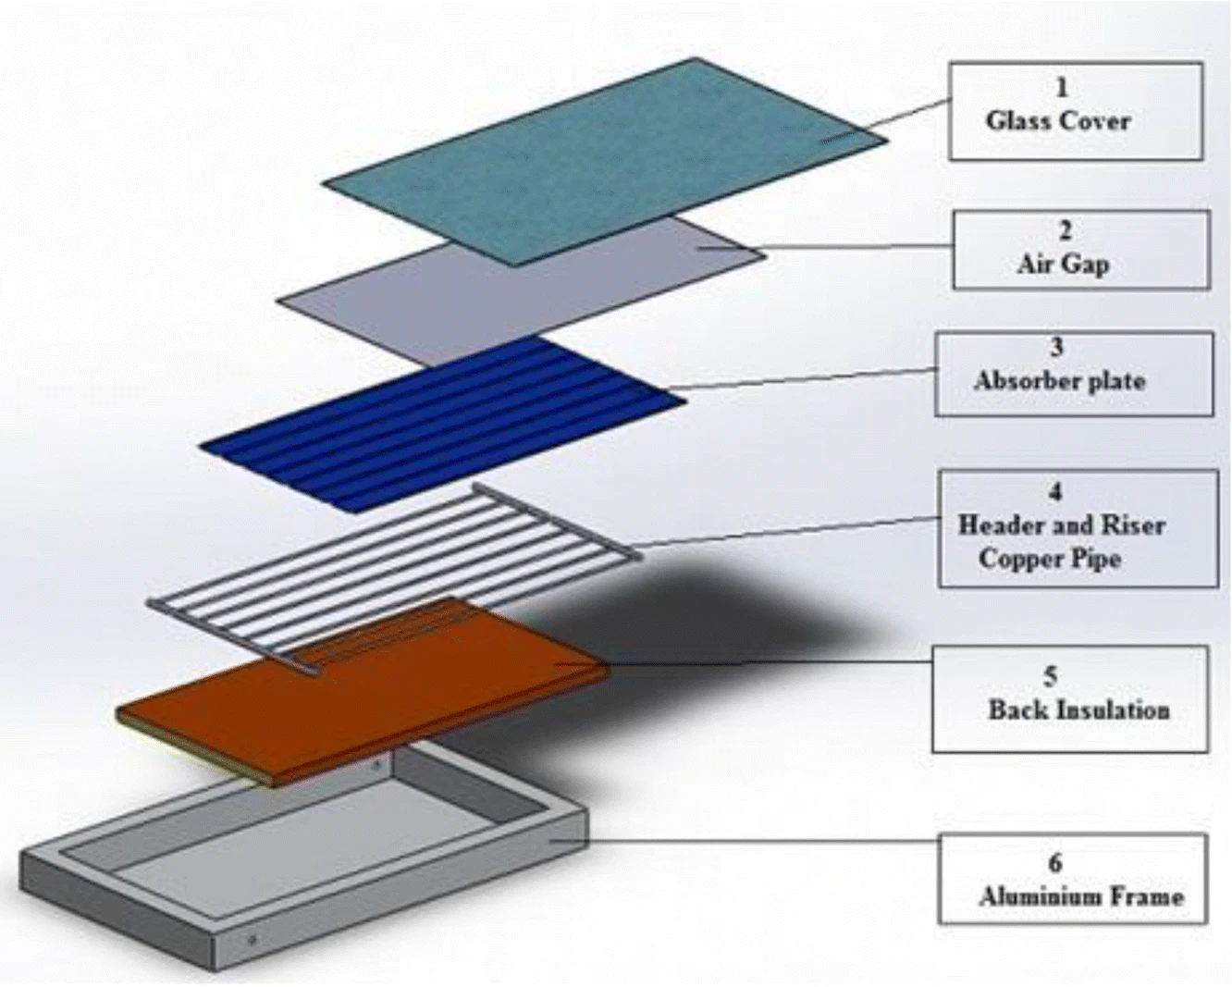
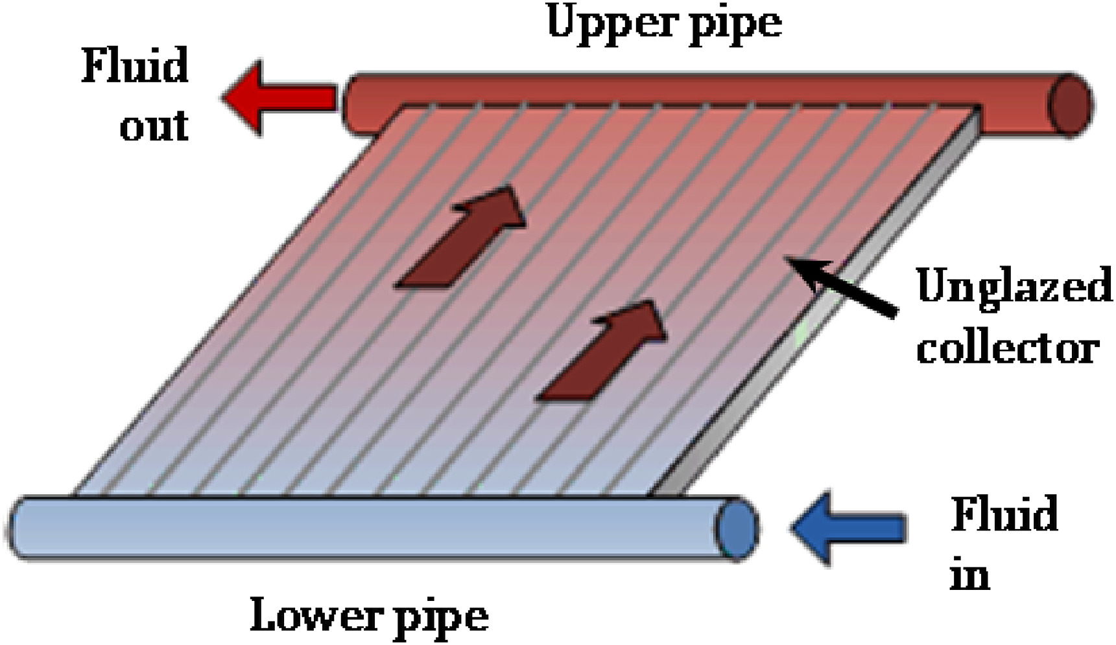
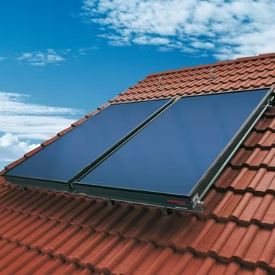
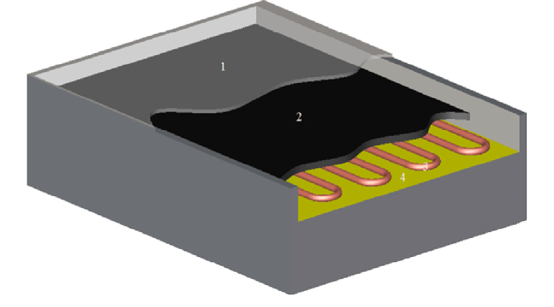
Flat plate collectors
Unglazed Flat Plate Collector
Glazed Flat Plate Collector
Flat Plate collector
Serpentine piping in Flat Plate collector

Slide 21
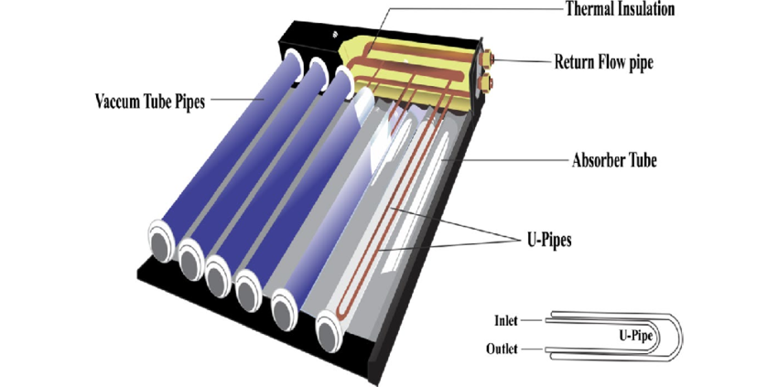
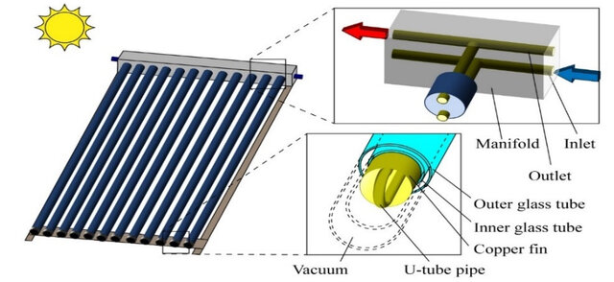
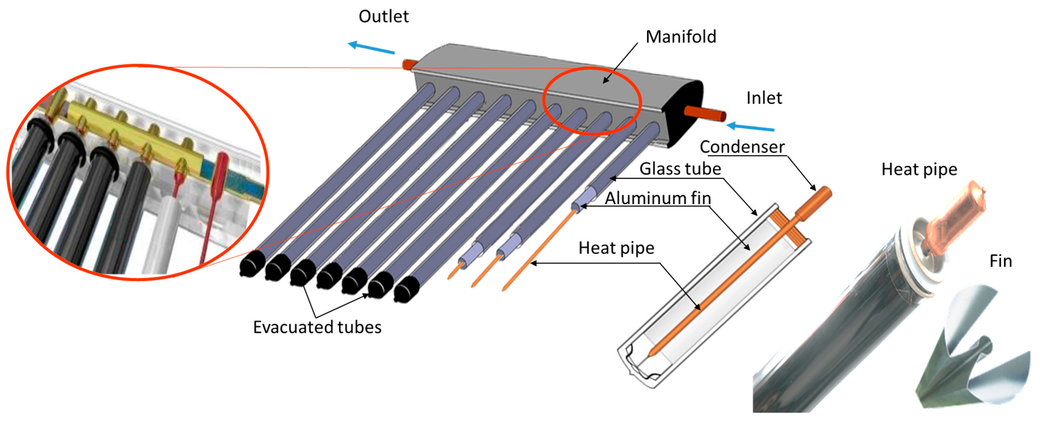
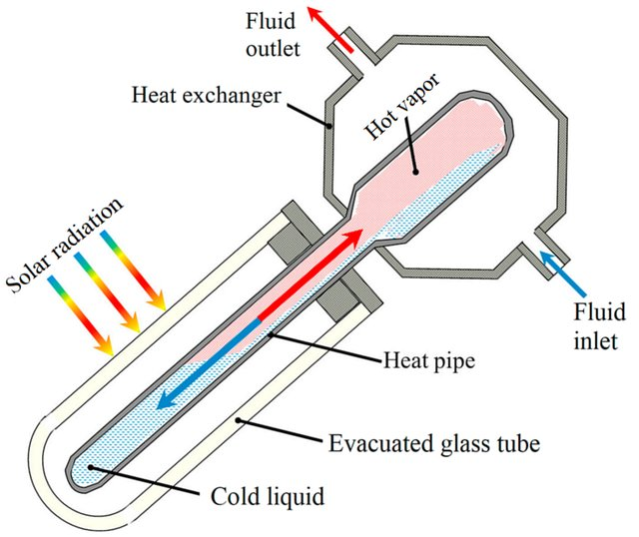
Evacuated tube solar collectors
U-Tube
Heat Pipe

Slide 22
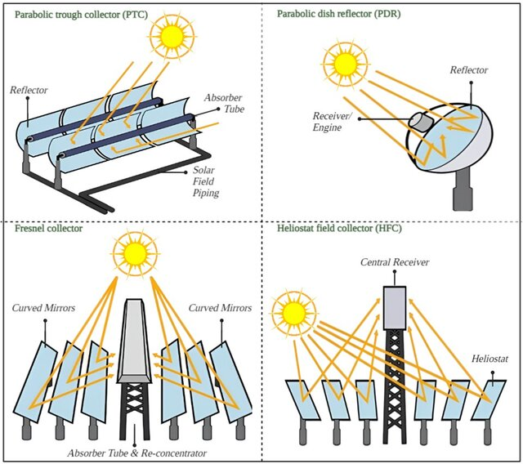
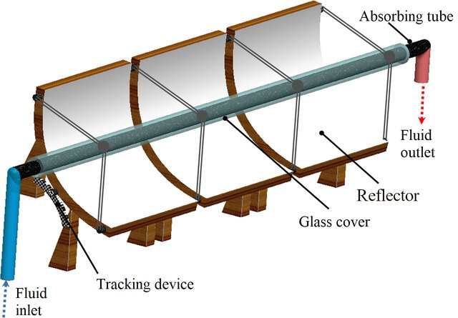
Concentrating solar collectors
Parabolic Trough Collector

Slide 23
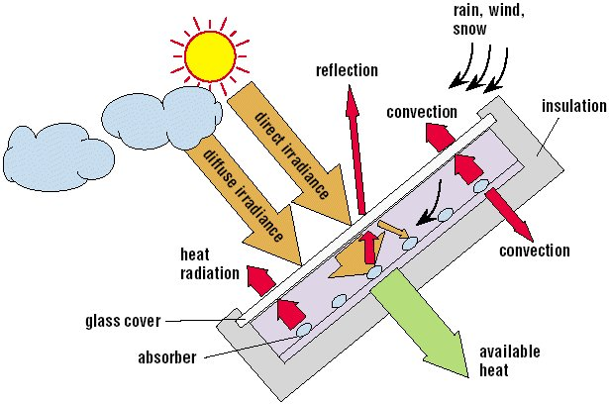
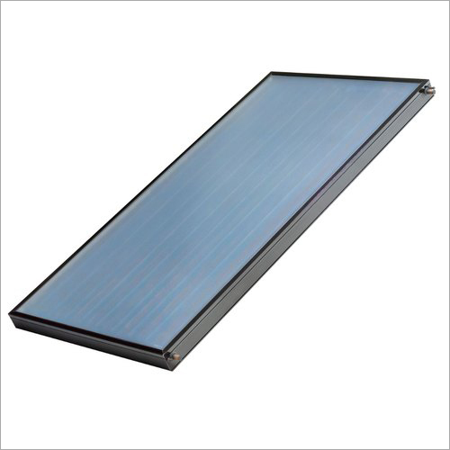

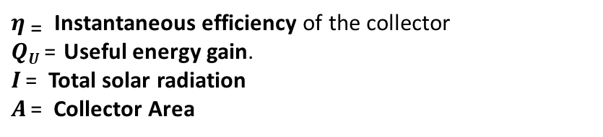
Energy balance of a flat plate collector
G_{T}
Q_{U}
Useful Energy = Absorbed Radiation –Total heat loss( Top+ bottom+edges)
$η_{ \text{=}}$ Instantaneous efficiency of the collector
$QU$ = Useful energy gain.
$I$ = Total solar radiation
$A$ = Collector Area

Slide 24
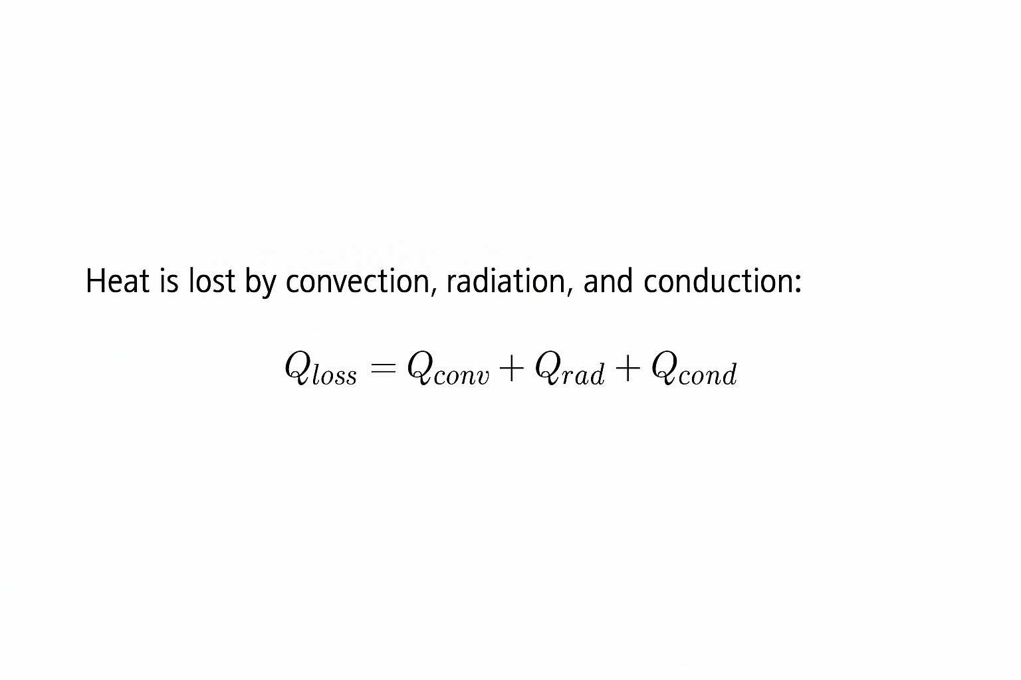




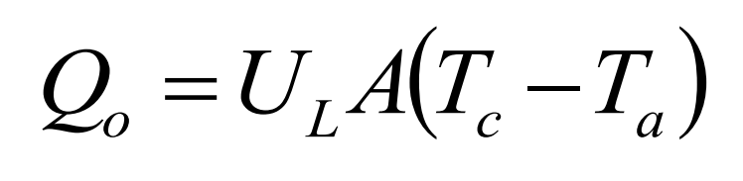

Heat loss in a flAT PLATE collector
Heat loss from the top surface
Incident solar energy:
I = Solar radiation intensity (W/m²)
A = Collector area (m²)
𝑄ᵢ = 𝐼 × 𝐴
Part of this radiation is reflected back to the sky, another component is absorbed by the glazing and the rest is transmitted through the glazing and reaches the absorber plate as short wave radiation.
α: transmittance of any glass or plastic cover sheets
ζ: absorptance of absorber
The rate of heat loss ($Qo$) depends on the collector overall heat transfer coefficient $(UL$) and the collector temperature $TC$.
Heat loss from the sides
The rate of useful energy extracted by the collector (Q_{u}), expressed as a rate of extraction under steady state conditions, is proportional to the rate of useful energy absorbed by the collector, less the amount lost by the collector to its surroundings.
Heat loss from the back surface

Slide 25


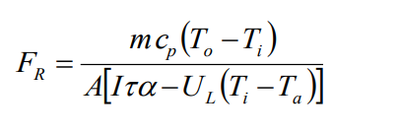
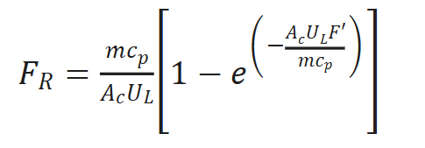

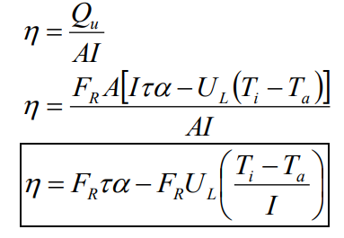
Energy balance of a flat plate collector
The useful energy for a solar thermal collector is the rate of thermal energy leaving the collector, usually described in terms of the rate of energy being added to a heat transfer fluid passing through the receiver or absorber:
c_{p} - specific heat of heat transfer fluid (J/kg.K)
T_{o} - temperature of heat transfer fluid leaving the absorber (K)
T_{i} - temperature of heat transfer fluid entering the absorber (K)
Since defining the collector’s average temperature is difficult, it is more convenient to define a factor that relates the actual useful energy gain to the gain if the entire collector surface were at the fluid inlet temperature. This is called the Collector Heat Removal Factor:
or
$F ′$(Collector Efficiency Factor): the heat resistance between the fluid channels and the absorber plate.
The maximum possible useful energy gain in a solar collector occurs when the whole collector is at the inlet fluid temperature. The actual useful energy gain (Qu), is found by multiplying the collector heat removal factor (FR) by the maximum possible useful energy gain.
The instantaneous thermal efficiency of the collector is:
Hottel Whillier-Bliss equation

Slide 26
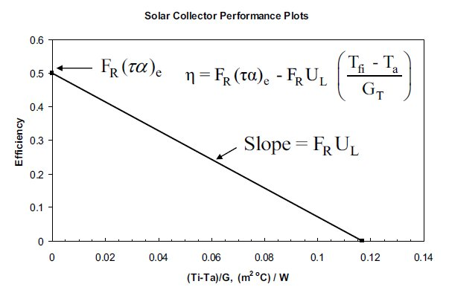

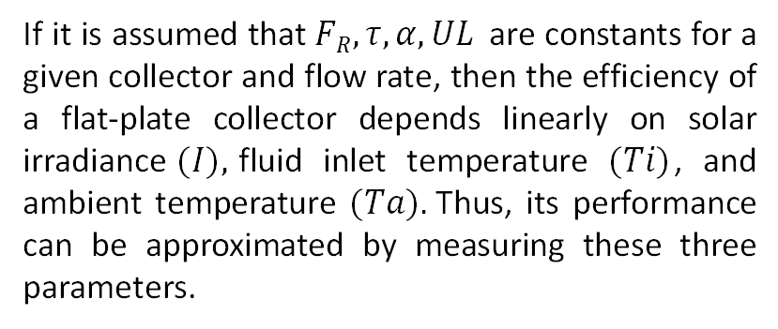
flat plate collector Efficiency plot
If it is assumed that $FR, τ, α, UL$ are constants for a given collector and flow rate, then the efficiency of a flat-plate collector depends linearly on solar irradiance$(I),$fluid inlet temperature $(Ti)$, and ambient temperature $(Ta).$Thus, its performance can be approximated by measuring these three parameters.

Slide 27
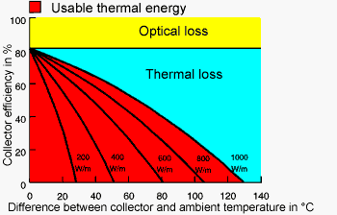



flat plate collector Efficiency plot
$η0$​: Optical efficiency (y-intercept at zero ΔT).
$a1$​: First-order loss coefficient (convection + conduction).
$a2$​: Second-order loss coefficient (radiation losses).
$Tm$​: Mean fluid temperature.
$Ta$​: Ambient temperature.
$G$: Solar irradiance.

Slide 28




Exercise
Problem: The solar radiation on a flat plate collector of $2.1 m2$of aperture is 800 𝑊/𝑚. The collector is tilted 40∘ and south. The angle of incidence of the radiation is 20∘. The following data is also known:
a) What is the fluid outlet temperature?
b) What is the solar collector efficiency under the given conditions?
Use:
Assume the given irradiance as irradiance on the tilted collector: ($FR$ SHOULD BE = 0.964)
MAKE SURE TO MULTIPLY COLLECTOR AREA BY MASS FLOW RATE

