Slide 1
Biomass Energy

Slide 2
CONTENTS
Biomass
Biomass Conversion
Biomass Characterization
Exercise
References

Slide 3
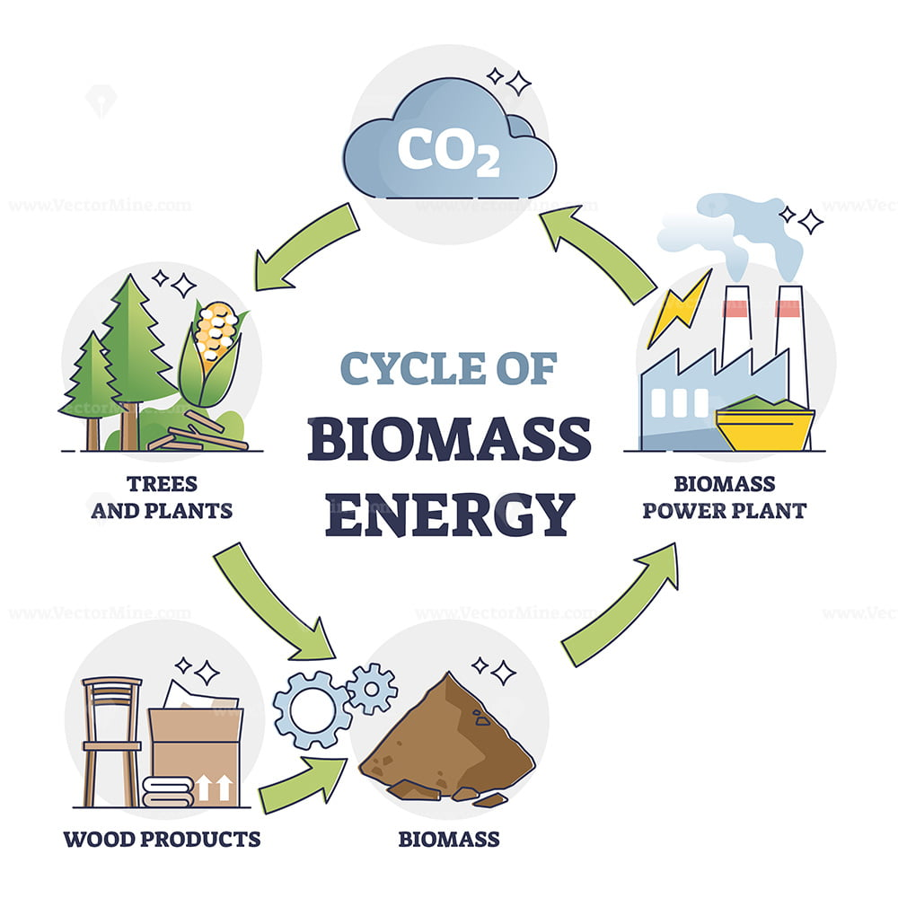
Biomass
Biomass is organic material derived from living or recently living organisms, such as plants, animals, and microorganisms. It can be used as a renewable source of energy.
Examples:
Agricultural residues (straw, husks, corn stover)
Forestry residues (sawdust, branches, bark)
Energy crops (switchgrass, miscanthus, short-rotation coppice)
Organic municipal solid waste (food waste, paper)
Animal manure and processing waste
Key Features:
Renewable and widely available / Potential for carbon neutrality / Converts waste into energy

Slide 4
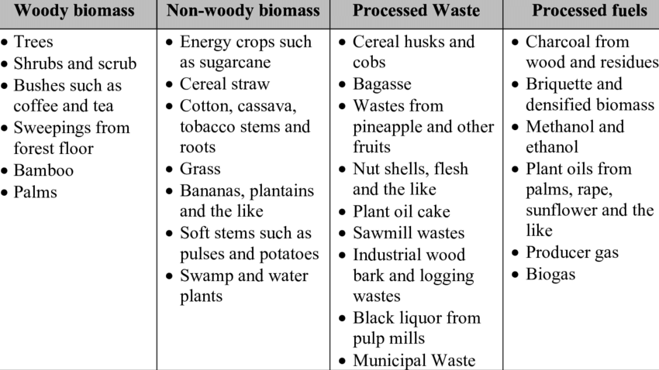
Biomass classification
By Origin
Lignocellulosic Biomass: High cellulose/lignin (wood, straw)
Algal Biomass: High lipid content (micro/macro algae)
Animal Waste: Rich in nitrogen and organic matter
Municipal Biowaste: Complex organic mixtures
By Application
Solid fuels (pellets, briquettes)
Liquid biofuels (bioethanol, biodiesel)
Gaseous fuels (biogas, syngas)
Chemicals (bioplastics, enzymes)

Slide 5
Biomass classification
The different type of biomass are divided into 2 categorizes.
1. Dry Biomass: Dry biomass consists of tree chips, paper, various other plant matter such as corn, soybean, sorghum, sunflower, oats, barley, wheat and hay. Tress, bagasse, grass, municipal solid waste etc, are also part of dry biomass
2. Wet Biomass: Wet biomass tends to be in water or to stay moist
Examples are water plants, animal wastes, Municipal sewerage plant, industrial waste stream plants and biodiesel oil Treated with hydrogasification at high pressure and low temperatures to produce a gas or biofuel oil)

Slide 6
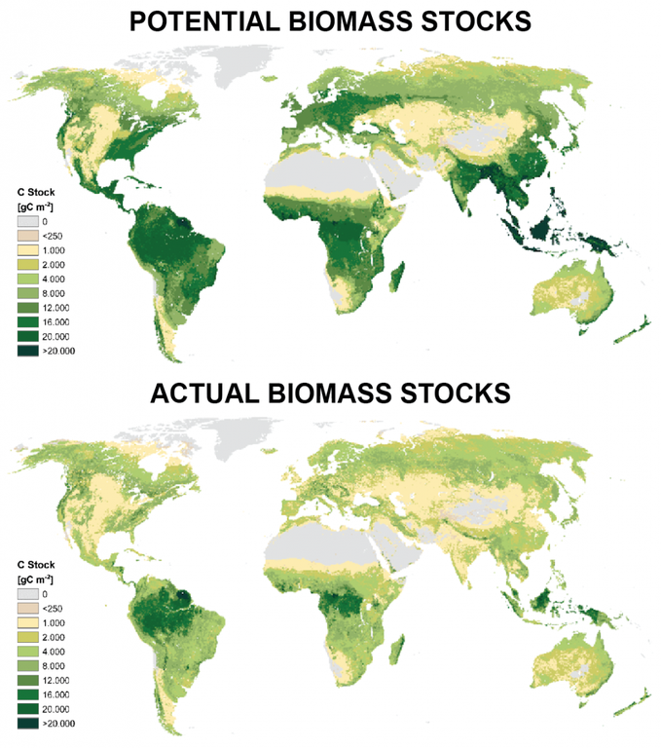
Global Biomass Availability and Potential
Global Technical Potential
Estimated 100–300 EJ per year by 2050, depending on various factors (IEA)
Main sources: Agriculture (residues, waste), Forestry, Energy crops
Current Use
~10% of global primary energy demand
50% of renewable energy in developing regions
Regional Breakdown
Europe: In 2021, the EU consumed 24.5 million tons of wood pellets, with the residential and commercial sectors accounting for 66.1% of this consumption
Asia: Southeast Asia generates over 120 million tons of biomass residues annually, with rice husk and sugarcane bagasse being the most promising
Africa: Over 850 million people rely on wood and charcoal for cooking, leading to significant health and environmental challenges
Americas: In 2021, the U.S. produced approximately 57 billion liters of bioethanol, primarily from corn starch

Slide 7
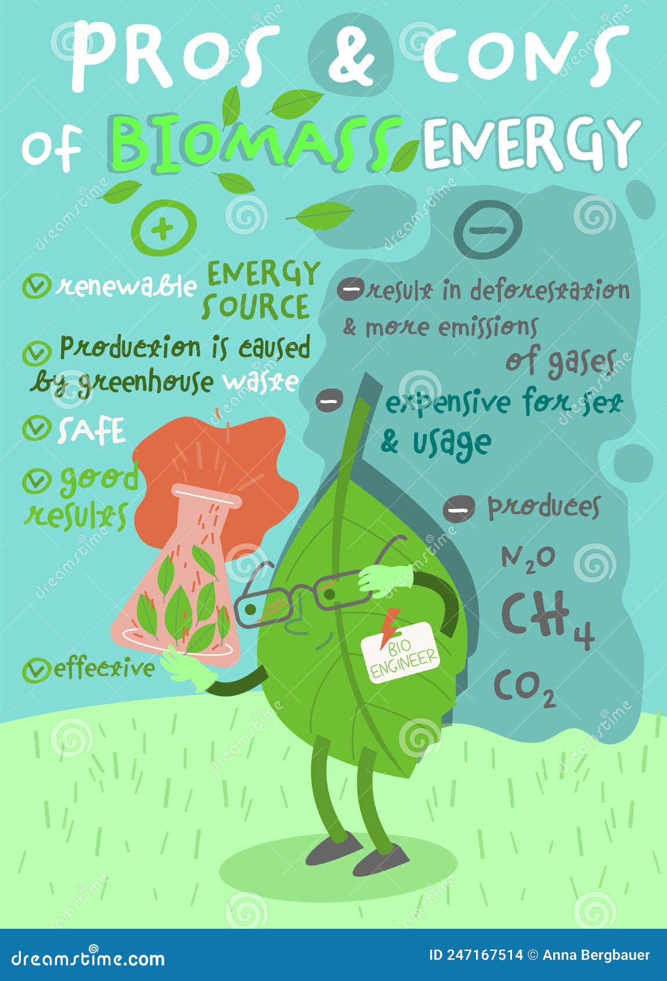
Advantages and Challenges
Advantages
Carbon Neutrality: When managed sustainably, biomass can be carbon-neutral.​
Feedstock Diversity: Wide range of biomass sources available.​
Economic Benefits: Potential for local job creation and rural development.​
Energy Security: Reduces dependence on fossil fuels.​
Waste Valorization: Effective utilization of waste materials.​
Challenges
Feedstock Variability: High moisture content and inconsistent composition can affect processing efficiency.​
Land Use Concerns: Potential conflicts with food production and biodiversity conservation.​
Logistical Issues: Complex supply chains and transportation challenges.​
Technological Costs: High initial investment and process optimization requirements.​
Environmental Impacts: Risk of deforestation and habitat loss if not managed responsibly.

Slide 8
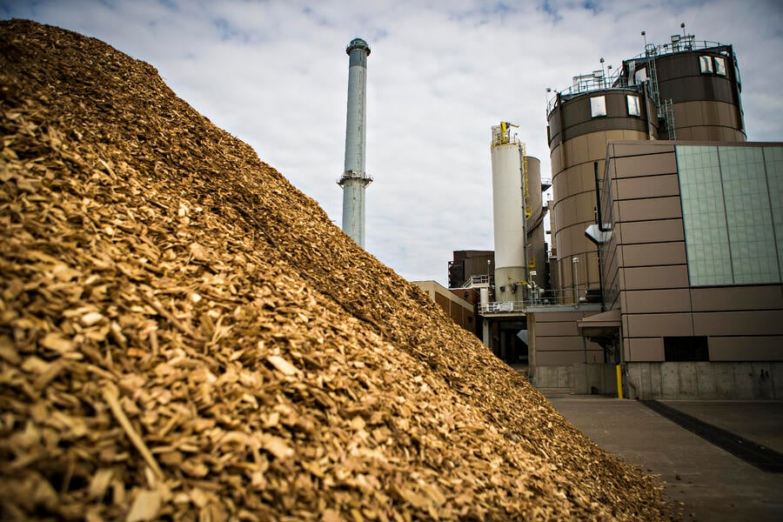
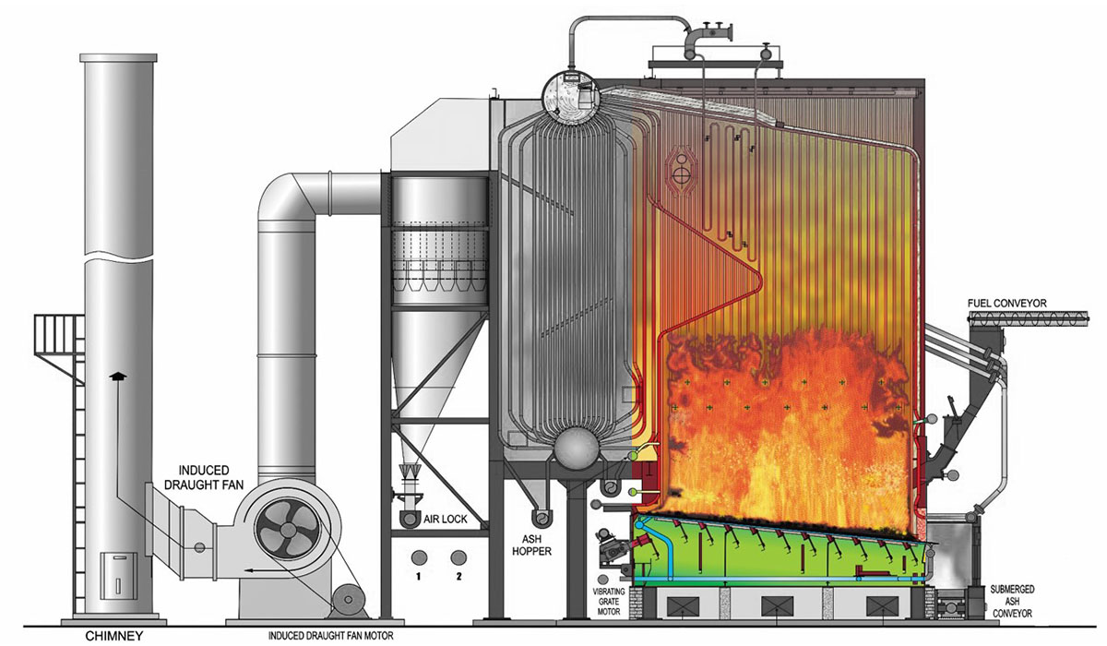
1. Biomass conversion
Thermochemical Processes
Combustion: Direct heat and power
Pyrolysis: Bio-oil, char
Gasification: Syngas for fuel and chemicals
Biochemical Processes
Fermentation: Bioethanol
Anaerobic Digestion: Biogas (CH4 + CO2)
Mechanical and Agrochemical
Oil extraction: Biodiesel
Pelletization/Briquetting: Densification

Slide 9
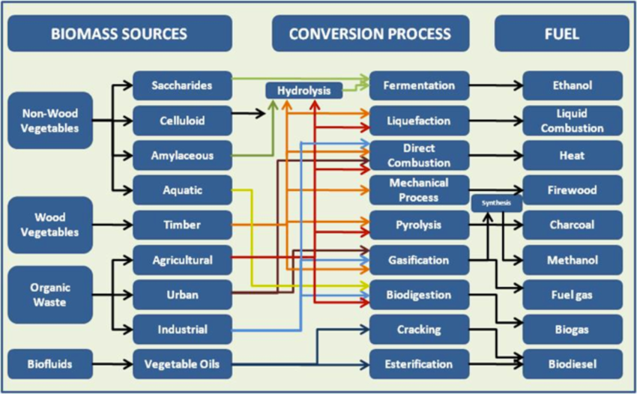
Biomass conversion

Slide 10
Biomass conversion
These are also categorized into 2 types
Wet processes
  Anaerobic digestion.
  Fermentation
  Chemical reduction
Dry processes.
  Pyrolysis
  Liquefaction
  Gasification
  Steam gasification
  Hydrogenation
  Hydrolysis

Slide 11
Biomass conversion
Biochemical conversion
Agrochemical and mechanical conversion
Biochemical conversion processes use bacteria, and enzymes to breakdown biomass into gaseous or liquid fuels.
Most common products are biogas and bioethanol
Most common processes are anaerobic digestion and fermentation
Processes that involve physical transformation of biomass into a raw product of solid or liquid fuel
Transformation into pellets or briquettes

Slide 12
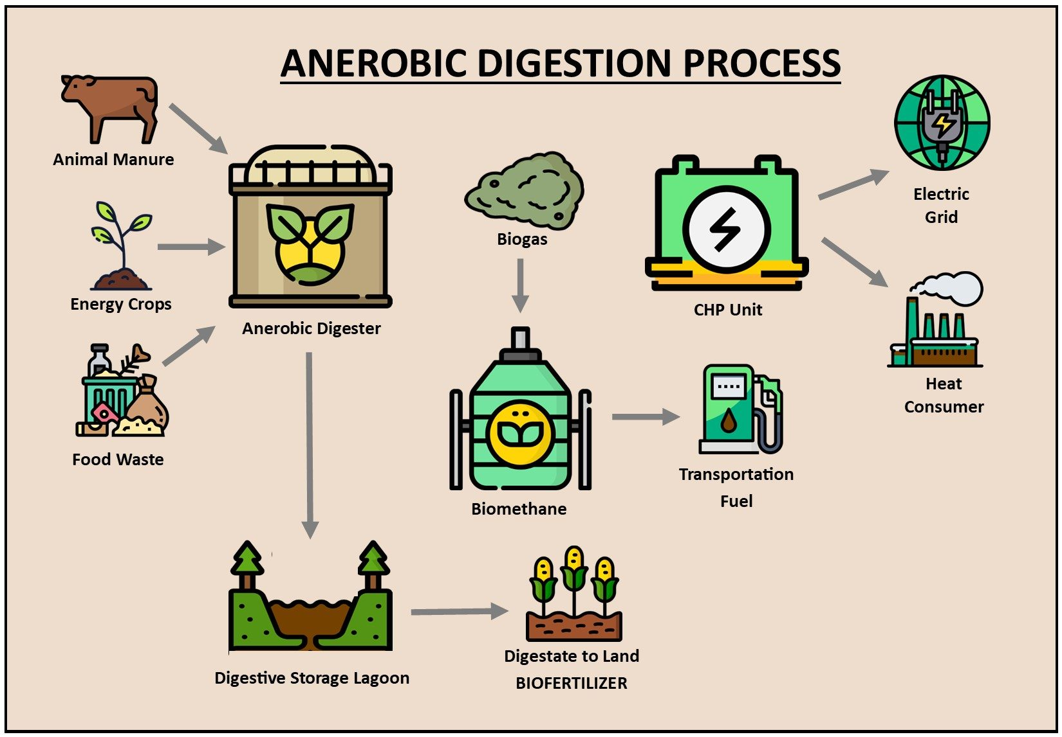
Biomass conversion
Anaerobic digestion
Anaerobic digestion or anaerobic fermentation process involves the conversion of decaying wet biomass and animal waste into biogas through decomposition process by the action of anaerobic bacteria.
Biogas is produced by the bacterial decomposition of wet sewage sludge, animal dung or green plants in the absence of oxygen but digestion takes much longer time.
The natural decay process anaerobic decomposition can be speeded up by using thermally insulation, air tight tank and heating system.
Optimum temperatuure 35˚C for complete decomposition of animal or human residue in 10 days. The residue left after digestion is valuable fertilizer.

Slide 13
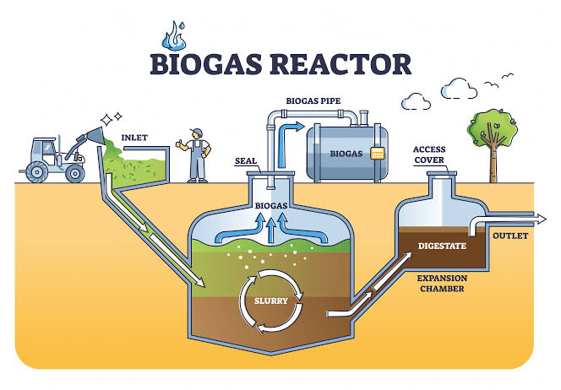
Biomass conversion
Biogas
Biogas is a combustible gaseous fuel that is collected from the microbial degradation of organic matter in anaerobic conditions
The gases methane, hydrogen, and carbon monoxide (CO) can be combusted or oxidized with oxygen
Biogas contains 55-65% methane, 30-40% CO2, and the remainders are impurities like H2S, H2, N2 gases.

Slide 14
Biomass conversion
Fermentation
Fermentation is a process of decomposition of complex molecules of organic compound under the influence of micro-organism(ferment) such as yeast, bacteria, enzymes etc.
Ethanol is produced by the fermentation of sugar solution by natural yeasts.
After 30 hours of fermentation the beer is contain 6-10% alcohol and can be removed by distillation.
The fibrous residue from plants like sugarcane bagasse, paddy straw, etc. have been burnt to provide heat. One tone of sugar will produce up to 520 liters of alcohol.
After fermentation the residue from grains and other feed stuffs contains high protein content and is a useful cattle feed supplement.

Slide 15
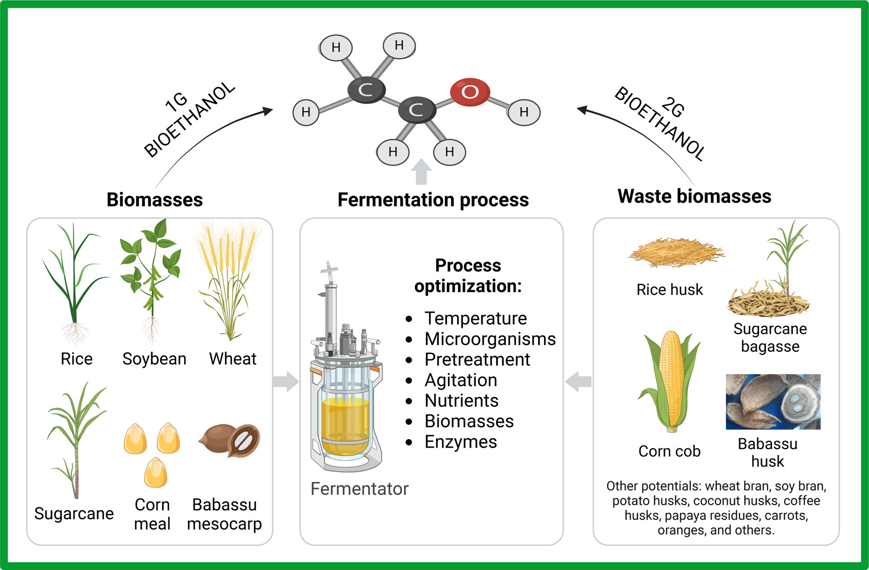
Biomass conversion
Fermentation

Slide 16
Biomass conversion
Chemical reduction
Thermochemical conversion step where the solid carbon in biomass is reduced by reacting with gases (like CO₂, H₂O, or H₂).
Produces syngas components (CO, H₂, CH₄) instead of fully oxidized products (CO₂, H₂O).
Key Reduction Reactions:
Boudouard reaction (CO₂ reduction): C + CO₂ ⇌ 2CO
Water–gas reaction (steam reduction): C + H₂O ⇌ CO + H₂
Hydrogenation: C + 2H₂ ⇌ CH₄
Conditions:
High temperatures (700–1200 °C)
Oxygen-deficient (sub-stoichiometric) environment
Why it matters in Biomass Conversion:
Core step in gasification and chemical looping.
Determines syngas yield and quality.
Enables hydrogen production and biofuels synthesis.

Slide 17
Biomass conversion
Thermochemical conversion
Pyrolysis
Gasification
Combustion
Thermochemical conversion
Thermochemical conversion processes such as pyrolysis and gasification use low moisture biomass and biowaste to produce electricity, heavy oil or gas fuels [2].
Pyrolysis (Slow, intermediate, fast and flash)
Gasification (Fixed bed, fluidized bed)
Combustion (Fixed bed, fluidized bed)
Char
Biofuel
Biogas
Heat
Biodiesel
Motor
Gas turbine
Boiler
Stove
Biochar
Generator
Steam turbine
Cooking char
Absorbent char
Electricity
District heat

Slide 18
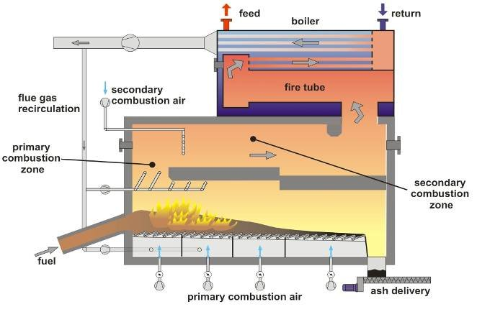
Biomass conversion
Direct combustion
Direct combustion is the most used conversion process, with over 90 % of the world’s primary energy supply being converted through direct combustion through boilers, burners, internal combustion engines and turbines among others [1]
Source: Researchgate

Slide 19
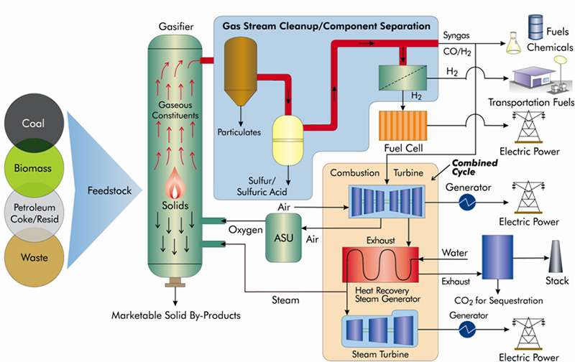
Biomass conversion
Gasification
A process that converts solid fuels (like biomass, coal, or waste) into a fuel gas (“syngas”) by reacting them with a limited amount of oxygen or steam.
Why it matters:
Produces a versatile gas (H₂, CO, CH₄) that can be used for power, fuels, or chemicals.
More efficient and flexible than direct combustion.
Can integrate with carbon capture for cleaner energy.
Where it’s used:
Electricity (gas turbines, engines)
Biofuels & hydrogen
Chemicals (ammonia, methanol)
Waste-to-energy solutions

Slide 20
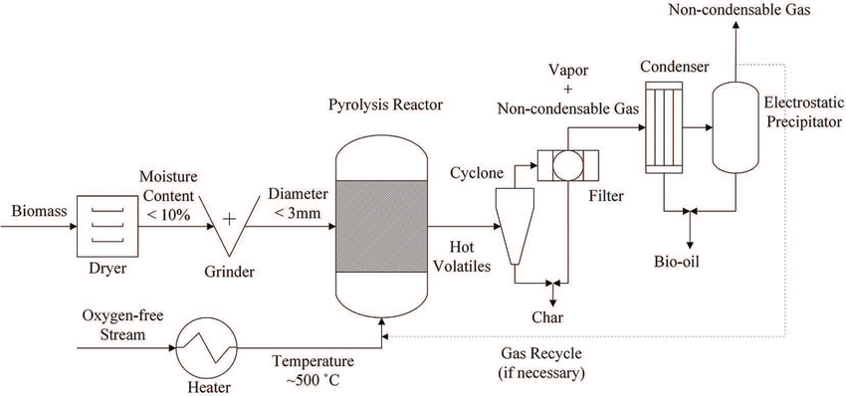
Biomass conversion
Pyrolysis
Thermochemical decomposition of biomass or waste in the absence of oxygen, producing liquids (bio-oil), gases, and solid char.
Key Features:
Operates at 300–600 °C
No oxygen → prevents combustion
Product distribution depends on temperature & heating rate
Main Products:
Bio-oil (liquid fuel, chemicals)
Syngas (H₂, CO, CH₄ for energy)
Biochar (soil amendment, carbon storage)
Why it matters:
Converts waste/biomass into valuable fuels and materials
Supports carbon sequestration through biochar
Foundation for bio-refinery concepts

Slide 21
2. Biomass characterization
Biomass is characterized by its physical, chemical and thermodynamic properties, which vary from different sources and types of biomass, and are measured by experimentation and calculations and affect their behavior during gasification.
The main physical properties are:
  Density
  Particle size, shape and porosity
Main chemical properties:
  Elemental composition
  Moisture content, volatile matter, fixed carbon

Slide 22

Biomass characterization
Physical properties - Density
For solid biomass there are four different characteristic densities, true, apparent, bulk and biomass growth [3].
True density is defined as the weight per unit volume of the biomass as shown in Eq. (1). It is the mass of the particle divided by its volume, excluding open and closed pores
The measurement of this density is difficult, it can be measured with a pycnometer or be estimated using the ultimate analysis.
Eq. (1)

Slide 23

Biomass characterization
Physical properties - Density
Apparent density is measured using the apparent volume of the biomass (porosity εp), including pores and internal solids as shown in Eq. (2). Apparent density is easy to measure and gives the actual volume occupied by the biomass.
Eq. (2)

Slide 24
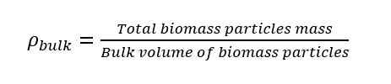
Biomass characterization
Physical properties - Density
Bulk density is the density of the overall space occupied by the biomass particles as a group; it includes interstitial volume between particles, having an interstitial volume known as bulk porosity (porosity εb) which can be expressed as a function of the total packed volume. Bulk density is expressed as shown in Eq. (3).
Eq. (3)

Slide 25
Biomass characterization
Physical properties – Particle size
Particle size, shape of the biomass particles and porosity are among the most relevant physical properties of biomass. Particle size considerably affects the performance of the gasification process, using sizes from 10-6 m to 10-2 m.
Biomass is usually grinded to the desired size, prior to gasification and the particle size distribution is determined to know the distribution of particle size within the biomass to be gasified, the usual particle size presents a normal probabilistic curve distribution [4].

Slide 26

Biomass characterization
Physical properties – Particle shape
Particle shape also affects the gasification process, including the reaction rates, having higher reaction rates in particles with more surface area.
Sphericity is the most common way to describe the shape of a particle, which compares the surface area of a spherical particle with the surface area of another particle of the same volume (Eq. 4), tending to be 1 for particles with a spherical shape.
Eq. (4)

Slide 27
Biomass characterization
Chemical properties
Biomass is composed by organic and inorganic compounds
Biomass has a complex composition and molecular structure
The composition and structure are essential for designing a gasifier and for doing biomass gasification processes
Two types of characterization are used to define biomass properties:
  Ultimate or elemental composition: Basic elements (C, H, O, N, S)
  Proximate composition: Ash content, fixed carbon, volatile matter, moisture content

Slide 28
Biomass characterization
Examples of biomass chemical composition
Biomass Type | C (%) | H (%) | O (%) | N (%) | S (%) | Ash (%)
Wood (hardwood/softwood) | 47–52 | 5.5–6.5 | 40–45 | <0.5 | <0.05 | 0.3–1.0
Agricultural residues (e.g., straw, husks) | 42–48 | 5.5–6.0 | 38–45 | 0.3–1.0 | <0.2 | 3–15
Energy crops (e.g., switchgrass, miscanthus) | 45–50 | 5.5–6.0 | 40–45 | 0.5–1.0 | <0.2 | 2–5
Herbaceous biomass | 44–48 | 5.5–6.0 | 40–44 | 0.5–1.5 | <0.2 | 4–10
Algae (microalgae, macroalgae) | 45–55 | 6–8 | 30–40 | 5–10 | <1 | 10–40
Animal manure | 35–45 | 4–6 | 25–35 | 2–6 | 0.2–1 | 15–30
Municipal solid waste (biogenic fraction) | 40–50 | 5–7 | 30–45 | 0.5–1.5 | <0.3 | 10–20

Slide 29
Biomass characterization
Examples of biomass composition
Biomass Type | Composition (approx., dry basis) | Energy Content (MJ/kg) | Key characteristics | Best Suited For
Wood | C: 47–52%, H: 5–6%, O: 40–45%, Ash <1% | 18–20 | High C, low ash → clean syngas; stable feedstock | Gasification, Pyrolysis, Combustion
Agricultural residues | C: 42–48%, H: ~6%, O: 38–45%, Ash 3–15% | 15–17 | Higher ash & alkali (K, Na) → fouling & slagging risk | Co-firing, Gasification (with pretreatment), Pyrolysis
Algae | C: 45–55%, H: 6–8%, O: 30–40%, N: 5–10%, Ash 10–40% | 10–20 | High N → NOx emissions; rich in lipids & proteins | Biofuels, Biogas, CO₂ capture integration
Manure/MSW | C: 35–45%, H: 4–6%, O: 25–35%, N: 2–6%, Ash 15–30% | 10–15 | High ash, variable composition; lower energy | Anaerobic Digestion, Waste-to-Energy

Slide 30
Biomass characterization
Examples of biomass chemical composition
Wood
High carbon, low ash
Produces clean, energy-rich syngas
Stable feedstock → ideal for gasification & pyrolysis
Agricultural residues
Higher ash and alkali metals (K, Na)
Risk of slagging, fouling, corrosion in reactors
Needs pretreatment or blending for stable operation
Algae
High nitrogen content
Leads to NOx emissions during combustion/gasification
Rich in proteins & lipids → promising for biofuels but needs emission control
Manure & MSW
High ash, variable composition
Lower energy content compared to wood
Suitable for waste-to-energy, but requires robust reactor design and emission control

Slide 31
Biomass characterization
Moisture content
Present in biomass, expressed as % of total weight. Strongly influences energy value, handling, and conversion efficiency.
Typical Ranges:
Wood: 10–50% (fresh → dried pellets)
Agricultural residues: 10–20% (usually air-dried in fields)
Algae: 50–90% (very high water content)
Manure/MSW: 50–80% (varies widely)
Importance:
High moisture = lower heating value (more energy wasted on drying).
Increases transport & storage costs.
Limits suitability for thermochemical conversion (gasification, pyrolysis, combustion).
Favors wet processes like anaerobic digestion or hydrothermal treatments.
Moisture decides the conversion route:
Low-moisture biomass → gasification/pyrolysis/combustion.
High-moisture biomass → anaerobic digestion/hydrothermal processing.

Slide 32
Biomass characterization
Handling
Biomass is bulky, variable, and degradable → storage & transport are key challenges.
Impacts logistics, costs, and process efficiency.
Typical Challenges by Feedstock:
Wood → Easy to store/densify (chips, pellets); relatively uniform; low degradation risk.
Ag Residues → Seasonal availability; bulky; prone to dust, fouling, and spontaneous combustion in storage.
Algae → Very wet; needs dewatering & drying (energy-intensive); high perishability.
Manure/MSW → Highly variable; odor & pathogen risks; requires controlled handling & preprocessing (sorting, drying, stabilization).
Handling:
Densification → pellets, briquettes, bales
Preprocessing → drying, size reduction, blending
Storage design → ventilation, covered silos, odor control
Logistics → decentralized collection, transport optimization
Takeaway:
Handling is as important as conversion technology — poor logistics can outweigh the energy benefits of biomass.

Slide 33
Biomass characterization
Examples of woody biomass chemical composition
Composition |  | Woody Biomass
 |  | Norway spruce | Grey alder | Scots pine | Silver birch
Elemental analysis [wt%] | C | 50.3 | 49.9 | 50.1 | 49.3
 | H | 6.6 | 6.6 | 6.6 | 6.6
 | N | 0.1 | 0.2 | 0.19 | 0.08
 | S | n.d. | n.d. | n.d. | n.d.
 | O* | 42.7 | 43.0 | 43.1 | 44.0
Proximate analysis [wt%] | Ash content | 0.3 | 0.3 | 0.3 | 0.3
 | Moisture | 6.9 | 7.6 | 8.5 | 7.7
 | Fixed carbon | 14.2 | 14.0 | 14.5 | 12.8
 | Volatile matter | 85.5 | 85.7 | 85.2 | 86.9
Calorific value [MJ/kg] | LHV | 18.6 | 18.5 | 18.4 | 18.0
 | HHV | 20.0 | 19.9 | 19.8 | 18.1

Slide 34
3. Biomass characterization. Exercise
Pick 4 biomass feedstocks from the list provided (e.g., wood, straw, algae, manure).
Using the given composition and properties, calculate:
Heating values (HHV, LHV) – dry and as-received
Stoichiometric oxygen and air requirements
Fouling/slagging risk (Alkali Index)
Compare the two feedstocks and answer:
Which has higher usable energy?
Which needs more air for combustion/gasification?
Which poses higher fouling* risk?
Which conversion route is most suitable and why?
Prepare a short 1 page report with calculations, results, answers, and your conclusion.
Homework: Biomass Feedstock comparison
You are given a database of different biomass feedstock. For each feedstock, you have:
Elemental composition on daf basis: C_daf, H_daf, O_daf, N_daf, S_daf (wt.%)
Ash_dry on dry basis (wt.%)
Moisture (M)_ar on as-received basis (fraction or %)
Alkali in ash (% K₂O+Na₂O in ash)
*daf = dry ash-free, dry = includes ash but no moisture, as-received (ar) = includes moisture and ash.
*Unwanted deposition of ash, alkali salts, or other condensed species on heat‐transfer or reactor surfaces.

Slide 35
3. Biomass characterization. exercise
Step 1. Convert bases (C, H, O, N, S) (daf → dry → ar)
Dry basis (incl. ash):
x(dry)% = x(daf)% * (1 − Ash(dry)/100)
As-received (ar):
x(ar)% = x(dry)% * (1 − M)
Ash(ar)% = Ash(dry)% * (1 − M)
Moisture(ar)% = 100 * M
Check: C(ar)+H (ar) +O (ar) +N (ar) +S (ar) +Ash (ar) +Moist (ar) ≈100% (mass balance)
Step 3. Stoichiometric oxygen and air demand
O₂ required (kg/kg fuel, dry):
O₂ = [(C(dry)/12) + (H(dry)/4) + (S(dry)/32) − (O(dry)/32)] * (32/100)
Air required (kg/kg fuel, dry):
Air = O₂ / 0.232 (since O₂ ≈ 23.2% of air by mass)
Step 2. Energy values
HHV(daf) = 0.3383·C + 1.422·(H − O/8) + 0.0942·S
HHV(dry) = HHV(daf) * (1 − Ash(dry)/100)
LHV(dry) = HHV(dry) − 2.443 × (9·H(dry)/100)
HHV(ar) = HHV(dry) * (1 − M)
LHV(ar) ≈ LHV(dry) * (1 − M) − 2.443·M
Step 4. Fouling / slagging risk (Alkali Index)
Ash(ar) = Ash(dry)/100 × (1 − M)
Alkali mass per kg fuel = Ash(ar) * (% alkali in ash / 100)
LHV(ar,GJ/kg) = LHV(ar,MJ/kg) / 1000
Alkali Index (AI) = Alkali mass / LHV(ar,GJ/kg) [kg alkali / GJ]

Slide 36
Biomass characterization. Exercise
Choose 4 feedstock from the database (wood, straw, algae, manure/MSW, etc.). Each has typical C, H, O, N, S, ash, and moisture values.
Name | Category | C daf % | H daf % | O daf % | N daf % | S daf % | Ash dry % | Moisture ar (fraction) | HHV dry MJ/ kg | Alkali in Ash %
Hardwood | Wood | 50 | 6 | 43 | 0.2 | 0.02 | 0.5 | 0.15 | 19.5 | 2
Softwood | Wood | 51 | 6.2 | 42 | 0.15 | 0.02 | 0.4 | 0.45 | 20 | 2
Rice straw | Ag residue | 45 | 5.8 | 45.5 | 0.6 | 0.1 | 13 | 0.12 | 16 | 20
Wheat straw | Ag residue | 46 | 6 | 45 | 0.5 | 0.1 | 8 | 0.12 | 16.5 | 18
Corn stover | Ag residue | 47 | 6 | 45 | 0.6 | 0.1 | 7 | 0.12 | 17 | 15
Sugarcane bagasse | Ag residue | 46 | 6.1 | 46.5 | 0.3 | 0.05 | 3 | 0.5 | 17 | 10
Miscanthus | Energy crop | 47.5 | 6 | 45 | 0.5 | 0.05 | 3.5 | 0.15 | 17.8 | 8
Switchgrass | Energy crop | 47 | 5.9 | 45.5 | 0.6 | 0.05 | 4 | 0.15 | 17.5 | 8
Microalgae | Algae | 50 | 7 | 33 | 8.5 | 0.3 | 25 | 0.8 | 18 | 8
Macroalgae | Algae | 47 | 6.5 | 35 | 8 | 0.3 | 30 | 0.85 | 16 | 10
Dairy manure | Manure | 40 | 5.5 | 32 | 3.5 | 0.4 | 25 | 0.75 | 14 | 12
Poultry litter | Manure | 42 | 5.7 | 32 | 5 | 0.6 | 20 | 0.4 | 15 | 15
Food waste (biogenic MSW) | MSW | 44 | 6.3 | 36 | 2.5 | 0.3 | 15 | 0.7 | 16 | 10
Mixed MSW (biogenic fraction) | MSW | 43 | 6 | 37 | 2 | 0.3 | 18 | 0.5 | 15 | 10
Sewage sludge (dried) | Waste | 42 | 5.8 | 33 | 6.5 | 1 | 30 | 0.8 | 15 | 10

Slide 37
REFERENCES
[1] - R. P. Overend, “Renewable energy sources charged with energy from the sun and originated from earth-moon interaction,” Direct Combust. biomass, vol. I.
[2] - A. A. Ahmad, N. A. Zawawi, F. H. Kasim, A. Inayat, and A. Khasri, “Assessing the gasification performance of biomass: A review on biomass gasification process conditions, optimization and economic evaluation,” Renew. Sustain. Energy Rev., vol. 53, pp. 1333–1347, 2016.
[3] V. Strezov and T. J. Evans, Biomass Processing Technologies. Boca Raton: CRC Press, 2014.
[4] J. Ahrenfeldt, T. P. Thomsen, U. Henriksen, and L. R. Clausen, “Biomass gasification cogeneration - A review of state of the art technology and near future perspectives,” Appl. Therm. Eng., vol. 50, no. 2, pp. 1407–1417, 2013.

Slide 38
REFERENCES
[5] C. Higman and M. van der. Burgt, Gasification, Gulf Profe. Gulf Professional Pub./Elsevier Science, 2008.
[6] S. K. Sansaniwal, K. Pal, M. A. Rosen, and S. K. Tyagi, “Recent advances in the development of biomass gasification technology: A comprehensive review,” Renew. Sustain. Energy Rev., vol. 72, no. December 2015, pp. 363–384, 2017.
[7] A. P. G. Peres, B. H. Lunelli, and R. Maciel FIlho, “Application of Biomass to Hydrogen and Syngas Production,” Chem. Eng. Trans., vol. 32, no. 2011, pp. 589–594, 2013.
[8] A. Chaurasia, “Modeling simulation and optimization of downdraft gasifier: Studies on chemical kinetics and operating conditions on the performance of the biomass gasification process,” Energy, no. 116, pp. 1065–1076, 2016.

Slide 39
REFERENCES
[9] S. K. Sansaniwal, K. Pal, M. A. Rosen, and S. K. Tyagi, “Recent advances in the development of biomass gasification technology: A comprehensive review,” Renew. Sustain. Energy Rev., vol. 72, no. December 2015, pp. 363–384, 2017.
[10] N. Mahinpey and A. Gomez, “Review of gasification fundamentals and new findings: Reactors, feedstock, and kinetic studies,” Chem. Eng. Sci., vol. 148, pp. 14–31, 2016.
[11] T. K. Patra and P. N. Sheth, “Biomass gasification models for downdraft gasifier--A state of teh art review,” Renew. Sustain. Energy Rev., no. 50, pp. 583–593, 2015.
[12] M. La Villeta, M. Costa, and N. Massarotti, “Modelling approaches to biomass gasification-review,” Renew. Sustain. Energy Rev., no. 74, pp. 71–88, 2017.

Slide 40
REFERENCES
[13] J. A. Ruiz, M. C. Juárez, M. P. Morales, P. Muñoz, and M. A. Mendívil, “Biomass gasification for electricity generation: Review of current technology barriers,” Renew. Sustain. Energy Rev., vol. 18, pp. 174–183, 2013.
[14] L. Wang, C. L. Weller, D. D. Jones, and M. A. Hanna, “Contemporary issues in thermal gasification of biomass and its application to electricity and fuel production,” Biomass and Bioenergy, vol. 32, no. 7, pp. 573–581, Jul. 2008.
[15] N. Couto, A. Rouboa, V. Silva, E. Monteiro, and K. Bouziane, “Influence of the Biomass Gasification Processes on the Final Composition of Syngas,” Energy Procedia, vol. 36, pp. 596–606, Jan. 2013.

Slide 41
REFERENCES
[16] M. Hosseini, I. Dincer, and M. A. Rosen, “Steam and air fed biomass gasification: Comparisons based on energy and exergy,” Int. J. Hydrogen Energy, vol. 37, no. 21, pp. 16446–16452, Nov. 2012.
[17] P. Klimantos, N. Koukouzas, A. Katsiadakis, and E. Kakaras, “Air-blown biomass gasification combined cycles (BGCC): System analysis and economic assessment,” Energy, vol. 34, no. 5, pp. 708–714, May 2009.
[18] M. Dogru, C. R. Howarth, G. Akay, B. Keskinler, and A. A. Malik, “Gasification of hazelnut shells in a downdraft gasifier,” Energy, vol. 27, no. 5, pp. 415–427, 2002.

