Slide 1
WIND energy
Mais Baqain Ph.D; Mais.Baqain@taltech.ee
Prof. Alar Konist

Slide 2
Wind energy
Wind is air in motion. It is produced by the uneven heating of the earth’s surface by the sun. Since the earth’s surface is made of various land and water formations, it absorbs the sun’s radiation unevenly.
some patches of air become warmer than others. These warm patches of air rise, other air rushes in to replace them – thus, wind blows.
Two factors are necessary to specify wind: speed and direction.
A wind turbine extracts energy from moving air by slowing the wind down, and transferring this energy into a spinning shaft, which usually turns a generator to produce electricity.
The power in the wind that’s available for harvest depends on both the wind speed and the area that’s swept by the turbine blades.

Slide 3
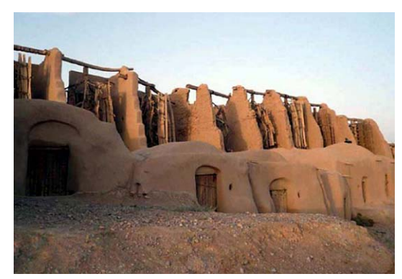
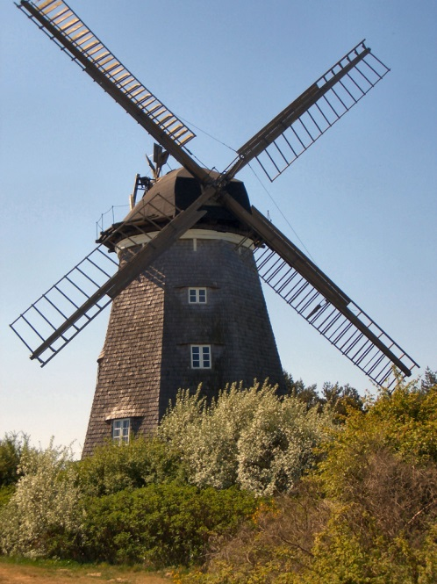

History
Wind power has been used since early history by mariners for sailing boats on rivers and lakes and then ships at sea
Windmills and water-driven mills were the only power generators for over 1200 years, the word “windmill” primarily refers to a wind-powered machine that grinds or mills grain such as wheat or corn and turns it into flour for bread making.
Remaining vestiges of ancient vertical-axis windmills or “Panemones” at Seistan, near the border between Iran and Afghanistan. The rotors were made from cloth or bundles of reeds and wood.
[Book: Wind Energy Engineering-chapter 7]
Dutch wind mill, Netherlands
Wind pump, Oklahoma, USA

Slide 4
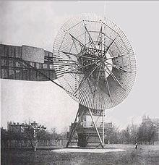
History
In the 12-15th centuries the construction of windmills spread throughout central Europe all the way to Scandinavia reaching Finland in AD 1400. Windmills became the prime power movers all over Europe for grinding grain, pumping water, paper making, pressing oil from oil seeds, and sawing wood for ships and homes construction.
The first electricity generating wind turbine, was a battery charging machine installed in July 1887 by Scottish academic, James Blyth to light his holiday home in Marykirk, Scotland.
Some months later American inventor Charles F Brush built the first automatically operated wind turbine for electricity production in Cleveland, Ohio.
In Denmark by 1900, there were about 2500 windmills for mechanical loads such as pumps and mills, producing an estimated combined peak power of about 30 MW.
The first automatically operated wind turbine, built in
Cleveland in 1887 by Charles F. Brush. It was 18 m tall,
weighed 3.6 tonnes and powered a 12kW generator.
[Book – Handbook on renewable energy sources]

Slide 5
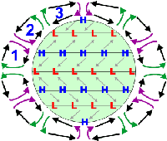
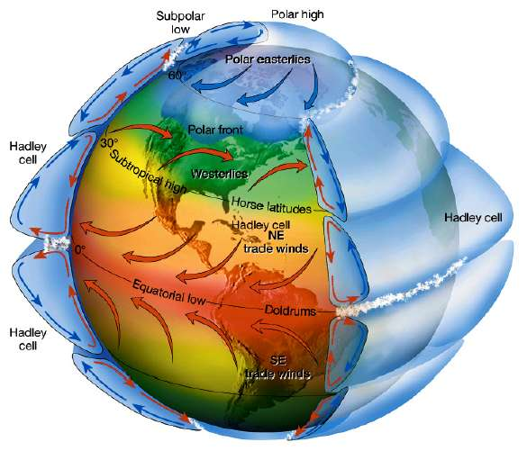
Global winds – system of the earth
Wind development by Uneven heating of earth’s surface by solar radiation, absorption (change land / water)
Wind is the movement of air caused by uneven global warming. As the surface layer of the earth can contain both soil and water, solar radiation is absorbed at different rates.
Changes in the air temperature and density, In the lower atmosphere the air is denser than in the higher one, so the air pressure is lower than in a higher atmosphere.
Earth rotation
Although air moves from a higher pressure area to lower pressure areas, the wind does not move in a straight line because the earth rotates. In the northern hemisphere, the winds curve to the right due to the Earth's spin, and in the southern hemisphere to the left. In the northern hemisphere, the winds blow clockwise around high-pressure areas and counterclockwise around lower-pressure areas. This is called the Coriolis effect
[http://www.atmosphere.mpg.de]

Slide 6
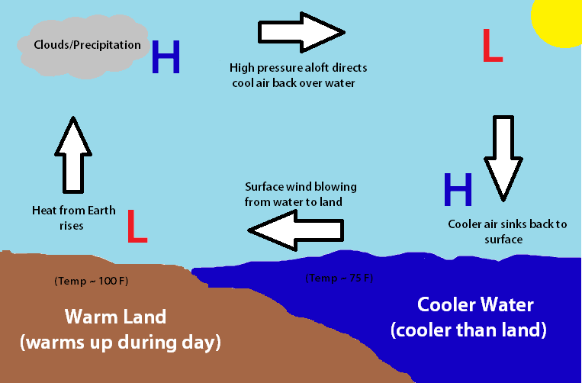
Air movements
As warm air has a lower density than cold air, it rises, and cold air is denser, it sinks down.
As warm air rises, colder air often moves in place, so the wind often moves from cooler areas to warmer ones
The greater the difference in air pressure or the shorter the distance between areas with different pressures, the faster the air moves.
Meteorologists predict wind speed and direction using a barometer

Slide 7
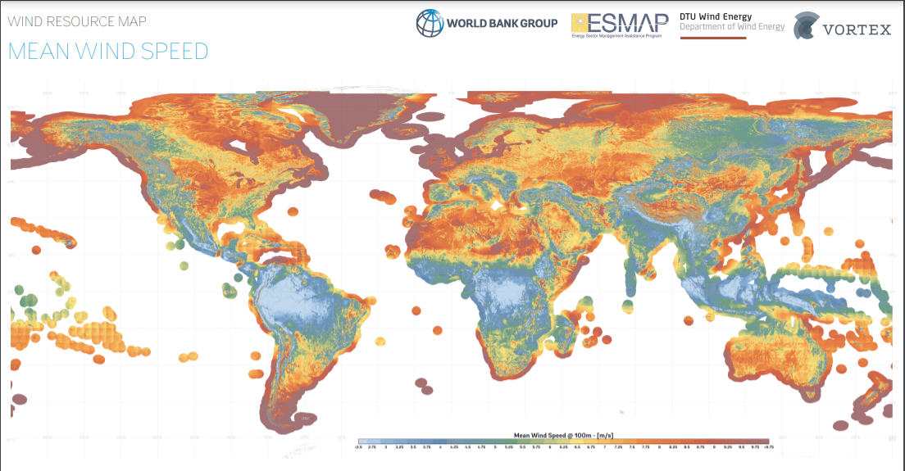
https://globalwindatlas.info/

Slide 8
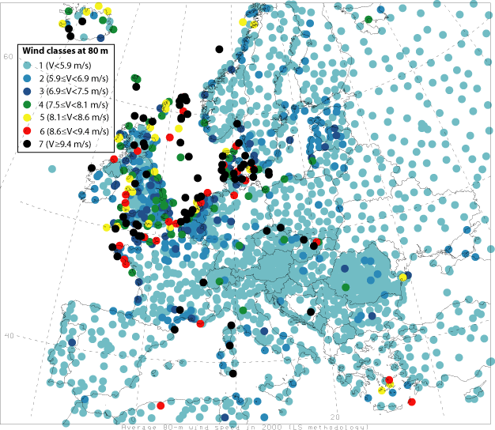
Wind Energy Potential in EUROPE
http://www.geni.org/
Notes:
5 ~ 11 m/s --- 5 m/s is the minimum operational speed. It is called “Cut-in speed”.
In 5 ~ 11 m/s wind, generated power increases with the wind speed

Slide 9
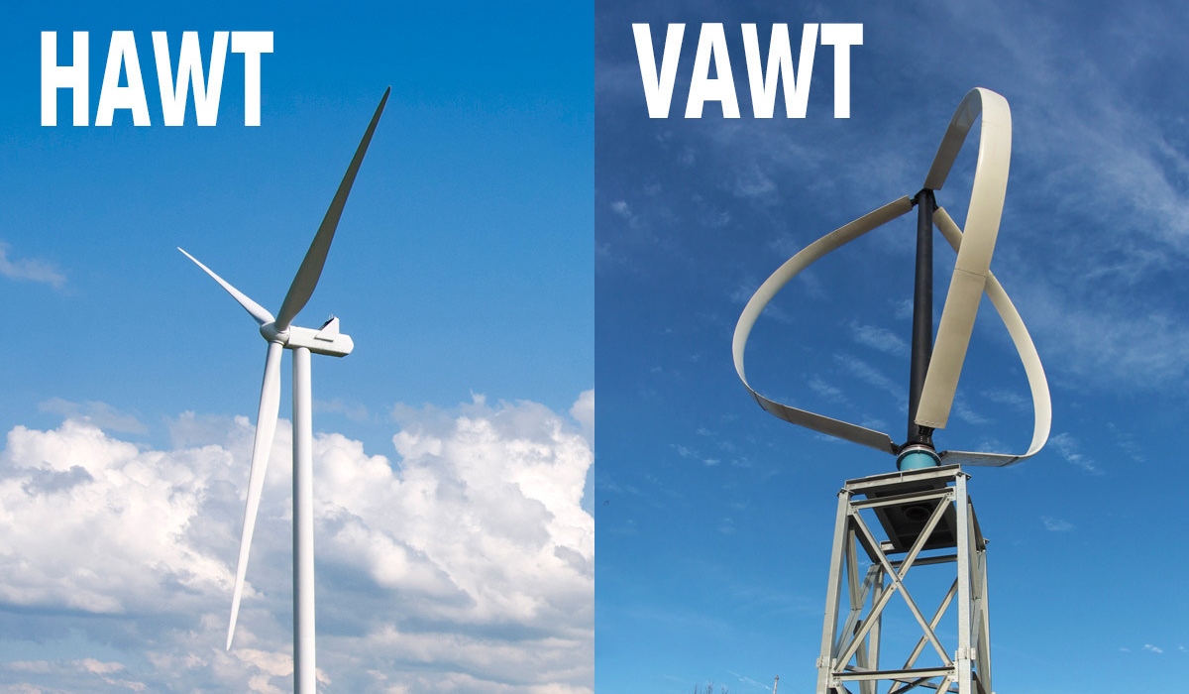
types of wind turbines
A wind turbine is a device that converts the wind's kinetic energy into electrical energy.
Two main types of wind turbines:
Horizontal axis (HAWT)
Vertical axis (VAWT)
The majority of installed wind turbines are of the HAWT type (approx. 99%) and have a high level of maturity
VAWT has mainly been installed in some experimental facilities and on top of buildings

Slide 10
types of wind turbines
Horizontal-axis wind turbine is the most used type of turbine. Its components include a shaft, generator, and blades. The blades are made facing the wind. The blades are hit by the wind causing the shaft to rotate. The generator is turned on by a gear connected to the shaft, and the production of electricity starts and is sent to the power grid.
In a vertical axis turbine, the shaft and the blade are connected vertically to the ground. The main components are all close to the ground. The wind turbines of the vertical one are near the ground, unlike the horizontal ones. The vertical axis wind turbine has two types, namely: lift-based and drag-based turbines.
[Wagner, H.J.: Wind energy conversion. in: Landolt-Börnstein New Series VIII/3C]

Slide 11
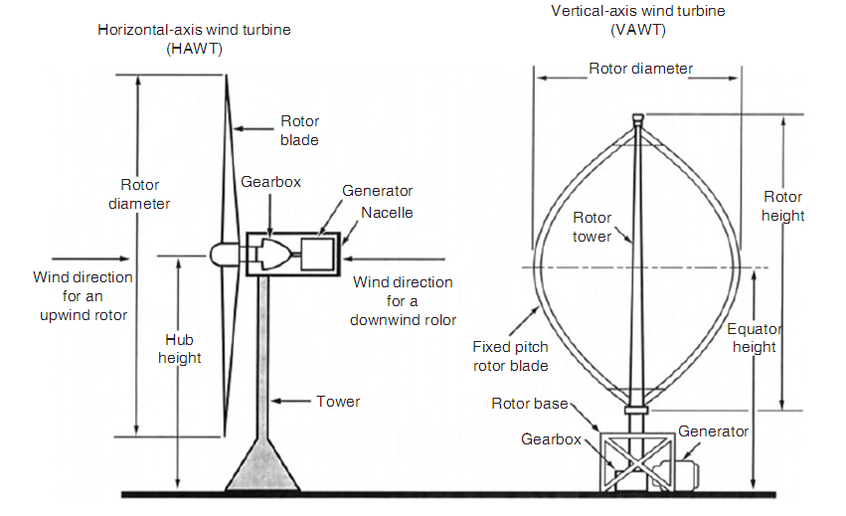
Comparison of HAWT and VAWT
[Handbook of Energy Efficiency and Renewable Energy, Wind energy conversion, Yogi Goswami, 2007]
Notes:
In horizontal axis turbine, it is possible to catch more wind and so the power output can be higher than that of vertical axis. But in horizontal axis design, the tower is higher and more blade design parameters have to be defined.
In vertical axis turbine, no yaw system is required and there is no cyclic load on the blade, thus it is easier to design. Maintenance is easier in vertical axis turbine whereas horizontal axis turbine offers better performance

Slide 12
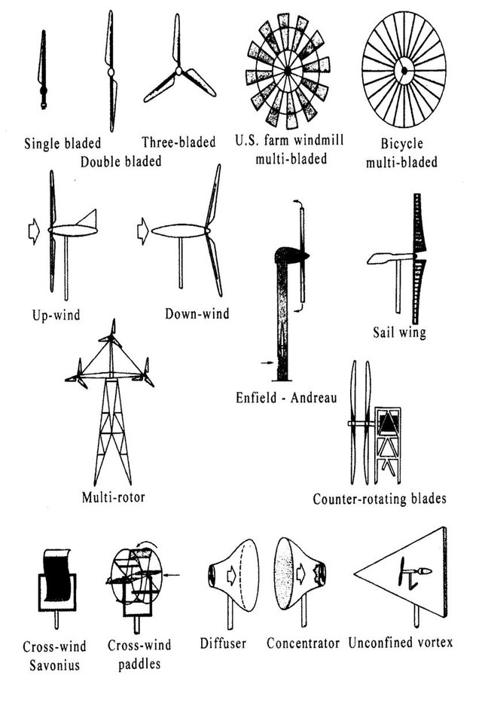
Horizontal type
Different Types of Horizontal Axis Wind Turbine
the horizontal-axis wind turbine. It is a lift-based wind turbine with very good performance
the wind turbine has some key elements. In the Nacelle, also known as the head, there is a wind vane, an anemometer, and a controller that reads the speed and direction of the wind. In case of a change in the winding course, a motor turns the Nacelle to ensure the blades face the wind
[Manwell, J. F-Wind Energy Explained; Theory, Design and Application-2002]

Slide 13
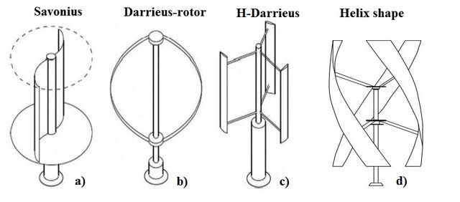
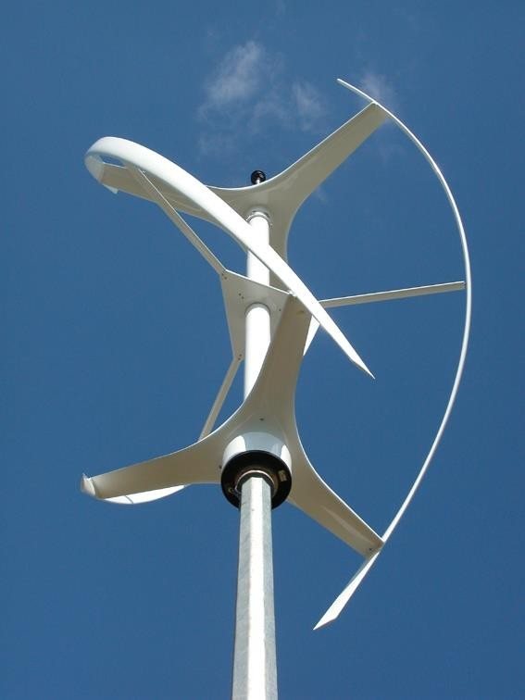
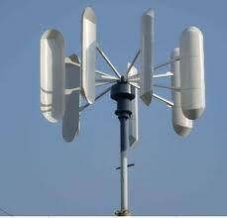
Vertical type
Different kinds of vertical axis wind turbines (VAWT): (a) Savonius; (b) Darrieus with "egg beater" design rotor; (c) H-shape blades; (d) helix shape blades.
has two types: lift-based and drag-based turbines. The lift design is more efficient than the drag or paddle-based design.
Darrieus is lift base and The Savonius wind turbine is the most common drag type turbine. Despite its low efficiency, it remains in use because of its robustness and simplicity to build and maintain.
[Francesco Castellani, et al., 2019]

Slide 14
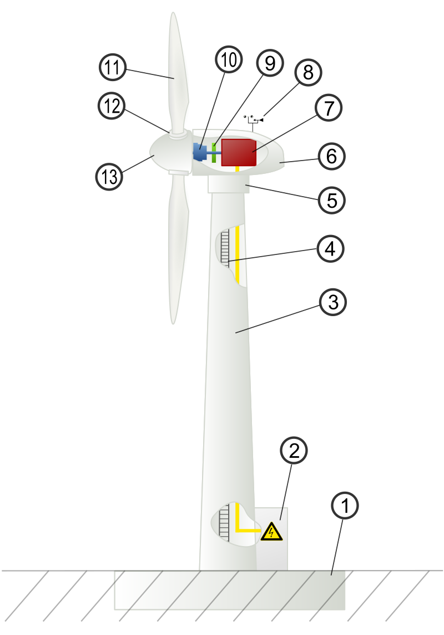
Main components of a Wind Turbine
Wind turbine components :
  1-Foundation
  2-Connection to the electric grid
  3-Tower
  4-Access ladder
  5-Wind orientation control (Yaw control)
  6-Nacelle
  7-Generator
  8-Anemometer
  9-Electric or Mechanical Brake
  10-Gearbox
  11-Rotor blade
  12-Blade pitch control
  13-Rotor hub
https://en.wikipedia.org/wiki/Wind_turbine_design

Slide 15
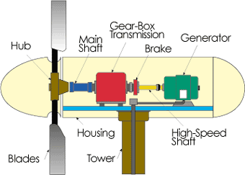
Main components of a Wind Turbine
Blades and rotor: Converts the wind power to a rotational mechanical power. made of aluminum and composite materials has contributed to low rotational inertia
Hub: In simple designs, the blades are directly bolted to the hub and are unable to pitch, which leads to aerodynamic stall above certain windspeeds. In more sophisticated designs, they are bolted to the pitch bearing, which adjusts their angle of attack with the help of a pitch system according to the wind speed
Nacelle: is a cover housing that houses all of the generating components in a wind turbine, including the generator, gearbox, drive train, and brake assembly
Gear box: Wind turbines rotate typically between 40 rpm and 400 rpm. Generators typically rotates at 1,200 to 1,800 rpm. Most wind turbines require a step-up gear-box for efficient generator operation (electricity production).
[Book – Handbook on renewable energy sources]
Notes:
the smaller the. rotational inertia, the bigger the rotational. acceleration.

Slide 16
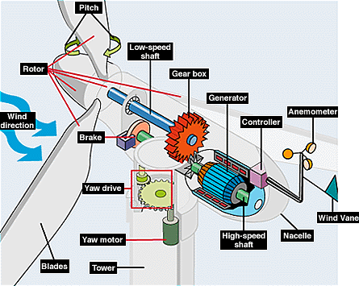
Main components of a Wind Turbine
Yawing: a mechanism that rotates the gondola so that it also changes position as the wind changes direction. Large turbines are typically actively controlled to face the wind direction measured by a wind vane situated on the back of the nacelle. At high wind speeds, wind direction is less variable.
Mechanical Brake: A mechanical drum brake or disc brake stops rotation in emergency situation such as extreme gust events.
Generator: Converts the rotational mechanical power to electrical power.
Tower: The blades and nacelle are mounted on top of a tower. The tower is constructed to hold the rotor blades off the ground and at an ideal wind speed. Towers are usually between 50-100 m above the surface of the ground or water. The variation in velocity with altitude, called wind shear, is most dramatic near the surface.
wikimedia.org
Notes:
The gondola is connected with the tower and is able to rotate, so that the nose of the gondola is always point in the wind direction. At the bottom of the tower there is a computer that controls all wind directions and speeds

Slide 17
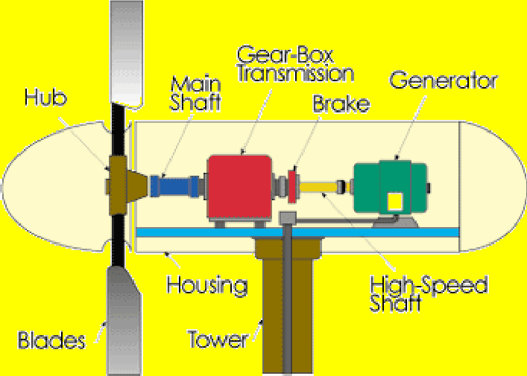
Main components of a Wind Turbine
The Generator
The generator converts the mechanical energy of the turbine to electrical energy (electricity).
Inside this component, coils of wire are rotated in a magnetic field to produce electricity. Different generator designs produce either alternating current (AC) or direct current (DC), available in a large range of output power ratings.
Most home and office appliances operate on 220 Volt, 50 Hz AC. Some appliances can operate on either AC or DC, such as light bulbs and resistance heaters
Generators that produce AC are generally equipped with features to produce the correct voltage (220 V) and constant frequency (50 Hz) of electricity, even when the wind speed is fluctuating.

Slide 18
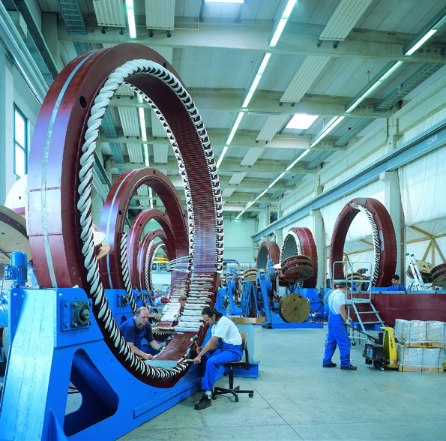
Generators: synchronous and asynchronous
Synchronous generator
Synchronous: can handle variable speed of rotor and indirect grid connection (frequency converter necessary), more complex construction
➔ variable rotor speed, no gearbox required
Rotation speed required in dependence of the number of pole pairs
Frequency adjustment for grid connection necessary (power electronics)
Allows variable turn rates of the rotor and no gearbox required
[TU Berlin-Wind power and conversion lecture-Johannes Wellman]

Slide 19
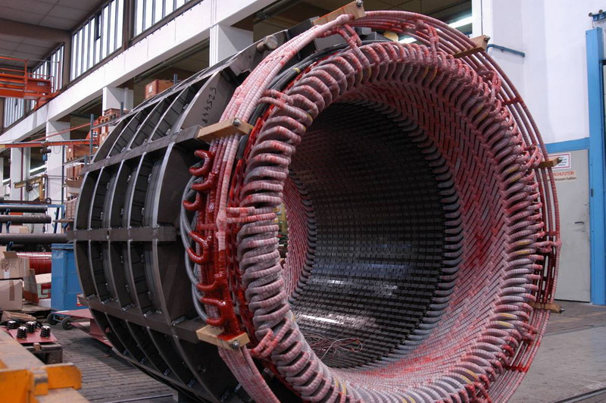
Generators: synchronous and asynchronous
Asynchronous generator
(like induction motor): require a fixed speed to generate alternating current AC for 50 Hz, can be directly grid connected
➔ need fixed rotor speed, gearbox required
Also called induction generators, normally used as induction motors
Very common as electric drive for various applications in industry
High efficiency (up to 90%), low costs, reliable and low maintenance requirement
Fixed speed for certain set of pole pairs (1500 rpm for 4 pole pairs)
[TU Berlin-Wind power and conversion lecture-Johannes Wellman]

Slide 20

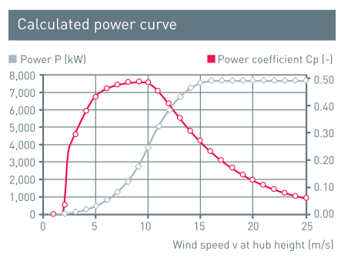
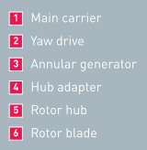
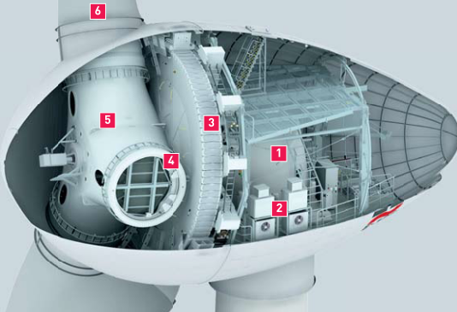
Largest wind turbine by Enercon
E-126 is the larges wind turbine available
Rated power up to 7580 kW
Rotor: up wind with active pitch control
Rotor diameter: 126 m, 12.668 m² area
Rotor rotation: from 5 – 12,1 rpm
Gearless with variable speed, single blade adjustment
[ENERCON, product overview]

Slide 21
Design and working principle of wind turbines

Slide 22
Typical Wind Turbine Operation
0 ~ 5 m/s --- Wind speed is too low for generating power. Turbine is not operational. Rotor is locked.
5 ~ 11 m/s --- 5 m/s is the minimum operational speed. It is called “Cut-in speed”.
In 5 ~ 11 m/s wind, generated power increases with the wind speed.
11 ~ 22 m/s --- Typical wind turbines reach the rated power (maximum operating power) at wind speed of 11m/s (called Rated wind speed). Further increase in wind speed will not result in substantially higher generated power by design. This is accomplished by, for example, pitching the blade angle to reduce the turbine efficiency.
The rated speed is the minimum wind speed at which the wind turbine will generate its designated rated power. For example, a "10 kilowatt" wind turbine may not generate 10 kilowatts until wind speeds reach around 11 m/s. Rated speed for most machines is in the range around 11 - 22 m/s. At wind speeds between cut-in and rated, the power output from a wind turbine increases as the wind increases. Most manufacturers provide graphs, called "power curves," showing how their wind turbine output varies with wind speed.
> 22 m/s--- Turbine is shut down when wind speed is higher than 22 m/s (called “Cut-out” speed) to prevent structure failure.
Notes:
Having a cut-out speed is a safety feature which protects the wind turbine from damage. Shut down may occur in one of several ways. In some machines an automatic brake is activated by a wind speed sensor. Some machines twist or "pitch" the blades to spill the wind. Still others use "spoilers," drag flaps mounted on the blades or the hub which are automatically activated by high rotor rpm's, or mechanically activated by a spring loaded device which turns the machine sideways to the wind stream. Normal wind turbine operation usually resumes when the wind drops back to a safe level.

Slide 23
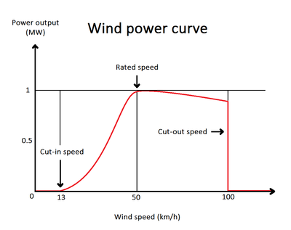
Wind speed
Wind speed largely determines the amount of electricity generated by a turbine. Higher wind speeds generate more power because stronger winds allow the blades to rotate faster. Faster rotation translates to more mechanical power and more electrical power from the generator.
Turbines are designed to operate within a specific range of wind speeds. The limits of the range are known as the cut-in speed and cut-out speed.
The cut-in speed is the point at which the wind turbine is able to generate power.
Between the cut-in speed and the rated speed, where the maximum output is reached, the power output will increase cubically with wind speed.
[ R. Wolfson, Energy, Environment and Climate, 2nd ed.]

Slide 24
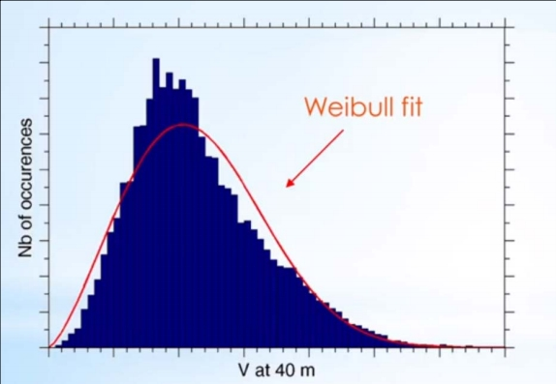

wind frequency distribution
Empirically, it has
been observed that
wind speed in most
locations is a
Weibull
distribution.
Furthermore, the
value of k is
approximately 2
for most wind
profiles.
K= shape factor, A=scale factor
[MIT, Wind power fundamentals, Kalmikov and Dykes, 2011]

Slide 25
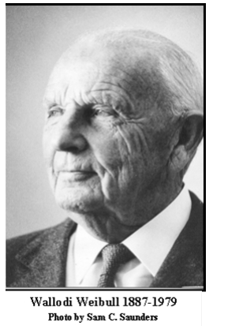
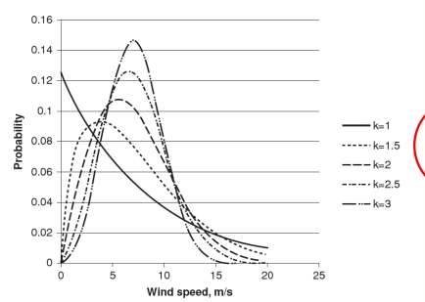
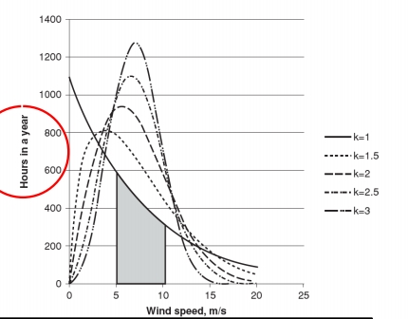

Statistical Distribution of Wind Speed
It is named after Swedish engineer, scientist, and mathematician Waloddi Weibull, who described it in detail in 1951.
Instead of a probability density function that represents the fraction of time wind speed is at v, it is sometimes customary to speak in terms of hours in a year
[MIT, Wind power fundamentals, Kalmikov and Dykes, 2011]
Notes:
The area under the curve between 5 and 10 m/s represents the total number of hours in a year the wind speed is likely to be in that wind speed range
8761 hours

Slide 26
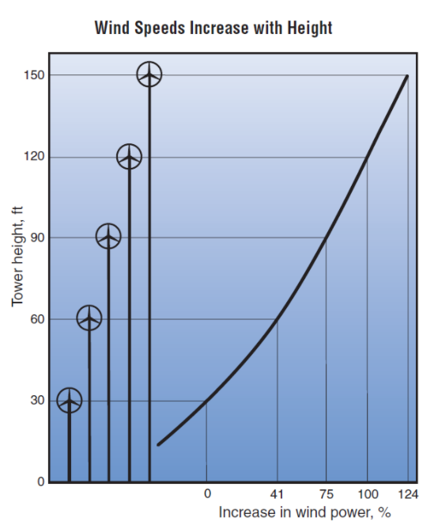
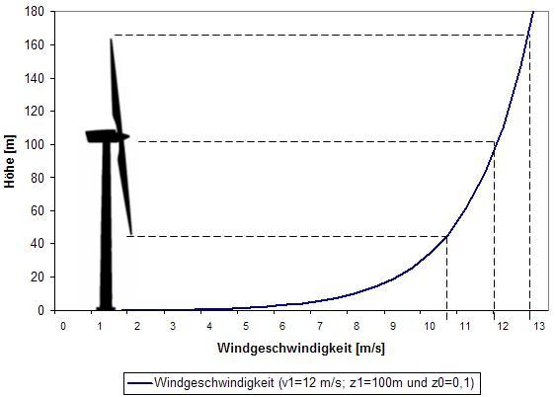
Loads and dynamics – Height of the tower
With increasing size of the towers, the wind speed vary on top and bottom of the turbine
Average wind speeds increase with height and may be 15% to 25% greater at a typical wind turbine hub height of 80 ft (24 m) than those measured at airport anemometer heights.
https://windexchange.energy.gov/
Notes:
Doubling the altitude of a turbine increases the expected wind speeds by 10% and the expected power by 34%. To avoid buckling, doubling the tower height generally requires doubling the tower diameter, increasing the amount of material by a factor of at least four.

Slide 27
Loads and dynamics – Height of the tower
Doubling the tower height increases the expected wind speeds by 10% and the expected power by 34%. Doubling the tower height generally requires doubling the diameter as well, increasing the amount of material by a factor of eight.
Tower heights approximately two to three times the blade length have been found to balance material costs of the tower against better utilization of the more expensive active components.

Slide 28
Size of turbine
Wind turbines with rotors (turbine blades and hub) that are about 2 m in diameter may peak at about 1,000 watts (1 kilowatt; kW), and generate about 75 kilowatt-hours (kWh) per month with a 5 m/s average wind speed. Turbines smaller than this may be appropriate for sailboats, cabins, or other applications that require only a small amount of electricity. [Small Wind]
Homes typically use 500-1,500 kilowatt-hours of electricity per month. Depending upon the average wind speed in the area this will require a wind turbine rated in the range 5-15 kilowatts, which translates into a rotor diameter around 5 - 9 m.
For wind turbine farms, it’s reasonable to use turbines with rotors up to 20 m in diameter. These turbines may peak at about 90,000 watts (90 kW), and generate 3,000 to 5,000 kWh per month at a 5 m/s average wind speed, enough to supply 200 homes with electricity.

Slide 29
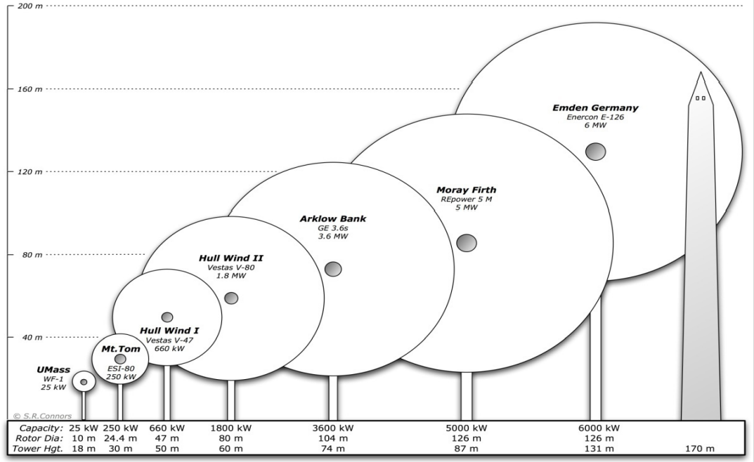
[MIT, Wind power fundamentals, Kalmikov and Dykes, 2011]

Slide 30
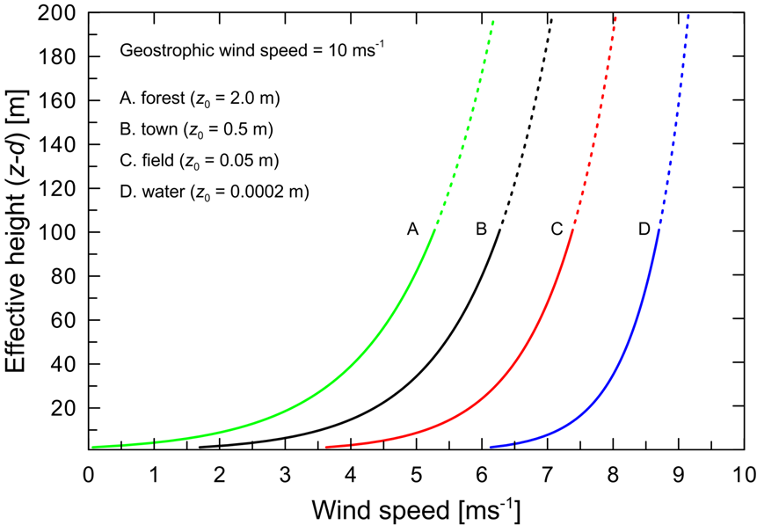
Loads and dynamics – Roughness
Surface roughness length is a property of the surface which can be used to determine the way the horizontal wind speed varies with height. The wind speed at a given height decreases with increasing surface roughness. It is very common to have a heterogeneous surface and this complicates the vertical wind profile. Internal boundary layers develop and the profile of wind speeds is influenced by surface roughness changes upwind.
Different surface roughness lengths result in different vertical profiles of wind speed. The y-axis is height above surface and the x-axis is wind speed. For a range of surface roughness lengths, the curves show the wind speed profile for neutral conditions and a geostrophic wind of 10 m/s.
https://globalwindatlas.info/about/method
Notes:
The higher the surface resistance, the lower the wind speed at lower altitudes
In atmospheric science, geostrophic flow is the theoretical wind that would result from an exact balance between the Coriolis force and the pressure gradient force. This condition is called geostrophic equilibrium or geostrophic balance. The geostrophic wind is directed parallel to isobars

Slide 31
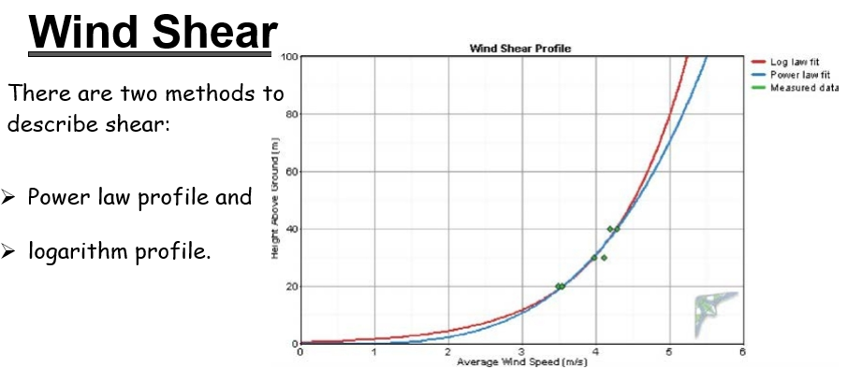
The effect of Wind Shear
www.weset-project.eu
Notes:
wind gradient, is a difference in wind speed and/or direction over a relatively short distance in the atmosphere. Atmospheric wind shear is normally described as either vertical or horizontal wind shear. Vertical wind shear is a change in wind speed or direction with a change in altitude. Horizontal wind shear is a change in wind speed with a change in lateral position for a given altitude

Slide 32
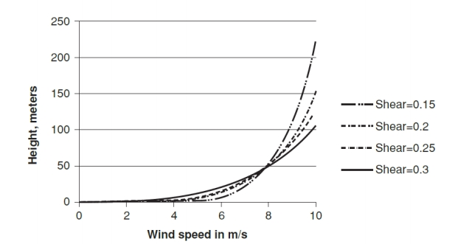
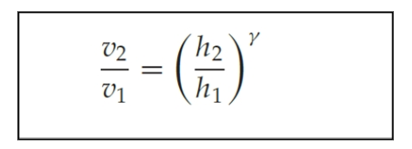
The effect of Wind Shear
The power law is the most common method to describe the relationship of wind speed and height. This is an engineering approximation and must be used with caution.
where v2 and v1 are wind speeds at heights h2 and h1, and exponent γ is called wind shear.
The figure below is a plot of height versus wind speed for different values of shear
www.weset-project.eu

Slide 33
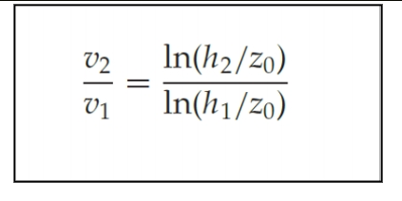
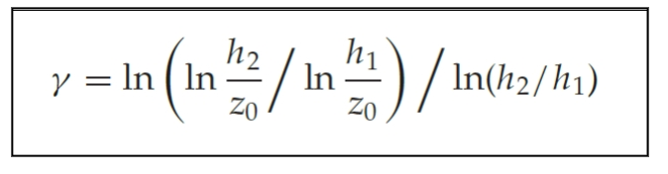
The effect of Wind Shear
Logarithmic profile
An alternate method to extrapolate wind speed is to use the logarithmic profile, which uses roughness of the surface.
where z0 is called the roughness length. If wind speed v1 is available at h1 = 10 m, then the above equation may be used to compute v2.
The value of shear can then be derived from where Shear, depends on the heights and roughness length.

Slide 34
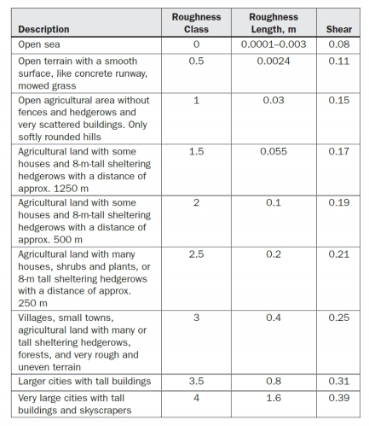
The effect of Wind Shear
The Table shown describes
classes of roughness,
roughness length, and shear
www.weset-project.eu
Notes:
Using the roughness length allows a prediction of wind speed in different heights according to the roughness of the landscape
The length of the roughness z0 describes the height in which the wind is completely stopped (vwind = 0)

Slide 35
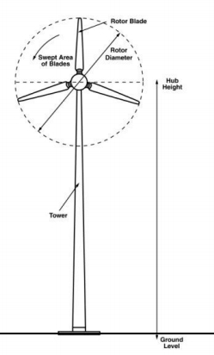
example
For a suggested wind energy project the mean wind speed is 4 m/s wind speed at 10 m in the desert with low roughness. Calculate the wind speed at 80 m hub height.
Case 2, in a forested area with high roughness. Calculate the wind speed at 80 m hub height
V(80m)=?
V(10m)=4 m/s
Desert (low roughness)

Slide 36
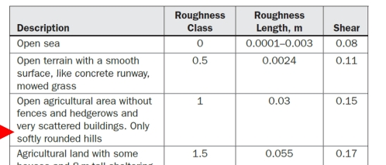
solution
From the roughness table choose 0.15 shear value for the desert location
v2/4 = (80/10) ^{0.15}
V2= 5.46 m/s
Case2:Forested area at 0.25 shear v2=6.73
height h1 | 10 | m
wind speed v1 | 4 | m/s
wind shear γ | 0.15
height h2 | 80 | m
wind speed v2 | 5.464161 | m/s
  ➔ as bigger z0 as bigger the influence on vwind

Slide 37
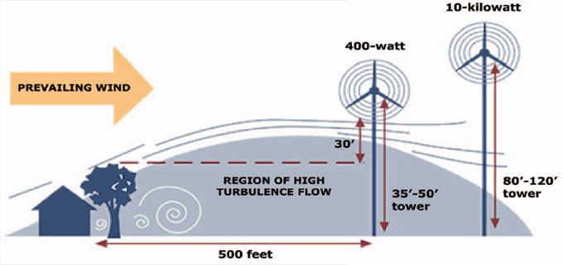
Loads and dynamics -Turbulence
To ensure the close spacing of the wind turbines will not affect (decrease) the lifetime of the turbine and its components, a turbulence calculation is necessary. The turbulence of the wind flow is a factor which causes stress and fatigue to several components of a wind turbine including blades, bearing and gearbox. It consists of the so called ambient turbulence applied to the wind flow by the coarseness of the earth (vegetation, buildings, rocks etc.) and the turbulence added by the other wind turbines of a wind park.
[http://house-energy.com]

Slide 38
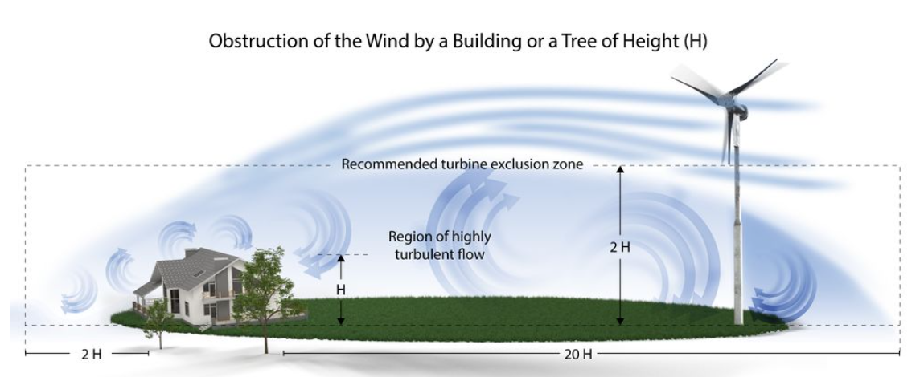
The farther you place your wind turbine from obstacles such as buildings or trees, the less turbulence you will encounter.
https://windexchange.energy.gov/
Notes:
Mainly small scale

Slide 39
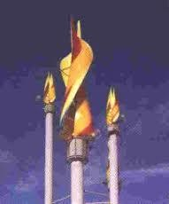
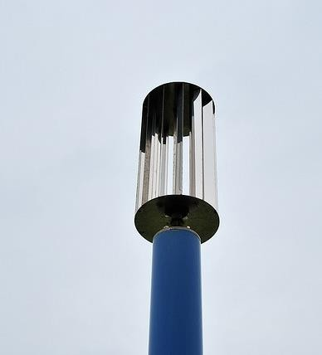
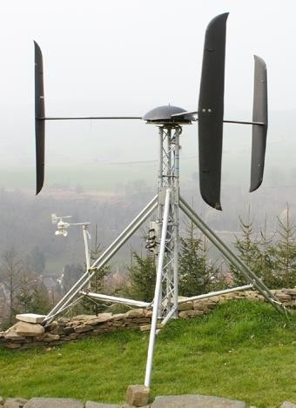
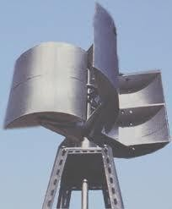
Wind Turbine – Blade Design
Drag Design
For the drag design, the wind literally pushes the blades out of the way. Drag powered wind turbines are characterized by slower rotational speeds and high torque capabilities. They are useful for the pumping, sawing or grinding work that Dutch, farm and similar "work-horse" windmills perform. For example, a farm-type windmill must develop high torque at start-up in order to pump, or lift, water from a deep well.
[Book – Handbook on renewable energy sources]
Notes:
Torque = r x F

Slide 40
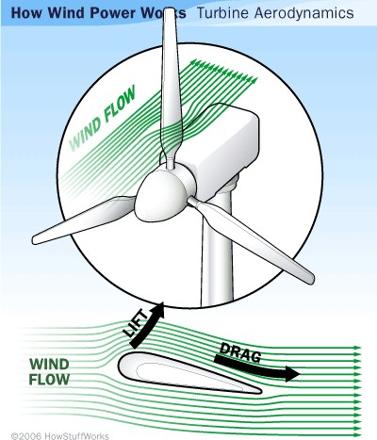
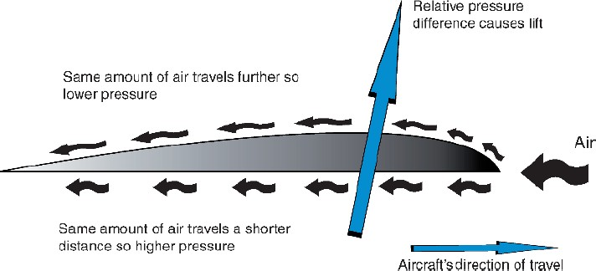
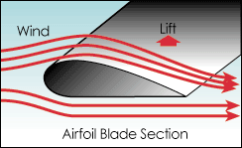
Wind Turbine – Blade Design
Lift Design
The lift blade design employs the same principle that enables airplanes, kites and birds to fly. The blade is essentially an airfoil, or wing. When air flows past the blade, a wind speed and pressure differential is created between the upper and lower blade surfaces. The pressure at the lower surface is greater and thus acts to "lift" the blade. When blades are attached to a central axis, like a wind turbine rotor, the lift is translated into rotational motion. Lift-powered wind turbines have much higher rotational speeds than drag types and therefore are well suited for electricity generation.
[Book – Handbook on renewable energy sources]

Slide 41
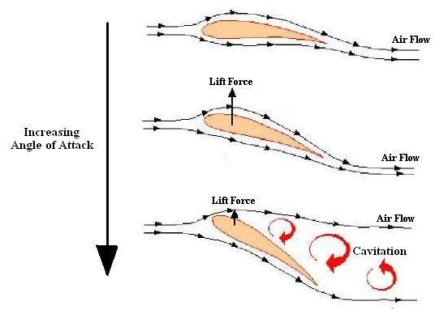



Wind Turbine – Blade Design
Angle of attack (blade angle)
The angle between the chord line of the airfoil and the flight direction is called the angle of attack. Angle of attack has a large effect on the lift generated by an airfoil. This is the propeller efficiency. Typically, numbers here can range from 1.0 to 15.0 degrees.

Slide 42

Stall effect
Increasing wind speed causes turbulent flow of the wind behind the blade, which decreases the rotation speed
For controlling wind turbines: fixed blade position, angle of attack increases with wind speed until turbulences behind the blade causes decreasing of rotation

Slide 43

Pitch effect
The angle of attack can be changed with increasing wind speed, which allows an active control of the rotation speed by aerodynamics of the blade
more expensive construction
For controlling wind turbines: variable blade position, changes with wind speed, allows active control of the shaft speed for better power curve

Slide 44

Wind Turbine – Blade Design
Blade Number
The determination of the number of blades involves design considerations of aerodynamic efficiency, component costs, system reliability, and aesthetics..
Aerodynamic efficiency increases with the number of blades but with diminishing return.
Increasing the number of blades from one to two yields a 6% increase in efficiency, whereas increasing the blade count from two to three yields only an additional 3% in efficiency. Further increasing the blade count yields minimal improvements in aerodynamic efficiency and sacrifices too much in blade stiffness as the blades become thinner.
Generally, the fewer the number of blades, the lower the material and manufacturing costs will be. Higher rotational speed reduces the torques in the drive train, resulting in lower gearbox and generator costs.
[Book – Handbook on renewable energy sources]
One blade rotor

Slide 45

Wind Turbine – Blade Design
Blade Number
Differences from 3-blade and 2-blade rotors in terms of pitching momentum
3-blade more balanced
3 blade rotor
2 blade rotor
[TU Berlin-wind energy conversion- Johannes wellman]
Notes:
Pitch controls adjust the blades in wind turbines by rotating them so that they use the right fraction of the available wind energy to get the most power output, all the while ensuring the turbine does not exceed its maximum rotational speed- harmony shape

Slide 46
Turbine Distances / Micro-siting
For the micro-siting certain minimum distances between the individual wind turbines have to be observed.
A common rule of thumb specifies three to five rotor diameters in cross wind directions (less than three is possible under some circumstances) and six to eight rotor diameters in main wind direction as a minimum spacing between the individual turbines.
The minimum distance of three times or less the rotor diameter in cross wind direction is only feasible in case the wind direction is strictly perpendicular to the row of wind turbines.
The smallest distances in cross wind direction are determined by a layout development iteration process, carried out under the condition that the wake losses do not fall below a chosen average level for the individual turbines, which is considered as necessary for the economical operation of the wind farm (e.g. the wake losses do not cause decrease in energy output below 85 % for the following wind turbines).
Depending on the location of the individual wind turbine and the ambient conditions (topography, location of nearby wind turbines, number of wind turbines towards the main wind direction) the distance between two adjacent turbines can be larger.

Slide 47








Wind power adaptability and scalability. All kinds of environment and sizes
Easy accessible ones
Complex ones
Small isolated ones
Big offshore ones
Really cold places
Really hot places
Urban areas
Rural areas

Slide 48
Basics of aerodynamics

Slide 49



Wind Turbine Principles
Converting one form of energy to another
Kinetic
Energy
Mechanical Energy
Electrical Energy
Component | Rotor | Gearbox | Generator | Converter
Efficiency | 45-52% | 95-97% | 97-98% | 96-99%
Overall: 42 – 50% Efficient Today… Theoretical Maximum is 59.3% (no losses)

Slide 50





Fundamental Equation of Wind Power
Wind Power depends on:
• amount of air (volume)
• speed of air (velocity)
• mass of air (density) A flowing through the area of interest (flux)
Energy definition: The kinetic energy for wind speed v is
1) Kinetic energy:
2)Power is KE per unit time:
3) Fluid mechanics gives mass flow rate (density * volume flux):
Where, • Power ~ cube of velocity
• Power ~ air density
• Power ~ rotor swept area
Notes:
The volume flow rate is calculated by multiplying the flow velocity of the mass elements, v, by the cross-sectional vector area, A.
M = density x volume
Volume flux = velocity x area

Slide 51

Momentum model of aerodynamics
Air volume
A
Δp
A = rotor area
v₀ = wind velocity before the rotor (fast)
v₁ = wind velocity after the rotor (slow)
A
v₁
with
v₀
[Handbook of Energy Efficiency and Renewable Energy, Wind energy conversion, Yogi Goswami, 2007]

Slide 52
Wind Turbine Efficiency η
Betz Limit
It is the flow of air over the blades and through the rotor area that makes a wind turbine function. The wind turbine extracts energy by slowing the wind down. The theoretical maximum amount of energy in the wind that can be collected by a wind turbine's rotor is approximately 59.3%. This value is known as the Betz limit.
If the blades were 100% efficient, a wind turbine would not work because the air, having given up all its energy, would entirely stop. In practice, the collection efficiency of a rotor is not as high as 59%. A more typical efficiency is 35% to 45%.
A complete wind energy system, including rotor, transmission, generator, storage and other devices, which all have less than perfect efficiencies, will deliver between 10% and 30% of the original energy available in the wind.

Slide 53



Wind Turbine Efficiency η
Betz Limit
Velocity and pressure: thrust on the rotor
Thrust expressed by momentum, newton’s second law
v₁
Thrust expressed by pressure drop

Slide 54
Wind Turbine Efficiency η
Betz Limit
From thrust to mechanical power
Air volume
A
Δp
The power is the product of thrust and velocity:
with
and
➔
Please note the following:
[Prof. Dr. Ingo Rechenberg, Skript Windenergie I]
Notes:
T = F

Slide 55
Wind Turbine Efficiency η
Betz Limit
➔ theory tells us, that for the best efficiency v₁ should be 1/3 of v₀
To strong
To weak
optimum
[Prof. Dr. Ingo Rechenberg, Skript Windenergie I]

Slide 56

Wind Turbine Efficiency η
Betz Limit
A
Albert Betz (1885 – 1968)
Mechanical power of rotor in the area A
Wind power in the area A of the rotor
[Prof. Dr. Ingo Rechenberg, Skript Windenergie I]

Slide 57



http://xn--drmstrre-64ad.dk/wp-content/wind/miller/windpower%20web/en/stat/betzpro.htm
Wind Turbine Efficiency η
Betz Limit
Maximum power is realized when:
Solving the equation gives us:
➔ maximum theoretical efficiency = 59,3 %
called “Betz limit”
[Prof. Dr. Ingo Rechenberg, Skript Windenergie I]

Slide 58

Example
How much power a wind turbine with 50 meters long blade can generate with a wind speed of 12 m/s? The site of the installation is about 1000 feet above sea level. Assume 40% efficiency (η).
Air density is lower at higher elevation. For 1000 feet above sea level, ρ is about 1.16 kg/m³
where we assumed the turbine efficiency is 40%.

Slide 59

Example (effect of wind speed)
What is the power of the turbine at a wind speed of 5 m/s and a wind turbine blade diameter of 100 m? How does the power change when the wind speed is 10 m/s? Assume an air density of 1.2 kg / m3.

Slide 60

Tip Speed Ratio
The Tip Speed Ratio (TSR) is an extremely important factor in wind turbine design. TSR refers to the ratio between the speed of the tips of the wind turbine blades to the wind speed
Electricity generation requires high rotational speeds. Lift- type wind turbines have maximum tip-speed ratios of around 10, while drag-type ratios are approximately 1. Given the high rotational speed requirements of electrical generators, it is clear that the lift-type wind turbine is the most practical for this application.
The number of blades and the total area they cover affect wind turbine performance. For a lift-type rotor to function effectively, the wind must flow smoothly over the blades. To avoid turbulence, spacing between blades should be great enough so that one blade will not encounter the disturbed, weaker air flow caused by the blade which passed before it.
The further away from the center, the faster the blades spin.

Slide 61


Tip speed ratio λ
The power coefficient is not a static value; it varies with the tip speed ratio of the turbine. Tip speed ratio is defined as:
The blade tip speed can be calculated from the rotational speed of the turbine and the length of the blades used in the turbine circumference (2∏r) or (∏D)
Where D is the diameter
Knowing the tip speed ratio of your turbine will help you maximize the power output and efficiency of your wind turbine. Remember that if your rotor spins too slowly, a lot of wind will pass through the gaps between the blades rather than giving energy to your turbine. But if your blades spin too quickly, they could create too much turbulent air or act as a solid wall against the wind. So, if you want to maximize your turbine’s efficiency, you’ve got to calculate the perfect Tip Speed Ratio.

Slide 62

Tip speed ratio λ
If the tip speed exactly the same like the wind speed, the ratio is 1
[Prof. Dr. Thamsen, Skript IV WKA]

Slide 63


Tip speed ratio λ
Typical performances of various types of wind turbines
Where Ω = 2 π r
R = rotational speed

Slide 64

Conclusions from theory
The wind speed accounts in ³ in this formula, that means: when the wind speed doubles, the power increases by factor 8 !
Wind turbines can convert maximal 59% of the wind power (Betz-limit), modern wind power turbines convert approx. 50%
Locations and the prediction of wind speeds is very prone to errors: 10% error in the prediction of the wind speed means 30% less power yield
Increasing size of the rotor increases the yield of the turbine

Slide 65
Exercise
Plot the power versus wind speeds of 1-15 m/s (in 1 m/s increments)
for wind turbine blades 150 m in diameter. Show the dependence on wind speed.
When applying the Betz limit - what is the maximum available capacity?
Vary the diameter of the blades - how do the results change?

Slide 66
Exercise
Given that the rotational speed of the turbine is 15 rpm, calculate λ using the previous equation and fill it in the table (next slide). Then read the corresponding value of Cp using the graph (next slide). This Cp value can then be used to calculate the power at that wind speed using wind power equation. Finally, calculate the energy using the following equation and complete the table:
Energy = Power × Time
Blade length l = 52 m
Air density, ρ = 1.23 kg/m3

Slide 67


Slide 68


Slide 69

Innovations in wind turbine design
Vortex Bladeless is a vortex induced vibration resonant wind generator. It harnesses wind energy from a phenomenon of vorticity called Vortex Shedding. Basically, bladeless technology consists of a cylinder fixed vertically with an elastic rod. The cylinder oscillates on a wind range, which then generates electricity through an alternator system. In other words, it is a wind turbine which is not actually a turbine.
https://vortexbladeless.com/

Slide 70



Innovations in wind turbine design
High altitude and Airborne wind energy (AWE) is the direct use or generation of wind energy by the use of aerodynamic or aerostatic lift devices. AWE technology is able to harvest high altitude winds, in contrast to wind turbines, which use a rotor mounted on a tower.
Notes:
He fillid balloon

Slide 71


Innovations in wind turbine design
NVELOX wind tunnel tower

Slide 72

https://environmental-conscience.com/wind-energy-pros-cons/
Notes:
After installation, only cost is maintenance
Wind is renewable
Available everywhere to some extent
No pollution
Supply of wind energy cannot be controlled by anyone (no political maneuvering)
Wind farms make it profitable
Expensive to set up, custom products
Wind speed varies a lot
Hard to predict
Not steady, so unreliable
Accurate data absolutely necessary
Environmental impact from manufacturing
Turbines can require large areas of land

Slide 73

Wind energy limitations
Wind Turbine Noise Levels

Slide 74



References

Slide 75
References
  https://globalwindatlas.info/
  https://www.ge.com/renewableenergy/wind-energy
  https://windeurope.org/
  https://energiatalgud.ee/Tuuleenergia_ressurss
  https://tuuleenergia.ee/?page_id=1024
  https://www.vestas.com/en
  www.enercon.de
  https://vortexbladeless.com/
  http://www.geni.org/
  https://windexchange.energy.gov/

Slide 76
THANK YOU
Mais Baqain; Mais.Baqain@taltech.ee
Sup. Prof. Alar Konist, Ph.D.

