Slide 1



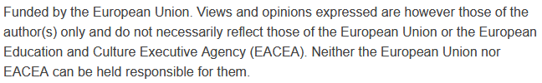
Sustainable and Affordable Transportation Solutions
Sustainability and Quality Assurance for Academic Governance and Redesign Engineering Studies
MODULE 2
Justyna Staszak-Winkler

Slide 2
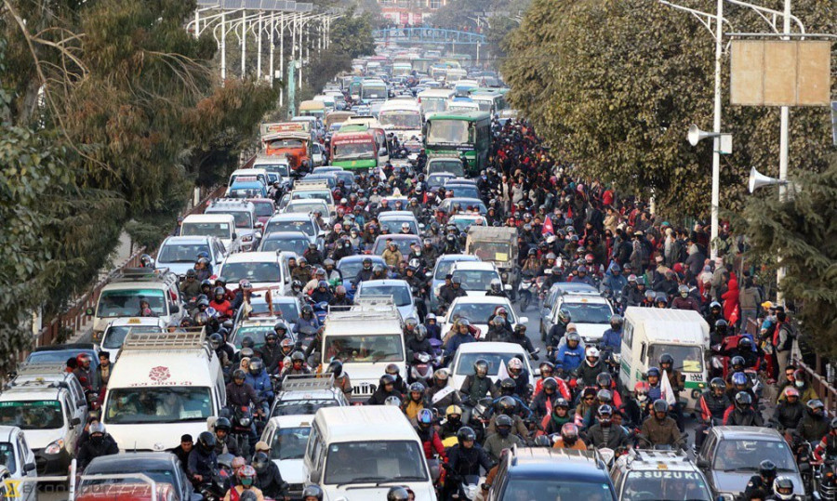
https://kathmandupost.com/valley/2019/03/28/metropolitan-traffic-police-division-launch-pilot-project-in-a-bid-to-alleviate-traffic-woes-in-the-valley

Slide 3
Sustainable Mobility Principles
Transport is not a problem to solve, but an opportunity to redesign our cities.
Sustainable urban mobility is not just about moving people — it's about moving them cleanly, efficiently, and equitably.

Slide 4
What Is Sustainable Mobility?
Sustainable mobility refers to a transportation system that meets society’s current mobility needs without compromising the ability of future generations to meet theirs.
It emphasizes environmental protection, social equity, and economic efficiency.

Slide 5
What Is Sustainable Mobility?
Sustainable mobility requires actions aimed at reducing the need for travel (fewer trips), shortening travel distances, shifting to more environmentally friendly modes of transport, increasing transport efficiency, and improving accessibility.
Shaping sustainable mobility in a city requires planning, monitoring, and evaluating the implementation of sustainable urban transport strategies.

Slide 6
Mobility Challenges – Developing Cities
Karachi (Pakistan)
KARACHI, PAKISTAN, URBAN TRANSPORT PROFILE
December 2024, Asian Transport Observatory

Slide 7
Mobility Challenges – Developing Cities
Karachi (Pakistan)
KARACHI, PAKISTAN, URBAN TRANSPORT PROFILE
December 2024, Asian Transport Observatory

Slide 8
Mobility Challenges – Developing Cities
Karachi (Pakistan)
KARACHI, PAKISTAN, URBAN TRANSPORT PROFILE
December 2024, Asian Transport Observatory

Slide 9
Mobility Challenges – Developing Cities
Karachi (Pakistan)
Karachi , Urban Transport - State of Play, Insights from the Asian Transport Observatory (ATO)

Slide 10
Mobility Challenges – Developing Cities
Karachi (Pakistan)
Karachi , Urban Transport - State of Play, Insights from the Asian Transport Observatory (ATO)

Slide 11
Mobility Challenges – Developing Cities
Karachi (Pakistan)
Karachi , Urban Transport - State of Play, Insights from the Asian Transport Observatory (ATO)

Slide 12
Mobility Challenges – Developing Cities
Karachi (Pakistan)
Public transport is insufficient, outdated, and overcrowded
Roads are often in poor condition, full of potholes, and some traffic signals are not automated
High number of private cars, motorcycles, and rickshaws
Lack of integration between public transport and pedestrian/cycling infrastructure
Issues with safety, accessibility, and urban planning

Slide 13
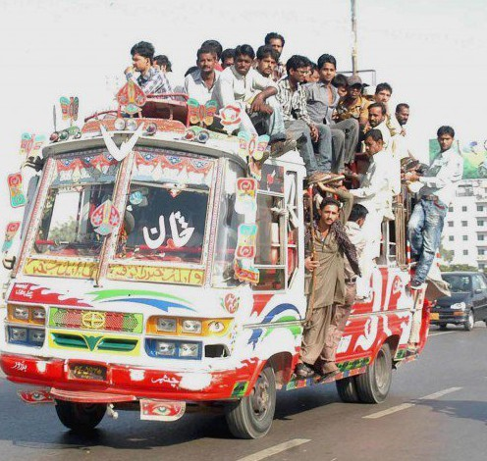
Mobility Challenges – Developing Cities
Karachi (Pakistan)
https://pakistanhorizon.wordpress.com/2015/04/19/karachi-the-transport-crisis/
„Considering the city’s population, there should be 20,448 35-seater minibuses and 5,566 50-seater buses, but the numbers available are much less than that” https://www.dawn.com/news/1494018

Slide 14
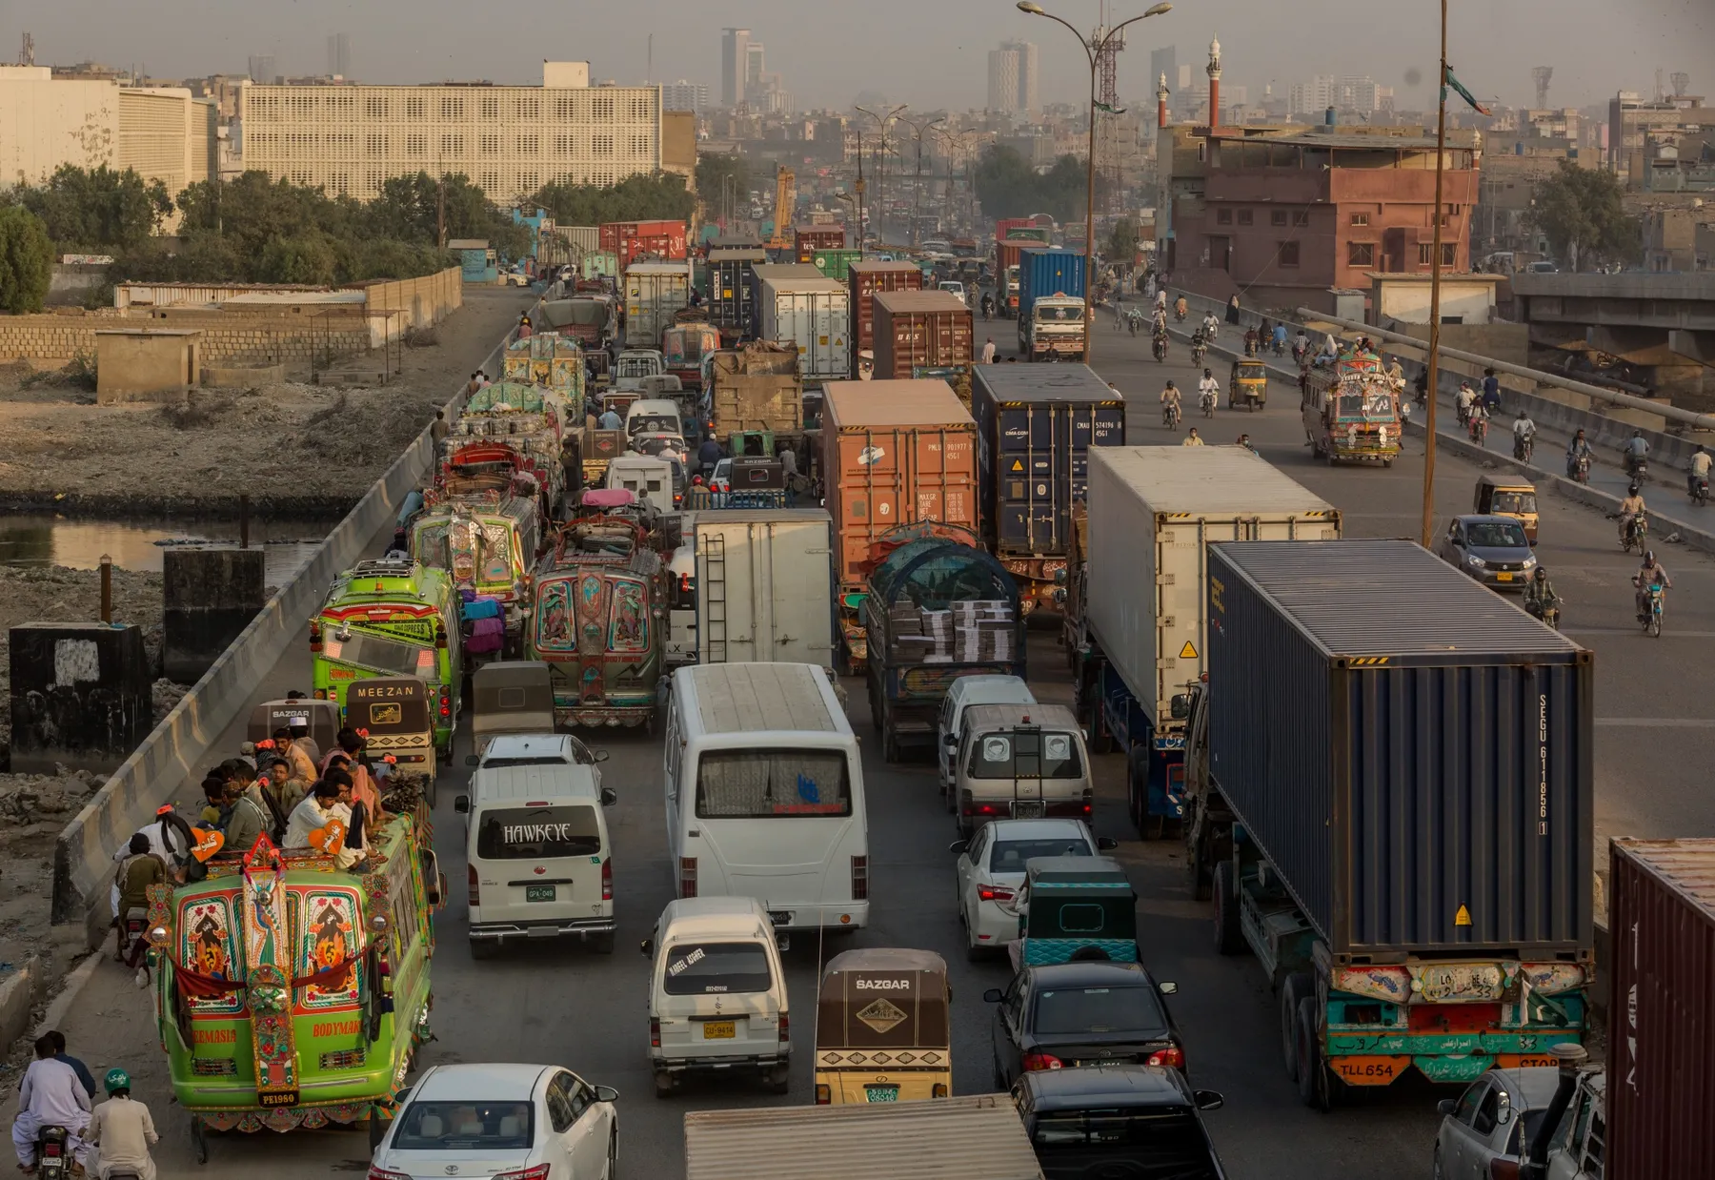
Mobility Challenges – Developing Cities
Karachi (Pakistan)
https://www.bloomberg.com/news/features/2020-11-02/pakistan-s-megacity-tries-to-modernize
„Karachi ranks as having the worst public transport system globally, according to a 2019 study by car-parts company Mister Auto that looked at 100 major cities.”
This index evaluated 100 major cities worldwide based on 15 factors, including road quality, safety, congestion, and public transport availability. Karachi ranked 96th, placing it among the cities with the worst driving conditions globally .
Notes:
This index evaluated 100 major cities worldwide based on 15 factors, including road quality, safety, congestion, and public transport availability. Karachi ranked 96th, placing it among the cities with the worst driving conditions globally .

Slide 15
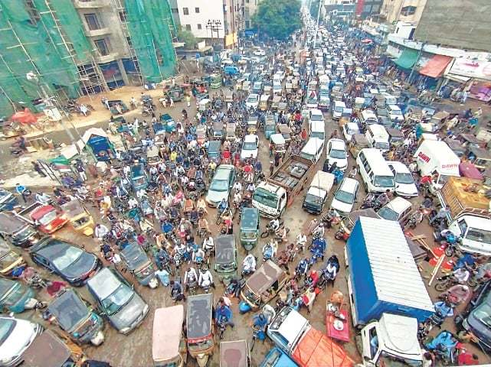
Mobility Challenges – Developing Cities
Karachi (Pakistan)
https://www.dawn.com/news/1612406
„The city now has 17 million citizens and a population density of 24,000 persons per square kilometer. Overall, 60 percent of Karachi’s population relies excessively on private transportation, causing massive traffic jams and severe air pollution.”
Rabia Soomro, Irfan Ahmed Memon, Agha Faisal Habib Pathan, Waqas Ahmed Mahar, Noman Sahito and Zulfiqar Ali Lashar: Factors That Influence Travelers’ Willingness to Adopt Bus Rapid Transit (Green Line) Service in Karachi

Slide 16
Mobility Challenges – Developing Cities
Lahore (Pakistan)
Syed Akhtar Ali SHAH: Urban Mobility in Pakistan: An Overview with a Focus on Lahore
Background Paper 23rd ASEF Summer University, ASEF Education Department, October 2021
Traffic Congestion: „Traffic congestion is increasing with the number of vehicles on the roads. The current traffic volumes on all Lahore's major roadways is estimated as 8,000 vehicles per lane which is a serious challenge to fluent urban mobility”

Slide 17
Mobility Challenges – Developing Cities
Lahore (Pakistan)
Syed Akhtar Ali SHAH: Urban Mobility in Pakistan: An Overview with a Focus on Lahore
Background Paper 23rd ASEF Summer University, ASEF Education Department, October 2021
Mixed Use of Road Space: „The absence of appropriate placed and well-designed traffic control devices, lane marking, pavement marking, traffic and signals on both major and minor roads encourages a mixed use of road space that causes traffic delays. Poorly designed traffic signal controls, poor and overloading of public transportation and unloading of passengers and freight along the roadside, trading obstructions, pedestrian obstructions and narrow traffic lanes further encourages the mixed and inefficient use of road space.”

Slide 18
Mobility Challenges – Developing Cities
Lahore (Pakistan)
Syed Akhtar Ali SHAH: Urban Mobility in Pakistan: An Overview with a Focus on Lahore
Background Paper 23rd ASEF Summer University, ASEF Education Department, October 2021
Parking Problems: „Unregulated on-road and off-road parking causes reduction in the potential capacity of roadways and is regarded as one of the major causes of traffic congestion”

Slide 19
Mobility Challenges – Developing Cities
Lahore (Pakistan)
Syed Akhtar Ali SHAH: Urban Mobility in Pakistan: An Overview with a Focus on Lahore
Background Paper 23rd ASEF Summer University, ASEF Education Department, October 2021
Improperly Designed Roads and Junctions: „Many roads of the old city in Lahore are not compatible with the present fast moving vehicular traffic. Poor geometric design of horizontal curves, no lane markings, ill placed signs and signals create a chaotic mobility situation”

Slide 20
Mobility Challenges – Developing Cities
Lahore (Pakistan)
Syed Akhtar Ali SHAH: Urban Mobility in Pakistan: An Overview with a Focus on Lahore
Background Paper 23rd ASEF Summer University, ASEF Education Department, October 2021
Poor traffic management: „Poor traffic management results in increasing crashes and environmental degradation, along with poor performance of the mobility infrastructuree. Institutional incapability with poor implementation of traffic rules and regulations is the main cause of existing haphazardness and chaos on the roads of Lahore”

Slide 21
Core Principles of Sustainable Mobility
Accessibility for all – mobility that serves diverse users (children, elderly, disabled)
Safety and health – promoting walking, cycling, and clean air
Environmental protection – reducing CO₂, noise, and resource use
Efficiency and integration – linking modes and optimizing systems
Affordability – cost-effective for individuals and public budgets

Slide 22
Pillars of Sustainable Mobility
– Low – Carbon Transport
Electric vehicles - do not emit exhaust fumes while driving, unlike internal combustion engine cars. When powered by clean energy sources (such as solar or wind), their impact on the climate and air quality is minimal.
Promotion of public transport over private cars – trams, buses, and trains (especially electric or hybrid) carry more people with lower per-capita emissions
Support for active travel - walking and cycling are completely emission-free and support public health
Shared Mobility – carsharing, bikesharing, and ridesharing reduce the number of vehicles on the road
Low-Carbon Transport refers to mobility solutions that significantly reduce greenhouse gas (GHG) emissions compared to traditional fossil fuel-based systems.

Slide 23
Pillars of Sustainable Mobility
– Energy – efficient transport system
Intelligent Transport Systems (ITS) - refer to the use of digital technologies and data to improve the efficiency, safety, and sustainability of transportation systems
Energy-efficient public transport – electric buses, trams, and trains powered by renewable energy sources
Smart traffic management systems - reduce idling, smooth traffic flow, and optimize fuel usage (e.g. adaptive traffic lights)
Electric and hybrid vehicles – use less energy per kilometer and emit fewer pollutants than internal combustion engines
Alternative fuels – biofuels, hydrogen, and synthetic fuels offer cleaner energy options
Energy-efficient transport systems reduce energy consumption, lower greenhouse gas emissions, and support long-term sustainability — all while improving system performance and cost-effectiveness.

Slide 24
Pillars of Sustainable Mobility –
Eco-Friendly Urban Planning
Reduces travel distances - compact, mixed-use neighborhoods support walking and cycling
Supports public transport - dense development makes bus, tram, and rail systems more efficient and accessible
Prioritizes walking and cycling - safe sidewalks, bike lanes, and traffic-calmed zones promote active travel
Discourages private car use - car-free zones, limited parking, and pedestrian-friendly design reduce car dependency
Eco-Friendly Urban Planning creates the physical and social environment that enables and encourages sustainable mobility

Slide 25
Reducing Emissions and Promoting Sustainable Transport in Cities - Why It Matters ?
Urban areas are major contributors to greenhouse gas (GHG) emissions, especially from transport. Shifting to low-emission and sustainable transport options is essential for:
Combating climate change
Improving air quality
Enhancing the health and well-being of urban residents
Making cities more livable and resilient

Slide 26
Affordable public transport models
Ensures access to jobs, education, and healthcare
Reduces transport-related poverty and social exclusion
Encourages shift from private vehicles to sustainable modes
Helps cities meet climate and equity goals

Slide 27
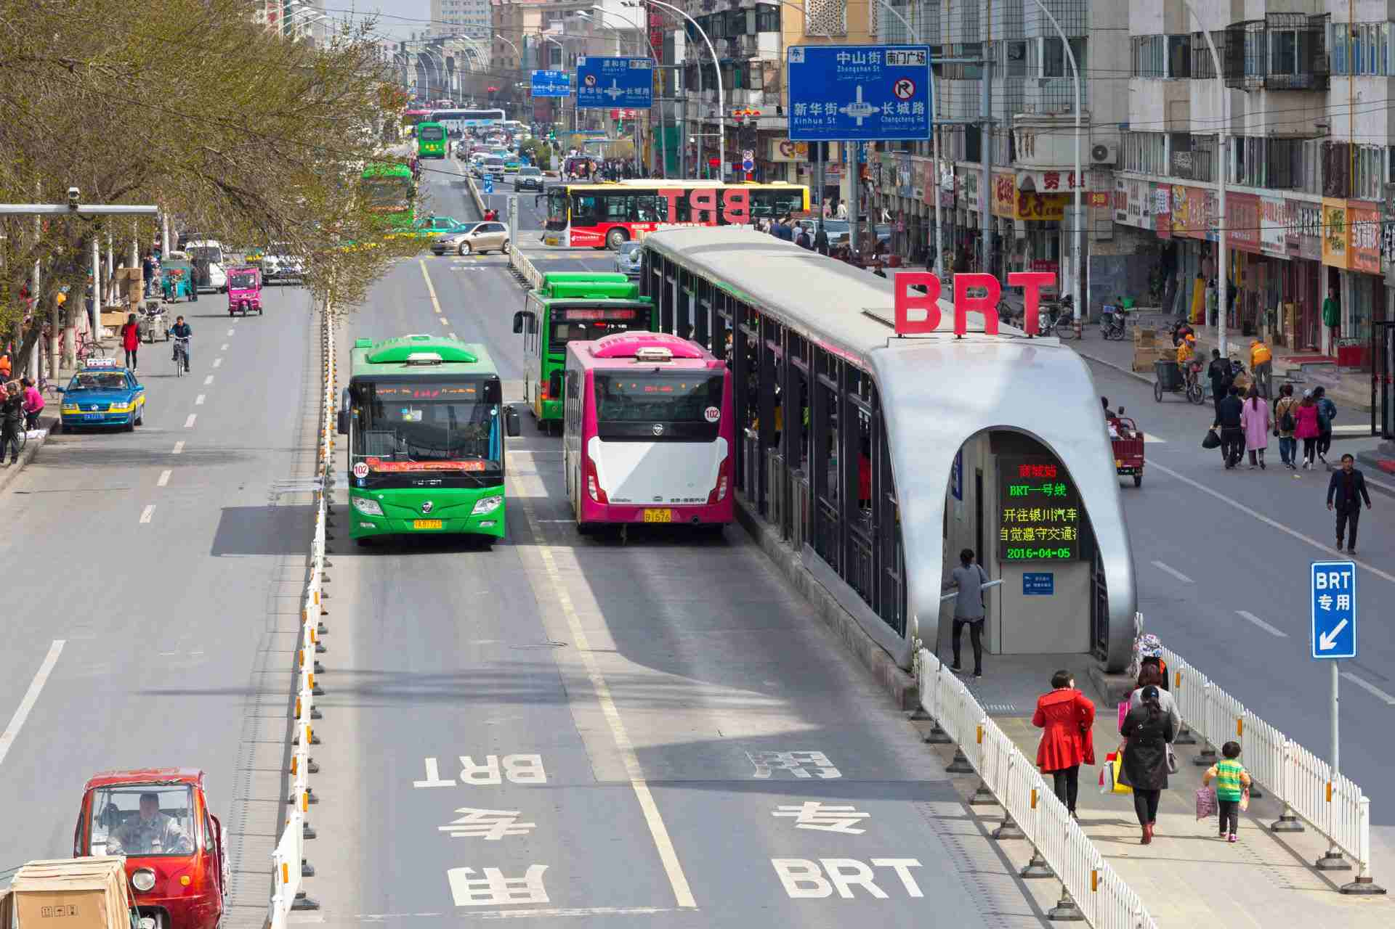
Bus Rapid Transit (BRT)
https://www.zatran.com/en/technology/bus-rapid-transit-brt/

Slide 28
Bus Rapid Transit (BRT)
High-quality bus-based system with dedicated lanes (physically separated lanes that prevent buses from getting stuck in regular traffic)
Cheaper than metro systems but with similar performance
Modern stations (accessible, sheltered stations often with pre-boarding ticketing and real-time info)
Priority at intersections (buses are given green light priority at intersections to reduce delays).
Bus Rapid Transit (BRT) is a high-quality, bus-based public transport system designed to deliver fast, comfortable, and cost-effective urban mobility. It combines the capacity and speed of a metro system with the flexibility and lower cost of buses.

Slide 29
Bus Rapid Transit (BRT)
Frequent and Reliable Service (high-frequency buses with headway-based schedules)
Integrated Fare System (allows smooth transfers between BRT and other public transport)
Level Boarding (raised platforms for easier and faster boarding, especially for people with disabilities)

Slide 30
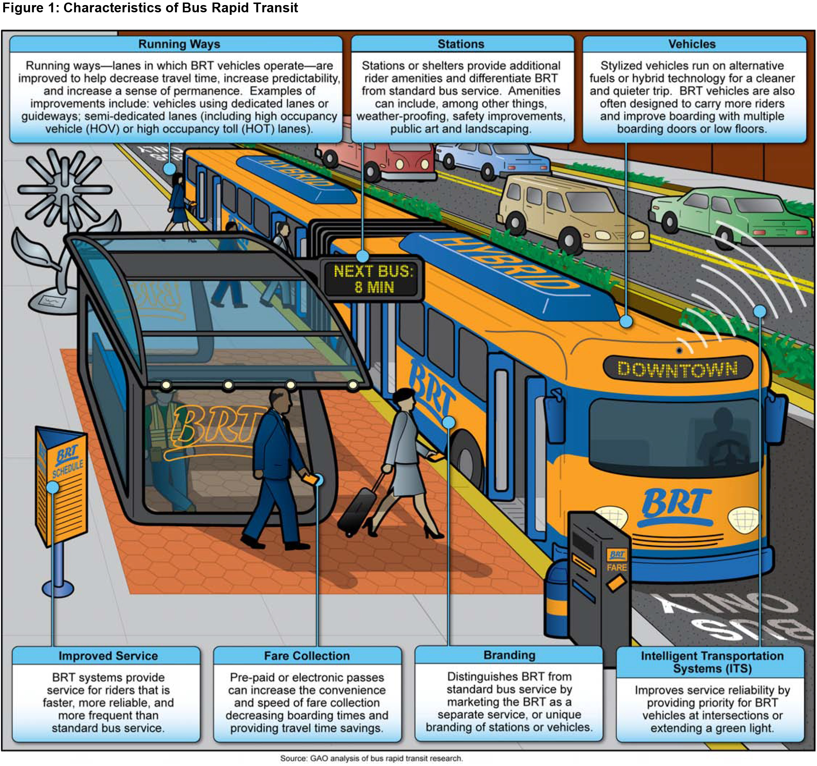
Characteristics of Bus Rapid Transit
https://www.gao.gov/blog/2016/04/13/rapid-buses-for-rapid-transit

Slide 31
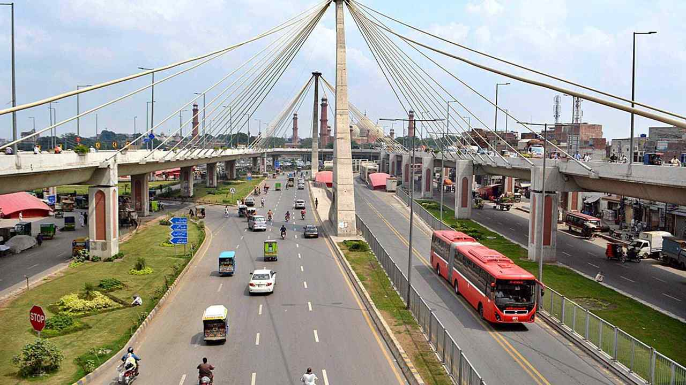
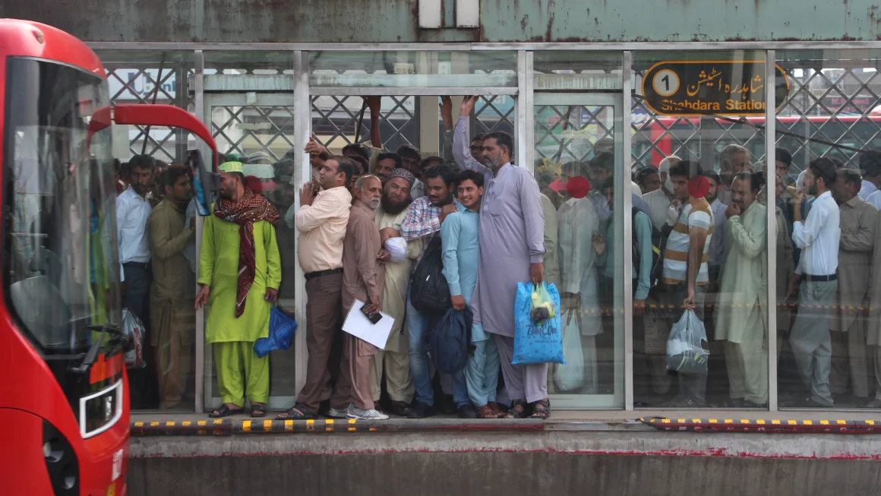
Local initiatives
https://cometinsure.com/blog/metro-bus-lahore-routes-ticket-prices-stations-timing-and-more/
Pakistan faces major urban mobility challenges due to rapid urbanization, traffic congestion, air pollution, and a lack of integrated transport systems.
Lahore Metrobus - launched in 2013 (Pakistan)
https://edition.cnn.com/travel/article/life-on-the-lahore-metrobus

Slide 32
Lahore Metrobus - launched in 2013 (Pakistan)
Local initiatives
First BRT system in Pakistan as a cost-effective, efficient, and rapid public transport solution.
27 km of dedicated corridor.
Serves over 150,000 passengers daily.
Fully segregated lanes.
Elevated platforms at stations matching bus floor height.
Electronic ticketing and automatic fare gates.

Slide 33
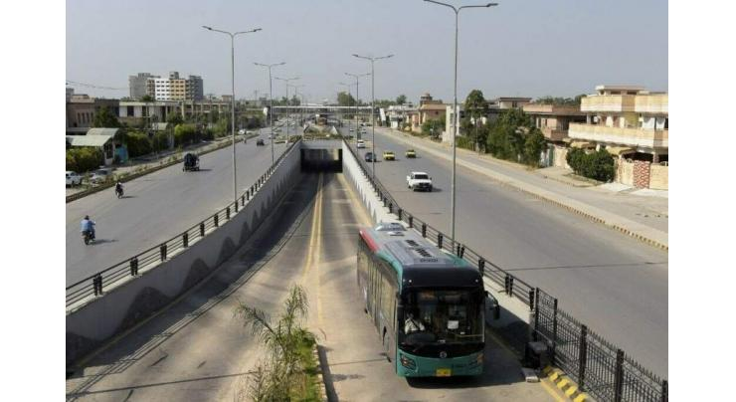
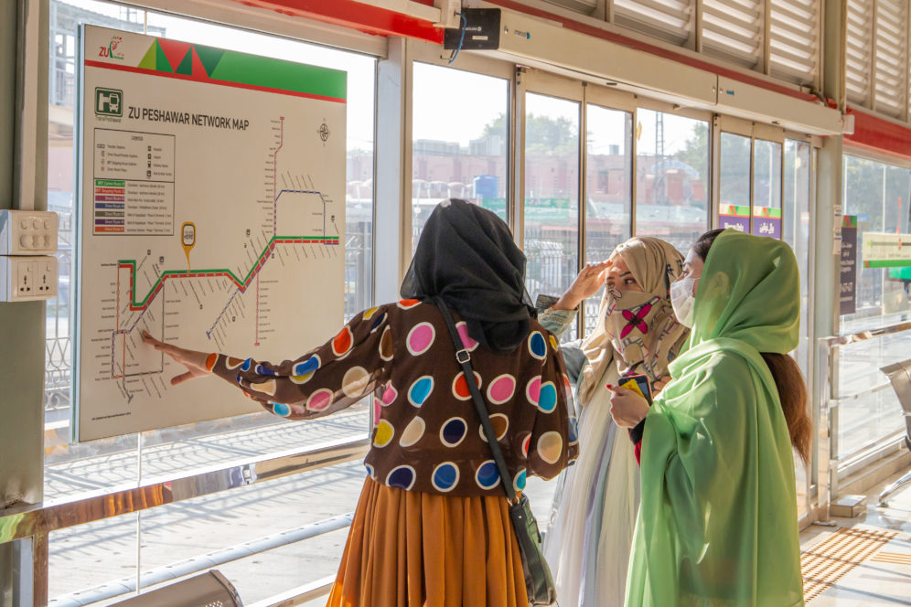
Local initiatives
https://www.urdupoint.com/en/business/transpeshawar-extends-service-hours-on-3-brt-1971136.html
Pakistan’s BRT shows that efficient, scalable transport systems can be developed without expensive metro infrastructure.
Rawalpindi-Islamabad Metrobus - launched in 2015 - Pakistan
https://itdp.org/2022/06/09/how-peshawar-approaches-sustainable-accessible-inclusive-transport/

Slide 34
One of the most modern BRT systems in South Asia:
27 km main corridor
60 km of feeder routes
450 vehicles (including hybrid buses)
30 stations with elevators, ramps, and solar lighting
Serves approximately 260,000 passengers daily.
Integrated with mobile app.
Highly rated by users.
Local initiatives
Rawalpindi-Islamabad Metrobus - launched in 2015 - Pakistan

Slide 35
Main Benefits of BRT
Lower Capital Costs than metro or light rail systems
Quick Implementation Time (can be built in months, not years)
Flexible (can be expanded or adjusted as cities grow)
Improved Travel Time (buses move faster in dedicated lanes)
Encourages Public Transport Use and reduces private car traffic
Environmentally Friendly (modern BRT fleets use electric or low-emission buses)
Social Inclusion (affordable and accessible for all income groups)

Slide 36
The Importance of Non-Motorized Transport (NMT) for Sustainable Cities
Non-motorized transport refers to forms of mobility that do not use engines, such as:
Walking
Cycling
Use of wheelchairs, pushcarts, rickshaws, and other human-powered or animal-powered modes

Slide 37
Why NMT is Crucial for Sustainable Urban Mobility?
Zero emissions, helping reduce air pollution and greenhouse gases
Less noise
Minimal resource use in infrastructure
Reduces traffic congestion
Lowers road space demand
Supports compact and livable urban development
Stimulates local economies
Promotes active lifestyles and public health
Provides access for those without vehicles
Complements public transport (e.g., walking or cycling to BRT stations)

Slide 38
Barriers to NMT in Asian Cities
NMT is often neglected in planning and infrastructure investment.
Lack of safe sidewalks, crossings, and bicycle lanes makes NMT dangerous and discouraging.
Poor pedestrian infrastructure
Low social status of walking/cycling
Inadequate lighting, signage, and shade
Conflicts with motorized traffic
Gender safety concerns (people, especially women and girls, feel unsafe while walking, cycling, or using public transport because of the risk of harassment, violence, or lack of secure infrastructure)
Weak integration with public transport

Slide 39
How to Promote NMT?
Build continuous sidewalks and bike lanes
Improve crossings, lighting, and safety measures
Launch public bike-sharing systems
Create car-free zones and walkable areas
Connect NMT routes to bus stops and metro stations

Slide 40
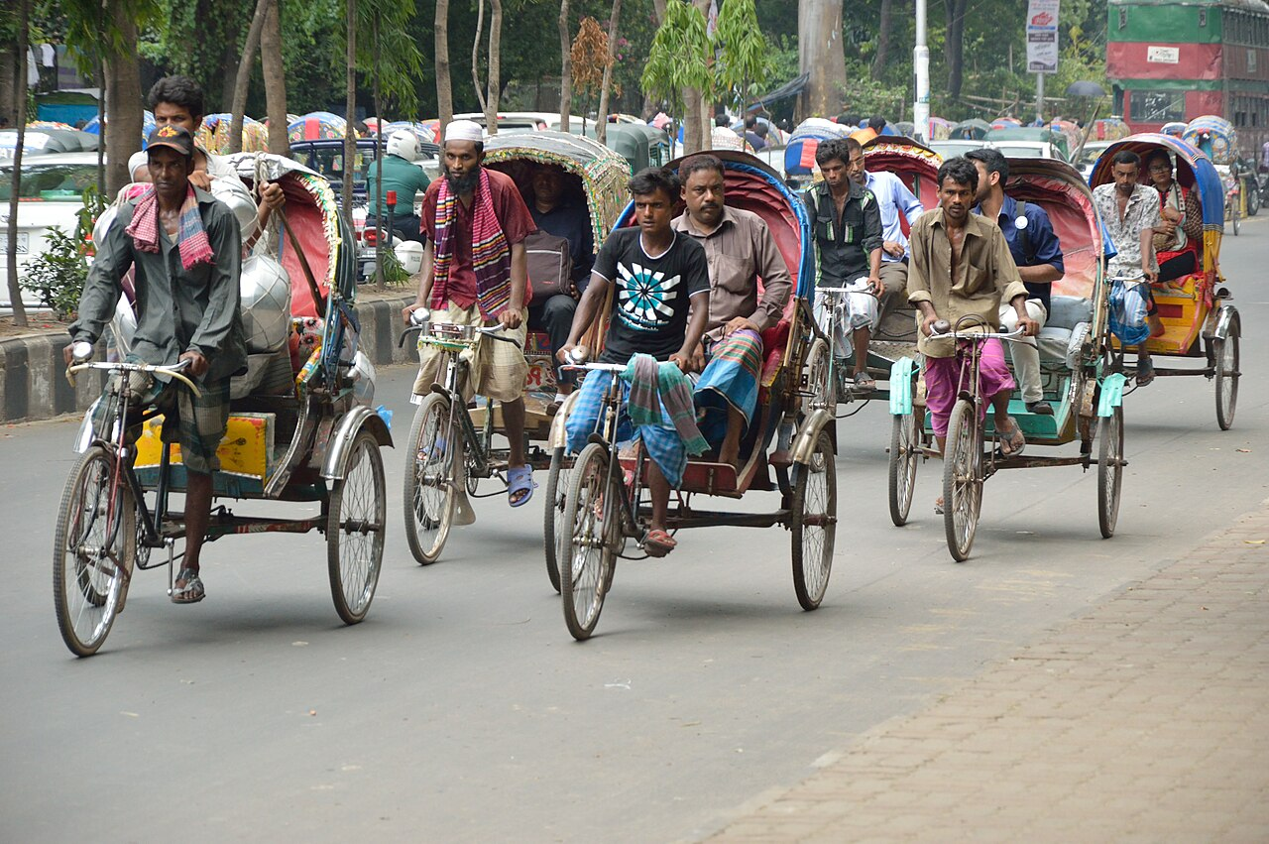
Seeds of solutions – local initiatives
https://en.wikipedia.org/wiki/Rickshaws_in_Bangladesh#/media/File:Cycle_Rickshaws_-_High_Court_Street_-_Dhaka_2015-05-31_2094.JPG
Cycle rickshaws are a strong local example of how traditional, human-powered transport can support sustainable mobility goals in Asian cities. Their integration into broader urban transport systems—alongside infrastructure improvements—can enhance the accessibility, inclusivity, and environmental performance of transport in cities like Dhaka.
Cycle rickshaws in Bangladesh

Slide 41
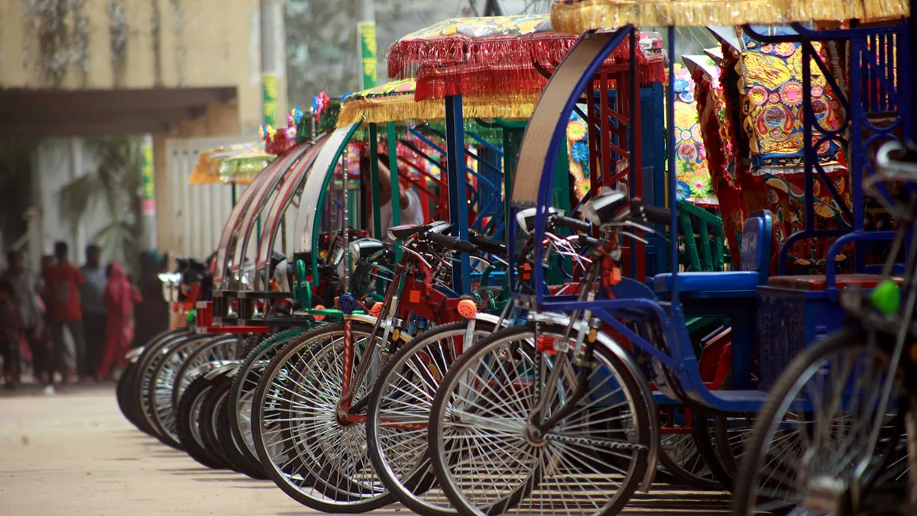
Seeds of solutions – local initiatives
https://restofworld.org/2024/bangladesh-e-rickshaw-legal-dhaka/
Electric rickshaws in Bangladesh illustrate how emerging low-emission technologies can be adapted to local contexts to improve urban mobility. With proper regulation, infrastructure, and support, e-rickshaws have the potential to become a reliable, affordable, and eco-friendly component of sustainable urban transport.
Electric rickshaws in Bangladesh

Slide 42
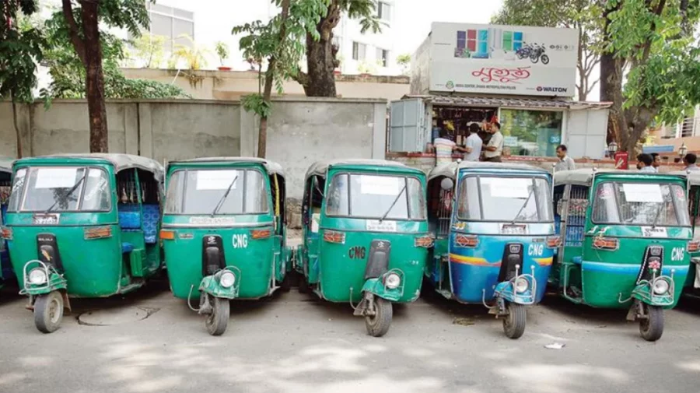
Seeds of solutions – local initiatives
Photo: Mahmud Hossain Opu/Dhaka Tribune, https://www.dhakatribune.com/bangladesh/332994/how-brta-owners%E2%80%99-body-gobbled-113c
CNG-run auto-rickshaws represent a transitional step toward cleaner urban transport in Bangladesh. While they are not entirely emission-free, their adoption has significantly reduced dependency on fossil fuels and improved air quality. With better traffic management and infrastructure planning, they can remain an integral part of sustainable mobility in Bangladeshi cities.
CNG-run auto-rickshaws
in Bangladesh

Slide 43
Seeds of solutions – local initiatives – key features
Affordable and accessible: Rickshaws provide an inexpensive travel option for short distances used for various purposes such as carrying passengers and delivering goods
help reduce air pollution and noise in dense urban centers.
High employment generation: The rickshaw sector employs hundreds of thousands of people, many of whom are rural migrants or workers with limited formal education.
Flexible and space-efficient: Rickshaws can navigate narrow streets and congested areas where larger vehicles cannot operate.
Last-mile connectivity: They play a vital role in connecting passengers to major transport hubs like bus terminals or railway stations.
Rickshaws in Bangladesh

Slide 44
Seeds of solutions – local initiatives
The city launched a pilot project to pedestrianize Durbar Marg (main commercial streets and a key area for shopping and tourism), temporarily restricting motorized traffic to create a safer, cleaner, and more walkable environment.
Goals: Reducing air and noise pollution in a busy urban area, encouraging walking and improving safety for pedestrians, enhancing the commercial appeal of the street by creating pleasant public spaces
Challenges encountered: managing traffic rerouting, gaining public support, and ensuring accessibility for deliveries and emergency vehicles.
The pilot project helped gather data and public feedback for future broader pedestrianization plans in Kathmandu.
Pilot Pedestrianization of Durbar Marg Kathmandu (Nepal)

Slide 45
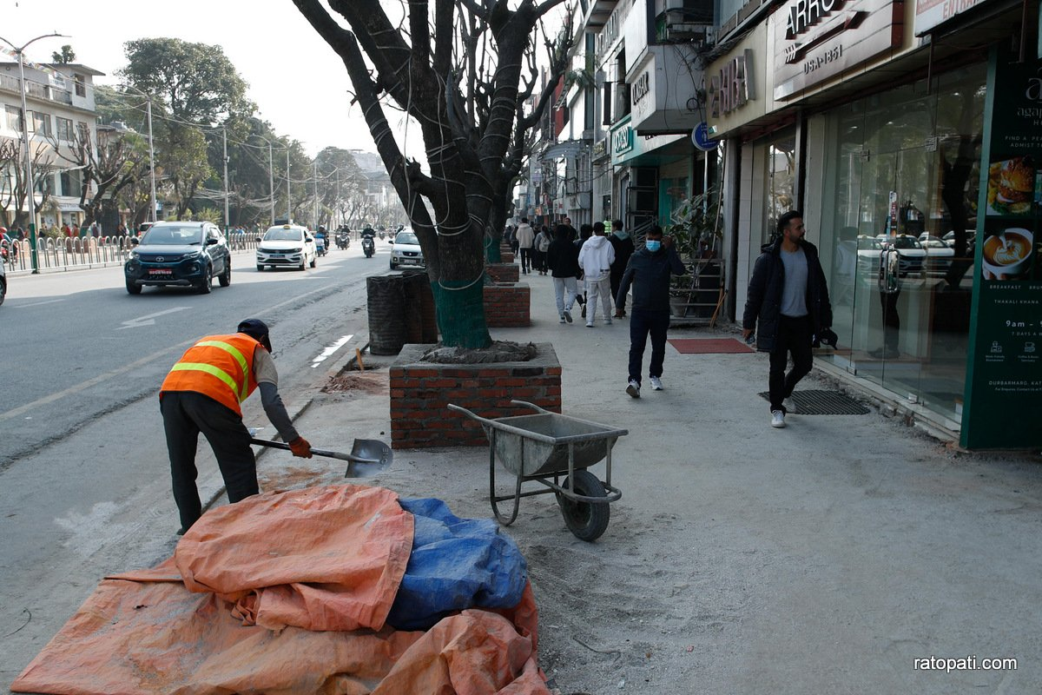
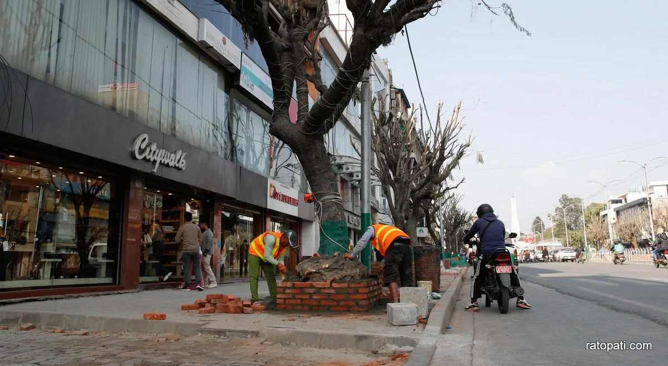
Seeds of solutions – local initiatives
https://english.ratopati.com/story/37169
„As part of the footpath expansion, Kathmandu Metropolitan City is currently focusing on improving drainage systems, undergrounding electrical wires, and preserving trees and plants.”
Pilot Pedestrianization of Durbar Marg Kathmandu (Nepal)

Slide 46
What is Shared Mobility?
Carpooling
Bike-sharing
Ride-sharing
Scooter-sharing
Car-sharing
Shared mobility refers to transportation services and resources that are shared among users, either simultaneously or one after another. It includes systems like carpooling, bike-sharing, ride-sharing, scooter-sharing, and car-sharing.

Slide 47
Carpooling - benefits
Lower transportation costs for each user
Fewer cars on the road (less congestion)
Lower emissions per passenger
Social interaction among commuters
Carpooling involves multiple individuals sharing a single vehicle for a trip, typically to work or school. It reduces the number of vehicles on the road and is often organized informally among friends or via apps.

Slide 48
Bike-sharing - benefits
Ideal for short trips and last-mile connectivity
Promotes physical activity
No emissions during operation
Reduces dependence on motorized transport
Bike-sharing systems allow users to rent a bicycle for short-term use, often through automated stations located across a city. Some systems include dockless bikes that can be picked up and left anywhere within a defined zone.

Slide 49
Car-sharing – how it works?
Users register with a car-sharing provider via an app or website.
They can reserve and unlock vehicles digitally.
Cars are typically parked at designated spots (station-based model) or available anywhere within a defined zone (free-floating model).
Payment is based on time and/or distance used.
Car sharing is a model of car rental where people access vehicles for short periods of time, typically by the hour or minute. It is usually managed via mobile apps and allows users to rent a car only when needed, without the costs and responsibilities of owning one.

Slide 50
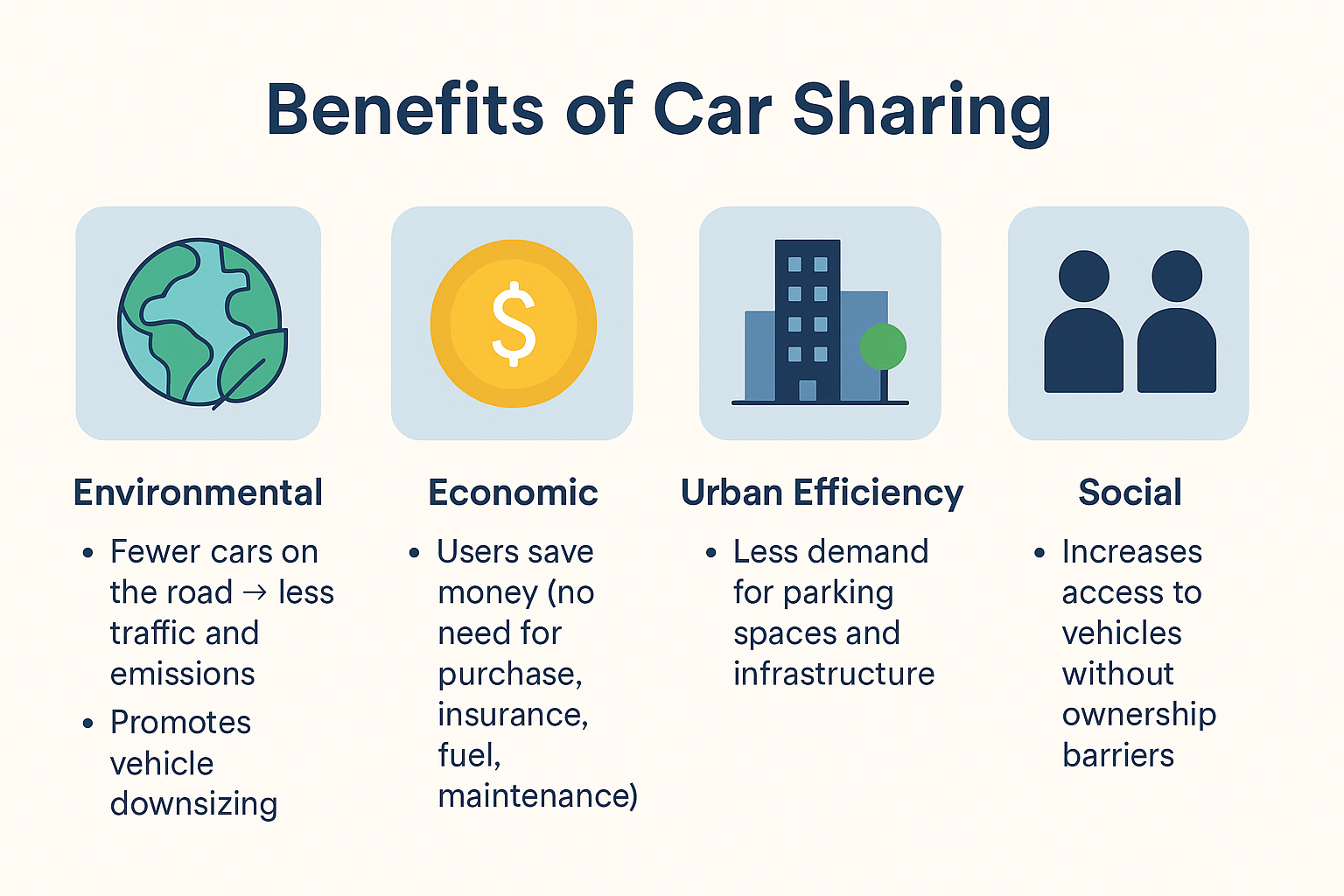
Benefits of car - sharing

Slide 51
Key Strategies
Investing in public transport (reliable, frequent, and clean buses, trams, and metro systems)
Promoting active travel
– Building safe cycling infrastructure and walkable public spaces
Supporting zero- and low-emission vehicles (electric buses, taxis, and private Evs)
Creating Low Emission Zones (LEZs) (restricting high-polluting vehicles in city centers)
Encouraging shared mobility (carsharing, bikesharing, and ridesharing reduce the number of vehicles on the road
Integrating transport and urban planning (compact, mixed-use neighborhoods reduce the need for long commutes)

Slide 52
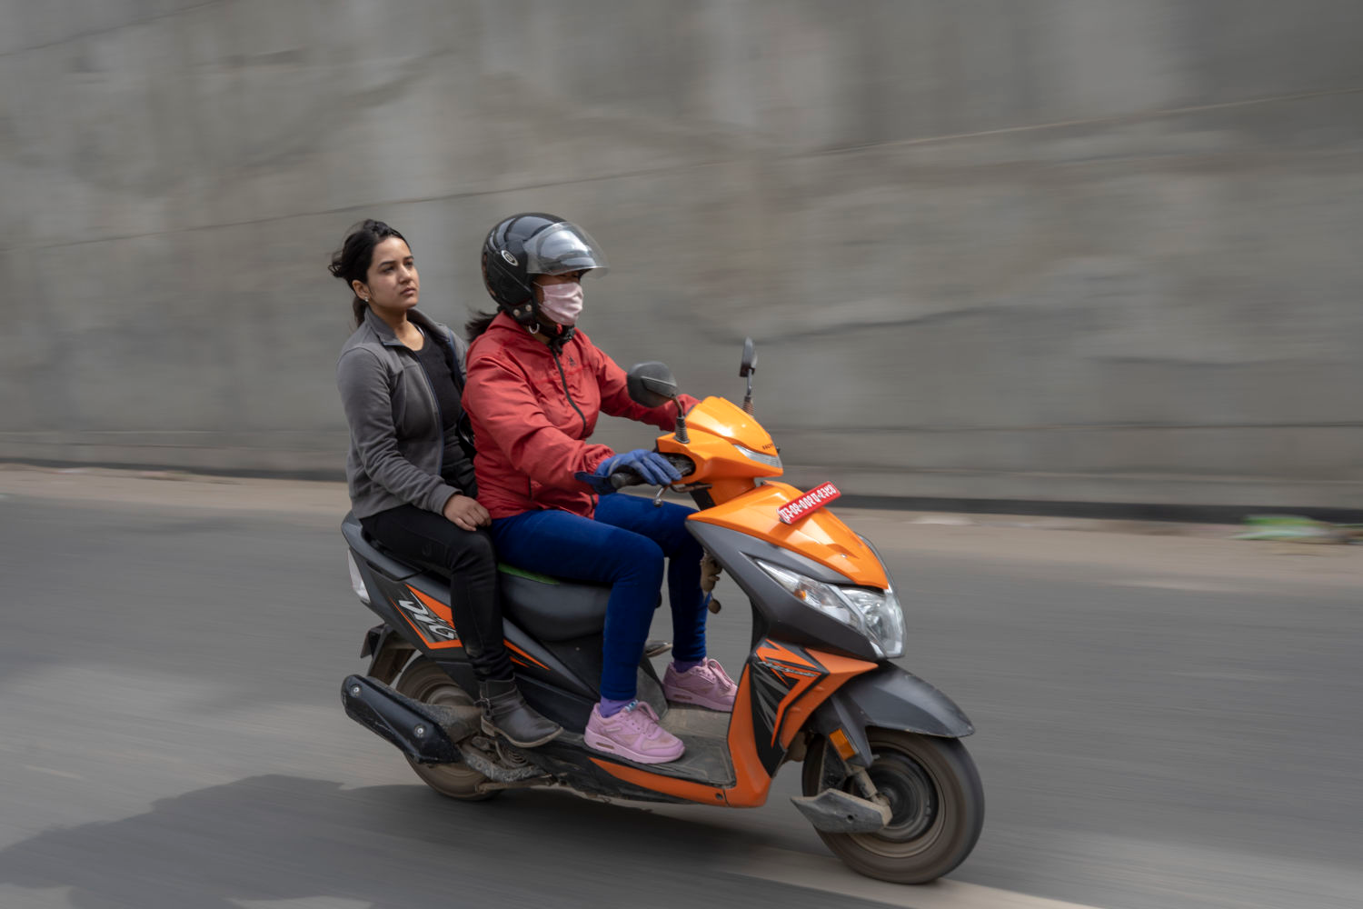
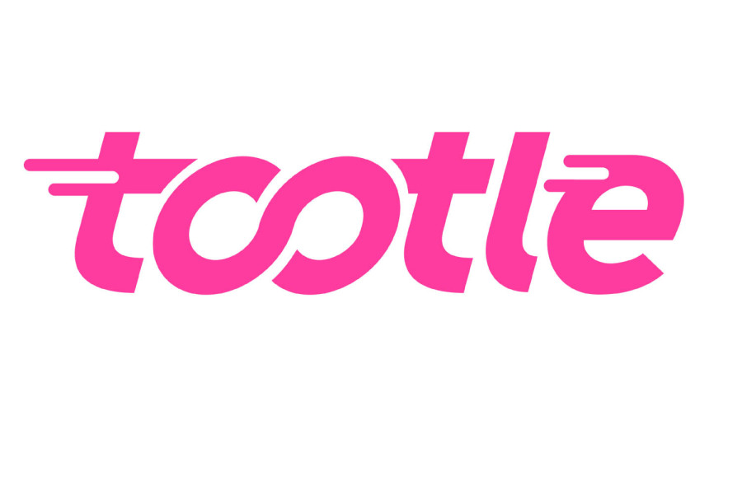
Seeds of solutions – local initiatives
Tootle is a Nepali ride-sharing app that connects passengers with motorcycle or scooter riders in urban areas, especially in Kathmandu.
Motorcycle-based shared mobility service.
Ideal for navigating narrow and congested streets.
Popular among students and office workers.
A local, low-cost solution for urban transport challenges.
Tootle (Nepal)
https://kathmandupost.com/money/2024/04/16/tootle-introduces-new-commission-rates-for-riders
https://www.dignityunbound.org/doing-development-differently-nepal-tootling-towards-prosperity/index.html

Slide 53
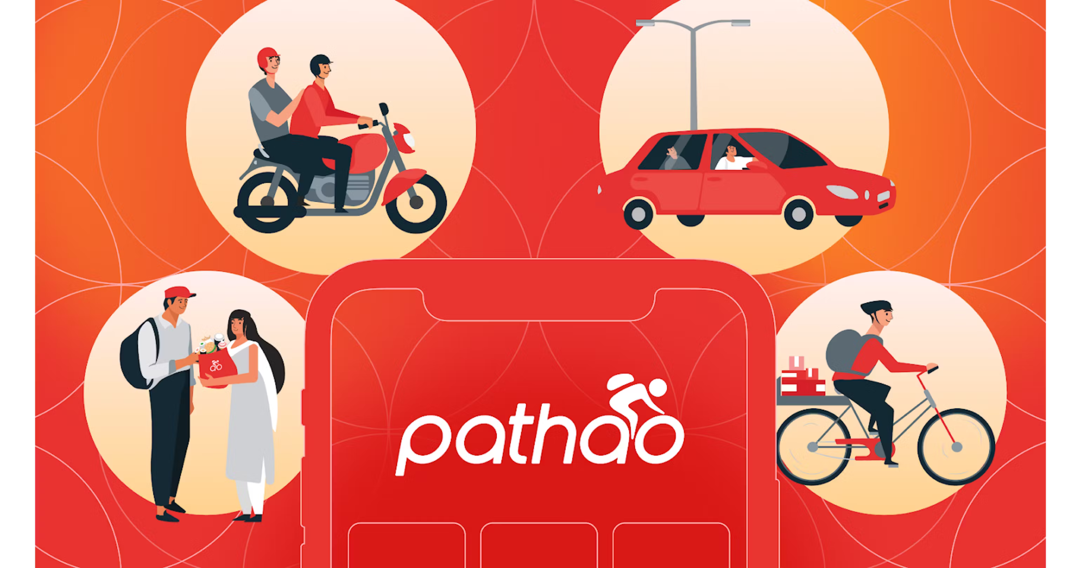
Seeds of solutions – local initiatives
Pathao is a Bangladeshi tech company that provides on-demand transportation, logistics, and digital payment services. It was founded in 2015 and has grown to become one of the largest digital platforms in the country.
Pathao started as a motorcycle ride-sharing app, helping commuters avoid traffic jams in cities like Dhaka and Chittagong (motorbikes are ideal for narrow streets and fast movement in dense urban areas).
Pathao (Bangladesh)
https://www.mongodb.com/solutions/customer-case-studies/pathao

Slide 54
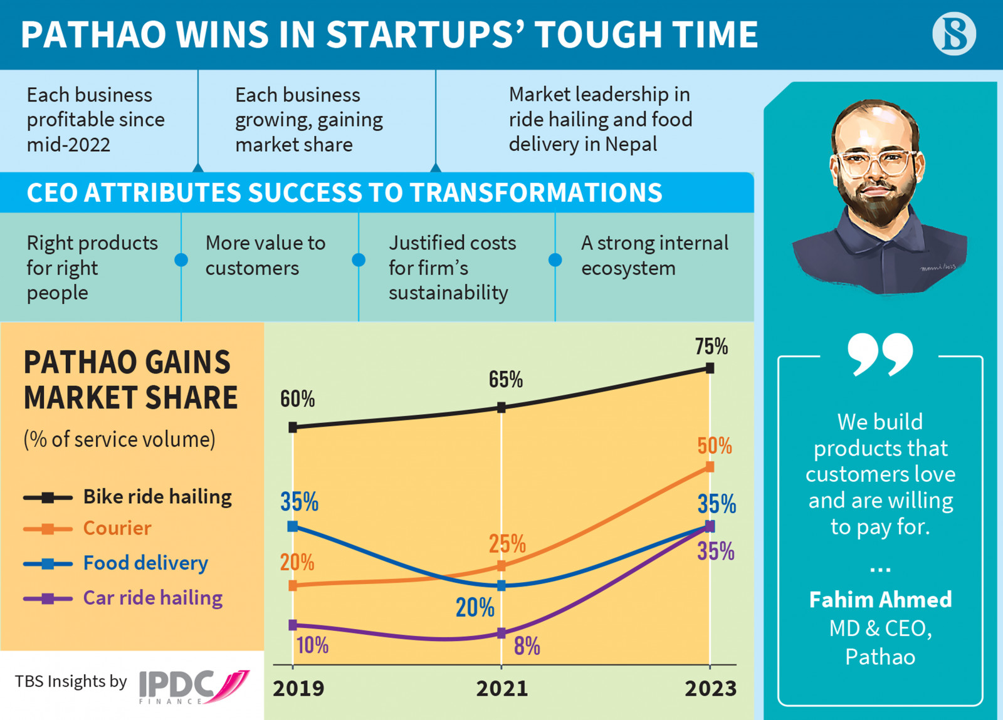
Seeds of solutions – local initiatives
Pathao (Bangladesh)
https://www.tbsnews.net/bangladesh/how-pathao-stays-lone-profitable-start-726214

Slide 55
Pathao Car: Offers private car rides through the app (suitable for longer commutes or when traveling in groups).
Parcel & Food Delivery: It also provides logistics services for e-commerce and food delivery businesses. Small businesses and individuals can use Pathao for sending packages.
Pathao Pay: A digital wallet and payment gateway is integrated with the app. Enables cashless transactions, which increases convenience and safety.
Seeds of solutions – local initiatives
Pathao (Bangladesh)

Slide 56
Electrification Trends in Urban Transport
Urban transport is increasingly shifting toward electrification, replacing fossil fuel–based systems with electric alternatives such as:
  Electric buses
  Electric cars and taxis
  Electric two- and three-wheelers
  Light rail and metro systems
  Electric micro-mobility (e-bikes, e-scooters)
  This trend is supported by rapid advancements in battery technology, declining costs of renewable energy, and global efforts to reduce greenhouse gas emissions.

Slide 57
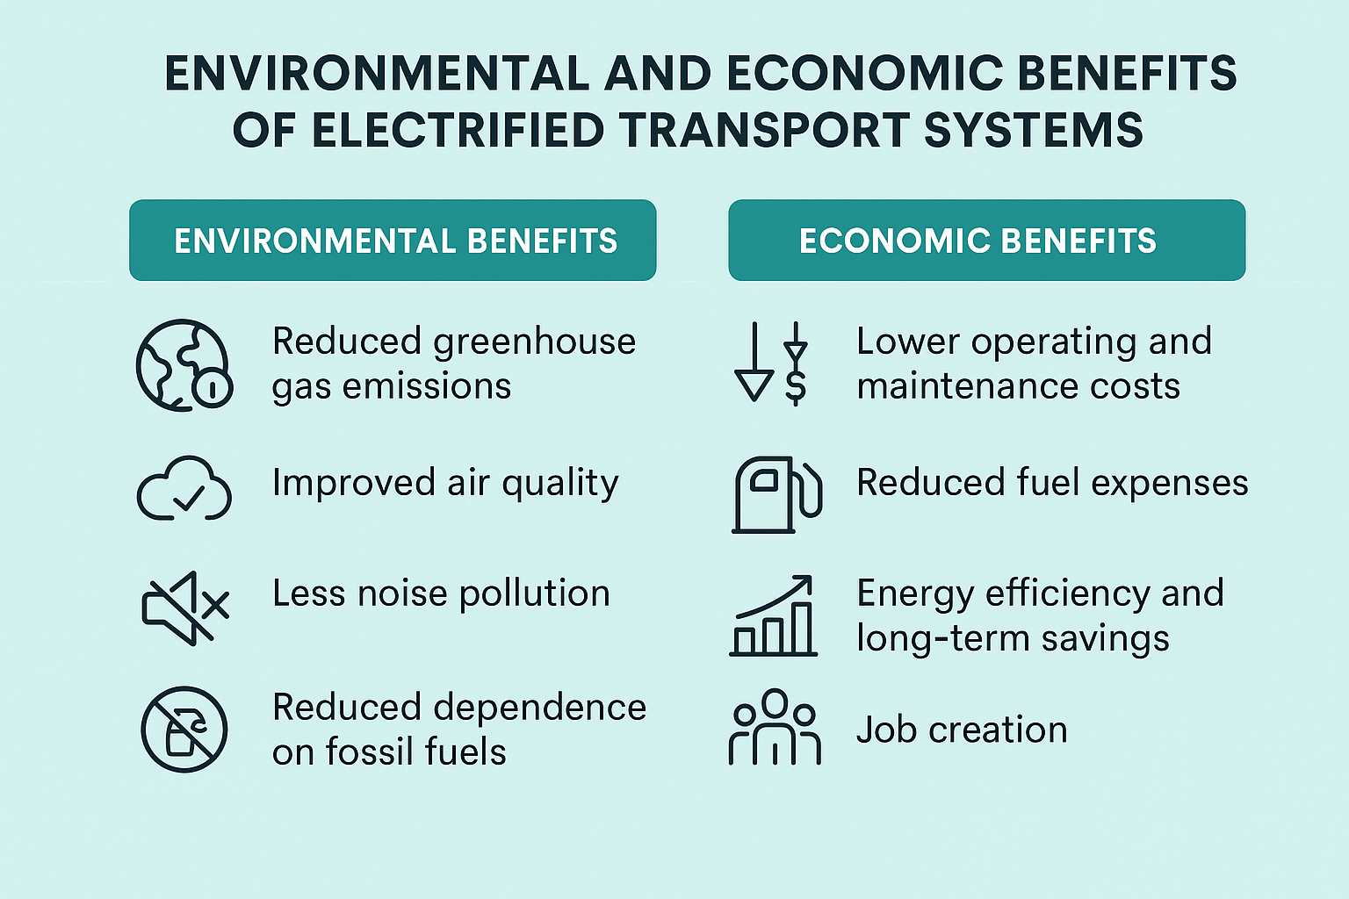
Environmental and Economic Benefits

Slide 58
Challenges
High Initial Cost of EVs: Despite long-term savings, upfront vehicle costs can be a barrier.
Charging Infrastructure: Many cities lack adequate public and private charging stations.
Grid Readiness: Increased electricity demand may stress urban power grids.
Battery Supply Chains: Environmental and ethical issues related to lithium, cobalt, and rare earth minerals.

Slide 59
Opportunities
Integration with Renewable Energy: Cities can link EV charging to solar and wind power sources.
Shared Electric Mobility: Electrified fleets (e.g., taxis, buses, bikes) lower costs and emissions for many users.
Smart Charging & V2G (Vehicle-to-Grid): Enables dynamic energy management and grid balancing.
Policy Innovation: Subsidies, tax benefits, and zoning incentives can accelerate EV adoption.

Slide 60
Student assignment: Sustainable Urban Mobility Solutions
Choose a city (real or hypothetical) and assess its current urban transport system.
Analyze sustainable mobility principles implemented or feasible for the city, including:
  Low-carbon and energy-efficient transport options
  Eco-friendly urban planning and infrastructure
  Explore public transport models:
    Affordable solutions such as Bus Rapid Transit (BRT)
    Informal transport systems and non-motorized transport (NMT) options (e.g., sidewalks, bike lanes, pedestrian zones)

Slide 61
Student assignment: Sustainable Urban Mobility Solutions
Examine shared mobility concepts such as carpooling, bike-sharing, or ride-sharing apps. Discuss their potential benefits for congestion, costs, and the environment. Consider electrification of transport: identify opportunities and challenges of introducing electric buses, scooters, or cars in the urban system.
Prepare a short report or presentation summarizing your analysis, findings, and practical recommendations for improving sustainable mobility in the selected city.

