Slide 1



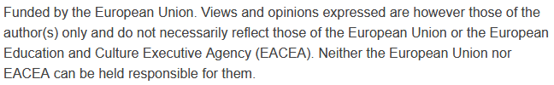
Best Practices in Smart Cities and Sustainable Mobility
Sustainability and Quality Assurance for Academic Governance and Redesign Engineering Studies
MODULE 5
Justyna Staszak-Winkler

Slide 2
https://www.rolandberger.com/en/Insights/Publications/Smart-City-Strategy-Index-Vienna-and-London-leading-in-worldwide-ranking.html

Slide 3
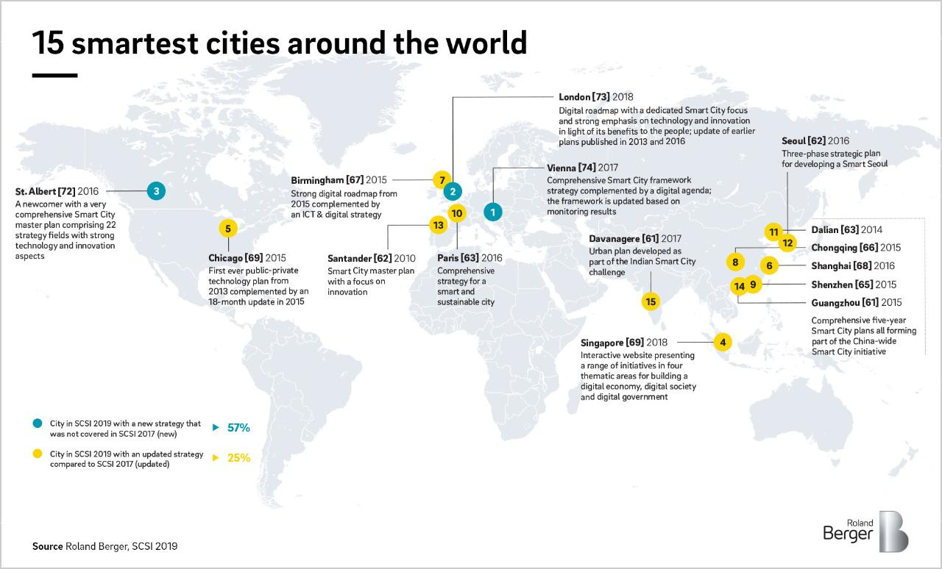
https://www.rolandberger.com/en/Insights/Publications/Smart-City-Strategy-Index-Vienna-and-London-leading-in-worldwide-ranking.html

Slide 4
Innovative Approaches to Sustainable Urban Mobility
Innovative approaches to sustainable urban mobility combine technological progress, policy tools, and human-centered design. Success depends on integration – between modes of transport, between technology and governance, and between environmental goals and social equity.

Slide 5
Singapore – Integrated Smart Mobility Ecosystem
Singapore has established one of the most advanced and holistic smart mobility ecosystems globally. Driven by its “Smart Nation” ambition and a vision to become a “45-minute city”, the nation seamlessly integrates urban planning, transport infrastructure, data systems, public-private partnerships, and sustainable technologies into a single, citizen-centric model.

Slide 6
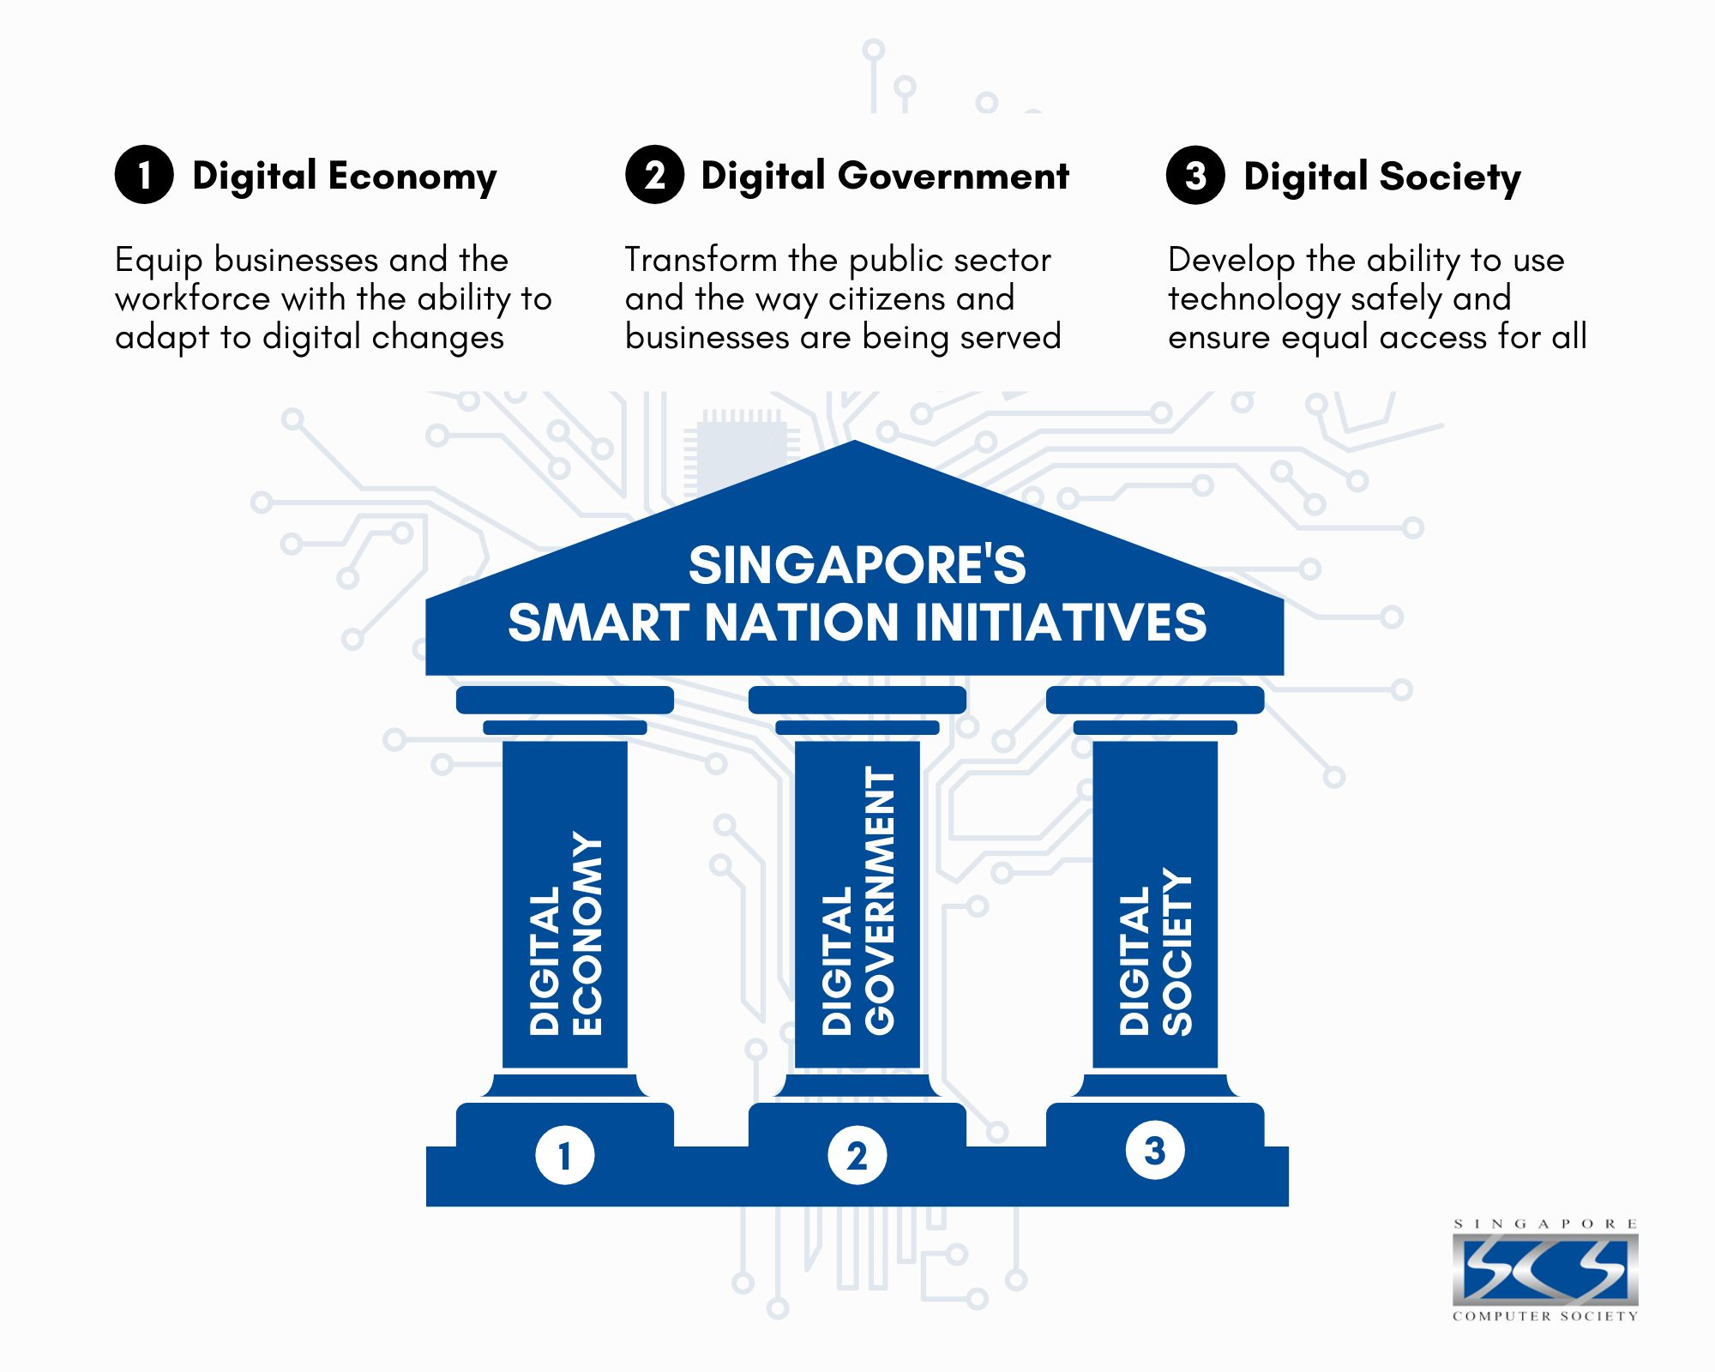
Singapore’s Smart Nation Initiatives Key Pillars
https://www.scs.org.sg/articles/smart-nation-singapore

Slide 7
Key Pillars od Integrated Smart Mobility System - Intelligent Transport Systems (ITS)
Uses IoT sensors, smart cameras, predictive analytics, and traffic control systems to optimize vehicle flow and reduce congestion.
Projects like Smart Mobility 2020 and the Travel Smart Programme help balance peak-travel demand, encouraging mode shifts and reducing overcrowding.

Slide 8
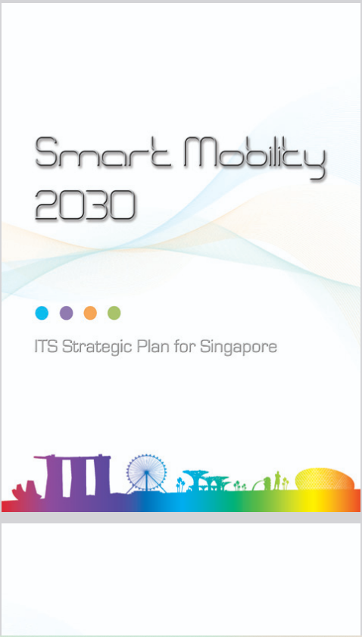
Key Pillars od Integrated Smart Mobility System - Intelligent Transport Systems (ITS)
Smart Mobility 2020 (later evolved into Smart Mobility 2030) is a strategic transport master plan developed by Singapore’s Land Transport Authority (LTA). It is not a single project, but a long-term vision for integrating digital technologies, public transport, and traffic management to ensure efficient, sustainable, and people-centric mobility.
https://www.lta.gov.sg/content/dam/ltagov/getting_around/driving_in_singapore/intelligent_transport_systems/pdf/smartmobility2030.pdf

Slide 9
Key Pillars od Integrated Smart Mobility System - Intelligent Transport Systems (ITS)
The Travel Smart Programme (TSP) is an initiative by Singapore’s Land Transport Authority (LTA) designed to spread out peak-hour commuting and make the transport system more efficient and comfortable.
Instead of everyone traveling at the same time (e.g., 8–9 AM), the programme encourages commuters and companies to shift travel patterns through incentives and flexible arrangements.

Slide 10
Key Elements of the Travel Smart Programme
Travel Smart Rewards: Commuters earn credits for traveling outside of the most congested peak periods.Credits can be converted into cash or rewards.
Travel Smart Network: Partnership with employers to adopt flexible work arrangements (e.g., flexible hours, telecommuting).Companies can receive support and consultancy on how to spread commuting demand among employees.

Slide 11
Key Elements of the Travel Smart Programme
Travel Smart Journeys: Pilot projects offering free or discounted rides for commuters who travel before the morning peak (free MRT rides for early commuters to certain city stations).
Travel Smart Consultancy: LTA works with organizations to analyze travel patterns, suggest staggered hours, shuttle services, or teleworking options.

Slide 12
Key Pillars od Integrated Smart Mobility System - Intelligent Transport Systems (ITS)
Smart Digital Junctions are being trialed to reduce waiting times using AI, edge processing, LiDAR (Light Detection and Ranging), and V2X (vehicle-to-everything) connectivity.
The system consists of three main components:
Management Platform – a central control system that monitors and coordinates multiple junctions.
Adaptive Control – uses AI and real-time edge processing to dynamically adjust signal timings based on actual traffic and pedestrian flow.
Traffic Controller – the on-site unit that manages the signals at individual junctions, communicating with the central system.

Slide 13
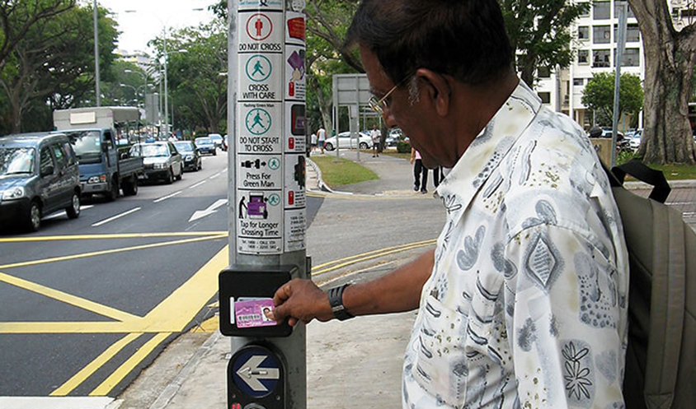
„To give the elderly and persons with disabilities more time to cross the roads, over 1,000 pedestrian crossings islandwide have been fitted with Green Man Plus (GM+), allowing the elderly and persons with disabilities to extend the green man time by tapping their concession cards on the GM+ reader. LTA plans to expand GM+ to another 1,500 pedestrian crossings by 2027.” https://www.mot.gov.sg/what-we-do/motoring-road-network-and-infrastructure/inclusive-transport-infrastructure
Key Pillars od Integrated Smart Mobility System - Intelligent Transport Systems (ITS)

Slide 14
Where and how is it being trialed in Singapore?
Pilots have been launched at roads such as Corporation Road and Boon Lay Way, in collaboration with the Land Transport Authority (LTA).
The technology can reduce waiting times by up to 20% by analyzing real-time conditions rather than relying on fixed signal cycles.
It detects vehicles, cyclists, and pedestrians using video analytics and LiDAR sensors (ex. pedestrian crossings can be activated without pressing a button or green signals can be extended if a pedestrian is still crossing)

Slide 15
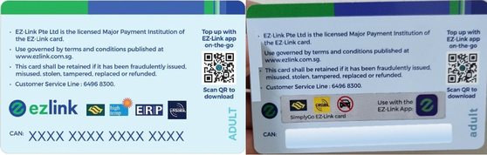
Seamless, Contactless Payments & Centralized Mobility Management
The EZ-Link card enables smooth fare payment across MRT, LRT, buses, and even ERP and parking systems.
https://en.wikipedia.org/wiki/EZ-Link

Slide 16
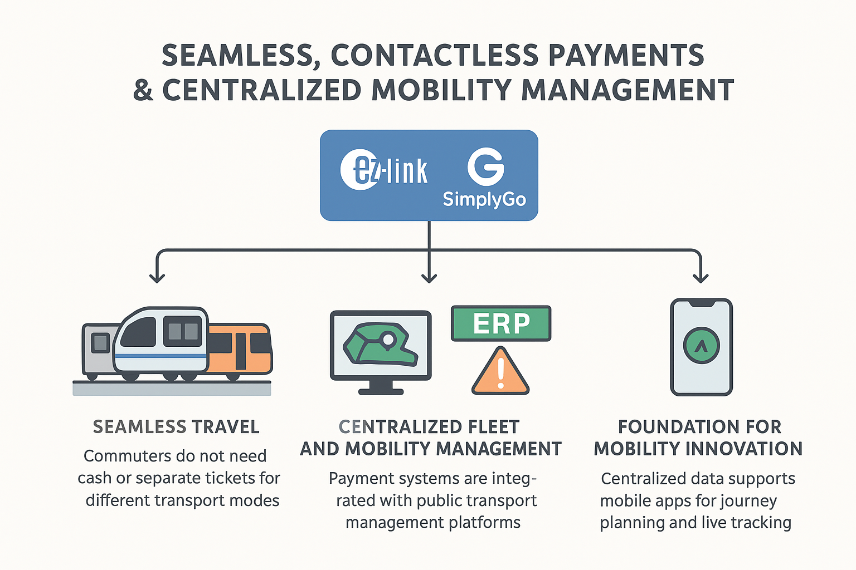
Seamless, Contactless Payments & Centralized Mobility Management

Slide 17
Key Benefits and Functionalities
Seamless Travel: Commuters do not need cash or separate tickets for different transport modes. Automatic fare deduction enables faster boarding and alighting, reducing congestion at fare gates.
Centralized Fleet and Mobility Management: Payment systems are integrated with public transport management platforms, allowing operators to monitor vehicle movements in real time. Data on passenger volumes, route usage, and delays helps optimize schedules and service frequency.

Slide 18
Key Benefits and Functionalities
Integration with Smart Traffic Management:
ERP linked with EZ-Link/SimplyGo enables dynamic road pricing, discouraging peak-hour congestion.T he system allows quick responses to traffic incidents, including rerouting buses or adjusting service levels.
Foundation for Mobility Innovation: Centralized data supports mobile apps for journey planning, live bus tracking, and new transport models such as car-sharing and ride-sharing. The system encourages sustainable mobility by promoting public transport over private car use.

Slide 19
Singapore – Integrated Smart Mobility Ecosystem – Electronic Road Pricing (ERP)
Electronic Road Pricing (ERP) is Singapore's primary method for managing road congestion.
Introduced in 1998 by the Land Transport Authority (LTA), ERP replaced the earlier Area Licensing Scheme (ALS) and Road Pricing Scheme (RPS).
It employs electronic toll collection via gantries equipped with sensors and cameras to automatically deduct tolls from vehicles equipped with In-Vehicle Units (IUs)
Encourages off-peak travel, reduces traffic in city centers, and promotes public transport usage.

Slide 20
Singapore – Integrated Smart Mobility Ecosystem
ERP charges are applied during peak hours on expressways and arterial roads leading to the Central Business District (CBD). The system aims to maintain optimal traffic speeds—20–30 km/h on arterial roads and 45–65 km/h on expressways—by adjusting toll rates based on real-time traffic conditions .
The ERP system is undergoing a significant upgrade to ERP 2.0, which is based on Global Navigation Satellite System (GNSS) technology. This transition eliminates the need for physical gantries, reducing infrastructure costs and visual clutter .

Slide 21
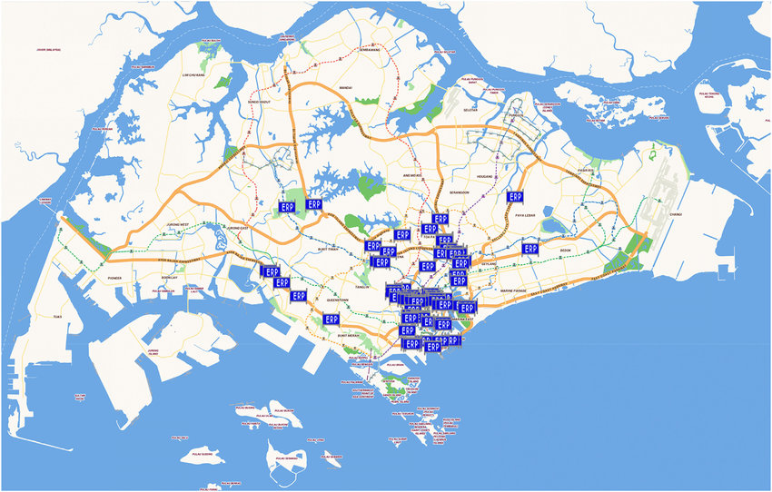
Map of Singapore and its Electronic Road Pricing gantries for managing road congestion on roads leading to the Central Business District by the Land Transport Au- thority (2018).
S. Chng, M.P. White, Ch. Abraham, S. Skippon: To drive or not to drive? A qualitative comparison of car ownership and transport experiences in London and Singapore

Slide 22
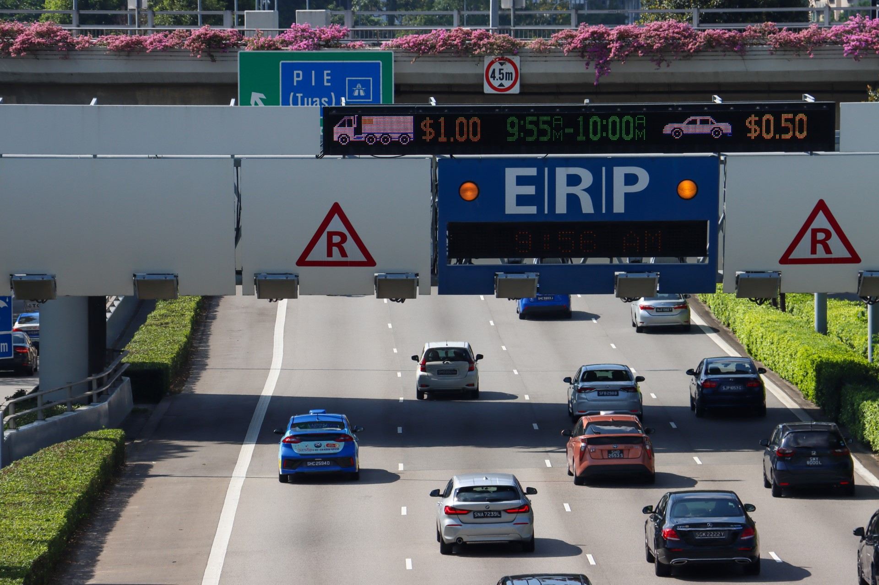
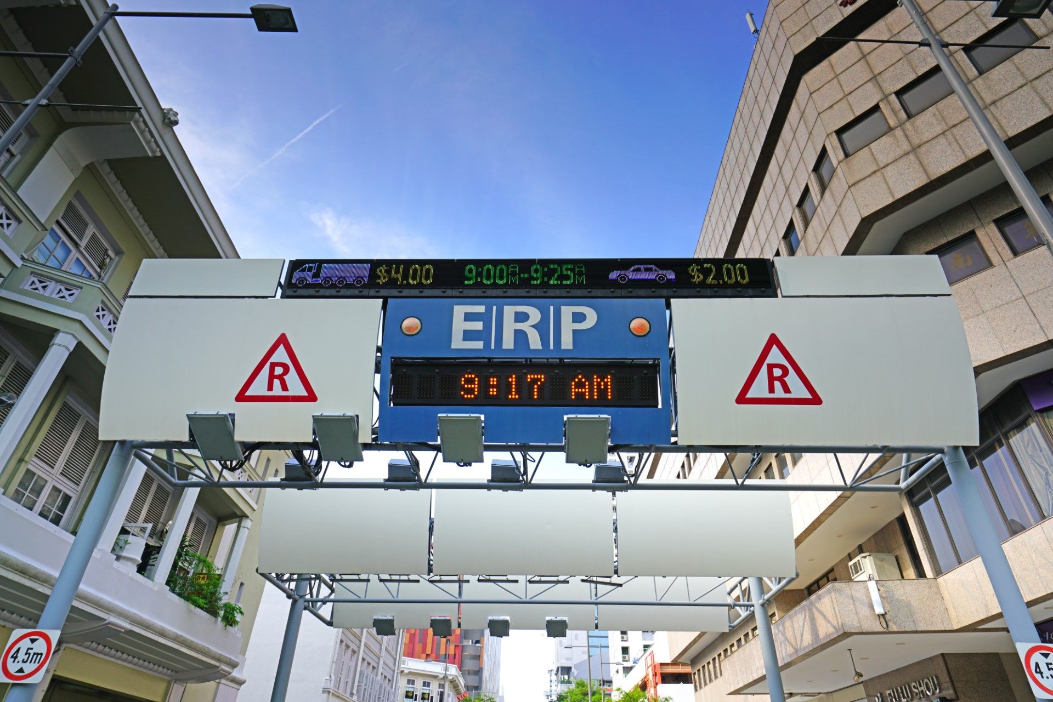
https://www.autoapp.sg/how-does-erp-work-in-singapore/

Slide 23
Mass Rapid Transit (MRT)
The Mass Rapid Transit (MRT) system is Singapore’s primary rail-based public transport network. It forms the backbone of the country’s public transport system, integrated with buses and other modes of mobility.
Trains run every 2–5 minutes during peak hours.
Most lines are driverless and use advanced signaling systems.
Unified ticketing via EZ-Link or SimplyGo (contactless cards and mobile apps).

Slide 24
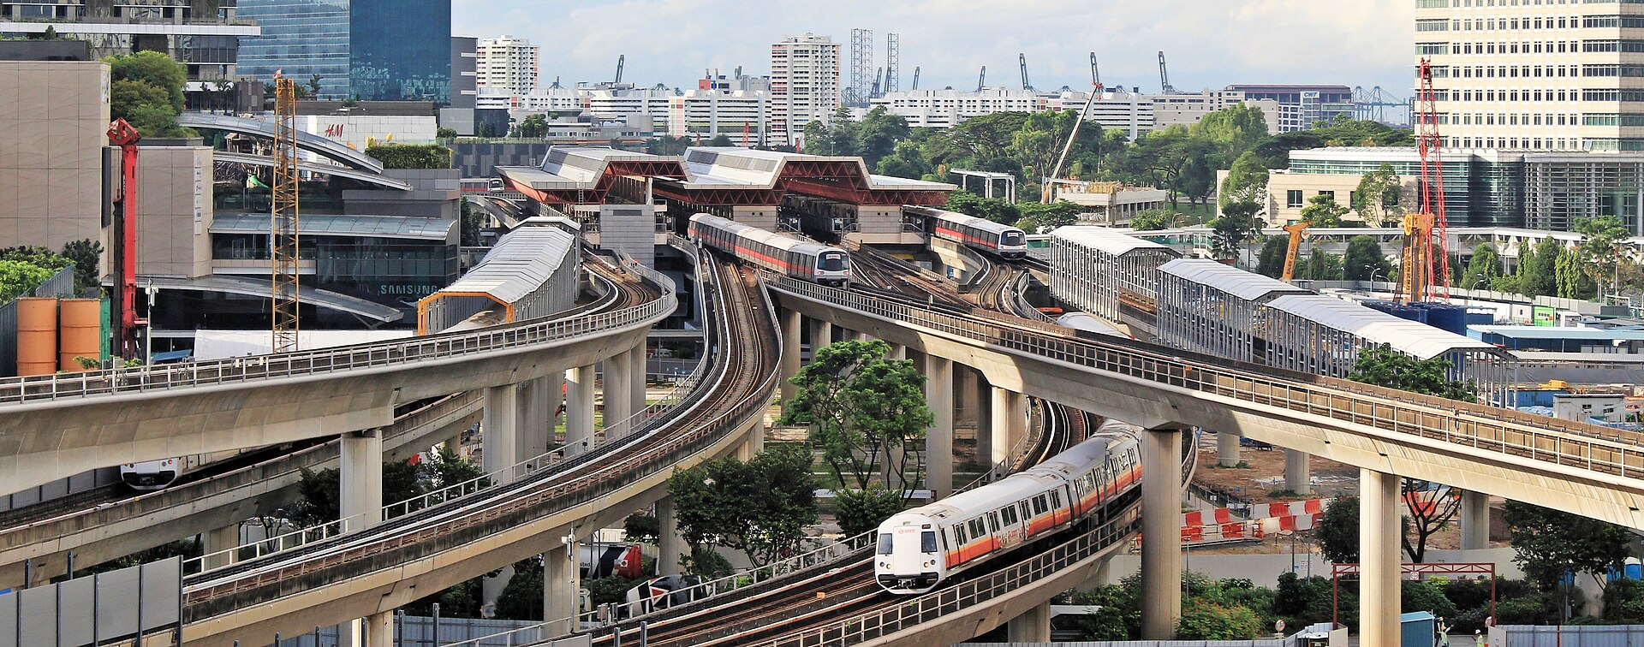
Mass Rapid Transit (MRT)
https://en.wikipedia.org/wiki/Mass_Rapid_Transit_%28Singapore%29#/media/File:Jurong_East_MRT_station_230622.jpg
Singapore’s Land Transport Master Plan (LTMP 2040) envisions that by 2040, 8 in 10 households will live within a 10-minute walk of a train station.

Slide 25
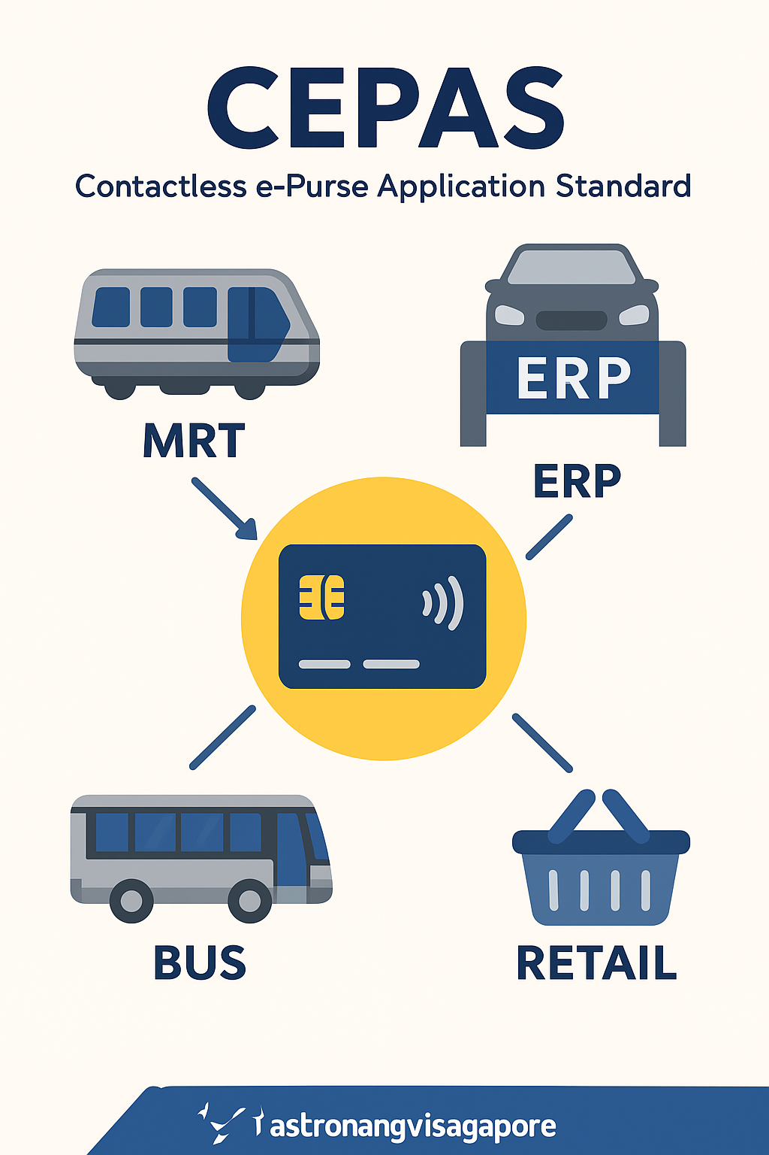
Contactless e-Purse Application Standard (CEPAS)
it is a national standard for contactless smart card payments in Singapore, developed by the Monetary Authority of Singapore (MAS).
allows different card issuers (e.g., EZ-Link, NETS) to operate under one common standard.
a single card or app can be used for multiple services: public transport (MRT, LRT, buses), Electronic Road Pricing (ERP), parking, retail purchases, vending machines, etc.
payments are processed quickly with contactless technology.

Slide 26
MyTransport.SG as a new communication platform in implementing smart mobility in Singapore
MyTransport.SG is a web portal and mobile application created by Singapore’s Land Transport Authority (LTA). It combines:
real-time data (bus arrival times, train disruptions, traffic conditions, and road works),
journey planning (multimodal trip planning combining bus, MRT, cycling, and walking),
parking information (including real-time car park availability),
bus crowding levels (colour-coded indicators show if a bus has available seats, only standing space, or is full),
EV charging points (locations, charger types, and navigation guidance) into a single platform.

Slide 27
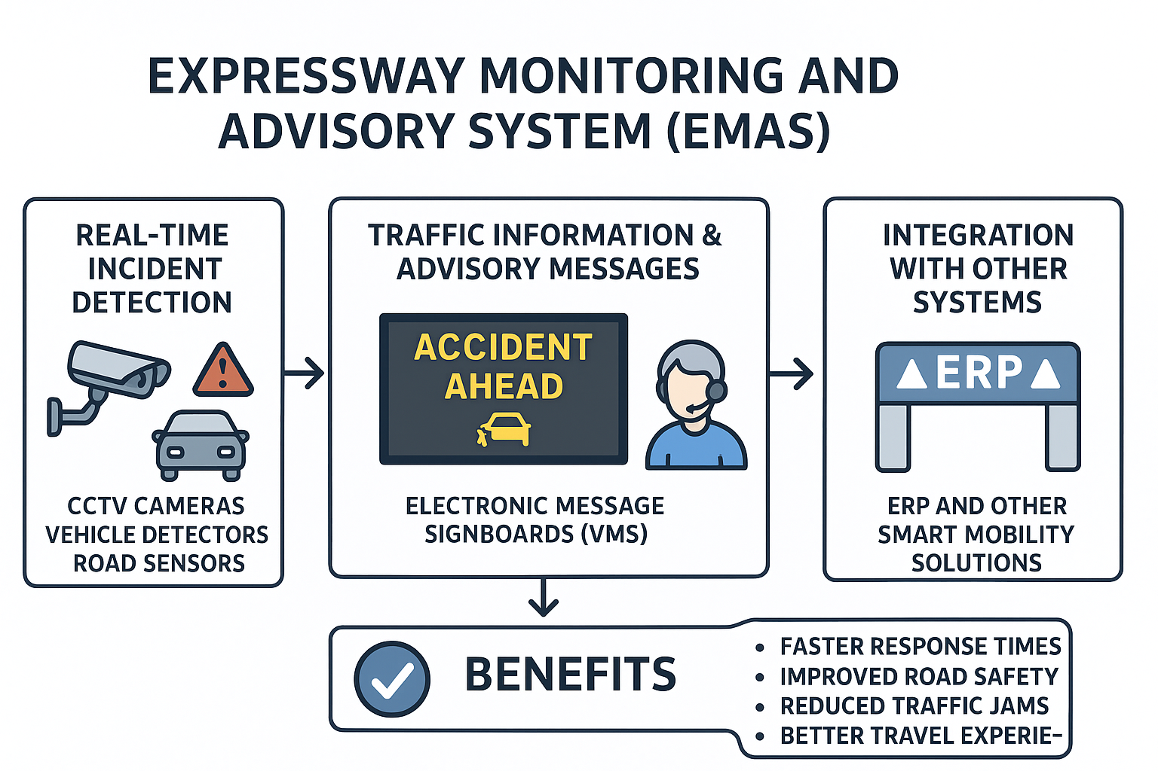
Expressway Monitoring and Advisory System (EMAS)

Slide 28
Expressway Monitoring and Advisory System (EMAS)
It is an intelligent traffic management system developed by the Land Transport Authority (LTA) to keep the expressway network safe and efficient.
EMAS uses CCTV cameras (Closed-Circuit Television cameras), vehicle detectors, and road sensors to monitor traffic flow (it automatically detects accidents, stalled vehicles, or unusual congestion)
Information is shared with motorists through electronic message signboards (VMS) placed along expressways (these provide real-time updates on accidents, road works, lane closures, or travel times)
EMAS is Singapore’s expressway “nerve system” — detecting incidents, informing drivers, and coordinating rapid response to keep traffic moving safely and smoothly.

Slide 29
Expressway Monitoring and Advisory System (EMAS)
Once an incident is detected, EMAS alerts LTA’s Expressway Monitoring Centre and the Singapore Civil Defence Force (SCDF) or Traffic Police if necessary.
Works alongside Electronic Road Pricing (ERP) and other smart mobility solutions to improve overall expressway efficiency (data from EMAS supports traffic planning and congestion management)

Slide 30
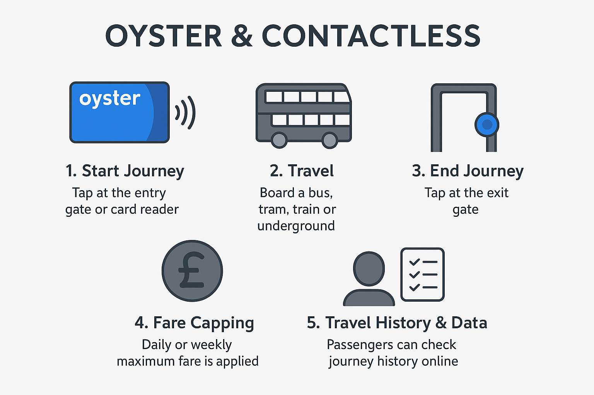
Transport for London (TfL) -Oyster Card and Contactless Payments

Slide 31
Transport for London (TfL) -Oyster Card
A smart card introduced in 2003 for paying fares on London’s public transport (buses, underground, trams, DLR, London Overground).
Prepaid card or pay-as-you-go balance.
Tap in at the start of a journey and tap out at the end (for tube/rail) to automatically calculate fare.
Daily and weekly fare capping prevents users from paying more than a set maximum.

Slide 32
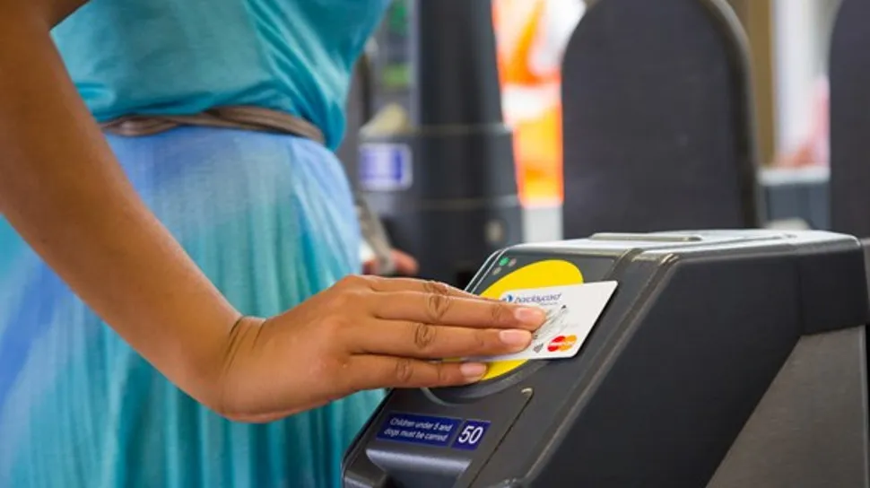
Transport for London (TfL) -
Contactless Payments
The same system as Oyster but using contactless bank cards, debit/credit cards, or mobile wallets (Apple Pay, Google Pay).
Tap the card/device at the entry and exit points.
TfL automatically charges the correct fare from the linked account.
Daily and weekly fare capping also applies, just like with Oyster.
https://www.techradar.com/news/tfl-journeys-dominated-by-contactless-payments

Slide 33
Impact on Smart City Functionality
Seamless travel: One integrated payment system across multiple transport modes.
Data collection: TfL can analyze travel patterns to optimize routes, schedules, and capacity.
Encourages public transport use: Easy, cashless payment reduces friction and speeds up boarding.
Supports sustainability: By making public transport more convenient, it helps reduce car usage and congestion.

Slide 34
Congestion Charge
A daily fee for driving within Central London during peak hours.
Introduced in 2003 by Transport for London (TfL).
Vehicles entering the Congestion Charge Zone (CCZ) between 07:00–18:00 (Mon–Fri) must pay a fee (currently £15 per day).
Payment is automatic if vehicles are registered (via Auto Pay) or can be done online.
Purpose: reduce traffic congestion in the city center, encourage use of public transport, walking, cycling, and shared mobility.
Congestion Charge = tackling traffic jams

Slide 35
Ultra Low Emission Zone (ULEZ)
A zone where vehicles must meet strict emission standards to drive without paying a fee.
Introduced in2019, covering Central London; expanded city-wide in 2023
Emission standards: Petrol cars must meet Euro 4 standards, Diesel cars must meet Euro 6 standards, Vehicles not compliant pay a daily charge (£12.50 for most cars/vans).
Automatic number plate recognition (ANPR) cameras detect vehicles entering the zone (non-compliant vehicles are charged automatically)
ULEZ = tackling air pollution

Slide 36
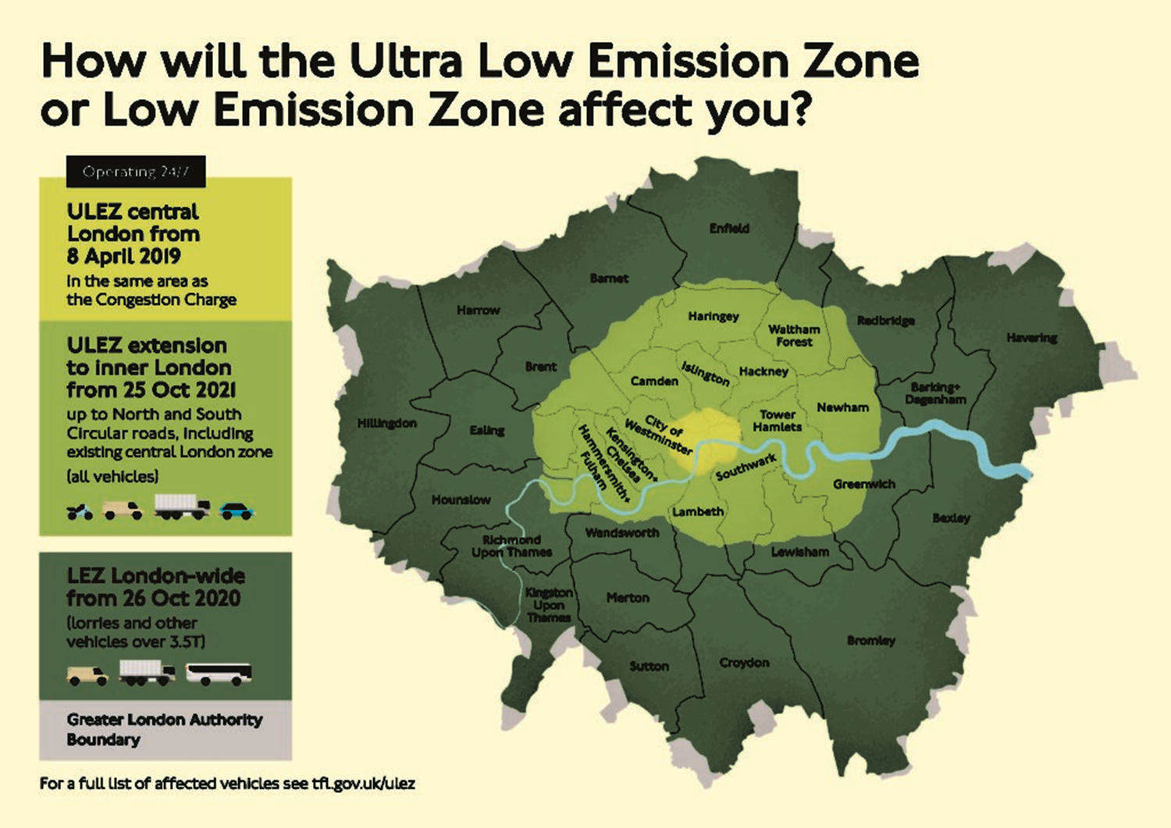

Ultra Low Emission Zone (ULEZ)
https://www.bvrla.co.uk/resource/ultra-low-emission-zone.html

Slide 37
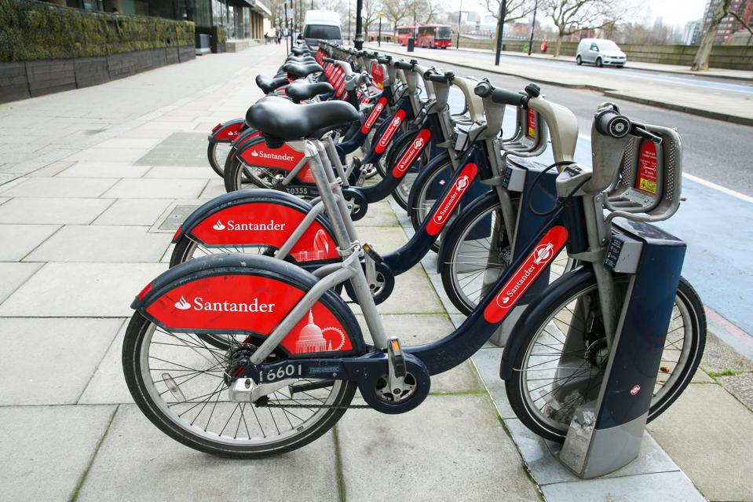
Cycle Hire / Santander Cycles – a smart bike-sharing system with app-based availability tracking
Santander Cycles, often called “Boris Bikes” (after former London Mayor Boris Johnson, who launched the scheme in 2010), is London’s public bike-sharing system. It is one of the largest in Europe and is operated by Transport for London (TfL) in partnership with Santander Bank (naming sponsor).
https://www.forbes.com/sites/davidphelan/2020/07/30/10-years-of-london-cycle-hire-10-top-tips-for-using-boris-bikes/

Slide 38
Cycle Hire / Santander Cycles – a smart bike-sharing system with app-based availability tracking
App-based availability tracking – the official app allows users to check in real-time where bikes are available and whether docking spaces are free to return a bike.
Users can:
Locate nearby docking stations using GPS.
Check the number of available bicycles at each station before arriving.
See how many empty docks are free to return a bike at the end of the trip.
Plan routes by combining cycling with other public transport options.
Unlock bikes directly through the app, making the process faster and cashless.

Slide 39
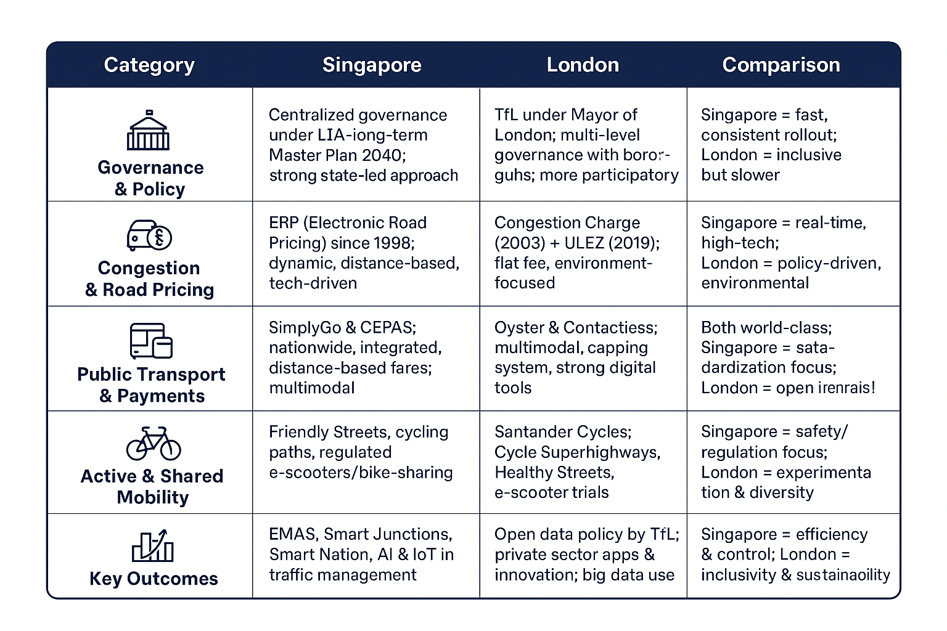
Comparative Analysis - Singapore vs. London – Smart Mobility

Slide 40
Smart Mobility Practices: Developed vs. Developing Cities
Aspect | Developed Cities | Developing Cities
Funding & Resources | Strong budgets, advanced financing (EU funds, PPPs, green bonds). | Limited resources, reliance on international aid .
Technology | Advanced digital systems (real-time apps, MaaS, AI, big data). | Low-cost digital tools, mobile-based apps, emerging platforms.
Transport Modes | Focus on decarbonization (EVs, cycling, metro, smart buses). | Affordable solutions (BRT, e-rickshaws, shared minibuses).
Governance | Strong institutional capacity, long-term strategies. | Fragmented institutions, often short-term planning.
Public Engagement | Citizens involved in co-creation, participatory planning. | Limited, but growing role of community-based initiatives.
Challenges | Congestion, high costs of infrastructure upgrades. | Informal transport integration, equity, financial barriers.
Success Factors | Innovation, integration, sustainability targets. | Affordability, scalability, adaptability to local context.

Slide 41
Key Factors for Success
Strong governance & leadership – clear vision and political commitment.
Integration – transport, land use, and environmental planning aligned.
Technology adoption – use of real-time data, apps, and digital payments.
Public engagement – involving citizens in planning and decision-making.
Sustainable financing – mix of public funding, PPPs, and international support.

Slide 42
Challenges in Implementation
Financial constraints in developing regions.
Resistance to change (cultural and institutional).
Limited technical expertise and data availability.
Managing informal transport and ensuring equity.
Need for long-term political stability and continuity.

Slide 43
Conclusion
Smart mobility best practices show that technology + governance + citizen focus can transform cities.
No “one-size-fits-all” solution – practices must be adapted to local needs and resources.
For developing regions, combining affordable innovations with long-term policy support is key to success.

Slide 44
Select a city that has successfully implemented smart mobility solutions
Research and describe the specific smart mobility initiatives in that city (transportation, urban planning, environmental sustainability).
Identify key factors that contributed to the success of these initiatives (e.g., governance, technology, public engagement, financing).
Analyze challenges the city faced during implementation (technical, financial, cultural, political).
Propose adaptations of these initiatives for a city in a developing region, considering local constraints, resources, and needs.
Prepare a short report or presentation summarizing your findings and recommendations.
Student assignment: Smart Mobility – Key Success Factors and Adaptation

