Slide 1


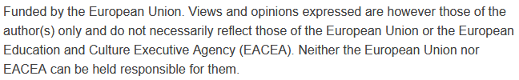

Smart Transportation Systems and Analytics:
Data-Driven Traffic Prediction and Pattern Analysis
Sustainability and Quality Assurance for Academic Governance and Redesign Engineering Studies
Jacek Oskarbski

Slide 2
Data-Driven Traffic Prediction and Pattern Analysis
Modern transportation systems generate massive amounts of heterogeneous data (loop detectors, GPS, mobile phones, social media, connected vehicles).
Big data analytics and machine learning (ML) are transforming traffic management by enabling accurate forecasting of traffic states, early detection of congestion, and optimisation of control strategies.
Traditional traffic flow models (macroscopic, mesoscopic, microscopic) are being complemented—and in some cases replaced—by data-driven approaches that capture complex, non-linear dynamics of urban mobility.
Objectives of the Lecture:
  To introduce the concept of big data in transportation and its relevance to intelligent traffic management.
  To explain machine learning algorithms commonly applied to traffic forecasting (regression, probabilistic models, deep learning).
  To explore practical applications of predictive modelling in identifying congestion hotspots and peak travel times.
  To discuss case studies that highlight the impact of data-driven approaches on real-world transport systems.

Slide 3
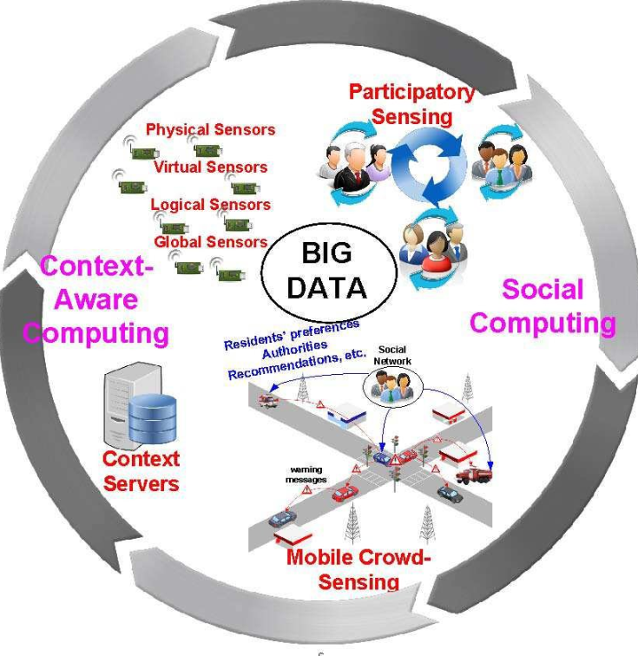
Big Data in Transportation - Definition & Sources
Big Data in transport refers to large-scale, heterogeneous, high-frequency datasets generated by intelligent transportation systems (ITS) and user devices.
Main sources include:
  Infrastructure sensors: inductive loop detectors, radar, thermal and video cameras.
  Vehicle-based data: GPS traces, in-vehicle sensors, connected vehicles.
  Mobile and telecom data: anonymised smartphone location data, call detail records.
  Crowdsourced & social media: applications such as Waze, Google Maps, Twitter providing incident and congestion reports.
https://vamosarema.com/

Slide 4
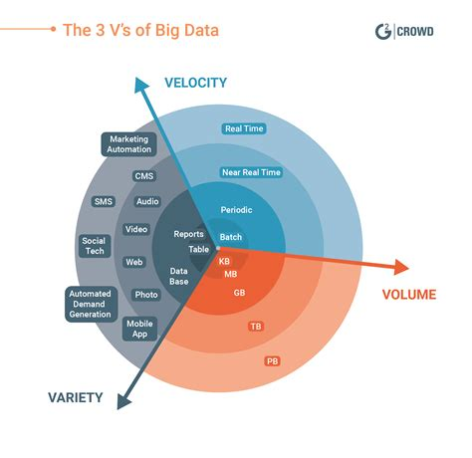
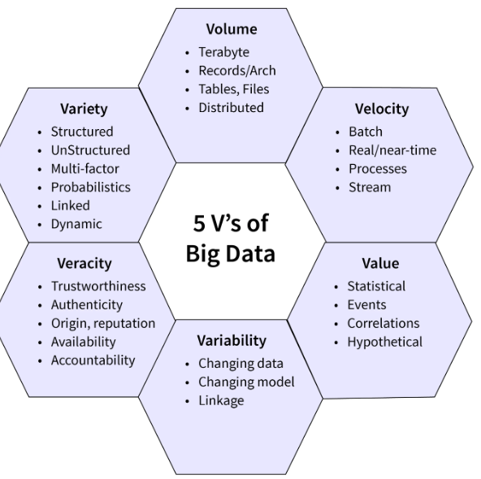
Big Data in Transportation - Key Characteristics (3Vs)
Volume – enormous scale of data (terabytes to petabytes) collected continuously in real-time from millions of devices.
Velocity – high frequency and speed of data generation (sub-second sensor readings, streaming GPS).
Variety – diverse data formats: structured (traffic counts), semi-structured (GPS traces), unstructured (social media text, images).
Some authors add Veracity – uncertainty/noise in data – and Value – usefulness of extracting actionable insights.
https://www.scaler.com/topics/5-vs-of-big-data
https://www.g2.com/articles/big-data

Slide 5
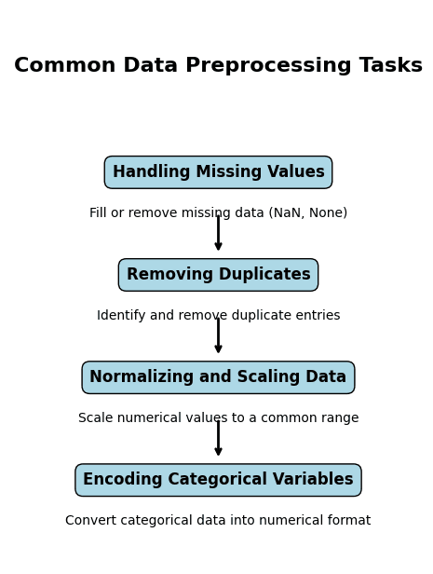
Big Data in Transportation - Importance of Data Quality
Missing values: detector failures, network communication gaps.
Bias in data: unequal distribution (e.g., smartphone data more common in urban than rural areas).
Noise & anomalies: errors due to weather, sensor miscalibration, or malicious reporting.
Data cleaning & preprocessing are critical for reliable predictive modelling.
https://emitechlogic.com/how-to-automate-data-preprocessing-in-python

Slide 6
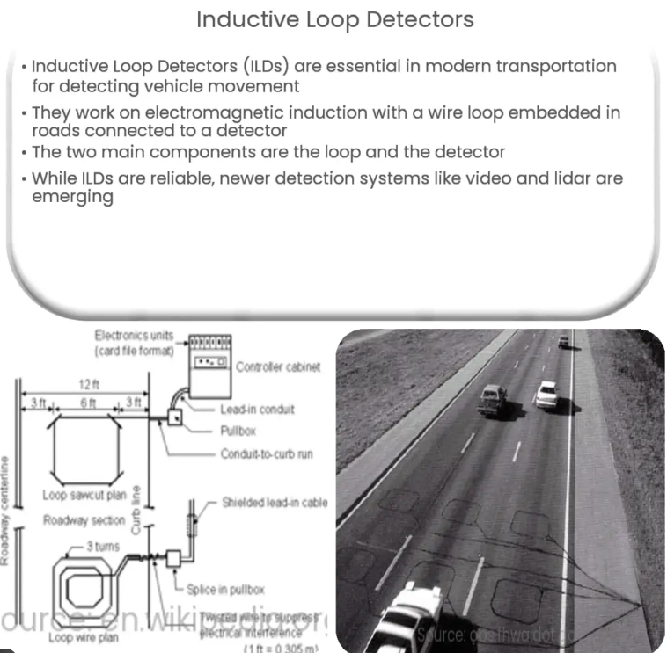
Traffic Data Collection Methods - Inductive Loop Detectors (ILDs)
Embedded beneath the road surface; measure vehicle presence, count, and occupancy.
Provide high temporal resolution data but limited spatial coverage.
Advantages: mature technology, widely deployed in highways and urban arterials.
Limitations: costly installation/maintenance, not suitable for flexible/mobile applications.
https://www.dreamstime.com/countdown-timer-pedestrian-crossing-traffic-light-countdown-timer-pedestrian-crossing-traffic-light-image24

Slide 7
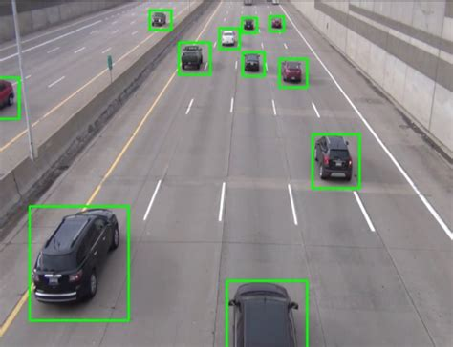
Traffic Data Collection Methods - Video Cameras & Image Recognition
Capture continuous streams of traffic images and video.
Computer vision (CV) algorithms and AI/ML detect vehicles, classify types, estimate speeds.
Applications: traffic counts, queue length estimation, incident detection, lane discipline monitoring.
Challenges: sensitive to weather (fog, rain, snow) and lighting conditions.
Bounding-box and annotation” infographic, featured on Infizoom

Slide 8
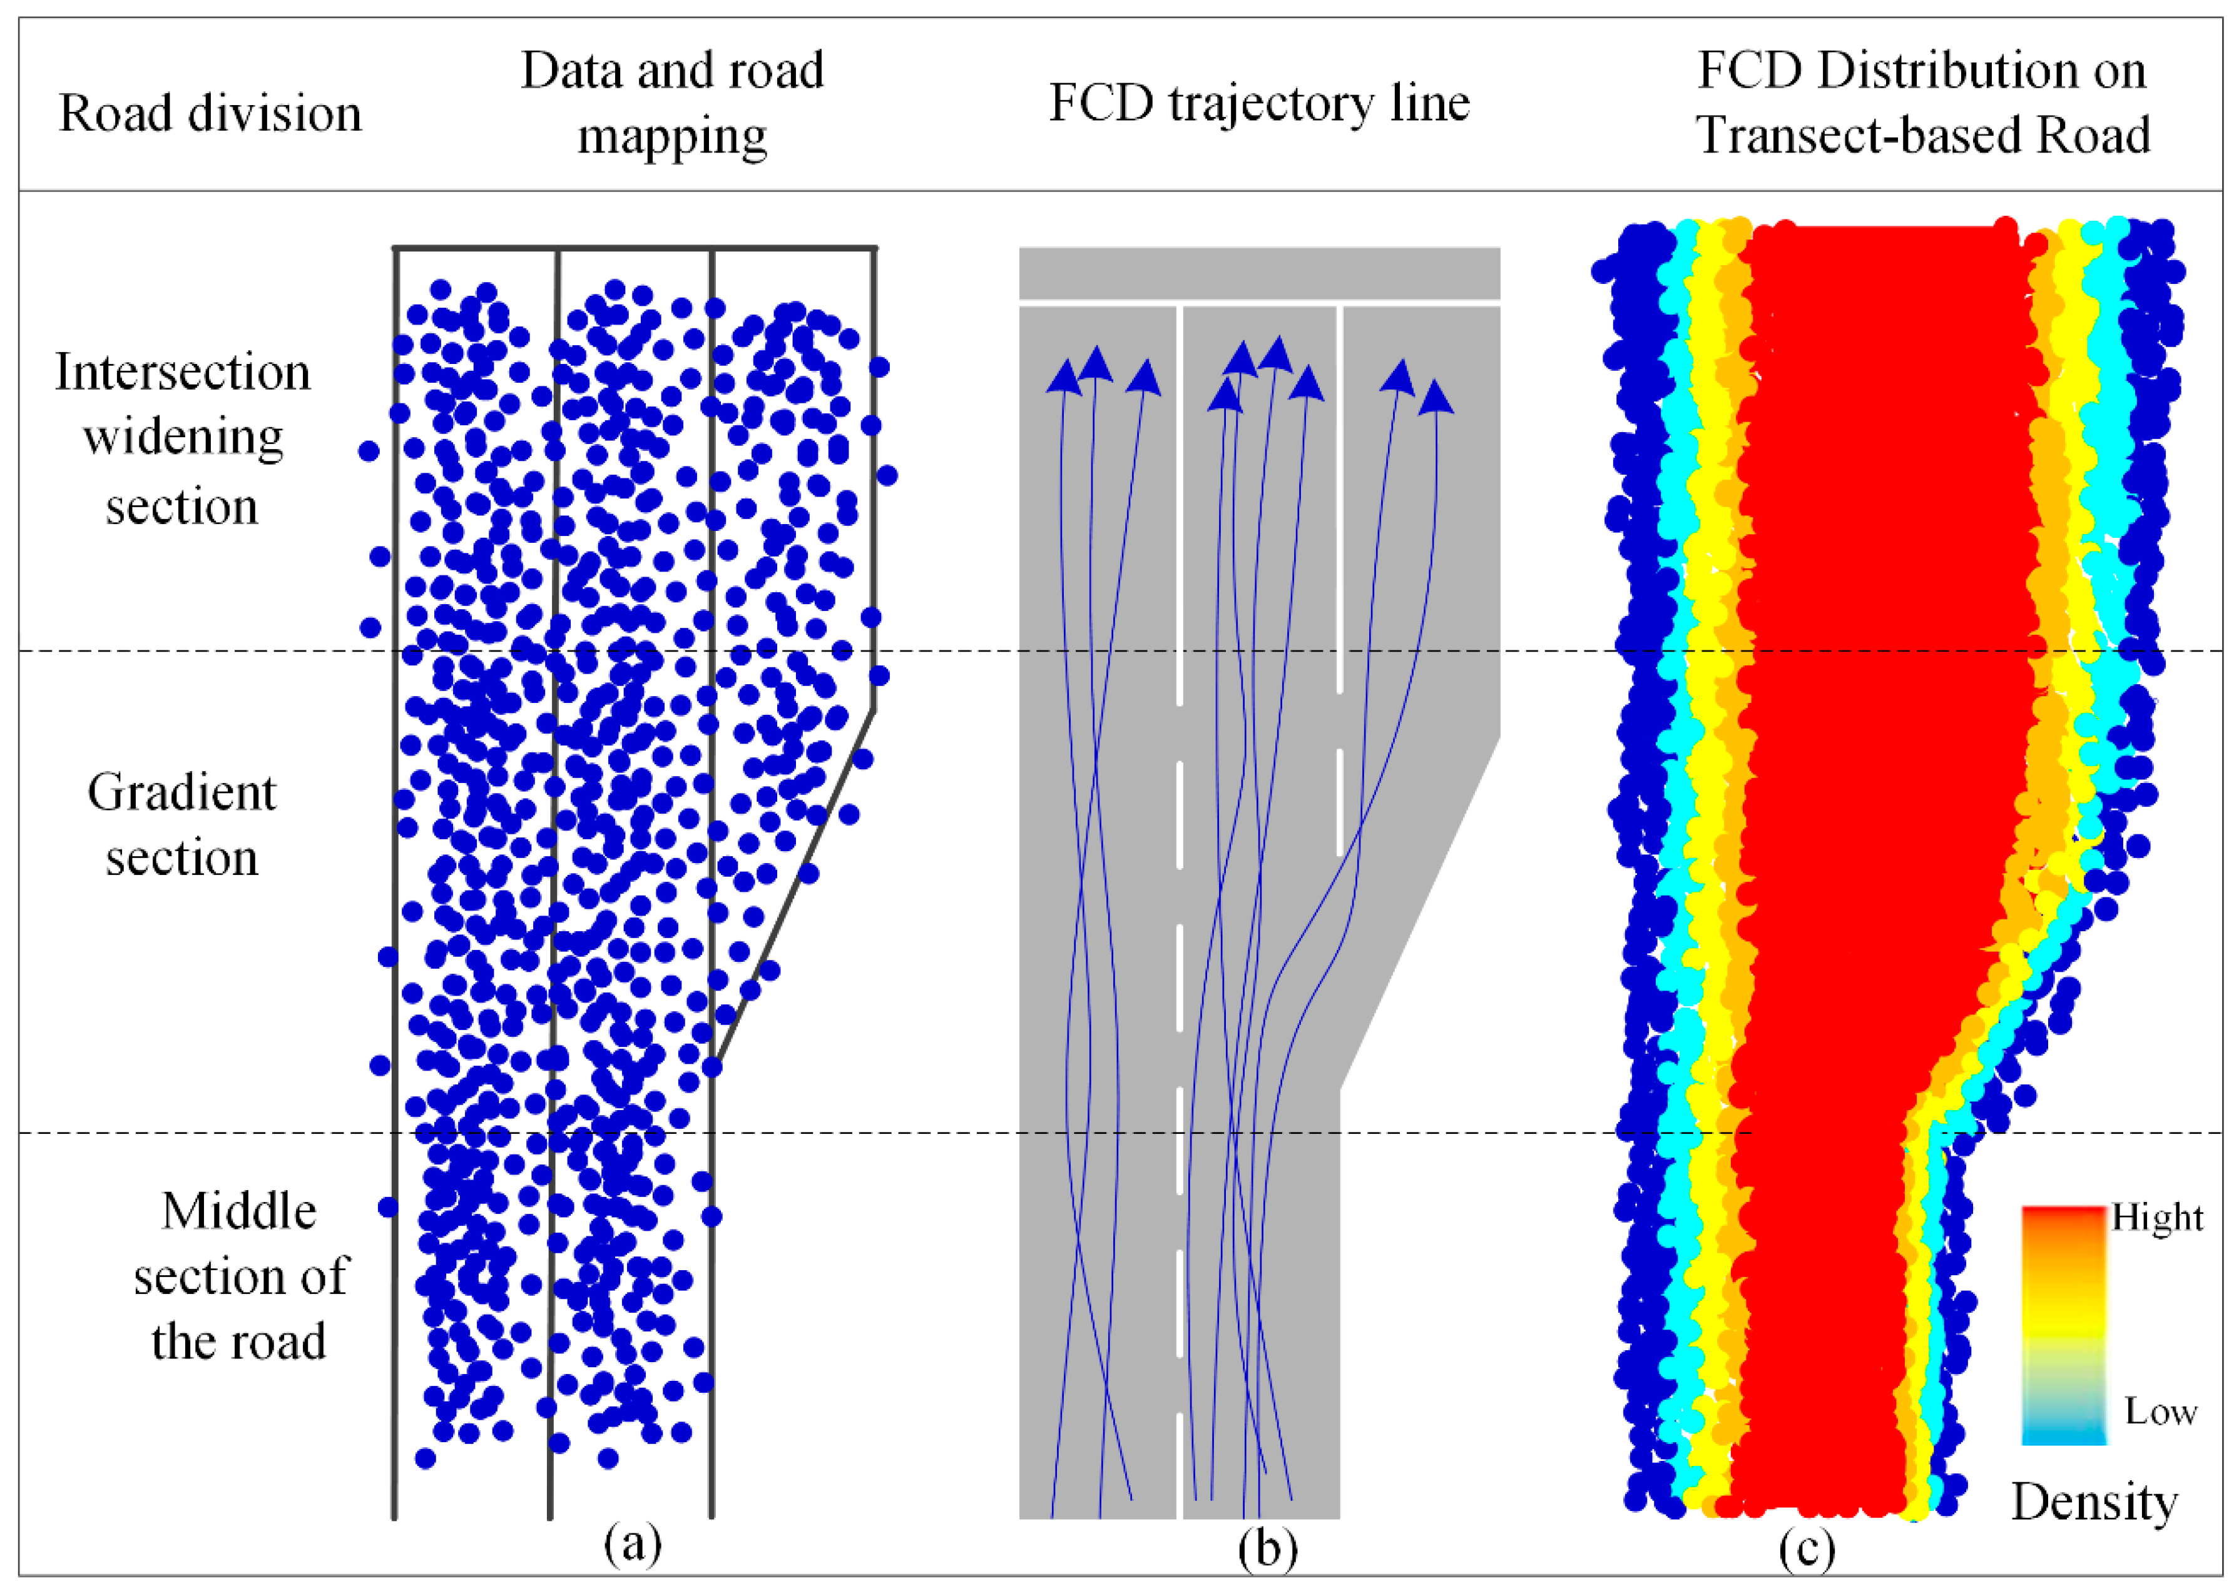
Traffic Data Collection Methods - Floating Car Data (FCD – GPS / Smartphones)
Data from GPS-equipped vehicles and smartphones provide real-time trajectories.
Applications: average speed estimation, travel time reliability, route choice behaviour.
Advantages: wide coverage, low infrastructure cost, real-time updates.
Issues: sampling bias (not all vehicles equipped), privacy concerns, dependence on telecom networks.
Li, X.; Wu, Y.; Tan, Y.; Cheng, P.; Wu, J.; Wang, Y. Method Based on Floating Car Data and Gradient-Boosted Decision Tree Classification for the Detection of Auxiliary Through Lanes at Intersections. ISPRS Int. J. Geo-Inf. 2018, 7, 317. https://doi.org/10.3390/ijgi7080317

Slide 9
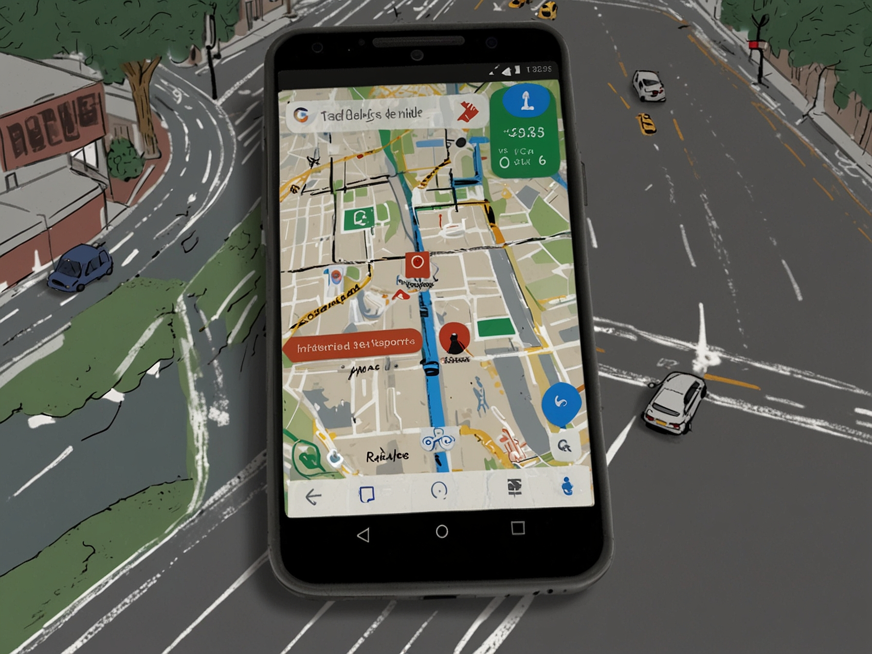
Traffic Data Collection Methods - Crowdsourced & Social Media Data
Platforms like Waze, Google Maps, TomTom collect user-reported incidents, congestion, road hazards.
Social media (Twitter, Facebook) adds real-time information on disruptions (accidents, weather, strikes).
Benefits: high responsiveness, wide participation, complements sensor data.
Risks: data veracity (false reports, malicious inputs), uneven coverage across demographics and regions.
https://fnews.ai/google-maps-and-waze-updated-with-enhanced-incident-reporting-and-destination-guidance

Slide 10
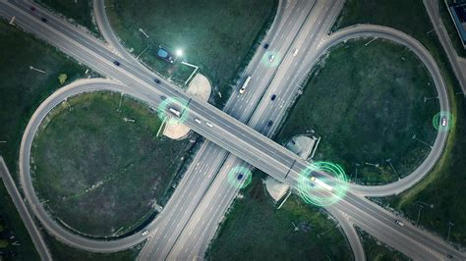
Challenges in Data Processing - Heterogeneity of Data Sources
Data comes from diverse systems: inductive loops, GPS traces, cameras, mobile apps, crowdsourced platforms.
Different formats: structured (traffic counts), semi-structured (GPS trajectories), unstructured (tweets, images).
Integration requires advanced data fusion techniques to align spatial and temporal resolutions.
https://www.smatstraffic.com/blog/5-reasons-floating-car-data

Slide 11
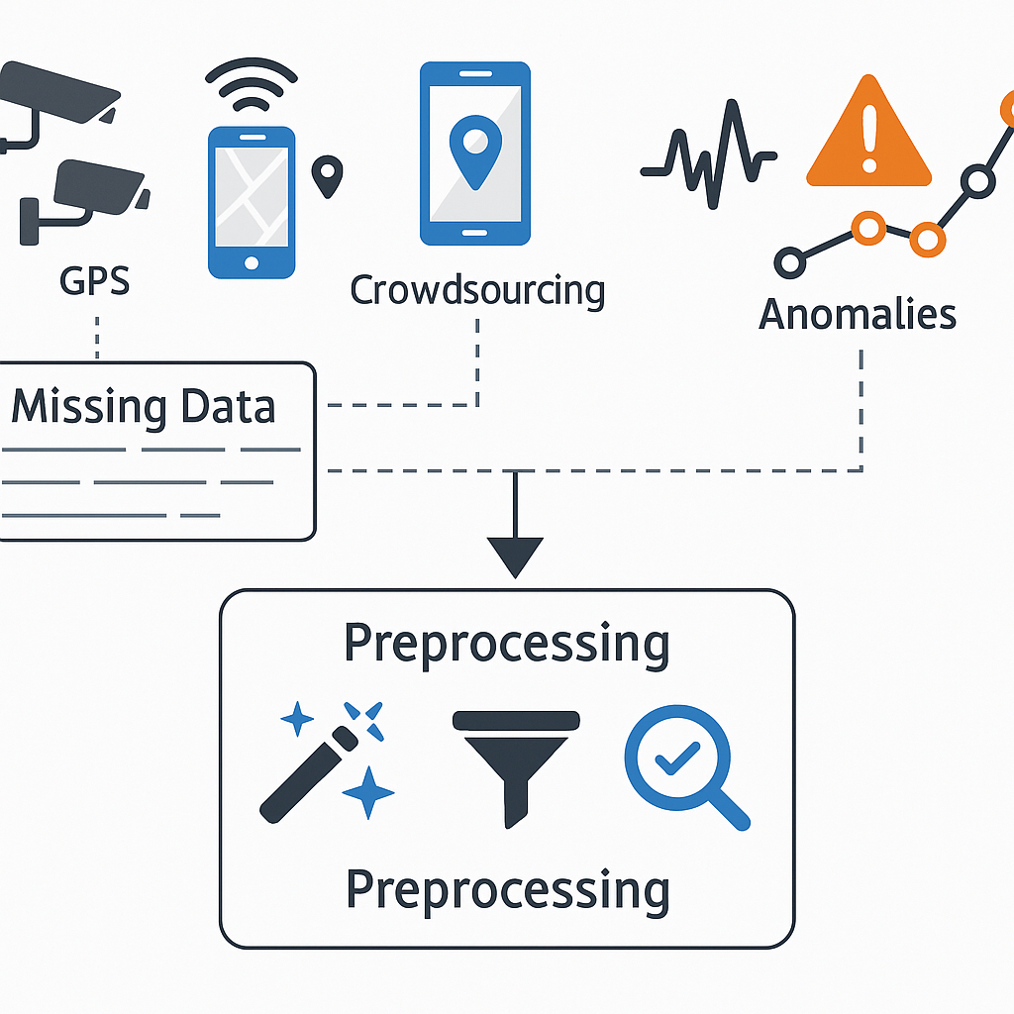
Challenges in Data Processing - Missing Data, Noise, and Anomalies
Missing values caused by detector malfunctions, communication failures, or incomplete coverage.
Noise and anomalies introduced by sensor miscalibration, harsh weather (fog, snow, rain), or malicious reporting.
Preprocessing steps (imputation, filtering, anomaly detection) are critical to ensure model reliability.
https://www.smatstraffic.com/blog/5-reasons-floating-car-data

Slide 12
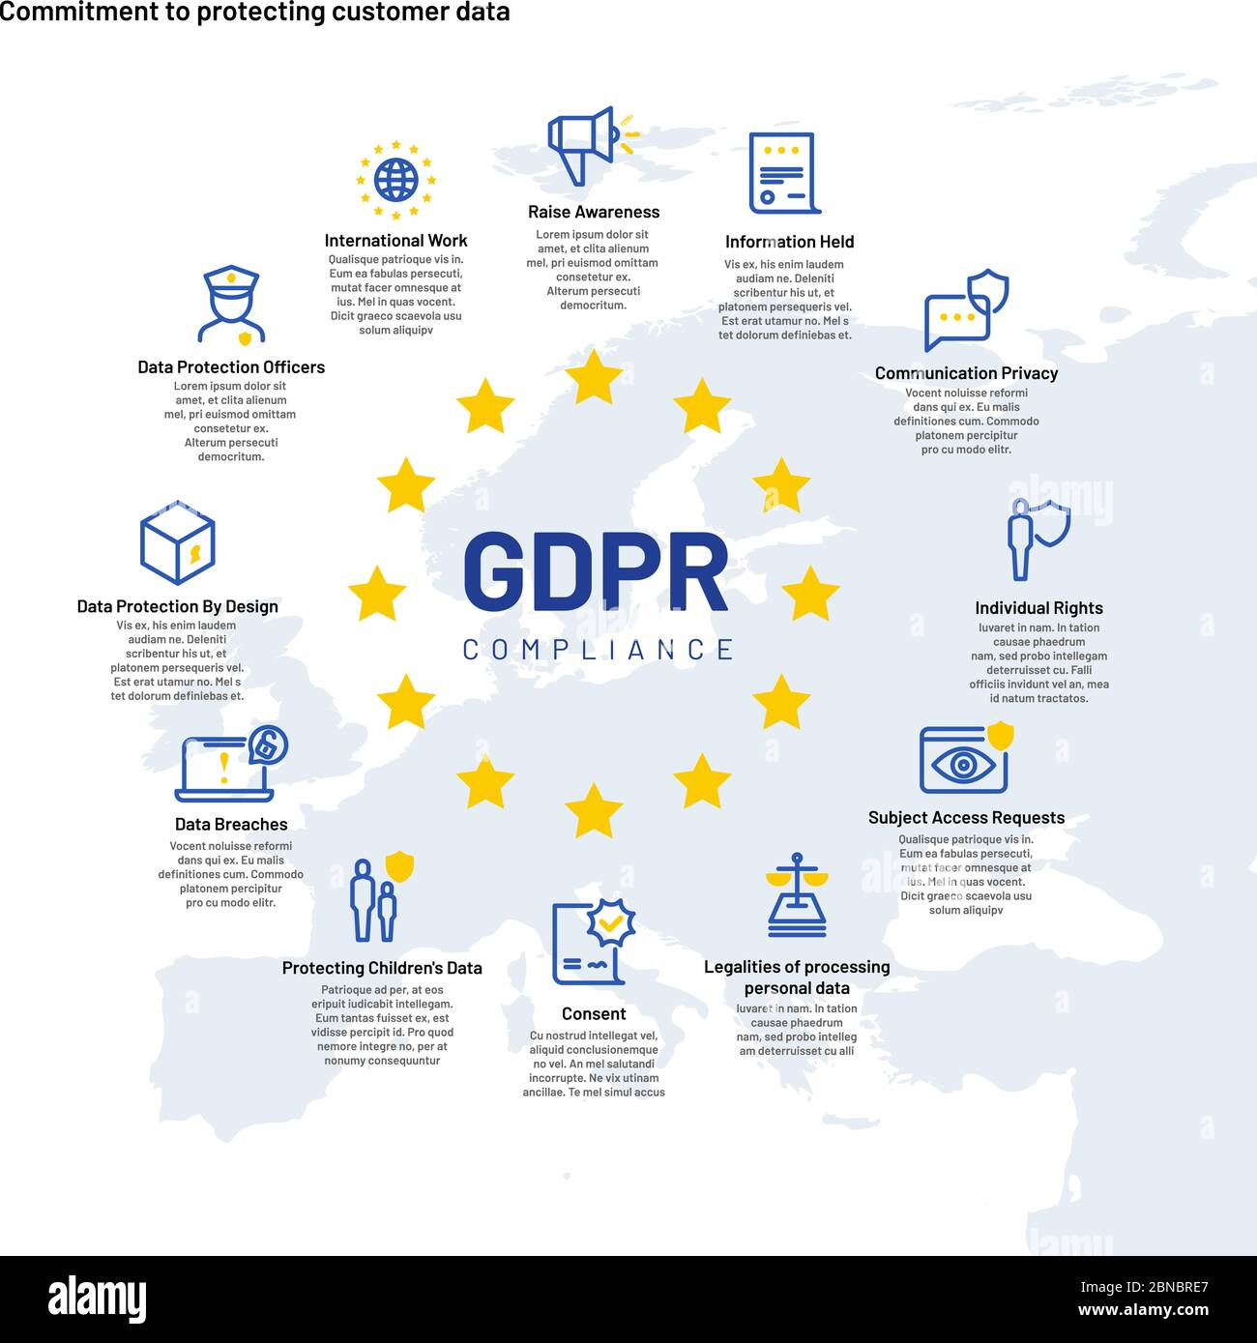
Challenges in Data Processing - Privacy and Data Security Issues
Location data from GPS and smartphones may expose personal mobility patterns.
Need for anonymisation and encryption in data storage and exchange.
Legal frameworks: GDPR (EU), CCPA (California) regulate data use and sharing.
Balancing data utility vs. privacy protection remains a major challenge.
https://www.smatstraffic.com/blog/5-reasons-floating-car-data

Slide 13
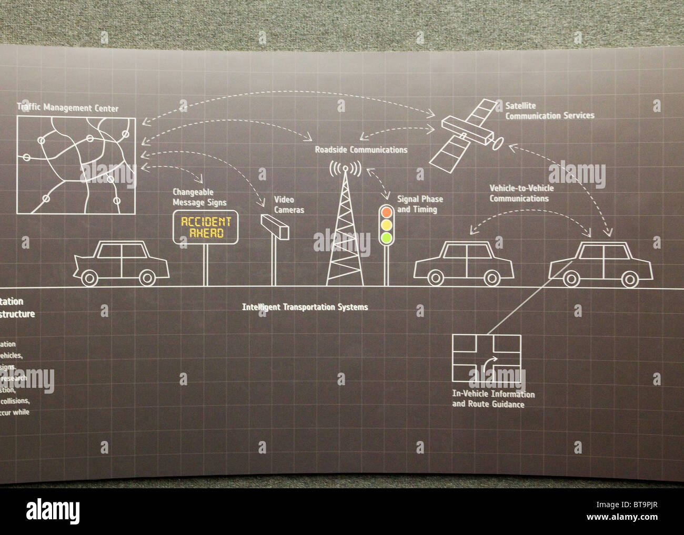
Challenges in Data Processing - Need for Standardisation
Lack of common data formats and exchange protocols across agencies/vendors.
Standards like DATEX II (Europe) or NTCIP (US) support interoperability but adoption is uneven.
Without harmonisation, integration into Intelligent Transport Systems (ITS) is fragmented and costly.
https://www.smatstraffic.com/blog/5-reasons-floating-car-data

Slide 14
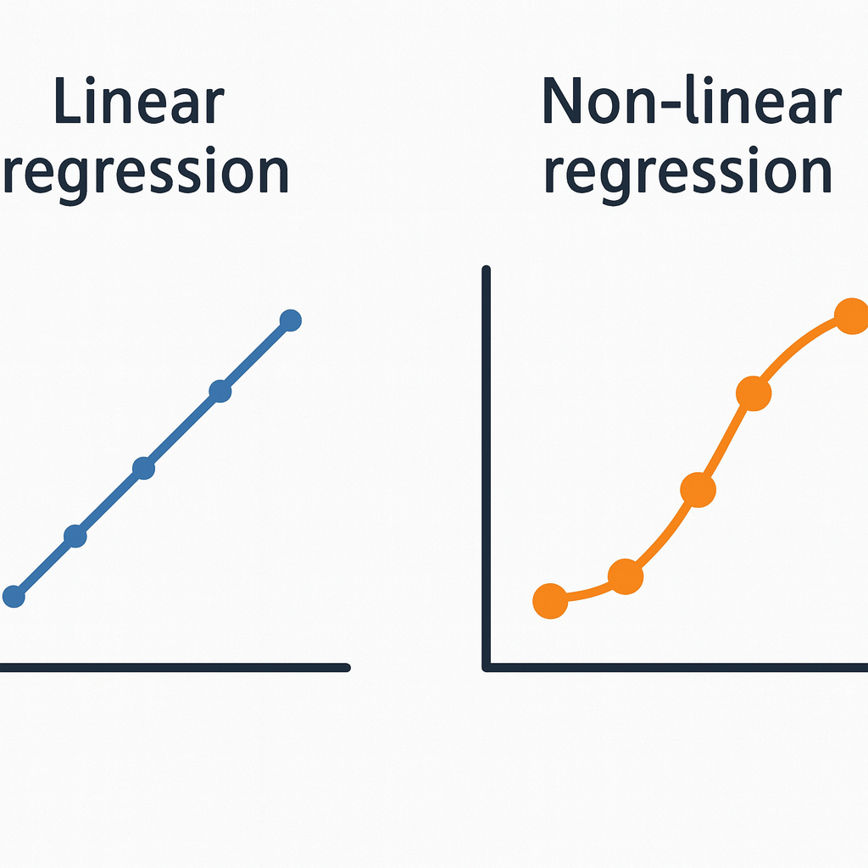
Machine Learning Basics for Traffic Forecasting - Linear and Non-linear Regression
Linear regression: Establishes a straight-line relationship between traffic variables (e.g., flow vs. time). Useful for short-term forecasting in stable conditions.
Non-linear regression: Captures complex traffic phenomena such as saturation, congestion onset, shockwaves.
Example: Polynomial regression, Support Vector Regression (SVR).

Slide 15

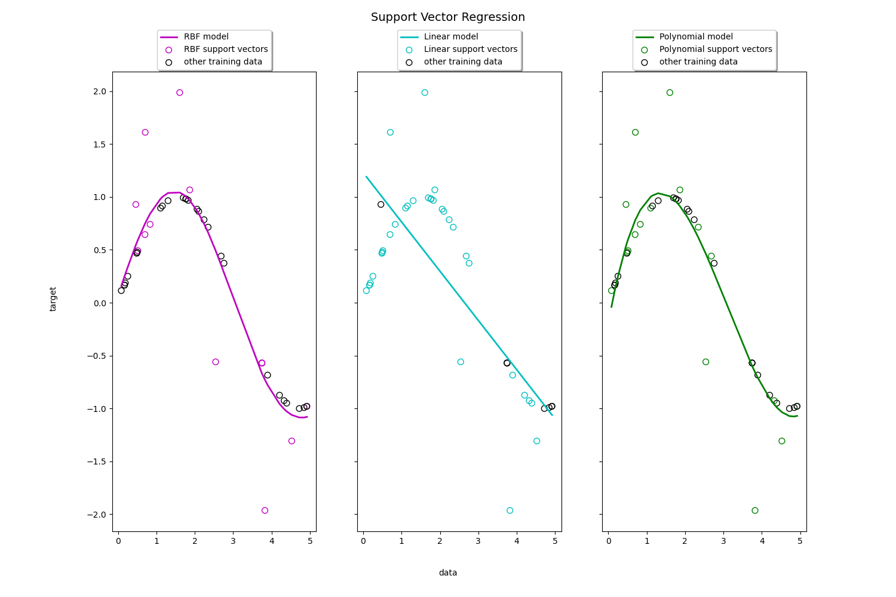
Machine Learning Basics for Traffic Forecasting - Linear and Non-linear Regression
Polynomial Regression:
  Extends linear regression by including polynomial terms (e.g. , ).
  Captures non-linear trends in traffic flow (e.g., sudden congestion growth after a threshold of vehicle density).
  Example: predicting speed–density relationships where flow increases with density up to a critical point, then decreases (fundamental diagram).
  Advantage: simple, interpretable; works for small datasets.
  Limitation: may overfit and fail with high-dimensional data.
Support Vector Regression (SVR)
  Based on Support Vector Machines, adapted for regression tasks.
  Finds a regression line (or hyperplane) that best fits the data within a margin of tolerance (epsilon-insensitive loss).
  Handles non-linear patterns through kernel functions (e.g., radial basis function).
  Widely used for short-term traffic flow forecasting, outperforming linear models in capturing variability.
  Advantage: robust against noise, flexible.
  Limitation: computationally expensive for very large datasets.

Slide 16
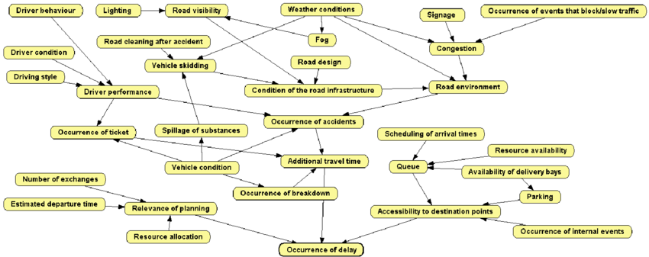
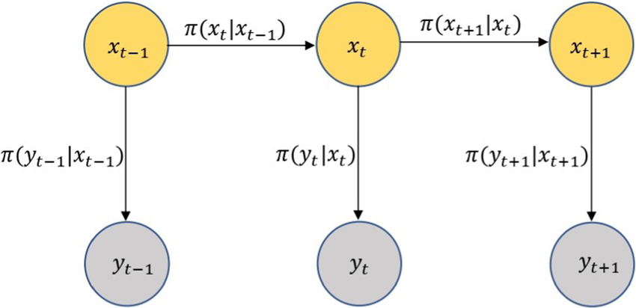
Machine Learning Basics for Traffic Forecasting - Probabilistic Models
Hidden Markov Models (HMM): Capture time-series state transitions, e.g., from “free flow” → “congested” → “recovery”.
Bayesian Networks: Encode causal relationships (e.g., incident → congestion → travel time delay).
Strength: handle uncertainty and missing data.
Application: incident detection, travel time reliability estimation
el Bouhadi, Ouafae & Azmani, Monir & Azmani, Abdellah & ftouh, Mouna. (2022). Using a Fuzzy-Bayesian Approach for Predictive Analysis of Delivery Delay Risk. International Journal of Advanced Computer Science and Applications. 13. 10.14569/IJACSA.2022.0130740.

Slide 17
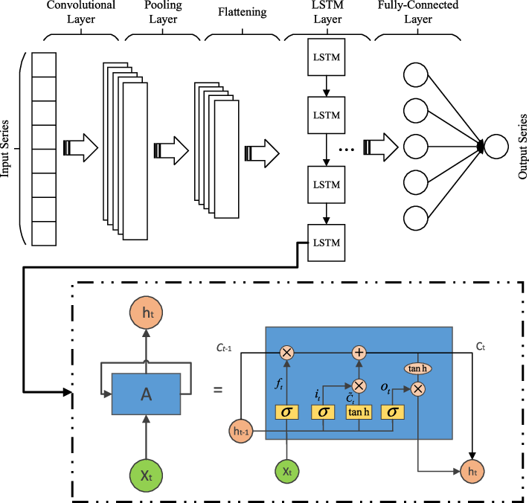
Machine Learning Basics for Traffic Forecasting - Classical Algorithms vs. Deep Learning Approaches
Classical ML methods: Decision trees, Random Forests, k-NN, SVM.
  Strength: interpretable, efficient for smaller datasets.
  Limitation: struggle with high-dimensional, spatio-temporal data.
Deep learning models:
  RNN / LSTM: capture temporal dependencies in sequential data.
  CNN: used for spatial correlations in traffic networks or image-based traffic data.
  GNN: model complex road network topologies.
  Strength: excellent at modelling non-linear, high-dimensional data.
  Limitation: require large labelled datasets, less interpretable (“black box”).
Deeplearning Structure Of 1dcnn And Lstm. https://dietmake.coesca.com/what-is-the-difference-between-cnn-and-lstm-time-series.html

Slide 18
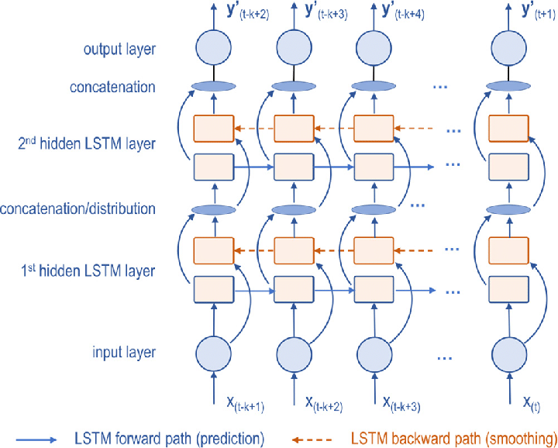
Neural Networks and Deep Learning - Recurrent Neural Networks (RNN) and Long Short-Term Memory (LSTM) for Time-Series Forecasting
RNNs are designed to model sequential dependencies, making them suitable for traffic flow and travel time prediction.
Challenge in basic RNNs: vanishing gradient problem, limiting their ability to learn long-term dependencies.
LSTM networks overcome this limitation with memory cells and gates (input, forget, output) that capture long-range temporal patterns.
Applications:
  Short-term traffic volume prediction (e.g., next 5–15 min).
  Travel time forecasting along freeway corridors.
LSTM architecture schematic illustrating forward and backward propagation through time. Source: “Schematic Of The Lstm Model Download Scientific Diagr,” vrogue.co

Slide 19
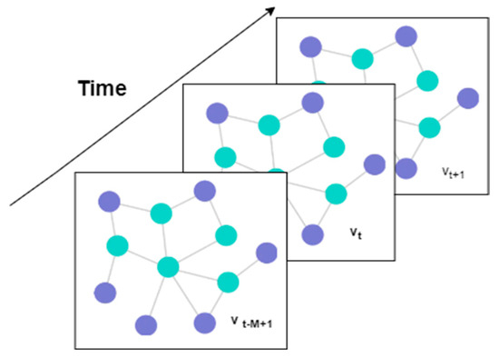
Neural Networks and Deep Learning - Graph Neural Networks (GNN) for Road Networks
Road networks can be represented as graphs (nodes = intersections, edges = road links).
GNNs learn spatial correlations by propagating information across connected nodes.
Particularly powerful when combined with temporal models (e.g., ST-GCN: Spatio-Temporal Graph Convolutional Networks).
Applications:
  Network-wide traffic flow prediction.
  Identifying congestion propagation across a road network.
Example: ST-GCN models both time dependencies (temporal graph) and network structure (spatial graph)
Singh, V.; Sahana, S.K.; Bhattacharjee, V. Integrated Spatio-Temporal Graph Neural Network for Traffic Forecasting. Appl. Sci. 2024, 14, 11477. https://doi.org/10.3390/app142411477

Slide 20
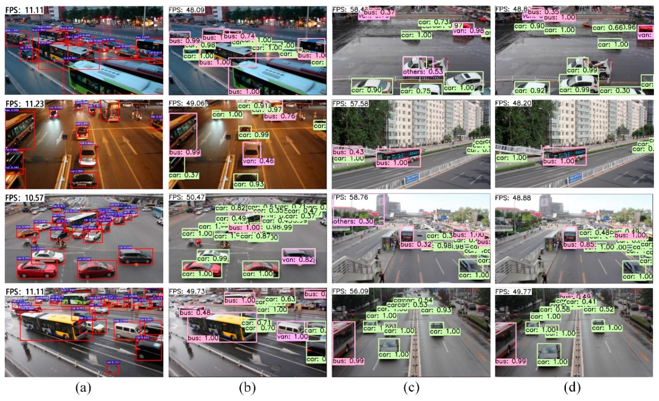
Neural Networks and Deep Learning - Convolutional Neural Networks (CNN) for Video/Image-Based Traffic Analysis
CNNs excel at image recognition tasks by extracting hierarchical spatial features.
In transport, they are applied to video feeds from roadside cameras for:
  Vehicle detection & classification (cars, trucks, buses, motorcycles).
  Speed estimation using frame-to-frame displacement.
  Incident detection (stalled vehicles, crashes).
  Pedestrian and cyclist recognition for safety studies.
Limitation: performance decreases under adverse weather/lighting, mitigated by thermal or infrared imaging.
Zhang, F.; Li, C.; Yang, F. Vehicle Detection in Urban Traffic Surveillance Images Based on Convolutional Neural Networks with Feature Concatenation. Sensors 2019, 19, 594. https://doi.org/10.3390/s19030594

Slide 21
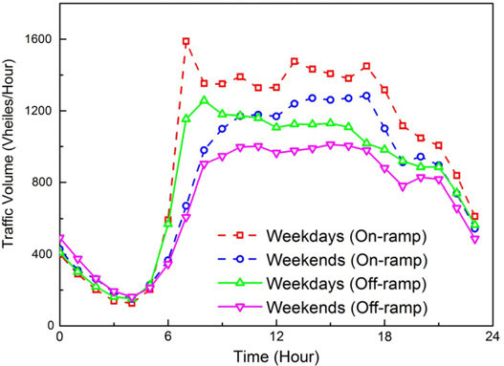
Traffic Pattern Analysis - Identification of Daily and Weekly Peaks
Traffic demand exhibits strong periodicity:
  Daily cycles: Morning and evening rush hours (commuting patterns).
  Weekly cycles: Higher weekday traffic vs. reduced weekend volumes.
Machine learning methods can automatically extract such periodic patterns from large datasets (GPS traces, loop detectors).
Applications:
  Optimization of traffic signal timings.
  Public transport scheduling aligned with peak demand.
He, Hong-di & Wang, Jun-li & Wei, Hai-rui & Ye, Cheng & Ding, Yi. (2015). Fractal behavior of traffic volume on urban expressway through adaptive fractal analysis. Physica A: Statistical Mechanics and its Applications. 443. 10.1016/j.physa.2015.10.004.

Slide 22
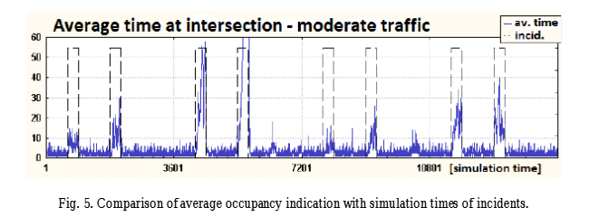
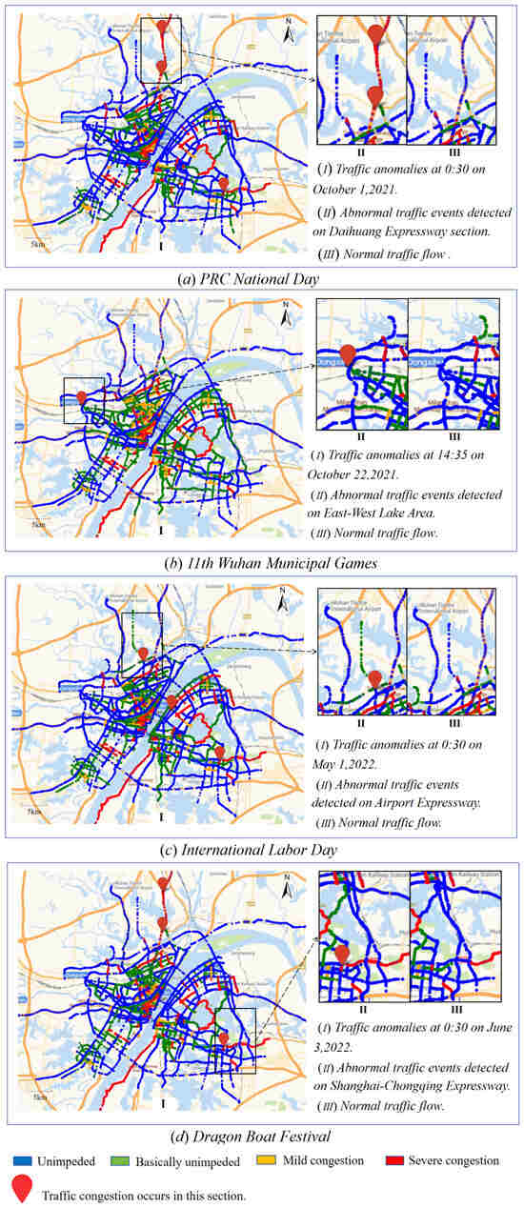
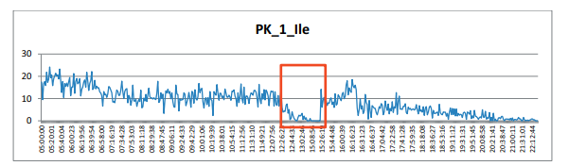
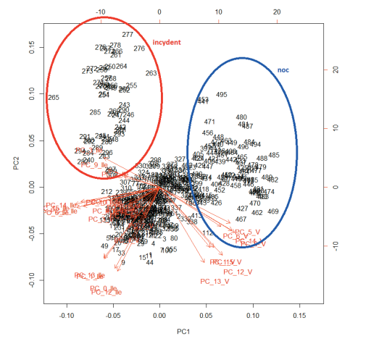
Traffic Pattern Analysis - Anomaly Detection (Accidents, Weather Events, Special Events)
Accidents: Cause sudden, localized disruptions detectable as sharp drops in speed or unexpected queues.
Weather events: Rain, snow, fog alter both traffic flow capacity and driver behavior.
Special events: Stadium matches, concerts, strikes create atypical demand surges.
ML techniques (e.g., clustering, autoencoders) distinguish between recurrent patterns and non-recurrent anomalies.
Applications:
  Early incident detection.
  Dynamic rerouting and traveler information.
Oskarbski, Jacek & Zawisza, Marcin & Żarski, Karol. (2016). Automatic Incident Detection at Intersections with Use of Telematics. Transportation Research Procedia. 14. 3466-3475. 10.1016/j.trpro.2016.05.309.
Mao, Y.; Shi, Y.; Lu, B. Detecting Urban Traffic Anomalies Using Traffic-Monitoring Data. ISPRS Int. J. Geo-Inf. 2024, 13, 351. https://doi.org/10.3390/ijgi13100351
Oskarbski J, Palikowska K, Żarski K. Systemy automatycznego wykrywania zdarzeń niepożądanych w miastach. Prace Naukowe Politechniki Warszawskiej - Transport. (2016);114(null):245-254.

Slide 23
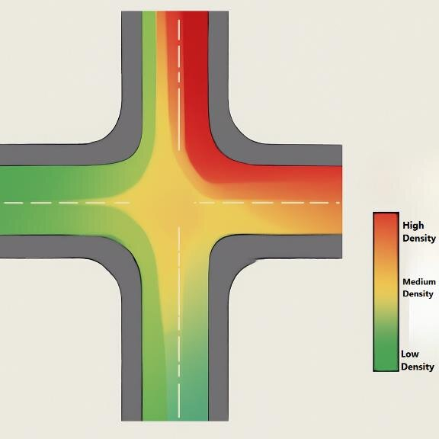
Traffic Pattern Analysis - Heatmaps of Traffic Density and Flow
Visual analytics tool: Represents spatial distribution of traffic volumes/speeds across networks.
Heatmaps enable intuitive identification of congestion hotspots, bottlenecks, and flow dynamics.
When combined with temporal layers (e.g., hourly maps), they provide spatio-temporal insights.
Applications:
  Urban mobility dashboards for city authorities.
  Policy evaluation (e.g., effect of congestion pricing or infrastructure changes).
Khaleefah, Rafid. (2025). An Intelligent Traffic Control System using Edge-Cloud Computing and Deep Learning for Smart Cities. International Journal of Engineering Research and. 14. IJERTV14IS070169. 10.17577/IJERTV14IS070169.

Slide 24
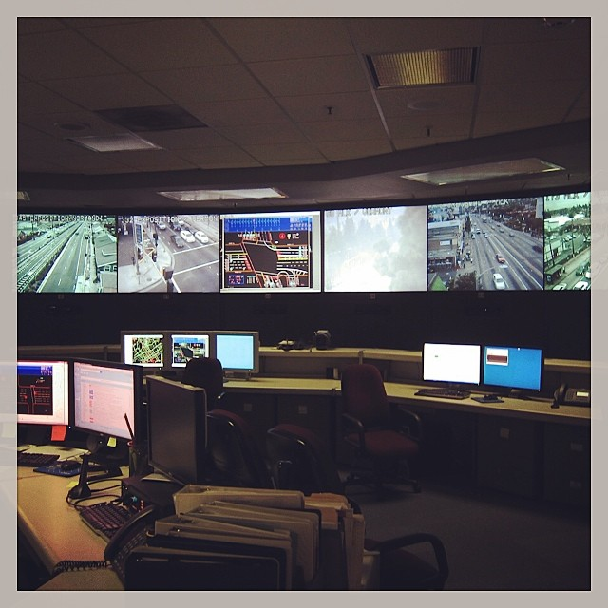
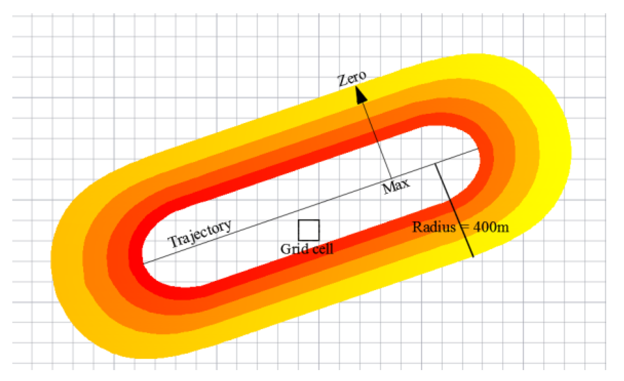
Real-Time Prediction in Large Cities
Megacities such as Los Angeles and Beijing have pioneered real-time traffic forecasting systems to mitigate chronic congestion.
Data-driven platforms integrate massive data streams from thousands of fixed and mobile sensors.
Achievements include:
  Los Angeles: real-time predictive analytics integrated into the Automated Traffic Surveillance and Control (ATSAC) system.
  Beijing: large-scale deployment of floating car data (GPS from taxis) and video-based monitoring for urban arterials.
Inside the ATSAC control room where staff monitor live traffic feeds from hundreds of cameras across Los Angeles.
Source: KCRW 89.9 FM, Photo: Gideon Brower
Zhang, J.; Chen, F.; Wang, Z.; Wang, R.; Shi, S. Spatiotemporal Patterns of Carbon Emissions and Taxi Travel Using GPS Data in Beijing. Energies 2018, 11, 500. https://doi.org/10.3390/en11030500

Slide 25
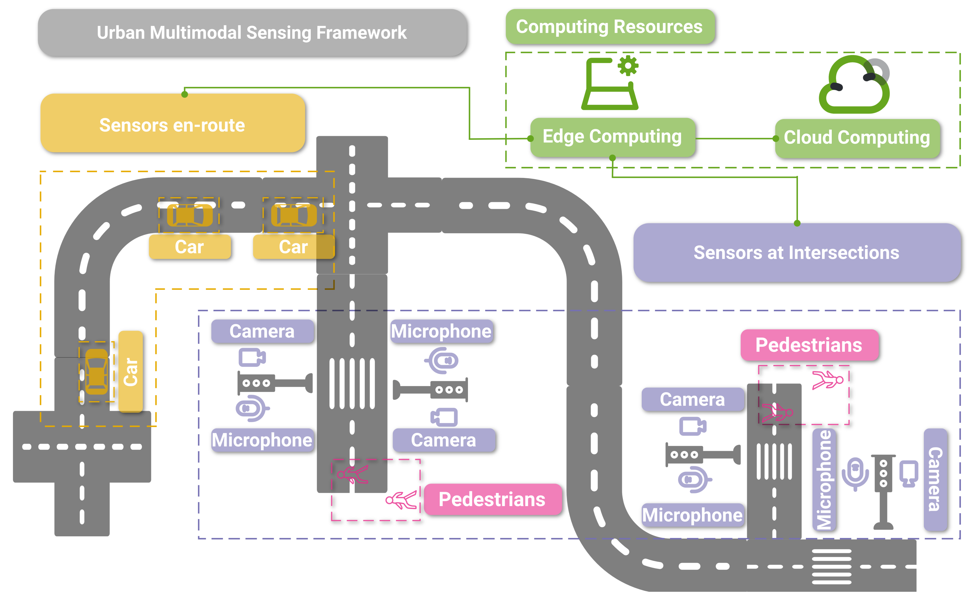
Real-Time Prediction in Large Cities - Integration of GPS and Camera Data
GPS trajectories from vehicles and smartphones capture macroscopic flow patterns and route choice dynamics.
Camera-based monitoring provides microscopic details: queue length, vehicle classification, incidents.
Fusion of these complementary sources improves the spatio-temporal coverage of prediction models.
Machine learning models (e.g., LSTM, ST-GCN) exploit this heterogeneous data to deliver robust short-term forecasts.
Piadyk, Y.; Rulff, J.; Brewer, E.; Hosseini, M.; Ozbay, K.; Sankaradas, M.; Chakradhar, S.; Silva, C. StreetAware: A High-Resolution Synchronized Multimodal Urban Scene Dataset. Sensors 2023, 23, 3710. https://doi.org/10.3390/s23073710

Slide 26
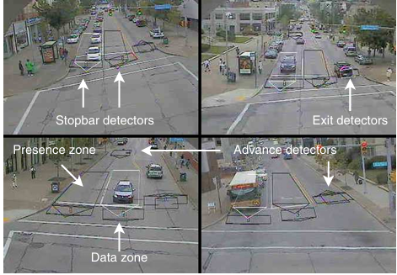
Real-Time Prediction in Large Cities - Improved Traffic Signal Management
Real-time prediction feeds directly into adaptive traffic signal control systems.
Example applications:
  Preemptive green extensions to mitigate incoming platoons.
  Dynamic offset adjustments for corridors.
  Priority strategies for public transport.
Reported benefits:
  10–20% reduction in average delay at intersections.
  Increased reliability of travel times during peak hours.
SURTRAC:Scalable Urban Traffic Control Stephen F. Smith and others

Slide 27
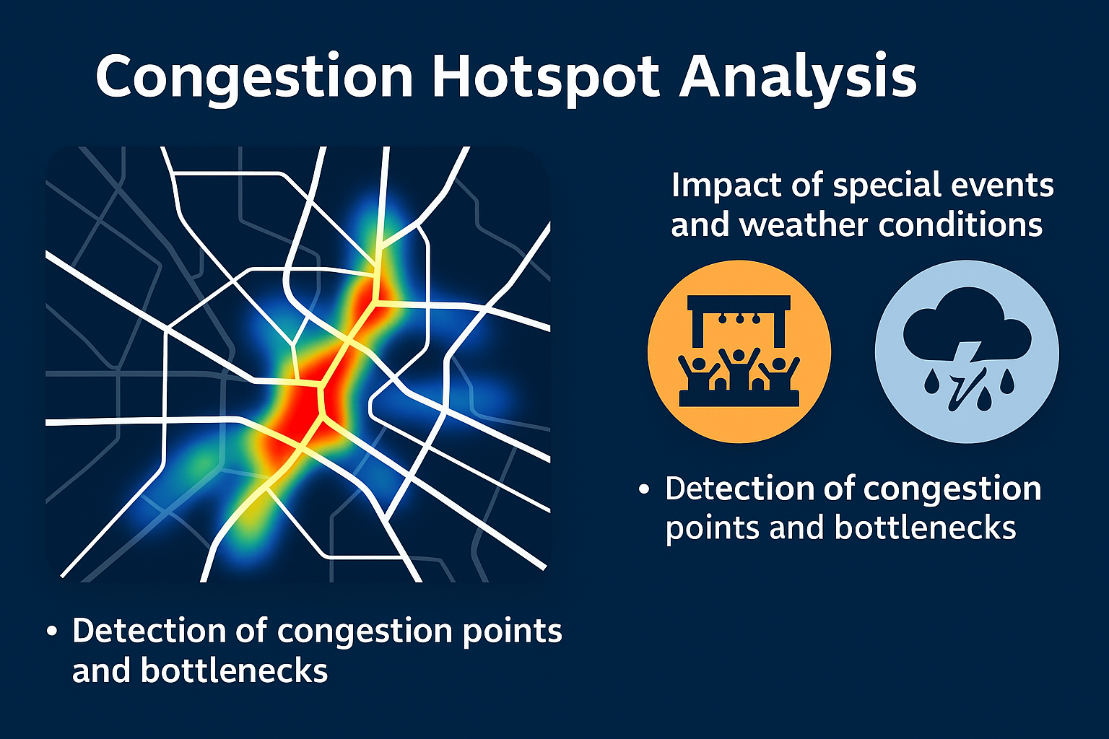
Congestion Hotspot Analysis
Detection of congestion points and bottlenecks
Impact of special events and weather conditions
Practical implementations (e.g., Singapore, London)

Slide 28
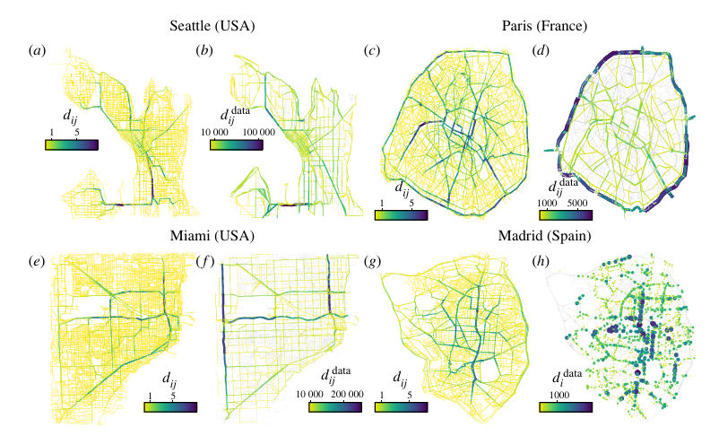
Congestion Hotspot Analysis - Detection of Congestion Points and Bottlenecks
Congestion hotspots are locations where traffic demand exceeds capacity, causing queues and delays.
Methods of detection:
  Loop detectors & radar sensors: measure speed and volume to identify recurring bottlenecks.
  GPS/Floating Car Data (FCD): reveals travel time variability and localized slowdowns.
  oMachine learning clustering techniques: automatically classify congested vs. non-congested links in real-time.
Outcomes: hotspot mapping enables targeted infrastructure improvements (e.g., adding turning lanes, redesigning junctions).
A link model approach to identify congestion hotspots. Aleix Bassolas, Sergio Gómez, Alex Arenas. https://royalsocietypublishing.org/doi/10.1098/rsos.220894

Slide 29
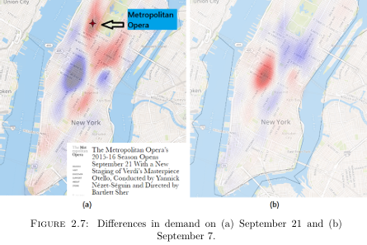
Congestion Hotspot Analysis - Impact of Special Events and Weather Conditions
Special events (sports, concerts, parades): generate non-recurrent congestion with atypical temporal/spatial demand.
Weather impacts:
  Rain, snow, and fog reduce roadway capacity, increase headways, and lower speeds.
  ML models (e.g., Bayesian Networks, LSTM) can distinguish these anomalies from normal peak periods.
Real-time hotspot analysis allows authorities to implement temporary control strategies such as contraflow lanes, variable message signs (VMS), and rerouting recommendations.
Figure: Taxi trajectory density map showing congestion hotspot during non-recurrent event (Pope’s visit at Saint Patrick’s Cathedral). Source: Markou (2020), “Detection, analysis and prediction of traffic anomalies due to special events”

Slide 30
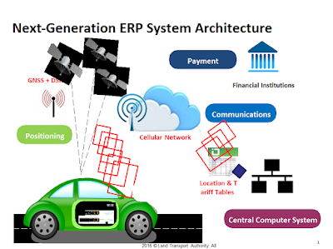
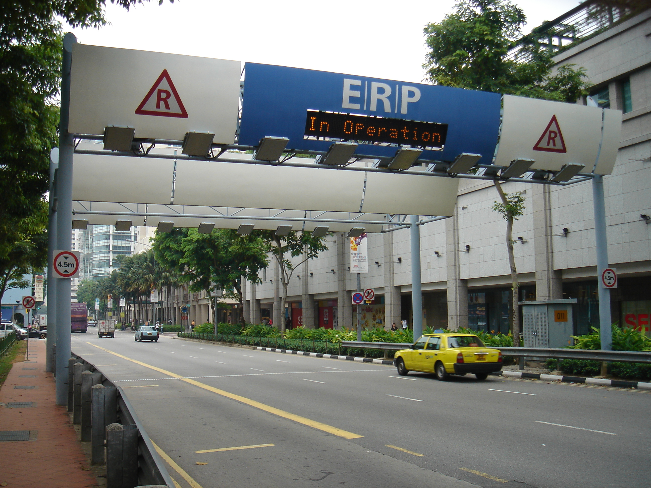
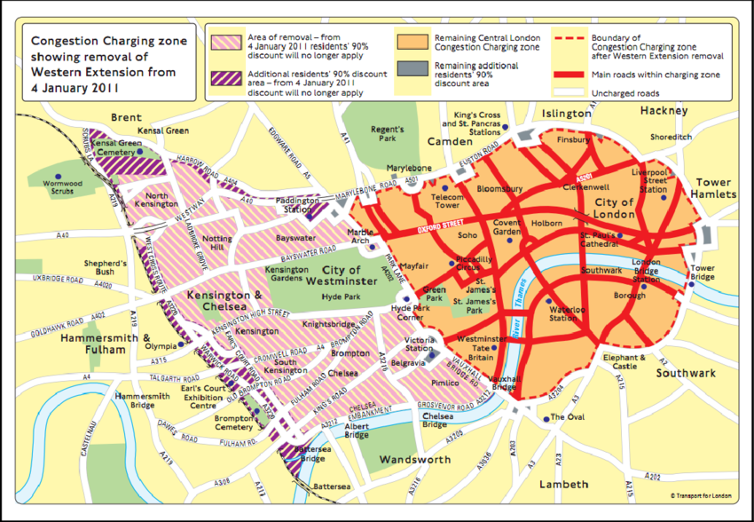
Congestion Hotspot Analysis - Practical Implementations
Singapore:
  Extensive deployment of ERP (Electronic Road Pricing) and real-time monitoring systems.
  Hotspot maps used for congestion charging and adaptive tolling, leading to 20–25% reduction in peak congestion.
London:
  Congestion Charging Zone (CCZ) combined with real-time traffic monitoring.
  Use of GPS and ANPR (Automatic Number Plate Recognition) data to identify and monitor traffic hotspots.
https://roadpricing.blogspot.com/2016/03/singapore-will-have-worlds-first-gnss.html
Tang, Cheng. (2020). The Cost of Traffic: Evidence from the London Congestion Charge. Journal of Urban Economics. 121. 103302. 10.1016/j.jue.2020.103302.

Slide 31
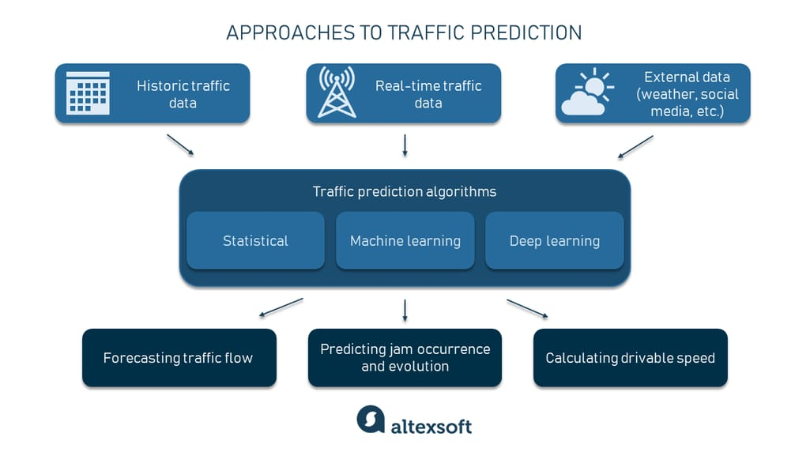
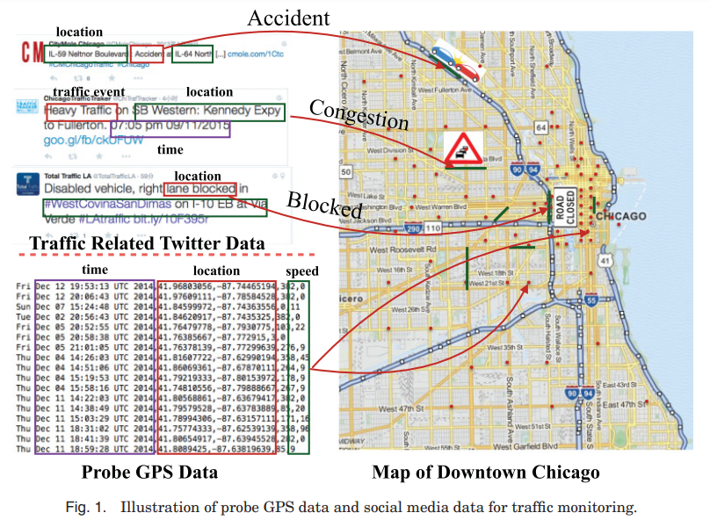
Conclusions & Future Perspectives - Key Takeaways
Enhanced precision: Machine Learning (ML) significantly improves the accuracy of traffic flow and travel time predictions compared to traditional statistical models.
Data-driven insights: Integration of diverse data sources (loop detectors, GPS, cameras, social media) enables detection of recurrent patterns and non-recurrent anomalies.
Operational benefits: Real-time prediction supports adaptive signal control, congestion hotspot management, and more reliable travel times, often reducing delays by 10–20% in practice.
https://www.altexsoft.com/blog/traffic-prediction

Slide 32
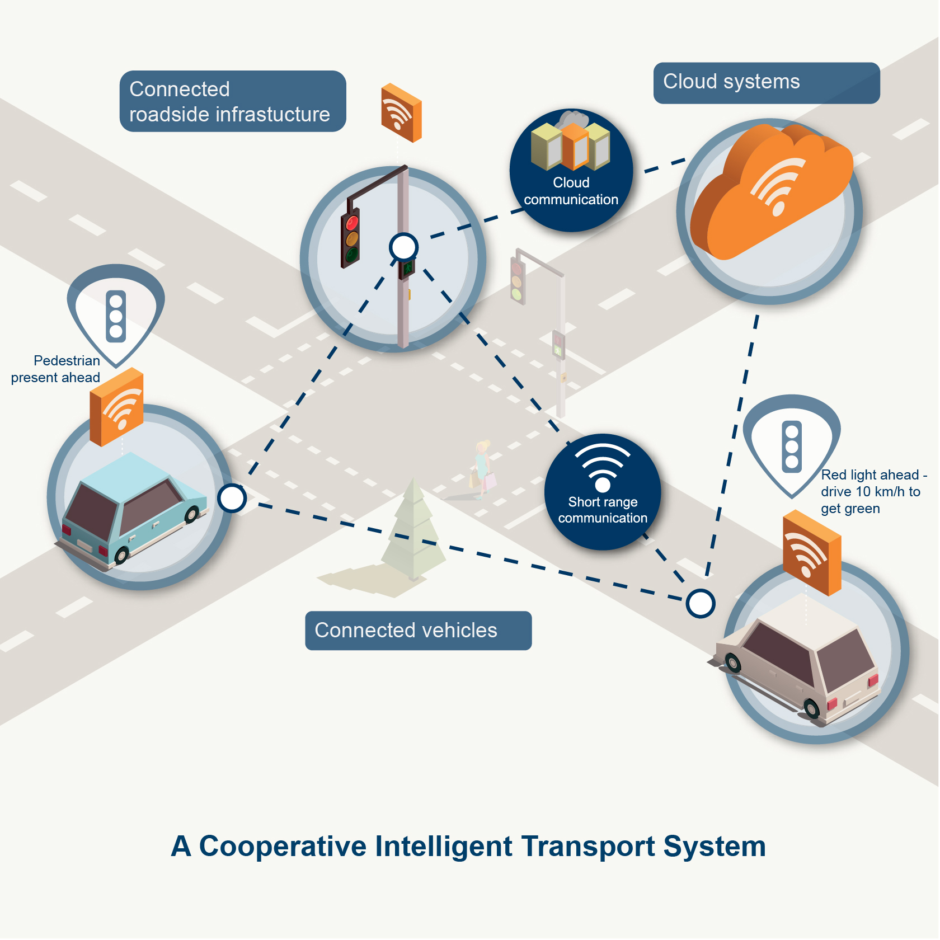
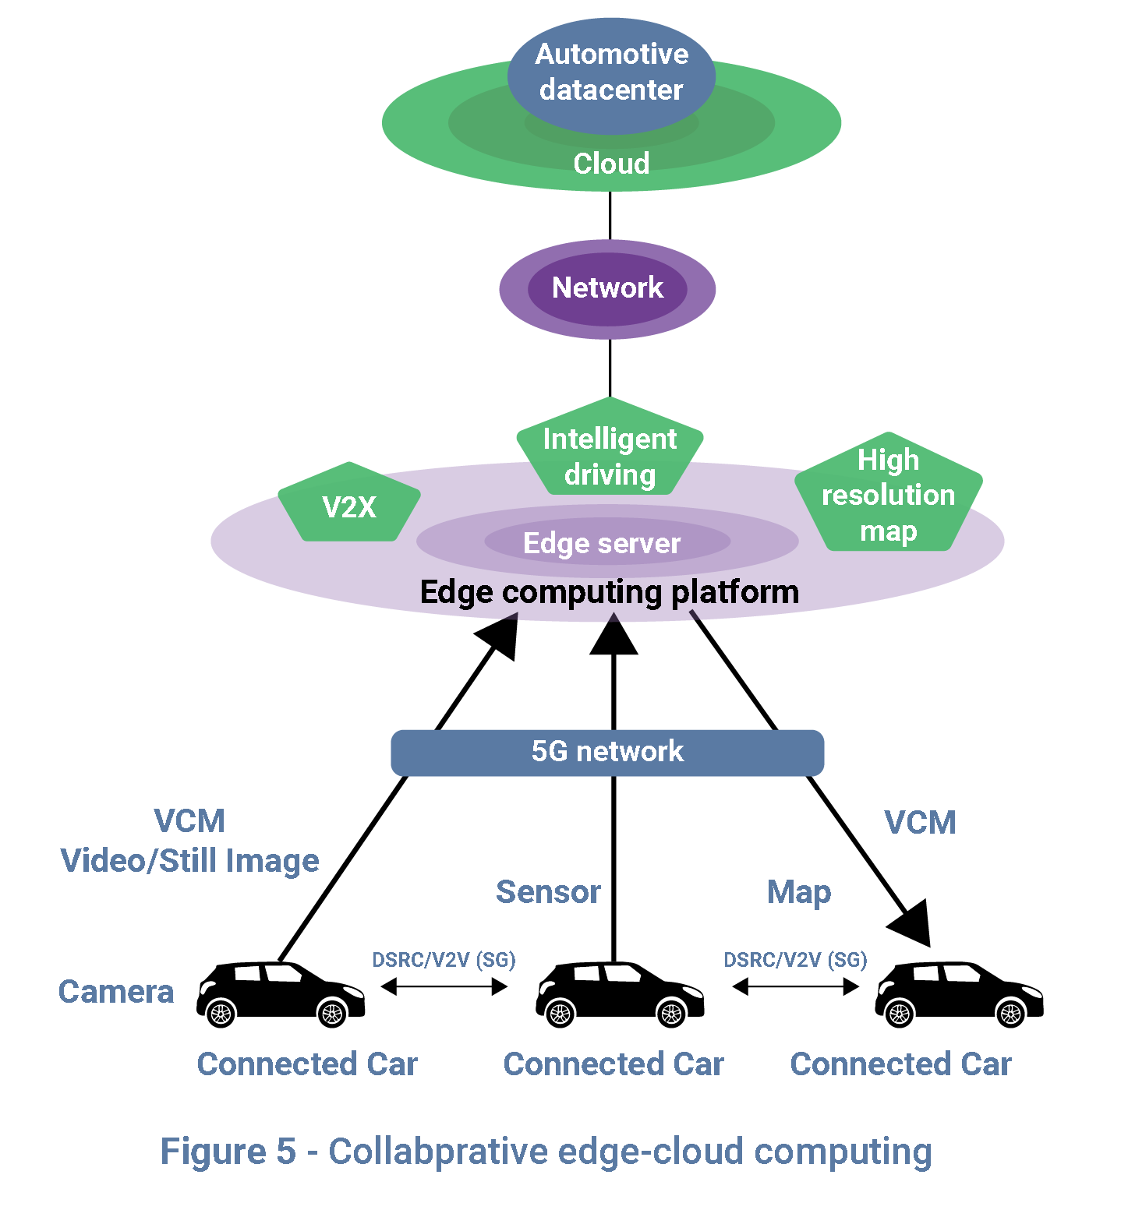
Conclusions & Future Perspectives - Future Outlook
Integration with Cooperative Intelligent Transport Systems (C-ITS):
  Real-time exchange of vehicle-to-vehicle (V2V) and vehicle-to-infrastructure (V2I) data.
  Improved coordination across multiple agencies and jurisdictions.
Autonomous Vehicles as Mobile Sensors:
  Large-scale data streams from connected autonomous vehicles (CAVs).
  Potential for high-resolution, low-latency traffic monitoring.
Edge & Cloud Computing:
  Decentralized, scalable processing of massive data flows.
  Supports immediate adaptive responses at the network level.
https://www.gsaglobal.org/forums/edge-ai-computing-advancements-driving-autonomous-vehicle-potential
https://www.qld.gov.au/transport/projects/cavi/connected-vehicles

Slide 33
Conclusions & Future Perspectives - Open Questions for Discussion
How can privacy-preserving techniques (e.g., differential privacy, federated learning) be effectively integrated into large-scale traffic forecasting?
What governance and data-sharing models are needed for international C-ITS interoperability?
How can we balance the explainability of ML models with the need for predictive accuracy in safety-critical traffic management?
What role should public–private partnerships (e.g., with mobility service providers like Uber or Waze) play in shaping future data-driven mobility systems?

