Slide 1


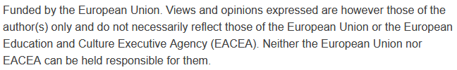

Smart Transportation Systems and Analytics:
Traffic Signal Optimization for Smart Cities
Sustainability and Quality Assurance for Academic Governance and Redesign Engineering Studies
Jacek Oskarbski

Slide 2
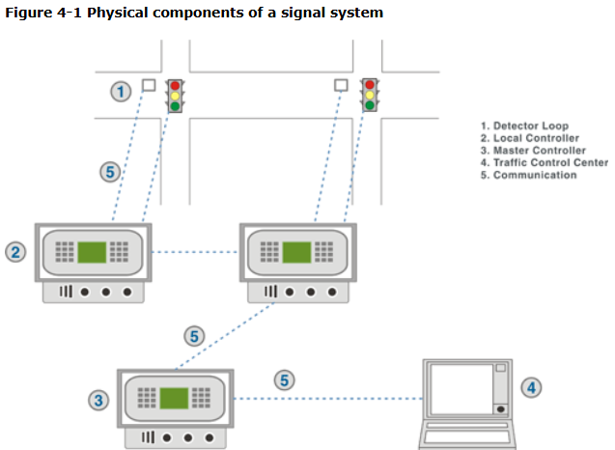
Definition of Traffic Signalization
Definition: a set of devices used for traffic control, including: control devices (controller), executive devices (signal heads along with supporting structures and cabling installation), detection devices (detectors, push buttons), information devices (speed displays, countdown timers), data transmission devices (modems, cable lines, radio transceivers), and auxiliary devices (contrast screens, acoustic and vibrating signal indicators for pedestrians, etc.).
https://ops.fhwa.dot.gov/publications/fhwahop08024/chapter4.htm

Slide 3
Objectives of Using Traffic Signals
Improving road safety by segregating conflicting traffic streams of vehicles, pedestrians, and cyclists, through providing users with appropriate signals indicating the right or prohibition to cross or proceed.
Enabling unprotected road users to cross or pass through the roadway under conditions of heavy traffic flow on the main road.
Allowing vehicles from less busy roads to enter under conditions of heavy traffic flow on the main road.

Slide 4
Advantages of Traffic Signalization
Organizing traffic and facilitating driving for motorists.
Increasing the capacity of approaches by grouping vehicles.
Reducing the number of certain types of accidents (pedestrian accidents, side collisions) – eliminating conflict points.
Allowing vehicles to pass and pedestrians to cross from subordinate cross-streets across heavily trafficked main roads.
Reducing time losses for vehicles entering from subordinate approaches.
Optimizing capacity (in the case of adaptive control).

Slide 5
Disadvantages of Traffic Signalization
Increased time losses during off-peak periods, especially on priority routes where most public transport lines operate.
Increase in certain types of accidents – rear-end collisions.
Unnecessary time losses and frustration of users in cases where signal programs are not properly adjusted to traffic conditions.

Slide 6
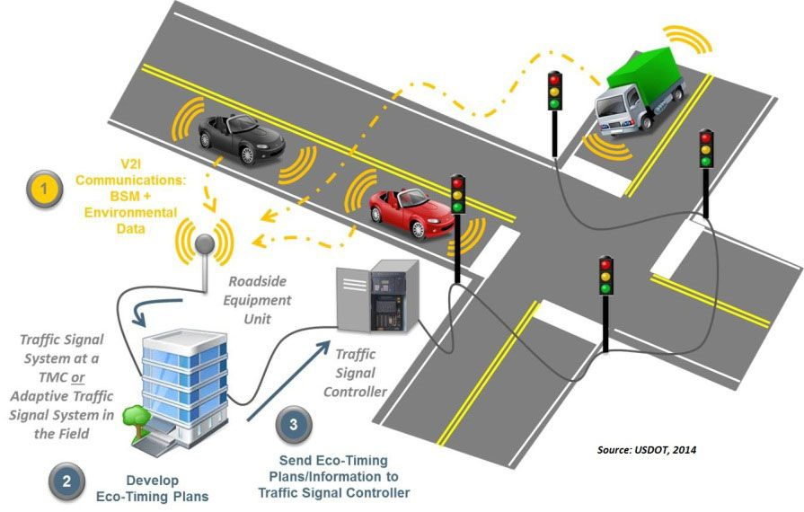
Basic Elements of Traffic Signalization
Control devices – controllers
Executive devices – signal heads along with supporting elements (masts, poles, gantries)
Detection devices – detectors and push buttons
Connection system – wired communication (fiber optics for system communication), cable installations (local communication), wireless communication (e.g., for public transport vehicle priority systems)

Slide 7
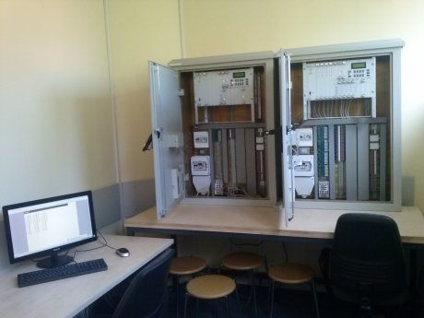
Basic Elements of Traffic Signalization – Controller
A traffic signal controller is an electronic device used to implement the programmed signal plan and ensure the safety of controlled vehicular and pedestrian traffic.
Controllers are divided into:
  Local controllers, managing signalization at a single intersection.
  Area (supervisory) controllers, overseeing the operation of several or a dozen local controllers.
  Central controllers, usually located in a control room, managing the operation of the control system composed of several dozen to several hundred local and area controllers.

Slide 8

Executive Devices – Signal Heads
Signal Head – a set of opto-electrical or opto-electronic devices (signal aspects/sections) used to display signals intended for road users.

Slide 9
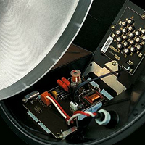
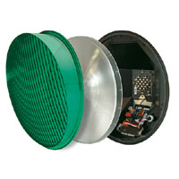
Executive Devices – LED Signal Heads
Main advantages of Light Emitting Diode (LED) traffic signals:
LEDs emitting light in red, yellow, or green successfully replace widely used incandescent bulbs.
Significant reduction in power consumption – an LED signal head uses 8–12 W, while an incandescent bulb consumes 135–165 W. Signal maintenance costs are reduced by 50–90%.
Longer effective service life – over 5 years.

Slide 10
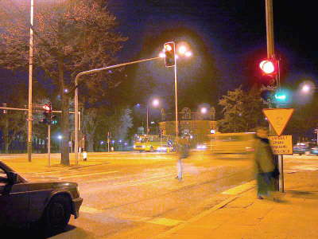
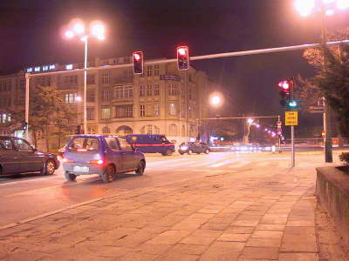
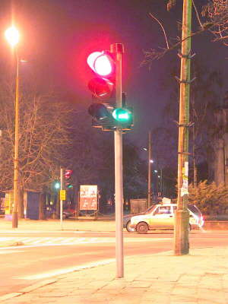
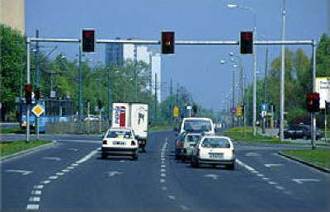
Executive Devices – Supporting Elements
Masts and poles – used for mounting traffic signal heads and ensuring visibility.
Gantry structures – applied at wide intersections or multilane roads, allowing signal heads to be placed directly above the lanes.
Foundations and brackets – providing stability and safety for mounted devices.

Slide 11
Main Functions of Detection – Identifying the Presence and Type of Road Users
Detection at intersections with traffic signals is crucial for effective and safe traffic control. Detectors provide information on the current traffic conditions, allowing for the dynamic adjustment of signal operation to the situation at the intersection.
Vehicle detection: Detectors register the presence of vehicles on particular approaches/traffic lanes. This is a basic function that enables assigning a green signal only when vehicles are waiting to pass. Detectors can distinguish vehicle types, allowing preferential treatment for certain categories (e.g., public transport).
Pedestrian detection: Detectors register the presence of pedestrians. This makes it possible to activate the green signal for pedestrians when they are waiting to cross.
Bicycle detection: Detectors can also register the presence of cyclists, enabling allocation of an additional signal phase or priority.
Detection of other objects: In some cases, detectors can be configured to identify other objects, such as special vehicles (e.g., ambulances, fire trucks).
Providing Information to the Control System: The data collected from detectors are transmitted to the local controller or the traffic control system. The controller or system uses this information to make decisions about which signals should be displayed at the intersection in order to optimize traffic flow and ensure safety.
https://www.smatstraffic.com/blog/5-reasons-floating-car-data

Slide 12
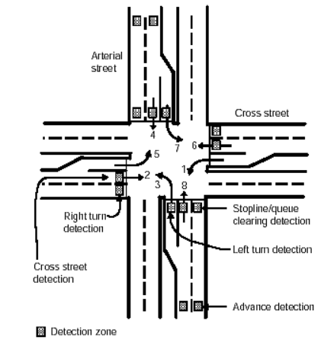
Placement of sensors for fully actuated intersection control
https://www.fhwa.dot.gov/publications/research/operations/its/06108/03

Slide 13
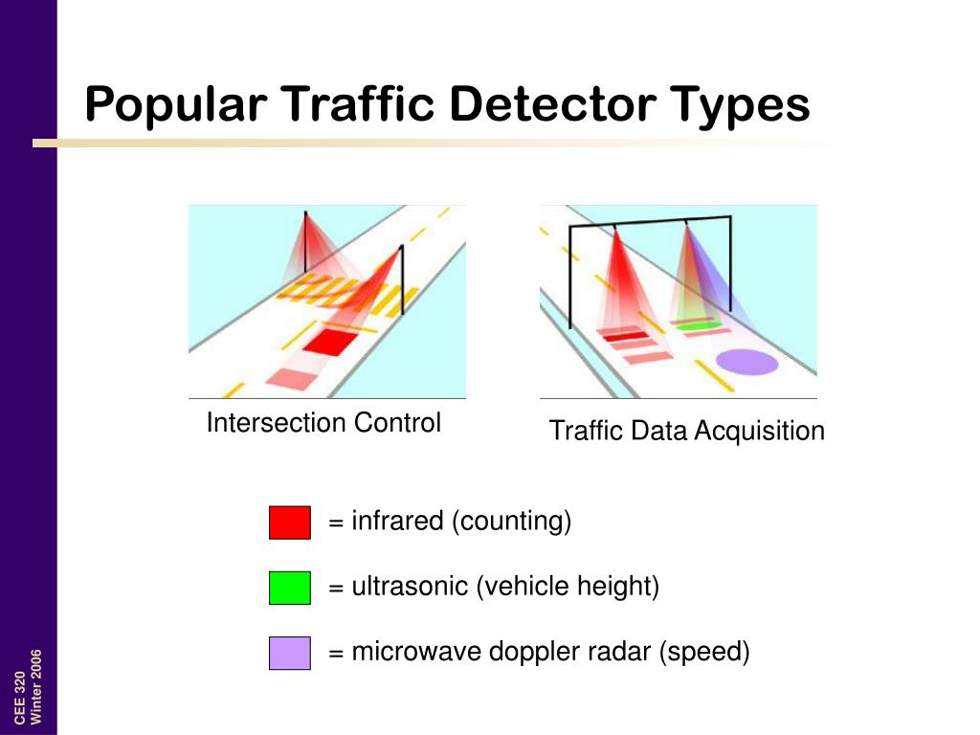
Types of Detectors
Inductive loops
Acoustic and ultrasonic
Laser
Optical (video cameras)
Radar
MagneticPush-button
Infrared/thermal imaging
Steve Muench prenentation CEE320

Slide 14
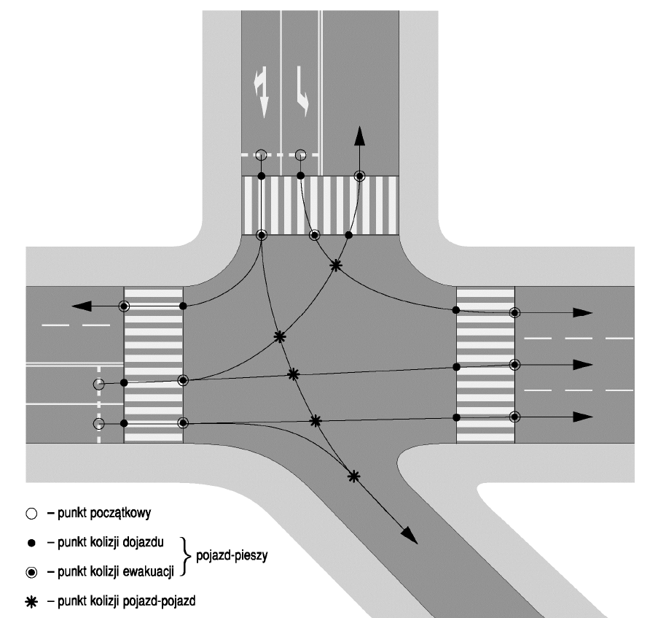
Definitions Related to Traffic Signalization – Traffic Streams and Conflict Streams
Traffic stream – a group of road users of the same type who cross the intersection area in a given direction between the starting and ending points of their movement.
Stream path (trajectory) – a notional line within the intersection area along which road users forming a given traffic stream cross the intersection.
Conflict point – a point within the intersection area where the paths of at least two traffic streams intersect or merge.
Conflict streams – a pair of traffic streams whose paths intersect or merge, forming a conflict point.
starting point
approach conflict point - vehicle–pedestrian
evacuation conflict point -vehicle–pedestrian
vehicle–vehicle conflict point

Slide 15
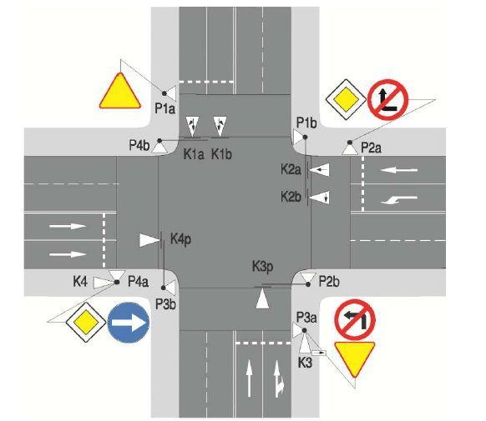
Definitions Related to Traffic Signalization – Signal Phase, Signal Group
Switching point – the moment in the signal program at which at least one signal changes.
Signal interval – the time between two successive switching points.
Signal phase – the period covering adjacent signal intervals during which a green signal is given to a specified set of traffic streams.
Signal group – a selected set of signal heads or a single signal head that, at any given time, displays identical signals assigned to specific traffic streams.

Slide 16
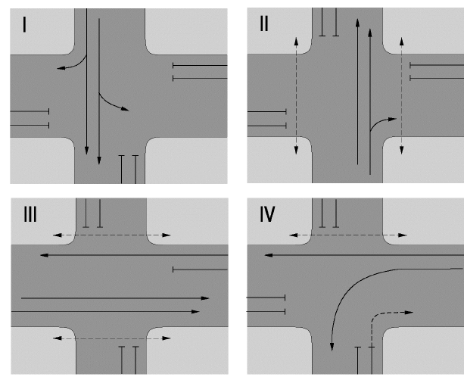
Definitions Related to Traffic Signalization – Illustration of Signal Phases

Slide 17
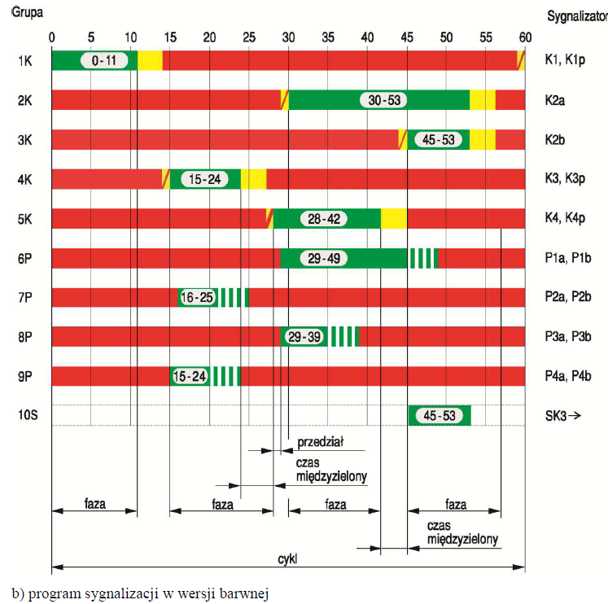
Definitions Related to Traffic Signalization – Signal Parameters
Group
Signal head
Signal cycle – the minimum repeatable ordered set of signals in the signal program with a defined structure, ensuring that each traffic participant receives a green signal at least once.
Phase offset (offset) – the time interval between the start of green signals at two adjacent intersections for the coordinated direction, reduced to a value not exceeding one cycle.
Green split (split) – the proportion of the duration of the green phase assigned to particular traffic directions at an intersection. In other words, it is the division of green time among different traffic lanes or movement directions.
Interval
Intergreen time
Phase
Phase
Phase
Phase
Cycle
Intergreen time

Slide 18
Green Split – Impact on Control Efficiency
The split has a significant impact on traffic flow and efficiency. An improperly chosen split may lead to congestion. The optimal split depends on many factors, such as:
  Traffic volume on individual approaches.
  Queue length of vehicles on individual approaches.
  Type of vehicles (cars, buses, trucks).
  Geometric conditions of the intersection and traffic organization.

Slide 19
Cycle Length – Impact on Control Efficiency
Traffic signal cycle length – The optimal cycle length is a compromise between traffic flow smoothness and capacity.
Short cycles: Short signal cycles (e.g., up to 60 seconds) are beneficial under low and variable traffic volumes. They allow for faster signal response to changes in traffic and minimize waiting times. However, short cycles can lead to frequent light changes, which may frustrate drivers and reduce capacity under high traffic volumes.
Long cycles: Long signal cycles (e.g., 60–120 seconds) are more effective under high and stable traffic volumes. They allow a larger number of vehicles to pass during each phase, increasing capacity. However, long cycles may result in long waiting times on approaches with lower demand and can reduce traffic flow smoothness under variable traffic conditions.
Shorter cycles are preferred: At intersections with low traffic volumes. Under conditions of highly variable traffic demand. At intersections with simple geometry. To ensure pedestrian safety (shorter waiting times). In residential areas with low vehicle traffic but higher pedestrian volumes.
Longer cycles (60–90 seconds or more) are preferred: At intersections with high and stable traffic volumes. At intersections with complex geometry and multiple lanes and directions. To increase capacity during peak hours. To ensure smooth traffic flow over larger areas (e.g., signal coordination at multiple intersections).

Slide 20
Definitions Related to Traffic Signalization – Signal Program, Control Algorithm
Group
Signal head
Traffic signal – an unambiguously defined (by color, possibly a set of colors, shape, or mode of display) message conveyed to road users.
Signal program – a time-defined method of cyclic traffic control, described at each control moment by the set of displayed signals, ensuring service for all conflicting streams while maintaining safety conditions.
Control algorithm – an ordered set of commands describing the method of traffic control at a signalized intersection, either adaptive or acyclic, depending on the real situation.
Interval
Intergreen time
Phase
Phase
Phase
Phase
Cycle
Intergreen time

Slide 21
Definitions Related to Traffic Signalization – Conflict Groups, Supervised Group
Conflict groups – a pair of signal groups that, in a given signal program, cannot simultaneously receive a green signal.
Supervised group – a signal group with a safeguard ensuring that, if a red signal is missing simultaneously on all signal heads of this group, the signalization is automatically switched to warning mode (flashing yellow). If an unplanned green signal appears on any of its signal heads, the signalization is automatically and immediately switched off completely.

Slide 22
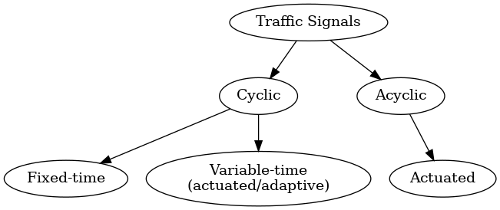
Methods of Traffic Control Using Traffic Signals in Terms of Program Execution and Work Repeatability
Cyclic – The signal operates in a fixed cycle, changing signals at specified intervals. It can be divided into:
  Fixed-time – The duration of individual phases is constant. These can be single-program (one fixed cycle) or multi-program (several cycles, e.g., for different times of day).
  Variable-time (actuated/adaptive) – The duration of phases is variable, adjusting to current traffic volumes.
Acyclic – The sequence of phases is variable, depending on the actual demand for passage. An example is actuated signals: the signal changes from a steady state to an active state after detecting traffic, and then returns to the steady state.

Slide 23
Fixed-time Cyclic Traffic Signal
It is characterized by a fixed cycle length. This means that the time from the start of one cycle to the start of the next is always the same. The sequence of phases (red, yellow, green for different traffic directions) is also fixed, and each phase has a predefined, constant duration.
Single-program: Uses only one predefined control program. The signal cycle is always the same, regardless of traffic conditions. This is the simplest form of traffic signal control, but also the least flexible.
Multi-program: Allows selection among several pre-programmed fixed-time programs. The program choice may depend on the time of day (e.g., one program during peak hours, another off-peak) or on current traffic characteristics (e.g., traffic detection triggers a program change). This is a more flexible solution, allowing adaptation to different conditions.
The choice of program may depend on current traffic characteristics, meaning that the traffic signal system analyses certain parameters describing the volume and movement of vehicles, and based on this selects one of the predefined control programs. Traffic characteristics that may influence the choice of program include: Traffic volume; Traffic density; Turning movements; Queue length; Vehicle speed; Traffic detection.

Slide 24
Fixed-time Cyclic Traffic Signal – Multi-program Control: Traffic Characteristics that May Influence the Selection of Program
Traffic Volume: The number of vehicles passing through the intersection within a given time. High volume may require a program prioritizing the flow of main traffic directions, while low volume may allow for longer times for secondary directions.
Traffic Density: The level of vehicle concentration on individual lanes. High density may indicate the need to adjust phase durations to prevent the formation of long queues.
Left/Right Turns: The proportion of vehicles turning left or right compared to those going straight. The system may adjust phase durations to accommodate turning vehicles, especially when conflicts with through traffic occur.
Queue Length: The system can monitor the length of vehicle queues waiting for the green signal. Long queues may be a signal to change the program in order to accelerate their clearance.
Vehicle Speed: The average speed of vehicles can be used to estimate travel time through the intersection and adjust phase durations accordingly.
Traffic Detectors: Sensors embedded in the roadway detect the presence of vehicles in different areas of the intersection. Data from detectors are a key source of information for assessing traffic characteristics and selecting the appropriate program.

Slide 25
Variable-Time (Actuated) Cyclic Signal Control
In this type of signal control, although the sequence of phases remains fixed, the duration of individual phases is variable.
The length of each phase is dynamically adjusted to current traffic conditions. Based on the provided setup, phase times may vary from 5 seconds up to n seconds, where n represents the maximum allowable duration.
The change in phase length results from traffic detection (e.g., in-road sensors) and allows for smoother traffic control, especially under variable conditions.
The cycle length may remain constant (e.g., a single program), but the duration of individual phases within that cycle is dynamically altered.
Although it retains its cyclic nature (a repeating cycle), its key feature is the dynamic adaptation of phase durations to the current traffic demand.

Slide 26
Variable-time (actuated/adaptive) cyclic traffic signal – adaptation mechanisms
It uses advanced control algorithms that, based on traffic detector data (inductive loops, cameras, radars), adjust the duration of signal phases. These algorithms take into account several factors, including:
Number of waiting vehicles: The more vehicles are waiting in a given direction, the longer the green phase for that direction.
Queue length: Allows for more precise adjustment of phase duration.
Vehicle speed: Helps estimate the time needed to clear the intersection and prevents the formation of queues.
Turning movements: Accounts for turning vehicles, dynamically adjusting the duration of phases.
Forecasting: Some systems use predictive traffic models to anticipate future demand and proactively adjust signal timing.

Slide 27
Variable-time Cyclic Traffic Signal (Actuated/Adaptive) – Control Algorithms
They can be based on different approaches, e.g.:
  Proportional–Integral (PI) Control – PI algorithms regulate the duration of phases based on the difference between the expected and actual number of vehicles passing through the intersection.
  Fuzzy Logic – Fuzzy logic allows for processing imprecise data from traffic detectors and making decisions based on linguistic rules (e.g., “if traffic is heavy, then extend green”).
  Neural Networks – Neural networks learn from historical traffic data and are able to predict future demand.

Slide 28
yclic Variable-Time (Accommodative) Traffic Signal Control – Advantages and Disadvantages
Advantages | Disadvantages
Dynamic adjustment of phase lengths to current traffic conditions. | Higher system complexity and the need for advanced control algorithms.
Increased traffic flow efficiency by reducing unnecessary waiting times. | High implementation costs (traffic detectors, control systems, software).
Potential reduction of queue lengths and prevention of traffic congestion. | Requires continuous maintenance and calibration of detectors (e.g., inductive loops, cameras).
Better adaptation under variable and irregular traffic demand. | Risk of malfunction in case of detector failure or incorrect input data.
Potential reduction of emissions and fuel consumption by minimizing vehicle idling. | Not always predictable for drivers – variable green times may be less intuitive.
Possibility of prioritizing certain types of traffic (e.g., public transport, emergency vehicles). | Requires compatibility with other ITS components and coordination at the network level.

Slide 29
Acyclic Signal Control
The sequence of phases is variable, depending on the current demand for passage. There are no fixed, repeatable cycles. The sequence of phases is dynamically modified in real time in response to ongoing changes in traffic. The selection of phases, their order, and their duration are not predefined but result from the analysis of current conditions.
There are no fixed, repeatable cycles. The sequence of phases is dynamically modified in real time in response to ongoing changes in traffic. The selection of phases, their order, and their duration are not predefined but result from the analysis of current conditions.
Acyclic signal control is an advanced traffic management system characterized by the absence of a fixed, repeatable operating cycle. Unlike cyclic control, where the order and duration of phases are predefined, acyclic control dynamically adjusts its operation to current traffic conditions.

Slide 30
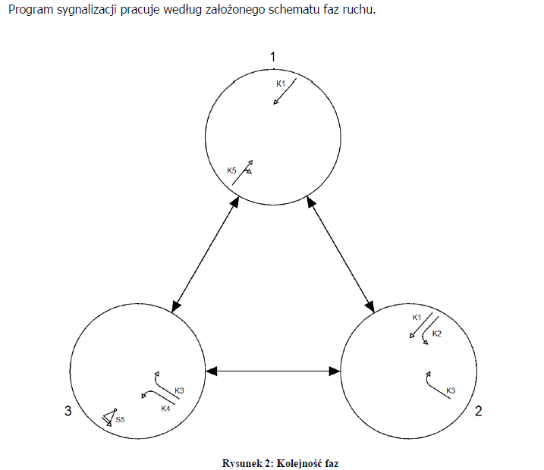
Key Features of Acyclic Traffic Signal Control
No Fixed Cycle – There is no recurring, periodic operating scheme. Traffic signals change in response to the current demand for passage.
Dynamic Control – Real-time control algorithms analyze data from detectors and decide on the sequence and duration of phases.
Variable Phase Sequence – The order of phases is not fixed. The system can switch between phases in any sequence.
Variable Phase Duration – The length of each phase is dynamically adjusted. If detectors identify a large number of vehicles waiting for a green signal in a given direction, the phase for that direction will be extended.
Algorithm Complexity – Acyclic signal control requires advanced algorithms capable of processing large amounts of data from traffic detectors and making optimal decisions in real time.

Slide 31
Types of Acyclic Traffic Signal Control
Demand-Actuated Control – The simplest form of acyclic traffic signal control. The green signal is activated only when a vehicle is detected waiting to pass. After the vehicle has passed, the signal returns to red. This type of control is most often used at intersections with low traffic volumes or at pedestrian/bicycle crossings.
Adaptive Control – These systems use advanced algorithms that take into account multiple variables such as traffic volume, queue length, vehicle speeds, and turning movements. The algorithms dynamically adjust the order and duration of phases to optimize traffic flow.
Model-Based Control – These systems use mathematical traffic flow models to predict future demand. This allows proactive signal adjustments, preventing congestion from forming.

Slide 32
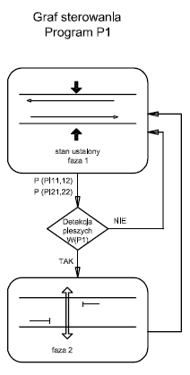
Demand-Actuated Control
Control Graph Program P1
steady state phase 1
Pedestrian detection
No
Yes
phase 2

Slide 33
Advantages and Disadvantages of Acyclic Traffic Signal Control
Advantages of Acyclic Traffic Signal Control | Disadvantages of Acyclic Traffic Signal Control
Higher efficiency – Better adapts to changing traffic conditions, minimizing congestion and waiting times. | Complexity – Implementation and maintenance of such systems are more complicated and costly.
Throughput optimization – Ability to handle a greater number of vehicles and other road users per unit of time. | Lower predictability – Drivers may find it difficult to anticipate signal behavior, which can lead to frustration and uncertainty.
Improved driving comfort – Smoother traffic flow and shorter waiting times enhance comfort for drivers. | Hardware requirements – Requires advanced traffic detection systems and control algorithms, along with robust data processing infrastructure.
Better safety – Dynamic adjustment to real-time situations reduces the risk of collisions.

Slide 34
Multi-program Cyclic Signal Control vs. Acyclic Signal Control
Aspect | Multi-program Cyclic Signal Control | Acyclic Signal Control
Cycle structure | Operates in fixed, repeatable cycles within each program. | No fixed, repeatable cycles.
Program switching | Program changes occur only at defined switching points between programs, not within a cycle. | Phase sequence, order, and duration are modified in real time.
Phase sequence | Predefined and repeated in each program. | Dynamic, depends on current traffic demand.
Adaptation | Adaptation at the program level (e.g., different programs for peak and off-peak hours). | Full dynamic adaptation based on real-time conditions.
System behavior | Cyclical at the level of individual programs, but variable in overall operation depending on program selection. | Entirely dynamic, no inherent cyclicity.
Perception | May resemble acyclic control if programs are switched very frequently. | Always acyclic – reacts instantly to changing traffic.
Key characteristic | Structured but adaptable at intervals. | Fully flexible and responsive at all times.

Slide 35
Generations of Traffic Control Systems – Generation 1First Generation: Fixed Time Systems
The first generation of traffic control systems is based on predefined time plans, developed offline on the basis of traffic analyses (e.g., historical data).These plans specify fixed cycles, green splits, and offsets between signals, which are stored in the computer’s memory and do not change in real time.
These systems use optimization algorithms such as TRANSYT, based on traffic models, without dynamic adaptation to current conditions. Communication between signals was limited or non-existent, and control was implemented using central computers.
The aim is to minimize time losses or the number of stops, but these systems do not respond to incidents (e.g., accidents), demand changes, or new traffic patterns. Manual adjustment of plans (e.g., by changing parameters at key intersections) is possible, but requires engineer intervention.
TRANSYT (Traffic Network Study Tool) – developed in the UK since the 1960s, it has been the global standard for fixed-time systems. It enables optimization of signal plans at the network level but requires manual data input.
Advantages: Simple implementation and low maintenance costs under stable traffic conditions. Effective in executing fixed strategies, e.g., managing capacity during specific hours. Provides traffic engineers with strong control over optimization goals (e.g., pedestrian priority).
Disadvantages: No response to dynamic changes such as accidents or sudden congestion. Inefficient under variable demand or in the presence of navigation systems. Limited adaptability to new traffic patterns over time.
Impact: The first generation provided the foundation for urbanization and growing traffic in the 1960s and 1970s, particularly in countries such as the UK, where TRANSYT was widely applied.

Slide 36
Generations of Traffic Control Systems – Generation 1.5
1.5 Generation: Hybrid Systems with Automatic Plan Selection (Plan Selection, Plan Generation, Local Adaptation)
This generation combines the features of fixed-time systems with elements of adaptability.
It automates the process of selecting or generating signal plans based on data from detectors distributed across the network, rather than relying solely on the time of day.
It uses traffic detectors to monitor conditions and modify predefined plans. These systems can generate new plans based on data or locally adapt existing plans, e.g., by skipping a phase.
Plan Selection Systems: Selection of a predefined plan based on detector data. Manual plan selection may be required for special events.
Plan Generation Systems: Creation of new timing plans based on detector data. However, the changes are limited and may not fully address incidents.
Local Adaptation: Local controllers modify centrally imposed plans, e.g., by shortening or lengthening phases.

Slide 37
Generations of Traffic Control Systems – Generation 1.5 – Examples
SCATS (Sydney Co-ordinated Adaptive Traffic System) – developed in Australia since 1983, is the most popular system of this generation. Installed in over 70 urban centres in 15 countries, it enables local adaptation and plan generation based on real-time data.
Advantages:
  Better response to local traffic changes compared to fixed-time systems.
  Automated plan selection increases efficiency in predictable scenarios.
  Local adaptation optimises capacity.
Disadvantages:
  Risk of selecting an inappropriate plan, which may lead to additional delays.
  Limited changes in generated plans, making it difficult to handle sudden incidents.
  Less engineer control over the system compared to the first generation.
Impact: These systems were groundbreaking in the 1980s and 1990s, enabling more flexible traffic management in medium and large cities.

Slide 38
Generations of Traffic Control Systems – Generation 2
2nd Generation: Traffic Responsive Centralised Systems
The second generation introduces full responsive control, where signal timing plans are generated and implemented online based on real-time detector data. Updates are carried out periodically (every 5–10 minutes), allowing adaptation to current traffic conditions.
These systems rely on a central computer connected to local controllers via continuous communication. They use detector data (induction loops, cameras) to optimise cycles, green splits, and offsets.
They can respond to changes in demand, daily variations, unexpected incidents, and time-based trends. Integration with driver information systems (e.g., variable message signs) and navigation is possible but requires centralised data analysis.

Slide 39
Generations of Traffic Control Systems – Generation 2 – Examples
SCOOT (Split, Cycle and Offset Optimisation Technique) – developed in the UK, implemented since the 1980s. Used in more than 170 cities worldwide, e.g., in London, it optimises traffic in real time, reducing delays by 12–20%.
UTMS (Universal Traffic Management System) – applied in Japan, integrates data from a wide network of detectors for comprehensive traffic management.
Advantages: Dynamic response to traffic changes, including incidents and trends. High network-wide coordination thanks to centralised data processing. Possibility of integration with other ITS systems, e.g., bus priority.
Disadvantages: Delays in plan updates (every 5–10 minutes) may be insufficient under very dynamic conditions. High infrastructure and maintenance costs. Failures in the communication network can significantly affect system efficiency.
Impact: The second generation revolutionised traffic management in large metropolitan areas during the 1980s and 1990s, particularly in Europe and Japan, preparing the ground for more advanced ITS systems.

Slide 40
Generations of Traffic Control Systems – Generation 3
3rd Generation: Fully Responsive Systems with Distributed Intelligence (Traffic Responsive Systems with Distributed Processing)
The third generation is based on fully responsive online control, where signal parameters (cycles, splits, offsets) are continuously adjusted in response to real-time data. It uses distributed intelligence, where local controllers communicate with each other, not only with a central computer.
These systems employ routing modules and communication between neighbouring controllers, sending messages through intermediate units. They use advanced optimisation algorithms and data from detectors, cameras, and V2I (Vehicle-to-Infrastructure) systems.
They provide continuous adaptation to changing traffic conditions, integration with navigation systems, and multimodal priorities (e.g., priority vehicles). They can operate autonomously but require complex communication protocols.

Slide 41
Generations of Traffic Control Systems – Generation 3 – Examples
OPAC (Optimisation Policies for Adaptive Control) – an American system that optimises traffic in real time with distributed intelligence.
PRODYN – a French system with similar features, used in Paris.
UTOPIA/SPOT (Urban Traffic Optimisation by Integrated Automation / System for Priority and Optimisation of Traffic) – an Italian system (developed further in the Netherlands), integrating priorities for public transport and real-time optimisation.
BALANCE/EPICS (Balancing Adaptive Network Control Method / Entire Priority Intersection Control System) – a German system. A fully responsive hybrid system combining network optimisation (BALANCE) with local adaptation (EPICS).

Slide 42
Generations of Traffic Control Systems – Generation 3 – Advantages and Disadvantages
Advantages:
  Continuous adaptation to traffic conditions, which increases efficiency in dynamic environments.
  Resilience to central system failures thanks to distributed architecture.
  Possibility of integration with navigation systems and autonomous vehicles.
Disadvantages:
  Complexity of implementation and communication protocol integration.
  Higher development and maintenance costs compared to previous generations.
  Potential difficulties in synchronisation between controllers in large networks.
Impact:
  The third generation, developed since the 1990s up to today, forms the foundation of modern ITS.
  Systems such as UTOPIA and OPAC are being tested and deployed in cities like Milan and Los Angeles, preparing infrastructure for the era of autonomous mobility.

Slide 43
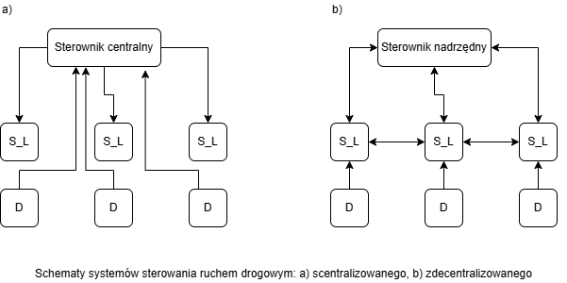
Structures of Road Traffic Control Systems
Central Controller
Master Controller
Diagrams of road traffic control systems: a) centralized, b) decentralized
a) central computer with controllers and detection (centralized),
b) hierarchical levels with master controller, local controllers, and detection (decentralized).mobility.

Slide 44
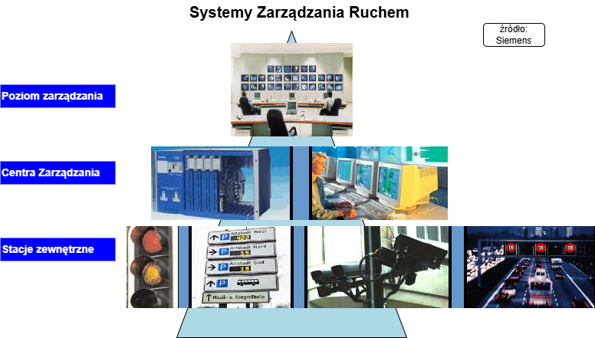
Types of Traffic Control System Structures
Centralized: Decisions are made in one place (central controller).
Decentralized: Decisions are made at different levels (central, supervisory, local).
Hybrid: A combination of centralization and decentralization, with functions divided between the control center and local controllers.
Traffic Management Systems
Management Level
Control Centers
Field Stations

Slide 45
Centralized Systems – Definition and Characteristics
A centralized system in the context of traffic management is a structure in which all decisions regarding traffic control are made in a single central point, called the central controller or the traffic control center. All decisions are made at the central controller, while local controllers function only as actuators. Detectors and local controllers are directly connected to the control center.
Examples: SCOOT, TRANSYT, MOTION.
Central computer
TMC
junction

Slide 46
Centralized Systems – Advantages and Disadvantages
Advantages | Disadvantages
High coordination at the network level. | Dependence on continuous communication with the central system.
Easy implementation of uniform strategies. | Risk of central system failure (network paralysis).
Ability to analyze large datasets from various sources in one place, which can lead to more complex traffic management strategies. | Centralized systems require constant and reliable communication between the central controller and local controllers, which may be problematic in areas with limited connectivity.
Ability to quickly implement changes across the entire system based on changing traffic conditions or special events.

Slide 47
Decentralized Systems – Definition and Features
A decentralized system in the context of traffic management is a structure in which decisions regarding traffic control are made at different hierarchical levels, and local controllers at intersections have significant autonomy.
It is a three-layer structure: central level, supervisory level, and local level.
Local controllers can operate independently or based on the requirements of supervisory controllers.
Examples: UTOPIA.
Central computer
Subarea 3
Subarea 1
TMC
Area Computers
Subarea 2
local level
supervisory level
central level

Slide 48
Decentralized Systems – Advantages and Disadvantages
Advantages | Disadvantages
Flexibility and resilience to failures (a failure of one controller does not affect others). | Difficulty in synchronizing between intersections. Achieving effective traffic management on a citywide scale may be harder, since individual local controllers do not cooperate as closely as in centralized systems.
Quick response to local traffic changes. | Limited optimization at the network level.
Usually require lower investments in communication infrastructure, which can lead to cost savings both during implementation and system maintenance. | Limited ability to analyze data from larger areas, which may result in suboptimal decisions at the local level that do not take the broader context into account.

Slide 49
Mixed Systems – Definition and Characteristics
Mixed systems combine elements of both centralized and decentralized traffic control structures. They operate hierarchically. They feature a central management level responsible for coordination and supervision of the entire network (e.g., optimization at the city or regional level), while at the same time allowing local autonomy of controllers at intersections. Local controllers can make real-time decisions, adapting to current traffic conditions, which is typical of the decentralized approach.
However, these local decisions are supported and coordinated by the central system, which ensures consistency and optimization at a higher level, reflecting centralized elements. In the traffic control systems literature, this approach is often referred to as hybrid, as it combines the advantages of both structures: high-level coordination (centralized) and resilience to local disturbances (decentralized).Functions of control are divided between the central system and local controllers. The supervisory level acts as an overseer, coordinating actions.
Examples: SCATS, BALANCE/EPICS.

Slide 50
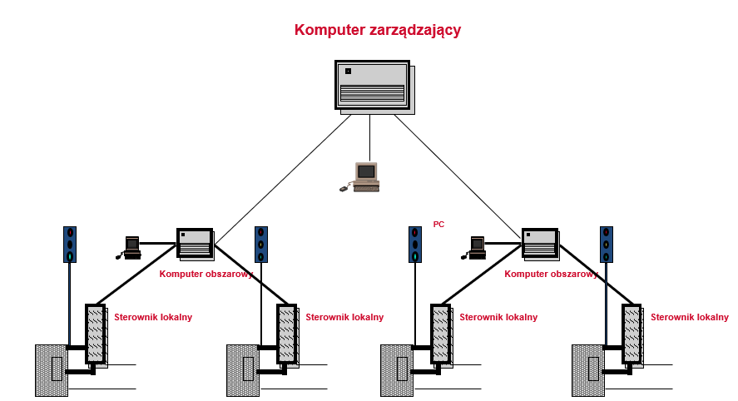
Mixed Systems – Structure on the Example of SCATS
Optional SCATS Hardware Structure(source: SCATS materials)
Management Computer
Area Computer
Area Computer
Local Controller
Local Controller
Local Controller
Local Controller

Slide 51
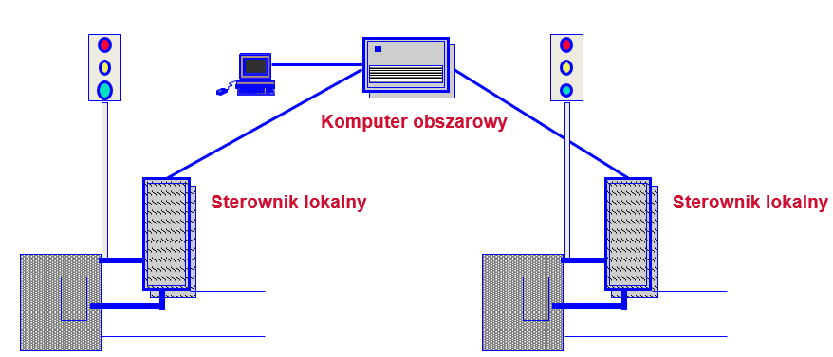
Mixed Systems – Structure on the Example of SCATS
SCATS Hardware Structure (Supervisory – Intermediate Structure)(source: SCATS materials)
Area Computer
Local Controller
Local Controller

Slide 52
Mixed Systems – the advantages and disadvantages
Advantages | Disadvantages
Greater flexibility: Combines centralized and decentralized elements, allowing better adaptability to both local needs and global strategies. | System complexity: Integration of different approaches can create a complex architecture requiring advanced management and maintenance.
Data optimization: Central data analysis combined with local decision-making enables optimization at the network level while considering local conditions. | Interoperability issues: Various system components may face interoperability challenges or require specific standards, leading to higher integration costs.
Improved traffic coordination: Mixed systems allow better signal coordination on a larger scale, improving traffic flow. | High implementation costs: Initial deployment and long-term maintenance/updates may be costly.
Failure resilience: If the central point fails, local systems can continue functioning, enhancing reliability and safety. | Need for continuous communication: Effective operation depends on reliable communication between central and local components, which may be challenging in areas with limited network coverage.
Faster adaptation to changes: Local solutions enable quick responses to traffic fluctuations or unforeseen events (e.g., accidents, roadworks). | Higher training requirements: Operators may require additional training to handle both central and local components, leading to higher costs and time demands.

Slide 53
Methods of Traffic Signal Plan Optimization
Maximization of Green Wave Band:
  Little & Morgan (MILP – Multi-band), Max Band
  Methods: NO-STOP, SIGPROG, COR
Minimization of Time Losses:
  Hillier & Rothery
  Combinatorial Method, Graph Tree Method, SIGOPT
Multi-Criteria Approaches
  Robertson
  TRANSYT, UNTS, UTCS-1

Slide 54
Methods of Signal Plan Optimization – ComparisonNO-STOP, SIGPROG, COR
Method | Description | Advantages | Disadvantages
NO-STOP | Method of determining offsets ensuring continuous traffic flow along a corridor in one direction. | Simple implementation. Effective in corridors with uniform traffic demand. | Only works well for one-directional corridors. Inefficient in complex networks or with variable demand.
SIGPROG | Program for progressive coordination of signals across a corridor. Considers bidirectional traffic. | More advanced than NO-STOP, allows coordination for two-way flows. | Requires more data and calculations. Less effective in highly variable conditions.
COR (Coordination) | Method of optimizing cycle lengths, green splits, and offsets for coordination of multiple intersections. | Enables area-wide optimization. Improves traffic flow in larger networks. | Complex implementation, requires significant computing power and reliable data.

Slide 55
Methods of Traffic Signal Plan Optimization – Comparison of Time Loss Minimization Methods
Method | Description | Advantages | Limitations
Hillery & Rothery | Classic method of minimizing time losses in traffic signal optimization. | Well-established, simple to apply. | May not capture complex traffic dynamics.
Combinatorial Method | Uses combinatorial optimization to minimize waiting times and delays. | Finds efficient solutions by testing multiple combinations. | Computationally intensive for large networks.
Graph Tree Method | Employs tree structures to model and minimize delays at intersections. | Useful for structured analysis of signal phases. | Less effective for highly dynamic or large-scale networks.
SIGOPT | Advanced optimization algorithm focusing on time-loss minimization in real-time. | Effective in adaptive control and real-time applications. | Requires advanced data and infrastructure support.

Slide 56
Methods of Traffic Signal Plan Optimization – Multi-Criteria Methods – Comparison
Method | Characteristics | Advantages | Disadvantages
Robertson | Balances multiple objectives such as minimizing delays, stops, and optimizing green bands. | Provides a good compromise between different optimization goals. | Complexity in calculations, requires detailed traffic data.
TRANSYT | Uses simulation and optimization techniques to minimize overall delay and stops in the network. | Well-established, widely used; effective in stable traffic conditions. | Limited adaptability to sudden traffic changes; relies on predefined data.
UNTS | Focuses on multi-objective optimization for urban traffic systems, considering different stakeholders’ needs. | Can optimize with multiple and conflicting objectives simultaneously. | High computational demand; complex implementation.
UTCS-1 | Early U.S. system using multi-criteria optimization for urban traffic networks. | Pioneering role in integrating multiple criteria into traffic management. | Outdated; limited ability to adapt to real-time changes.

Slide 57
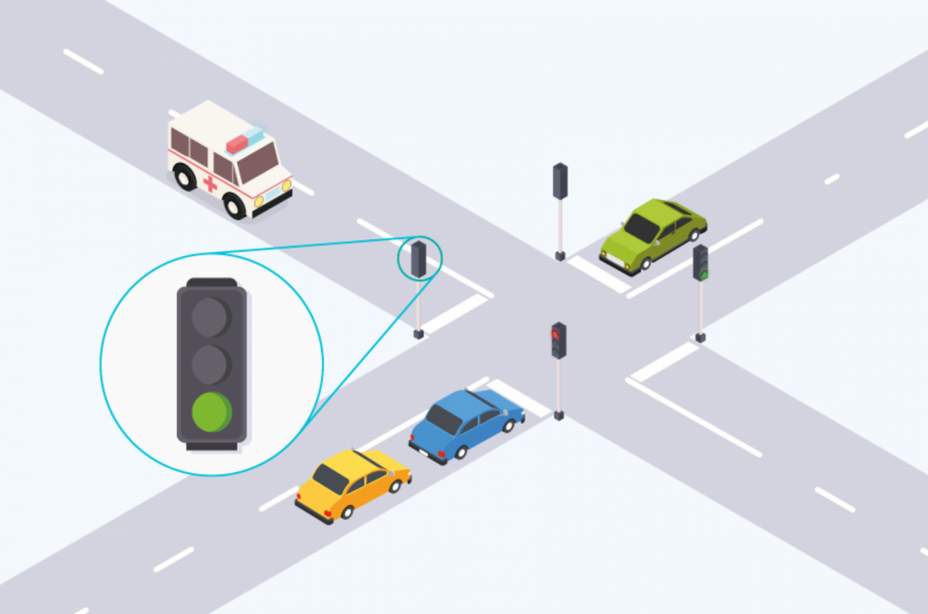
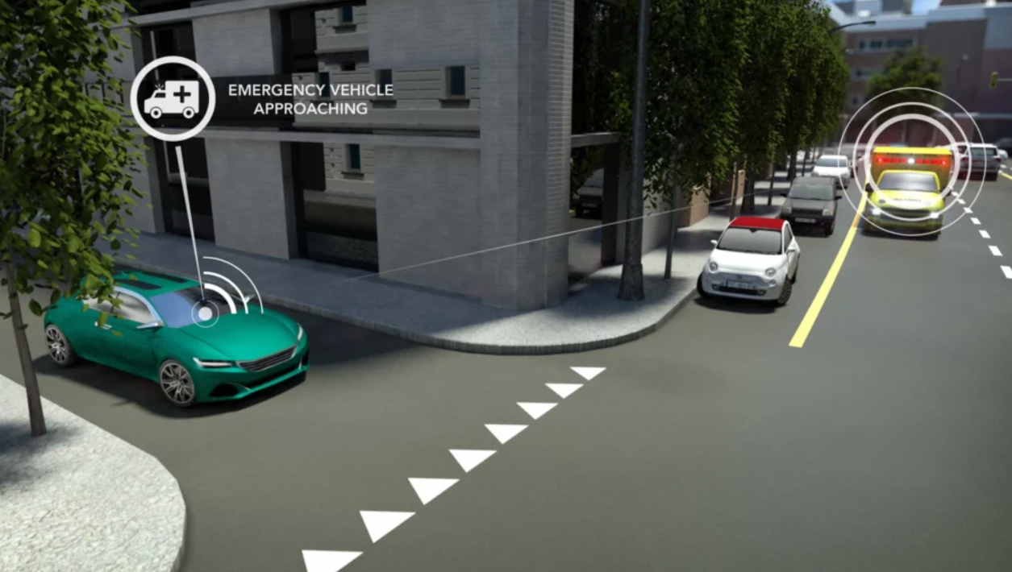
Introduction to Emergency Vehicle Prioritization
Ensures faster and safer passage of emergency vehicles (ambulances, fire trucks, police).
Reduces response times in critical incidents.
Minimizes disruption to general traffic flow while granting priority.
Emergency vehicle prioritization is a crucial ITS (Intelligent Transport Systems) function. The goal is to reduce delays for emergency services, while balancing overall network efficiency and safety.
https://www.megaride.eu/projects/emer-go

Slide 58
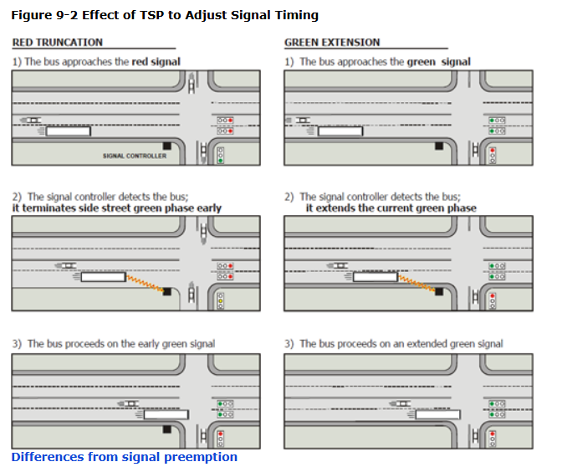
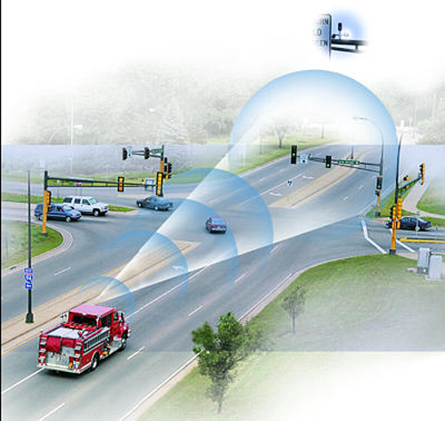
Strategies for Prioritization
Preemption Control: Traffic signals immediately switch to green for the emergency vehicle route.
Priority Request Control (PRC): Emergency vehicles request priority; signal timing is adjusted but not fully overridden.
Dedicated Lanes / Corridors: Special lanes or dynamically reserved routes for emergency vehicles.
Connected Vehicle Technology (V2I):Vehicle-to-infrastructure communication sends priority requests automatically.
https://ops.fhwa.dot.gov/publications/fhwahop08024/chapter9.htm

Slide 59
Emergency Vehicle Prioritization - Benefits vs. Challenges
Benefits | Challenges
Rapid emergency response times | High infrastructure costs for detection and communication systems
Improved public safety | Potential disruption to regular traffic patterns
Resiliency in crisis scenarios | Requires reliable, robust tech and maintenance
Integration with modern ITS/C-ITS | Complex implementation and vehicle interoperability

