Slide 1


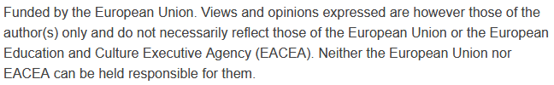

Smart Transportation Systems and Analytics:
Public Transit Integration and Priority Systems
Sustainability and Quality Assurance for Academic Governance and Redesign Engineering Studies
Jacek Oskarbski

Slide 2
Priorities in Traffic Signal Control: Traffic Optimization for Public Transport
Introduction to the topic: Traffic signal priority mechanisms allow faster passage of public transport (PT) vehicles through intersections, improving punctuality and the efficiency of urban transport.
Presentation objective: To discuss strategies, methods, system architecture, effects, and examples of implementations of traffic signal priorities.

Slide 3
Importance of Priorities for Public Transport
Increase in transport speed: Public transport (PT) priority leads to a significant reduction in travel time, improving punctuality and attractiveness for passengers.
Reduction of travel times: Studies in cities such as Athens (15.5% reduction), Munich, and Turin (14% reduction) confirm the effectiveness of priority measures.
Additional benefits: Reduction of exhaust emissions, improvement of overall traffic flow, and an increase in PT ridership (e.g., in Malmö, an increase from 10% to 25%).
City | Travel Time Reduction (%) | Range of Travel Time Reduction (%)
Cardiff | 11.0
Munich | 14.0
Glasgow | 10.0
London | 8.0
Turin | 14.0
Athens | 15.5 | 12–19
Gothenburg | 15.0
Toulouse | 7.5 | 5–10
Sapporo | 6.0
Lyon | 12.5 | 11–14
Melbourne | 8.0 | 6–10
Source:
Transplan

Slide 4
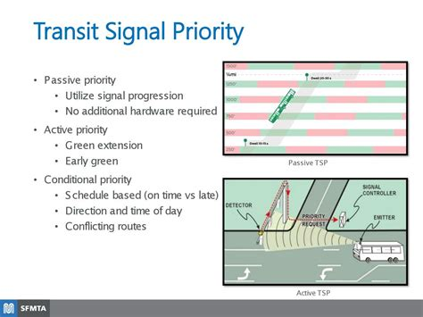
Priority Strategies – Passive and Semi-Active
Passive priority – traffic signal control programs are designed in a fixed way, taking into account the volume and/or weight of public transport flows. This strategy is very inflexible to changes in traffic structure, which is why it is used less and less often.
Semi-active priority – before reaching the intersection, detection and identification of public transport vehicles take place. By sending a priority request, these vehicles can locally influence the signal program through phase extensions, calling a special phase for public transport vehicles, or skipping certain phases.

Slide 5
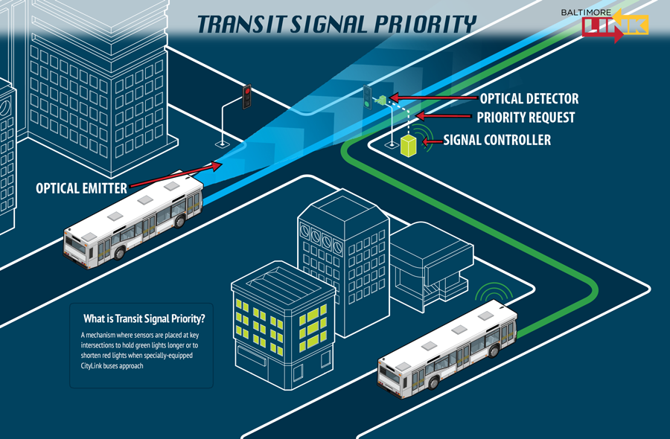
Priority Strategies – Active
Active priority:
  Conditional – priority is granted to vehicles that, at the time of detection, meet predefined criteria. The most common rule is “priority only for delayed vehicles.” Only vehicles running late according to the timetable receive priority. This solution helps maintain a balance between giving preference to public transport and ensuring sufficient traffic conditions for private vehicles.
  Unconditional – all public transport vehicles are granted absolute priority. The main objective is to increase the operating speed of public transport. However, this approach often leads to significant deterioration of traffic conditions for private vehicles as well as for public transport vehicles on side streets.
https://jp.pinterest.com/pin/transit-signal-priority-explainer--256001560046058537

Slide 6
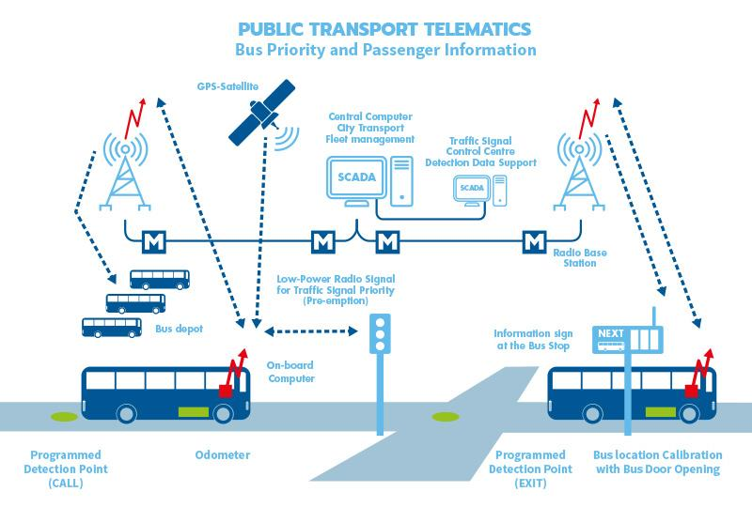
Priority Strategies – Adaptive
Adaptive priority is granted in real time within advanced traffic management systems based on a cost–benefit balance for both public transport and private transport. Factors considered include, for example, user travel time losses, delays for public transport vehicles, and delays for private transport vehicles. Advanced algorithms enable the optimization of traffic parameters in such a way as to facilitate the passage of public transport vehicles while minimizing the impact on private transport conditions.
To make this possible, adaptive priorities require the use of real-time vehicle location systems with precise estimation of arrival times at intersections, real-time traffic condition detection on the network, advanced traffic control algorithms, and vehicle communication systems with the Traffic Management Center (and/or signal controllers – depending on whether the system is decentralized, centralized, or hybrid).
https://www.satel.com/references/traffic-system-public-transport-helsinki/

Slide 7
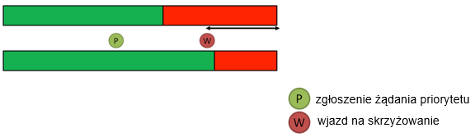
Methods of Granting Priority
Extension of the active phase – this method consists of extending the active phase that gives priority by the time needed for the public transport vehicle to pass through the intersection (from detection to clearance). The method requires vehicle detection close to the intersection (up to 150 m) and the use of defined time limits (e.g., maximum extension time of the phase).
priority request submission
entry into the intersection

Slide 8
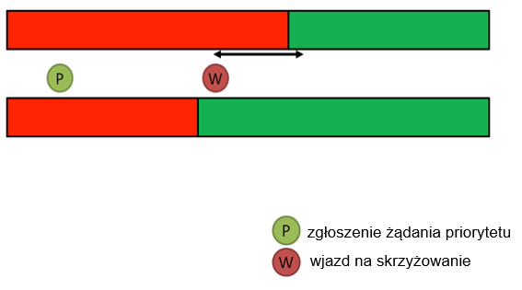
Methods of Granting Priority
Red signal shortening – consists of reducing the duration of the red signal and calling the green signal to give priority to the vehicle.
priority request submission
entry into the intersection

Slide 9
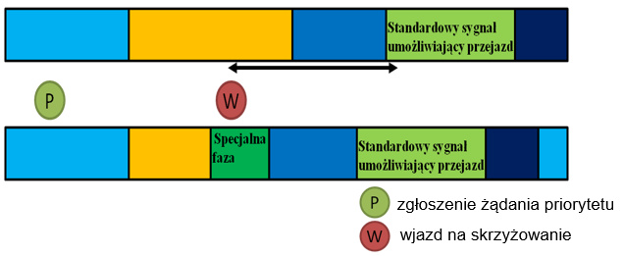
Methods of Granting Priority
Activation of a special phase for a public transport vehicle – after the vehicle is detected, a separate signal phase is activated, intended only for public transport vehicles. This may occur simultaneously with the shortening of the active phase. The method is often used when granting priority to trams.
Standard signal allowing passage
Special phase
Standard signal allowing passage
priority request submission
entry into the intersection

Slide 10
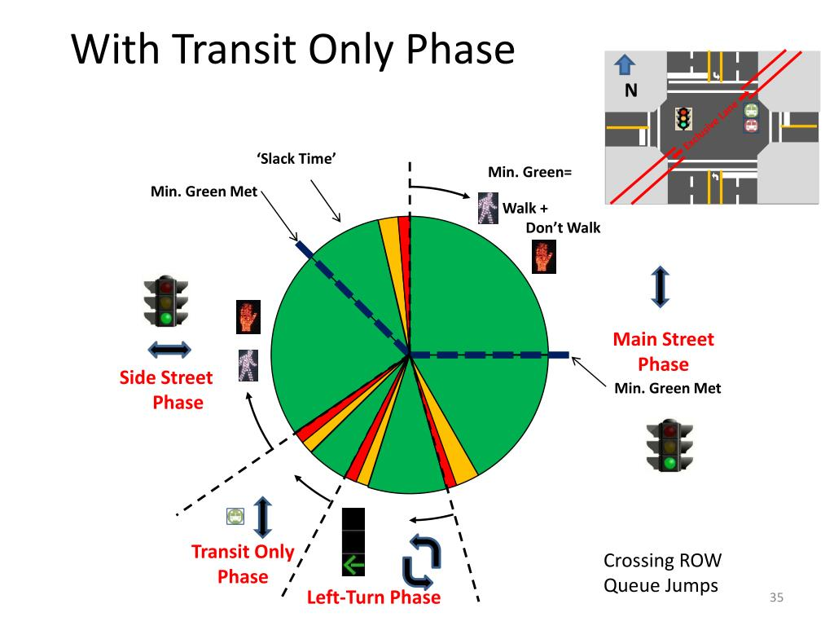
Methods of Granting Priority
Phase skipping – after detecting a public transport vehicle, subsequent inactive phases are skipped in order to trigger the priority phase as quickly as possible. This method is characterized by intervention in the signal program, which is particularly dangerous in the case of skipping pedestrian phases, as impatient pedestrians may enter the roadway on a red light.
Sabra, Wang & Associates, Inc. (2013). Transit Signal Prioritization (TSP) and RTS Transit Signal Priority Work Group. Presentation prepared for Montgomery County, Maryland, State Highway Administration. July 16, 2013.

Slide 11
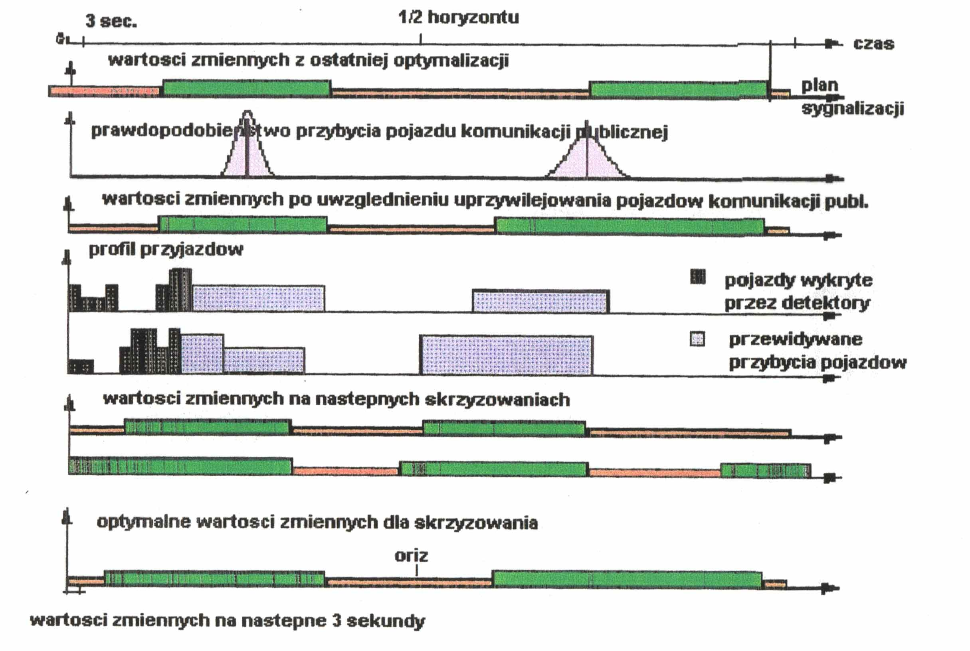
Methods of Granting Priority
Moving horizon – based on the gradual adaptation of signal programs to grant priority. It takes place with a significant time lead (e.g., 120 s in the SPOT-UTOPIA system), so that changes in signal programs occur gradually and smoothly. Due to the relatively long time lead in contrast with the high dynamics of traffic profile variability and random factors, it is extremely difficult to determine the exact arrival time of a public transport vehicle at the intersection.
SPOT-UTOPIA Peek Traffic

Slide 12
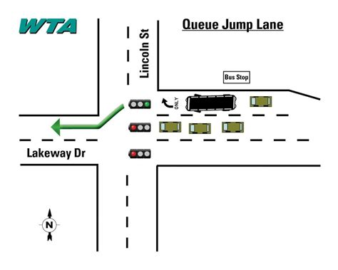
Methods of Granting Priority
Queue relocation – priority for public transport vehicles is granted if it is possible to relocate queues of private vehicles at the approach, to a location where separation of private and public transport occurs. This requires the use of bus gates or virtual (dynamically allocated) bus lanes.
“Green wave” – priority granted by the Traffic Management Center for the entire route, regardless of delays imposed on other users (absolute priority). This method is mainly used for emergency vehicles (e.g., rescue services). With respect to public transport vehicles, this method is applied very rarely.
https://www.whatcomtalk.com/2018/08/20/what-is-a-queue-jump-lane/

Slide 13
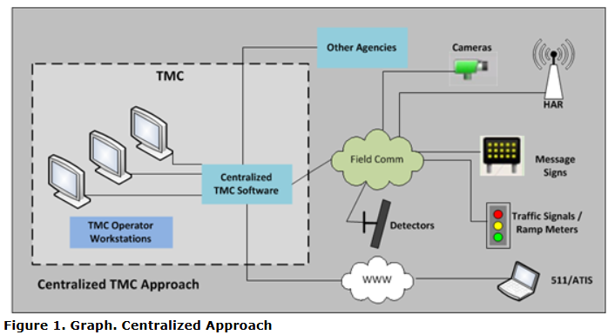
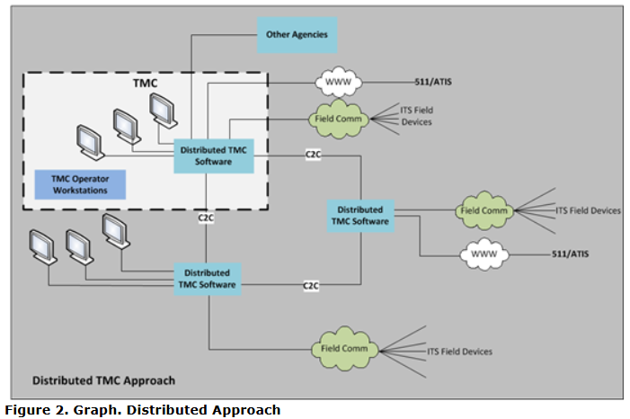
Architecture of Priority Systems
Centralized system: All decisions are made in the control center (UTC).
  Advantages: Possibility of prioritization hierarchy, automatic adaptation to the situation.
  Disadvantages: Data transmission delays (2–3 s), sensitivity to disruptions.
Decentralized (local) system: Priority is granted locally by controllers.
  Advantages: Quick implementation of priority, independence from the control center.
  Disadvantages: Limitations in using advanced algorithms, potential traffic disturbances.
Hybrid system: Combines features of centralized and decentralized systems.
https://ops.fhwa.dot.gov/publications/fhwahop14016/ch2.htm

Slide 14
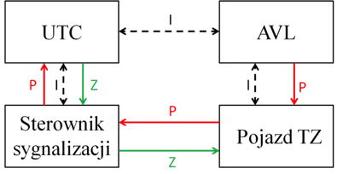
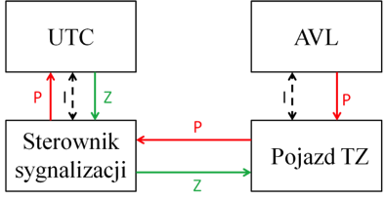
Architecture of Priority Systems – Centralized Priority
A system with the most advanced two-way communication between individual components. The AVL system determines which vehicles require priority, after which the information, supplemented with instructions from the UTC traffic control center, is transmitted to the vehicle and then to the signal controller.
Signal Controller
PT Vehicle
Signal Controller
PT Vehicle
Intelligence: centralized
Priority request submission: local
Decision: centralized
Examples of application: Genoa
Intelligence: centralized
Priority request submission: central/local
Decision: centralized
Examples of application: London

Slide 15
Centralized Priority – Advantages
Possibility of dispatcher/operator intervention in real time: In a centralized system, the dispatcher or operator can monitor the situation in real time and manually intervene in granting priorities, allowing flexible responses to unusual situations, e.g., significant delays of PT vehicles.
Automatic route planning for emergency and special vehicles: The centralized system can automatically plan routes for emergency vehicles (e.g., ambulances) or special vehicles (e.g., buses on key lines), granting them priority along the entire route, which increases travel efficiency.
Ability to prioritize multiple priority requests: In the case of many PT vehicles, the centralized system makes it possible to establish a hierarchy of priorities, e.g., giving precedence to more delayed vehicles or to routes of greater importance, optimizing traffic across the entire area.
Adaptability – automatic adjustment of priority to current traffic conditions: The centralized system can dynamically adjust priorities based on current traffic data (e.g., volumes, delays), enabling more effective traffic management in real time.
Possibility of advance priority implementation at subsequent intersections: Thanks to centralized management, the system can prepare priorities in advance at consecutive intersections along the PT vehicle route, ensuring smoother travel and minimizing delays.

Slide 16
Centralized Priority – Disadvantages
Delays in implementing priority (data transmission to the UTC center and signal controller) approx. 2–3 seconds: In a centralized system, data must be transmitted from the vehicle to the UTC center and then back to the signal controller. This process causes a delay of about 2–3 seconds, which may affect the effectiveness of priority, especially under dynamic traffic conditions.
Sensitivity to transmission disruptions (e.g., GSM network): Centralized systems often use data transmission via GSM networks. Disruptions in communication (e.g., weak signal, network overload) can interfere with communication between system elements, leading to errors in granting priority.
Priority can only be granted with an operational connection to the UTC center: The centralized architecture is entirely dependent on continuous connectivity with the UTC center. If the connection is interrupted (e.g., due to a network failure), the system will not be able to grant priority, which may result in delays for PT vehicles.

Slide 17
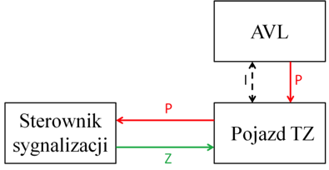

Architecture of Priority Systems – Local Priority
Before the intersection, the vehicle sends (or is detected by a detector) a request for priority directly to the traffic signal controller, which implements the priority.
Signal Controller
PT Vehicle
Signal Controller
PT Vehicle
Structure: local
Priority request submission: local
Decision: local
Examples of application: Geneva, Malmö, Nantes, Prague
Intelligence: centralized
Priority request submission: local
Decision: local
Examples of application: Aalborg, Helsinki, Brighton and Hove

Slide 18
Local Priority – Disadvantages
Possible major traffic disruptions after granting priority: In a decentralized system, priority is granted locally, which may lead to disruptions at the intersection, e.g., longer waiting times for other vehicles, especially if priority is granted frequently.
Need for additional vehicle–signal controller communication channels: The decentralized architecture requires direct communication between the PT vehicle and the signal controller, which means the use of additional communication channels such as short-range radio, increasing system complexity.
Limitations in the use of advanced traffic control algorithms – strategies covering corridors or areas: Decentralized systems operate locally, which limits the possibility of applying advanced algorithms that require coordination at the level of larger areas or road corridors, e.g., a “green wave” for the entire route.
Complicated dispatcher/operator intervention (need for local controller programming): In case manual intervention is required, the operator must program each controller locally, which is time-consuming and less flexible compared to a centralized system where changes can be made remotely.
Sensitivity to interference when using short-range radio: If communication between the vehicle and the controller is based on short-range radio, the system is vulnerable to disturbances, e.g., electromagnetic interference or physical obstacles, which may disrupt priority granting.

Slide 19
Local Priority – Advantages
Possibility of application without a traffic control system: The decentralized architecture does not require a central control system, making it suitable for smaller cities or areas without a developed traffic management system (e.g., UTC).
Very low delays in implementing priority: Since decisions are made locally, the process of granting priority is fast – there is no need to transmit data to the control center and back, eliminating delays (in contrast to centralized systems, where the delay is 2–3 seconds).
The decentralized architecture is simple and quick in operation, making it suitable for smaller systems or in situations where centralized control is not available. However, its limitations, such as the lack of area-level coordination, susceptibility to interference, and potential traffic disruptions, make it less effective in large, complex road networks. Compared to centralized architecture, the decentralized system is more independent but less advanced in terms of large-scale traffic optimization.

Slide 20
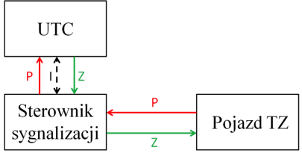
Architecture of Priority Systems – Hybrid Priority
The vehicle sends a priority request to the signal controller. The controller then forwards the request to the UTC, which makes the decision on granting priority.
Signal Controller
PT Vehicle
Intelligence: local
Priority request submission: local
Decision: centralized
Options of application: local and centralized
Examples of application: Glasgow

Slide 21
Hybrid Priority – Advantages
Flexibility in decision-making at different levels: The hybrid architecture allows decisions to be made both locally and centrally. For example, local controllers can operate independently or based on general requirements imposed by a supervisory or central controller (e.g., in the UTOPIA system).
Combining the advantages of centralization and decentralization:
  From centralization: the ability to coordinate at the area level, e.g., prioritization hierarchy and adaptation to traffic conditions.
  From decentralization: fast local decisions without delays related to data transmission to the control center (similar to a decentralized system).
Supervisory role of the higher level: The higher level serves only a supervisory role, meaning it can monitor and adjust the actions of local controllers without directly interfering in every decision. This makes the system more flexible and less burdened than a fully centralized system.
Scalability and the ability to optimize at different levels.

Slide 22
Hybrid Priority – Disadvantages
System complexity resulting from the division of functions: The hybrid architecture combines elements of centralization and decentralization, which means that control functions are divided between the control center and local controllers. Such a hybrid structure can be more difficult to design, implement, and maintain, as it requires integration of different management levels (central, supervisory, and local).
Potential communication delays between levels: Although the hybrid architecture allows for local decisions, some data must be transmitted between levels. This may cause delays, although smaller than in a fully centralized system.
Sensitivity to communication disruptions between levels: Similar to the centralized system, the hybrid architecture is partially dependent on connectivity between levels. Disruptions in data transmission may affect the effectiveness of granting priorities.
Need for precise coordination between levels: The supervisory level plays an overseeing role, which requires precise coordination between local controllers and the control center. Lack of synchronization may lead to inefficient priority granting, e.g., when local decisions conflict with general guidelines.
The hybrid architecture for PT vehicle priority offers flexibility and the ability to combine the advantages of centralized and decentralized systems, making it suitable for large and complex road networks. However, its complexity, the need for coordination between levels, and partial dependence on connectivity may pose challenges. Compared to centralized architecture, it is less prone to delays, and compared to decentralized architecture, it allows for better area-wide coordination, though at the cost of greater system complexity.

Slide 23
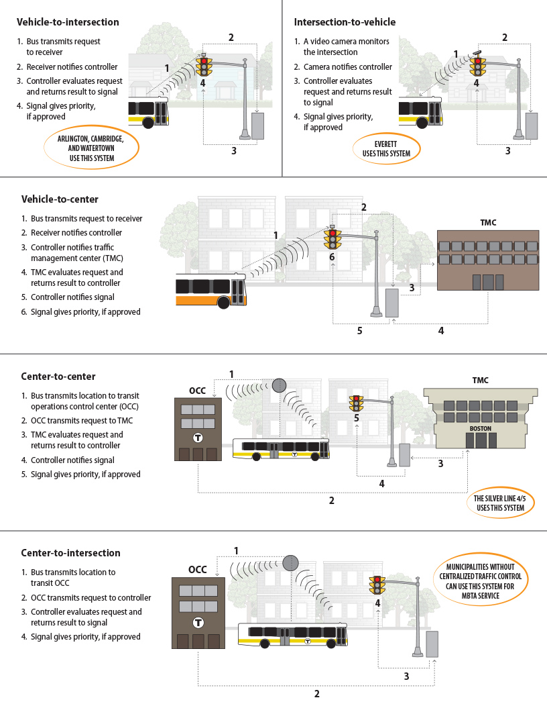
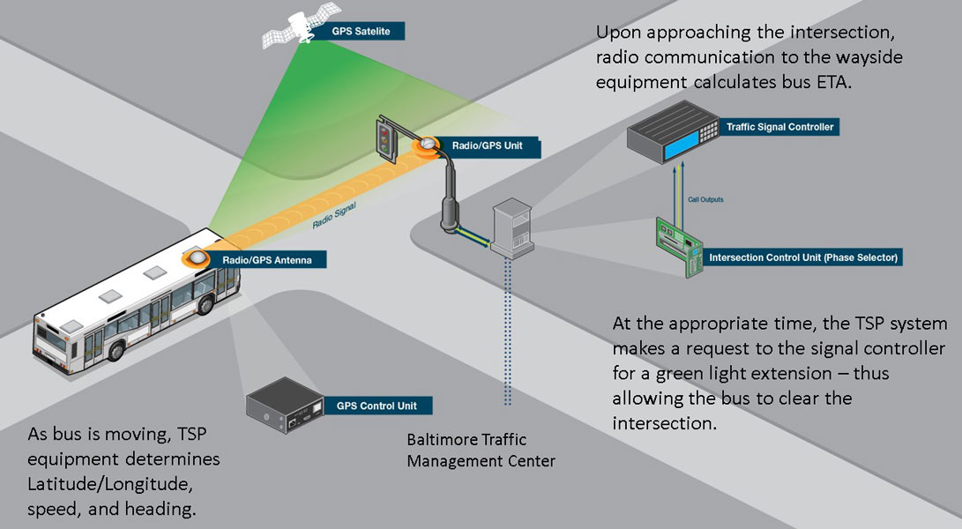
Public Transport Vehicle Detection Methods
Inductive loops: A traditional but still effective detection method. Possibility of using intelligent loops with transponders for better PT vehicle identification.
GPS and radio transmitters: Precise localization and communication with the control system.
Optical systems: Use of cameras or infrared sensors to detect PT vehicles.
Short-range communication (V2I): Direct communication between the vehicle and the infrastructure.
https://jp.pinterest.com/pin/transit-signal-priority-explainer--256001560046058537
https://www.ctps.org/data/calendar/htmls/2018/MPO_1220_Report_Transit_Signal_Priority_Guide

Slide 24
Effects of Implementing Priorities
Malmö: Increase in bus speed by 1.4 km/h, improvement in punctuality by 2–5%, increase in PT modal share from 10% to 25%, but also an increase in travel time for private vehicles by 2–14%.
The project to introduce priority in Malmö’s traffic signal control system was implemented at 42 signalized intersections as part of the Civitas Smile program. Priority is granted locally. Vehicles are located using an AVL system with GPS receivers installed in buses.
The effectiveness study of the priority system showed:
  an average increase in bus operating speed by 1.4 km/h during the afternoon peak and by 0.7 km/h during the rest of the day,
  an increase in travel time losses for other vehicles by 2–14% during the morning peak and 0–13% during the afternoon peak,
  an improvement in bus punctuality (within the range: no earlier than 30 s and no later than 3 minutes) by 2–5% on the studied line,
  an increase in public transport modal share from 10% to 25% of all trips.

Slide 25
Effects of Implementing Priorities
In the street network of Oslo, bus priority was implemented at 300 signalized intersections. Communication between the bus and the controller is carried out by radio at predefined locations, which are virtual reporting points. Three categories of priority were adopted depending on the delay time and the hierarchy of the line at a given intersection:
  Zero priority – vehicles running ahead of schedule or lines with a low hierarchy level are treated like private vehicles (no priority granted).
  Low priority – for delayed vehicles on lower-hierarchy lines and vehicles on schedule on higher-hierarchy lines, the green signal time is extended while other phases are shortened.
  High priority – for delayed vehicles on higher-hierarchy lines, the green signal is extended, and if there are more than three phases, the possibility of skipping phases is allowed, with pedestrian safety preserved.
With a 10% increase in traffic between 2003 (system launch) and 2007, it was possible to reduce public transport vehicle travel times by 5–7%.

Slide 26
Effects of Implementing Priorities
In the city of Genoa, priority was introduced at 113 intersections within the SIGMA traffic control system. Priority is granted conditionally depending on the delay relative to the timetable, the importance of the line, and the travel direction. Data from the AVL system is sent to the Traffic Management Center, where signal parameters at a given intersection are optimized to facilitate the passage of public transport vehicles. As buses approach the intersection, they submit a radio priority request, while the controller, using a decision algorithm, determines which predefined level of priority will be granted.
The implementation of the system contributed to a 7–10% reduction in public transport vehicle travel times.
London (TfL): Tram travel times were reduced by 8–12%. The TfL system is an example of a well-integrated solution that takes into account not only tram priorities but also other aspects of traffic management.

Slide 27
Examples of Traffic Control Systems with Priorities
UTOPIA: Decentralized system, Italy.
SIGMA: Centralized system with conditional priority, Genoa.
OPTICOM: The OPTICOM system in the USA applies priority for emergency vehicles (e.g., ambulances) using infrared, radio, or GPS.
The choice of an appropriate system depends on the specifics of the city, available infrastructure, budget, and objectives. Often, the best solution is a hybrid system that combines the advantages of centralized and decentralized systems.
Systems such as OPTICOM, SCOOT, or SITRAFFIC are often used not only for public transport but also for emergency vehicles, although they include dedicated modules for bus and tram priorities.
Implementations of these systems show that the effectiveness of priority measures depends on local traffic conditions and the detection technology used (e.g., GPS, inductive loops, infrared). Centralized systems (e.g., SIGMA, TRANSYT) and hybrid systems (e.g., SPOT-UTOPIA, SCOOT) are more popular in large cities where area-wide coordination is necessary.

Slide 28
Challenges and Limitations
Centralization: Communication delays, vulnerability to failures, high implementation and maintenance costs.
Decentralization: Difficulties in large-scale coordination, lack of optimization at the city-wide level.
Safety: Priorities for PT may negatively affect pedestrian safety if not properly designed. Skipping pedestrian phases can increase accident risk. Careful analysis and simulation are essential.
Private traffic: Granting PT priorities may increase travel times for private vehicles, which can lead to frustration and reduced public acceptance. In Malmö, travel time losses for private vehicles increased by 2–14%.
Costs: Implementation and maintenance of priority systems can be expensive.
Need for integration with ITS (Intelligent Transportation Systems) to ensure better efficiency.

