Slide 1


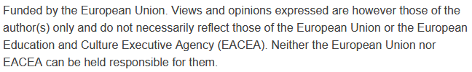

Smart Transportation Systems and Analytics:
Intelligent Transportation System: Components and Applications
Sustainability and Quality Assurance for Academic Governance and Redesign Engineering Studies
Jacek Oskarbski

Slide 2
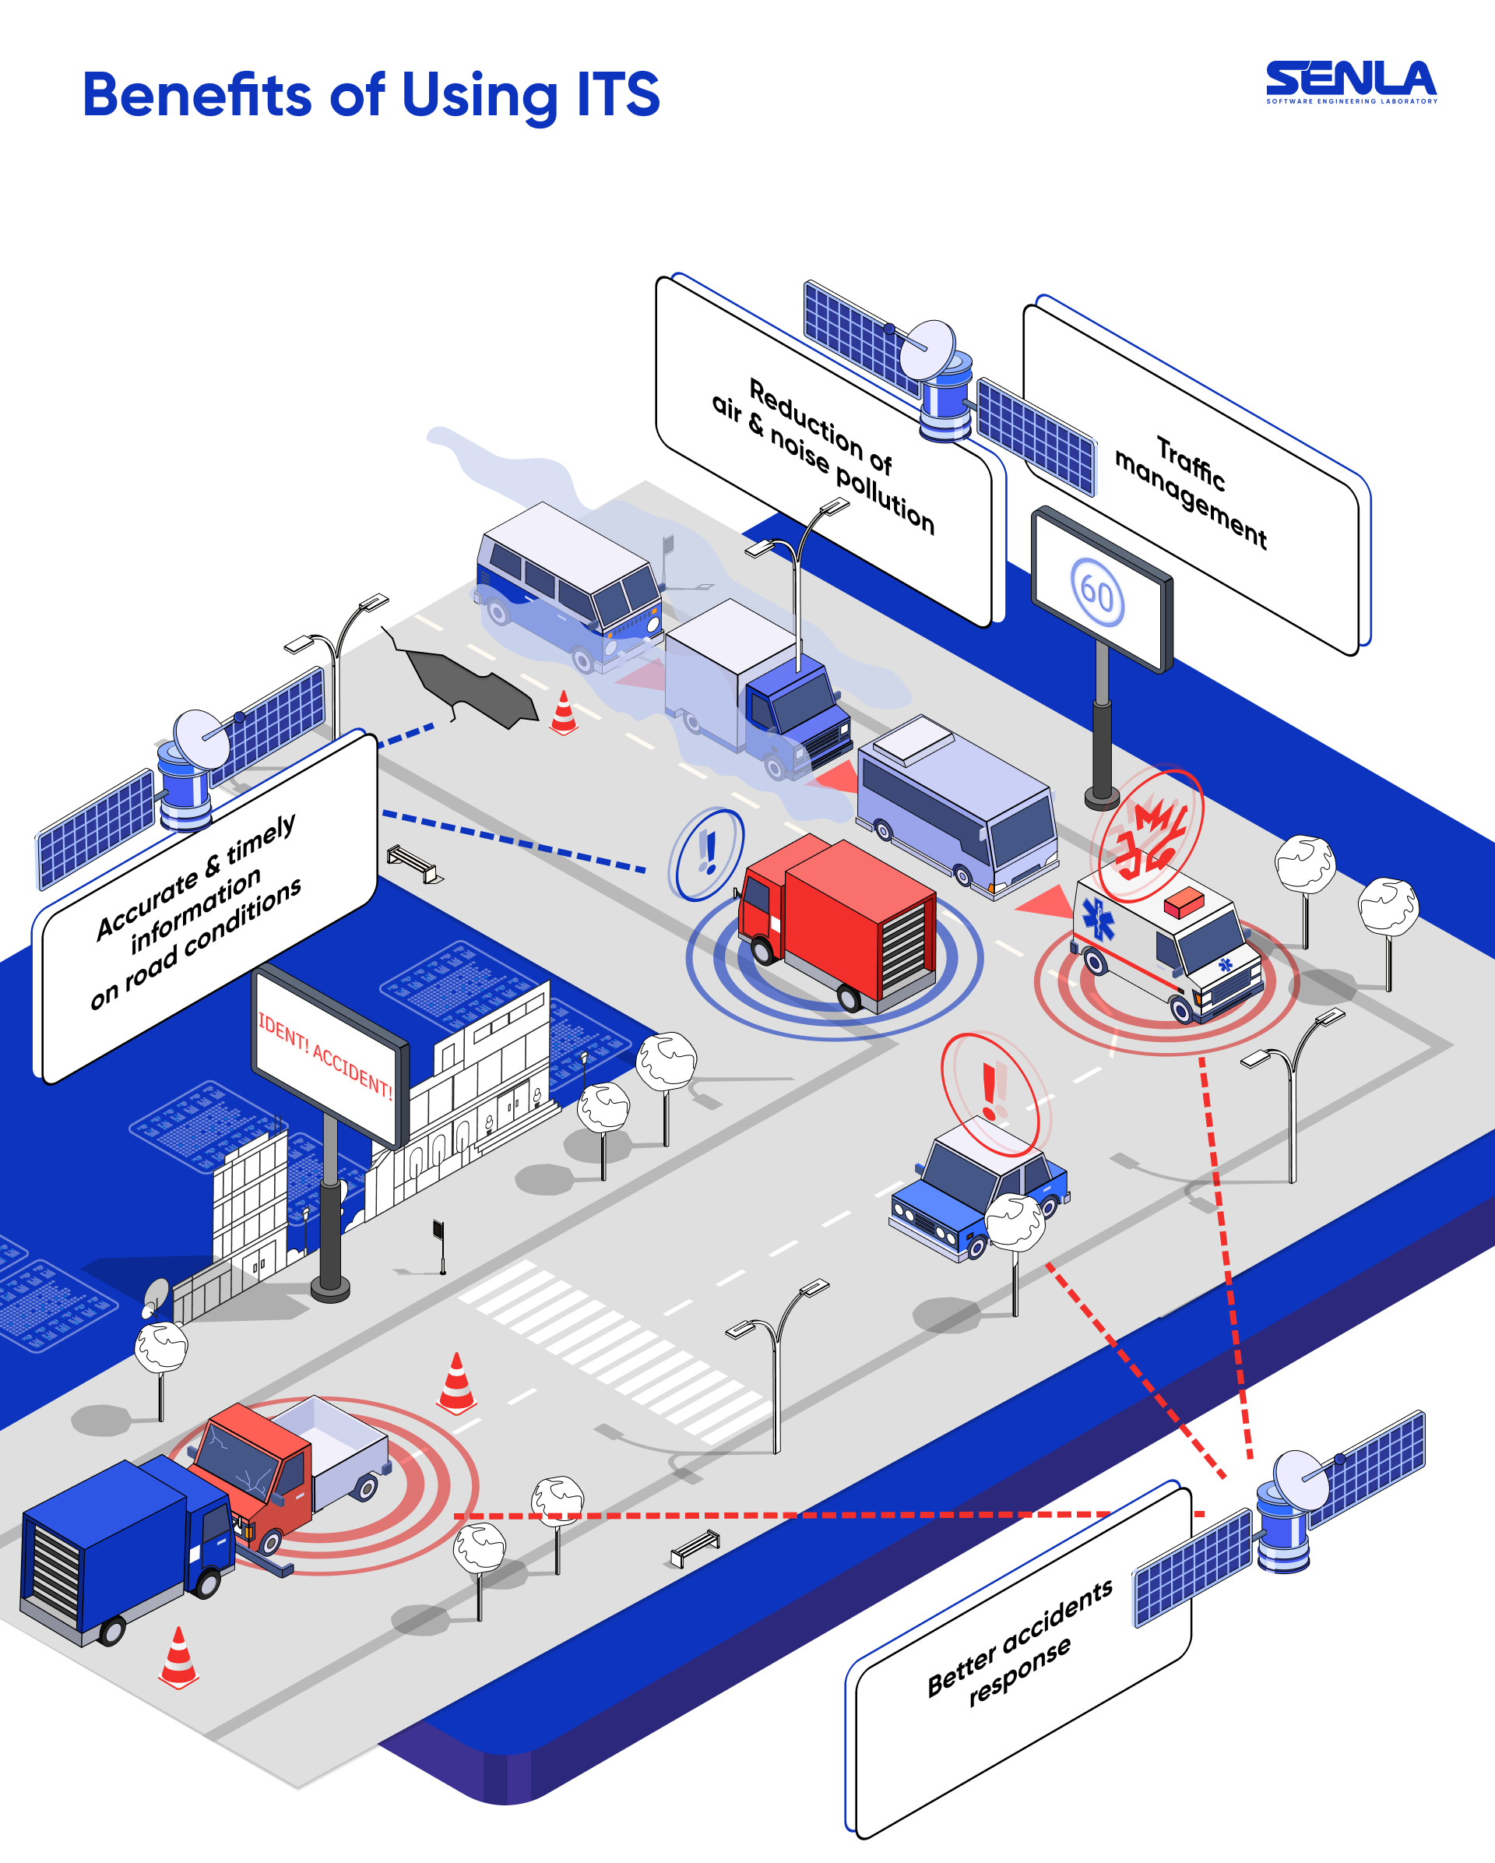
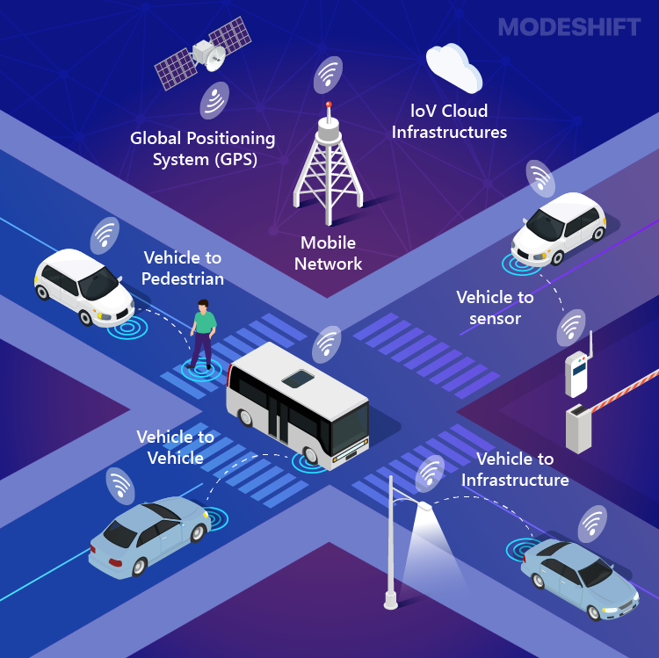
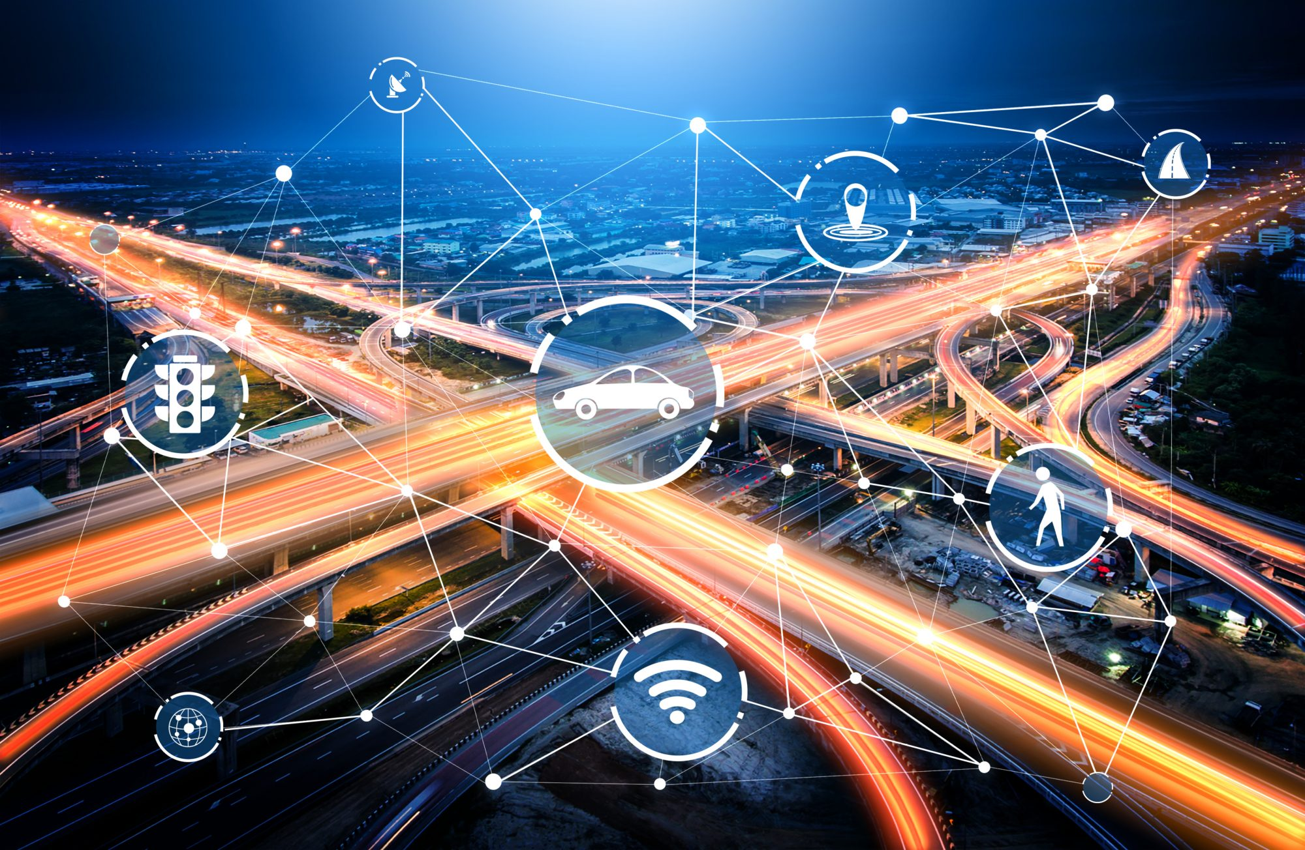
Intelligent Transportation System (ITS)
Intelligent Transportation System (ITS) – tools help to manage transport infrastructure and travellers service effectively.
  Intelligent infrastructure – transportation infrastructure equiped with telematics devices
  Intelligent vehicles – vehicles equiped with telematics devices
https://intelligent0system.blogspot.com/2023/01/intelligent-transportation-system-its.
https://www.modeshift.com/what-is-an-intelligent-transport-system-and-how-does-it-work
https://senlainc.com/blog/intelligent-transportation-system-importance/

Slide 3
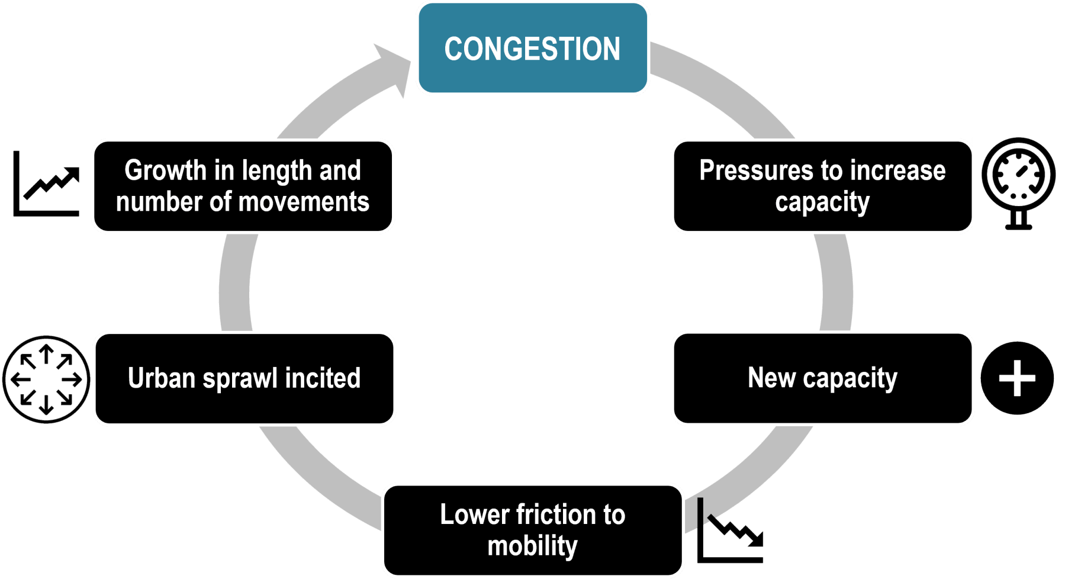
Transport system – problems
Why ITS, mobility management, autonomous vehicles?
Increase in mobility and congestion
Passenger and freight transport varying over time (variable demand)
Limited network capacity, frequent capacity reductions (variable supply)
Safety issues, time and money losses, and negative impacts on the environment, social threats
https://transportgeography.org/contents/chapter8/urban-transport-challenges/vicious-circle-congestion/

Slide 4
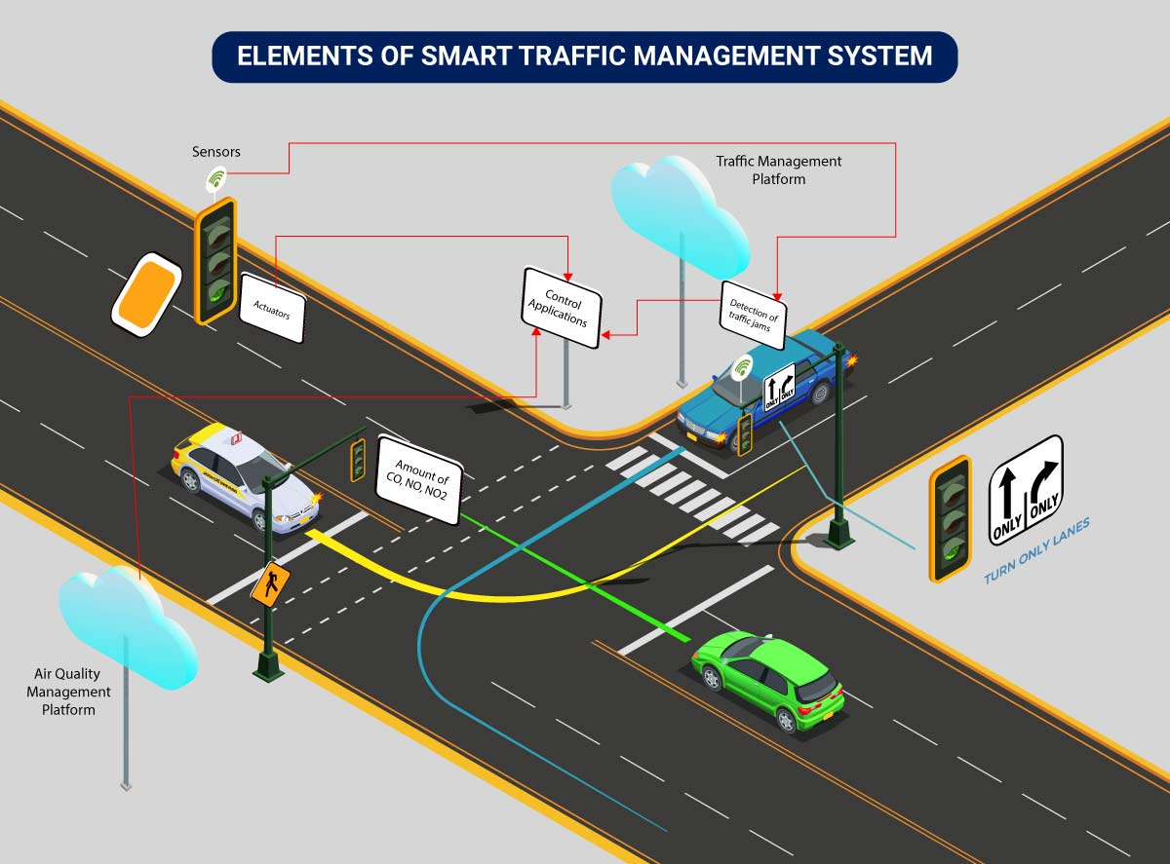
Examples of Low-Cost ITS Solutions
Traffic signal control (urban traffic control)
Dynamic speed limits
Lane-use control
Public transport priority
Variable Message Signs (VMS)
https://www.rishabhsoft.com/blog/smart-traffic-control-using-iot

Slide 5
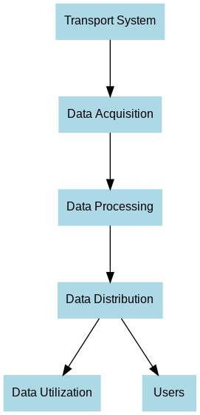
How an Intelligent Transportation System (ITS) operates
👉 This cycle illustrates how an Intelligent Transportation System (ITS) operates: from data collection, through analysis, to providing information for improved efficiency and safety of transport.
Transport System – the source of data (vehicles, infrastructure, traffic signals, passengers).
Data Acquisition – collecting data from sensors, cameras, traffic detectors, GPS, etc.
Data Processing – analysing and processing data in traffic management centres.
Data Distribution – delivering processed information to various recipients (e.g., VMS boards, mobile apps, control systems).
Data Utilization – practical use of data for traffic management, route planning, and transport optimization.
Users – final recipients of the information: drivers, passengers, transport operators, and authorities.

Slide 6
Traffic management on motorways and expressways
SYSTEMS | SUBSYSTEMS
Traffic control system at interchanges | • Vehicle traffic control system on main road entrances • Priority system for emergency vehicles • Vehicle and pedestrian traffic control system at intersections
Traffic control system on inter-node sections | • Traffic surveillance (CCTV cameras) • Traffic safety management system • Speed control system • Lane control • System for directing to alternative routes
Traffic information system | • Weather condition information system • Traffic condition information system • Information system about P+R (Park and Ride) strategic parking services

Slide 7
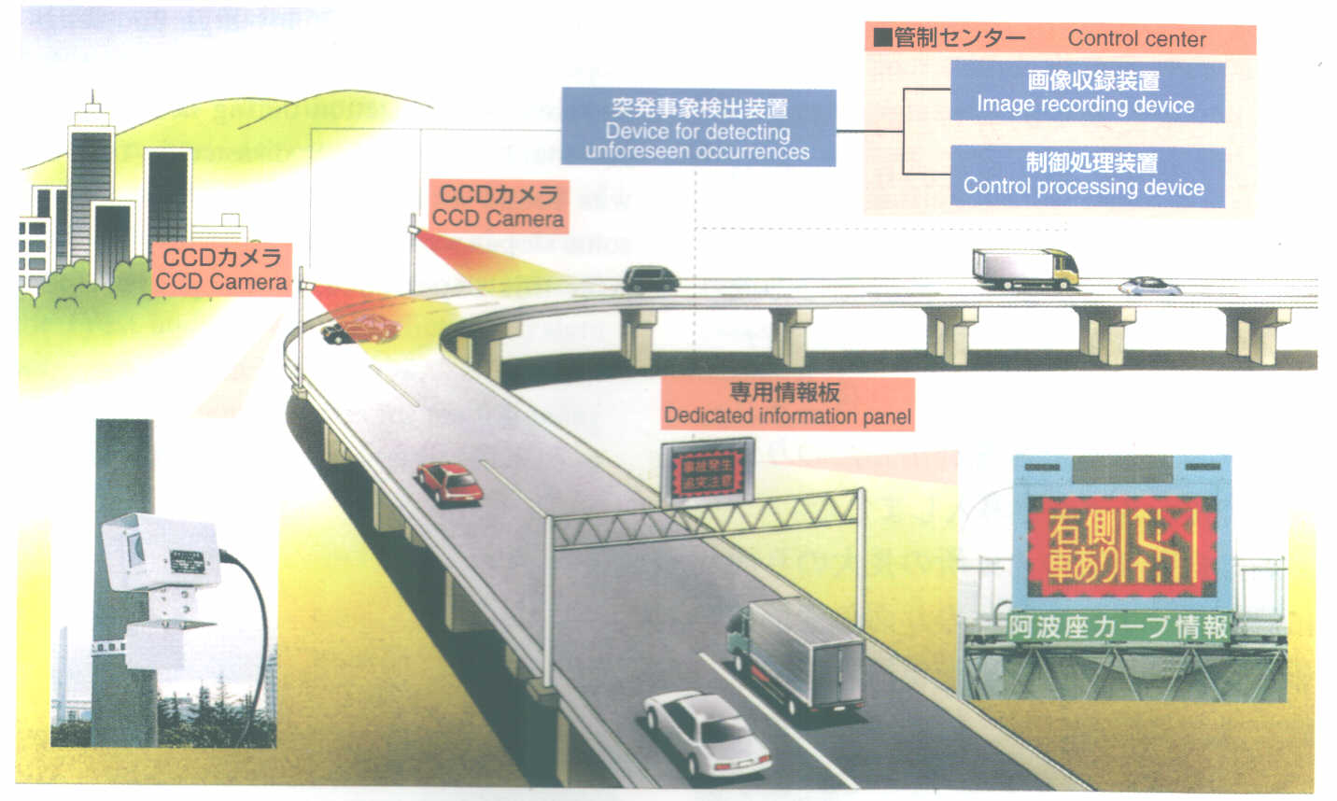
Example Accident Detection System

Slide 8
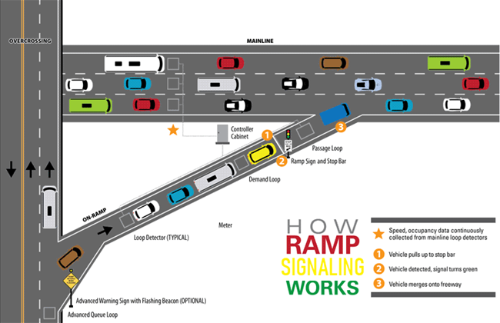
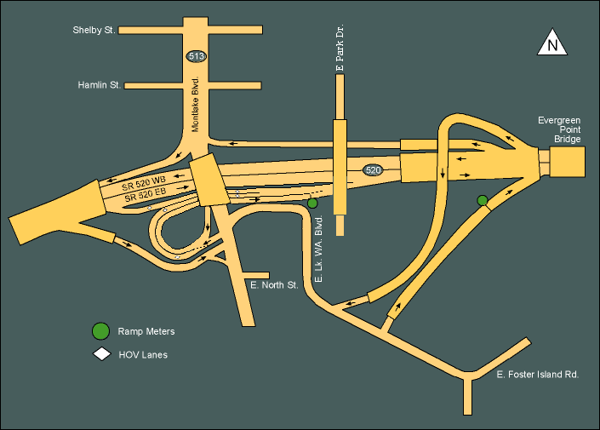
Ramp Metering
GOAL: closing the entrance ramps to these carriageways so that traffic on the main carriageway operates within the optimal range of speed and density (maintaining safe distances between vehicles, which reduces the number of rear-end collisions).
EFFECT: ramp metering enables a reduction of accidents by more than 20%.
https://www.youtube.com/watch?v=SYbceSqk_Mk
https://www.fdot.gov/traffic/Ramp-Signaling

Slide 9
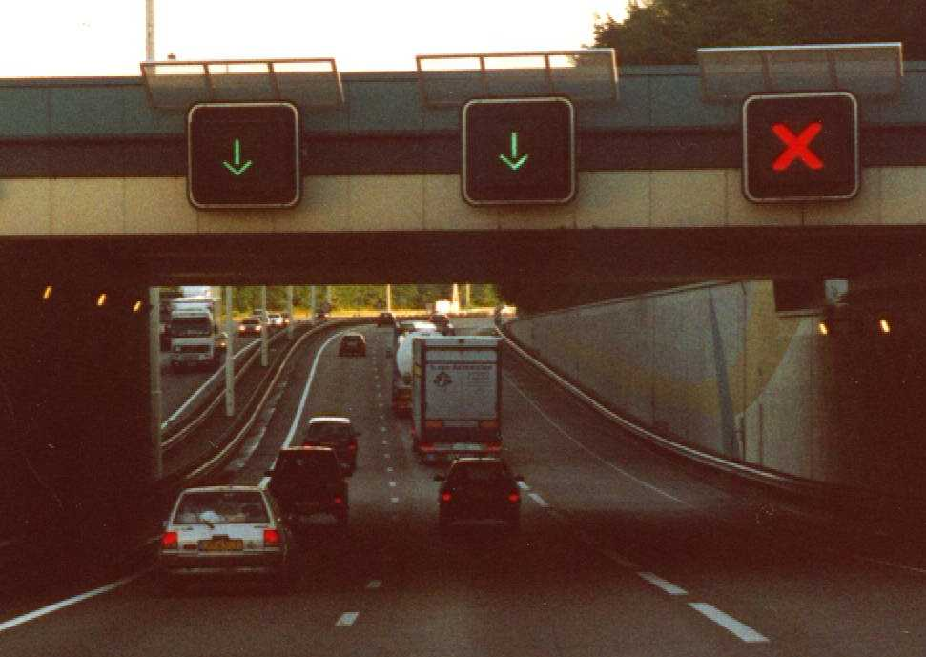
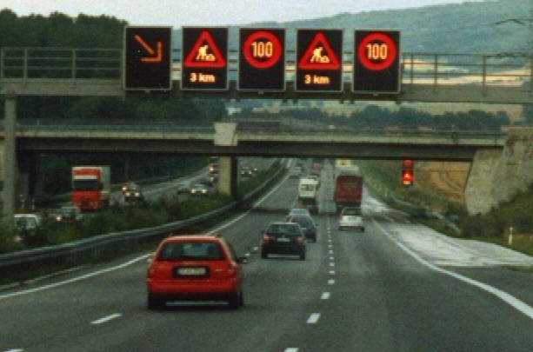
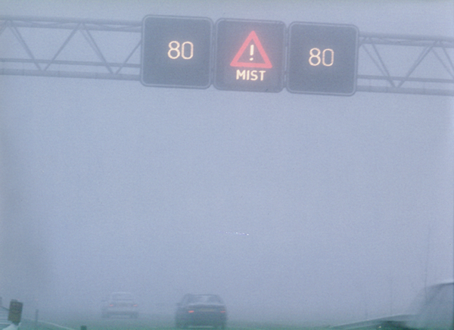
Traffic management on motorway sections between interchanges
Accidents and incidents
Roadworks
Lane management

Slide 10
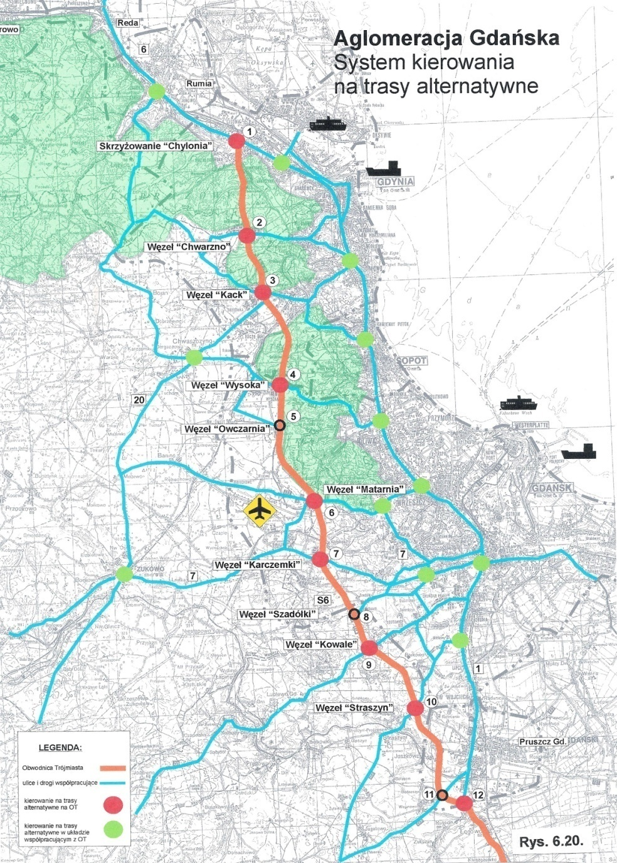
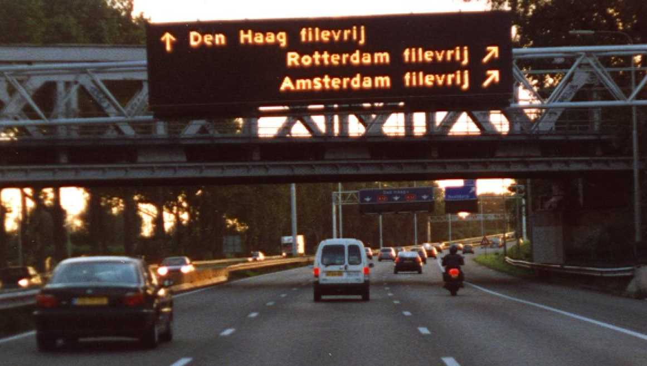
Diversion route management system
The objective of the system is to ensure balanced and full utilization of the entire infrastructure of the area under various traffic conditions (peak hours, weekend departures, emergency situations) – with the necessity of integration with the urban traffic management system.

Slide 11
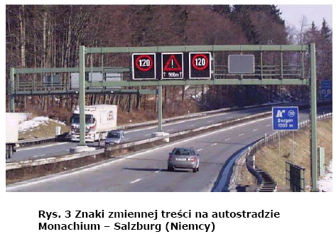
Speed Control
Homogenization of traffic flowInfluence on the density–flow relationship: traffic flow is maintained at higher densitiesImproved safety under adverse weather conditions or when approaching an incident

Slide 12
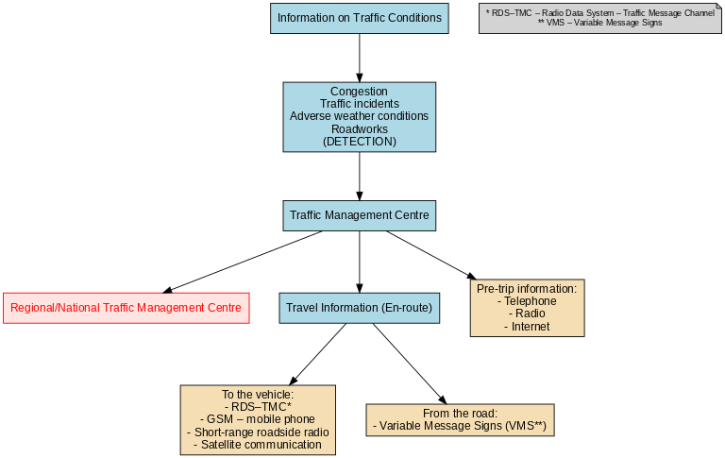
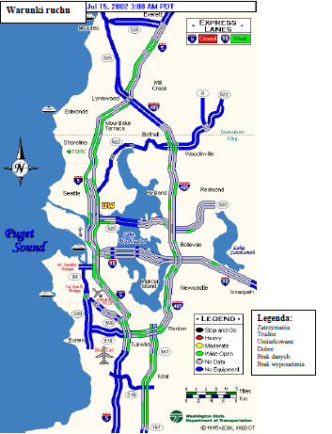
Information System for Drivers

Slide 13
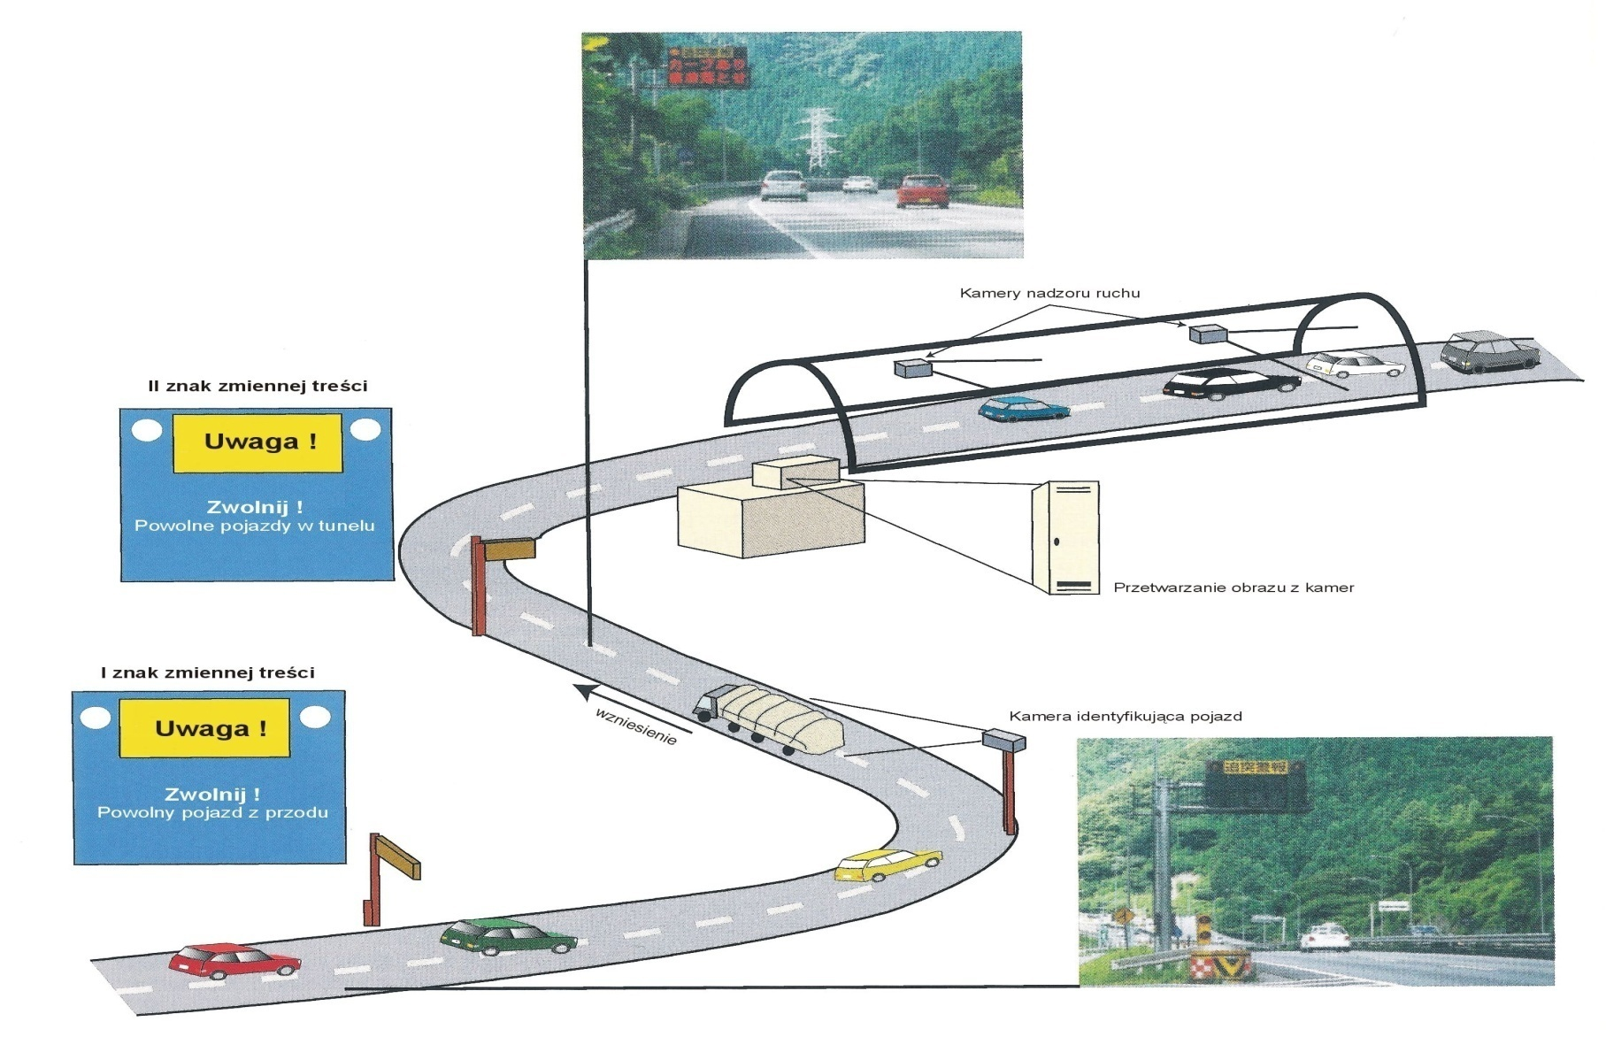
Freight Traffic Control Systems - example

Slide 14
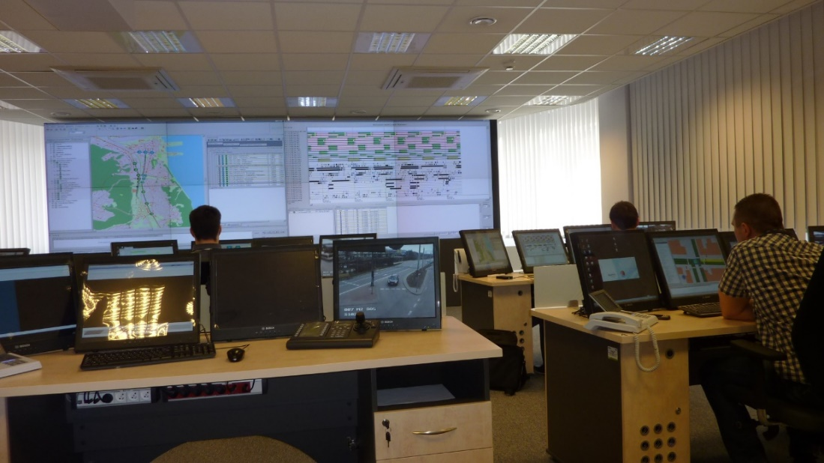
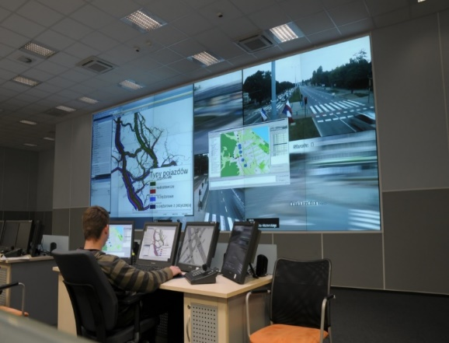
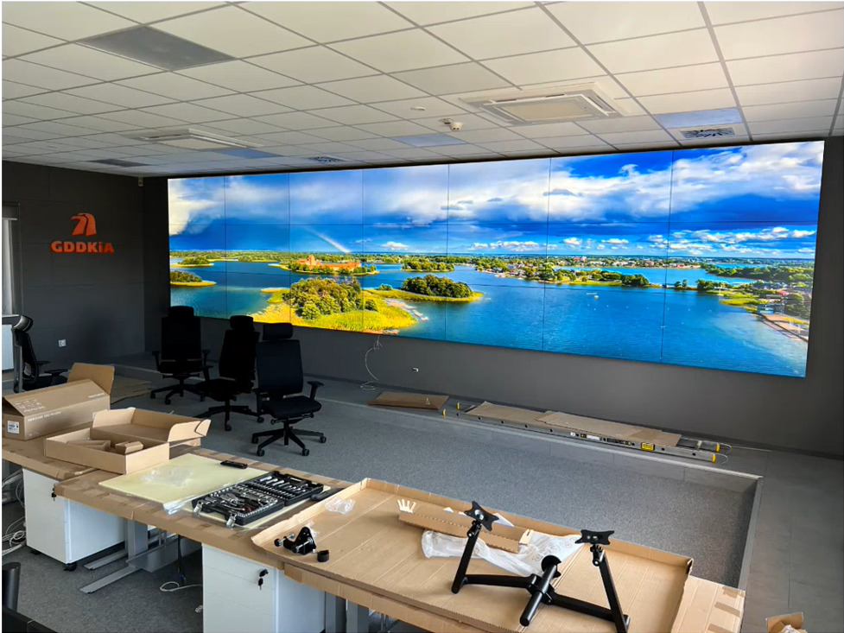
Traffic Management Center
GDYNIA
GDAŃSK
DWOREK

Slide 15
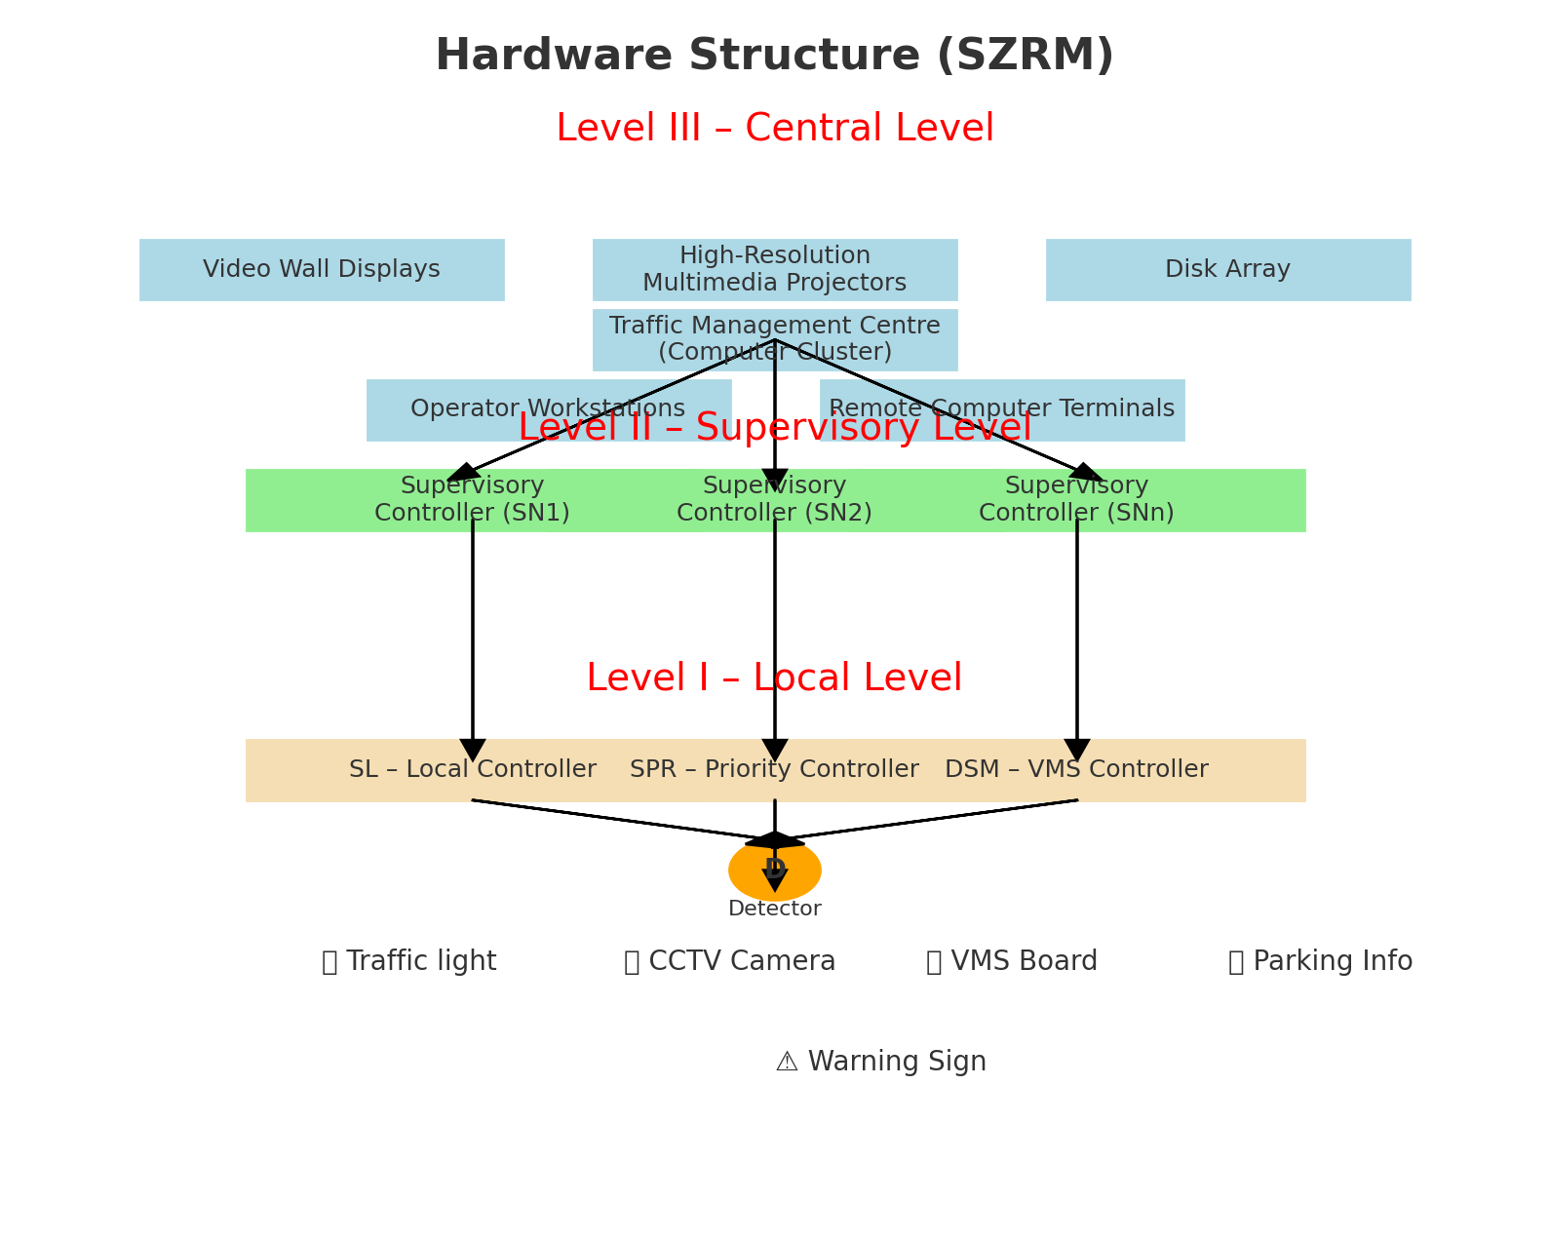
Hardware structure of Traffic Management System

Slide 16
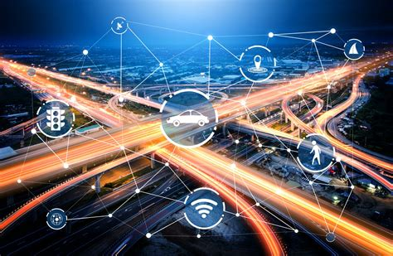
ITS Services – Interurban Systems (Traffic Efficiency)
Ramp metering – reduction of travel time losses by 36%, traffic volume increase by 6–20% (but in other studies a decrease in traffic volume by 9–14%).
Variable speed limits – speed reduction achieved for 76% of drivers, traffic volume increase by 3–5%.
Road surface condition information – reduction of accidents by 39% (under conditions of information being provided).
Incident management – reduction of incident duration (from emergency response to restoration of normal traffic conditions) by 29–300%.
Electronic toll collection – reduction of travel time losses by 50–55%, average speed increase by 57%.Intelligent vehicles – reduction of travel time losses by 8%.
Traveller information systems – increase of average speed by 81% (modelling studies).

Slide 17
Centralized Priority – Advantages
Possibility of dispatcher/operator intervention in real time: In a centralized system, the dispatcher or operator can monitor the situation in real time and manually intervene in granting priorities, allowing flexible responses to unusual situations, e.g., significant delays of PT vehicles.
Automatic route planning for emergency and special vehicles: The centralized system can automatically plan routes for emergency vehicles (e.g., ambulances) or special vehicles (e.g., buses on key lines), granting them priority along the entire route, which increases travel efficiency.
Ability to prioritize multiple priority requests: In the case of many PT vehicles, the centralized system makes it possible to establish a hierarchy of priorities, e.g., giving precedence to more delayed vehicles or to routes of greater importance, optimizing traffic across the entire area.
Adaptability – automatic adjustment of priority to current traffic conditions: The centralized system can dynamically adjust priorities based on current traffic data (e.g., volumes, delays), enabling more effective traffic management in real time.
Possibility of advance priority implementation at subsequent intersections: Thanks to centralized management, the system can prepare priorities in advance at consecutive intersections along the PT vehicle route, ensuring smoother travel and minimizing delays.

Slide 18
Rural/Interurban Systems (Traffic Safety)
Ramp metering – reduction of accidents by 24–50%.
Variable speed limits – speed reduction achieved for 76% of drivers, reduction of hazardous events by 10–30%, reduction of accident severity by 30%.
Road surface condition information – reduction of accidents by 39% (under conditions of information being provided).
Incident management – reduction of incident duration by 29–300%, reduction of secondary incidents (bundle of services).
Electronic toll collection – reduction of hazardous events by 22–26%.
Intelligent vehicles – reduction of accident involvement risk by 41%; automatic incident detection increases survival probability by 15%.
Traveller information systems – reduction of fatalities by 3% (modelling studies).Automatic speed enforcement – reduction of accidents by 9–60%.

Slide 19
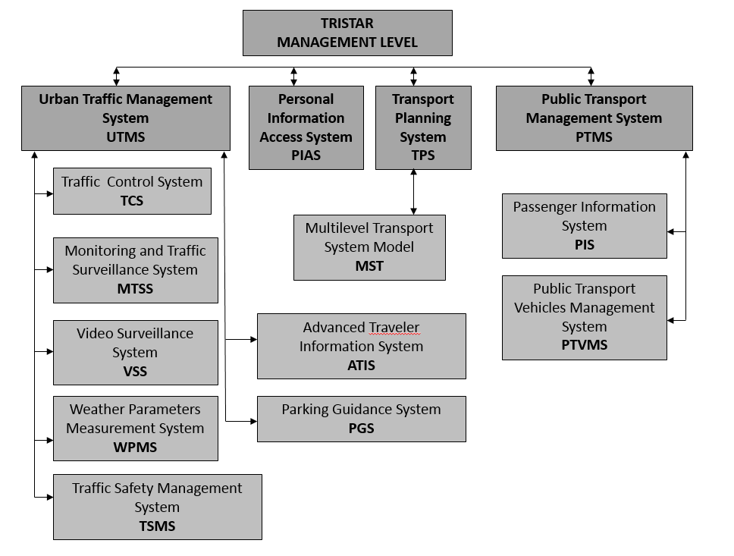
Urban ITS – example: TRISTAR system Architecture

Slide 20
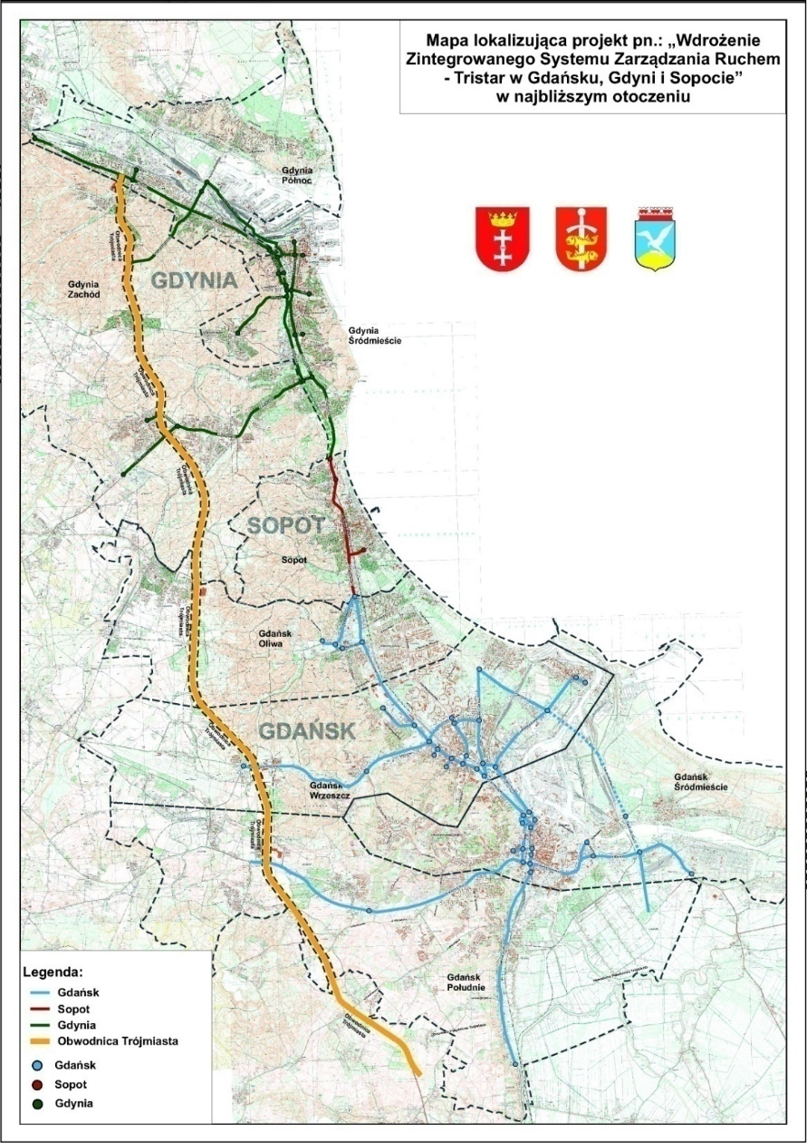
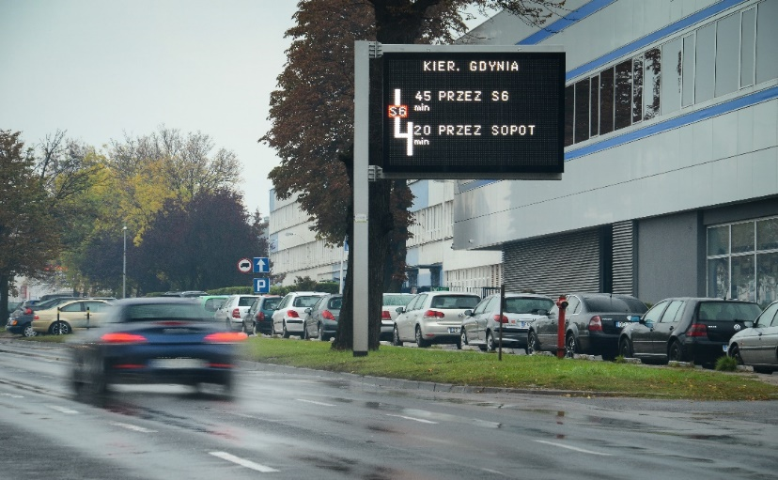
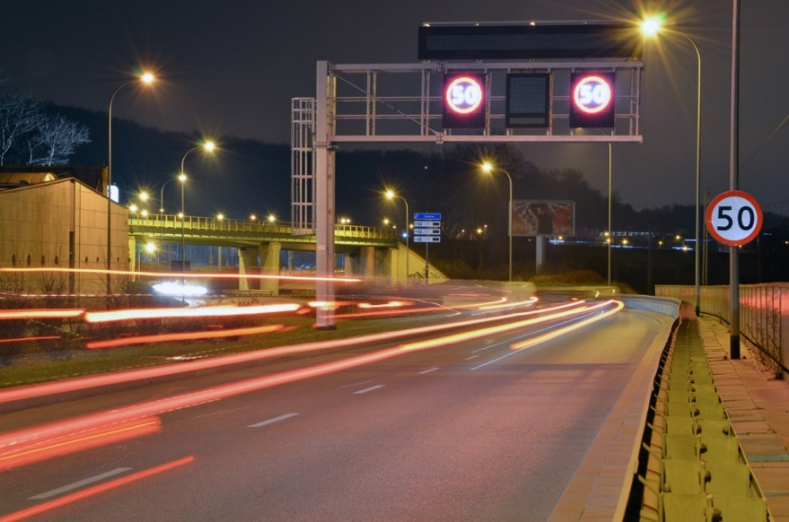
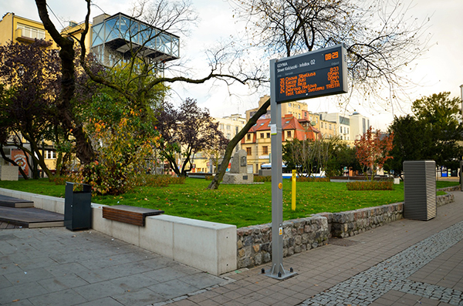
TRISTAR SYSTEM IN TRI-CITY (Gdańsk-Sopot-Gdynia)
2 Traffic Management Centres
148 km of fiber optic connections
161 intersections with traffic signals (BALANCE/EPICS system)
73 video surveillance cameras
61 points with ANPR cameras
36 guidance parking information signs
34 PT passenger Information boards
22 Bluetooth/WiFi scanners
19 Variable Message Boards
16 Tripplanners
14 Weather stations
7 Variable Message Signs

Slide 21
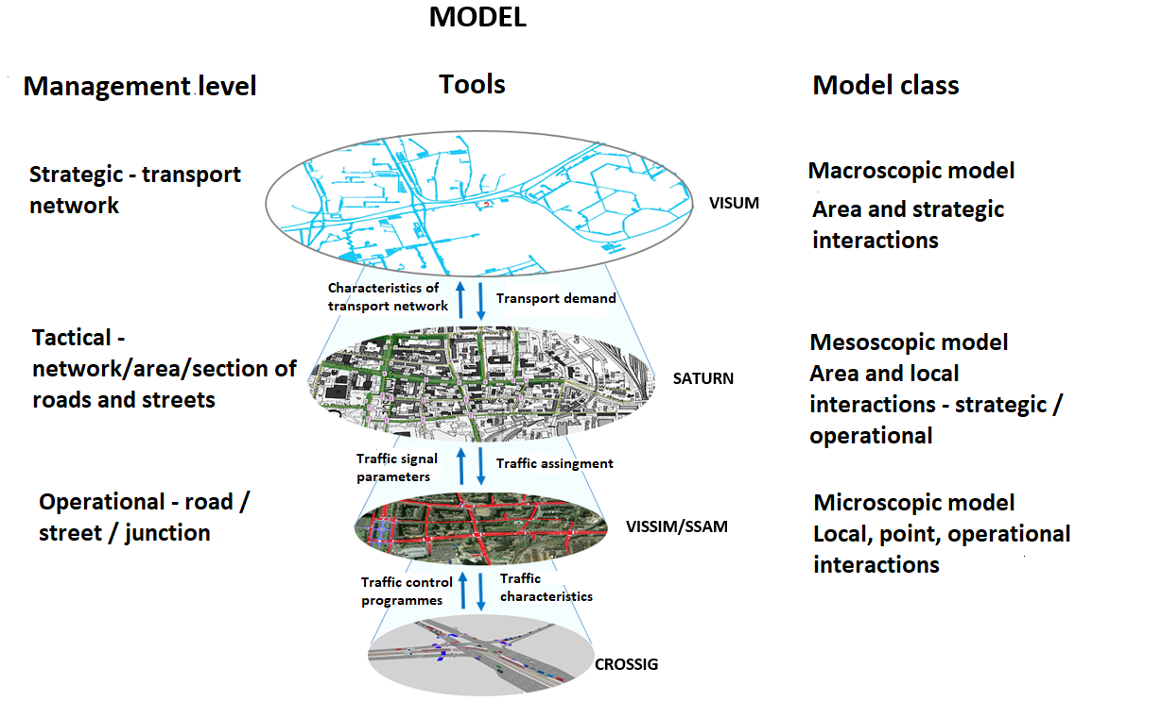
Multi-level Model of Transportation Systems supports ITS Management

Slide 22
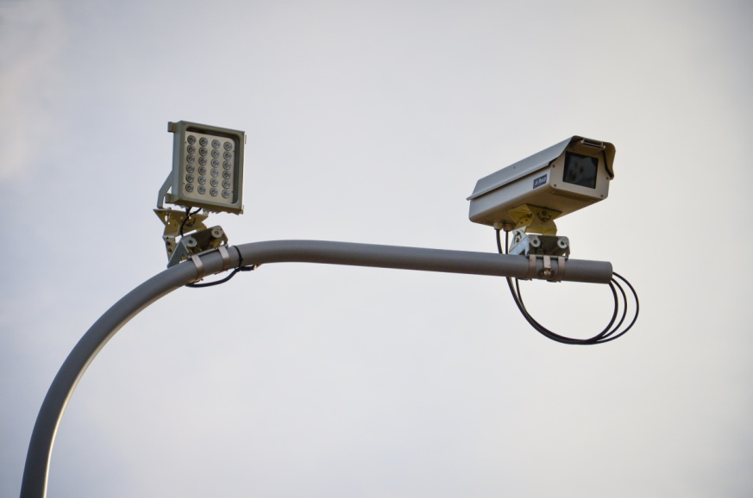
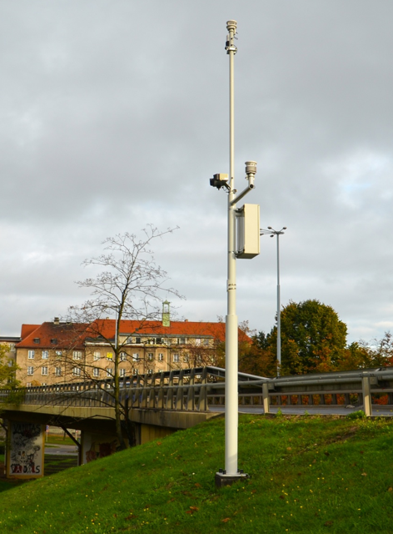
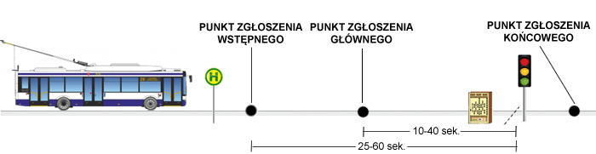
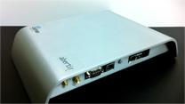
Monitoring and Traffic Surveillance System
Road Traffic Data Collection
Example detection modules in the TRISTAR system:
Traffic measurement stations – 161 intersections – inductive loops
Inductive loops and video detection – Traffic Control System
Bluetooth/Wi-Fi scanners and ANPR cameras – Incident Detection Module (Traffic Safety Management System) and Driver Information System
Public transport vehicles (on-board computers) – Public Transport Vehicle Management System
Meteorological parameters – Weather stations

Slide 23
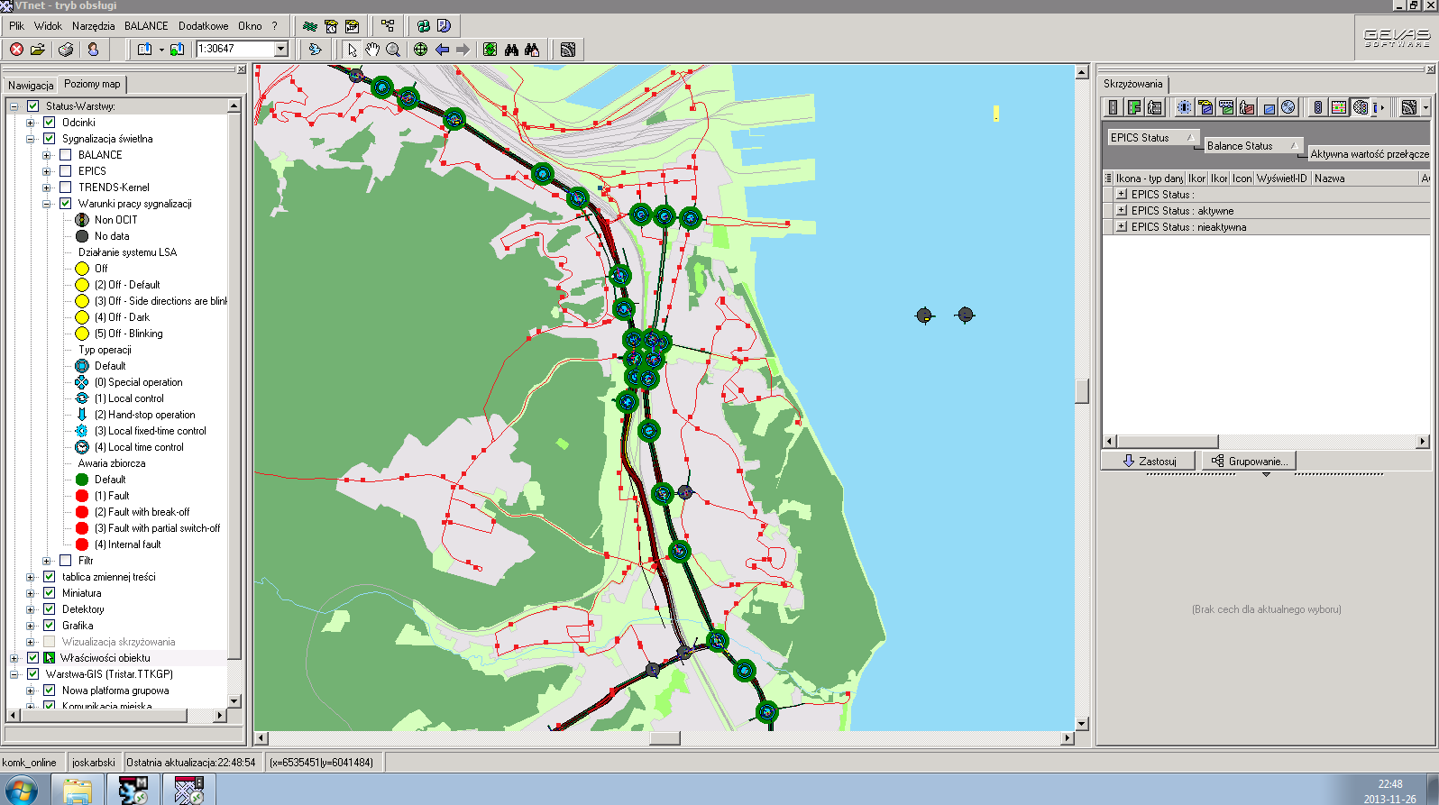
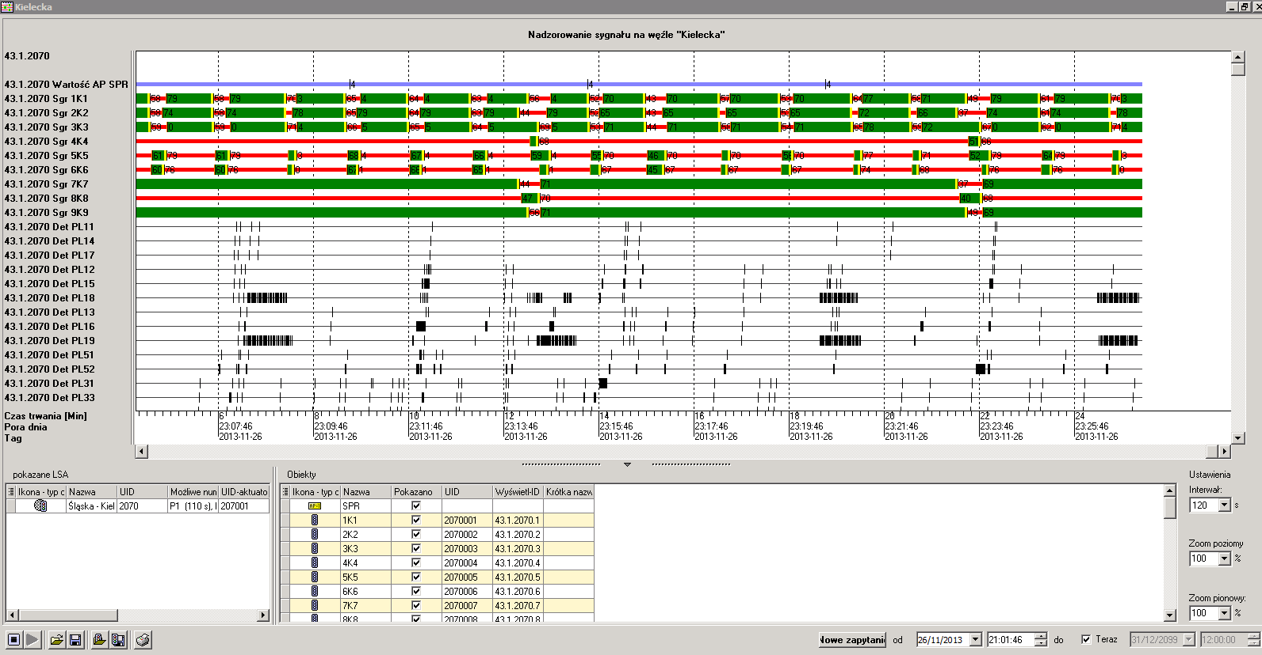
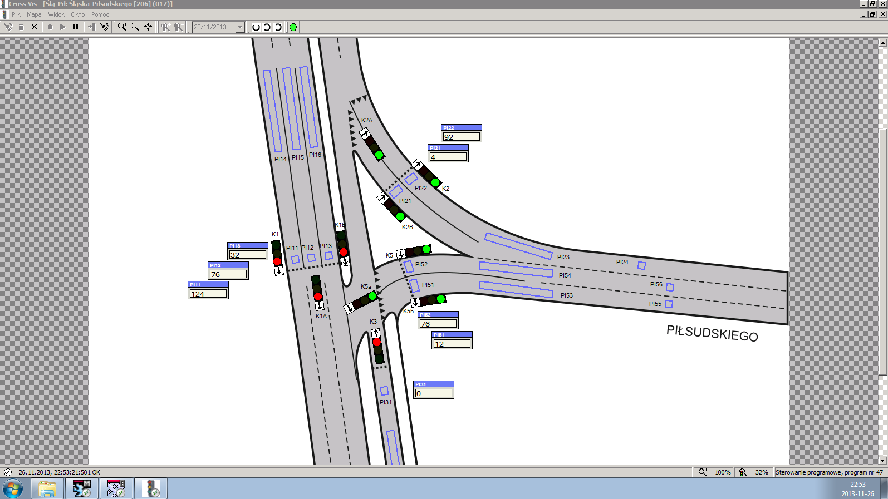
Traffic Control System
Over 160 intersections covered by the system
Replacement of outdated traffic signal equipment (LED upgrade)
BALANCE-EPICS Traffic Control System (GEVAS) – local control with public transport priority and area-wide control.
EPICS – microscopic optimization (1-minute forecasts – possibility to extend a phase during the current cycle).
BALANCE – macroscopic optimization (objective function) – short-term forecasts of 5–15 minutes.

Slide 24
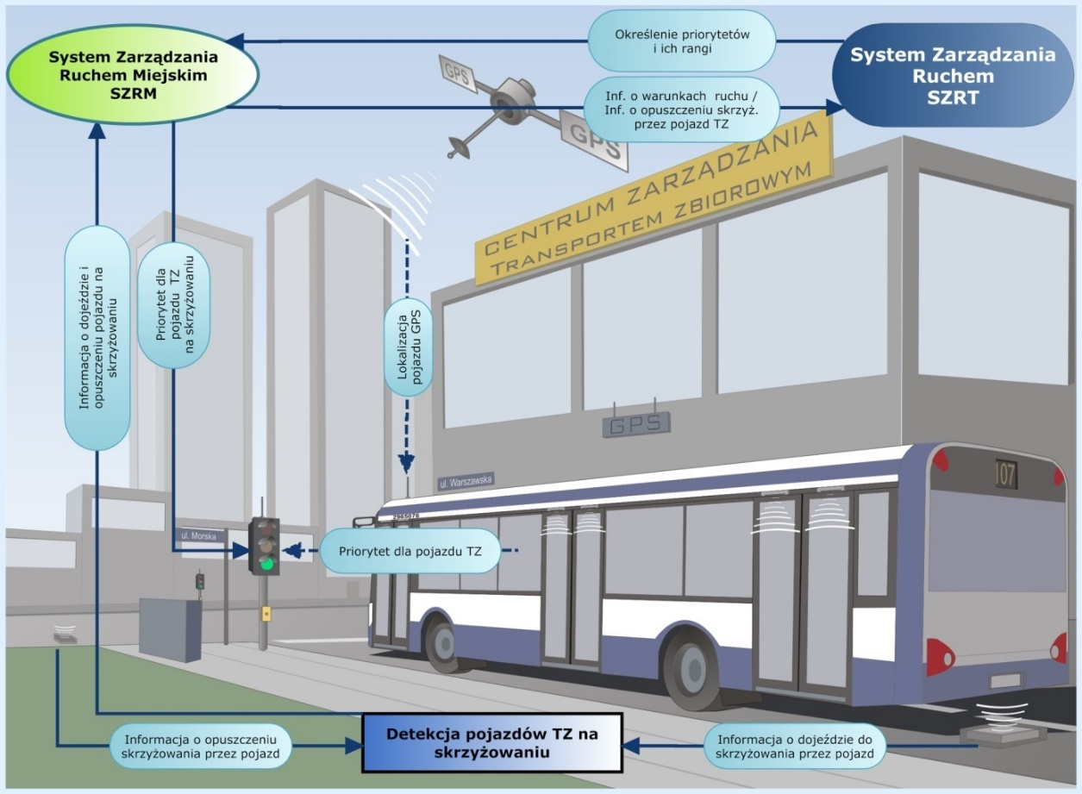
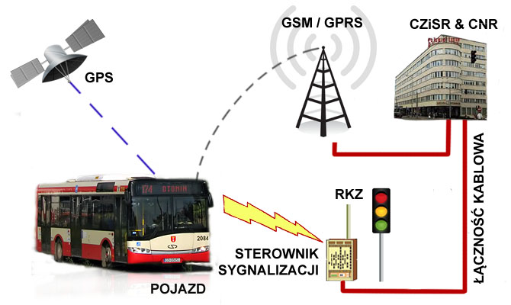
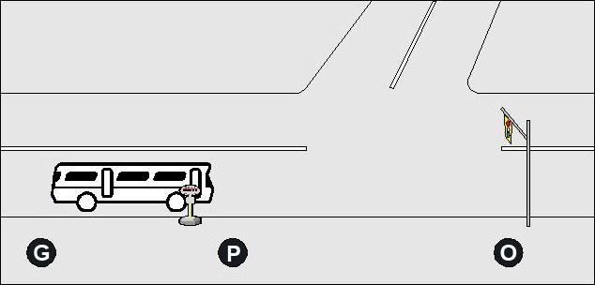
Public Transport Signal Priority (TSP)
Relative Priority:
Public transport vehicles delayed in relation to the timetable
Absolute Priority:
Ambulances, fire brigades, police (in the future)

Slide 25
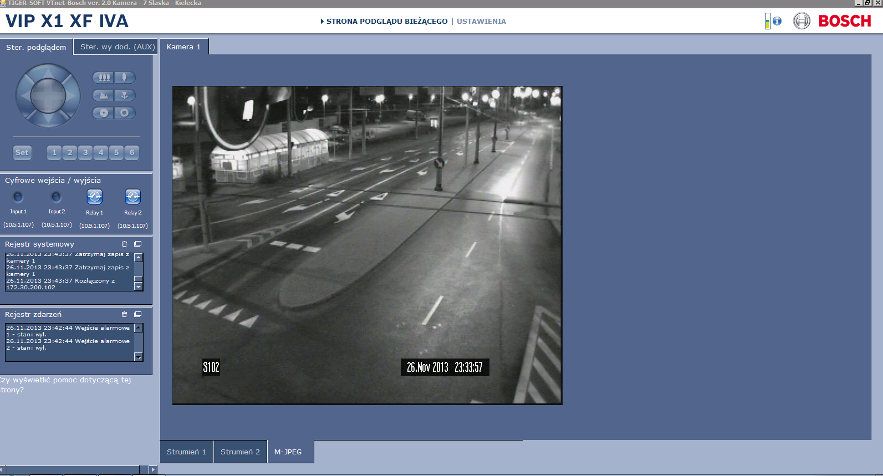
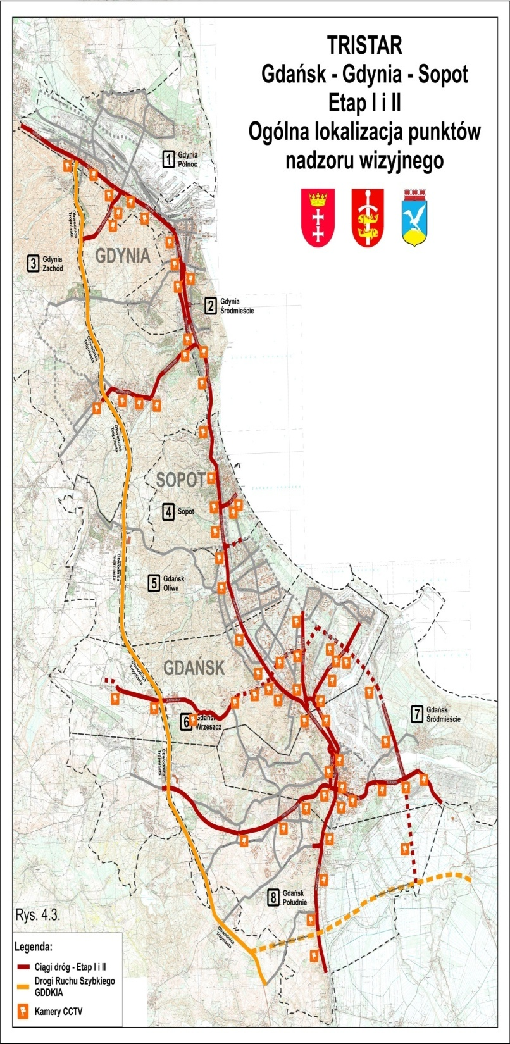
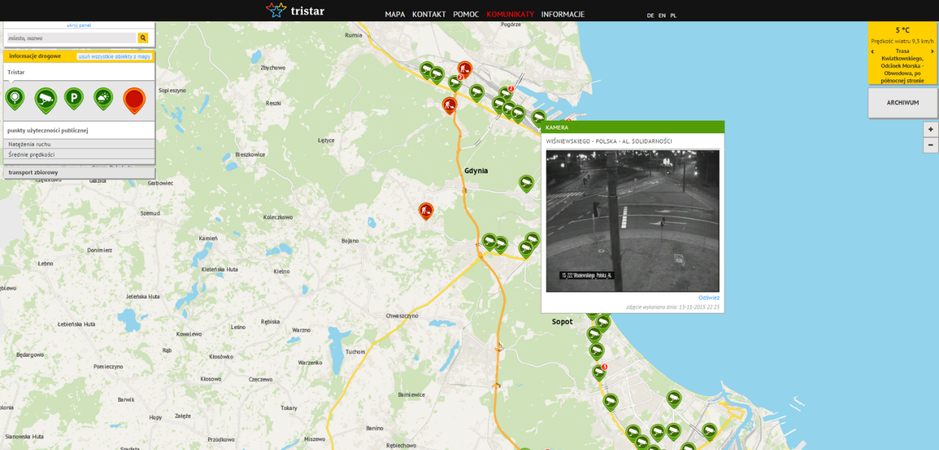
Video Surveillance System

Slide 26
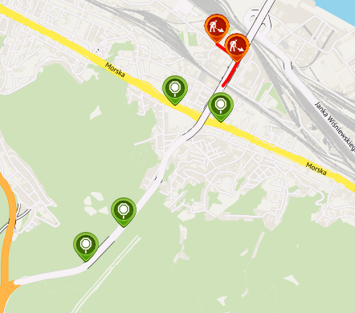
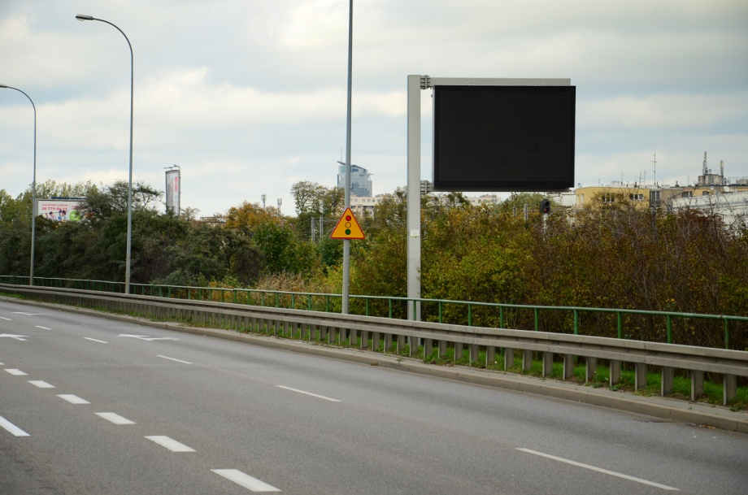
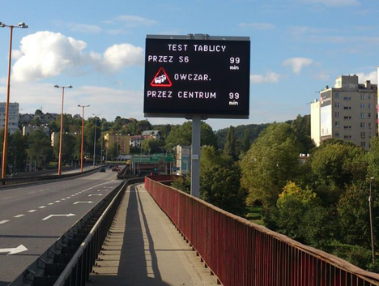
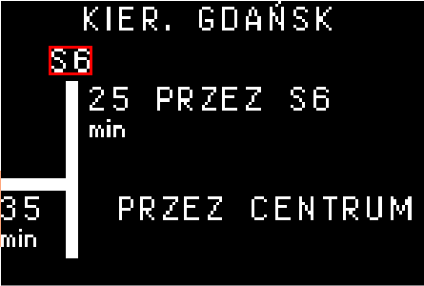
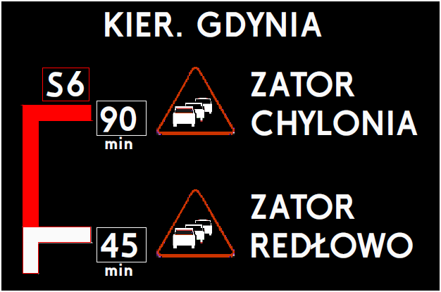
Advanced Traveller Information System

Slide 27

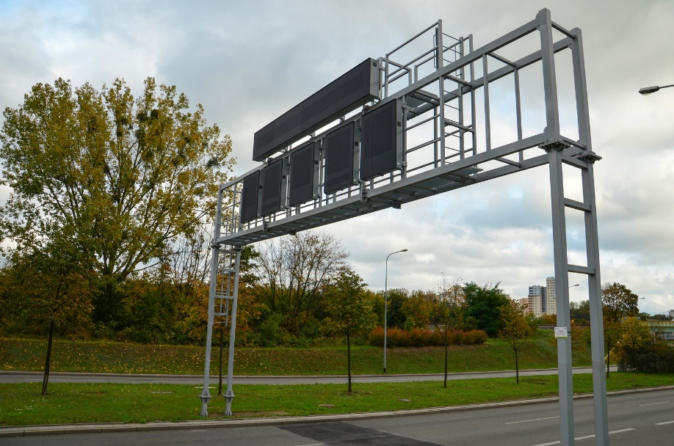
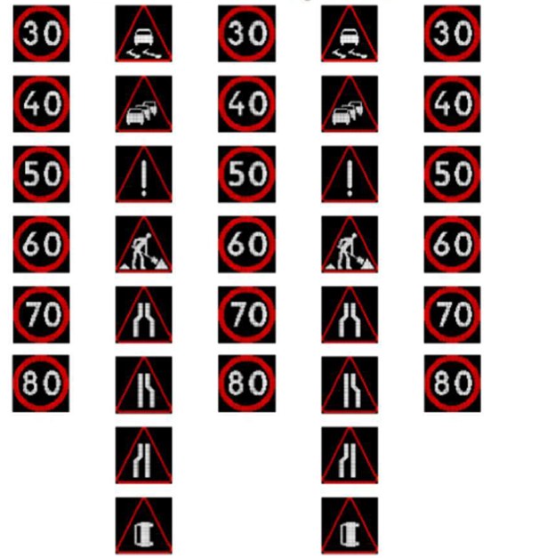

Advanced Traveller Information System

Slide 28


Advanced Traveller Information System
Alternative routes
Traffic diversion in case of an incident
Traffic dispersion in case of congestion

Slide 29


Advanced Traveller Information System
Example of accident detection – incident detection module – pilot
Real-time data – historical data
Kwiatkowski Route – Gdynia
Algorithm based on Kalman filter

Slide 30





Incident Detection at Intersections
Multidimensional Cycles – PCA-based Analysis

Slide 31



Traffic Violation Enforcement System
ANPR Cameras
“Black list”, “white list”
Travel time information (short-term forecasts in the future)
Violation registration (in the future)

Slide 32




Parking Guidance System
ANPR Cameras
“Black list”, “white list”
Travel time information (short-term forecasts in the future)
Violation registration (in the future)

Slide 33

Passenger Information System
Online information
Online trip planning (web, trip planners)
745 public transport vehicles equipped with on-board computers with GPS, GPRS, and short-range radio.
Passenger information displays (73 units)
Website
Passenger information terminals (22 units at integration hubs and other facilities)

Slide 34


PT vehicles Management System
Dispatch traffic management
Schedule control
Detour planning
Online visualization on the metropolitan map
Communication with drivers
Source: QUMAK, GMV

Slide 35





Open Data
Open Data
NAP
Waze
Google Maps
Commercial Apps
SMART CITY
MaaS
TMaaS

Slide 36
Benefits Of System Implementation
Possibility of real-time traffic management
Reduction of travel time for both private vehicles and public transport – decrease in travel time along individual corridors by several to more than ten percent
Improved traffic flow, reduction in the number of stops, reduction in exhaust emissions (thanks to the Traffic Control System and the Driver Information System)
Reduction in the number of road incidents and faster clearance of congestion after an incident (thanks to warning systems, red-light enforcement, speed control, and the Driver Information System)
Enhancement of the passenger information system for public transport users (real-time trip planning)Increased reliability of passenger waiting times
Lower costs and shorter time required for reprogramming traffic signals

Slide 37
Benefits Of System Implementation
Increased punctuality and reliability of public transport, improved attractiveness – higher competitiveness of public transport (greater number of passengers)
Increased scheduled speed (data for timetable planning) – more efficient use of rolling stock – reduced costs
Real-time monitoring of equipment operation and condition

