Slide 1


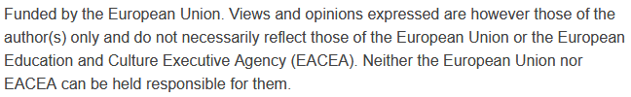

Urban Mobility and Smart City Infrastructure:
Fundamentals of Smart City Transportation Planning
Sustainability and Quality Assurance for Academic Governance and Redesign Engineering Studies
Jacek Oskarbski

Slide 2
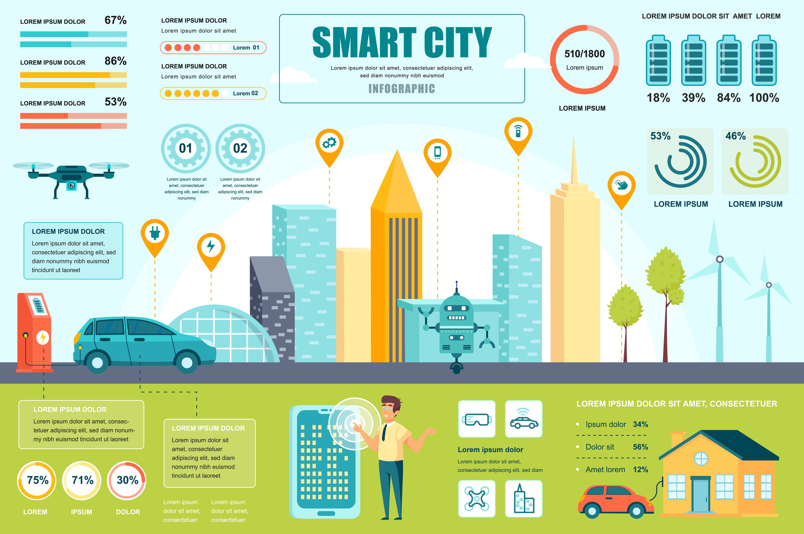
Smart City
A Smart City is not just a city packed with technology — it’s a place where digital solutions support residents in their daily lives, and where governance is data-driven and focused on sustainable development.
Transportation acts as the city’s circulatory system — without efficient, integrated, and intelligent mobility, the other Smart City components cannot function effectively.
That’s why planning transportation systems in Smart Cities must combine cutting-edge technology, sustainability principles, and effective mobility management.
In this presentation, we will explore how to assess mobility needs, apply sustainable planning principles, integrate innovative technologies, and measure outcomes — all to create transport systems that are fast, safe, inclusive, and environmentally friendly.
Source: Smart City Infographic Template Graphic – Infographics, Designer: alexdndz Platform: Creative Fabrica

Slide 3
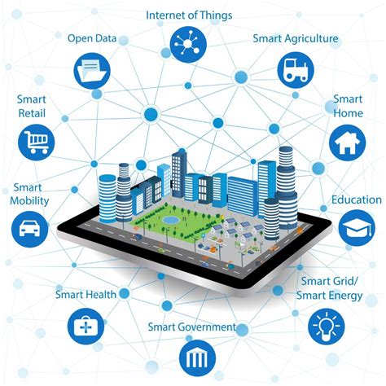
What is a Smart City?
Definition (EU & ISO 37122) - A Smart City is an urban area that uses digital technologies and data-driven decision-making to enhance performance, improve citizens’ quality of life, and ensure environmental sustainability — meeting the needs of present and future generations.
Smart City is more than just a “tech-enabled” urban space. It’s a holistic approach to city management where digital tools and real-time data help improve operational efficiency, service delivery, and the sustainability of urban life.
Source: freepik.com

Slide 4
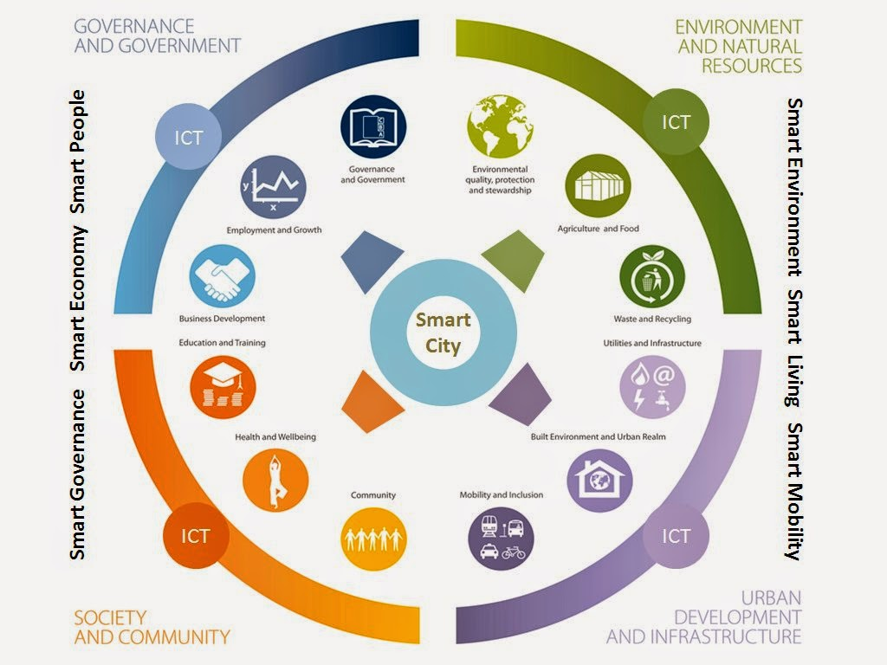
Core Pillars of a Smart City:
Mobility – efficient, safe, and sustainable movement of people and goods
Environment – clean energy, resource efficiency, reduced emissions
Economy – innovation, competitiveness, and inclusive growth
Quality of Life – health, safety, culture, social inclusion
Governance – transparency, participation, efficient public services.
These elements are interconnected — for example, efficient mobility reduces pollution, strengthens the economy, and enhances quality of life.
Source: https://urp-bd.blogspot.com/2014/07/concept-of-green-city.

Slide 5
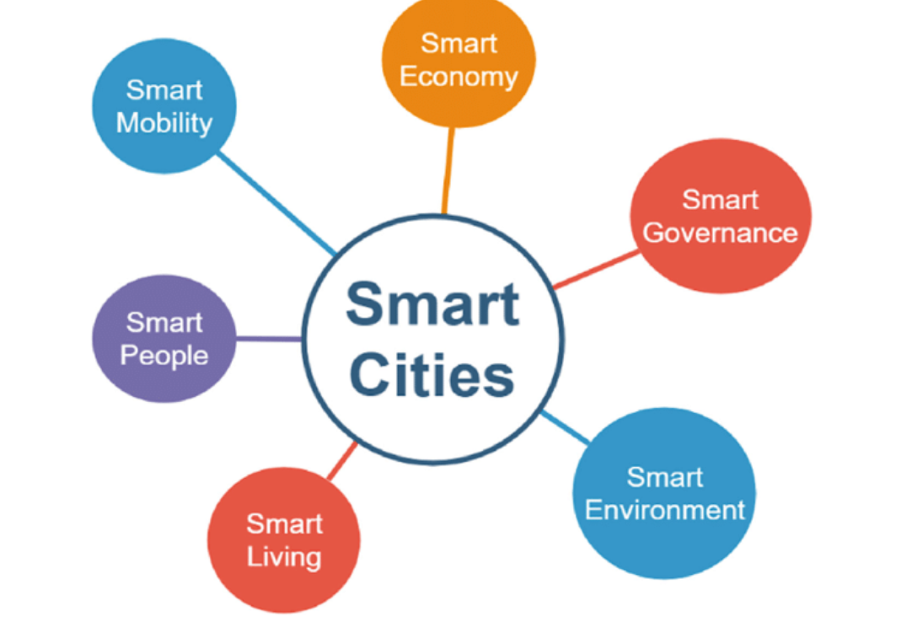
Transport’s Role in Smart City Goals:
Connects all other pillars by enabling access to services, jobs, and resources
Reduces congestion, emissions, and travel times through Intelligent Transport Systems (ITS)
Supports sustainable mobility: walking, cycling, public transport, and shared mobility
Uses real-time data and technology to adapt to changing conditions and needs.
Transportation is not just one pillar among others — it is the enabler of a Smart City. Without well-integrated, safe, and sustainable transport systems, the city cannot achieve its environmental, economic, or social goals.
Intelligent Transport Systems allow cities to manage traffic dynamically, prioritize sustainable modes, and make data-informed decisions.
Source: Matos, Ana & Pinto, Bruna & Barros, Fábio & Martins, Sérgio & Martins, José & Au-Yong Oliveira, Manuel. (2019). Smart Cities and Smart Tourism: What Future Do They Bring?. 10.1007/978-3-030-16187-3_35.

Slide 6
Key Challenges in Urban Mobility
Rapid Urban Population Growth – increasing travel demand, pressure on infrastructure
Traffic Congestion – loss of productivity, increased travel times, economic costs
Air Pollution & Noise – negative impacts on public health and urban livability
Inequitable Access – gaps in availability and quality of transport services across different areas and social groups.
Rapid population growth in cities brings more residents, more trips, and higher demand for both public and private transport, pushing existing infrastructure to its limits.
Traffic congestion is not just an inconvenience — it carries substantial economic and social costs, from lost working hours to higher fuel consumption and reduced reliability of public transport.
Air pollution and noise generated by transport negatively affect public health, increasing the incidence of respiratory diseases, cardiovascular issues, and reducing overall quality of urban life.
Inequitable access to transport services means that some residents, especially in suburban or underserved areas, face longer, more expensive, or less safe journeys, limiting their access to jobs, education, and healthcare

Slide 7
Key Challenges in Urban Mobility
Addressing these challenges requires a multifaceted and coordinated approach.
Integrated planning means aligning urban development, land use, and transport strategies so that residential, commercial, and recreational areas are well connected, reducing unnecessary travel demand and encouraging active and public transport modes.
Investment in sustainable mobility solutions involves expanding high-capacity public transport, building safe cycling and walking infrastructure, promoting shared mobility services, and accelerating the transition to low-emission and zero-emission vehicles.
Leveraging Intelligent Transport Systems (ITS) enables cities to manage traffic flows dynamically, prioritize sustainable modes such as public transit and cycling, optimize traffic signal timing, provide real-time travel information to users, and monitor environmental impacts.
Combined, these measures improve traffic efficiency, reduce emissions and noise, enhance equitable access to mobility options, and create healthier, more liveable urban environments.

Slide 8
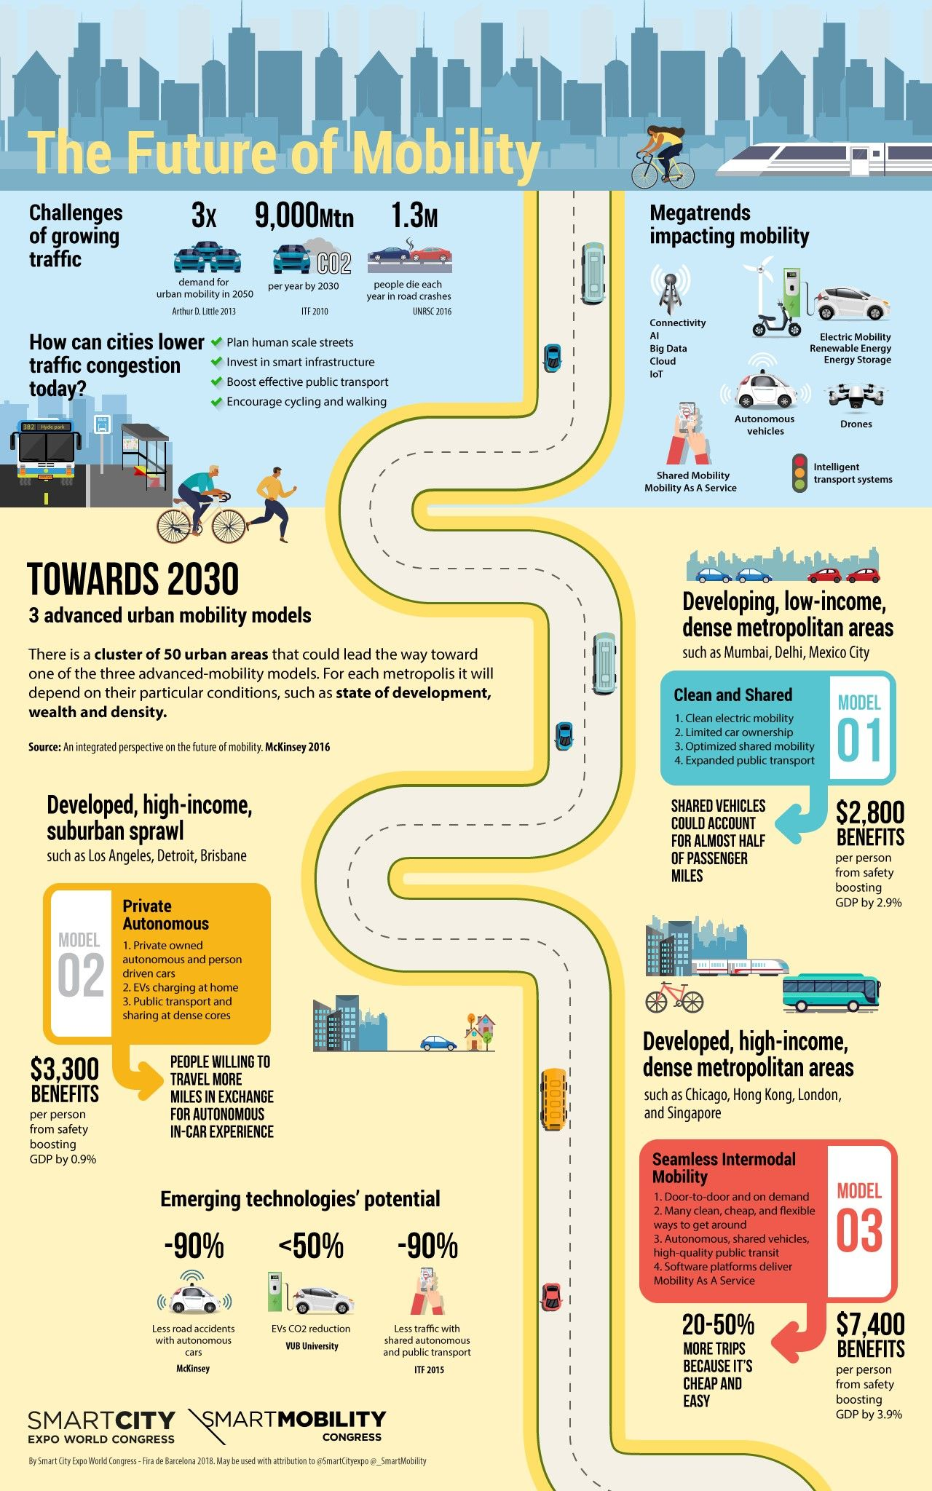
Key Steps in Mobility Needs Assessment
User Needs Analysis – evaluating travel behavior and preferences across all modes: walking, cycling, public transport, private vehicles
Data Collection & Analysis – leveraging Big Data, IoT sensors, GPS tracking, travel surveys, and manual counts to understand demand and performance
Transport Problem Mapping – identifying congestion hotspots, underserved areas, unsafe locations, and environmental stress zones
Source: Pinterest

Slide 9
Key Steps in Mobility Needs Assessment
Understanding the mobility needs of a city’s residents is the foundation of effective transport planning in a Smart City context.
A comprehensive analysis of user needs — not just focusing on cars or public transport, but also on active modes like walking and cycling, which are often underestimated in traditional planning. This involves identifying travel patterns, trip purposes, peak periods, and barriers to modal shift.
Data collection and analysis -we can use Big Data from mobile devices, IoT sensors embedded in infrastructure, GPS traces from vehicles and bikes, automatic passenger counting in public transport, and online or in-person travel surveys. These data sets enable dynamic, real-time insights into how people and goods move through the city.
Mapping transport problems — visualizing congestion points, accident-prone intersections, areas with poor public transport coverage, and zones with high pollution or noise levels. Geographic Information Systems (GIS) and data analytics help planners target interventions more precisely, ensuring resources are allocated where they have the greatest impact.
In Smart Cities, this process is not a one-off — it’s continuous, allowing for adaptive planning and the integration of new technologies as conditions change.

Slide 10
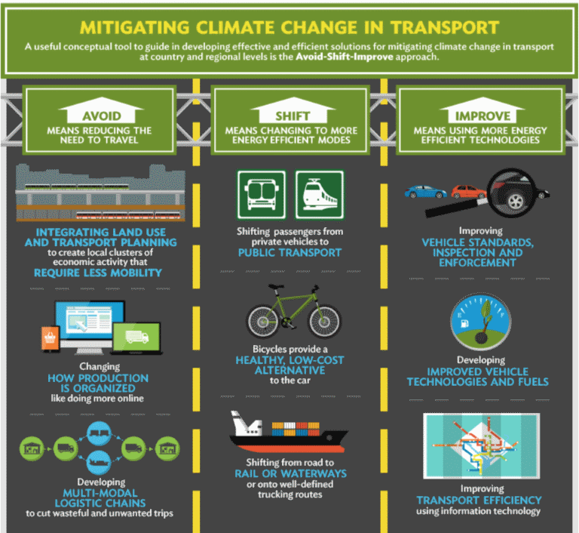
Sustainable Transport Planning Principles - Core Principles for Sustainable Mobility
Avoid–Shift–Improve:
Avoid: reduce unnecessary trips and travel distances through compact urban design and telecommuting
Shift: promote modal shift from private cars to walking, cycling, and public transport
Improve: enhance efficiency and environmental performance of all transport modes
Integrate Land Use & Transport Planning – design mixed-use, accessible neighborhoods to shorten travel distances and increase sustainable transport use
Promote Active Mobility & Public Transport – invest in safe walking and cycling infrastructure, high-quality public transport, and intermodal hubs
Minimize Environmental Impact – adopt low-emission vehicles, improve energy efficiency, and protect urban green spaces
Source: https://development.asia/explainer/three-steps-tackle-traffic-gridlock

Slide 11
Avoid – Shift – Improve: Sustainable Transport Framework: Avoid
Goal: reduce the need to travel and shorten travel distances for residents.
Achieved through compact urban design – dense, mixed-use development placing residential, commercial, and recreational facilities close together.
Promoting telecommuting and the digitalization of services (e-government, online shopping) to reduce physical trips.
Outcome: lower traffic volumes, reduced emissions, and improved quality of life.

Slide 12
Avoid – Shift – Improve: Sustainable Transport Framework: Shift
Encourage a modal shift from private cars to public transport, cycling, and walking.
Expand and modernize infrastructure for active mobility (bike lanes, sidewalks, pedestrian zones) and improve the quality and accessibility of public transport (high frequency, reliability, integrated ticketing).
Develop multimodal hubs to facilitate easy transfers between different modes.
Outcome: less congestion, improved energy efficiency in the transport system.

Slide 13
Avoid – Shift – Improve: Sustainable Transport Framework: Improve
Increase efficiency and reduce the environmental impact of all transport modes.
Introduce low- and zero-emission vehicles (electric, hydrogen), cleaner fuels, and stricter emission standards.
Optimize traffic and reduce energy consumption through Intelligent Transport Systems (ITS): adaptive traffic signals, public transport priority, and real-time fleet management.
Maintain and upgrade infrastructure in ways that minimize energy loss and emissions.
Outcome: higher operational efficiency, reduced climate impact, and improved safety.

Slide 14
Avoid – Shift – Improve: Sustainable Transport Framework: Improve
Increase efficiency and reduce the environmental impact of all transport modes.
Introduce low- and zero-emission vehicles (electric, hydrogen), cleaner fuels, and stricter emission standards.
Optimize traffic and reduce energy consumption through Intelligent Transport Systems (ITS): adaptive traffic signals, public transport priority, and real-time fleet management.
Maintain and upgrade infrastructure in ways that minimize energy loss and emissions.
Outcome: higher operational efficiency, reduced climate impact, and improved safety.

Slide 15
Integrate Land Use & Transport Planning
Objective: Ensure that the location of housing, jobs, services, and recreational facilities supports short travel distances and encourages the use of sustainable modes of transport.
Mixed-use neighborhoods: Combine residential, commercial, educational, and leisure spaces within walkable or bikeable distances, reducing reliance on private cars.
Accessibility focus: Design urban layouts that provide direct, safe, and convenient access to public transport hubs, cycling routes, and pedestrian networks.
Urban density: Encourage compact development that supports efficient public transport and active mobility infrastructure while avoiding urban sprawl.
Sustainable connections: Integrate green corridors, safe crossings, and multimodal hubs to make transitions between modes seamless and attractive.
Benefits: Reduces travel times and transport costs for residents, Supports local economies by concentrating activity in well-connected areas, Decreases greenhouse gas emissions and air pollution, Improves quality of life by fostering vibrant, walkable communities

Slide 16
Promote Active Mobility & Public Transport
Objective: Encourage people to choose sustainable and healthy transport options by making them safe, convenient, and attractive.
Active mobility infrastructure:
  Develop continuous, safe, and accessible walking networks with wide sidewalks, pedestrian crossings, and traffic-calming measures.
  Build protected and connected cycling lanes, bike parking, and repair facilities to support everyday cycling.
  Implement wayfinding systems, lighting, and urban design elements that make active travel comfortable and enjoyable year-round.
High-quality public transport:
  Offer reliable, frequent, and affordable services across buses, trams, metros, and trains.
  Ensure accessibility for all, including people with reduced mobility, through low-floor vehicles, elevators, and tactile guidance systems.
  Integrate real-time passenger information via apps, displays, and audio announcements.

Slide 17
Promote Active Mobility & Public Transport
Intermodal hubs:
  Design modern transport nodes where multiple modes (e.g., bus, rail, bike-sharing, car-sharing) seamlessly connect.
  Provide amenities such as secure bike storage, EV charging points, and retail services to make transfers efficient and pleasant.
  Use mobility-as-a-service (MaaS) platforms to integrate ticketing and trip planning across modes.
Benefits:
  Reduces car dependency, congestion, and emissions.
  Improves public health through increased physical activity.
  Enhances social inclusion by ensuring mobility options for all income and ability levels.

Slide 18
Minimize Environmental Impact
Objective: Reduce the ecological footprint of the transport sector while supporting urban livability and resilience.
Low-emission and zero-emission vehicles::
  Transition public transport fleets, taxis, and municipal vehicles to electric, hydrogen, or hybrid models.
  Provide incentives for private adoption of clean vehicles through subsidies, tax benefits, and charging infrastructure.
  Encourage shared mobility options to reduce the number of vehicles on the road.
Energy efficiency improvements:
  Optimize routes and schedules in public transport to reduce fuel use and emissions.
  Use Intelligent Transport Systems (ITS) to manage traffic flow and minimize idling.
  Invest in energy-efficient infrastructure such as LED street lighting and solar-powered facilities.

Slide 19
Minimize Environmental Impact
Protection and integration of green spaces:.
  Design transport projects that avoid unnecessary removal of trees or green areas.
  Integrate green infrastructure such as green roofs, noise-reducing vegetation, and urban forests along transport corridors.
  Create buffer zones between busy roads and residential areas using trees and vegetation to improve air quality and reduce noise pollution.
Benefits:
  Lower greenhouse gas and pollutant emissions.
  Improved public health and biodiversity.
  Increased climate resilience of urban areas.

Slide 20
Intelligent Transport Systems in Smart Cities - Definition:
Intelligent Transport Systems (ITS) are the application of advanced technologies — including information processing, telecommunications, and control systems — to improve the safety, efficiency, and sustainability of transport networks.
In Smart Cities, ITS integrates with other urban systems to provide real-time monitoring, data-driven decision-making, and seamless mobility services.
Intelligent Transport Systems are at the heart of Smart City mobility. They combine hardware like sensors and control devices with software for data analytics and decision-making.
In a Smart City, ITS doesn’t work in isolation — it’s part of a connected urban ecosystem. For example, adaptive traffic signals respond instantly to congestion, public transport gets priority at intersections, and real-time passenger information is shared across multiple platforms.
These systems bring tangible benefits: improved road safety through quicker incident detection, reduced congestion through optimized traffic control, lower fuel consumption, and enhanced passenger satisfaction.
ITS is also future-proof — it’s ready to integrate with connected and autonomous vehicles, Mobility-as-a-Service (MaaS) platforms, and environmental monitoring systems.

Slide 21
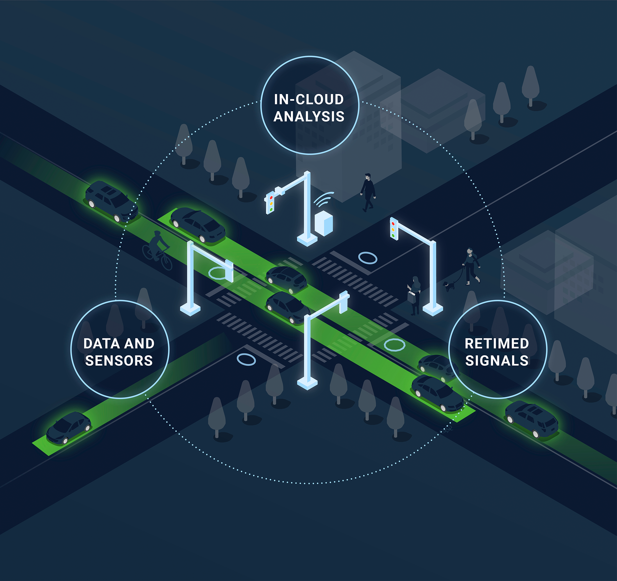
Intelligent Transport Systems in Smart Cities - Examples of ITS in Smart Cities:
Adaptive Traffic Signal Control – systems like SCATS or SCOOT that adjust signal timings based on real-time traffic conditions.
Real-Time Traffic Management – monitoring traffic flow via sensors, cameras, GPS data, and adjusting lane usage, speed limits, or diversions dynamically.
Passenger Information Systems (PIS) – providing real-time arrival/departure information, disruption alerts, and multimodal travel planning via displays, apps, and websites.
Public Transport Priority – giving buses and trams priority at traffic lights to improve punctuality.
Incident Detection and Response – automatic detection of accidents or breakdowns and rapid dispatch of emergency or service teams.
https://www.parsons.com/products/intelligent-intersections/

Slide 22
Technology Integration in Smart City Transport Systems
In a Smart City, technology integration means that all mobility-related systems can communicate, share data, and work together toward common objectives.
IoT Sensors & Connected Vehicles (V2X):
  Deployment of IoT-based traffic counters, environmental sensors, and smart cameras to collect continuous, real-time data.
  Vehicle-to-Everything (V2X) communication enabling direct data exchange between vehicles, infrastructure, and control centers for improved safety and efficiency.
  IoT sensors and connected vehicles are the front-line data sources — detecting vehicle counts, speeds, environmental conditions, and even hazardous events in real time. With V2X, vehicles themselves become active data nodes, warning of traffic jams, slippery roads, or accidents.
Big Data Analytics for Decision-Making:
  Processing large, heterogeneous data sets (traffic flow, weather, public transport usage, social events) to predict demand and optimize operations.
  AI-driven forecasting models for congestion management and infrastructure planning.
  All data inputs feed into Big Data analytics platforms that process millions of data points to forecast congestion, optimize public transport schedules, and plan maintenance proactively.

Slide 23
Technology Integration in Smart City Transport Systems
C-ITS & Urban Platforms:
  Cooperative Intelligent Transport Systems (C-ITS) integrating road users, infrastructure, and operators to share information in real time.
  Examples like transport management system - TRISTAR in the Gdańsk–Gdynia–Sopot area, combining traffic control, public transport management, and traveler information services.
  C-ITS extends these capabilities by creating a cooperative ecosystem, where drivers, infrastructure, and control systems exchange information instantly. The TRISTAR system is a regional example, integrating traffic control, public transport management, and traveler information into one platform.
Interoperability & Standards (DATEX II, FRAME):
  Use of common data exchange formats such as DATEX II to ensure compatibility between systems.
  Application of the FRAME architecture for consistent, scalable ITS planning and integration across jurisdictions.
  Standards and interoperability are essential. Without agreed data formats like DATEX II or reference architectures like FRAME, cities risk creating isolated, incompatible systems. These standards ensure scalability, vendor neutrality, and long-term sustainability of ITS investments.

Slide 24
Key Success Factors for Smart City Transport Implementation
The success of Smart City transport initiatives depends not only on technology but also on the strategic and organizational framework behind them.
Coherent Transport Strategy:
  A long-term vision aligning urban mobility goals with wider Smart City, environmental, and economic objectives.
  Integrated planning across all modes, guided by data and performance indicators
  A coherent transport strategy ensures that all interventions support a shared long-term vision and align with broader goals such as climate neutrality, economic growth, and improved quality of life.
Public Participation:
  Involving residents in decision-making to ensure solutions meet real needs and gain public acceptance.
  Use of surveys, workshops, and participatory planning tools.
  public participation is critical — engaging communities early builds trust, increases acceptance, and often generates valuable local insights.

Slide 25
Key Success Factors for Smart City Transport Implementation
Cross-sector Collaboration:
  Coordination between government agencies, transport operators, technology providers, and research institutions.
  Sharing data, expertise, and resources to accelerate implementation.
  Cross-sector collaboration brings together different stakeholders, from municipal departments and public transport operators to private tech companies and universities. This diversity of expertise accelerates innovation and problem-solving.
Long-term Funding & Evaluation:
  Securing stable investment streams for infrastructure, operations, and innovation.
  Continuous monitoring and evaluation to adapt strategies and demonstrate benefits.
  Long-term funding and continuous evaluation are essential to sustain improvements. Securing stable resources allows for the maintenance and scaling of solutions, while regular monitoring ensures they remain effective and adaptable to changing needs.

Slide 26
Summary & Outlook – The Future of Smart City Transport Planning
Smart City Transport Planning:
  Integration of technology, sustainability principles, and residents’ needs.
  Holistic approach combining Intelligent Transport Systems, urban design, and inclusive mobility policies.
  Smart City transport planning sits at the intersection of technological innovation, sustainable development, and people-centric design. Success comes from integrating ITS, green infrastructure, and inclusive policies to create systems that are efficient, safe, and equitable
Flexibility & Adaptation:
  Systems designed to respond to changing conditions such as population growth, climate change, and evolving travel behaviors.
  Continuous monitoring and iterative planning to keep solutions relevant and effective.
  no plan is ever final. The urban mobility environment is constantly changing — from demographic shifts and climate challenges to disruptive innovations. This requires flexibility, with systems capable of rapid adaptation and continuous improvement.

Slide 27
Summary & Outlook – The Future of Smart City Transport Planning
Future Trends:
  Artificial Intelligence (AI): predictive analytics for traffic, demand forecasting, and adaptive control.
  Autonomous Vehicles: integration with public transport networks, shared mobility, and first/last-mile solutions.
  Green Mobility: electrification, renewable energy integration, and promotion of active transport modes.
  AI will become a critical tool for predictive decision-making, enabling proactive rather than reactive traffic management. Autonomous vehicles will need to be integrated intelligently, ensuring they complement rather than compete with public transport. And green mobility will remain a priority — not only in reducing emissions through electrification but also in making active modes the default choice for short trips.

