Slide 1


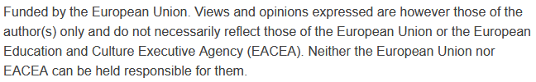

Urban Mobility and Smart City Infrastructure:
Multimodal Transportation Systems and Information Technology for Urban Mobility
Sustainability and Quality Assurance for Academic Governance and Redesign Engineering Studies
Jacek Oskarbski

Slide 2
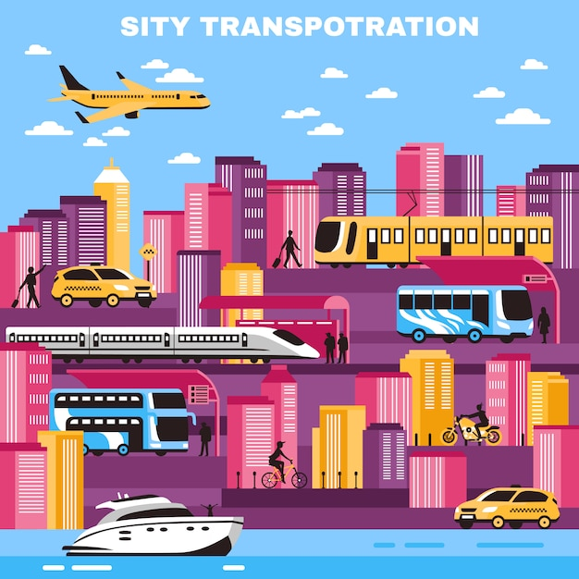
Multimodal Transportation Systems and Information Technology for Urban Mobility
Lecture objectives:
  Explore emerging ITS technologies
  Understand strategies for multimodal integration
  Discuss real-world case studies and tools
  This lecture will explore the intersection of technology and urban mobility, focusing on how Intelligent Transport Systems (ITS) enhance planning, integration, and management of multimodal transport networks.
  We will examine cutting-edge technologies, practical strategies, and case studies from leading cities around the world.
  By the end of this lecture, you should have a clearer understanding of how to leverage IT solutions to improve urban mobility efficiency, sustainability, and user satisfaction.
Source: Source: Freepik – “City Transportation Vector Illustration” (macrovector)

Slide 3
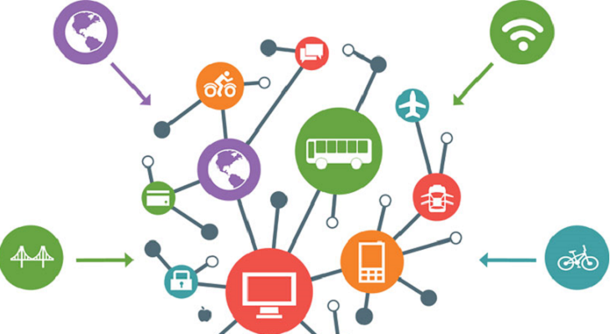
Key Definitions
Multimodal transportation – seamless integration of multiple transport modes to enable efficient, user-friendly travel. Multimodality aims to provide travellers with a connected journey in which transfers between modes are easy, predictable, and comfortable.
ITS (Intelligent Transport Systems) – use of advanced information and communication technologies for managing and optimizing transport operations. ITS forms the technological backbone, enabling real-time data exchange, traffic management, and optimization.
MaaS (Mobility-as-a-Service) – digital platforms that integrate trip planning, booking, and payment across various transport modes into a single service. MaaS sits at the user interface, allowing passengers to plan, book, and pay for their trips — from bike share to metro to ride-hailing — through one platform.
Together, these concepts create an ecosystem that improves efficiency, accessibility, and sustainability.
Source: Smart City Mag – “MaaS: le nouveau service de transport multimodal”

Slide 4
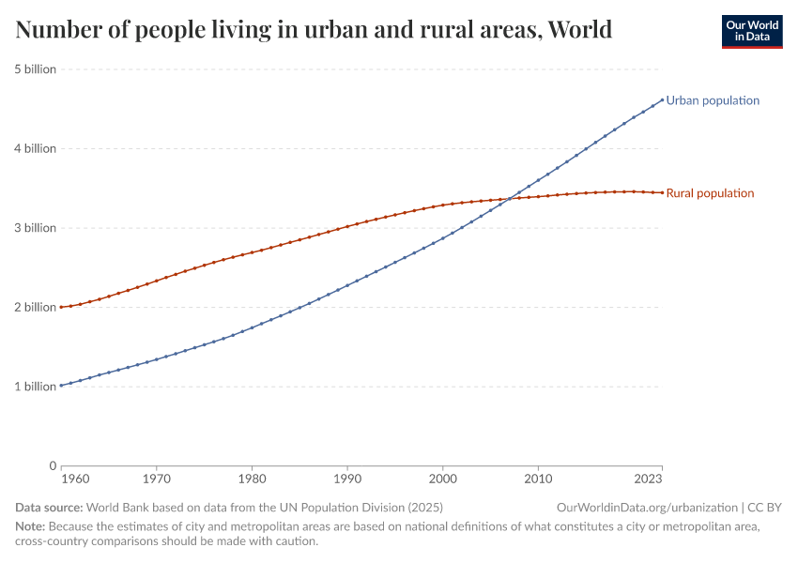
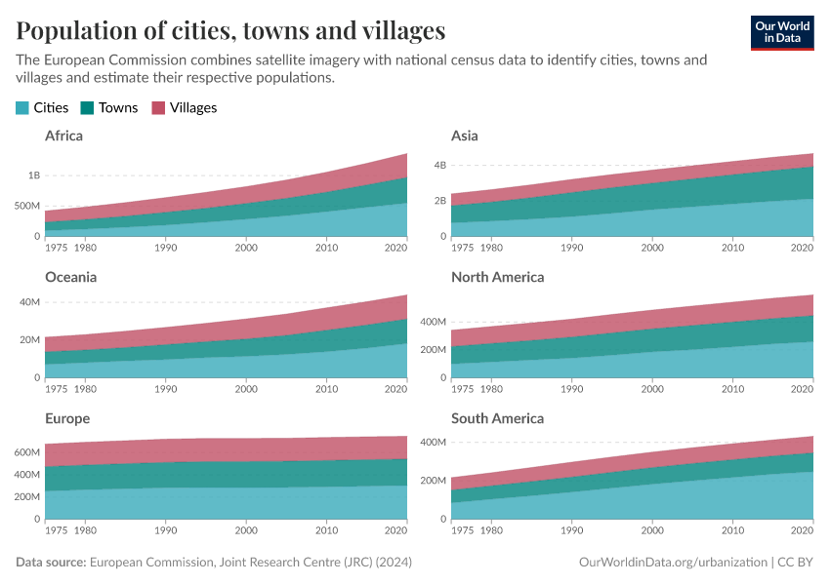
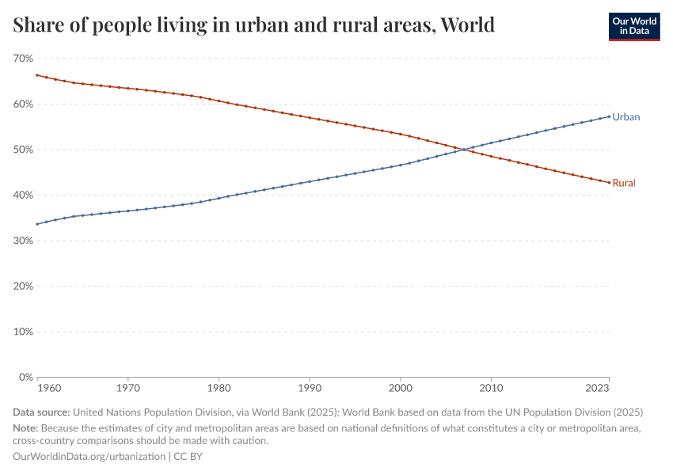
Why Multimodality Matters:
Urbanization → rapid growth in city populations leads to increased travel demand.
The 21st century has brought an unprecedented wave of urbanization. More people living in cities means more trips, greater pressure on infrastructure, and higher risks of congestion.
Source: https://ourworldindata.org/urbanization

Slide 5
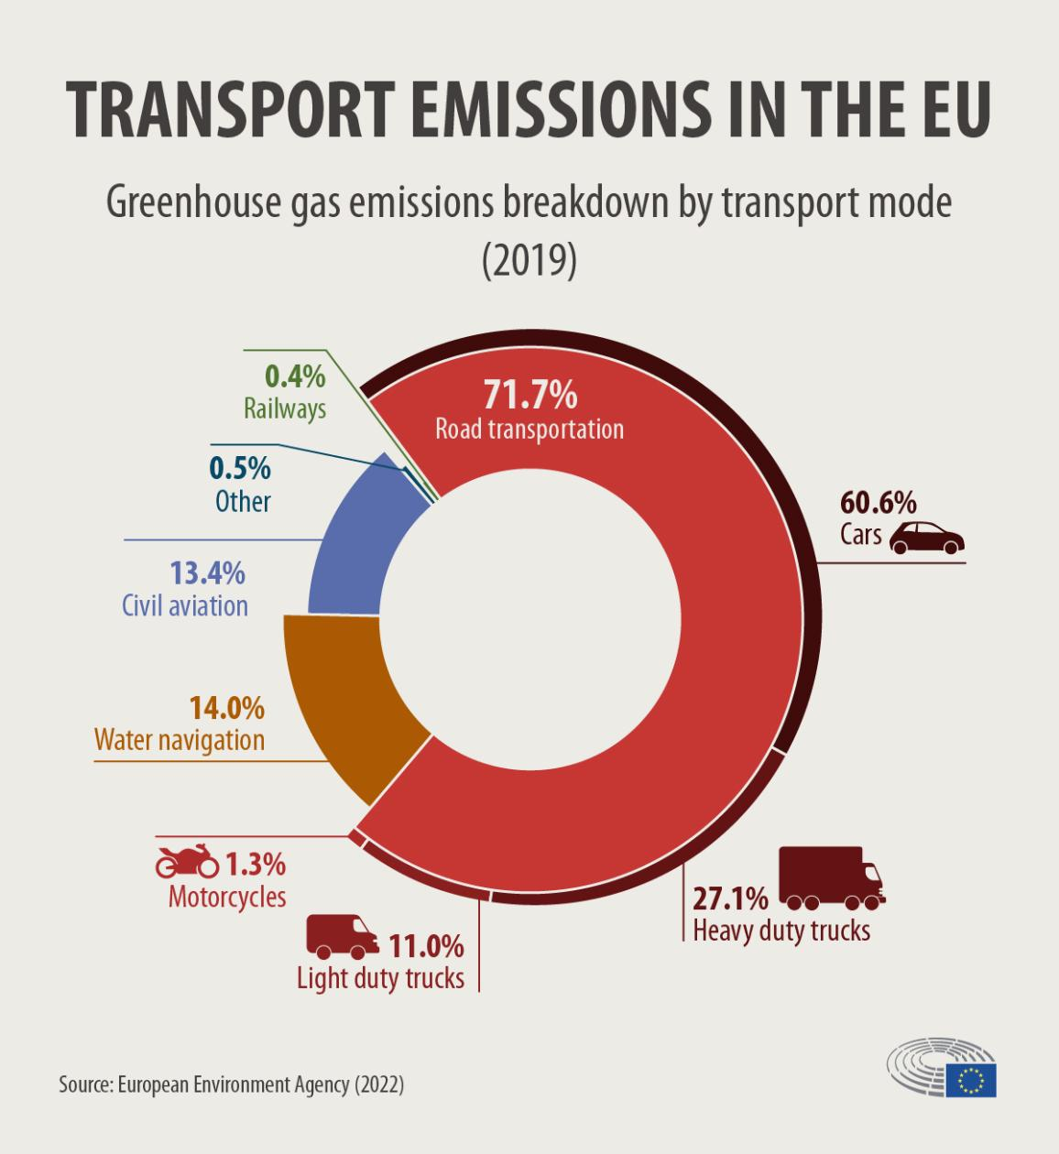
Why Multimodality Matters:
Environmental challenges → the need to promote sustainable and low-emission transport modes. transport emissions are a major contributor to climate change and urban air pollution, making sustainable modes such as public transit, cycling, and walking essential.
Source: https://www.statista.com/topics/7845/sustainability/#editorsPicks.

Slide 6
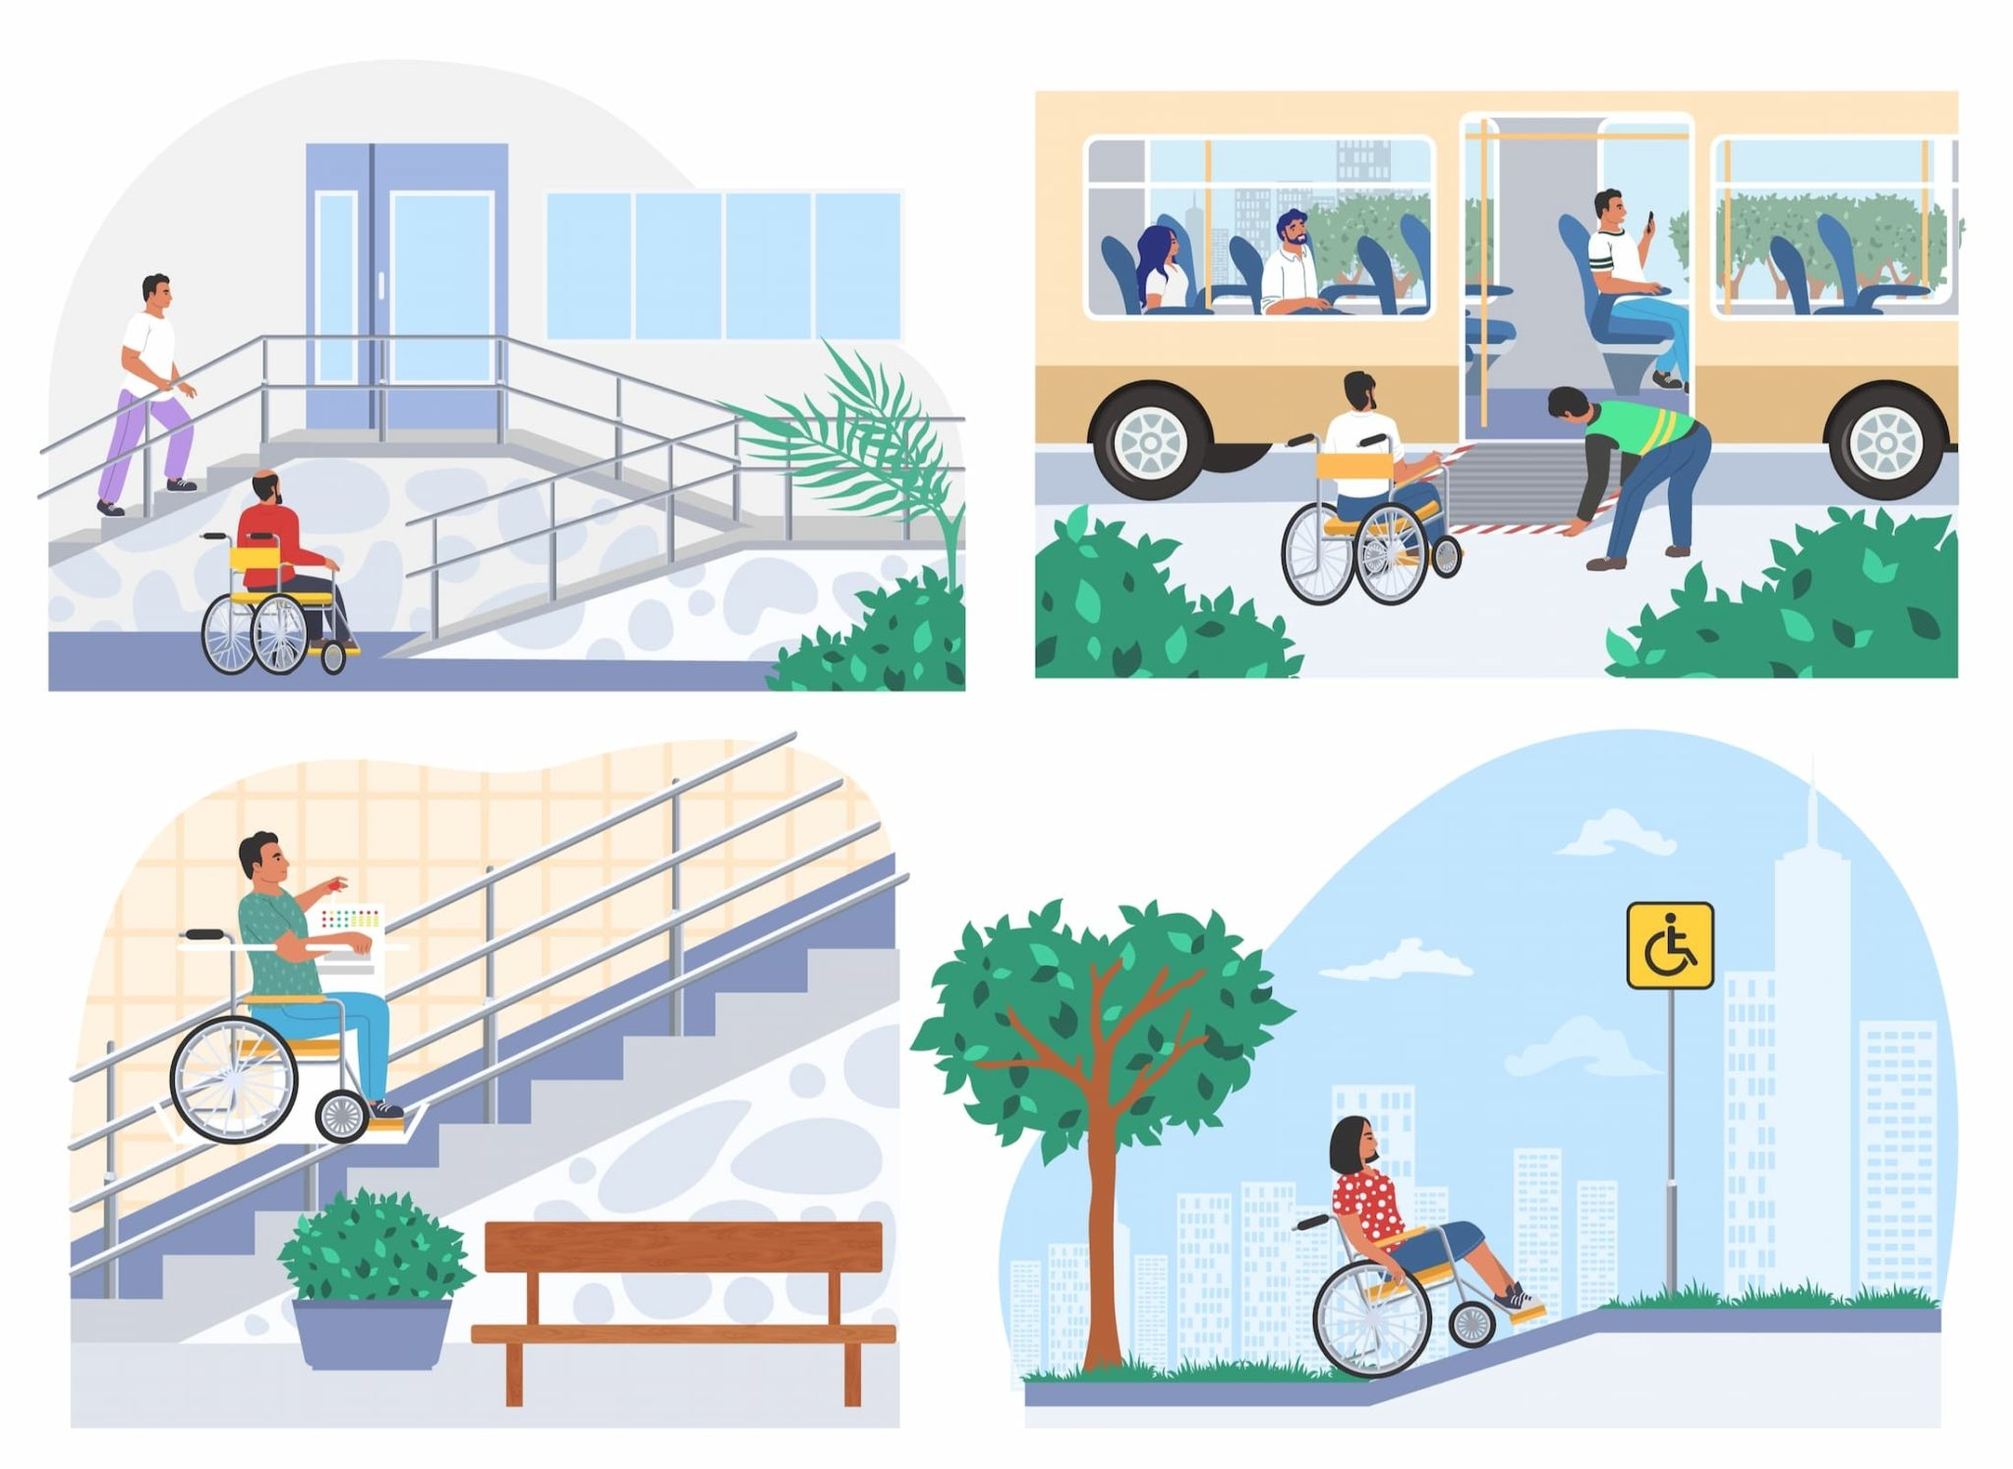
Why Multimodality Matters
Equity → ensuring that all population groups, including vulnerable users, have equal access to mobility options. Multimodality addresses both efficiency and fairness: it enables smoother traffic flows, reduces environmental impacts, and ensures that transport services are accessible to all residents — regardless of income, age, or physical ability.
Source: Best Website Accessibility – “Accessibility in Transportation Industries” bestwebsiteaccessibility.com/accessibility-in-transportation-industries

Slide 7
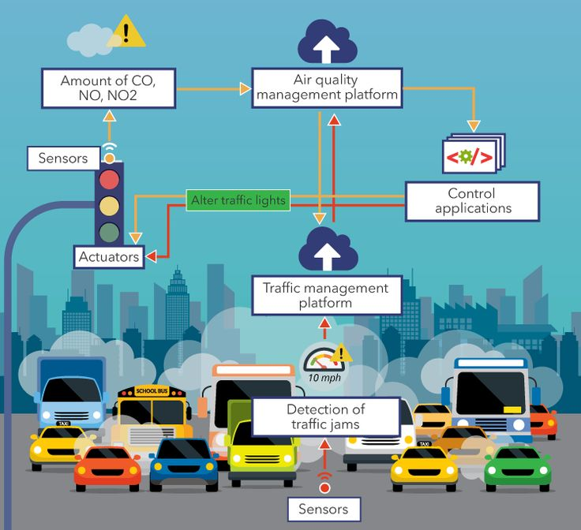
Role of ITS in Urban Mobility
Data-driven decision-making – leveraging traffic data from sensors, GPS, connected vehicles, and mobile devices to guide strategic and operational planning. Data-driven decision-making means cities no longer rely only on periodic traffic counts or surveys; instead, they use continuous streams of data to detect patterns and optimize network performance.
Real-time operations management – enabling dynamic control of traffic lights, lane usage, speed limits, and public transport scheduling. Real-time operations management ensures that the transport system reacts instantly to incidents, congestion, or demand changes—keeping traffic flowing and improving reliability.
Enhancing user experience – providing travelers with accurate, real-time information on travel times, routes, and disruptions via apps, websites, and digital displays. Enhancing user experience is critical for encouraging modal shift. When travelers have access to real-time, accurate, and reliable information, they are more likely to choose public transport or active modes.
Source: “IoT for Smart Cities: Use Cases and Implementation Strategies” via Pinterest

Slide 8
Emerging Technologies in Multimodal Transportation Overview of Modern ITS
Modern Intelligent Transport Systems rely on a combination of adaptive control algorithms, connectivity, and pervasive sensing to manage mobility in real time.
Adaptive traffic control – dynamic signal timing adjustments based on real-time traffic flow data, reducing congestion and improving travel times. Adaptive traffic control systems, like SCOOT or SCATS, continuously analyze traffic patterns and adjust signal phases accordingly.
Connected vehicles (V2X) – vehicle-to-vehicle (V2V), vehicle-to-infrastructure (V2I), and vehicle-to-everything (V2X) communications enhance safety, optimize routing, and support automated driving functions. Connected vehicle technologies provide a constant stream of information to infrastructure and other vehicles, helping anticipate and prevent incidents.
IoT and sensor networks – deployment of roadside units, environmental sensors, and cameras to collect continuous traffic, weather, and safety data. IoT devices and sensor networks feed massive amounts of data into control centers, enabling integrated decision-making across all modes of transport.
These components work together as a unified ecosystem—turning previously static road networks into dynamic, responsive, and predictive mobility systems.
https://youtu.be/wgv990rTYO4

Slide 9
Public Transport Integration
Integrating public transport into a multimodal network is key to reducing private car dependency.
Unified ticketing – implementation of integrated payment systems (e.g., contactless cards, mobile apps) that work across buses, trams, metro, bike-sharing, and even ride-hailing services. Unified ticketing simplifies the payment process, allowing passengers to use a single medium for multiple transport services.
Real-time arrival info – provision of accurate, live updates via passenger information displays, smartphone apps, and web platforms to reduce uncertainty and improve user satisfaction. Real-time arrival information helps passengers make better travel decisions, reducing perceived wait times and increasing trust in the system.
Priority at signals – adaptive traffic signal systems that detect approaching buses or trams and extend green lights or shorten red phases to improve punctuality. Priority at traffic signals ensures buses and trams maintain schedules, improving operational efficiency and making public transport more competitive with private vehicles.
When these elements are combined, they create a smoother, more convenient, and attractive public transport experience, which is essential for the success of a multimodal mobility strategy.

Slide 10

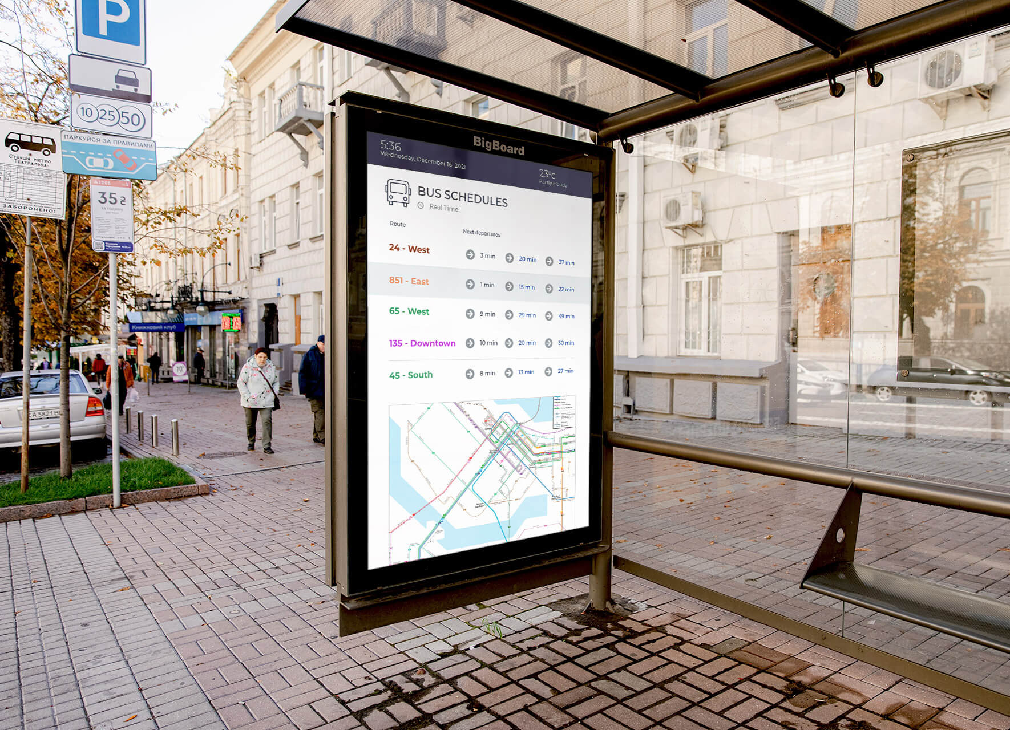
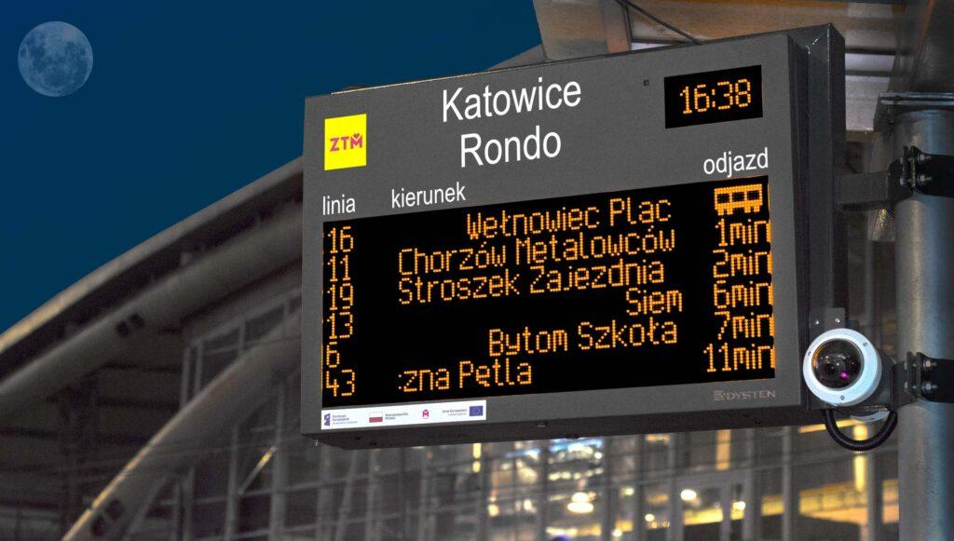
Public Transport Integration
https://youtu.be/cM4fP9p7WPA
Source:https://smartcitydisplays.com/pl/sdip-system-dynamicznej-informacji-pasazerskiej/

Slide 11


Active Mobility Tech
Active mobility — walking, cycling, and micro-mobility — plays a critical role in reducing congestion and emissions.
Bike-sharing & e-scooters – deployment of docked or dockless systems, integrated with public transport apps, enabling first/last-mile connectivity. Bike-sharing and e-scooter systems provide flexible transport options that complement public transit.
Navigation for walking/cycling – GPS-based route planning that prioritizes safe, comfortable, and direct paths for pedestrians and cyclists, with real-time hazard or closure updates. Navigation tools guide users through low-traffic, bike-friendly routes and inform them of detours or hazards.
Safety enhancements – smart helmets, high-visibility wearables, intersection sensors detecting cyclists/pedestrians, and infrastructure with automated lighting or warning systems. Safety is supported through intelligent infrastructure (e.g., bicycle detection at signals), smart devices, and visibility aids that help prevent collisions.
Integrating these tools into a city’s multimodal mobility ecosystem encourages more people to switch from cars to active modes, improving both public health and environmental quality.

Slide 12
E-Mobility in Multimodal Systems
E-mobility is a key enabler of sustainable multimodal transport systems, but its potential goes far beyond private electric cars.
EV charging integration – deploying public charging points at key multimodal hubs (e.g., park-and-ride facilities, train stations) to facilitate seamless transfers between modes. EV charging integration ensures that charging opportunities are conveniently located, reducing range anxiety and encouraging adoption.
Shared EV fleets – incorporating electric car-sharing and e-van services into the mobility ecosystem, providing flexible, sustainable first/last-mile options. Shared EV fleets provide affordable, flexible alternatives to car ownership, fitting neatly into a multimodal trip that may also involve public transit, cycling, or walking.
Energy management – using smart grid technologies and renewable energy sources to optimize charging schedules, reduce peak load, and lower carbon emissions. Energy management is critical for balancing grid demands, integrating solar or wind energy, and ensuring that electrification truly delivers environmental benefits.
When electric modes are seamlessly embedded in the wider mobility network, cities can significantly reduce emissions while maintaining travel convenience and flexibility.

Slide 13
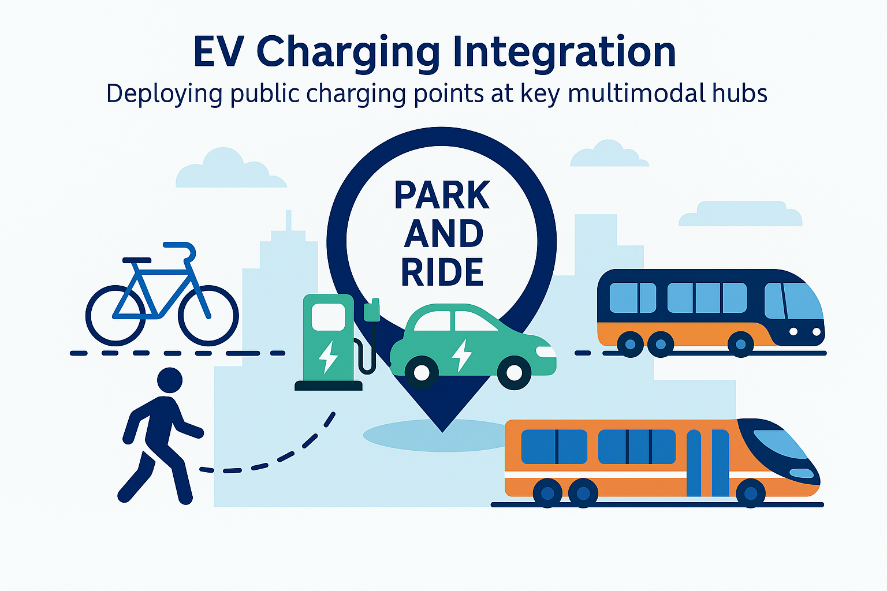
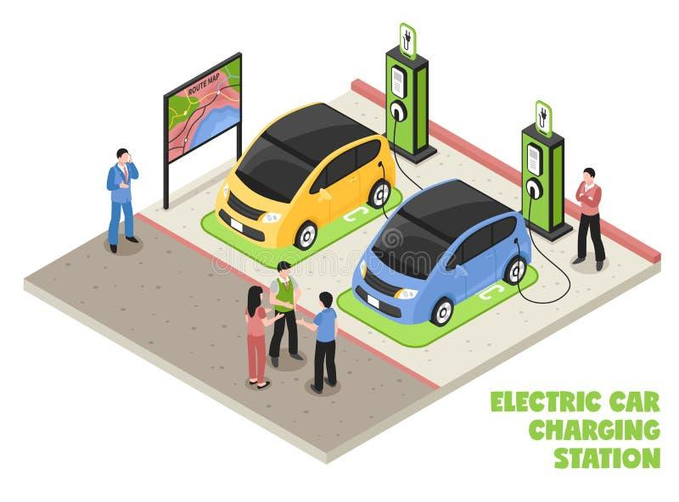
EV charging integration
EV charging integration involves strategically deploying public charging points at key multimodal transport hubs such as park-and-ride facilities, railway stations, bus terminals, and intermodal transfer centers. By positioning chargers in places where travelers naturally switch between modes, cities can seamlessly connect electric mobility with public transport, cycling, and walking networks.
Such integration offers multiple benefits:
  Convenience: Charging opportunities are available where people already spend time, reducing the need for detours.
  Reduced range anxiety: Users can confidently plan trips knowing chargers are accessible along their journey.
  Boosted adoption rates: Easy access to charging infrastructure encourages more people to switch to electric vehicles, both private and shared.
  Optimized infrastructure use: Co-locating charging with existing hubs maximizes land use efficiency and supports sustainable urban planning.
SourceSource: Dreamstime – “Isometric Electric Vehicle Charging Station with Solar Power Concept”

Slide 14
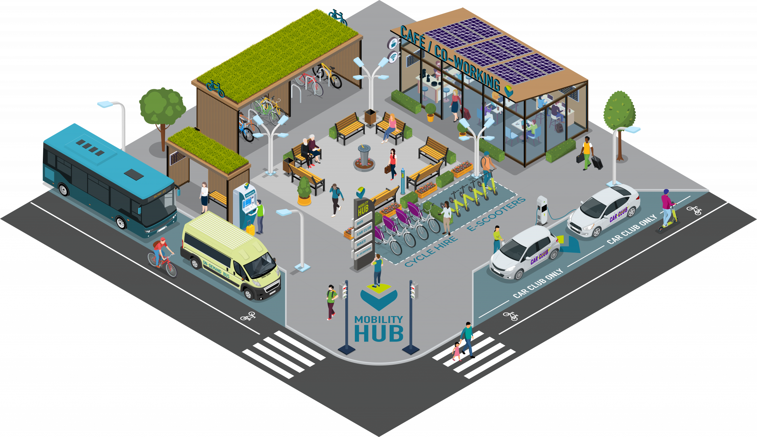
Shared EV fleets
Integrating electric car-sharing services, e-vans, and other shared electric modes into the urban mobility ecosystem creates a sustainable, on-demand travel option. These fleets reduce the need for private vehicle ownership, lower emissions, and offer cost-effective flexibility for both short and long trips. They are especially valuable for first- and last-mile connections, complementing public transport, cycling, and walking. Digital booking platforms and real-time availability maps make them easy to access, while integration with Mobility-as-a-Service (MaaS) platforms ensures seamless trip planning and payment across all transport modes.
Source: UITP – “Mobility hubs: Steering the shift towards integrated sustainable mobility”

Slide 15
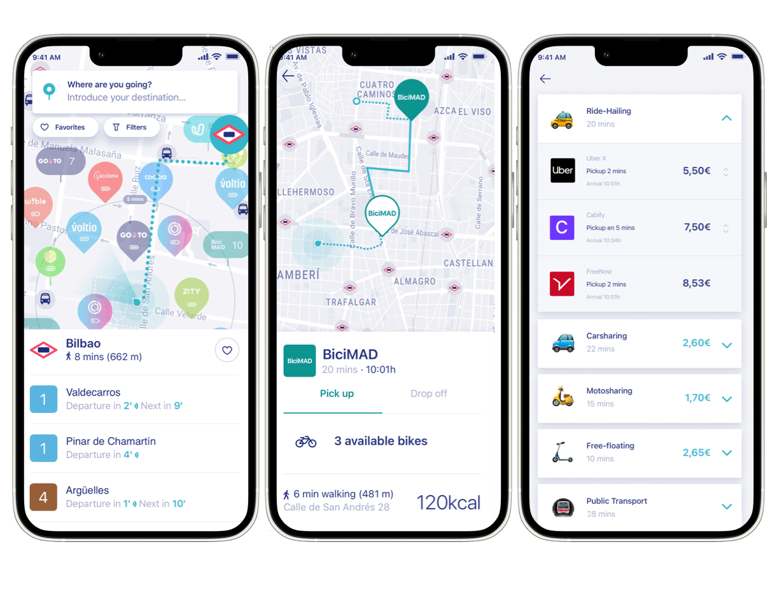
Digital booking platforms and real-time availability maps
Digital booking platforms and real-time availability maps make shared mobility services—such as car-sharing, bike-sharing, and e-scooters—simple and convenient to use. These platforms allow users to instantly locate, reserve, and unlock vehicles using smartphones, ensuring flexibility and reducing waiting times. When integrated with Mobility-as-a-Service (MaaS) platforms, they become part of a unified mobility ecosystem, enabling seamless trip planning, booking, navigation, and payment for all transport modes—public transit, shared mobility, walking, and cycling—within a single interface. This integration improves the user experience, supports multimodal journeys, and encourages a shift away from private car ownership toward sustainable mobility solutions.
Source: Worldwide Mobility – MaaS platform app screenshot

Slide 16
MaaS (Mobility-as-a-Service)
Mobility-as-a-Service represents a paradigm shift in how people move within urban areas. Instead of thinking about separate transport services — each with its own schedules, fares, and apps — MaaS brings them together into a single, user-friendly platform.
Definition: Mobility-as-a-Service (MaaS) is a technology-driven mobility concept that consolidates various public and private transport services into one unified digital platform.
Goal: Provide seamless door-to-door travel by enabling trip planning, booking, and payment across multiple modes within a single interface.
Modes included: Public transit (bus, metro, tram), active mobility (bike-sharing, e-scooters), shared mobility (car-sharing, ride-hailing), taxis, ferries, and microtransit services.
Core idea: Shift from private car ownership to on-demand access to mobility.

Slide 17
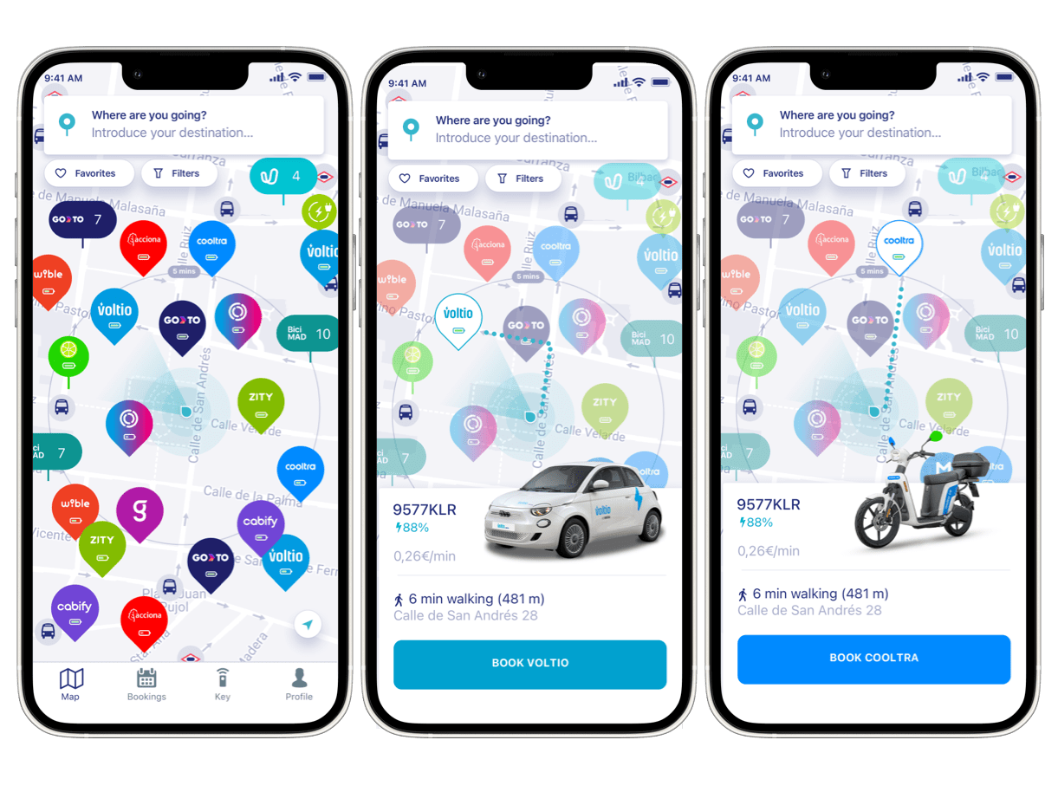
MaaS (Mobility-as-a-Service)
With MaaS, a commuter could:
  Plan a journey from home to work using the fastest or most sustainable option.
  Book a combination of modes (e.g., bike-share to the station, train to the city center, e-scooter for the last mile) in one go.
  Pay once for the entire journey, regardless of the number of operators involved.
  By removing friction in the user experience and offering reliable real-time information, MaaS makes public and shared mobility competitive with — and often superior to — private cars.
  This approach supports environmental goals, congestion reduction, and equitable mobility access for all residents.
Source:https://worldwidemobility.io/_nuxt/Maas_1_worldwidemobility.C3FUCU_3.png

Slide 18
MaaS Key Components
The success of MaaS depends on its ability to integrate multiple moving parts into a frictionless, unified experience.
Multimodal Trip Planning – The system suggests optimal door-to-door routes, seamlessly combining modes such as buses, trams, trains, bike-share, and e-scooters based on travel time, cost, and environmental impact. With multimodal trip planning, the system is not just telling you the next bus time — it’s telling you that you can take a shared bike to the bus stop, catch a tram, and then hop into an e-scooter for the last mile, all in one suggested route.
Real-Time Information – Continuous updates on vehicle locations, availability, service disruptions, and delays ensure users can adapt their journey dynamically. Real-time information is critical for trust. If a tram is delayed, the app immediately suggests an alternative, like a bike-share dock nearby.
Integrated Payment – A single account or subscription model covers all mobility services, eliminating the need for multiple tickets, cards, or apps. Integrated payment is what makes MaaS truly convenient. Whether it’s pay-as-you-go, a monthly pass, or a mobility subscription, the user doesn’t need to think about separate transactions.
Personalized Services – Data-driven recommendations that match the user’s travel patterns, preferences (e.g., avoiding stairs, prioritizing low-emission modes), and past behavior. Finally, personalization transforms MaaS from a static tool into a smart travel assistant — learning user habits, suggesting greener options, or prioritizing comfort and speed.

Slide 19
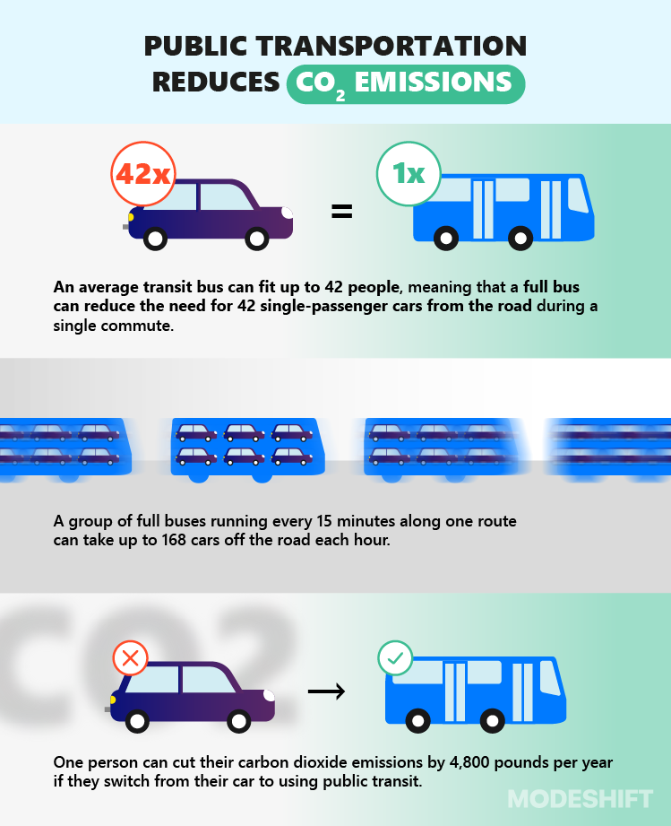
MaaS Benefits
Reduces reliance on private cars – Encourages a modal shift towards shared, public, and active transport, lowering car ownership rates. By offering attractive and affordable alternatives to owning a private car, MaaS can lower congestion levels, free up urban space, and reduce the environmental footprint of travel.
Improves accessibility and equity – Ensures that all population groups, including the elderly, low-income residents, and people with disabilities, have equal access to mobility options. It levels the playing field by ensuring that residents in underserved neighborhoods, those without driving licenses, or those with mobility impairments can access a variety of transport services.
Source: Modeshift – "Public transportation reduces CO₂ emissions by replacing multiple cars with one bus"

Slide 20
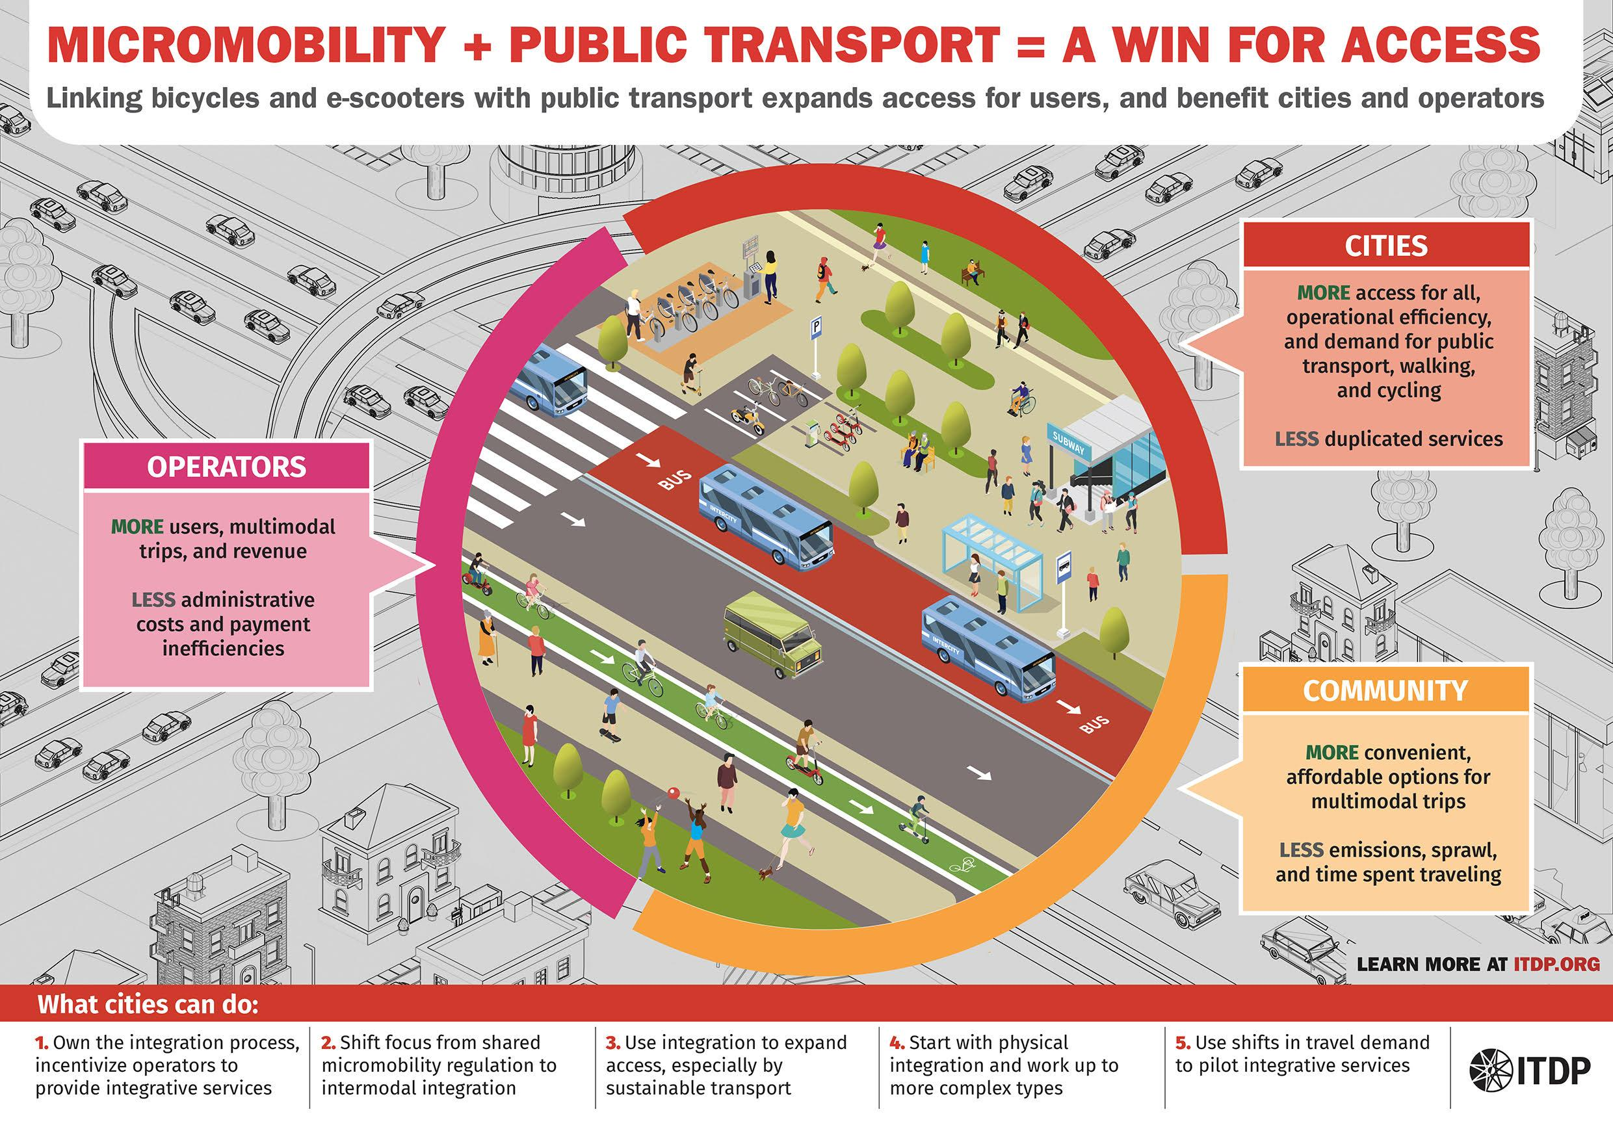
MaaS Benefits
Integrated Payment – A single account or subscription model covers all mobility services, eliminating the need for multiple tickets, cards, or apps. Integrated payment is what makes MaaS truly convenient. Whether it’s pay-as-you-go, a monthly pass, or a mobility subscription, the user doesn’t need to think about separate transactions.
Personalized Services – Data-driven recommendations that match the user’s travel patterns, preferences (e.g., avoiding stairs, prioritizing low-emission modes), and past behavior. Finally, personalization transforms MaaS from a static tool into a smart travel assistant — learning user habits, suggesting greener options, or prioritizing comfort and speed.
Source: ITDP – "Linking Micromobility and Public Transport – a win for accessibility and equity"

Slide 21
MaaS Challenges
Data sharing & interoperability – ensuring different mobility providers (public transit agencies, bike-sharing companies, ride-hailing services) can share and process data using common standards (e.g., GTFS, NeTEx, SIRI). Many operators use proprietary systems; standardizing APIs and ensuring real-time information flow is technically and politically challenging.
Regulatory & policy barriers – existing laws may not cover integrated ticketing, cross-operator revenue sharing, or personal data protection in multimodal platforms. Fare integration, liability in case of disruptions, and cross-border services often require legal frameworks that do not yet exist.
User trust & adoption – concerns about data privacy, payment security, service reliability, and transparency of pricing can slow adoption. Without clear benefits and reliable service, people may stick to private cars. Trust is built through transparent pricing, reliable trip planning, and visible service quality.
Financial sustainability – finding profitable or self-sustaining business models while keeping MaaS affordable for users and attractive for operators. Subscription-based MaaS models (e.g., monthly mobility packages) need to balance affordability with operational costs; public subsidies may be required, especially during early stages.

Slide 22
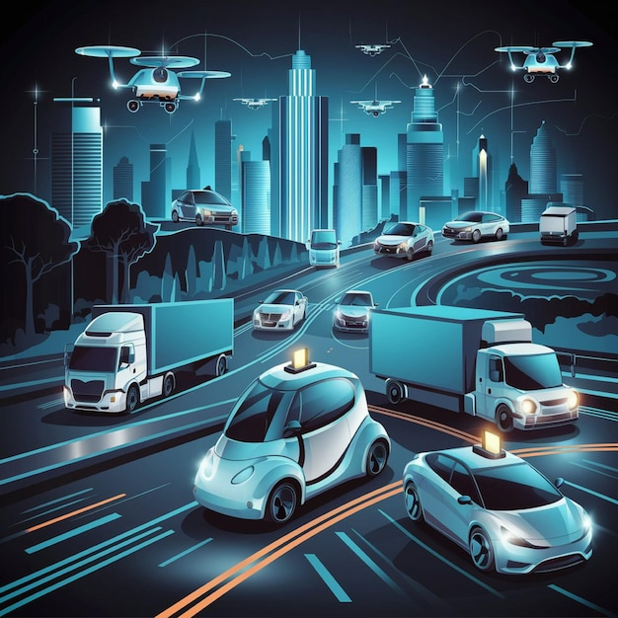
Future of MaaS
MaaS is evolving from a digital booking platform into the central nervous system of urban mobility.
Integration with autonomous vehicles & drones – Self-driving shuttles and on-demand aerial delivery/taxi drones can extend MaaS coverage to underserved or hard-to-reach areas, especially for first/last-mile travel. Self-driving minibuses, robotaxis, and cargo drones will complement existing modes, improving coverage, especially in low-density or rural-urban fringe areas.
AI-powered demand prediction – Artificial intelligence and big data analytics will forecast travel patterns in real time, dynamically adjusting supply (e.g., vehicle availability, pricing) to match demand and reduce congestion. By analyzing millions of mobility data points, AI can anticipate peak demand, optimize fleet deployment, and even suggest alternative routes to balance network load.
Source: Freepik – “Vector of self-driving cars, trucks, and drones navigating smart cities”

Slide 23
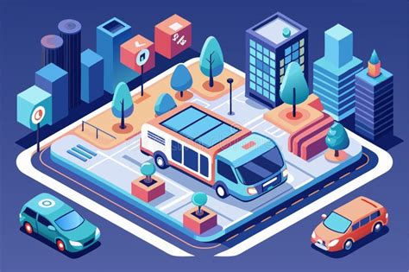
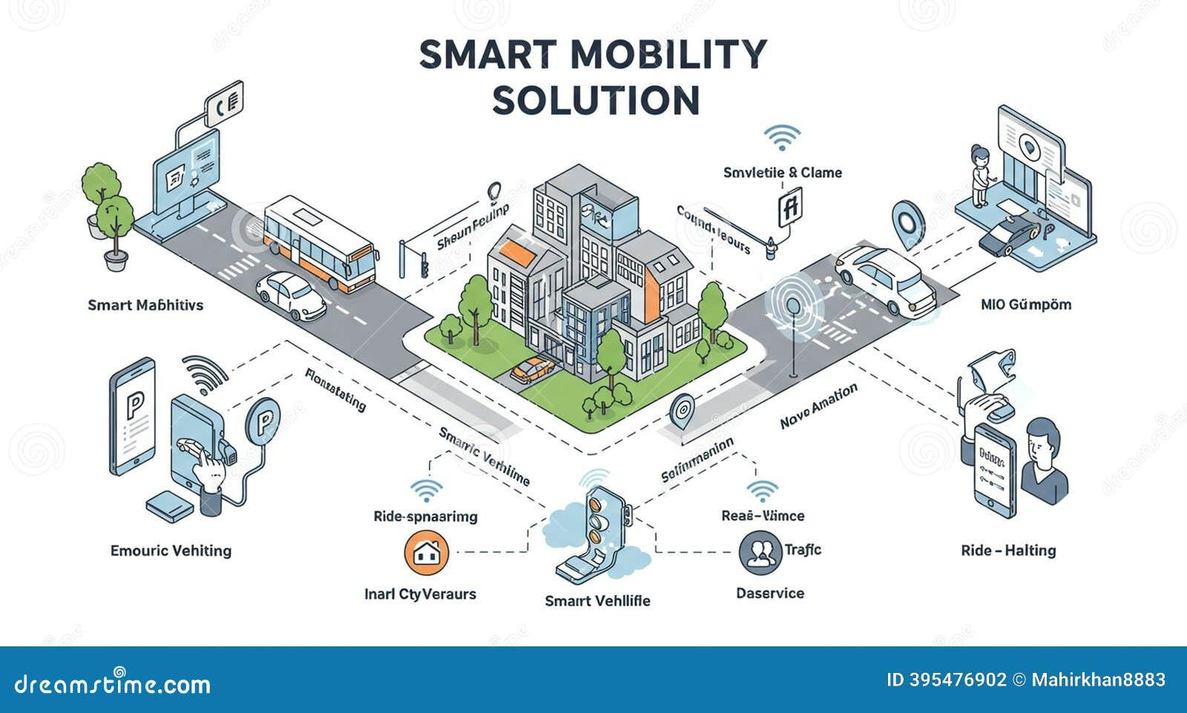
Future of MaaS
Full integration into Smart City ecosystems – MaaS will connect with traffic management systems, urban logistics platforms, and environmental monitoring tools, creating a unified urban mobility control layer. MaaS platforms will communicate directly with traffic signals, parking management systems, EV charging infrastructure, and even weather services to optimize mobility in real time.
Subscription-based mobility replacing car ownership – Monthly or pay-as-you-go mobility packages will provide unlimited access to a range of transport modes, making personal car ownership less attractive. Just like streaming services replaced buying DVDs, integrated mobility subscriptions will replace private car ownership for many urban residents, bundling buses, trams, bikes, car-sharing, and taxis into one plan.
Source: Dreamstime – “Artwork depicts smart mobility concept featuring various vehicles & urban infrastructure enhancements” https://www.dreamstime.com/illustration/smart-mobility.html

Slide 24
Accessibility & Inclusivity Tools
Accessibility tools are essential for ensuring that multimodal mobility systems truly serve all users, regardless of physical abilities.
Real-time accessibility info – live updates on elevator/lift availability, step-free access points, platform changes, and accessible facilities at stations or hubs. Real-time accessibility information helps travelers adapt their routes on the go, avoiding inaccessible links or malfunctioning infrastructure.
Step-free route planning – algorithms prioritizing paths without stairs or steep gradients, integrating ramps, tactile paving, and wide doors for wheelchair and stroller access. Step-free route planning supports wheelchair users, parents with strollers, and travelers with heavy luggage, making multimodal transport more inclusive.
Audio guidance systems – turn-by-turn navigation and stop announcements for visually impaired users, integrated with tactile maps and haptic feedback. Audio guidance systems, coupled with tactile and visual cues, create an environment where visually impaired users can navigate independently and confidently.
These features align with the principles of universal design, ensuring equitable access to mobility for all.

Slide 25
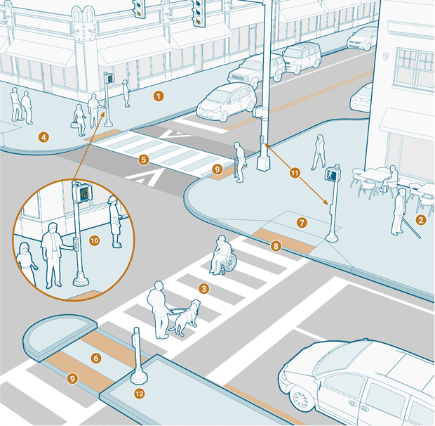
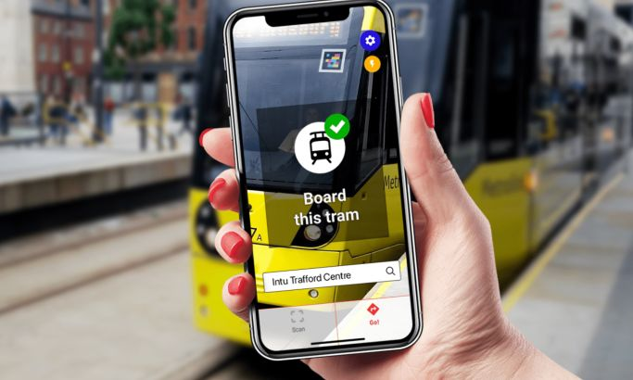
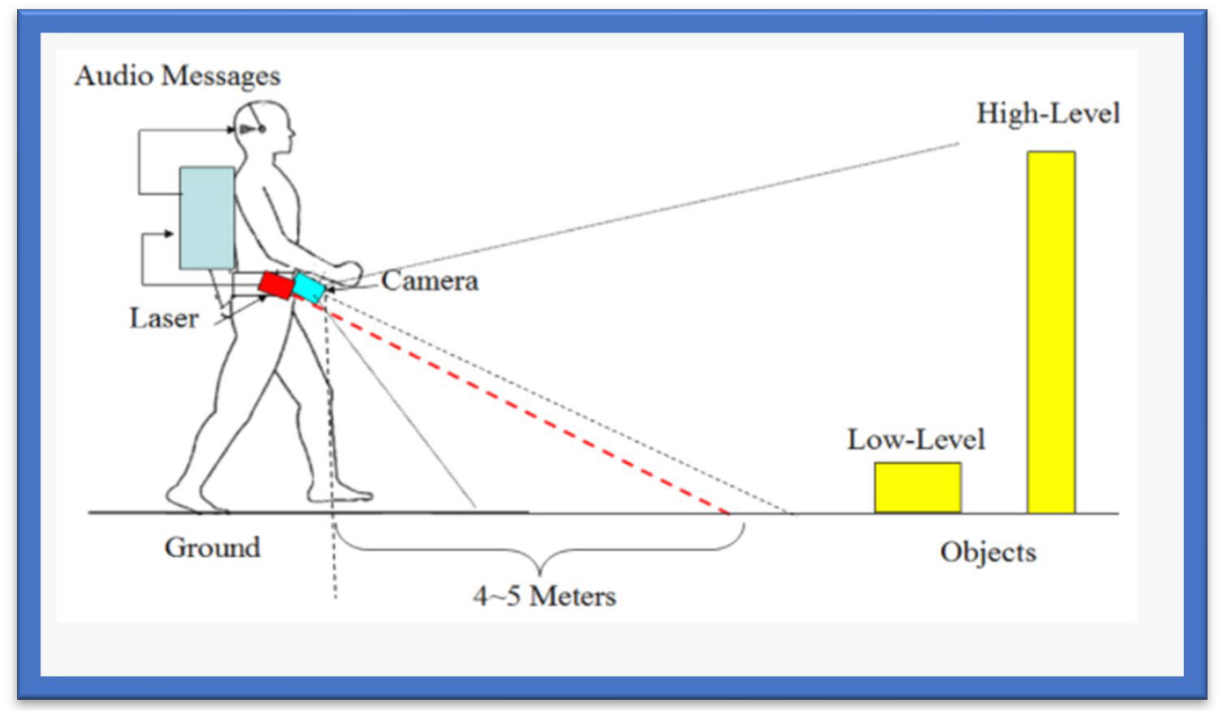
Accessibility & Inclusivity Tools
Step-free route planning
Real-time accessibility info
Source: https://www.designrush.com/best-designs/apps/transport-accessibility-app-design
Audio guidance systems
Sourcehttps://pl.pinterest.com/pin/329818372694310173/
https://encyclopedia.pub/entry/33159

Slide 26
Future Tech Trends
Emerging technologies are set to transform how multimodal transport systems are planned and operated
AI for predictive mobility – Artificial Intelligence will forecast demand, optimize routes, and dynamically adjust transport supply, improving efficiency and reducing congestion. AI-driven predictive mobility will integrate historical travel data, live traffic information, and external factors like weather or events to predict future mobility needs. This will enable proactive traffic management, better fleet allocation, and reduced delays.
Autonomous shuttles – Self-driving, on-demand minibuses will provide flexible last-mile connectivity, complementing mass transit and reducing reliance on private cars. Autonomous shuttles will be deployed in both high-density city centers and low-density suburbs, bridging the “last-mile” gap. They will operate as part of integrated Mobility-as-a-Service platforms, making public and shared transport more attractive.
Digital twins for cities – Virtual 3D replicas of urban areas will allow planners to simulate traffic, mobility patterns, and infrastructure changes in real time before physical implementation. Digital twins will serve as powerful planning and decision-making tools. By mirroring the city’s transport network in real time, they will allow testing of scenarios (e.g., road closures, new cycle lanes) before committing resources, ensuring data-driven and sustainable urban mobility strategies.

Slide 27
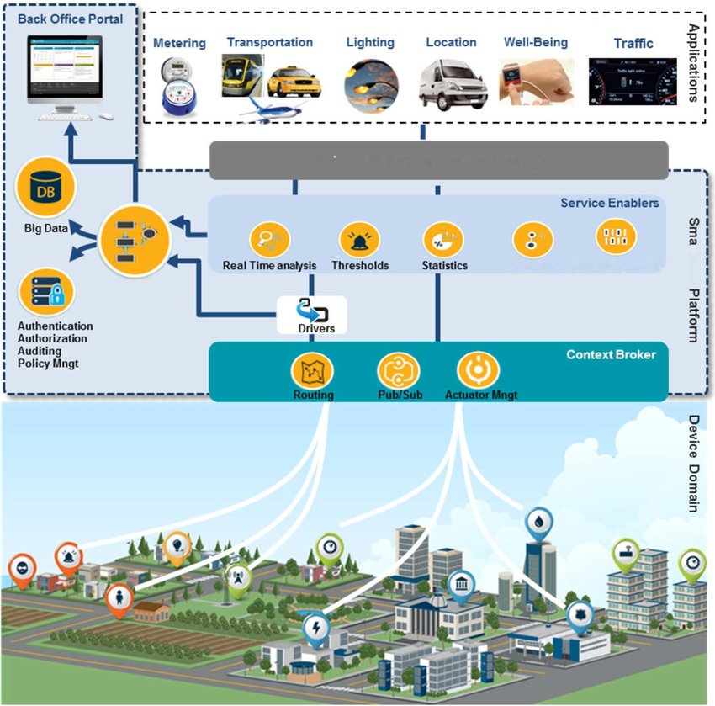
Strategies for Integrating Multiple Modes Using ITS and MaaS - Core Principles for Integration
Integrating multiple modes through ITS requires both technical interoperability and policy-level cooperation.
Interoperability across systems – ensuring compatibility between public transport, private operators, micromobility services, and digital platforms through open data exchange standards (e.g., GTFS, SIRI, DATEX II). Interoperability ensures that data on schedules, vehicle availability, fares, and disruptions can be exchanged automatically and without loss between systems.
Unified data platforms – centralized repositories or cloud-based solutions that integrate real-time information from multiple sources, enabling consistent planning, management, and reporting. Unified data platforms reduce fragmentation and enable quick responses to changes in traffic conditions, breakdowns, or sudden demand spikes.
Source: https://www.researchgate.net/figure/sualization-of-a-Smart-City-Infrastructure-with-Sensors-Smart-Data-Platform-and_fig1_283769999

Slide 28

Strategies for Integrating Multiple Modes Using ITS - Core Principles for Integration
User-centered design – creating interfaces and services that prioritize passenger needs, including those with disabilities, rather than focusing solely on operator convenience. User-centered design builds trust and loyalty — interfaces must be simple, consistent, and intuitive, regardless of the service provider.
Scalability and flexibility – allowing the system to expand with new transport modes or functionalities without requiring a complete architectural overhaul. Scalability is critical to adapt to future technology developments (e.g., autonomous vehicles) and evolving mobility trends.
Source: https://pegotec.net/mastering-user-centric-digital-interface-design-a-guide-to-success/

Slide 29
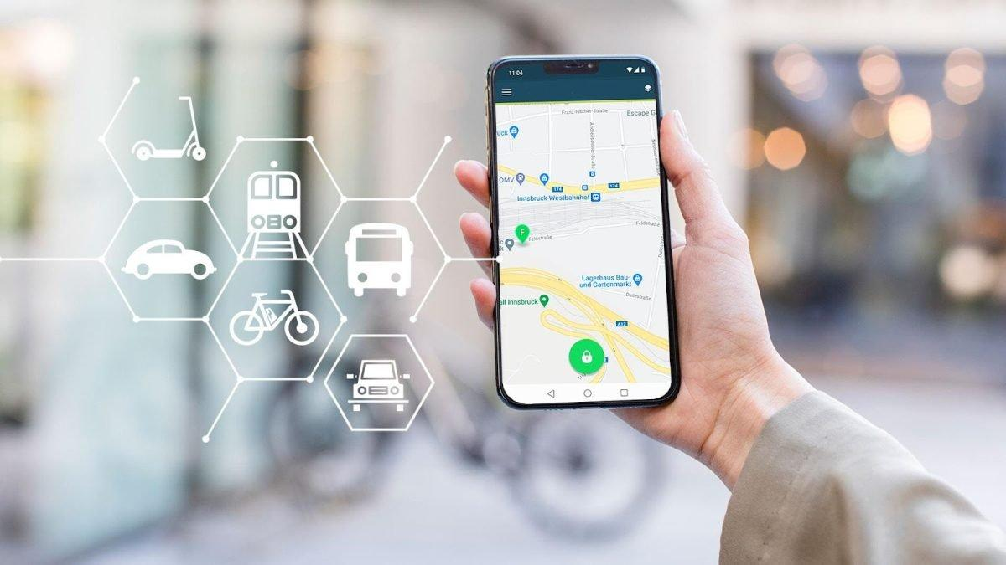
Mobile Apps & Integrated Ticketing
Single app for planning & payment – Consolidates trip planning, booking, and payment for buses, trains, bike-sharing, ride-hailing, and other modes in one interface. By unifying multiple services into a single, user-friendly app, passengers can seamlessly organize their entire trip — from route selection to ticket purchase — without switching between multiple platforms.
Real-time multimodal updates – Provides live information on delays, cancellations, vehicle arrival times, and alternative routes. Real-time multimodal updates help users adapt to changes instantly, improving reliability and convenience.
E-wallets & QR codes – Enables quick, contactless payments and easy access to services without physical tickets. Integrated e-wallets and QR code functionality streamline fare payments, reduce queuing, and support contactless travel.
This approach enhances user experience, fosters adoption of sustainable modes, and increases operational efficiency for providers.
https://metrorailnews.in/maas-the-plan-book-ride-journey/

Slide 30

Real-Time Data Sharing
Vehicle location updates – Continuous GPS tracking allows accurate ETAs, reducing passenger uncertainty and improving transfer coordination.
Demand-responsive services – Live monitoring enables dynamic route adjustments or on-demand vehicle dispatch to meet fluctuating passenger needs.
Incident alerts – Instant notifications about accidents, disruptions, or weather hazards allow both operators and passengers to adapt quickly.
Real-time data sharing transforms static schedules into living, adaptive mobility networks. By connecting vehicle telematics, infrastructure sensors, and user-facing apps through interoperable standards, transport operators can react to unexpected events—rerouting vehicles, adjusting capacity, or informing passengers in seconds.
This level of integration depends on robust partnerships between public agencies, private operators, and technology providers, supported by agreed-upon data formats (e.g., GTFS-Realtime, DATEX II).When done right, real-time data exchange not only improves reliability but also builds user trust by keeping passengers informed and in control of their journey.
https://www.electronicproducts.com/designers-guide-for-deploying-sensors-in-smart-cities/

Slide 31
Coordinated Urban Traffic Management
Coordinated urban traffic management relies on integrated ITS platforms that connect traffic signals, sensors, and control centers.
Adaptive signal control – Traffic signals adjust their timing in real time based on actual traffic demand and conditions. Adaptive signal control uses real-time data from loop detectors, cameras, or connected vehicles to optimize intersection performance, reducing unnecessary stops and travel times.
Public transport priority – Buses and trams receive green-light priority at intersections to improve reliability and reduce delays. Public transport priority systems communicate directly with traffic lights, ensuring buses and trams move efficiently through busy corridors.
Dynamic lane management – Lanes can be reassigned in real time for buses, carpools, or general traffic depending on demand and incidents. Dynamic lane management reallocates space on the road network—for example, converting a general-purpose lane into a bus lane during peak hours, or opening reversible lanes to accommodate tidal flows.
The ultimate goal is to balance efficiency and sustainability, giving more road space and priority to high-capacity, low-emission modes while keeping the overall network fluid.

Slide 32
Cybersecurity & Reliability
As urban mobility becomes more connected, cybersecurity is not optional — it is mission-critical. ITS platforms collect and transmit sensitive operational and personal data, including vehicle positions, payment details, and passenger information. Without robust security, these systems are vulnerable to hacking, data breaches, or operational sabotage.
Secure data transmission – Encryption and authentication protocols to safeguard information exchanged between vehicles, infrastructure, and control systems. Secure data transmission involves strong encryption, multi-factor authentication, and secure APIs for third-party integration.
System redundancy – Backup servers, communication links, and failover strategies to maintain service continuity during technical failures or cyber incidents. System redundancy ensures that if one component fails — whether due to technical malfunction, cyberattack, or natural disaster — operations can seamlessly switch to backups without disrupting services.
Compliance with standards – Adherence to recognized frameworks such as ISO 27001 (information security), IEC 62443 (industrial control systems security), and relevant ITS interoperability standards. Compliance with standards not only meets legal and contractual obligations but also fosters interoperability, enabling safe and secure integration between different operators and platforms.
Cybersecurity and reliability are key trust enablers for both users and operators in a multimodal ITS ecosystem.

Slide 33
Impact of ITS on Urban Mobility - Enhanced User Experience
A core benefit of Intelligent Transport Systems (ITS) is how they improve the day-to-day travel experience for passengers.
Real-time travel info – Accurate, up-to-the-minute updates on vehicle arrivals, delays, service disruptions, and alternative routes. Real-time travel information — delivered via station displays, mobile apps, and even wearable devices — reduces the anxiety of waiting, helps passengers make informed choices, and allows them to adapt to disruptions instantly.
Predictable journey times – Consistent travel durations thanks to adaptive traffic control, priority for public transport, and optimized routing. Predictable journey times are critical for both commuters and occasional travelers. Through adaptive traffic signal control, real-time fleet management, and congestion avoidance strategies, ITS minimizes variability, making arrival times more reliable.
Seamless transfers – Coordinated schedules and integrated ticketing that make switching between modes smooth and stress-free. Seamless transfers ensure that passengers can switch from bus to tram, train, bike-share, or other modes without delays or confusion. This is enabled by synchronized timetables, physical infrastructure (e.g., well-designed interchange hubs), and digital integration such as unified ticketing and Mobility-as-a-Service (MaaS) platforms.

Slide 34
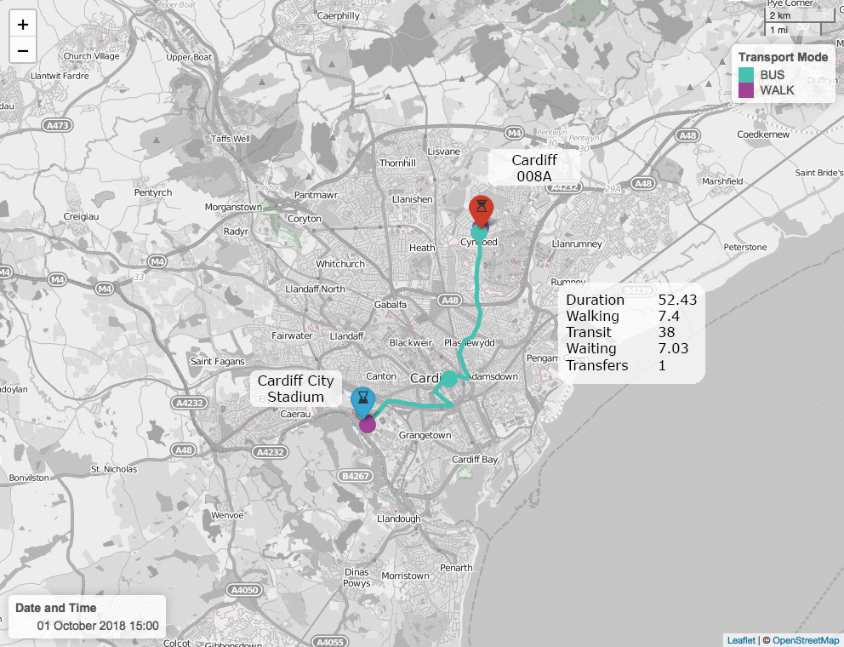
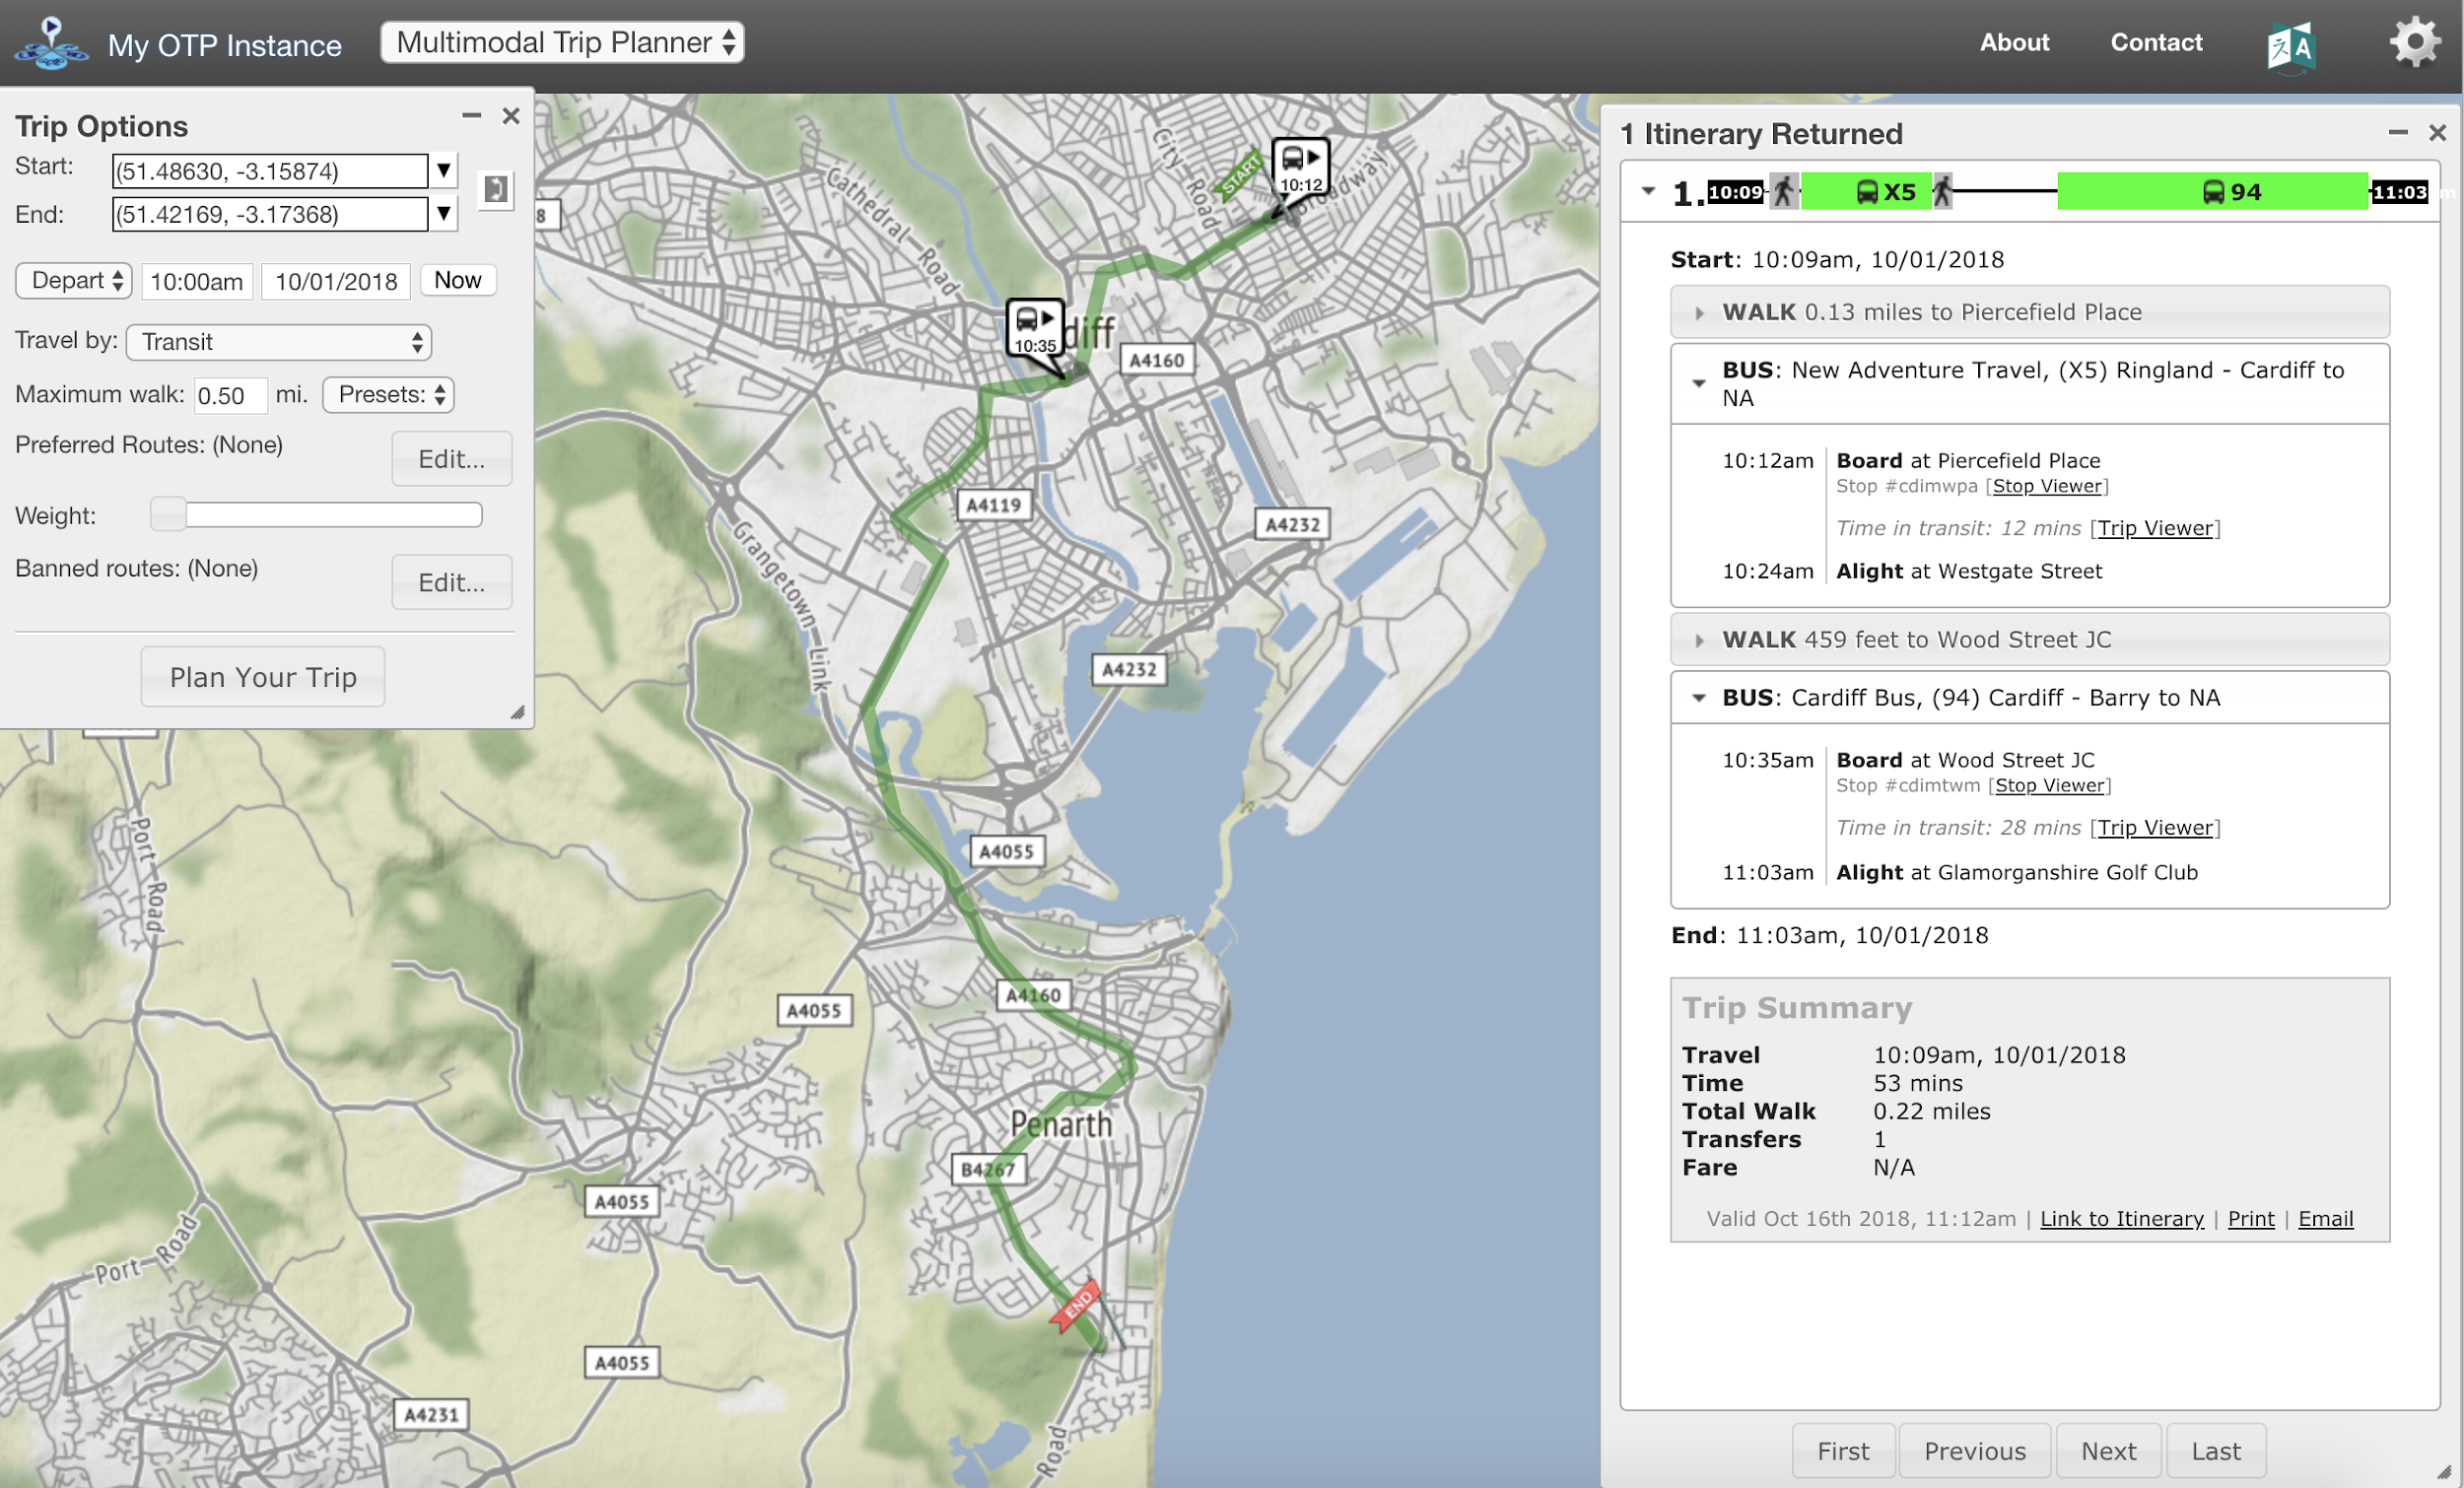
Multimodal Route Optimization
Multimodal route optimization is a key function of modern Intelligent Transport Systems (ITS) and Mobility-as-a-Service (MaaS) platforms. Instead of simply offering the shortest path for a single mode, these systems combine different transport options to produce a journey that balances time, cost, environmental impact, and convenience.
https://datasciencecampus.ons.gov.uk/access-to-services-using-multimodal-transport-networks/

Slide 35
Multimodal Route Optimization
Cross-mode route planning – At the heart of modern multimodal mobility lies a set of sophisticated routing algorithms capable of combining data from diverse transport modes into a single, optimized travel plan. These algorithms typically operate in three stages:
  Data aggregation and normalization – Real-time feeds are collected from public transport operators (GTFS-real-time for schedules and vehicle positions), micro-mobility providers (bike/e-scooter availability), road traffic sensors, and weather services. Because each source uses different formats, the system must standardize inputs to enable seamless analysis.
  Graph-based network modeling – The city’s transport infrastructure is represented as a multi-layer network graph, where each layer corresponds to a mode (e.g., bus, metro, bike). Nodes represent stops, stations, or key intersections, while edges represent possible travel segments with associated costs (time, price, energy use, CO₂ emissions). Cross-layer edges enable mode transfers, with penalties for walking time, waiting, or accessibility barriers.
  Multi-criteria pathfinding – Instead of just finding the “shortest” path, algorithms use multi-objective optimization techniques (e.g., Dijkstra’s or A* variants, label-setting algorithms, or Pareto-optimal search) to balance competing priorities: Travel time – minimizing door-to-door duration. Cost – optimizing for the cheapest fare or fuel use. Sustainability – minimizing emissions or energy consumption. User preferences – avoiding stairs, maximizing cycling, or minimizing transfers.
  Some advanced systems apply machine learning models to personalize recommendations based on past user choices and real-time demand prediction. Others integrate dynamic re-routing, continuously re-evaluating the trip plan as conditions change (delays, congestion, weather).

Slide 36
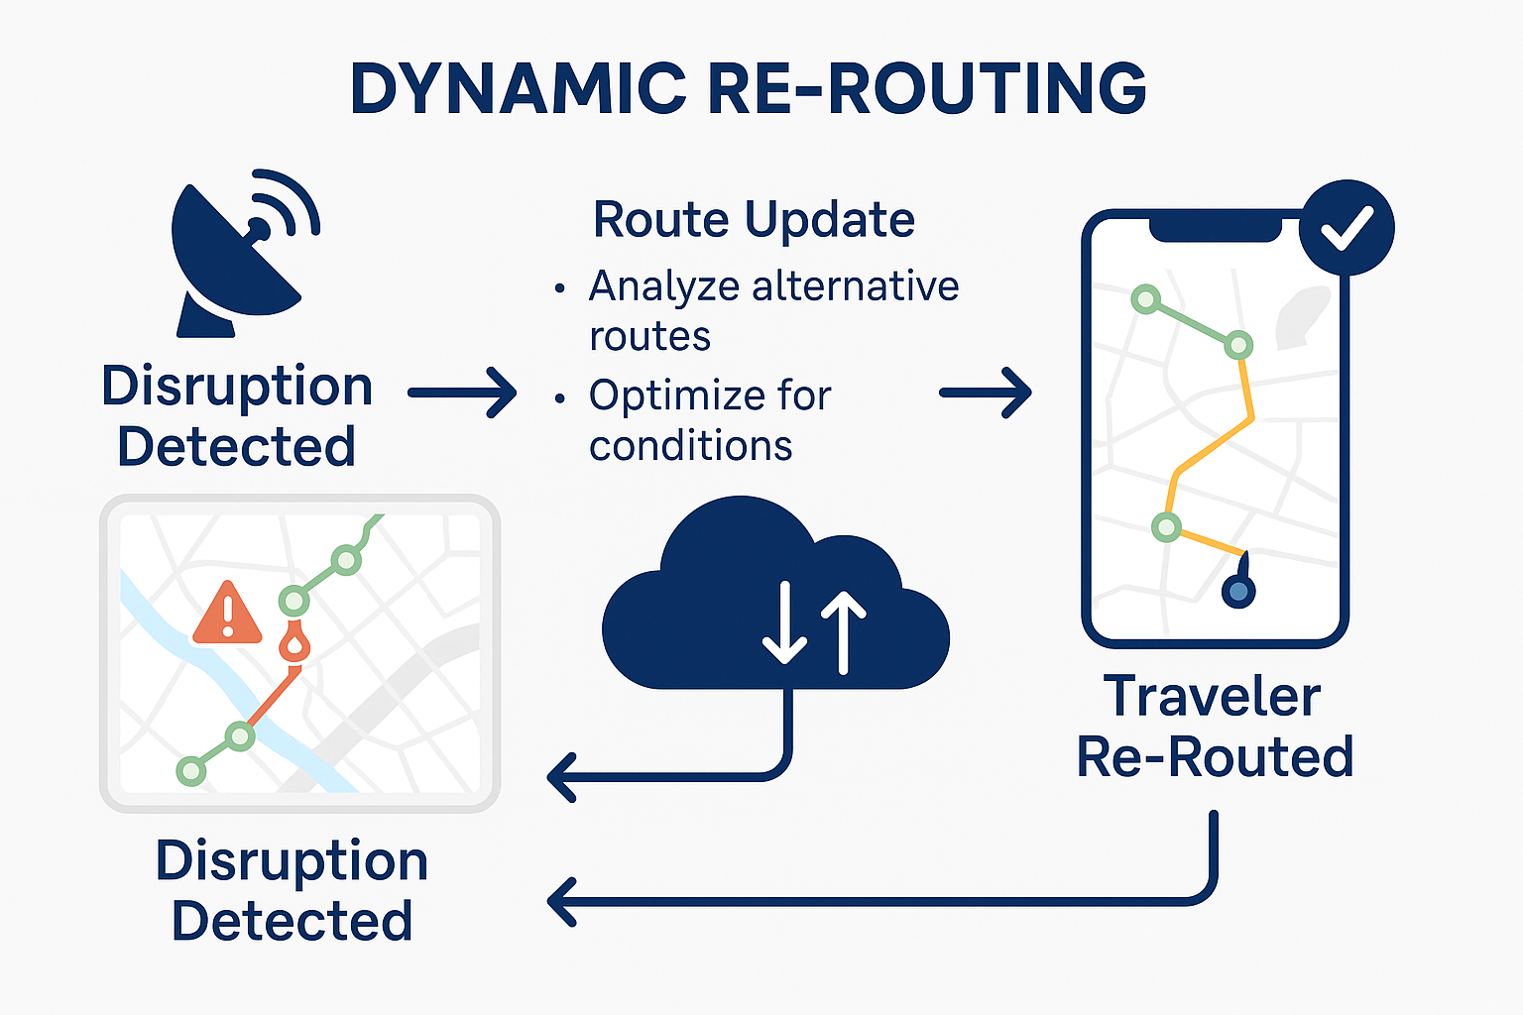
Multimodal Route Optimization - Dynamic re-routing
Dynamic re-routing – In a truly responsive multimodal network, the route a traveler starts with is not necessarily the route they finish with. Dynamic re-routing continuously monitors network conditions and updates journey recommendations in real time, ensuring that users always follow the most efficient, reliable, and comfortable path.

Slide 37
Multimodal Route Optimization - Dynamic re-routing
Continuous condition monitoring: Real-time feeds from traffic sensors, GPS-equipped vehicles, public transport control centers, and crowdsourced apps (e.g., Waze, Moovit) detect disruptions such as traffic jams, signal failures, accidents, road closures, and extreme weather. Data latency is critical — even a 1–2 minute delay in incident reporting can make a route suggestion obsolete in fast-changing urban environments.
Automated re-optimization: Once a disruption is detected, routing algorithms (often based on incremental shortest path recalculation rather than full recomputation) determine if an alternative is preferable. Algorithms weigh costs and benefits of switching routes — for example, avoiding a 15-minute bus delay by transferring to a metro line, even if it adds one extra transfer. In multimodal cases, re-routing may involve changing modes entirely (e.g., switching from shared e-scooter to bus) if that’s the fastest way to complete the journey.

Slide 38
Multimodal Route Optimization - Dynamic re-routing
User notification and interaction: Updates are pushed to the traveler’s app with clear, actionable instructions (e.g., “Exit at next stop and take tram line 5 — arrival in 4 minutes”). Systems can provide multiple re-route options ranked by travel time, cost, or environmental impact, letting the user choose.
Context-aware adjustments: Advanced systems integrate personal preferences (e.g., avoiding stairs, minimizing walking) so the new route still fits the user’s needs. External factors like rain or poor air quality can automatically shift recommendations toward covered or indoor transfer points.
Integration with MaaS ecosystems: When tied to Mobility-as-a-Service platforms, dynamic re-routing can automatically update tickets, reservations, and payments so the traveler doesn’t have to re-book manually.

Slide 39
Multimodal Route Optimization - Event-based adjustments
Event-based adjustments play a critical role in keeping urban mobility systems resilient and responsive. Large-scale events such as concerts, sports matches, festivals, political gatherings, or even planned construction works can cause sudden spikes in travel demand or restrict access to certain areas.
Modern Intelligent Transport Systems (ITS) integrate multiple data sources — including event schedules, ticket sales, crowd density sensors, and historical mobility patterns — to forecast these demand surges in advance. Predictive models, often supported by machine learning algorithms, can estimate passenger volumes by time, mode, and location.

Slide 40
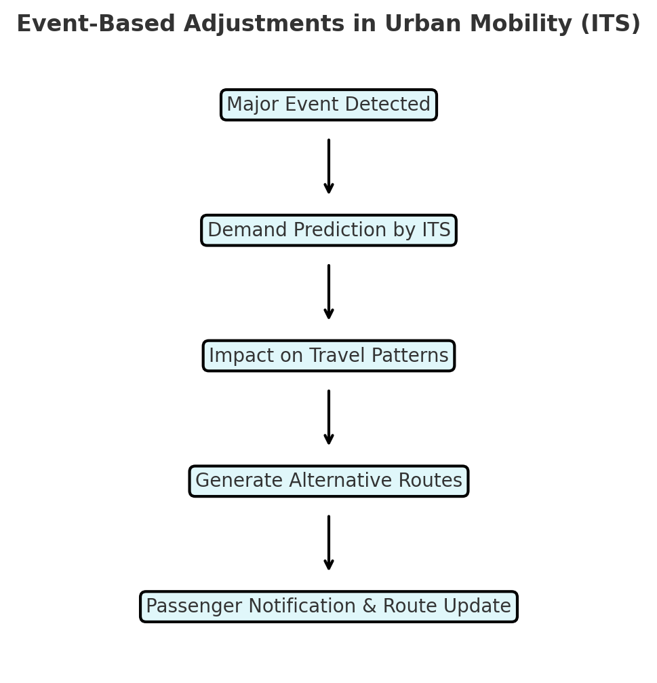
Multimodal Route Optimization - Event-based adjustments
When a potential bottleneck is identified, the system can automatically:
  Adjust traffic signal timings to favor public transport or key corridors.
  Deploy additional services such as extra buses, trains, or shared mobility vehicles.
  Push targeted notifications to affected passengers, suggesting alternative routes, departure times, or modes (e.g., cycling, park-and-ride, or walking for short distances).
  Coordinate with police and event organizers to manage road closures and crowd control.
By acting proactively rather than reactively, event-based adjustments minimize congestion, reduce travel time variability, and maintain safety for both event attendees and the wider urban transport network.

Slide 41
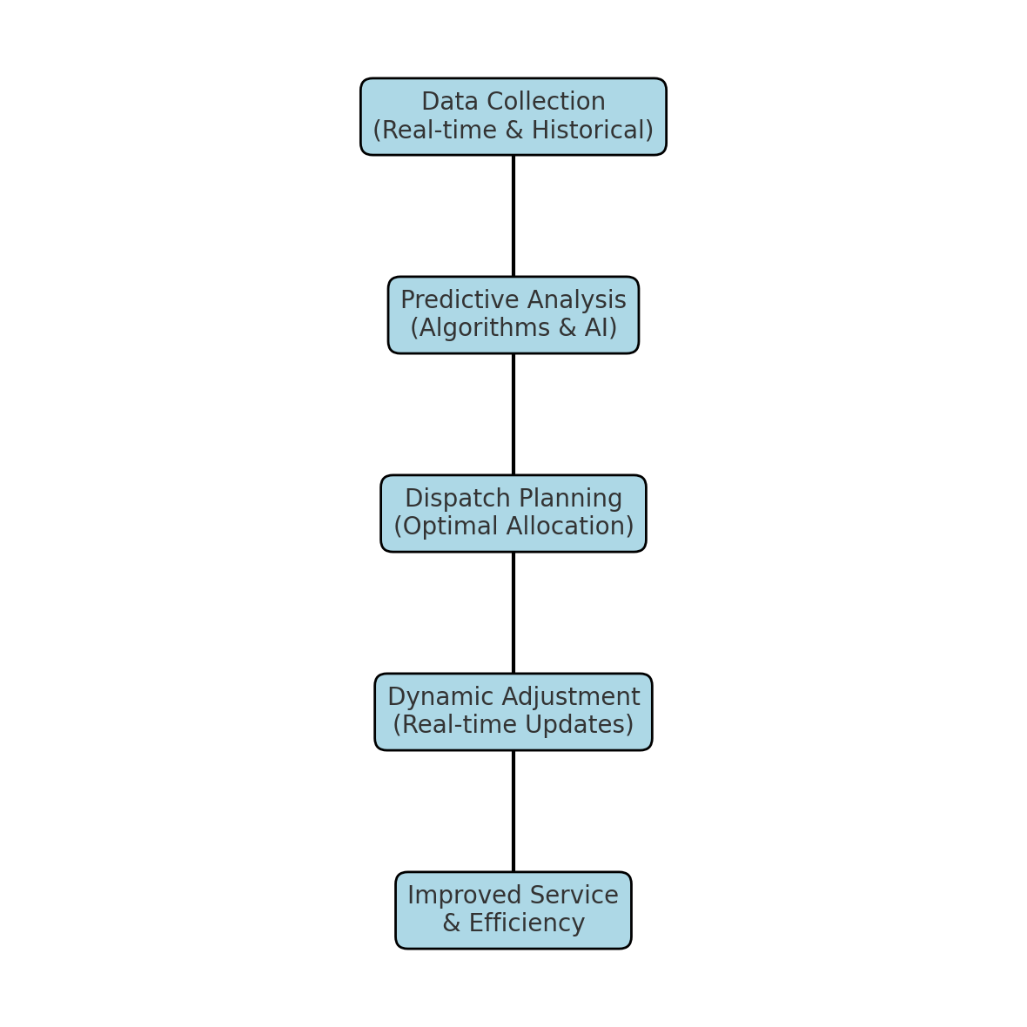
Operational Efficiency- Optimized vehicle dispatch
Optimized vehicle dispatch – the use of predictive algorithms and real-time data to plan and allocate vehicles exactly where they are most needed.
This involves continuously analyzing factors such as passenger demand, traffic conditions, vehicle locations, and service schedules to ensure the right number and type of vehicles are deployed at the right time and place.
By anticipating demand patterns rather than reacting only when a shortage or surplus occurs, transport operators can:
  Reduce waiting times for passengers.
  Minimize empty runs and unnecessary mileage.
  Increase fleet utilization rates, ensuring that vehicles are active when and where they bring the most value.
Predictive dispatch systems can integrate with Automatic Vehicle Location (AVL) data, ticketing systems, and traffic management platforms, enabling dynamic adjustments in response to accidents, weather disruptions, or special events. Over time, machine learning models can further refine these dispatch strategies by learning from historical patterns and outcomes.

Slide 42
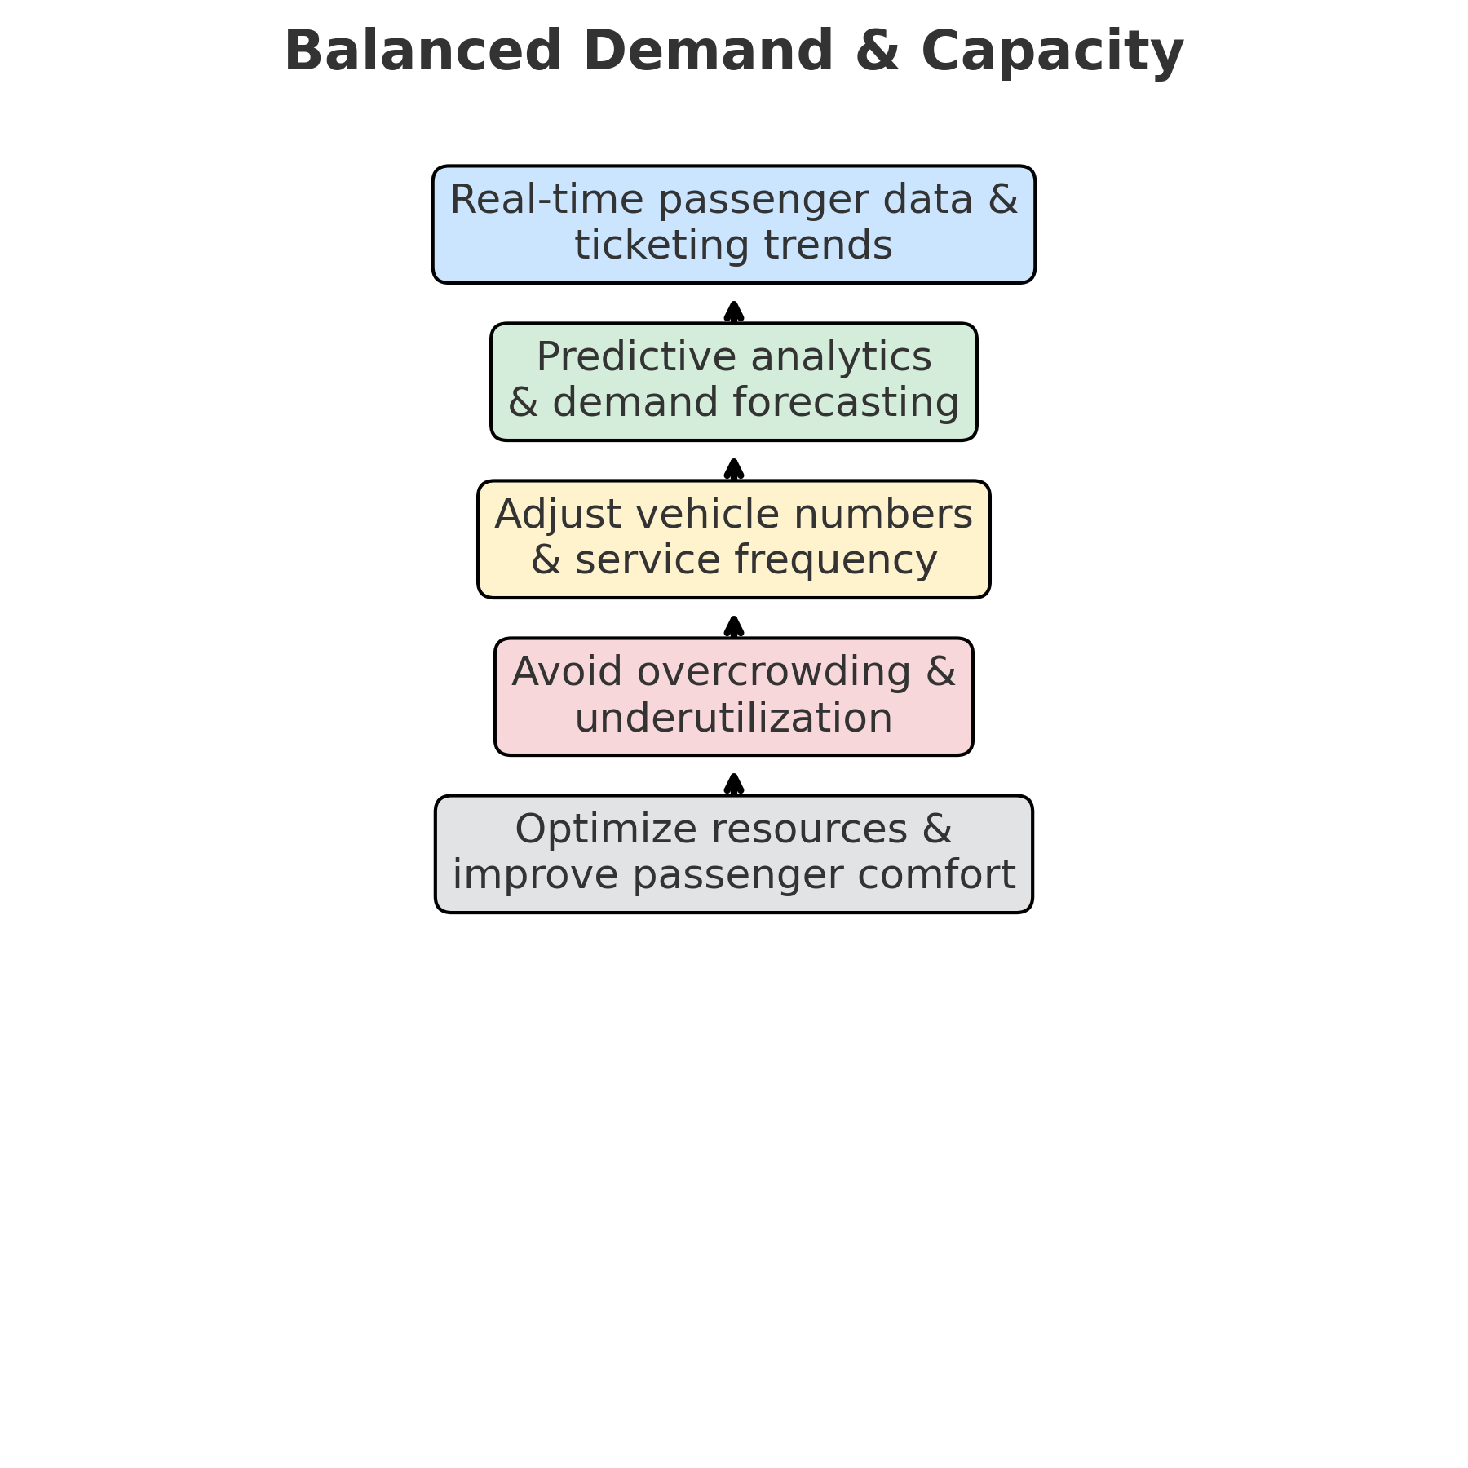
Operational Efficiency- Optimized vehicle dispatch
Balanced demand and capacity – The use of real-time passenger data, ticketing trends, and predictive analytics to continuously adjust the number of vehicles in operation and service frequency.
This ensures that supply matches actual demand throughout the day. By preventing both overcrowding during peak hours and underutilization during off-peak times, operators can optimize resource allocation, improve passenger comfort, and reduce unnecessary operating costs.

Slide 43
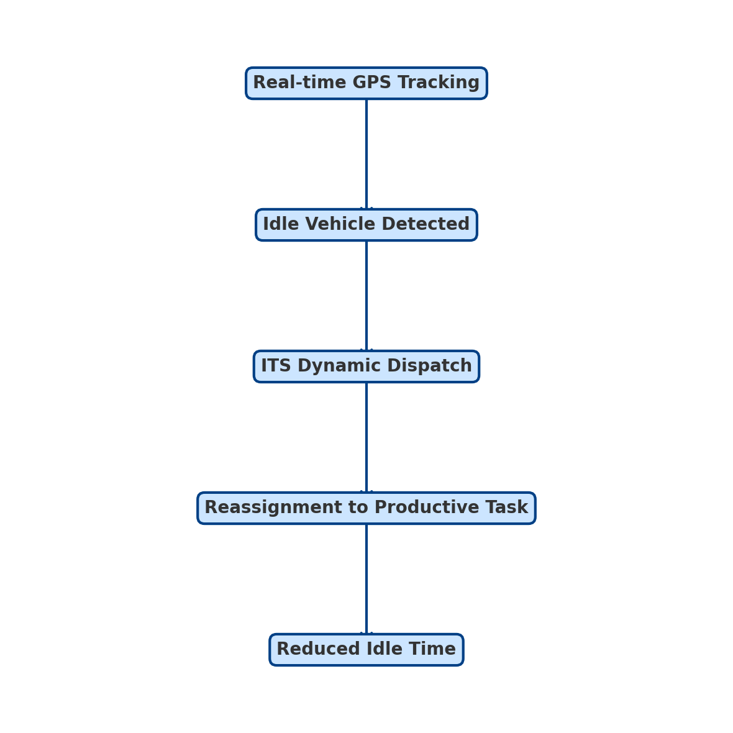
Operational Efficiency- Reduced idle time
Reduced idle time – minimizing vehicle downtime through dynamic dispatching and intelligent scheduling. Using real-time GPS tracking, fleet telematics, and predictive algorithms, ITS can identify idle vehicles and immediately reassign them to productive routes or tasks. This approach:
Maximizes fleet utilization – every vehicle is kept in motion where it is most needed.
Cuts operational costs – less wasted fuel, fewer unproductive driver hours.
Improves responsiveness – faster deployment for unexpected demand or service disruptions.
Reduces congestion and emissions – by avoiding unnecessary circulation or deadheading trips.
Typical ITS tools for reducing idle time include:
Dynamic task allocation platforms (automatic job assignment).
Geo-fencing to trigger task alerts when a vehicle enters a certain area.
Demand forecasting to anticipate upcoming needs.

Slide 44
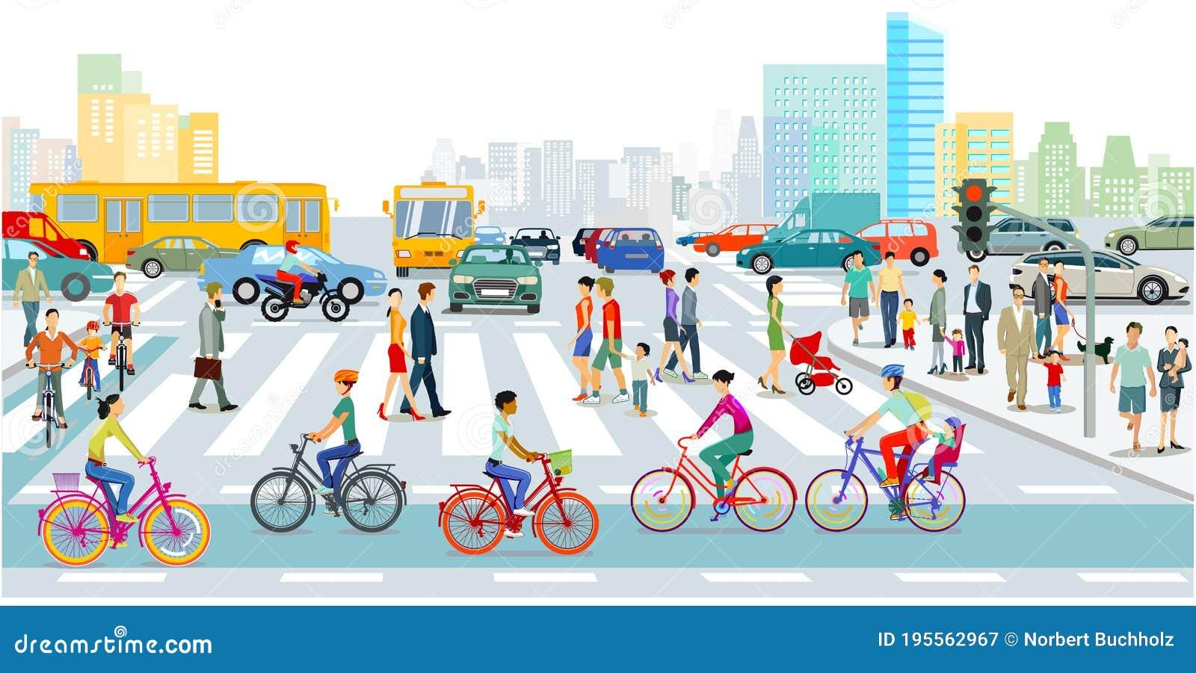
Impact of ITS on Urban Mobility - Environmental & Health Impacts
ITS plays a crucial role in achieving environmental and health benefits in urban mobility systems.
Reduced emissions are achieved by promoting modal shift from private vehicles to public transport, cycling, and walking, alongside the integration of electric mobility and adaptive traffic control that minimizes idling.
Noise reduction results from both traffic flow improvements and the adoption of quieter transport modes such as EVs, reducing exposure to harmful noise levels linked to stress, cardiovascular issues, and sleep disturbance.
Encouraging active travel through ITS-powered navigation, safe cycling routes, and multimodal integration fosters better public health outcomes, lowering rates of obesity and related diseases.
Source: Alamy – “Eco-Friendly Transportation Set”

Slide 45
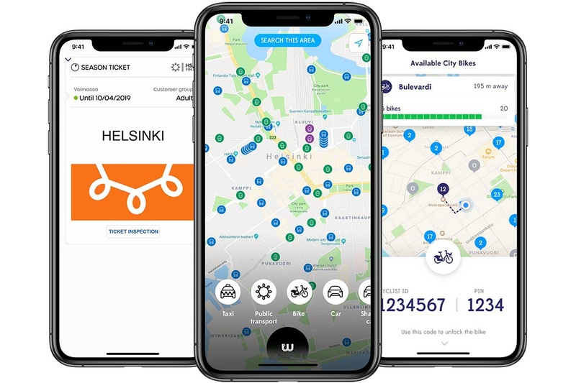
Case Studies of Successful Multimodal Systems Utilizing ITS - Helsinki (Whim Platform) - Whim by Whim (Full MaaS Integration)
Full integration across public transit, taxis, car-sharing, and bicycles
Subscription-based mobility plans
Multi-operator collaboration
Helsinki’s Whim platform, developed by MaaS Global, exemplifies full MaaS integration. It allows users to plan, book, and pay for trips across multiple modes—such as public transit, taxis, car-sharing, and bikes—through one app and subscription plan. By integrating offerings from various operators, it provides a compelling alternative to private car ownership. Whim packages often include unlimited public transit, capped taxi fares, and optional car rentals or bike-sharing, all under unified pricing plans.
https://kollektivtrafikk.no/app/uploads/2021/04/Ramboll_whimpact-2019.pdf

Slide 46
Case Studies of Successful Multimodal Systems Utilizing ITS - Helsinki (Whim Platform) - Subscription-Based Mobility
Flat-fee mobility plans as an alternative to ownership
Pay-as-you-go and all-inclusive options
User-centric flexibility and choice
Whim offers several subscription tiers that bundle public transit, taxis, car rentals, and bike-share—providing flexibility based on user needs. Options range from pay-as-you-go to all-inclusive unlimited plans. For instance, the "Unlimited" package offers unlimited public transit, free short taxi rides (within 5 km), and car usage—all for a fixed monthly fee. This subscription model reduces dependence on personal car ownership and promotes modal shift.

Slide 47
Case Studies of Successful Multimodal Systems Utilizing ITS - Helsinki (Whim Platform) - Multimodal Operator Collaboration
Integration of public, private, and shared mobility services
Seamless booking and ticketing across modes
Legislation enabling data-sharing and provider cooperation
Whim’s success stems from its ability to collaborate with a wide range of providers—from public transit authorities to car rental firms like Sixt and Hertz, taxi companies, and micromobility operators. This ecosystem is supported by Finnish legislation mandating data openness since 2017, enabling interoperability and unified booking experiences. Through the MaaS approach, users benefit from seamless payment and travel across a provider-spanning network.

Slide 48
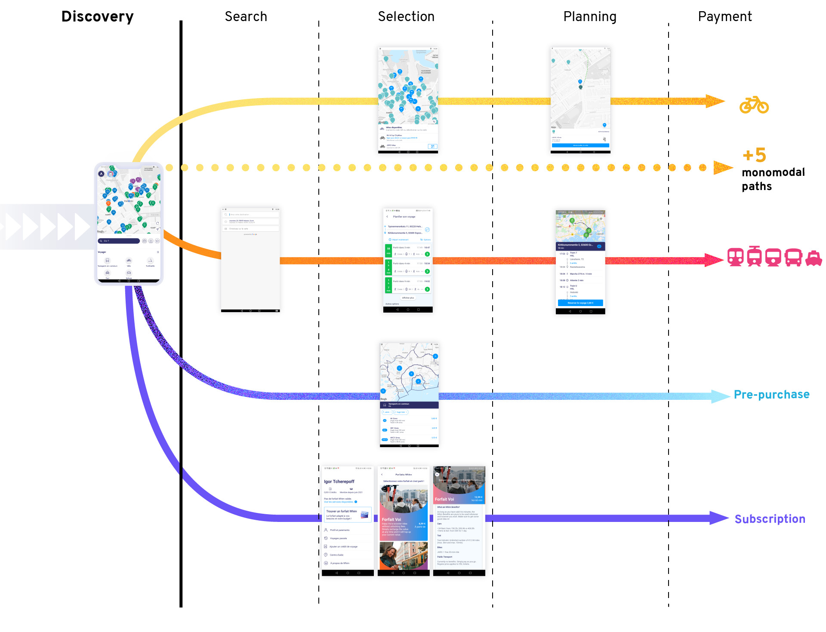
Case Studies of Successful Multimodal Systems Utilizing ITS - Helsinki (Whim Platform) - Multimodal Operator Collaboration
Complete MaaS integration
Subscription-based mobility models
Cross-operator collaboration enabled by open data frameworks
https://m2050.media/en/whim-user-experience-application-maas-ux-design

Slide 49
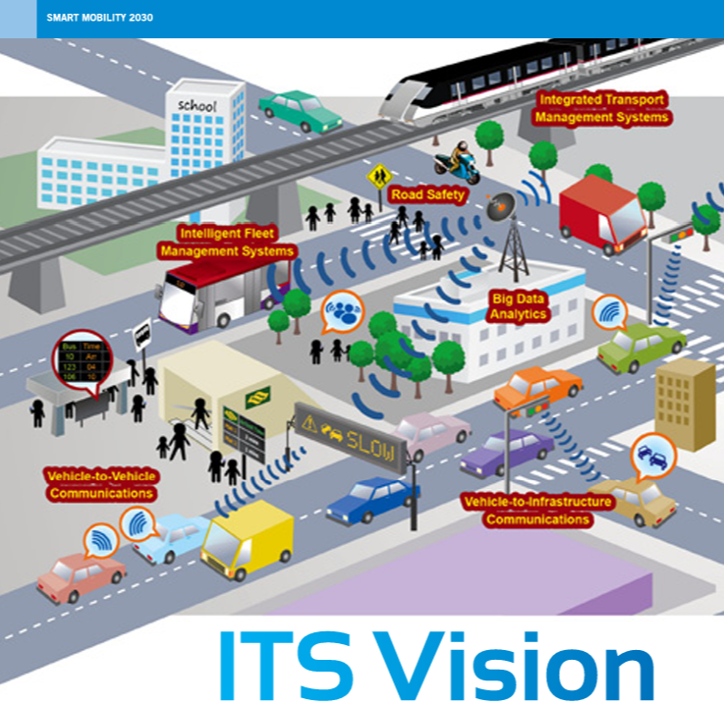
Case Studies of Successful Multimodal Systems Utilizing ITS - Singapore (Smart Mobility 2030)
Singapore’s ITS Masterplan (Smart Mobility 2030)
National ITS masterplan led by LTA and ITS Singapore
Integrated “iTransport” platform for coordinated control
Multi-stakeholder alignment for future mobility
Singapore’s Smart Mobility 2030 is a comprehensive blueprint jointly developed by the Land Transport Authority (LTA) and the Intelligent Transportation Society of Singapore (ITSS). Central to this strategy is the iTransport platform, which unifies live data feeds for traffic management and incident response across modes and agencies. This plan prioritizes progressive adoption of ITS standards, sustainable technology, and close public–private collaboration.
https://www.lta.gov.sg/content/dam/ltagov/getting_around/driving_in_singapore/intelligent_transport_systems/pdf/smartmobility2030.pdf

Slide 50
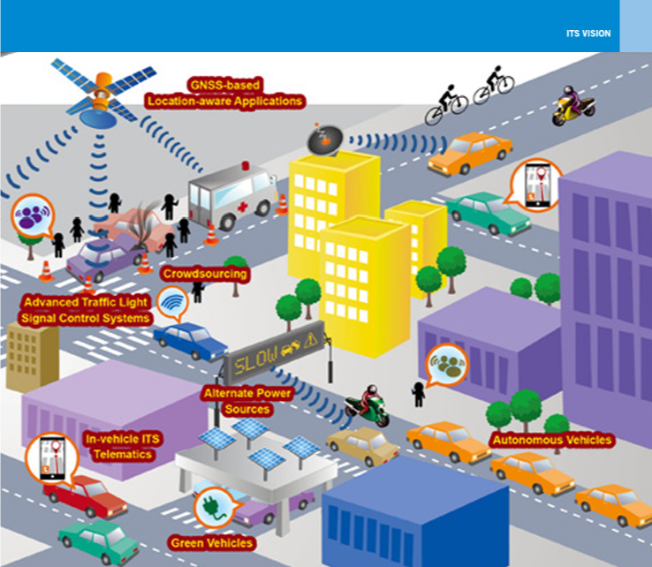
Case Studies of Successful Multimodal Systems Utilizing ITS - Singapore (Smart Mobility 2030)
Real-Time Traffic Optimization
AI and sensor-based congestion management
Dynamic control of traffic lights and electronic tolls (ERP)
Highly responsive traffic control in dense urban layout
Singapore’s ITS infrastructure includes sensor networks, AI-based monitoring, and Adaptive Traffic Management systems that dynamically optimize signal timings and electronic tolling (ERP) to reduce congestion in real time. The system is capable of forecasting traffic flows and automating responses to incidents, improving both efficiency and commuter comfort.
https://www.lta.gov.sg/content/dam/ltagov/getting_around/driving_in_singapore/intelligent_transport_systems/pdf/smartmobility2030.pdf

Slide 51
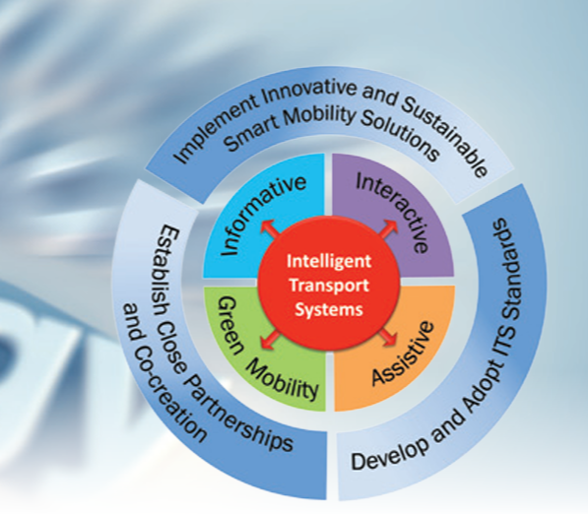
Case Studies of Successful Multimodal Systems Utilizing ITS - Singapore (Smart Mobility 2030)
Integrated Payment Systems
Unified fare systems: EZ-Link, CEPAS, SimplyGo
Contactless, account-based ticketing across transit modes
Seamless rider experience with digital wallet support
Singapore’s fare system is among the most integrated globally. Starting with the magnetic-turned-CEPAS contactless cards, the system evolved into account-based ticketing through SimplyGo, enabling payments via bank cards, mobile wallets, and EZ-Link/NETS stored-value cards. This integration enhances user convenience and supports a smooth, unified travel experience.
https://www.lta.gov.sg/content/dam/ltagov/getting_around/driving_in_singapore/intelligent_transport_systems/pdf/smartmobility2030.pdf

Slide 52
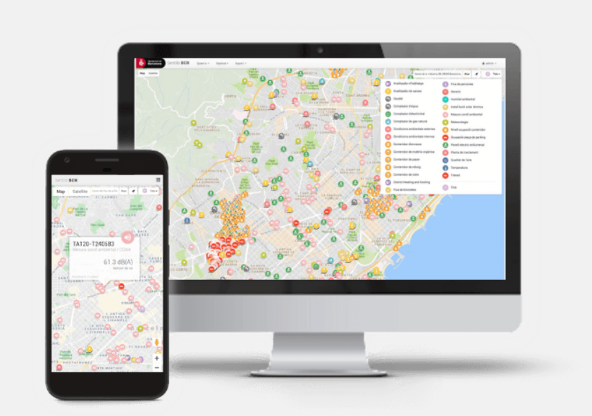
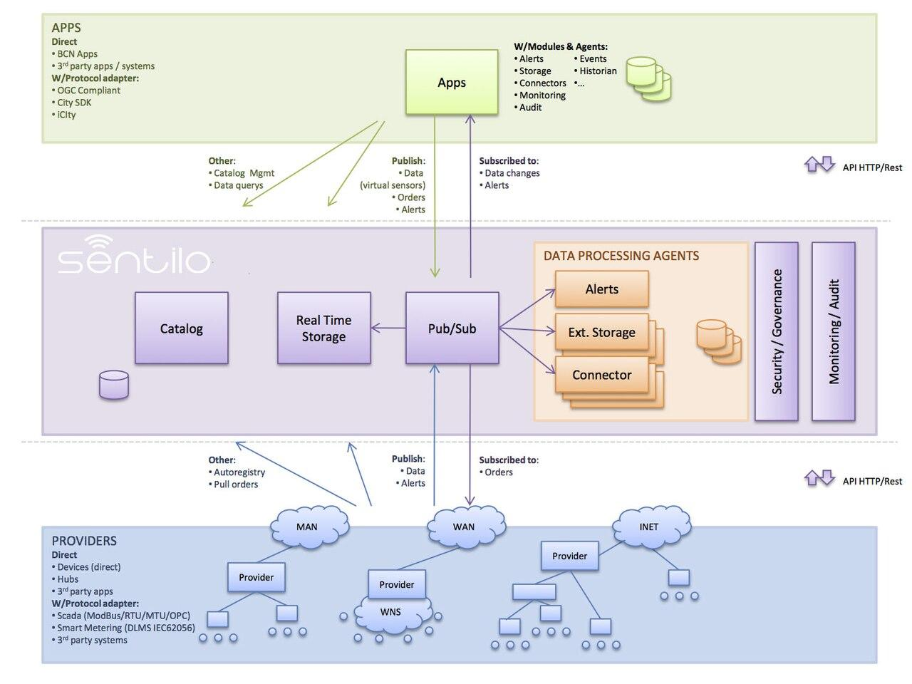
Case Studies of Successful Multimodal Systems Utilizing ITS - Barcelona (Smart Mobility Platform)
Data-Driven Mobility Decisions
Centralized mobility data hub
Real-time data from sensors, vehicles, and users
Evidence-based policy and operations
Barcelona’s Smart Mobility Platform aggregates mobility data from public transit, shared mobility services, bike counters, and IoT sensors across the city. This data is analyzed in real time to inform operational adjustments and long-term planning. Evidence-based decision-making allows the city to optimize bus routes, allocate bike infrastructure where it is most needed, and proactively address congestion.
https://www.opentrends.us/en/building-smart-cities-with-IoT-platform

Slide 53
Case Studies of Successful Multimodal Systems Utilizing ITS - Barcelona (Smart Mobility Platform)
Integration of Public and Shared Modes
Unified trip planning across metro, bus, tram, bike, car-share
Single payment and ticketing system
Seamless transfers between modes
The platform enables interoperability between public transport and shared mobility operators, so users can plan a journey from door to door without switching between multiple apps or payment systems. This integration promotes efficiency and accessibility while encouraging the use of sustainable transport options over private cars.
https://www.opentrends.us/en/building-smart-cities-with-IoT-platform

Slide 54

Case Studies of Successful Multimodal Systems Utilizing ITS - Barcelona (Smart Mobility Platform)
Emphasis on Cycling and Walking
Real-time bike availability and walking route suggestionsExpansion of “superblocks” (superilles)Safe and accessible infrastructure design
Barcelona promotes active mobility through real-time information on bike-share availability, pedestrian-friendly navigation, and continued development of superblocks — car-light neighborhoods prioritizing walking and cycling. These policies contribute to reduced emissions, improved public health, and more vibrant street life.
https://ajuntament.barcelona.cat/superilles/en

Slide 55
Summary & Outlook
Integration of technology, sustainability, and user needs – Modern urban mobility requires harmonizing advanced ITS technologies, sustainable transport strategies, and a passenger-first approach to create systems that are efficient, inclusive, and resilient. It’s important to emphasize that the future of urban mobility depends on our ability to integrate cutting-edge ITS solutions with sustainability goals and human-centered design.
Adaptability to change – Cities must be prepared for evolving mobility patterns, disruptive innovations, and external shocks (e.g., pandemics, climate events) by designing flexible, interoperable solutions. Adaptability will be a defining factor — technologies, regulations, and user expectations evolve rapidly, and cities must remain agile.
Future trends – Artificial intelligence, autonomous vehicles, Mobility as a Service (MaaS), and zero-emission transport will reshape urban mobility between now and 2035. By 2035, we expect to see AI-driven transport optimization, fully autonomous shared shuttles, city-wide electrification of fleets, and a significant modal shift towards active travel and public transport.
Long-term vision – Building equitable, safe, and environmentally friendly multimodal ecosystems that meet the needs of growing urban populations while reducing environmental impact. The path forward is not only about deploying new tools but ensuring they serve the public good — reducing inequality, improving accessibility, and making cities healthier and more livable.

