Slide 1
Transport Research and Analysis
Global Course Structure: Lecture Series

Slide 3
Table of Contents
Global Course Structure: Lectures
Section 1: Introduction of Global Course Structure: Lecture Series ……..……………………………… 3
1.1 Global Overview & Objectives …………………………….…….…………………………….………….. 4
1.2 Global Course Structure Diagram: Lectures Series ……………………………………………….. 5
Section 2: Course Modules at a Glance …………………..……...……………………………………............ 7
2.1 Summary of All Modules ……….…………………………..………………………………………………. 8
2.2 Detailed Breakdown: Module 1 to Module 6 ……………………….…………………………….......... 9
Section 3: Lecture Content and Time Allocation …………..………………..……………………………….. 16
3.1 Lecture Topics: Lecture 1 to Lecture 27 ……………………………………………………………… 17
Section 4: Expectations & Support ………..….…………………………………….………………………….. 46
4.1 What We Expect from Students ……….……………………………………….………………………... 47
4.2 What You Can Expect from Us ……….………………..……………………………………………… 48
Section 5: References ………………………..…..…………………………………….………………………….. 49
5.1 Reference Textbooks & Video Resources ………...………………………….………………………... 50

Slide 4
Section 01:
Introduction of Global Course Structure: Lectures

Slide 5
1. Introduction of Global Course Structure: Lectures
1.1 Global Overview & Objectives
This lecture series introduces key ideas in transport research and analysis. You will learn about transport demand, traffic flow, public transport, and sustainable mobility. The lectures will help you understand how transport systems work, how to model them, and how to evaluate policies. We will also explore new technologies like intelligent systems and autonomous vehicles. This course builds the knowledge you need to solve real transport problems in the future.
Course Competencies:
✅ Learn the fundamentals of transport research and system analysis.
✅ Understand transport demand, traffic flow, public transport, and sustainable planning.
✅ Explore modern transport technologies like intelligent transport systems and autonomous vehicles.
✅ Analyze transport data using theoretical models and real-world examples.
✅ Develop skills to evaluate transport policies from economic, environmental, and social perspectives.

Slide 6
1. Introduction of Global Course Structure: Lectures
1.2 Global Course Structure Diagram: Lectures Series
Transport Research and Analysis
Module 1
Module 2
Module 3
Module 4
Module 5
Module 6
Lecture 1
Lecture 5
Lecture 10
Lecture 15
Lecture 20
Lecture 25
Lecture 2
Lecture 6
Lecture 11
Lecture 16
Lecture 21
Lecture 26
Lecture 3
Lecture 7
Lecture 12
Lecture 17
Lecture 22
Lecture 27
Lecture 4
Lecture 8
Lecture 13
Lecture 18
Lecture 23
Lecture 9
Lecture 14
Lecture 19
Lecture 24

Slide 7
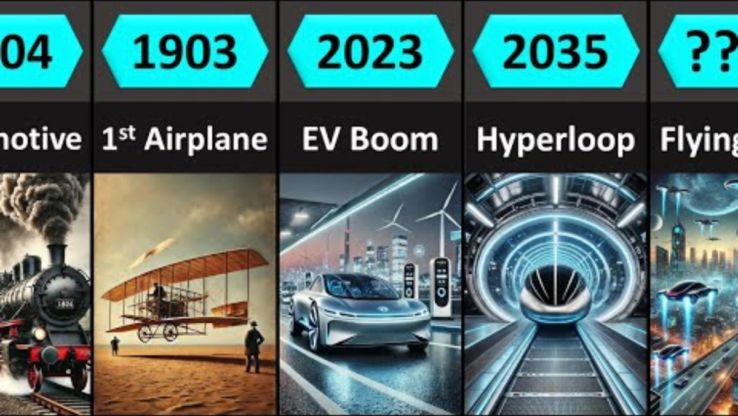
Evolution of Transportation - Video
Evolution of Transportation:
This video provides a quick overview of how transportation has evolved from ancient methods to modern, high-tech systems shaping our future mobility.
Video Credits: Worldostats
Video link:
https://youtu.be/YYsaZdy6TwU

Slide 8
Section 02:
Course Modules at a Glance

Slide 9
2. Course Modules at a Glance
2.1 Summary of All Modules
This course introduces students to the fundamentals of transportation research, modeling, and simulation. It combines theoretical lectures with hands-on labs using tools like Python, VISSIM, and GIS.
Module | Topic | Lectures Count | Labs Count | Duration (hours)
Module 1 | Introduction to Transport Research and Analysis | 4 | 2 | 10
Module 2 | Transport Data Collection and Management | 5 | 3 | 20
Module 3 | Transport Modeling and Simulation | 5 | 3 | 20
Module 4 | Sustainable Transport and Policy | 5 | 3 | 20
Module 5 | Advanced Topics and Case Studies | 5 | 3 | 20
Module 6 | Review and Final Assessment | 3 | 1 | 10
Total |  | 27 | 15 | 100

Slide 10
2. Course Modules at a Glance
2.2 Detailed Breakdown: Module 1 to Module 6
2.2.1 Module 1: Introduction to Transport Research and Analysis
Objective: Explore fundamental concepts in transport systems, research methods, data analysis, and ethical considerations, with hands-on practice using transport datasets and survey tools.
Course Type | Topic | Duration (hours)
Lecture 1 | Overview of Transport Systems and Research | 2
Lecture 2 | Transport Research Methods | 1
Lecture 3 | Transport Data Analysis Techniques | 1
Lecture 4 | Ethical Considerations in Transport Research | 1
Total |  | 5

Slide 11
2. Course Modules at a Glance
2.2.2 Module 2: Transport Data Collection and Management
Objective: Learn transport data types, collection methods, cleaning, and visualization techniques, including hands-on fieldwork and big data handling for transport planning.
Course Type | Topic | Duration (hours)
Lecture 5 | Transport Data Types and Sources | 2
Lecture 6 | Data Collection Techniques | 3
Lecture 7 | Data Management and Cleaning | 3
Lecture 8 | Big Data in Transport | 1
Lecture 9 | Data Visualization in Transportation | 1
Total |  | 10

Slide 12
2. Course Modules at a Glance
2.2.3 Module 3: Transport Modeling and Simulation
Objective: Understand and apply modeling techniques such as the four-step model and traffic flow theory using simulation tools to analyze and forecast transport system performance.
Course Type | Topic | Duration (hours)
Lecture 10 | Introduction to Transport Modeling | 2
Lecture 11 | Travel Demand Modeling | 2
Lecture 12 | Traffic Flow Theory and Simulation | 3
Lecture 13 | Public Transport Modeling | 2
Lecture 14 | Scenario Analysis and Forecasting | 1
Total |  | 10

Slide 13
2. Course Modules at a Glance
2.2.4 Module 4: Sustainable Transport and Policy Analysis
Objective: Explore sustainable transport strategies, evaluate policies using data-driven methods, and assess impacts on accessibility, equity, environment, and urban mobility systems.
Course Type | Topic | Duration (hours)
Lecture 15 | Sustainable Transport Concepts | 2
Lecture 16 | Environmental Impact of Transport | 2
Lecture 17 | Transport Policy and Planning | 2
Lecture 18 | Economic & Financial Analyses of Transport Projects | 2
Lecture 19 | Social Equity and Transport | 2
Total |  | 10

Slide 14
2. Course Modules at a Glance
2.2.5 Module 5: Advanced Topics and Case Studies
Objective: Examine emerging transport technologies, analyze real-world case studies, and apply research skills to evaluate complex transport challenges and innovative solutions.
Course Type | Topic | Duration (hours)
Lecture 20 | Intelligent Transport Systems (ITS) | 2
Lecture 21 | Autonomous & Connected Vehicles | 2
Lecture 22 | Urban Mobility and Smart Cities | 2
Lecture 23 | Freight Transport and Logistics | 2
Lecture 24 | Case Studies in Transport Research | 2
Total |  | 10

Slide 15
2. Course Modules at a Glance
2.2.6 Module 6: Review and Final Assessment
Objective: Consolidate knowledge from all modules, review key concepts, and demonstrate understanding through final assessments, presentations, and applied project work.
Course Type | Topic | Duration (hours)
Lecture 25 | Review Sessions | 1
Lecture 26 | Final Project Presentations | 2
Lecture 27 | Final Assessment | 2
Total |  | 5

Slide 16
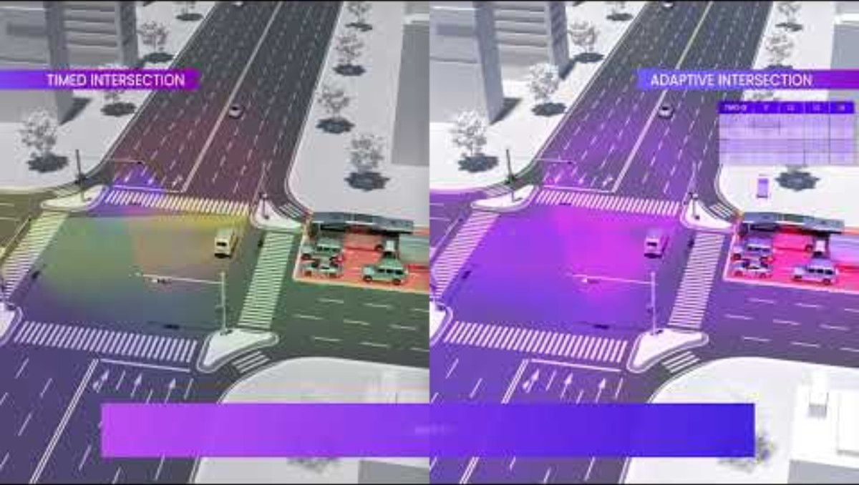
Autonomous Vehicles - Video
Intelligent Transportation System Solution for Smart Cities
This video introduces TIMOS, TIMO-IX, and TraXight™— a smart ITS solution offering real-time traffic detection, radar-based monitoring, and AI-powered traffic optimization for smart cities.
Video Credits: Bitsensing
Video link:
https://youtu.be/f_ajC1wtwYA

Slide 17
Section 03:
Lecture Content and Time Allocation

Slide 18
3. Lecture Content and Time Allocation
3.1.1 Module 1 > Lecture 1: Overview of Transport Systems and Research
Objective: Introduce students to transport systems and the role of research in planning, managing, and improving mobility for people and goods.
# | Topic | Activity Type | Activity Done By | Duration (minutes)
1 | Introduction to transport systems | Presentation | Teacher | 10
2 | Importance of transport research | Presentation | Teacher | 20
3 | Definitions of key concepts, coverage, scope, applications | Presentation | Teacher | 25
4 | Audience/Users of Transport Statistics | Presentation | Teacher | 20
5 | Quiz & Group Discussion | Quiz | Student | 15
Total |  |  |  | 90
This lecture provides an overview of transport system components modes, networks, and operations and explains how research supports decision-making in infrastructure, policy, and technology for sustainable mobility.

Slide 19
3. Lecture Content and Time Allocation
3.1.2 Module 1 > Lecture 2: Transport Research Methods
Objective: Introduce key transport research methods, including qualitative, quantitative, and mixed approaches for analyzing mobility, behavior, and system performance.
# | Topic | Activity Type | Activity Done By | Duration (minutes)
1 | Background and motivation | Presentation | Teacher | 05
2 | Qualitative research method | Presentation | Teacher | 05
3 | Quantitative research method | Presentation | Teacher | 05
4 | Mixed methods research | Presentation | Teacher | 10
5 | Data collection techniques, data sources | Presentation | Teacher | 10
6 | Quiz & Group Discussion | Quiz | Student | 10
Total |  |  |  | 45
Covers basic research methods used in transport studies, such as surveys, interviews, experiments, and data analysis to support planning and policy decisions.

Slide 20
3. Lecture Content and Time Allocation
3.1.3 Module 1 > Lecture 3: Transport Data Analysis Techniques
Objective: Introduce fundamental data analysis techniques used in transport research, including data types, summary statistics, and interpretation for informed decision-making.
# | Topic | Activity Type | Activity Done By | Duration (minutes)
1 | Introduction | Presentation | Teacher | 05
2 | Data in Transportation | Presentation | Teacher | 05
3 | Importance of Data | Presentation | Teacher | 05
4 | Descriptive Analysis | Presentation | Teacher | 05
5 | Inferential Analysis | Presentation | Teacher | 05
6 | Predictive Analysis | Presentation | Teacher | 05
7 | Quiz & Group Discussion | Quiz | Student | 10
Total |  |  |  | 45

Slide 21
3. Lecture Content and Time Allocation
3.1.4 Module 1 > Lecture 4: Ethical Considerations in Transport Research
Objective: Understand the ethical principles in transport research, including informed consent, data privacy, bias reduction, and responsible use of data and technology.
# | Topic | Activity Type | Activity Done By | Duration (minutes)
1 | Background and motivation | Presentation | Teacher | 10
2 | Ethical issues in data collection | Presentation | Teacher | 10
3 | Consent and confidentiality | Presentation | Teacher | 10
4 | Ethical research practices | Presentation | Teacher | 05
5 | Quiz & Group Discussion | Quiz | Student | 10
Total |  |  |  | 45
This lecture explores key ethical concerns such as protecting participants, ensuring fairness, avoiding misuse of data, and promoting transparency in transport research practices.

Slide 22
3. Lecture Content and Time Allocation
3.1.5 Module 2 > Lecture 5: Transport Data Types and Sources
Objective: Introduce various types of transport data and their sources, including traffic counts, GPS, surveys, and sensor data, for effective analysis and decision-making.
# | Topic | Activity Type | Activity Done By | Duration (minutes)
1 | Overview and Objectives | Presentation | Teacher | 5
2 | Background and motivation | Presentation | Teacher | 5
3 | Data vs Information | Presentation | Teacher | 10
4 | Traffic data | Presentation | Teacher | 15
5 | Public transport data | Presentation | Teacher | 15
6 | Environmental data | Presentation | Teacher | 15
7 | Socioeconomic/Demographic data | Presentation | Teacher | 15
8 | Quiz & Group Discussion | Quiz | Student | 10
Total |  |  |  | 90

Slide 23
3. Lecture Content and Time Allocation
3.1.6 Module 2 > Lecture 6: Data Collection Techniques
Objective: Understand key data collection methods in transport, including manual counts, automatic sensors, GPS tracking, surveys & how to select the right technique for a given study.
# | Topic | Activity Type | Activity Done By | Duration (minutes)
1 | Introduction | Presentation | Teacher | 15
2 | Surveys and questionnaires | Presentation | Teacher | 25
3 | Sensor and GPS data collection | Presentation | Teacher | 25
4 | Observational techniques | Presentation | Teacher | 25
5 | Case studies | Presentation | Teacher | 30
6 | Quiz & Group Discussion | Quiz | Student | 15
Total |  |  |  | 135
This lecture covers tools and techniques for collecting transport data in the field or remotely, focusing on accuracy, efficiency, and suitability for different research needs.

Slide 24
3. Lecture Content and Time Allocation
3.1.7 Module 2 > Lecture 7: Data Management and Cleaning
Objective: Equip students with skills to organize, manage, and clean transport data by handling missing values, outliers, and inconsistencies for accurate analysis.
# | Topic | Activity Type | Activity Done By | Duration (minutes)
1 | Background and motivation | Presentation | Teacher | 15
2 | Data storage solutions | Presentation | Teacher | 25
3 | Data cleaning and pre-processing | Presentation | Teacher | 25
4 | Handling missing data | Presentation | Teacher | 25
5 | Data validation | Presentation | Teacher | 25
6 | Quiz & Group Discussion | Quiz | Student | 20
Total |  |  |  | 135
This lecture introduces best practices in managing transport datasets, focusing on data quality, formatting, and preprocessing to ensure reliable analytical outcomes.

Slide 25
3. Lecture Content and Time Allocation
3.1.8 Module 2 > Lecture 8: Big Data in Transport
Objective: Introduce the role of big data in transport, including sources like mobile apps and sensors, and how it supports real-time analysis, forecasting, and smart mobility planning.
# | Topic | Activity Type | Activity Done By | Duration (minutes)
1 | Introduction to big data | Presentation | Teacher | 05
2 | Applications of big data in transport | Presentation | Teacher | 10
3 | Challenges of Big Data | Presentation | Teacher | 05
4 | Opportunities of Big Data | Presentation | Teacher | 05
5 | Benefits of Big Data | Presentation | Teacher | 05
6 | Future of Big Data | Presentation | Teacher | 05
7 | Quiz & Group Discussion | Quiz | Student | 10
Total |  |  |  | 45

Slide 26
3. Lecture Content and Time Allocation
3.1.9 Module 2 > Lecture 9: Data Visualization in Transportation
Objective: Teach students how to visualize transport data effectively using charts, maps, and dashboards to support communication, analysis, and decision-making.
# | Topic | Activity Type | Activity Done By | Duration (minutes)
1 | Introduction | Presentation | Teacher | 05
2 | Purpose of Data Visualization (DV) | Presentation | Teacher | 05
3 | Principles of Data Visualization (DV) | Presentation | Teacher | 05
4 | Challenges & opportunities related to DV | Presentation | Teacher | 10
5 | Tools and software for visualization | Presentation | Teacher | 10
6 | Creating effective transport data visualizations | Presentation | Teacher | 10
Total |  |  |  | 45

Slide 27
3. Lecture Content and Time Allocation
3.1.10 Module 3 > Lecture 10: Introduction to Transport Modeling
Objective: Introduce the fundamentals of transport modeling, including model types, structure, and applications for analyzing travel behavior and forecasting transport system performance.
# | Topic | Activity Type | Activity Done By | Duration (minutes)
1 | Background and motivation | Presentation | Teacher | 10
2 | Transport Modeling | Presentation | Teacher | 15
3 | Purpose of Transport Modeling | Presentation | Teacher | 15
4 | Transport Model, purpose of transport models | Presentation | Teacher | 15
5 | Types of transport models | Presentation | Teacher | 20
6 | Model development process | Presentation | Teacher | 15
7 | Quiz & Group Discussion | Quiz | Student | 05
Total |  |  |  | 90

Slide 28
3. Lecture Content and Time Allocation
3.1.11 Module 3 > Lecture 11: Travel Demand Modeling
Objective: Explain the concept and purpose of travel demand modeling, focusing on the four-step model to predict trip generation, distribution, mode choice, and route assignment.
# | Topic | Activity Type | Activity Done By | Duration (minutes)
1 | Overview and Objectives | Presentation | Teacher | 10
2 | Fundamentals of Travel Demand | Presentation | Teacher | 10
3 | Travel Demand Modelling | Presentation | Teacher | 15
4 | Principles of Travel Demand Modeling | Presentation | Teacher | 15
5 | The Four-Step Travel Demand Model (FSM) | Presentation | Teacher | 20
6 | Case Studies | Presentation | Teacher | 10
7 | Quiz & Group Discussion | Quiz | Student | 10
Total |  |  |  | 90

Slide 29
3. Lecture Content and Time Allocation
3.1.12 Module 3 > Lecture 12: Traffic Flow Theory and Simulation
Objective: Introduce traffic flow theory concepts & simulation approaches, covering microscopic, macroscopic & mesoscopic models to analyze and improve traffic system performance.
# | Topic | Activity Type | Activity Done By | Duration (minutes)
1 | Overview and Objectives | Presentation | Teacher | 5
2 | Fundamentals of Travel Demand | Presentation | Teacher | 10
3 | Fundamental Concepts of Traffic Flow | Presentation | Teacher | 10
4 | Microscopic Traffic Flow | Presentation | Teacher | 15
5 | Macroscopic Traffic Flow | Presentation | Teacher | 15
6 | Mesoscopic Traffic Flow | Presentation | Teacher | 15
7 | Comparison of Traffic Flow Models | Presentation | Teacher | 20
8 | Mathematical Models in Traffic Flow | Presentation | Teacher | 25
9 | Quiz & Group Discussion | Quiz | Student | 20
Total |  |  |  | 135

Slide 30
3. Lecture Content and Time Allocation
3.1.13 Module 3 > Lecture 13: Public Transport Modeling
Objective: Introduce methods for modeling public transport systems, including scheduling, capacity analysis, and integration with demand models for effective transit planning.
# | Topic | Activity Type | Activity Done By | Duration (minutes)
1 | Introduction | Presentation | Teacher | 5
2 | Purpose of Transport System Modeling | Presentation | Teacher | 10
3 | Principles of the Transport System | Presentation | Teacher | 10
4 | Development & Application of Transport Models | Presentation | Teacher | 10
5 | Principles of Transportation | Presentation | Teacher | 10
6 | Components of Transportation System | Presentation | Teacher | 10
7 | Optimization in Transportation | Presentation | Teacher | 10
8 | Service frequency and route optimization | Presentation | Teacher | 10

Slide 31
3. Lecture Content and Time Allocation
# | Topic | Activity Type | Activity Done By | Duration (minutes)
9 | Case studies | Presentation | Teacher | 15
10 | Quiz & Group Discussion | Quiz | Student | 10
Total |  |  |  | 90
This lecture focuses on techniques to simulate and evaluate bus, rail, and multimodal systems, helping students understand service performance and passenger flow dynamics.

Slide 32
3. Lecture Content and Time Allocation
3.1.14 Module 3 > Lecture 14: Scenario Analysis and Forecasting
Objective: Learn to model future scenarios in transport planning, simulating different growth, policy, or infrastructure changes.
# | Topic | Activity Type | Activity Done By | Duration (minutes)
1 | Background and Motivation | Presentation | Teacher | 05
2 | Purpose of Scenario Analysis | Presentation | Teacher | 10
3 | Developing Scenarios, Examples | Presentation | Teacher | 10
4 | Forecasting Techniques in Transport | Presentation | Teacher | 10
5 | Scenario Analysis Tools + Conclusion | Presentation | Teacher | 10
Total |  |  |  | 45
Introduces forecasting techniques such as trend projections and scenario-based modeling to evaluate planning alternatives.

Slide 33
3. Lecture Content and Time Allocation
3.1.15 Module 4 > Lecture 15: Sustainable Transport Concepts
Objective: Explore principles of sustainability in transport, covering low‑carbon mobility, shared modes, and lifecycle assessments.
# | Topic | Activity Type | Activity Done By | Duration (minutes)
1 | Introduction | Presentation | Teacher | 05
2 | Definition & importance of sustainable transport | Presentation | Teacher | 15
3 | Examples of sustainable modes, dimensions | Presentation | Teacher | 15
4 | Dimensions of sustainable transport | Presentation | Teacher | 15
5 | Key indicators, strategies | Presentation | Teacher | 15
6 | Strategies for sustainable transport | Presentation | Teacher | 10
7 | Quiz & Group Discussion | Quiz | Student | 15
Total |  |  |  | 90

Slide 34
3. Lecture Content and Time Allocation
3.1.16 Module 4 > Lecture 16: Environmental Impact of Transport
Objective: Understand environmental effects of transport and tools to assess impacts on air quality, noise, and ecosystems.
# | Topic | Activity Type | Activity Done By | Duration (minutes)
1 | Background, Motivation | Presentation | Teacher | 05
2 | Emissions & Pollution | Presentation | Teacher | 15
3 | Detection, Measurement | Presentation | Teacher | 15
4 | Measurement of Pollution | Presentation | Teacher | 15
5 | Mitigation Strategies of Pollution | Presentation | Teacher | 15
6 | Environmental Impact Assessment | Presentation | Teacher | 15
7 | Quiz & Group Discussion | Quiz | Student | 10
Total |  |  |  | 90
Covers assessment methods and mitigation measures such as green infrastructure and EV adoption.

Slide 35
3. Lecture Content and Time Allocation
3.1.17 Module 4 > Lecture 17: Transport Policy and Planning
Objective: Learn about transport policies, planning principles, governance structures, and stakeholder engagement in urban mobility.
# | Topic | Activity Type | Activity Done By | Duration (minutes)
1 | Introduction | Presentation | Teacher | 05
2 | Overview of Transport Policy | Presentation | Teacher | 10
3 | Overview of Transport Planning | Presentation | Teacher | 10
4 | Policy vs Planning | Presentation | Teacher | 15
5 | Principles of Transport Planning | Presentation | Teacher | 15
6 | Policy Development Process | Presentation | Teacher | 10
7 | Case studies of Successful Policies | Presentation | Teacher | 15
8 | Quiz & Group Discussion | Quiz | Student | 10
Total |  |  |  | 90

Slide 36
3. Lecture Content and Time Allocation
3.1.18 Module 4 > Lecture 18: Economic & Financial Analyses of Transport Projects
Objective: Understand cost–benefit analysis, financial planning, and funding strategies for transport infrastructure investments.
# | Topic | Activity Type | Activity Done By | Duration (minutes)
1 | Introduction | Presentation | Teacher | 05
2 | Cost-Benefit Analysis | Presentation | Teacher | 15
3 | Economic Impact Analysis | Presentation | Teacher | 15
4 | Economic Analysis vs Financial Analysis | Presentation | Teacher | 15
5 | Costs Benefit Analysis (CBA) | Presentation | Teacher | 15
6 | Financing Transport Projects | Presentation | Teacher | 15
7 | Quiz & Group Discussion | Quiz | Student | 10
Total |  |  |  | 90

Slide 37
3. Lecture Content and Time Allocation
3.1.19 Module 4 > Lecture 19: Social Equity and Transport
Objective: Explore the role of equity in transport planning, including access, affordability, and distributional impacts.
# | Topic | Activity Type | Activity Done By | Duration (minutes)
1 | Introduction | Presentation | Teacher | 05
2 | Purpose of Equity in Transport | Presentation | Teacher | 15
3 | Equity Theory in Transport | Presentation | Teacher | 15
4 | Social Equity Issues in Transport | Presentation | Teacher | 15
5 | Accessibility, Mobility | Presentation | Teacher | 15
6 | Policy Implications | Presentation | Teacher | 15
7 | Quiz & Group Discussion | Quiz | Student | 10
Total |  |  |  | 90

Slide 38
3. Lecture Content and Time Allocation
3.1.20 Module 5 > Lecture 20: Intelligent Transport Systems (ITS)
Objective: Learn ITS technologies like adaptive signals, traffic management systems, and connected mobility solutions.
# | Topic | Activity Type | Activity Done By | Duration (minutes)
1 | Background & Motivation | Presentation | Teacher | 05
2 | Overview of ITS | Presentation | Teacher | 10
3 | Applications of ITS | Presentation | Teacher | 10
4 | Benefits of ITS | Presentation | Teacher | 10
5 | Components of ITS Architecture | Presentation | Teacher | 10
6 | Difficulties of Implementing ITS | Presentation | Teacher | 10
7 | Pros and Cons | Presentation | Teacher | 10
8 | Case studies | Presentation | Teacher | 10
9 | Quiz & Group Discussion | MCQ | Student | 15
Total |  |  |  | 90

Slide 39
3. Lecture Content and Time Allocation
3.1.21 Module 5 > Lecture 21: Autonomous & Connected Vehicles
Objective: Explore AV and CV principles, deployment status, impacts, and integration into transport systems.
# | Topic | Activity Type | Activity Done By | Duration (minutes)
1 | Overview and Objectives | Presentation | Teacher | 05
2 | Autonomous Vehicles (AVs) | Presentation | Teacher | 15
3 | Fundamental Concepts of Traffic Flow | Presentation | Teacher | 15
4 | Autonomous vs Connected Vehicles | Presentation | Teacher | 15
5 | Impact on Transport Systems | Presentation | Teacher | 15
6 | Challenges & Future Prospects | Presentation | Teacher | 15
7 | Quiz & Group Discussion | Discussion | Student | 10
Total |  |  |  | 90

Slide 40
3. Lecture Content and Time Allocation
3.1.22 Module 5 > Lecture 22: Urban Mobility and Smart Cities
Objective: Understand integrated transport solutions in smart cities, using tech-enabled mobility services and planning.
# | Topic | Activity Type | Activity Done By | Duration (minutes)
1 | Introduction | Presentation | Teacher | 10
2 | Concepts of Urban Mobility | Presentation | Teacher | 20
3 | Role of Transport in Smart Cities | Presentation | Teacher | 20
4 | Innovative Mobility Solutions | Presentation | Teacher | 20
5 | Quiz & Group Discussion | Quiz | Student | 20
Total |  |  |  | 90
Discusses multimodal integration, MaaS, data platforms, and smart infrastructure for equitable and sustainable mobility.

Slide 41
3. Lecture Content and Time Allocation
3.1.23 Module 5 > Lecture 23: Freight Transport and Logistics
Objective: Learn key principles of freight logistics, network optimization, supply chains, and urban freight challenges.
# | Topic | Activity Type | Activity Done By | Duration (minutes)
1 | Introduction | Presentation | Teacher | 10
2 | Principles of Freight Transport | Presentation | Teacher | 25
3 | Logistics & Supply Chain Management | Presentation | Teacher | 25
4 | Case Studies | Presentation | Teacher | 20
5 | Discussion | Discussion | Student | 10
Total |  |  |  | 90
Covers freight modeling, last-mile delivery, intermodal systems, and strategies to reduce emissions and congestion.

Slide 42
3. Lecture Content and Time Allocation
3.1.24 Module 5 > Lecture 24: Case Studies in Transport Research
Objective: Examine real-world transport projects and research to distill lessons and innovative methodologies.
# | Topic | Activity Type | Activity Done By | Duration (minutes)
1 | Introduction | Presentation | Teacher | 05
2 | Detailed Analysis of Successful Transport Research Projects | Presentation | Teacher | 25
3 | Lessons Learned | Presentation | Teacher | 25
4 | Best Practices | Presentation | Teacher | 20
5 | Discussion | Discussion | Student | 10
Total |  |  |  | 90
Provides guided analysis of studies (ex: transit expansion, ITS trials), highlighting outcomes and transferable methods.

Slide 43
3. Lecture Content and Time Allocation
3.1.25 Module 6 > Lecture 25: Review Sessions
Objective: Reinforce key transport concepts through summary discussions, clarify doubts, and prepare students for the final assessment and project presentations.
# | Topic | Activity Type | Activity Done By | Duration (minutes)
1 | Summary of Key Concepts | Presentation | Teacher | 15
2 | Clarification of Doubts | Discussion | Teacher/Student | 15
3 | Interactive Discussions | Discussion | Teacher/Student | 15
Total |  |  |  | 45
This session allows students to present their final projects, showcasing their use of transport modeling, data analysis, and simulation tools. Each presentation includes the problem, methods, results, and reflections, followed by feedback from peers and instructors.

Slide 44
3. Lecture Content and Time Allocation
3.1.26 Module 6 > Lecture 26: Final Project Presentations
Objective: Allow students to present and defend their transport research or simulation projects, applying theory, tools, and data learned throughout the course.
# | Topic | Activity Type | Activity Done By | Duration (minutes)
1 | Student Presentations on Selected Transport Topics | Presentation | Student | 60
2 | Peer Reviews | Review | Teacher | 20
3 | Instructor Feedback | Feedback | Teacher | 10
Total |  |  |  | 90
This session provides a platform for students to present their final projects, demonstrating their ability to apply transport modeling, data analysis, and simulation tools to real-world or theoretical scenarios. Presentations will include problem statements, methodology, results, and reflections.

Slide 45
3. Lecture Content and Time Allocation
3.1.27 Module 6 > Lecture 27: Final Assessment
Objective: Assess students’ overall understanding of transport research concepts, modeling methods, and practical tools through structured evaluation.
# | Topic | Activity Type | Activity Done By | Duration (minutes)
1 | Written Exam Covering all Modules | Exam | Student | 60
2 | Evaluation of Final Projects | Evaluation | Teacher | 20
3 | Feedback & Future Directions | Feedback | Teacher | 10
Total |  |  |  | 90
The final assessment tests each student’s understanding of key course topics. It may include a written exam, simulation review, or oral questions, focusing on theory, data processing, modeling, and result interpretation to ensure critical thinking and practical application.

Slide 46
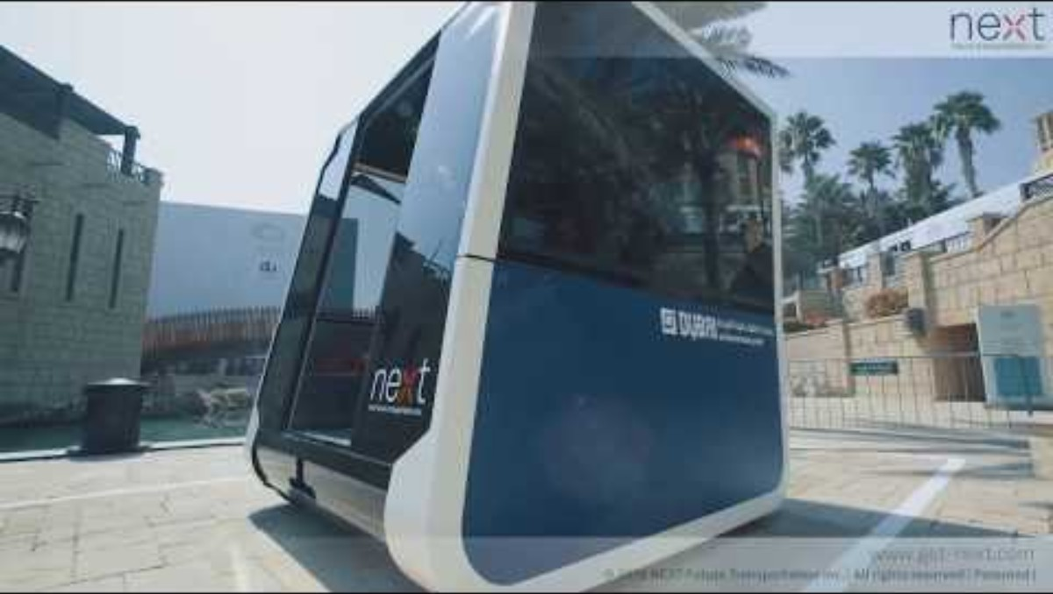
Future Transportation - Video
Future Transport Pods Tested in Dubai:
This video showcases modular electric transport pods tested in Dubai, featuring autonomous docking, independent steering, and flexible passenger redistribution.
Video Credits: Tommaso Gecchelin
Video link:
https://youtu.be/kJlQaCIUHTI

Slide 47
Section 04:
Expectations & Support

Slide 48
4. Expectations & Support
4.1 What We Expect from Students:
We encourage you to participate actively in all lectures, ask questions, and fully engage with the course materials. Your success in this course depends on consistent attendance, thoughtful learning, and your willingness to explore the topics discussed.
✅ Regular participation in all lectures
✅ On-time review of lecture materials
✅ A curious and open mindset
✅ Active note-taking and reflection
✅ Engagement with real-world transport issues

Slide 49
4. Expectations & Support
4.2 What You Can Expect from Us:
You can expect clear explanations, simple learning materials, and supportive guidance throughout the course. We will help you understand complex topics step by step and encourage you to ask questions and think critically. You will always have access to help when you need it.
✅ Clear, simple explanations of complex topics
✅ Easy-to-follow slides and learning materials
✅ Interactive discussions and space for questions
✅ Guidance for applying theory to practice
✅ Encouragement to develop critical thinking

Slide 50
Section 05:
References

Slide 51
5. References
Reference Textbooks:
  “Transportation Engineering and Planning” by C.S. Papacostas & P.D. Prevedouros
  “Urban Transportation Planning” by Michael D. Meyer & Eric J. Miller
  “Data Science for Transportation” by Mashrur A. Chowdhury, Amy Apon, and Asad J. Khattak
Video Resources:
  The Future of Transport – Mobileye
  A quick overview of future transport technologies like smart mobility and autonomous vehicles.
  https://youtu.be/nJwD0WIP50s

Slide 52
Thank you for your attention!

