Slide 1
Transport Research and Analysis
Global Course Structure: Lab Series

Slide 3
Table of contents
Global Course Structure: Labs
Section 1: Introduction of Global Course Structure: Lab Series …………..……………………………… 3
1.1 Global Overview & Objectives ………………………….…….…………………………….…………….. 4
1.2 Global Course Structure Diagram: Lab Series …..………………………………………………….. 5
Section 2: Course Modules at a Glance …………………..……...……………………………………............ 7
2.1 Summary of All Modules ……….………………………..…………………………………………………. 8
2.2 Detailed Breakdown: Module 1 to Module 6 …………………….……………………………............. 9
Section 3: Tools & Technologies ……………………….……..………………..……………………………….. 16
3.1 Tools & Technologies Used in Labs ………………………………………...………………………… 17
Section 4: Lab Content and Time Allocation …………..……………………..……………………………….. 16
4.1 Lab Topics: Lab 1 to Lab 15 ……………….…………………………………………………………… 17
Section 5: Expectations & Support ………..….…………………………………….………………………….. 46
5.1 What We Expect from Students ……….…………………………………….…………………………... 47
5.2 What You Can Expect from Us ……….…………………...…………………………………………… 48
Section 6: References ………………………..…..…………………………………….………………………….. 49
6.1 Reference Textbooks & Tutorials ………………...………………………….…………………………... 50

Slide 4
Section 01:
Introduction of Global Course Structure: Lab Series

Slide 5
1. Introduction of Global Course Structure: Labs
1.1 Global Overview & Objectives
The lab sessions offer practical, hands-on experience in transport research. You’ll work with real datasets and use tools like Python, VISSIM, and GIS to clean, visualize, and analyze transport data. Each lab builds your skills step by step, from basic data handling to advanced simulations, helping you connect theory to practice and prepare for real-world transport analysis.
Course Competencies:
✅ Gain hands-on experience in cleaning, transforming, and visualizing transport datasets.
✅ Apply Python, MATLAB, VISSIM, and GIS tools to solve practical transport problems.
✅ Build and simulate traffic flow models and public transport systems.
✅ Analyze performance metrics like congestion, delays, and travel demand through simulations.
✅ Evaluate real-world transport solutions using environmental, cost-benefit, and equity analysis.

Slide 6
1. Introduction of Global Course Structure: Lab Series
1.2 Global Course Structure Diagram: Lab Series
Transport Research and Analysis
Module 1
Module 2
Module 3
Module 4
Module 5
Module 6
Lab 1
Lab 3
Lab 6
Lab 9
Lab 12
Lab 15
Lab 2
Lab 4
Lab 7
Lab 10
Lab 13
Lab 5
Lab 8
Lab 11
Lab 14

Slide 7
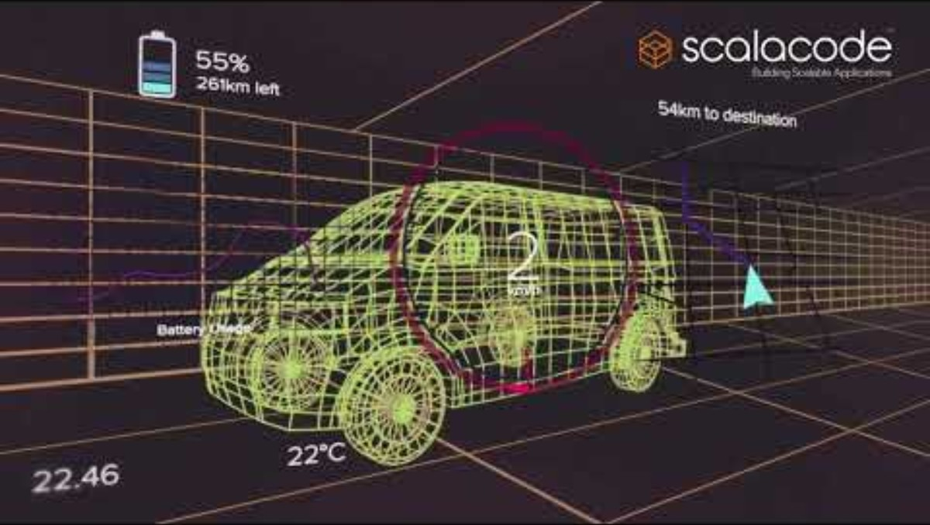
AI in Modern Transportation - Video
How AI is Revolutionizing Transportation:
This video explores how AI is transforming transportation through self-driving cars, smart cities, and intelligent traffic systems, along with key challenges and benefits.
Video Credits: ScalaCode™
Video link:
https://youtu.be/3bRVMMXyMAA

Slide 8
Section 02:
Course Modules at a Glance

Slide 9
2. Course Modules at a Glance
2.1 Summary of All Modules
This course introduces students to the fundamentals of transportation research, modeling, and simulation. It combines theoretical lectures with hands-on labs using tools like Python, VISSIM, and GIS.
Module | Topic | Lectures Count | Labs Count | Duration (hours)
Module 1 | Introduction to Transport Research and Analysis | 4 | 2 | 10
Module 2 | Transport Data Collection and Management | 5 | 3 | 20
Module 3 | Transport Modeling and Simulation | 5 | 3 | 20
Module 4 | Sustainable Transport and Policy | 5 | 3 | 20
Module 5 | Advanced Topics and Case Studies | 5 | 3 | 20
Module 6 | Review and Final Assessment | 3 | 1 | 10
Total |  | 27 | 15 | 100

Slide 10
2. Course Modules at a Glance
2.1 Detailed Breakdown: Module 1 to Module 6
Module 1: Introduction to Transport Research and Analysis
Objective: Explore fundamental concepts in transport systems, research methods, data analysis, and ethical considerations, with hands-on practice using transport datasets and survey tools.
Course Type | Corresponding Lectures | Topic | Duration (hours)
Lab 1 | Lecture 3 | Familiarize students with transport datasets and analytical tools | 2
Lab 2 | Lecture 4 | Develop skills in creating surveys for data collection | 3
Total |  |  | 5

Slide 11
2. Course Modules at a Glance
Module 2: Transport Data Collection and Management
Objective: Learn transport data types, collection methods, cleaning, and visualization techniques, including hands-on fieldwork and big data handling for transport planning.
Course Type | Corresponding Lectures | Topic | Duration (hours)
Lab 3 | Lecture 6 | Field Data Collection Techniques | 4
Lab 4 | Lecture 7 | Data Cleaning and Preprocessing | 3
Lab 5 | Lecture 9 | Data Visualization Techniques | 3
Total |  |  | 10

Slide 12
2. Course Modules at a Glance
Module 3: Transport Modeling and Simulation
Objective: Understand and apply modeling techniques such as the four-step model and traffic flow theory using simulation tools to analyze and forecast transport system performance.
Course Type | Corresponding Lectures | Topic | Duration (hours)
Lab 6 | Lecture 10 | Introduction to Transport Modeling | 3
Lab 7 | Lecture 12 | Traffic Flow Simulation | 4
Lab 8 | Lecture 11 | Travel Demand Forecasting | 3
Total |  |  | 10

Slide 13
2. Course Modules at a Glance
Module 4: Sustainable Transport and Policy Analysis
Objective: Explore sustainable transport strategies, evaluate policies using data-driven methods, and assess impacts on accessibility, equity, environment, and urban mobility systems.
Course Type | Corresponding Lectures | Topic | Duration (hours)
Lab 9 | Lecture 16 | Environmental Impact Assessment | 3
Lab 10 | Lecture 18 | Cost-Benefit Analysis of Transport Projects | 4
Lab 11 | Lecture 19 | Equity and Accessibility Analysis | 3
Total |  |  | 10

Slide 14
2. Course Modules at a Glance
Module 5: Advanced Topics and Case Studies
Objective: Examine emerging transport technologies, analyze real-world case studies, and apply research skills to evaluate complex transport challenges and innovative solutions.
Course Type | Corresponding Lectures | Topic | Duration (hours)
Lab 12 | Lecture 20 | Intelligent Transport Systems (ITS) Applications | 3
Lab 13 | Lecture 21 | Case Study on Autonomous Vehicles | 4
Lab 14 | Lecture 22 | Urban Mobility and Smart Cities | 3
Total |  |  | 10

Slide 15
2. Course Modules at a Glance
Module 6: Review and Final Assessment
Objective: Consolidate knowledge from all modules, review key concepts, and demonstrate understanding through final assessments, presentations, and applied project work.
Course Type | Corresponding Lectures | Topic | Duration (hours)
Lab 15 | Lecture 26 | Capstone Project and Presentation | 5
Total |  |  | 5
Notes:
This slide outlines Module 6, which brings the course to a close through review, assessment, and project presentations. The module begins with a dedicated review session that helps students consolidate key concepts from earlier modules. This is followed by final project presentations, where students showcase the outcomes of their applied research or practical work.
The capstone lab provides time for students to present their projects in detail, integrating both theoretical understanding and hands-on skills developed throughout the course. The module concludes with a formal final assessment that evaluates overall knowledge and learning outcomes.
With a total duration of 10 hours, this final module emphasizes reflection, synthesis, and the demonstration of practical competence. It ensures that students are not only familiar with transport research concepts, but also confident in applying them to real-world challenges.

Slide 16
Section 03:
Tools & Technologies

Slide 17
3. Tools & Technologies
3.1 Tools & Technologies used in Labs
The labs use tools like Excel, Python, QGIS and VISSIM to support data analysis, simulation, and visualization. These beginner-friendly tools help students apply theory to real-world transport problems.
# | Tool | Package | Company | License | Link
1 | Python | Google Colab | Google | Free | https://colab.research.google.com/
2 | MATLAB | MATLAB | MathWorks | Paid | https://www.mathworks.com/
3 | PTV VISSIM PTV VISUM | VISSIM (Student Version) VISUM (Student Version) | PTV Group | Free | https://your.visum.ptvgroup.com/vision-traffic-suite-students-en
4 | ArcGIS/QGIS | MAPOG | ESRI | Free | https://story.mapog.com/dashboard
5 | Excel | Microsoft Office | Microsoft | Paid | https://www.office.com/
6 | Google Sheets | Google Docs | Google | Free | https://docs.google.com/
Notes:
This course blends theory with practical application. Students use widely adopted tools in the transport research industry. These include:
Python via Google Colab for scripting and data analysis (free and cloud-based).
PTV VISSIM (student version) for microscopic traffic simulation.
ArcGIS/QGIS for spatial analysis — QGIS is free and open-source; ArcGIS is proprietary.
MATLAB for advanced modeling and numerical computation (licensed).
Excel and Google Sheets for accessible data management and basic analysis.
Each tool aligns with lab activities and builds skills for real-world transport challenges.

Slide 18
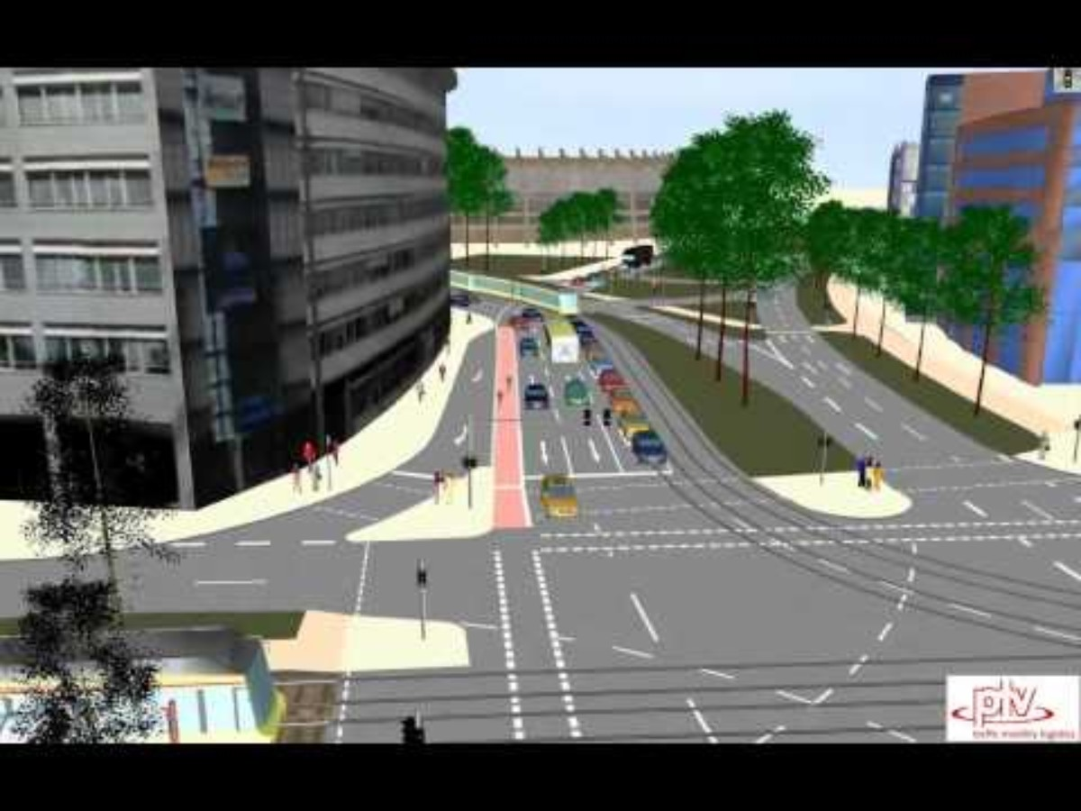
Traffic Simulation in a City - Video
Traffic Simulation in a City Using VISSIM:
This video demonstrates how VISSIM can realistically simulate urban traffic flow, showcasing vehicle interactions, intersections, and congestion patterns in a busy city environment.
Video Credits: PTV Mobility
Video link:
https://youtu.be/OtYby7QnyAE

Slide 19
Section 04:
Lab Content and Time Allocation

Slide 20
4. Lab Content and Time Allocation
Module 1 > Lab 1: Familiarize Students with Transport Datasets & Analytical Tools
Objective: Familiarize students with transport datasets and analytical tools.
# | Topic | Activity Type | Activity Done By | Duration (minutes)
1 | Introduction of Transport Datasets | Presentation | Teacher | 15
2 | Demonstration of Open-Source Datasets | Class Activity | Teacher | 15
3 | Importing Datasets and Basic Plotting | Class Activity | Teacher | 25
4 | Introduce Python in Google Colab | Class Activity | Teacher | 25
5 | Short Introduction of Excel | Class Activity | Teacher | 10
Total |  |  |  | 90
Introduces students to transport data types and tools for analysis. Covers basic operations and exploration of public datasets for initial hands-on experience.
Notes:
This lab introduces foundational skills in handling transport data. The session begins by presenting key transport datasets and demonstrating where open-source datasets can be accessed. Participants are guided through importing datasets and performing basic plotting operations. Emphasis is placed on practical application using Python in Google Colab, providing a hands-on introduction to coding-based analysis. A brief overview of Excel is also included to highlight its role in preliminary data handling. The goal is to build confidence with essential tools required for transport data analysis.

Slide 21
4. Lab Content and Time Allocation
Module 1 > Lab 2: Develop Skills in Creating Surveys for Data Collection
Objective: Develop skills in creating surveys for data collection.
# | Topic | Activity Type | Activity Done By | Duration (minutes)
1 | Introduction to Survey Design | Presentation | Teacher | 15
2 | Survey Creation Principles | Presentation | Teacher | 15
3 | Creating a Passenger Survey Form in collaboration with lecturer and students. | Class Activity | Student | 20
4 | Share the Google Form and Collect the Answer From Students | Class Activity | Student | 05
5 | Analyze Responses Google Sheets | Class Activity | Student | 20
6 | Basics of Sampling | Presentation | Teacher | 15
7 | Discuss the Ethical Conflict of using Transportation Data | Discussion | Student | 15
8 | Ethical Considerations in Surveys | Presentation | Teacher | 15
9 | Sampling Methods | Presentation | Teacher | 15
Total |  |  |  | 135
Notes:
This lab session is structured to build foundational competencies in survey design specifically for transport research. It opens with a conceptual introduction to survey design and creation principles. Students collaboratively design a passenger survey form, reinforcing both practical form-building skills and collaborative learning. Responses are collected via Google Forms and analyzed using Google Sheets.
Additionally, the lab introduces key concepts of sampling and addresses the ethical considerations involved in gathering transportation data. Emphasis is placed on both methodological soundness and ethical responsibility. The session concludes with an overview of common sampling methods, ensuring that students gain both technical and critical insights necessary for reliable data collection in real-world contexts.

Slide 22
4. Lab Content and Time Allocation
Module 2 > Lab 3: Field Data Collection Techniques
Objective: Provide hands-on experience in collecting transport data.
# | Topic | Activity Type | Activity Done By | Duration (minutes)
1 | Introduction to Field Data Collection | Presentation | Teacher | 10
2 | Importance of Accuracy and Consistency in Field Data | Presentation | Teacher | 10
3 | Types of Data: Traffic counts, Travel times, Pedestrian flows | Presentation | Teacher | 10
4 | Introduce Students to GPS Tracking for Recording Travel Routes | Class Activity | Student | 20
5 | Export Travelled Routes by Using Students' Mobile Phones Timeline History | Class Activity | Student | 10
6 | Introduce Google My Maps and ask Students to Create their Own Map for their University Routes | Class Activity | Student | 15
Notes:
This lab session equips students with practical experience in gathering transport data through fieldwork. It begins with an introduction to field data collection, emphasizing the significance of accuracy and consistency. Various types of transport data, such as traffic counts, travel times, and pedestrian flows, are presented to highlight real-world relevance.
Students are introduced to GPS tracking for mapping travel routes using mobile phone tools and timeline histories. They learn to visualize these routes via Google My Maps and are guided in creating personalized maps reflecting their daily university commutes.
To simulate real-world conditions, students use mobile apps to collect real-time traffic data at busy intersections using structured templates. The session includes hands-on data recording, route verification for accuracy, and collaborative discussions on challenges encountered during the fieldwork. This approach reinforces both technical skills and critical reflection on the complexities of real-time data collection in urban environments.

Slide 23
4. Lab Content and Time Allocation
# | Topic | Activity Type | Activity Done By | Duration (minutes)
7 | Introduce Mobile Apps for Real-Time Data Collection | Class Activity | Student | 15
8 | Students Need to Record Traffic Counts at a Busy Intersection Using Pre-Designed Template | Outdoor Activity | Student | 45
9 | Log their traffic count data into Excel or Google Sheets | Class Activity | Student | 15
10 | Review The GPS Routes On Maps To Ensure Accuracy | Class Activity | Student | 15
11 | Discuss Data Quality And Challenges Faced In The Field | Discussion | Student | 15
Total |  |  |  | 180
Notes:
This lab session equips students with practical experience in gathering transport data through fieldwork. It begins with an introduction to field data collection, emphasizing the significance of accuracy and consistency. Various types of transport data, such as traffic counts, travel times, and pedestrian flows, are presented to highlight real-world relevance.
Students are introduced to GPS tracking for mapping travel routes using mobile phone tools and timeline histories. They learn to visualize these routes via Google My Maps and are guided in creating personalized maps reflecting their daily university commutes.
To simulate real-world conditions, students use mobile apps to collect real-time traffic data at busy intersections using structured templates. The session includes hands-on data recording, route verification for accuracy, and collaborative discussions on challenges encountered during the fieldwork. This approach reinforces both technical skills and critical reflection on the complexities of real-time data collection in urban environments.

Slide 24
4. Lab Content and Time Allocation
Module 2 > Lab 4: Data Cleaning and Preprocessing
Objective: Teach methods for preparing raw data for analysis.
# | Topic | Activity Type | Activity Done By | Duration (minutes)
1 | Lab Overview and Required Tools | Presentation | Teacher | 10
2 | Data Preprocessing Techniques | Presentation | Teacher | 10
3 | Data Format Standardizing | Presentation | Teacher | 10
4 | Case Study | Class Activity | Student | 15
5 | Class Activity: Data Preprocessing | Presentation | Teacher | 80
6 | Homework Assignment | Class Activity | Student | 10
Total |  |  |  | 135
Students apply preprocessing steps to ensure data consistency and quality for analysis using Python, and Excel.
Notes:
This session focuses on preparing transport data for accurate and meaningful analysis. The lab opens with an introduction to the concept of data preprocessing, followed by practical techniques such as handling missing values, filtering noise, and correcting inconsistencies.
Students explore the relevance of clean data in the transport domain, recognizing how small errors in preprocessing can significantly skew insights. Emphasis is placed on data standardization and harmonization to ensure comparability and consistency across datasets.
A real-world case study illustrates common preprocessing challenges and solutions. The session concludes with a guided hands-on class activity where students apply the concepts learned by preprocessing a raw transport dataset. This lab ensures students gain both conceptual understanding and technical proficiency essential for quality transport data analysis.

Slide 25
4. Lab Content and Time Allocation
Module 2 > Lab 5: Data Visualization Techniques
Objective: Develop skills in presenting transport data effectively.
# | Topic | Activity Type | Activity Done By | Duration (minutes)
1 | Discuss the Importance of Visuals in Transport Research - Identifying Trends, Patterns, and Anomalies | Presentation | Teacher | 15
2 | Guide Students in Creating Histograms, Line Charts, and Scatter Plots with Provided Dataset | Class Activity | Student | 30
3 | Creating More Interactive and Complex Visualizations - Histograms, Line Charts, Scatter Plots, Heatmap | Class Activity | Student | 45
4 | Present Their Findings, Highlighting Trends and Patterns Observed | Class Activity | Student | 30
5 | Discuss How Different Visualizations Can Influence Decision-Making in Transport Planning | Discussion | Student | 15
Total |  |  |  | 135
Notes:
This session explores the role of visual representation in interpreting and communicating transport data. The lab begins by examining how visual tools help identify trends, anomalies, and patterns that may remain hidden in raw numerical datasets.
Students are guided through the process of creating basic charts, including histograms, line charts, and scatter plots, using provided transport datasets. Following this, the session expands into advanced visualization techniques such as interactive charts and heatmaps to better convey complex relationships and spatial distributions.
Participants then present their visual findings, reinforcing communication skills and encouraging peer-based critique. The lab concludes by examining how effective visualizations can support informed decision-making in transport planning, emphasizing clarity, accuracy, and impact in data storytelling.

Slide 26
4. Lab Content and Time Allocation
Module 3 > Lab 6: Transport Modeling
Objective: Introduce basic transport modeling concepts.
# | Topic | Activity Type | Activity Done By | Duration (minutes)
1 | Introduction to Modelling Concepts | Presentation | Teacher | 10
2 | Creating Trip Generation Models in Excel | Presentation | Teacher | 15
3 | Use Excel Formulas to Calculate Trip Generation | Class Activity | Student | 10
4 | Visualize the Results - Bar Charts to Show Trip Generation Patterns | Class Activity | Student | 10
5 | Calculate Trip Generation Using Gravity Models | Class Activity | Student | 30
6 | Visualize the Generated Trips Using Plotting Tools | Class Activity | Student | 30
7 | Import Data and Apply the Gravity Model and Visualize Inter-Zonal Trips | Class Activity | Student | 20
8 | Validate and Interpret Results | Class Activity | Student | 10
Total |  |  |  | 135
Notes:
This lab introduces foundational modeling concepts in transportation systems, focusing on trip generation and distribution models. Participants begin by constructing basic trip generation models in Excel, leveraging formulas to estimate trip volumes based on predefined input variables such as land use or population data.
The session then transitions into visualizing these results using bar charts to help identify generation trends and travel behavior patterns. Students are subsequently introduced to gravity models as a more advanced approach to estimate inter-zonal trips.
Participants engage in importing relevant data and applying the gravity model, using plotting tools to visualize spatial patterns in generated trips. The lab concludes with an exercise in validating the model output and interpreting key insights for transport planning decisions. Emphasis is placed on modeling logic, accuracy, and the ability to critically evaluate and present model-based findings.

Slide 27
4. Lab Content and Time Allocation
Module 3 > Lab 7: Traffic Flow Simulation
Objective: Simulate and analyze traffic flow dynamics.
# | Topic | Activity Type | Activity Done By | Duration (minutes)
1 | Lab Overview and Required Tools | Presentation | Teacher | 10
2 | Introduction and Install VISSIM | Class Activity | Student | 15
3 | Create and Run VISSIM Simulation | Class Activity | Student | 35
4 | Analyzing and Improving Traffic Flow | Class Activity | Student | 25
5 | Adjust Signal Timings | Class Activity | Student | 20
6 | Traffic Performance Metrics Analysis and Data Export | Class Activity | Student | 20
7 | Homework Assignment | Homework | Student | 10
Total |  |  |  | 135
Notes:
This lab session focuses on simulating and analyzing traffic flow using PTV VISSIM, a microscopic traffic simulation software. Participants are guided through the installation process before proceeding to set up a basic intersection scenario.
Once the model is established, the simulation is run to visualize real-time traffic movement, allowing identification of flow patterns, bottlenecks, and queue formations. Special attention is given to using VISSIM’s visual outputs to diagnose inefficiencies in the system.
Students are introduced to traffic signal control features, adjusting signal phases and timing within the simulation environment. Subsequent analysis focuses on comparing traffic performance before and after signal timing adjustments.
The lab concludes with the extraction and interpretation of performance metrics such as delays, queue lengths, and throughput, enabling students to understand how simulation-based evidence supports informed transport planning and operational decisions.

Slide 28
4. Lab Content and Time Allocation
Module 3 > Lab 8: Travel Demand Forecasting
Objective: Forecast future travel demand using modeling techniques.
# | Topic | Activity Type | Activity Done By | Duration (minutes)
1 | Lab Overview and Required Tools | Presentation | Teacher | 10
2 | Introducing to Travel Demand Forecasting | Presentation | Teacher | 10
3 | Class Activity 1: Four-Step Travel Demand Model | Class Activity | Student | 30
4 | Class Activity 2: Demand Estimation | Class Activity | Student | 55
5 | Class Activity 3: Scenario Modeling | Class Activity | Student | 55
6 | Homework Assignment | Discussion | Student | 20
Total |  |  |  | 180
Notes:
This lab introduces participants to the principles of travel demand forecasting, an essential process in transport planning. The session begins with a conceptual overview of why forecasting future travel behavior is necessary for designing sustainable and efficient transport systems.
Participants then implement the widely used Four-Step Travel Demand Model using a sample dataset. The model includes trip generation, trip distribution, mode choice, and route assignment.
A major portion of the session is dedicated to visualizing and analyzing the model’s results. Students interpret network-wide traffic flow through visual tools such as heatmaps and flow diagrams to identify trends and spatial distributions.
Further, participants explore how demand evolves over time and identify potential bottlenecks in the system. Strategies for improvement and mitigation are discussed in relation to observed data.
The session concludes with a critical review of the limitations of the forecasting model and introduces ways to enhance accuracy through calibration, validation, and incorporation of emerging mobility patterns and technologies.

Slide 29
4. Lab Content and Time Allocation
Module 4 > Lab 9: Environmental Impact Assessment
Objective: Assess environmental impacts of transportation projects.
# | Topic | Activity Type | Activity Done By | Duration (minutes)
1 | Explain the Goals and Its Relevance to Transport Projects | Presentation | Teacher | 05
2 | Introduce Key Environmental Indicators | Presentation | Teacher | 05
3 | Discuss Examples of Major Transport Projects and Challenges in Conducting EIAs | Presentation | Teacher | 05
4 | Excel Formulas for Emissions | Class Activity | Teacher | 05
5 | Provide a Dataset with Vehicle Types And Fuel Usage for Analysis | Class Activity | Teacher | 05
6 | Estimate Vehicle Emissions Using Emission Models | Class Activity | Teacher | 20
Notes:
This lab focuses on evaluating the environmental consequences of transport systems. It begins by introducing the goals of Environmental Impact Assessments (EIAs) and key indicators used in transport-related evaluations. Students analyze sample datasets containing vehicle types and fuel usage, then apply Excel-based formulas to estimate emissions using standard models.
Using these estimates, students calculate CO₂ output, visualize emission patterns by vehicle type through pie charts, and explore what happens when switching to electric vehicles. Later stages include modeling emissions based on traffic flow and incorporating variables like speed and congestion for deeper impact analysis. The session concludes with simulation exercises to test pollution reduction strategies under various scenarios, providing hands-on insight into how transport policy changes affect environmental outcomes.

Slide 30
4. Lab Content and Time Allocation
# | Topic | Activity Type | Activity Done By | Duration (minutes)
7 | Calculate CO2 Emissions Using Emission Factors | Class Activity | Teacher | 10
8 | Create Visualizations (Pie Charts) of Emissions by Vehicle Type | Class Activity | Teacher | 15
9 | Explore the Impact of Switching to Electric Vehicles by Modifying Vehicle Datasets | Class Activity | Teacher | 15
10 | Model Vehicle Emissions Based on Traffic Flow Data | Class Activity | Teacher | 10
11 | Introduce Variables Like Speed and Congestion for Impact Analysis | Presentation | Teacher | 10
12 | Simulate Pollution Reduction Scenarios | Class Activity | Teacher | 30
Total |  |  |  | 135
Notes:
This lab focuses on evaluating the environmental consequences of transport systems. It begins by introducing the goals of Environmental Impact Assessments (EIAs) and key indicators used in transport-related evaluations. Students analyze sample datasets containing vehicle types and fuel usage, then apply Excel-based formulas to estimate emissions using standard models.
Using these estimates, students calculate CO₂ output, visualize emission patterns by vehicle type through pie charts, and explore what happens when switching to electric vehicles. Later stages include modeling emissions based on traffic flow and incorporating variables like speed and congestion for deeper impact analysis. The session concludes with simulation exercises to test pollution reduction strategies under various scenarios, providing hands-on insight into how transport policy changes affect environmental outcomes.

Slide 31
4. Lab Content and Time Allocation
Module 4 > Lab 10: Cost-Benefit Analysis of Transport Projects
Objective: Perform economic evaluations of transport initiatives.
# | Topic | Activity Type | Activity Done By | Duration (minutes)
1 | Explain the Principles of CBA and its Importance in Transport Planning | Presentation | Teacher | 10
2 | Discuss Components: Costs and Benefits (Time Savings, Emissions Reduction) | Presentation | Teacher | 10
3 | Introduce Excel Templates for CBA Calculations | Class Activity | Teacher | 10
4 | Provide a Realistic Transit Project Scenario Data Set and Analyze | Class Activity | Teacher | 20
5 | Calculate Total Project Costs - Break Costs into Categories | Class Activity | Teacher | 20
Notes:
This lab introduces the core principles of CBA and its relevance to transport planning decisions. Students explore key cost and benefit components such as time savings and emission reductions. A transit project dataset is provided for practical application.
Using Excel and Python tools, students calculate Net Present Value (NPV) and Benefit-Cost Ratio (BCR), break down project costs, and estimate benefits. They then automate calculations, interpret outputs, and visualize financial outcomes. The lab concludes with a sensitivity analysis and a summary of insights for policy or planning action.

Slide 32
4. Lab Content and Time Allocation
# | Topic | Activity Type | Activity Done By | Duration (minutes)
6 | Estimate Project Benefits (Ex: Time Savings, Reduced Emissions) | Class Activity | Teacher | 20
7 | Calculate Net Present Value (NPV) and Benefit-Cost Ratio (BCR) | Class Activity | Teacher | 15
8 | Interpret And Visualize Results | Class Activity | Teacher | 15
9 | Calculate NPV and BCR Using Pandas and Numpy | Class Activity | Teacher | 10
10 | Automate NPV And BCR Calculations | Class Activity | Teacher | 10
11 | Run Sensitivity Analysis | Class Activity | Teacher | 15
12 | Visualize Financial Trends | Class Activity | Teacher | 15
13 | Summarize Results and Recommend Actions | Class Activity | Teacher | 10
Total |  |  |  | 180
Notes:
This lab introduces the core principles of CBA and its relevance to transport planning decisions. Students explore key cost and benefit components such as time savings and emission reductions. A transit project dataset is provided for practical application.
Using Excel and Python tools, students calculate Net Present Value (NPV) and Benefit-Cost Ratio (BCR), break down project costs, and estimate benefits. They then automate calculations, interpret outputs, and visualize financial outcomes. The lab concludes with a sensitivity analysis and a summary of insights for policy or planning action.

Slide 33
4. Lab Content and Time Allocation
Module 4 > Lab 11: Equity and Accessibility Analysis
Objective: Analyze the social equity implications of transport systems.
# | Topic | Activity Type | Activity Done By | Duration (minutes)
1 | Define Equity and Accessibility in Transport Planning | Presentation | Teacher | 05
2 | Highlight Key Metrics (Ex: Access to Public Transport, Travel Time Equity) | Presentation | Teacher | 05
3 | Show Examples of Equity Challenges in Urban Areas | Class Activity | Teacher | 05
4 | Import Public Transport Data into GIS Software | Class Activity | Teacher | 10
5 | Create Maps Showing Travel Time to Key Destinations | Class Activity | Teacher | 15
Notes:
This lab focuses on analyzing transport equity and accessibility using real-world datasets. It begins with key definitions and metrics such as travel time equity and access to public transport.
Students import GIS and demographic data, create maps to identify underserved areas, and calculate accessibility and equity scores. The session continues with visualizing spatial inequities and simulating the impact of new transit routes. Finally, results are compared across scenarios to evaluate policy effectiveness and optimal solutions.

Slide 34
4. Lab Content and Time Allocation
# | Topic | Activity Type | Activity Done By | Duration (minutes)
6 | Overlay Demographic Data to Identify Underserved Areas | Class Activity | Teacher/Student | 10
7 | Calculate Accessibility Metrics | Class Activity | Teacher/Student | 15
8 | Potential Solutions to Improve Accessibility in Low-Access Areas | Class Activity | Teacher/Student | 10
9 | Load Demographic and Transport Data | Class Activity | Teacher/Student | 5
10 | Calculate Equity Metrics | Class Activity | Teacher/Student | 10
11 | Visualize Equity Gaps Using Bar Charts and Heat Maps | Class Activity | Teacher/Student | 15
12 | Simulate the Impact of Adding New Transit Routes on Equity Metrics | Class Activity | Teacher/Student | 15
13 | Compare Results Across Scenarios to Identify Optimal Solutions | Class Activity | Teacher/Student | 15
Total |  |  |  | 135
Notes:
This lab focuses on analyzing transport equity and accessibility using real-world datasets. It begins with key definitions and metrics such as travel time equity and access to public transport.
Students import GIS and demographic data, create maps to identify underserved areas, and calculate accessibility and equity scores. The session continues with visualizing spatial inequities and simulating the impact of new transit routes. Finally, results are compared across scenarios to evaluate policy effectiveness and optimal solutions.

Slide 35
4. Lab Content and Time Allocation
Module 5 > Lab 12: Intelligent Transport Systems (ITS) Applications
Objective: Explore the role of ITS in modern transportation.
# | Topic | Activity Type | Activity Done By | Duration (minutes)
1 | Introduction to Intelligent Transport Systems and Their Components | Presentation | Teacher | 10
2 | Discuss Real-World Applications of ITS | Presentation | Teacher | 10
3 | Set Up a Simple Adaptive Traffic Signal Model in Python | Presentation | Teacher | 20
4 | Integrate Parameters Such as Traffic Arrival Rates or Delays Into the Adaptive Signal Model | Presentation | Teacher | 15
5 | Run Simulations for Different Traffic Conditions (Ex: Peak & Off-Peak Hours) | Class Activity | Teacher/Student | 15
Notes:
This lab explores real-world applications of Intelligent Transport Systems. It begins with a brief overview of ITS components and real-life use cases. Students build a simple adaptive signal model in Python and simulate different traffic conditions, integrating parameters such as arrival rates.
Results are compared with traditional systems. The lab then shifts to analyzing ITS benefits, like reduced congestion and improved safety, using real-world case study data. Finally, students conduct a basic cost-benefit analysis and summarize key takeaways through visualizations.

Slide 36
4. Lab Content and Time Allocation
# | Topic | Activity Type | Activity Done By | Duration (minutes)
6 | Visualize the Results & Compare with Traditional Signal Systems | Class Activity | Teacher/Student | 10
7 | Introduce Key ITS Benefits (Ex: Congestion Reduction, Travel Time Reliability, Safety) | Presentation | Teacher | 10
8 | Perform a Case Study Analysis of ITS Implementations Using Real-World Data from ITS Projects | Presentation | Teacher | 15
9 | Conduct a Cost-Benefit Analysis for Implementing ITS | Class Activity | Teacher/Student | 15
10 | Create Visualizations to Summarize Benefits (Ex: Congestion Reduction, Accident Rates) | Class Activity | Teacher/Student | 15
Total |  |  |  | 135
Notes:
This lab explores real-world applications of Intelligent Transport Systems. It begins with a brief overview of ITS components and real-life use cases. Students build a simple adaptive signal model in Python and simulate different traffic conditions, integrating parameters such as arrival rates.
Results are compared with traditional systems. The lab then shifts to analyzing ITS benefits, like reduced congestion and improved safety, using real-world case study data. Finally, students conduct a basic cost-benefit analysis and summarize key takeaways through visualizations.

Slide 37
4. Lab Content and Time Allocation
Module 5 > Lab 13: Autonomous Vehicles
Objective: Investigate the integration of smart technologies in urban transport.
# | Topic | Activity Type | Activity Done By | Duration (minutes)
1 | Lab Overview and Required Tools | Presentation | Teacher | 10
2 | Overview of Autonomous | Presentation | Teacher | 10
3 | Benefits and Challenges of AVs | Presentation | Teacher | 15
4 | Ethical and Legal Considerations | Presentation | Teacher | 15
5 | Class Activity 1: Analyze Autonomous Vehicle Performance | Class Activity | Student | 30
6 | Class Activity 2: Simulate AV Behaviour in VISSIM | Class Activity | Student | 90
7 | Homework Assignment | Homework | Student | 10
Total |  |  |  | 180
Notes:
This session examines autonomous vehicles from both theoretical and data-driven perspectives. The first half covers an overview of AV technology, benefits and challenges, ethical concerns, and relevant regulations.
The second half transitions into data analysis. Students explore AV datasets, run statistical evaluations, generate visual insights, and simulate AV behavior using VISSIM. A final comparison between AV and human driver performance wraps up the lab.

Slide 38
4. Lab Content and Time Allocation
Module 5 > Lab 14: Urban Mobility and Smart Cities
Objective: Analyze the implications of autonomous vehicle deployment.
# | Topic | Activity Type | Activity Done By | Duration (minutes)
1 | Introduce to Smart Cities and their Role in Urban Transport | Presentation | Teacher | 15
2 | Discuss Key Challenges in Urban Mobility (Congestion, Emissions) and The Potential of Smart Technologies to Address them | Presentation | Teacher | 10
3 | Simulate Public Transit Efficiency in Smart City Frameworks Using Python | Class Activity | Teacher | 20
4 | Input Smart Technology Variables (Ex: Real-Time Scheduling, Dynamic Route Adjustments) | Class Activity | Teacher | 20
5 | Run Simulations for Different Scenarios (Ex: Peak Hours, Optimized Scheduling) | Class Activity | Teacher | 25
Notes:
This lab explores how smart city technologies can enhance urban transport. The first part introduces the concept of smart cities and examines major urban mobility issues like congestion and emissions.
Students then simulate public transit systems using Python, adjusting parameters like scheduling and routing. In the second half, results are visualized, and the benefits of smart mobility are discussed, alongside real-world success stories and implementation challenges.

Slide 39
4. Lab Content and Time Allocation
# | Topic | Activity Type | Activity Done By | Duration (minutes)
6 | Visualize Simulation Results (Ex: Passenger Flow Efficiency, Reduced Travel Time) | Class Activity | Teacher | 20
7 | Discuss Opportunities Created by Smart Mobility Solutions with Success Stories of Smart Mobility | Presentation | Teacher | 20
8 | Analyze Challenges in Implementation (Ex: Cost, Data Privacy, Infrastructure Requirements) | Presentation | Teacher | 15
Total |  |  |  | 135
Notes:
This lab explores how smart city technologies can enhance urban transport. The first part introduces the concept of smart cities and examines major urban mobility issues like congestion and emissions.
Students then simulate public transit systems using Python, adjusting parameters like scheduling and routing. In the second half, results are visualized, and the benefits of smart mobility are discussed, alongside real-world success stories and implementation challenges.

Slide 40
4. Lab Content and Time Allocation
Module 6 > Lab 15: Capstone Project and Presentation
Objective: Synthesize knowledge and skills acquired throughout the course.
# | Topic | Activity Type | Activity Done By | Duration (minutes)
1 | Explain Project Expectations, Deliverables, and Assessment Criteria | Presentation | Teacher | 15
2 | Encourage Students to Choose a Specific Problem (Ex: Traffic Congestion, Emissions, Accessibility, AV, Etc) to Focus on | Discussion | Teacher | 10
3 | 10-20 minutes Presentation from Students. Post-Presentation Feedback from Lecturer - Technical Aspects, Use of Tools, Suggestions and Improvements, etc. | Presentation | Student | 200
Total |  |  |  | 225
Provides guided analysis of studies (ex: transit expansion, ITS trials), highlighting outcomes and transferable methods.
Notes:
This final session focuses on applying course knowledge to a chosen transport issue. Brief expectations and assessment criteria are shared. Students then select a topic (e.g., congestion, emissions, AVs) and deliver short presentations. Each presentation is followed by targeted feedback on technical execution, tool use, and possible improvements.

Slide 41
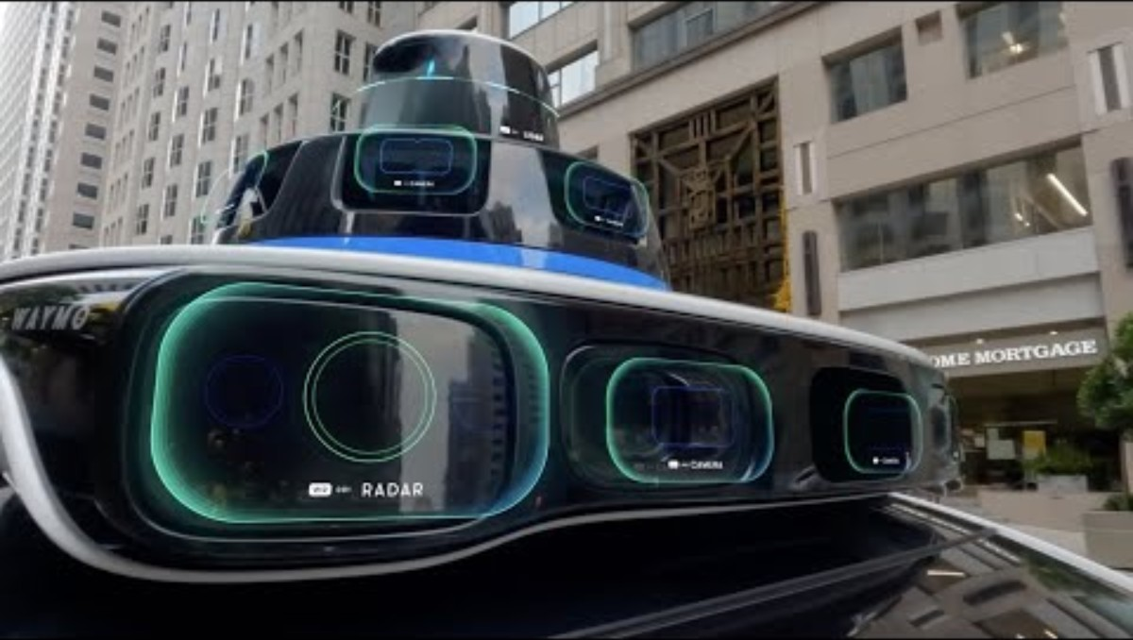
Autonomous Cars - Video
The Magic of the Waymo Autonomous Cars:
Waymo’s autonomous cars use lidar, cameras, and radar to safely sense, solve, and navigate complex driving environments.
Video Credits: PTV Mobility
Video link:
https://youtu.be/hA_-MkU0Nfw

Slide 42
Section 05:
Expectations & Support

Slide 43
5. Expectations & Support
5.1 What We Expect from Students:
During labs, we expect you to be fully involved in hands-on activities. Try to solve problems actively, work well with your classmates, and make honest efforts in all tasks. Labs are designed for beginners, so no prior coding knowledge is needed.
✅ Full participation in lab activities
✅ On-time completion of exercises
✅ Teamwork and peer support
✅ Willingness to learn by doing
✅ Honest work on all lab tasks

Slide 44
5. Expectations & Support
5.2 What You Can Expect from Us:
You can expect step-by-step lab instructions, supportive guidance, and beginner-friendly tools throughout each activity. We provide hands-on help, useful templates, and a comfortable space to practice, make mistakes, and grow your skills with confidence.
✅ Step-by-step instructions for each lab
✅ Beginner-friendly coding support
✅ Lab templates and practice files
✅ Supportive feedback and troubleshooting help
✅ A safe space to experiment and make mistakes

Slide 45
Section 06:
References

Slide 46
6. References
Reference Textbooks:
  “Python for Data Analysis” – Wes McKinney
  “Data Science for Transportation” – Mashrur A. Chowdhury, Amy Apon, Asad J. Khattak
Tutorials:
  W3 Schools Tutorials:
  https://www.w3schools.com/
  A to Z video tutorials for VISSIM from PTV Group:
  https://us-resources.ptvgroup.com/en-us/ptv-academy/getting-to-know-ptv-vissim
  MATLAB and Simulink tutorials from MathWorks:
  https://de.mathworks.com/support/learn-with-matlab-tutorials.html

Slide 47
Thank you for your attention!

