Slide 1
Course C.03.06.01
Asphalt binders
Marek Pszczola
(presentation was prepared on the basis of lectures prof. Romanochi, USA)

Slide 2
Road Transportation Systems Engineering Development in the Sub-Saharan Africa – Modern EU Master Programme & Capacity Building

Slide 4
History of Road Construction
First roads in Mesopotamia and Roman Empire
  Large stones on a bed of sand (gaps filled with clay)
  Ex: Via Appia ( Appian Way)
Latin saying:
  “VIA VITAE” - roads are life

Slide 5
History of Road Construction
Unpaved roads in Western Europe and later in the US
McAdam (England) & Tresaguet (FR):
  layer of larger stone covered by a layer of smaller stone, compacted by hand
  stone must be clean and of appropriate size
  importance of drainage is recognised

Slide 6
History of Road Construction
Unpaved roads – Major problems:
  Weak / Deforming / Impracticable when wet
  Dusty when dry
  Require periodic maintenance
  Sometimes the materials need to be replaced
Need for a construction solution to:
  Bond / tie material together
  Improve strength and reduce permeability
  All these when traffic and wheel loads were increasing

Slide 7
History of Road Construction
SOLUTION:

Slide 8
History of Road Construction
HOT MIX ASPHALT
  Efficient
  Suitable for mechanised production and placement
  Affordable
CONCRETE PAVEMENT
  Higher initial cost but reduced maintenance costs
  Especially suitable for heavy traffic roads

Slide 9
History
First US hot mix asphalt (HMA) constructed in 1870s
  Pennsylvania Ave.
  Used naturally occurring asphalt from a lake on Island of Trinidad
Two sources:
  Island of Trinidad
  Bermudez, Venezuela
Notes:
The first paved roadway in the United States was Pennsylvania Avenue in front of the White House. This pavement was constructed with an asphalt product quarried from a naturally occurring “lake” of asphalt on the island of Trinidad off the coast of Venezuela. A second source of this type of asphalt product can be found in Bermudez, Venezuela. These asphalts are still used today. In fact, a Trinidad lake asphalt project was placed near Mobile, Alabama in July, 1998.
Each lake asphalt has consistent but different amounts of bitumen, inorganic material. Because of these consistent differences, the amount of solvent-insoluble inorganic material is one common method used to identify and specify the lake asphalt source. This solubility test was used in all subsequent asphalt cement specifications throughout the 20th century.

Slide 10
History
Each lake asphalt source very consistent
  Used the solubility test to determine the source
    Insolubles differed substantially between sources
Demand for paved roads exceeded supply of lake asphalts in late 1800s
  Led to use of petroleum asphalts (1902)
Notes:
During the late 1800's and early 1900's the demand for paved roads increased so fast that the time-intensive processing and shipping of lake asphalt was limiting the miles of paved roads constructed each year. This led to the increasing use of petroleum refinery-based asphalts. It is interesting to note that these asphalts were originally considered inferior to lake asphalt because of their crude source-dependent material properties.

Slide 11
Background
Asphalt
  Soluble in petroleum products
  Generally a by-product of petroleum distillation process
  Can be naturally occurring
Tar
  Resistant to petroleum products
  Generally by-product of coke (from coal) production
Notes:
Students commonly use the words “asphalt” and “tar” interchangeably. However, asphalt is actually a waste product from the refining of petroleum crude oil while tar is a coal by-product. These chemical distinctions are important in a selecting the appropriate product for a given application.
For example, if protection from oil and fuel spills is desired, then a coating which will not be dissolved by these products is needed. Since motor oils, fuel, and asphalt are all derived from petroleum, any spills on this pavement can damage the asphalt-based coating as well as the asphalt concrete. The old chemistry rule-of-thumb applies: Like dissolves like. Because tar is a coal rather than asphalt-based product, sealers from this material will not be damaged by petroleum product spills.

Slide 12
Bitumen
Tar
(from coal)
road tar
coal tar
Asphalt Cement
(from petroleum crude)
asphaltic bitumen
asphaltic binder

Slide 13
Hot Mix Asphalt (HMA) – Terminology
US Terminology:
  Asphalt concrete / Asphalt paving mix / Asphalt mix / Asphalt
EU / International Terminology:
  Bituminous concrete / Bituminous paving mix / Bituminous mix
Bituminous concrete
Bituminous paving mix
Bituminous mix
Notes:
Hence, there is a need for a mechanical test which can tell us whether the designed mix is resistant to rutting. It should be able to proof test the mixes and tell us whether a mix satisfies a definite criteria and passes or fails the torture test. This test should be a laboratory test method so that it can be used on designed mixes, and it should be a simple test method so that it can be used routinely by the folks who actually build our pavements.

Slide 14
Petroleum-Based Asphalts
Asphalt is a waste product from refinery processing of crude oil
  Sometimes called the "bottom of the barrel"
Properties depend on:
  Refinery operations
  Composition of crude oil (source-dependent)
Gasoline
Kerosene
Lt. Gas Oil
Diesel
Motor Oils
Asphalt
Barrel of Crude Oil
Notes:
A number of products are obtained from one barrel of crude. Asphalt cement is what is left after the more volatile products are removed and it is commonly referred to as the “bottom of the barrel”.

Slide 15
Crude Oil
Classified using the API (American Petroleum Institute) gravity:
  API gravity = [ 141.5 / SG ] – 131.5
  Asphalts – API gravity of 5–10
  Gasoline – API gravity of 55
  Low API gravity = crude oil rich in asphalt
Sour crude oil – high sulfur content – bad bitumen
Notes:
During the late 1800's and early 1900's the demand for paved roads increased so fast that the time-intensive processing and shipping of lake asphalt was limiting the miles of paved roads constructed each year. This led to the increasing use of petroleum refinery-based asphalts. It is interesting to note that these asphalts were originally considered inferior to lake asphalt because of their crude source-dependent material properties.

Slide 16
Significant Crude Oil Sources
Domestic
Gulf coast
Mid-continent
Rocky Mountain
West coast
Alaska
Foreign
Mexico
Venezuela
Canada
Middle East

Slide 17
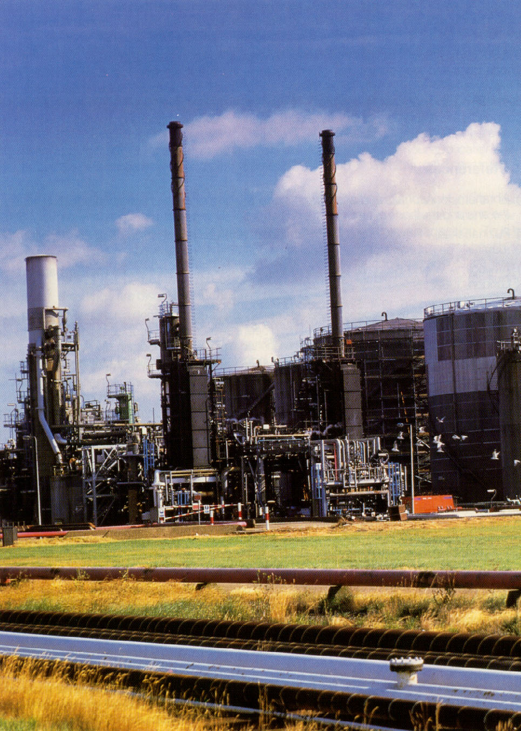

Slide 18
Refinery Operation
LIGHT DISTILLATE
PUMPING
STATION
MEDIUM DISTILLATE
FIELD STORAGE
HEAVY DISTILLATE
TOWER
DISTILLATION
REFINERY
RESIDUUM
PROCESS
UNIT
STORAGE
TUBE
HEATER
CONDENSERS
AND
COOLERS
OR
ASPHALT
CEMENTS
GAS
PETROLEUM
AIR
BLOWN
ASPHALT
FOR PROCESSING INTO
EMULSIFIED AND
CUTBACK ASPHALTS
SAND AND WATER
AIR
STILL
Notes:
Distillation is used to separate the various crude fractions by boiling point ranges. The crude oil is heated in a large furnace to about 343 ºC and partially vaporized. The remaining material is transferred to a distillation tower. Different fractions reach their boiling point ranges at various heights in the tower. When the temperature is reduced, each material condenses on a tray and is drawn off at each level.

Slide 19
Distillation is the First Step
Separates various crude fractions with different boiling ranges
Residuum (Resid) is asphalt
Atmospheric and vacuum distillation
Superheated steam also used
Various fractions condensed in trays
Vacuum and steam distillation avoids cracking (molecular breakdown)
  Vacuum (1 PSI) / Vacuum & Steam (0.25 PSI)

Slide 20
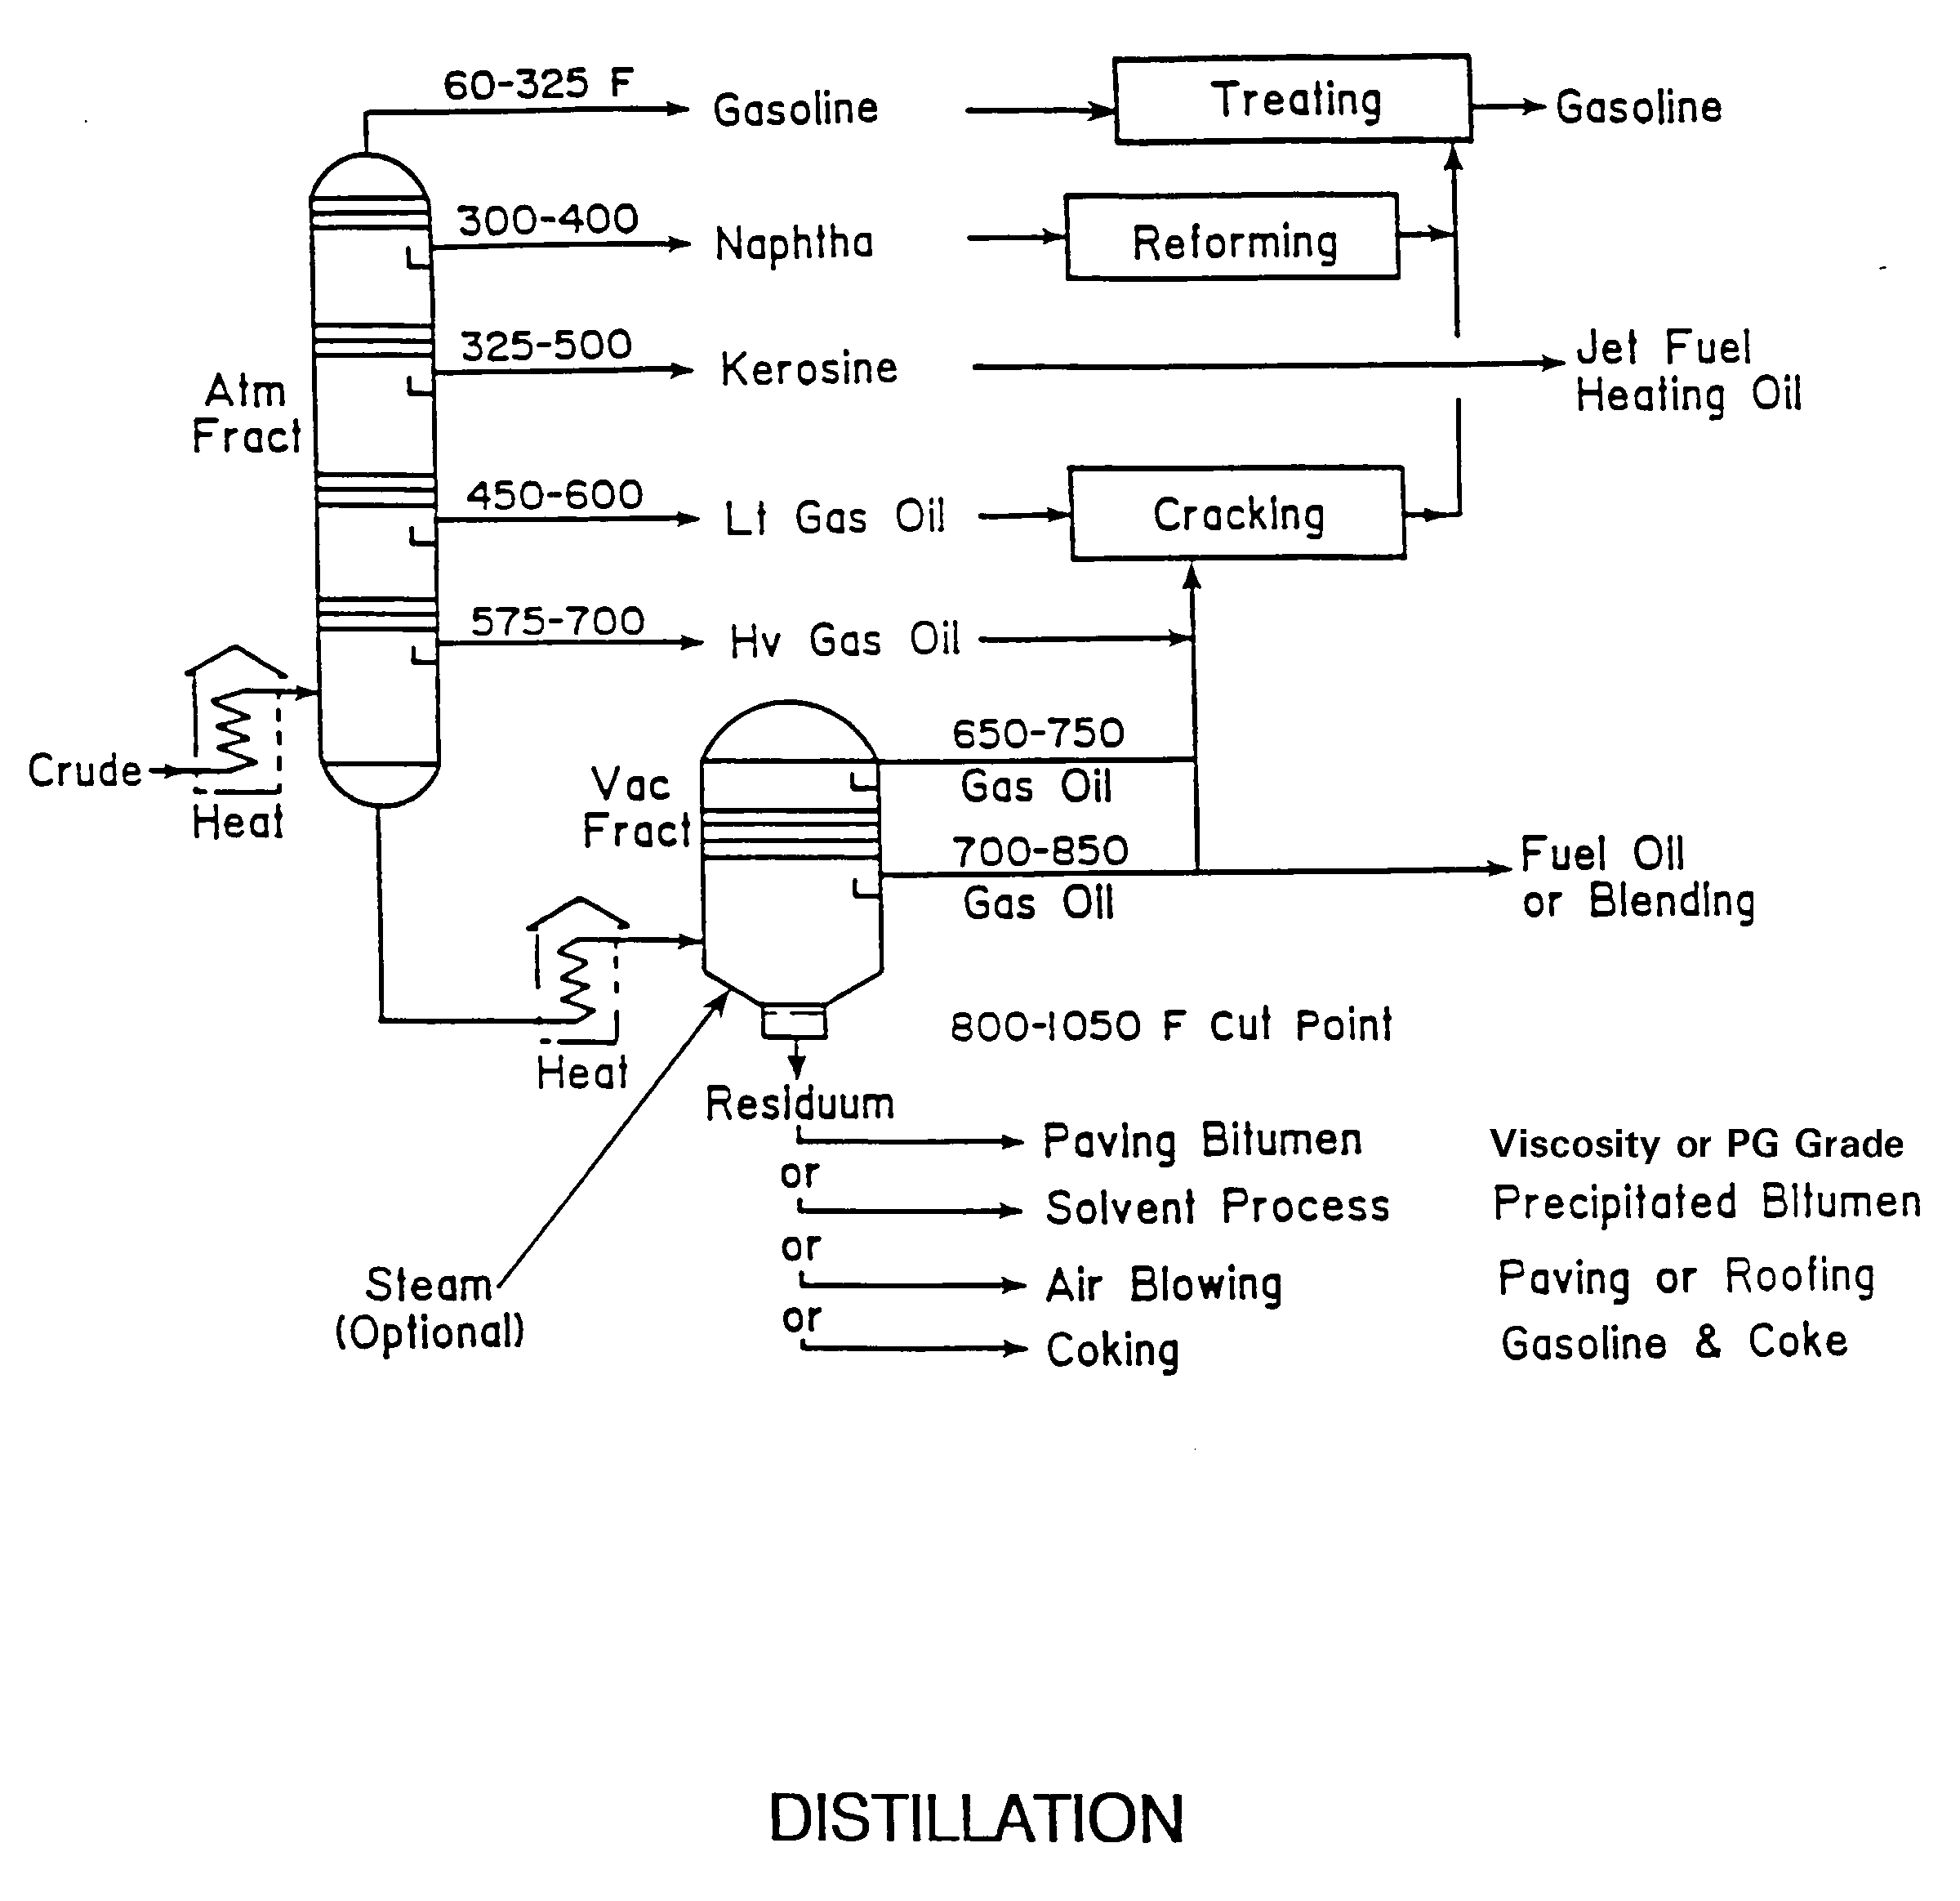

Slide 21
Petrochemicals
Obtained by cracking crude oil into chemical building blocks (olefins)
Products synthesized from petrochemicals:
  Plastics, Rubber, Fabrics, Synthetic drugs
  Dyes, glues & paints
Polymers synthesized from petrochemicals:
  SBS, Neoprene, Polyester, Nylon, EVA, Polyethylene, PVC, SBR
Not in crude or asphalt – made from olefins

Slide 22
Solvent Deasphalting
Asphalt broken down into 2 components:
  Asphaltenes and resins
  Oils
Blended to produce asphalt of desired properties

Slide 23
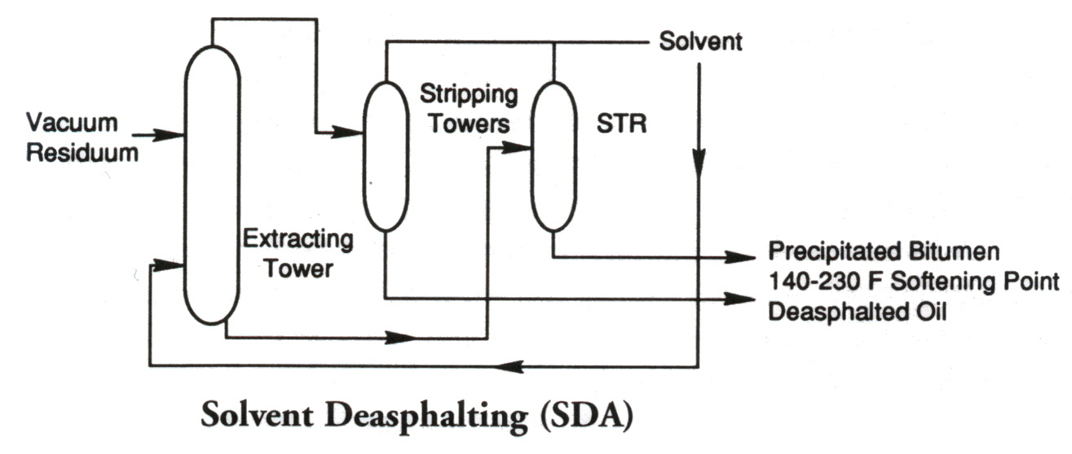
Solvent Deasphalting

Slide 24
Residuum Oil Supercritical Extraction (ROSE)
Asphalt broken down into 3 components:
  Asphaltenes
  Resins
  Oil
Blended to produce asphalt of desired properties

Slide 25
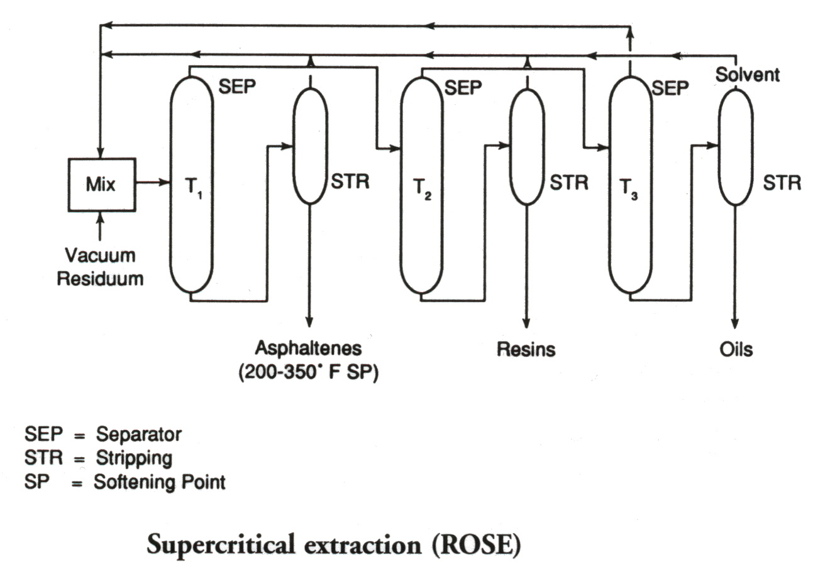
Supercritical Extraction (ROSE)

Slide 26
Air-Blowing of Asphalt
To produce asphalt of desired consistency (more viscous)
To reduce temperature susceptibility
Selection of production method depends on type of crude oil and desired asphalt

Slide 27
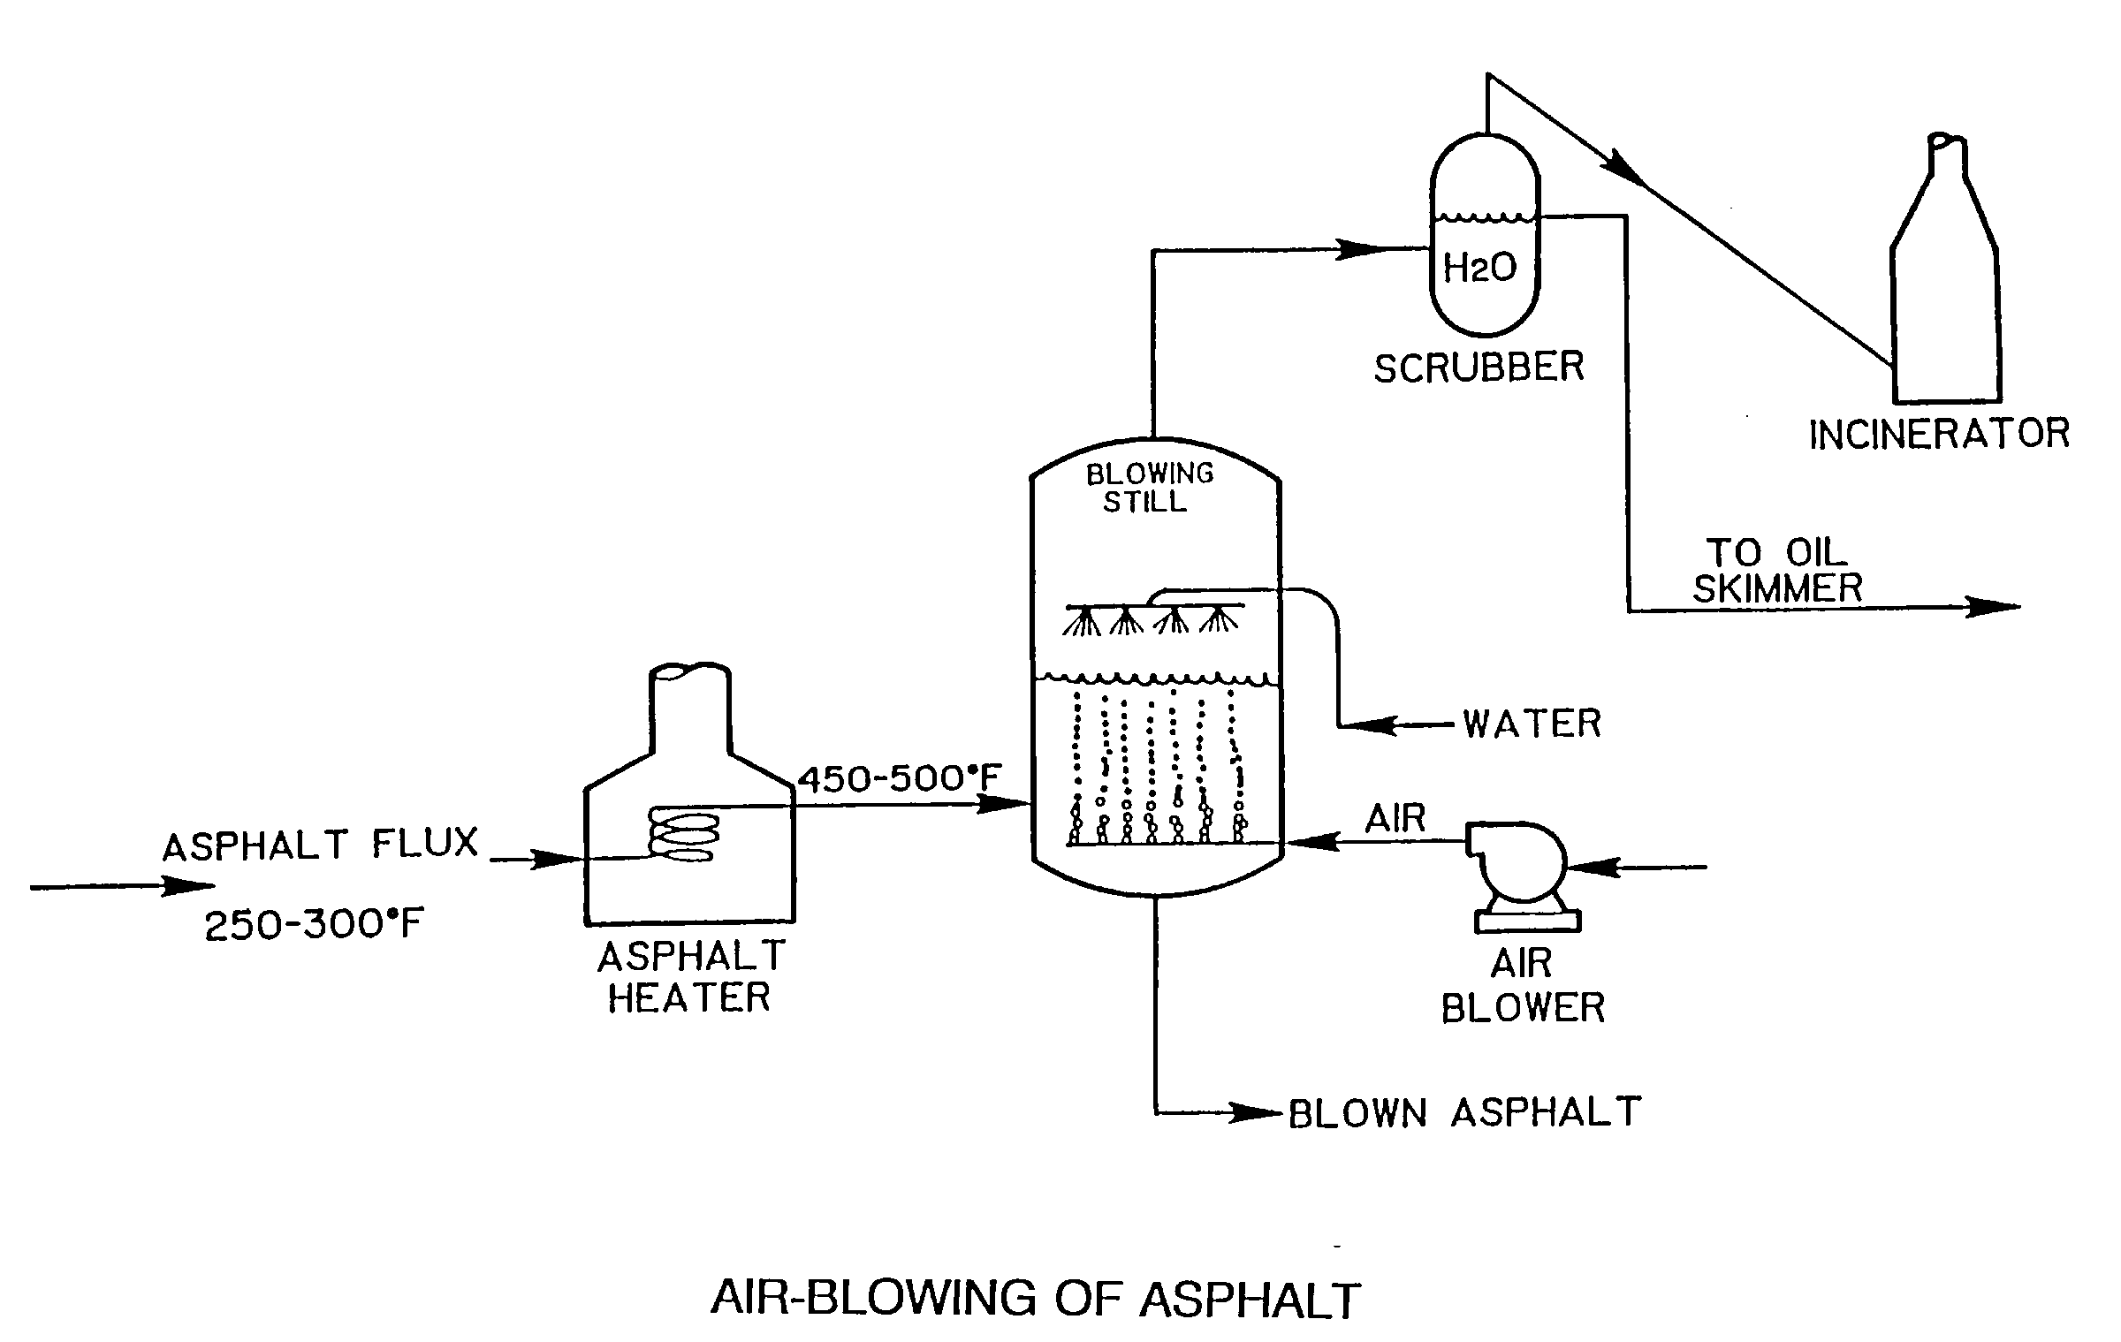

Slide 28
Asphalt Cement Components
Asphaltenes
  Large, discrete solid inclusions (black)
  High viscosity component
Resins
  Semi-solid or solid at room temperature
    Fluid when heated
    Brittle when cold
Oils
  Colorless liquid
  Soluble in most solvents
  Allows asphalt to flow
Notes:
The simplest general compositional model considers asphalt cements to be made up of asphaltenes, resins, and oils. The combination of the resins and oils is also referred to as the maltenes.
Asphaltene contents vary considerably from asphalt to asphalt. Low concentrations have been linked to tenderness in the HMA by some researchers.
Resins are credited with dispersing the solid asphaltene particles in the asphalt. Oxidation of resins produce asphaltene-type molecules.
Oils are soluble in most solvents. Upon oxidation, they produce both resin and asphaltene-type molecules.

Slide 29
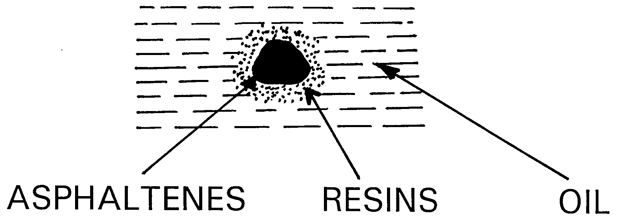
Peptizer
Semisolid
Gives temperature susceptibility
Gives ductility
Polar
Liquid
Nonpolar
Black powder
Gives body to AC
Highly polar

Slide 30
What are the civil engineering use of asphalt concrete?

Slide 31
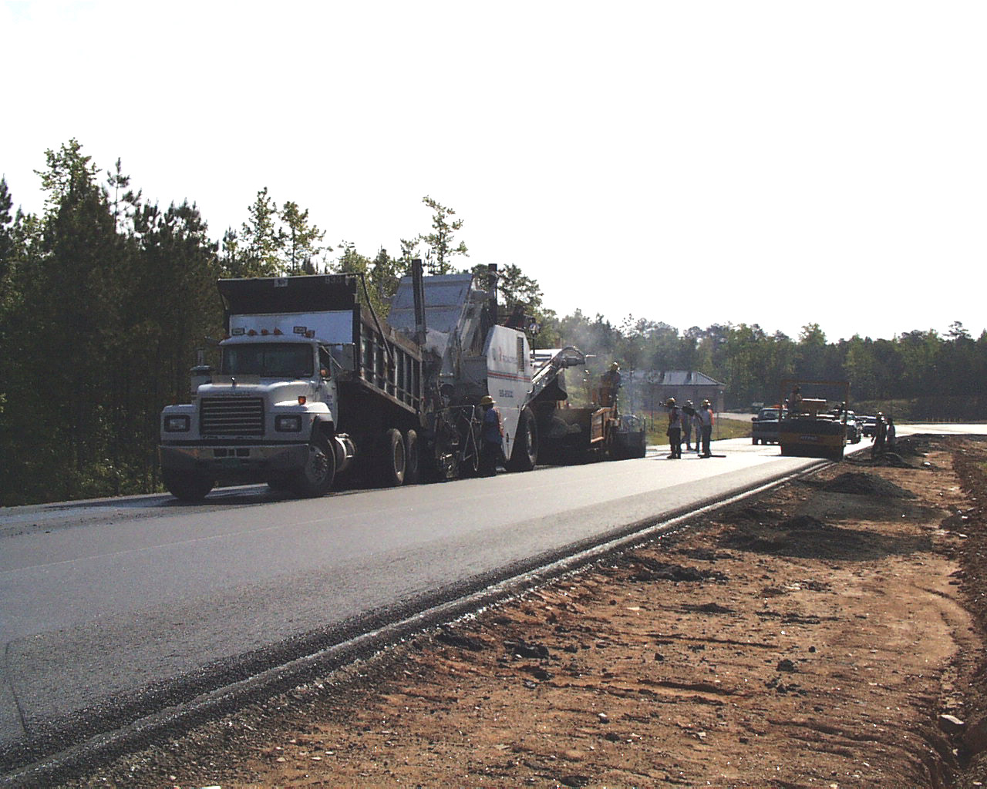

Slide 32
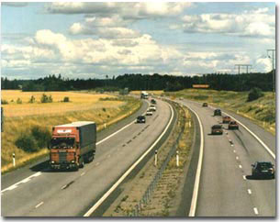

Slide 33


Slide 34
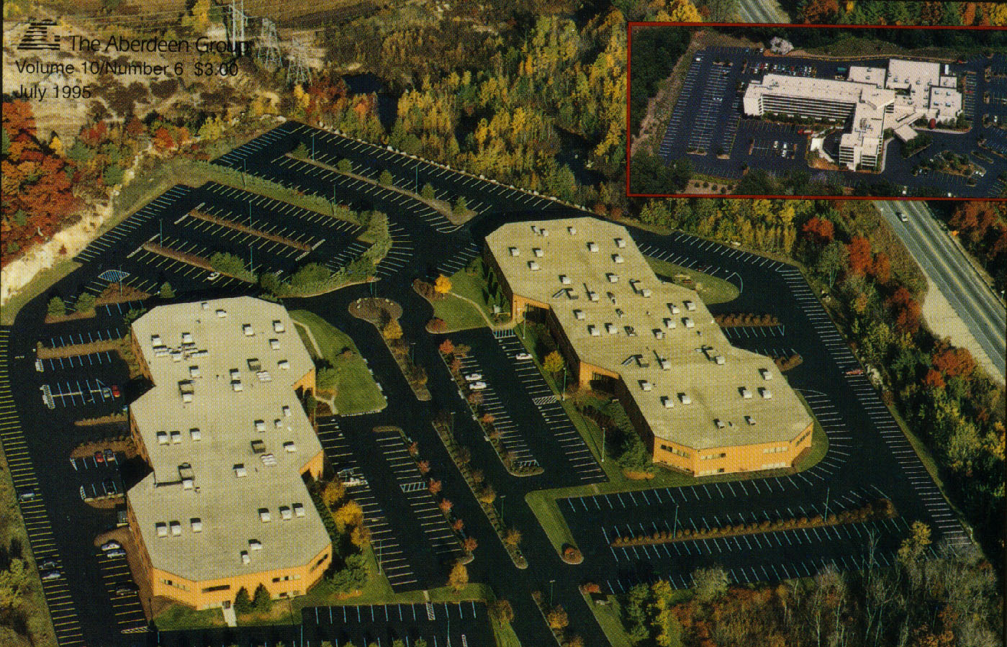

Slide 35
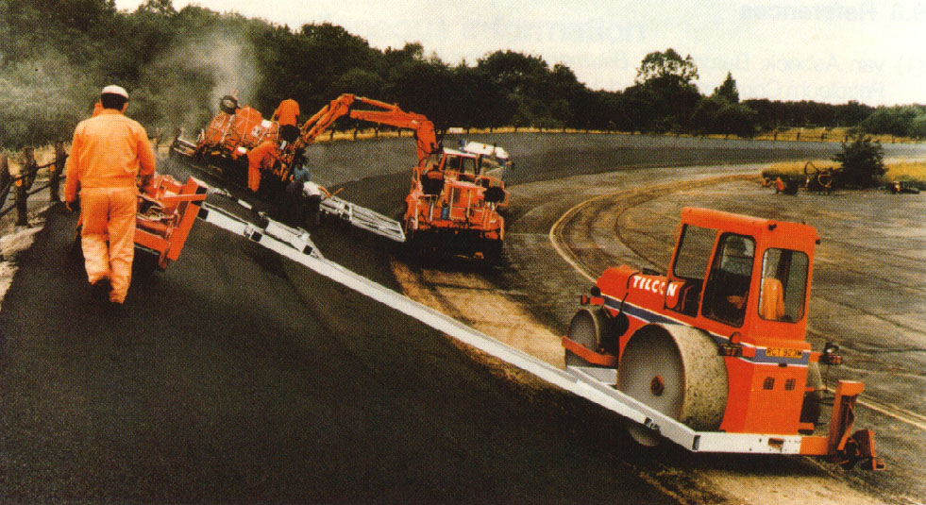

Slide 36
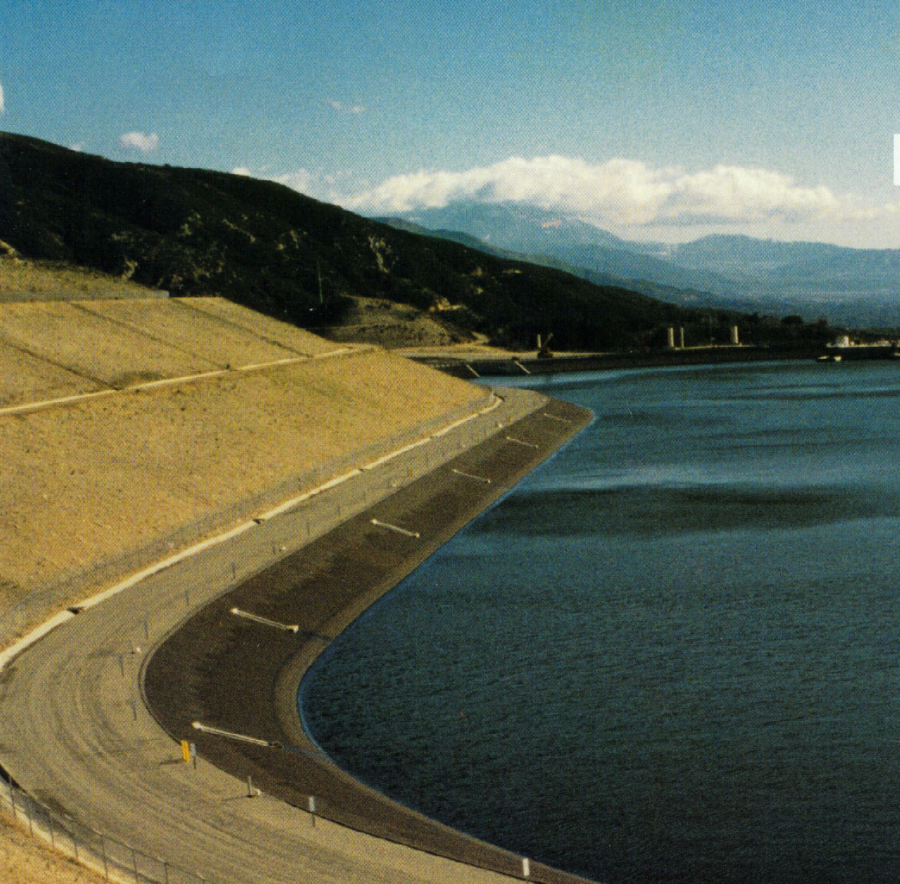

Slide 37
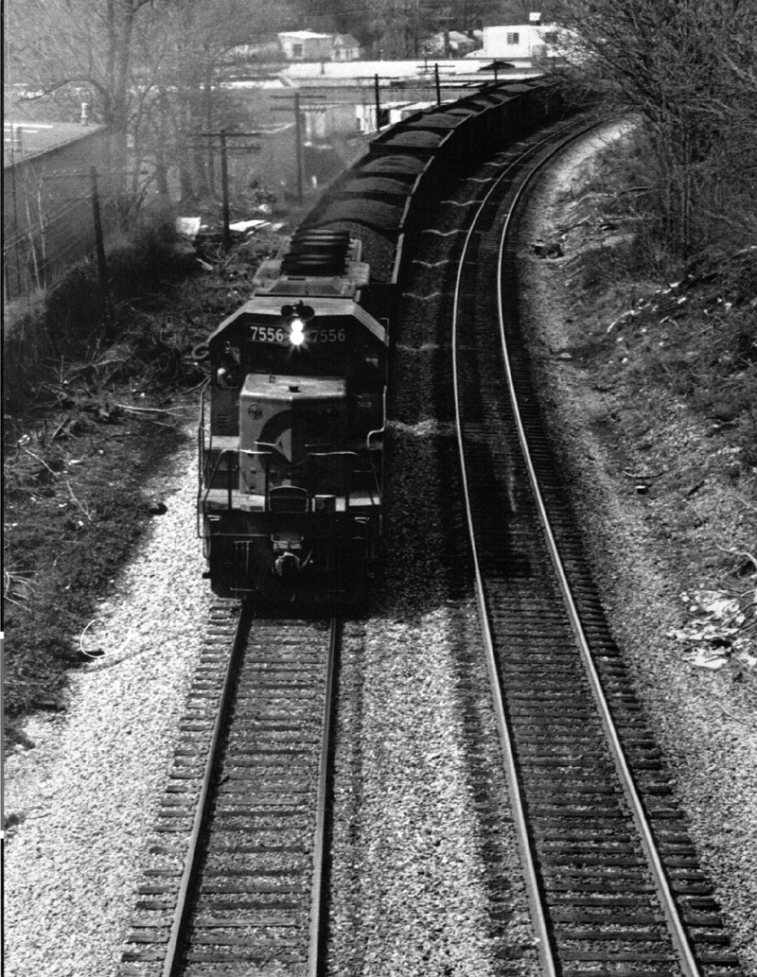

Slide 38
How do we use asphalt cement in road construction ?
How do we use asphalt cement in road construction?

Slide 39
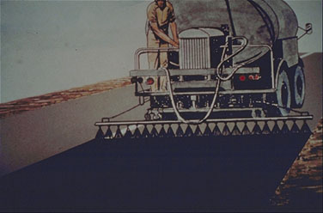

Slide 40
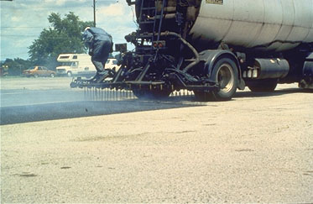

Slide 41
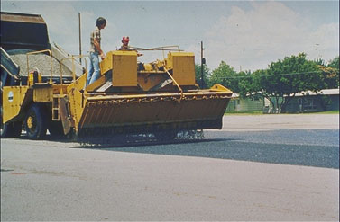

Slide 42
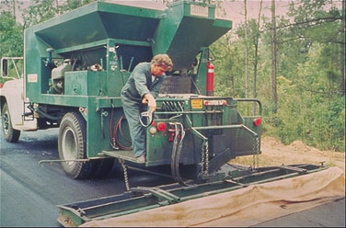

Slide 43
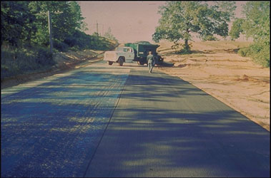

Slide 44
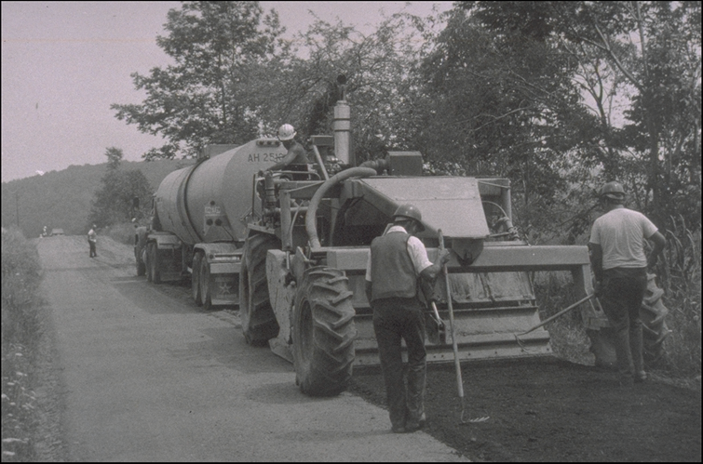
Single Machine Recycling
Notes:
This slide shows a photo of a single machine CIR operation.

Slide 45
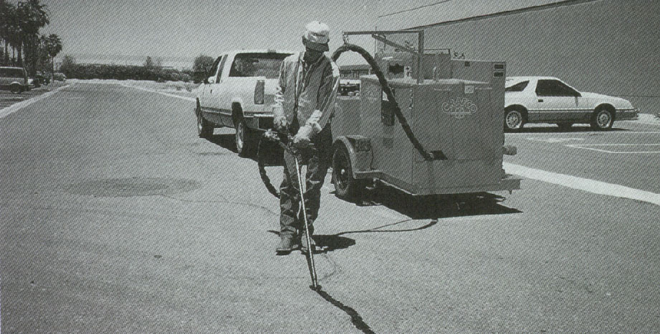

Slide 46
Asphalt Binder Types
Asphalt Cement
  Generally refinery produced material
  Air blown asphalt cement
Cutbacks
  Asphalt cements "cut" with petroleum solvents
Asphalt Emulsions
  Mixture of asphalt cement, water, and emulsifying agent
Notes:
The residuum or “resid” from the distillation process is used to make various asphalt cement products.

Slide 47
Cutbacks
Rapid cure (RC) (Naphtha or Gasoline)
  High volatility of solvent
  Tack coats, surface treatments
Medium cure (MC) (Kerosene)
  Moderate volatility
  Stockpile patching mix
Slow cure (SC) (Low viscosity oil)
  Low volatility
  Prime coat, dust control
Notes:
Cutbacks are liquid at room temperature and are manufactured by adding or “cutting” asphalt cements with petroleum solvents. The volatility of the solvent dictates the rate at which the solvent evaporates. How fast the solvent escapes into the atmosphere regulates how fast a mixture of cutback and aggregate will set. Environmental regulations are increasingly limiting the use of these products.

Slide 48
Cutback Asphalts
Medium Curing (MC)
Asphalt + Kerosene
Stockpile Patch
Prime Coat
MC - 30
MC - 70
MC - 250
MC - 800
Slow Curing (SC)
Asphalt + Oil
SC - 70
SC - 250
SC - 800
SC - 3000
Rapid Curing (RC)
Asphalt + Naphtha
Surface Treatment
RC - 30
RC - 70
RC - 250
RC - 800

Slide 49
Cutback Asphalt – Limitations
High volatility of solvent:
  Vapors dangerous to workers
  May ignite in hot weather
  Environmentally unsafe
Expensive – use of high-energy solvents
Notes:
Cutbacks are liquid at room temperature and are manufactured by adding or “cutting” asphalt cements with petroleum solvents. The volatility of the solvent dictates the rate at which the solvent evaporates. How fast the solvent escapes into the atmosphere regulates how fast a mixture of cutback and aggregate will set. Environmental regulations are increasingly limiting the use of these products.

Slide 50
Emulsions
Emulsifier gives surface charge to asphalt droplets suspended in water
  Anionic: Negative charge / Alkaline / Good with limestones (+)
  Cationic: Positive charge / Acid / Good with silica gravels (−)
Notes:
Emulsions are produced by blending asphalt cements, water and an emulsifier (e.g. soap) in a high shear colloid mill. The resulting asphalt droplet suspended in the water has a charge which reflects the chemistry of the emusifier. The charge of the emulsion is usually selected so that it is opposite that of the aggregate to promote adhesion of the asphalt to the aggregate surface.
Emulsions are an asphalt-based product which is also liquid at room temperature.

Slide 51
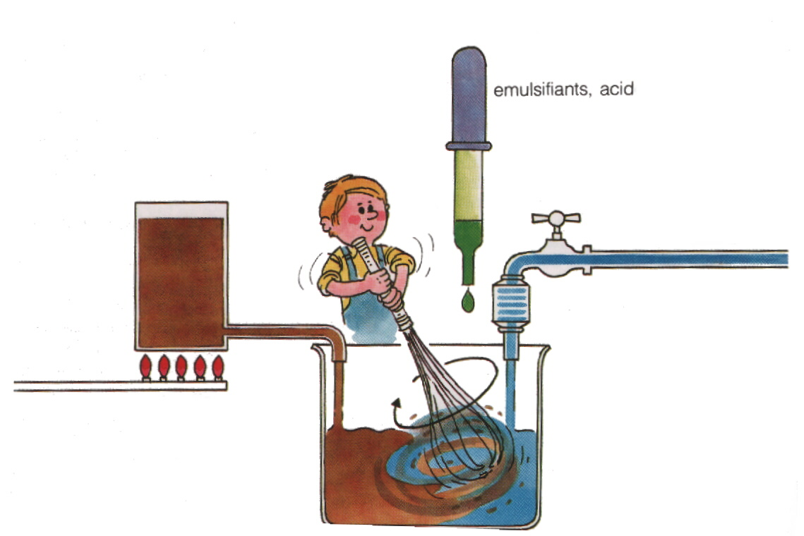
Emulsion Manufacturing
Notes:
This slide shows a schematic of the emulsion mixing operation.

Slide 52
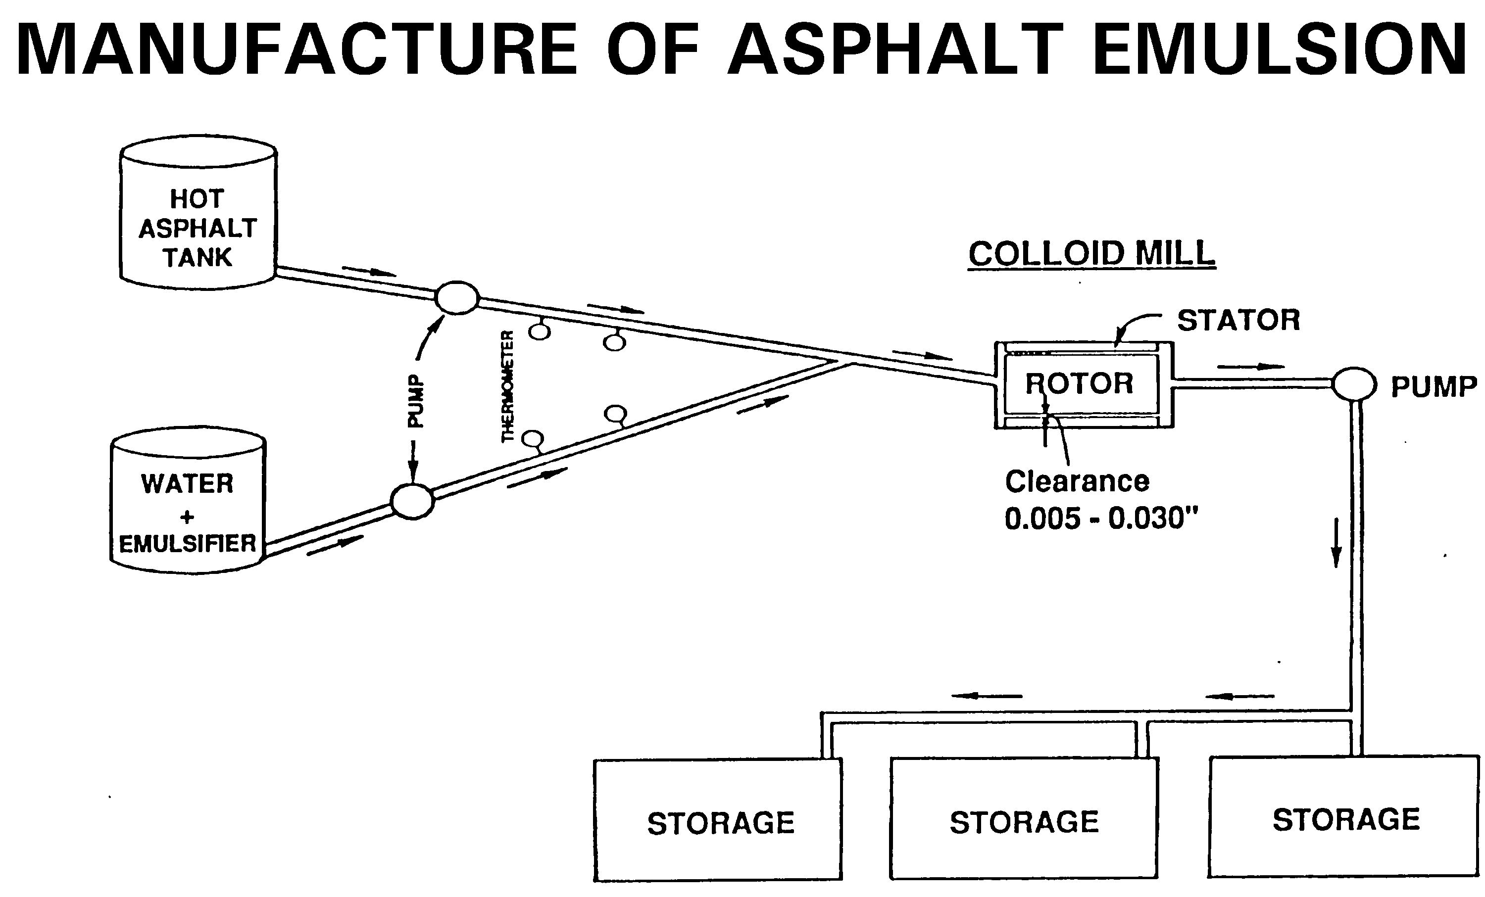

Slide 53
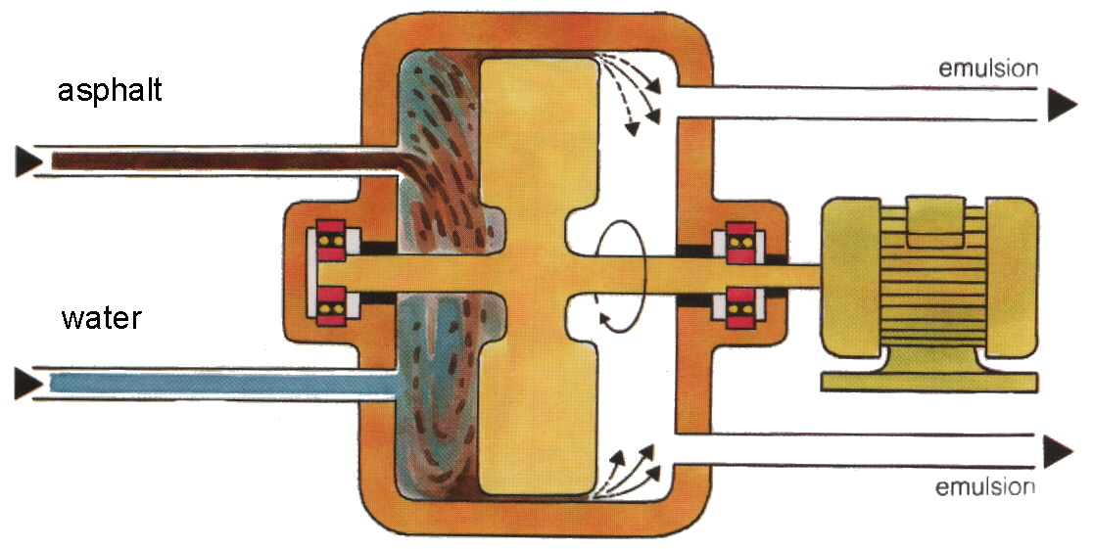
Emulsion Manufacturing
Notes:
This slide shows a photo of a single machine CIR operation.

Slide 54
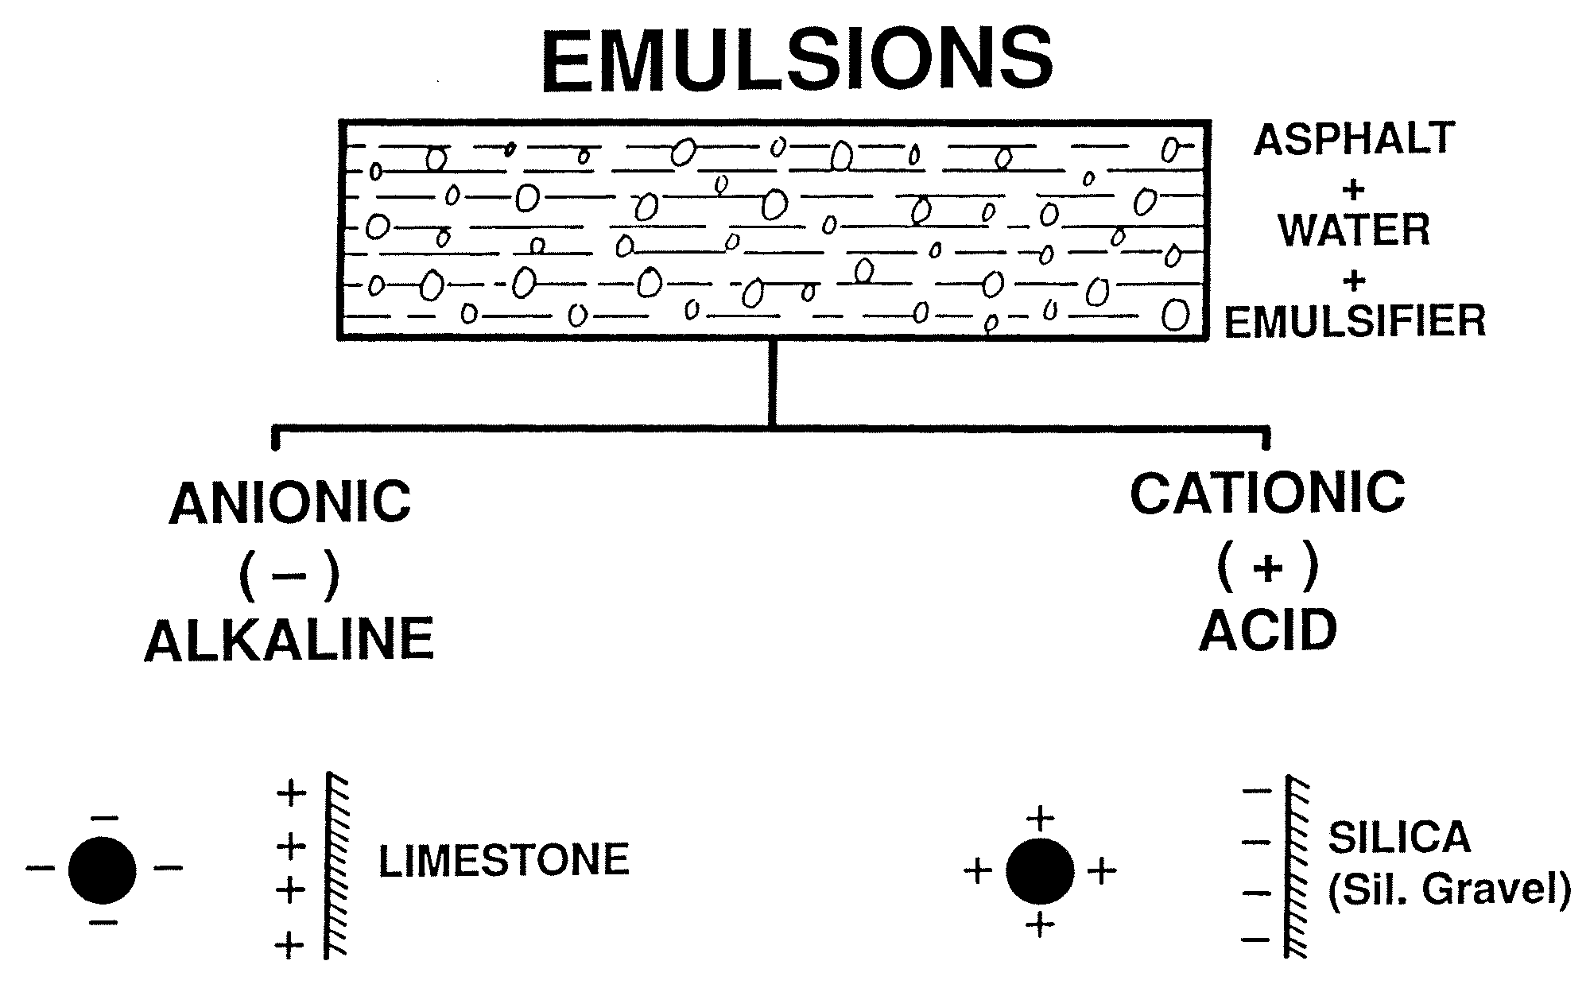

Slide 55
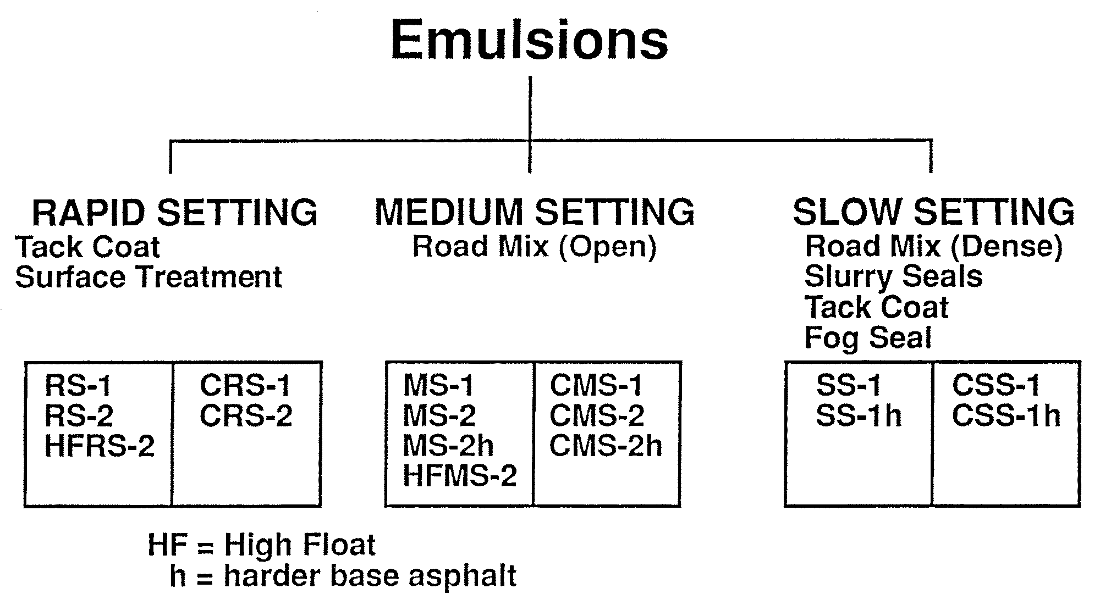

Slide 56
Emulsions vs. Cutbacks
Environmental issues – emulsions are pollution free
Safety issues – cutbacks are dangerous
Cheaper – high energy solvents wasted into atmosphere
Emulsions may be used at lower temperatures
Emulsions may be used on damp pavement
Notes:
Emulsions are produced by blending asphalt cements, water and an emulsifier (e.g. soap) in a high shear colloid mill. The resulting asphalt droplet suspended in the water has a charge which reflects the chemistry of the emusifier. The charge of the emulsion is usually selected so that it is opposite that of the aggregate to promote adhesion of the asphalt to the aggregate surface.
Emulsions are an asphalt-based product which is also liquid at room temperature.

Slide 57
Emulsions vs. Conventional Asphalt Cement
Cost is the main factor in selection of appropriate material
Emulsion is very popular in Europe, less used in the United States
About 95% is cationic emulsion
Notes:
Emulsions are produced by blending asphalt cements, water and an emulsifier (e.g. soap) in a high shear colloid mill. The resulting asphalt droplet suspended in the water has a charge which reflects the chemistry of the emusifier. The charge of the emulsion is usually selected so that it is opposite that of the aggregate to promote adhesion of the asphalt to the aggregate surface.
Emulsions are an asphalt-based product which is also liquid at room temperature.

Slide 58
Properties of Asphalt Cements
Liquid at normal temperatures
Softens at high temperatures
Brittle at low temperatures
Ages with time (oxidation)
Must be compatible with aggregates to assure adhesion
Notes:
In order to purchase a product, the desirable characteristics and important material properties must be known. When these parameters are presented in written form, they are called specifications.

Slide 59

Emulsions
Notes:
In order to purchase a product, the desirable characteristics and important material properties must be known. When these parameters are presented in written form, they are called specifications.

Slide 60
Purchasing of Asphalt Cements
Need to be able to specify desirable characteristics
"Desirable characteristics" have evolved over time with increasing technological advances
Purchasing requires specifications
Notes:
In order to purchase a product, the desirable characteristics and important material properties must be known. When these parameters are presented in written form, they are called specifications.

