Slide 1
Course C.03.06.01
Eartchworks
Marek Pszczola

Slide 2
Road Transportation Systems Engineering Development in the Sub-Saharan Africa – Modern EU Master Programme & Capacity Building

Slide 4
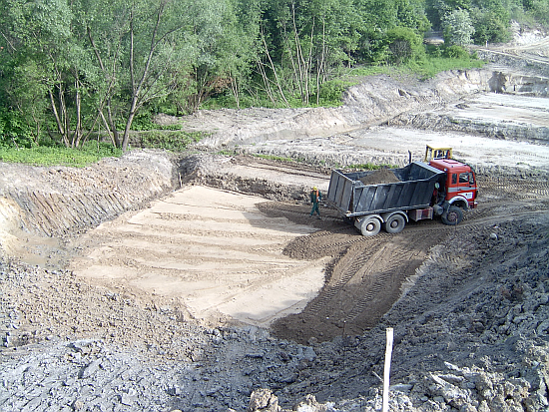
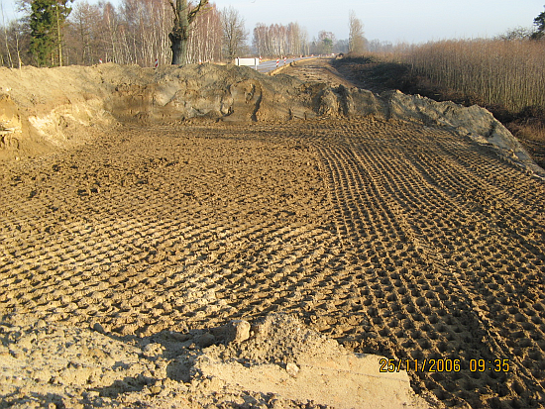
Types of earthworks during road construction
Earthworks on a limited area, for ex.: bridge abutment (head of a bridge)

Slide 5
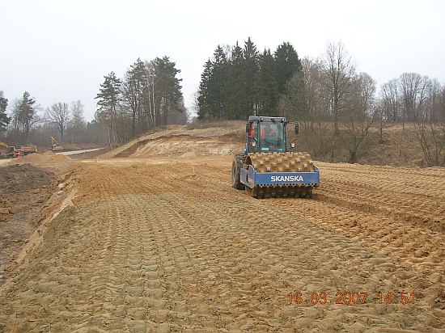
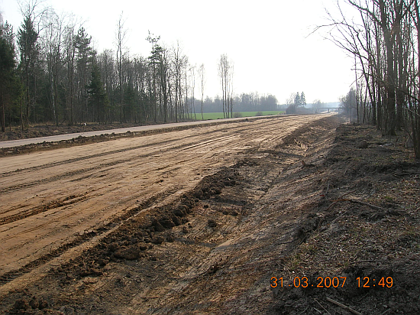
Types of earthworks during road construction
Linear earthworks:

Slide 6
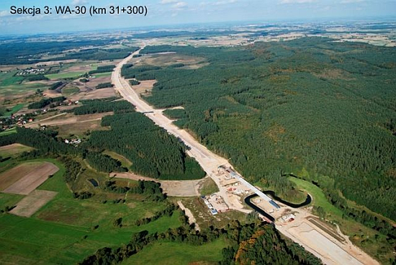
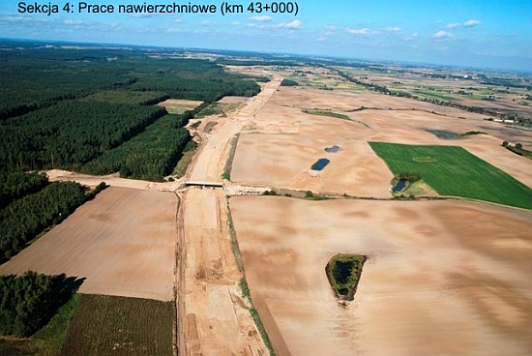
Types of earthworks during road construction
Linear earthworks:

Slide 7
Linear earthworks
There are stages:
  Preparatory works: ranging, stubbing
  The works with cut
  Soil movement
  Fill formation
  Compaction of soil in embankment
  Ground leveling

Slide 8
Basic definitions
Cut > Fill
Cut < Fill

Slide 9
General rules of earthworks design
The aim of earthworks is to limit the volume of soil movement and to accomplish the cost effectiveness:
Cut = Fill
The earthworks leveling on a small distances
The earthworks design with a slope of superelevation

Slide 10
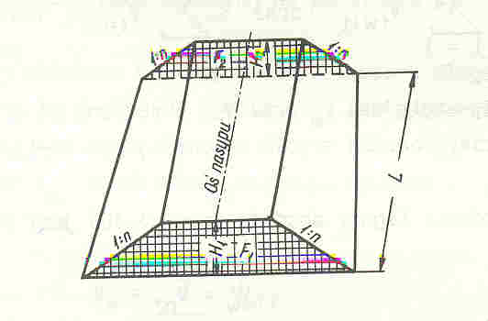
Earthworks volume calculations
Earthworks volume is calculated with use of cross sections:
V=¹/₂ x (F₁ + F₂) x L
F₂
¹/₂ x (F₁ + F₂)
F₁

Slide 11
Earthworks volume calculations
The scale of cross sections is 1:100, or 1:200 in case of width roads and highways
The frequency of cross sections generally depands on type of road – typically is every 30 – 40 m

Slide 12
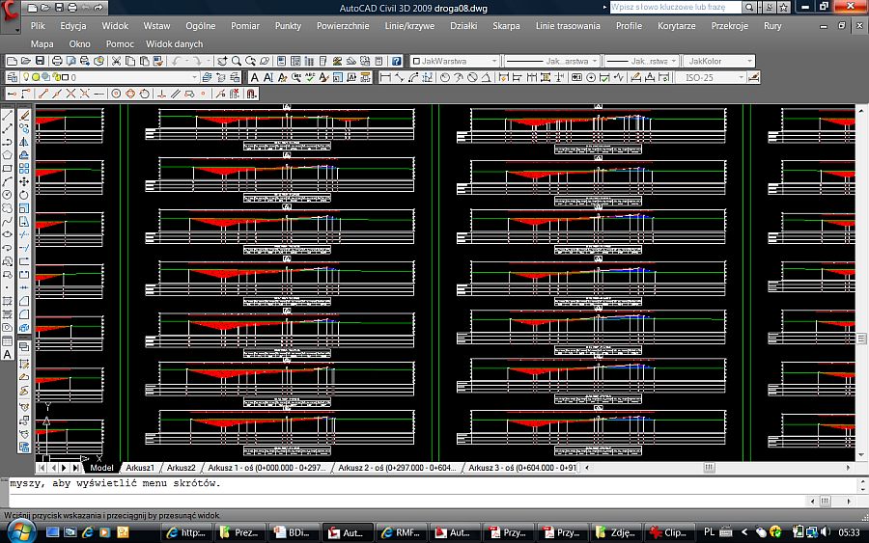
Use of Auto-Cad for design of cross sections areas

Slide 13
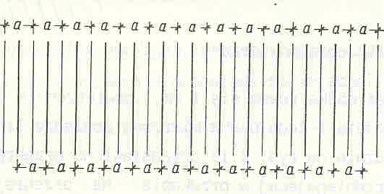
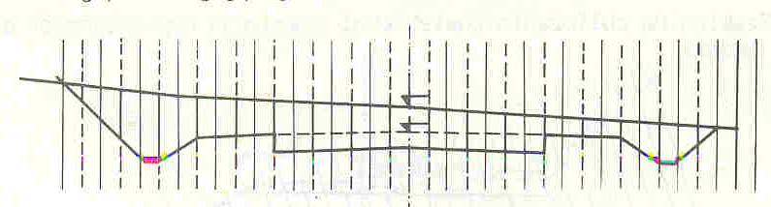
Earlier methods
Strips method:

Slide 14
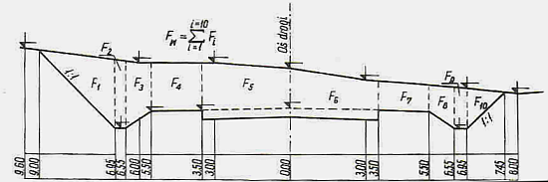
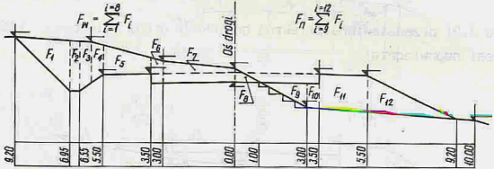
Earlier methods
Partition on the simply figures:

Slide 15
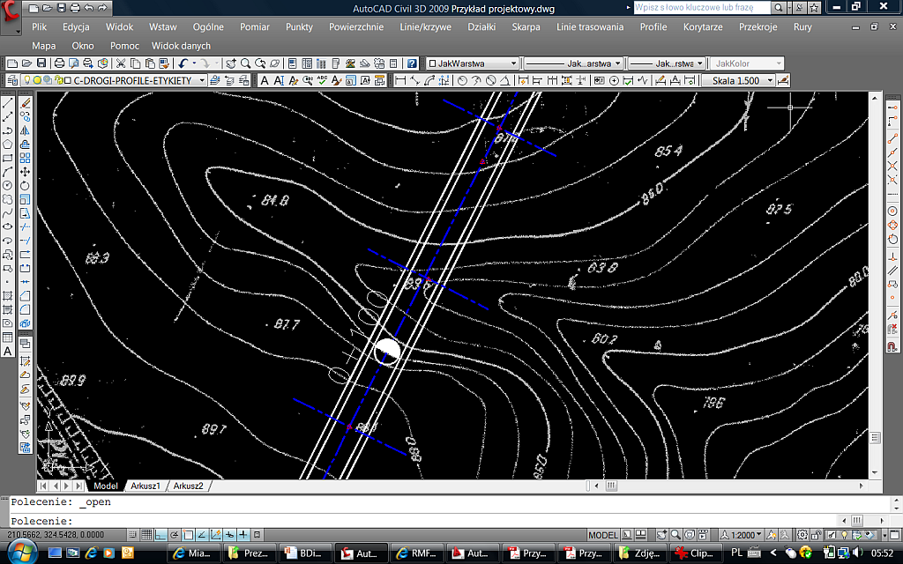
Design with use of Auto-Cad (1)
Route plan

Slide 16
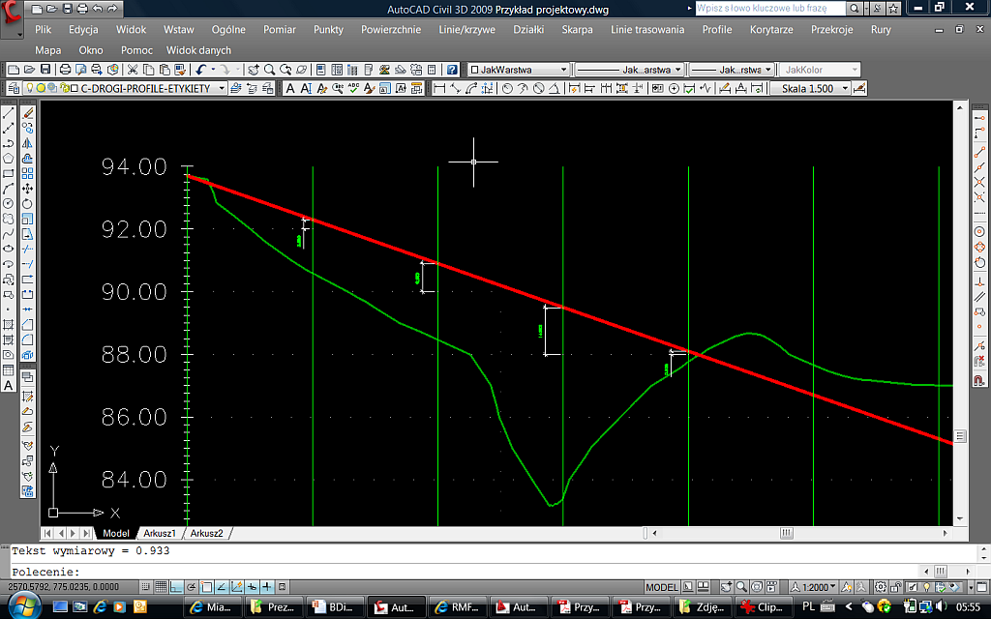
Design with use of Auto-Cad (2)
Height of superelevation

Slide 17
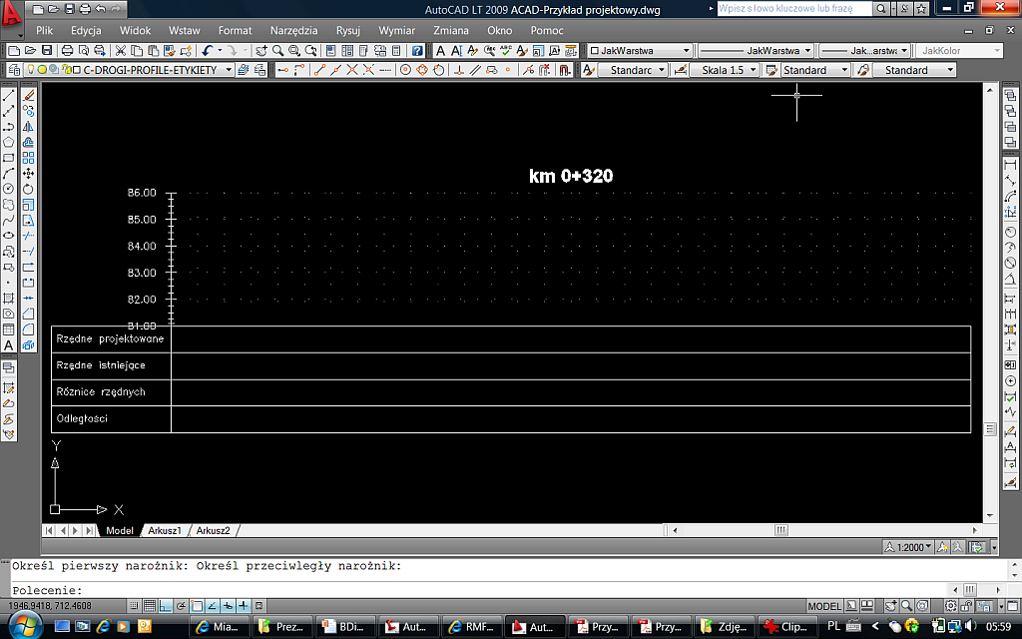
Design with use of Auto-Cad (3)
Tables:

Slide 18
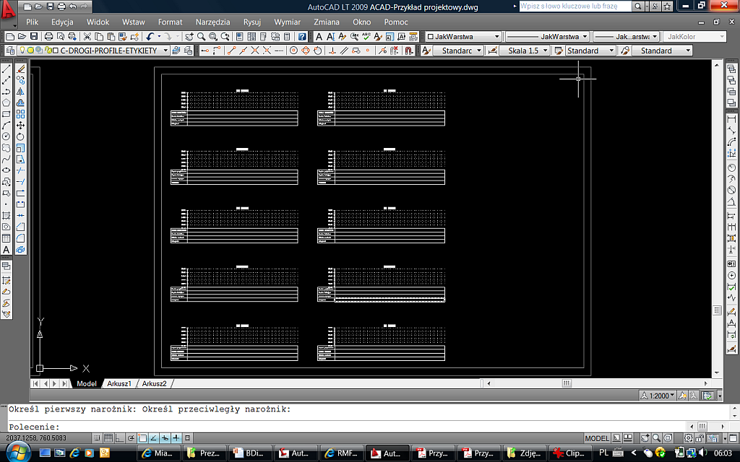
Design with use of Auto-Cad (4)
Tables:

Slide 19
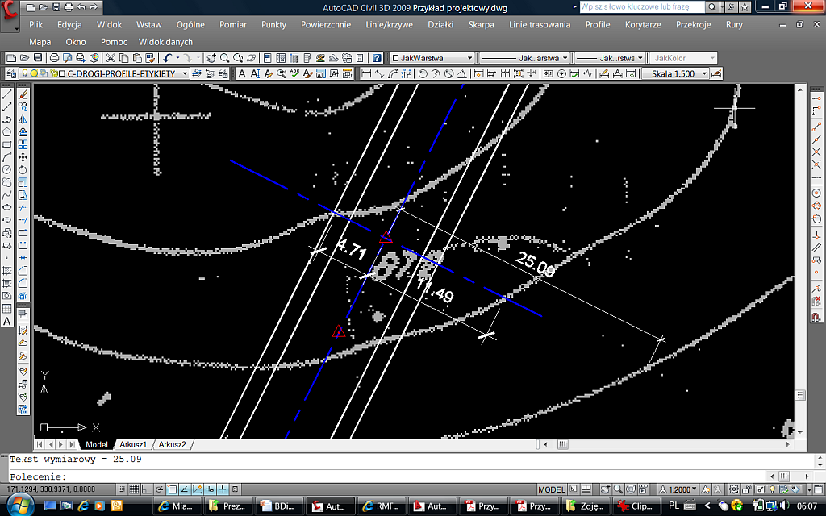
Design with use of Auto-Cad (5)
Measuring of distance between contour line and superelevation

Slide 20
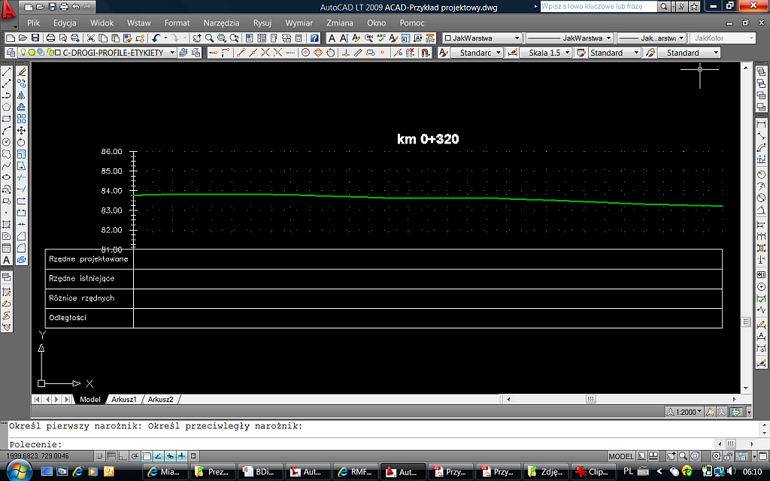
Design with use of Auto-Cad (6)
Ground line

Slide 21
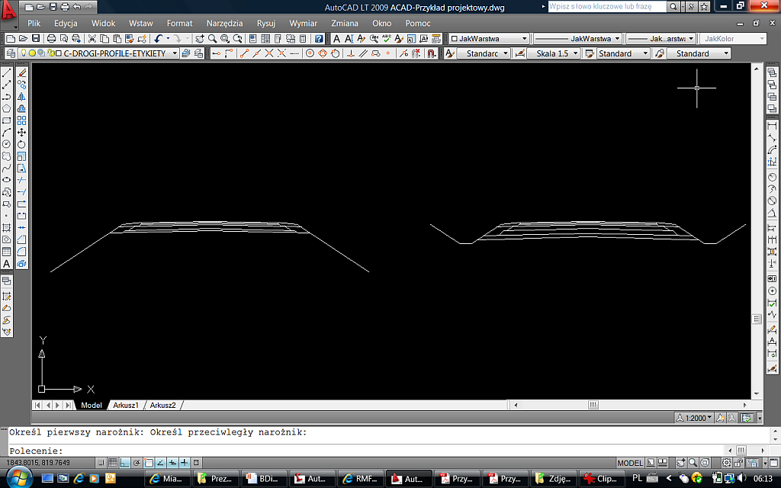
Design with use of Auto-Cad (7)
Typical cross sections for cut and fill

Slide 22
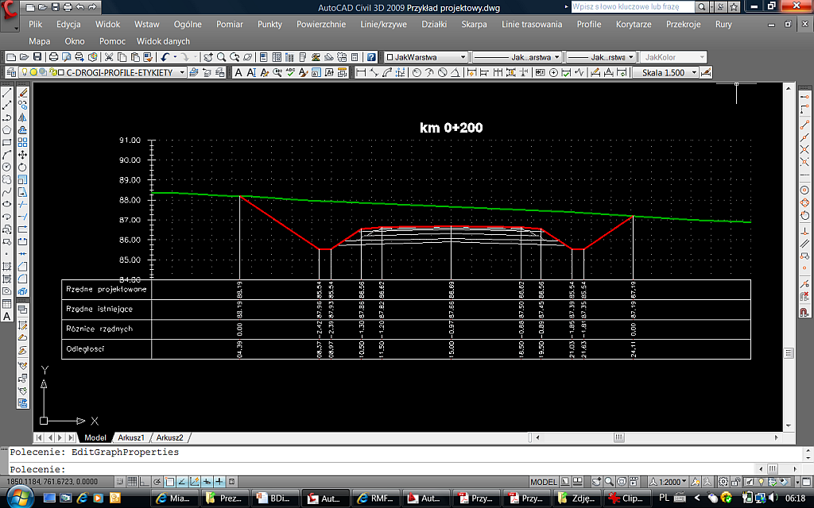
Design with use of Auto-Cad (8)
Copy and paste

Slide 23
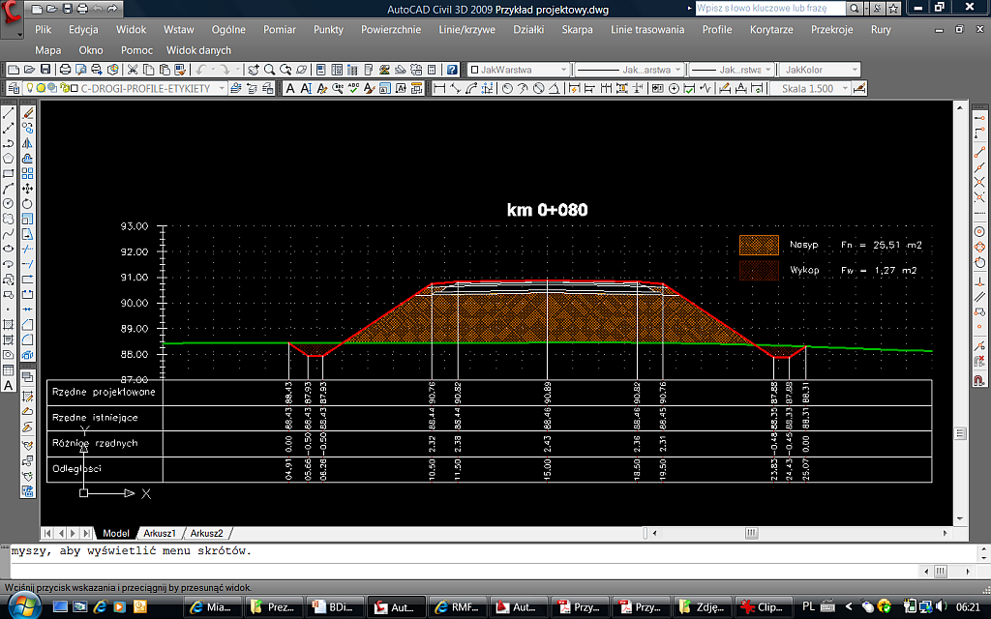
Design with use of Auto-Cad (9)
Introduce cut and fill

Slide 24
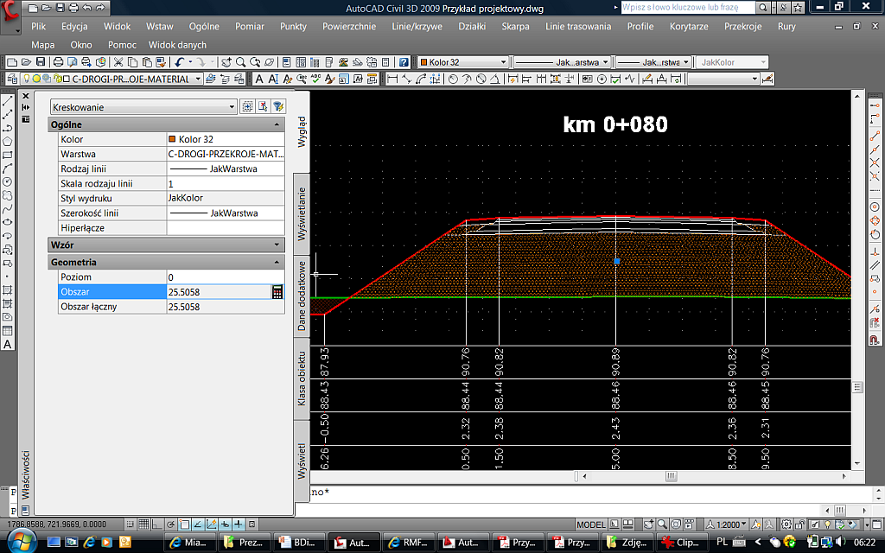
Design with use of Auto-Cad (10)

Slide 25
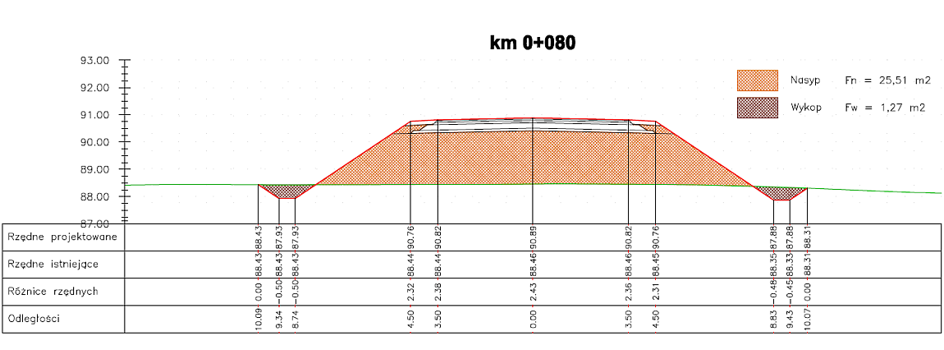
An example

Slide 26
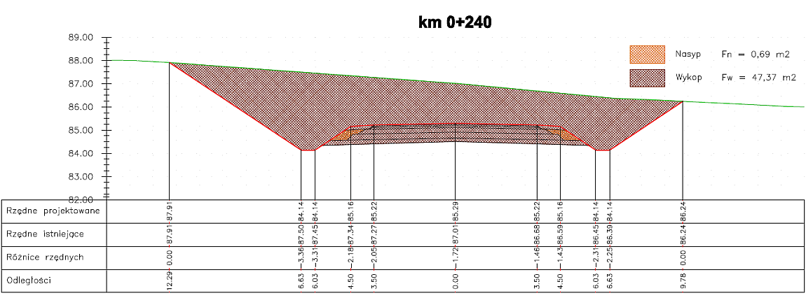
An example

Slide 27
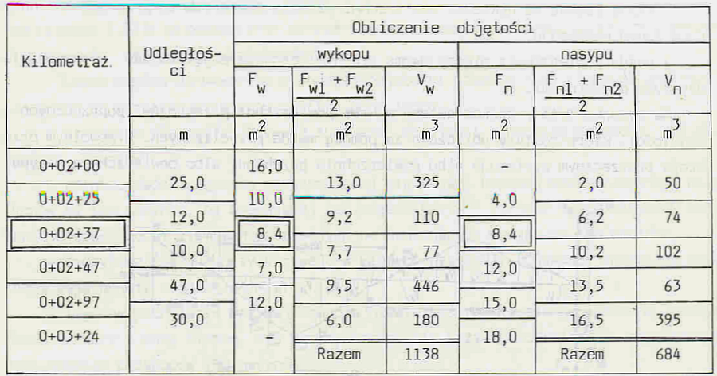
Volume of earthworks calculation
There is a table:

