Slide 1
Course C.03.06.02
Portland Cement Concrete (PCC) Pavements
Marek Pszczola
(presentation was prepared on the basis of lectures prof. S. Romanoschi, USA)

Slide 2
Road Transportation Systems Engineering Development in the Sub-Saharan Africa – Modern EU Master Programme & Capacity Building

Slide 4
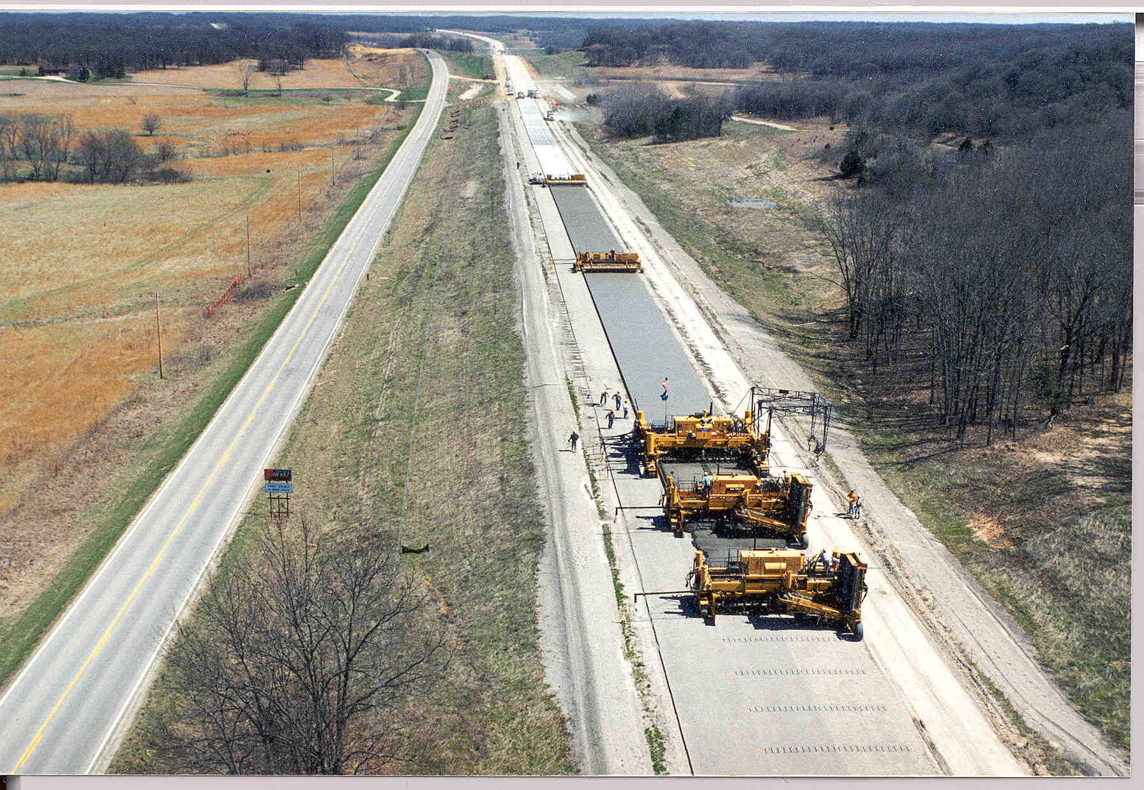

Slide 5
Paver Set-Up
Square up paving kit
Check pan for trueness
Adjust pan for crown
Adjust pan attitude (draft)

Slide 6
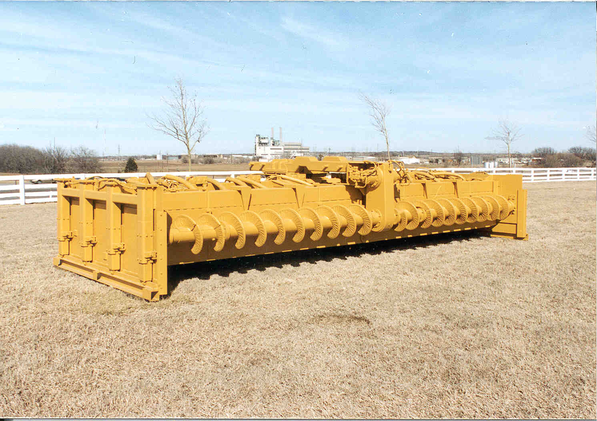

Slide 7
Extrusion Envelope
Excess Concrete
Movement
Strike Off
Vibrator
Tamper
Concrete Head
Profile Pan
Fluidized
Concrete
Side Form Resistance Batter
Profile Pan Batter -
Compression-Paver Uplift

Slide 8
Paver Sensor System
Check thoroughly
Set wands same distance apart
Set wands level
Set counterbalance

Slide 9
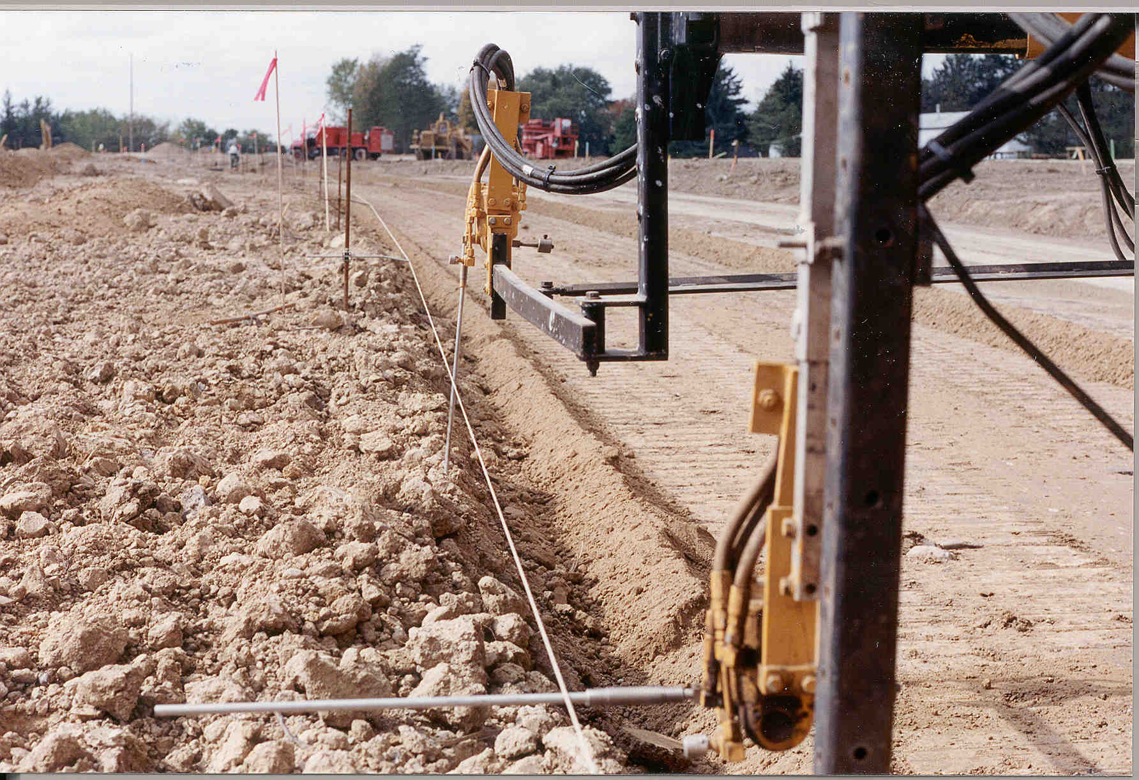

Slide 10
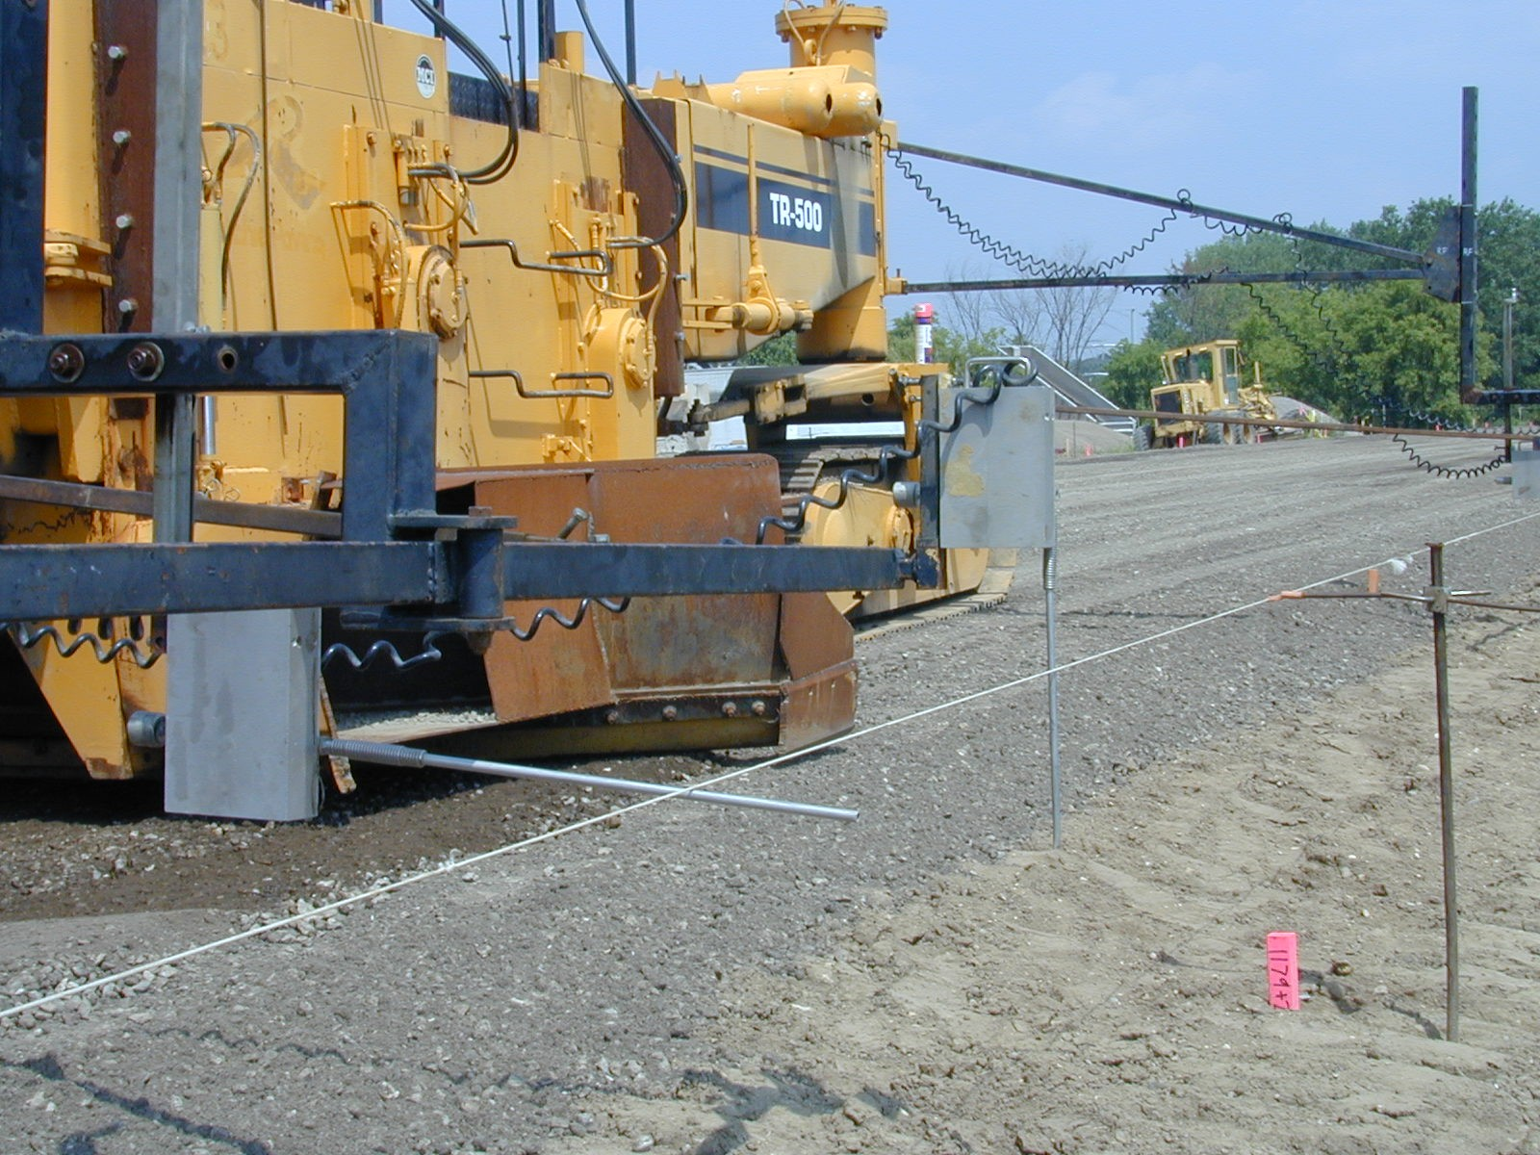

Slide 11
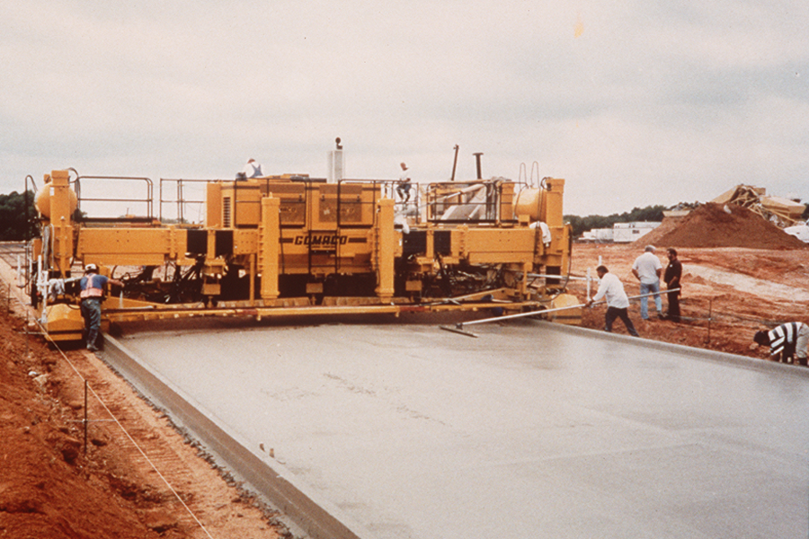

Slide 12
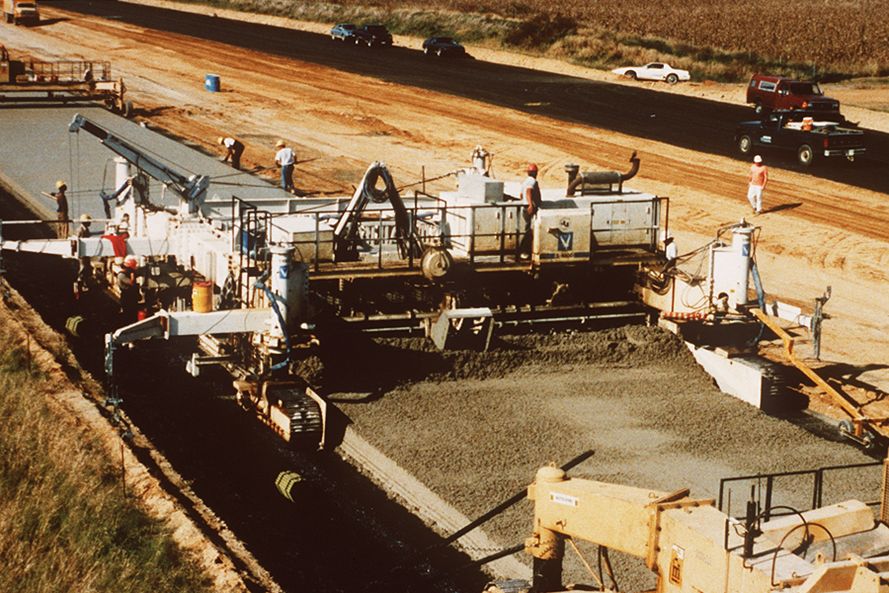

Slide 13
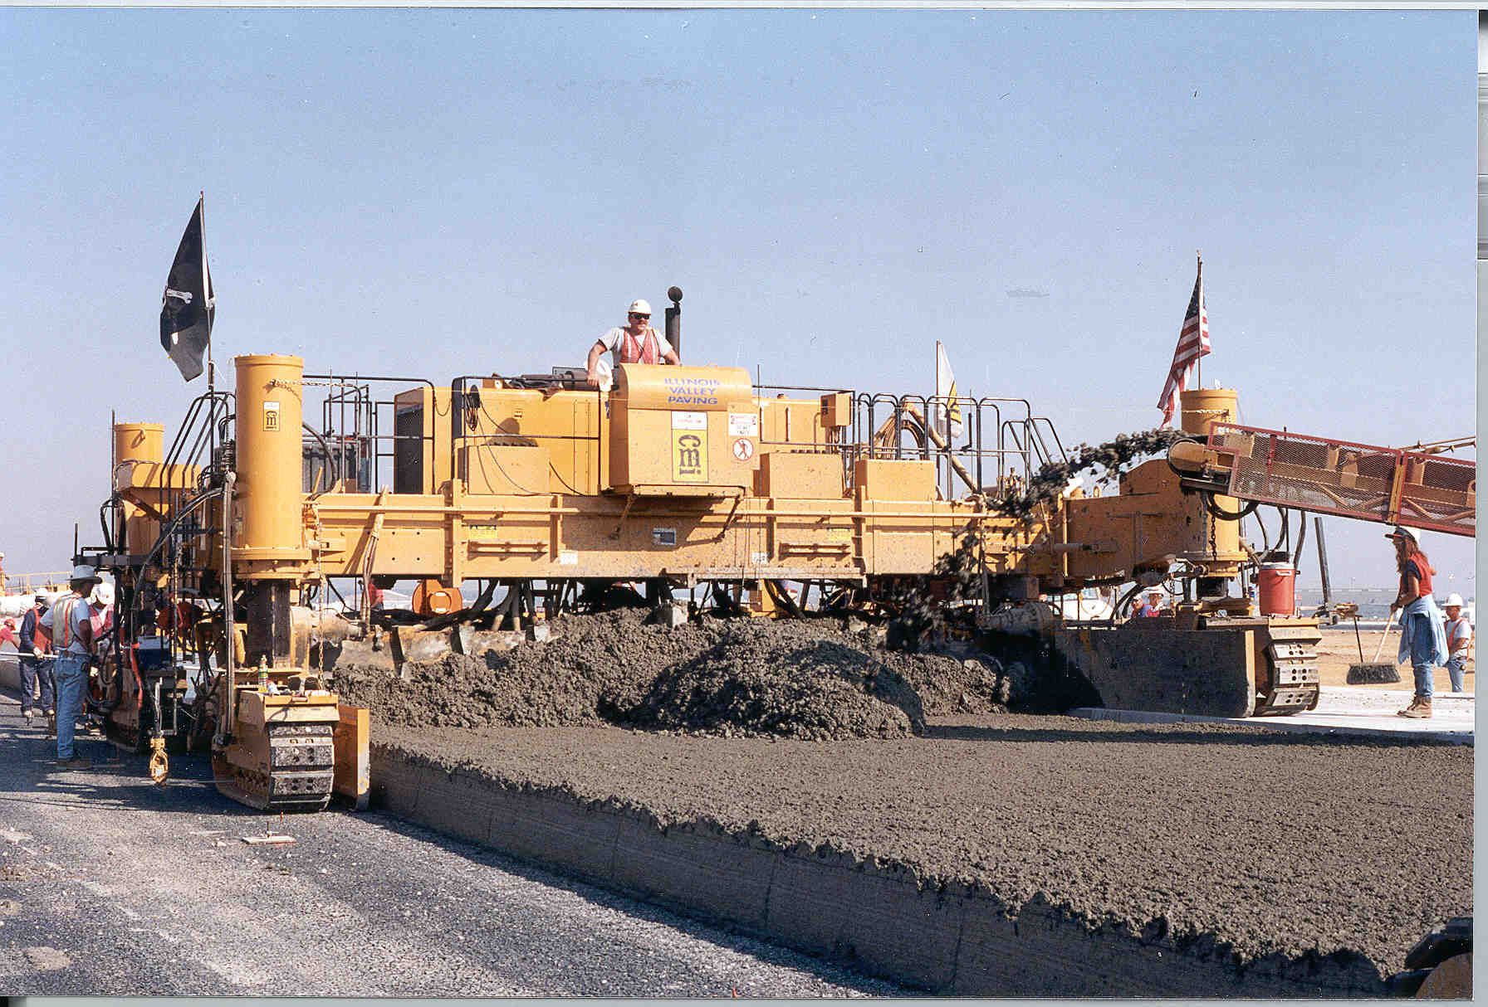

Slide 14
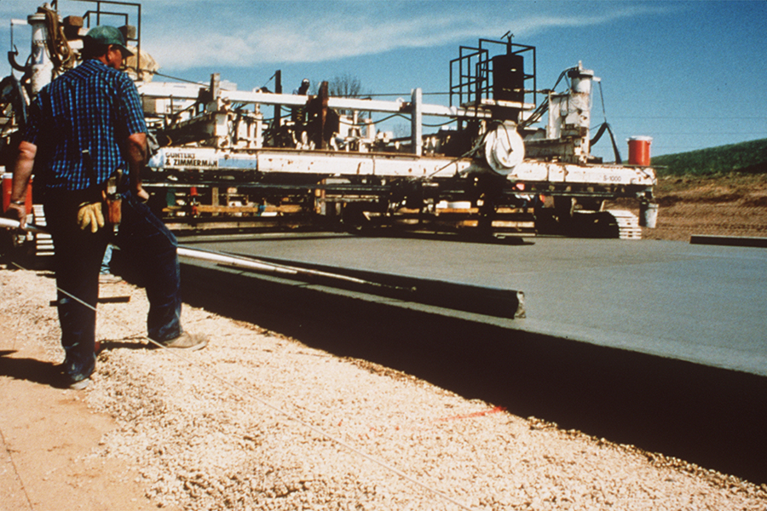

Slide 15
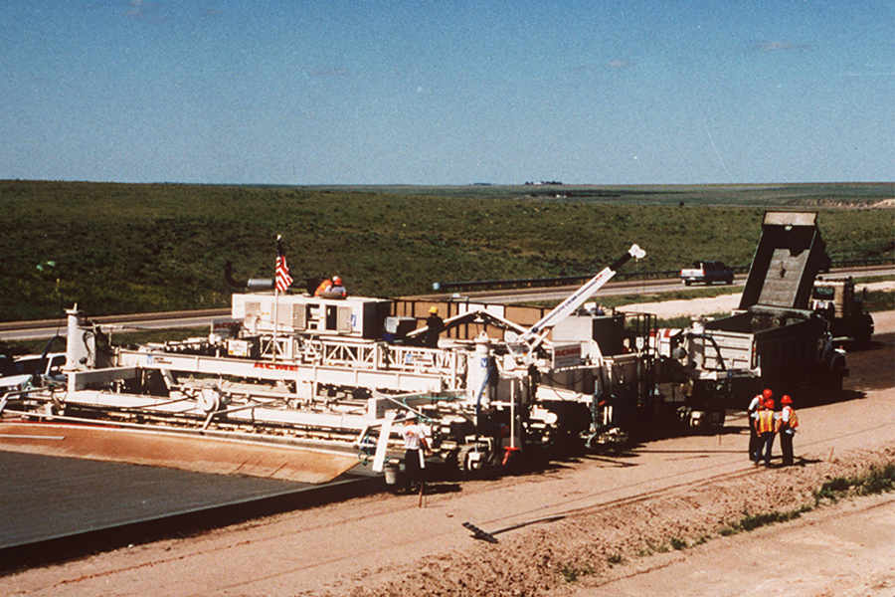

Slide 16
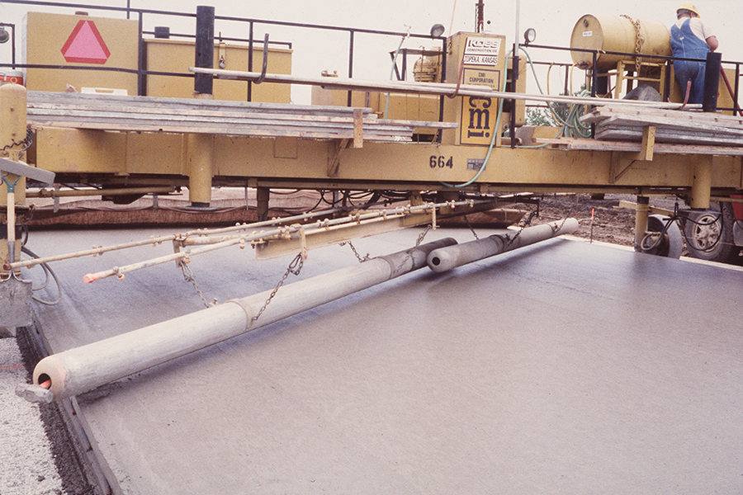

Slide 17
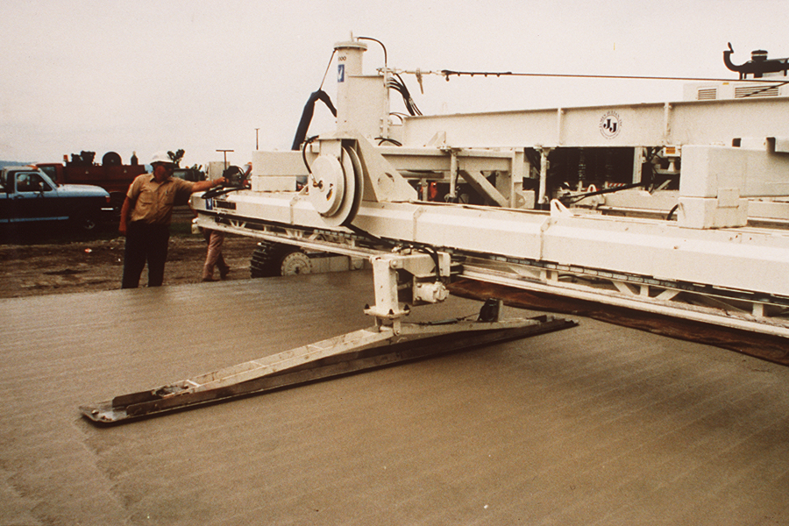

Slide 18
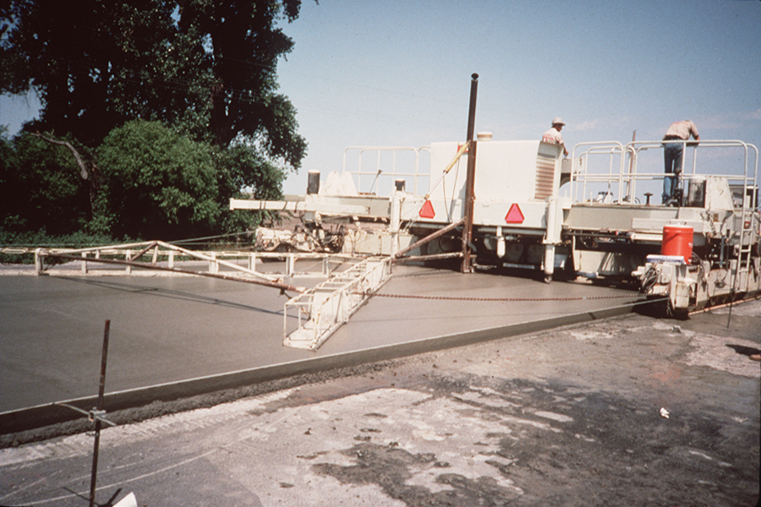

Slide 19
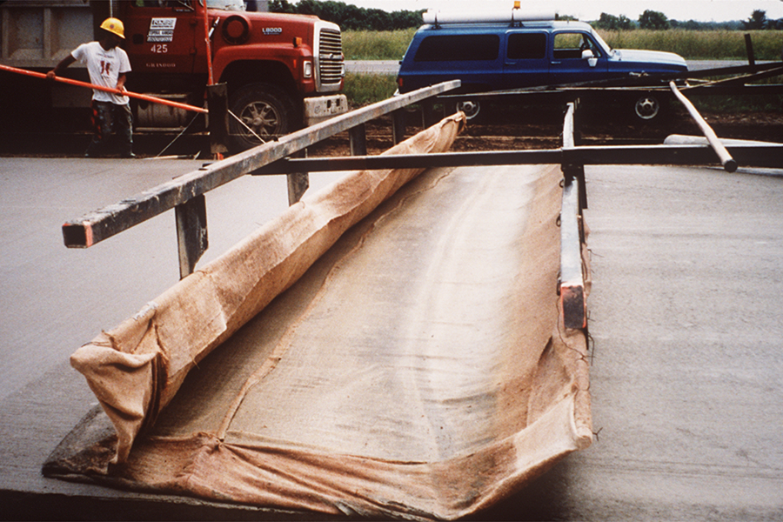

Slide 20
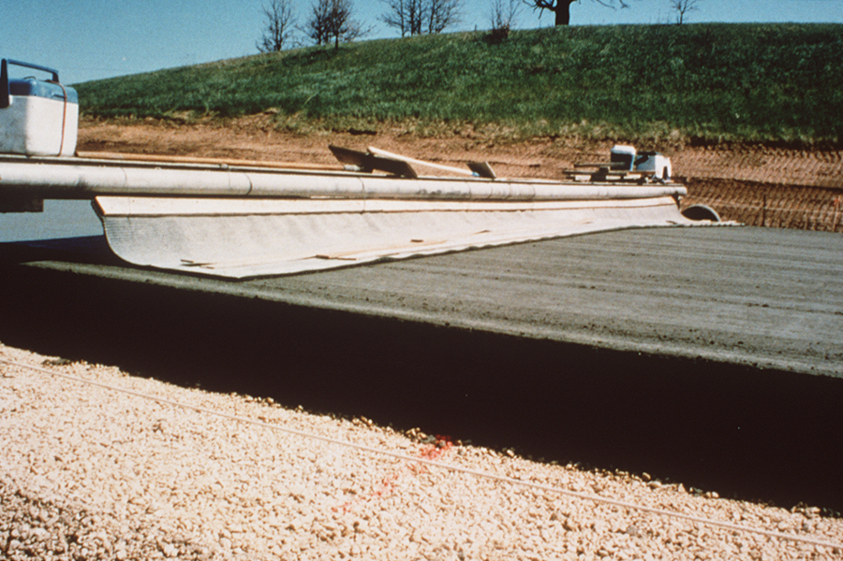

Slide 21
Texturing - Tining
Longitudinal
Transverse
Spacing of ¾ in (20 mm) or less
Random tine spacing

Slide 22
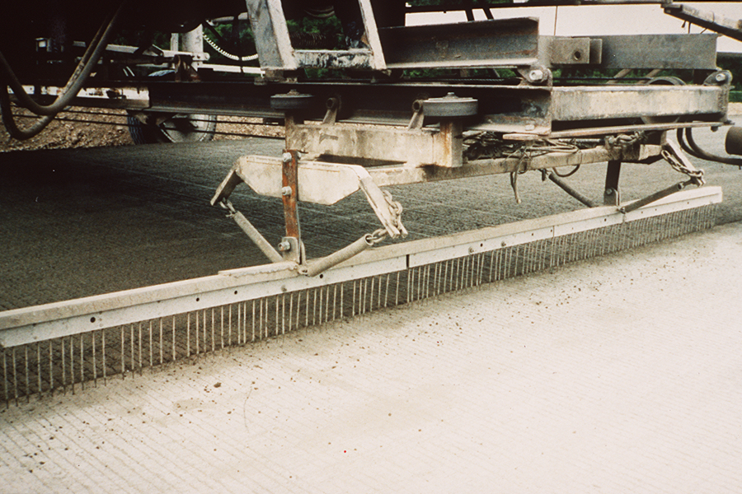

Slide 23
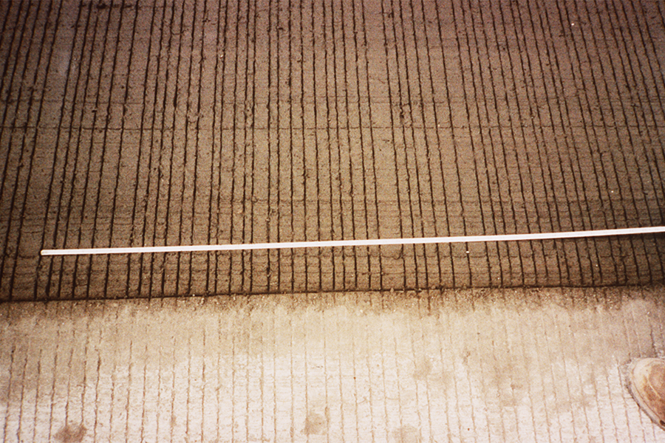

Slide 24
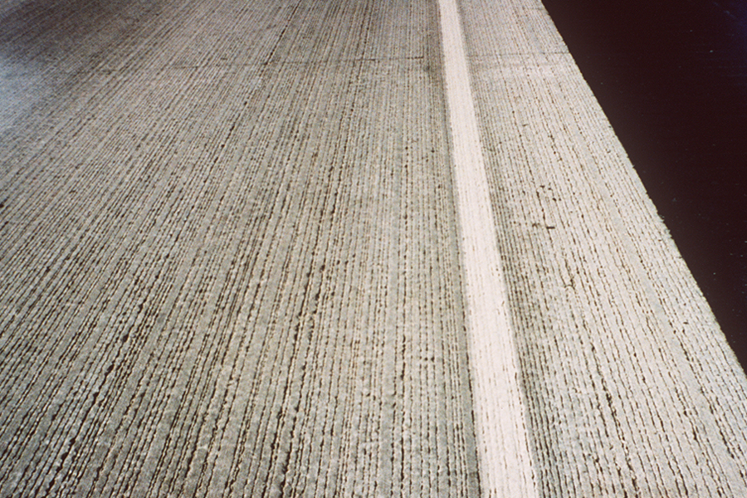

Slide 25
Headers
Use fresh concrete
Consolidate thoroughly
Straight edge
Stringline
Edge tool
Texture and cure in a timely manner

Slide 27
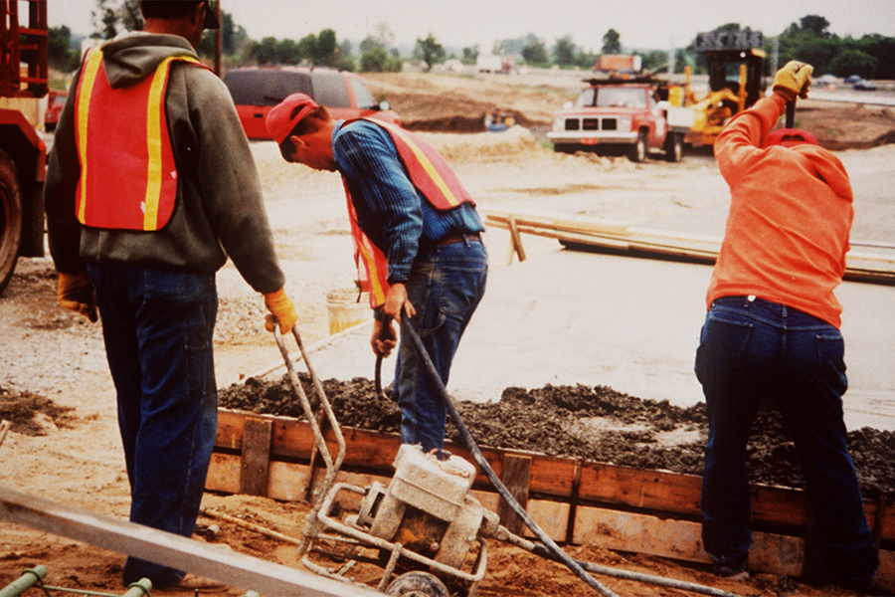

Slide 28
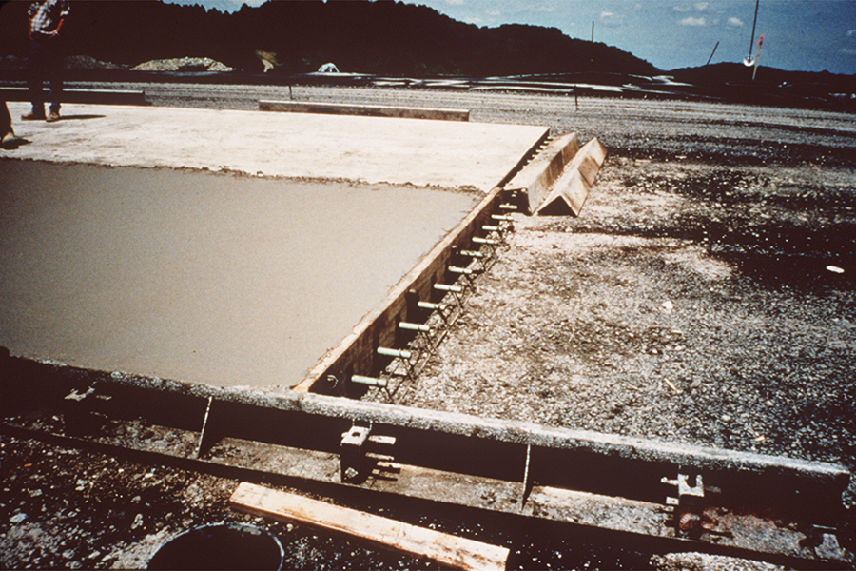

Slide 29
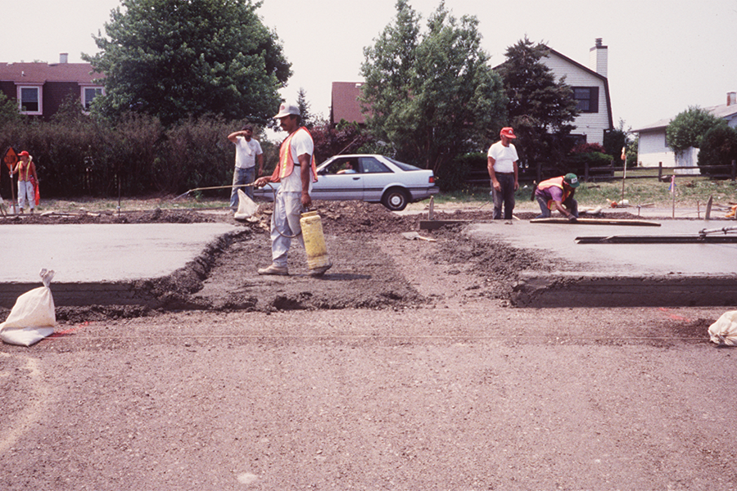

Slide 30
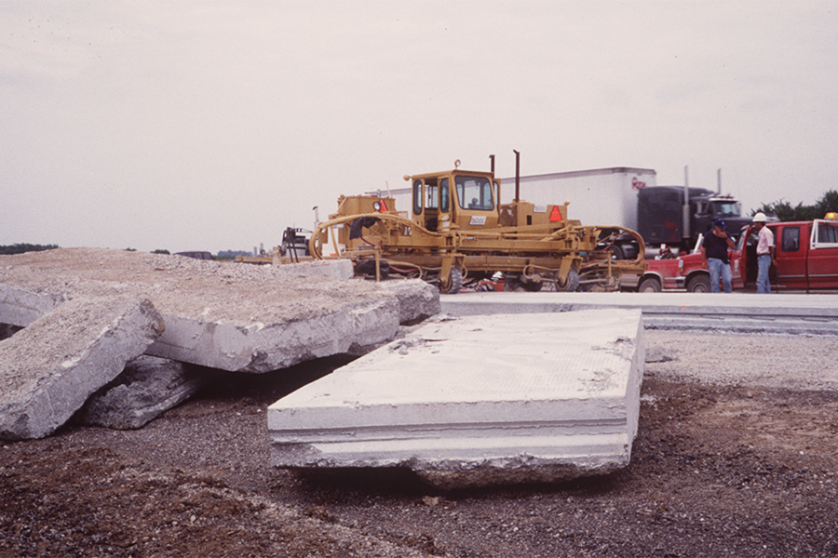

Slide 31
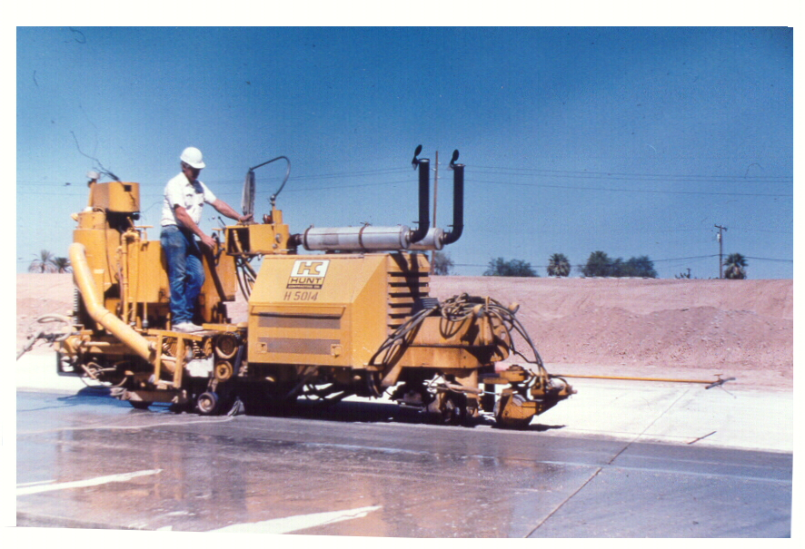

Slide 32
Extreme Weather Placement
Specifications will include high and low temperatures at which precautions must be taken to protect new concrete

Slide 33
Hot Weather Placement Considerations
Control temperature of PCC mix
Use set retarders
Timely sawing
Fog new pavement (until sawing completed)

Slide 34
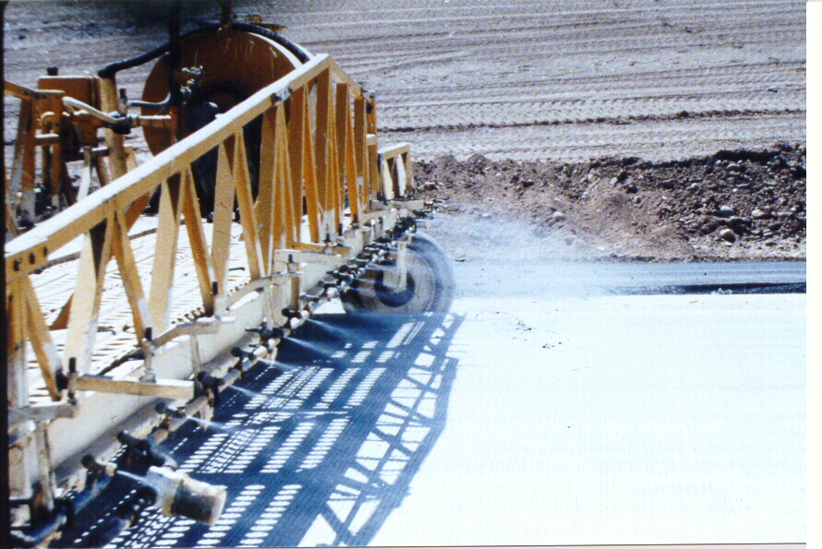

Slide 35
Cold Weather Placement
Use set accelerators
Cover new pavement
  Polyethylene sheeting
  Straw
  Curing blankets

Slide 36
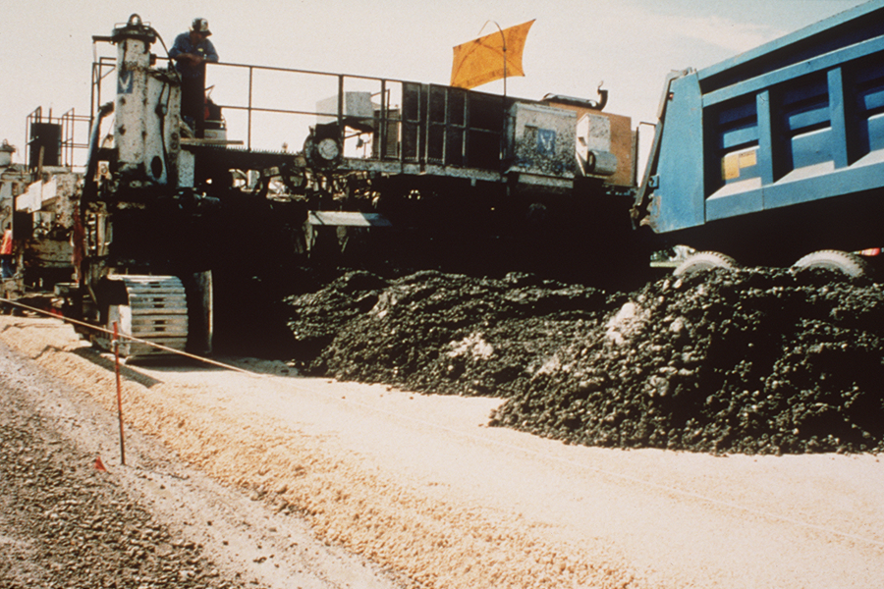

Slide 37
Poor Placement Practice
Excess PCC at auger
"Station dumping" difficult to control
PCC has very low slump and appears to be slightly segregated

Slide 38
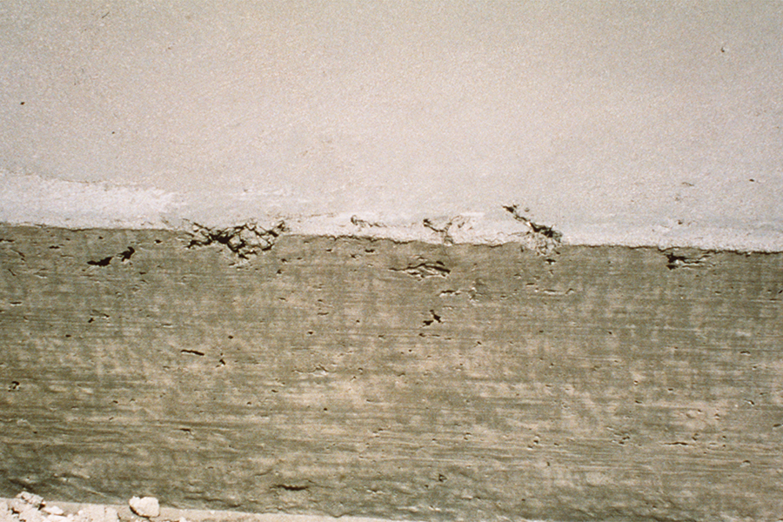

Slide 39
Tearing of the Mix
Check:
Speed of paver
Square of paving kit to stringline
Vibration frequency
Draft of the pan
Mix proportions
Air content
W/C ratio

Slide 40
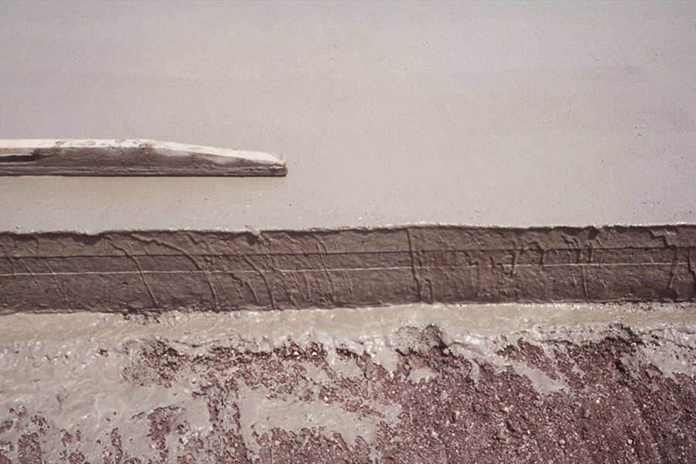

Slide 41
Too Much Grout on Surface
Too much water applied to surface
Over-vibration (vibration speed too high)
Machine moving too slow for vibration
Rain!

Slide 42
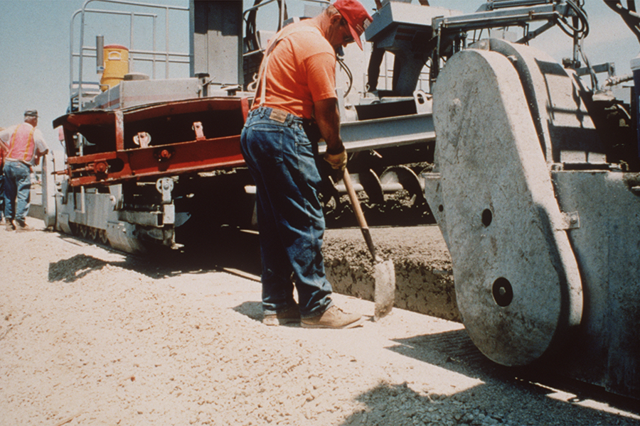

Slide 43
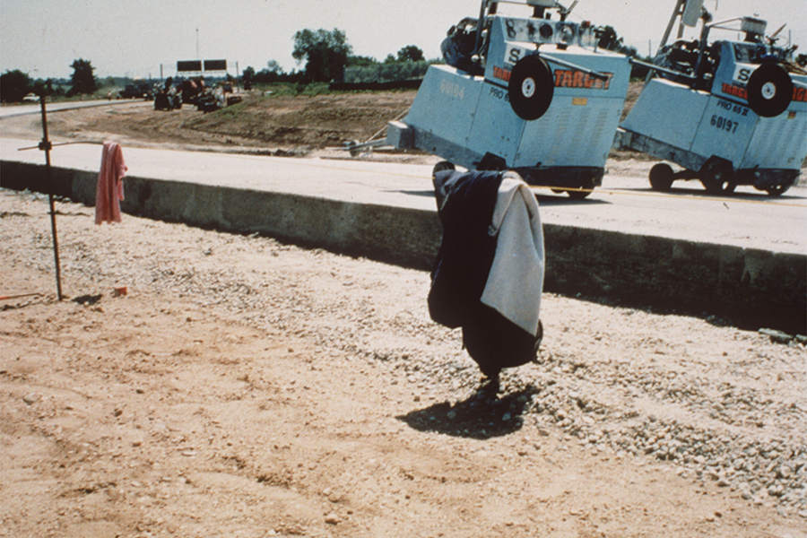

Slide 44
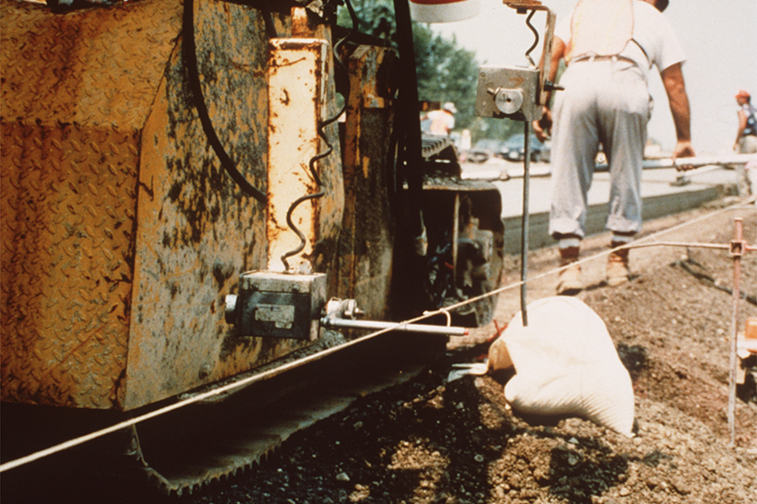

Slide 45
Trackline and Stringline
A clean trackline helps in constructing a smooth pavement
Protect the stringline from displacement
Avoid knots in the stringline

Slide 46
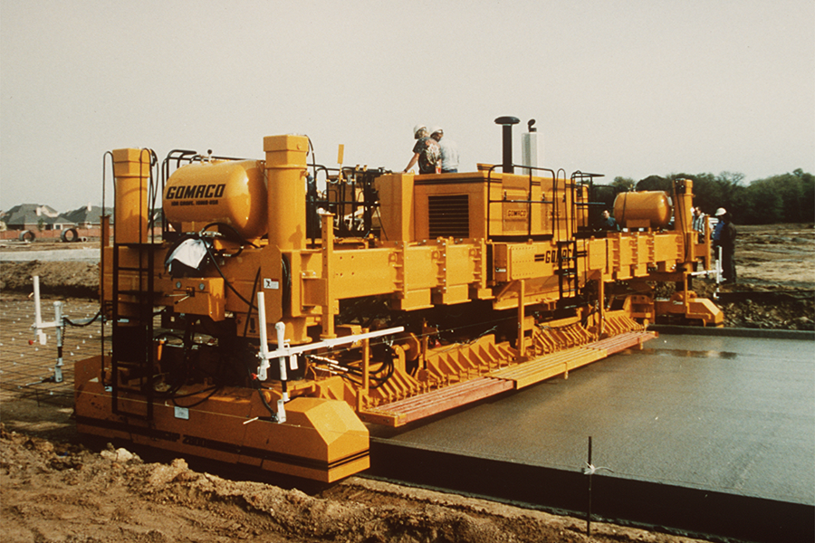

Slide 47
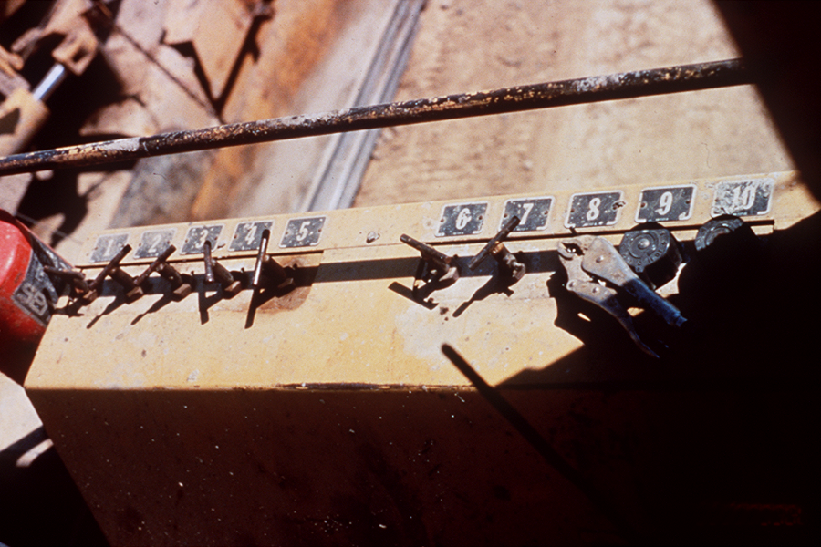

Slide 48
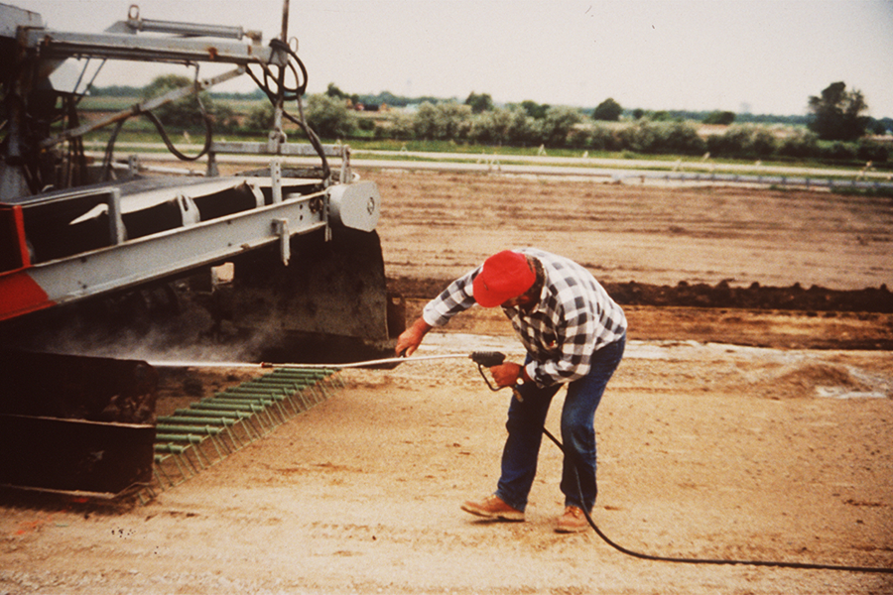

Slide 49
Maintain Equipment
Repair hydraulic leaks
Use proper replacement parts
Clean up after each use
  Don't create soft spots in base
Other

Slide 50
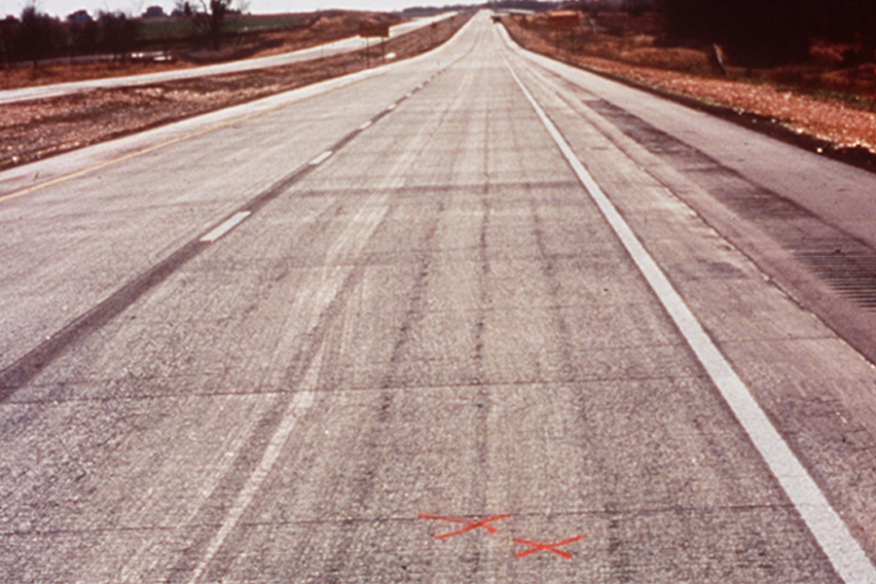

Slide 51
Vibrator Streaking
Check:
Head above vibrators
Materials and mixtures
Frequency
Paver speed
Vibrator positions and spacing
Blown vibrator

Slide 52
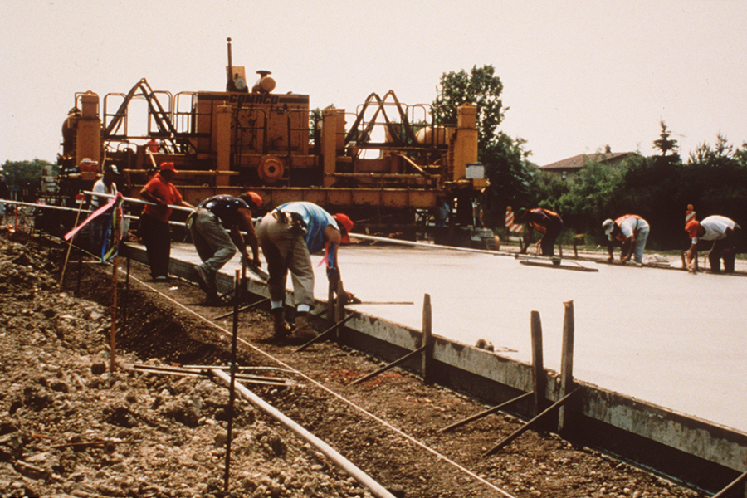

Slide 53
Edge Slump
Verify consistency of PCC
  Slump
  Air
  Gradation
Paver edge overbuild

Slide 54
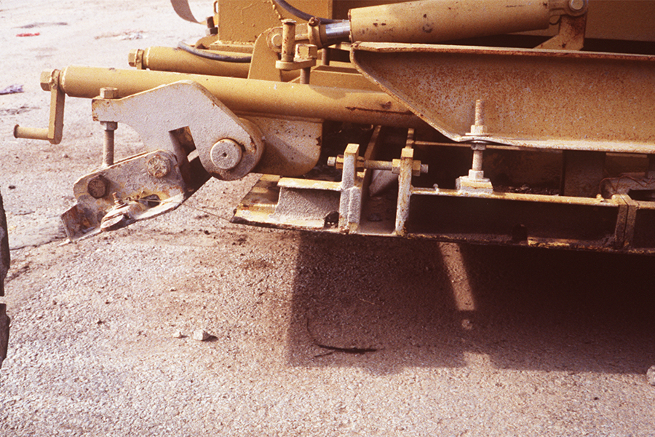

Slide 55
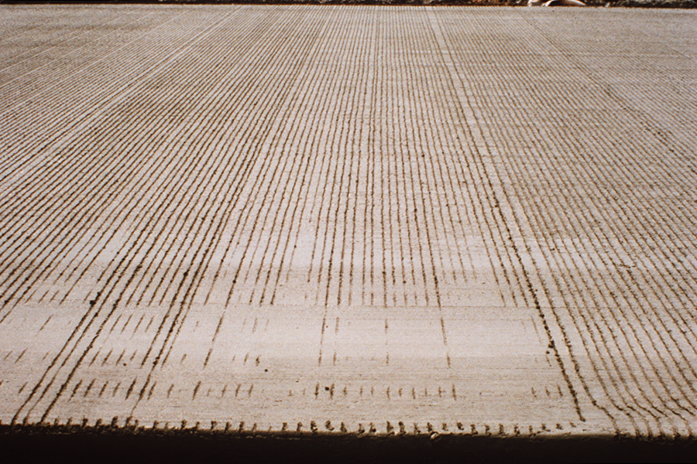

Slide 56
Variation in Texturing
Review mixing and batching operations
Check placing and finishing process
Observe operation of tining equipment
Check tining equipment trackline
Check vibrator positioning and operation
Other

Slide 57
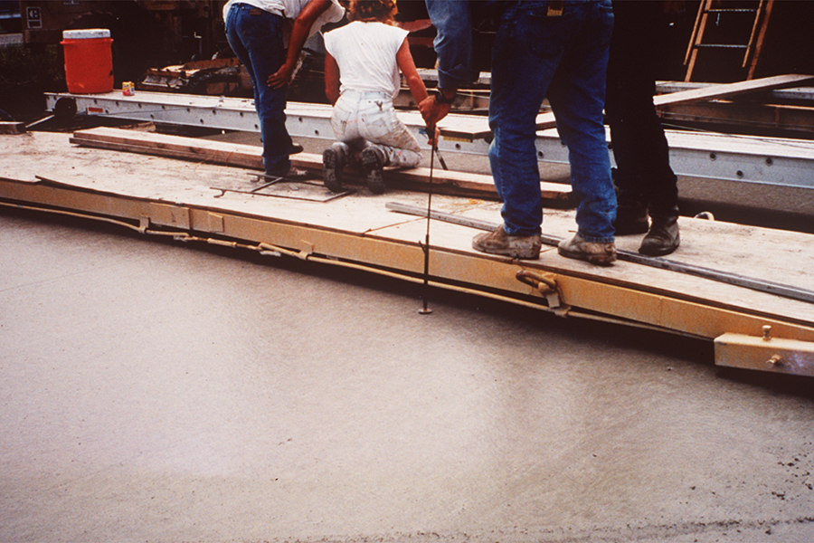

Slide 58
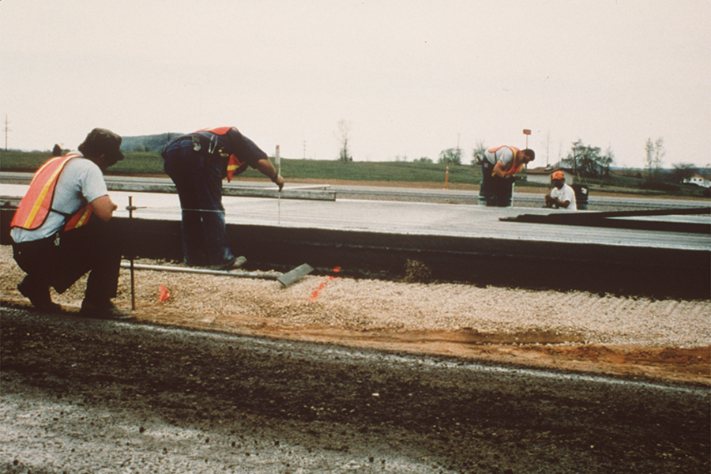

Slide 59
Verify Thickness
Probe concrete for thickness
Check surface for specified profile

Slide 60
Summary
High-quality PCC pavement is achieved with:
Accurate line and grade control
Uniform, well compacted grade
Consistent PCC production and delivery
Consistent, uninterrupted forward motion of paver
Adequate internal vibration
Timely texturing and curing

