Slide 1
What is Logistics?
Daniel Kaszubowski

Slide 2
Road Transportation Systems Engineering Development in the Sub-Saharan Africa – Modern EU Master Programme & Capacity Building

Slide 4
Learning Objectives
Understand the evolution of purchasing to supply management
Define logistics, procurement, and supply chain management
Recognize the role of supply management for business advantage
Compare traditional vs. modern supply management approaches

Slide 5
Evolution: Purchasing → Supply Management
1960s-1970s: Basic purchasing - "Buy materials at lowest price"
1980s-1990s: Strategic sourcing - "Build supplier relationships"
2000s-Present: Supply management - "Manage entire supply network"
Today: Integration with quality, sustainability,
risk management

Slide 6
What Changed?
Traditional vs. Modern
Traditional: Focus only on price, short-term orders, adversarial relationships
Modern: Focus on total cost, long-term partnerships, collaboration
Example: Old approach - "Find cheapest cocoa supplier"
Example: New approach - "Partner with cocoa farmers for quality, fair prices, sustainability"

Slide 7
What is Logistics?
Planning, implementing, and controlling the flow of goods, services, and information from point of origin to end customer.
Simple definition: "Getting the right product to the right place, at the right time, in the right condition, at the right cost"
Example: Moving timber from Cameroon forests
to furniture factory in Douala

Slide 8
What is Procurement?
The process of finding, acquiring, buying goods and services from external sources.
Includes: Identifying needs, selecting suppliers,
negotiating prices, placing orders
Example: A hospital in Brazzaville procuring medical supplies from various suppliers

Slide 9
What is Supply Management?
Strategic coordination of purchasing, supplier relationships, and entire supply network to achieve business goals.
Broader than just buying - includes planning,
risk management, quality control
Example: Managing all suppliers for a textile factory
in Yaoundé

Slide 10
What is a Supply Chain?
The network of organizations, people, activities,
and resources involved in creating and delivering
a product to the final customer.
Includes: Suppliers → Manufacturers → Distributors → Retailers → Customers
Example: Coffee supply chain - Farmer → Processor → Exporter → Roaster → Café → Consumer

Slide 11
The Supply Chain Mix: Key Activities
Planning: Forecasting demand, production schedules
Procurement: Finding and buying from suppliers
Production: Manufacturing, assembly, packaging
Inventory: Managing stock levels and costs
Distribution: Delivering products to customers

Slide 12
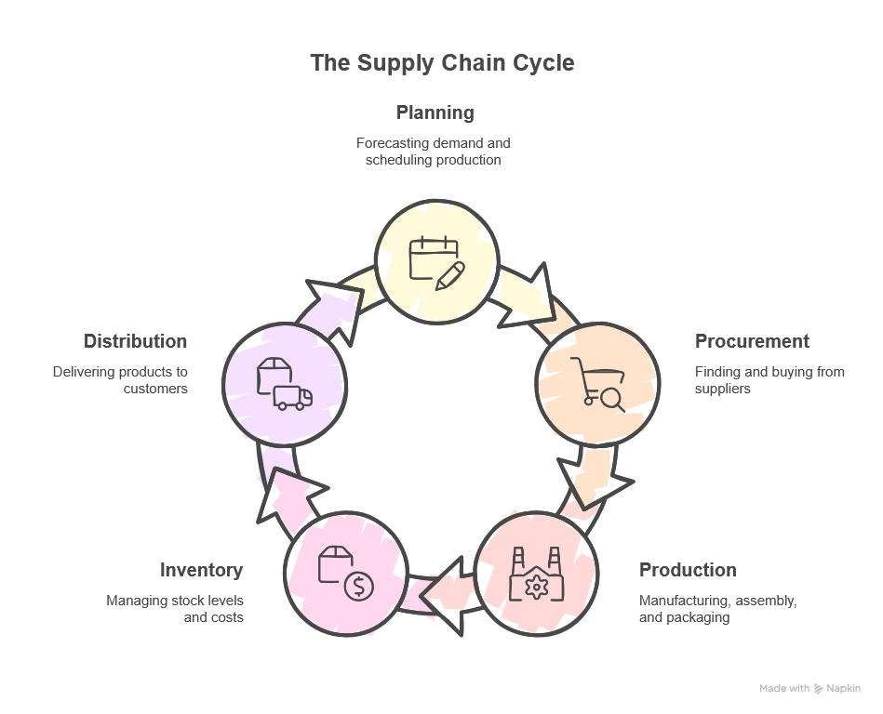

Slide 13
Real Example: Cocoa to Chocolate
Step 1: Farmers in Cameroon grow and harvest cocoa beans
Step 2: Beans transported to port (Douala) for export
Step 3: Shipped to chocolate factory in Europe
Step 4: Factory processes beans into chocolate bars
Step 5: Distributed to retailers worldwide
Each step requires logistics, procurement, quality control

Slide 14
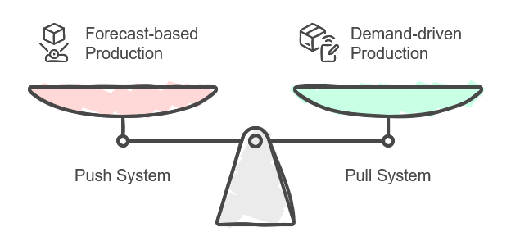
Push vs. Pull Systems
Push System: Make products based on forecast,
push to market
Pull System: Make products only when customer orders
Push Example: Factory produces 1000 shirts based on predicted demand
Pull Example: Factory waits for orders before making shirts

Slide 15
Push vs. Pull: Which is Better?
Push advantages: Economies of scale, steady production
Push risks: Excess inventory if forecast wrong, wasted products
Pull advantages: Less inventory, no waste, customer-responsive
Pull challenges: Requires fast production, reliable suppliers
Modern approach: Combine both strategies!

Slide 16
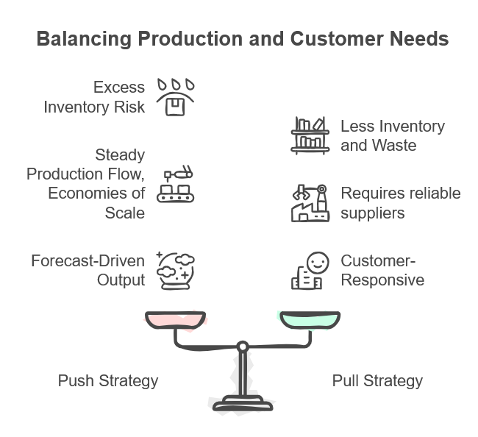

Slide 17
Why Supply Chain Matters for Business
Companies compete on supply chains, not just products!
Better supply chain = Lower costs, faster delivery, higher quality
Poor supply chain = Delays, stockouts, unhappy customers
Good management creates competitive advantage

Slide 18
Success Stories: Companies with Great Supply Chains
Amazon: Fast delivery (sometimes same day!) through efficient logistics
Zara (fashion): New designs in stores within 2 weeks
Toyota: Just-in-Time system reduces inventory costs
Local example: Mobile money operators (MTN, Orange) manage nationwide distribution networks

Slide 19
Why Study Supply Management?
Career opportunities: Growing demand for supply chain professionals
Business impact: Supply costs = 50-80% of company revenue!
Problem solving: Complex challenges need smart solutions
Regional development: Better supply chains help African economies grow

