Slide 1
Supply Chain Fundamentals
Understanding the Value Chain
Daniel Kaszubowski

Slide 2
Road Transportation Systems Engineering Development in the Sub-Saharan Africa – Modern EU Master Programme & Capacity Building

Slide 4
Learning Objectives
Understand Porter's Value Chain concept
and framework
Identify primary and support activities in a supply chain
Recognize supply chain structure (upstream
and downstream)
Understand how activities are interconnected
Introduce integration vs. fragmentation challenges

Slide 5
What is the Value Chain?
A value chain is the sequence of activities that a business performs to create and deliver value to customers.
Concept: Developed by Michael Porter in 1985
Key idea: Each activity adds value to the product
Example: Raw materials → Processing → Assembly → Packaging → Distribution → Customer
Insight: Companies compete on how efficiently they execute their value chain

Slide 6
Porter's Value Chain: Two Types of Activities
Primary Activities (5): Directly involved in creating and delivering the product
1. Inbound Logistics 2. Operations 3. Outbound Logistics 4. Marketing/Sales 5. Service
Support Activities (4): Help make primary activities more effective
1. Coordination 2. Technology Development 3. Human Resources 4. Procurement

Slide 7
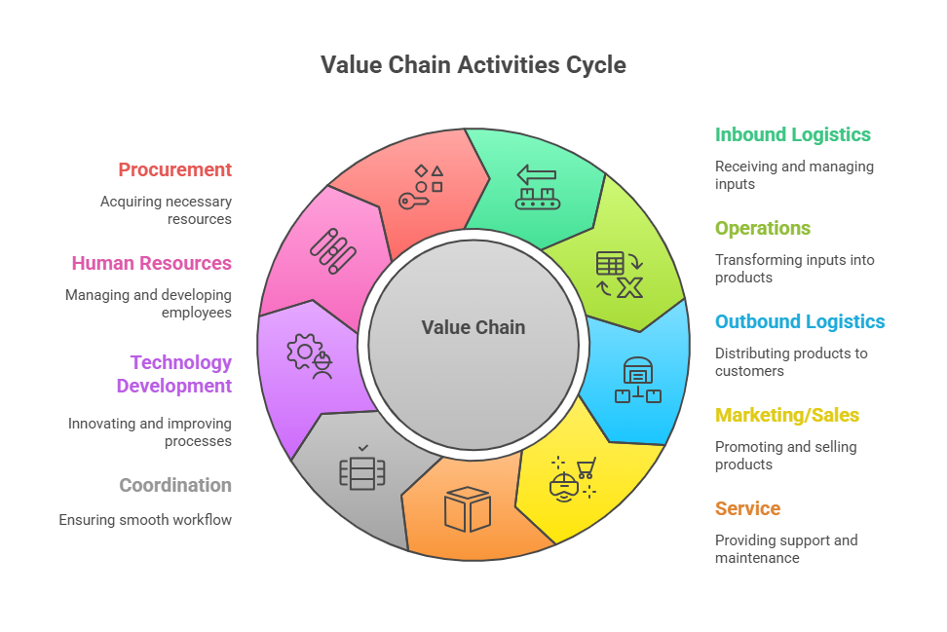

Slide 8
Primary Activity 1: Inbound Logistics
Definition: Receiving, storing, and managing raw materials from suppliers.
Arranging delivery of materials from suppliers
Receiving inspection and quality checks
Storing materials in warehouses
Managing inventory levels
Example: A cotton textile factory in Yaounde receives bales of cotton from suppliers in Cameroon and Mali, inspects quality, stores in warehouse, manages stock levels

Slide 9
Primary Activity 2: Operations
Definition: Transforming raw materials into finished products.
Manufacturing and assembly processes
Quality control and testing
Production scheduling and planning
Maintenance of equipment
Example: The same textile factory transforms cotton into fabric through spinning, weaving, dyeing, and finishing processes.

Slide 10
Primary Activity 3: Outbound Logistics
Definition: Storing and moving finished products to customers.
Storing finished products in warehouses
Order picking and packing
Shipping to distributors and retailers
Tracking and delivery management
Example: Finished fabric is stored, packaged,
and shipped to clothing manufacturers across Central Africa and beyond.

Slide 11
Primary Activity 4: Marketing & Sales
Definition: Promoting products and managing customer relationships.
Advertising and promotion
Sales force management
Pricing strategies
Customer relationship management (CRM)
Example: Sales teams promote fabric to clothing manufacturers, negotiate prices, manage accounts,
and build long-term relationships.

Slide 12
Primary Activity 5: Service
Definition: After-sales support to keep customers satisfied.
Product returns and warranties
Technical support and troubleshooting
Maintenance and repairs
Customer feedback and improvement
Example: If a customer's fabric shipment has defects,
the company handles returns, replaces product, and investigates the problem.

Slide 13
Support Activities: Making Primary Activities Effective
Support activities run across the entire value chain, strengthening all primary activities.
Coordination: Finance, accounting, legal, management
Technology Development: Equipment, software, research & innovation
Human Resources: Recruitment, training, compensation
Procurement: Sourcing materials and services for the entire business

Slide 14
Support Activity: Coordination
The backbone systems that support all business operations.
Finance: Managing cash, payments, investment decisions
Accounting: Tracking costs and revenues
Legal: Contracts, compliance, dispute resolution
Quality Assurance: Setting and monitoring quality standards
Strategic Management: Setting business direction and goals

Slide 15
Support Activity: Technology Development
Tools, equipment, and knowledge that enable efficient operations.
Equipment: Machinery, tools, production equipment
Software: Systems for planning, tracking, accounting
Research & Development: Improving processes and products
Technical Knowledge: Expertise and continuous learning
Example: Investing in better looms, dyeing equipment, or inventory management software improves all primary activities.

Slide 16
Support Activity: Human Resources
People are the foundation of all business activities.
Recruitment: Finding and hiring qualified employees
Training & Development: Building skills and knowledge
Compensation: Fair wages and benefits
Performance Management: Motivating and evaluating work
Why it matters: A textile factory's success depends on skilled workers, motivated managers, and good labor practices.

Slide 17
Support Activity: Procurement
Sourcing materials and services needed across the entire value chain.
Raw Materials: Cotton, chemicals, dyes (for primary activities)
Equipment & Supplies: Machinery parts, office supplies, IT systems
Services: Consulting, maintenance, transportation, energy
Strategic Role: Finding best suppliers at best value, not just lowest price

Slide 18
Supply Chain Structure
The supply chain extends in both directions from your company:
Upstream (Supplier side): Where raw materials come from
Example: Cotton farmers → Suppliers → Our textile factory
Downstream (Customer side): Where products go after us
Example: Our textile factory → Clothing manufacturers → Retailers → Consumers

Slide 19
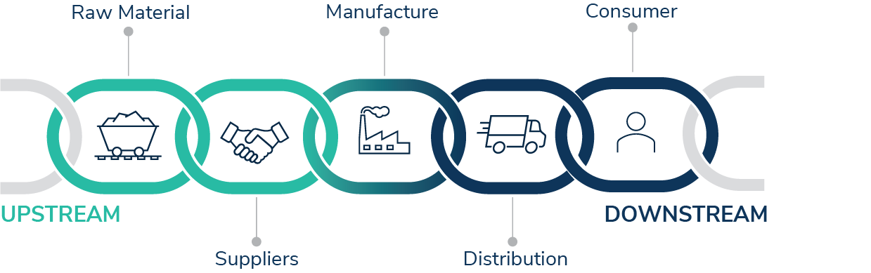

Slide 20
Upstream Supply Chain:
The Textile Factory Example
Tier 3 Suppliers → Tier 2 Suppliers → Tier 1 Suppliers → OUR FACTORY
Tier 3: Raw material providers (cotton farmers in Cameroon/Mali, chemical producers in Europe)
Tier 2: Intermediate suppliers (cotton brokers, fabric mills, dye suppliers)
Tier 1 (Direct Suppliers): Cotton traders, chemical suppliers, energy providers
Insight: Your factory depends on reliable Tier 1 suppliers, who depend on Tier 2, who depend on Tier 3. The entire chain matters!

Slide 21
Downstream Supply Chain:
Distribution to Customers
OUR FACTORY → Direct Customers → Retailers
→ End Users
Direct Customers: Clothing manufacturers who buy fabric from us
Intermediaries: Distributors, wholesalers, traders
Retailers: Shops, markets, online stores that sell final products
End Users: Consumers who wear the clothes made from our fabric

Slide 22
Challenge: Integration vs. Fragmentation
How well do different parts of the supply chain work together?
Integrated: All activities coordinated, information flows freely, decisions align
Result: Efficiency, fewer delays, happy customers
Fragmented: Different parts work independently, poor communication, conflicting goals
Result: Delays, excess inventory, missed opportunities, frustrated customers

Slide 23
Integration in Action: Textile Factory Example
INTEGRATED: Sales forecasts demand for July. Operations plans production for June. Procurement orders cotton for May. Everyone coordinates
Result: No stockouts, no excess inventory, happy customers
FRAGMENTED: Sales doesn't tell anyone about July demand. Operations makes what it thinks is needed. Procurement buys whatever it can find.
Result: Either rush orders (expensive!)
or stockouts (lost sales!)

Slide 24
The Bullwhip Effect:
A Supply Chain Problem
Small changes in customer demand cause huge ripples upstream in the supply chain.
Why? Demand forecasting errors, order batching, safety stock policies, poor communication
Result: Unnecessary inventory, production inefficiency, supplier frustration, costs rise

Slide 25
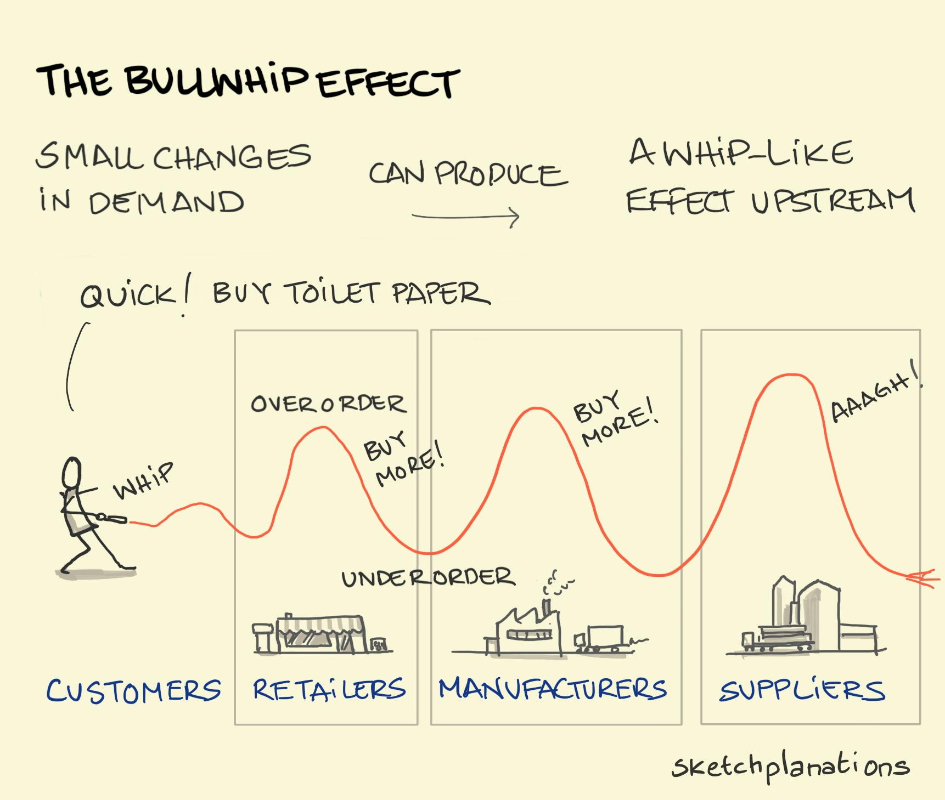

Slide 26
The Bullwhip Effect:
A Real Example
Consumer level: 10% increase in retail demand for cotton shirts
  Retailer thinks: "Better order 20% more to be safe"
Distributor level: Receives 20% larger order, thinks demand is up 30%
  Orders 35% more fabric from manufacturer
Manufacturer (us): Receives 35% larger order, thinks demand is up 50%
  Frantically orders 60% more cotton from suppliers
Farmer/supplier: Sudden 60% spike in orders!

Slide 27
The Bullwhip Effect:
A Supply Chain Problem
Excess inventory = High holding costs, risk of obsolescence
Workforce stress = Overtime, then lay-offs when demand drops
Supplier problems = Strained relationships, quality issues
Cash flow problems = Too much cash tied up in inventory
Missed opportunities = Can't respond quickly to real demand spikes
Solution: Better communication, real demand data sharing, coordinated planning across the chain (more in Session 5!)

Slide 28
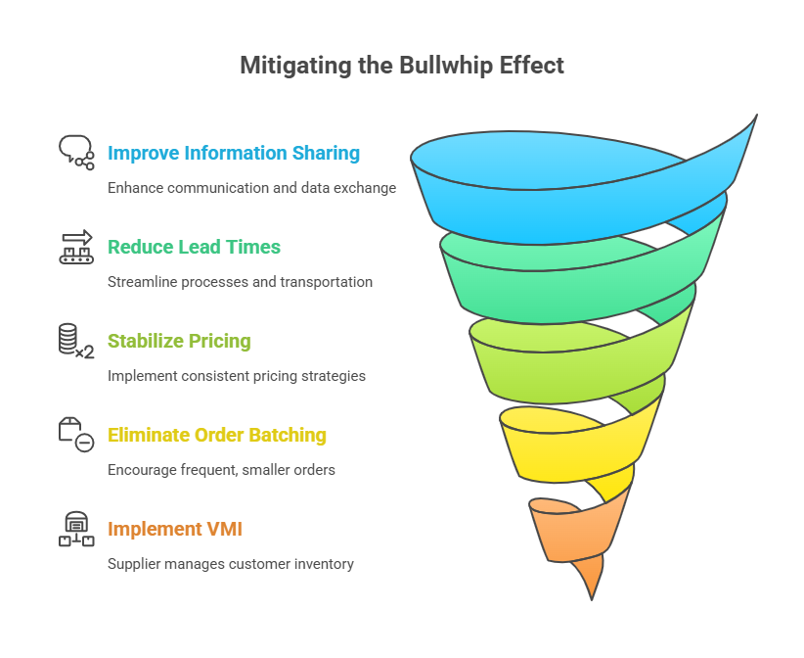

Slide 29
Best Practice: Integrated Supply Chain
Visibility: All parties can see real-time demand and inventory
Communication: Regular information exchange between suppliers, manufacturers, distributors
Alignment: Plans and forecasts coordinated across the chain
Collaboration: Solving problems together, not blaming each other
Technology: Systems that connect buyers and suppliers
Result: Smoother flows, lower costs, better customer service, stronger relationships

Slide 30
Key Takeaways
Value chains have primary activities (direct work) and support activities (enabling)
Supply chains extend upstream (suppliers) and downstream (customers)
Integration across all parts of the chain is essential for success
Fragmentation and poor communication create the bullwhip effect
Understanding the entire value chain helps companies make better strategic decisions

