Slide 1
Course C.03.06.01
Cross sections
Marek Pszczola

Slide 2
Road Transportation Systems Engineering Development in the Sub-Saharan Africa – Modern EU Master Programme & Capacity Building

Slide 4
Typical cross section:
Designed to present the elements of roads and highways for each section, for example:
Number and width of road lanes,
Number and width of roadsides,
Number and width of sidewalks,
Drainage elements, ex (trench, drainage),
Slopes of embankment banks and trench banks.
Typical cross-sections are designed for each section. There are no cross sections in each characteristic place that are drawn to calculate the earthworks.

Slide 5
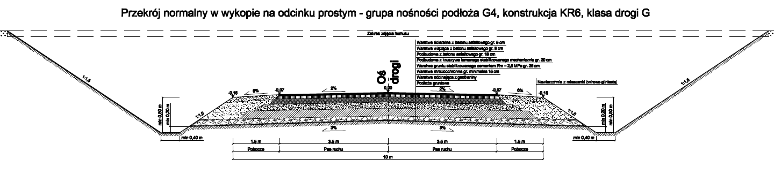
Typical cross section of road (out of urban area -1):

Slide 6
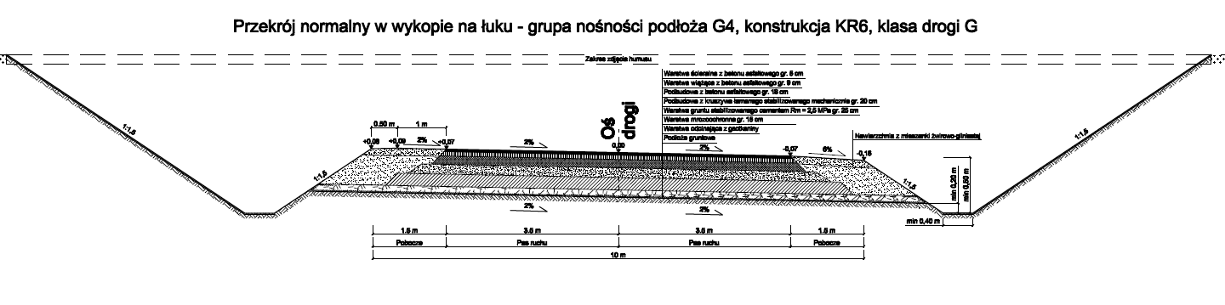
Typical cross section of road (out of urban area - 2):

Slide 7
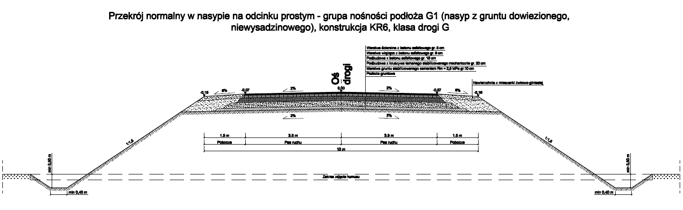
Typical cross section of road (out of urban area - 3):

Slide 8
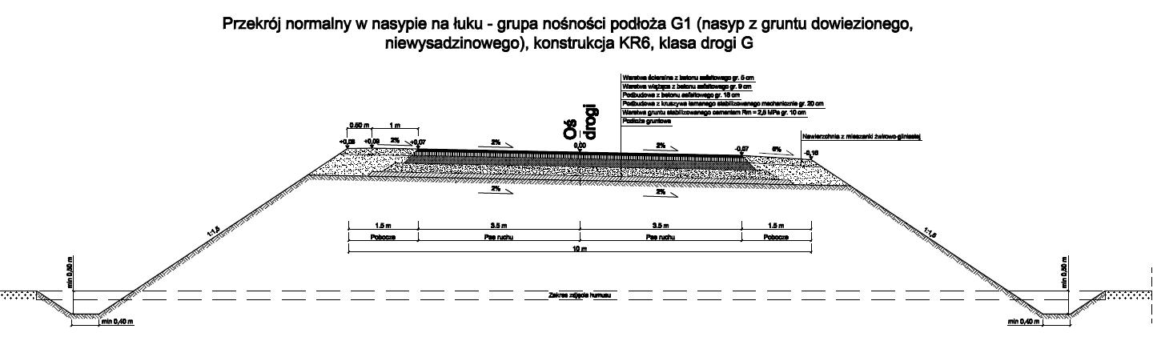
Typical cross section of road (out of urban area - 4):

Slide 9
Details of pavement edge:
  For correct design of pavement in each road edge,
  There are requirements for construction details,
  Good compaction requirements,
  Bearing capacity of road edge in sytuation of loading of heavy wheel.
Insufficient or wrong design of pavement edge can be a reason of premature failures.

Slide 10
General rules:
Asphalt layers – cut vertically (shift of each layer equal to thickness of upper layer or slope 1:1 (without shift of each layer),
Base course made of crushed aggregate or gravel - slope 1:1,5 + shift of 15 – 20 cm,
Loan concrete, aggregate treated with hydraulic binder, soil treated with hydraulic binder – slope 1:1 + shift of 15 – 20 cm,
Cement concrete (in rigid pavements) - cut vertically + shift of layer for site equipment (40 – 50cm),
Drainage and frost resistance layers should be constructed on the whole width of road.

Slide 11
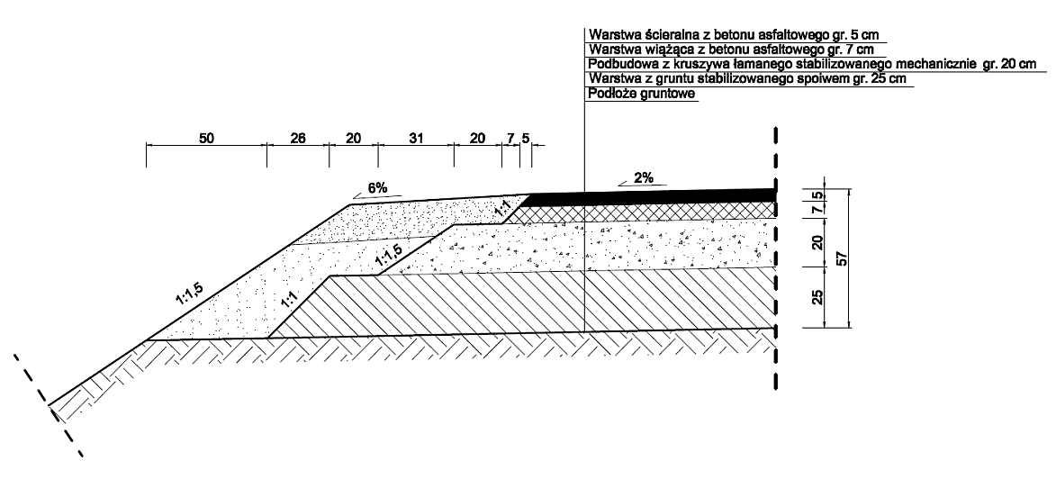
An example of detail of pavement edge:

Slide 12
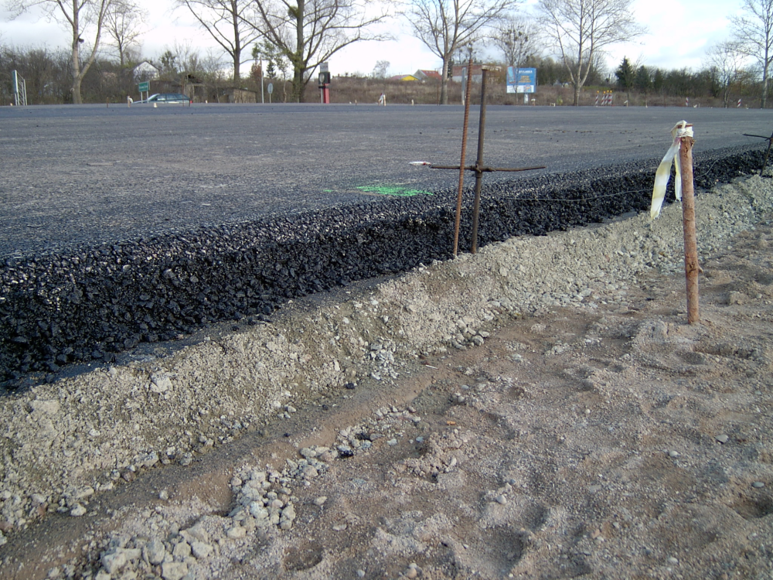
The shift of bottom layer during construction:

Slide 13
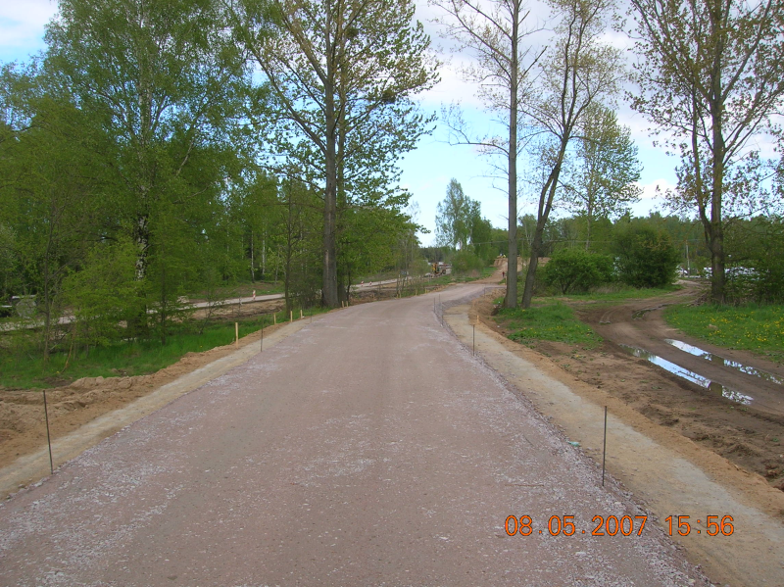
The shift of bottom layer during construction:

Slide 14
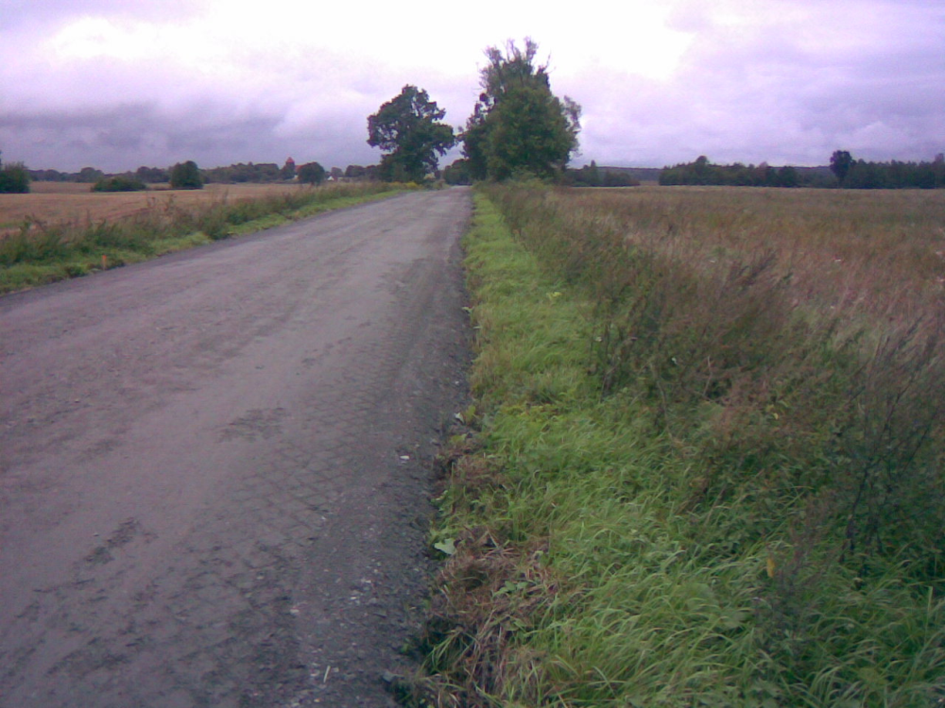
The mistakes during construction of bottom layer made of crushed aggregate. The aggregate was constructed on grass!!!
!

Slide 15
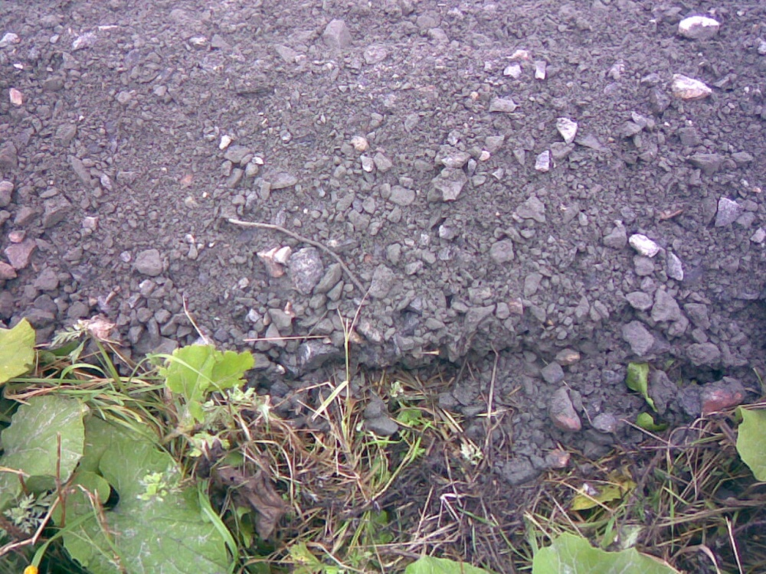
The aggregate was constructed on grass!!!
!!!

Slide 16
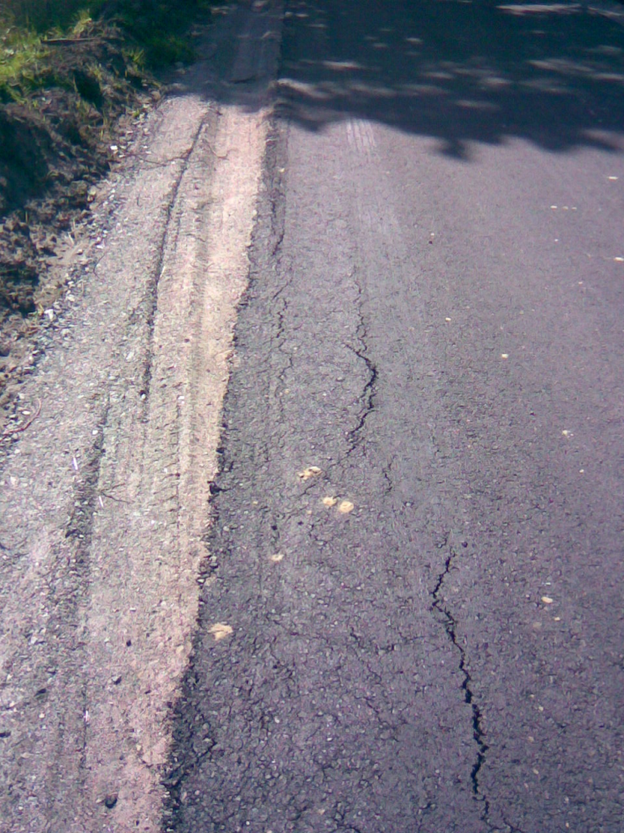
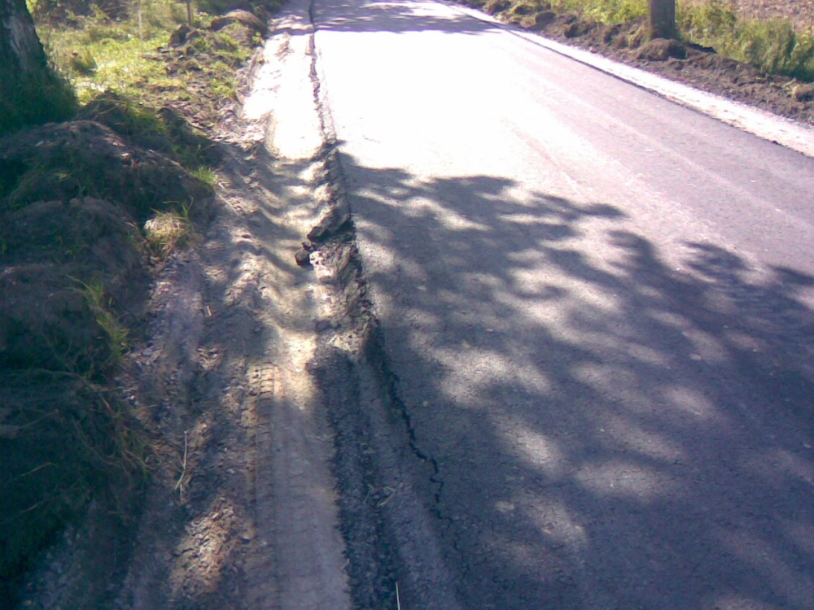
An example showing insufficient compaction of pavement edge.

Slide 17
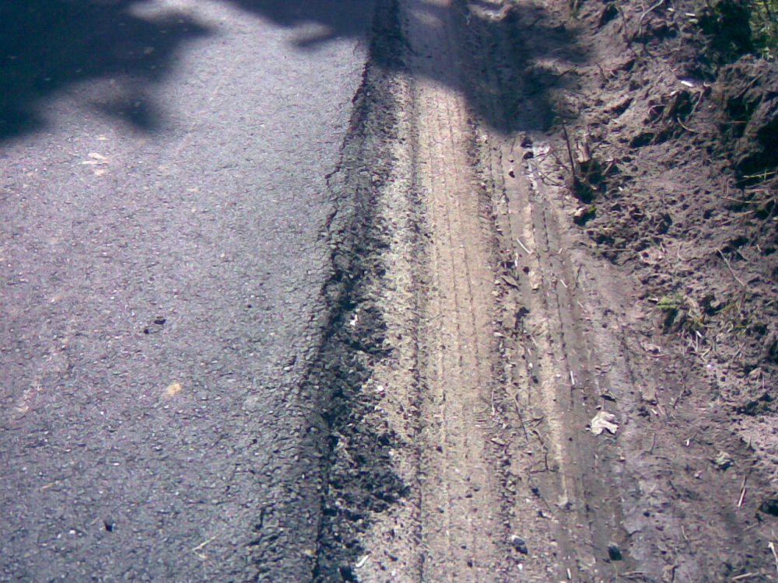
An example showing insufficient compaction of pavement edge.

Slide 18
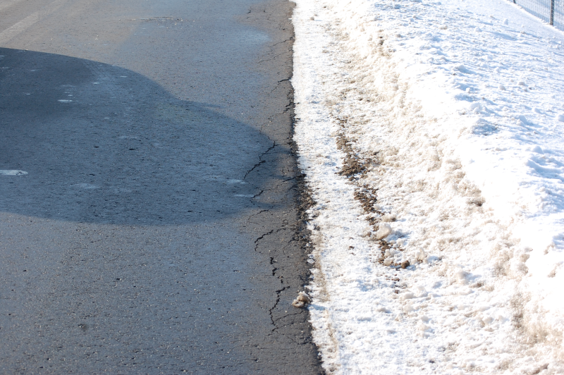
Failures of the edge of asphalt layers after 2 years of service.

Slide 19
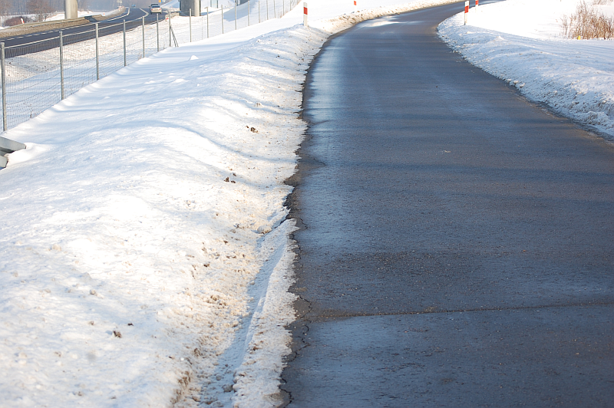
Failures of the edge of asphalt layers after 2 years of service.

Slide 20
Typical cross section in the urban areas
There are elements like:
sidewalks, roads for bikes,
kerbs (8x30 cm, 6x20 cm),
kerbs (heavy – 20x30 cm, light – 15x30 cm),
layer under the kerb made of mixture cement and sand (1:4),
foundation made of cement concrete and thickness not less than 10 – 15 cm.

Slide 21
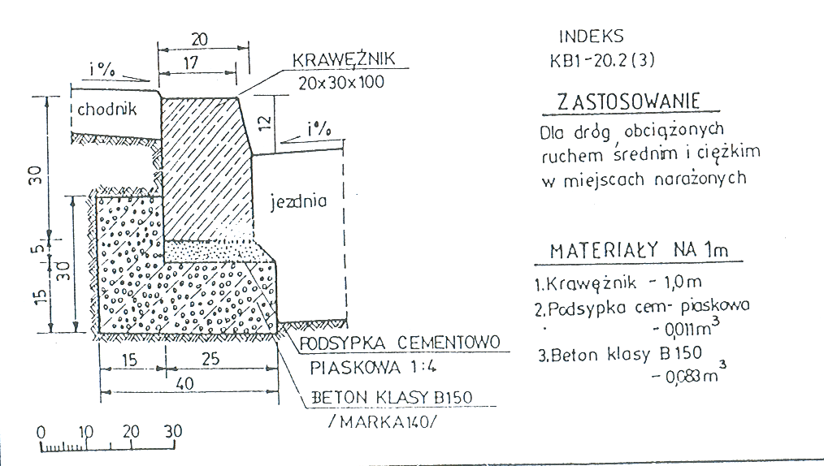
Typical cross section in the urban areas

Slide 22
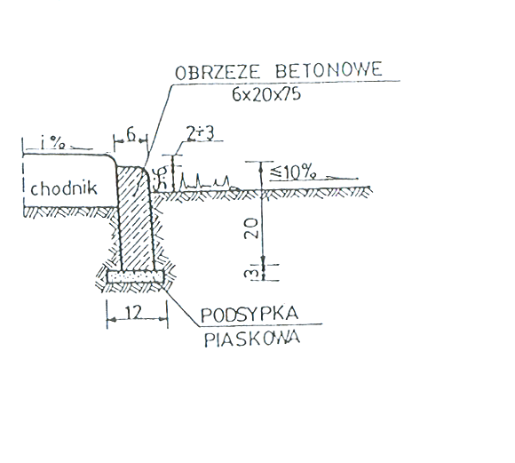
Typical cross section in the urban areas

Slide 23
Typical cross section in the urban areas
The width of sitewalk (pavement) must be not less than 2 m if the sitewalk is directly near road lines.
The width of sitewalk (pavement) must be not less than 1,5 m if the sitewalk is not directly near road lines.
In case of class Z, L and D of road the sitewalk can be directly near road lines.
In case of class S, GP and G of road the sitewalk must be separated from road lines by use of green area (for roads class S – 10 m, for class GP - 5 m, for class G - 3,5 m).

Slide 24
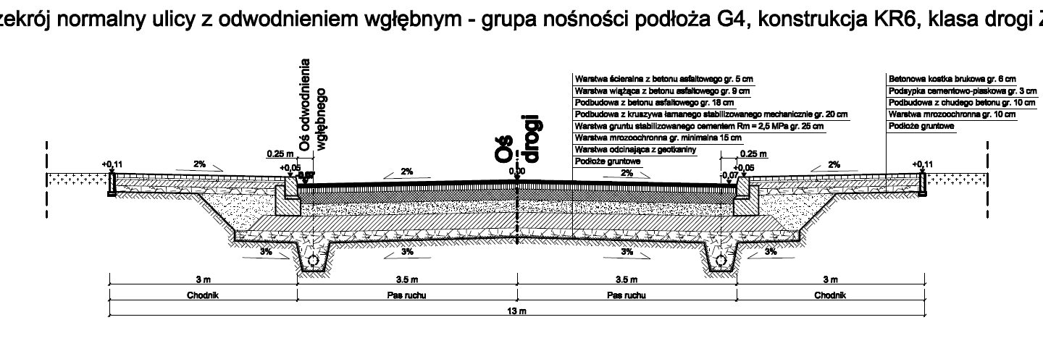
Typical cross section in the urban areas

Slide 25
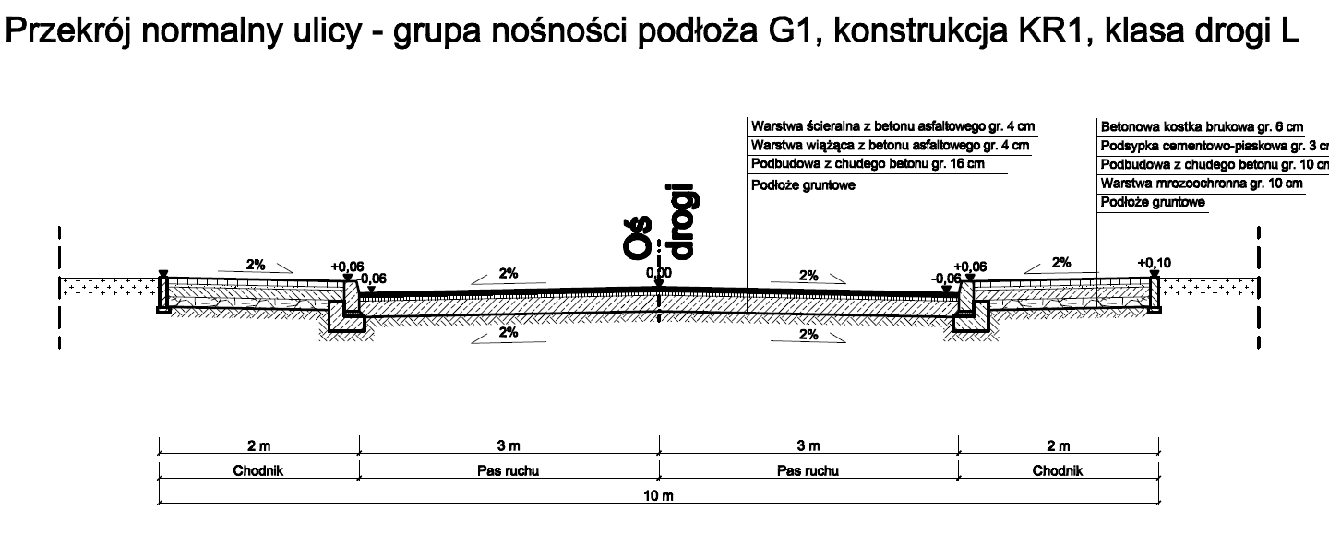
Typical cross section in the urban areas

