Slide 1
Course C.03.06.01
Traffic assessment
Marek Pszczola

Slide 2
Road Transportation Systems Engineering Development in the Sub-Saharan Africa – Modern EU Master Programme & Capacity Building

Slide 4

Factors affecting design process
Traffic
Climatic conditions
Conditions of subbase (type of soil, water level)
Type of materials that can be used
Number of layers and their thickness

Slide 5
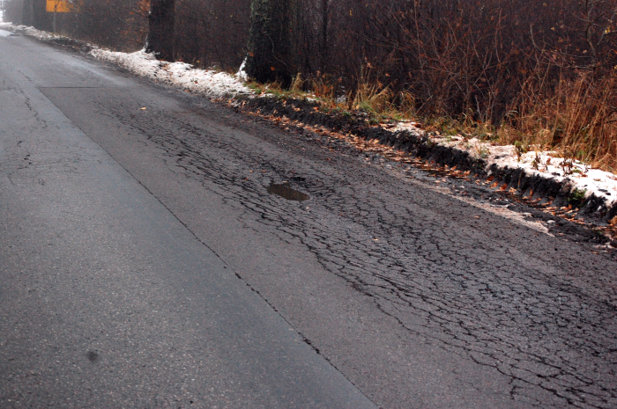
Traffic conditions and their influence on road and motorway pavements

Slide 6
Influence of vehicles on road pavements
Type of vehicle,
Overall weight,
Axle configuration and number of axles,
Load of wheel and wheel numbers,
Tyre pressure,
Type of tyre,
Type of suspension (pl. zawieszenie),
Speed of vehicle.

Slide 7
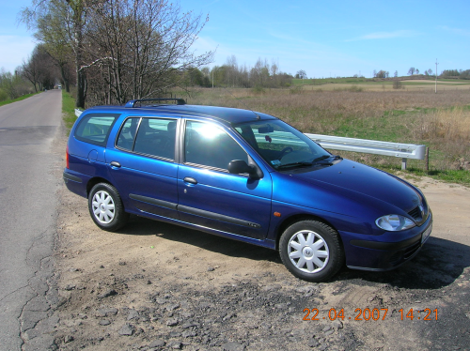
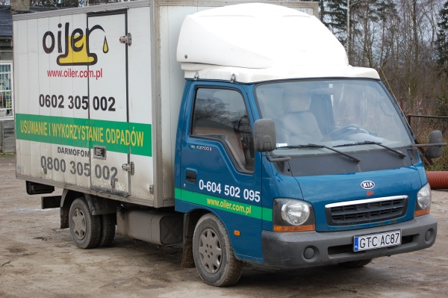
Type of vehicle
Cars (up to 3,5 t) should be omitted from the design process. They have a minor influence on pavement stresses and strains, and as a consequence on the fatigue life of pavement

Slide 8
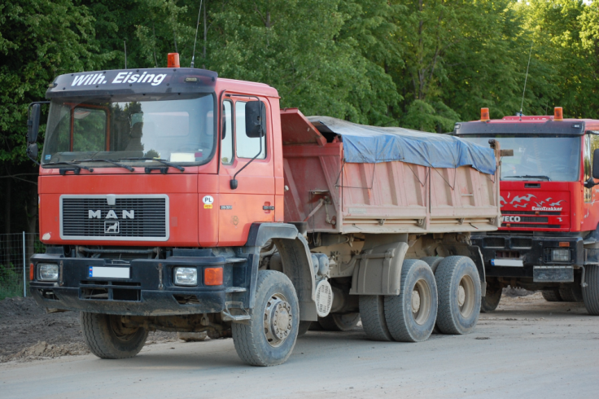
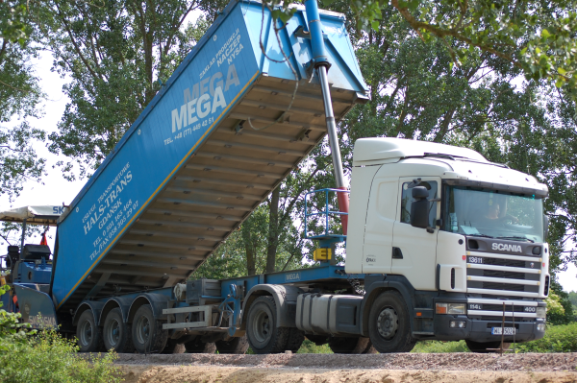
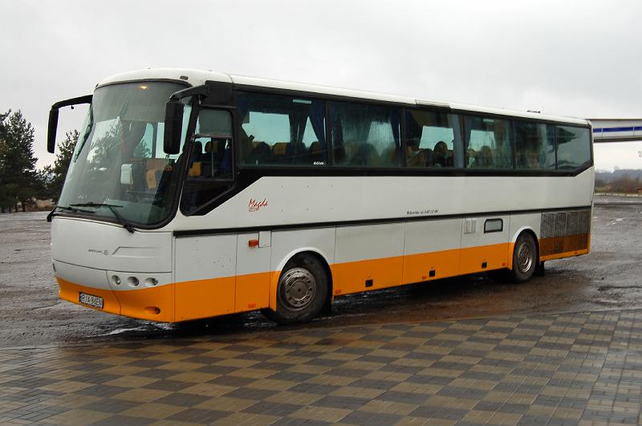
Type of vehicle
In the design process, only vehicles with a total weight over 3,5 t are taken into consideration:
Heavy Goods Vehicles (HGV),
HGV with trailers,
HGV with semitrailers
Buses

Slide 9
Configuration and load of the axle
Depands on axle configuration there are:
  single axle,
  dual axle (tandem)
  triple axle (tridem).
In Poland there is limitation in axle load:
Single axle: 100 kN (115 kN),
Dual axle: 145 kN – 160 kN (depands on configuration).
In the European Union in general single axle load limitation is 115 kN but there are many exceptions based on domestic regulations: for example in Spain, France Netherland the limitation is 130 kN per axle

Slide 10
Configuration and load of the axle
. Depending on axle configuration, there are:
  single axle,
  dual axle (tandem)
  triple axle (tridem).
In Poland, there is a limitation on axle load:
  Single axle: 100 kN (115 kN),
  Dual axle: 145 kN – 160 kN (depends on configuration).
  In the European Union, in general, single axle load limitation is 115 kN but there are many exceptions based on domestic regulations: for example in Spain, France Netherland the limitation is 130 kN per axle

Slide 11
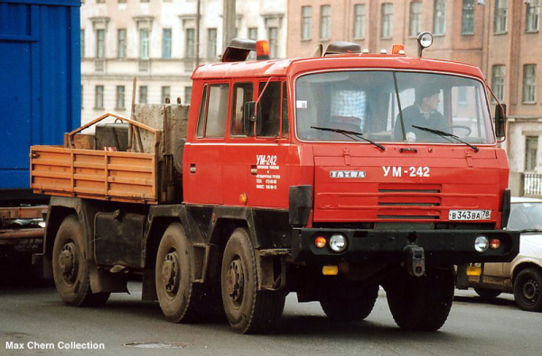

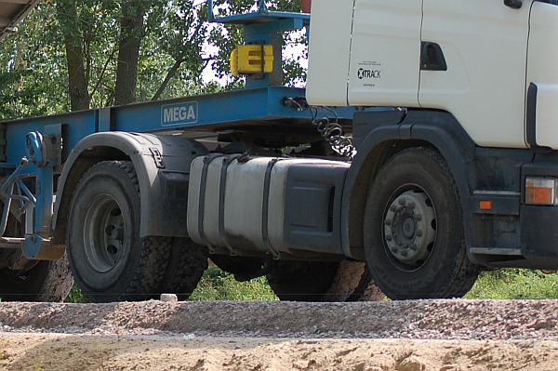

Wheels configuration
Dual wheels
Single wheels

Slide 12

HGV with semitrailer

Slide 13
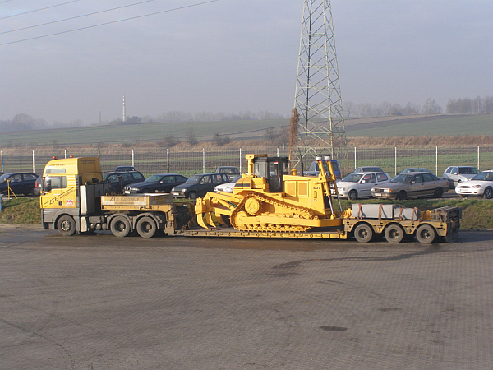
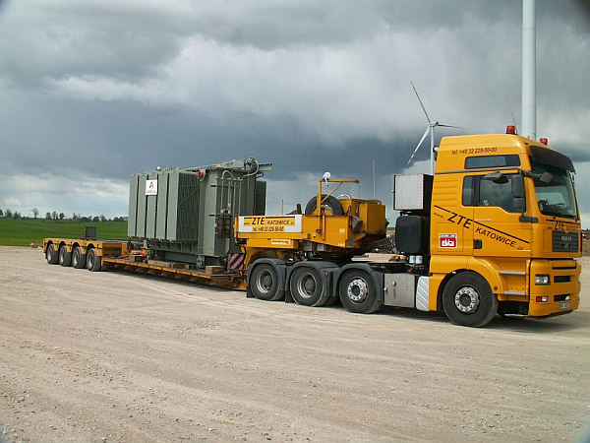
Special vehicles

Slide 14
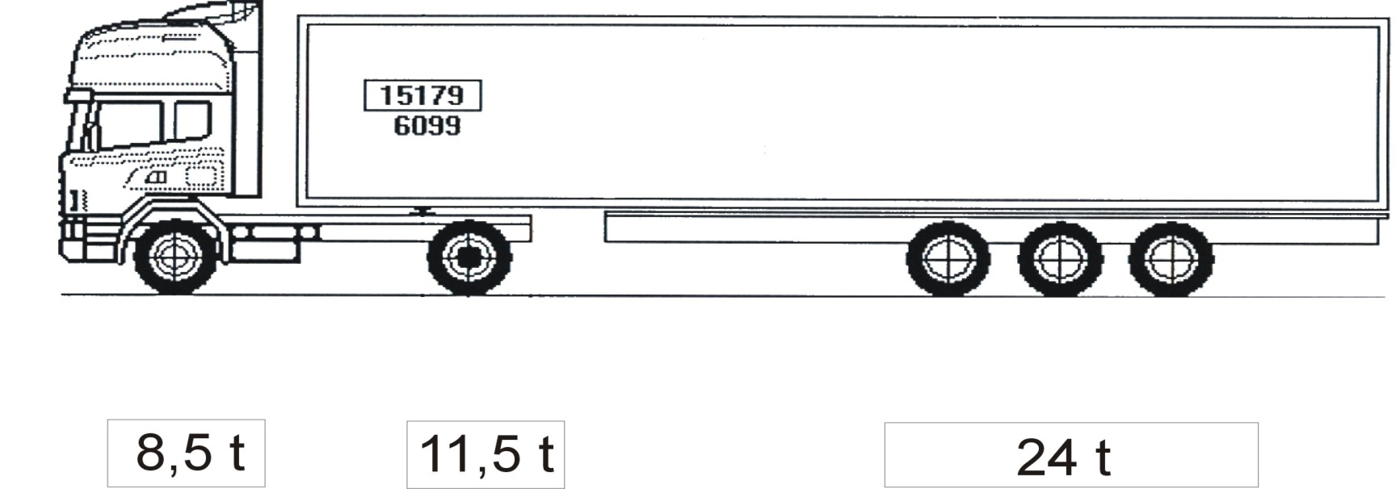
The heaviest vehicle in the UE
44 t
F_{j} = 1,82 osi 115 kN
F_{j} = 3,18 osi 100 kN
F_{j} = 7,76 osi 80 kN

Slide 15

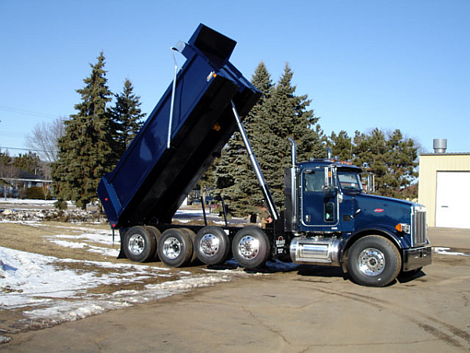
In comparison the vehicles in USA

Slide 16
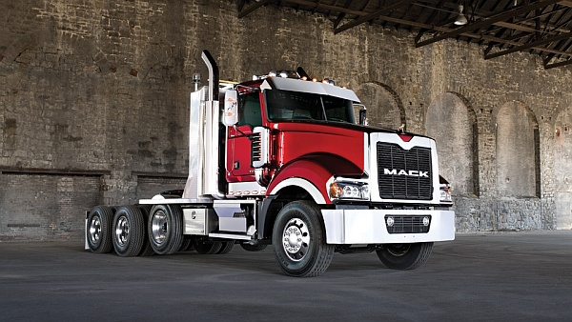

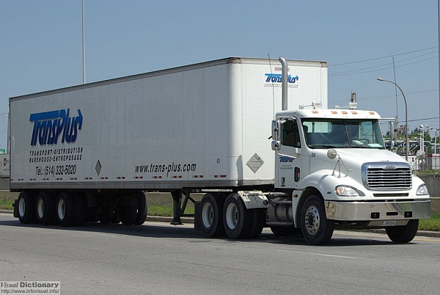
Vehicles in USA

Slide 17

Weight of vehicle
In the USA, the weight of a vehicle can be compensated for by an increased number of axles and wheels. As a consequence of that, the pavements can be built
not as thick as in Europe
In Europe, higher loads per axle and single wheels are allowed, so pavements have to be thicker (more durable)

Slide 18
Load equivalency factor
There is a ratio between total number of axle load that was measured during traffic assessment (real number of vehicles) and number standard axle loads (for example 100 kN)
The exponent in that equetion can be 4 (as presented above for flexible pavements and can be equal to 10 or 12 in case of rigid pavements)

Slide 19
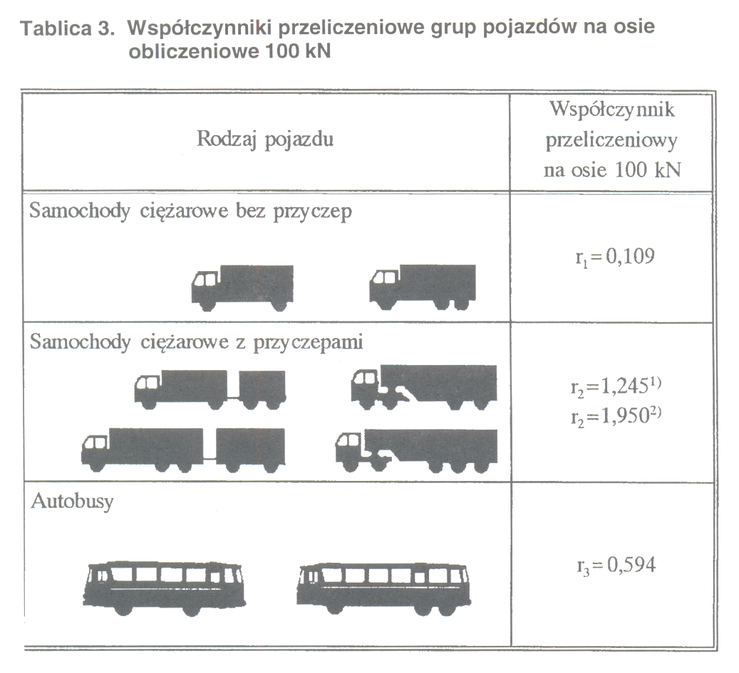
Average Daily Traffic
The equivalency factors for different types of vehicles:
Heavy Goods Vehicles (HGV)
Heavy Goods Vehicles with trailer and semitrailer
Buses

Slide 20
Methods for traffic prediction
Back calculation method – based on results of traffic measurement during whole period of road in service
General Traffic Measurements – in Poland every 5 years – last one was conducted in 2010 (www.gddkia.gov.pl)

Slide 21
Total traffic calculations
Back calculation method – based on results of traffic measurement during whole period of road in service
General Traffic Measurements – in Poland every 5 years – last one was conducted in 2010 (www.gddkia.gov.pl)

Slide 22
Total traffic calculations
Method 1 – traffic addition in the design period of time:
where:
N_{total} - total traffic in standard axle loads of 100 kN in the design period of time (20 years)
f₁ - lane distribution factor
ADT100_{i} – average daily traffic in each year of design period of time in standard axles of 100 kN (all lanes)
T_{i} – numer of years in the design period of time.

Slide 23
Lane distribution factor

Slide 24
Total traffic calculations
Method 2 – when the Average Daily Traffic (ADT) is known in the middle point of design period:
where:
ADT100_{middle}- average daily traffic in the middle point of design period of time in standard axles of 100 kN (all lanes)

Slide 25
Design traffic
Design traffic= Traffic at the beginning x growth factor

Slide 26
Total traffic calculations
Method 3 – geometrical increase of traffic when the Average Daily Traffic (ADT) is known at the beginning point of design period:
where:
ADT100₀ - average daily traffic at the beginning point of the design period in standard axles of 100 kN (all lanes)
p [%] – annual increase of traffic
t _{design}– design period

Slide 27
Total traffic calculations

Slide 28
Total traffic distribution
Traffic | L [axle load 100 kN] | N_{total} [axle load 100 kN] | N_{total} [axle load 115 kN]
KR1 | ≤ 12 | ≤ 90 000 | ≤ 51 500
KR2 | 13 ÷ 70 | 90 001 ÷ 510 000 | 51 501 ÷ 291 600
KR3 | 71 ÷ 335 | 510 001 ÷ 2 500 000 | 291 601 ÷ 1 429 400
KR4 | 336 ÷ 1000 | 2 500 001 ÷ 7 300 000 | 1 429 401 ÷ 4 173 800
KR5 | 1001 ÷ 2000 | 7 300 001 ÷ 14 600 000 | 4 173 801 ÷ 8 347 600
KR6 | ≥ 2001 | ≥ 14 600 001 | ≥ 8 347 601

Slide 29
An example – back calculated traffic
Year | 1990 | 1995 | 2000 | 2005 | 2010
Average daily traffic [number of vehicles/lane/day] | 1500 | 1830 | 2220 | 2700 | 3290
Contribution of Heavy Goods Vehicles | 9,5% | 9,2% | 8,9% | 8,8% | 8,6%
Contribution of Heavy Goods Vehicles with trailers | 8,5% | 8,1% | 7,9% | 7,8% | 7,7%
Contribusion of buses | 3,3% | 3,0% | 2,7% | 2,2% | 2,0%
Number of Heavy Goods Vehicles | 142 | 168 | 198 | 238 | 283
Number of Heavy Goods Vehicles with trailers | 127 | 148 | 175 | 211 | 253
Number of buses | 49 | 55 | 60 | 59 | 66
Notes:
29

Slide 30
An example – back calculated traffic - cd
Year | 1990 | 1995 | 2000 | 2005 | 2010
ADT 100_{HGT} – HGT (r₁=0,109) | 15,5 | 18,4 | 21,5 | 25,9 | 30,8
AVT 100_{HGT+T} – HGT with trailers (r₂=1,95) | 248,6 | 289,0 | 342,0 | 410,7 | 494,0
AVT 100_{bus} – BUSES (r₂=0,594) | 29,4 | 32,6 | 35,6 | 35,3 | 39,1
AVT_{YEAR}=Ʃ(AVT_{HGV, HGV+T,} _{BUS}) axle100 kN/day/lane | 294 | 340 | 399 | 472 | 564
AVT (20 years) | 410 axle load 100 kN/day/lane
Total traffic (20 years) | 2,99 milionów axle loads 100 kN/lane (KR4)
Notes:
30

Slide 31
An example – Method 3
Important data:
  National road (2 lanes each direction) – lane distribution factor f₁=0,45,
  Data from site measurement in 2005
Type of vehicles | Number of vehicles (2 lanes each direction in 2005 [number of vehicles per day] | Equivalent factors | Number of design axles 100 kN/day In 2005 (ADT100₀)
HGV | 896 | r₁ = 0,109 | 98
HGV with trailers | 1584 | r₂ = 1,950 | 3089
Buses | 1152 | r₃ = 0,594 | 684
Sum: |  | ADT100₀: | 3871

Slide 32
An example – Method 3
Important data:
  The beginning year – 2005,
  Design period: 20 years
  Growth factor per year: 2%
The equation:

Slide 33
An example – Method 3
So:
Finally:
N_{total}=15,45 mln axle load 100 kN/design lane
And:
N_{total}=8,83 mln axle load 115 kN/design lane

