Slide 1
Course C.03.06.02
Maintenance – Pavement condition
Marek Pszczola
(presentation was prepared on the basis of materials of dr Majlun, Poland)

Slide 2
Road Transportation Systems Engineering Development in the Sub-Saharan Africa – Modern EU Master Programme & Capacity Building

Slide 4
What has been done up to this point…
Selection of the road section
Collection of input data about a road section
Field inspection of pavement condition
Identification of pavement damages

Slide 5
The task (homework details 1/2)
Based on the results of the performed work, assess the road damages (their frequency, size, degree, hypothetical causes, etc.).
Based on this, assess the surface condition - determine the surface condition values for individual condition parameters, their condition class and condition level, dominant parameters and the general condition level and condition class of the road section.

Slide 6
The task (homework details 2/2)
After completing this work, prepare in groups a summary report (table) in the form of a PowerPoint presentation.
Single presentation = single class.
One presentation for each working group (road section) should last up to 30 minutes.
In the presentation, each student from the working group presents the part that he/she was responsible for developing.
Student reports will be presented during the next 4 classes.

Slide 7
How to do that? Repetition.
Determination of the values of pavement condition parameters.
Performing of normalization of condition parameter values to a scale of 0-100.
Determination of the pavement condition class for each condition parameter (classes A, B, C, D).
Determination of the dominant parameters in each group of condition parameter and the collective parameter for all condition parameters.
Determination of pavement condition classes in each condition parameter group and the collective condition level for all condition parameters.
Determination of pavement condition levels in each condition parameter group and the collective condition level for all condition parameters.

Slide 8
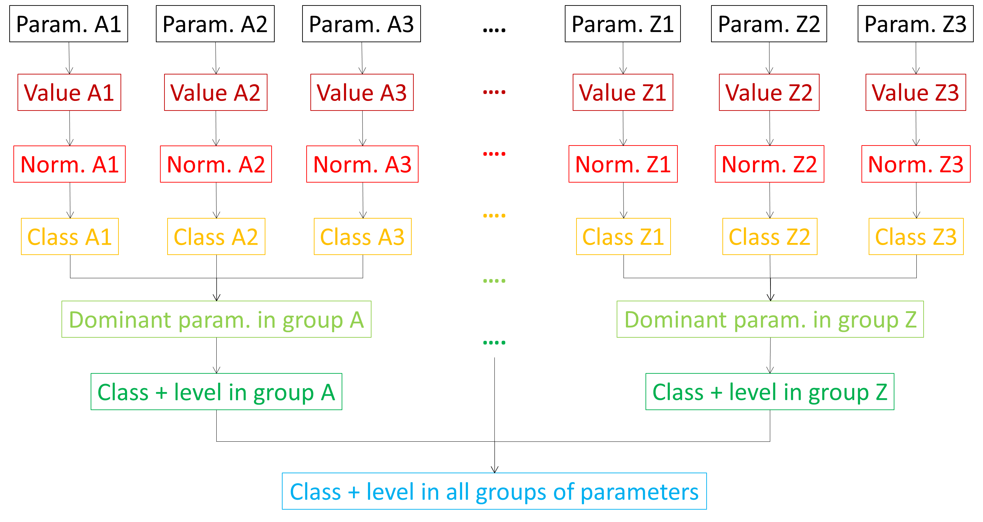
How to do that? Repetition.

Slide 9
Remember about…
… normalizing functions
… sign coefficients
… threshold values for individual parameters
… the relationship between class and state level
… method of determining dominant parameters

Slide 10
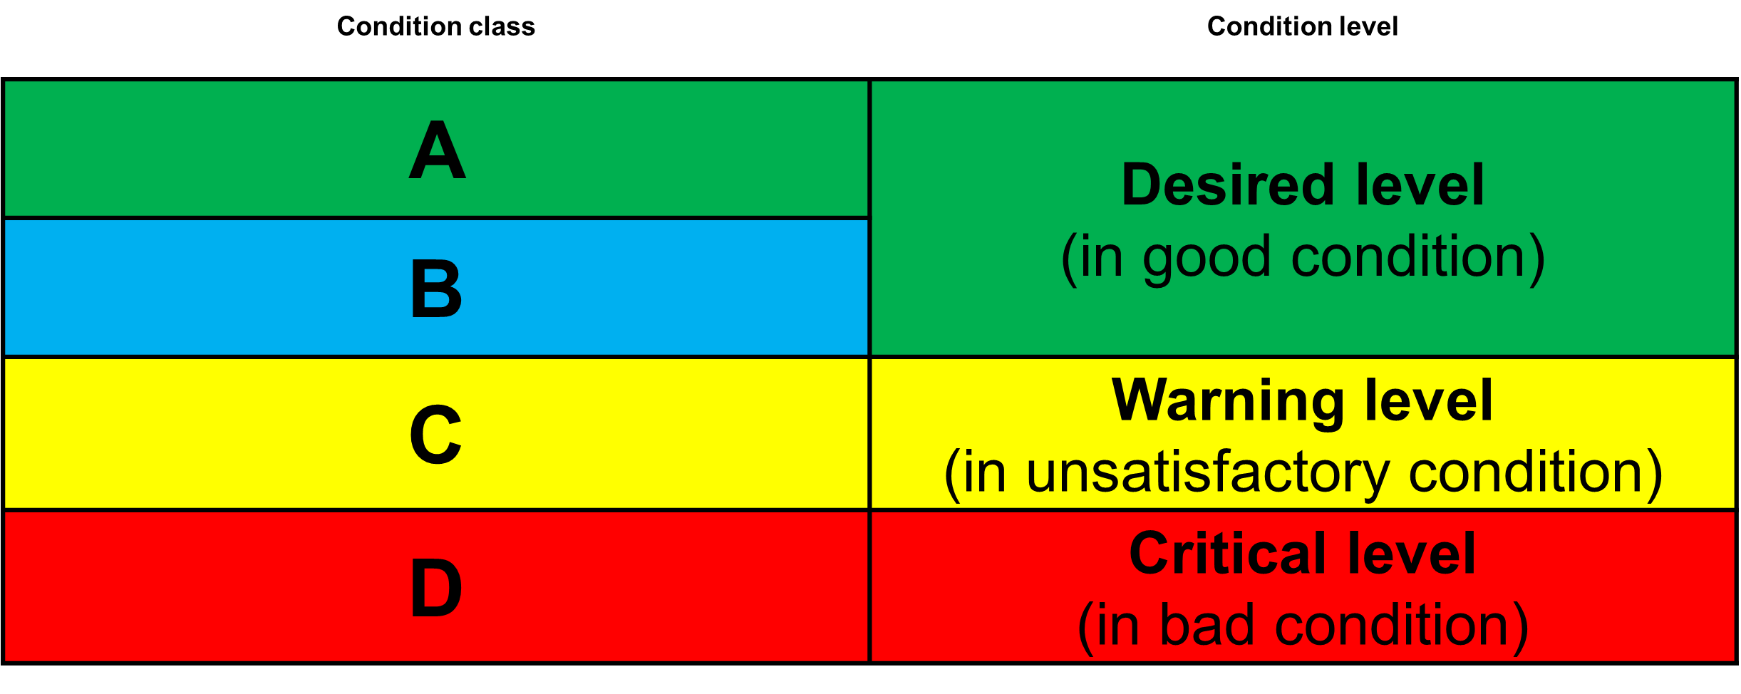
Remember about…
Use the following colors to indicate classes and levels of pavement condition…

