Slide 1
Additional material
Climate-Resilient, Low-Volume Road Design and Management
TRB Webinar
Gordon R. Keller, Genesee Geotechnical; Donald N. Lindsay, CA Geological Survey; moderator Laura Fay, WTI; TRB, 07.08.2023

Slide 2
Road Transportation Systems Engineering Development in the Sub-Saharan Africa – Modern EU Master Programme & Capacity Building

Slide 4
TRB Webinar: Climate-Resilient, Low-Volume Road Design and Management
Extreme weather impacts to roads can be damaging and costly, but measures for adaptation and storm damage mitigation are available.
TRB hosted a webinar on Monday, August 7, 2023 from 1:00 PM to 2:30 PM Eastern that presented useful and practical climate adaptation measures that road designers and managers can implement to help “stormproof” roads and reduce the risk of climate-induced damage.
Presenters shared key measures for road maintenance, drainage design, slope stabilization, and debris flow mitigation to prevent or minimize damage from fires and storms.
This webinar was sponsored by TRB’s Standing Technical Committees on Mechanics and Drainage of Saturated and Unsaturated Geomaterials, Transportation Earthworks, and Geotechnical Instrumentation and Modelling.

Slide 5
TRB Webinar: Climate-Resilient, Low-Volume Road Design and Management
Webinar agenda and presenters
  Climate-resilient, low-volume road design – Gordon R. Keller, Genesee Geotechnical
  Fire, floods, and debris flow impacts on rural infrastructure – Donald N. Lindsay, California Geological Survey
  Question and answer session moderated by Laura Fay, Western Transportation Institute

Slide 6
TRB Webinar: Climate-Resilient, Low-Volume Road Design and Management
Learning Objectives:
  Utilize a variety of tools or design measures, particularly related to drainage, to prevent storm damage to roads
  Implement damage prevention measures and fire-flood-debris flow mechanisms

Slide 7
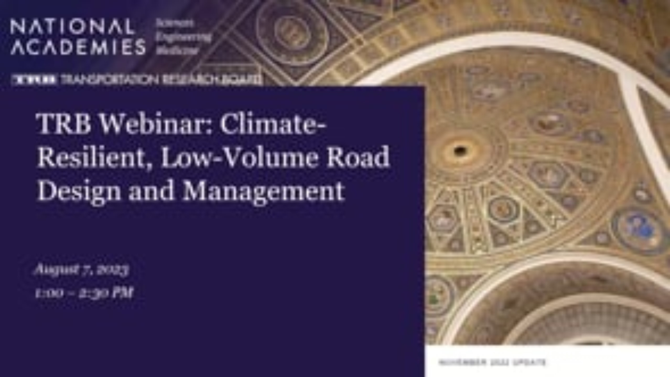
TRB Webinar: Climate-Resilient, Low-Volume Road Design and Management

