Slide 1
Additional material
Pavement Foundations—Designing for 100 Years
TRB Webinar
Nayyar Siddiki, Kumar Dave, INDOT; Soheil Nazarian, UTEP; David White, Ingios; moderator John Siekmeier; TRB, 30.05.2024

Slide 2
Road Transportation Systems Engineering Development in the Sub-Saharan Africa – Modern EU Master Programme & Capacity Building

Slide 4
TRB Webinar: Pavement Foundations—Designing for 100 Years
Pavement foundation deformation under asphalt or concrete surface layers cause damage at the surface and reduce service life. Extreme weather and seasonal climate change create additional uncertainty, making it difficult to estimate and reduce foundation degradation and deformation for life cycle assessment periods up to 100 years.
TRB hosted a webinar on Thursday, May 30, 2024 from 1:00 PM to 2:30 PM Eastern that provided examples of current technology that is enhancing highway resilience and improving long term performance by reducing pavement foundation deformation.
This webinar was sponsored by TRB’s Standing Technical Committees on Mechanics and Drainage of Saturated and Unsaturated Geomaterials, Transportation Earthworks, and Geotechnical Instrumentation and Modelling.

Slide 5
TRB Webinar: Pavement Foundations—Designing for 100 Years
Webinar agenda and presenters
  Design and construction to achieve long-lasting pavement – Nayyar Siddiki & Kumar Dave, Indiana Department of Transportation
  Role of quality management in extending pavement life – Soheil Nazarian, University of Texas, El Paso
  E-compaction for pavement foundations – David White, Ingios
  Question and answer session moderated by John Siekmeier, Affiliation

Slide 6
TRB Webinar: Pavement Foundations—Designing for 100 Years
Learning Objectives:
  Understand how extreme weather and seasonal climate change create uncertainty during pavement system design
  Avoid poor design choices and expensive or ineffective pavement system design
  Reduce pavement foundation degradation and deformation for life cycle assessment periods up to 100 years

Slide 7
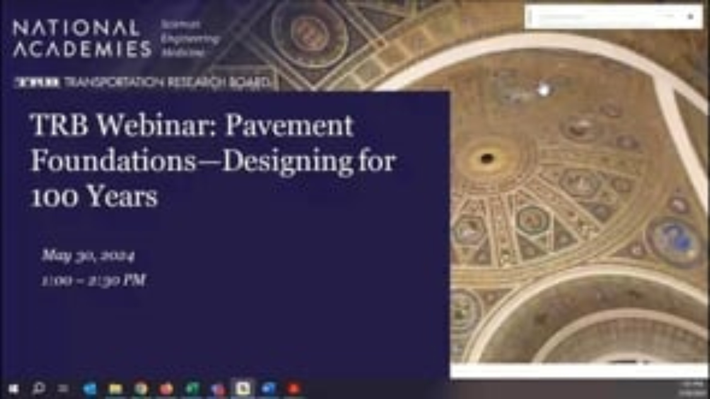
TRB Webinar: Pavement Foundations—Designing for 100 Years

