Slide 1
Course C.03.06.02
Maintenance – Introduction
Ngankeu Martial, Intime

Slide 2
Road Transportation Systems Engineering Development in the Sub-Saharan Africa – Modern EU Master Programme & Capacity Building

Slide 4
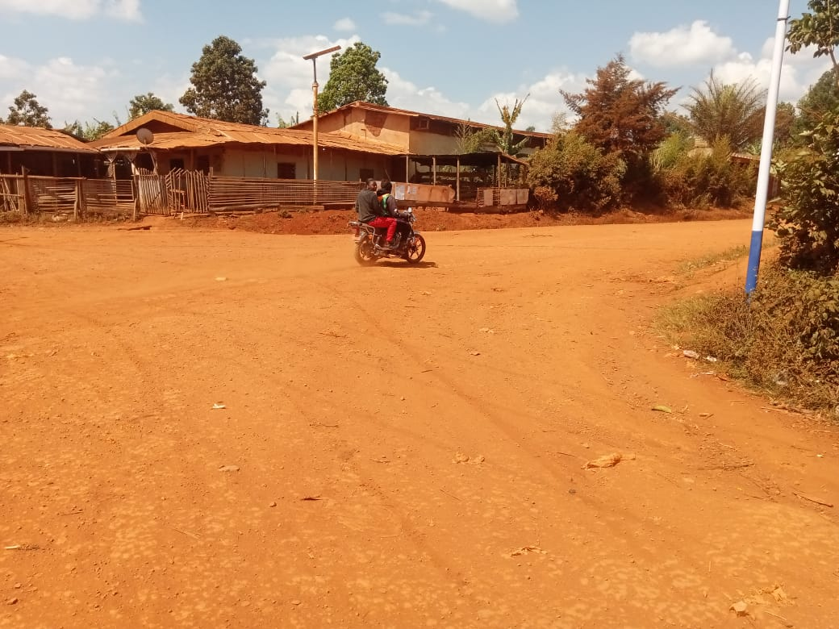
Introduction
What are the main technical challenges specific to unpaved roads compared to paved roads, and how do climate conditions (dry season vs. rainy season) affect their deterioration?
Figure: local road unpaved, Bafou, Cameroon

Slide 5
Introduction
The importance of the road network in the economic well-being of a country should not be underestimated.
The increasing need for access and mobility dictate the need for an ever-improving road network.
The agricultural, mining, forestry and tourist industries of all countries depend almost totally on an adequate network of all-weather roads for their economic viability and sustainability.
Unsealed roads are the major component of the road network in most developing countries and comprise the dominant proportion of the network even in many highly developed countries such as the United States.

Slide 6
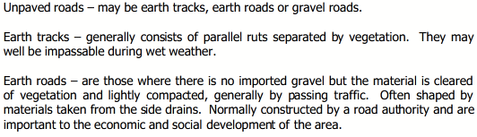
Course objective

Slide 7
Course objective
To understand and master the technical aspects of unpaved local roads, including:
  Classification of unpaved roads (natural trails, dirt roads, elaborate unpaved roads)
  Technical specifications (structure, materials, design methods)Identification of typical defects (surface deteriorations and deformations)
  Causes and evolution of road degradation
  Maintenance and rehabilitation techniques (routine maintenance, reprofiling, reconstruction)
  Safety considerations
  Socio-economic impact of unpaved local roads

Slide 8
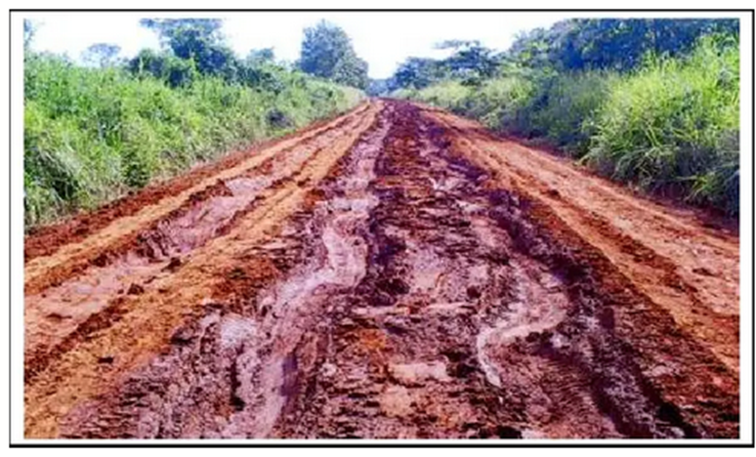
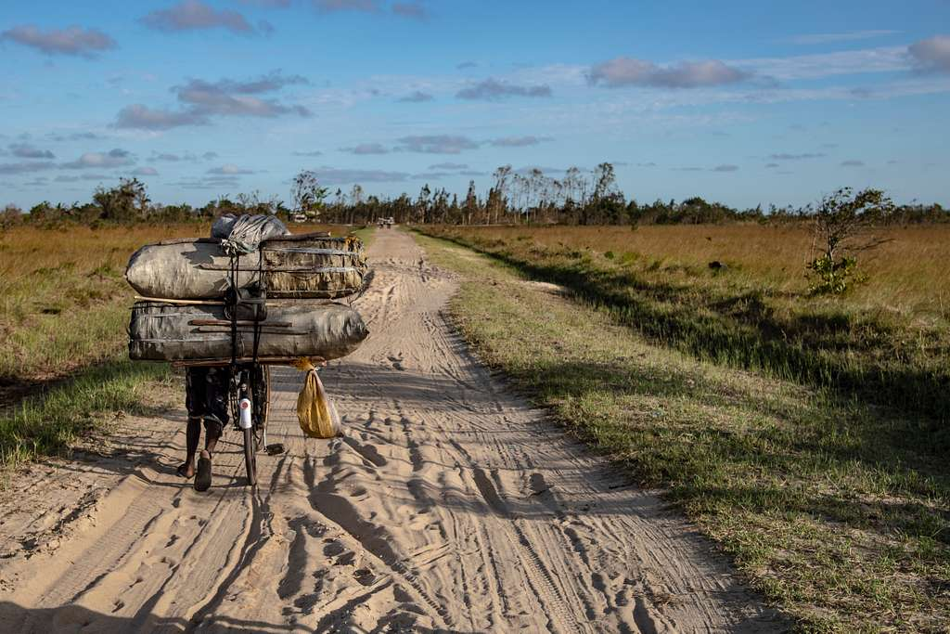
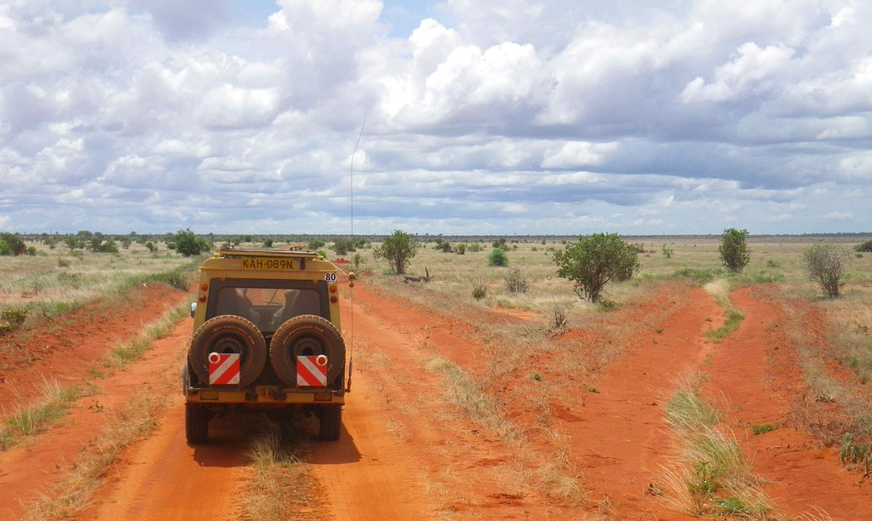
Typical deterioration problem in rural areas, Africa

Slide 9
Classification of unpaved local roads
The term “unpaved road” is useful for distinguishing unpaved roads from paved ones, but it is far too vague or broad to define a specific type of road, level of service, or level of maintenance.
“Unpaved road” refers to everything from natural tracks that are barely passable to roads with the same basic speed limits as paved roads, including various stages where maintenance or various improvements mean that traffic conditions can be controlled or not.
We will refer to these traffic conditions as the “viability” of the road and will distinguish three levels in the hierarchy of unpaved roads

Slide 10
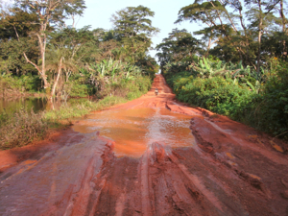
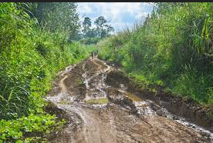
Classification of unpaved local roads

Slide 11
Classification of unpaved local roads
As its name suggests, this is a trail that has not been specially treated; traffic travels on the ground itself, taking the least damaged route among those opened up by previous vehicles
It is entirely dependent on the natural conditions of the site.
Natural tracks exist and serve a purpose, but their limitations are immediately apparent: the absence of a road surface and the lack of infrastructure mean that neither the possibility of travelling nor the journey time can be controlled.
There is no maintenance for this type of road, let alone maintenance management.

Slide 12
Classification of unpaved local roads
The dirt road
  The refusal to be entirely dependent on natural conditions leads to improvements being made to the track by giving it a specific layout and dealing with difficult sections, for example, through drainage works or the construction of crossing structures.
  On this type of road, traffic is temporary, light, and practically reserved for off-road vehicles.
  Dirt roads are often used for agricultural activities linked to the production and transport of crops, and are therefore seasonal.
  Seasonal maintenance is carried out to make them passable at the appropriate time.

Slide 13
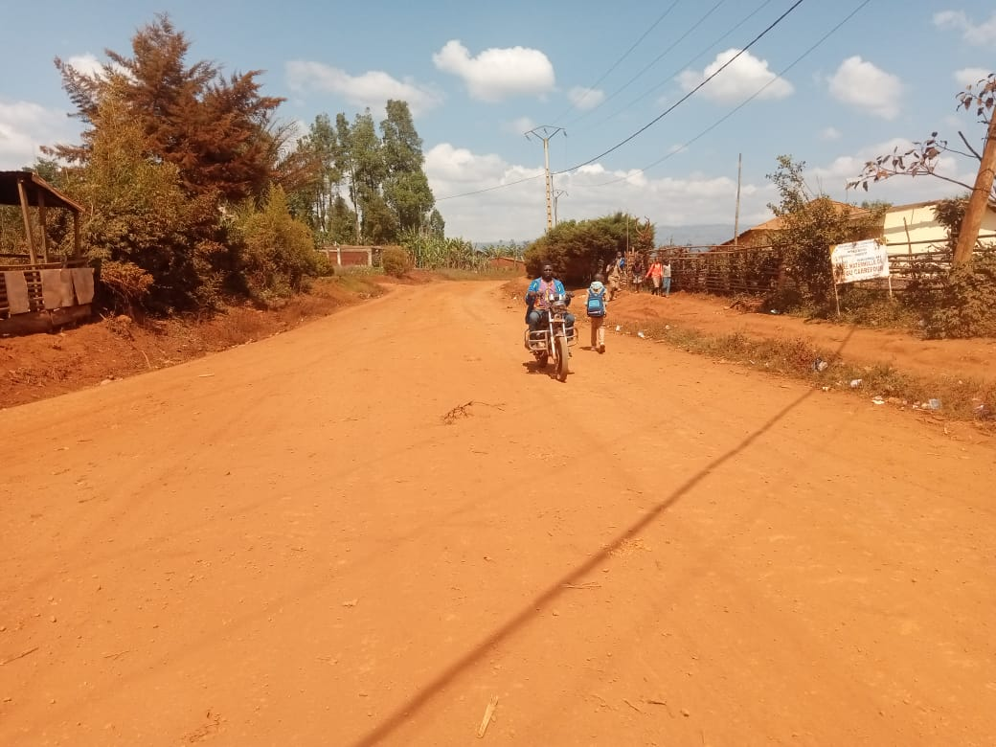
Classification of unpaved local roads
The dirt road

Slide 14
Classification of unpaved local roads
The elaborate unpaved road
  Its objective is to ensure permanent traffic flow under decent conditions.
  Permanent means that the road is accessible to ordinary vehicles daily and that traffic is only exceptionally interrupted (river flooding, submersible crossings, rain barriers, etc.).
  Decent conditions mean that travelling on this road is not an expedition where you have no idea how long it will take or how many vehicles will break down.

Slide 15
Structure of an unpaved road
Formation of the platform
  The platform is the surface prepared after stripping the natural terrain. It results from:
  excavation (removing excess or unstable soil), or
  backfilling (adding material to stabilize and level the ground).
It forms the foundation of the road and plays an important role because it:
  ensures water drainage,
  distributes the weight of vehicles over the natural ground,
  prevents subsidence.

Slide 16
Natural foundation layer
The foundation consists of
  well-compacted existing soil, or
  improved local fill.
It stabilizes and supports the upper layer (dirt track). It allows:
  limiting rutting,
  reducing erosion,
  ensuring vehicle passage even in light rain.

Slide 17
Absence of asphalt wearing course
Unlike paved roads, unpaved roads do not have asphalt, bituminous layer, or concrete. Their wearing course consists of:
  compacted soil,
  laterite,
  natural gravel.
This keeps costs low but poses challenges:
  dust in the dry season,
  mud in the rainy season,
  rapid deterioration under heavy traffic.

Slide 18
Materials used
Treated or untreated local soil
  left as is (compacted natural soil), or
  improved with lime, cement, or a bituminous stabilizer.
The treatment serves to:
  increase water resistance,
  improve load-bearing capacity,
  reduce deformation.

Slide 19
Laterite gravel and natural gravel
Laterite gravel
  Reddish-brown material rich in iron and aluminum, widely found in tropical Africa.
  Compacts well, relatively resistant to rain, good cohesion. Often used as a base course.
Natural gravel
  Small stones or rock fragments.
  Increases mechanical resistance, reduces rutting, improves surface stability.
  Used mixed with soil or as a top layer.

Slide 20
Stabilized sand
Sand alone does not hold well. It is stabilized with:
  cement,
  lime,
  or chemical additives.
Objectives:
  obtain a firmer surface,
  limit slipping and dust,
  improve durability.

Slide 21
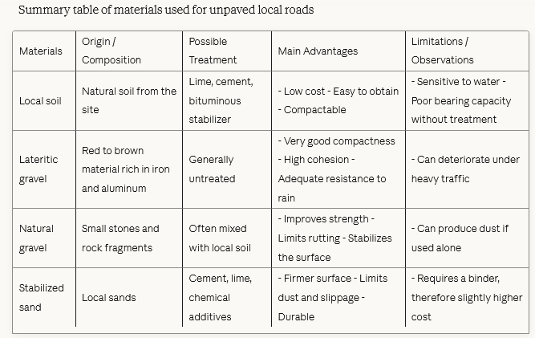

Slide 22
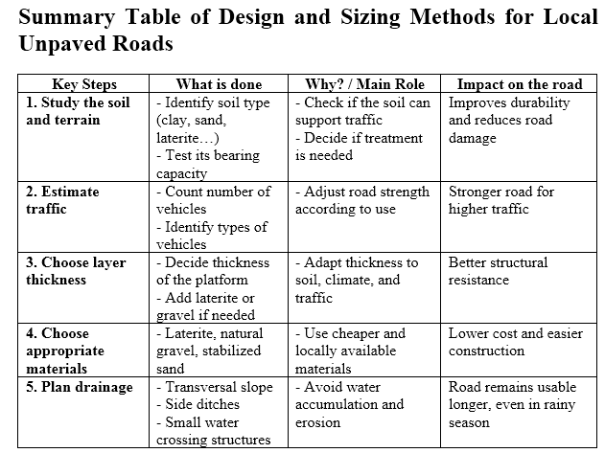
Design and sizing methods

Slide 23
Typical unpaved local roads defects - Surface Deteriorations
Dust
  Dust in the air is a loss of fine, binder aggregates from road surfaces.
  Loss of these fines leads to other types of road distress, such as loss of cohesion and compaction of the road fill material, and reduced capacity to maintain moisture in the road fill.
  These deficiencies also tend to feed on themselves, compounding the problems - especially the lack of moisture within the road fill.

Slide 24
Typical unpaved local roads defects - Surface Deteriorations
Ravelling
  Ravelling is the loss of coarser aggregates. This is brought about when the coarser aggregates are worn away by traffic after fine, binder aggregates have been lost due to dust or erosion.

Slide 25
Typical unpaved local roads defects - Surface Deteriorations
Slipperiness
  Slipperiness is caused when the road surface contains excessive fine aggregates in proportion to coarser aggregates, especially within the crust.
  Traffic wear can reduce coarse aggregates to finer aggregates, thus dis-proportioning the original road fill aggregate mix.
  During wet weather, the road surface becomes slippery and may become impassible.
  This problem can be corrected by mixing the surface fines with coarser aggregate by grading and/or blading the road surface and compacting back in place.
  Occasionally, coarser aggregate will need to be hauled in and added to the roadway.

Slide 26
Typical unpaved local roads defects - Surface Deformations
Rutting
  Ruts are longitudinal depressions in the wheel paths caused by high moisture content in the subsurface soil or base, inadequate surface course thickness, and /or heavy traffic loads.
  Rutting can be corrected by adding suitable material, grading, crowning, and rolling the road surface.
  Do not simply fill ruts with stone or soil.
  Filing ruts with stone can lead to new ruts being generated beside the original ones and thus would be an expensive and temporary “fix” which can also interfere with grading.
  The surface must be re-mixed and properly bladed or graded in more severe cases.

Slide 27
Typical unpaved local roads defects - Surface Deformations
Corrugating/“Washboarding”
  Corrugating/“washboarding” is a series of ridges and depressions across the road surface caused by the lack of surface cohesion.
  This lack of cohesion is a result of the loss of fines in the road surface which, in turn, is usually a result of very dry conditions within the road surface.
  These conditions are aggravated and enhanced by excessive vehicle speeds and high traffic volumes.

Slide 28
Typical unpaved local roads defects - Surface Deformations
Depressions”
  Depressions are localized low areas one or more inches below the surrounding road surfaces caused by settlement, excessive moisture content, and improper drainage.
  These are larger areas not to be confused with potholes.

Slide 29
Typical unpaved local roads defects - Surface Deformations
Potholes”
  Potholes are small depressions or voids in the road surface one or more inches deep, which are caused by excessive moisture content, poor drainage, poorly graded aggregate, or a combination of these factors.

Slide 30
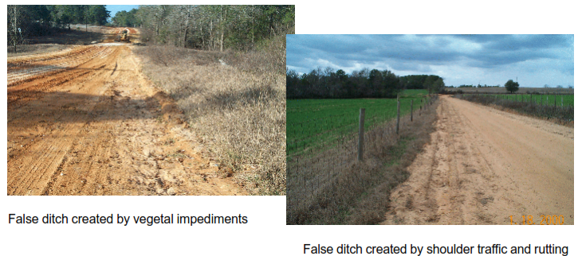
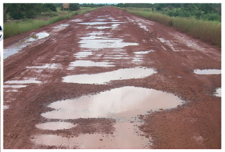
Typical unpaved local roads defects - Surface Deformations

Slide 31
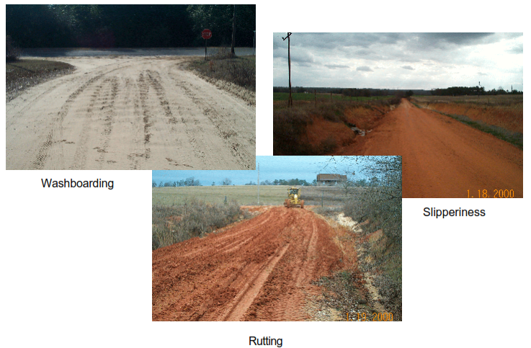

Slide 32
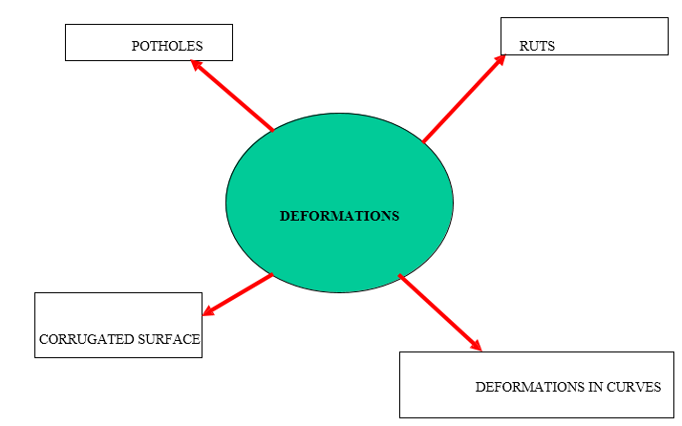
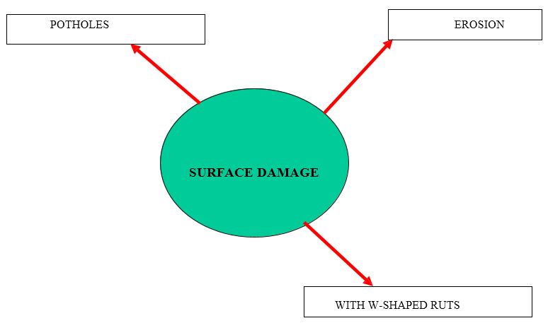
ATTEMPT TO REGROUP

Slide 33
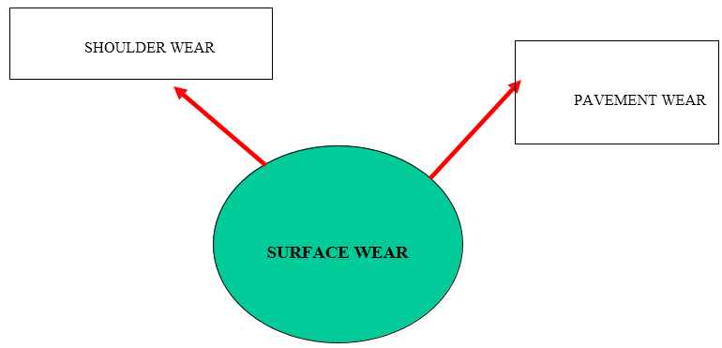

Slide 34
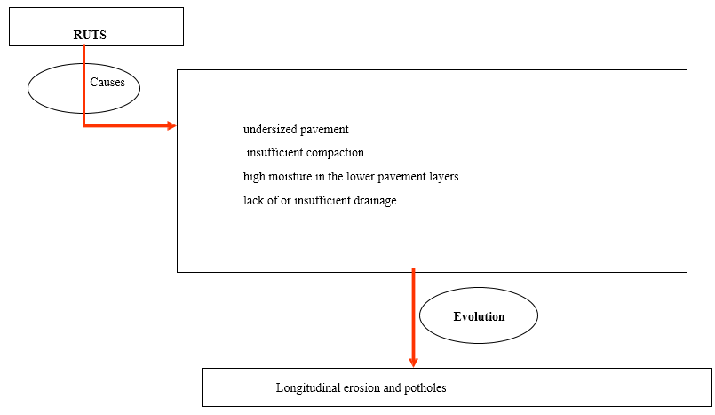
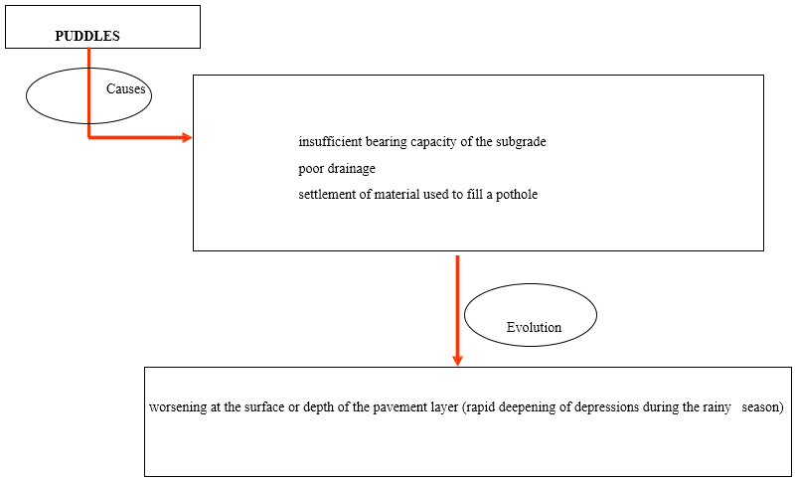
MAIN CAUSES AND DEVELOPMENTS

Slide 35
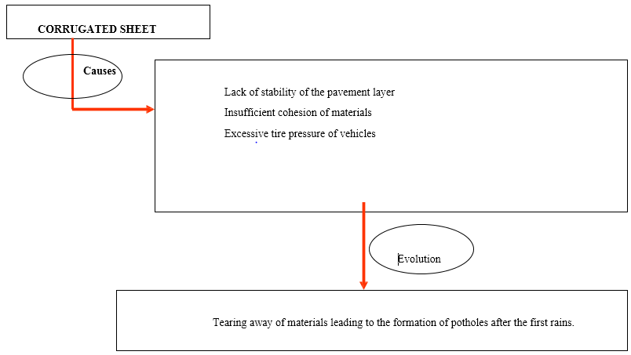
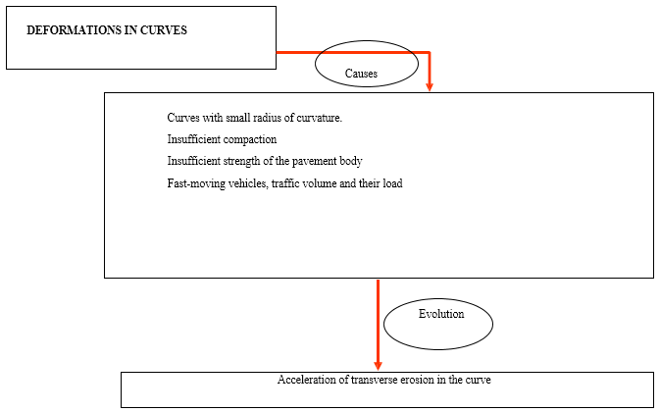

Slide 36
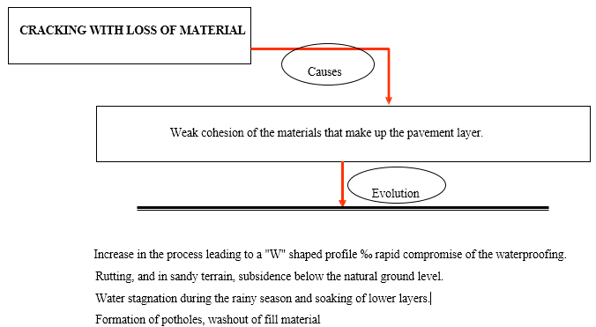
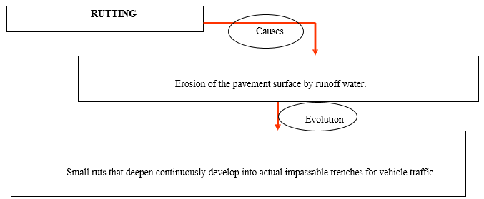
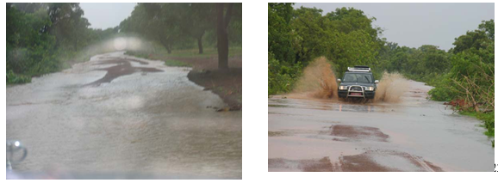

Slide 37
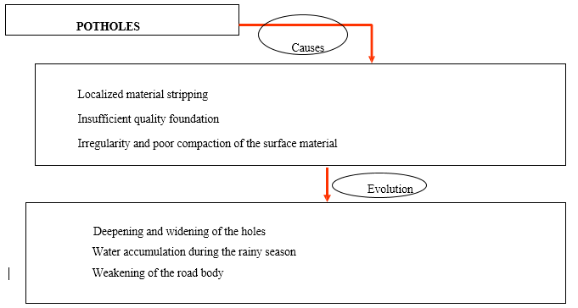
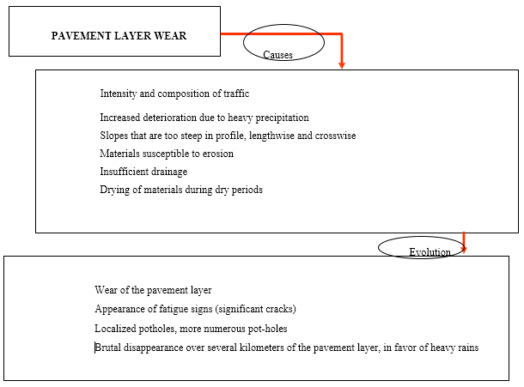

Slide 38
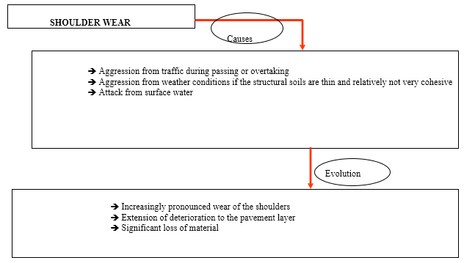
NOTES
Contrary to what one might think, all these forms of degradation are closely linked.

Slide 39
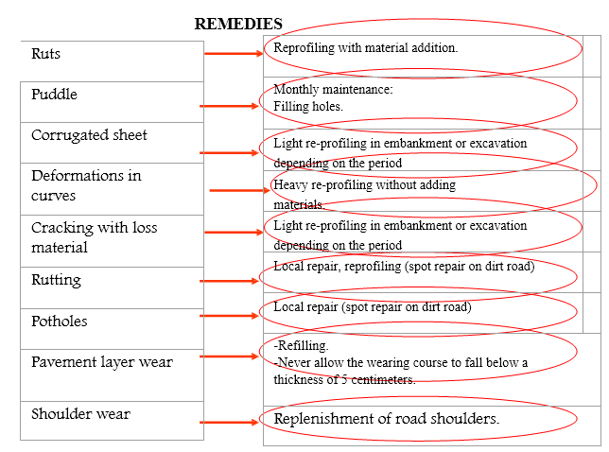

Slide 40
Maintenance and rehabilitation techniques
According to the VIZIRET method, in terms of maintenance and rehabilitation techniques for unpaved roads, we have:
  Routine maintenance
    Manual or minimally mechanized maintenance of roads and outbuildings: timely application of lightly compacted material in very localized areascompacted material in very localised areas (using a tamper or vehicle tyre); repair of drainage outlets (clearing ditches, cleaning culverts, etc.); clearing of roadside vegetation, etc. (using a tamper or vehicle tire); repair of drainage outlets (clearing ditches, cleaning culverts, etc.); clearing of roadside vegetation, etc..
    Light reprofiling A mechanized operation that involves leveling the surface of the existing pavement with a grader or scraper, without adding material or compacting. This operation may be preceded bmechanised maintenance of roads and outbuildings: timely application of lightlyy spot grading; it is accompanied by an improvement in ditches and is carried out at the expense of the structure (scraping of thickness) and the usable width (accentuated cross slope).

Slide 41
Heavy reprofiling
A mechanized operation that involves restoring the shape and size of the pavement by scarifying, moistening, and compacting the material.

Slide 42
Heavy reprofiling
A mechanized operation that involves restoring the shape and size of the pavement by scarifying, moistening, and compacting the material.

Slide 43
Reconstruction
Operation consisting of rebuilding the road; this reconstruction may correspond to a new project accompanied by changes to the gauge and/or the red line.

Slide 44
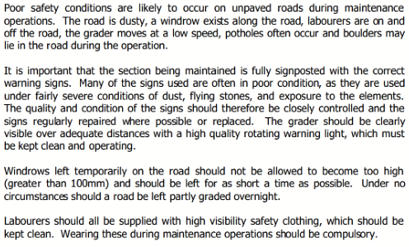
SAFETY

Slide 45
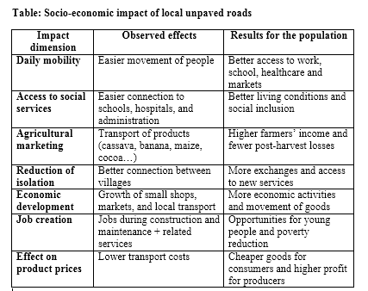
SOCIO-ECONOMIC IMPACT OF UNPAVED LOCAL ROADS

Slide 46
Conclusion
Unpaved roads are the backbone of rural transportation networks in Sub-Saharan Africa and developing countries, connecting communities and supporting economic development.
Throughout this course, we have explored their classification, construction materials, common deterioration patterns, and maintenance strategies.

Slide 47
Conclusion
Understanding these fundamentals from choosing appropriate local materials to implementing timely maintenance is essential for ensuring road viability.
The various forms of deterioration are interconnected challenges that require proper intervention to extend road lifespan and maintain rural accessibility.

Slide 48
Conclusion
The success of unpaved road networks depends on balancing technical knowledge with practical constraints: limited budgets, local materials, climate, and community needs.
The challenge ahead is to build sustainable, maintainable, and economically viable road networks that truly serve the communities that depend on them

