Slide 1
Course C.03.06.02
Maintenance – Practice
Marek Pszczola
(presentation was prepared on the basis of materials of dr Majlun, Poland)

Slide 2
Road Transportation Systems Engineering Development in the Sub-Saharan Africa – Modern EU Master Programme & Capacity Building

Slide 4
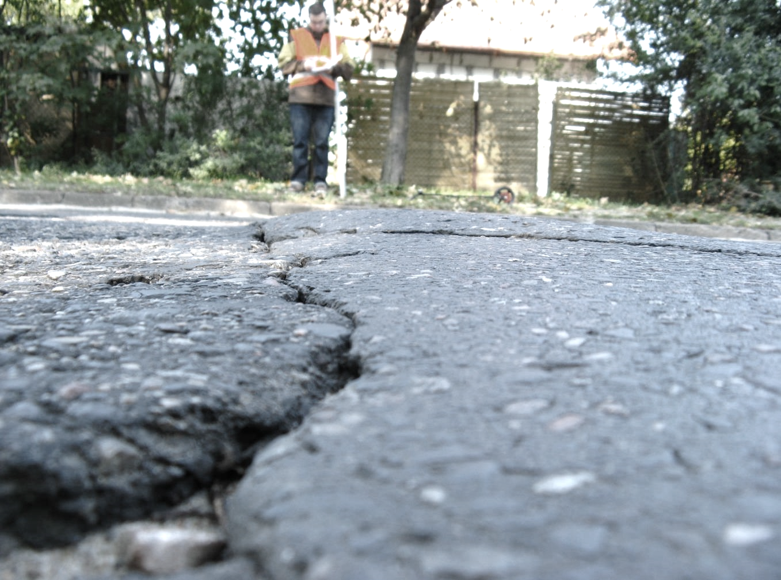
Pavement Condition Diagnostic System

Slide 5
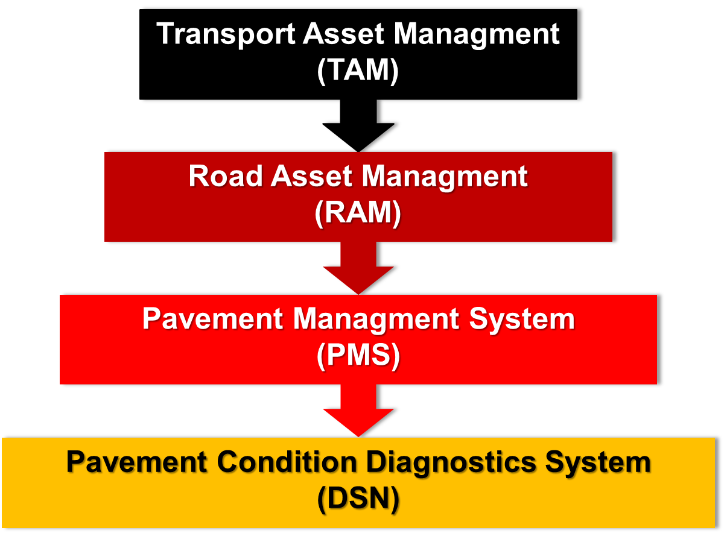
Pavement Condition Diagnostic System

Slide 6
Pavement Condition Diagnostic System
Content of the guidelines of the Pav. Cond. Diagn. System:
Definitions of quantities, ranges and quality of measurement data
Rules for carrying out measurements on the road network
Rules for recording and collecting measurement results
Methods and principles of processing measurement results
Principles of analysis, evaluation and prioritization of collected data
Principles of prioritization of strategic remedial actions
Organization of the IT system (database)
Division of responsibilities of system implementation participants
Modes of financing activities within the system.

Slide 7
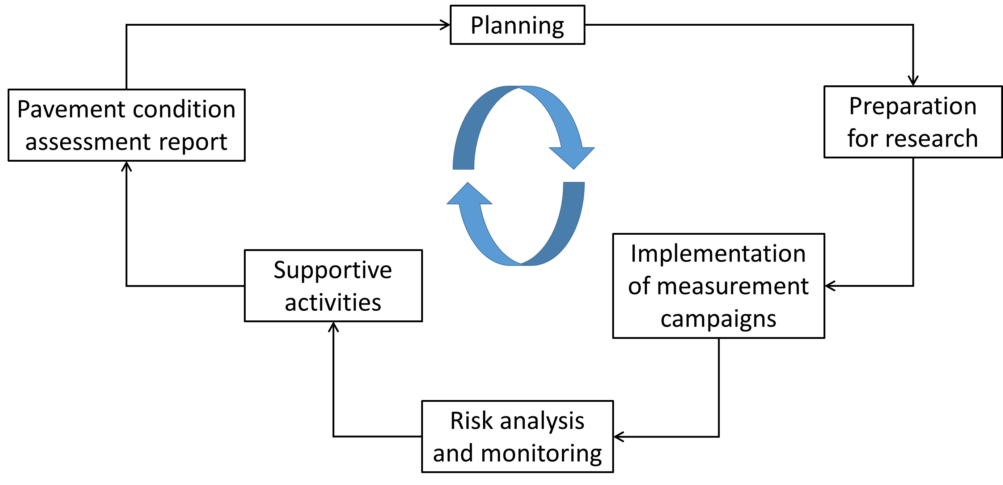
Pavement Condition Diagnostic System
Periodic data updating

Slide 8
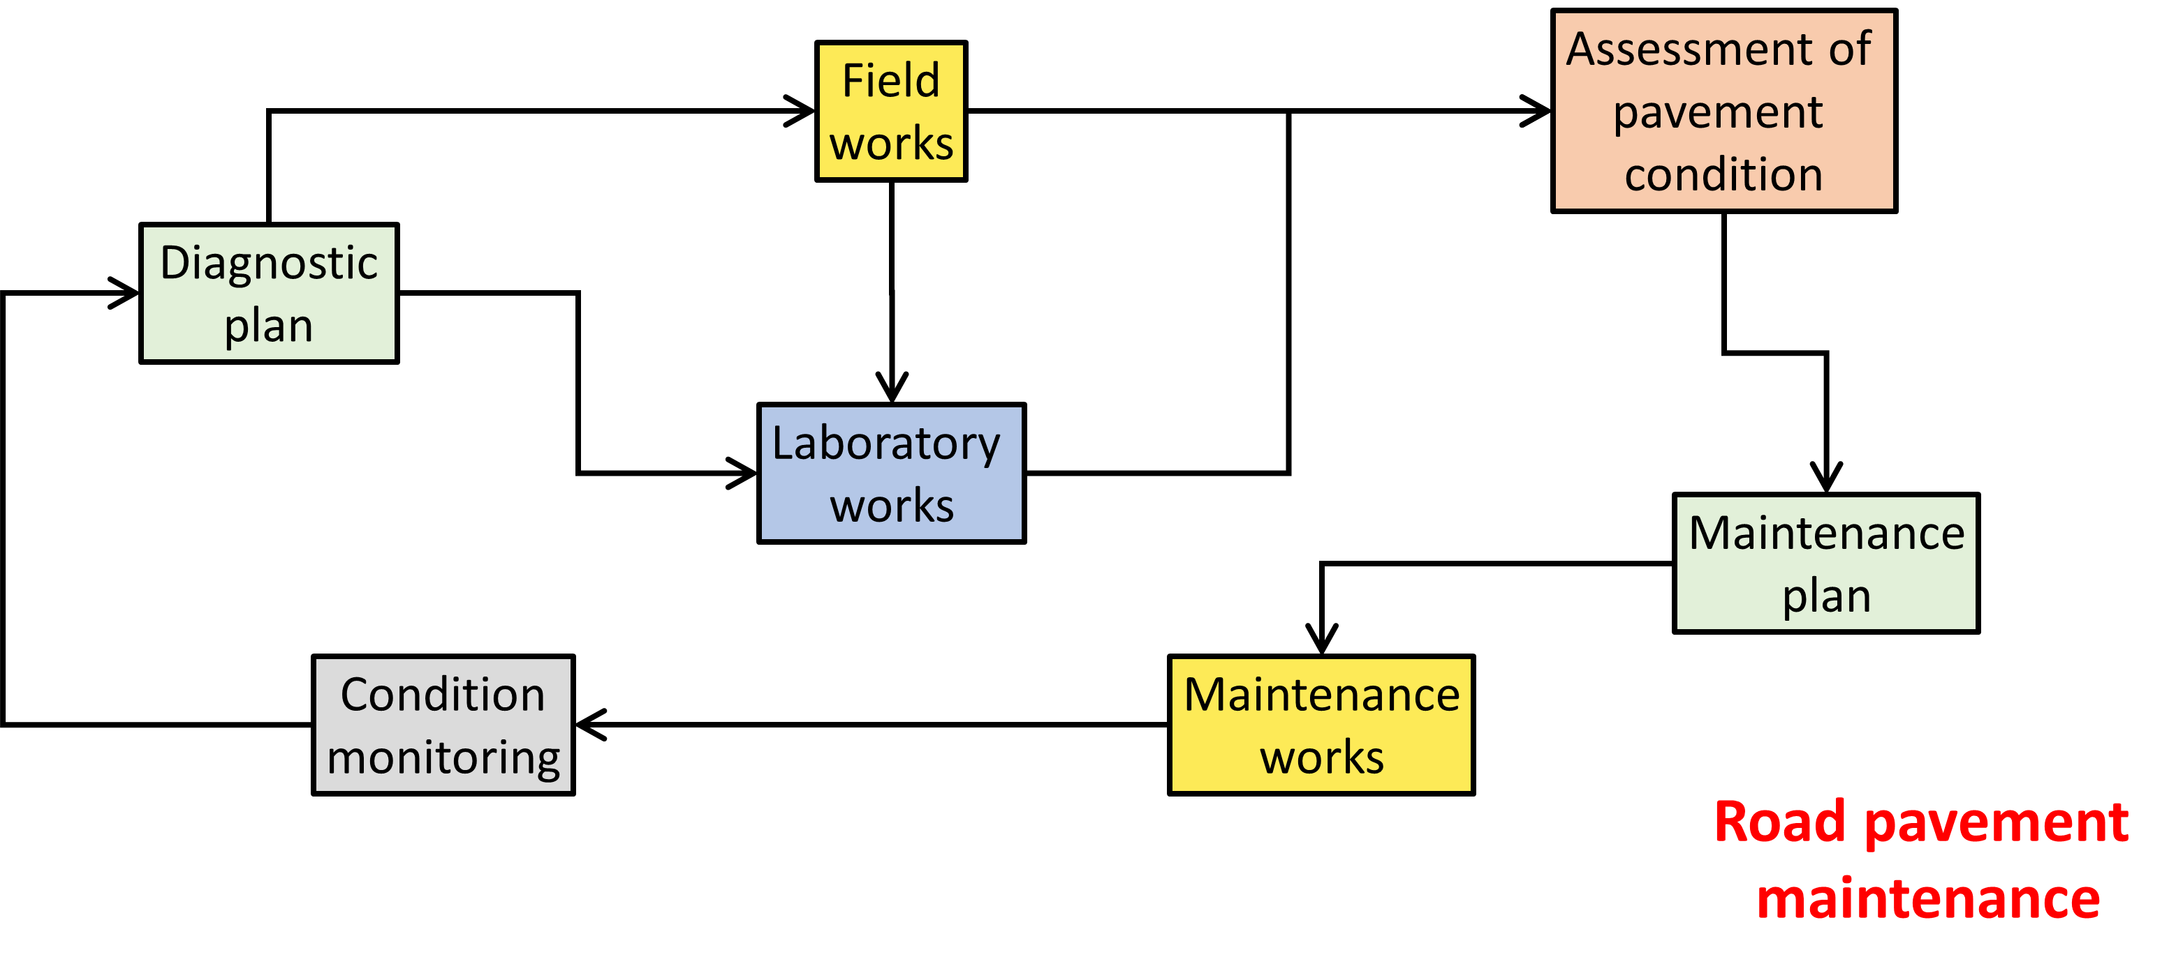
Pavement Condition Diagnostic System
General approach

Slide 9
Pavement Condition Diagnostic System
General procedure:
Measurement campaign.
Reliable and marking sections.
Sectional ratings and the average level of sectional ratings.
Dominant parameter(s) at the warning level and critical level.
Renovation needs.
Global assessment of the pavement condition.

Slide 10
Pavement Condition Diagnostic System
Assessment of pavement condition:
General current assessment
Detailed assessment prior to maintenance work

Slide 11
Pavement Condition Diagnostic System
Current assessment of pavement condition:
Initial assessment – zero-tests, which are the reference point for assessing pavement degradation
Systematic tracking – continuous measurements of selected features to determine the condition of the pavement
Final tests – tests diagnosing the causes of damage and determining the necessary maintenance or modernization works.

Slide 12
Pavement Condition Diagnostic System
Assessment prior to maintenance work:
Assessment of the condition of the existing surface
Assessment of the condition of individual layers
Conducting preliminary research
Selection of renovation technology
Conducting research for the selected renovation.

Slide 13
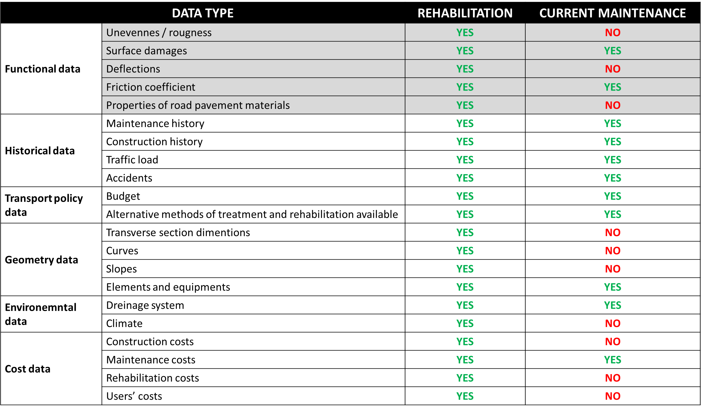
Pavement Condition Diagnostic System
What is there to assess?

Slide 14
Parameters in the Pavement Condition Diagnostic System

Slide 15
Pavement surface condition – parameters
surface durability
pavement deflection index
pavement deflection curvature index
condition of cracks on the surface
longitudinal equality
depth of ruts
coefficient of friction
surface macrotexture
road surface condition

Slide 16
Horizontal marking condition – parameters
retroreflective luminance coefficient
luminance coefficient under diffused lighting
slip resistance value

Slide 17
Normalizing parameters values
STANDARDING – the process of transforming a physical parameter describing the road surface condition into a standardized (on a scale of 0-100) dimensionless parameter (pavement condition value).
Normalized value = 0 → worst possible condition
Normalized value = 100 → best possible condition

Slide 18
Condition values, classes and levels
Condition values:
– assigning dimensionless numerical values to individual pavement condition parameters ranging from 0 to 100, where higher values mean better technical condition of the pavement.
Pavement condition classes:
– class A (good condition), class B (satisfactory condition),
class C (unsatisfactory condition), class D (bad condition).
Pavement condition levels:
– desirable level (good or satisfactory condition), warning level (unsatisfactory condition), critical level (poor condition).

Slide 19
Dominant parameters
Dominant parameter at critical level (poor condition)
– that parameter that has been rated in class D and has the highest priority.
Dominant parameter at warning level (unsatisfactory condition)
– that parameter that has been rated in class C and has the highest priority.
The dominant parameter at the desired level (good condition)
– does not occur if no parameter has been assessed in class C and D.

Slide 20
Homework details

Slide 21
Homework details
The task is:
In groups, prepare 30-minute PowerPoint presentation on a given topic.
Show your presentation on the given date (class No.).
Homework should be distributed among all students in the group. Each student in group should be assigned a certain homework assignment.
During the presentation in class, everyone has to present (tell and show) the results of their own homework as part of the homework assignment.

Slide 22
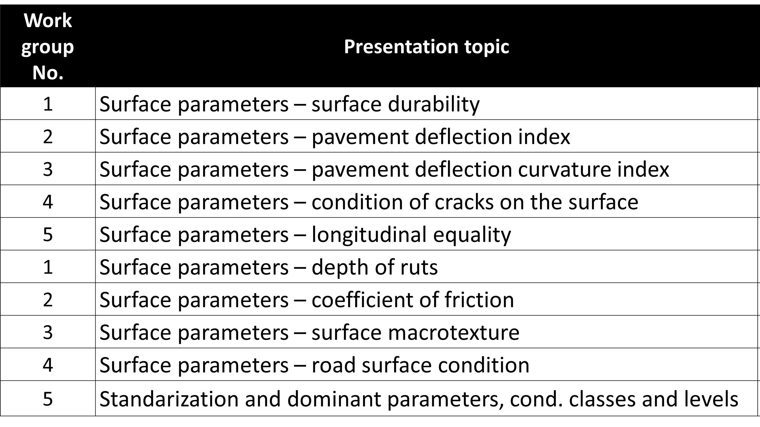
Homework details
Topics and work groups – plan for further 10 classes:

Slide 23
Homework details
Presentations about pavement parameters:
What is the phisical meaning of the parameter?
What is the unit of the parameter?
What are the limit and acceptable values of the parameter?
How to measure this parameter?
What equipment is needed for measurements?
How does this equipment work?
How to evaluate and analyze measurement results?

Slide 24
Homework details
Presentation about stand., classes and levels:
How to standardize?
How to determine state classes?
How to determine status levels?
How do standardized values relate to grades and state levels?
What are the limit values?
How to determine dominant parameters?
How to associate dominant parameters with classes and state levels?

Slide 25
Homework details
Also remember about:
Provide the literature sources you use...
Explore the topic before you start developing your presentation...
A simple, clear and understandable presentation of the topic to other people...
The knowledge you will pass on will be the basis for further considerations about maintaining the surface (in-depth, comprehensive study of the problem)...

Slide 26
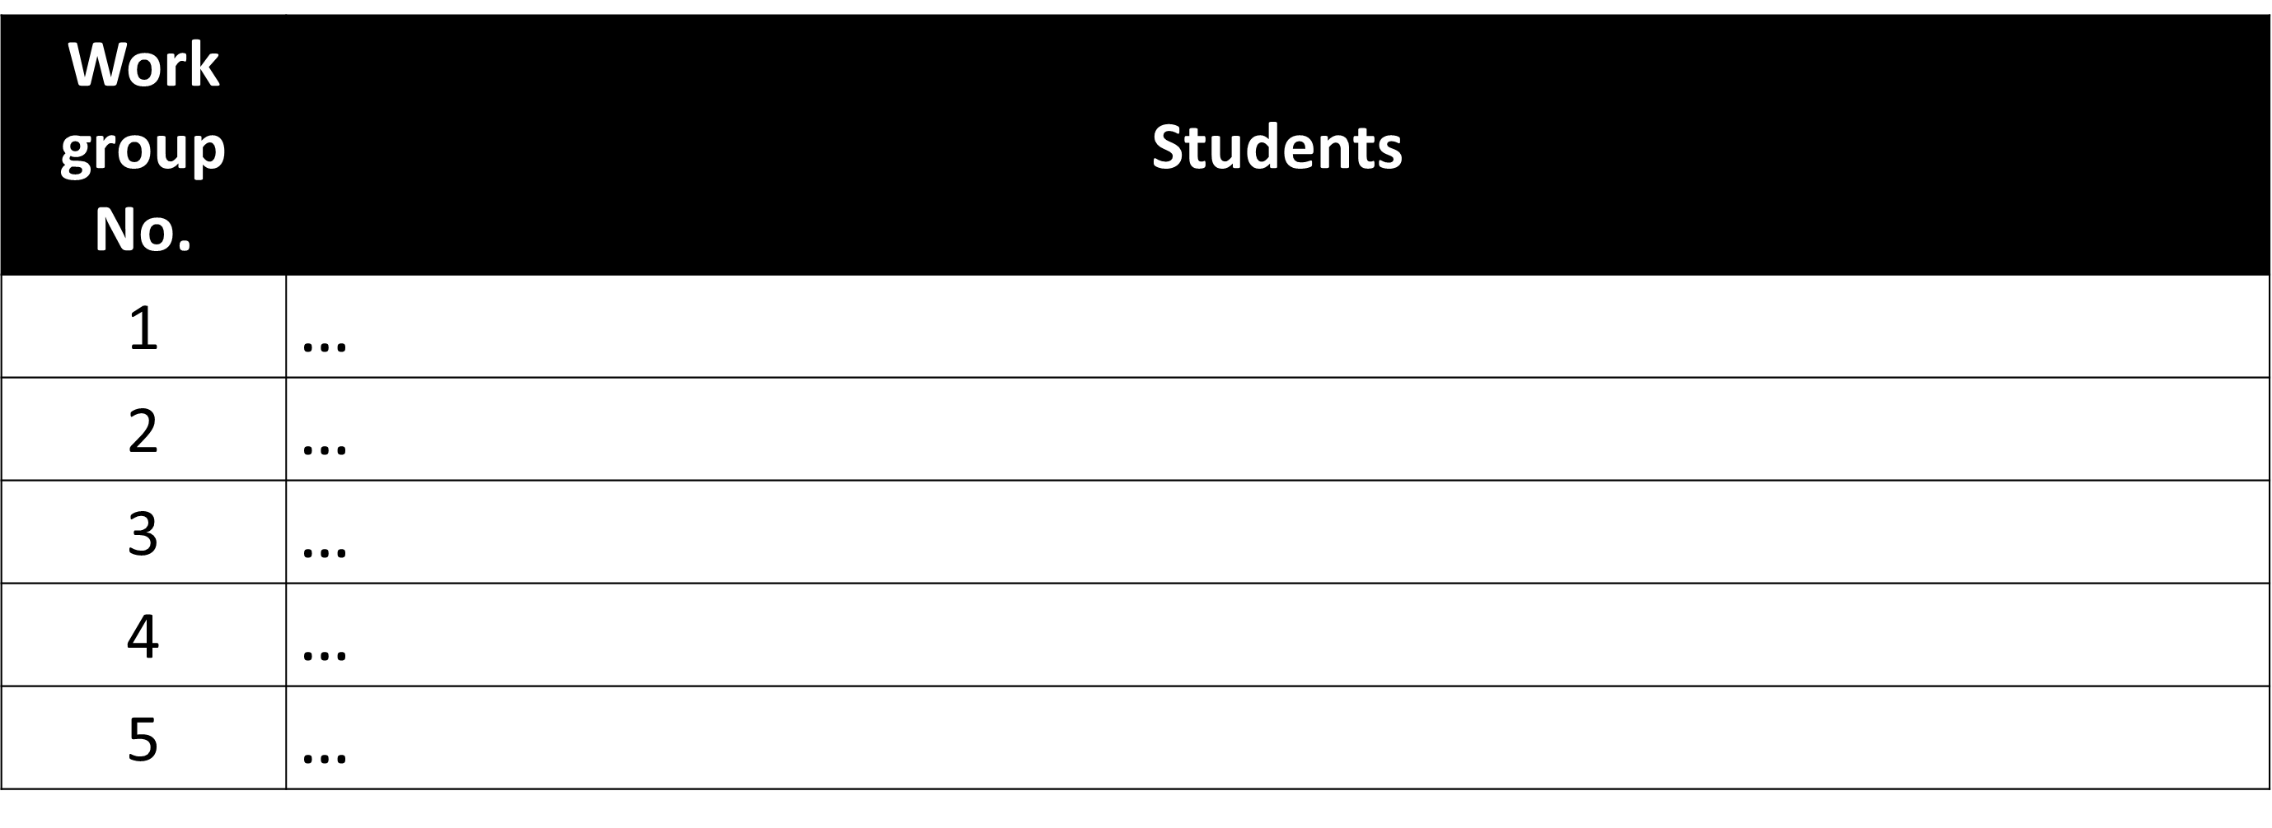
Homework details
Divison into working groups:

