Slide 1
Course C.03.06.02
Maintenance – Introduction
Marek Pszczola
(presentation was prepared on the basis of lectures of dr Majlun, Poland)

Slide 2
Road Transportation Systems Engineering Development in the Sub-Saharan Africa – Modern EU Master Programme & Capacity Building

Slide 4

MAINTENANCE OF ROAD ASPHALT PAVEMENT
Chapter No. 1.
Introduction
to the course

Slide 5


Lecture plan
1
„Pavement maintenance” – what does it mean?
2
What will we learn about in our classes?
3
How will we learn in our classes?
4
Plan of the course.
5
Discussion.
6
Next topic.

Slide 6
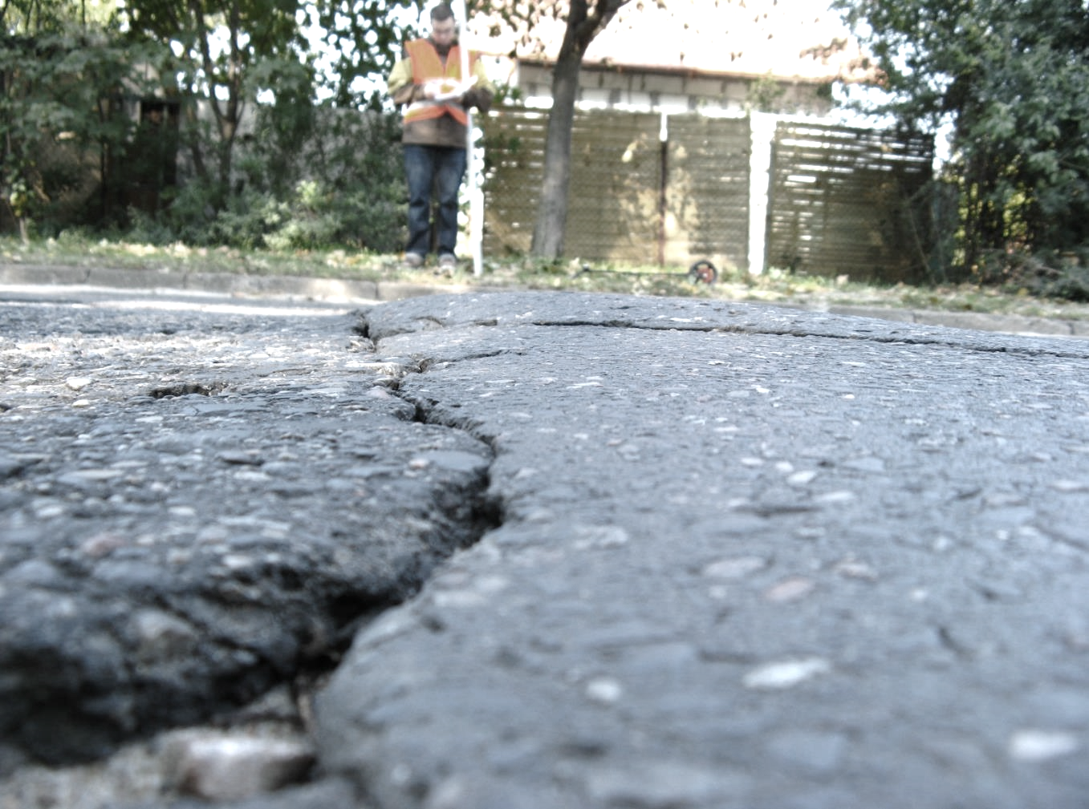
„Pavement mainetenance”
– what does it mean?

Slide 7
Fundamental questions
Why will we learn about pavement maintenance?
Why is maintenance of the pavements
so important?
Why will we only learn about only
asphalt pavements?

Slide 8
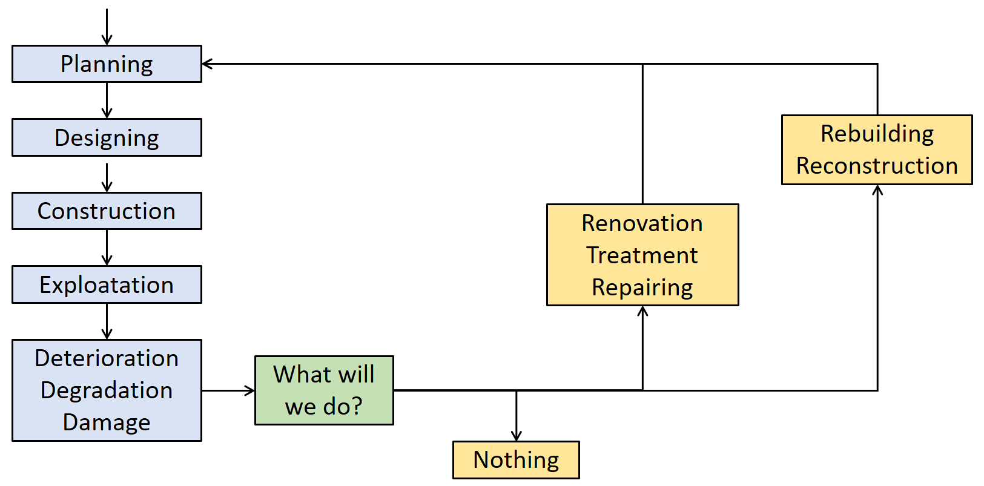
Pavement life cycle

Slide 9
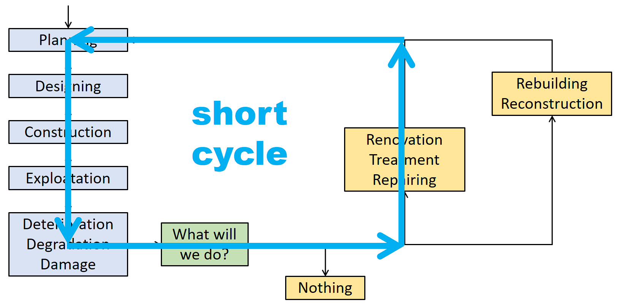
Pavement life cycle

Slide 10
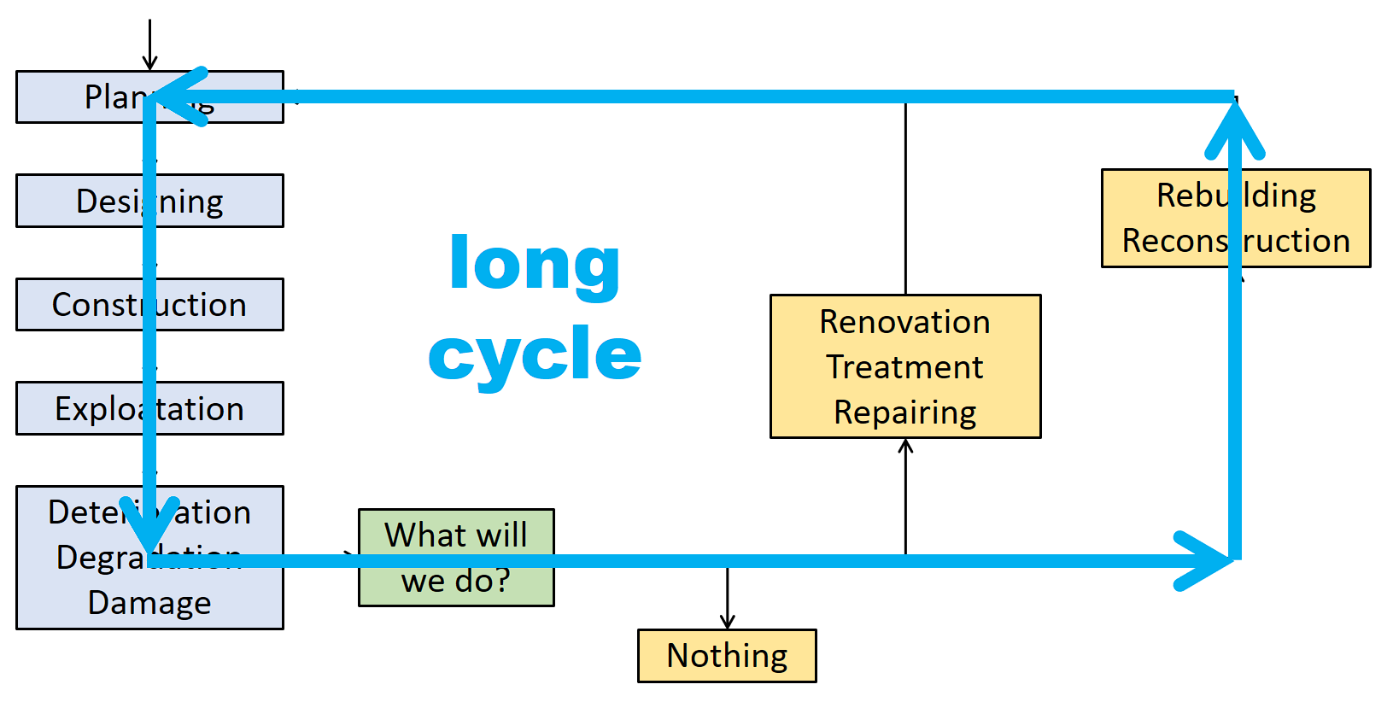
Pavement life cycle

Slide 11
What will we learn about in our classes?

Slide 12
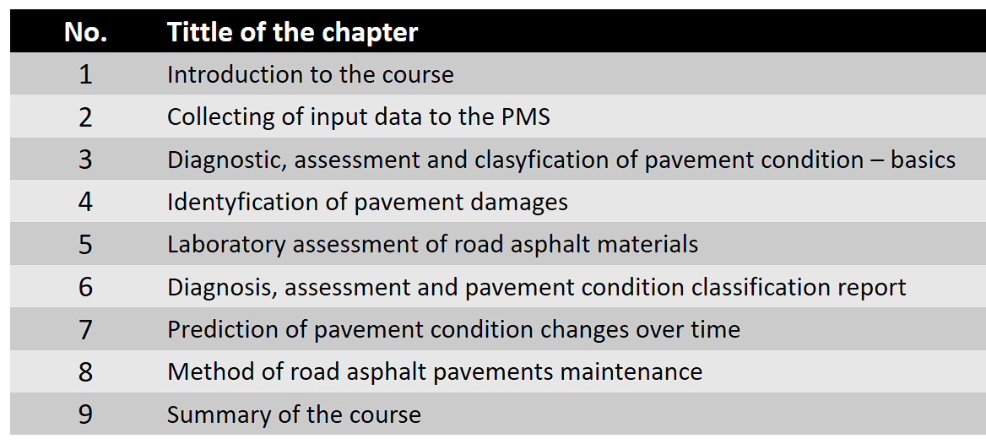
Chapters of our course…

Slide 13
Chapter No. 1 – short look
Introduction to the course
Types of road pavement structures
Asphalt pavements and asphalt materials
Pavement Management System

Slide 14
Chapter No. 2 – short look
Collecting of input data to the PMS
Needed (necessary) data
Additional data

Slide 15
Chapter No. 3 – short look
Diagnostic, assessment and classification of pavement condition
Diagnostic methods
Diagnostic devices
Diagnostic parameters
Methods of pavement condition assessment
Methods of pavement condition classification

Slide 16
Chapter No. 4 – short look
Identification of pavement damages
Types of road asphalt pavement damages
Identification of pavement damages
Characterization of pavement damages
Classification of pavement damages

Slide 17
Chapter No. 5 – short look
Laboratory assessment of asphalt road materials
Taking samples from the pavement
Laboratory tests for asphalt road materials
Standards and requirements for lab-tests
Assessment of asphalt road materials

Slide 18
Chapter No. 6 – short look
Diagnosis, assessment and pavement condition classification report
Practical and field works on road diagnosis
Analytical works on road condition assessment
Preparing of students’ reports about pavement condition classification

Slide 19
Chapter No. 7 – short look
Prediction of pavement condition changes over time
Prediction methods and models
Predictive confidence and usefulness of prediction

Slide 20
Chapter No. 8 – short look
Maintenance of road asphalt pavement
Treatment methods of asphalt road pavements
Maintenance methods of asphalt pavements
Summer maintenance of asphalt road pavements
Winter maintenance of asphalt road pavements

Slide 21
Chapter No. 9 – short look
Summary of the course

Slide 22
What will we do in our classes?
Selection of the road section for further work
Collecting data about selected road
Field work on pavement condition and damages
Identyfication of pavement damages
Assessment and classyfiction of pavement condition
Prediction of pavement condition changes over time
Maintenance works plan

