Slide 1
Course C.03.06.02
Maintenance – Exercises
Marek Pszczola
(presentation was prepared on the basis of materials of dr Majlun, Poland)

Slide 2
Road Transportation Systems Engineering Development in the Sub-Saharan Africa – Modern EU Master Programme & Capacity Building

Slide 4
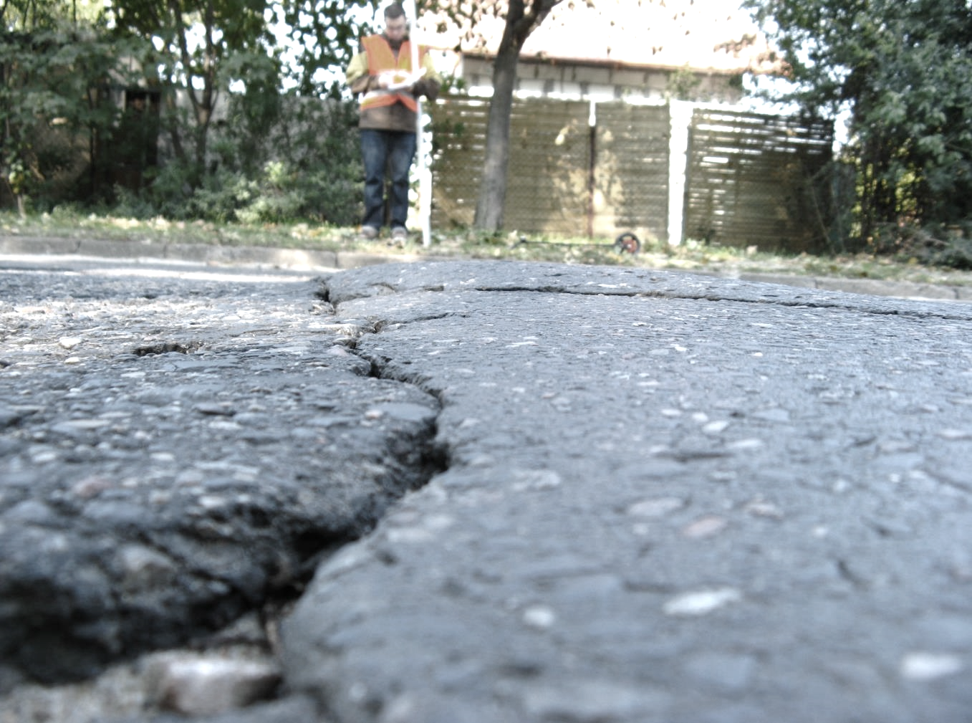
The task

Slide 5
The task is...
Recognise (name) the type of damage visible in the photo.
Each student, in turn, names the visible damage (one by one).

Slide 6
Exercise in damage recognition

Slide 7
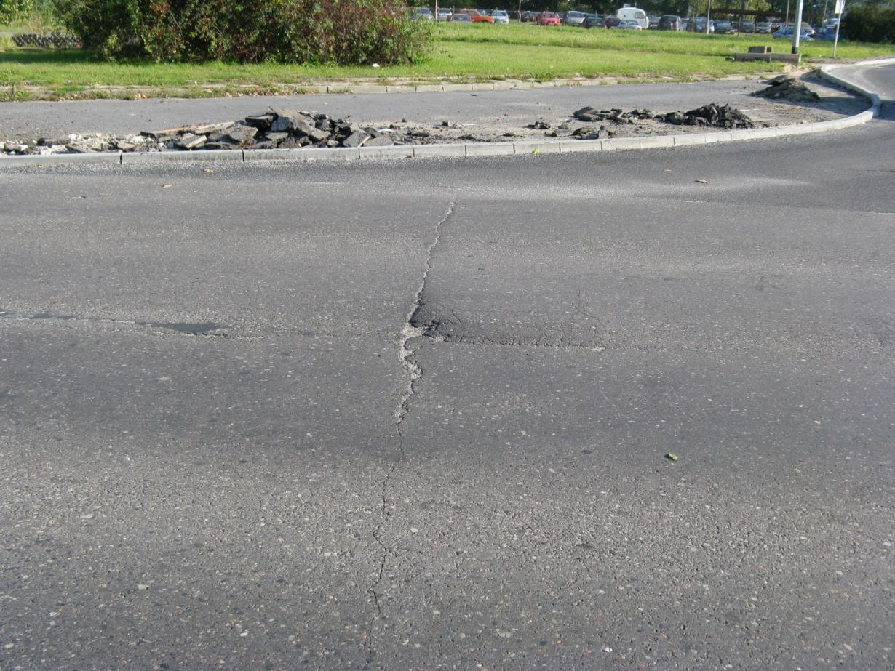
Exercise – damege No. 1

Slide 8
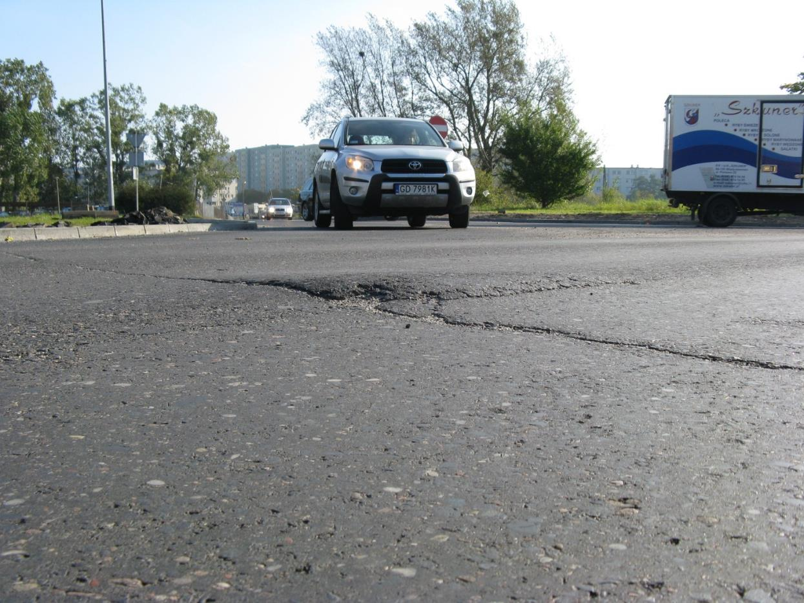
Exercise – damege No. 2

Slide 9
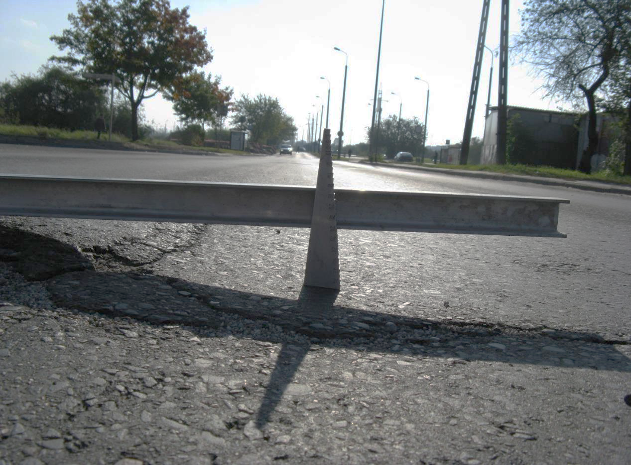
Exercise – damege No. 3

Slide 10
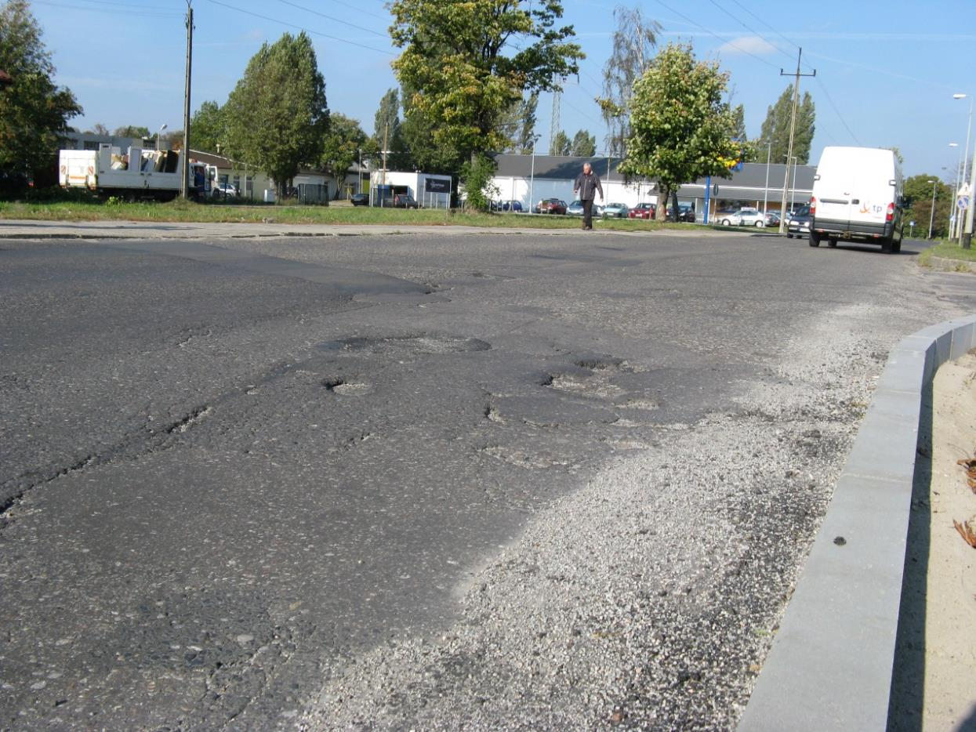
Exercise – damege No. 4

Slide 11
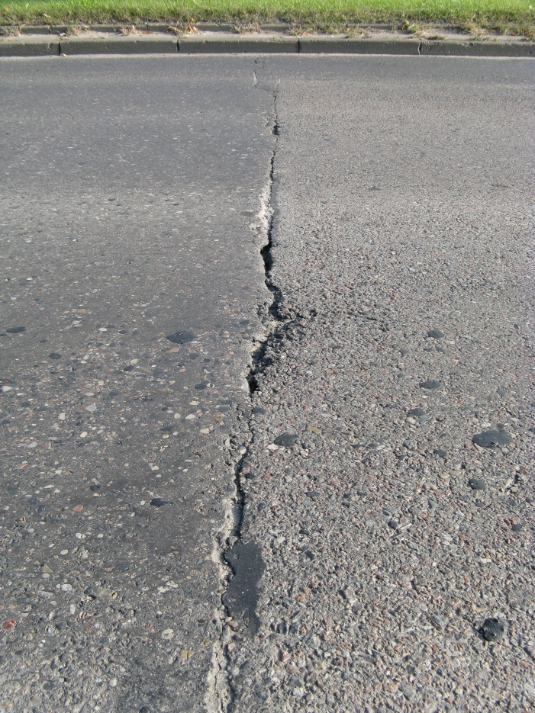
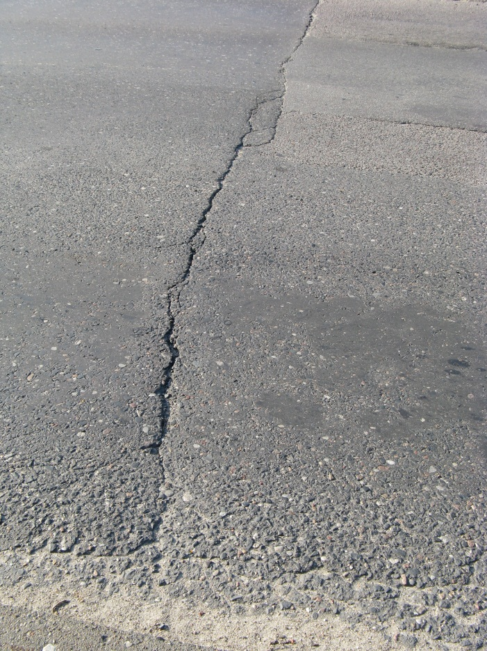
Exercise – damege No. 5

Slide 12
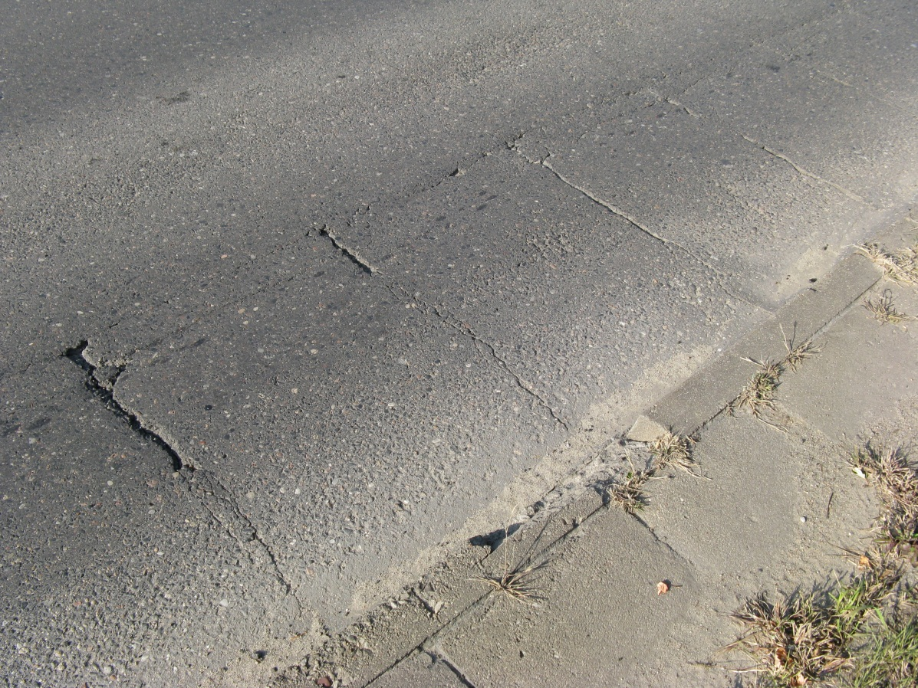
Exercise – damege No. 6

Slide 13
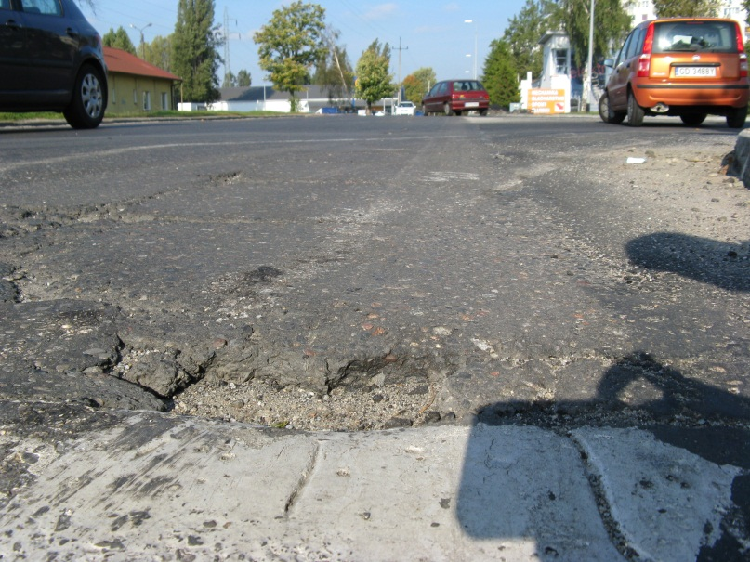
Exercise – damege No. 7

Slide 14
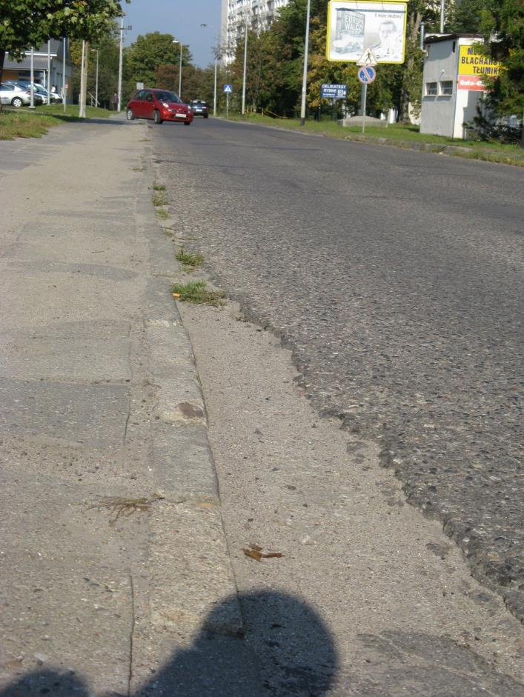
Exercise – damege No. 8

Slide 15
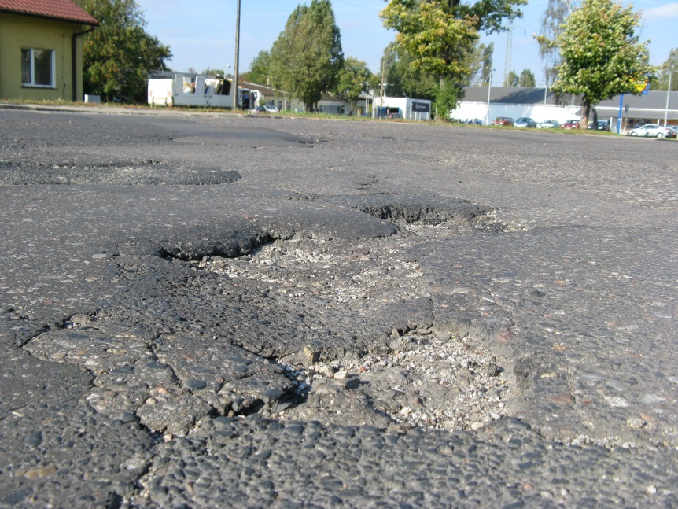
Exercise – damege No. 9

Slide 16
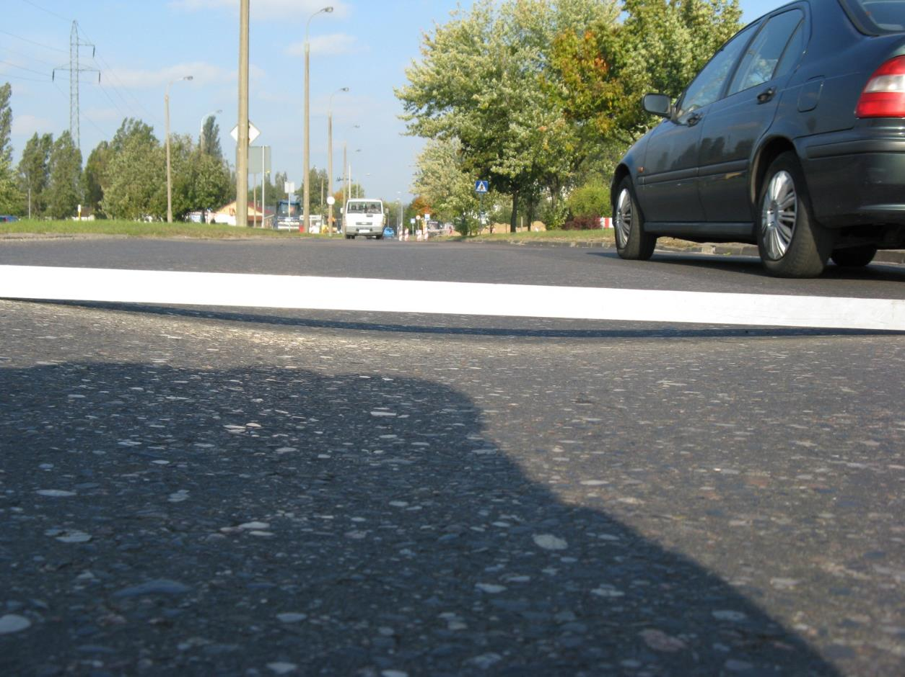
Exercise – damege No. 10

Slide 17
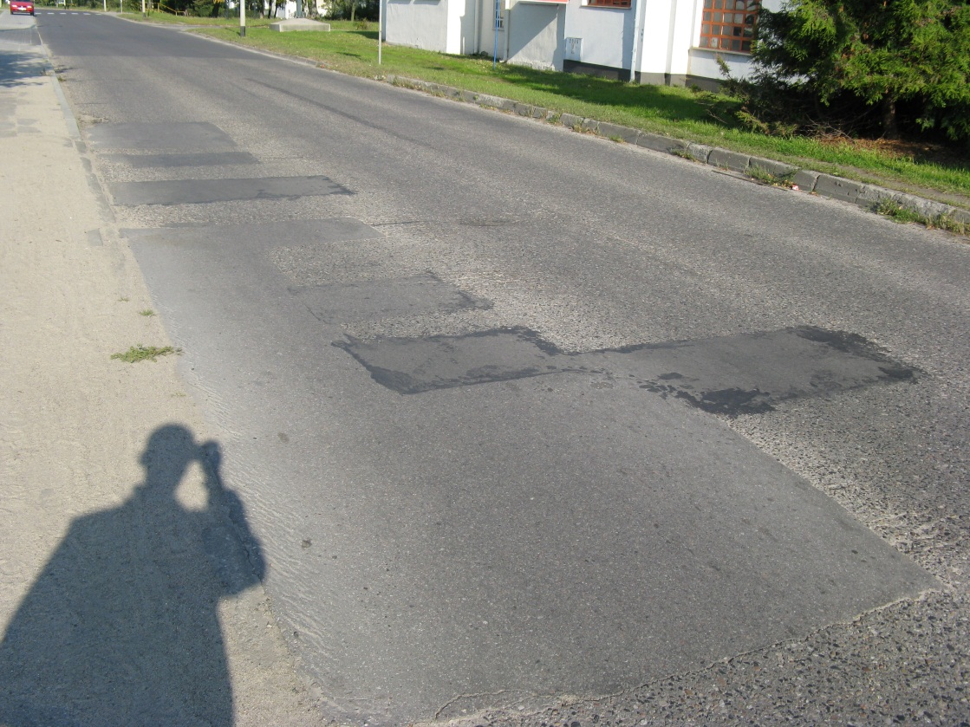
Exercise – damege No. 11

Slide 18
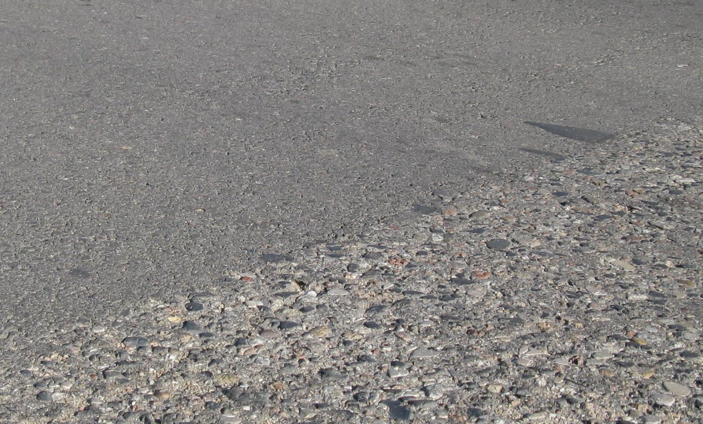
Exercise – damege No. 12

Slide 19
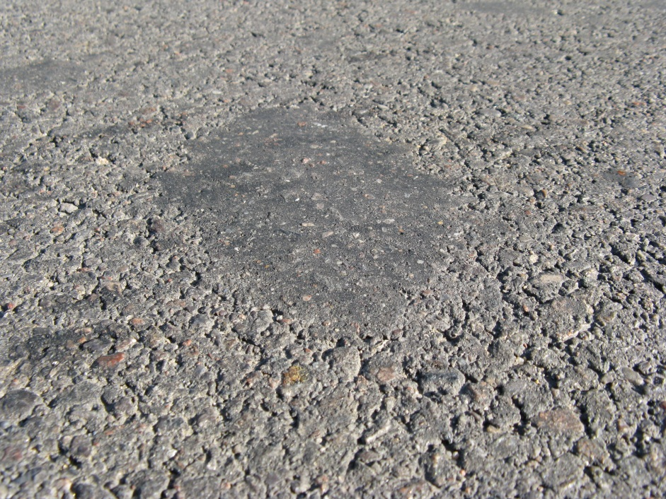
Exercise – damege No. 13

Slide 20
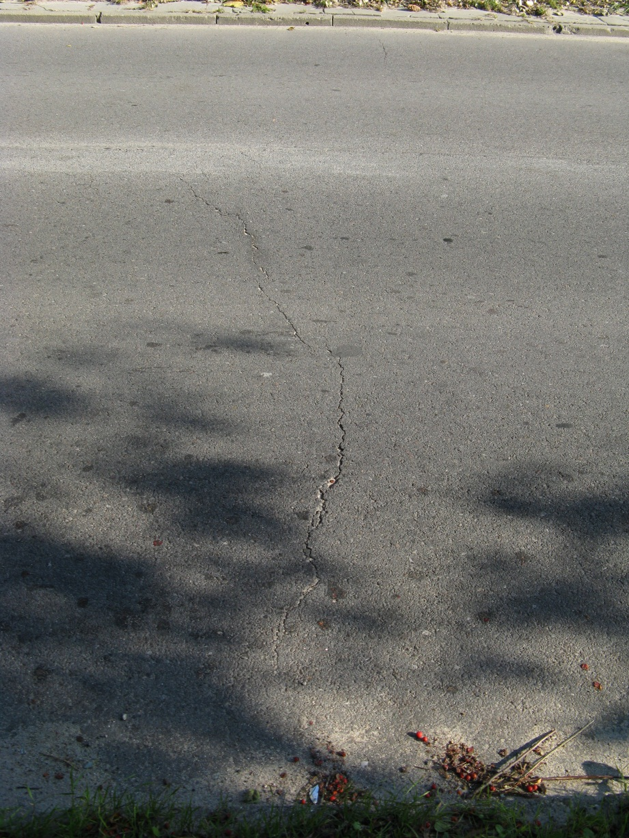
Exercise – damege No. 14

Slide 21
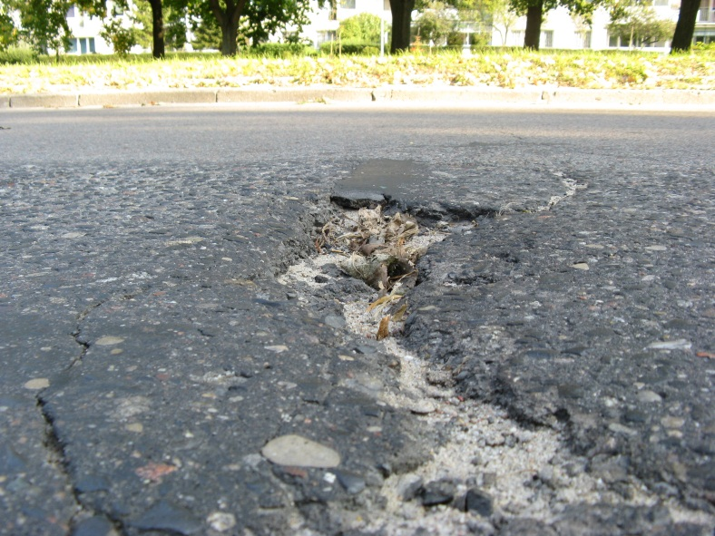
Exercise – damege No. 15

Slide 22
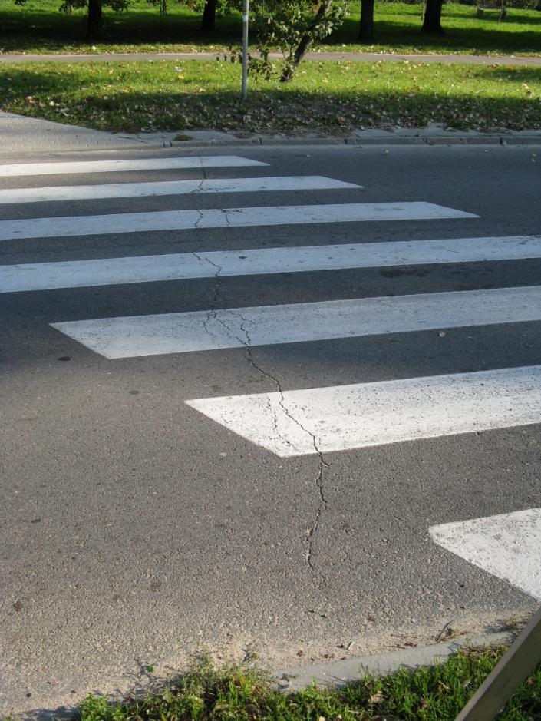
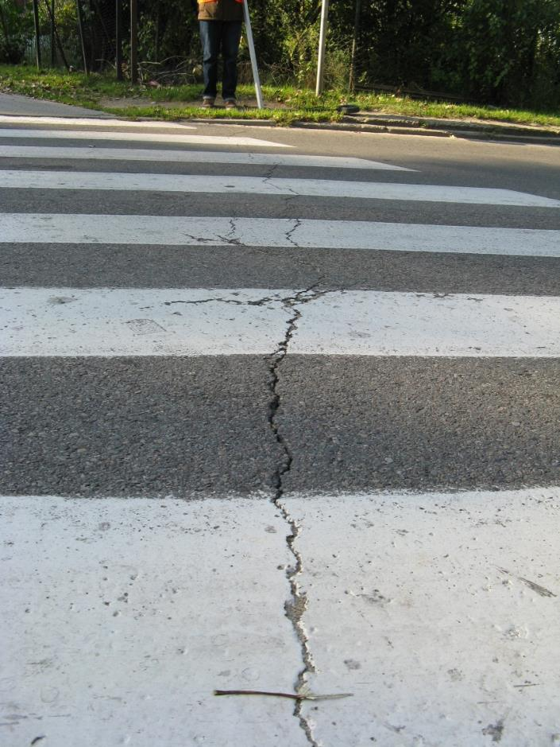
Exercise – damege No. 16

Slide 23
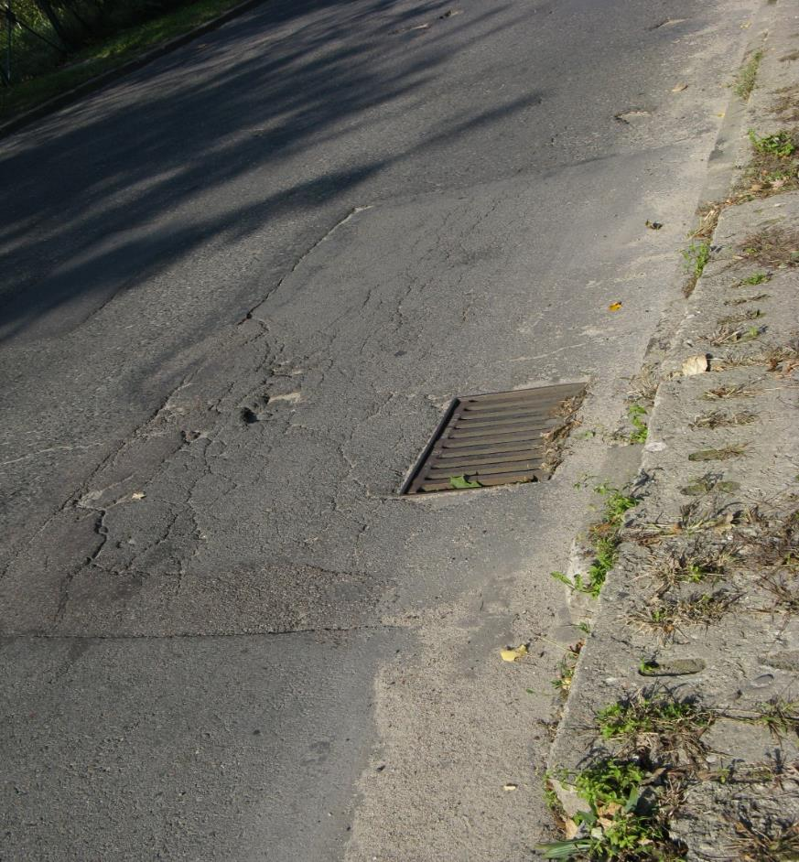
Exercise – damege No. 17

Slide 24
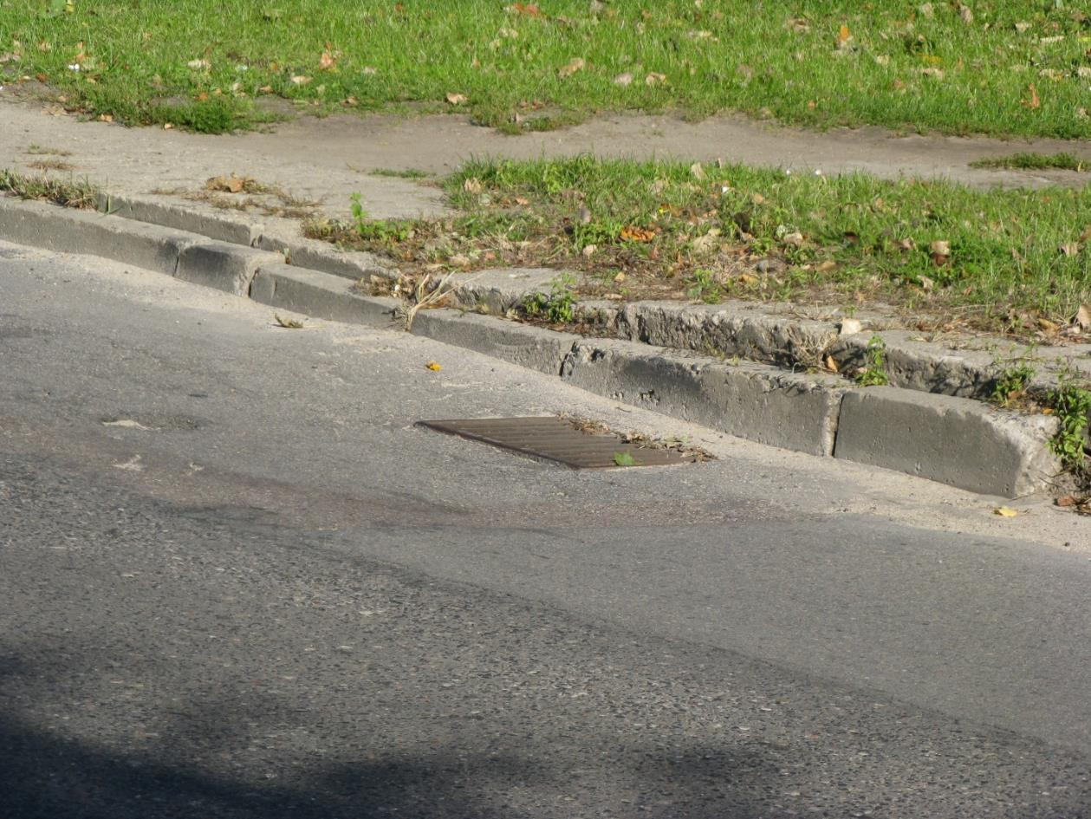
Exercise – damege No. 18

Slide 25
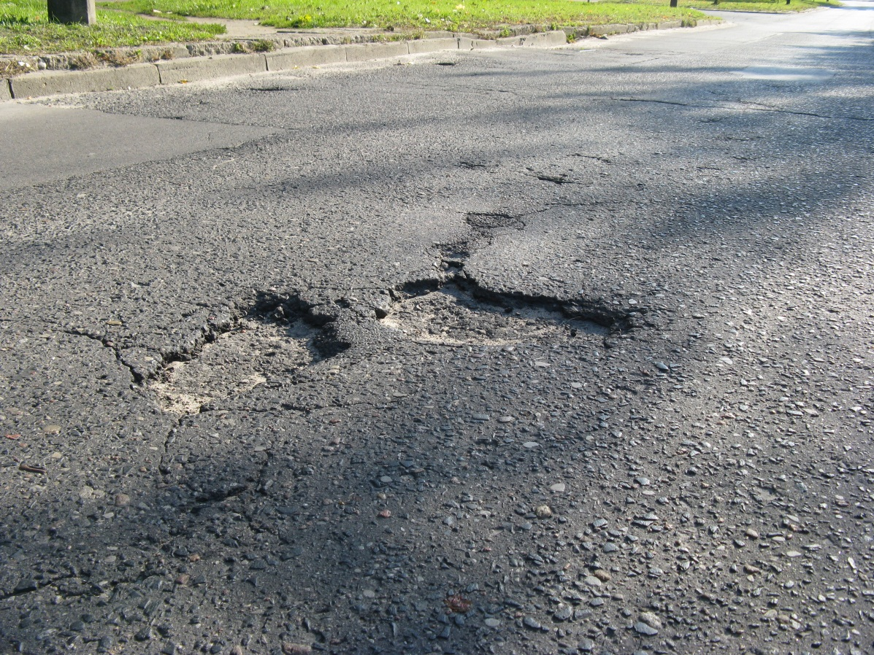
Exercise – damege No. 19

Slide 26
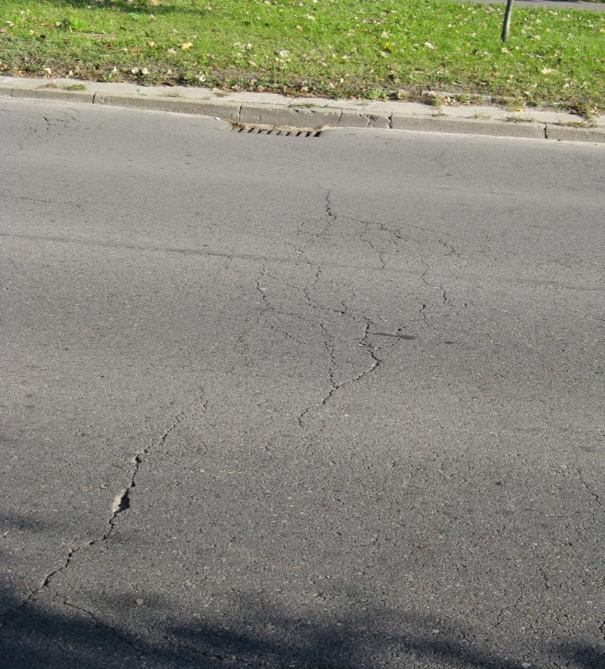
Exercise – damege No. 20

Slide 27
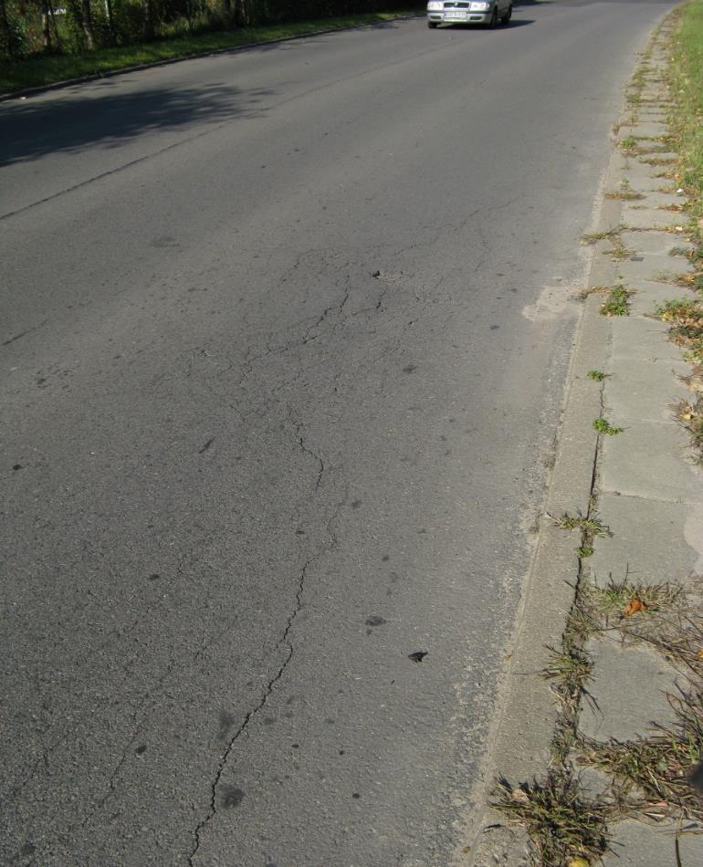
Exercise – damege No. 21

Slide 28
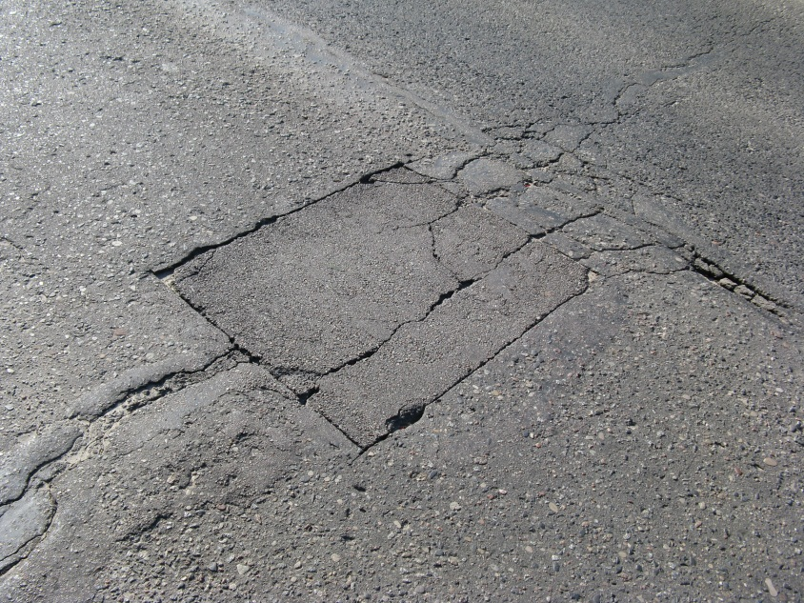
Exercise – damege No. 22

Slide 29
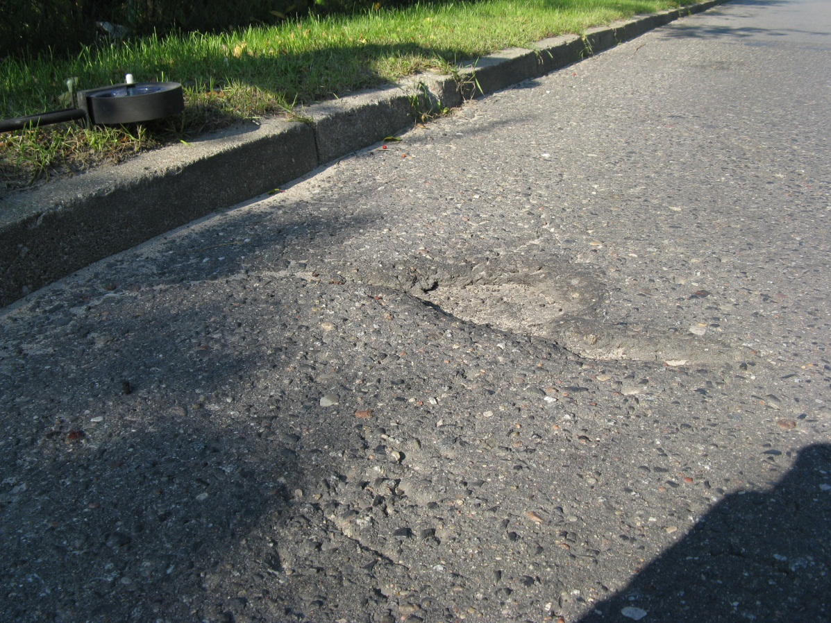
Exercise – damege No. 23

Slide 30
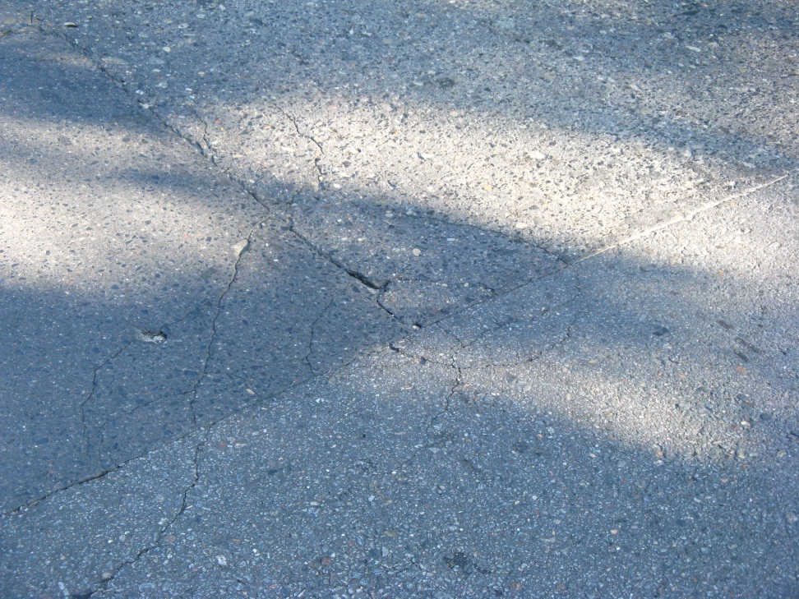
Exercise – damege No. 24

Slide 31
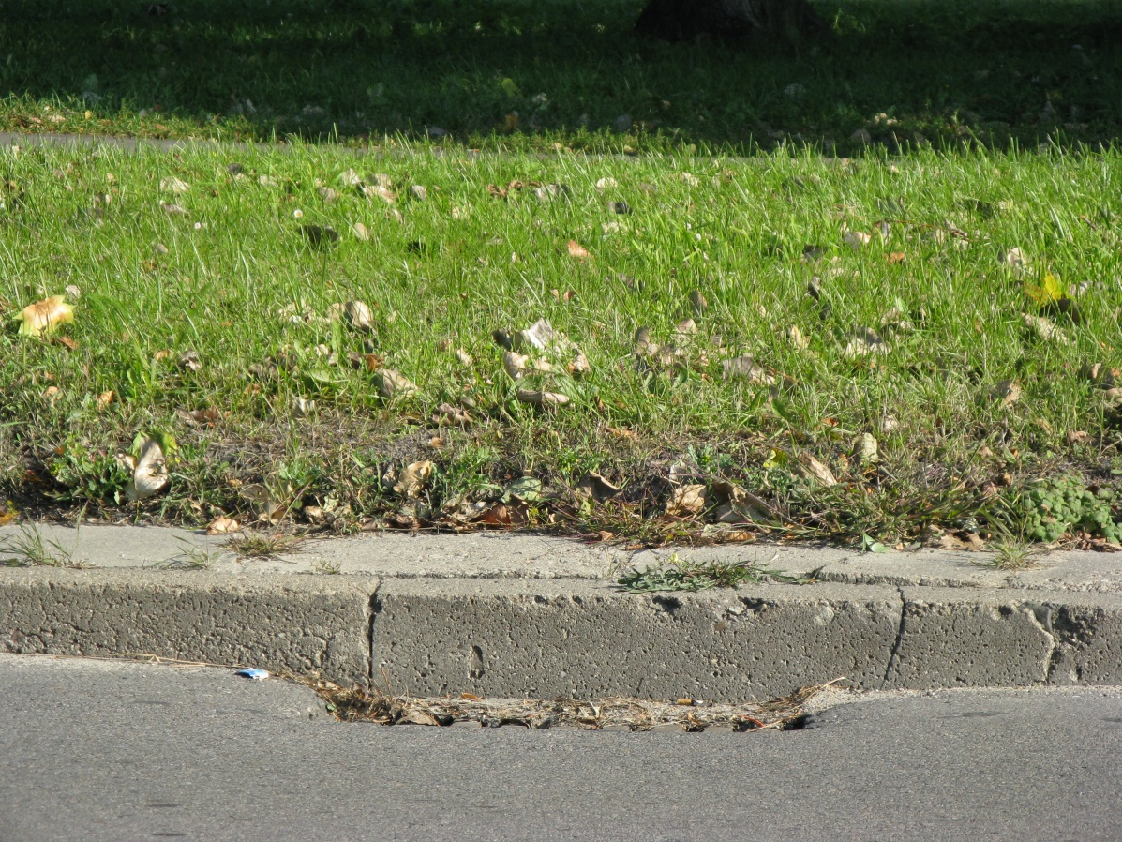
Exercise – damege No. 25

Slide 32
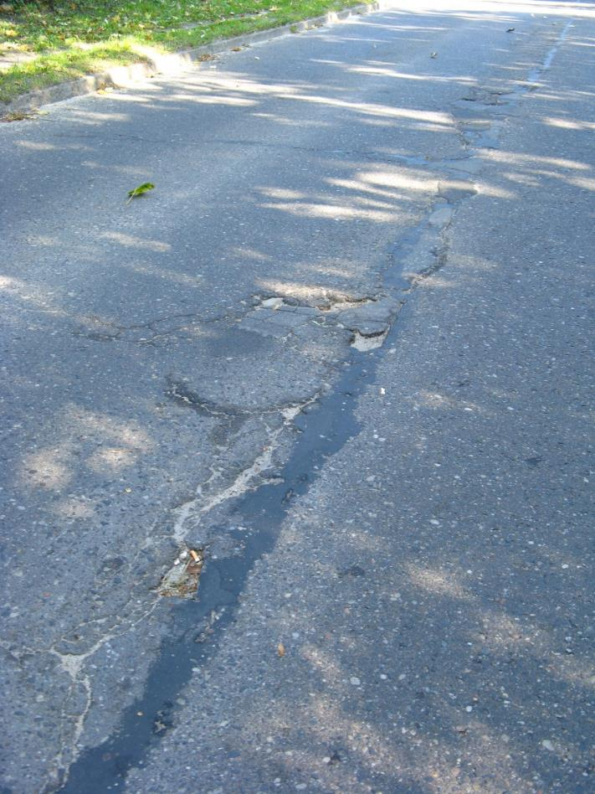
Exercise – damege No. 26

Slide 33
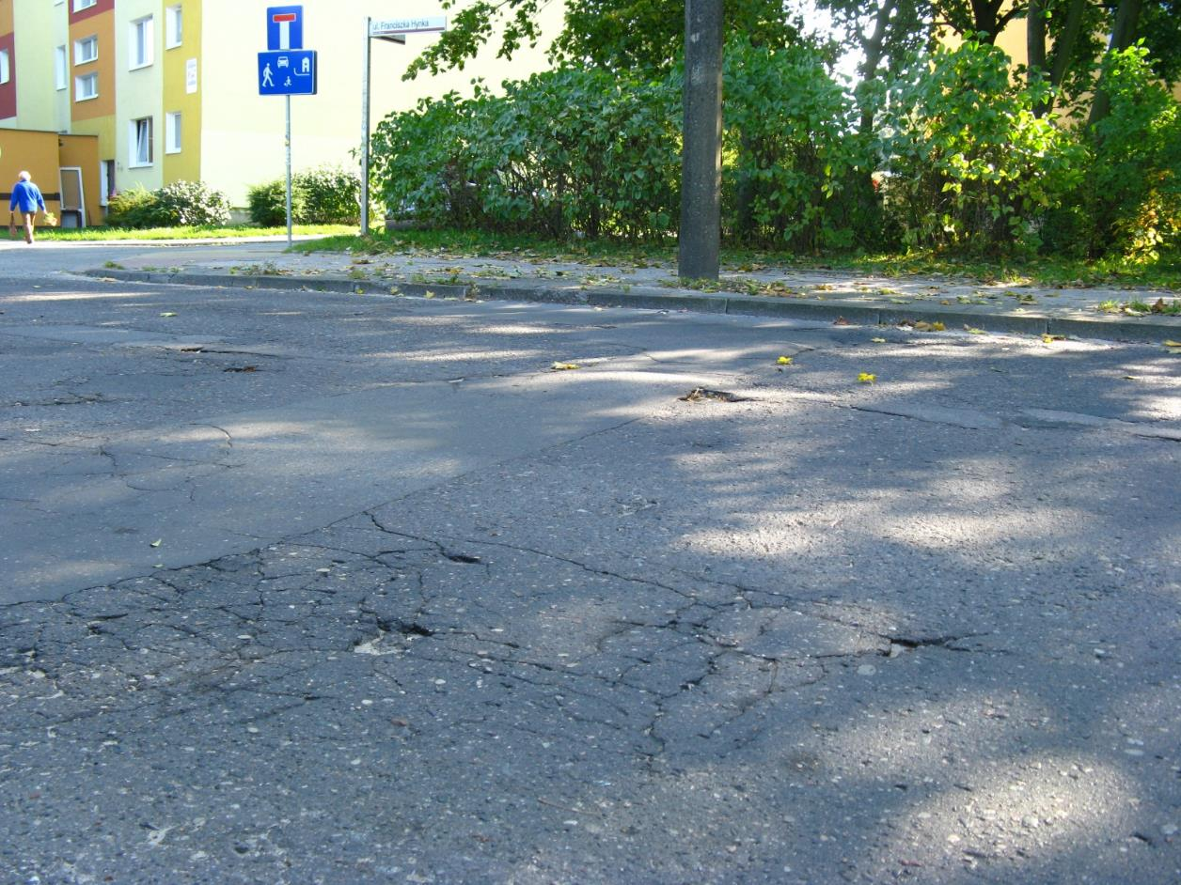
Exercise – damege No. 27

Slide 34
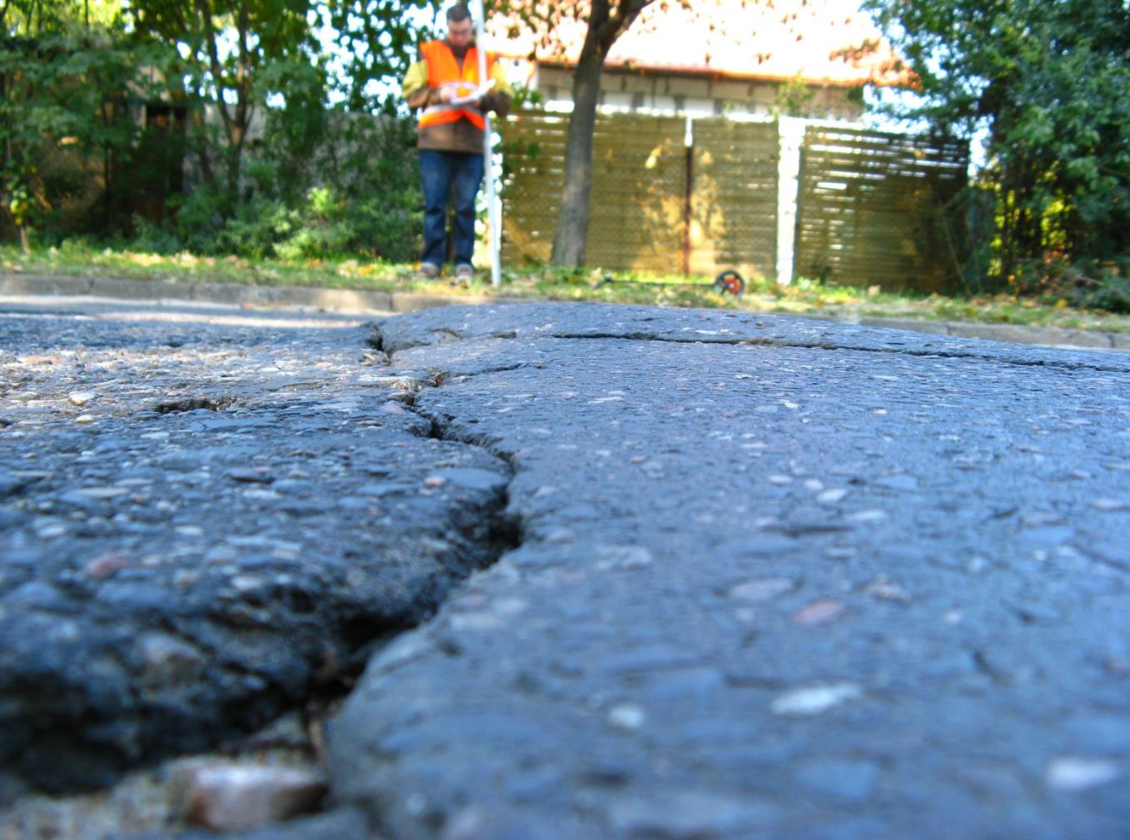
Exercise – damege No. 28

Slide 35
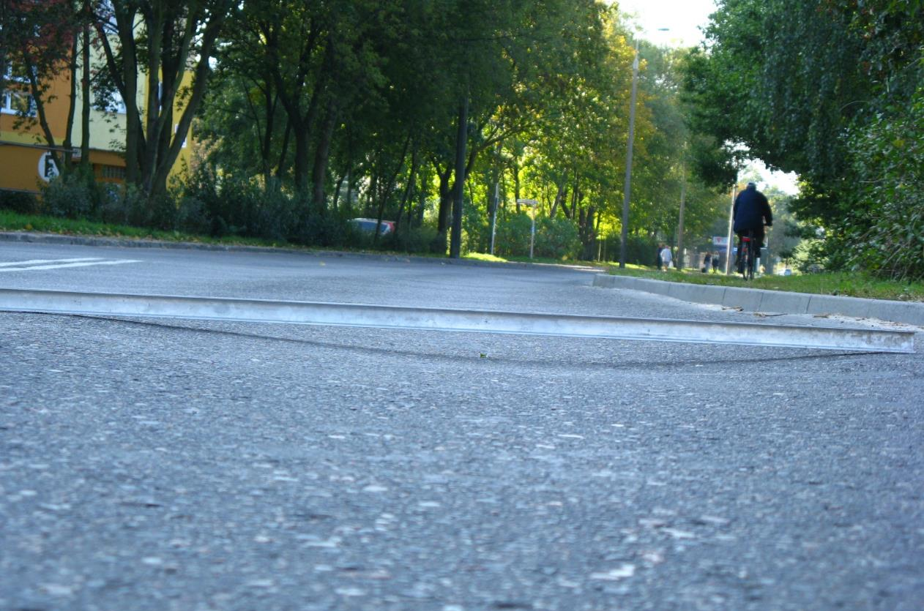
Exercise – damege No. 29

Slide 36
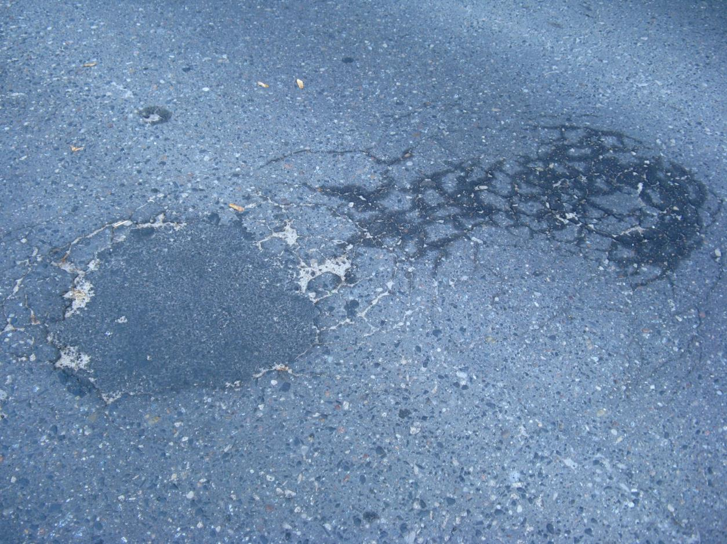
Exercise – damege No. 30

