Slide 1
Supplier Selection
Daniel Kaszubowski

Slide 2
Road Transportation Systems Engineering Development in the Sub-Saharan Africa – Modern EU Master Programme & Capacity Building

Slide 4
Learning Objectives
Identify the four critical supplier selection criteria (quality, cost, delivery, capability)
Calculate Total Cost of Ownership (TCO) beyond purchase price
Design supplier evaluation and rating systems
Compare single vs. multiple sourcing strategies and their trade-offs
Develop supplier partnership models for mutual value creation
Plan supplier development programs to improve performance

Slide 5
Section 1
The Four Pillars of Supplier Selection

Slide 6
Dimension 1: Quality
Definition: The supplier's ability to consistently deliver products or services that meet or exceed specifications
and customer expectations.
Quality Metrics to Evaluate:
Defect Rate: Percentage of goods received that don't meet specifications (target: <1%)
On-Spec Delivery: Percentage of shipments that meet all quality requirements first time
Quality Certifications: ISO 9001, ISO 14001, industry-specific certifications (medical devices, automotive, food safety)
Testing & Inspection: Does supplier have in-house testing capability? Third-party verification?
Quality History: Track record with previous customers and references
Continuous Improvement: Does supplier actively invest in quality improvement programs?

Slide 7
Cost of Poor Quality
Low-quality suppliers create hidden costs: rework, scrap, warranty claims, customer returns, brand damage, operational disruptions. A supplier with 5% defect rate might appear cheaper but costs significantly more in total cost of ownership.

Slide 8
Dimension 2: Cost
Definition: The supplier's pricing, payment terms, and cost structure relative to market rates and your budget..
Quality Metrics to Evaluate:
Unit Price: Price per unit or hour (but NOT the only cost factor)
Volume Discounts: Does supplier offer tiered pricing for larger orders?
Payment Terms: Net 30? Net 60? Early payment discounts? (affects cash flow)
Minimum Order Quantities: Does supplier require large minimums? (affects inventory carrying costs)
Lead Times: Shorter lead times reduce inventory carrying costs
Total Cost of Ownership: Price + quality + delivery + service (covered in detail in Section 2)
Key Insight:
The cheapest supplier
is rarely the best choice. A supplier 10% cheaper but with 5% defect rate, poor delivery, and high service costs will cost you significantly more overall.

Slide 9
Dimension 3: Delivery
Definition: The supplier's ability to deliver goods or services on time, in the right quantity, to the right location.
Delivery Performance Metrics:
On-Time Delivery Rate: Percentage of shipments arriving on the promised date (target: >95%)
Order Accuracy: Percentage of orders containing correct items
in correct quantities
Lead Time Consistency: Does supplier always deliver
in promised timeframe, or are delays common?
Flexibility: Can supplier accommodate emergency orders or expedited delivery?
Location: Is supplier geographically positioned for efficient delivery to your sites?
Distribution Network: Does supplier have reliable logistics partners and warehousing?
Key Insight:
Late deliveries cause production stoppages, stockouts, missed customer orders, and revenue loss. A supplier with poor delivery reliability can cripple your operations regardless of low price.

Slide 10
Dimension 4: Capability
Definition: The supplier's technical, financial, and organizational capacity to meet your needs now and in the future.
Capability Assessment:
Technical Capability: Can supplier handle your product complexity?
Does it have required technology and expertise?
Financial Stability: Is supplier financially healthy? Risk of bankruptcy or abandonment?
Capacity: Can supplier scale production to meet your growth?
Or are they at maximum capacity?
Scalability: If you grow 50%, can supplier grow with you?
Innovation: Does supplier invest in R&D and new capabilities? Or static?
Management Quality: Does supplier have experienced, professional management?
Industry Experience: Has supplier worked with companies like yours before?

Slide 11
Real-World Example: The Startup Trap
A manufacturing company selects a startup supplier offering 30% lower prices. Initially, all goes well.
But when the company grows 50% and needs to increase orders, the startup supplier cannot scale.
It doesn't have capital to invest in additional equipment
or staff. The company is stuck: contractually committed but supplier cannot deliver. Results: production delays, customer dissatisfaction, revenue impact.
Lesson:
Supplier capability to grow with you is as important
as current price.

Slide 12
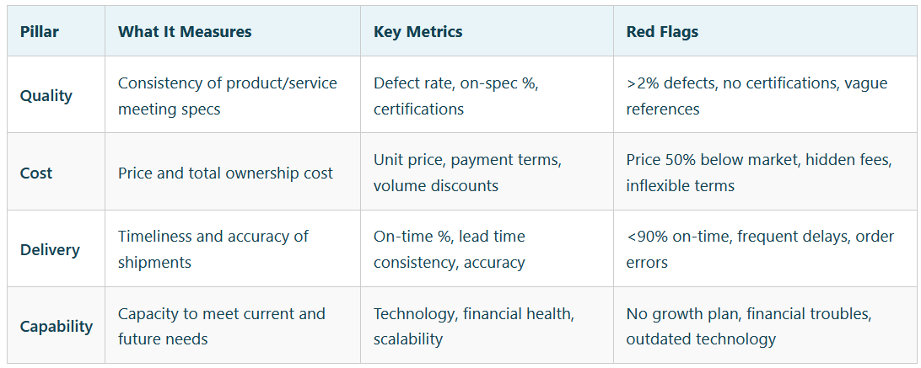
The Four-Pillar Supplier Profile

Slide 13
Section 2
Total Cost of Ownership (TCO)

Slide 14
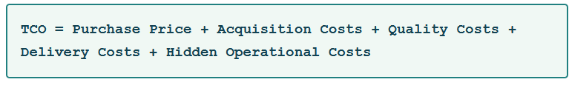
Beyond Purchase Price:
What's Hidden?
One of the most common procurement mistakes is selecting suppliers based solely on purchase price. In reality, the purchase price is often only 30-40% of the total cost.
The true cost includes many hidden factors.

Slide 15

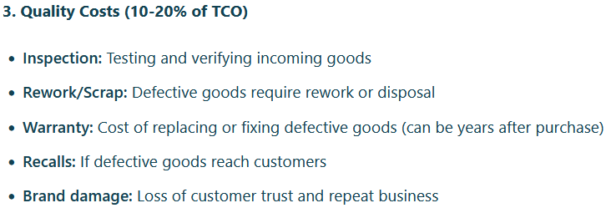
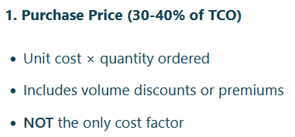
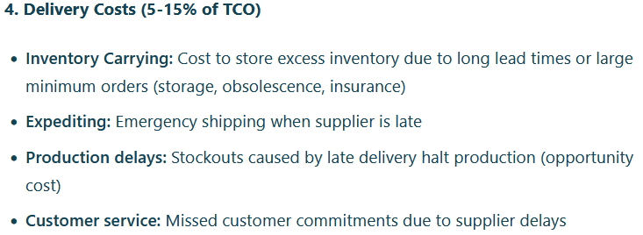
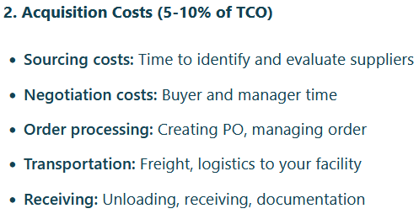
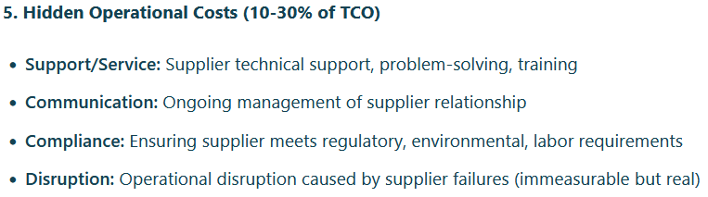

Slide 16
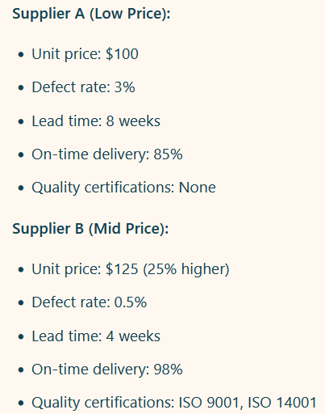
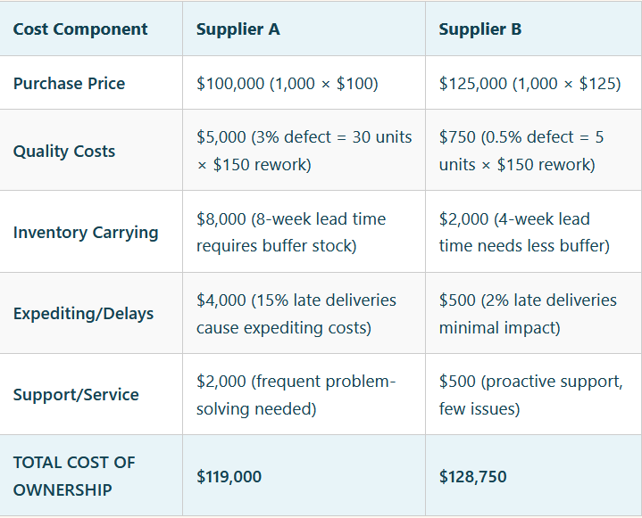
TCO Calculation Example

Slide 17
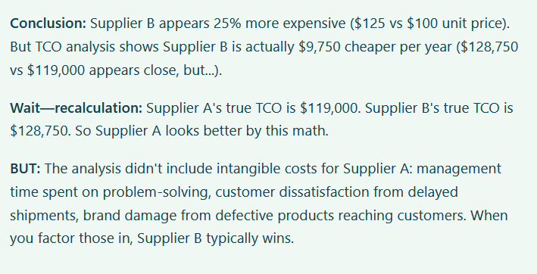
TCO Calculation Example

Slide 18
Section 3
Supplier Evaluation and Rating Systems

Slide 19
Why Supplier Evaluation Matters
Accountability: Suppliers know you're monitoring performance and will take it seriously
Early Warning: Detect performance decline early before it becomes a crisis
Continuous Improvement: Identify specific areas where suppliers can improve
Renewal Decisions: Data-driven decisions on contract renewal, renewal at same price, or termination
Benchmarking: Compare supplier performance against industry standards and competitors

Slide 20
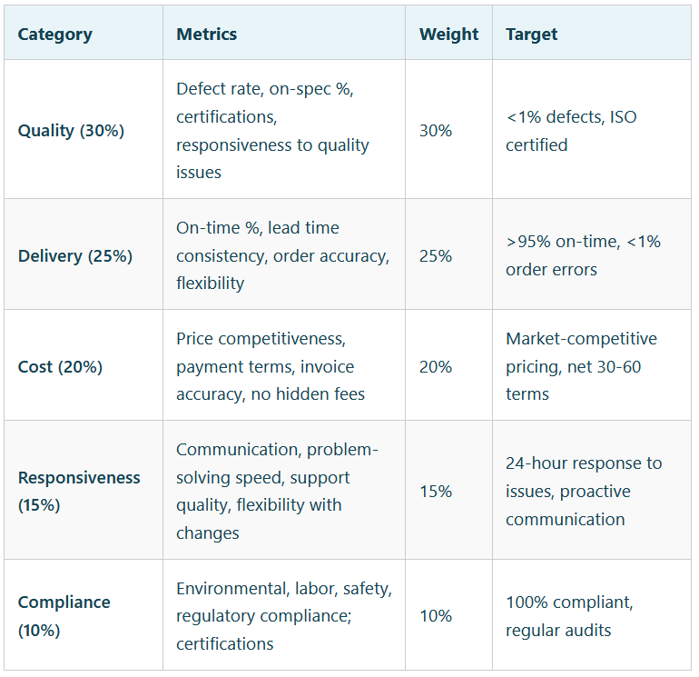
Balanced Scorecard Approach
Rather than rating suppliers on a single metric (price), use a balanced scorecard covering multiple dimensions

Slide 21
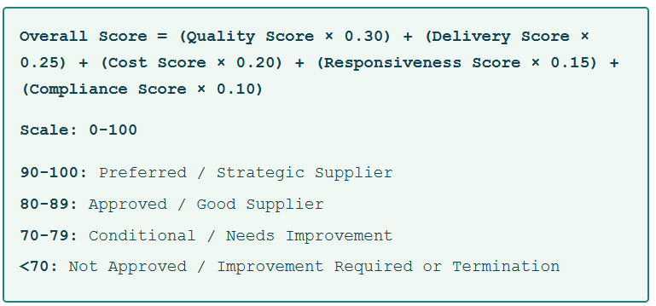
Supplier Rating Calculation

Slide 22
Section 4
Single Sourcing vs. Multiple Sourcing

Slide 23
Strategy 1: Single Sourcing
Definition: Relying on one supplier for a particular material or service.
Advantages of Single Sourcing:
Maximum Volume/Leverage: All volume goes to one supplier → highest volume discounts and negotiating power
Lower Management Cost: Manage one relationship instead of multiple (less communication, coordination, administration)
Better Quality Control: Easier to build deep quality relationship and implement improvements with one partner
Cost Stability: Stable pricing (vs. playing suppliers against each other)
Supplier Commitment: Supplier invests more in your account if they're confident of your full business
Integrated Supply Chain: Can implement just-in-time (JIT) logistics and real-time integration

Slide 24
Strategy 1: Single Sourcing
Disadvantages of Single Sourcing:
Total Dependency: If supplier fails, you have no backup. Production could stop completely.
Reduced Competition: Supplier has no competition; less incentive to innovate or improve
Limited Negotiating Power: Once committed, supplier knows you're locked in (can raise prices over time)
Capacity Risk: If supplier reaches capacity, you may not be able to grow
Innovation Risk: Without competitive pressure, supplier may not invest in R&D

Slide 25
Strategy 2: Multiple Sourcing
Definition: Sourcing from two or more suppliers for the same material or service.
Advantages of Multiple Sourcing:
Risk Mitigation: If one supplier fails, you have backup suppliers (business continuity)
Competitive Pressure: Suppliers compete on price, quality, service (you benefit)
Innovation Drive: Competitive pressure encourages suppliers to innovate
Flexibility: Can switch suppliers if one underperforms or becomes unavailable
Capacity Redundancy: If you grow beyond one supplier's capacity, others can scale with you
Market Intelligence: Multiple suppliers provide competitive insights and pricing benchmarks

Slide 26
Strategy 2: Multiple Sourcing
Disadvantages of Multiple Sourcing:
Lower Volume Discounts: Each supplier gets smaller volume → less leverage for pricing
Higher Management Cost: Manage multiple relationships, contracts, quality systems, communication
Variability: Different suppliers may have different quality, delivery, specifications (harder to standardize)
Complex Supply Chain: More coordination required; harder to implement JIT
Supplier Commitment: Suppliers less committed since they know volume could shift to competitors

Slide 27
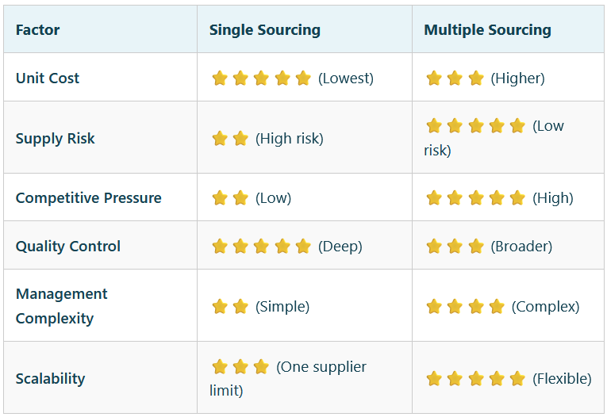
Comparison Matrix

