Slide 1
Introduction to Procurement
& Purchasing Management
Daniel Kaszubowski

Slide 2
Road Transportation Systems Engineering Development in the Sub-Saharan Africa – Modern EU Master Programme & Capacity Building

Slide 4
Learning Objectives
Understand procurement's role in value chain
and supply chain
Learn the procurement process from need identification to payment
Master supplier evaluation and selection criteria
Develop negotiation strategies for purchasing
Understand different purchasing models and strategies
Apply procurement principles to African business context

Slide 5
What is Procurement?
Definition: The process of acquiring goods and services from external suppliers.
Strategic function: NOT just buying cheap. It's about value (quality + price + reliability)
Scope: Raw materials, equipment, services, technology, anything the company needs
Goal: Get the right materials, from the right supplier,
at the right time, at the right price, with right quality
Impact: Directly affects company's profitability and competitiveness
Supply chain role: Links the company to all upstream suppliers

Slide 6
Procurement vs. Purchasing:
What's the Difference?
Purchasing: The transactional activity of actually buying (order placement, payment).
Tactical, focused on execution
Example: "Place purchase order with supplier for 500 kg cotton"
Procurement: The strategic process of sourcing, supplier selection, negotiation, and purchasing.
Strategic, focused on value and relationships
Example: "Identify cotton suppliers, evaluate three options, negotiate price/terms, select best supplier, place orders„
In this course: We use "procurement" broadly to mean the entire process

Slide 7
The Procurement Process: 7 Steps
Step 1: Identify need (what do we need to buy?)
Step 2: Describe specification (exactly what quality/characteristics?)
Step 3: Identify suppliers (who can supply this?)
Step 4: Request quotations (ask suppliers for price and terms)
Step 5: Evaluate and select (choose best supplier)
Step 6: Negotiate contract (agree on price, delivery, terms)
Step 7: Order and follow-up (place order, receive, inspect, pay)

Slide 8
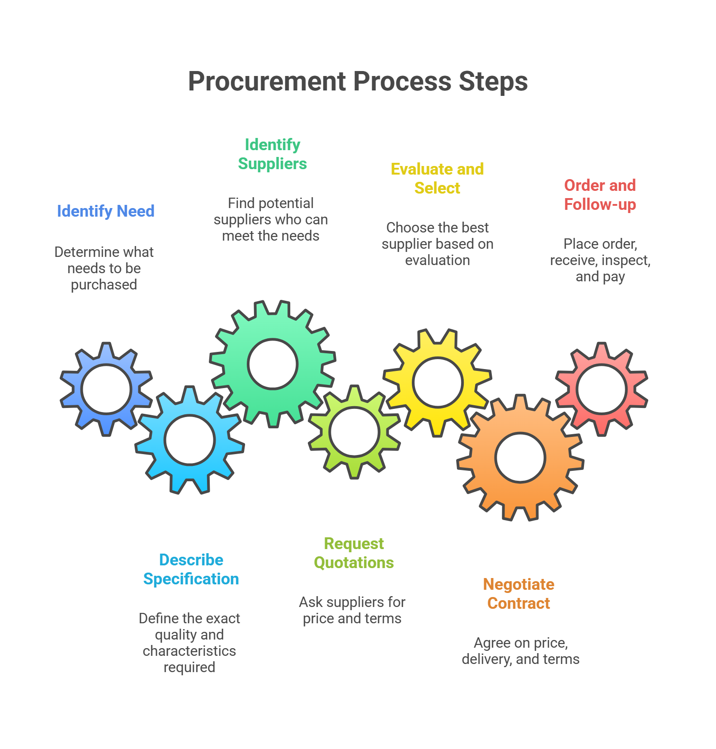

Slide 9
Step 1: Identifying Needs
Question: What does the company need to buy?
Raw materials: Cotton for textile factory (based on production plan)
Equipment: New looms for production (when old ones break or capacity needed)
Services: Transportation, maintenance, consulting
Supplies: Office supplies, cleaning materials, spare parts
Utilities: Energy, water (in some cases)
Who identifies needs? Operations, Maintenance, Finance, each department based on their requirements
Challenge: Needs often come as emergencies ("We need this ASAP!"), which makes procurement difficult

Slide 10
Step 2: Specifying Requirements
Critical: Clear specifications prevent misunderstandings and quality problems.
Quantity: How much? (exact numbers, with tolerance)
Quality: What grade? (Grade A, Grade B? Standards?)
Dimensions: Size, weight, color, thickness, etc.
Delivery: When? Where? How?
Packaging: How should it be packaged?
Standards: Must it meet specific standards? (certifications, compliance)
Price: Budget constraints? Fixed price or negotiable?
Example: Not just "cotton" but "Long-staple cotton, Grade A, 500 kg, 95% purity, delivered to Douala port by March 15, CIF terms, ISO certified"

Slide 11
Step 3: Identifying Potential Suppliers
Task: Who can supply what we need?
Existing suppliers: Do we already work with suppliers who can provide this?
Industry directories: Lists of suppliers in Congo/Cameroon/Africa
Trade associations: Industry groups that maintain supplier lists
Referrals: Other companies recommend suppliers
Tender/RFQ: Publicly announce need, suppliers respond
Trade shows: Meet suppliers in person, see products
International suppliers: If local unavailable, consider imports
Best practice: Identify at least 2-3 potential suppliers for competition

Slide 12
Step 4: Request for Quotation (RFQ)
Process: Send specifications to suppliers, ask for price and terms
What to include in RFQ: Detailed specifications, delivery requirements, payment terms needed, timeline for response
Request elements: Unit price, total price, delivery costs, lead time, warranty, payment terms (30 days? 60 days?)
Supplier response: Quotation showing price, terms, delivery date
Compare: Review all quotes side-by-side
African context: Response times can be slow. SMS, email, face-to-face meetings all used. Follow up if no response in reasonable time.

Slide 13
Step 5: Evaluating & Selecting Suppliers
Decision criteria (NOT just lowest price!):
Price: Competitive? Reasonable? (40% of decision)
Quality: Can they meet specifications? Certifications? (20%)
Reliability: On-time delivery track record? Communication? (20%)
Financial stability: Will they stay in business? Can they deliver consistently? (10%)
Location/Distance: How far are they? Transportation cost impact? (5%)
Relationship: Are they responsive? Do they listen to needs? (5%)
Common mistake: Choosing cheapest option without considering quality/reliability. Often costs more in long run!

Slide 14
Supplier Evaluation Matrix Example
Compare 3 cotton suppliers.
Result: Calculate weighted score for each.
Supplier A likely wins (best quality + reliability, not cheapest)
Criteria | Weight | Supplier A | Supplier B | Supplier C
Price | 40% | 75/100 | 90/100 | 60/100
Quality | 20% | 95/100 | 70/100 | 80/100
Reliability | 20% | 90/100 | 75/100 | 85/100
Financial | 10% | 85/100 | 80/100 | 70/100
Location | 10% | 80/100 | 70/100 | 90/100

Slide 15
Step 6: Negotiation & Contract
Goal: Reach agreement on price, delivery, quality, payment terms
Price negotiation: Start with their quote, ask if they can improve. Offer volume (larger quantity = lower price)
Delivery terms: When? Where? How? Who pays shipping? Incoterms (CIF, FOB, etc.)
Quality terms: Inspection rights? What if quality is poor? Return/replacement policy
Payment terms: Net 30 (pay in 30 days)? Net 60? Cash upfront? Letter of credit?
Contract: Everything agreed in writing. Prevents misunderstandings.
Key negotiation principle: Both sides should win (win-win).
Not about dominating other party.

Slide 16
Negotiation Strategies & Tactics
Prepare thoroughly: Know your needs, suppliers' constraints, market prices
Build relationships: Personal relationships matter in African business. Invest time.
Offer volume: "If you give us 20% discount, we'll buy 1,000 kg instead of 500 kg"
Multiple suppliers: Supplier knows you have alternatives = more willing to negotiate
Payment terms: Paying cash upfront? Ask for discount. Needing 60-day terms? Agree to slightly higher price.
Long-term commitment: "If you meet quality standards for a year, we'll give you 80% of our business"
Patience: Don't rush. Rushing puts you at disadvantage.

Slide 17
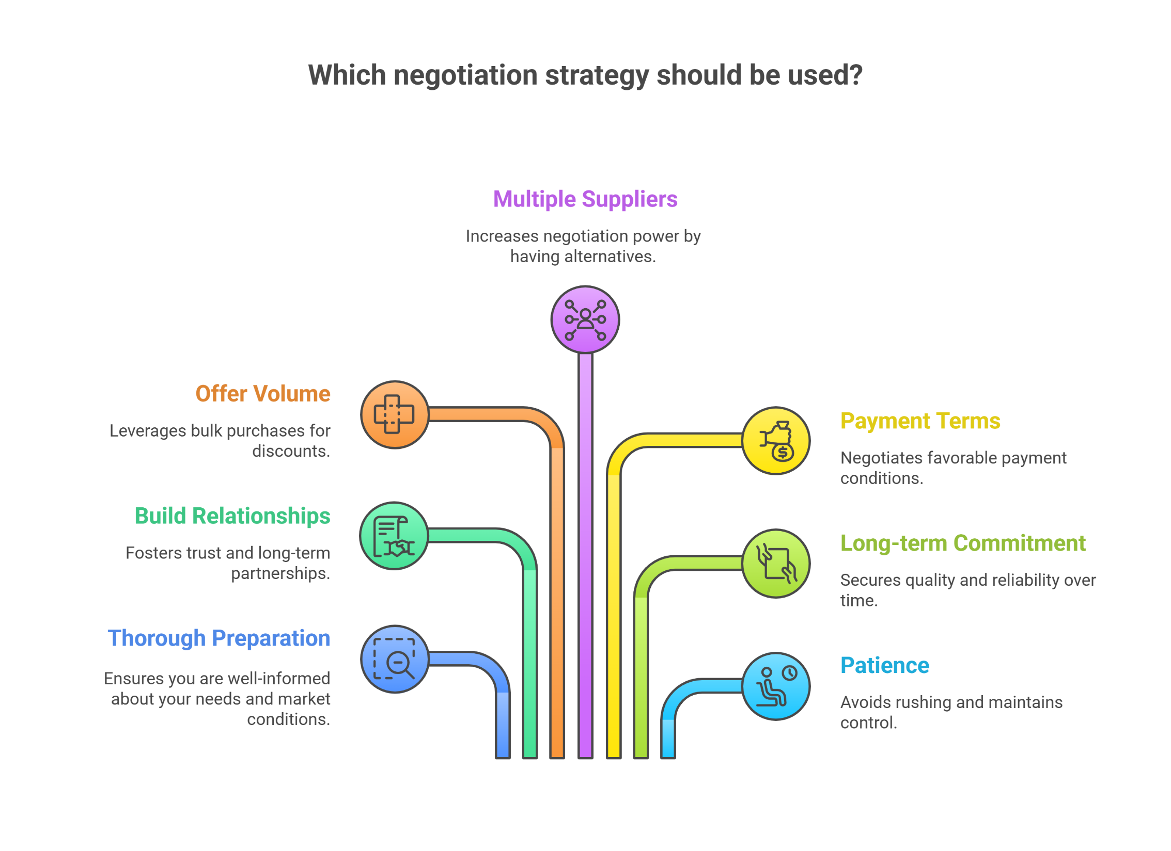

Slide 18
Step 7: Ordering & Follow-up
Purchase Order (PO): Formal document confirming order with supplier. Includes quantity, price, delivery date, terms.
Communication: Confirm supplier received PO. Ask for acknowledgment.
Tracking: Ask supplier for status. When shipping? Any delays?
Receiving: When goods arrive, inspect immediately. Check quantity, quality, damage.
Documentation: Keep delivery notes, inspection reports, photos of any damage.
Payment: Once received and inspected, process payment per agreed terms.
Feedback: Let supplier know performance. Good performance = future orders. Poor = next time try different supplier.

Slide 19
Purchasing Models & Strategies
One-time purchase: Buy once when need arises. Flexible but time-consuming.
Spot purchasing: Buy at best available price when opportunity comes. Risky—no guaranteed supply.
Systems contracting: Long-term agreements with supplier for ongoing supplies. Stable, predictable.
Blanket order: Agreement on price and terms, but release quantities as needed over time.
Framework agreements: Establish supplier relationship for category of goods, negotiate individually for each purchase.
JIT (Just-in-Time): Small, frequent deliveries exactly when needed. Reduces inventory but requires trust and coordination.

Slide 20
Make or Buy Decision
Question: Should we buy this, or make it ourselves?
Buy when: Supplier is cheaper, more specialized, or can handle volume
Make when: We have capability, volume justifies investment, proprietary (secret technology)
Cost analysis: Compare: (Supplier price × volume) vs. (In-house cost including equipment, labor, overhead)
Strategic consideration: What's core to our business? What should we outsource?
Example: Textile factory: Make fabric in-house (core skill), but buy dyes from supplier (not core skill).

Slide 21
Total Cost of Ownership (TCO)
Important: Real cost isn't just purchase price!
Purchase price: What supplier charges
Delivery cost: Shipping, insurance, customs
Quality cost: Inspection, rework if defective
Inventory carrying: Storage, insurance, risk of obsolescence
Administrative: Procurement staff time, systems
Relationship cost: Multiple suppliers = more management
Example: Cheap supplier ($100) + high defect rate (rework cost $20) + shipping ($10) = $130 TCO. Better supplier ($110) with zero defects = $110 TCO. Better supplier wins!

Slide 22
Supplier Relationship Management
Key insight: Long-term relationships create value.
Regular communication: Monthly meetings, performance reviews
Performance metrics: Track on-time delivery, quality, responsiveness
Transparency: Share your plans and forecasts. Help suppliers prepare.
Fair treatment: Pay on time, give feedback, acknowledge good performance
Continuous improvement: Work together to reduce costs and improve quality
Recognition: Reward suppliers who perform well. Give them more business.
Problem-solving together: When issues arise, solve as partners not adversaries

Slide 23
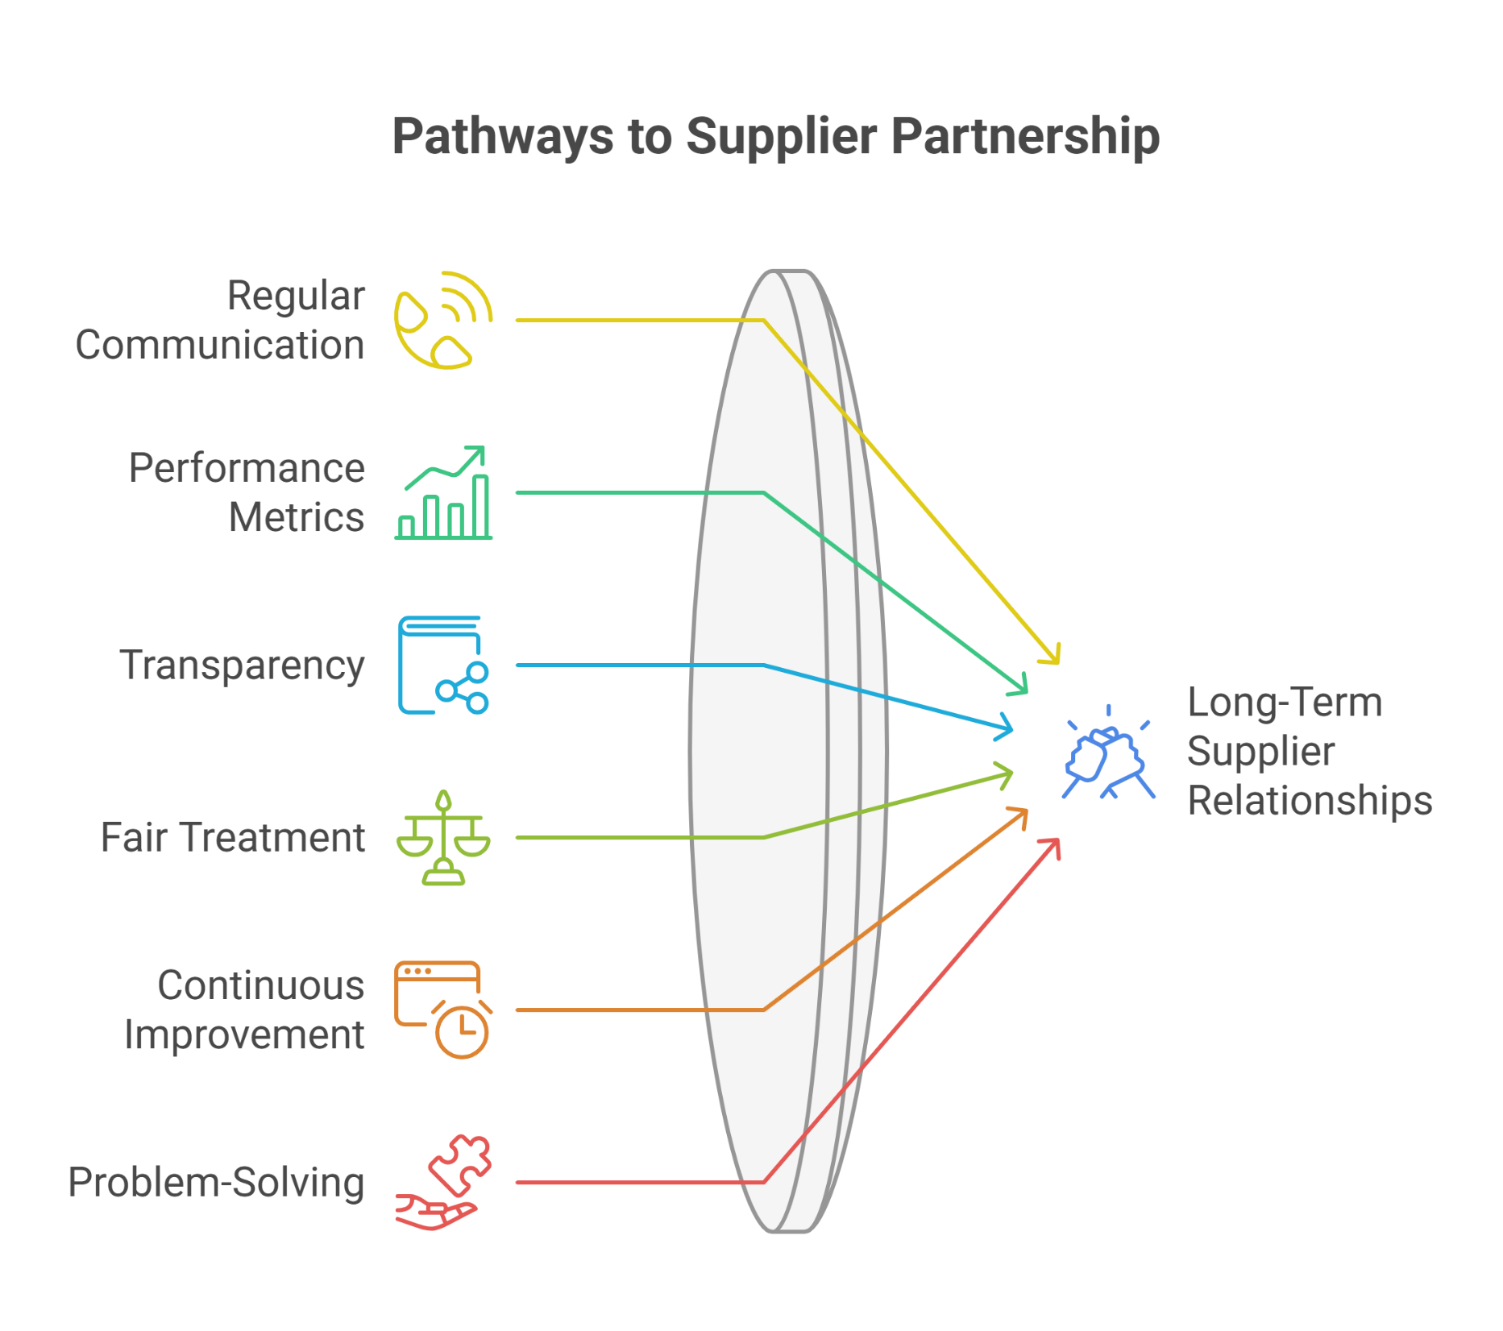

Slide 24
Supplier Segmentation Strategy
Not all suppliers are equal. Manage differently:
Strategic suppliers: Critical to business (cotton for textile factory). Heavy engagement, long-term partnership.
Important suppliers: Significant volume but not critical. Medium engagement.
Convenience suppliers: Low volume, low risk (office supplies). Minimal engagement, transactional.
Nuisance suppliers: Small volume, hard to manage. Consider consolidating purchases.
Strategy: Invest relationship effort in strategic suppliers.
Use efficient processes for convenience suppliers.

Slide 25
Procurement Challenges in Africa
Limited supplier base: Fewer options than developed countries. Less competitive pressure.
Reliability: Suppliers may not meet deadlines. Quality inconsistency.
Documentation: Some suppliers informal, no written contracts, no clear terms
Communication: Slow response times. May need to visit in person.
Currency risk: Supplier prices in different currencies. Fluctuation affects costs.
Payment challenges: Banking is slow. Letter of credit costs. Cash-based relationships common.
Logistics: Port delays, road conditions affect delivery reliability
Informal sector: Many suppliers informal, harder to verify

Slide 26
Best Practices for Procurement in Africa
Build relationships: Personal relationships matter more than in developed countries. Invest time.
Visit suppliers: Don't just email. Go see their operations, meet people, build trust.
Multiple suppliers: Reduced dependence on single source. Have backup suppliers.
Buffer inventory: Plan for delays. Keep safety stock.
Clear contracts: Even with informal suppliers, get terms in writing. Prevents disputes.
Regular follow-up: Don't assume supplier knows what you need. Confirm status frequently.
Fair pricing: Don't squeeze suppliers too hard. They need profit to survive and invest.
Payment reliability: Pay on time. Build reputation as good customer.

Slide 27
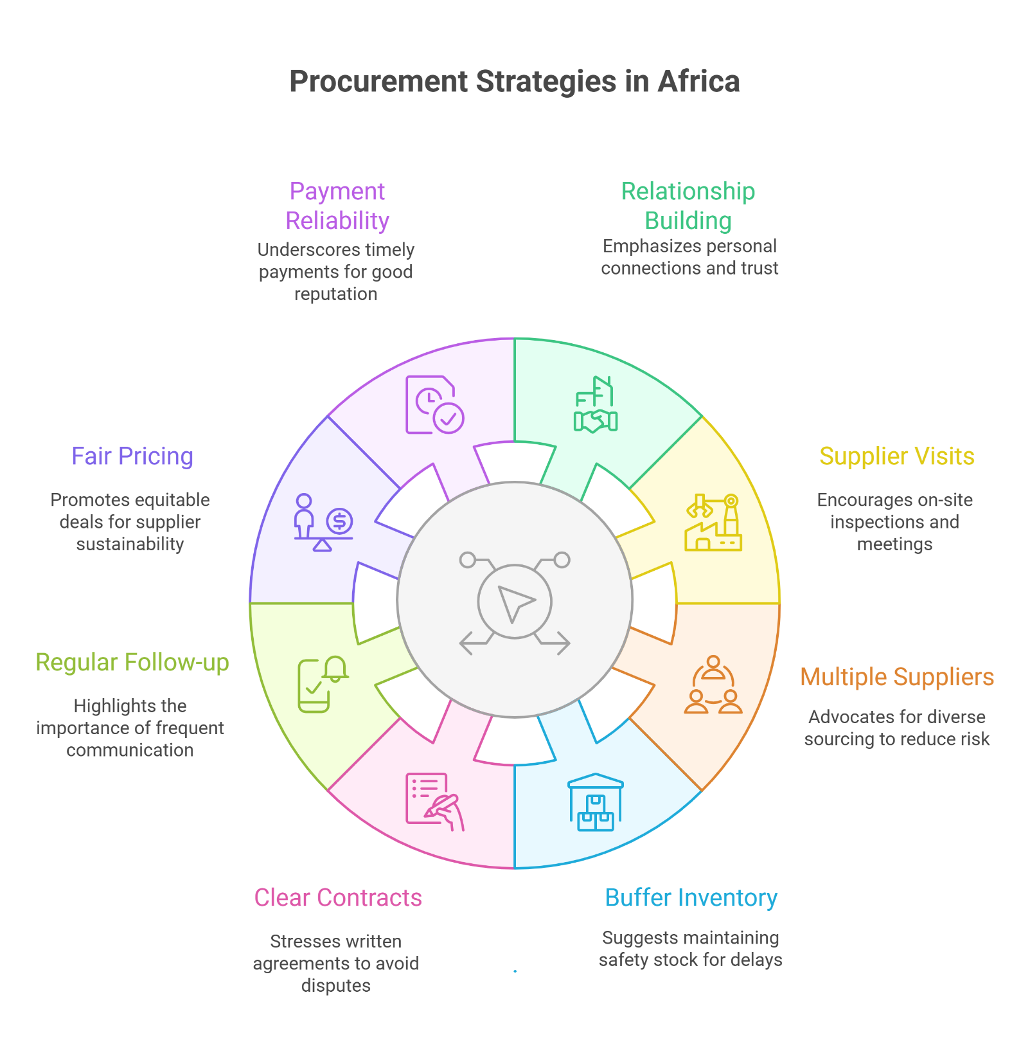

Slide 28
E-Procurement & Digital Tools
E-procurement platforms: Online marketplaces connecting buyers and suppliers
Advantages: Faster access to suppliers, price comparison, reduced paperwork, transparent pricing
African adoption: Growing but limited. Mobile-based solutions popular (WhatsApp, MTN services)
Challenges: Internet access limited, digital literacy varies, trust in online systems low
Blended approach: Online for information gathering, in-person for relationships and negotiations
Future: As mobile money and internet improve, e-procurement will grow significantly in Africa

Slide 29
Ethical Procurement & Sustainability
Fair labor practices: Ensure suppliers treat workers fairly. No child labor, safe conditions.
Environmental sustainability: Suppliers should minimize environmental impact
Conflict minerals: Know where minerals come from. Avoid funding conflicts.
Transparency: Know your supply chain. Where is it coming from?
Business ethics: No bribery, corruption, or unethical practices
Regulatory compliance: Follow laws on import/export, certification, safety
Business benefit: Ethical procurement builds reputation, attracts customers, reduces risk

Slide 30
Key Takeaways
Procurement is strategic, not just about buying cheap
7-step process: Need → Specification → Identify suppliers → RFQ → Evaluate → Negotiate → Order
Choose suppliers on value (price + quality + reliability), not price alone
Long-term supplier relationships create value
Total cost of ownership is more important than purchase price
African procurement requires relationship-building and adapted strategies
Ethics and sustainability are increasingly important in procurement

