Slide 1
Procurement Strategies
Daniel Kaszubowski

Slide 2
Road Transportation Systems Engineering Development in the Sub-Saharan Africa – Modern EU Master Programme & Capacity Building

Slide 4
Learning Objectives
Analyze global vs. local sourcing trade-offs for your business context
Conduct make-or-buy analysis to decide insourcing vs. outsourcing
Develop commodity procurement strategies for cost optimization
Understand contract management fundamentals and risk allocation

Slide 5
Section 1
Global vs. Local Sourcing Decisions

Slide 6
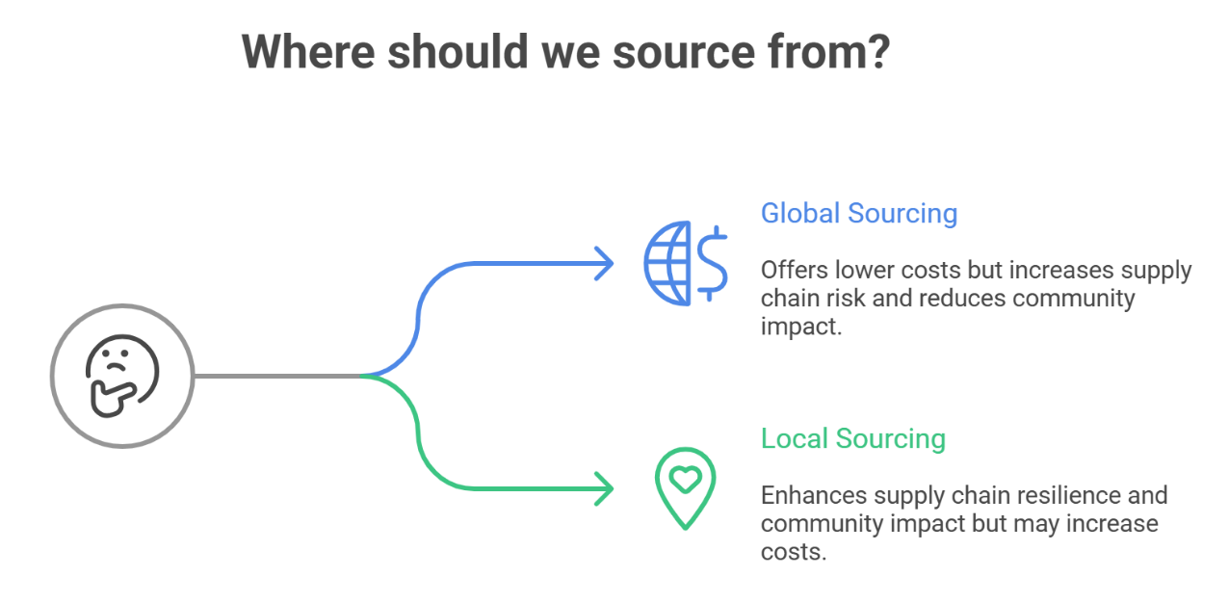
Global vs. Local Sourcing Decisions
One of the most strategic decisions companies face is where to source from: globally (to get lowest cost) or locally (to reduce risk and build regional capacity). This decision has massive implications for supply chain resilience, cost, and community impact.

Slide 7
Global Sourcing (International Suppliers)
Advantages:
Cost Leadership: Lowest-cost suppliers often in low-labor-cost countries (Asia, Mexico, parts of Africa)
Specialized Capability: Some products only available from specific geographies (certain minerals, specialized manufacturing)
Economies of Scale: Large suppliers with efficient operations and volume discounts
Advanced Technology: Developed countries often have latest technology and innovation

Slide 8
Global Sourcing (International Suppliers)
Disadvantages:
Long Lead Times: Longer transit times (4-8 weeks shipping) require larger inventory buffers and working capital
Supply Disruption Risk: Port delays, carrier failures, geopolitical events, natural disasters impact entire supply chain
Quality Control Challenges: Harder to monitor and control quality from distance; limited on-site support
Currency Risk: Exchange rate fluctuations affect final cost
Hidden Costs: Import duties, shipping, inspection, compliance, longer payment cycles
Ethical Concerns: Labor practices, environmental standards, transparency harder to verify
Intellectual Property Risk: Counterfeiting, theft of designs/specifications

Slide 9
Local Sourcing
(Regional/Domestic Suppliers)
Advantages:
Supply Security: Short lead times, easier disruption response, better visibility
Responsive Partnerships: Local suppliers more accessible for problem-solving and changes
Lower Working Capital: Shorter lead times reduce inventory carrying costs
Quality Control: Easier on-site audits and quality management
Risk Mitigation: Geo-diversification reduces concentration risk
Community Impact: Jobs, skills development, local economic growth
Ethical Alignment: Easier to verify labor and environmental practices
Tariff/Compliance Benefits: AfCFTA trade agreements reduce tariffs within region

Slide 10
Local Sourcing
(Regional/Domestic Suppliers)
Disadvantages:
Higher Unit Cost: Local suppliers often can't compete on price with global mass-production
Limited Capacity: Local suppliers may not have economies of scale
Capability Gaps: May lack advanced technology
or specialized expertise
Quality Variability: Developing suppliers may have inconsistent quality
Single Source Risk: If local supplier fails, alternatives limited (increases need for multiple sourcing)

Slide 11
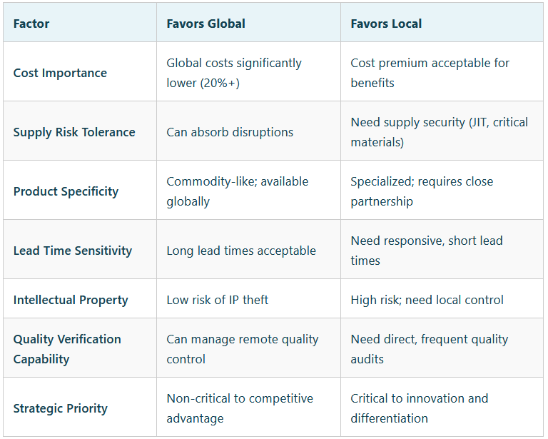
Decision Framework: Global vs. Local

Slide 12
Section 2
Make-or-Buy Analysis
(Insourcing/Outsourcing)

Slide 13
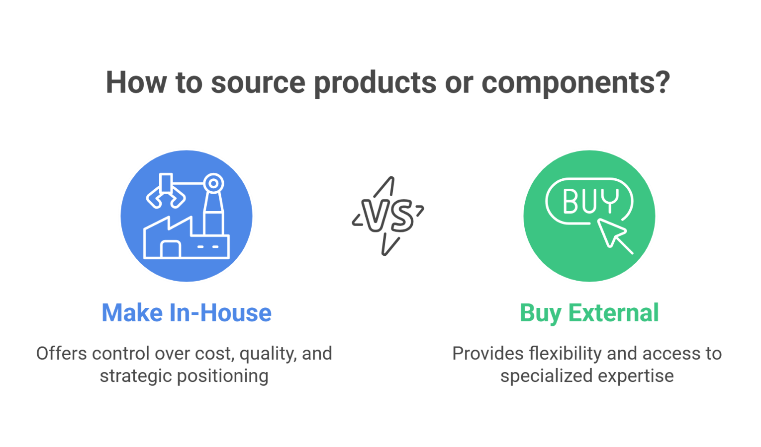
Make-or-Buy Analysis
Another important strategic decisions is whether to make a product or component in-house or buy it from an external supplier. This decision has massive implications for cost, flexibility, quality, and strategic positioning.

Slide 14
MAKE (Insourcing)
Advantages of making:
Quality Control: Direct control over product quality and specifications
Intellectual Property: Keep proprietary designs and processes confidential; no risk of copying
Flexibility: Can quickly change design or volume without supplier coordination
Strategic Advantage: Core capability that competitors can't easily replicate
Vertical Integration: Control entire supply chain; reduce dependency on suppliers
Profit Capture: Keep supplier margin as profit

Slide 15
MAKE (Insourcing)
Disadvantages of making:
High Capital Investment: Equipment, facilities, technology required upfront
High Ongoing Costs: Labor, overhead, maintenance ongoing
Fixed Costs: Overhead doesn't decrease if volume drops (low flexibility)
Specialization Risk: Employees may lack specialized expertise of dedicated suppliers
Opportunity Cost: Capital tied up in manufacturing could be invested in core business
Technology Obsolescence: Need to continuously invest to stay competitive

Slide 16
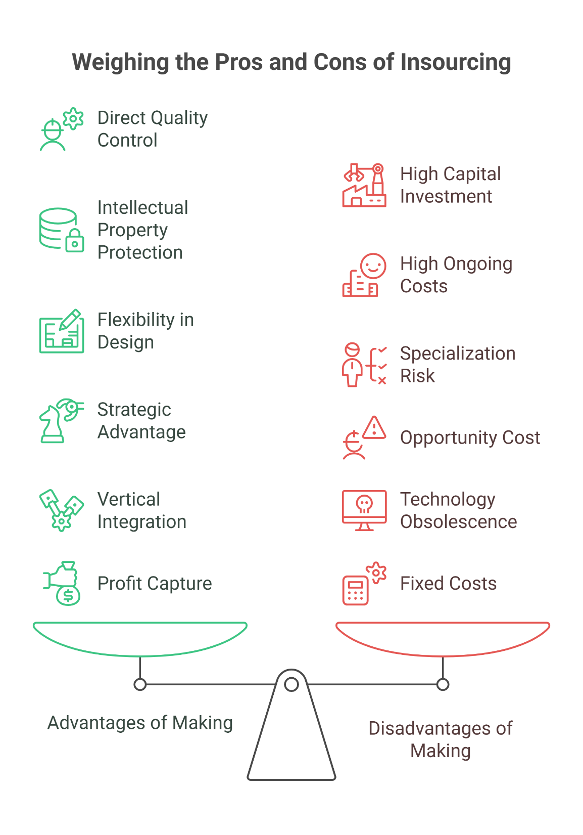

Slide 17
BUY (Outsourcing)
Advantages :
Lower Capital Investment: No upfront equipment/facility costs
Lower Operating Costs: Supplier achieves economies of scale; may be 20-40% cheaper
Flexibility: Can increase/decrease volume; don't own fixed assets
Specialization: Supplier is expert in this product; you focus on core competency
Speed to Market: Buy from existing supplier vs. time to build capability
Risk Transfer: Supplier takes on demand/technology risk

Slide 18
BUY (Outsourcing)
Disadvantages of making:
Quality Risk: Dependent on supplier quality; less direct control
IP Risk: Sharing specifications with external supplier risks copying/counterfeiting
Dependency: If supplier fails or raises prices, you have limited options
Flexibility Loss: Changes require supplier coordination; slower response
Supply Disruption: Supplier problems directly impact your production
Margin Loss: Supplier keeps margin; you pay more than in-house cost

Slide 19
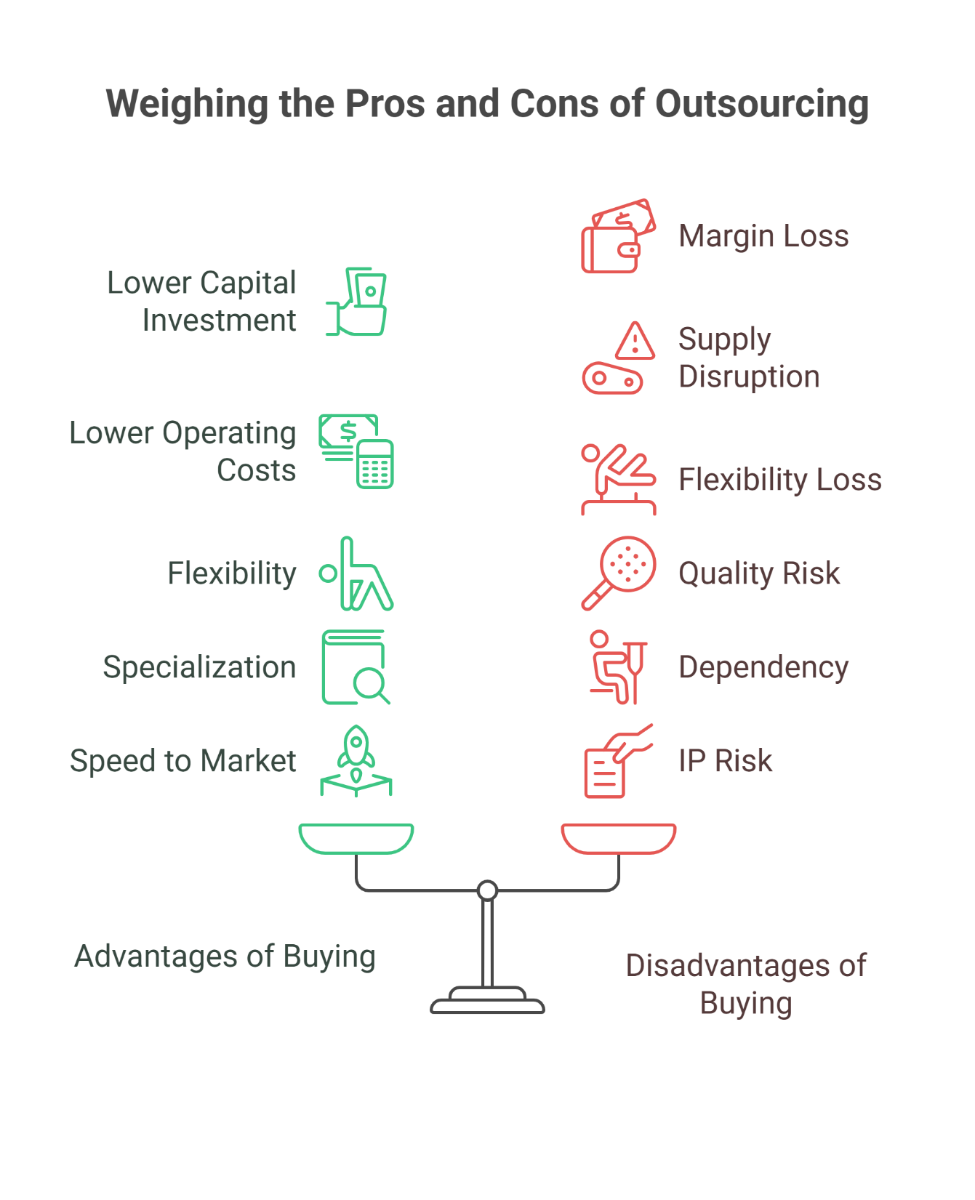

Slide 20
Section 3
Commodity Procurement Planning

Slide 21
Commodity vs. Non-Commodity Procurement
Commodity procurement deals with standardized materials where price fluctuates based on global supply and demand (oil, metals, agricultural products, etc.). These require different strategies than manufactured goods.

Slide 22
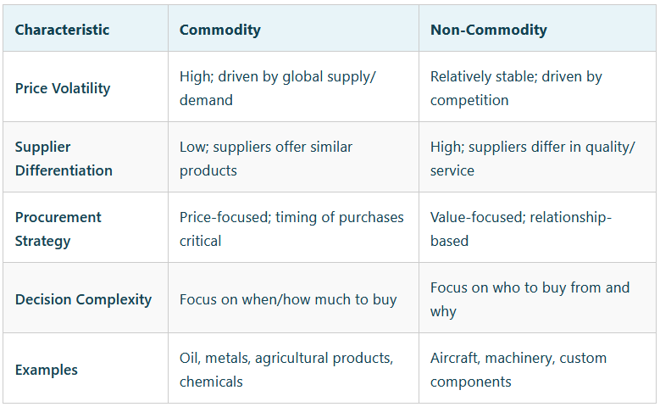
Commodity vs. Non-Commodity Procurement

Slide 23
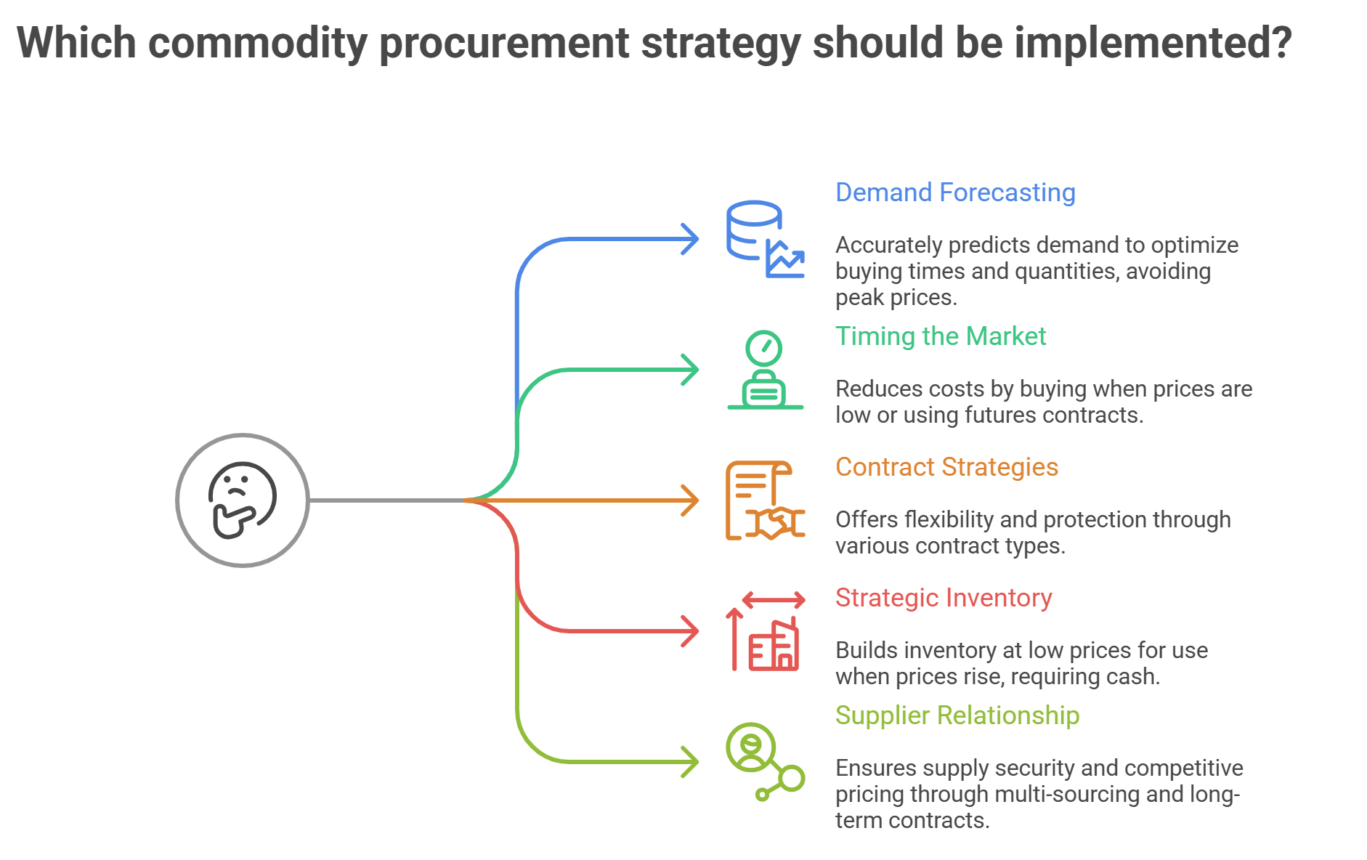

Slide 24
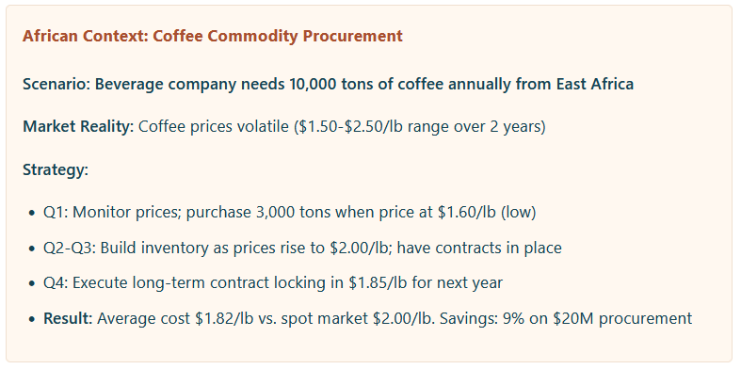

Slide 25
Section 4
Contract Management Basics

Slide 26
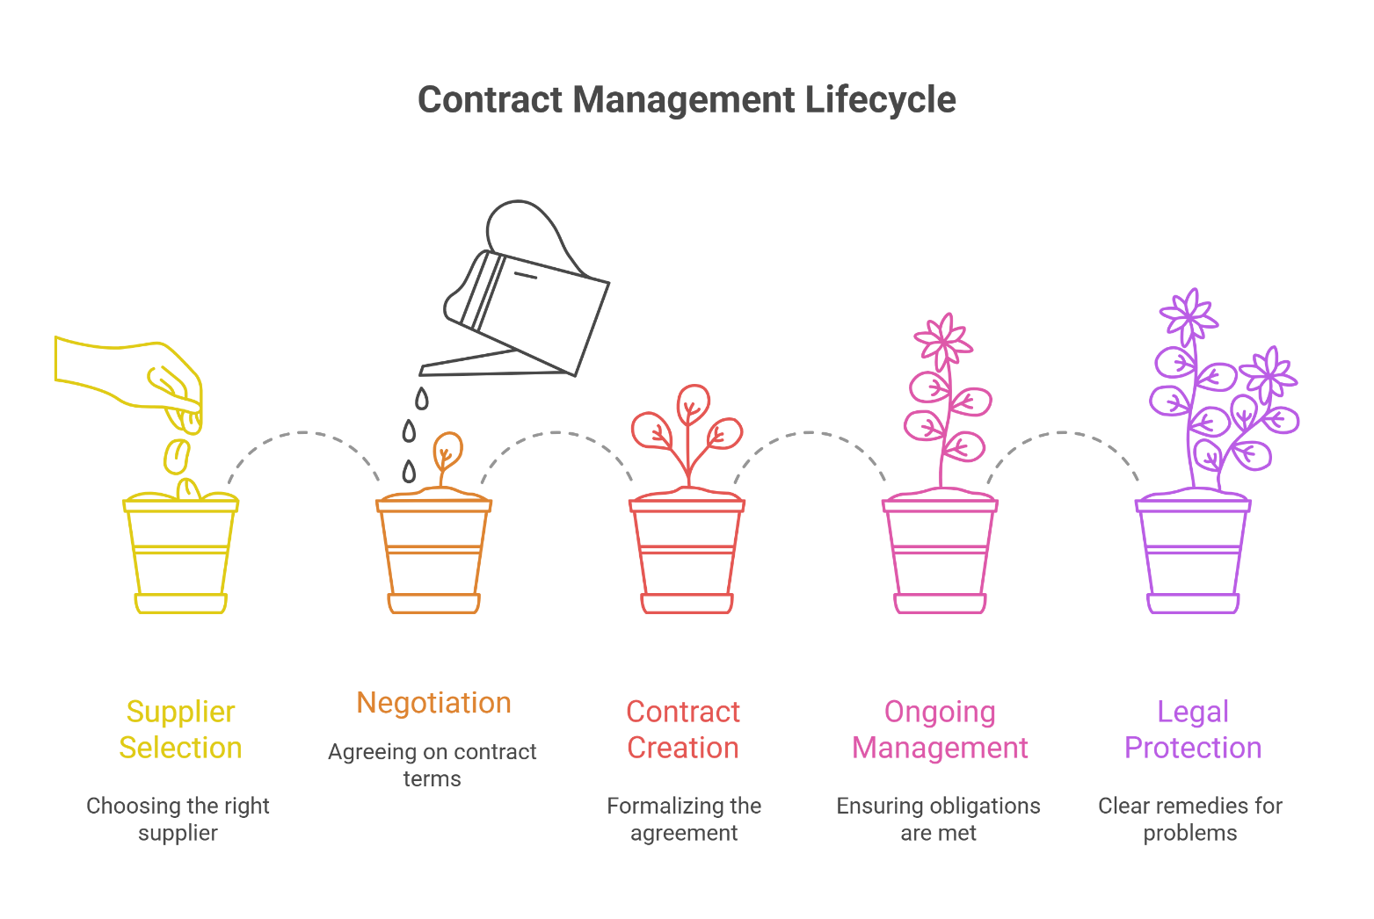
Contract Management Basics
Once you've selected
a supplier and negotiated terms, the contract becomes your legal protection and operational guide.
Good contract management ensures both parties understand obligations and have clear remedies if problems arise

Slide 27
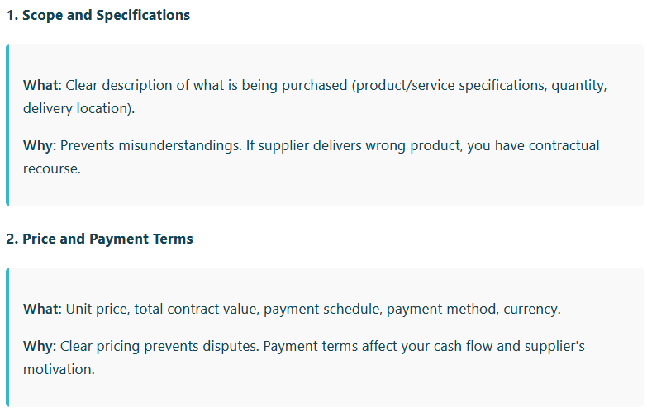
Essential Contract Elements (1/5)

Slide 28
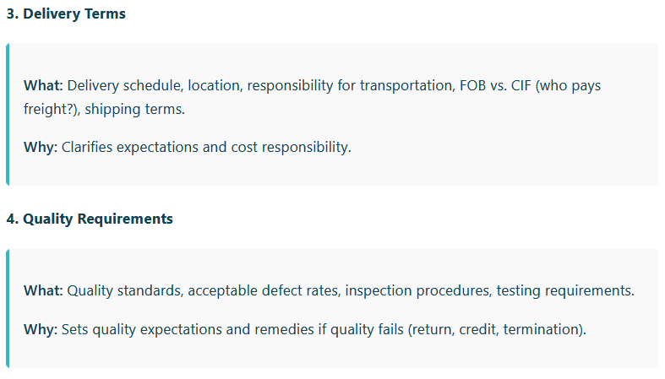
Essential Contract Elements (3/5)

Slide 29
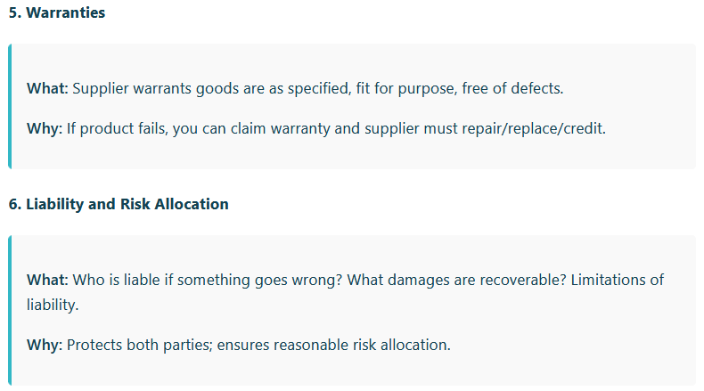
Essential Contract Elements (3/5)

Slide 30
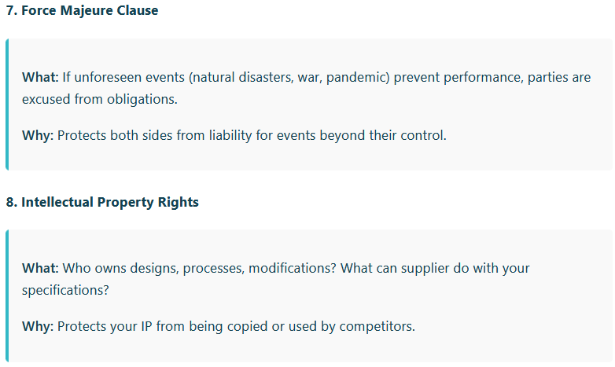
Essential Contract Elements (4/5)

Slide 31
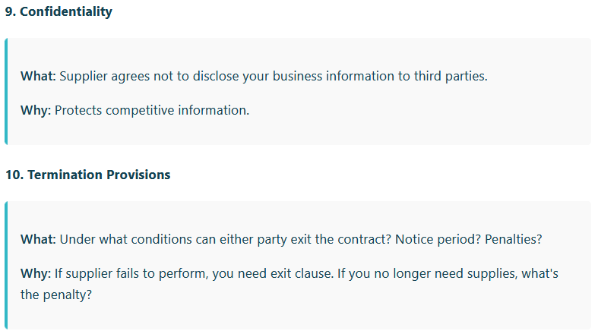
Essential Contract Elements (5/5)

Slide 32
Key Takeaways
Global vs. Local: Balance cost benefits of global sourcing with supply security, ethical verification, and local capacity building of local sourcing
Make-or-Buy: Decision based on cost analysis PLUS qualitative factors (IP, quality, flexibility, strategic importance)
Commodity Procurement: Requires timing the market, hedging price volatility, and strategic inventory planning
Contract Management: Essential elements (scope, price, delivery, quality, warranties, liability, IP, confidentiality, termination)

