Slide 1
Practical Exercises
Daniel Kaszubowski

Slide 2
Road Transportation Systems Engineering Development in the Sub-Saharan Africa – Modern EU Master Programme & Capacity Building

Slide 4
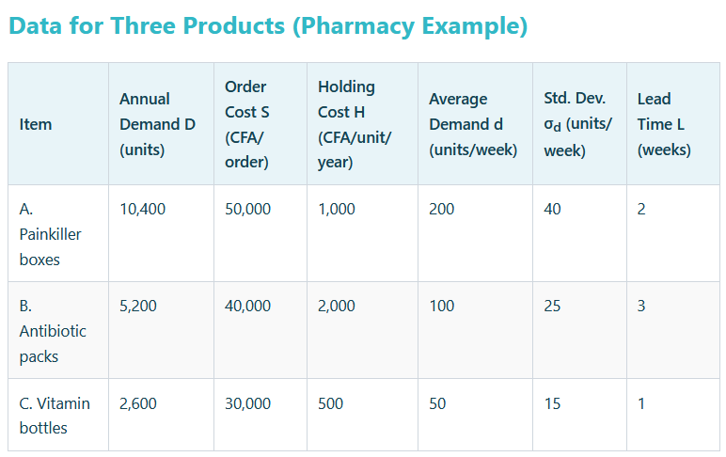
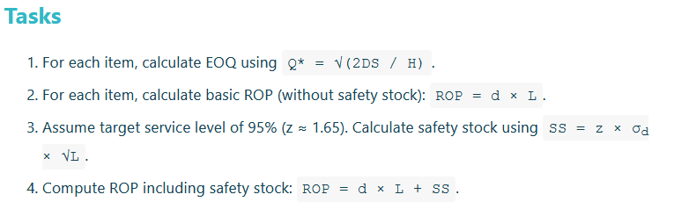
Calculation Exercise: EOQ, ROP, Safety Stock (3 Products)

Slide 5
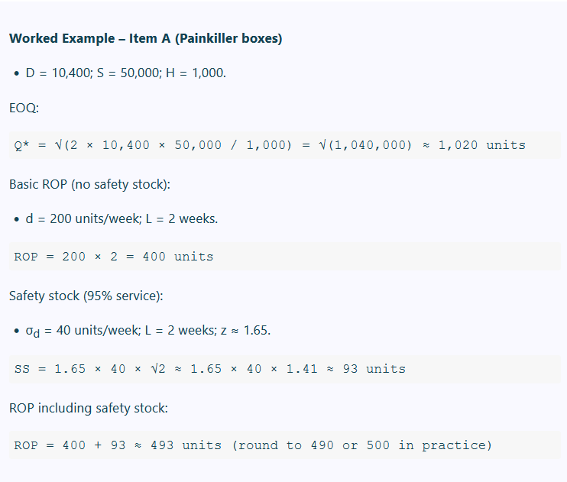
Worked example:
EOQ, ROP, Safety Stock (3 Products)

Slide 6
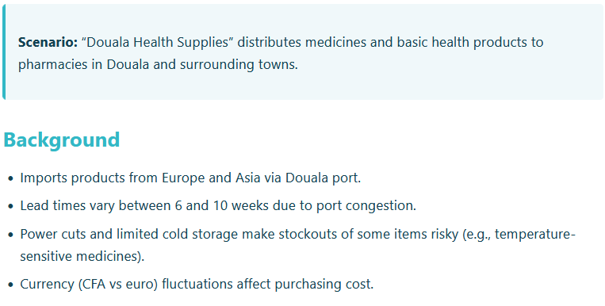
Case Study: Inventory Optimization for a Distributor in Douala

Slide 7
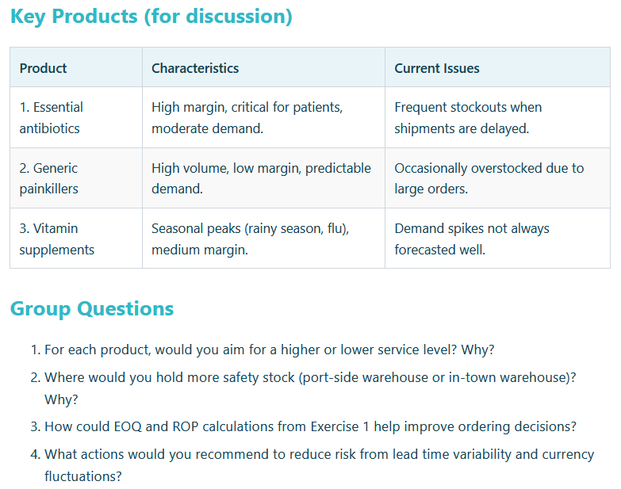
Case Study:
Inventory Optimization for a Distributor in Douala

Slide 8
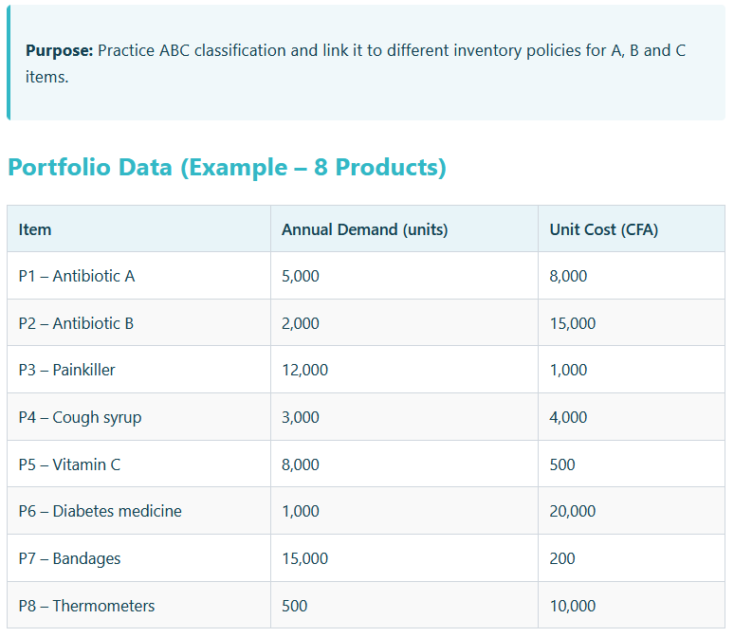
Group Work:
ABC Analysis of a Product Portfolio

Slide 9
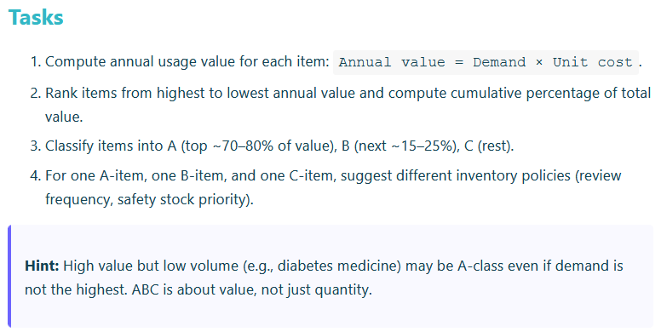
Group Work:
ABC Analysis of a Product Portfolio

Slide 10
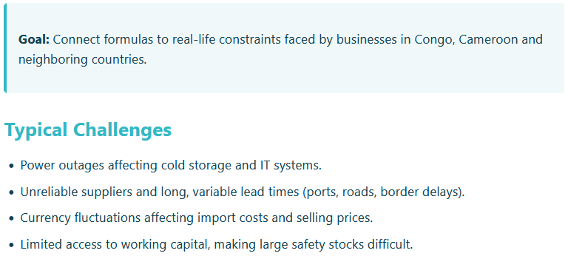
Discussion: Inventory Challenges in Central Africa

Slide 11
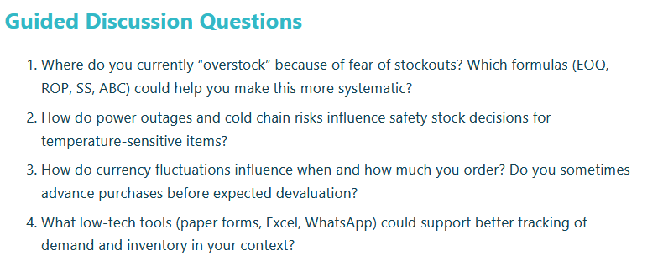
Discussion: Inventory Challenges in Central Africa

