Slide 1
Demand Forecasting
Daniel Kaszubowski

Slide 2
Road Transportation Systems Engineering Development in the Sub-Saharan Africa – Modern EU Master Programme & Capacity Building

Slide 4
Learning Objectives
Explain why forecasts are needed and how the lead-time gap creates risk.
Describe basic qualitative and quantitative forecasting methods.
Compute simple forecast error and accuracy measures (MAD, MAPE).
Discuss how to deal with high uncertainty in African markets.
Apply basic principles of collaborative forecasting with suppliers and customers.

Slide 5
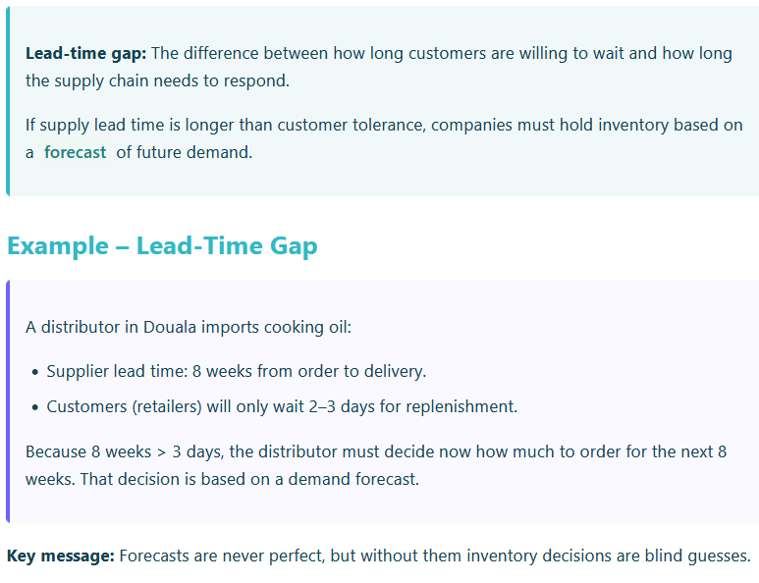
Why Forecast? The Lead-Time Gap

Slide 6
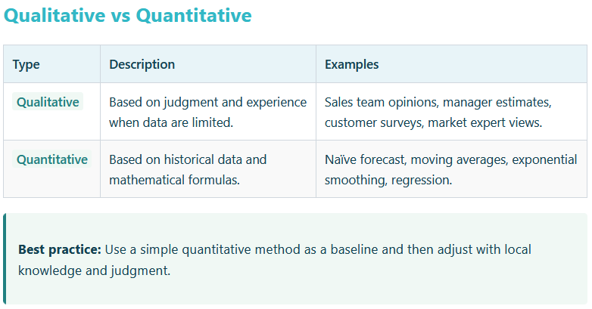
Forecasting Methods

Slide 7
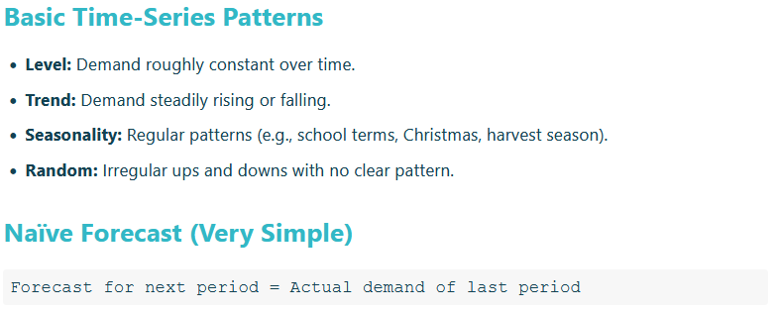
Forecasting Methods

Slide 8
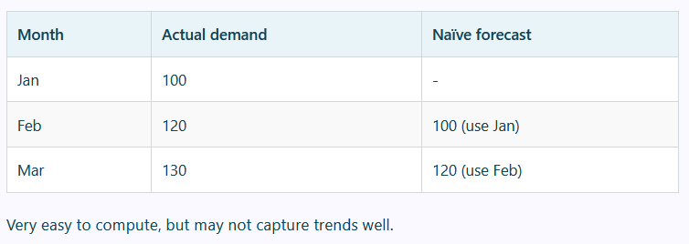
Example – Naïve Forecast

Slide 9
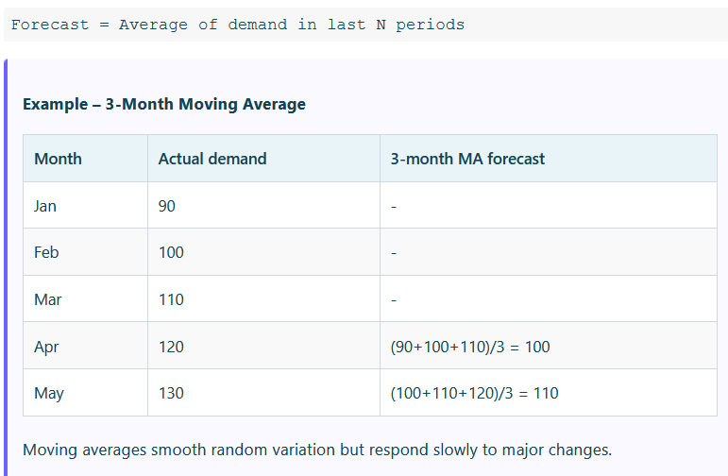
Moving Average (MA)

Slide 10
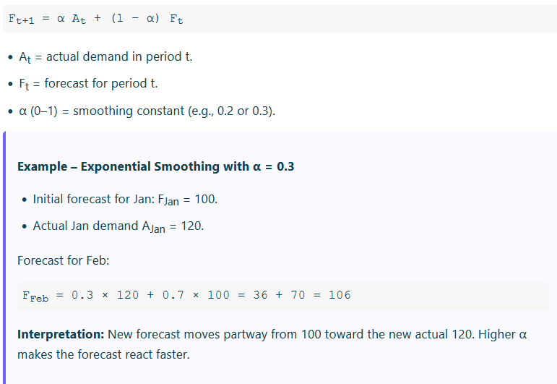
Simple Exponential Smoothing

Slide 11
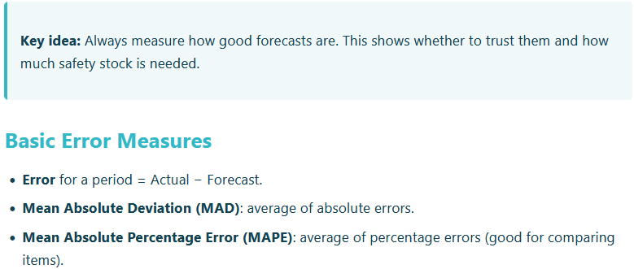
Forecast Error and Accuracy Measurement

Slide 12
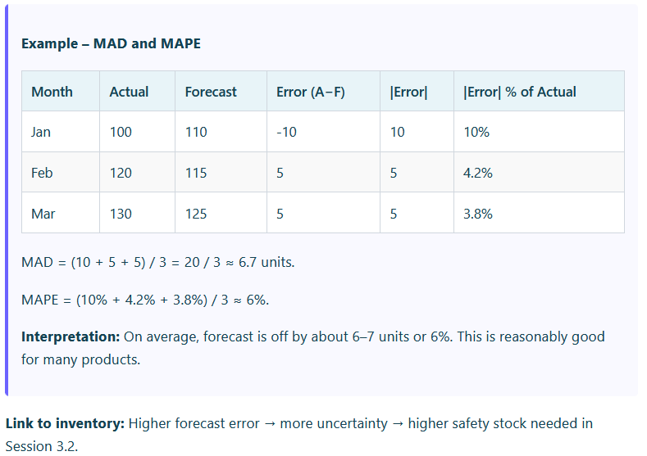
Example – MAD and MAPE

Slide 13
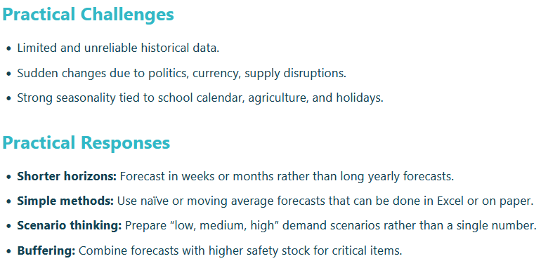
Dealing with Uncertainty in African Markets

Slide 14
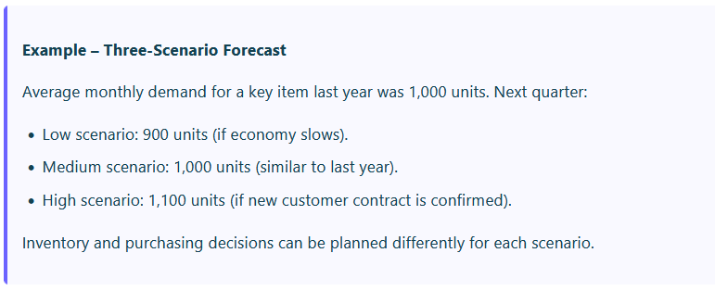
Dealing with Uncertainty in African Markets

Slide 15
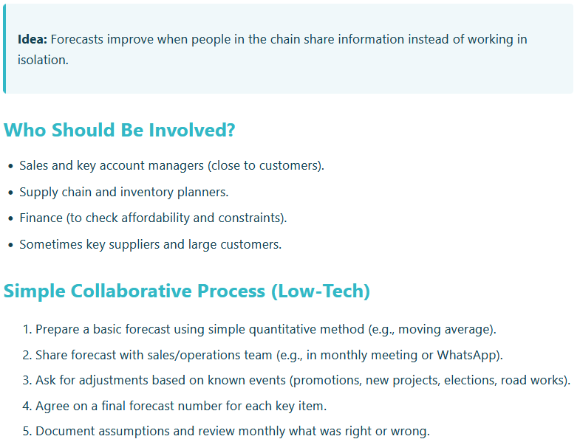
Collaborative Forecasting Principles

Slide 16
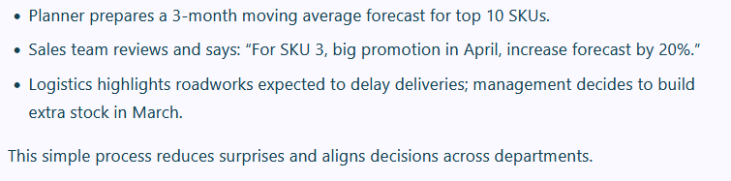
Example – Monthly Forecast Meeting

